Slide 1
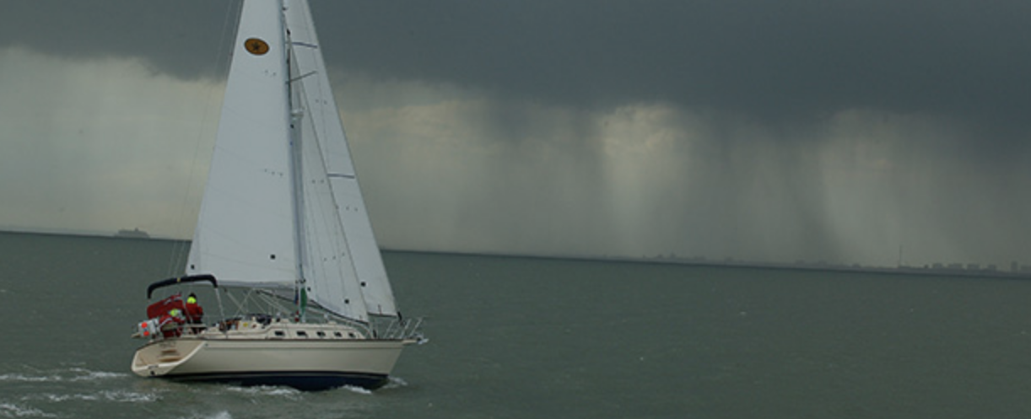
How to Master the Weather
Cliff Mass
University of Washington

Slide 2
You Need to Know
Where to get reliable information
Current state of the technology of weather prediction
How to read the sky and how to interpret basic weather information
About local meteorology

Slide 3
Where can you get weather information?
Print newspapers
  Forecasts are generally old and superficial
Radio
  Often old or wrong
TV
  Varies substantially in quality
  Tends to hype storms
NOAA weather radio-
  Straight from the National Weather Service, up to date.
Online and mobile
  Probably the best and most comprehensive source

Slide 4
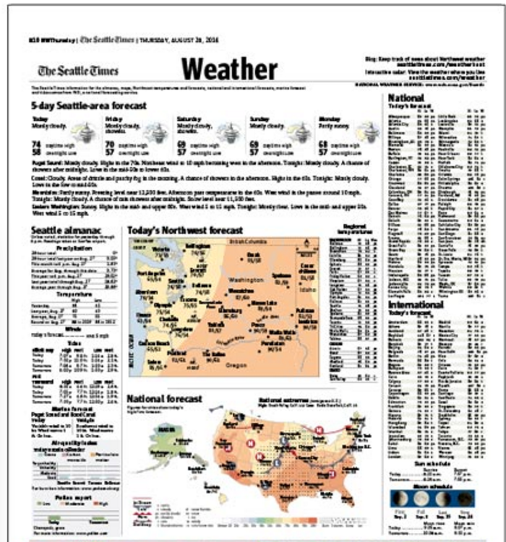
Newspaper Weather Pages
Outdated forecasts

Slide 5

NOAA WeatherRadio (good in remote areas, alarm for warnings)
Weather Forecast
Straight from the Local
National Weather
Service Office

Slide 6
TV Weather
Only about half are really meteorologists (i.e., have an actual degree). The rest are “weathercasters”
The weekday ones tend to have stronger backgrounds.
Their forecasts for the first few days tend to be very similar to the National Weather Service
Lots of hype--
  “Pinpoint severe weather center”
  “County by county forecasts”
  “Doppler radar weather”

Slide 7


Local TV Weather Types with Degrees in Atmospheric Sciences

Slide 8
Online
You can get the latest forecasts
You can secure the raw weather observations (e.g., surface observations, radar)
You can look at the forecasts from the computer models.
You can view weather cams all over the region
You can get deceiving and wrong information that looks compelling.

Slide 9
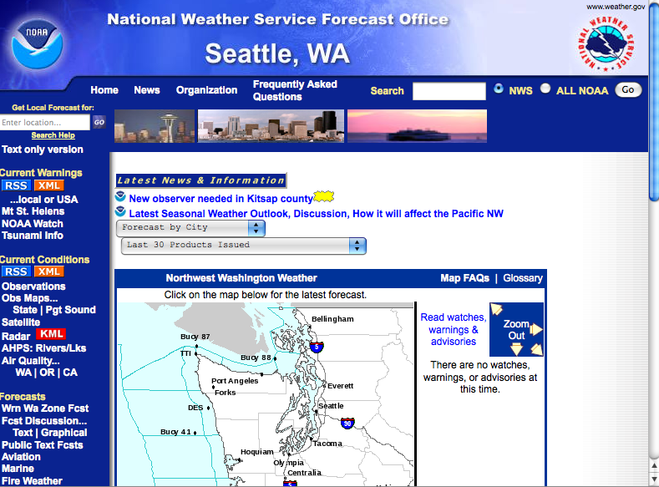
The National Weather Service:
A Online Good Source

Slide 10
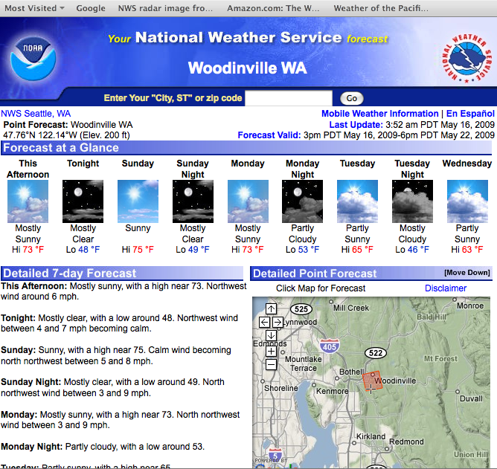

Slide 11
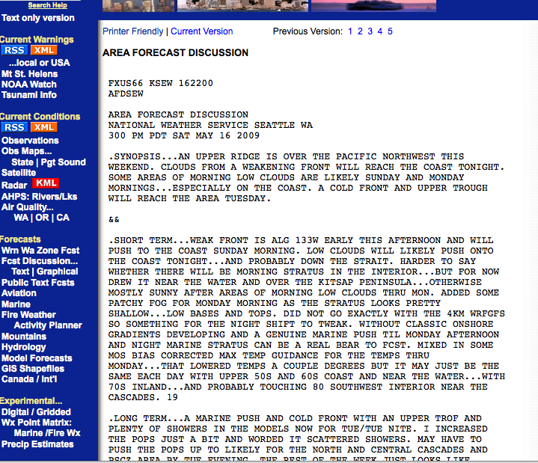
The NWS Forecast Discussion: get into the mind of the forecaster

Slide 12
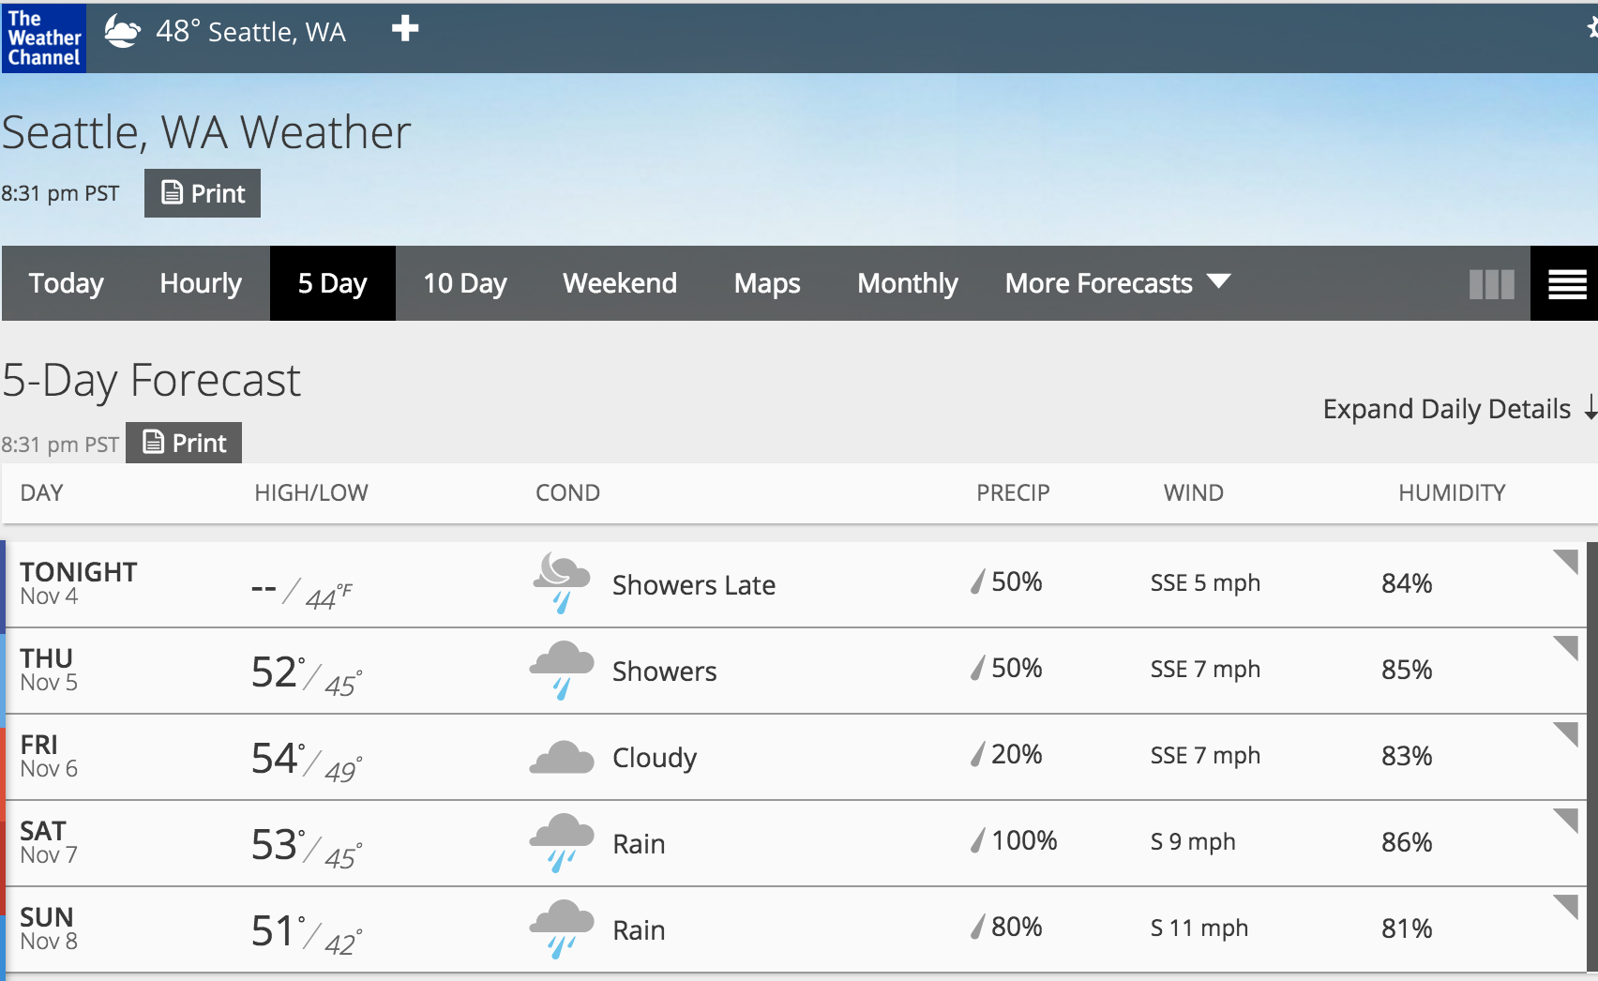
Weather.com has very good forecasts—better than the National Weather Service
Completely automated.
Highly sophisticated statistical improvement of National Weather Service and other forecast models.

Slide 13
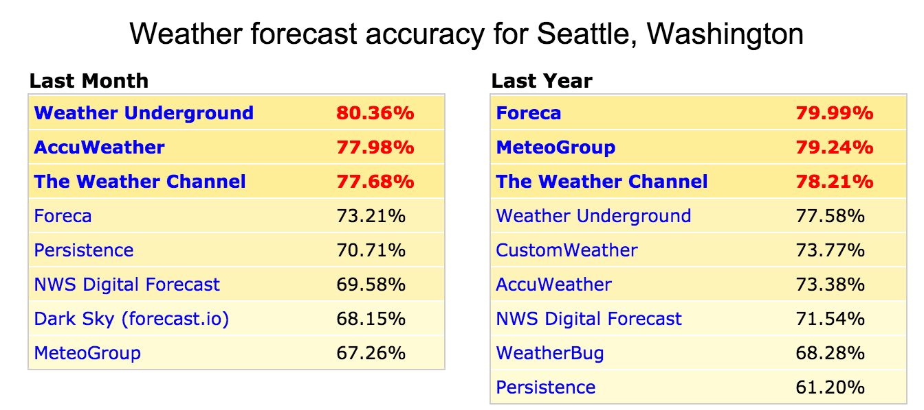
Who has the best forecasts online? Check forecastadvisor.com

Slide 14
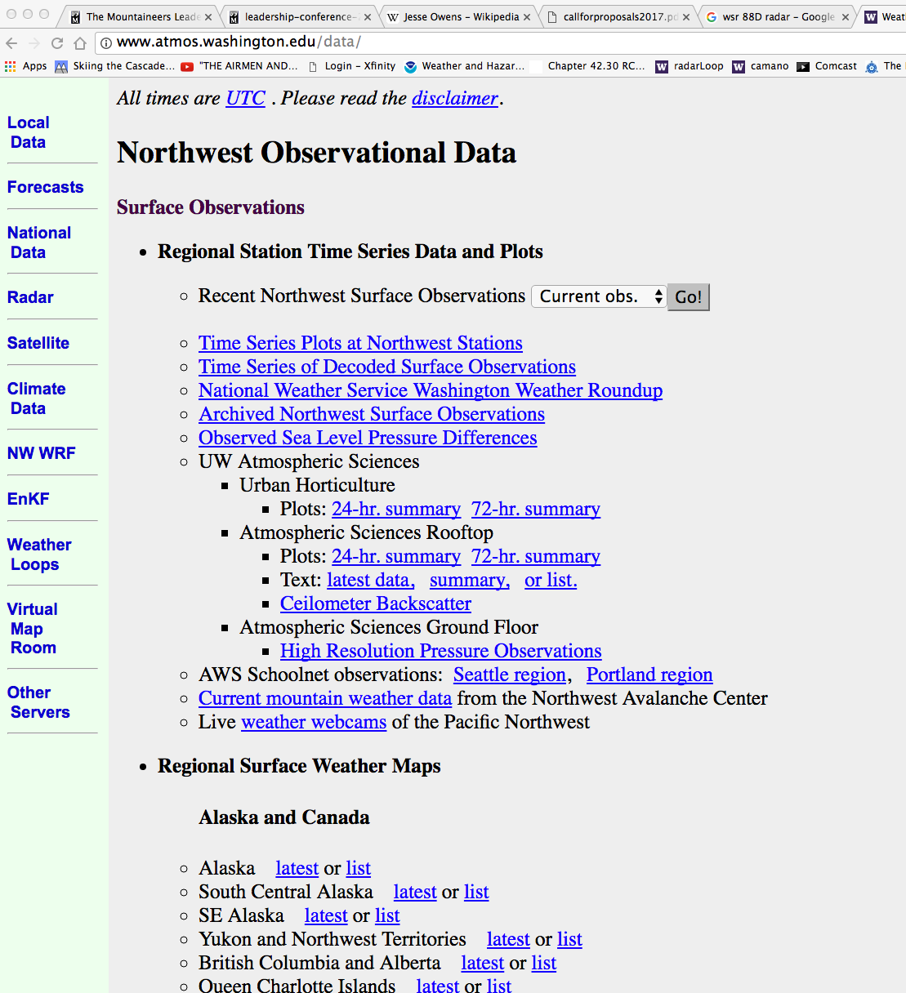
UW Website
Has Everything

Slide 15
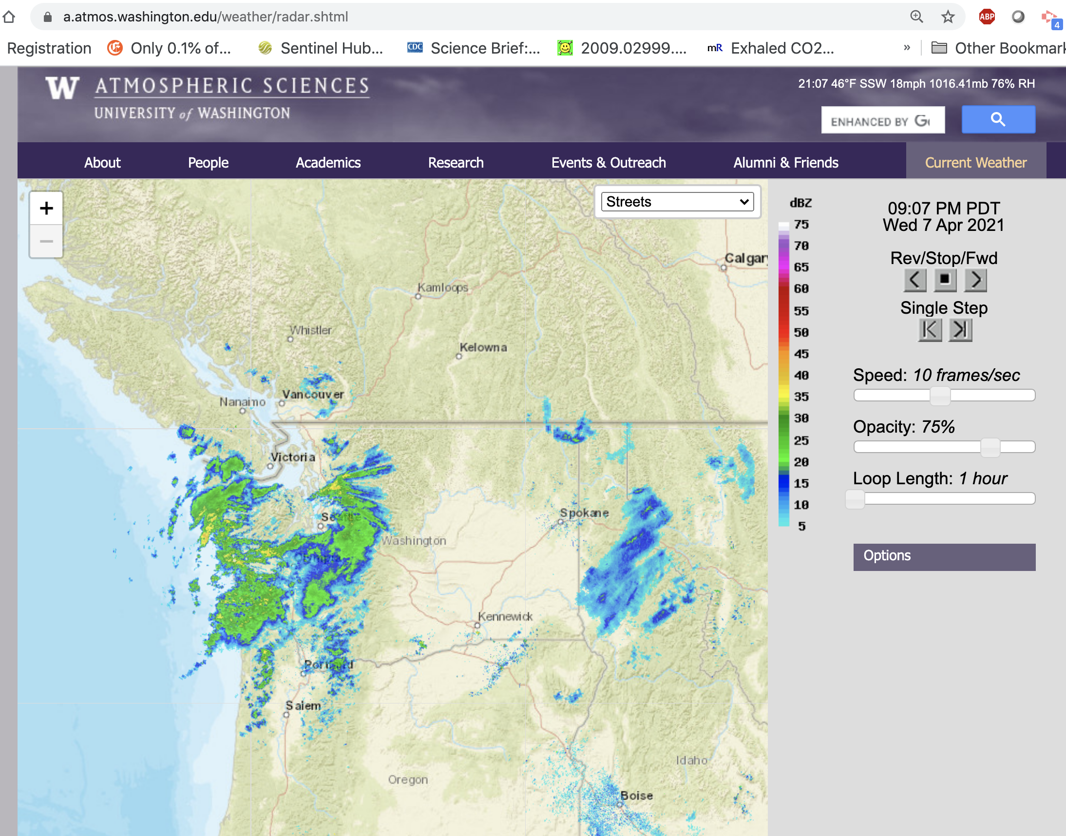
Radar (areas of precipitation)

Slide 16
Smartphone Weather Apps Are Very Useful
Smartphones are the perfect weather delivery devices for weather
  Good graphics,
  they know where you are,
  good communications,
  and more…

Slide 17
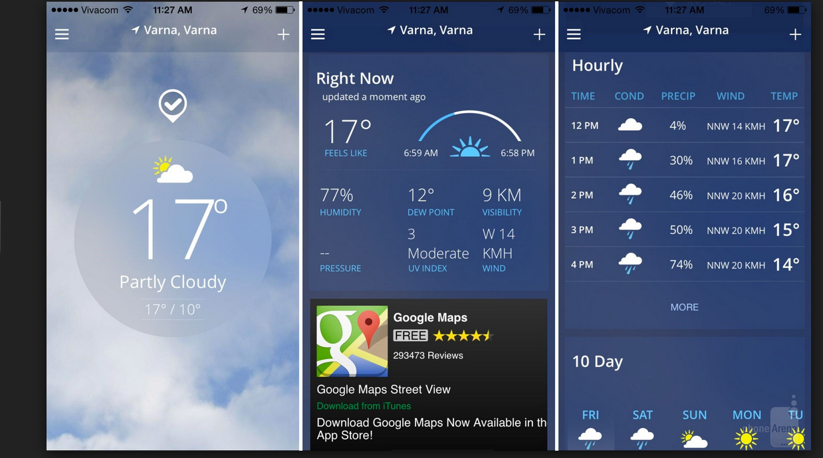
WeatherChannel App

Slide 18
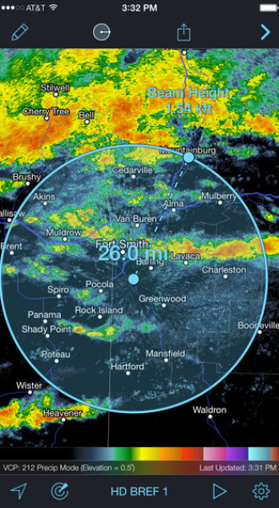
Radarscope: The Professional’s Choice for Looking at Radar Imagery

Slide 19
Understanding Local Winds
Local winds are mainly a combination of several factors:
  Diurnal winds (sea breezes, land breezes of several scales)
  Large scale winds, produced by major systems (“synoptic” high and low pressure systems)
  Regional circulations forced by terrain.

Slide 20
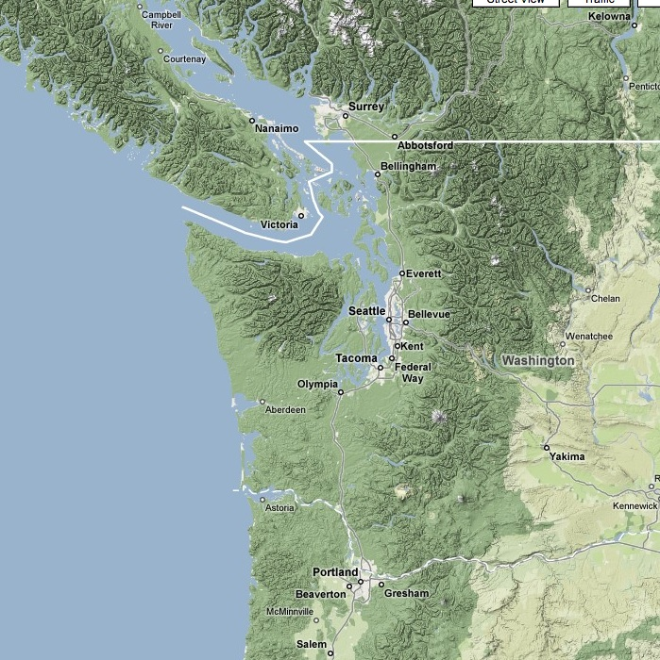
Complex array of land/water contrasts and terrain

Slide 21
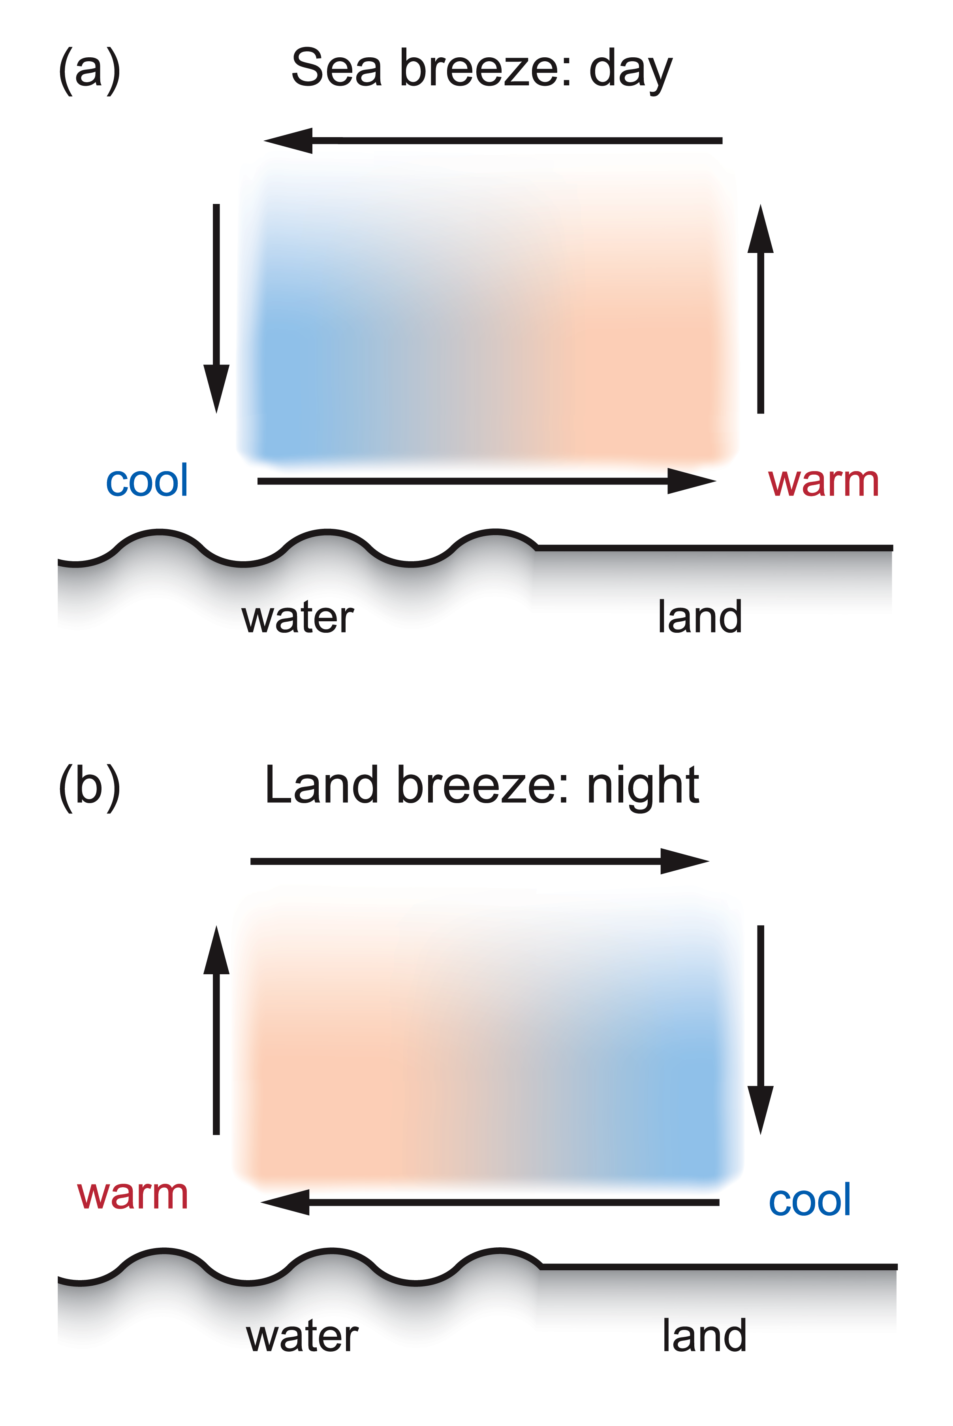
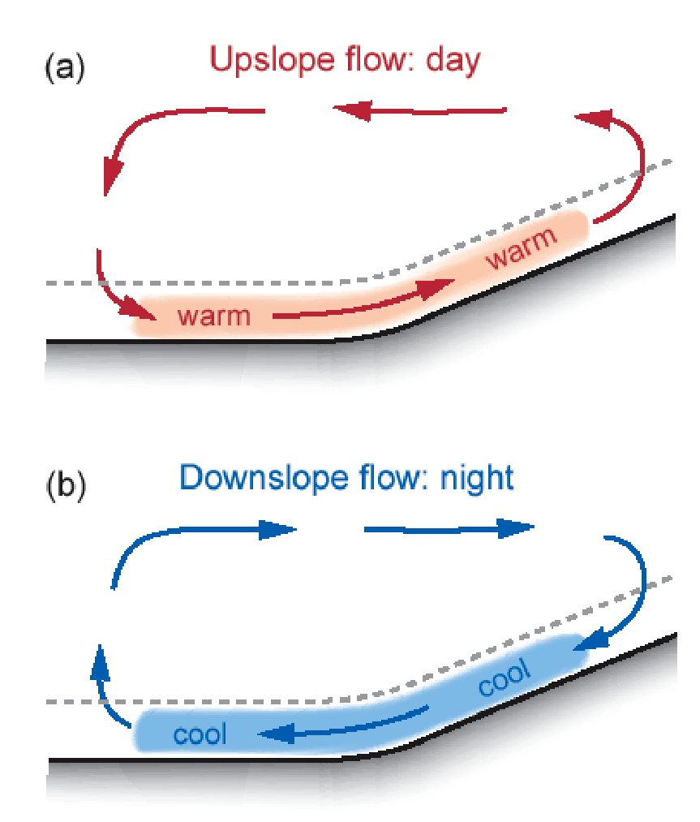
Diurnal Winds 101

Slide 22
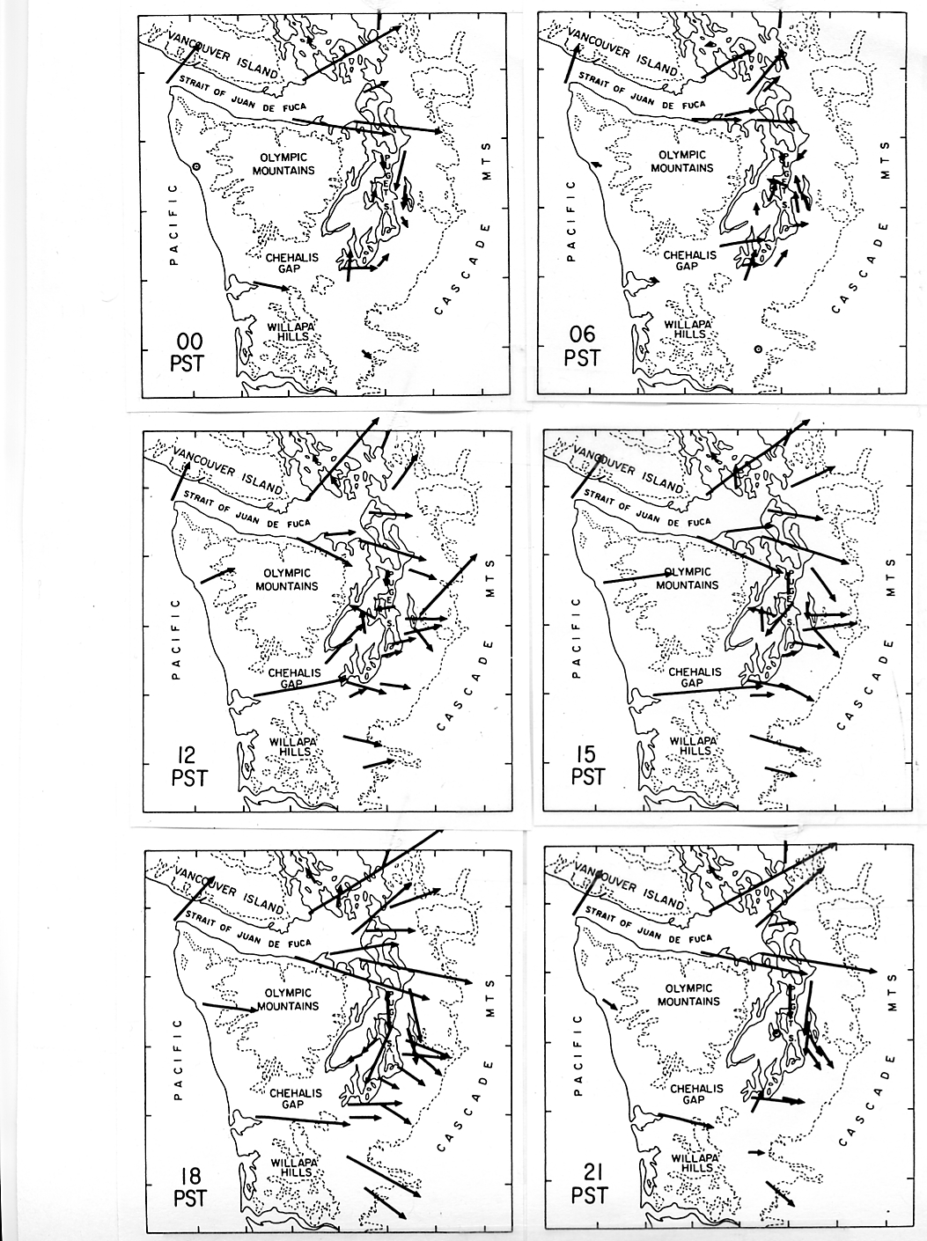
Summer
Diurnal
Winds

Slide 23
Summer
Diurnal
Winds
6 AM

Slide 24
Summer
Diurnal
Winds
3 PM

Slide 25
Summer
Diurnal
Winds
6 PM

Slide 26
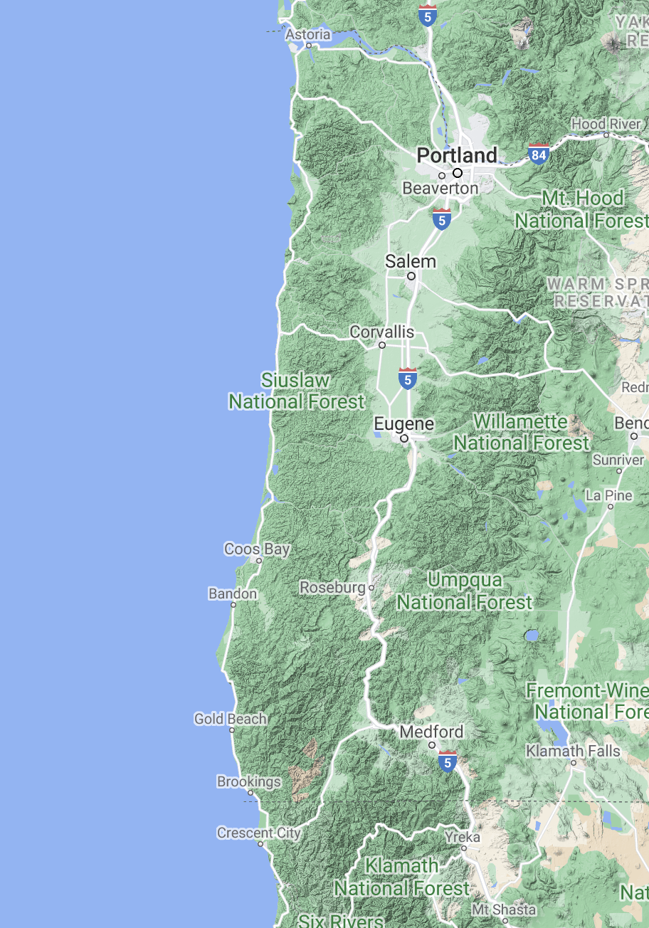
Sea Breeze Winds Washington and Oregon Coasts
Gusts frequently reach 30-35 knots during the summer during the afternoon along the southern Oregon Coast.

Slide 27
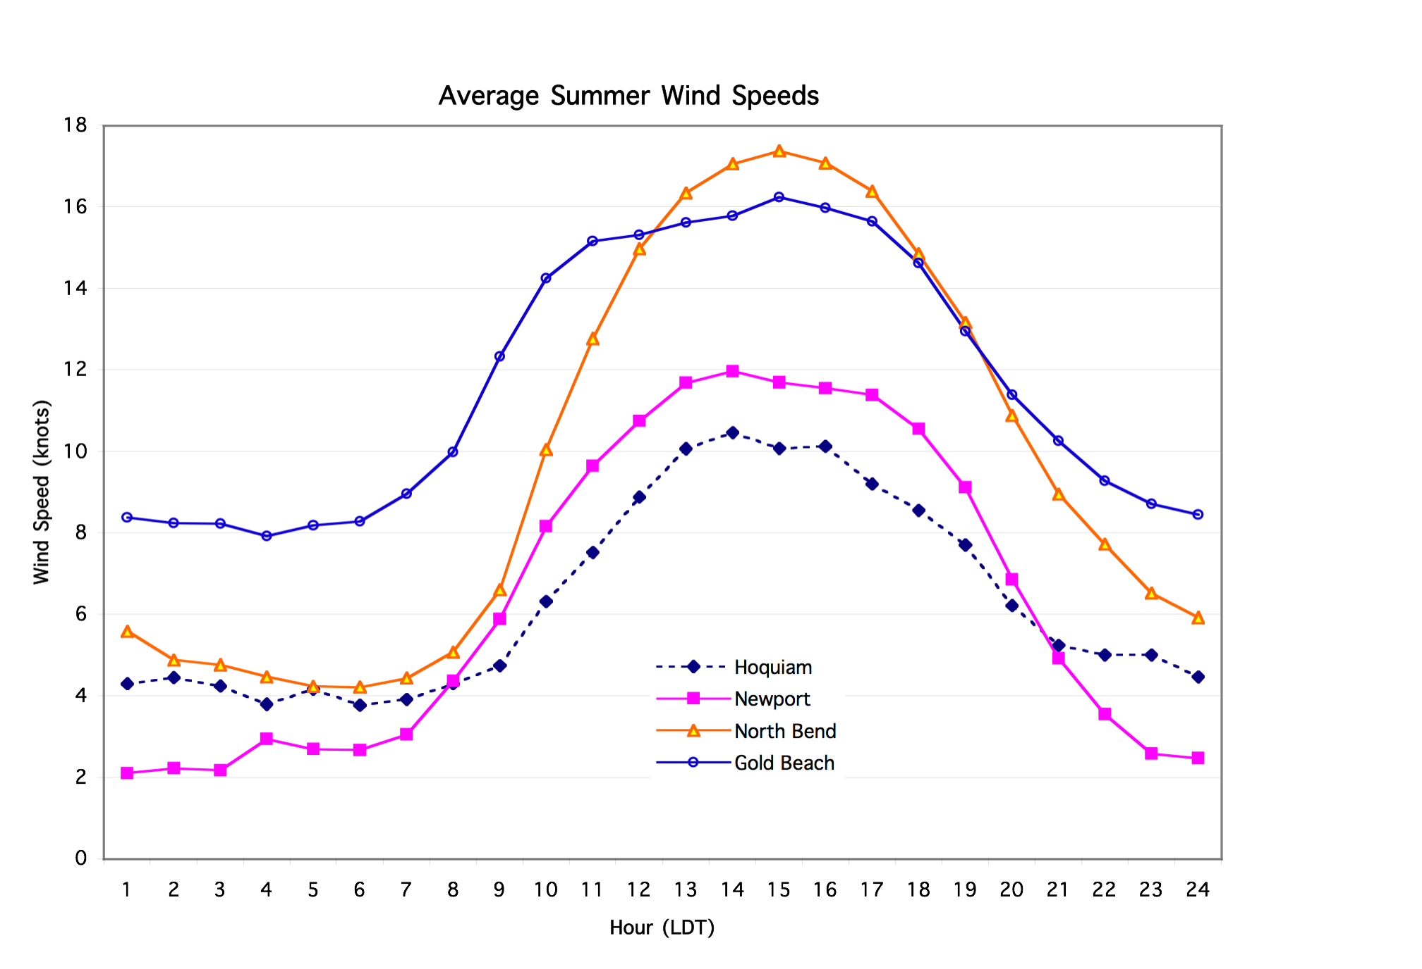
2-minute average July-August winds along the Northwest coast.

Slide 28
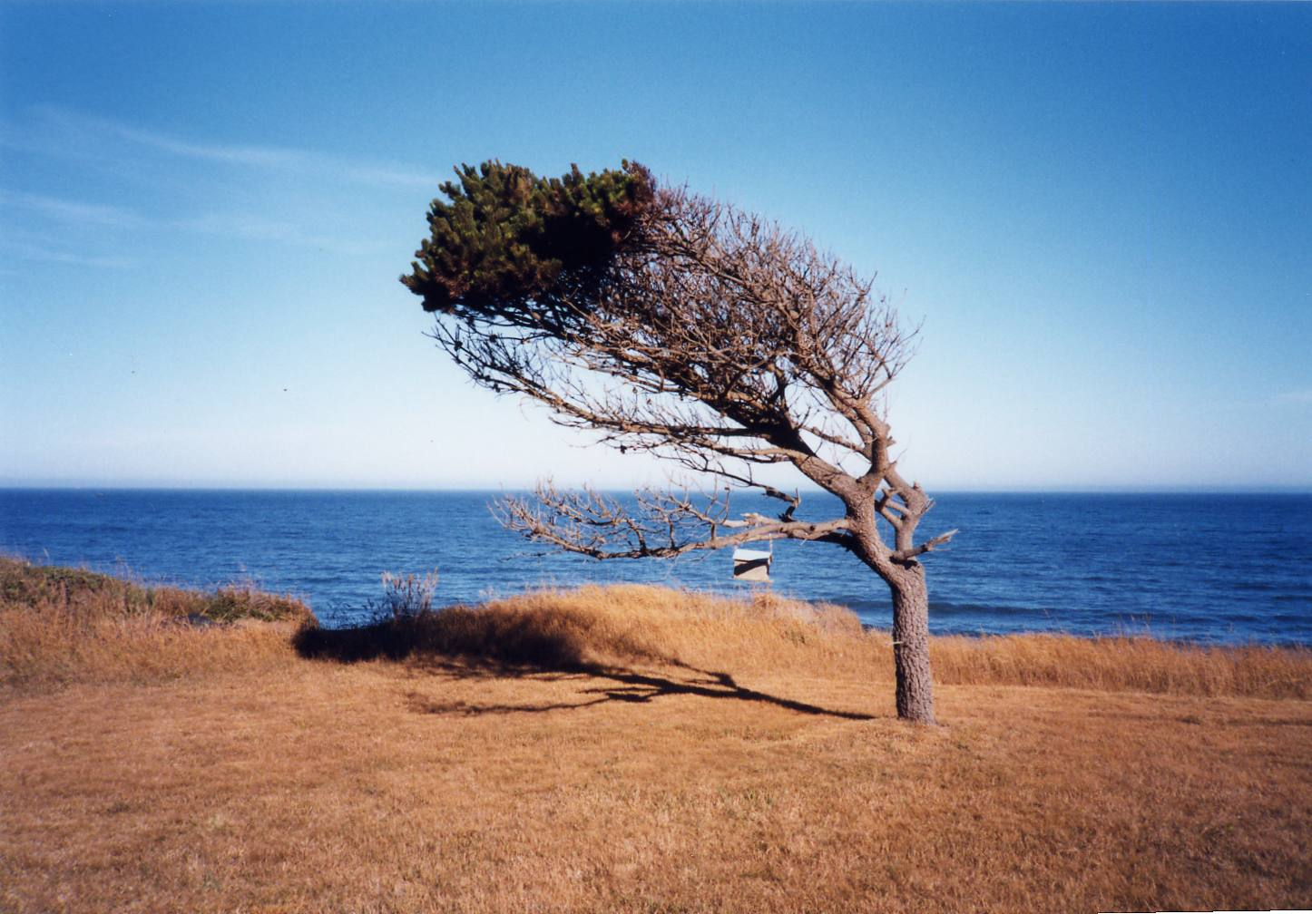
South
North
Southern Oregon Coast Near Brookings

Slide 29
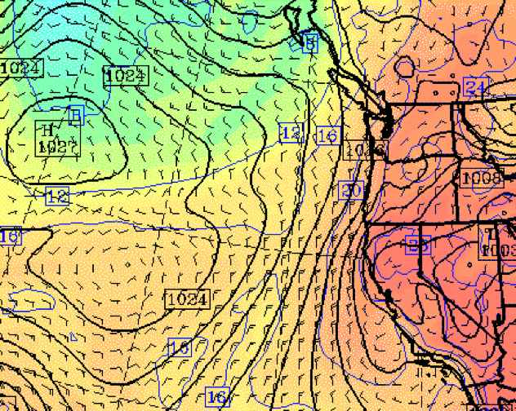
Why so windy along the southern Oregon coast?

Slide 30
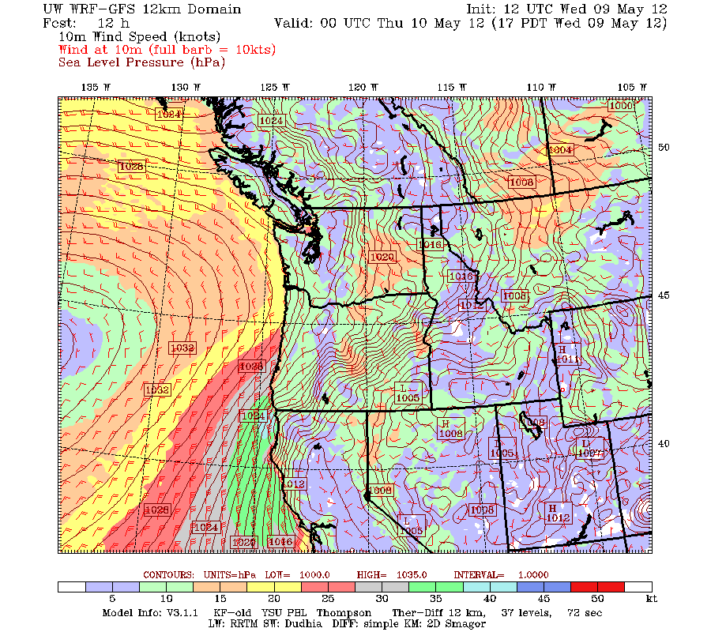
Strong Winds from southern Oregon to southern CA

Slide 31
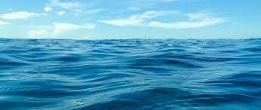
Winds are generally much stronger over water than land
Water is aerodynamically smooth
Winds are often 50% to 300% stronger over water than land
Only takes a few miles of overwater conditions to facilitate a speed up

Slide 32
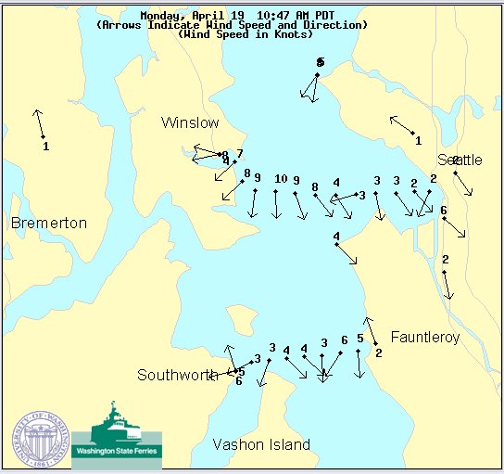

Slide 33
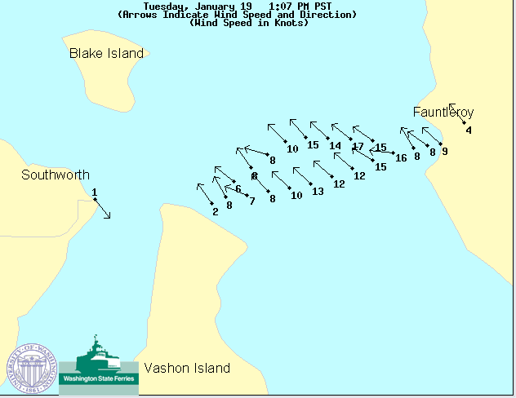

Slide 34
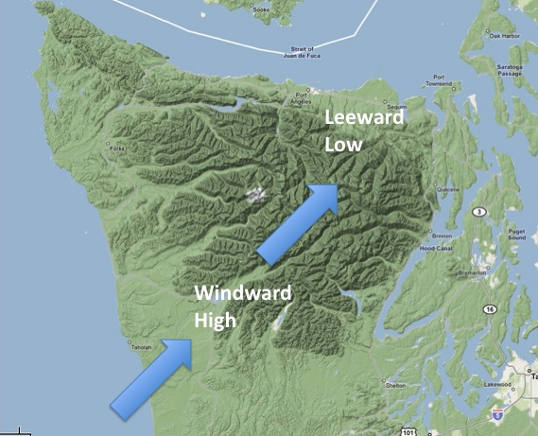
The Influence of Terrain on Local Winds
On the windward, upslope side air rises and cools, causing high pressure.
On the leeward side, downslope air sinks and warms, causing lowered pressure.

Slide 35
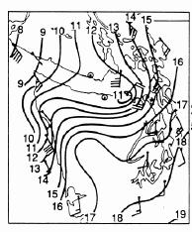
Topographic Pressure Effects: Example
L
H
Sea Level Pressure

Slide 36
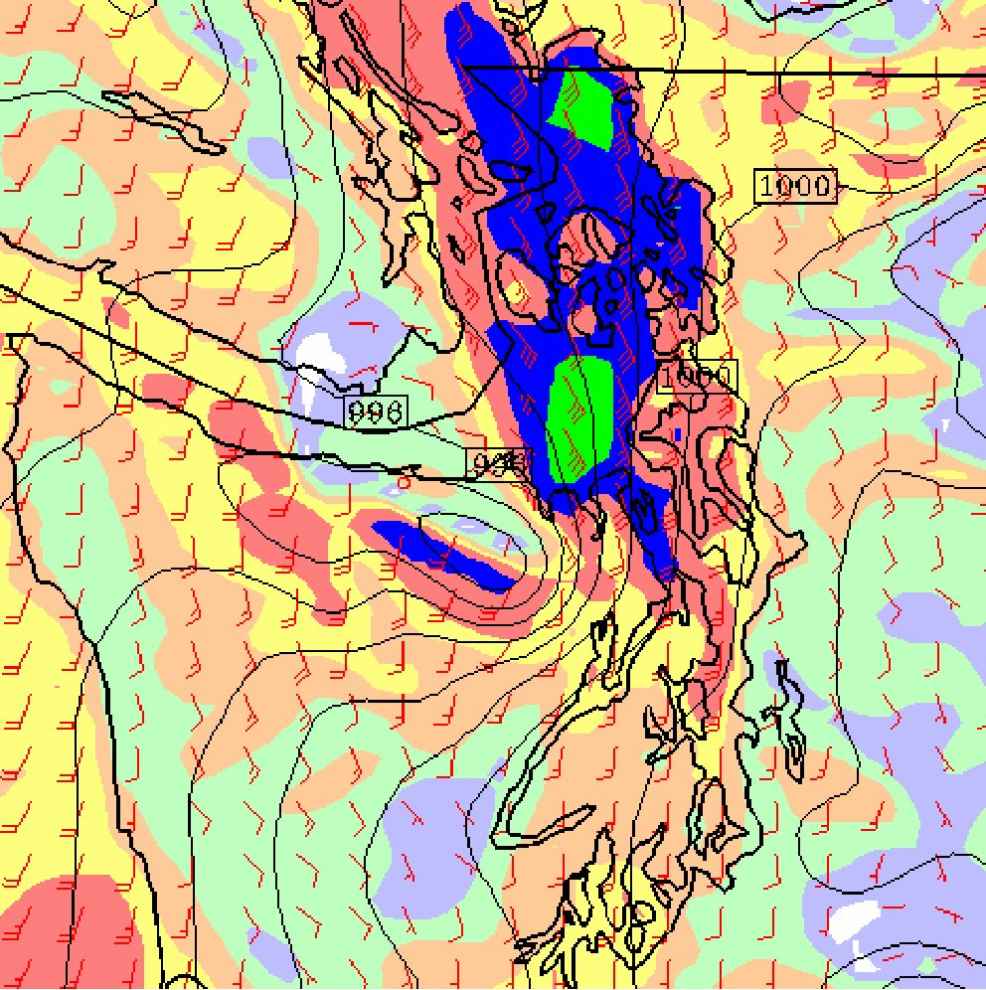
:Strong southeasterlies over NW Washington

Slide 37
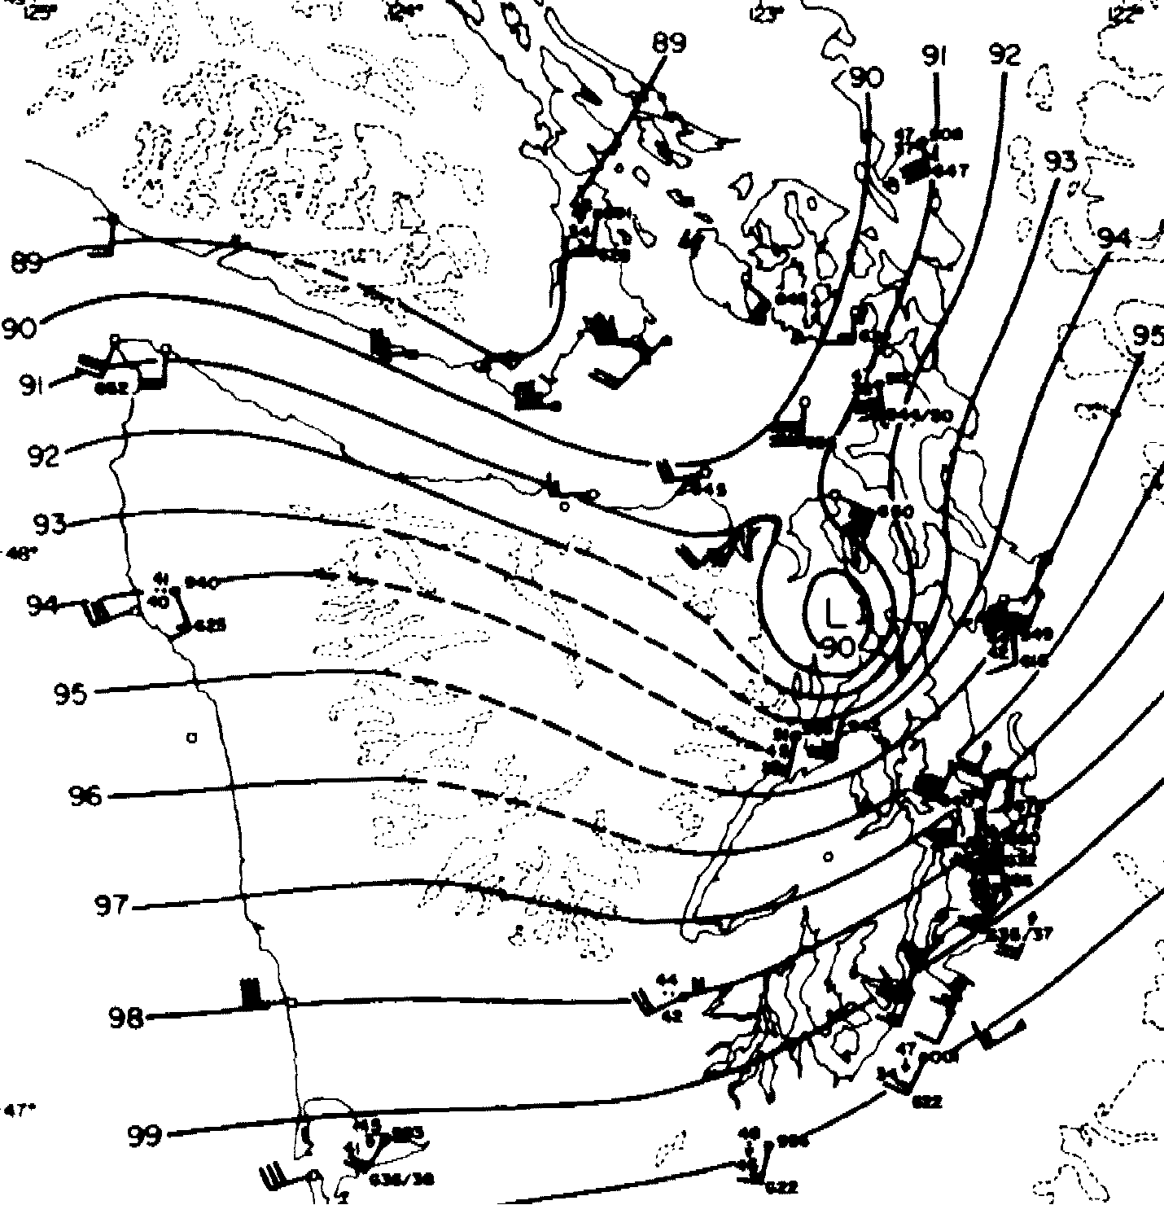
February 13
1979: The Hood Canal
Storm

Slide 38
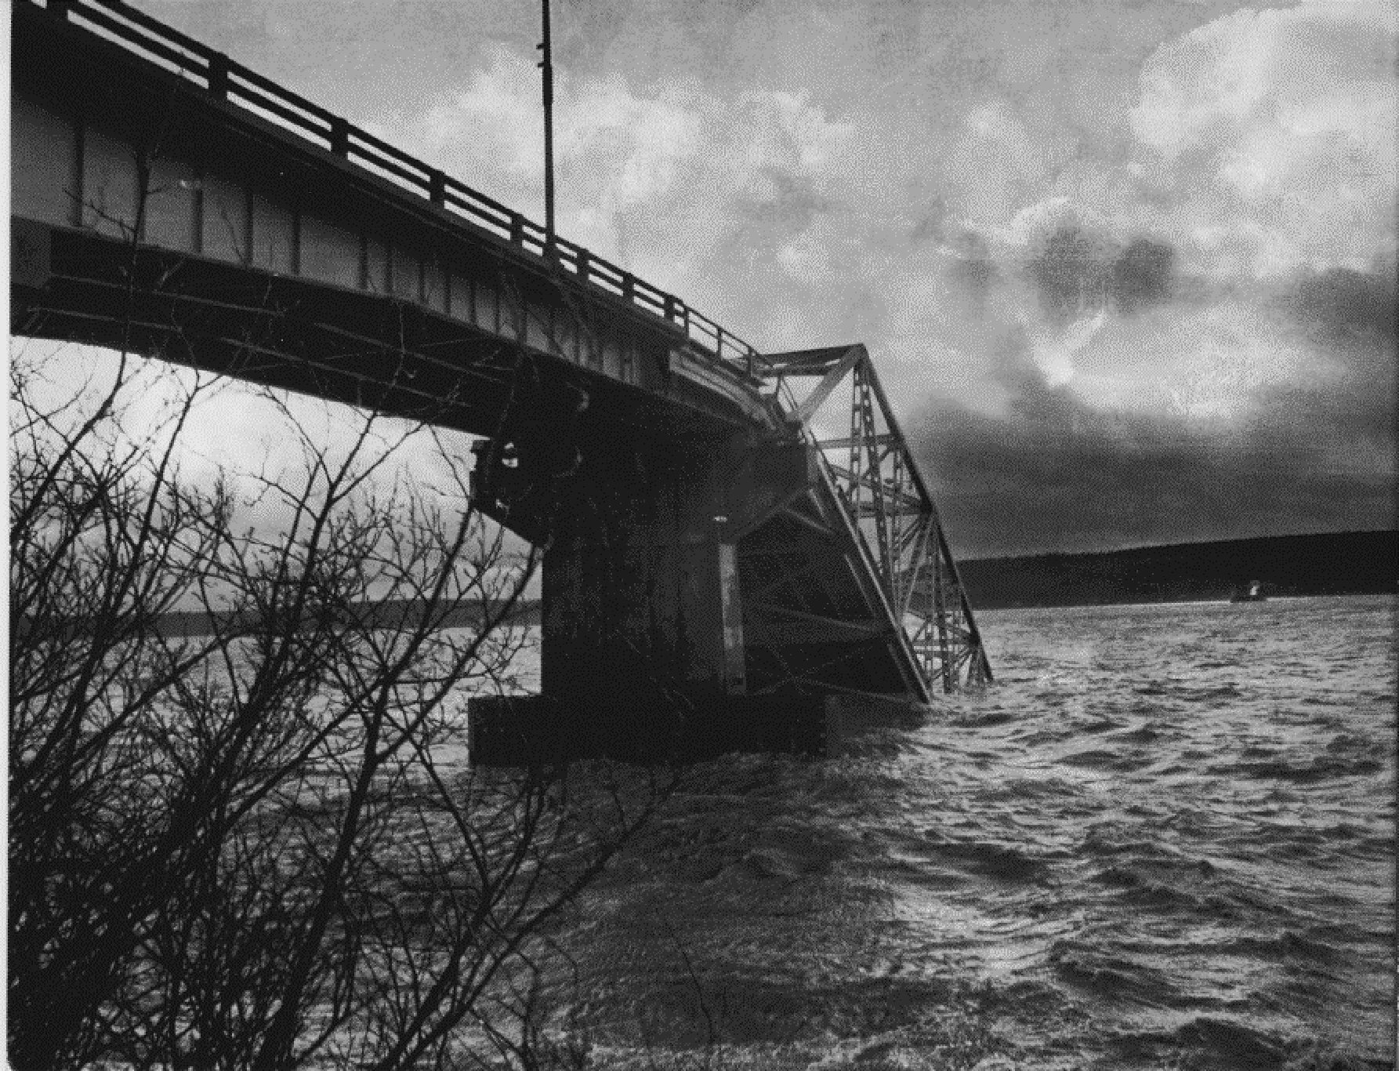
Winds over 100 kts destroyed the Hood Canal Bridge
Cost to replace: over 100 million dollars

Slide 39
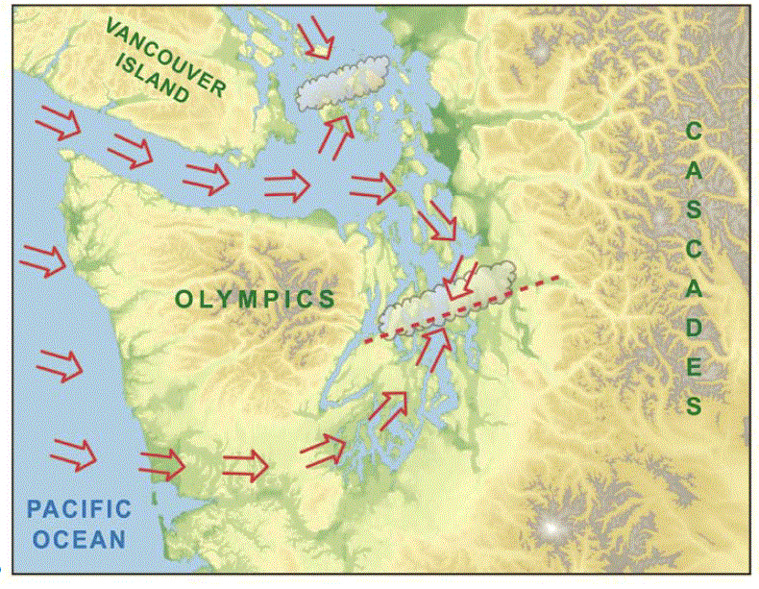
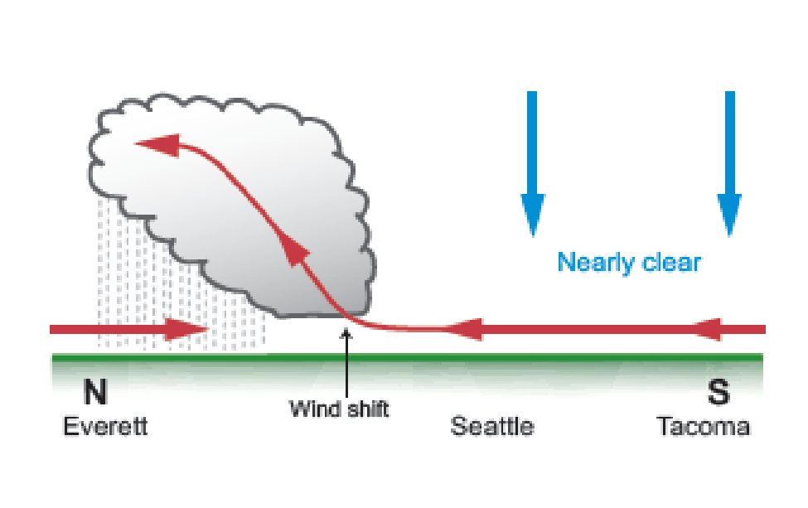
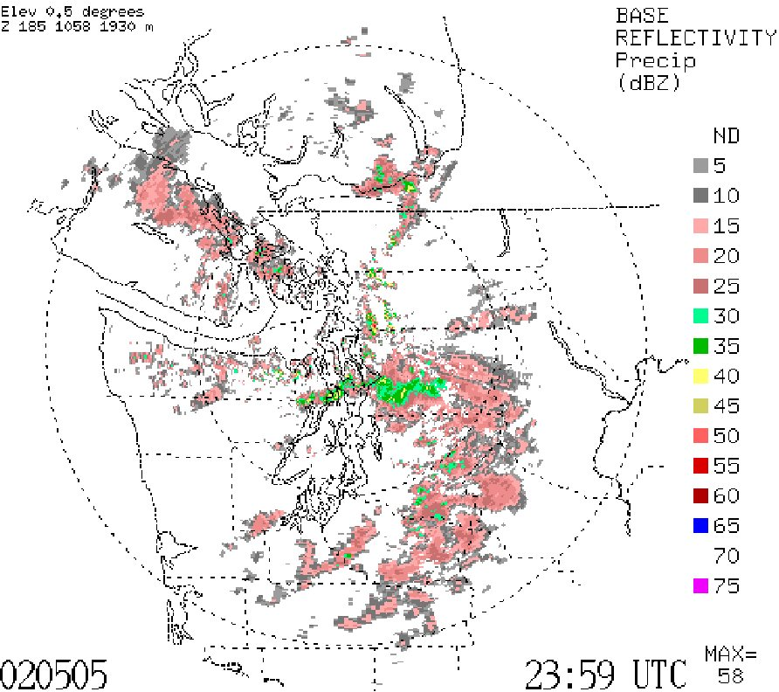
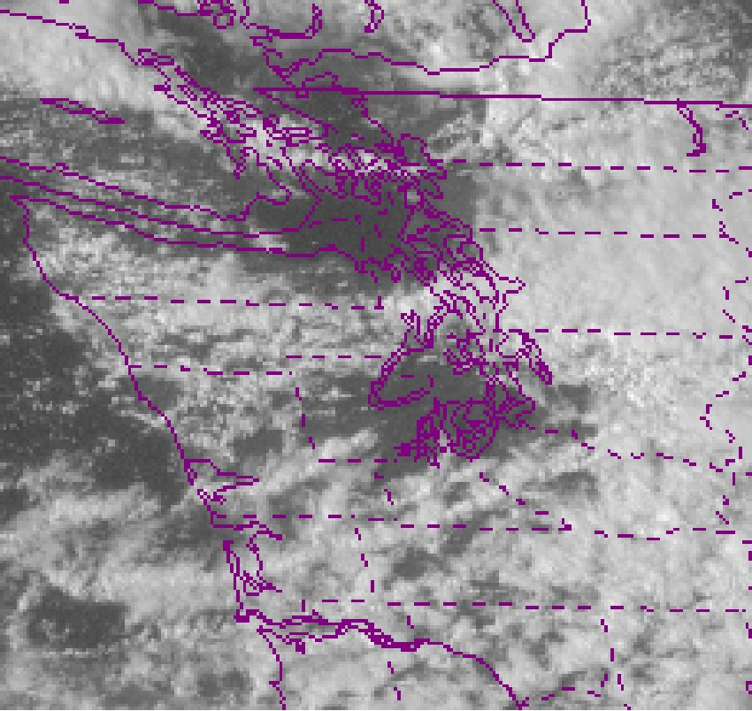
Puget Sound Convergence Zone

Slide 40
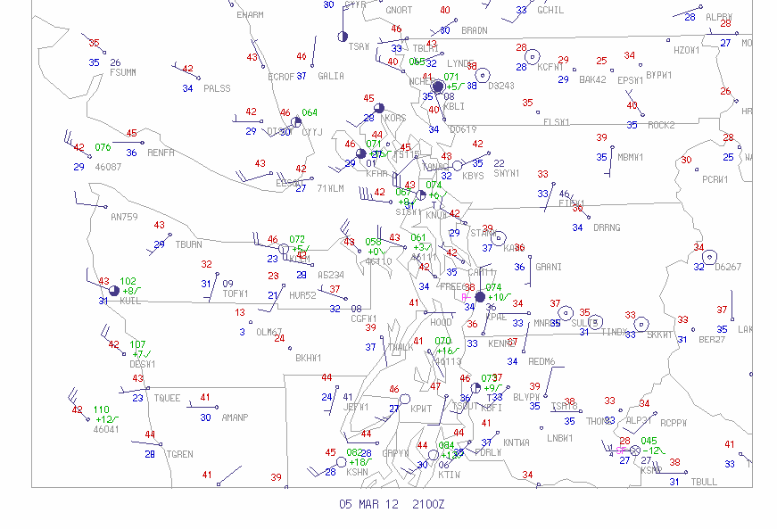

Slide 41
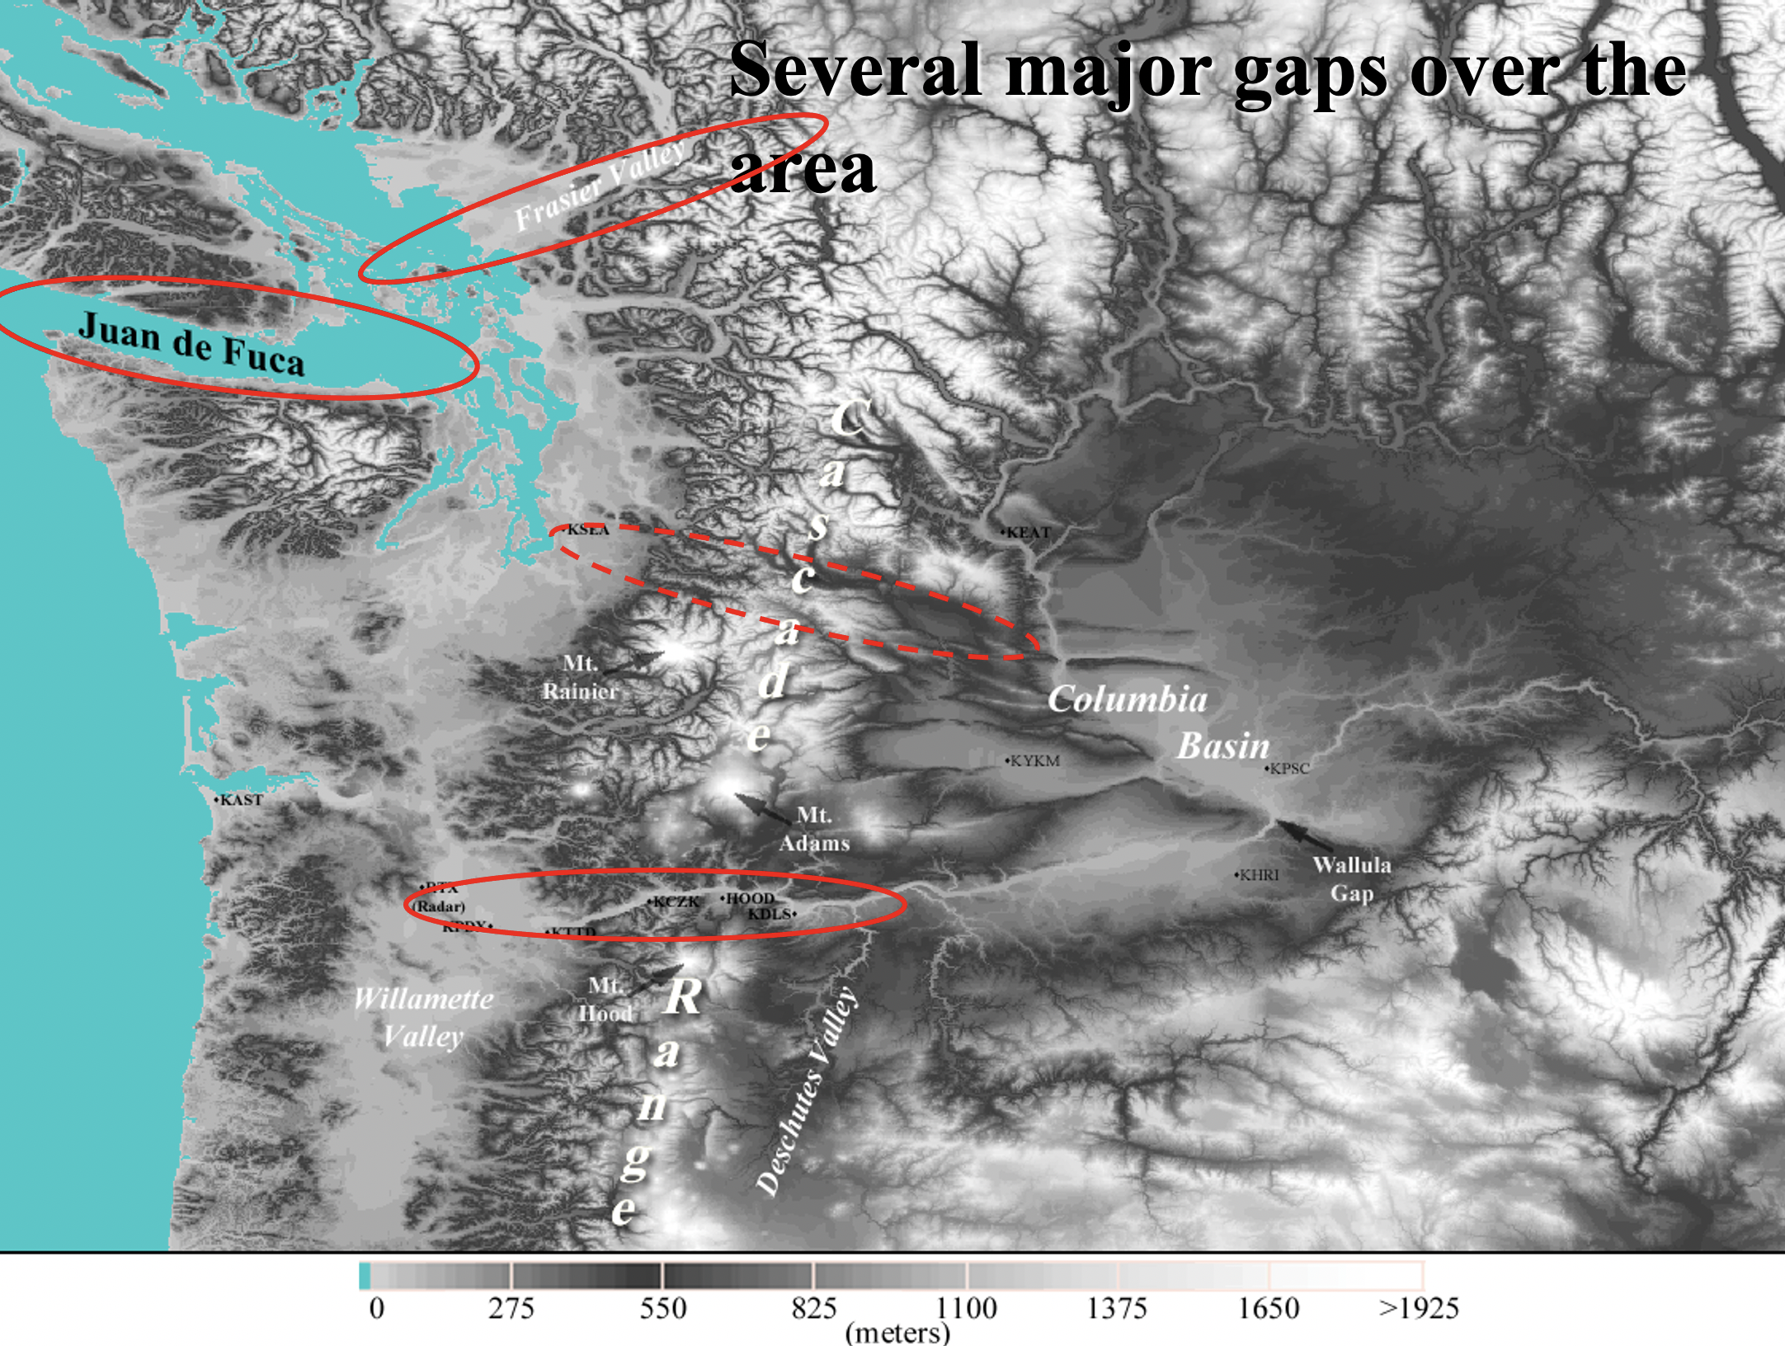
Gap Winds

Slide 42
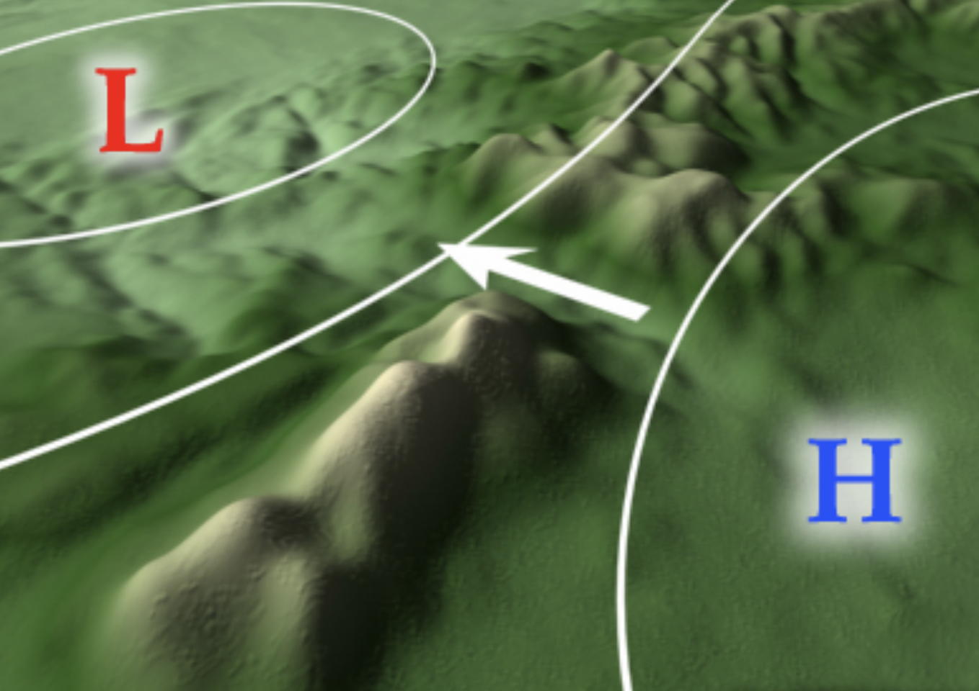
Key Gap Wind Facts
Winds tend to blow down the gaps from high to low pressure
Winds are generally strongest at the exits of the gaps, not in the middle.

Slide 43
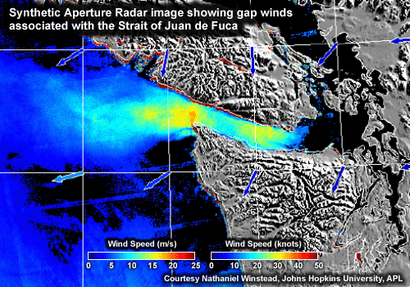
Strait of Juan de Fuca is well known for its easterly gales in the gap exit region.

Slide 44
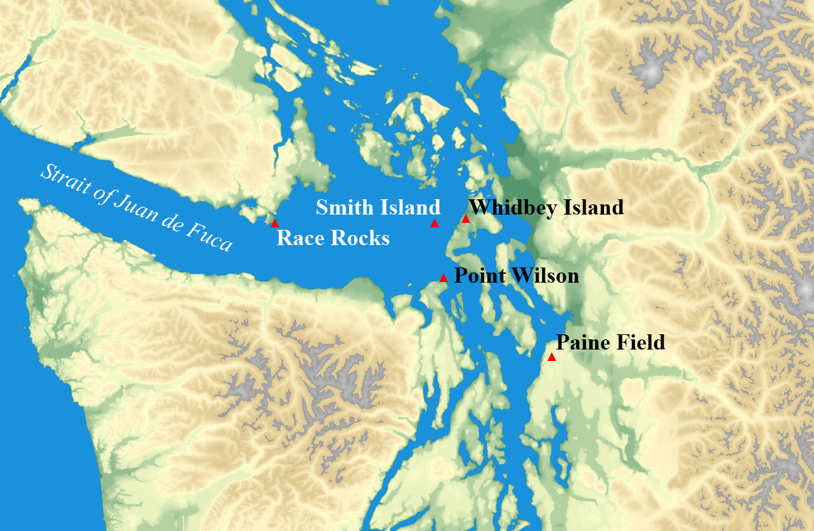
Westerly Wind Surges in the Strait of JDF
Snohomish
County
Seattle
Can get to 70-80 mph

Slide 45
October 28, 2003 – The Ivar’s Storm
Strong winds surged eastward through the Strait, producing wind gusts exceeding 60 mph from Edmonds to Whidbey Island.
Nearly 100,000 people lost power
One death on Whidbey Island from a tree falling onto a parked car
Partial destruction of Ivar’s restaurant at Mukilteo Landing
Notes:
Our next case study, October 28, 2003, looks much the same as the first one… very strong winds throughout the north sound, particularly in the vicinity of Everett Harbor.
In this case, nearly 100,000 people lost power.
Additionally, one man was killed at Whidbey Park after a tree toppled onto his parked car.
BUT, the big news (which is kind of sad considering there was a death related to the storm) was the partial destruction of the Ivar’s restaurant at Mukilteo Landing.
45

Slide 46
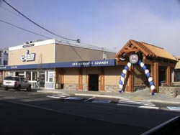
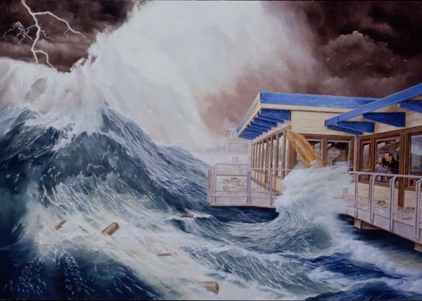
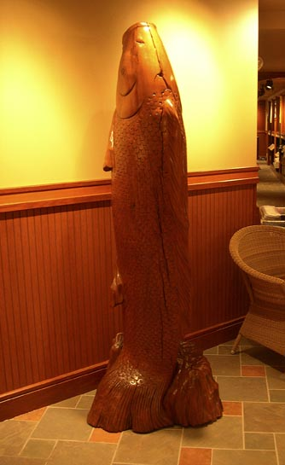
Ivar’s “rogue wave” mural
Notes:
And since the storm was named after it… This presentation wouldn’t be complete without talking about Ivar’s further… so here we go…
After the storm, Ivar’s redecorated their entire restaurant, incorporating the storm into their décor. I actually had the chance to have lunch with the artist, who painted the mural as accurately as possible according to first hand accounts… like by these people…
Also, as you can see in the painting, there is the wooden statue of “the carp”… which was washed away in the storm. Free fish and chips for a year to anyone who safely returns the beloved carp to its home… and here it is.
46

Slide 47
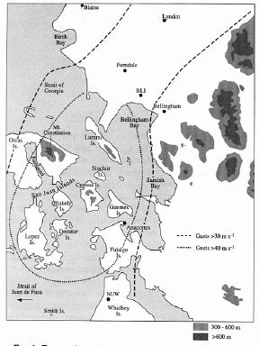
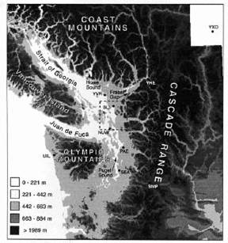
Fraser River NE Gap Flow
Max Winds, 28 Dec. 1990
> 80 kt

Slide 48
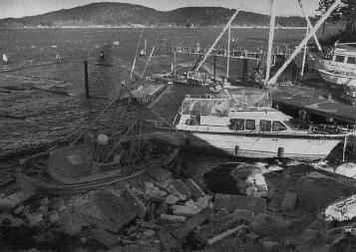
Anacortes Marina

Slide 49
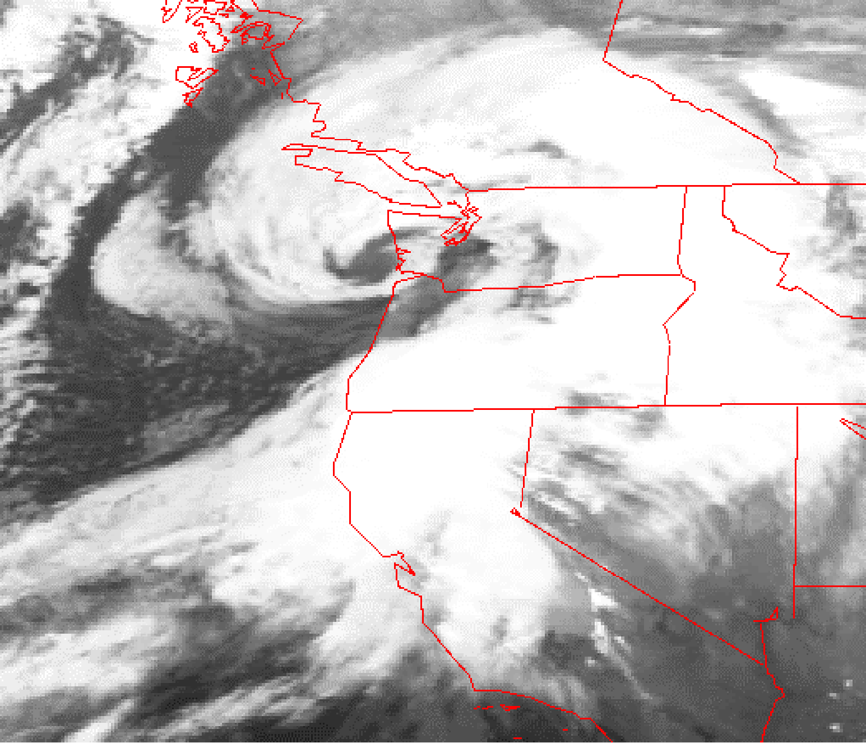
Strong Winds From Strong Pacific Cyclones
1993 Inauguration Day Storm

Slide 50
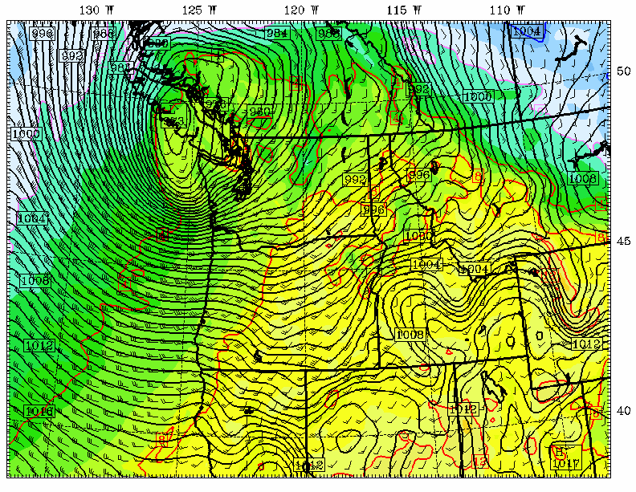
Chanukah Eve Storm 2006
Chanukah Eve Storm: 18-h forecast for 10 PM December 14, 2006
L

Slide 51
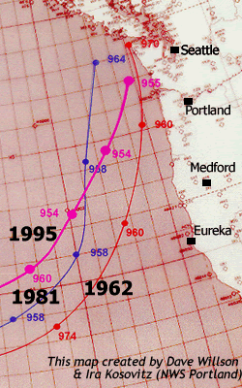
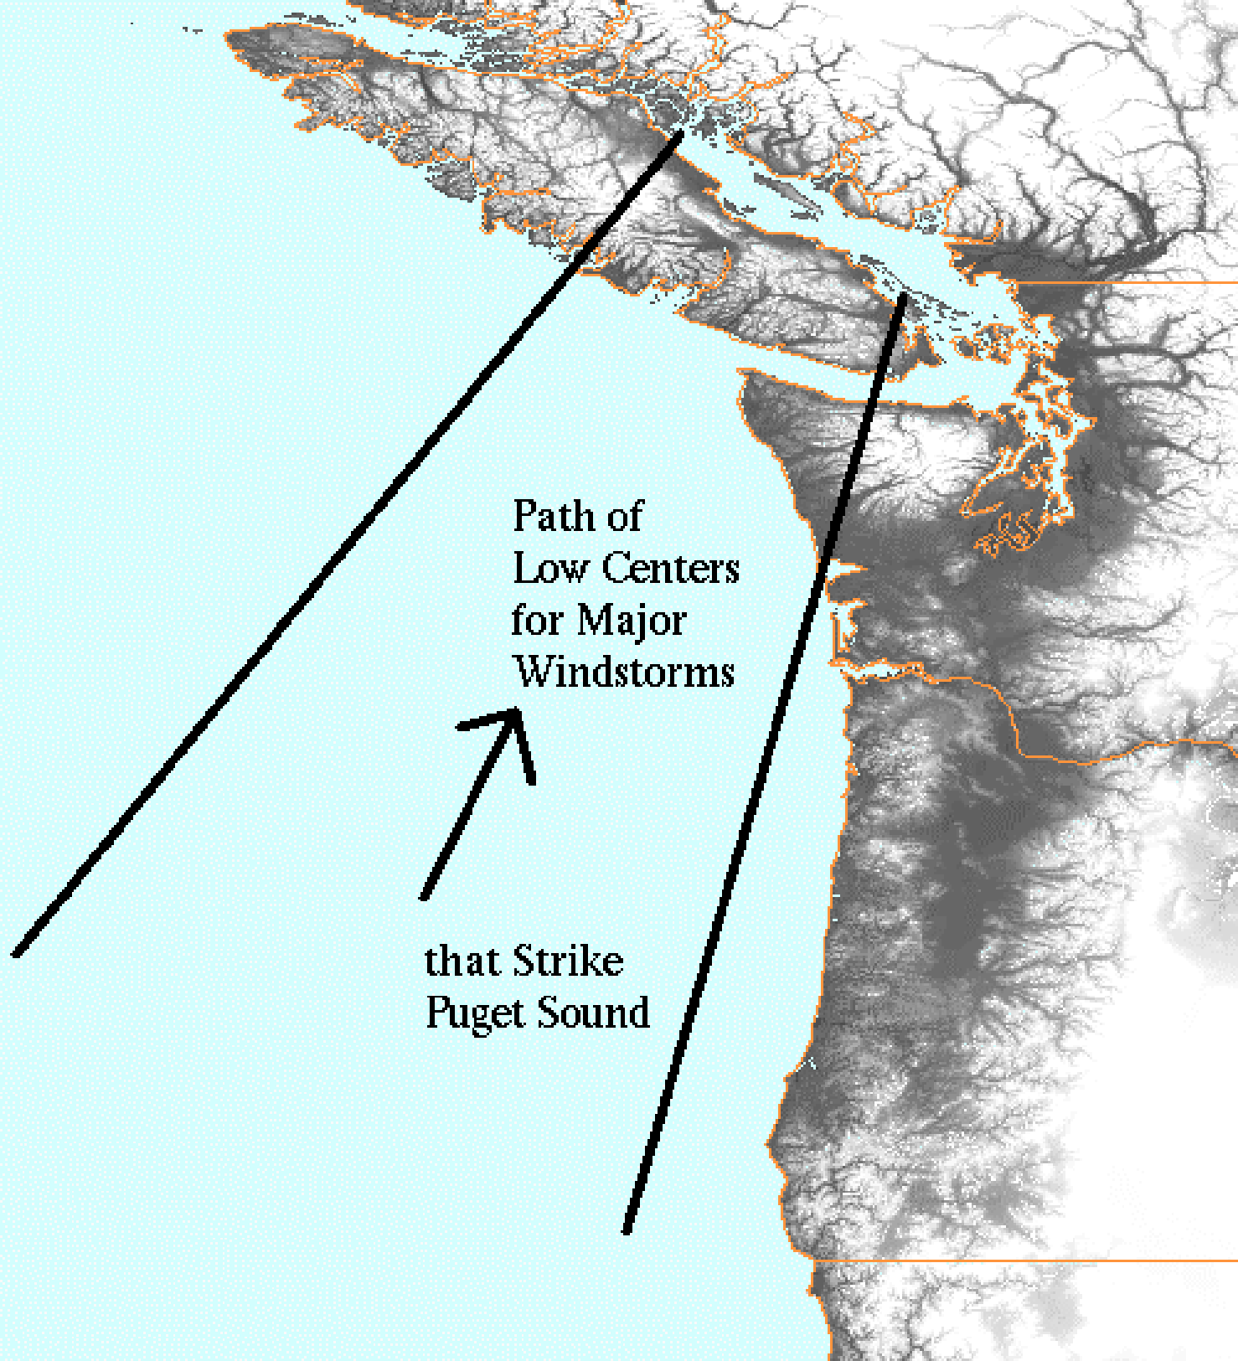
The path of most strong windstorms that affect Puget Sound

Slide 52
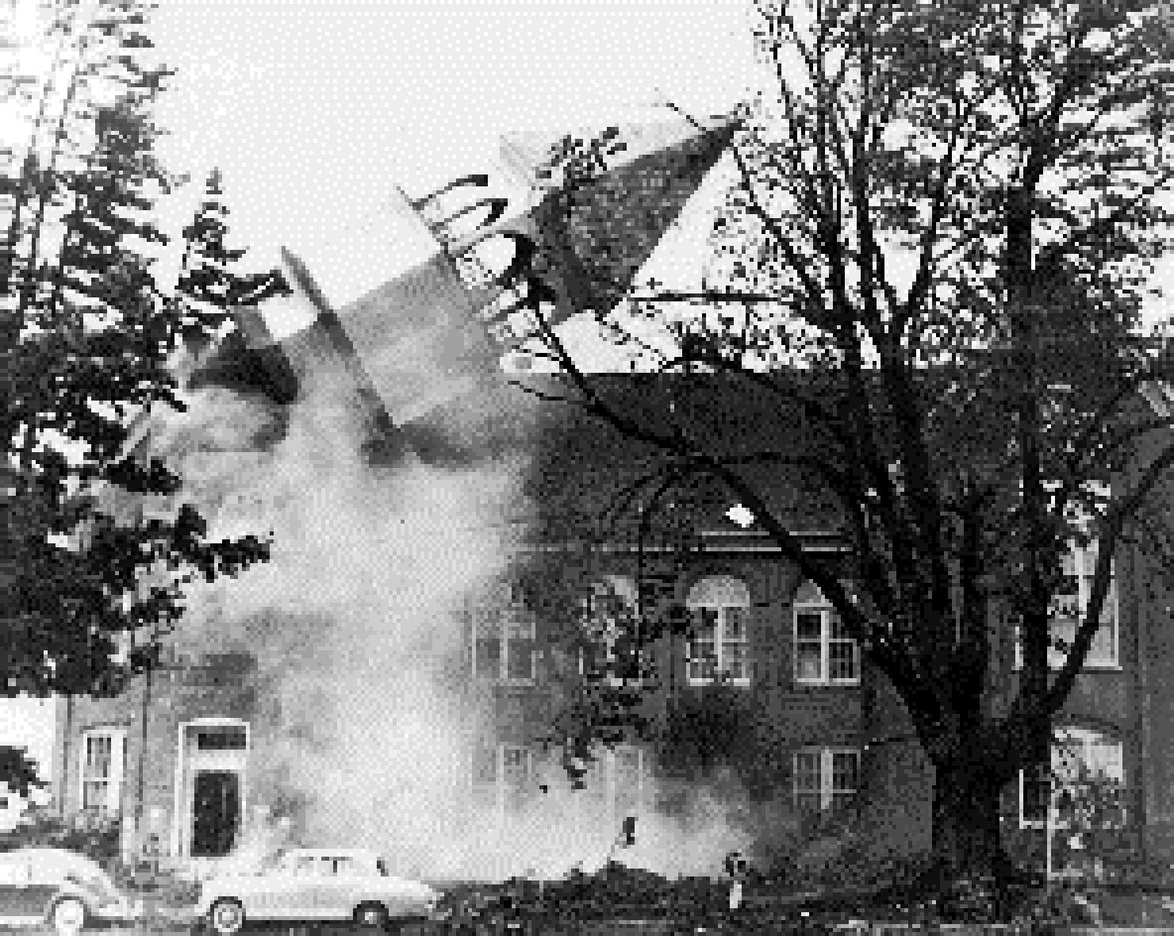
The Most Extreme of the Extreme: The Columbus Day Windstorm of 12 October 1962

Slide 53
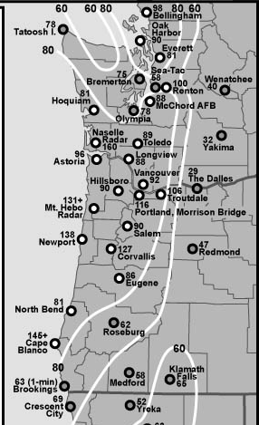
Max Winds (mph)
Columbus Day Storm 1962

Slide 54
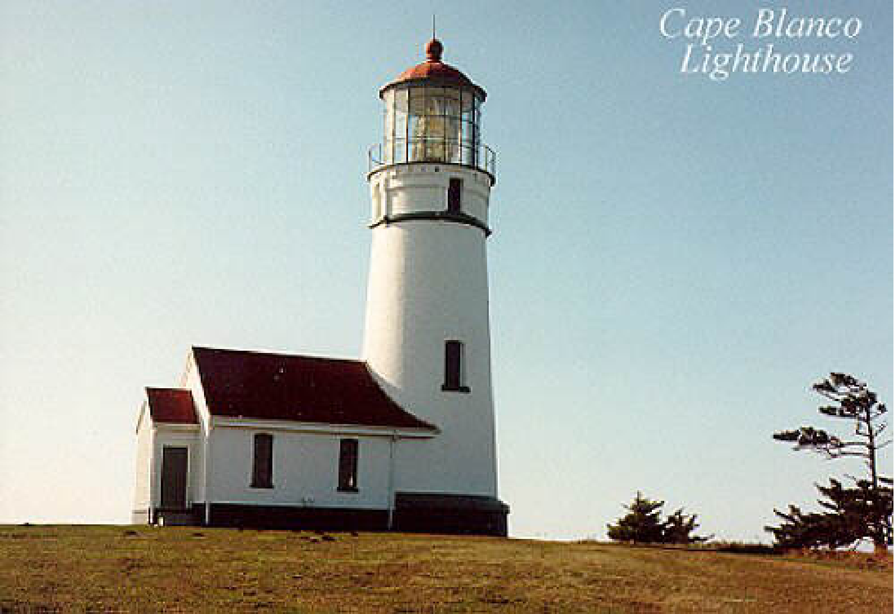
Columbus Day 1962: At Cape Blanco there were 150 mph with gusts to 179! Strongest winds on bluffs and windward slopes of coastal orography

Slide 55
Summary
Weather observing and forecasting technology has advanced considerably during the past 30 years.
We now have substantial understanding of the winds and weather features of the region.
Local mariners should take advantage of both!
Vast amounts of weather information is now online and highly accessible.

Slide 56

The End

