Slide 1
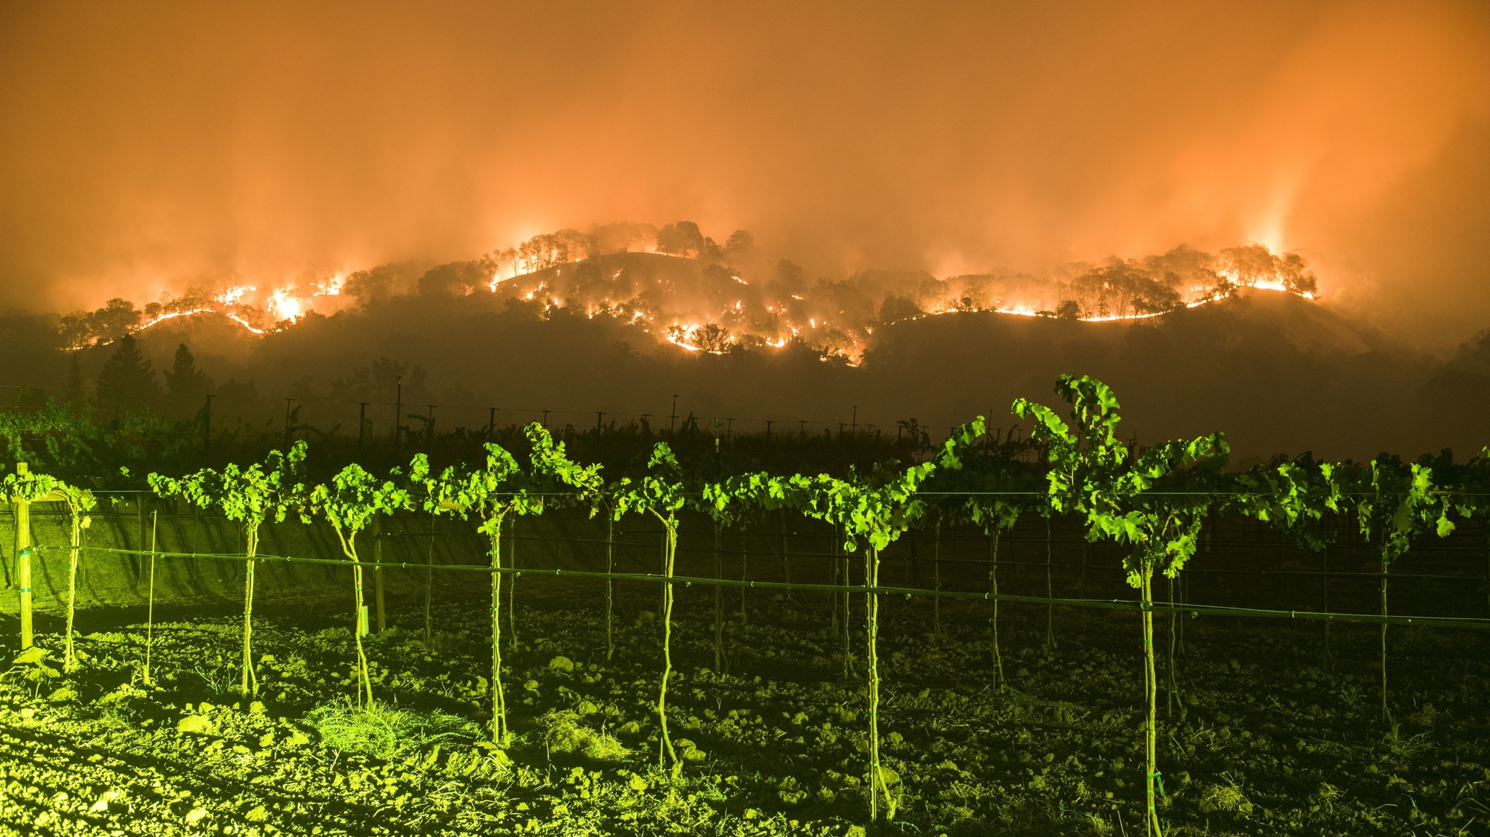
The Wine Country Fires of October 2017: A Coastal California Wildfire Event
Cliff Mass
Atmospheric Sciences
University of Washington

Slide 2
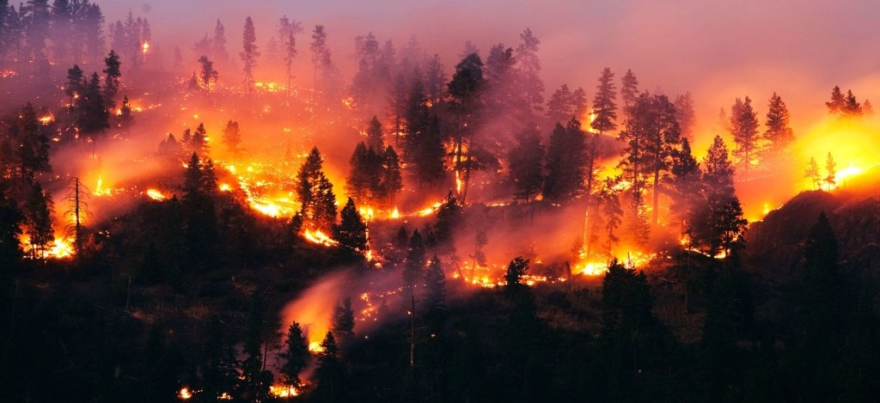
During the evening of Sunday, October 8, 2017, wildfires began in the hills above Santa Rosa, Napa, and other towns of the ”wine country” north of San Francisco

Slide 3
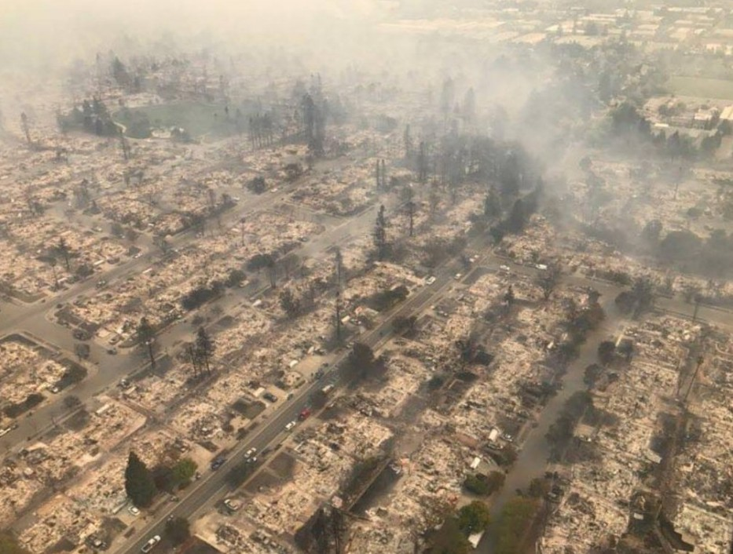
And then, pushed by strong winds, rapidly descended into populated areas

Slide 4
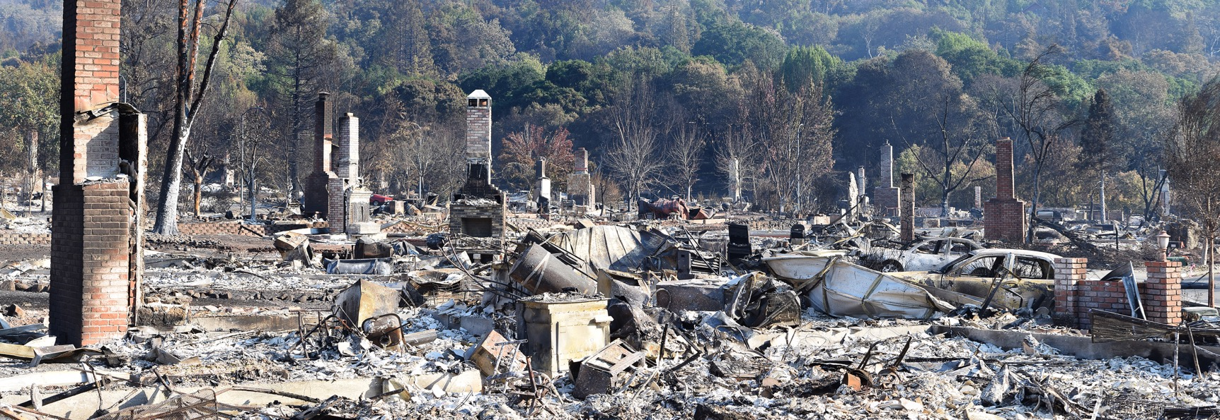
The Fountaingrove Neighborhood

Slide 5
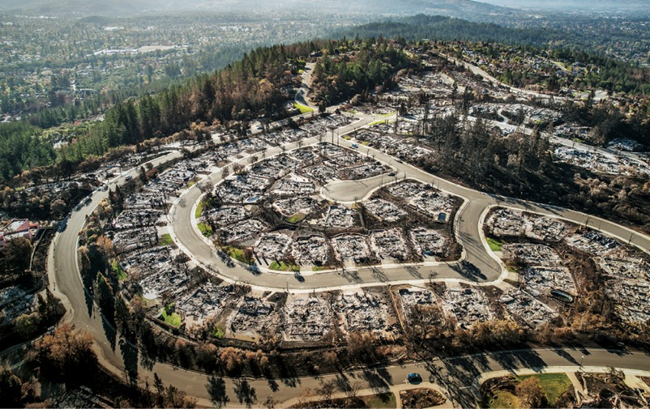
Before it was over, the “Wine Country” wildfires became the most devastating in CA history
44 died and hundreds were hospitalized
More than 9,000 structures were destroyed. 21,000 damaged.
Burned 245,000 acres of land
More than 10 billion in insured property loss
Total damage/loss much more.
Serious air quality degradation over the region for over a week.

Slide 6
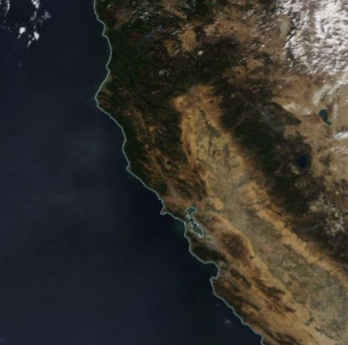
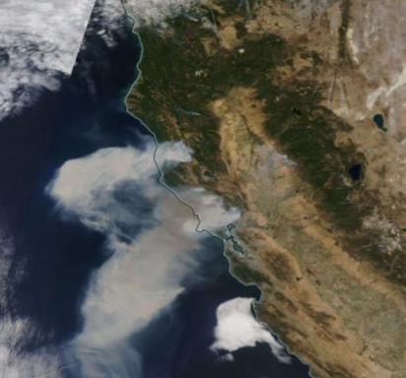
Modis Imagery: October 8 versus October 9, 2017

Slide 7
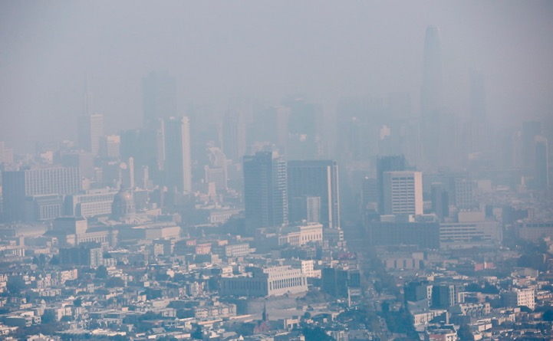
Serious Air Quality Impacts
Many Bay Area AQ sites had their worst air quality on record
Air quality declined to extremely unhealthy levels for millions of people
Remained unhealthy for days.
Hundreds of people ended up in Bay Area hospitals from the effects of smoke

Slide 8
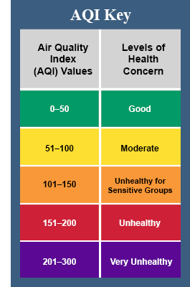
October 10

Slide 9

Some key questions
What meteorological conditions accompanied the fires?
Were these conditions predictable?
What started the fires?
Could this disaster have been prevented?
Did anthropogenic global warming play a significant role in this event?

Slide 10
The Geography of the Region

Slide 11
Major Wine Country Fires

Slide 12
Climatological Lead Up

Slide 13
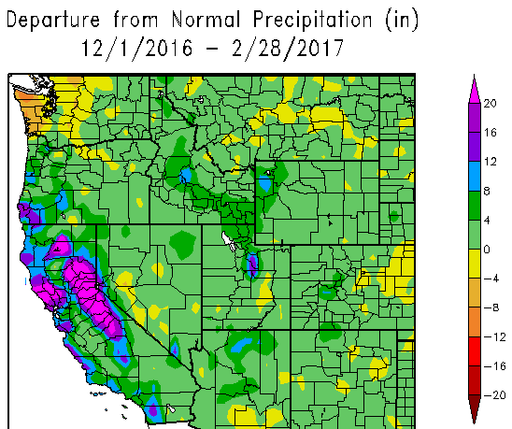
A Very Wet Winter Before the Fires

Slide 14
The Wet Winter Led to Luxuriant Grass Growth

Slide 15
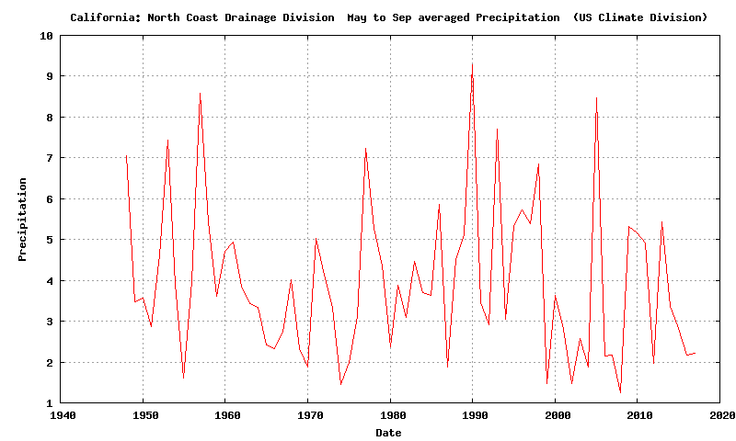
The Preceding Summer Was Typically Dry
Division Data: North Coast Drainage

Slide 16
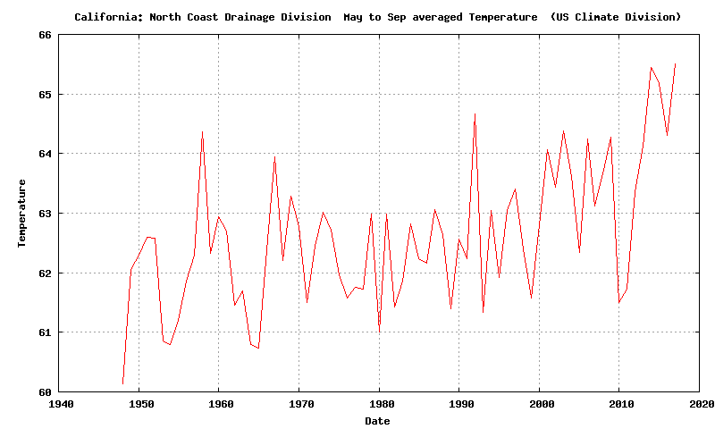
But it was warmer than normal by ~3F.

Slide 17
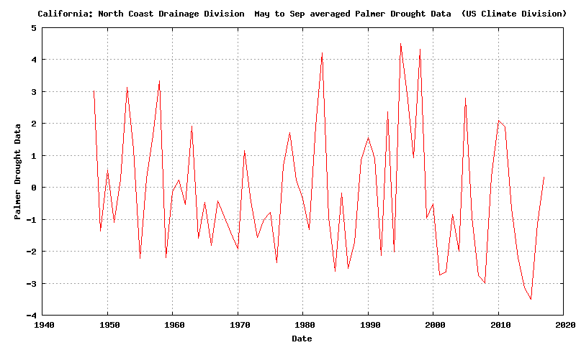
With a wet winter/spring, and a normally dry, but warmer than normal summer, the Palmer Drought Severity Index was near normal

Slide 18
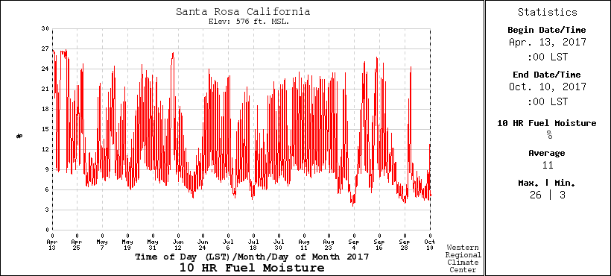
10-hour Fuel Moisture (.25 to 1 inch diameter)
Varies rapidly, drops with offshore flow. Below 10% is dangerous

Slide 19
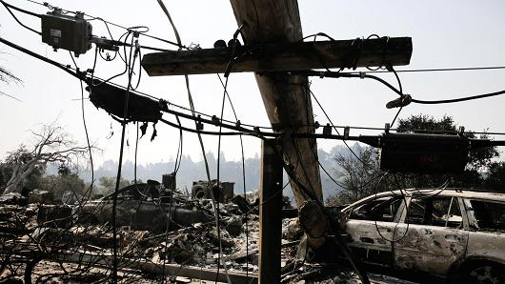
Fire Initiation
172 fire starts leading to 18 major fires
911 calls about power outages and small fires started around 9 PM October 8, just when winds accelerated
Initial investigation traced most fires to failing electrical infrastructure (downed lines, exploded transformers) resulting from strong winds

Slide 20
The Winds

Slide 21
Max Gusts During the Event (knots):
Big spatial variation with strongest winds (60-95 knots) on upper lee (SW) slopes of terrain

Slide 22
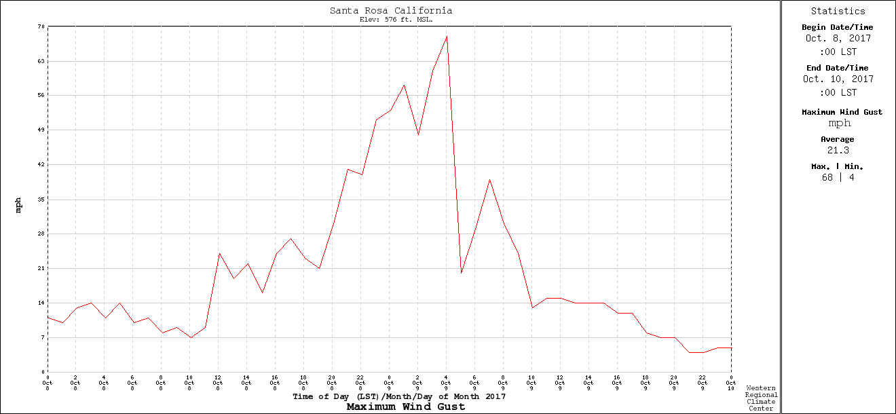
Temporal Variation: Rapid Increase and Decline
Santa Rosa RAWS
9 PM
PDT
midnight
6AM

Slide 23
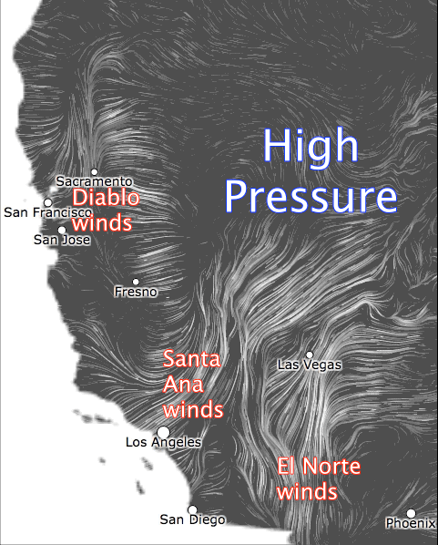
Such warm, dry offshore winds are associated with high pressure over the intermountain west and an offshore pressure gradient
Known as Diablo Winds
High Pressure

Slide 24


Slide 25
The Synoptic and Mesoscale Origins of the Strong Winds

Slide 26
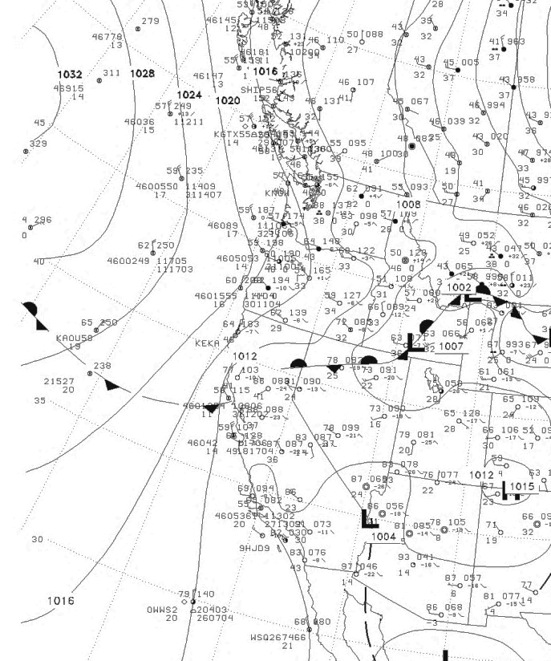
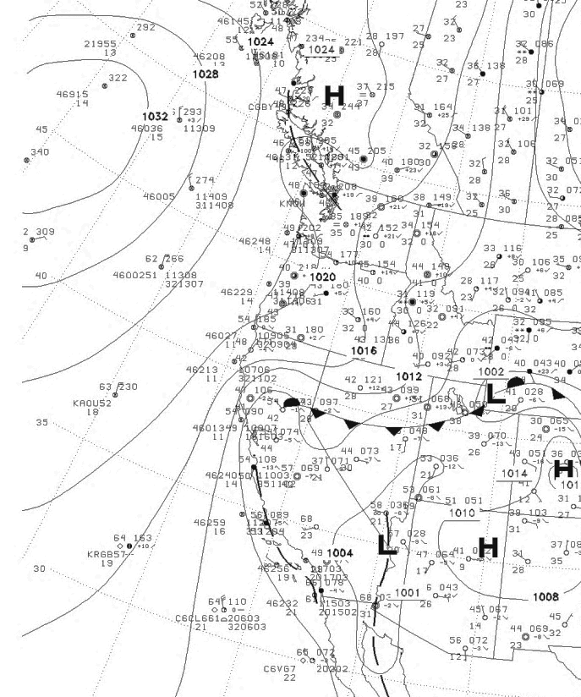
High Pressure
Built into the
Northwest and then into the Intermountain West
0000 UTC 8 October
1200 UTC 8 October

Slide 27
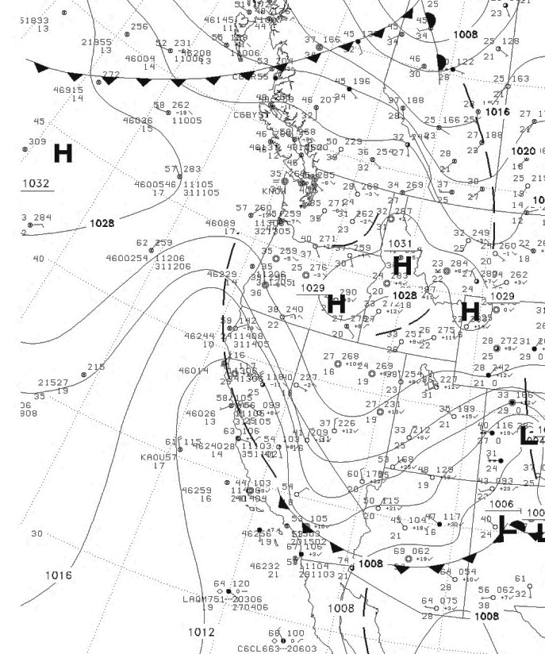
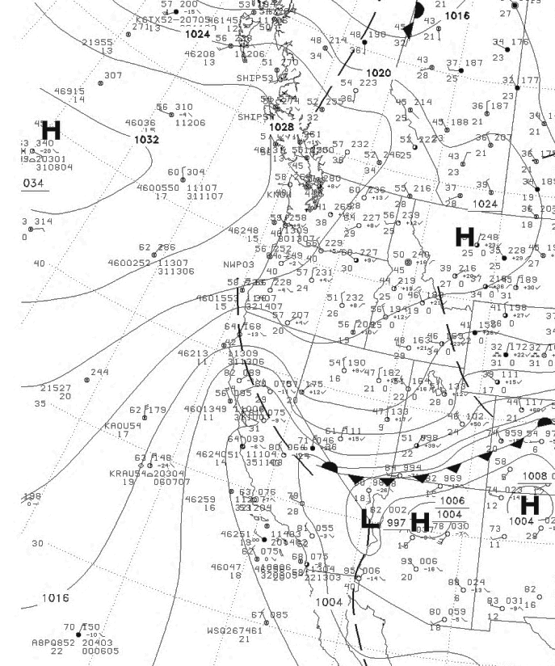
0000 UTC 9 October
1200 UTC 9 October

Slide 28
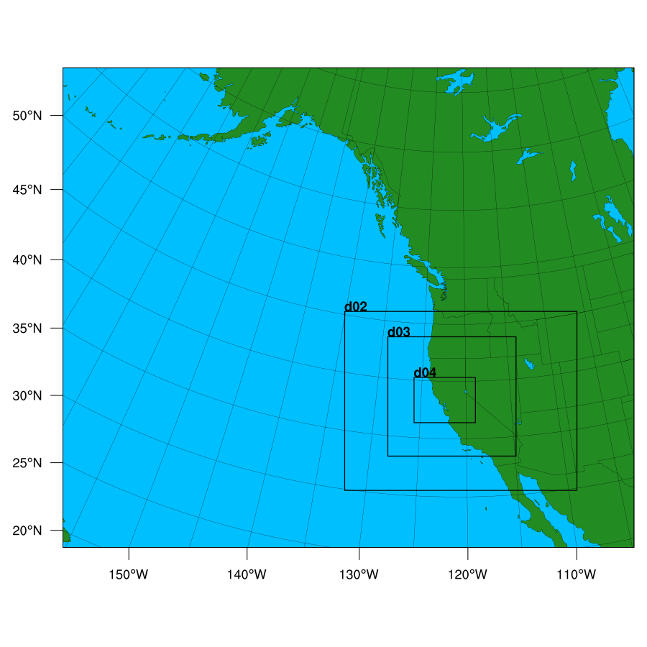
High-Resolution WRF Simulation of the Event
36-12-4-1.3 km domains
Initialized at 1200 UTC Oct. 8

Slide 29
12-km domain
9
1200 UTC 8 October

Slide 31
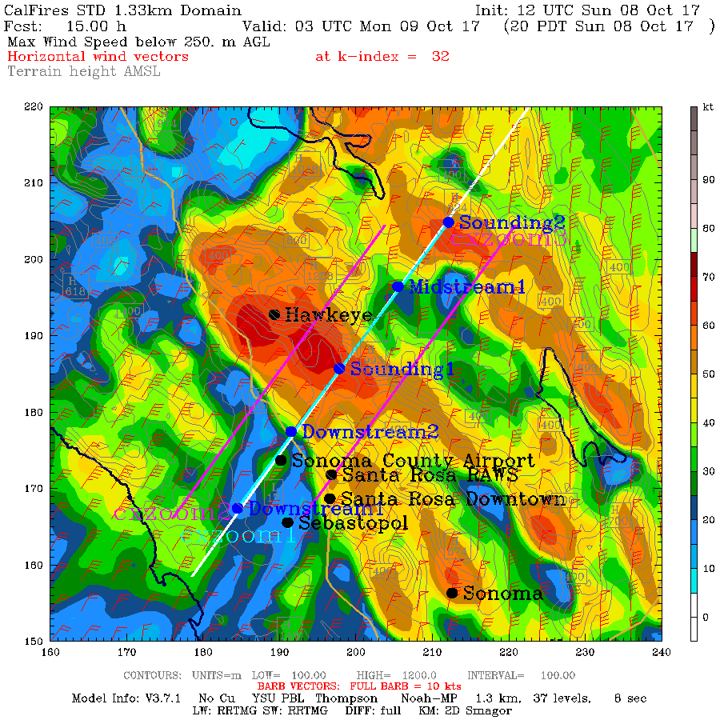
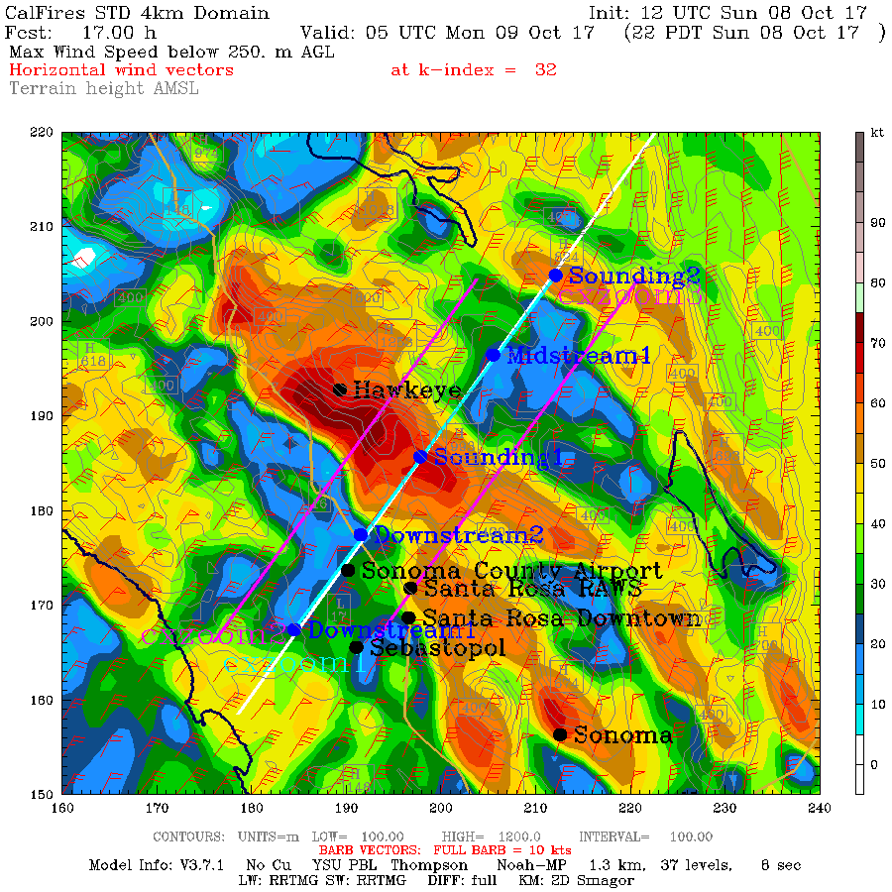
8 PM October 8
10 PM October 9

Slide 32
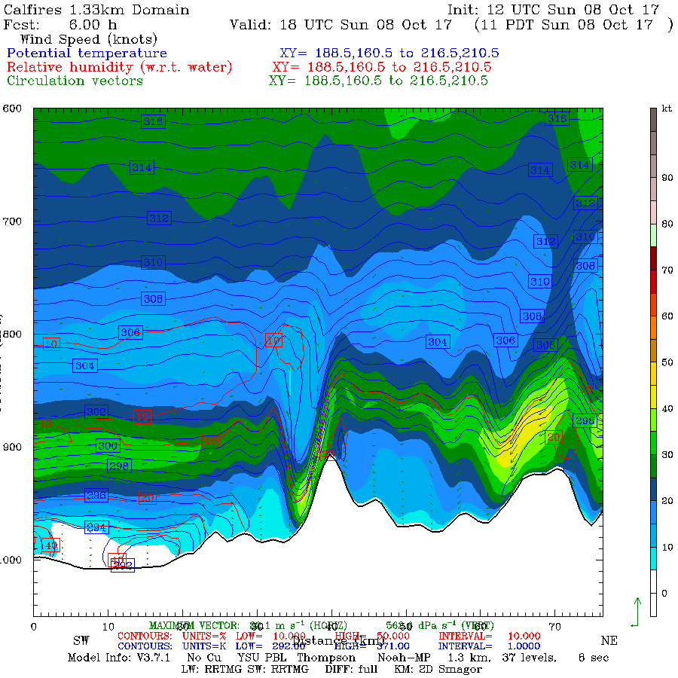

Slide 33
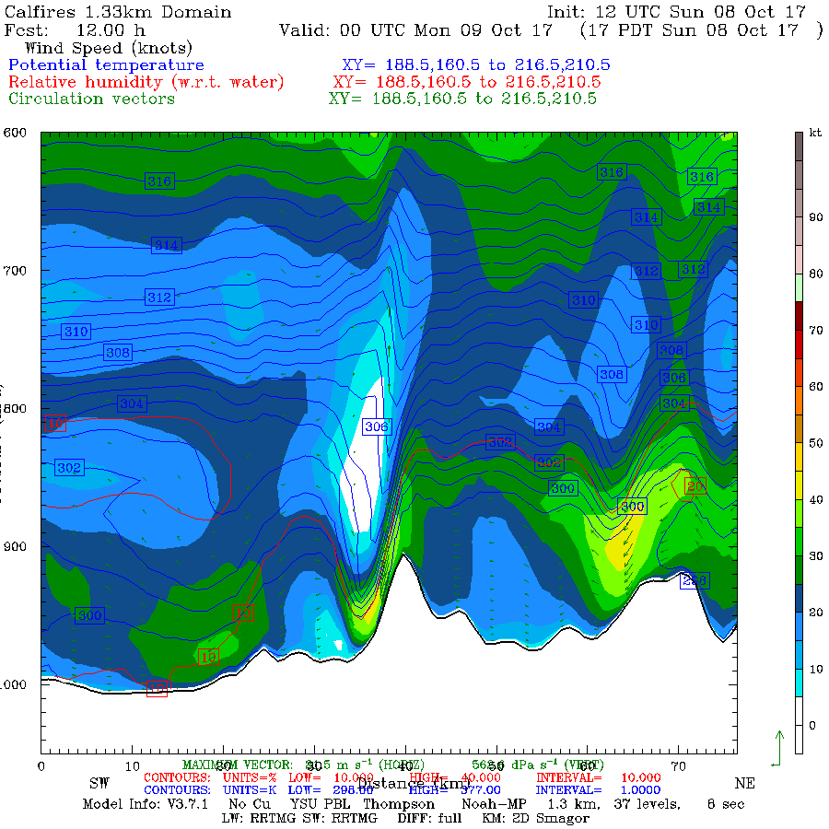

Slide 34
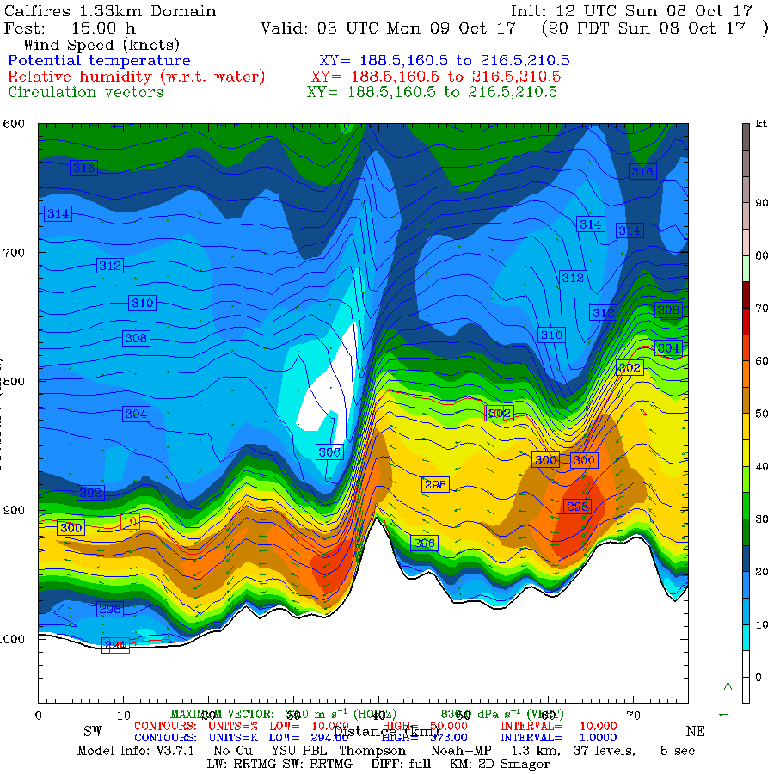

Slide 35
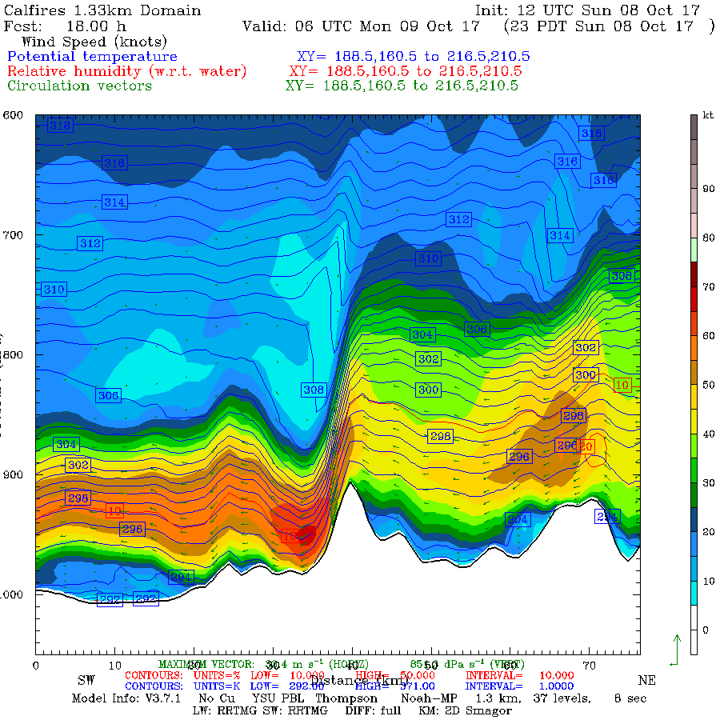
Terrain-Related
Downslope
Windstorm

Slide 36
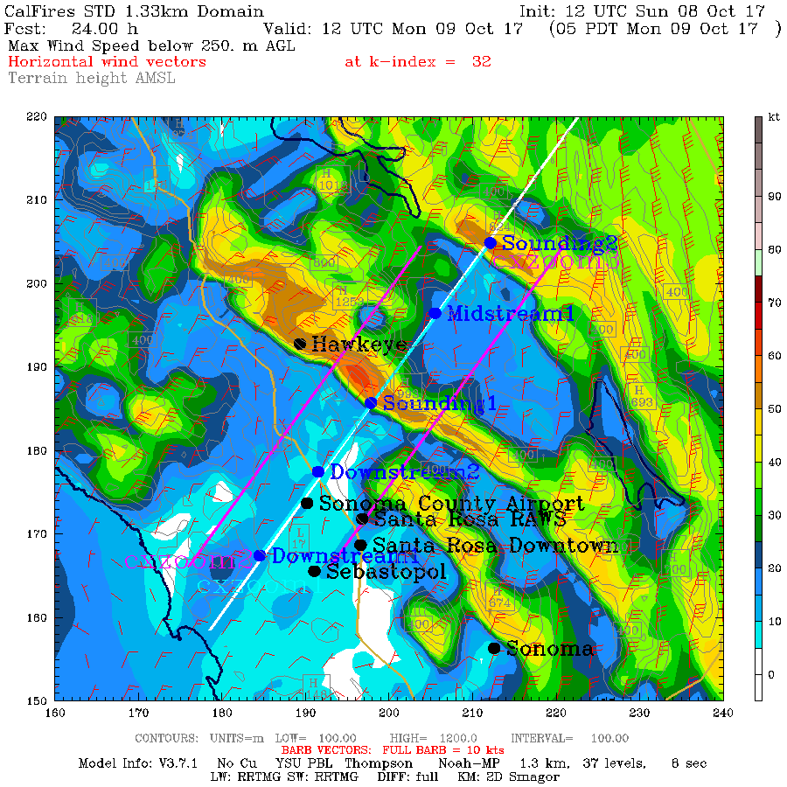
Conclusions Based On the Model Simulation
WRF model did an excellent job in duplicating the pattern and temporal evolution of the winds. Good forecast.
Strong winds were associated with a downslope wind event.

Slide 37
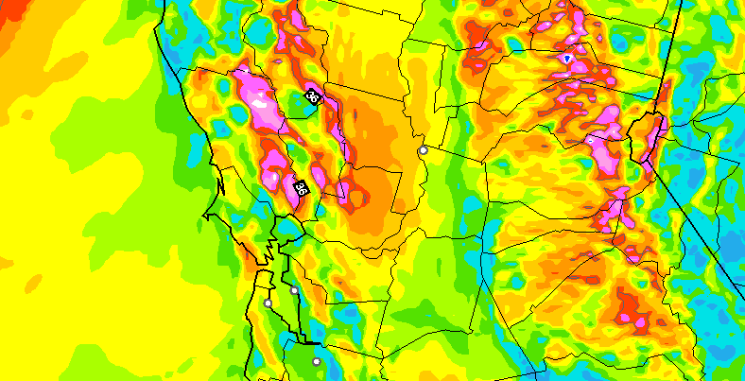
Operational Forecast Guidance Was Excellent, Even Days Out
10-h surface (10-m) wind gust forecast (kt) valid at 0700 UTC 9 October 2017. The model was initialized at 1200 UTC 8 October 2017. Wind gusts are derived by determining the highest wind speed in the lowest km.
NOAA/NWS Operational
HRRR Model
NOAA/NWS Operational
HRRR Model

Slide 38
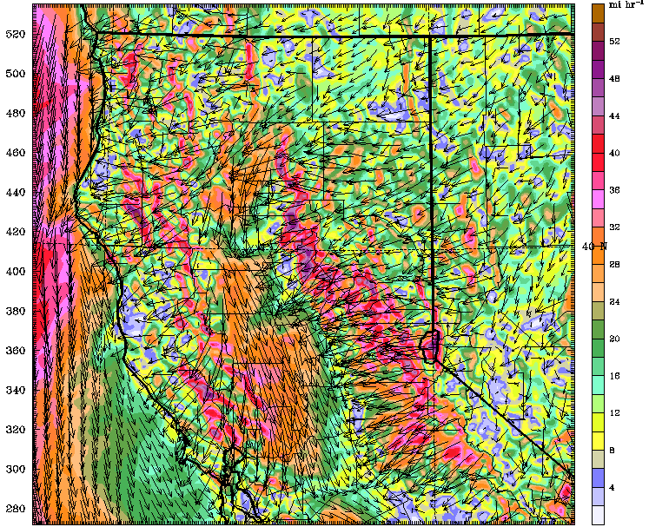
Operational CANSAC Model
30-h surface wind forecast (mph) for 0600 UTC 9 October 2017 for a run initialized at 0000 UTC 8 October 2017 from the nested 2-km domain

Slide 39
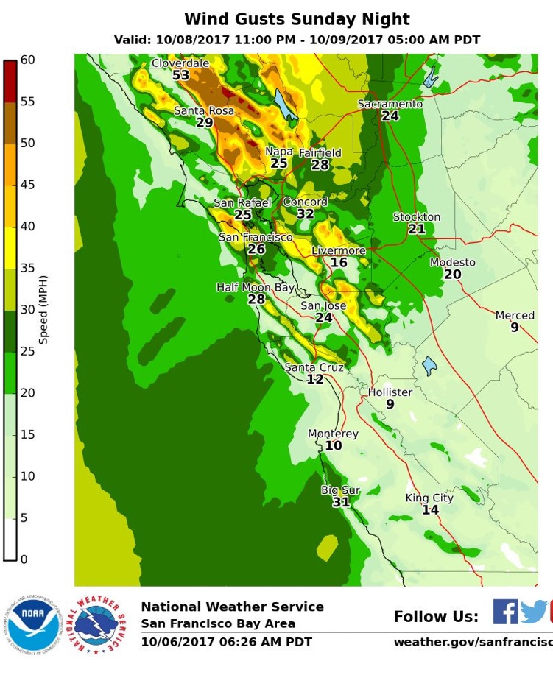
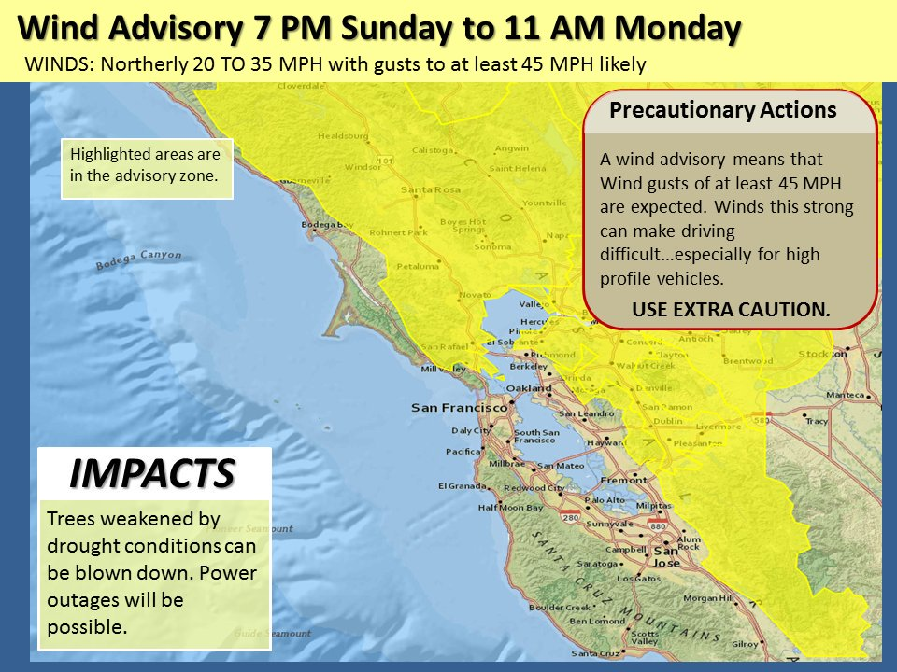
Based on these and other modeling systems, the NWS released high wind and red flag warnings—days before.
Two Days Before

Slide 40
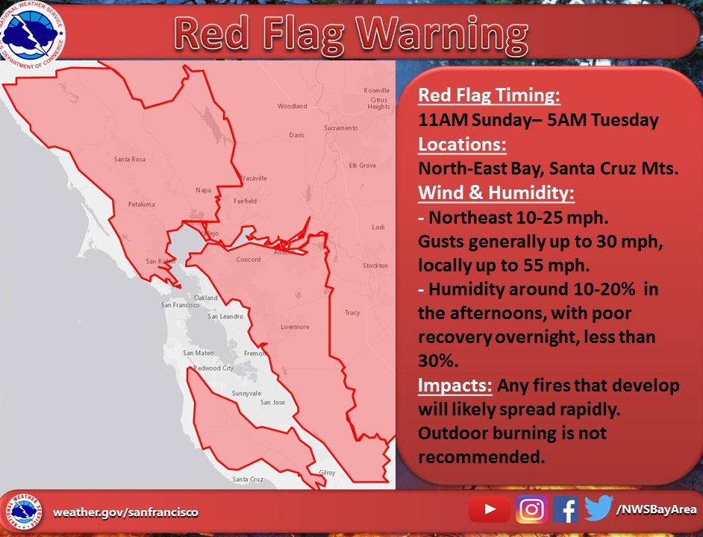

Slide 41
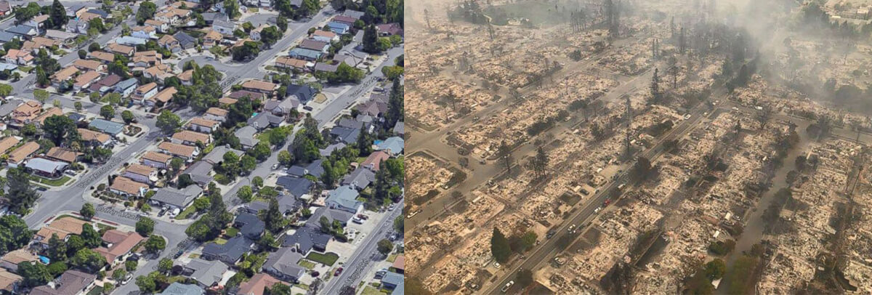
Could we have prevented the fires with better use of weather forecasts?

Slide 42
Quite possibly, yes, with pre-emptive power outages
The winds caused the fires and allowed them to explode that night.
The winds were skillfully forecast the previous day.
With such strong predicted winds, power failures/fires were inevitable.
Why not de-energize the powerlines in the hills and vulnerable areas a few hours before the winds were going to hit?
Might doing so have saved 44 lives and billions of dollars of damage?

Slide 43
Were the Wine Country Wildfires Associated with Anthropogenic Global Warming?

Slide 44
Little Evidence That Anthropogenic Global Warming Contributed to the Wildfires
The fire was initiated and supported by very strong winds.
No reason to believe that Diablo Winds are associated with global warming, in fact the opposite is probably true.

Slide 45
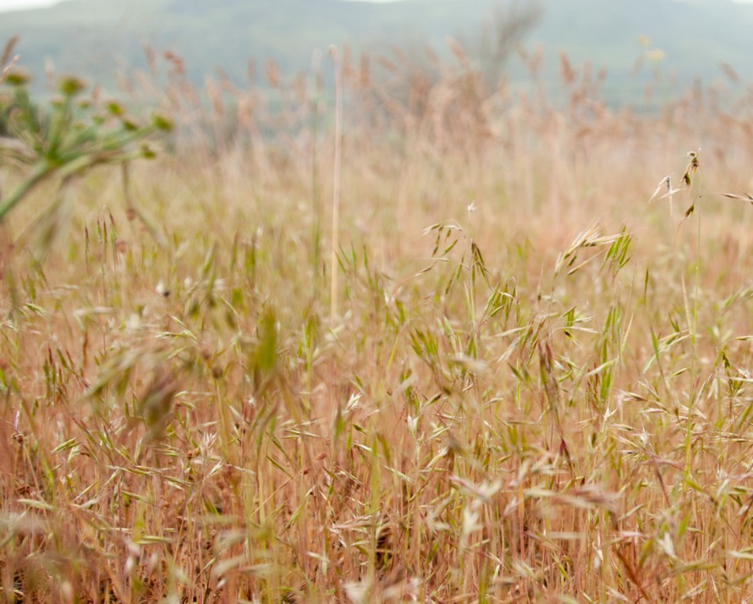
The Role of Invasive Grasses
Invasive, non-native grasses played an important role
Cheatgrass, “Bromus tectorum”
a.k.a. grassoline

Slide 46
If the temperatures were a few degrees warmer, or the summers a bit drier, it would not make a difference for coastal CA wildfires
A normal summer is warm and dry enough to allow fires.
And 1-hr and 10-hr fuels are always dry enough to burn in summer under offshore flow.
There is a deep literature, based on observed conditions and fires, that supports this conclusion.
“The extent of preceding drought is largely irrelevant to the size of these autumn fires because of the severity of weather during the fire event”

Slide 47
No long-term trends in wildfires
No long-term upward trend in fires for coastal California
The region has a long history of fire.

Slide 48
Fire is No Stranger to the Region

Slide 49
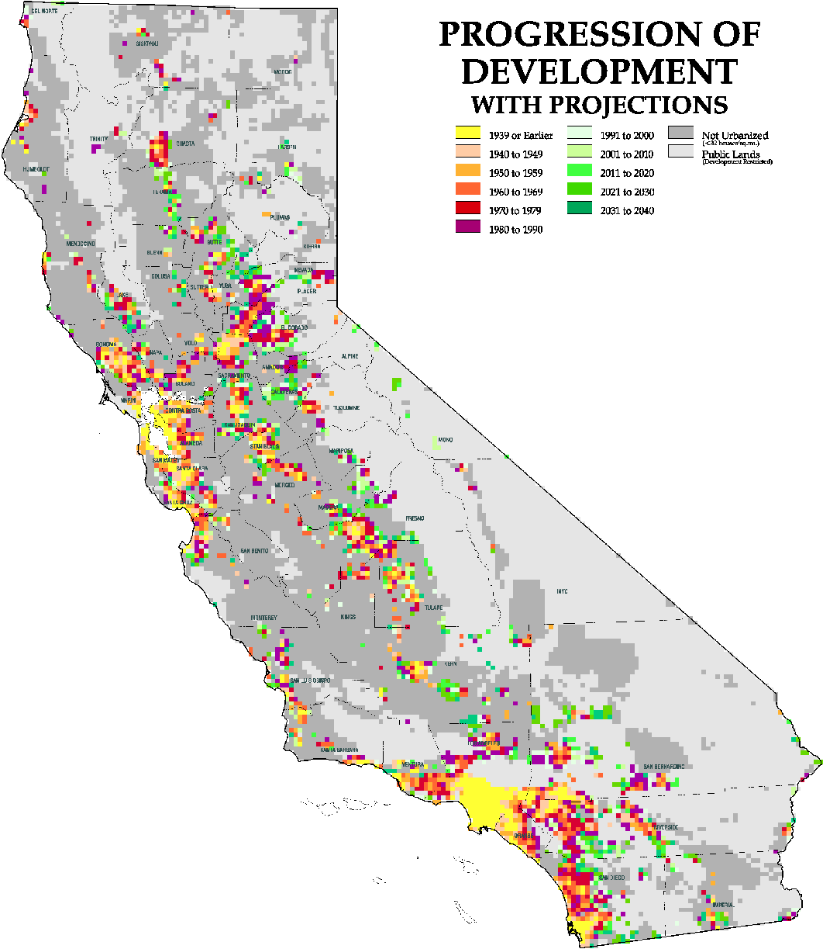
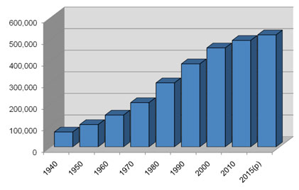
Urbanization Makes Fires More Frequent and Destructive
Sonoma County Population

Slide 50
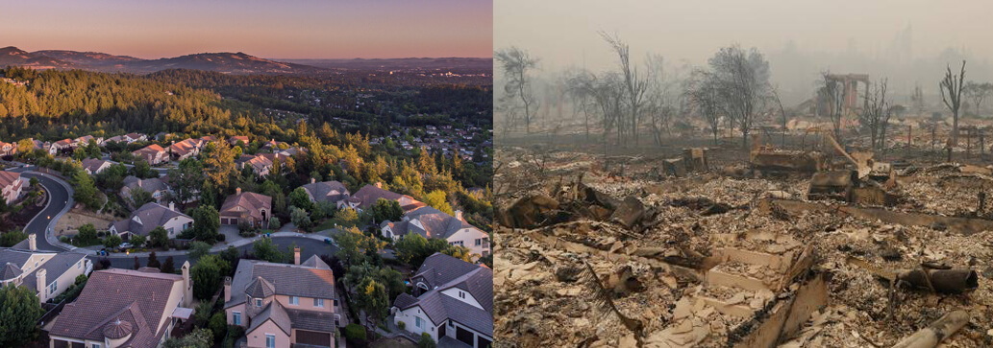
Fountaingrove Neighborhood

Slide 51
Bottom Line
There is no evidence that anthropogenic global warming contributed to the Wine Country fires or will enhance them in the future.

Slide 52
Dealing With the Issue
Homes and buildings must be moved out of areas that are prone to wildfire.
Restore wildland areas or bring back fire?
The electrical distribution system must be updated to be less prone to starting fires (e.g., underground lines, fix the recloser problem)
Societal decision makers must learn how to use improved predictions.
Better warnings and coordinated fire fighting capabilities are needed

Slide 53
The End

