Slide 1
Atmospheric Sciences 101 Weather Satellites Autumn 2023

Slide 2
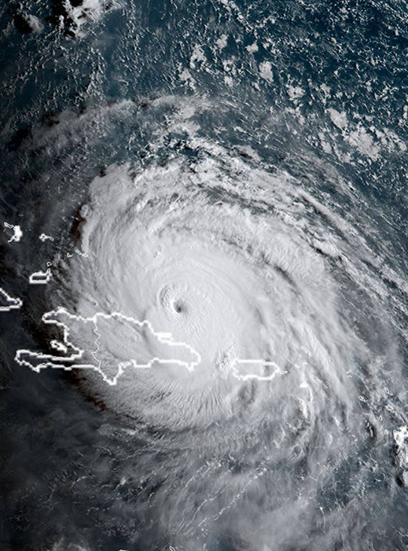
Weather Satellites
Provide a comprehensive view of the earth’s atmosphere and surface
Have radically improved weather prediction
Have greatly improved our understanding of weather systems
You will learn the basics of interpreting satellite imagery in this class

Slide 3
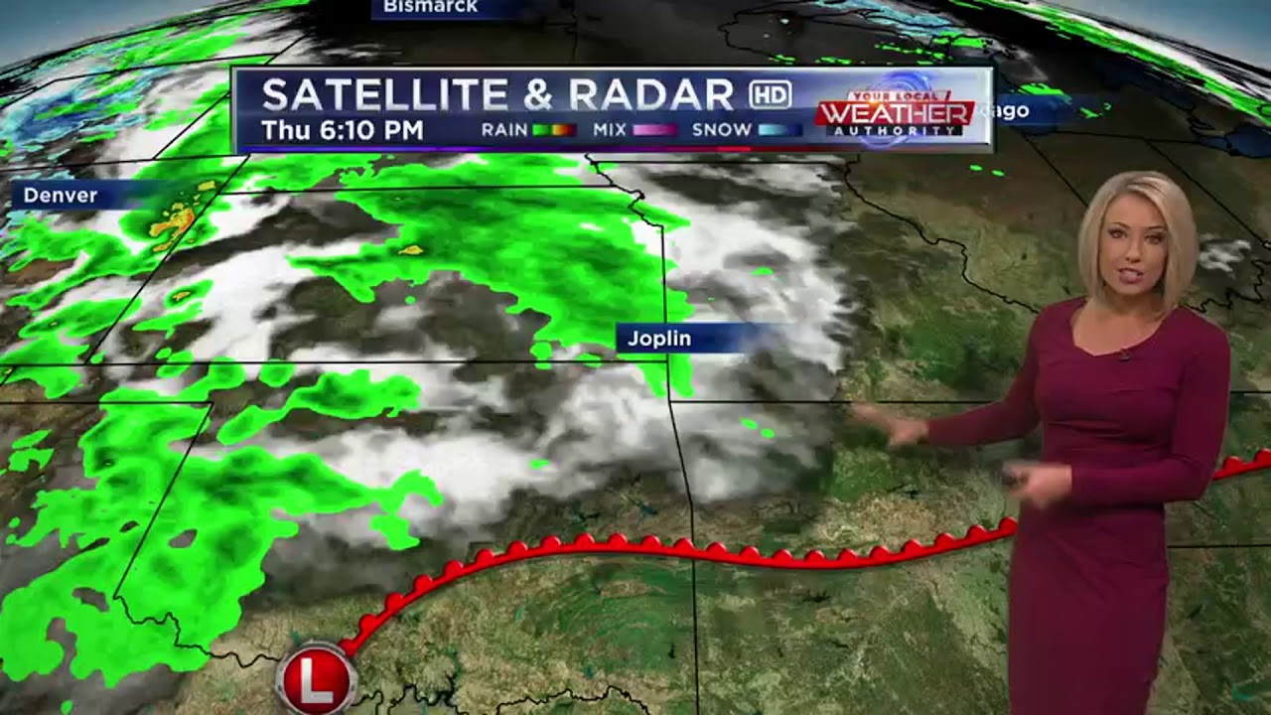
You Will Know More Than Some of These Folks

Slide 4

Before Weather Satellites
Storms could sneak up on coastal locations
1938 Hurricane

Slide 5
But NOT Anymore! We can view storms over the entire planet

Slide 6
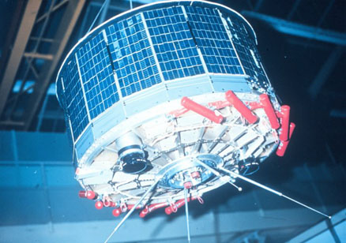
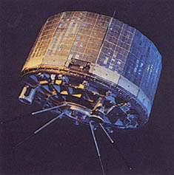
TIROS-1: The First Weather Satellite--1960

Slide 7
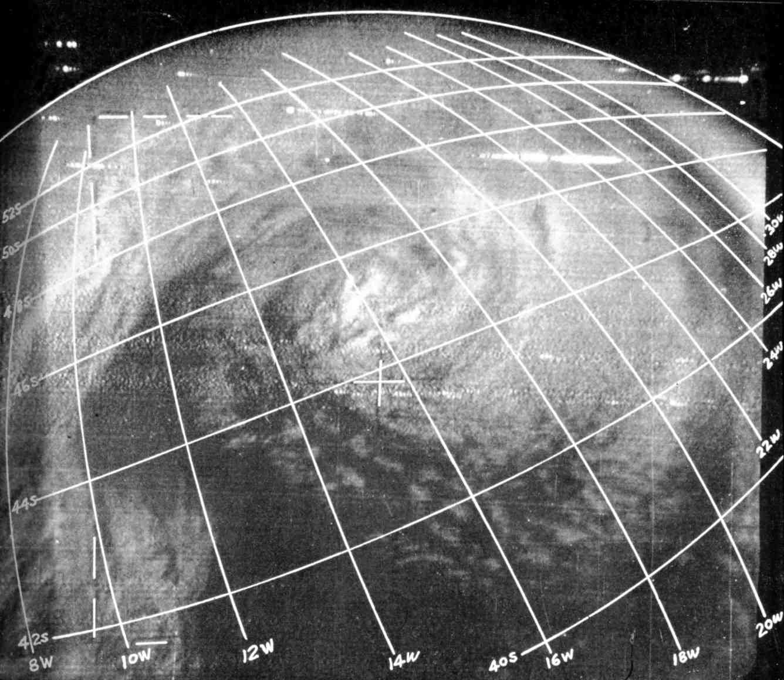
One of the first TIROS-1 images

Slide 8
Two Major Types of Weather Satellites (Different Orbits)
Geostationary
Polar-Orbiting

Slide 9
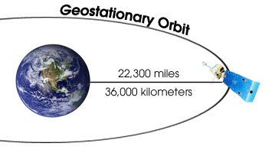
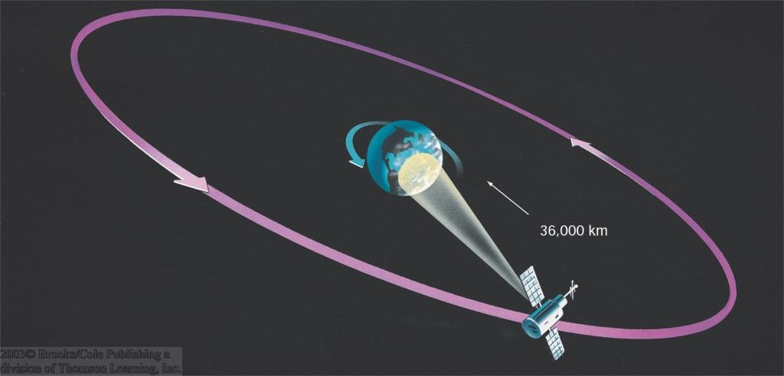
Geostationary Orbit
Satellite over the equator. Stays over the same area as earth rotates

Slide 10
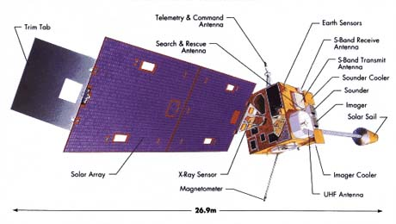
NOAA GOES Weather Satellite

Slide 11
Geostationary Weather Satellites
About 35,000- 36,000 km above the equator
Revolves with earth
Thus, sees the same location throughout the day.
Doesn’t view the polar regions well.
What you generally see in the media.

Slide 12
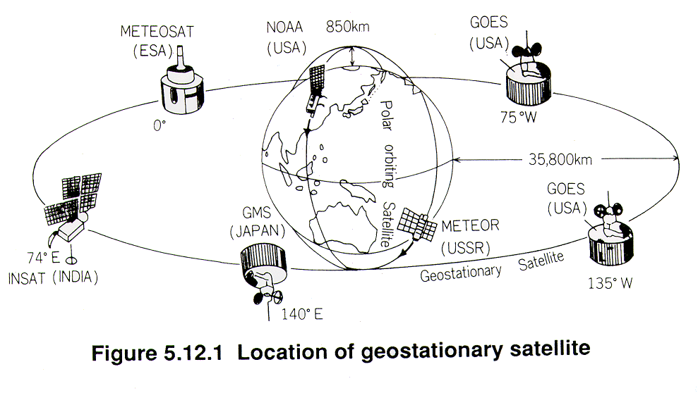
5 Operational GOES satellites

Slide 13
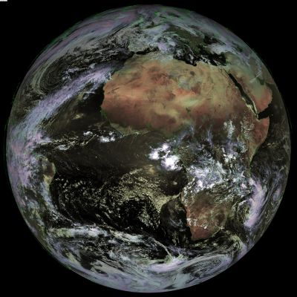
Geostationary satellite see the whole hemisphere

Slide 14
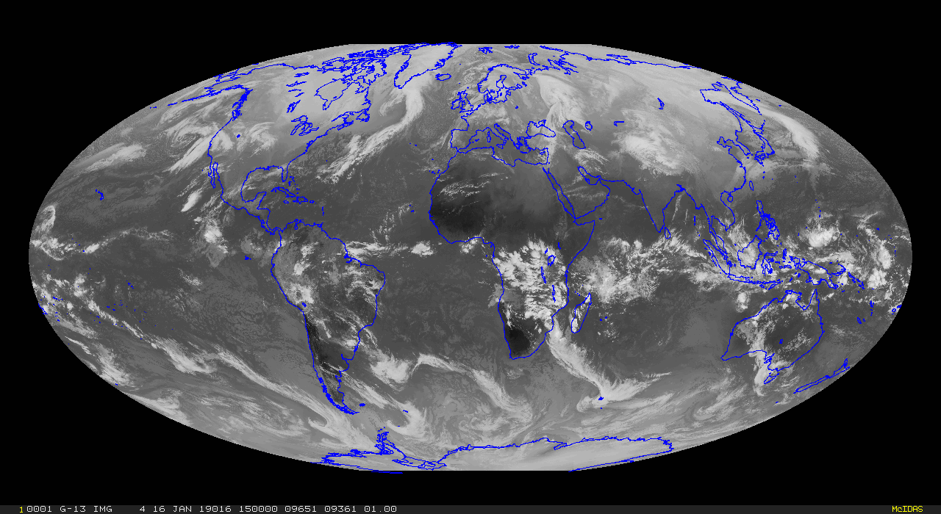
Putting them together, one can monitor the entire planet

Slide 15
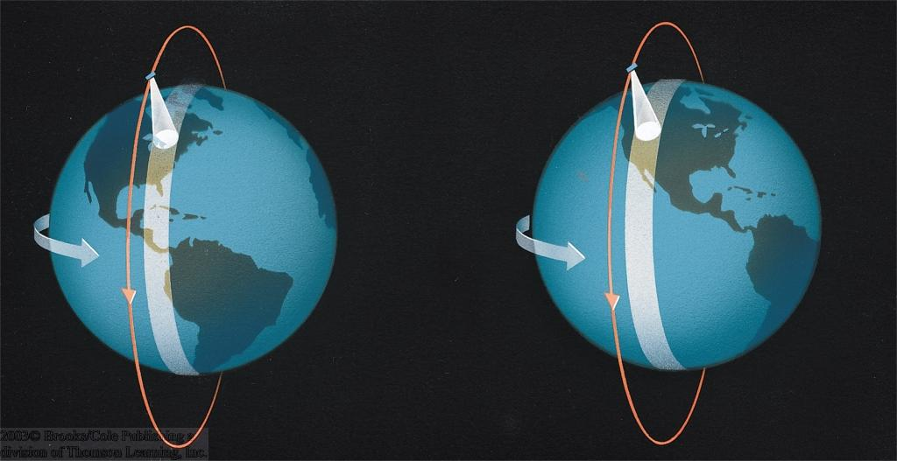
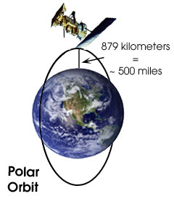
Polar Orbiting Satellites
Orbits about 800-900 km above the earth
Earth rotates underneath
Only views a swath of earth’s surface
Constantly changing view
Includes polar coverage

Slide 16
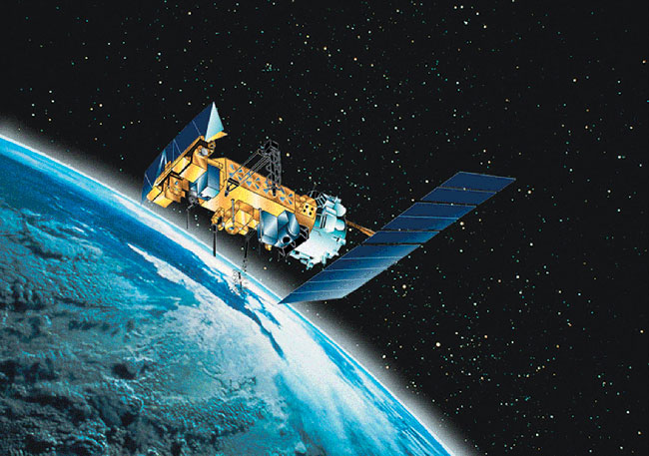
NOAA Polar Orbiter

Slide 17
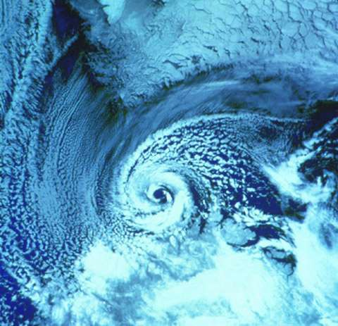
A polar
low
Polar Orbiters Provide a High-Resolution View

Slide 18
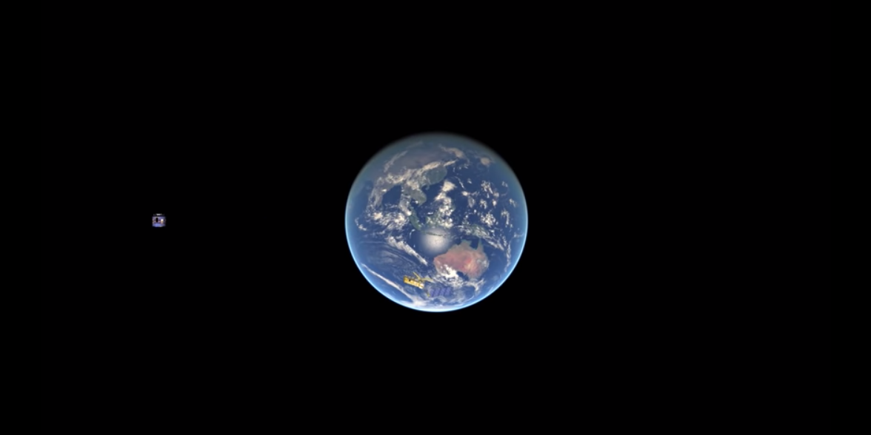
Comparison Between Geostationary and Polar Orbiting Weather Satellites
https://www.youtube.com/watch?v=Irxg-9svRtc&t=56s

Slide 19
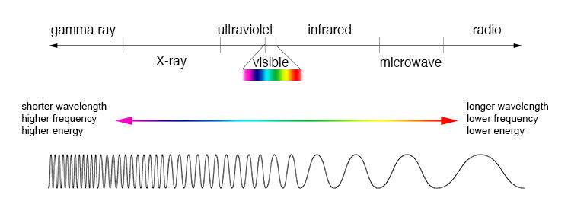
To understand weather satellites you need to know about the electromagnetic spectrum

Slide 20
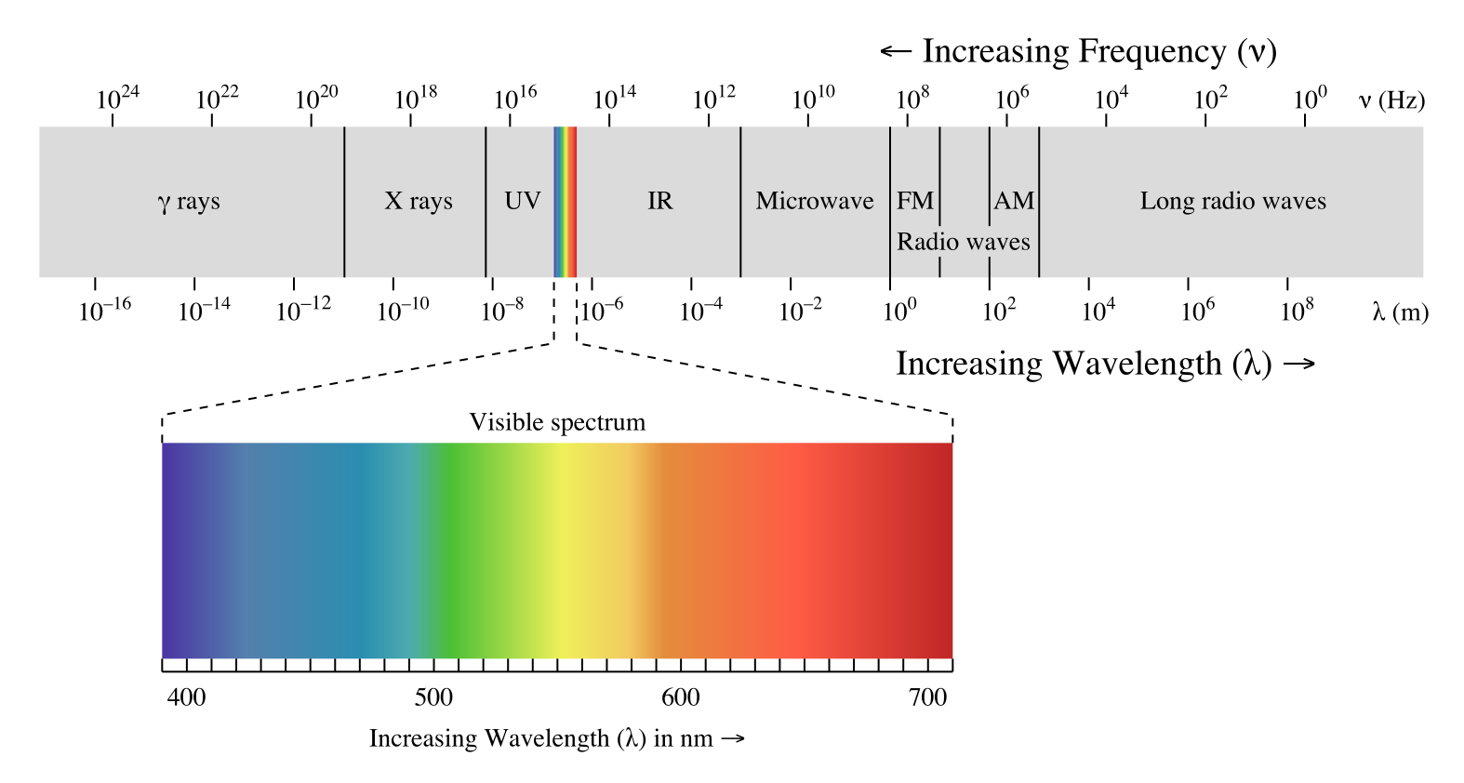

Slide 21
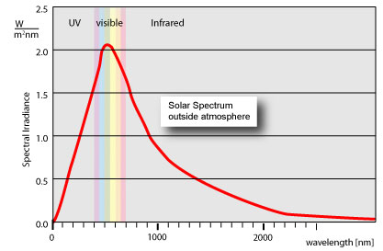
Solar (from the sun) radiation peaks in the visible

Slide 22
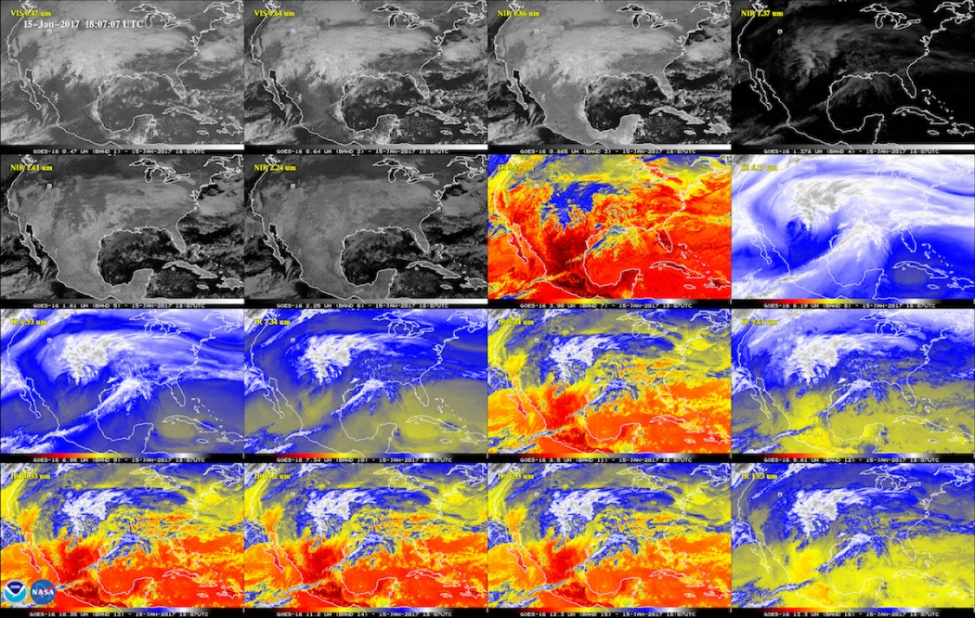
There are several types of satellite imagery that vary by wavelength
Visible
Infrared
Water Vapor
And others

Slide 23
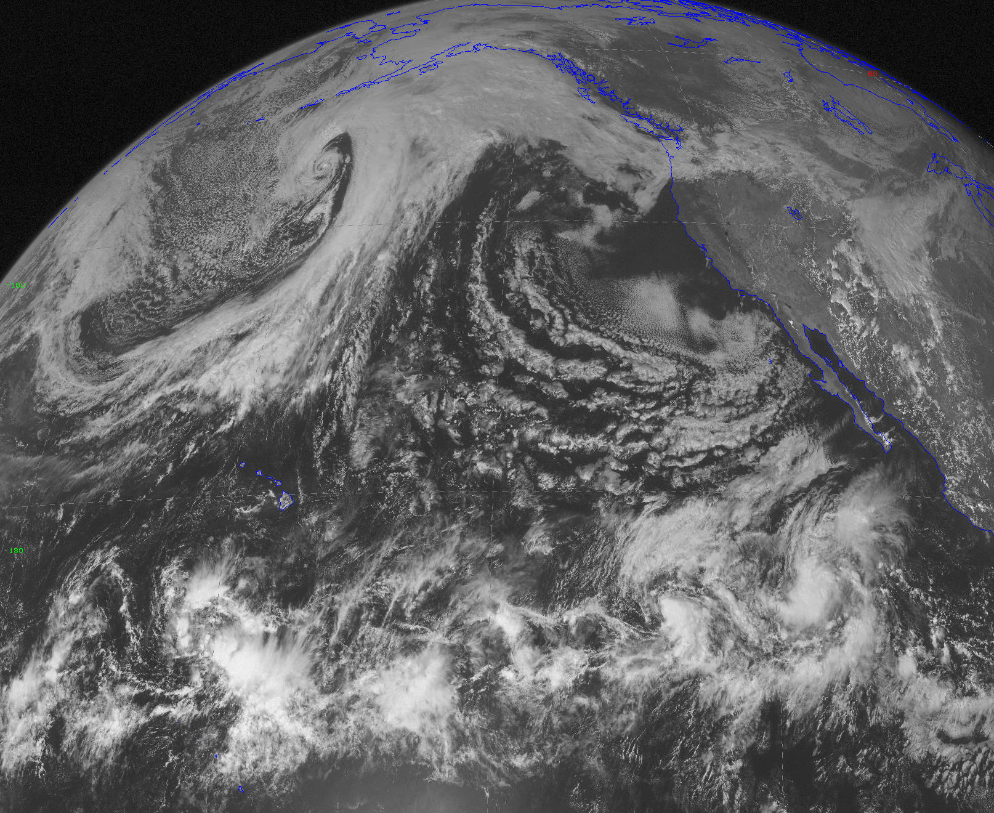
Visible: what YOU would see from space.
Visible light from sun reflects off clouds and the surface
Visible light (.4-.7 microns--millionths of a meter)

Slide 24
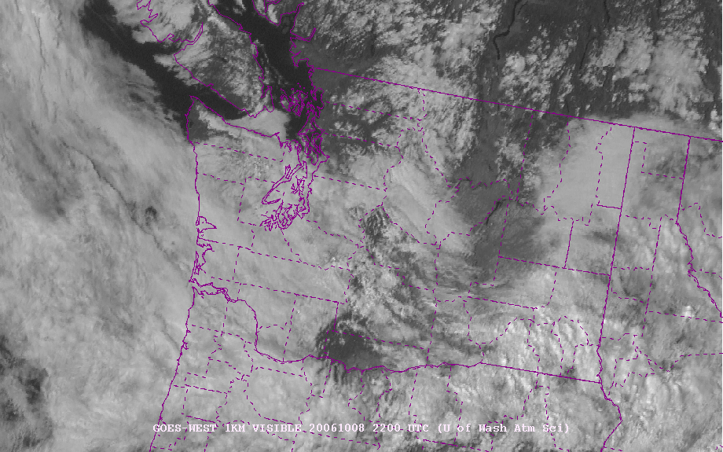
GOES High Resolution Visible Imagery

Slide 25
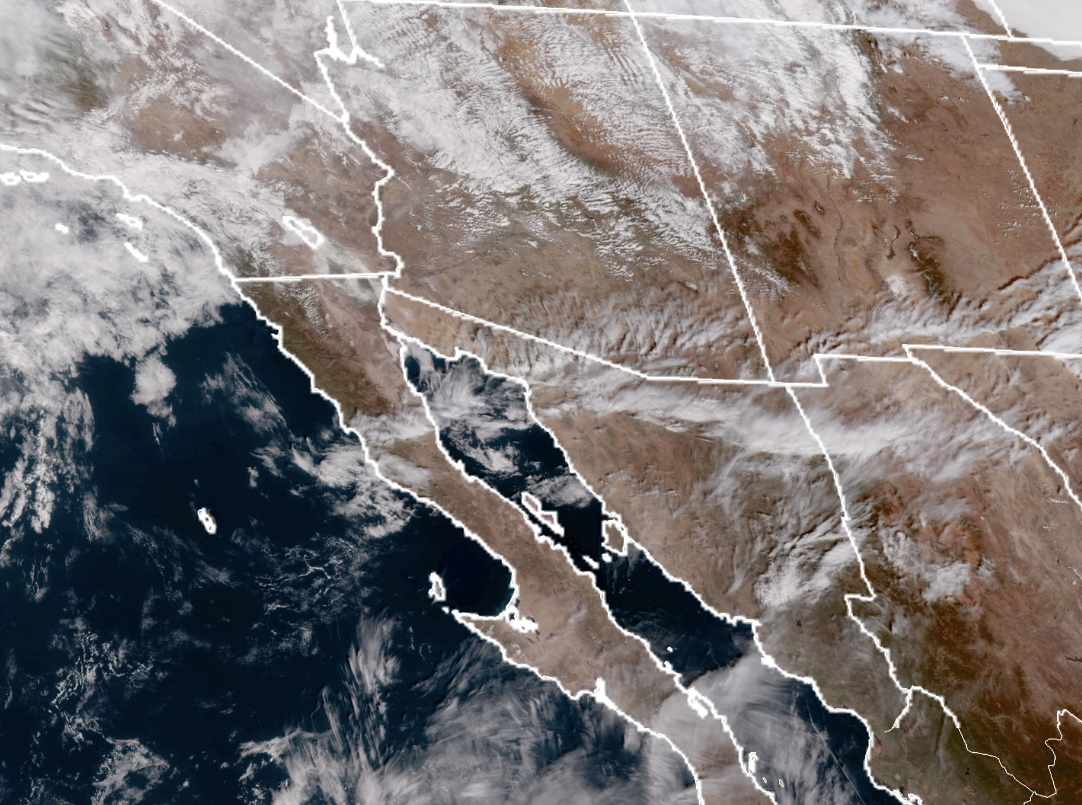
New GOES 17 Color Visible Imagery

Slide 26
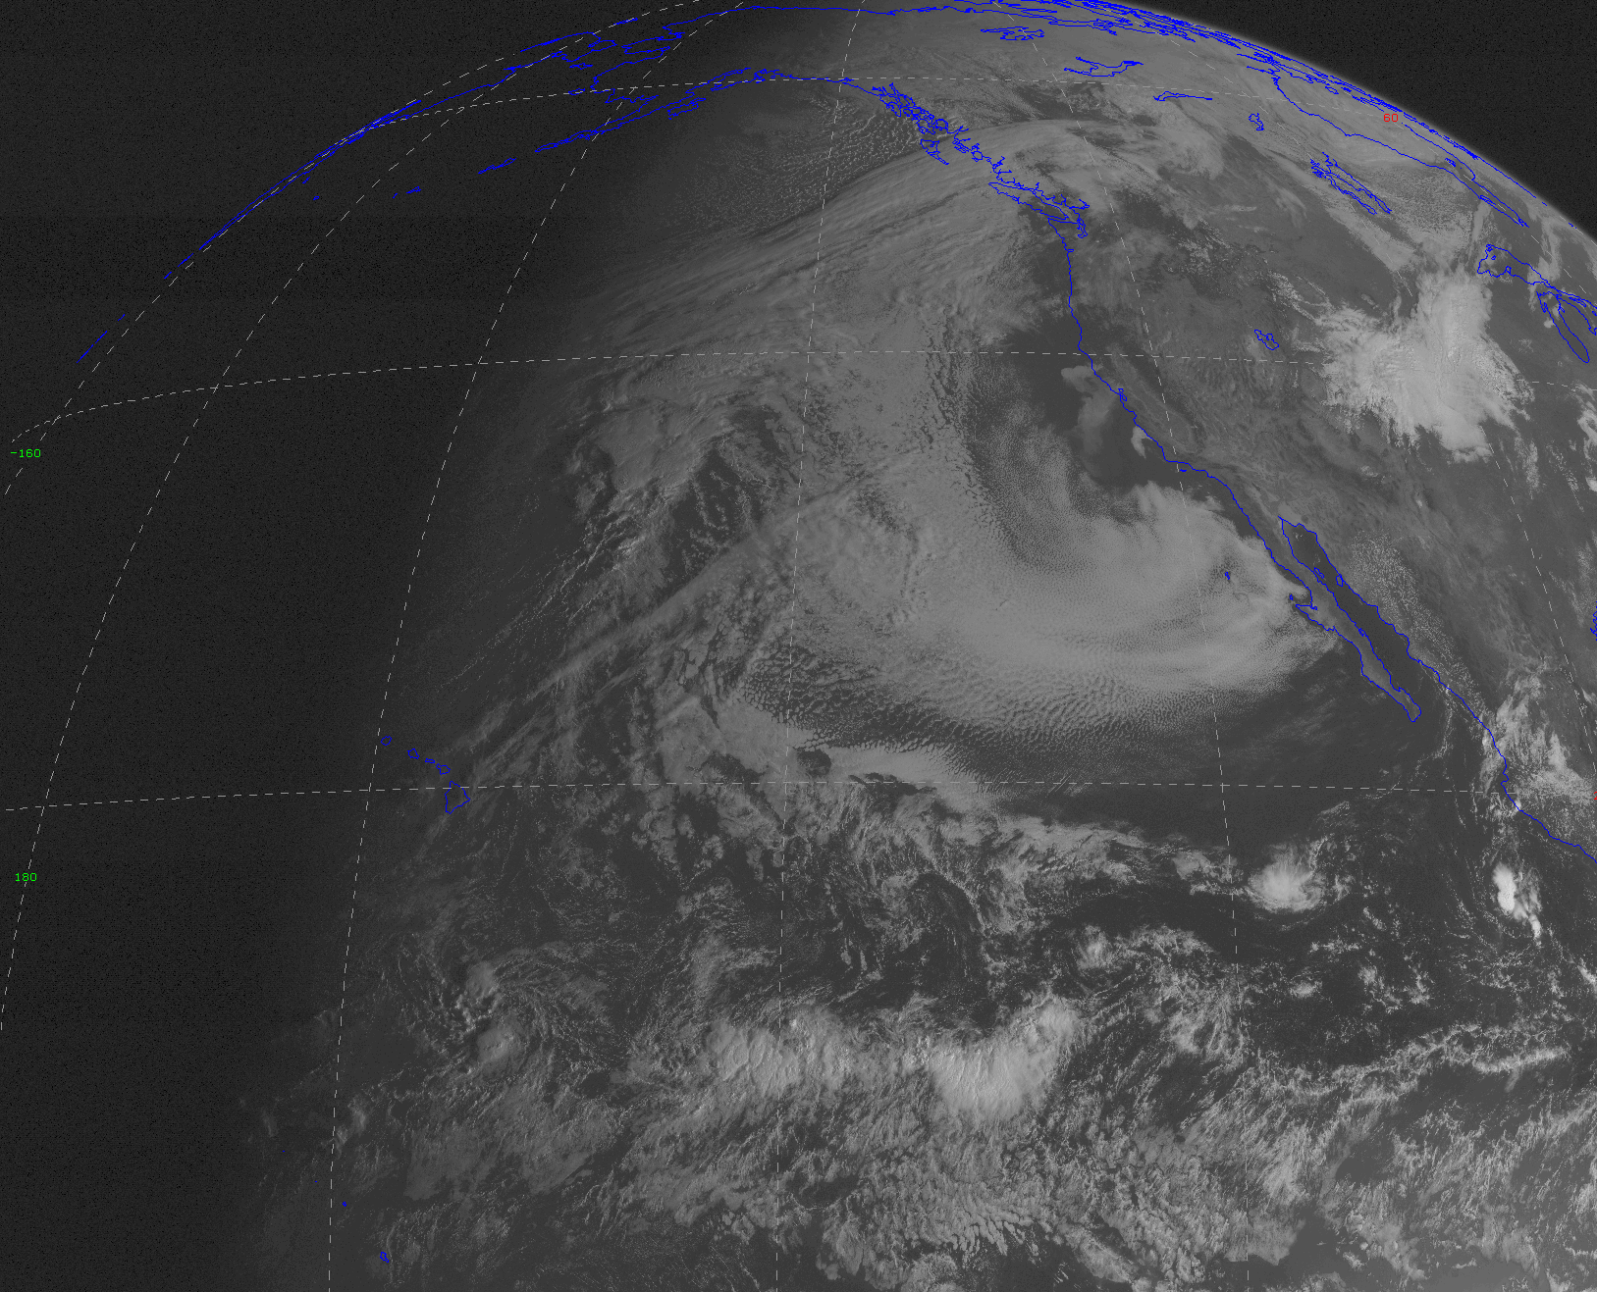
Problems: Visible imagery not available at night! And how high are the clouds?

Slide 27
One solution: infrared satellite imagery
Senses infrared radiation emitted by clouds and the surface
Wavelengths are typically 8-12 microns
Warmer objects emit more infrared radiation than cooler objects
Can thus tell temperature of clouds or surface by emitted infrared radiation
Good during both night and day!

Slide 28
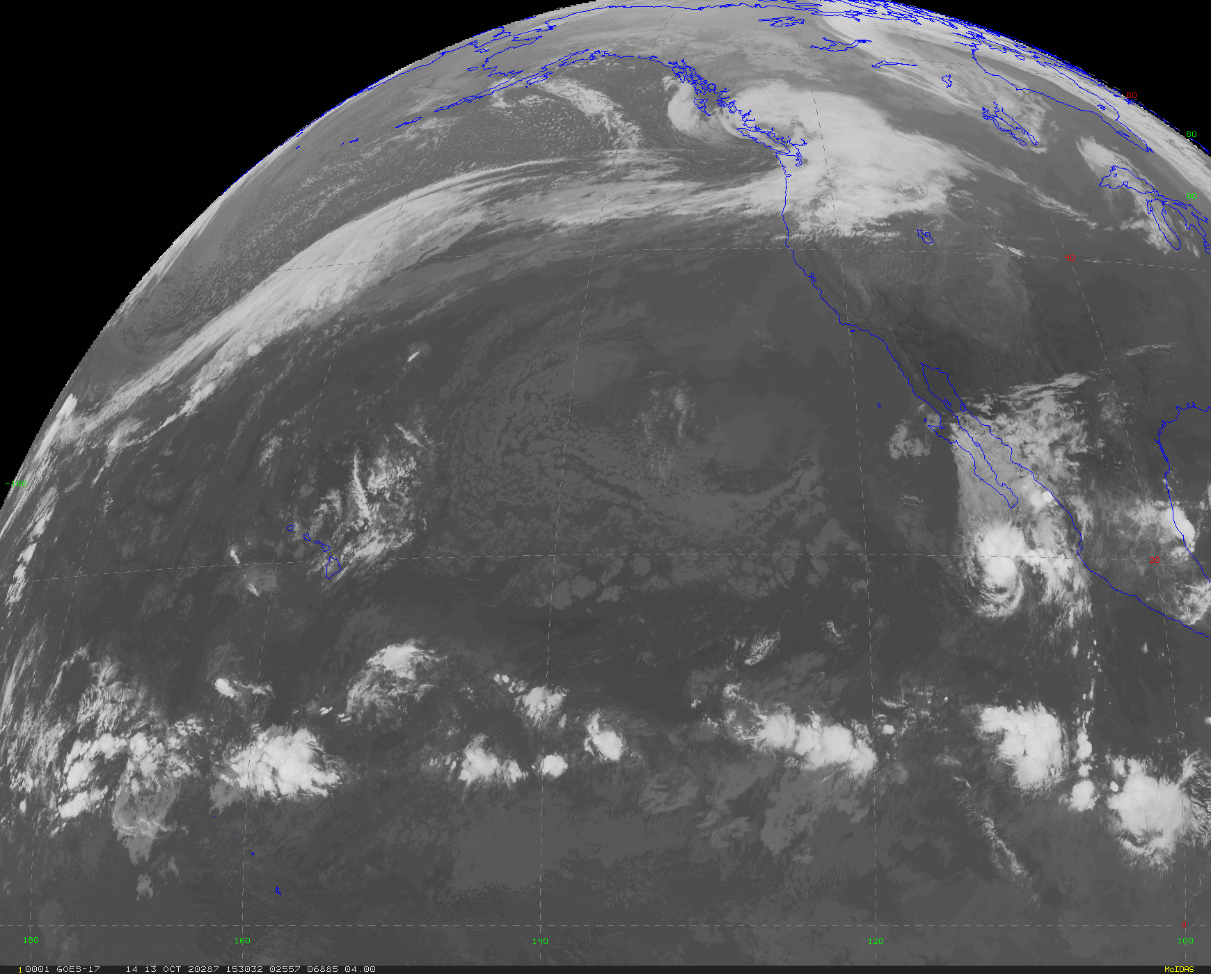
Infrared Satellite Imagery
Gives insights into height of clouds, since cold clouds are generally higher
Often shown in gray scale with white being cold, dark being warm.

Slide 29
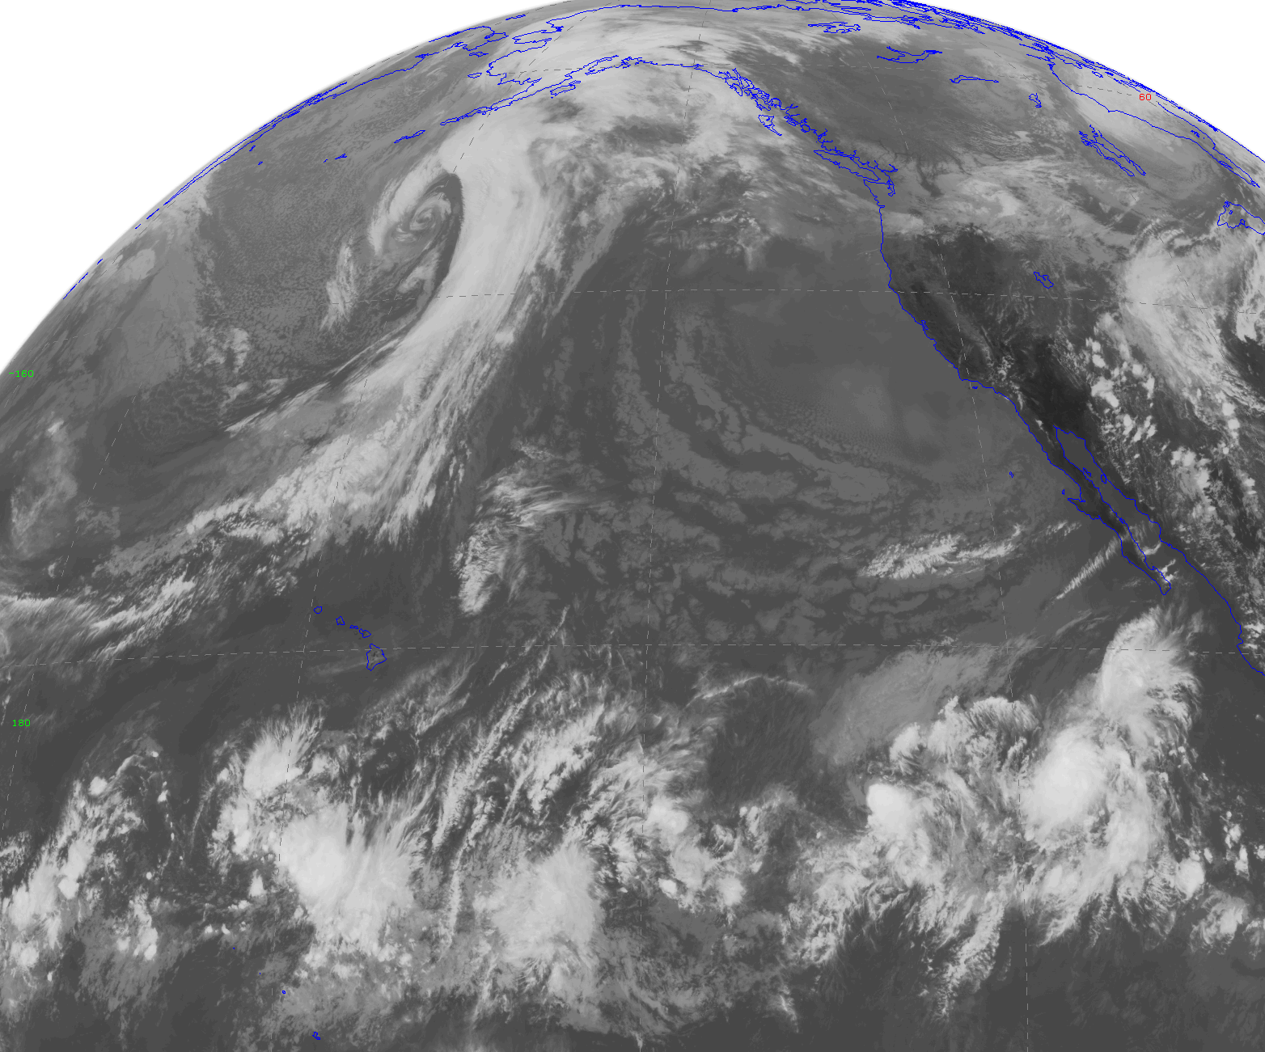
Infrared satellite image over the Pacific

Slide 30
Now let’s compare visible and infrared satellite images at the same time

Slide 31
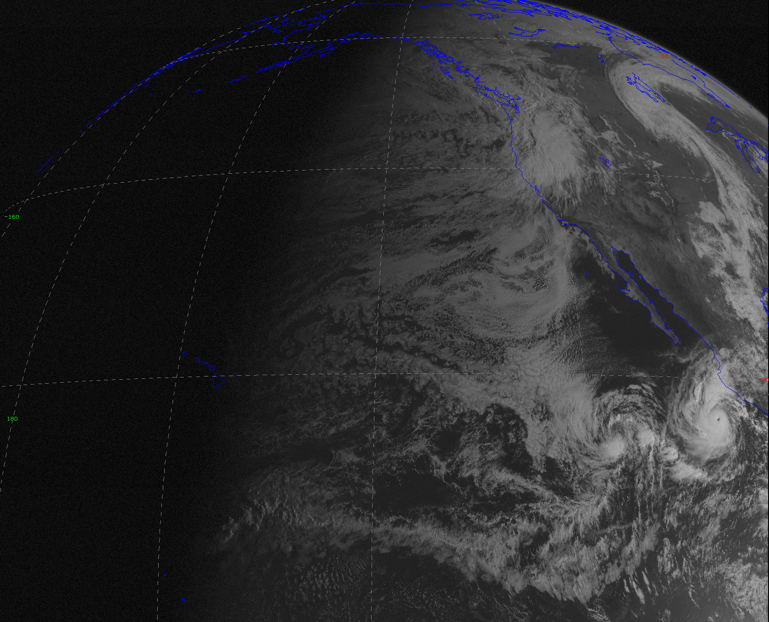
visible

Slide 32
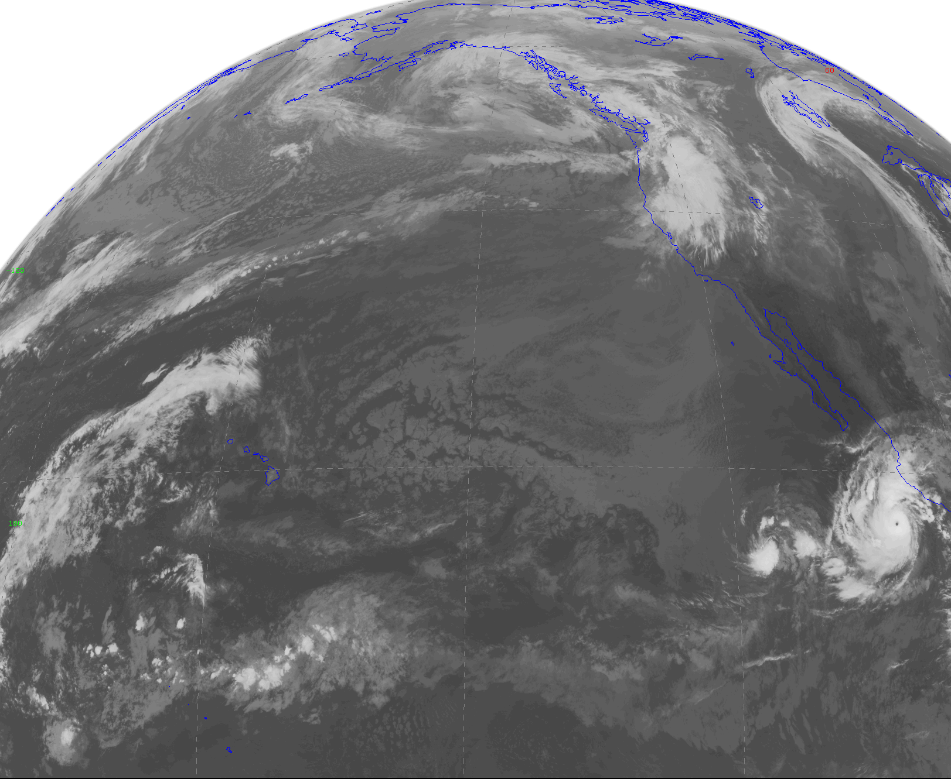
Infrared (IR)

Slide 33
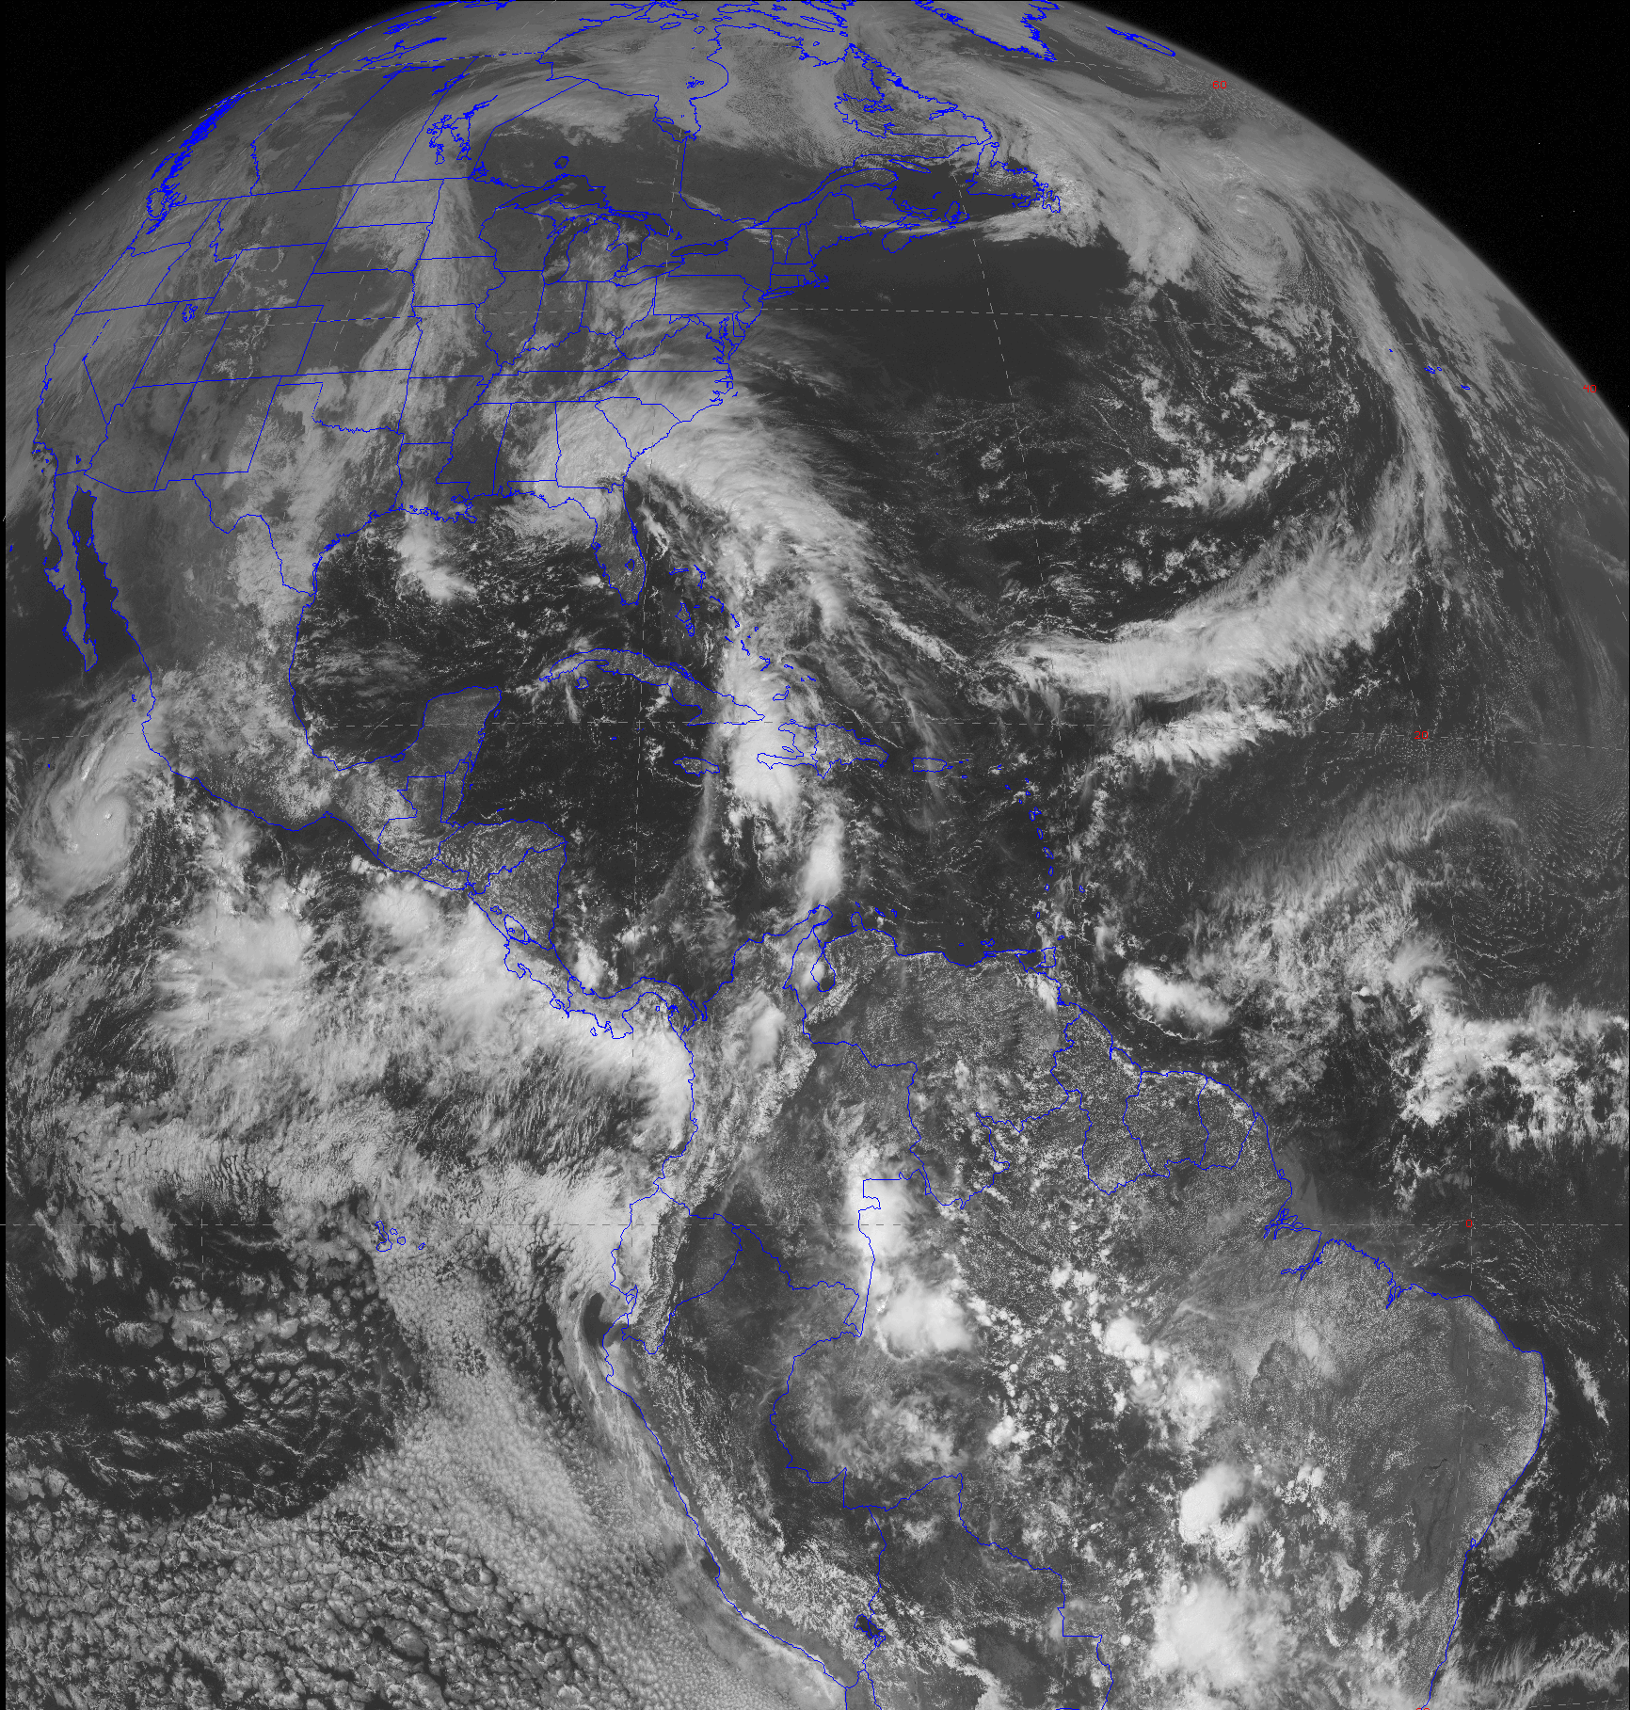
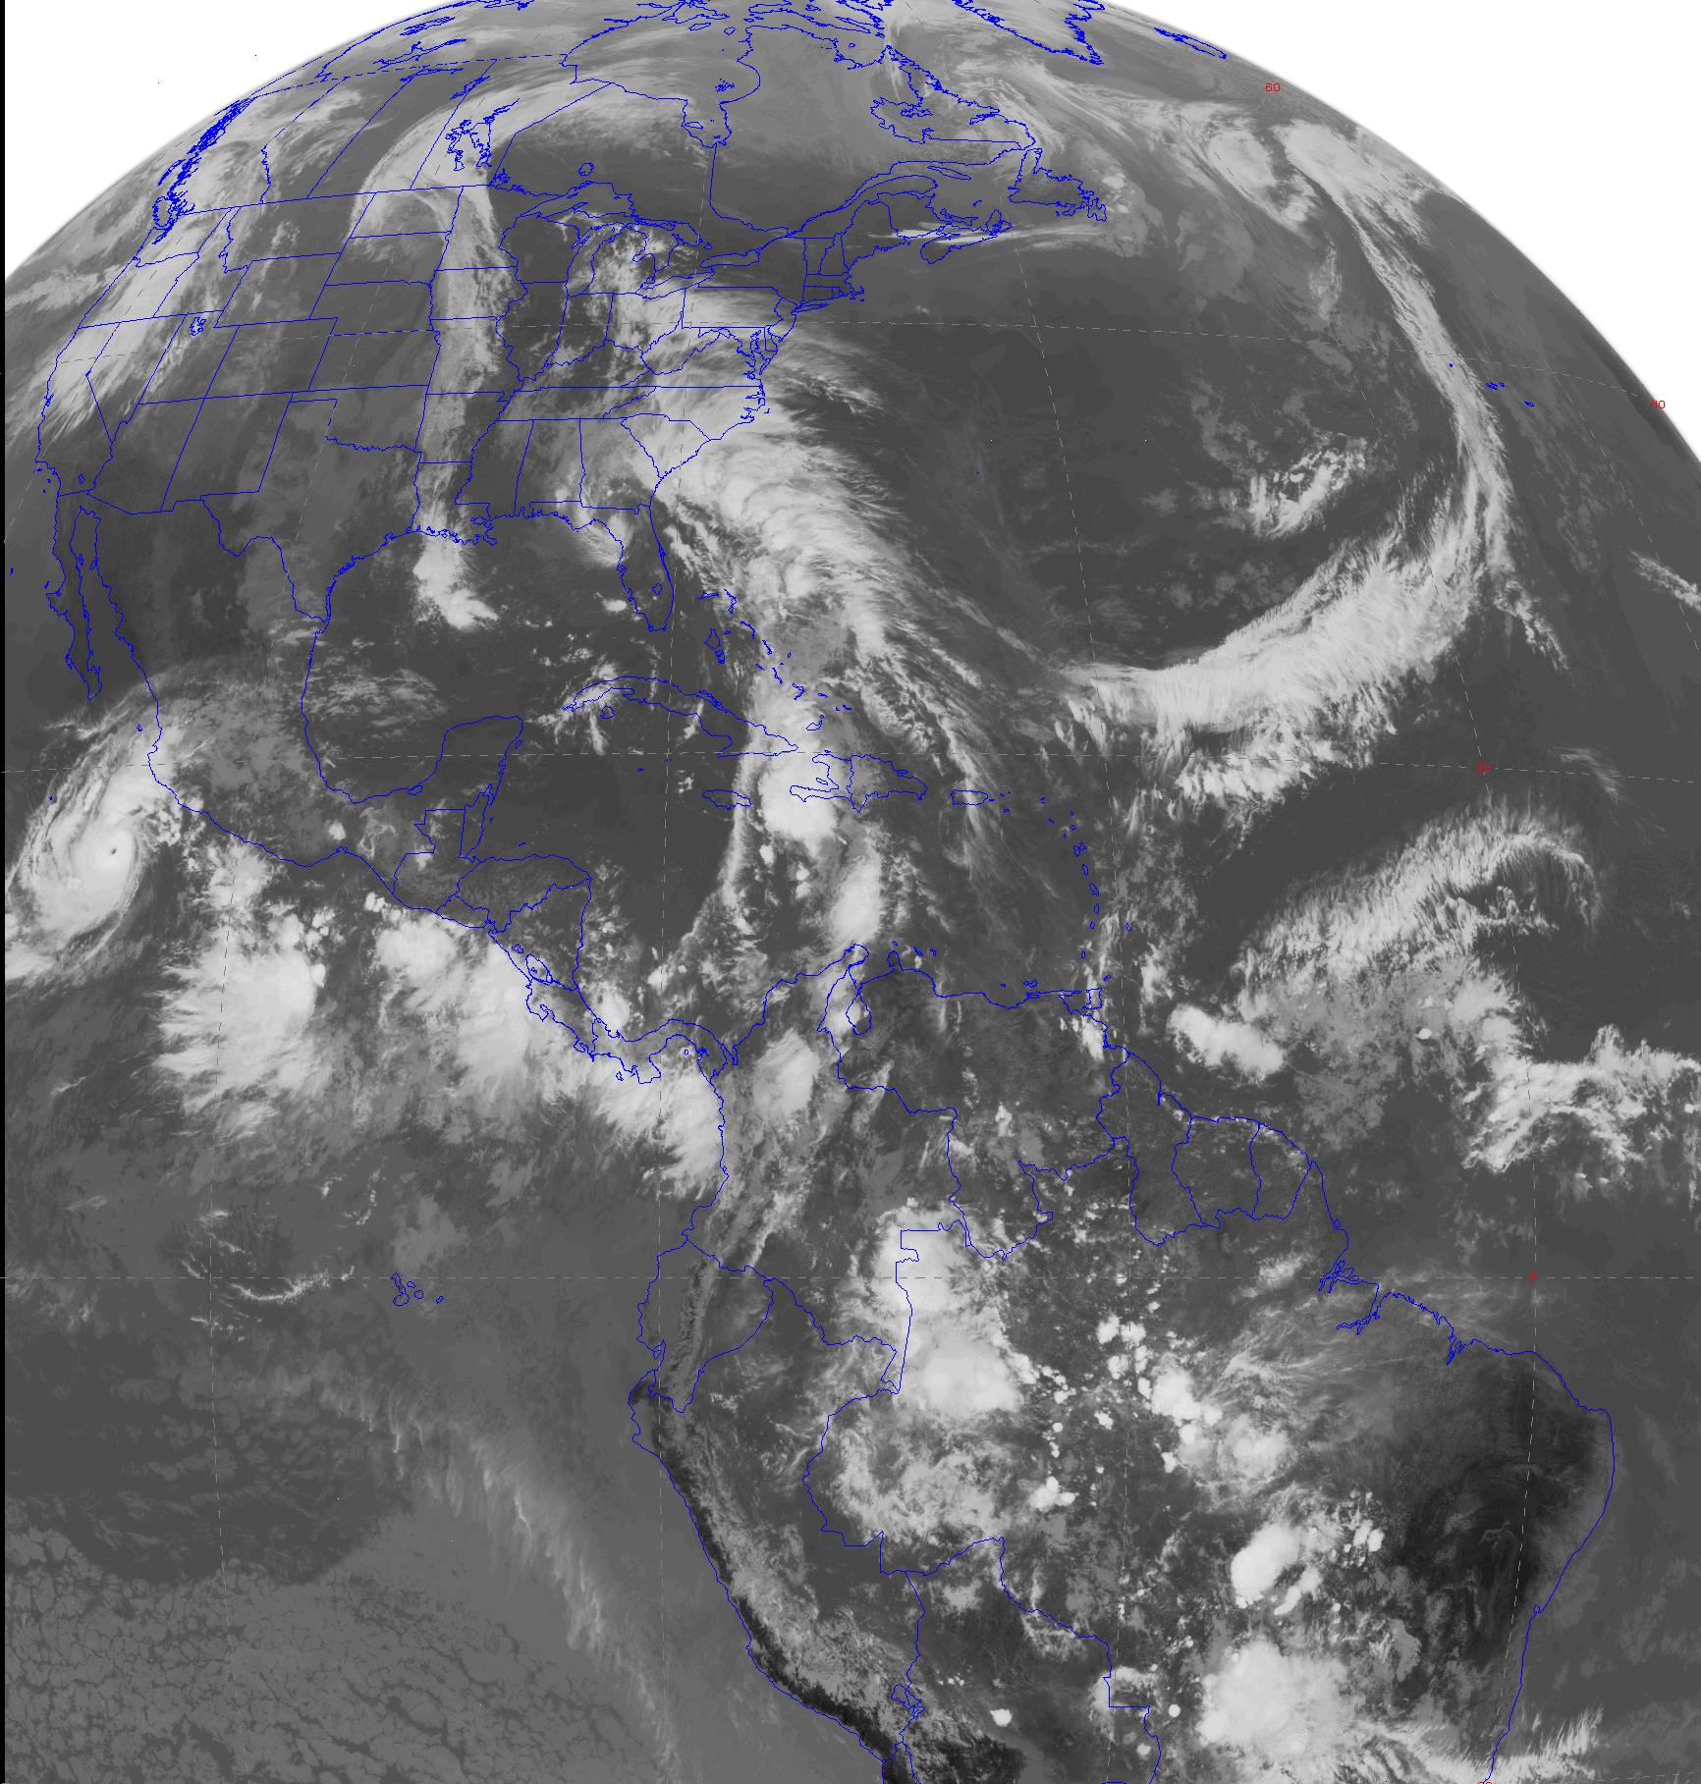
visible
infrared

Slide 34
Major Weather Features As Seen by Weather Satellite

Slide 35
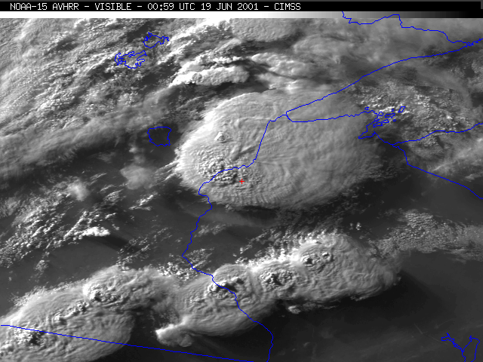
Thunderstorms Evident by Oval Shapes (Anvils)
Small size
Siren, WI Tornado

Slide 36
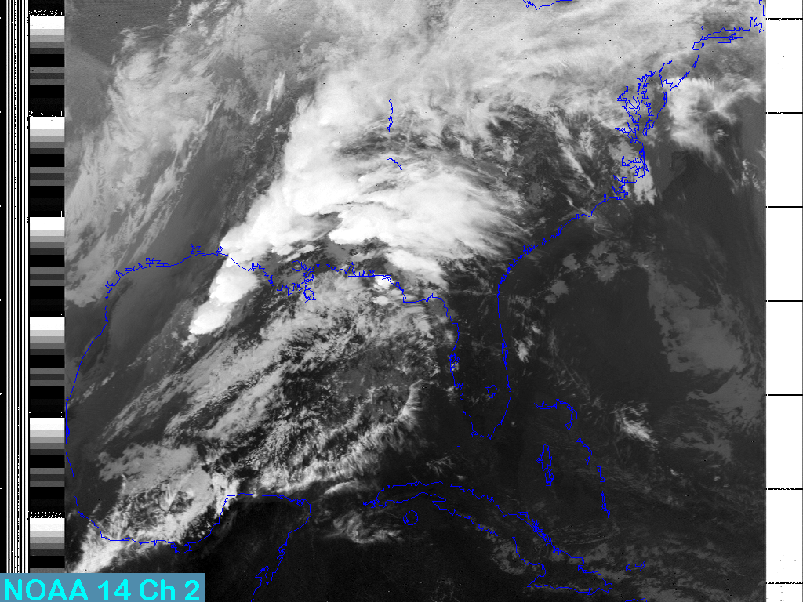
Squall lines with thunderstorms (infrared)

Slide 37
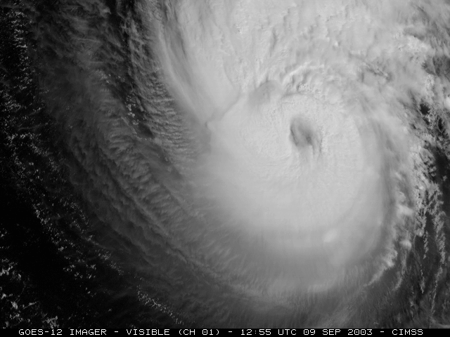
Hurricane
Hurricane Isabel

Slide 38
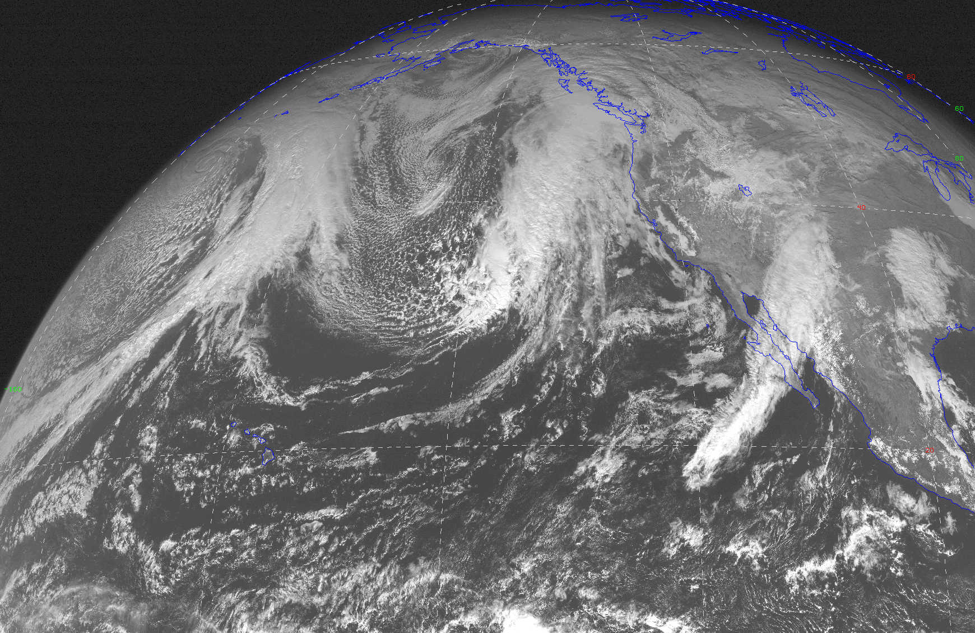
Fronts” evident in long bands of clouds

Slide 39
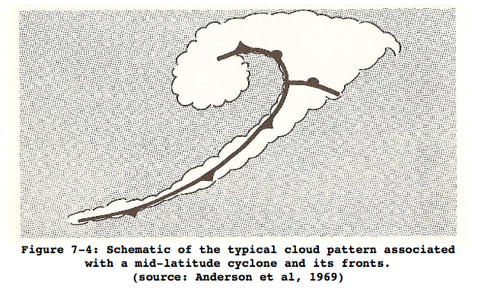
Fronts
L

Slide 40
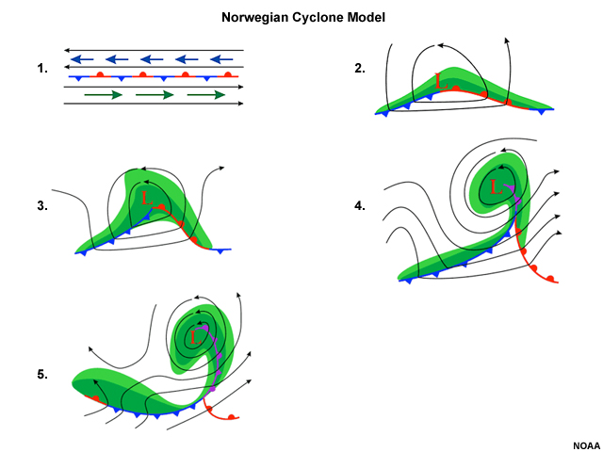

Slide 41
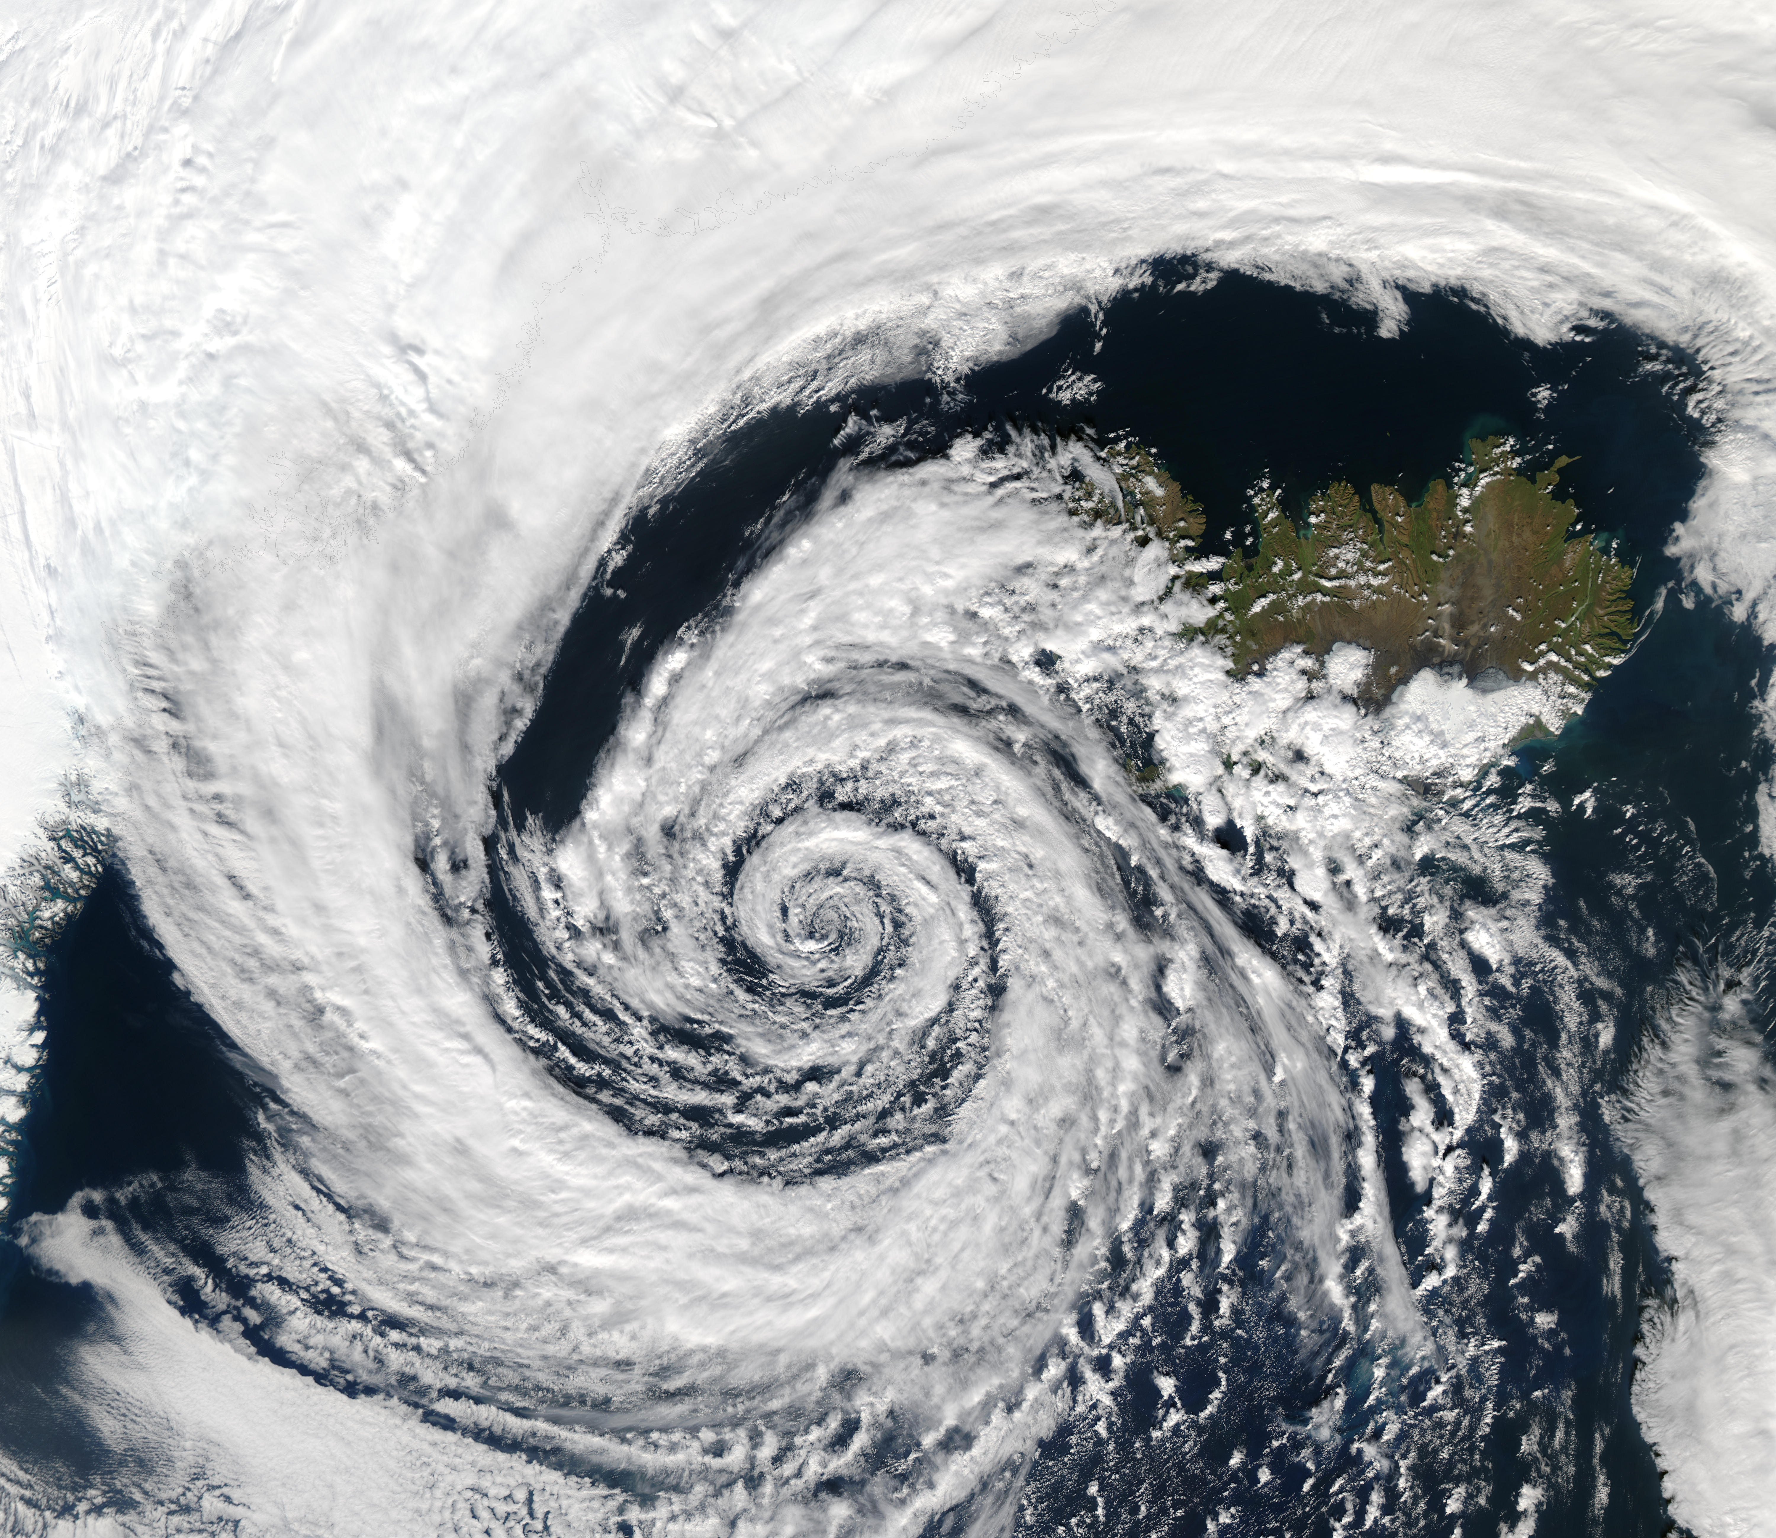
Swirl of Clouds Associated with Low Pressure Centers
L

Slide 42
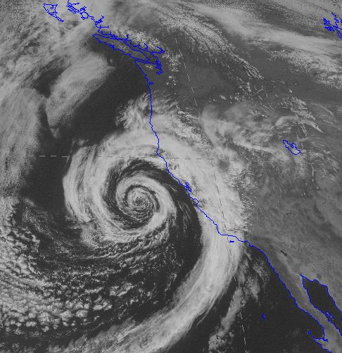
Midlatitude Cyclone

Slide 43
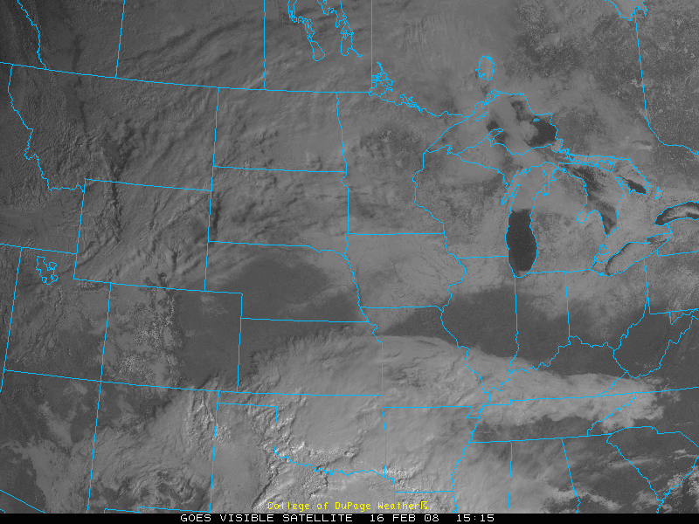
Snow
Clouds move, the snow doesn’t.
snow
L
Valley Fog

Slide 45
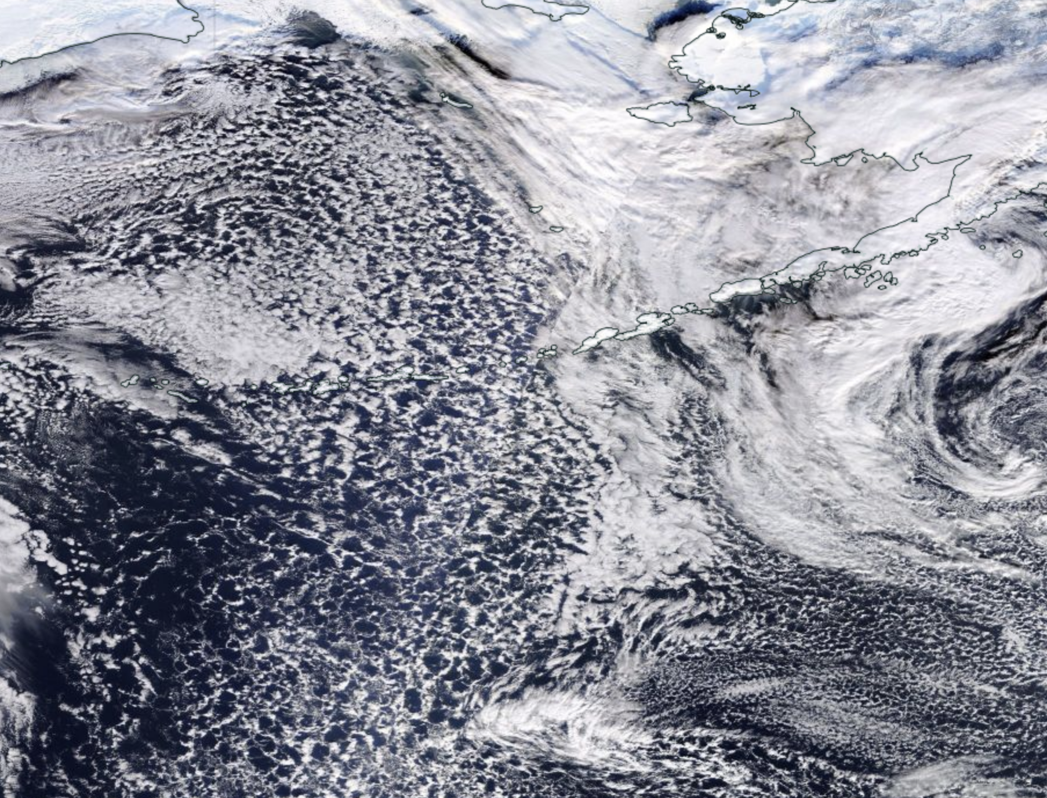
Instability (cumulus and thunderstorms)

Slide 46
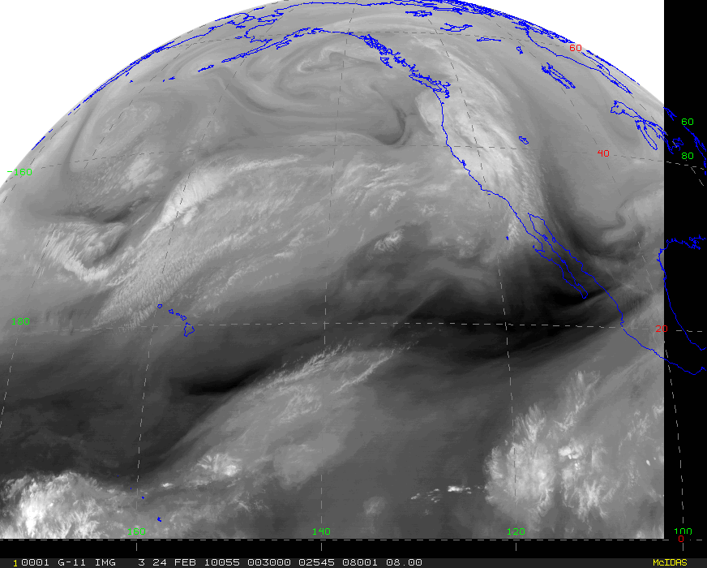
Water Vapor Imagery

Slide 47
Water Vapor Imagery
Essentially shows regions in which there is a lot of water vapor in the upper troposphere (20,000-35,000 ft).
Whiter areas have more water vapor
Can show atmospheric structures event where there is NO clouds

Slide 48
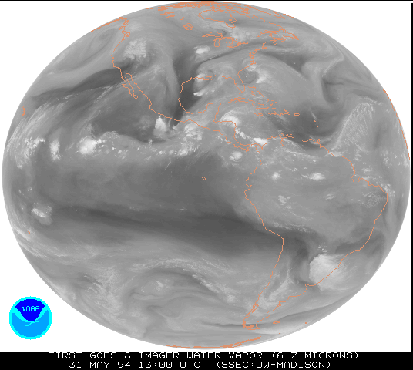

Slide 49
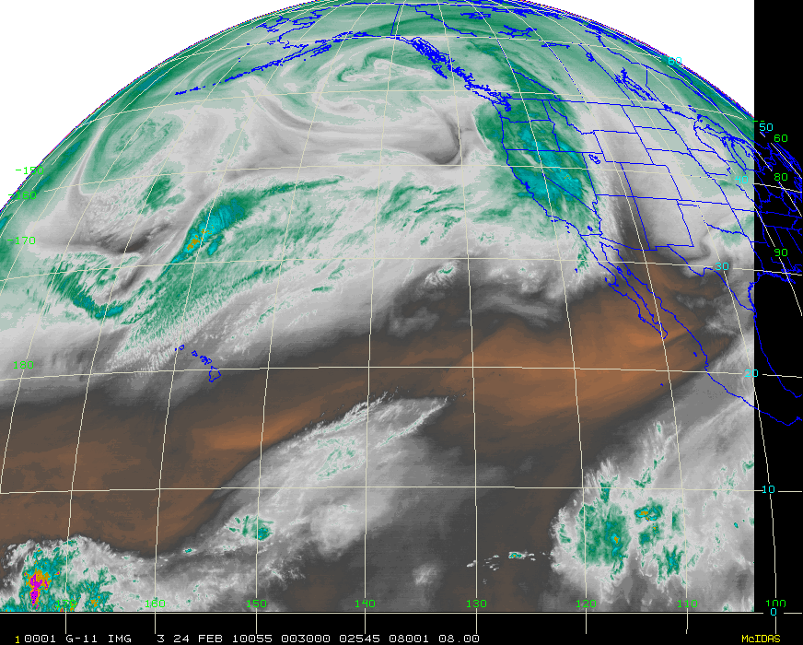

Slide 50
