Slide 1
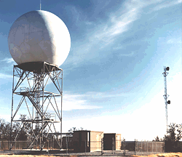
Weather Radar 370
Winter 2021

Slide 2
Weather Radar 101
Weather radars can determine where precipitation is falling
Can also tell the intensity of the precipitation
Doppler radars can also determine the velocity of precipitation toward or away from the radar.
Dual-polarization radars can determine precipitation type and more.
Radars can track storms, fronts, and other major features
An essential tool for the National Weather Service and other meteorologists.

Slide 3
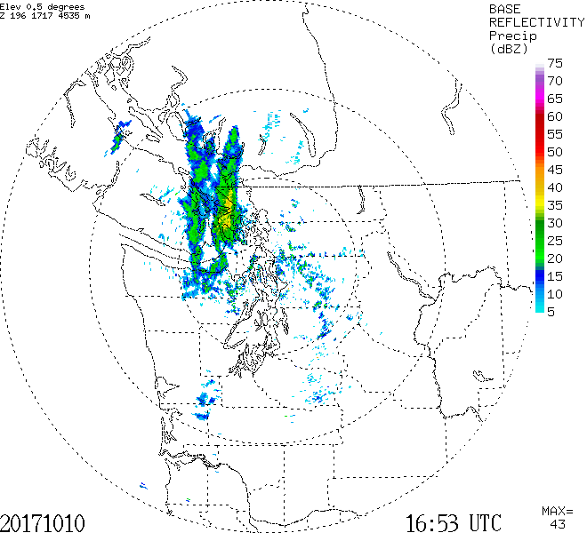
Weather Radar

Slide 4
What is Radar?
RAdio Detection And Ranging
Weather radars emit pulses of electromagnetic radiation in the microwave part of the electromagnetic spectrum
Radar wave pulses interact with and are reflected/scattered back from a target (precipitation)
The time it takes to return tells the distance
The amount of return tells us about precipitation intensity and type

Slide 5
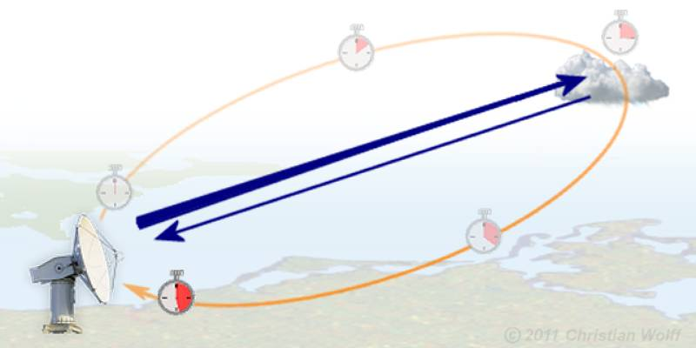
Radar moves at the speed of light (186,000 miles per second in vacuum).
Thus, the time from transmission to return tells how far the object is away.

Slide 6
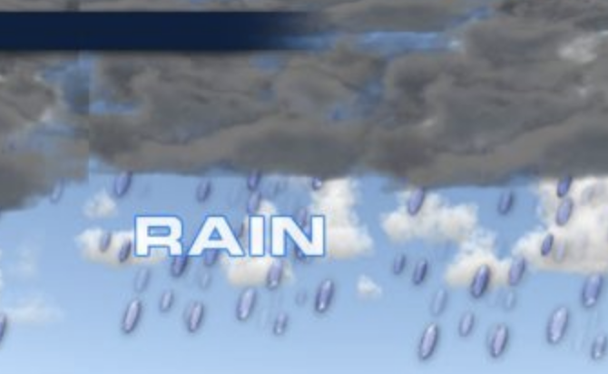
The amount of radar signal returned tells one about the nature of the object: type and intensity of precipitation
Amount scattered ~ D⁶ where D is diameter
Big objects (e.g., large rain drops associated with heavy rain)---big radar return
Small objects (small droplets)—lesser return
More objects—more return
Liquid water provides more radar return than
snow

Slide 7
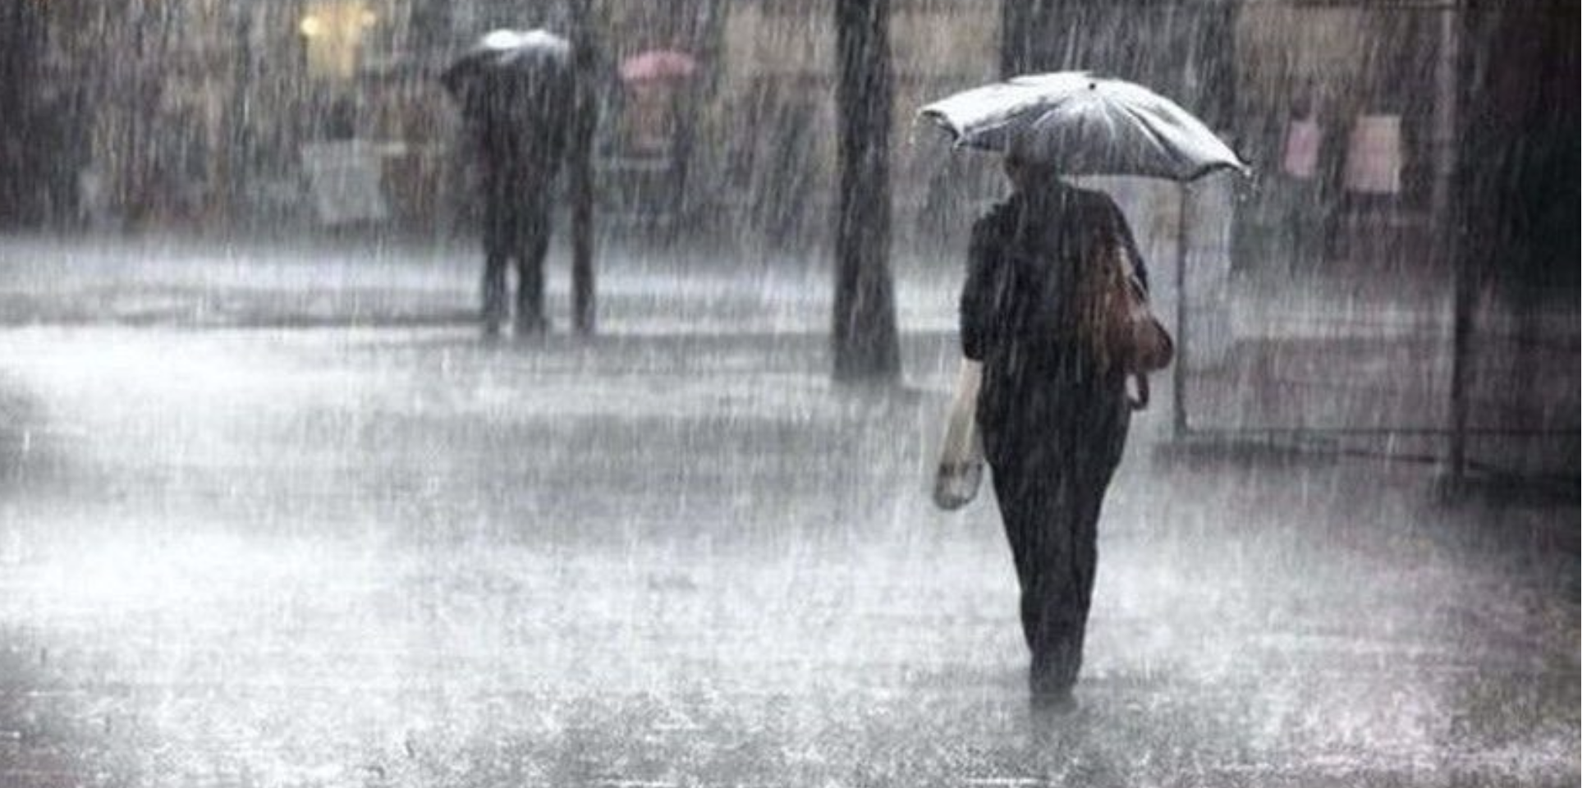
Thus, heavy rain with lots of big droplets give a big radar return

Slide 8
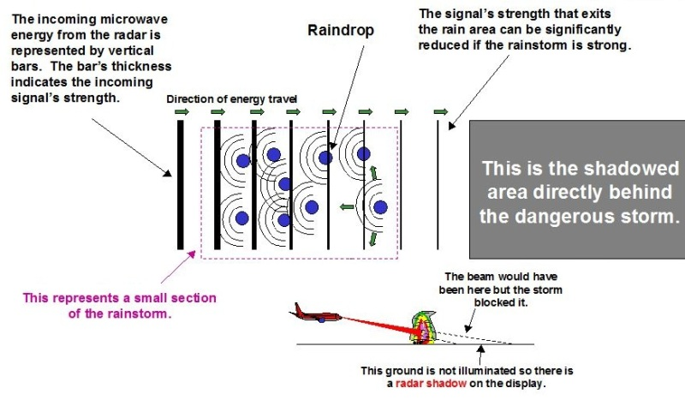
Weather Radar Attenuation: loss of energy as beam passes through targets.

Slide 9
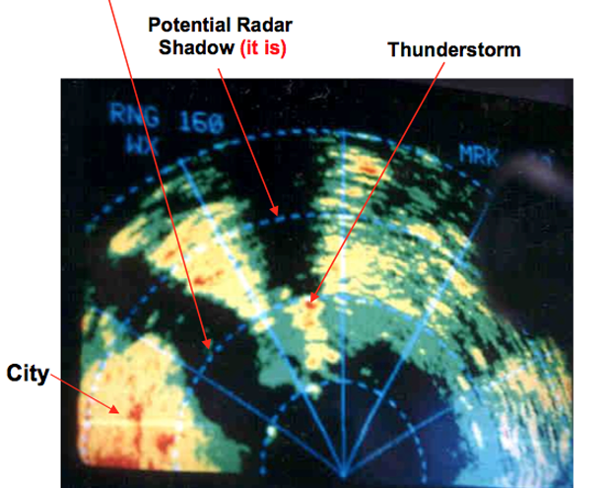
Weather Radar Attenuation

Slide 10
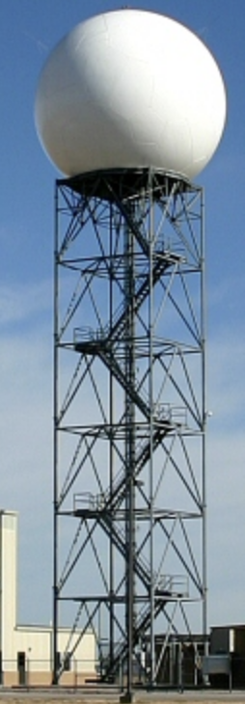
Weather Radar Wavelengths
S band radars operate on a wavelength of 8-15 cm and a frequency of 2-4 GHz.
S band radar beams are not easily attenuated. Thus useful for near and far range weather observation when precipitation is present
The National Weather Service (NWS) uses S band radars of ~10 cm.
Requires a large antenna dish and a large motor to power it. It is not uncommon for a S band dish to exceed 25 feet in size.
Typically megawatt power!

Slide 11
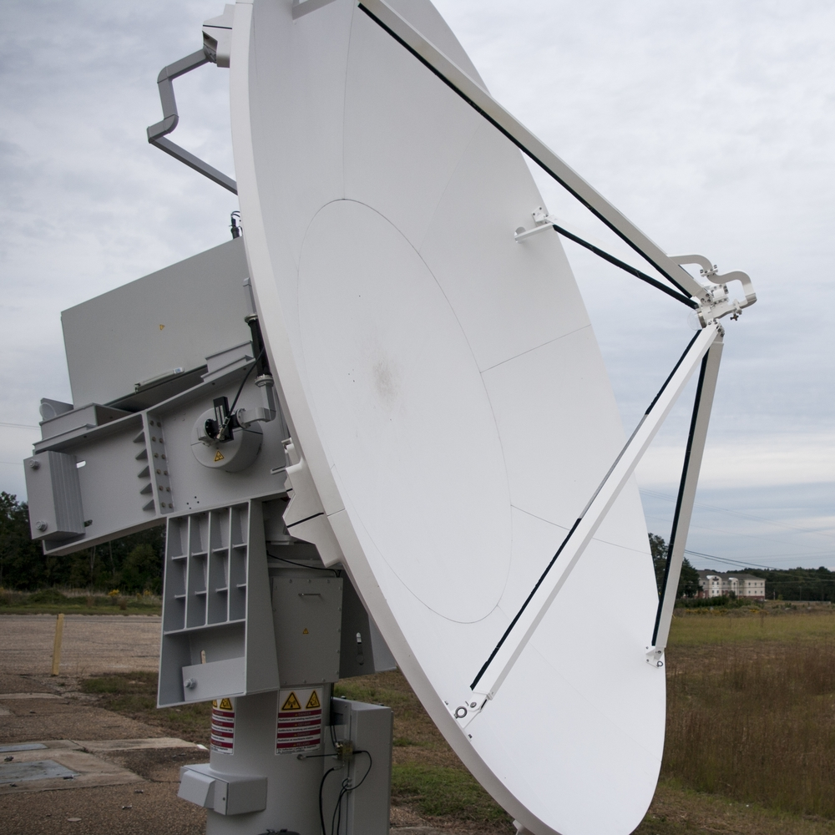
Weather Radar Wavelengths
C band radars operate on a wavelength of 4-8 cm and a frequency of 4-8 GHz.
Because of the wavelength and frequency, the dish size does not need to be very large. This makes C band radars affordable for TV stations.
The signal is more easily attenuated, so best used for short range weather observation.
Typically, about 250,000 watts of power with their C band radar.

Slide 12
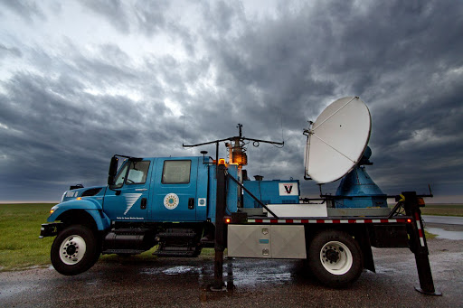
Weather Radar Wavelengths
X band radars operate on a wavelength of 2.5-4 cm and a frequency of 8-12 GHz.
Because of the smaller wavelength, the X band radar is more sensitive to smaller particles.
Attenuate very easily, so most useful for short range weather observation.
Also, due to the small size of the radar, it can therefore be portable like the Doppler on Wheels. (DOW)
Many aircraft are equipped with an X band radar to pick up turbulence and other weather phenomenon.

Slide 13
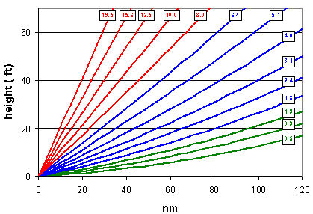
Radar Imagery is generally not observed or displayed for a level surface
Radars scan in azimuth ( 0 to 360) at a series of increasing scan angles from the horizontal.

Slide 14
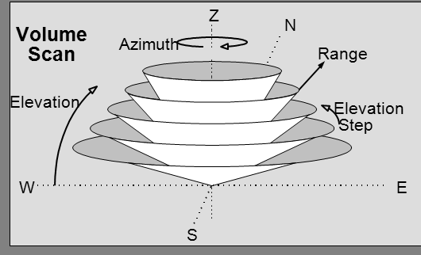

Slide 15
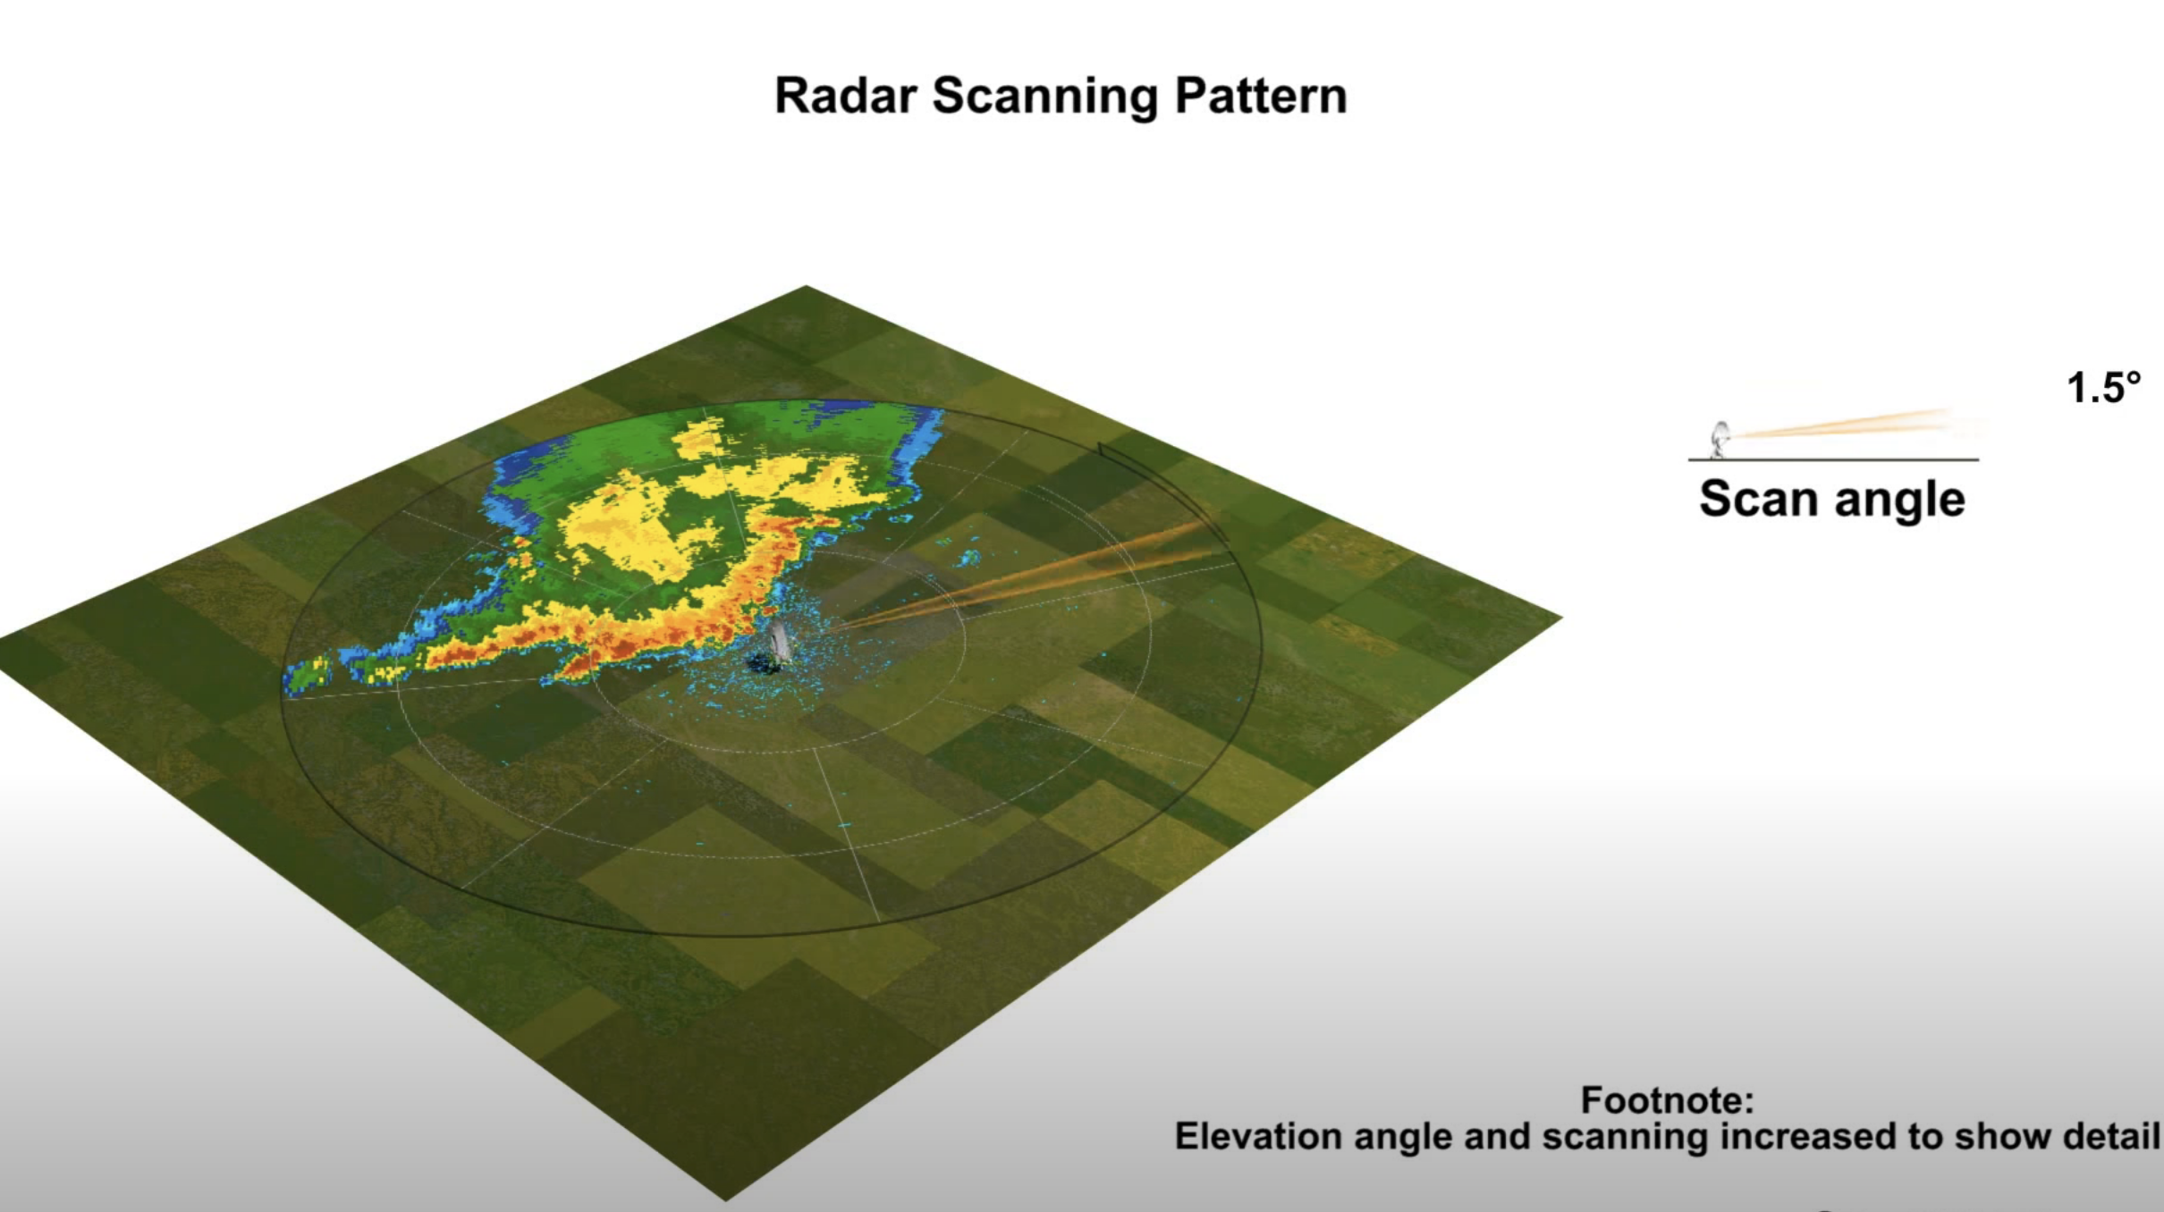
So radar imagery generally does not show a single level, but a sloping cut through the atmosphere
Thus, it is showing precipitation higher and higher up in the atmosphere as you move away from the center of the radar image.
https://www.youtube.com/watch?v=Yrq2TVdM8HI

Slide 16
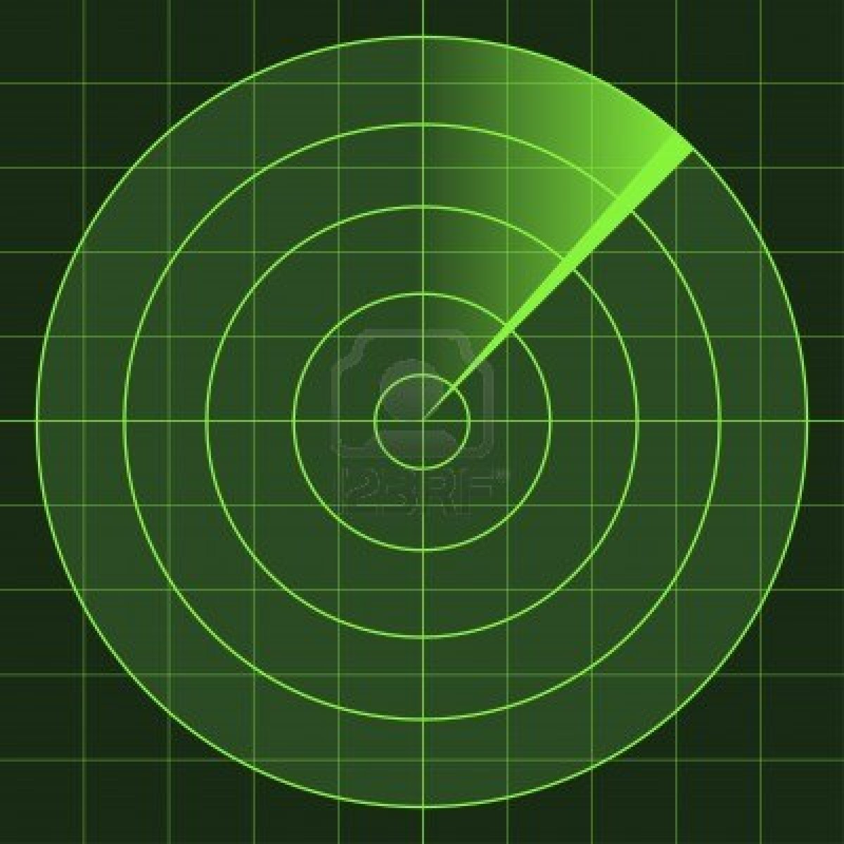
Radar imagery is generally shown on a polar-type chart with range circles

Slide 17
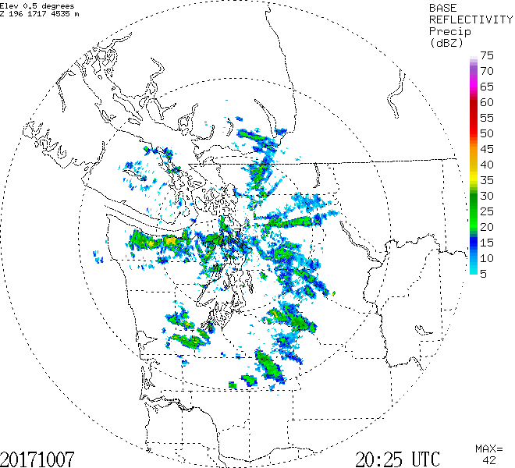
Range circle every 100 km (60 miles)

Slide 18
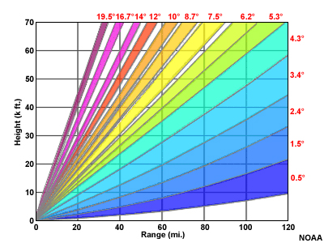
Keep in mind that the beam spreads out with distance

Slide 19
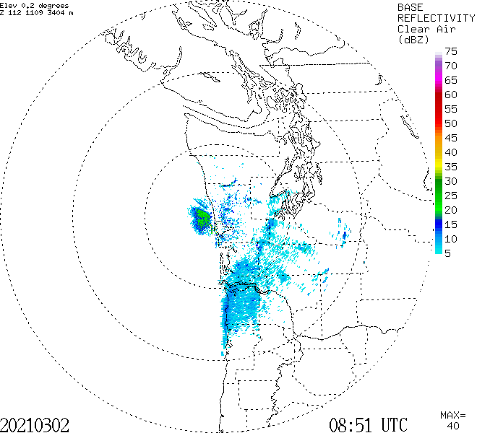
Can Even Hit the Surface Close In!

Slide 20
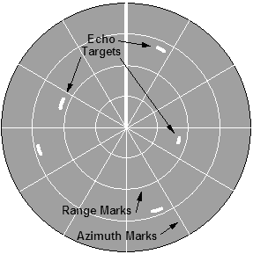
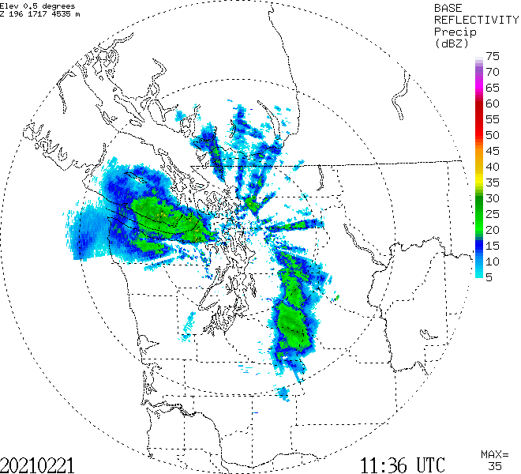
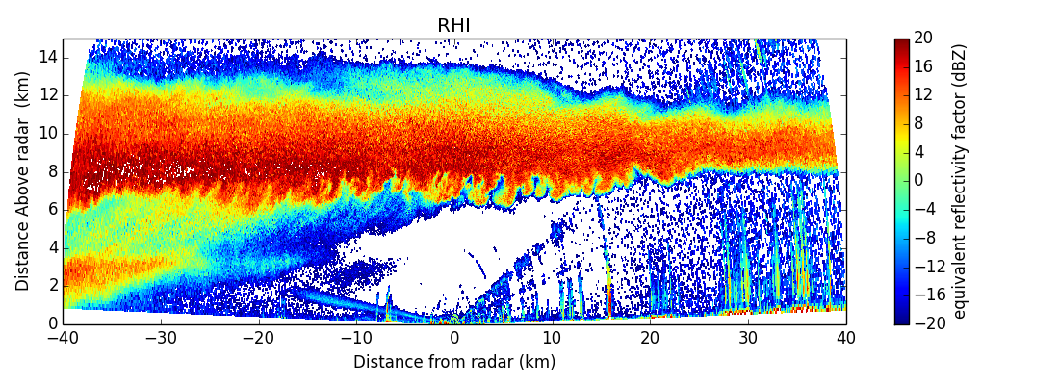
Two types of radar displays
Plan Position Indicator (PPI): radar scanning in azimuth (direction)
Range Height Indicator (RHI): radar scanning in elevation

Slide 21
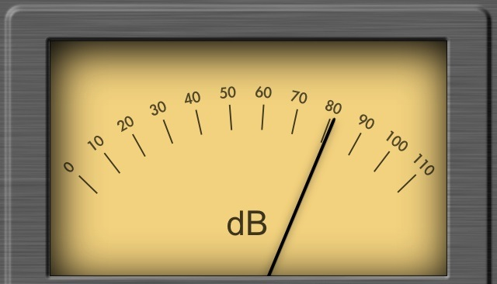
Reflectivity
A fancy name for the amount of radar signal that is returned by an object: reflectivity (Z) is given in units of dbZ
db or decibels-unit of power on a logarithmic scale
Precipitation intensity is proportional to Z (or dbZ)

Slide 22
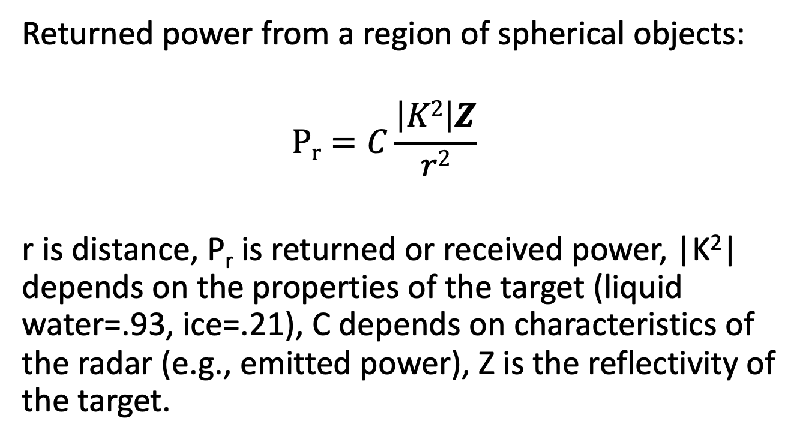
Radar Equation
Returned power from a region of spherical objects:
  $$\operatorname{Pr}{=C\frac{\left|K2\right|Z}{r2}}$$
r is distance, P_{r} is returned or received power, |K²| depends on the properties of the target (liquid water=.93, ice=.21), C depends on characteristics of the radar (e.g., emitted power), Z is the reflectivity of the target.

Slide 23
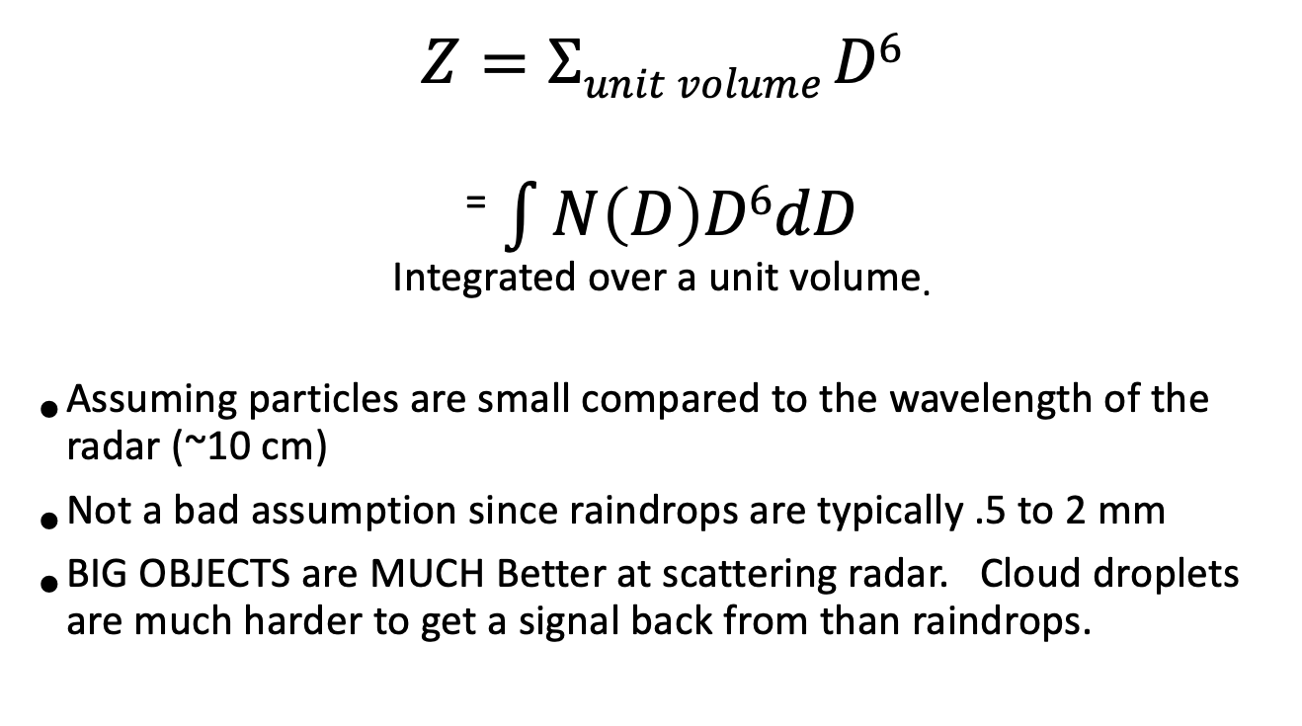
Reflectivity
$$Z=Σunit volume D6$$
⁼ $\int{N\left(D\right)D6dD}$
^{Integrated over a unit volume.}
Assuming particles are small compared to the wavelength of the radar (~10 cm)
Not a bad assumption since raindrops are typically .5 to 2 mm
BIG OBJECTS are MUCH Better at scattering radar. Cloud droplets are much harder to get a signal back from than raindrops.

Slide 24

Good Target for Weather Radar!

Slide 25
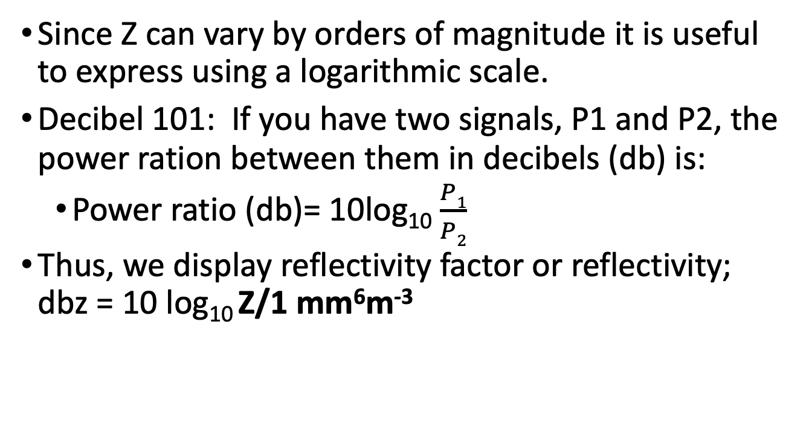
Units of reflectivity
Since Z can vary by orders of magnitude it is useful to express using a logarithmic scale.
Decibel 101: If you have two signals, P1 and P2, the power ration between them in decibels (db) is:
  Power ratio (db)= 10log₁₀ $\frac{P1}{P2}$
Thus, we display reflectivity factor or reflectivity; dbz = 10 log₁₀ Z/1 mm⁶m⁻³

Slide 26
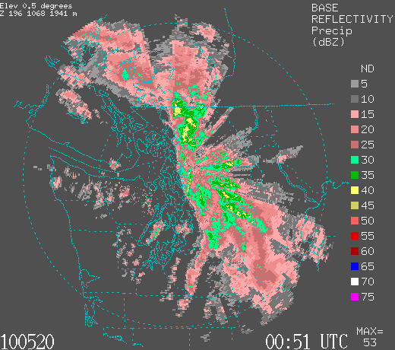
Reading a Radar Image
Intensity of precipitation is color coded (units—dbZ)

Slide 27
Reading a Radar Image
Black (white in some)-no precip
Grey and pink (5-20 dbZ)…light rain…not too bad.
Dark pink to green-moderate rain (20-35)
Yellows are heavy rain 40-50 (forget it)
Reds and higher (dont even think about it)

Slide 28
Reading a Radar Image
Radar beam can be blocked by mountains
Time is in UTC (GMT).

Slide 29
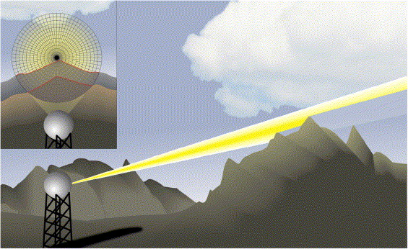
Important points
Shallow drizzle often does not appear on radar, particularly when a distance away.
Can only see deep and high-level precipitation at a distance.
Radar beam can be blocked by local terrain.

Slide 30
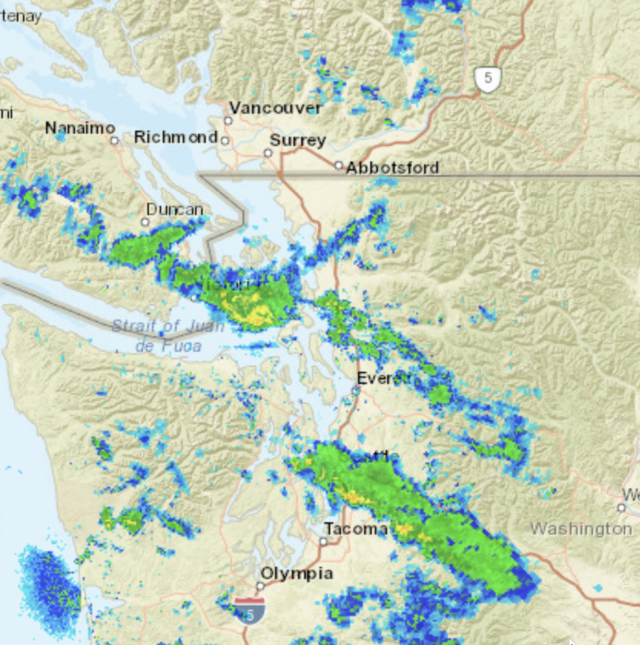
Why don’t we see local mountains?
Ground clutter removal. Not perfect

Slide 31
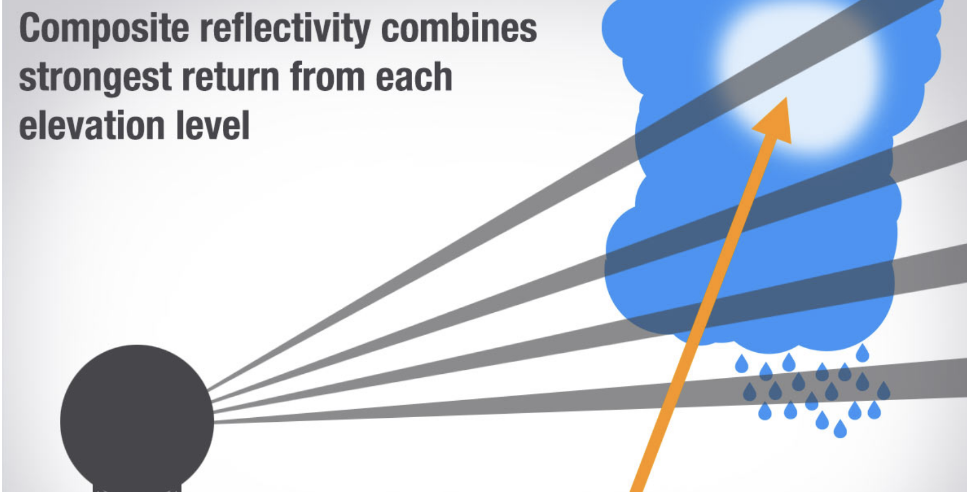
A frequent produce is composite reflectivity: the highest reflectivity of any scan angle above a point.

Slide 32
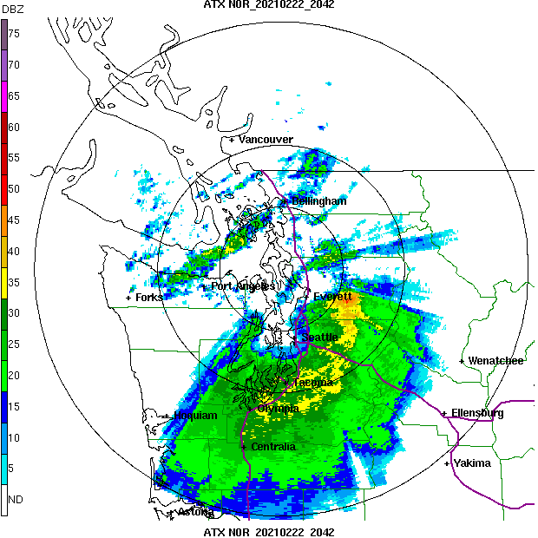
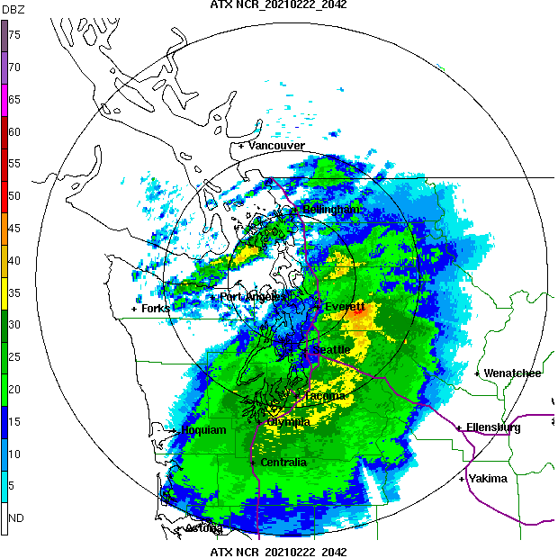
.5 degree
Composite

Slide 33
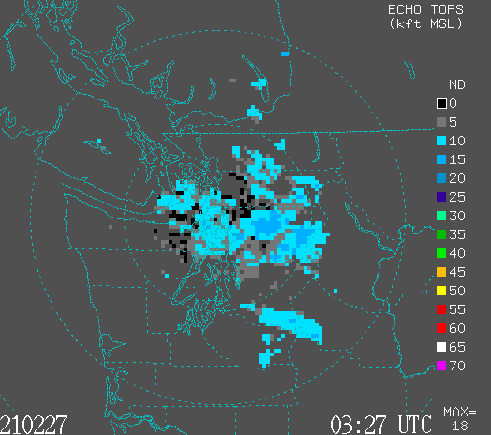
Echo Tops from Radar

Slide 34
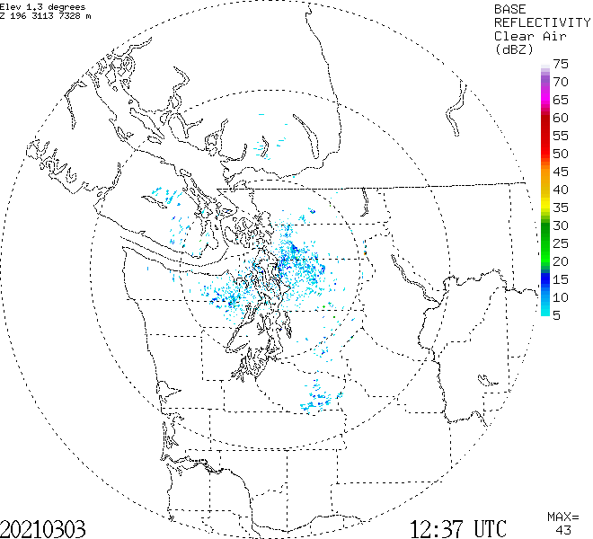
Normal versus Clear Air Mode

Slide 35
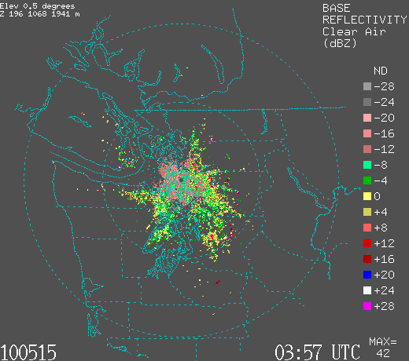
Clear Air Mode
Provides more sensitivity to weaker echoes
Radar turns more slowly
The pulse repetition frequency is reduced.
Only scans lower elevation angles.
Good to see bugs, birds, and atmospheric density differences

Slide 36
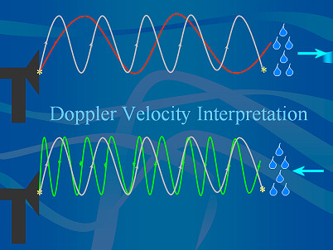
Modern Radars are Doppler Radars
Doppler radars can tell the speed of the target towards or away from the radar.
The wavelength/phase of the radar signal changes, depending the speed of the target towards or away from the radar.

Slide 37


Same principle used in police radar guns

Slide 38
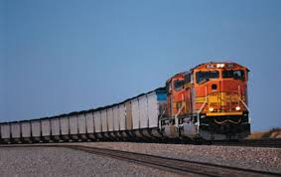
Based on Doppler Effect: evident when a train or car passes
https://www.youtube.com/watch?v=a3RfULw7aAY

Slide 39
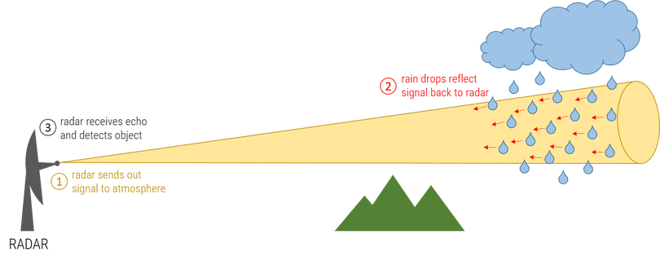
Doppler Effect for Weather Radars
The ”targets” are generally precipitation particles (rain drops, snow flakes)…but can include birds, bugs, and even tornado debris.
Meteorological targets generally move with the wind…so we get wind information as well.

Slide 40
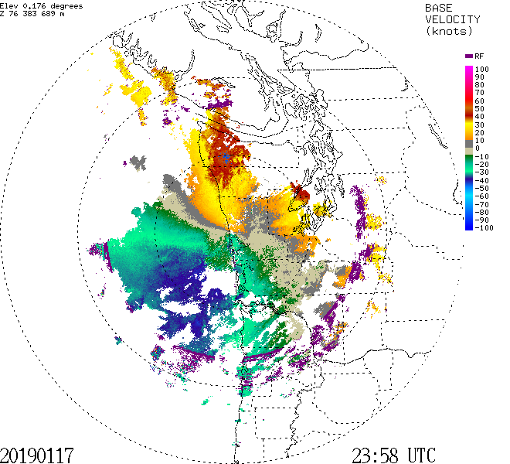
Doppler Radar Imagery: Rarely Shown by the Media

Slide 41
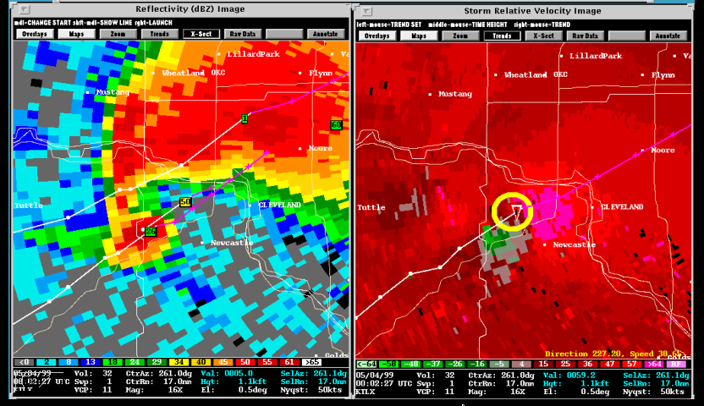
Lots of uses: such as seeing rotation associated with tornadic thunderstorms

Slide 42
Weather Radar History

Slide 43

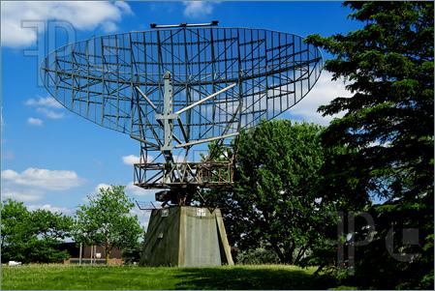
Radar Was An Important Tool in WWII: Had One Pesky Problem—Precipitation!

Slide 44
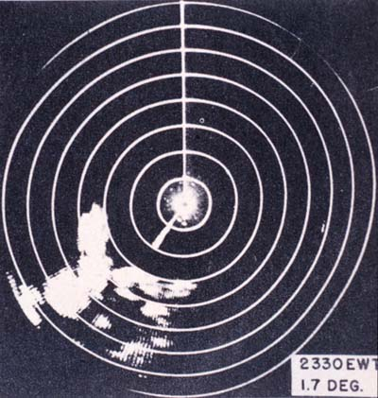
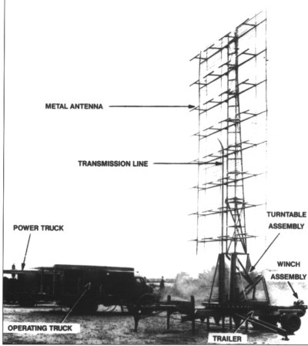
WWII Radars

Slide 45
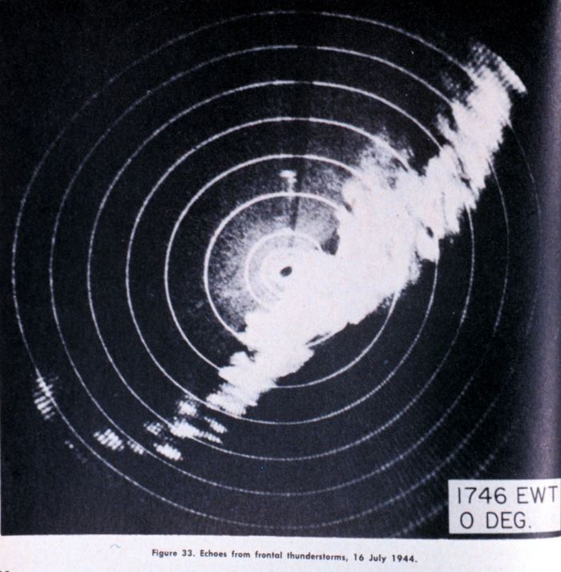
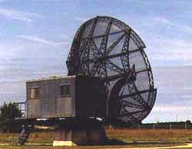
After WWII, Meteorologists Experimented with Military Radars: Thunderstorms and Convection Clearly Seen

Slide 46
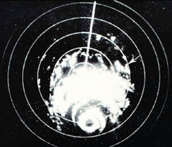
Hurricanes Also Apparent, Including Eye Walls, Rainbands

Slide 47
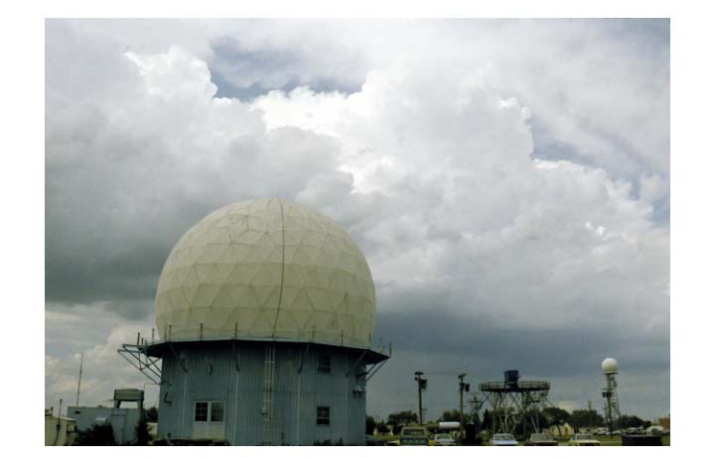
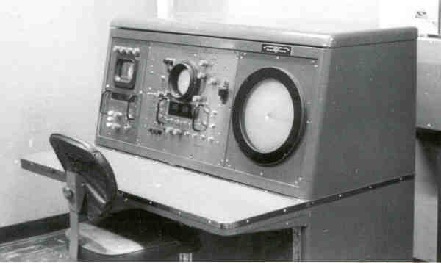
In the late 1950’s a national meteorological radar network was established (WSR-57).

Slide 48
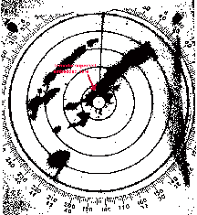
WSR-57 (no Doppler capability)

Slide 49
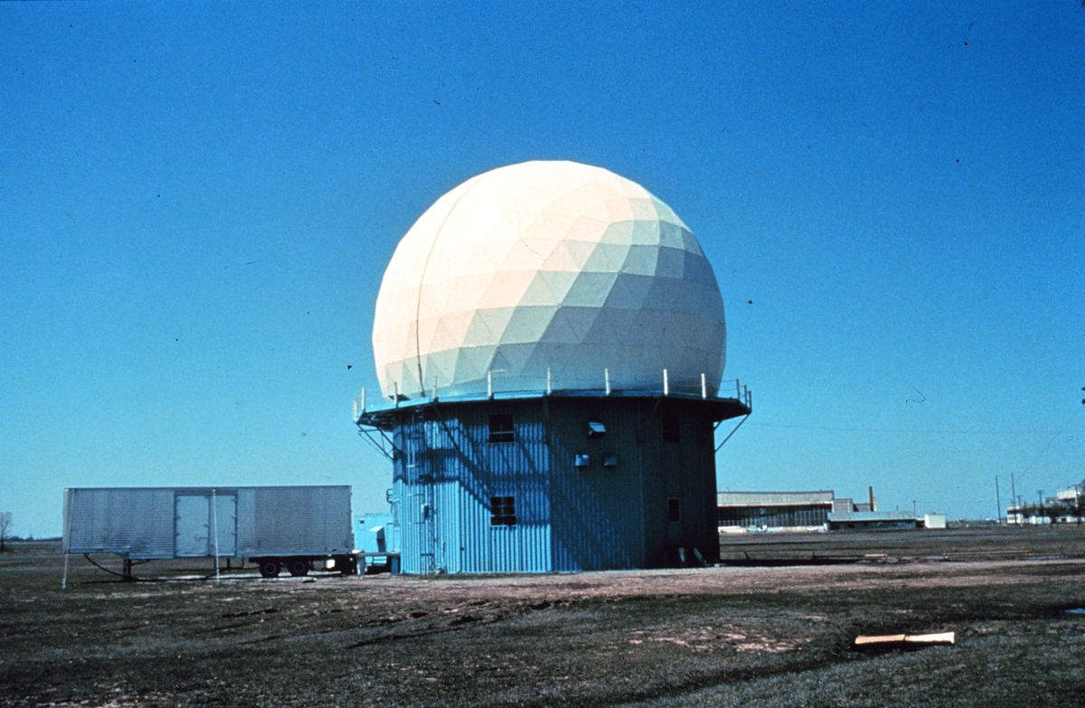
During the 1970s and early 80s a lot of experimentation with Doppler Weather Radars
Can show wind shifts and circulations
Diagnose how wind changes with height
Particularly useful for showing the rotation in severe convection—the mesocyclone

Slide 50
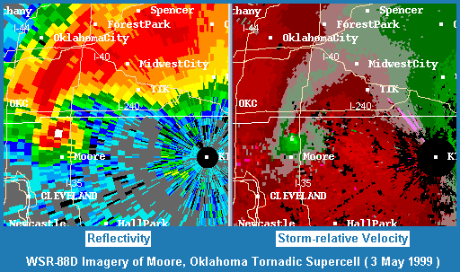

Slide 51
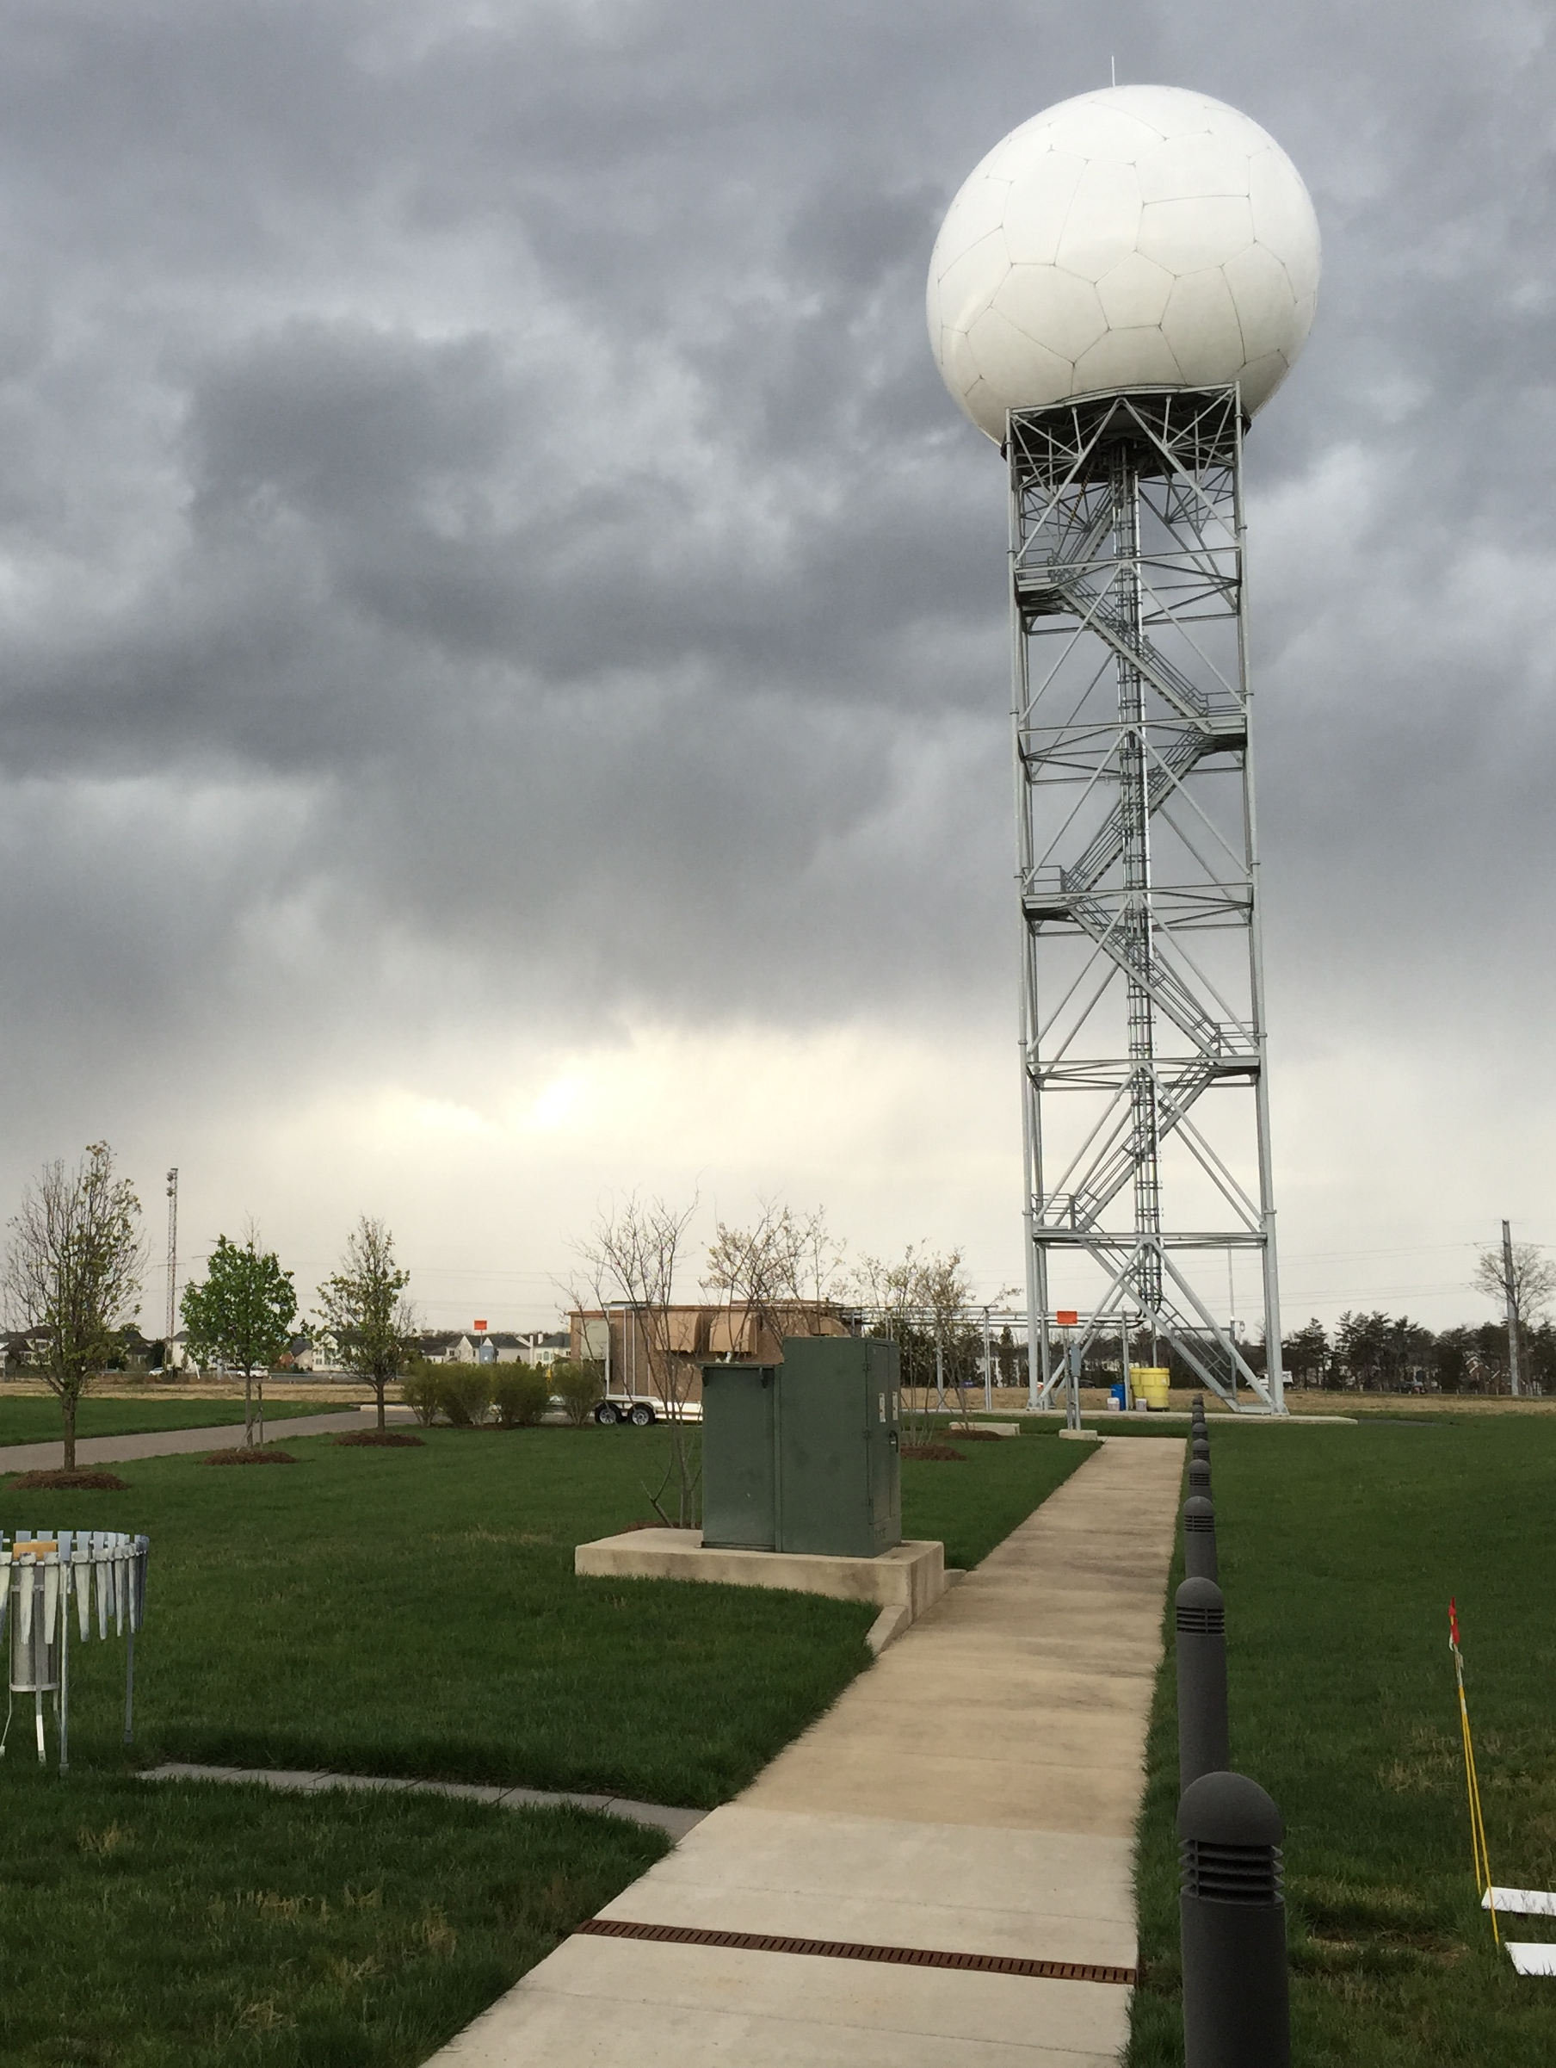
In the late 1980s,
the NWS put in a network of Doppler Weather
Radars:
NEXRAD
WSR88D
(Weather Surveillance Radar 88 Doppler)

Slide 52


Slide 53

The National Weather Service has Installed Doppler Weather
Radars Across the Country
Available every 5-6 minutes

Slide 54

Big Radar Advance in 2011: Dual-Polarization

Slide 55

Can determine precipitation type and more

Slide 56

Some Dual-Polarization Radar Products

Slide 57


Slide 58


Slide 59


Slide 60

Correlation Coefficient (also called Rho)
A measure of how uniform the features being observed by the radar are.
It ranges in value from 0 to 1.05. ... Meteorological echoes will typically have Correlation Coefficient values higher than 0.8 with non meteorological echoes (birds, insects, etc.) typically have values less than 0.8

Slide 61


Slide 62


Slide 63


Slide 64
Other Dual Pol Variables (you are not responsible to know about these)
Differential Phase Shift (ΦDP)
Specific Differential Phase (KDP):
Represents the difference in phase shift between horizontal and vertical polarized returned energy due to forward propagation.

Slide 65
Doppler Radar Interpretation

Slide 66

Uniform winds with height

Slide 67

Doppler Radar Interpretation

Slide 68

Warm advection-veering

Slide 69

Front

Slide 70


Slide 71

Examples
After fronts go through, we often have showers and sun breaks.

Slide 72


Slide 73

Showers as seen in weather radar

Slide 74

Puget Sound Convergence Zone: Go north or south to stay dry!

Slide 75

Puget Sound Convergence Zone: Very Narrow Zone of Rain

Slide 76

Rainshadows: Find them with weather radar
Windward
Enhancement
Rainshadow

Slide 77


Slide 78

The Bright Band

Slide 79


Slide 80


Slide 81

Why? Melting snow crystals scatter radar waves like HUGE raindrops

Slide 82

Radars as Rain Gauges
It is possible to estimate precipitation intensity and precipitation accumulation from radar data.
Very valuable because you can’t have rain gauges everywhere.
This relationship has been studied extensive in many regions, seasons, and precipitation regimes.

Slide 83

Z-R relationship (reflectivity-rainfall rate)
Different values used at various sites
Can calibrate using radar and rain gauge data

Slide 84
Also a dual-polarization algorithm for rain rate estimation
Rainfall retrievals using combinations of reflectivity (Z_{h}), differential reflectivity (Z_{dr}), and specific differential phase (K_{dp}) are made.
Have advantages over traditional Z–R methods because more information about the drop size distribution (DSD) and hydrometeor type are available.
Generally better

Slide 85


Dual Pol
Traditional Z-R

Slide 86


Slide 87

Where to view radar imagery
On TV
On the web
Dedicated app
Radarscope: My Favorite Radar App

Slide 88

Radar Imagery Available on Atmospheric Sciences Department website

Slide 89

https://a.atmos.washington.edu/weather/radar.shtml

