Slide 1

Why Has U.S. Numerical Weather Prediction Fallen Behind and What Can Be Done About It?
Cliff Mass
University of Washington
Emergency Colloquium Presentation

Slide 2
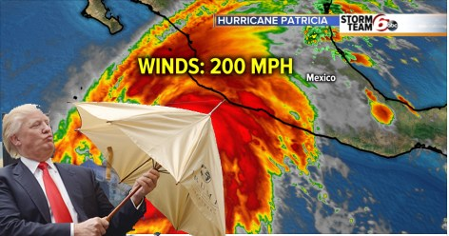
Including a Trump Administration Update

Slide 3
"The fault, dear Brutus, is not in our stars,
But in ourselves, that we are underlings."

Slide 4
The value of science to society depends not only on the inspired work of researchers but on organization of the enterprise and the leadership of major players

Slide 5
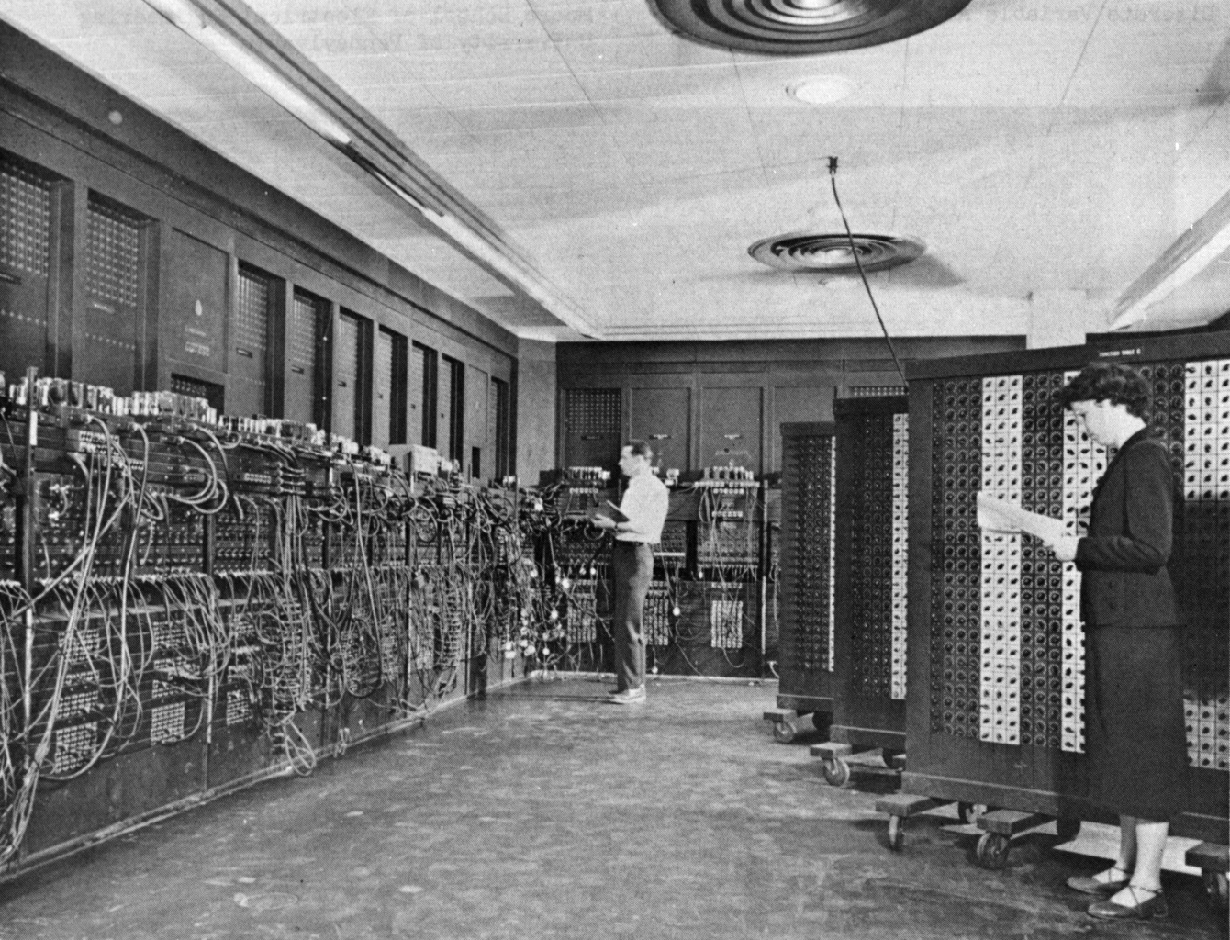
Numerical weather prediction began in the U.S. (1950)
ENIAC Computer

Slide 6
A Huge Accomplishment
Complex and expensive observing systems (satellite, radar, and more)
Use of the largest computers
Complex data assimilation and modeling systems with millions of lines of code
Cooperation among nations
Modeling from the molecular to the planetary scales.

Slide 7

It’s a miracle …

Slide 8
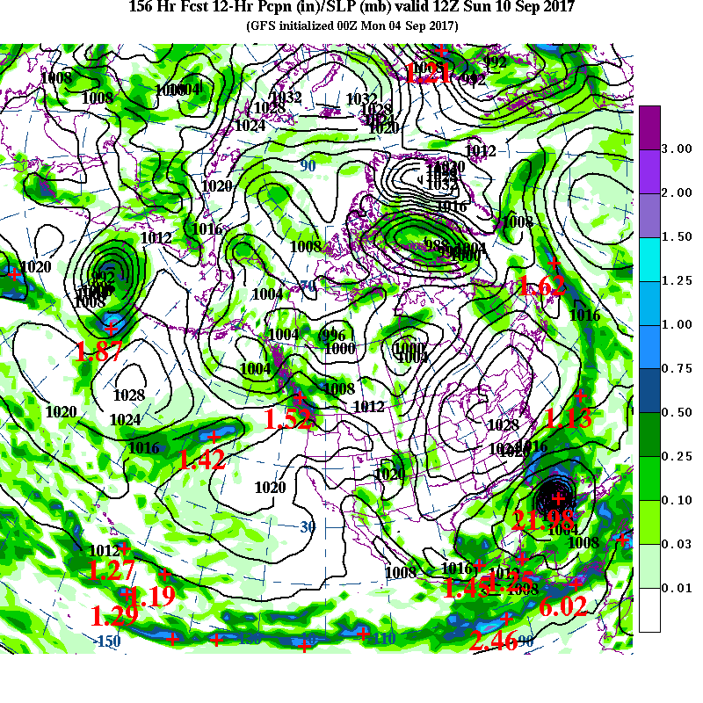
A Recent
Miracle: Hurricane
Irma
6.5 day
Forecast

Slide 9
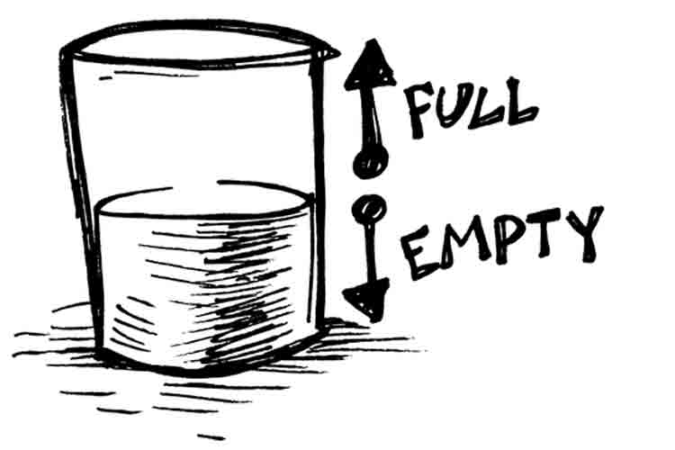
But something is wrong in U.S NWP: NOAA/NWS NCEP EMC is consistentl in 3rd or 4th place in global prediction

Slide 10
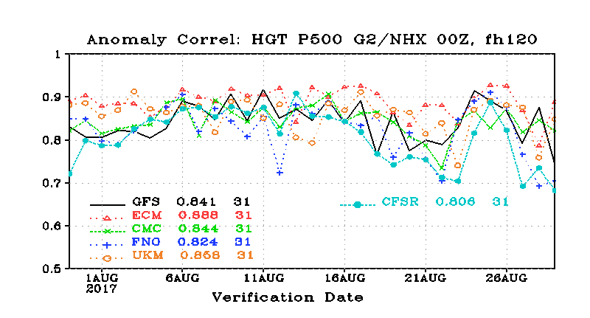
The Order: ECMWF, UKMET, CMC, NCEP
5 Days, N. Hemisphere, 500 hPa

Slide 11
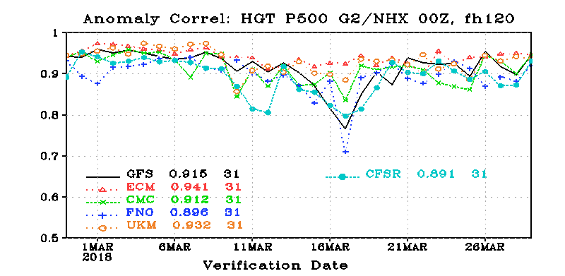

Slide 12
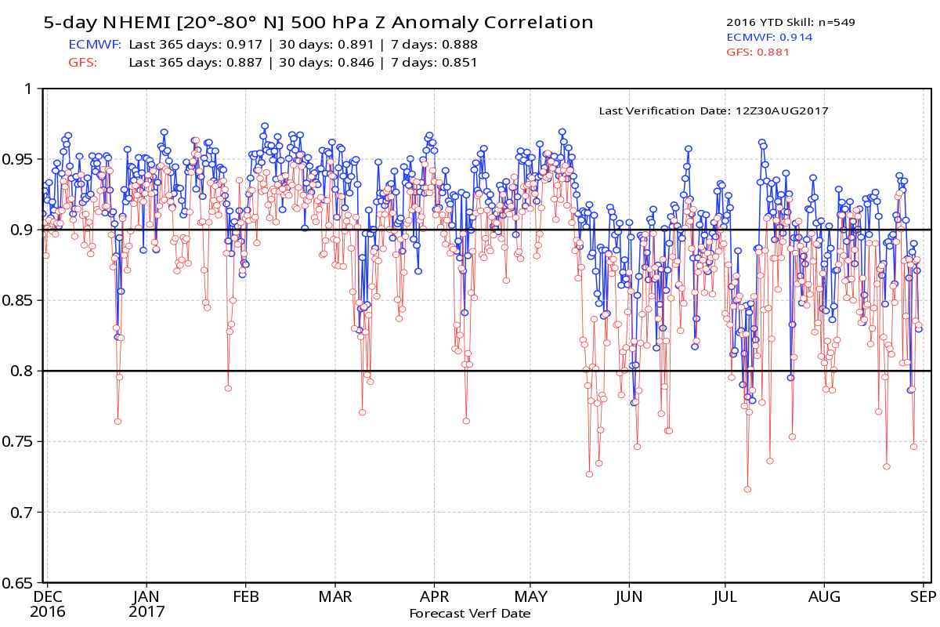
NWS GFS Leads in Drop Outs

Slide 13
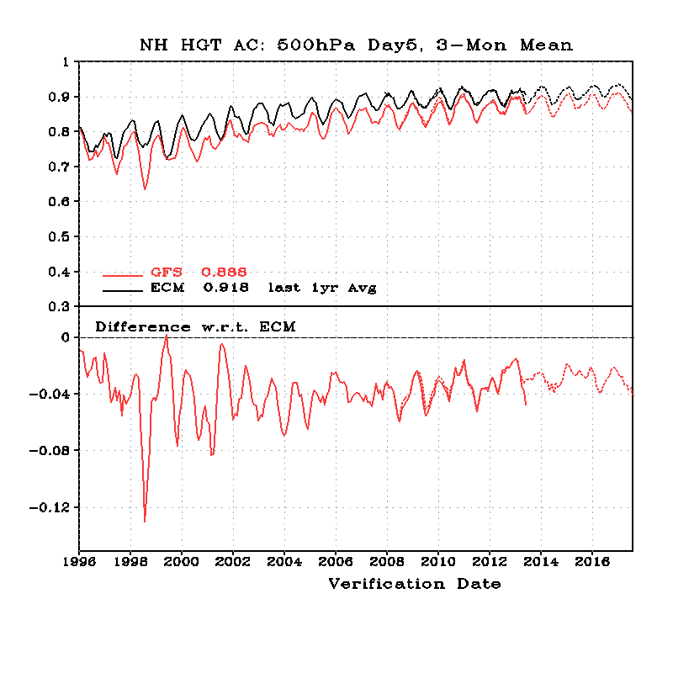
20-year Trend in NH Skill (500 hPa, Day 5)
Black-EC
Red-NCEP
NCEP
Worse
NCEP-ECMWF

Slide 14
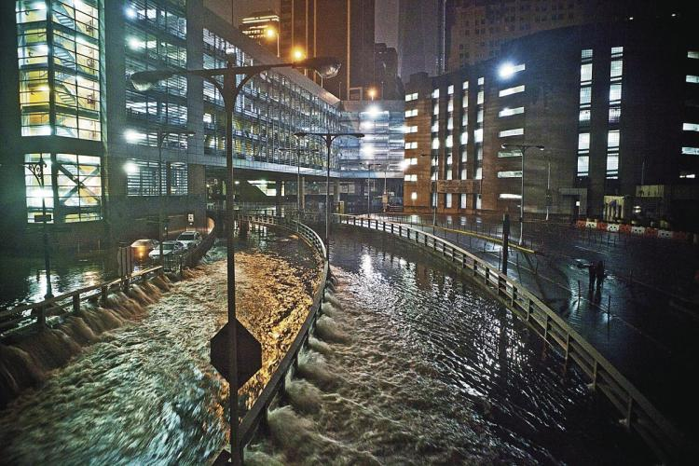
Hurricane Sandy: The Watershed Event

Slide 15
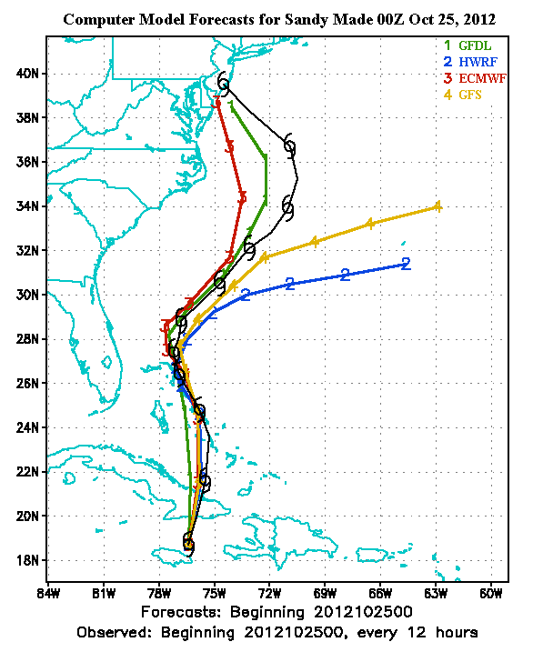
Hurricane Sandy
A week before, the ECMWF took the storm into the NE U.S, while GFS directed it out to sea.
ECMWF was right.

Slide 16
The Public and Media Noticed

Slide 17

NBC Nightly News
“we led the world during the 80s and 90’s, but we let it slip”
Al Roker, NBC News

Slide 18
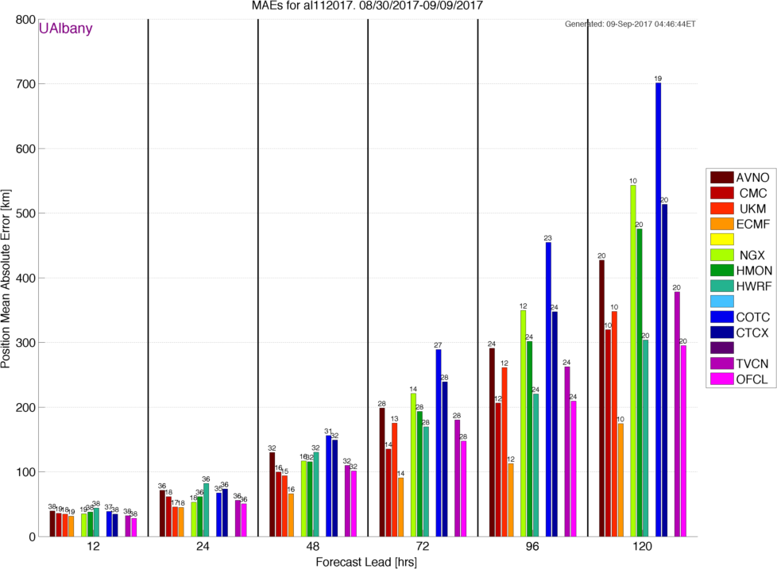
Hurricane Irma: EC is Still Better
Statistics courtesy of Brian Tang, University of Albany

Slide 19
But the problems extend beyond global modeling…

Slide 20
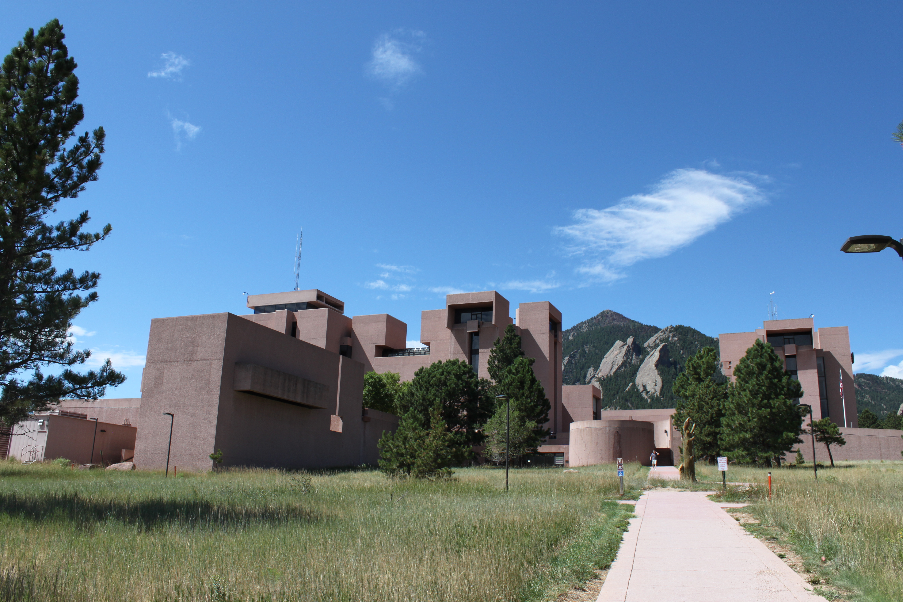

The research community and the operational communities are not working together effectively
WRF, MPAS
GFS, NMMB

Slide 21
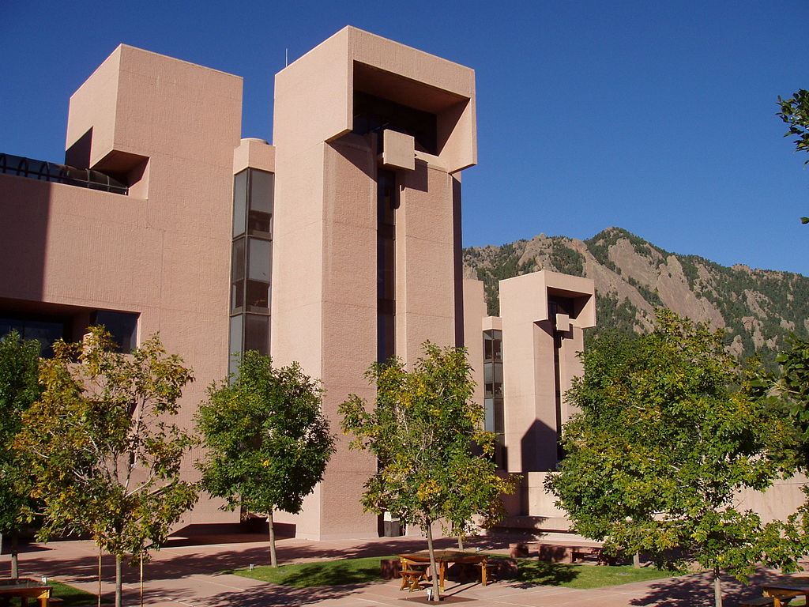
The U.S. has the largest weather research community in the world, but its contributions to U.S. operational NWP have been limited

Slide 22
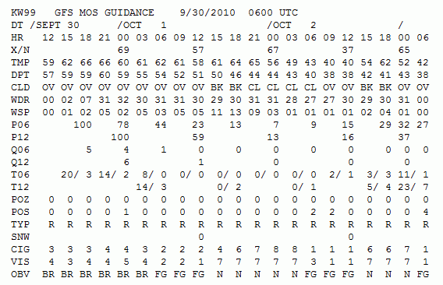
NWS Model Postprocessing Uses a Technique of the late 1960s:
Model Output Statistics (MOS)

Slide 23
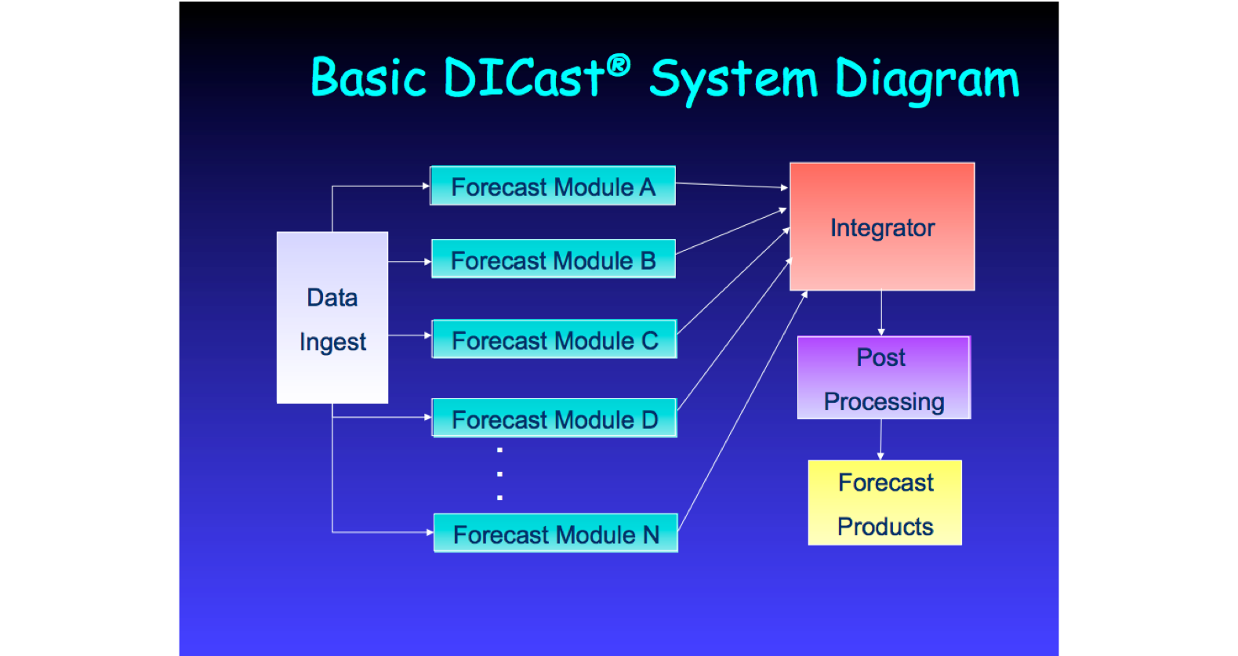
In contrast, the private sector is using more sophisticated post-processing, some developed by the University community/NCAR

Slide 24
As a result, private sector firms have far more skillful forecasts than the NWS, using the same models
Forecastadvisor.com

Slide 25
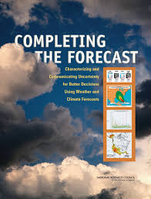
The National Weather Service Has Delayed Moving Towards High Resolution Ensembles
Over a dozen workshops and NRC reports have called for a more aggressive move towards ensembles and probabilistic prediction

Slide 26
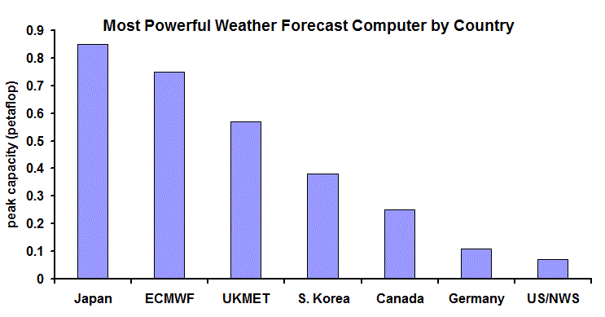
And NWS Computer Resources Have Been Under-Resourced For Years
2013

Slide 27
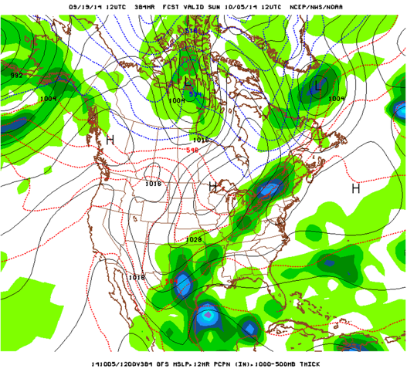
This Talk
The history of U.S. NWP
Why have we fallen behind in global prediction
Deficiencies in regional and local prediction
What can be done to fix the situation.

Slide 28
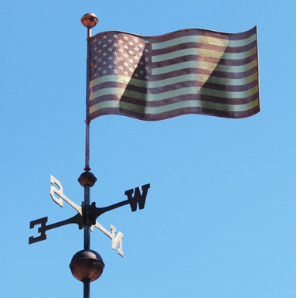
Numerical Weather Prediction (NWP) Began in the U.S.

Slide 29
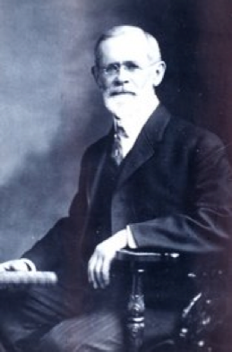
American Cleveland Abbe (1901): forecasting is a matter of solving known equations
Ol’ Probs

Slide 30
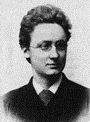
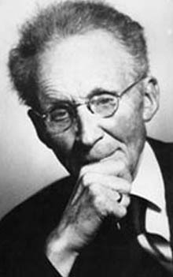
Norwegians Agreed
In 1904, Vilhelm Bjerknes suggested that the primitive equations could be used to numerically predict the future atmosphere.
NWP wasn’t practical because there was no way to do the computations quickly and 3D data was not available.

Slide 31
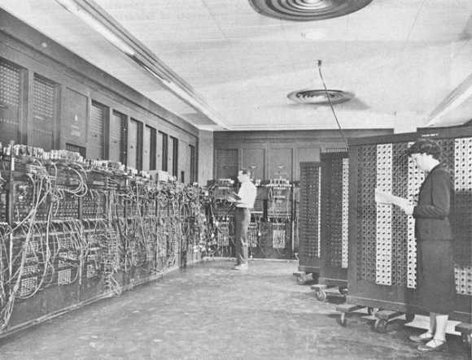
The Dream Becomes Possible (in the U.S.)
By the late 1940s there was an extensive upper air radiosonde network.
Digital programmable computers became available …the first being the ENIAC
ENIAC

Slide 32
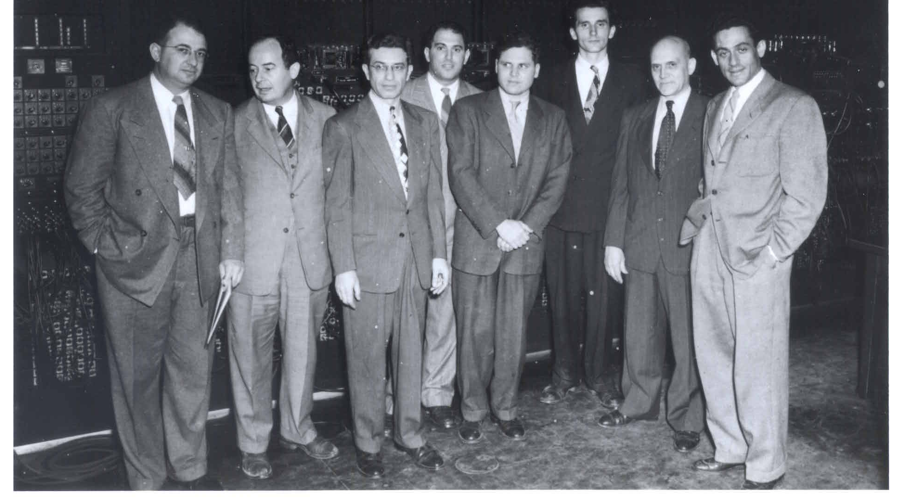
Harry Wexler, John von Neumann, M. H. Frankel, Jerome Namias, John Freeman, Ragnar Fjörtoft, Francis Reichelderfer and Jule Charney
In 1948, John von Neumann, the developer of the ENIAC, assembled a group of meteorologists at the Institute of Advanced Study in Princeton to attempt the first NWP. Headed by Jule Charney.

Slide 33
The First Successful Numerical Weather Prediction
Took place in April 1950, using the ENIAC
The prediction was for 500-hPA height over North America, using a two-dimensional grid with 270 points about 700 km apart.
One-level barotropic model.
The NWP era had begun.

Slide 34
First Numerical Weather Forecast

Slide 35
The Exciting Early Days of U.S. NWP:
Global Leadership and Close Cooperation

Slide 36
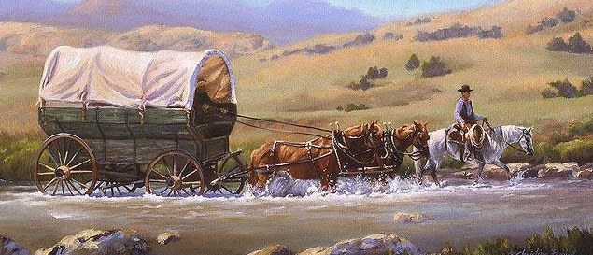
First Decades
U.S. operational NWP was dominated by the pioneers:
  Shuman, Cressman, Charney, Phillips, and others
  Creative, innovative individuals, often with close academic ties
National NWP was the only act in town (limited access to computer resources), so folks were compelled to work together.
Government agencies worked closely together

Slide 37
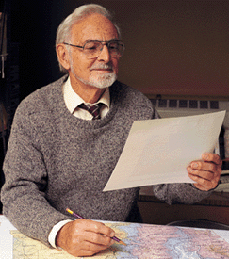
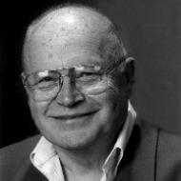
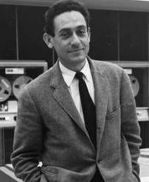
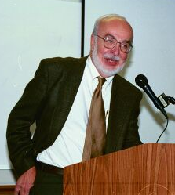
A Characteristic of the Early Decades: Close Relationship Between Gov. Agencies/Academia
Richard Reed
Norm Phillips, MIT
Bill Bonner
Jule Charney

Slide 38

And then a major competitor appears
Created in 1975 to pool European resources to produce medium range and seasonal forecasts
1979: Start of operational global prediction
Aggressive approach, entraining the best talent and advice from around the world, including the U.S.

Slide 39
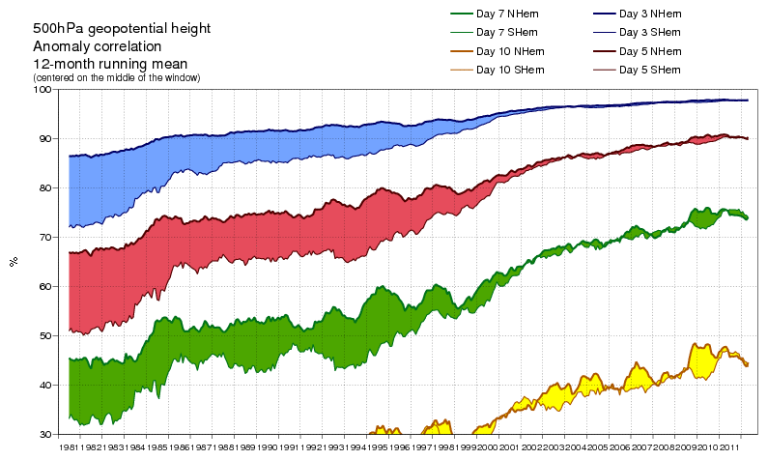
ECMWF: Strategic, Cooperative, Innovative
Able to secure state-of-the-art computers.
In 1997 moved to a more advanced data assimilation approach, 4DVAR

Slide 40
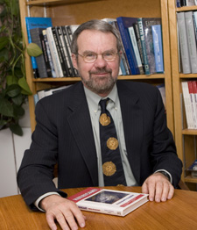
In the 1980s and early 1990s, a change of culture occurred in U.S. NWP
Computer resources became available to the academic community and model development spread outside of the NWS.
1980s: Rick Anthes and NCAR developed the MM4 mesoscale model, starting with Anthes’ hurricane model
1992: MM5: nonhydrostatic, multi-nested, FDDA, improved physics and numerics

Slide 41
A Huge Modeling Community Develops Outside of Government
A large MM5 community grew, including thousands of users around the world.
Tutorials, workshops, help desks, and more
Operational NWP developed outside NWS
The NWS did not adopt MM5. A mistake.

Slide 42

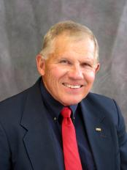
Spread of NWP: RAMS Model
RAMS, the Regional Atmospheric Modeling System, developed by Roger Pielke and Bill Cotton of Colorado State.
Similar to MM5 in many ways, but more limited in distribution.
Favorite of the air quality community

Slide 43

In 1989 NSF Sponsored the Development of ANOTHER Mesoscale Modeling System: ARPS
Directed towards storm-scale modeling
Valuable work on data assimilation for convective storms.
In general, this model has been supplanted by WRF

Slide 44

The Navy Develops a Redundant Capability
The U.S. Navy began running low-end NWP models in the 1960s (barotropic)
By the 1980s, they developed a model suite that paralleled what was run by the National Weather Service:
  NOGAPS: a global model, like the NWS Spectral. Now NAVGEM.
  NORAPS: an NGM regional model clone.
  By the mid-1990s, COAMPS, a non-hydrostatic model similar to MM5/WRF

Slide 45

Even more
The Air Force Weather Agency began running regional domains operationally (MM5).
Was running WRF under GFS, but moving to the UKMET Unified Model

Slide 46

Bottom Line
U.S. NWP efforts became split over many modeling systems and efforts:
  National Weather Service
  Navy
  Air Force
  NCAR/Penn State
  Oklahoma
  Colorado State
  And others: e.g., Wisconsin, Drexel, …
U.S. research and operational communities were not sufficiently engaged with each other

Slide 47

The US NWP Became an Uncoordinated Giant
Slow in progress
Inefficient with resources
USA

Slide 48

National Weather Service NWP Becomes More Bureaucratic and Isolated
By the mid-1980s most of the pioneers of NWP had left leadership roles in NWS.
The National Weather Service NWP bureaucracy grew large and inward looking
The university community, with its own capabilities, increasingly disengaged from NWS NWP model development.
NWS
Universities

Slide 49
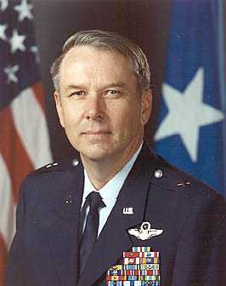
National Weather Service Turned to Military Leadership: Allowed the Ship to Drift
General Jack Kelley 1998-2004
General David Johnson 2004-2007
Colonel Jack Hayes 2007-2012
General David Johnson
NOT a meteorologist

Slide 50
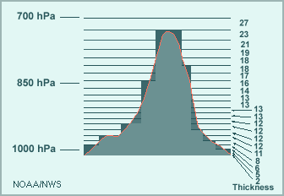
The Landmark Decision in 1993: Which Regional Model for the U.S.
ETA or MM5?
A replacement for the hydrostatic NGM was needed.
Instead of picking the popular MM5, the NWS acquired an experimental model brought to the U.S by some Yugoslavian émigrés…the Eta model

Slide 51
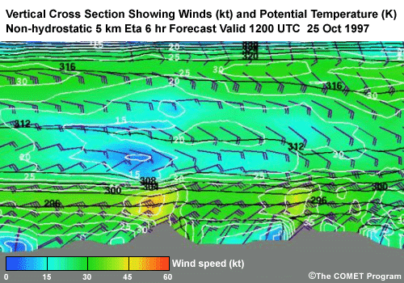
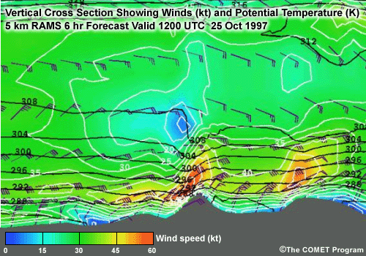
Eta: A Disaster for U.S. NWP
Problematic vertical coordinate system
Eta was unable to do mountain waves
Required excessive vertical resolution
Rejected by the academic community.

Slide 52
A Second Chance Lost:
NMM Versus WRF
By 2000, it was clear that the Eta model was inadequate and needed to be replaced.
NCAR had developed a replacement for MM5 called WRF.
After substantial talks with NCAR about WRF, the National Weather Service rejected WRF in favor of a cleaned up version of Eta (changed vertical coordinate system): NMM.

Slide 53
NMM Becomes the NWS Mesoscale Modeling System
Physics lagged WRF.
Far more diffusive than WRF
Academic community avoided it.
In a desperate move, NCEP rebranded NMM as WRF-NMM

Slide 54


Slide 55
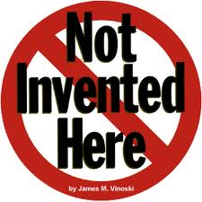
A Key NWS Issue

Slide 56
ECMWF Surges Ahead
By the mid-1990s ECMWF pulled even with NCEP.
With more computer resources, ECMWF moved to superior data assimilation (4DVAR), higher resolution, better model physics, assimilating more observation types, and better quality control.
Their forecasts became increasingly superior.

Slide 57

NCEP Loses Key Users
Many U.S. private sector firms abandoned NCEP’s global model (GFS) for ECMWF
$ 100-200K a year charge by ECMWF
In 2015, the US Air Force announces it is abandoning GFS for UKMET office model.

Slide 58
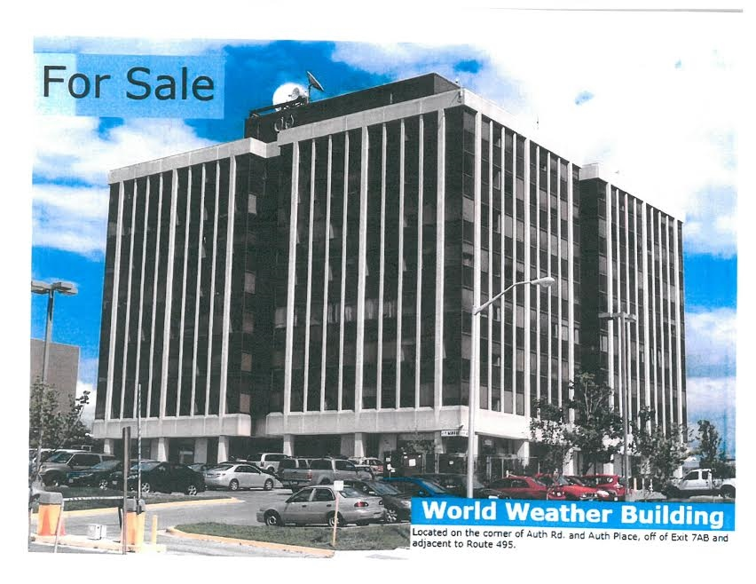
National Weather Service NWP Infrastructure Problems
The World Weather Building (home until 2014)
Decaying, cramped, no large meeting rooms
Mold/Fungus in vents
Unhealthy environment.

Slide 59
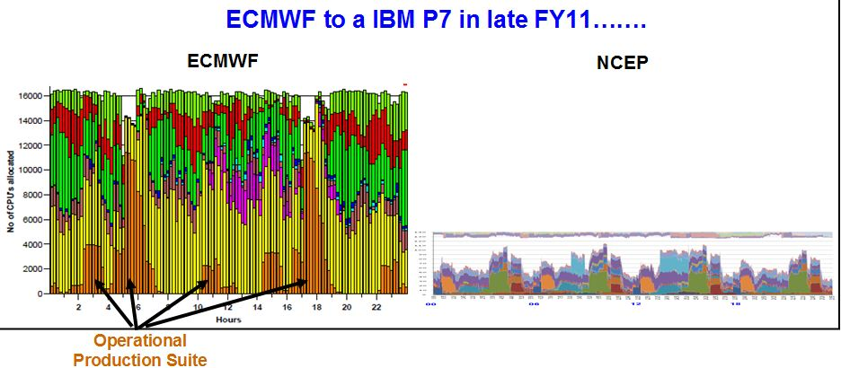
Inadequate Computing
Until recently NCEP had roughly 10% of the computer power of ECMWF for doing far more

Slide 60

NOAA and the NWS Have Major Structural Problems

Slide 61
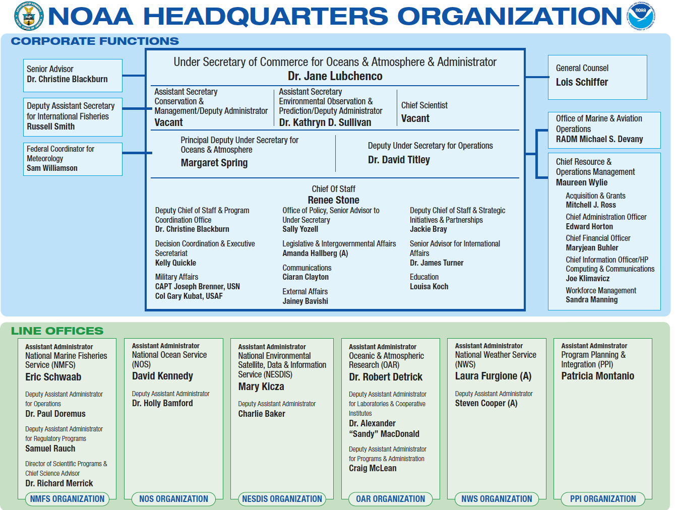
Research and Operations for NWP Separated in NOAA
NWP Research
Operational NWP

Slide 62
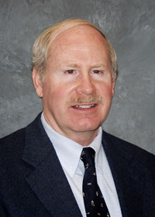
Research and Development of NWS NWP Models Done Outside NWS in NOAA Labs (ESRL, GFDL)
Individuals responsible for operation NWP (NCEP EMC) do not control the individuals developing the models.
This has led to major problems and inefficiencies.
Sandy McDonald
Past Head of ESRL

Slide 63

ESRL Developed Two Global Models That Will Never Be Used: FIM And NIM
NIM
FIM

Slide 64
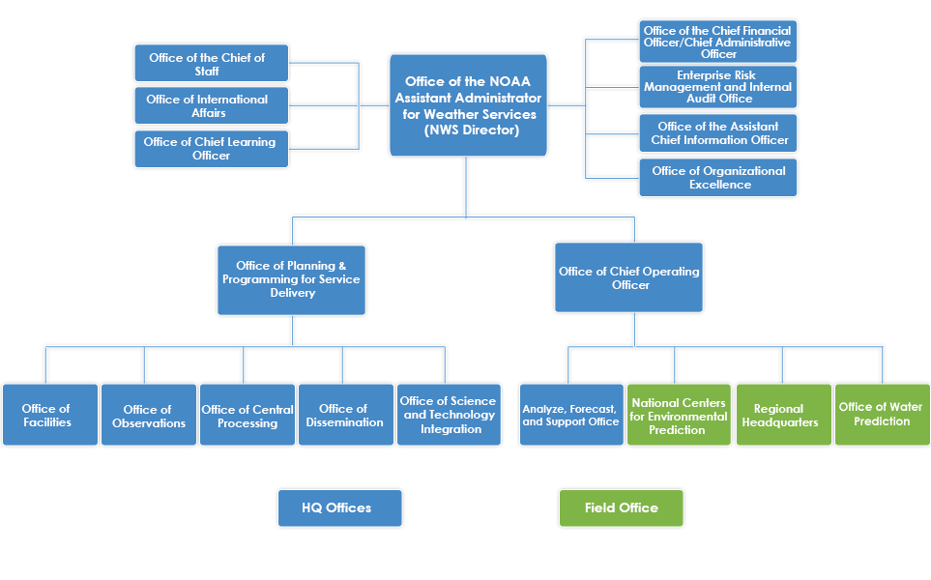
Even Worse than That
Post Processing and Water Prediction Outside of NCEP

Slide 65
And the decisions on model development are made OUTSIDE of NCEP in the Office of Science and Technology Integration

Slide 66
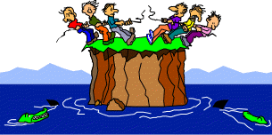
NWS/NOAA NWP Organization
ECMWF
UKMET

Slide 67
NOAA and the U.S. Government Have No Detailed Strategic Plan for U.S. NWP
NWS competitors do! ECMWF, UKMET, CMC, and others.

Slide 68
US Strategic Plan

Slide 69

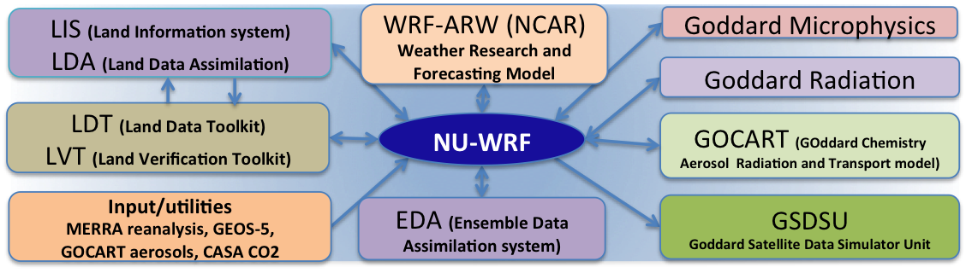
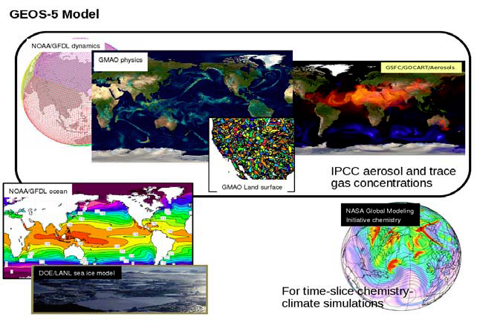
And NASA is Off Doing Its Own Thing
NU-WRF
GEOS-5

Slide 70
No rational observing system design
NOAA needs to determine the optimal collection of observations, including dropping old data sources that are no longer needed.
Rational way: Observing System Simulation Experiments (OSSEs) and Observing System Experiments (OSEs).
NOAA/NWS has done very little of this and billions of dollars of hardware have been purchased without a clear understanding of the impacts of new sensors and satellites.

Slide 71
NCEP Hurricane Modeling is a Mess
After Sandy, roughly 50 million dollars was put into HWRF.
Today, HWRF has less skillful track forecasts than EC
HWRF is being dropped for HMON
HMOM did very poorly for Irma and other storms.

Slide 72
Recent Positive Developments
New Building for US NWP and NCEP, College Park

Slide 73
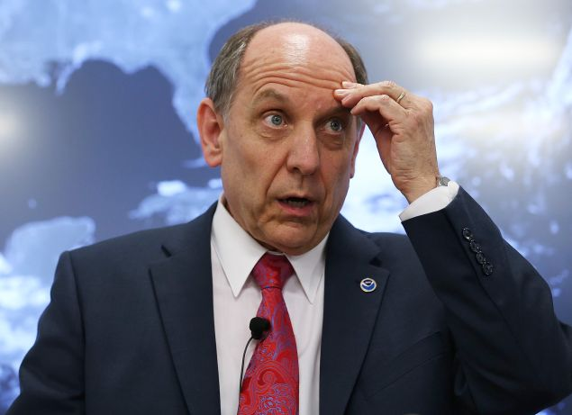
More Funds for Extramural Research
Dr. Louis Uccellini, Director, NWS
Pushed for the new building and more research funding

Slide 74
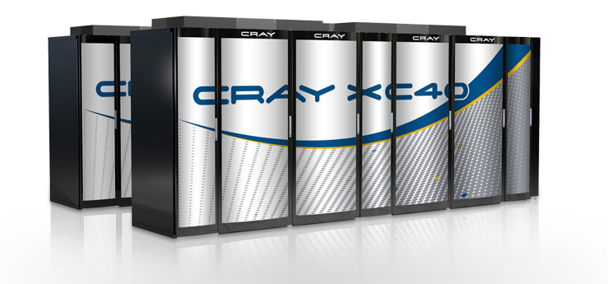
After Sandy, Congress Provided Money for a Major Computer Upgrade
Two CRAY XC-40s. Each about 2 petaflops. US and ECMWF nearly equal.

Slide 75
The Dated Global Forecasting System (GFS) Model is Being Replaced….finally

Slide 76
Next Generation Global Prediction System (NGGPS): FV-3 selected

Slide 77
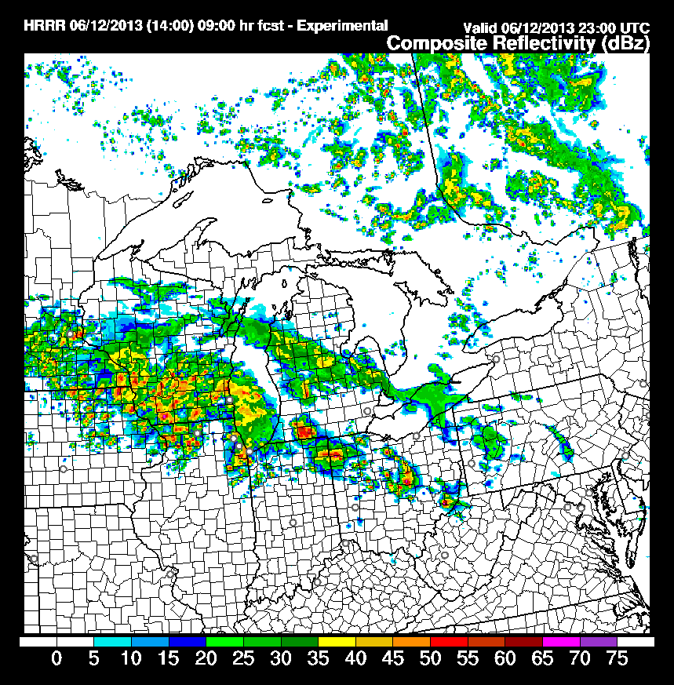
The High Resolution Rapid Refresh (HRRR, 3-km): A Major Advance

Slide 78
Creation of New NCEP Advisory Groups, such as UMAC

Slide 79
Weather Research and Forecasting Innovation Act of 2017
Bipartisan Support for Better Weather Prediction

Slide 80
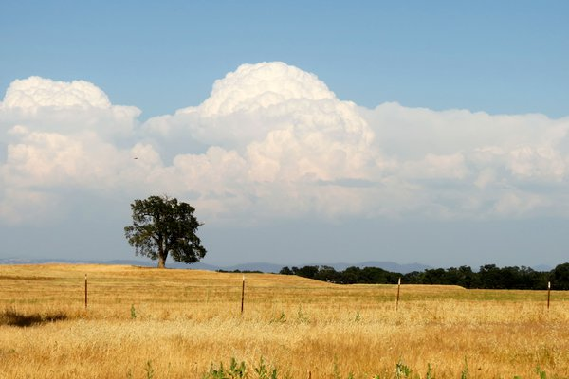
Some New Clouds on the Horizon

Slide 81


A Major New Player in Global Prediction: the Private Sector
The private sector has been running high-resolution regional models for a long time.
Today, some firms are running or planning to run operational global models with full data assimilation.

Slide 82
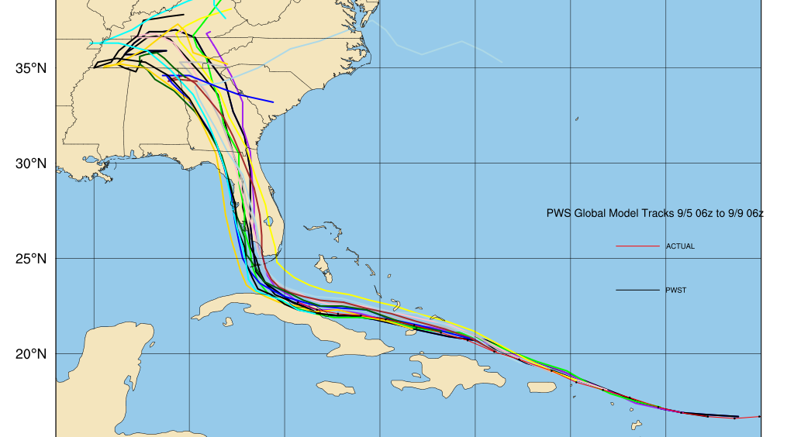
Panasonic Version of GFS Beat NCEP

Slide 83


New Non-Traditional NOAA Leadership
Barry Myers, Accuweather
Neal Jacobs, Panasonic

Slide 84

FV-3 Development is Slow, Without Establishing the Infrastructure for a Community Modeling System

Slide 85

How to fix U.S. NWP

Slide 86

NOAA Needs A Complete Organizational Restructuring of U.S. NWP Operations and Research
Need one entity responsible for NWP research and operations.
Boulder, Colorado would be an excellent location

Slide 87

Unified and Community Modeling
NOAA should have one modeling platform for all scales.
NOAA is running too many redundant modeling systems. Must be simplified.
The U.S. model must be a community model that is available to the research and private sector communities

Slide 88
Physics Research and Development Requires More Emphasis
Organize and FUND the research community to concentrate on key problems (e.g., PHYSICS, e.g., stable boundary layer, convection)
National coordination of research and development across agencies.

Slide 89

Shocking revelation—our modeling systems are not progressively improving
We add more physics options and complexity but the results are not necessarily improving.

Slide 90
NCEP Should Run a Large Convection-Resolving Ensemble over the U.S. (2-4 km)
NCAR is doing this on 5000 cores. NCEP has 140,000 cores

Slide 91

NCEP Computer Resources Need to Be at Least 10-100x Larger
State of science global and region modeling for the U.S. requires far more resources than ECMWF.
New CRAY machines and GPU technology can make 50 petaflop machines available now.

Slide 92


$
ONE
THREE
=
F18: 60 million

Slide 93

Extended Range Forecasting
Currently, the NWS runs the CFS model (low resolution GFS model with coupled ocean) out to 9 months. 24 runs a day!
Little indication of skill past about 3 weeks.
Stop doing something that doesn’t work and explore convection-allowing resolution over the tropics.

Slide 94
The Problem is NOT Money

Slide 95
Optimistic
Today there is reason to be optimistic about the future of US NWP.
But major cultural/structural change is necessary both inside and outside of the NOAA.
Consolidation and more national organization is need.

Slide 96

ECMWF is not the ceiling of what is possible: the large U.S. weather community can do better

Slide 97
The End

