Slide 1
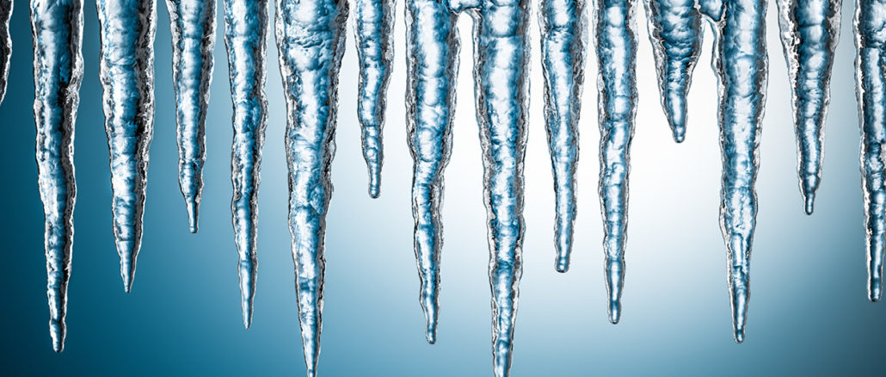
Super Cold Waves and NOAH-MP
Cliff Mass and David Ovens
University of Washington
WRF Workshop June 2019

Slide 2
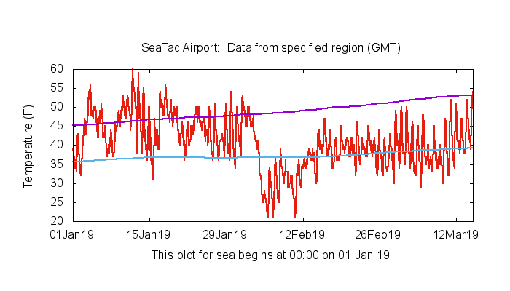
During February 2010, the Pacific Northwest Was Hit by an Unusual Cold Spell

Slide 3
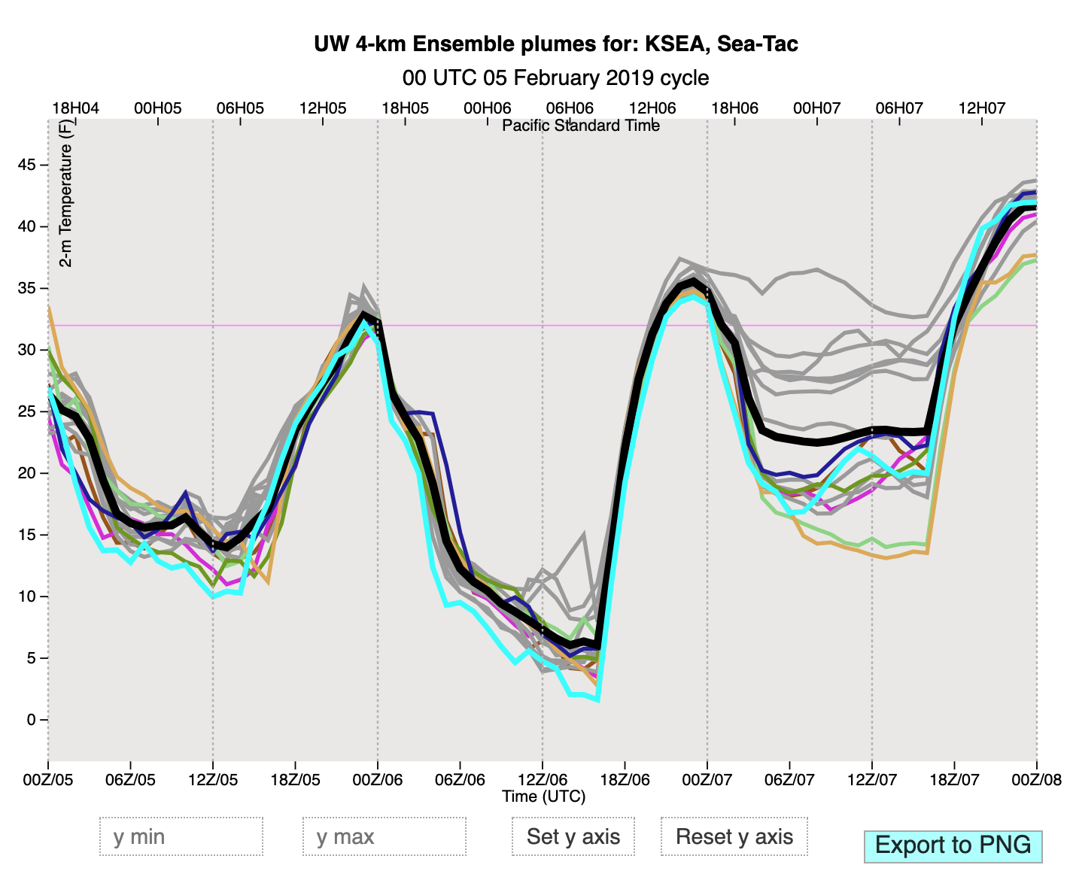
But the UW WRF Running WRF 3.7.1 and Using NOAH-MP Was Doing Something Else
Minimum Temperatures Forecast by WRF on
February 6th were around 5 F.

Slide 4
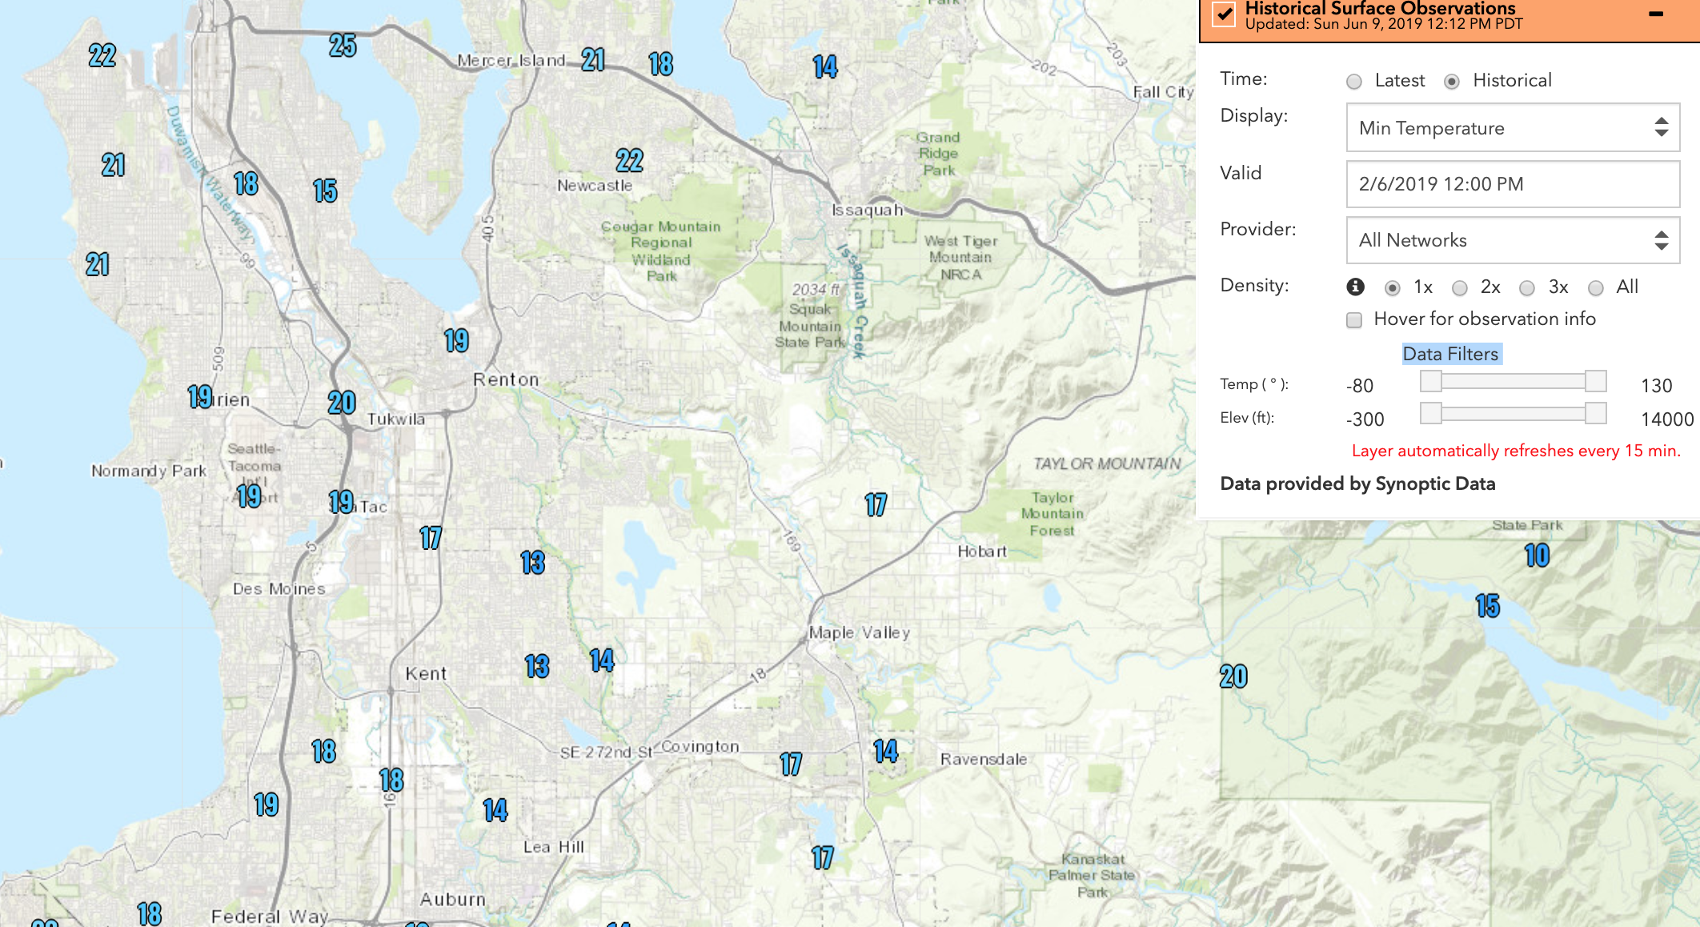
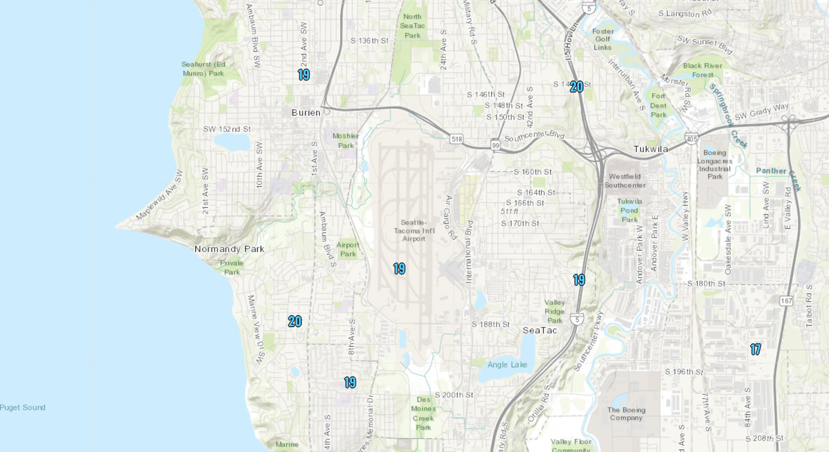

Slide 6
Noah MP Nighttime Cold Bias over Snow
David Ovens
Department of Atmospheric Sciences
University of Washington

Slide 7
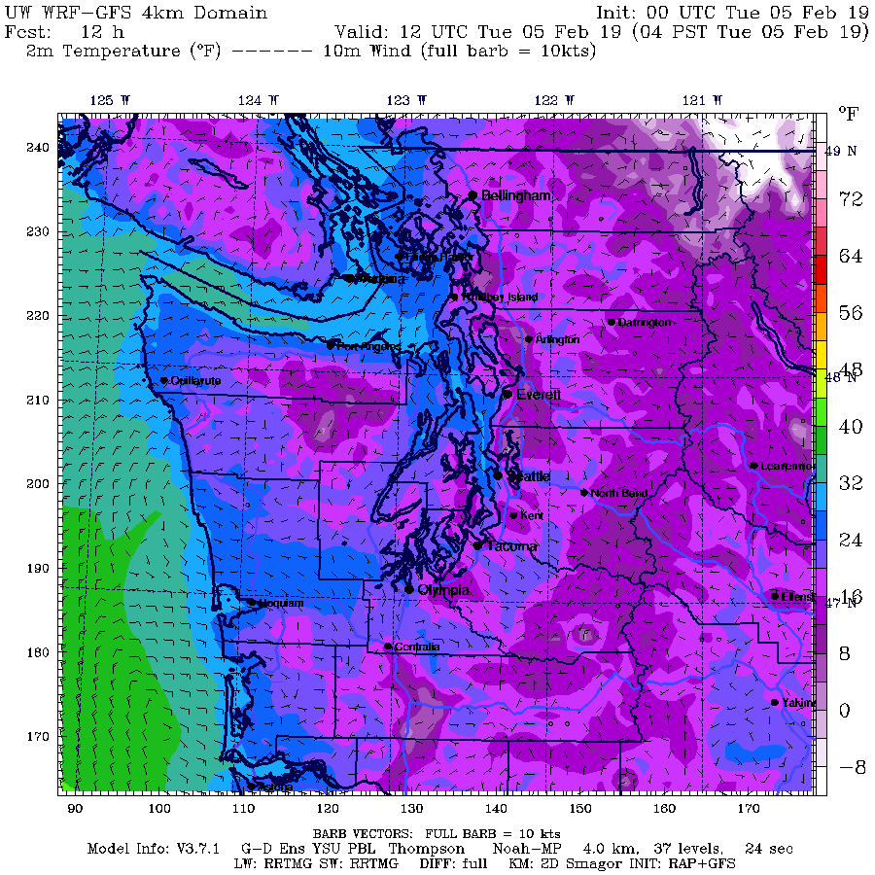
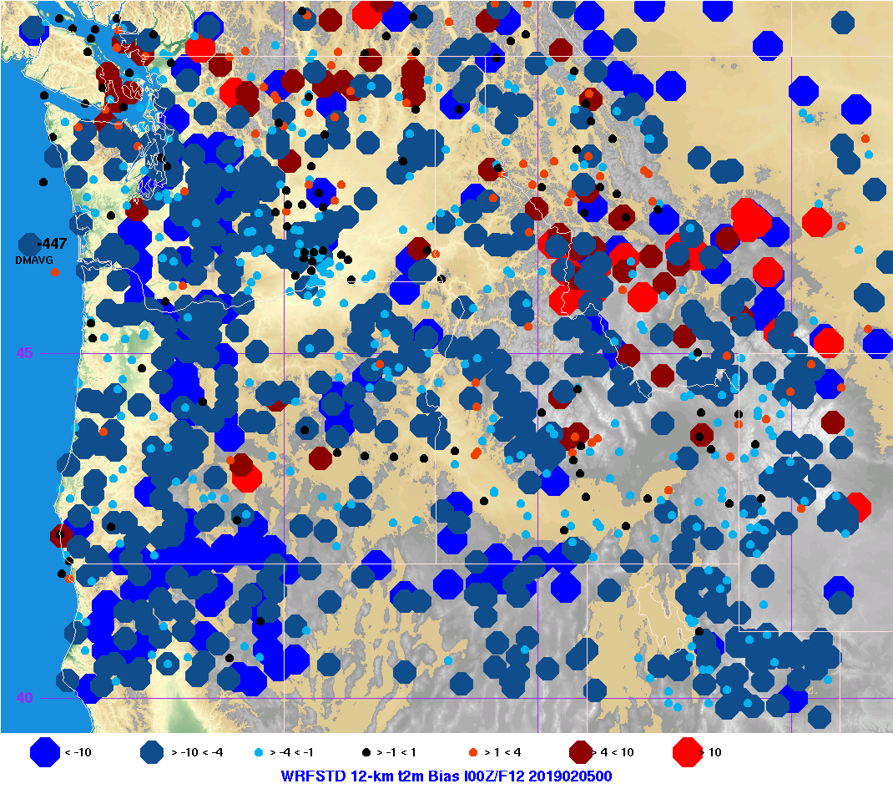
Noah MP Nighttime Cold Bias over Snow
WRF 2-m Temperature Forecasts over Snow are Unrealistically Cold
12Z Feb 5, 2019 forecast over Western Washington showed cold biases around Seattle of more than 4ºF.
For all sites within the 4-km domain, the mean error was -4.97ºF.

Slide 8
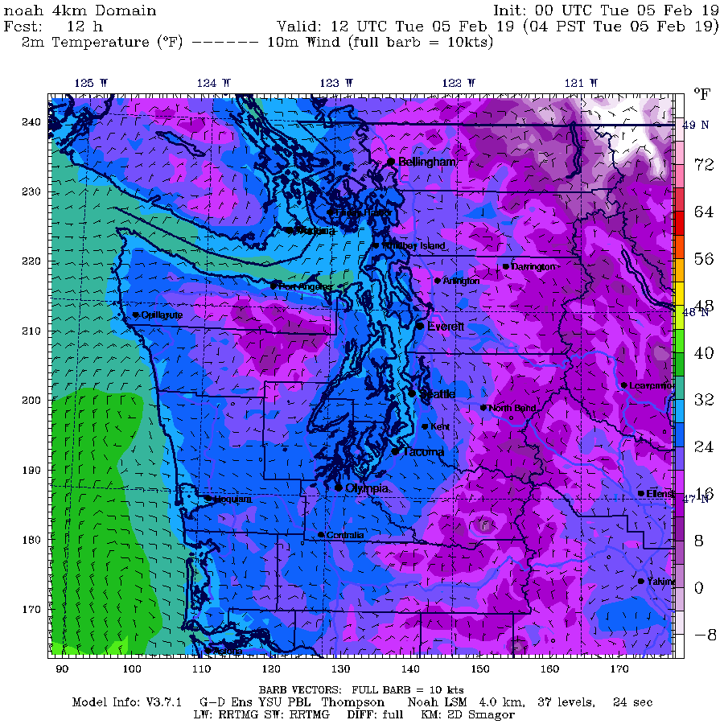
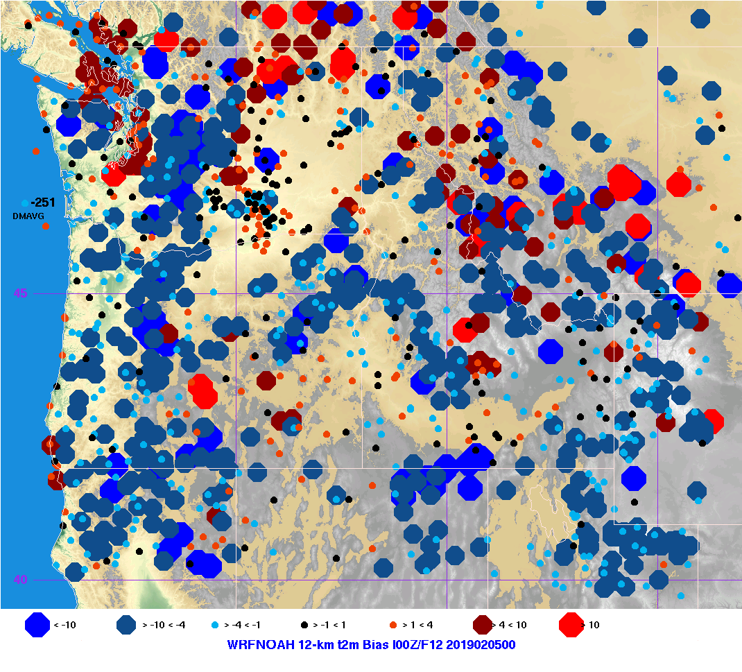
Noah MP Nighttime Cold Bias over Snow
Using other LSMs improves the forecast.
Using Noah LSM show mixed warm and cold biases near Seattle.
Overall 4-km domain 2-m temperature bias is -2.51ºF.

Slide 9
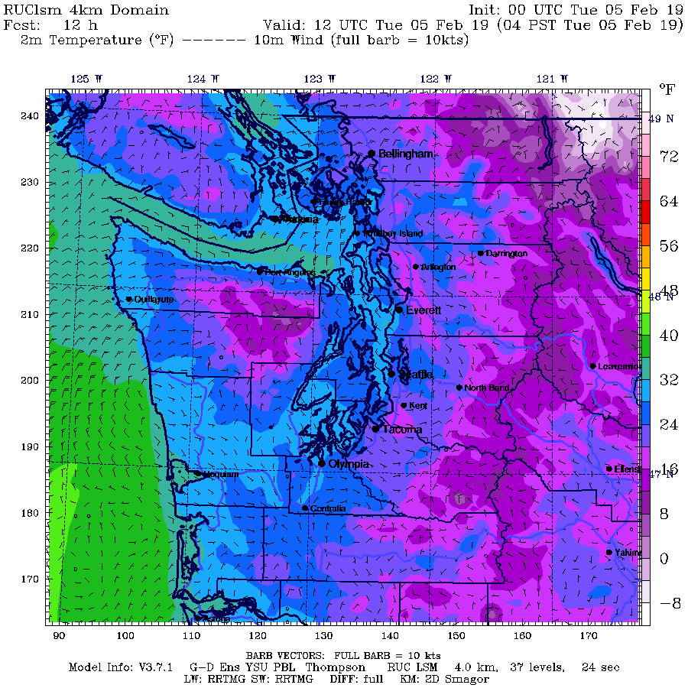
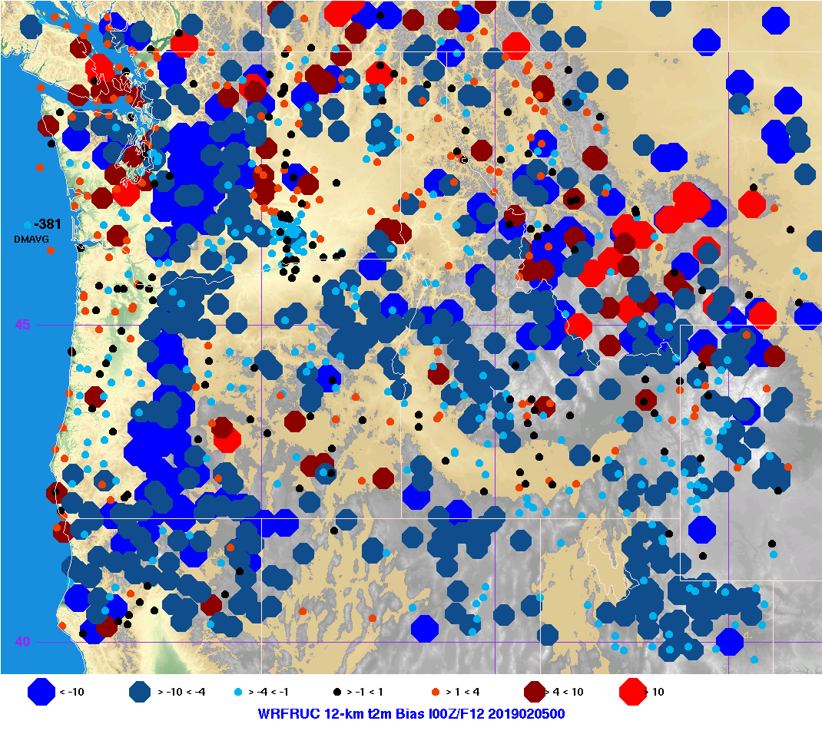
Noah MP Nighttime Cold Bias over Snow
Using other LSMs improves the forecast.
Using RUC LSM showed improved cold biases near Seattle.
Overall 4-km domain 2-m temperature bias is -3.81ºF.

Slide 10
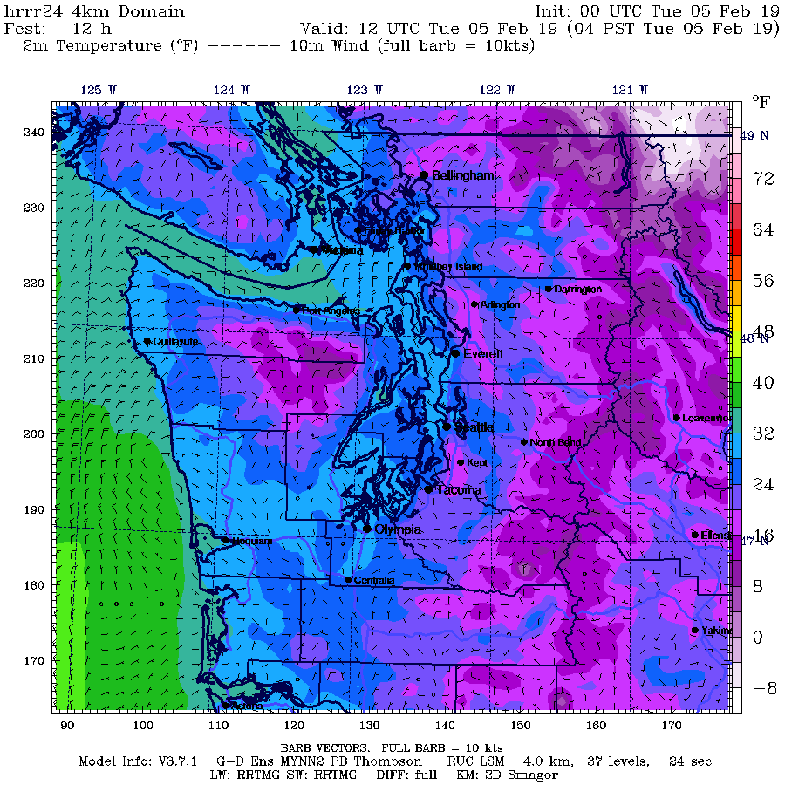
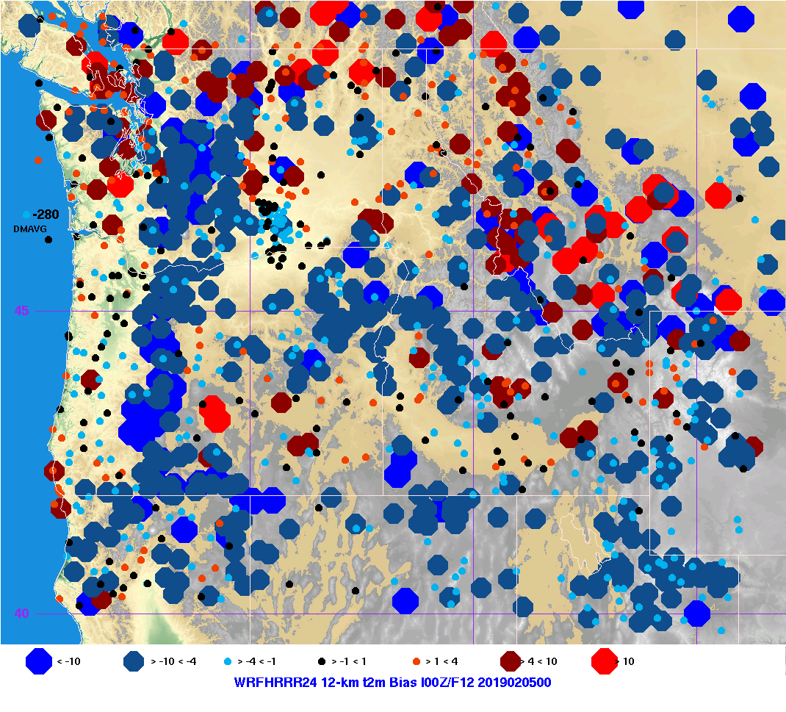
Noah MP Nighttime Cold Bias over Snow
Using other LSMs improves the forecast.
Using HRRR physics with MYNN LSM also showed improved cold biases near Seattle.
Overall 4-km domain 2-m temperature bias is -2.8ºF.

Slide 11
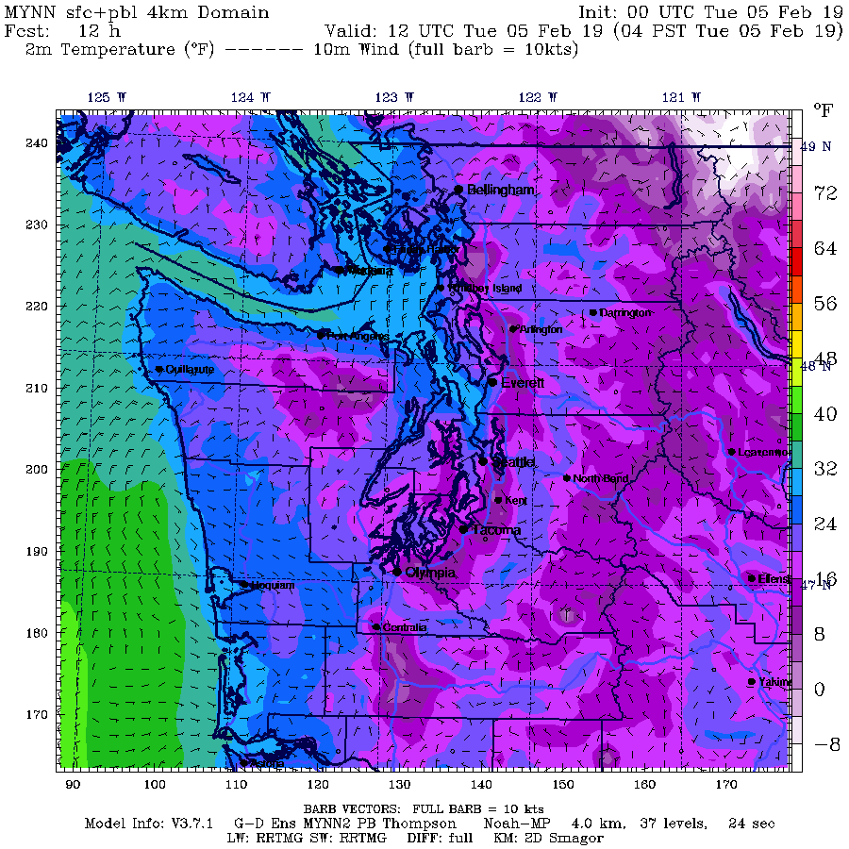
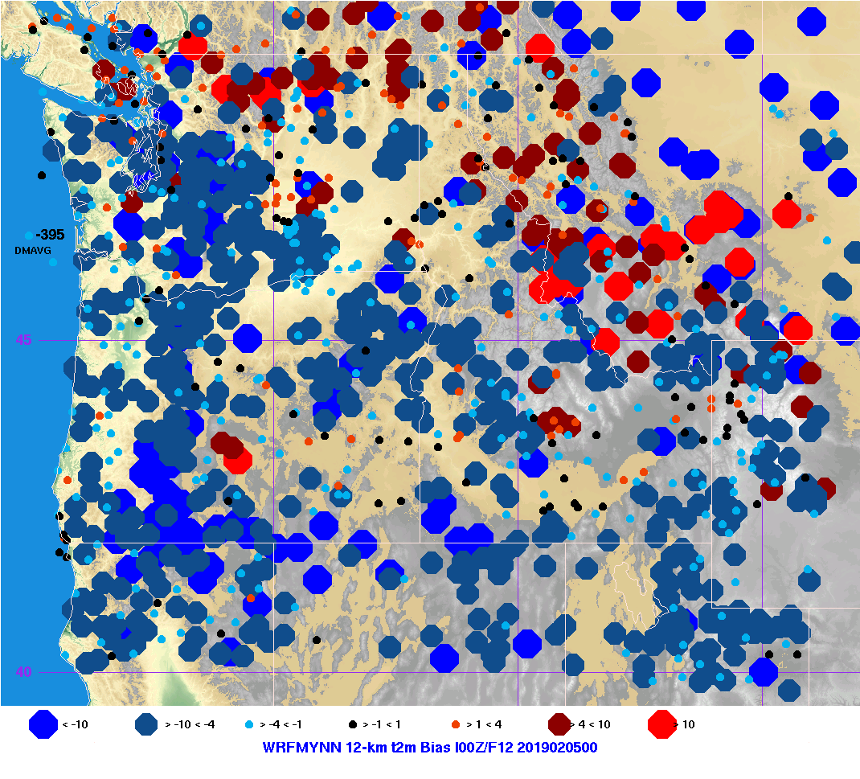
Noah MP Nighttime Cold Bias over Snow
Using other LSMs improves the forecast.
Using MYNN LSM and surface layer also showed modest improvement in cold biases near Seattle.
Overall 4-km domain 2-m temperature bias is -3.95ºF.

Slide 12
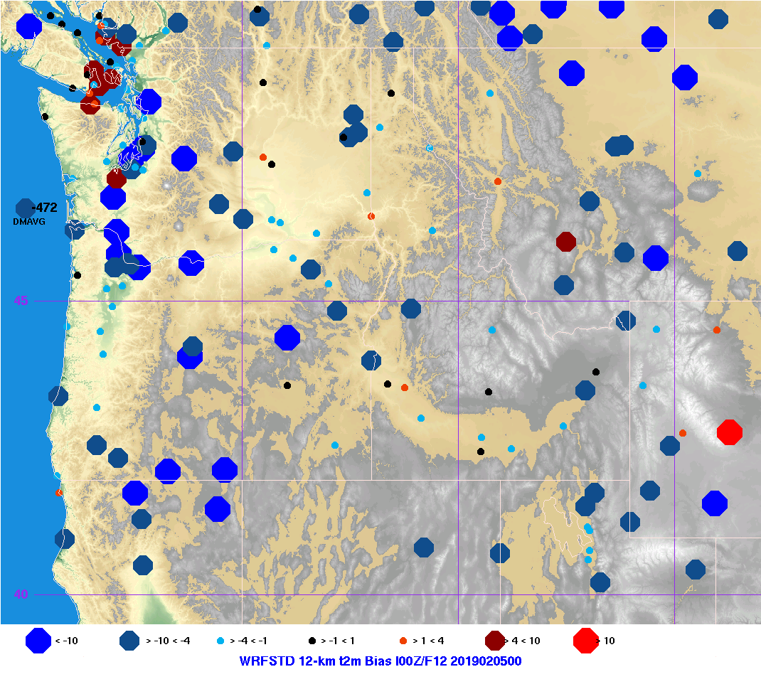
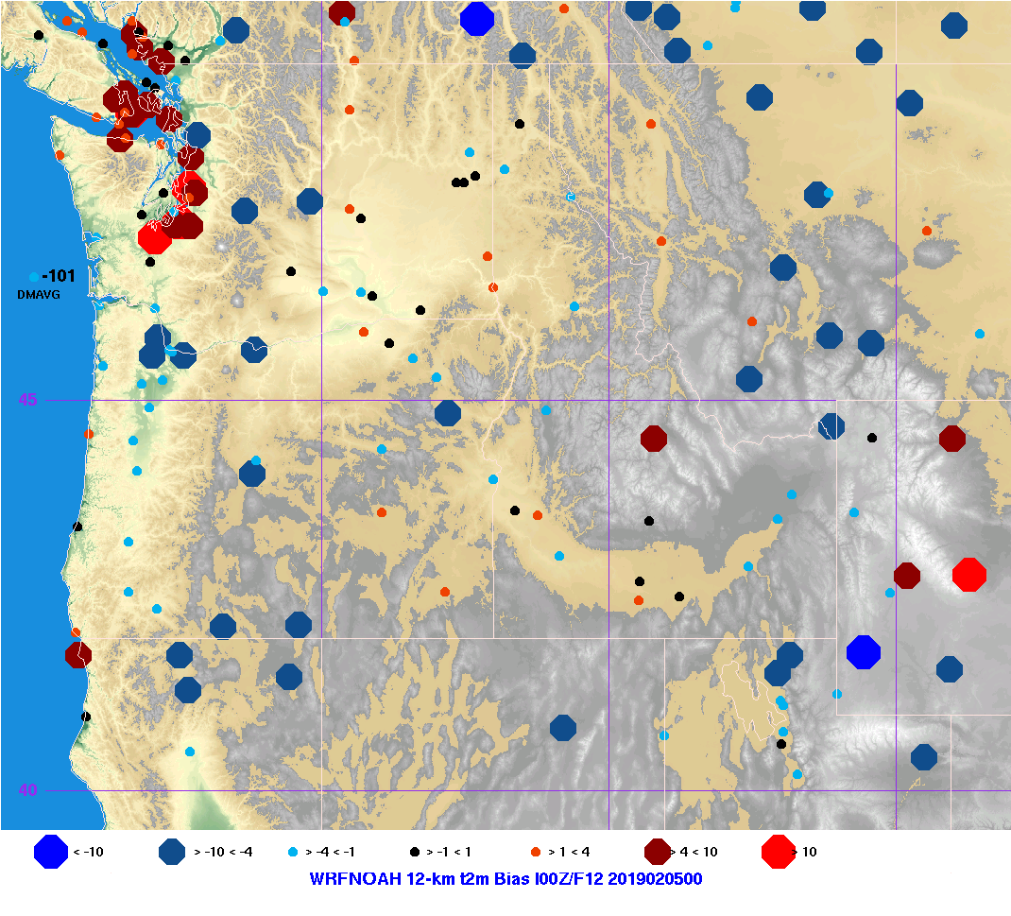
Noah MP Nighttime Cold Bias over Snow
At only METAR (or surface airways, SA) sites, the cold bias for Noah-MP over the domain and particularly Western Washington is apparent.
The 4-km domain averaged 2-m temperature bias is -4.72ºF for Noah-MP (left) and -1.01ºF for Noah (right).

Slide 13
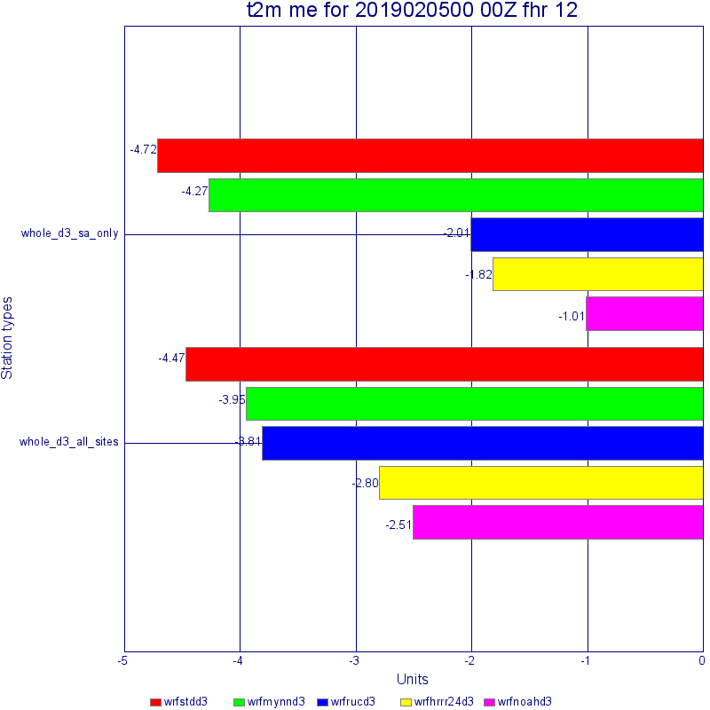
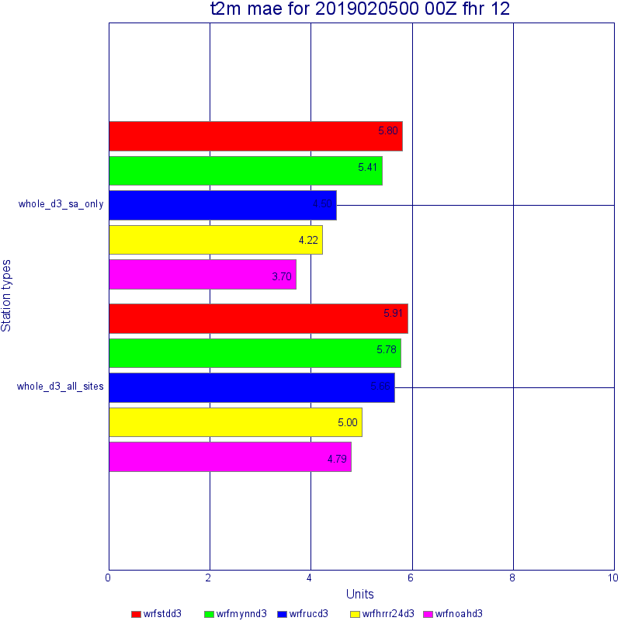
Noah MP Nighttime Cold Bias over Snow
Using other LSMs improves the forecast.
Bar charts show Noah MP (red, wrfstdd3) as the worst in terms of mean error (me) and mean absolute error (mae) while the standard Noah LSM (magenta, wrfnoahd3) as the best.
The top set of bars are for only SA (METAR) stations, while the bottom represent all observation networks in the 4-km domain.

Slide 14
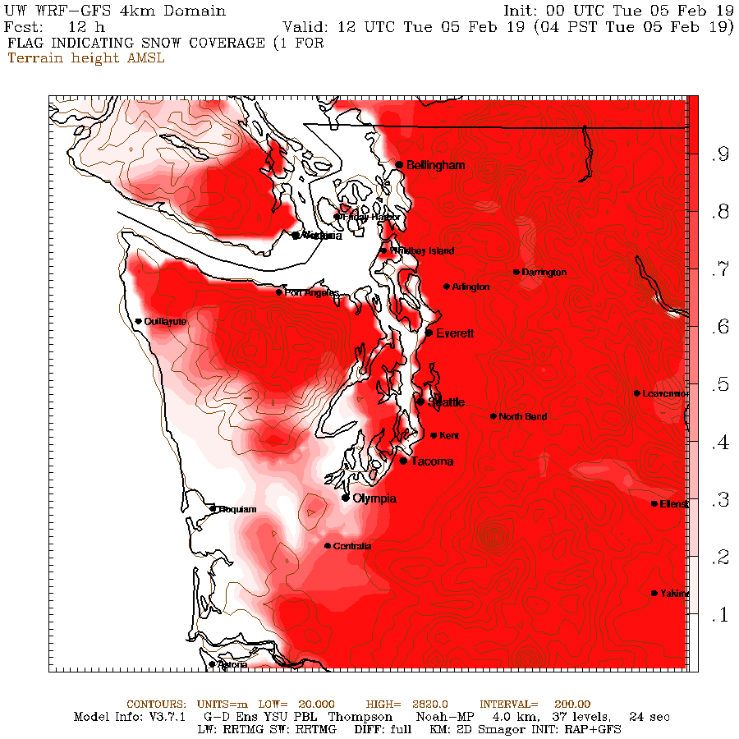
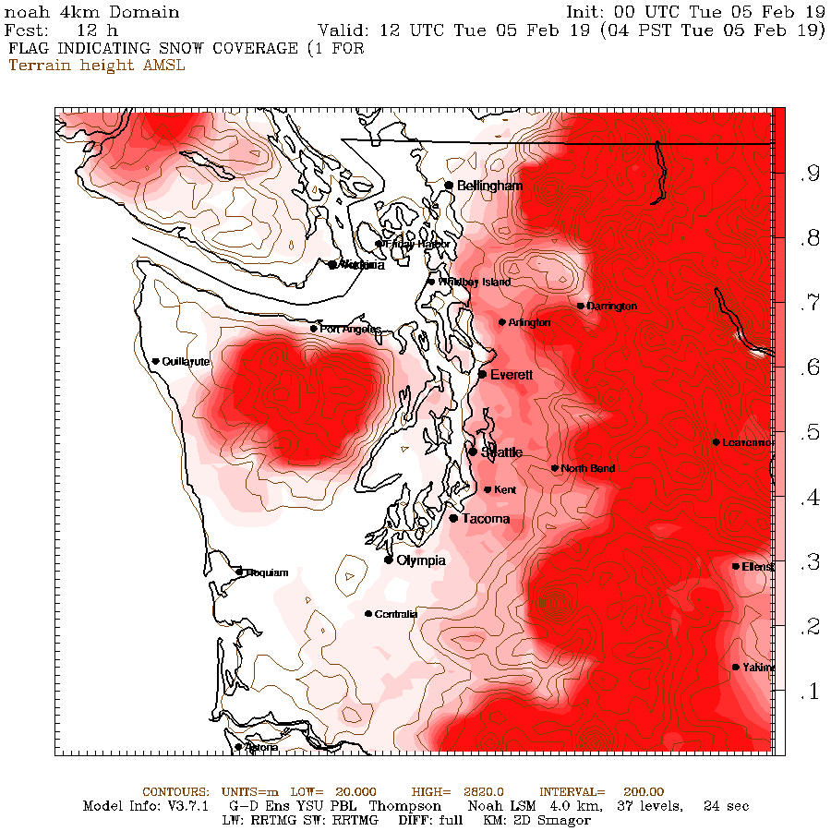
Noah MP Nighttime Cold Bias over Snow
Apparently the SNOWC field (the fractional snow cover) is the relevant field showing the biggest difference between Noah MP and Noah.
These differences appear by the first hour of the simulation, though forecast hour 12 is shown here.
WRF-GFS (left) is the Noah MP simulation, the standard Noah LSM is on the right.

Slide 15
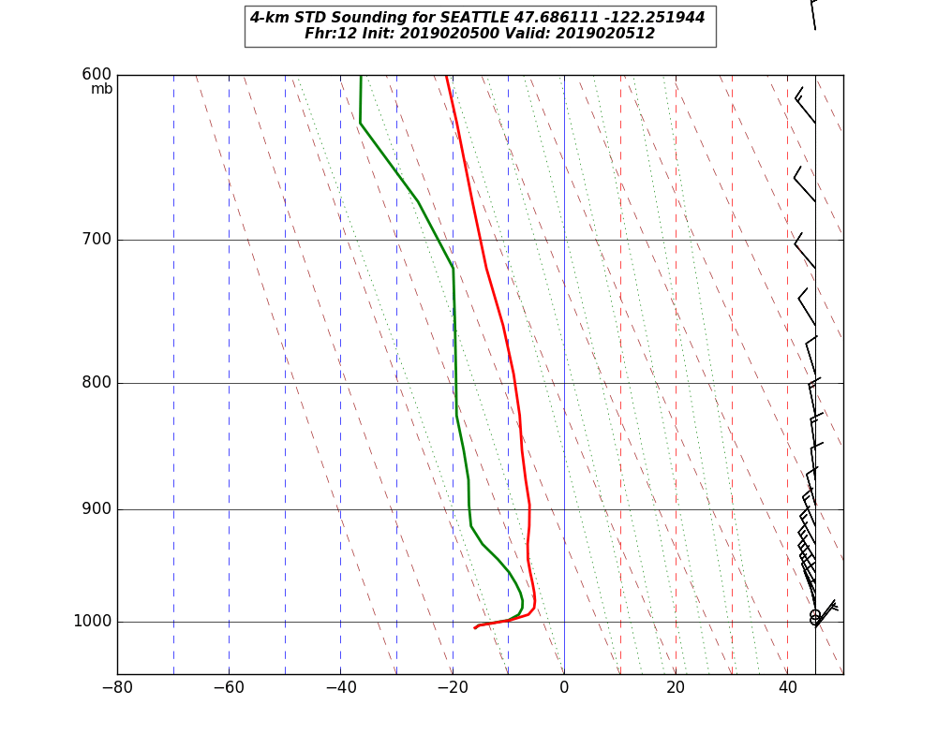
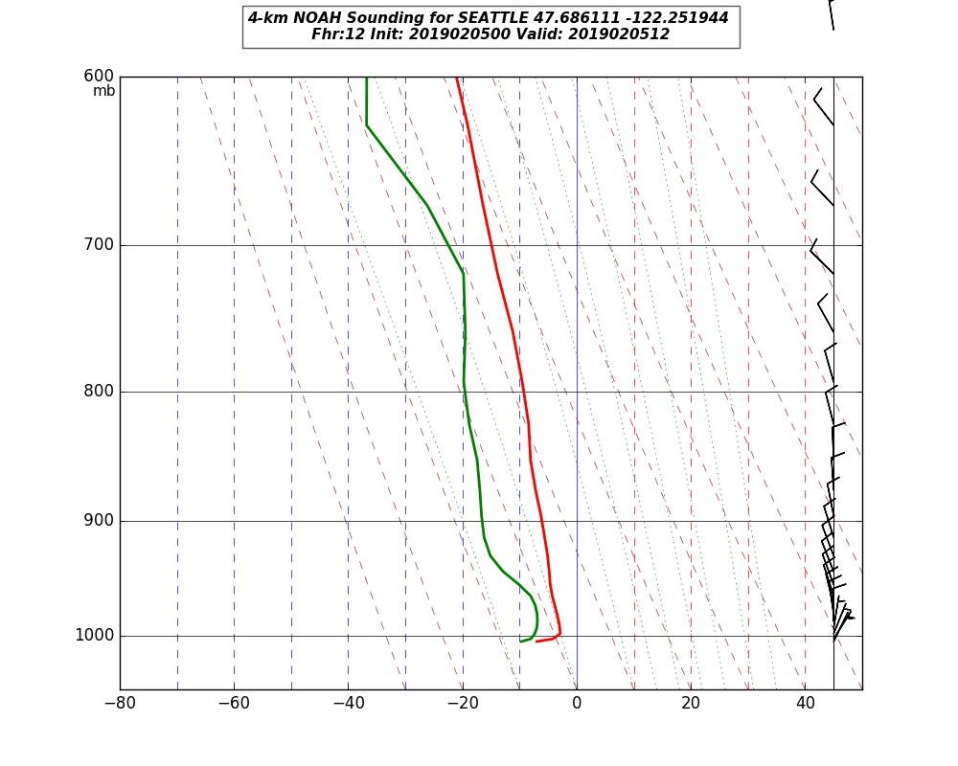
Noah MP Nighttime Cold Bias over Snow
Vertical profiles further illustrate the unrealistic inversion formed in the Noah MP case and the more realistic Noah LSM profile.
The Noah MP (STD) is on the left; Noah LSM is on the right.

Slide 16
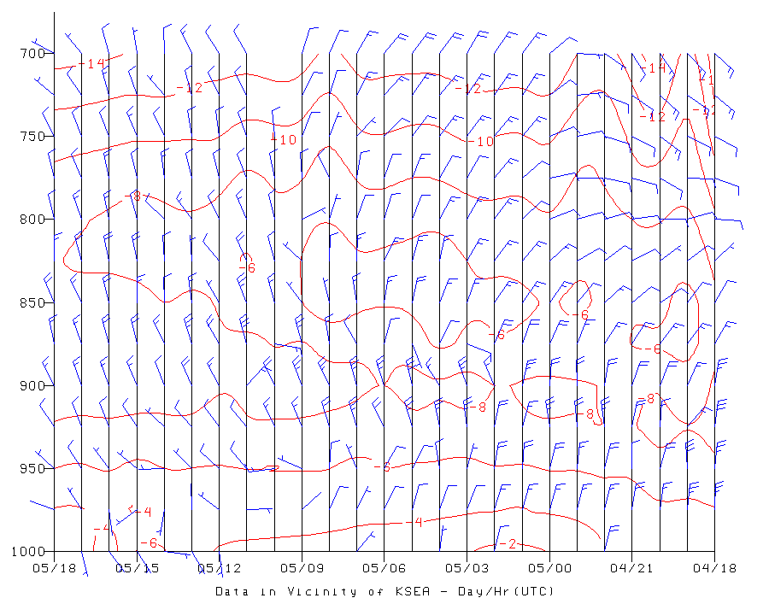
Noah MP Nighttime Cold Bias over Snow
Aircraft reports near Seattle for the morning of Feb 5, 2019 show temperatures more in line with the Noah LSM profile.
Temperatures in the time-height section at left are derived from aircraft reports in the vicinity of Seattle-Tacoma airport for the morning of Feb 5, 2019. Times shown are UTC.

Slide 17
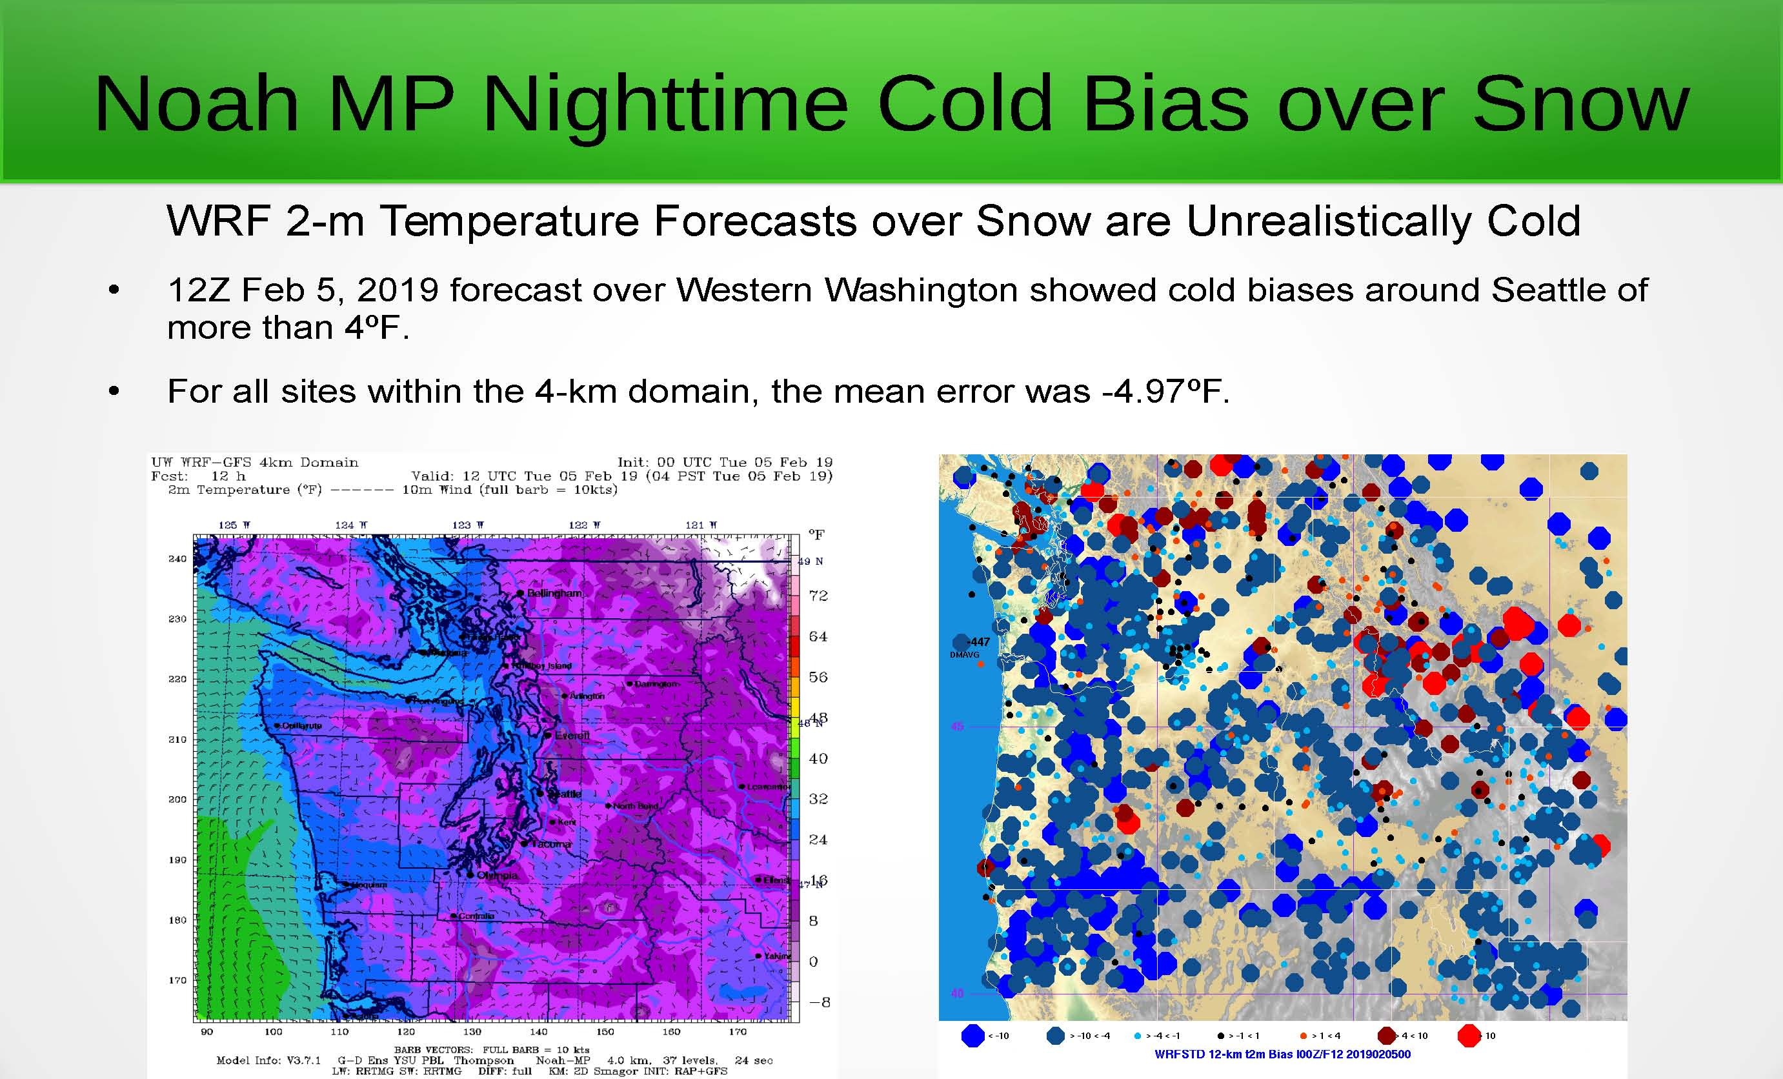

Slide 18
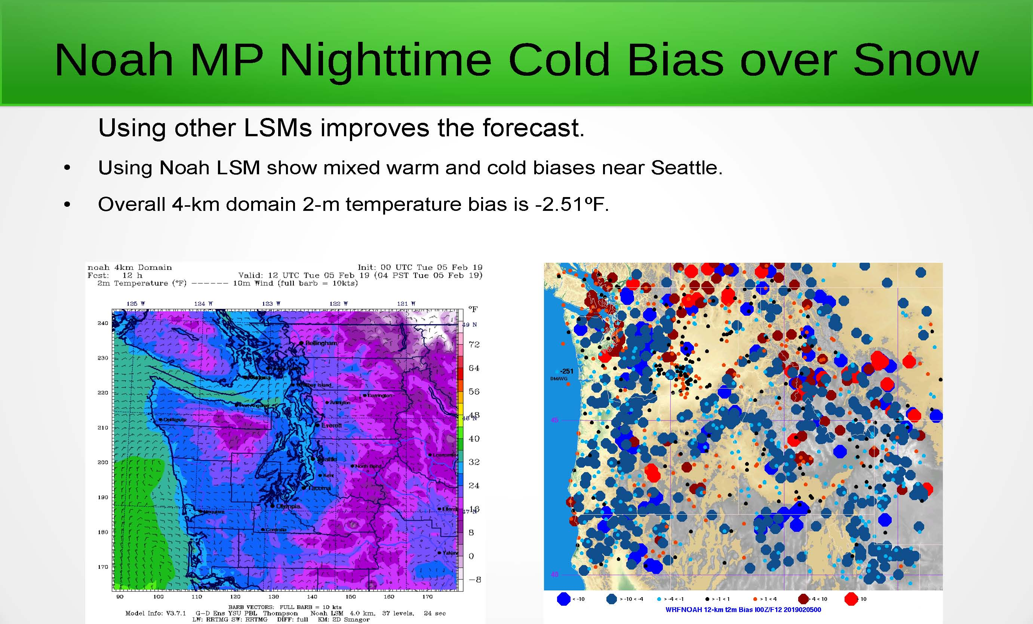

Slide 19
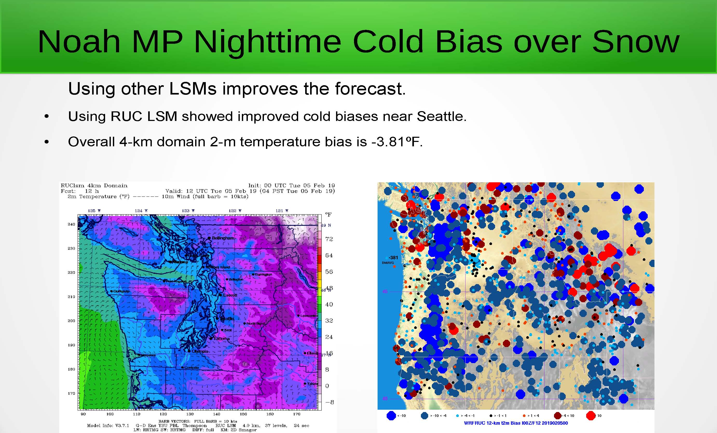

Slide 20


Slide 21
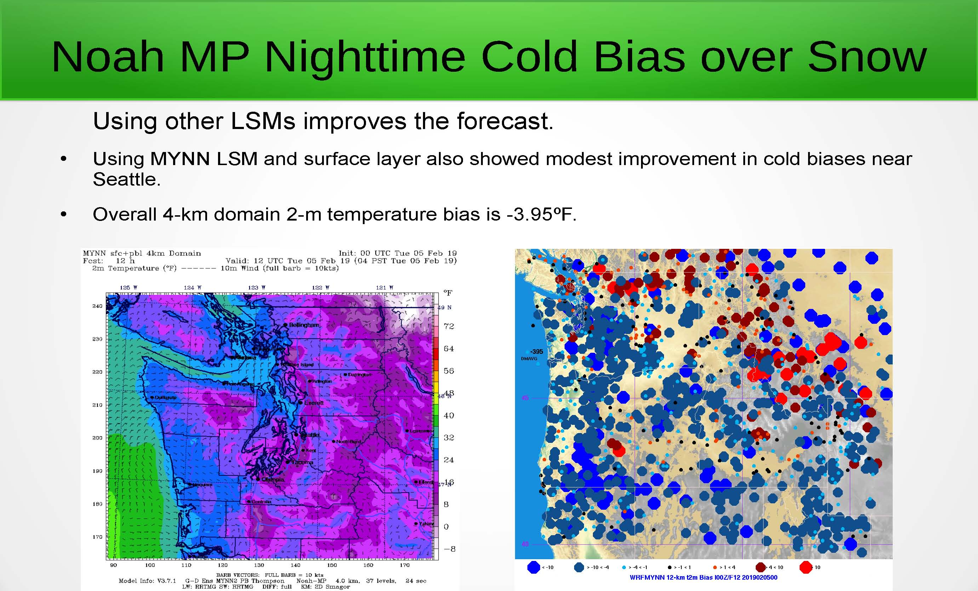

Slide 22
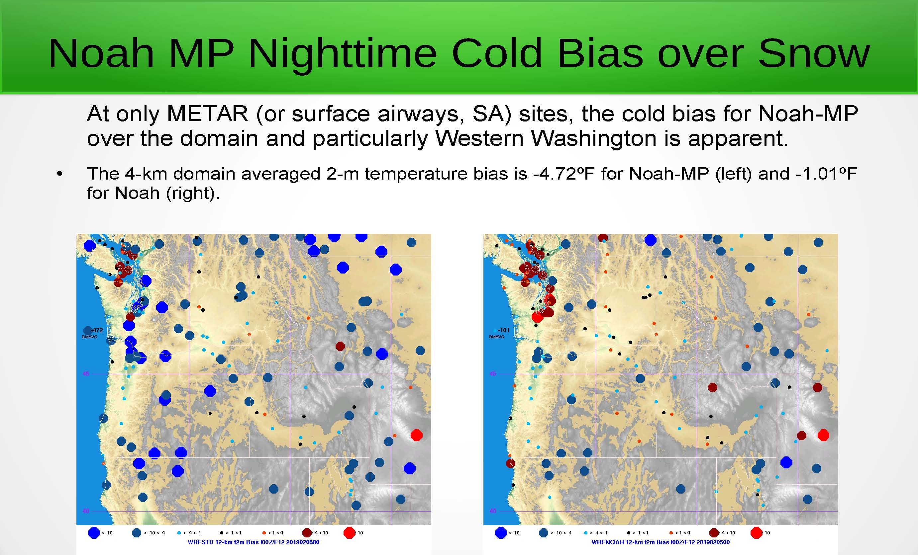

Slide 23
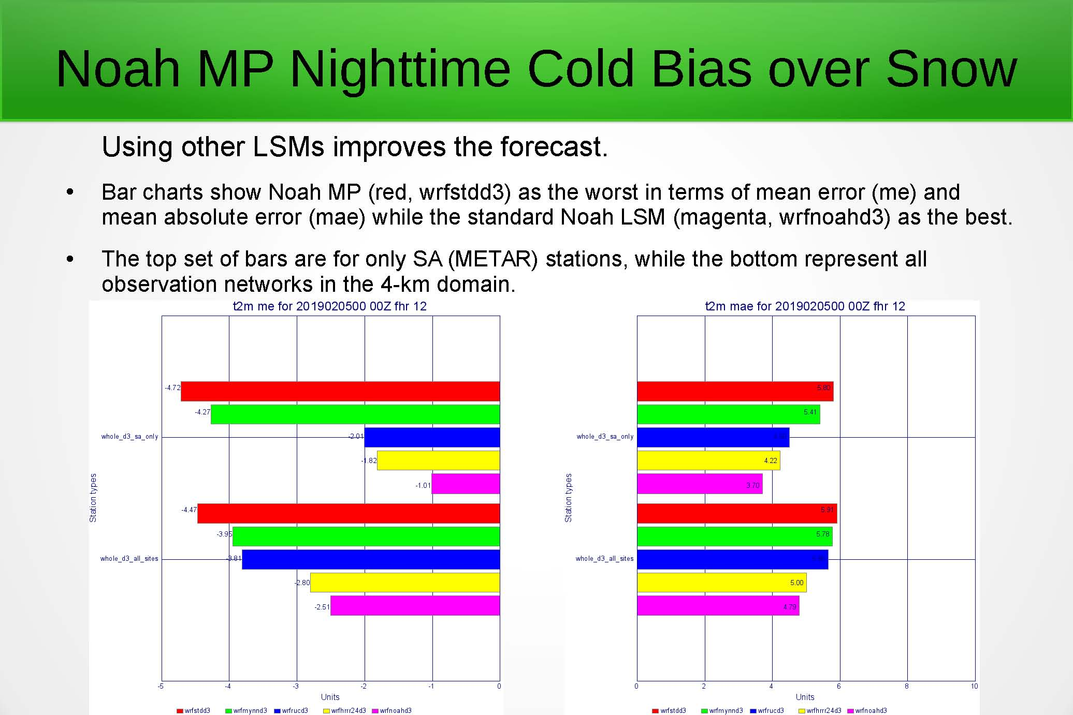

Slide 24
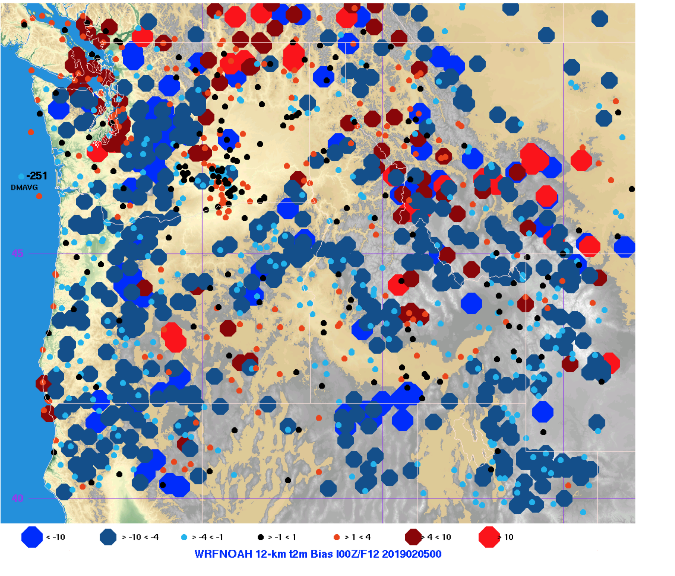
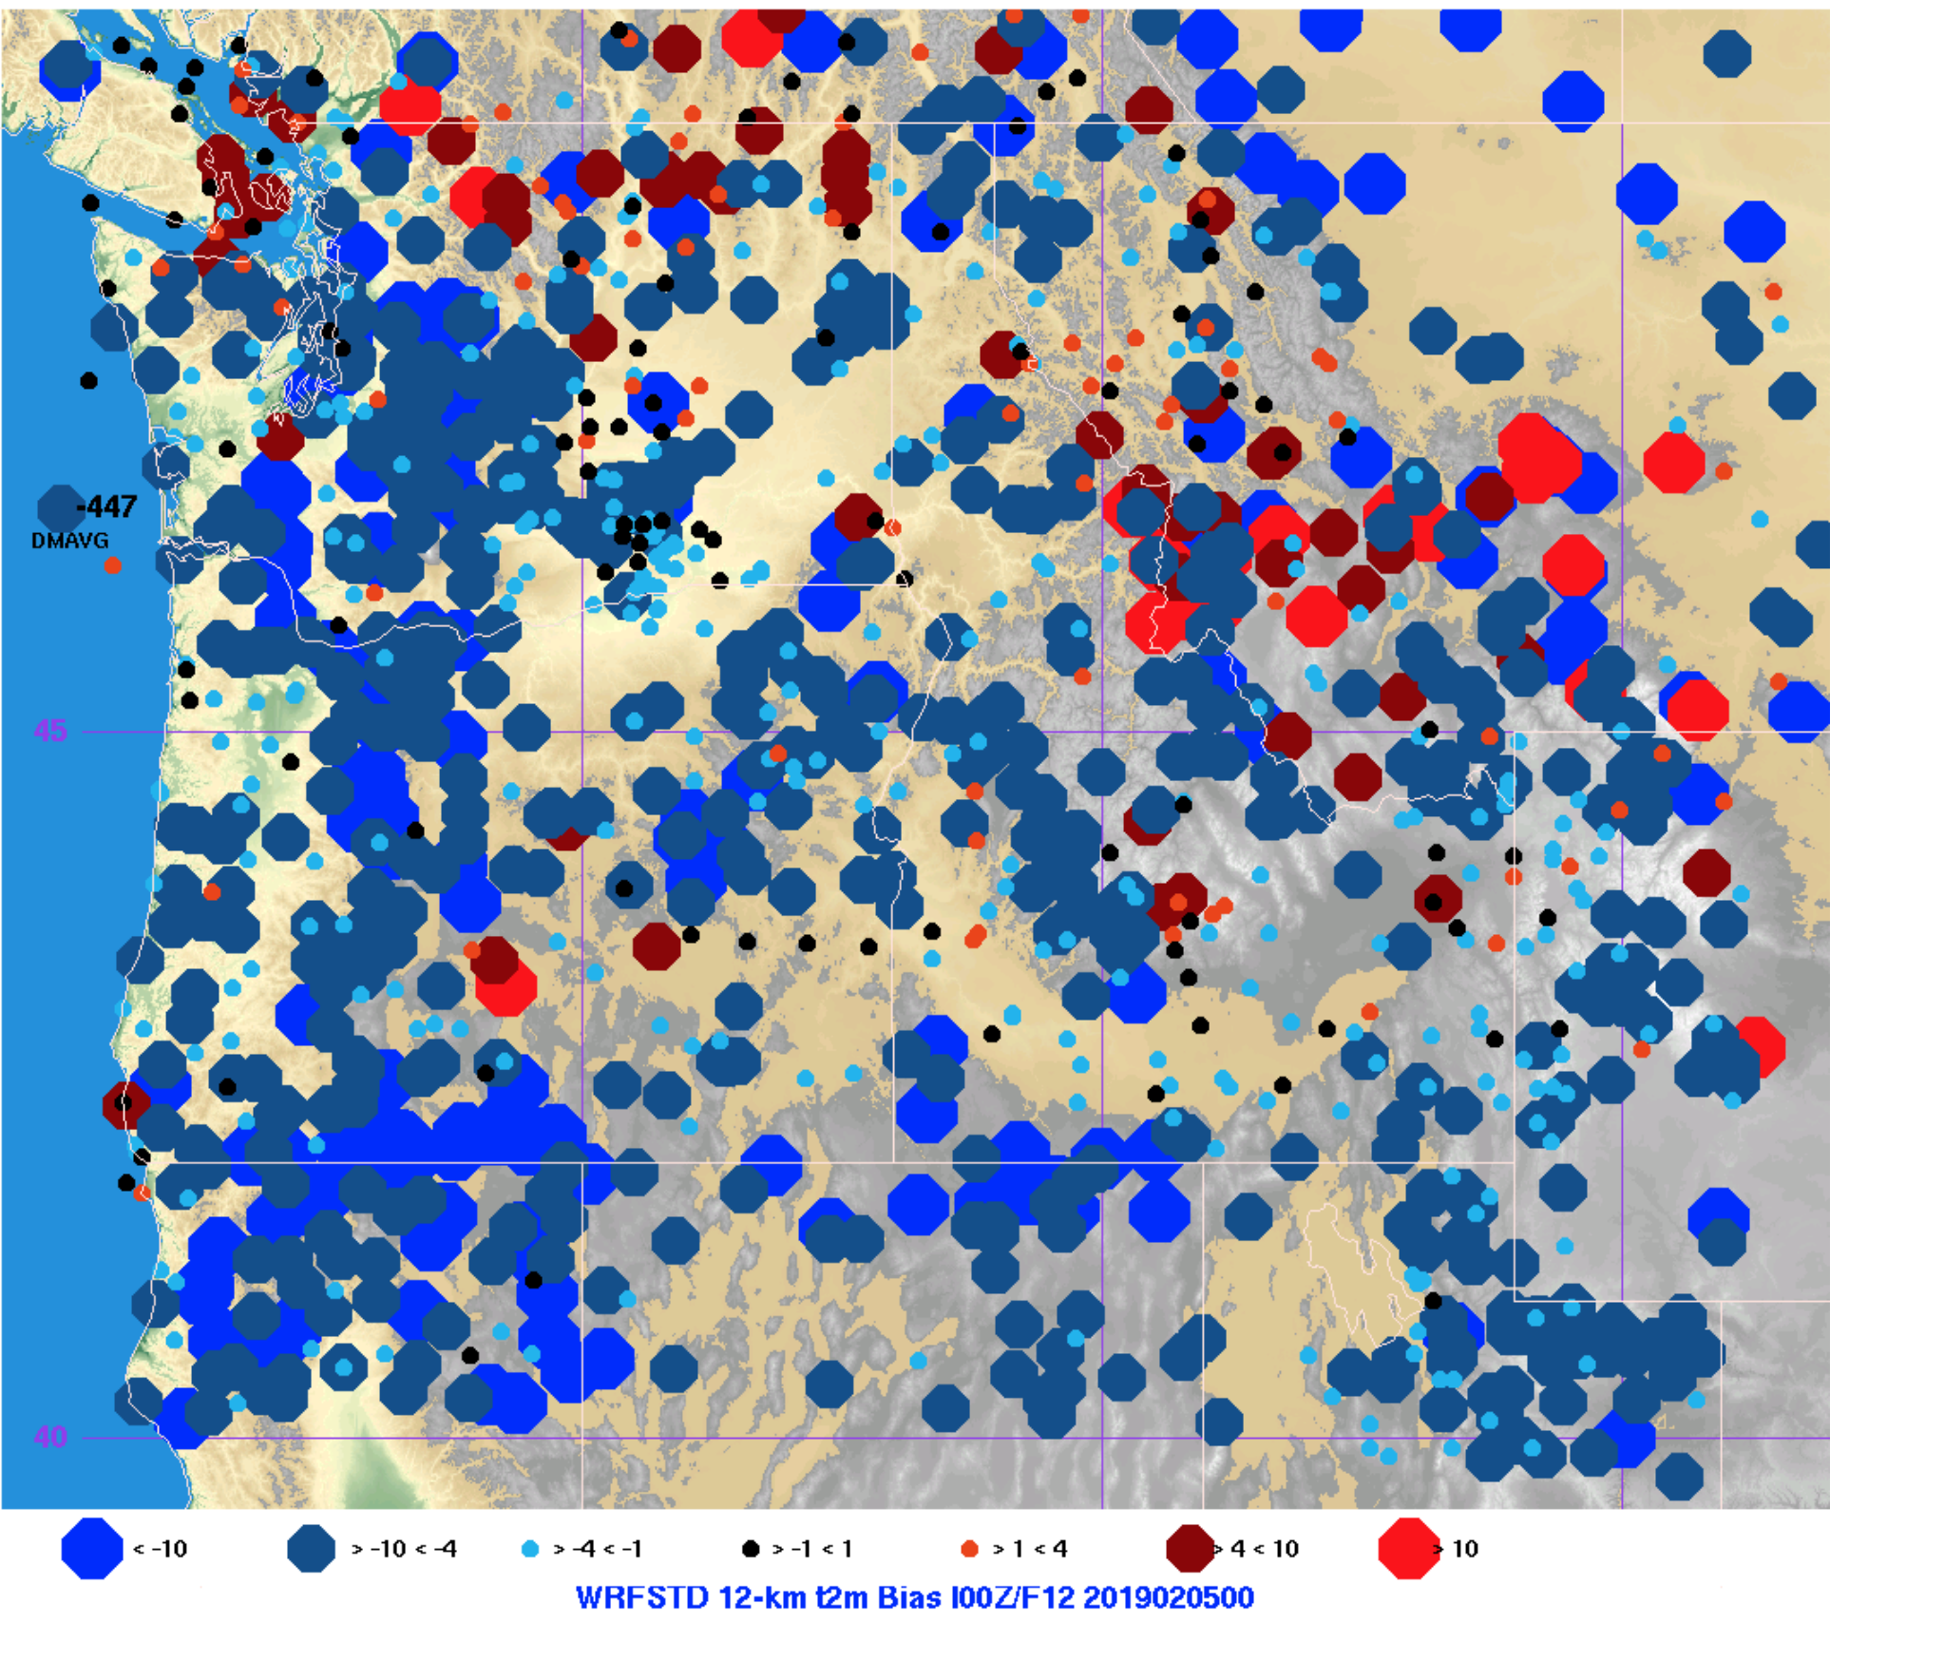
https://a.atmos.washington.edu/~ovens/nobackup/fixsnow/

Slide 25
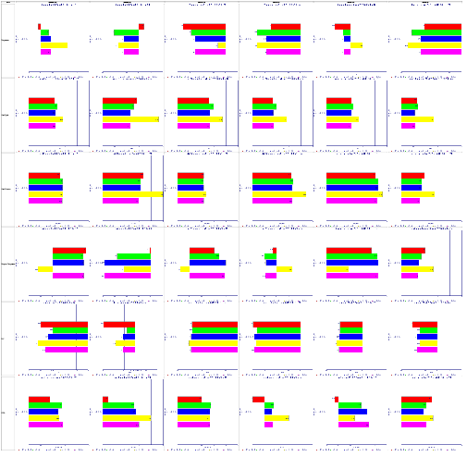
WRF 4.0.3 vs 3.7.1 12-km Suface Bias
(Red is current, others 4.0.3 options)
Summer Winter Spring
AM PM AM PM AM PM
Temp 2m
WSP 10m
Wind Dir 10m
Dewpoint 2m
SLP
6-hr Pcpn

Slide 26
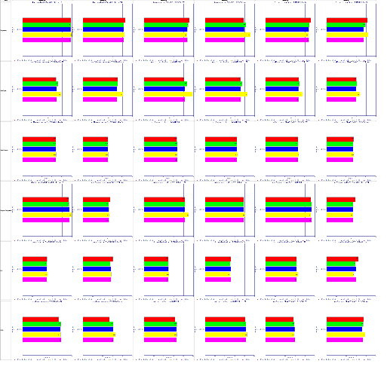
WRF 4.0.3 vs 3.7.1 12-km MAE
(Red is current, others 4.0.3 options)
Summer Winter Spring
AM PM AM PM AM PM
Temp 2m
WSP 10m
Wind Dir 10m
Dewpoint 2m
SLP
6-hr Pcpn

Slide 27
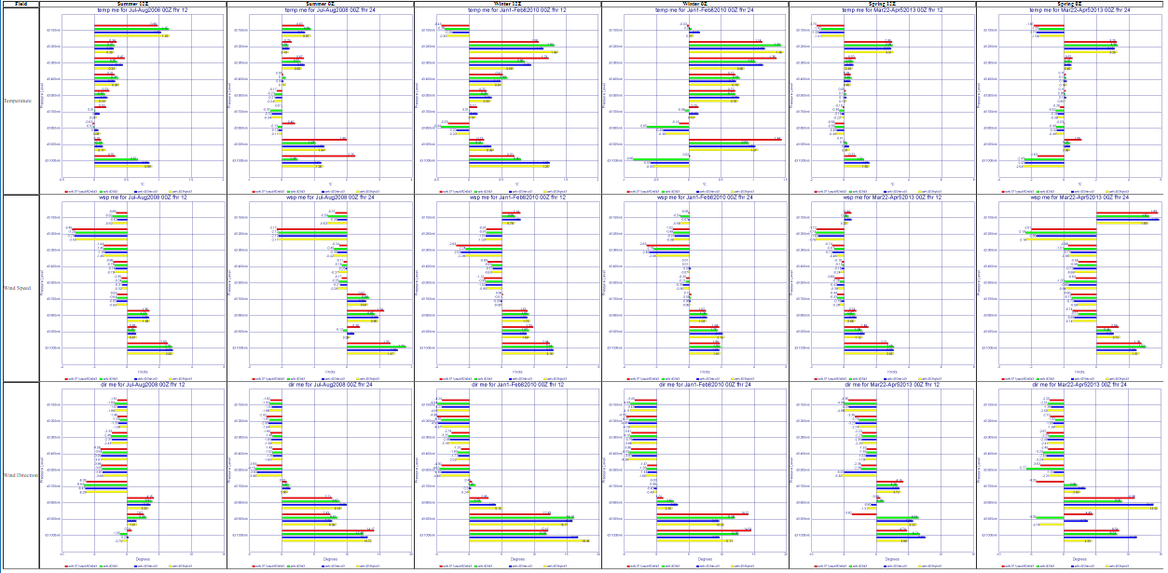
WRF 4.0.3 vs 3.7.1 4-km Vertical Biases
(Red is current, others 4.0.3 options)
Summer Winter Spring
AM PM AM PM AM PM
Temp
WSP
Wind Dir

Slide 28
WRF 4.0.3 vs 3.7.1 4-km Vertical Biases
(Red is current, others 4.0.3 options)
Summer Winter Spring
AM PM AM PM AM PM
Temp
WSP
Wind Dir
Inconsistent results. At some levels and some times WRF 3.7.1 may be best or worst. Same is true for WRF 4.0.3

Slide 29
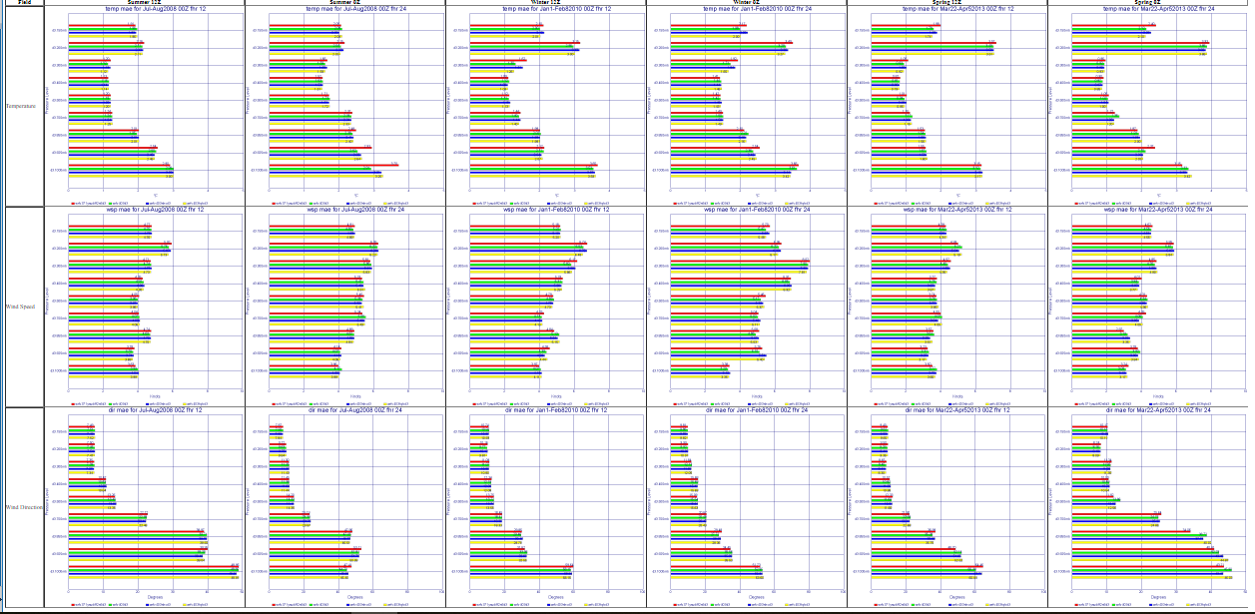
WRF 4.0.3 vs 3.7.1 4-km Vertical MAE
(Red is current, others 4.0.3 options)
Summer Winter Spring
AM PM AM PM AM PM
Temp
WSP
Wind Dir

Slide 30
WRF 4.0.3 vs 3.7.1 4-km Vertical MAE
(Red is current, others 4.0.3 options)
Summer Winter Spring
AM PM AM PM AM PM
Temp
WSP
Wind Dir
Same as the bias, results are inconclusive. At some levels and some times WRF 3.7.1 may be best or worst. Same is true for WRF 4.0.3

Slide 31
WRF 4.0.3 vs 3.7.1 4-km Vertical Biases
(Red is current, others 4.0.3 options)
Summer Winter Spring
AM PM AM PM AM PM
Temp
WSP
Wind Dir
Inconsistent results. At some levels and some times WRF 3.7.1 may be best or worst. Same is true for WRF 4.0.3

