Slide 1
Forecasting Visibility
ATMS 452
Spring 2023

Slide 2
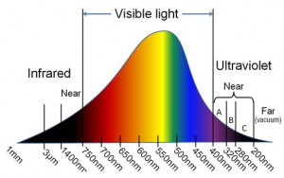
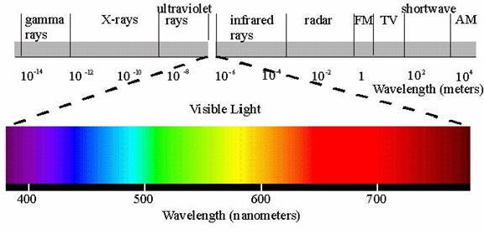
Visibility deals with visible light

Slide 3
Reductions to visibility are caused by the scattering and absorption of visible light. Major causes:
Hydrometeors: fog, drizzle, snow, rain…particularly heavy rain and snow
Dust and smoke: wildfires, dust raised by strong winds, volcanic eruptions
Other particles such as sand
Air pollution

Slide 4
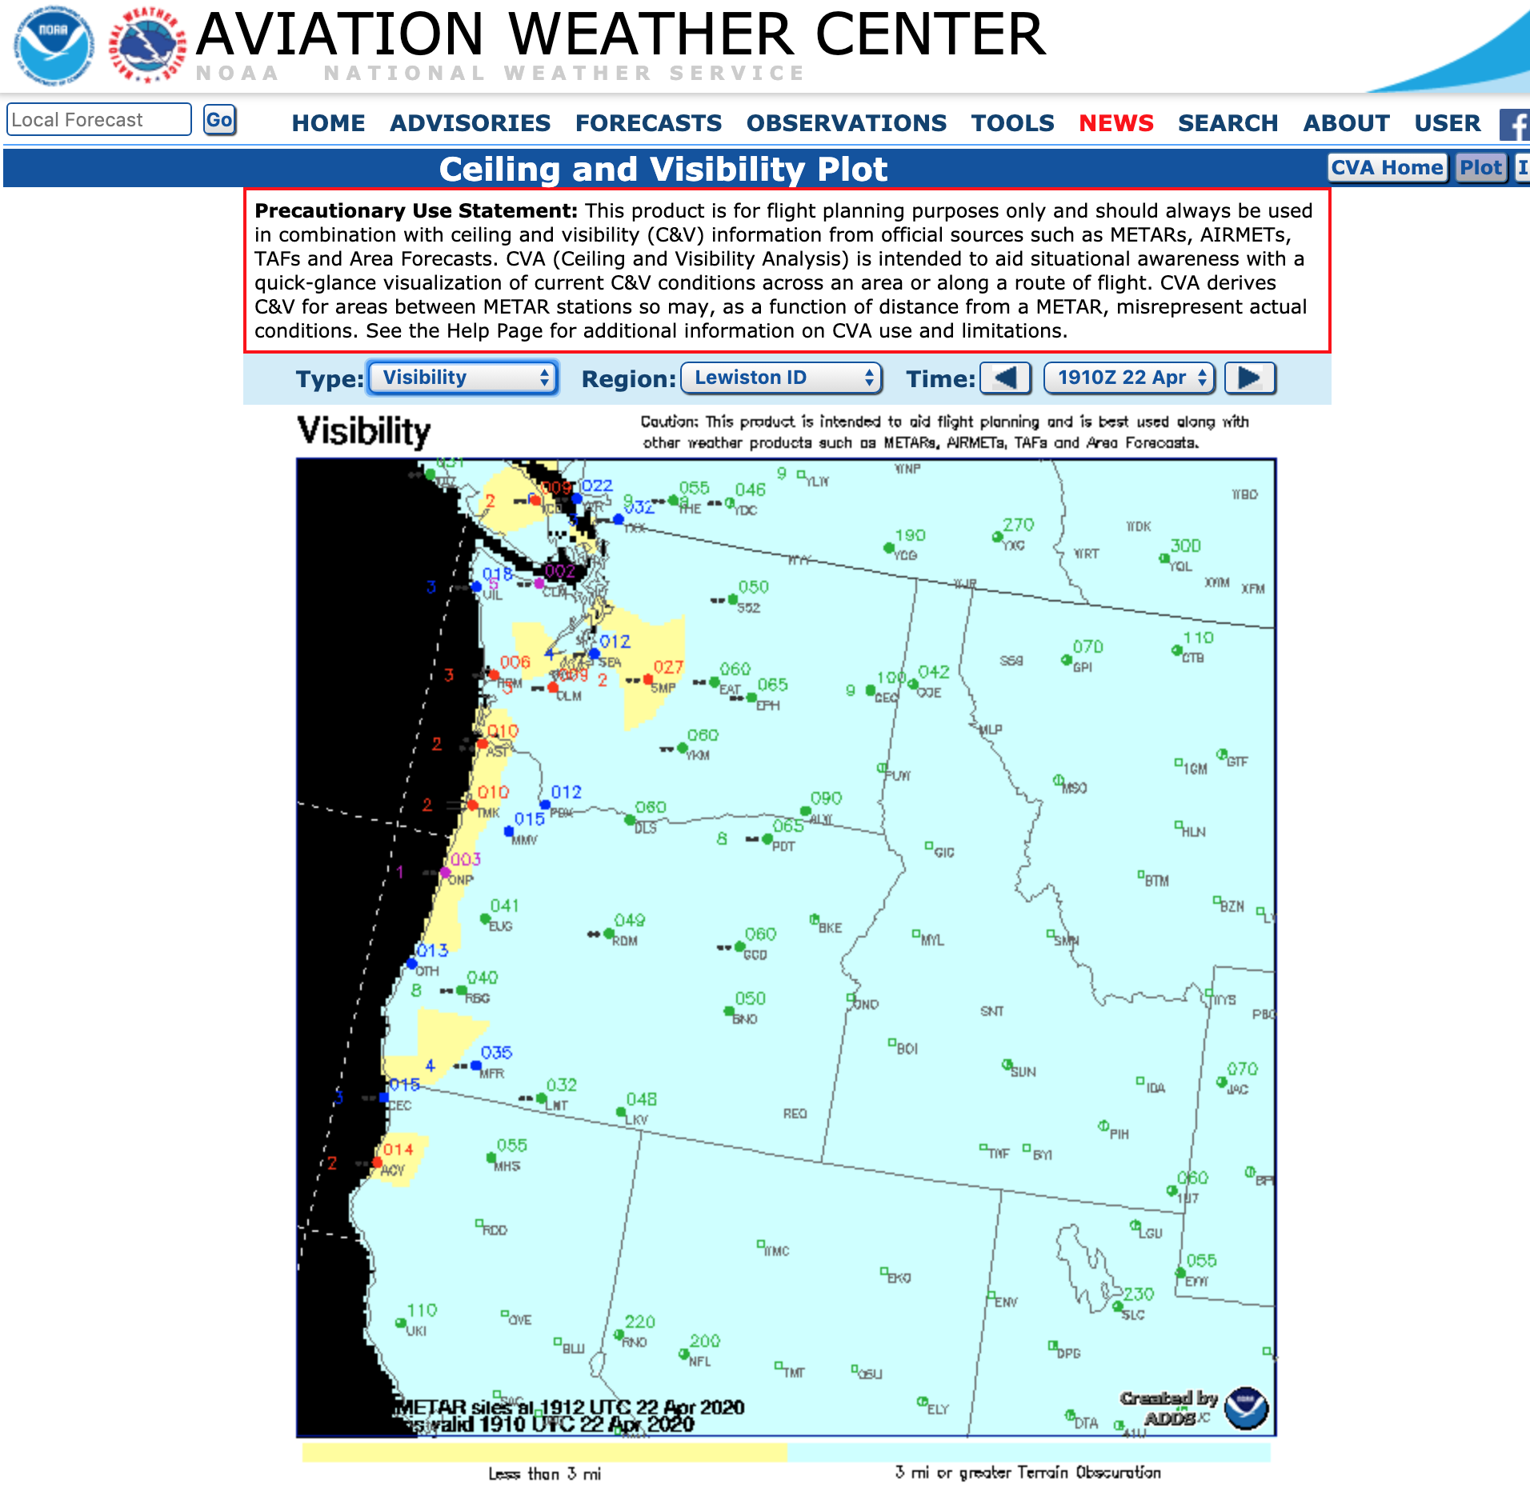
Why forecasting visibility is important
Essential for aviation. Flight rules (VFR, IFR) dependent on visibility.
Transportation safety: many accidents on roadways are related to visibility issues (dust, smoke, fog)

Slide 5
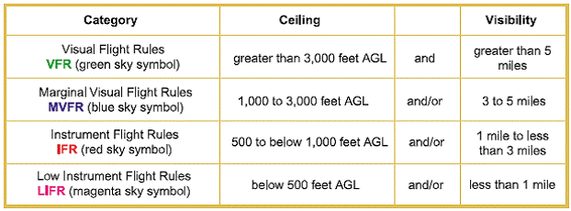
Aviation Flight Rules: Visibility is a Key Component

Slide 6
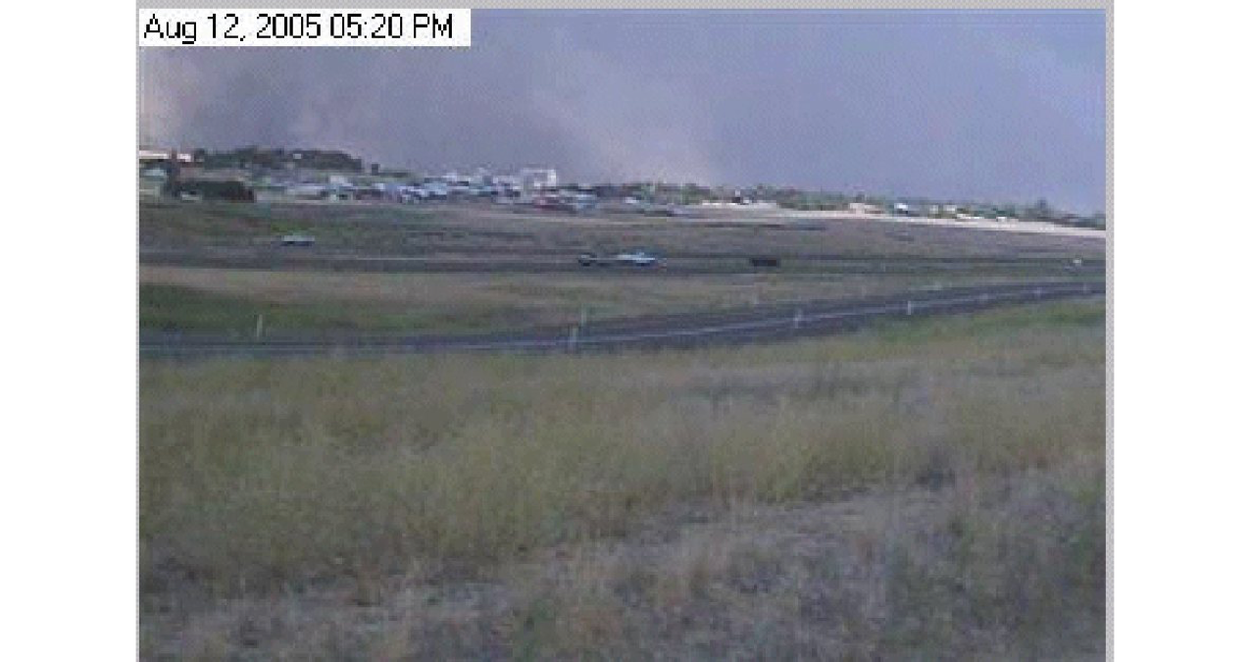
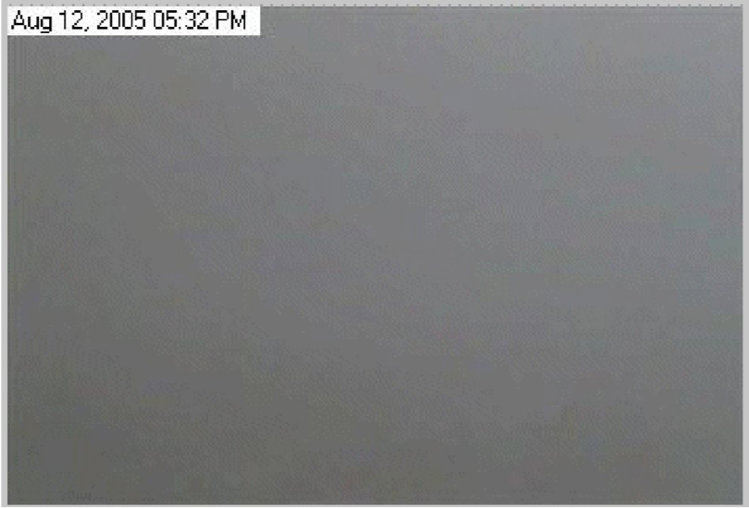
Dust Storms in Eastern Washington
Winds, increasing rapidly from a thunderstorm outflow or a cold front, interacting with plowed fields, can cause rapid decline of visibility resulting in multiple accidents, sometimes involving 10-30 cars/trucks.
Can close major roads, such as I-90.

Slide 8
Heavy wildfire smoke can do the same….

Slide 9
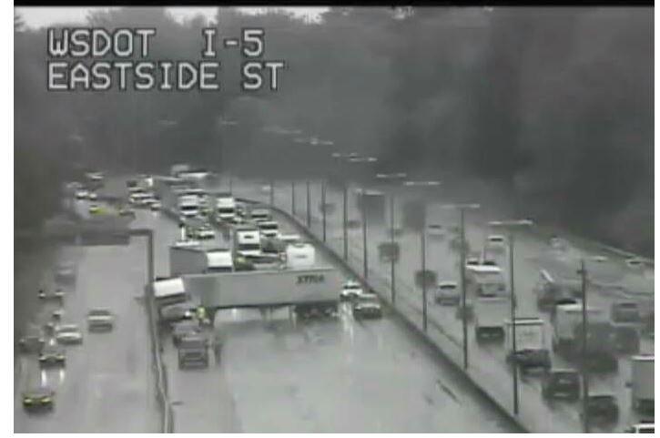
Heavy Rain Over Roadways
Visibility loss from heavy rain can cause chain reaction accidents involving many vehicles.
First, one car slows as loses visibility entering rain, or being blinded leaving rain by the sun
Following cars are too close and hit the first car, followed by more cars behind.

Slide 10
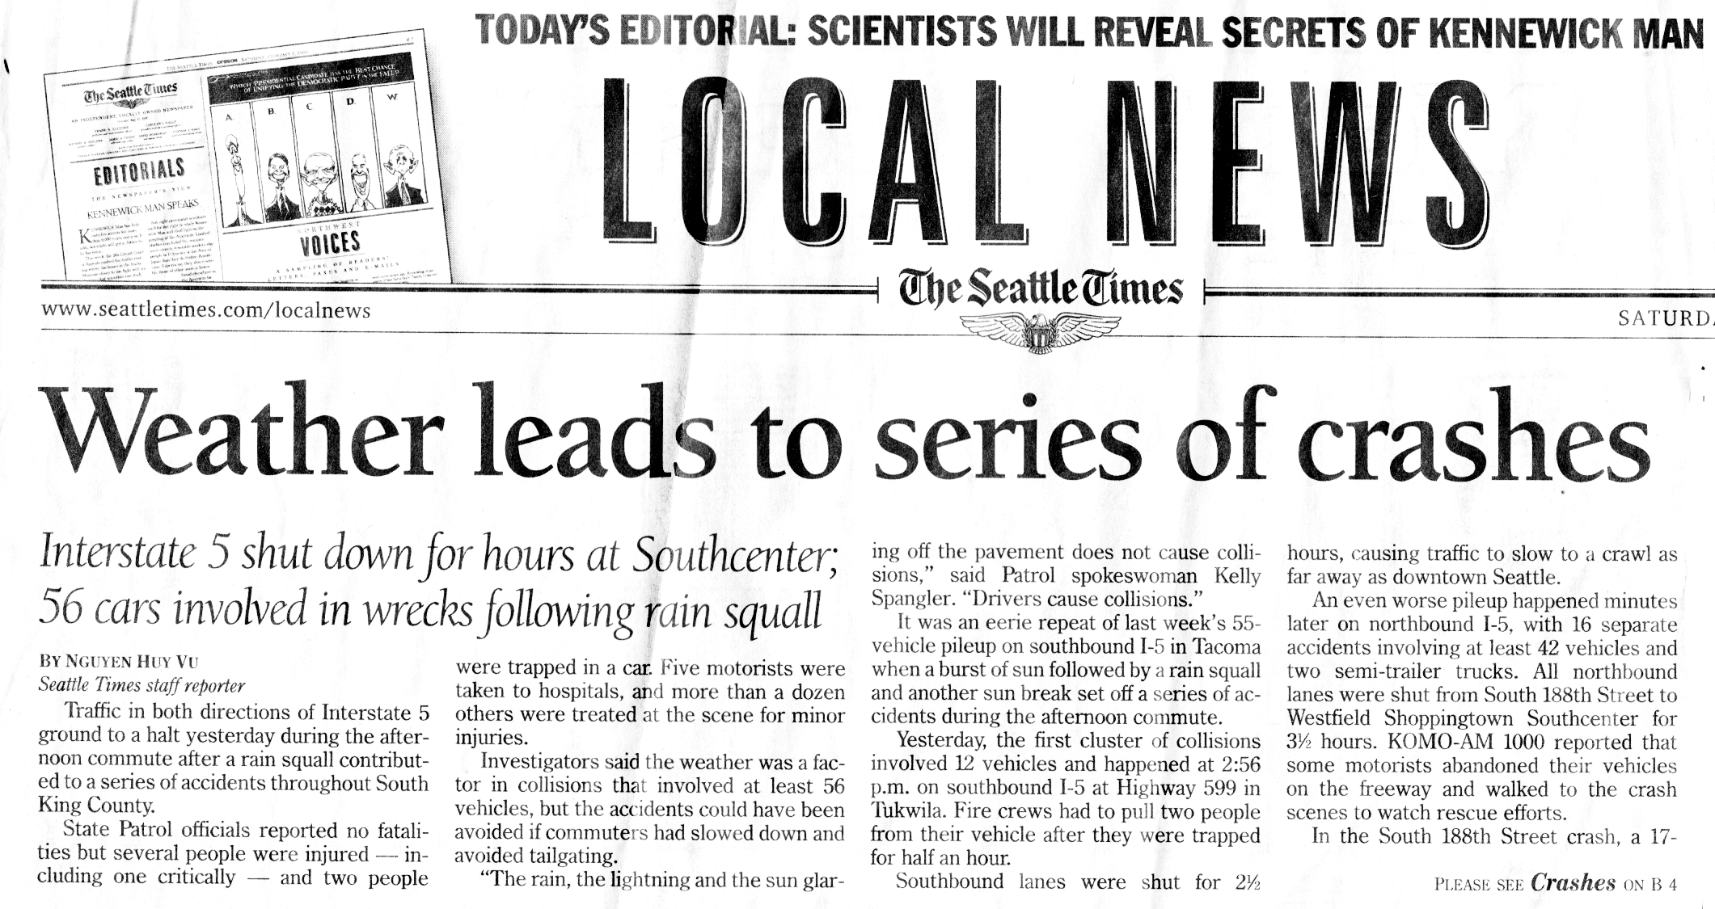
Within two weeks there were TWO multi-car accident incidents: one with 56 cars and another with 55 cars involving reduced visibility

Slide 11
Visibility is a great weakness for models
Plays into failure modes, like poor boundary layer schemes. Poorly simulated fog
Highly localized problems (e.g., in valleys and near sources) that models often don’t have the resolution to deal with, or lack information about relevant particle sources.

Slide 12
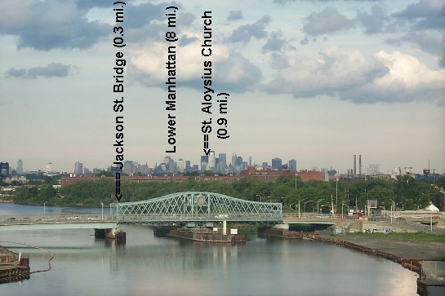
Observing Visibility
Old days: human observers would use local landmarks of known distances

Slide 13
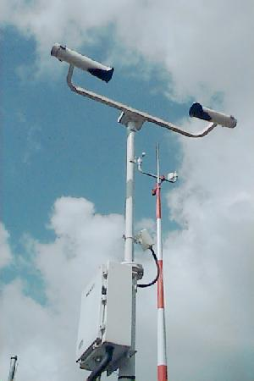
Today: automated sensors such as the ASOS Visibility Sensor
Uses Xenon light source and then measures how much light is scatttered into sensor
Scattered light can be related to visibility
Point value, not integrated over distance. A Problem.

Slide 14
Particle size and visibility
Large particles (compared to the wavelength of light): Mie Scattering. Not wavelength dependent (whitish haze)
  E.g., Large hygroscopic salt particles
Small particles (compared to light). Bluish haze. Rayleigh Scattering. Scattering proportional to 1/λ⁴
  E.g., Combustion particles

Slide 15

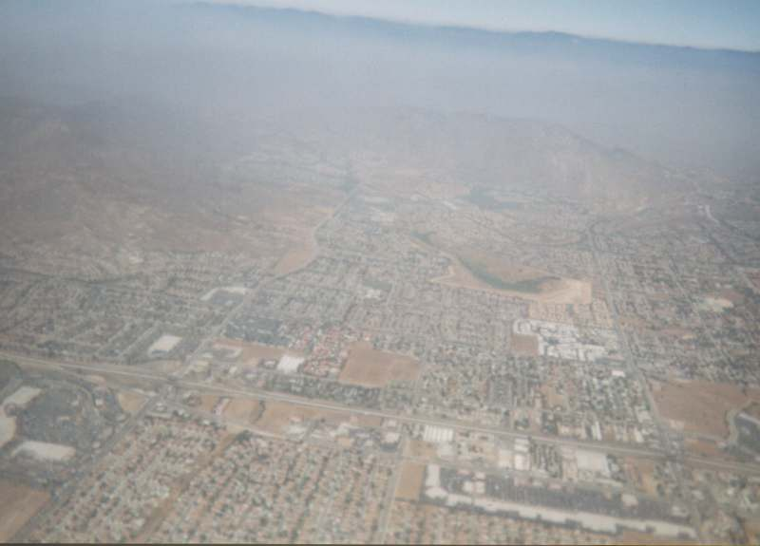
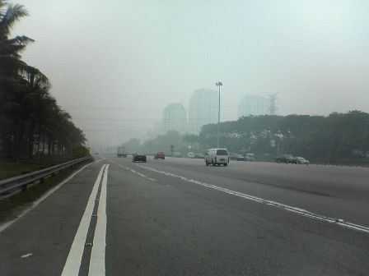
Rayleigh Scattering
Mie Scattering

Slide 16
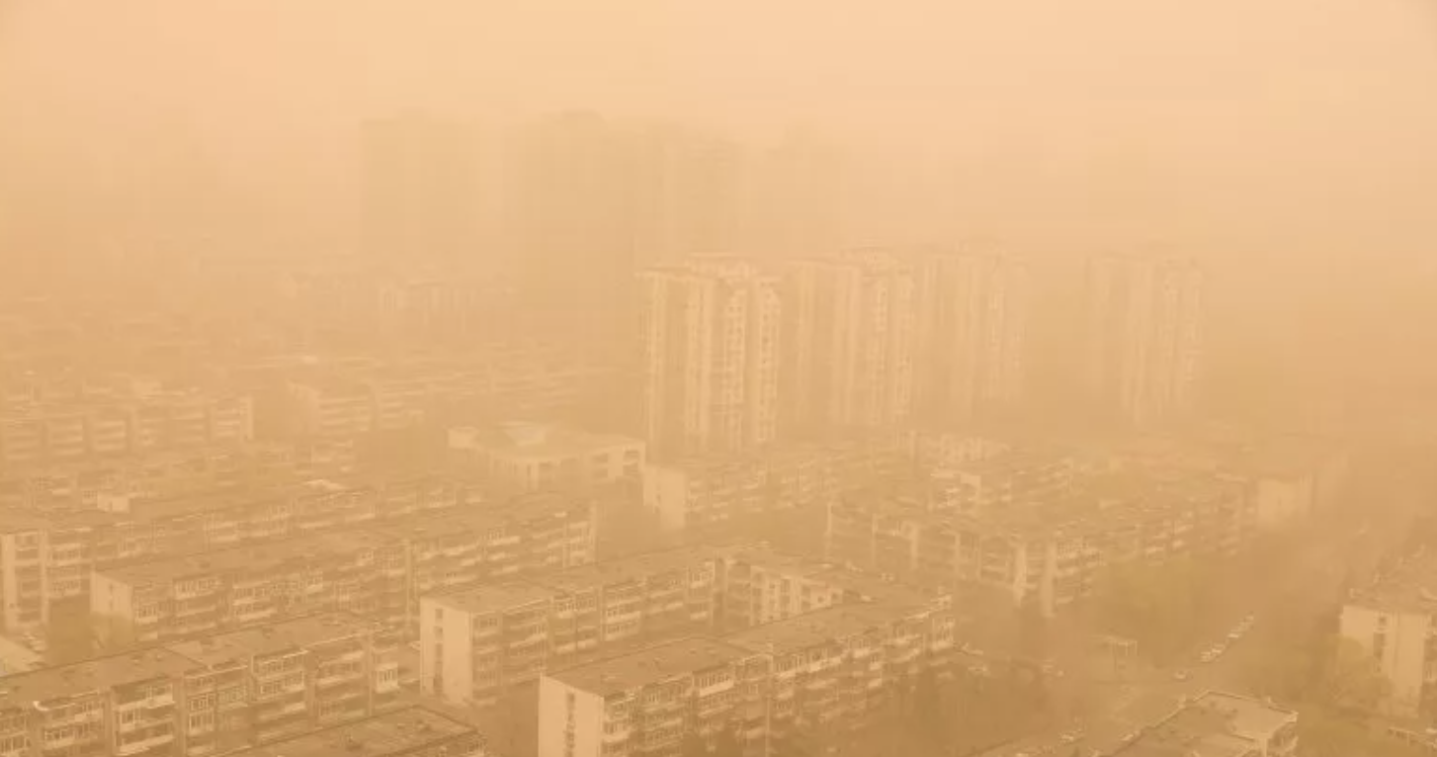
More particles and larger particles result in lower visibility

Slide 17
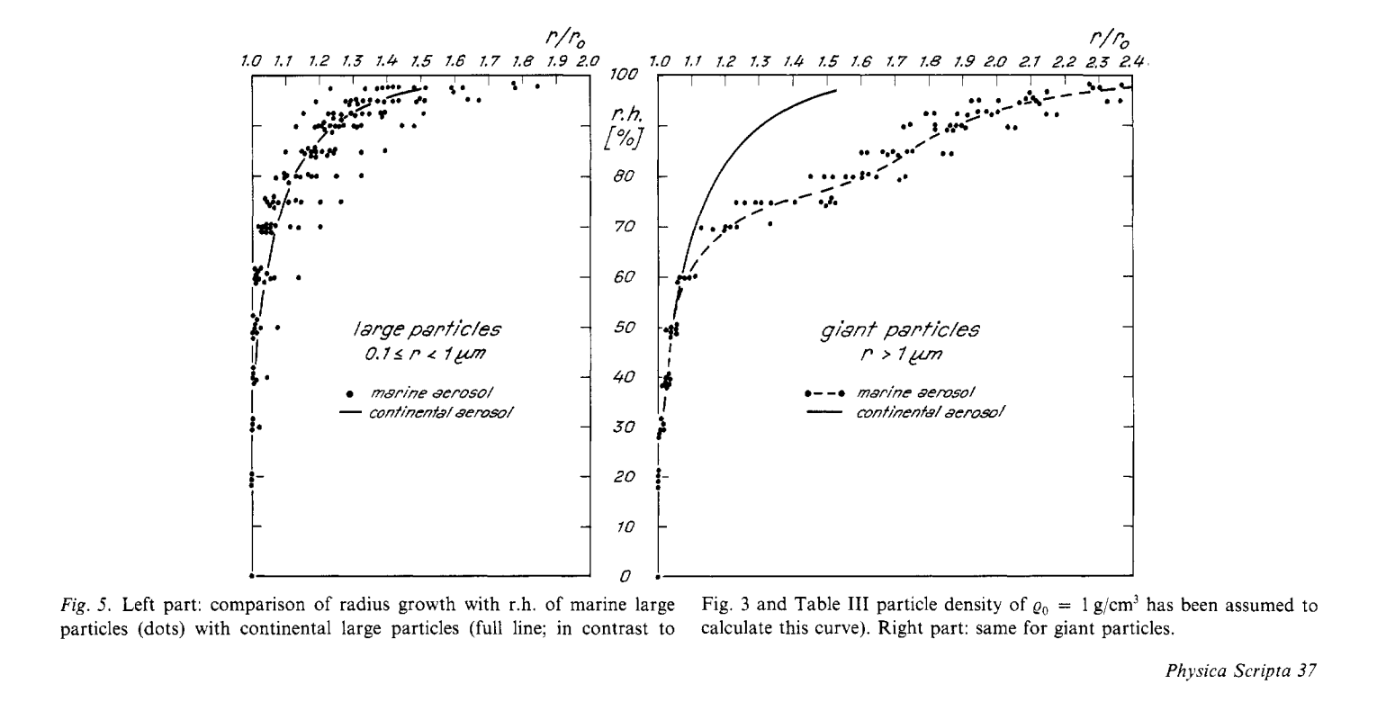
Relative humidity variations affect the size of particles, particularly hygroscopic (water attracting) substances (e.g., salt)

Slide 18

Hygroscopic nuclei can start to grow when RH is below saturation
There is growth starting around 60-70% RH
“Sticky” salt shaker example.
Other condensation nuclei are not effective until near 100%RH

Slide 19
Thus, Visibility Can Depend on Relative Humidity and the Presence of Hygroscopic Nuclei

Slide 20
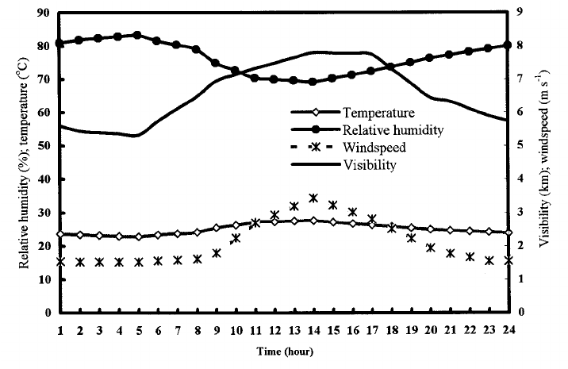
Visibility Generally Improves During the Day
Temperatures increase, causing RH to decline. Particles shrink.
Less stable during day, mixes near-surface water vapor into BL, drier mixed air down
Also cleaner mixed air
down (with exceptions)

Slide 21
Visibility Generally Improves During the Day

Slide 22
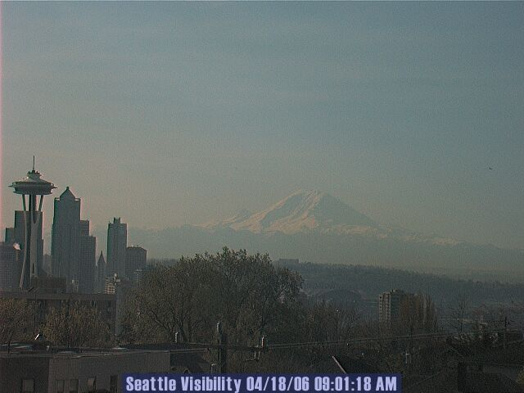

Slide 23
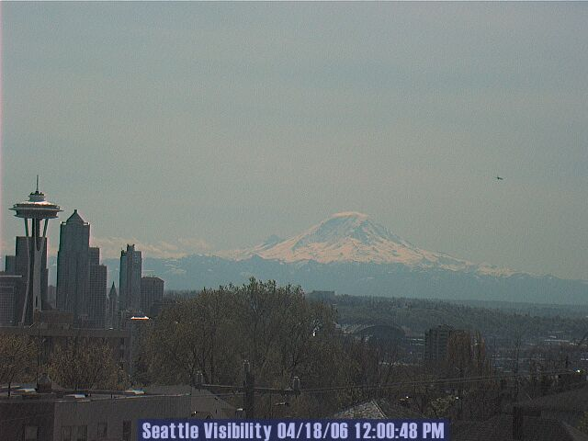

Slide 24
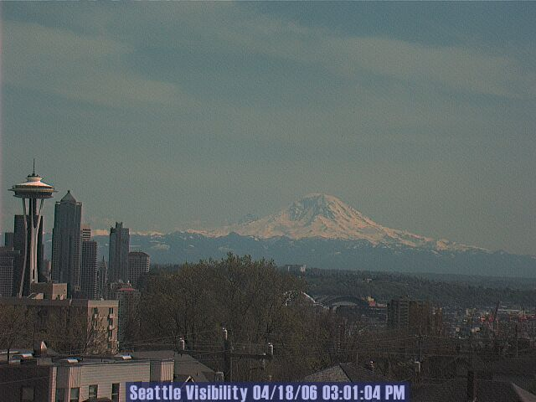

Slide 25
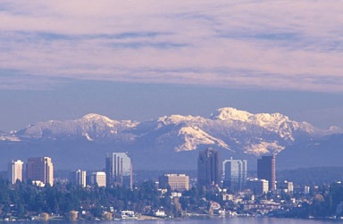
Offshore-directed Flow/Downslope Flow Enhances Visibility. Why?

Slide 26
Why offshore-directed (generally easterly) flow has better visibility?
Offshore flow on the West Coast originates from a drier, continental area.
Descent over western slopes of Cascades reduces RH, shrinks particles
Interior CCN are less hygroscopic, not many salt particles.

Slide 27
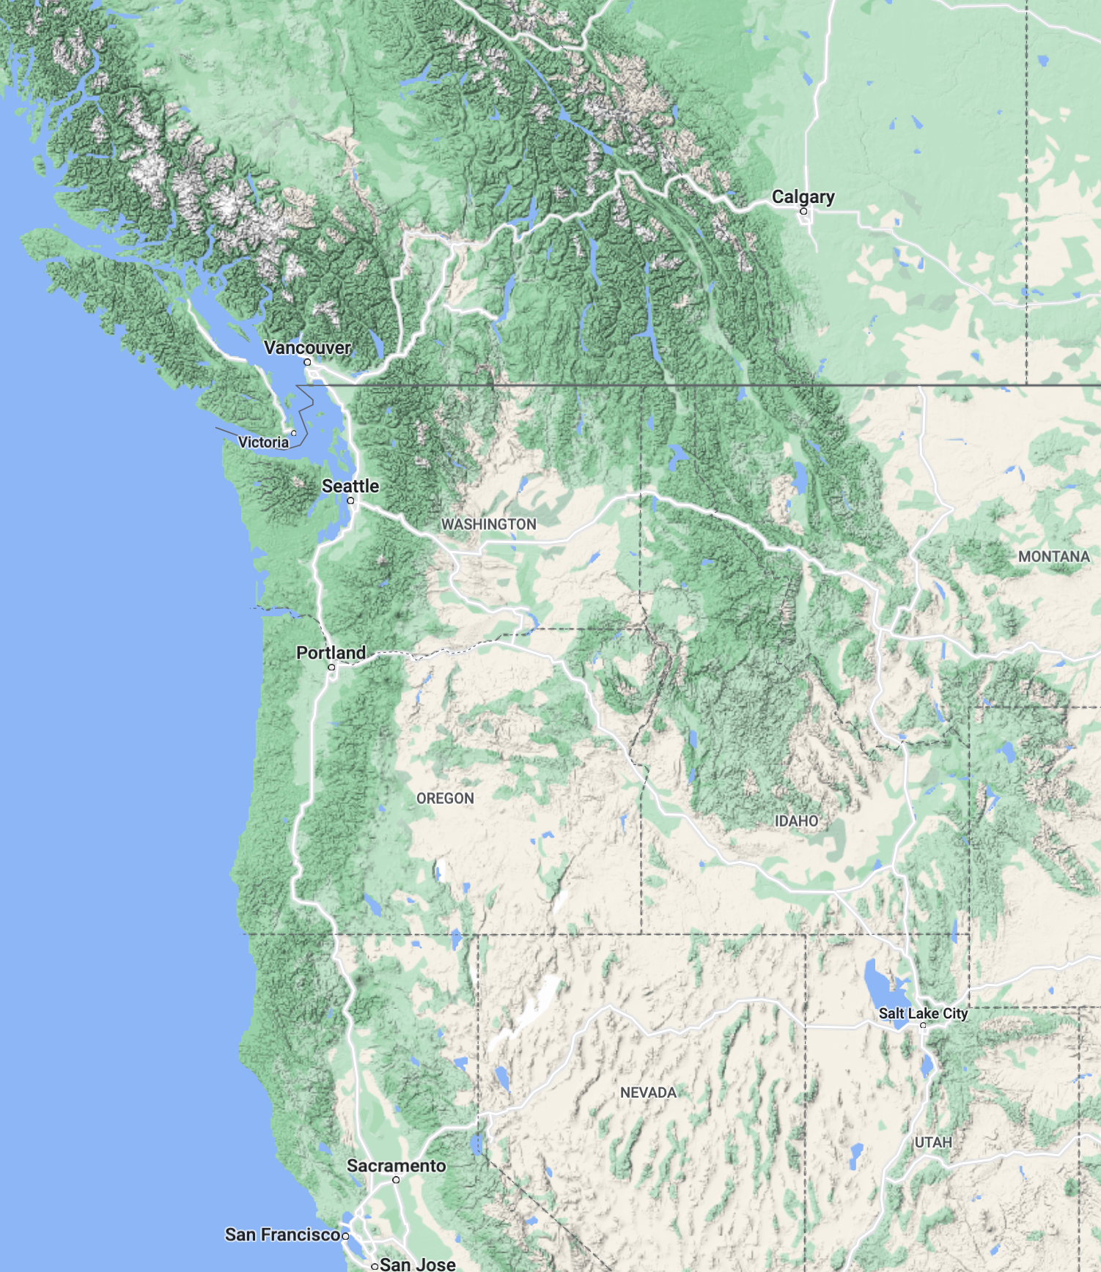

Slide 28
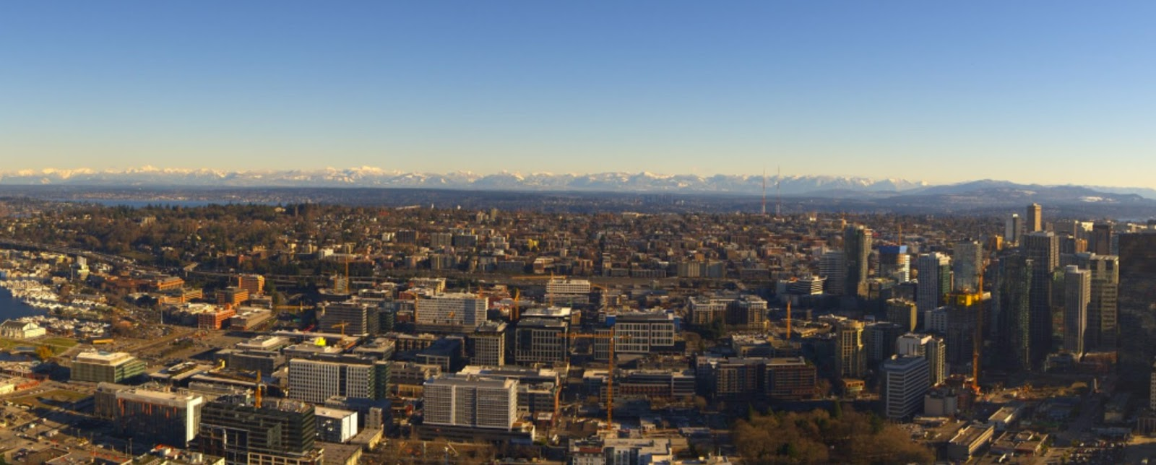
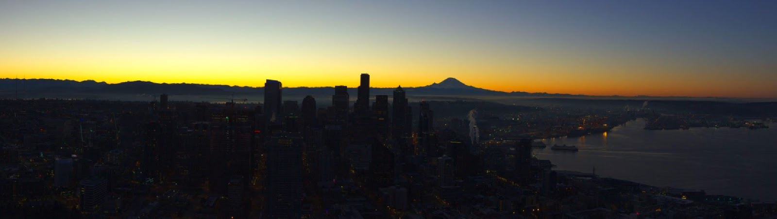
Offshore flow situation

Slide 29

Visibility Often Degrades Rapidly with Onshore Flow (even without clouds)

Slide 30
Reasons: high relative humidity, more hygroscopic nuclei (salt particles)

Slide 31
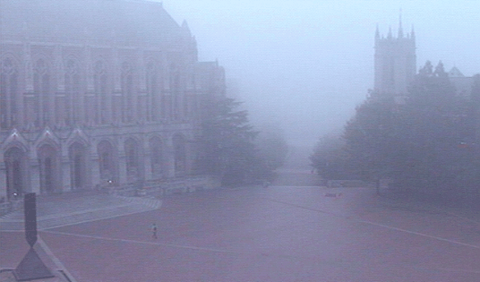
Fog: The most important (and difficult) visibility issue

Slide 32
Fog plays to all forecast deficiencies
Requires models to have ultra high resolution in both the horizontal and vertical
Depends critically on PBL schemes…and current ones have major problems, as does other relevant physics (e.g., microphysics, radiation)
Requires accurate simulation of surface properties (e.g., soil moisture)
Often highly localized, and thus difficult to predict.

Slide 33
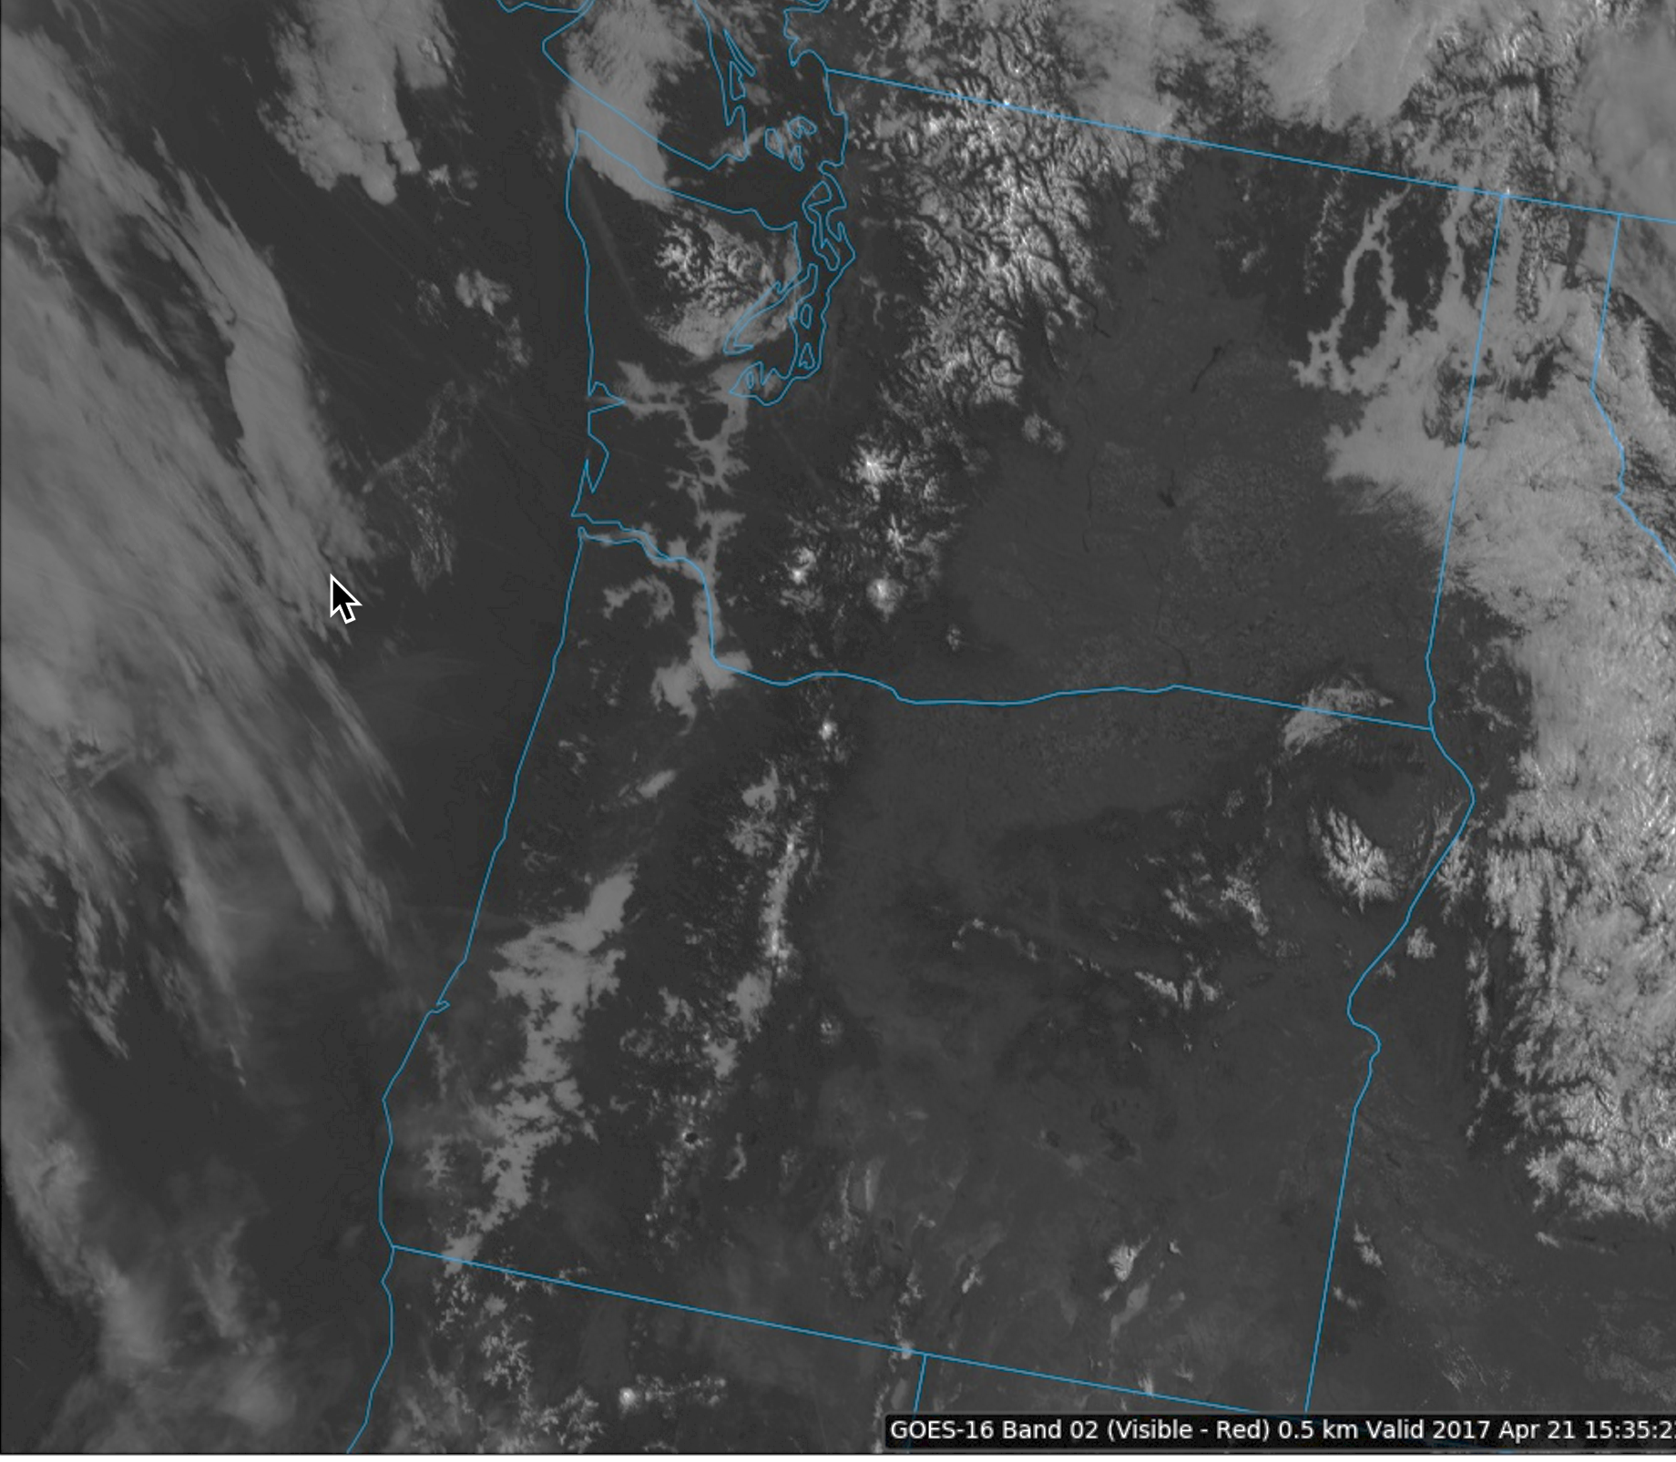

Slide 35
FOG Prediction
101

Slide 36
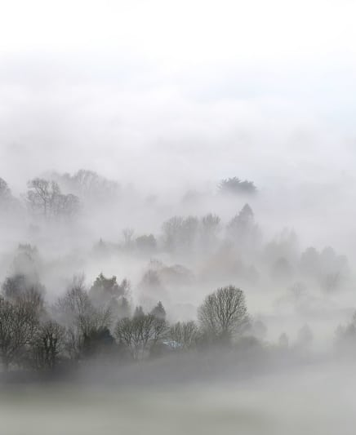
Fog is made of either liquid water droplets or ice crystals
Produced by:
  Cooling air to saturation (by radiation or adiabatic processes) or….
  Adding moisture to the air to saturate (e.g., evaporation of precipitation, evap from surface)
Or a combination of the two.

Slide 37
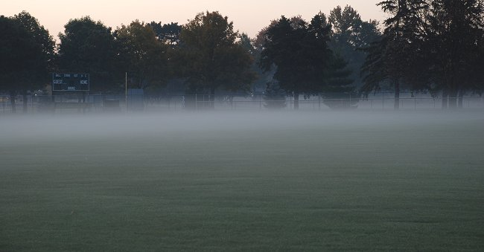
Fog Depth
Can be very shallow (ground fog, GF)
Or can extend to several hundred meters above the surface.

Slide 38
Fog Forecasting
Forecasters often compare T and T_{d} at the surface to predict fog
Fog seldom forms when T-Td > 4F
But does when T –Td is 1-2 F or less
Need some wind (and thus turbulence) to produce fog through any depth (more on this later)

Slide 39
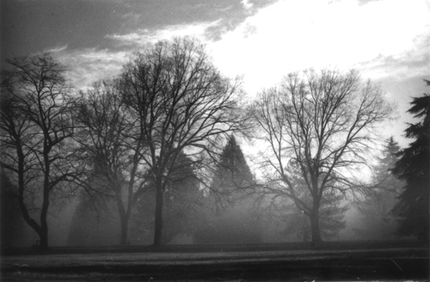
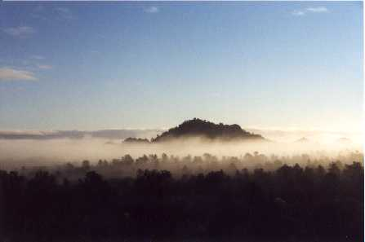
Radiation Fog

Slide 40
Radiation Fog
Associated with good radiational (LW) cooling to space
Needs clear or nearly clear skies aloft (particularly no low to mid-level clouds)
Usually associated with high pressure
Moist surface/PBL helps. e.g. swamps, wetlands, after rainy period). Brings T_{d} up.
Often associated with surface-based inversions

Slide 41
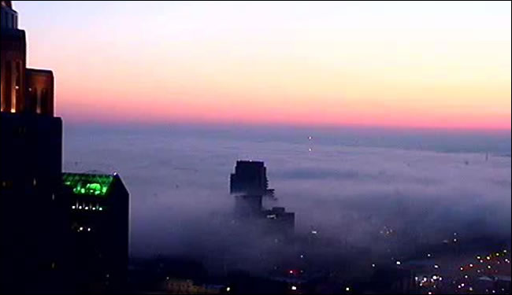
Radiation Fog
Dry in middle to upper troposphere helps. Why?
Light winds help (~2-7 knots).
Calm winds lead to ground fog
If winds are too strong, there is too much mixing of dry, warm air from above—no fog.

Slide 42
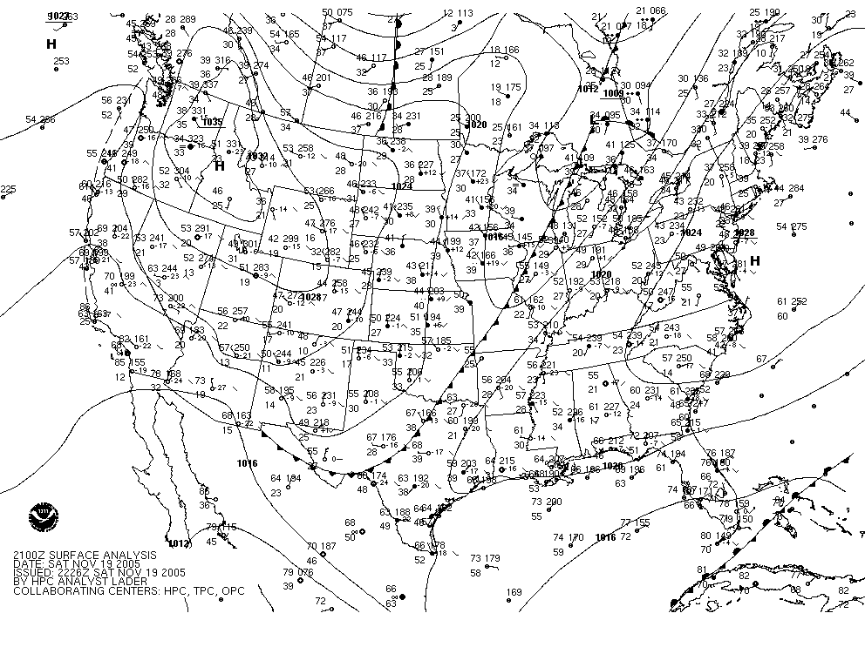
Fog Synoptics for Our Region

Slide 43
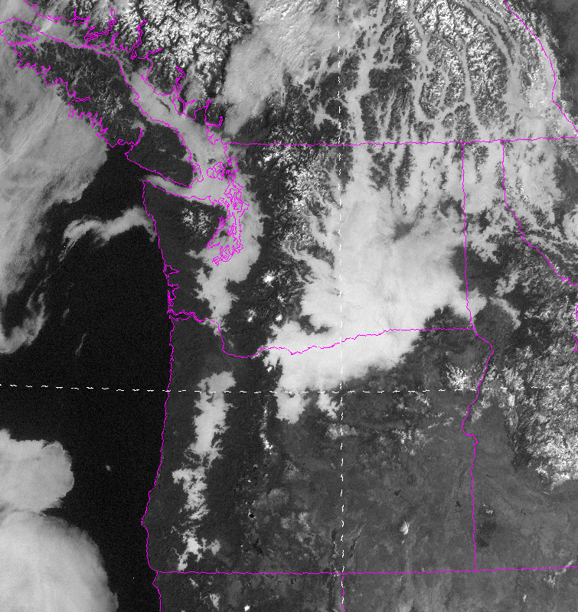

Slide 44
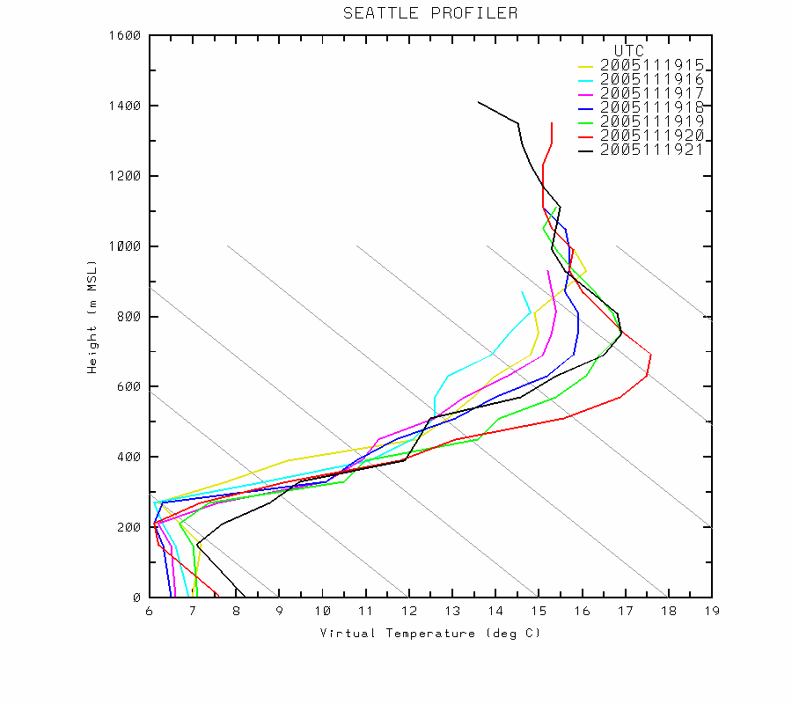

Slide 45
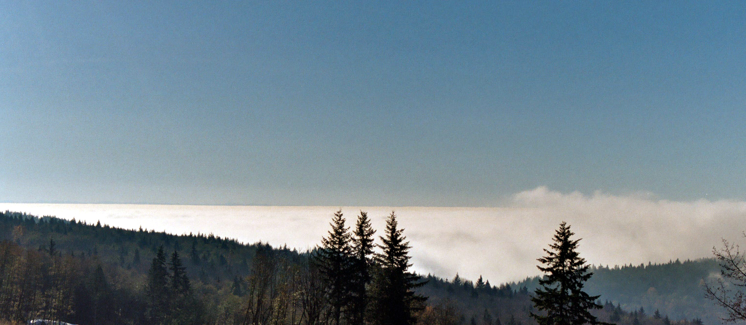
Radiation Fog From Above

Slide 46
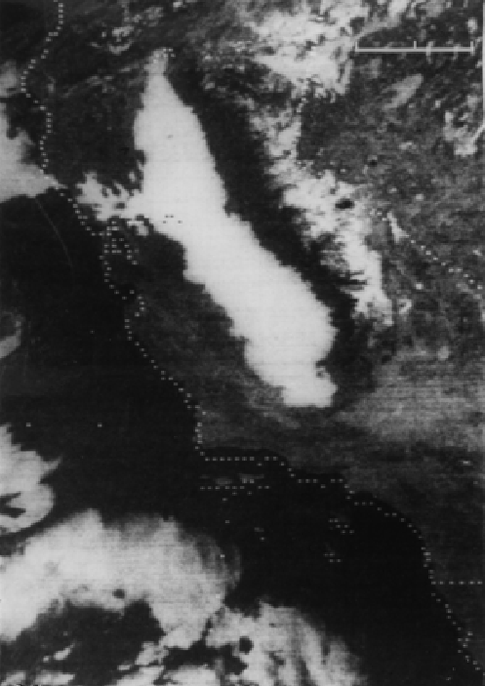
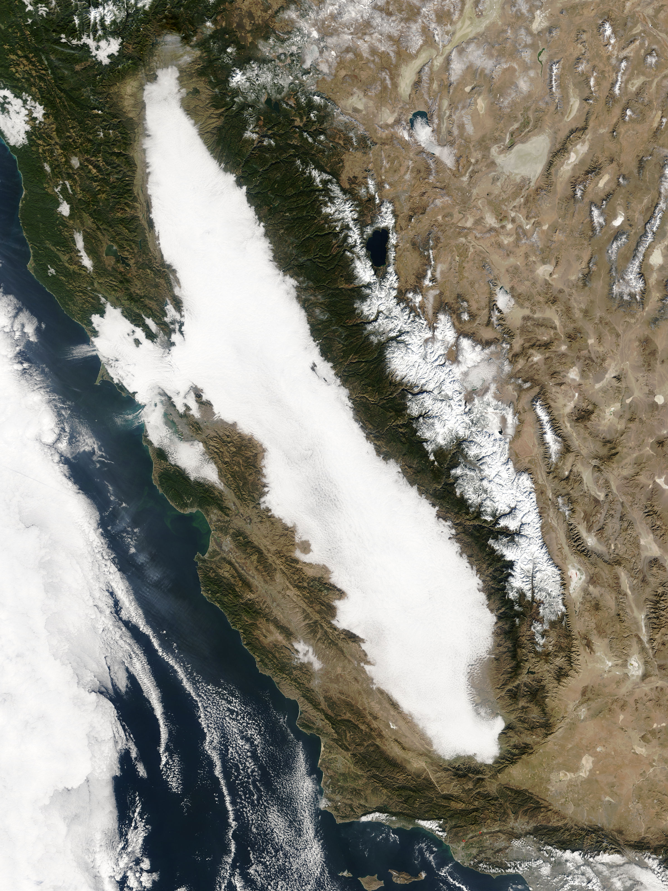
Tule Fog

Slide 47
An important element of fog forecasting is the hydrolapse
The hydrolapse is the vertical gradient of water vapor
If moisture is too limited in the vertical, may not get significant fog…just dew, frost, or ground fog.
Or nothing…
But how does a forecaster know the hydrolapse?

Slide 48
Determinng the Hydrolapse
Radisondes (RAOBS) and aircraft observations can help (not many aircraft observe water vapor)
Many operational forecasters look at the T_{d} at the surface during the previous afternoon near the time of max temp.
Often called the crossover temp.

Slide 49
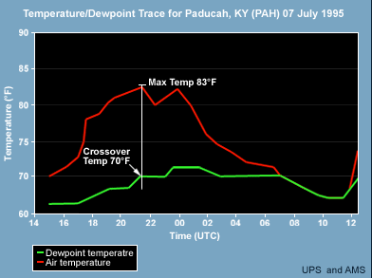
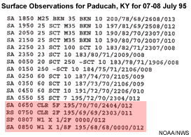
Crossover temperature of 70F

Slide 50
Why does crossover temp give information on moisture aloft?
During max temp time, PBL mixing reaches its max height
Brings down air from aloft, so sampling T_{d} at the top of the PBL.
If T_{d} drops substantially in the afternoon, that means moisture is shallow.

Slide 51
Using the crossover temp
Expect substantial fog if the temperature at night is predicted to fall to or below the crossover temperature.

Slide 52
NWS Discussion
000 FXUS62 KGSP 131857 AFDGSP AREA FORECAST DISCUSSION NATIONAL WEATHER SERVICE GREENVILLE-SPARTANBURG SC 253 PM EDT THU APR 13 2006 .SHORT TERM /TONIGHT THROUGH SATURDAY/... NORTHWESTERLY FLOW ALOFT WILL REMAIN OVER THE AREA THRU FRIDAY. …. THERE IS THE POSSIBILITY THAT KAND/KCLT COULD HAVE A BRIEF PERIOD OF MVFR FOG AROUND SUNRISE FRI GIVEN THE FORECAST HYDROLAPSE. HOWEVER CROSSOVER TEMPS ARE WELL BELOW FORECAST LOW TEMPS...THEREFORE WILL LEAVE OUT FOR NOW. CANNOT RULE OUT SOME VFR CEILINGS FROM TIME TO TIME...BUT CHANCE NOT HIGH ENOUGH TO INCLUDE AT THIS TIME. && .GSP WATCHES/WARNINGS/ADVISORIES... GA...NONE. NC...NONE. SC...NONE. && $$ SHORT TERM...RWH/CSH LONG TERM...CSH AVIATION...RWH

Slide 53
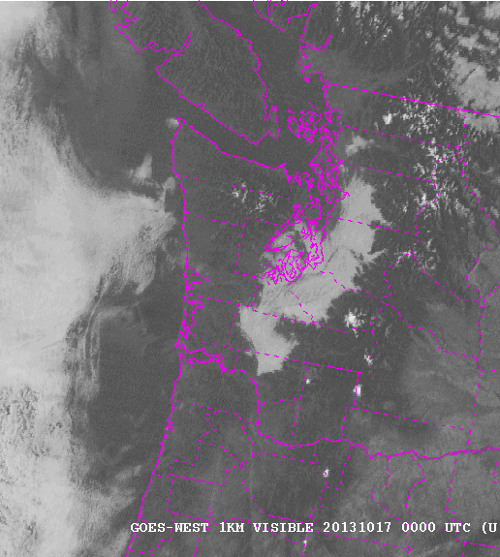
Radiation fog evolution
Radiation fog often lifts during the day (burns up from the ground)
Burns off from the edges.

Slide 54
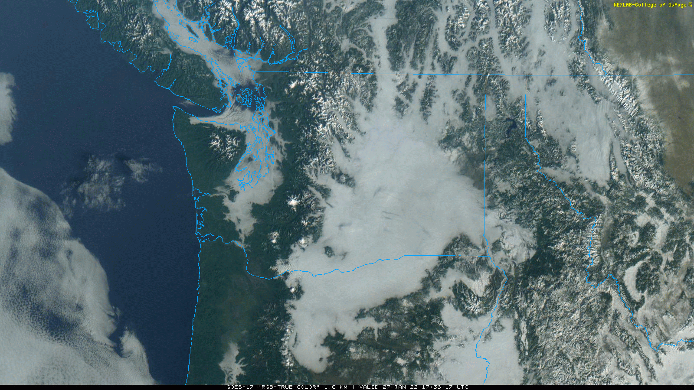

Slide 55
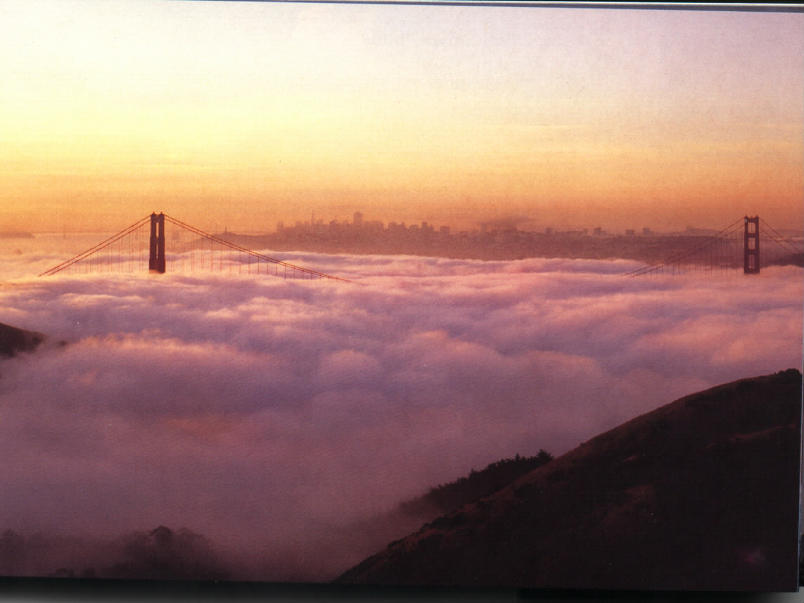

Advection Fog

Slide 56
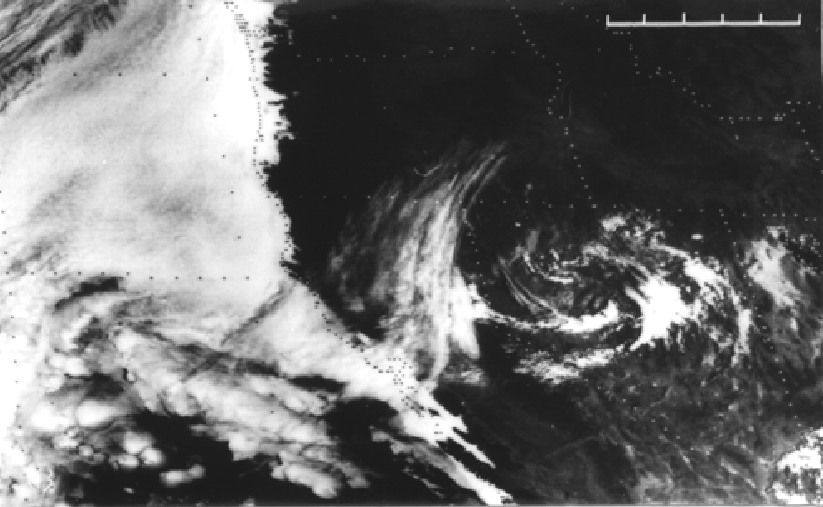

Slide 57
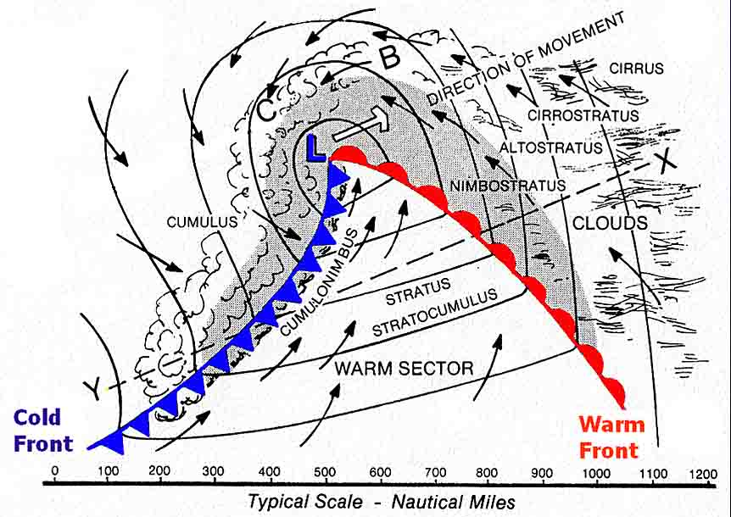
Advection Fog
Associated with relatively warm, moist air moving over a cool surface.
Examples: warm/moist air passing over cool, upwelling coastal waters, snow.
Northern warm sectors over oceans

Slide 58
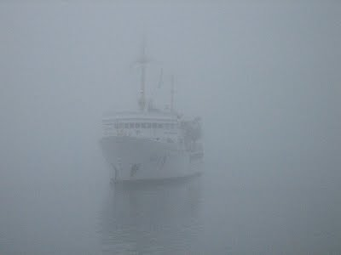

Slide 59
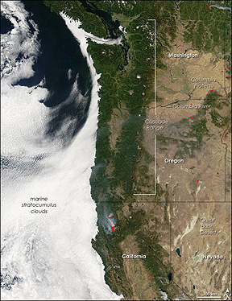
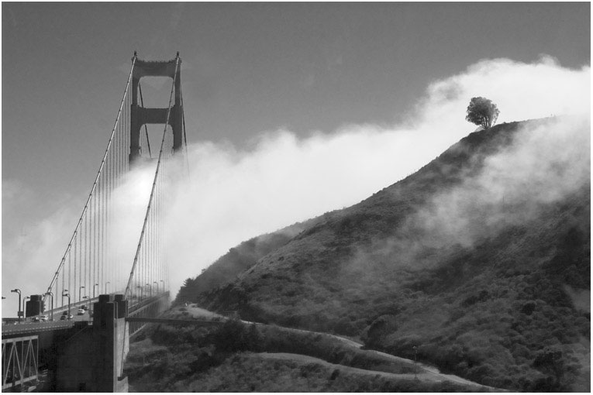
West Coast Advection Fog

Slide 60
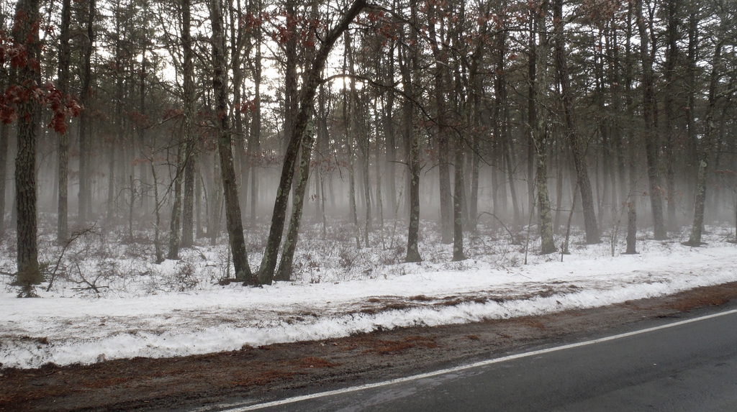
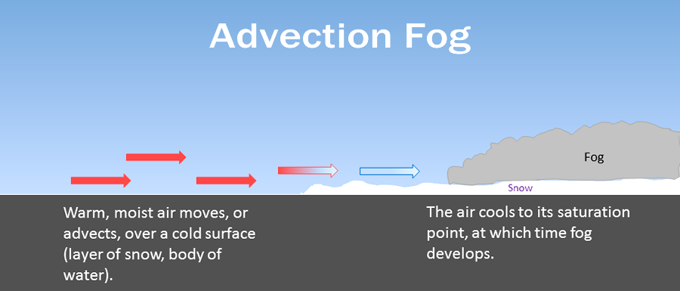
Advection fog over snow

Slide 61
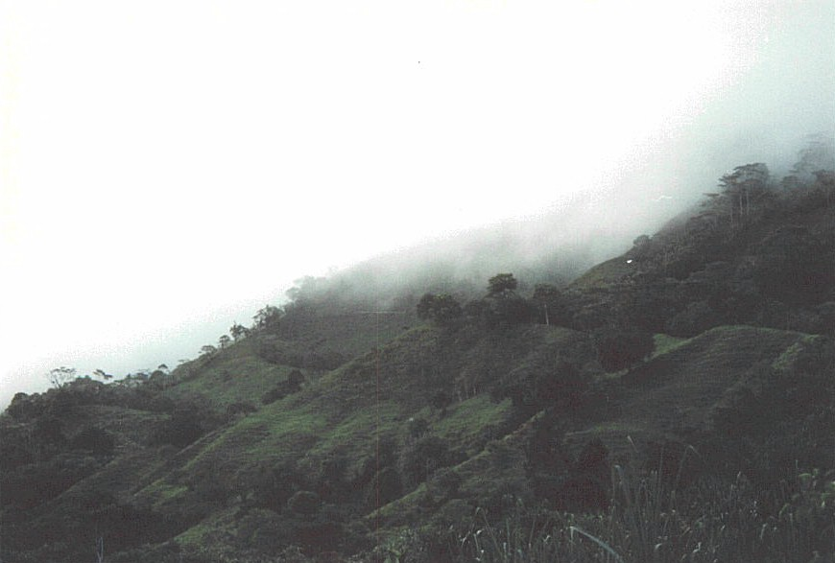
Upslope Fog

Slide 62
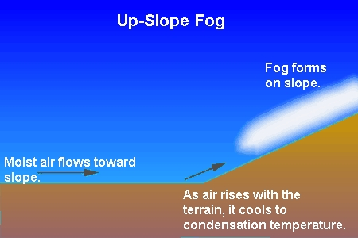
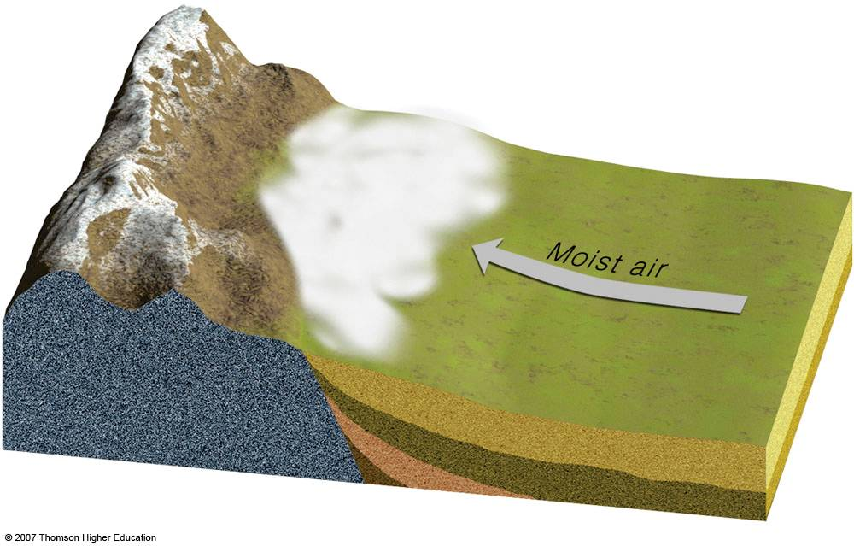
Results from adiabatic cooling on slopes
Often in Cascade passes, from flow from either direction

Slide 63

Upslope Fog: Snoqualmie Pass

Slide 64


Slide 65


Frontal Fog

Slide 66

Frontal fog
Adding moisture to cool air below until it saturates
Big player in warm frontal zone.

Slide 67

More Generally: Precipitation Fog
Precipitation often associated with fog.

Slide 68

Steam Fog

Slide 69


Slide 70

Resulting from mixing of cold, dry air and moist, warm air

Slide 71

Steam Fog
Unsaturated cold air passing over warm water mixes with warmer and moister air adjacent to water
The two air masses may not be saturated, but the mixture is.

Slide 72

Steam Fog
Usually need a big difference in temperature in the vertical between the two air masses, generally 20F or more
Often happens during arctic outbreaks here in the Northwest as cold air goes over our warm water (~50F).

Slide 73


Slide 74
Geographical Distribution of Fog

Slide 75

Cold water offshore
Upslope
Fog on Appalachians

Slide 76

Number One Fog Location in US
Cape Disappointment (106 days year of heavy fog)

Slide 77

Annual Variation

Slide 78
Annual Fog Variation
Most locations over land have a maximum frequency in autumn because of:
  Long nights
  Not many big storms/clouds (good IR cooling)
  Greater vertical stability (less mixing)
  Moister ground in autumn
Advection fog locations are different…often have higher frequency in late spring and summer (e.g., US West Coast)

Slide 79


Advection Fog Along West Coast Maximum in Spring and Summer When Coastal Northerlies are Strongest

Slide 80


Why Then? Upwelling.

Slide 81
Fog often collects in bowls and valleys

Slide 82

Fog can become very persistent, particularly in winter due to its radiative properties.
IR emission at top of fog helps maintain it

Slide 83

Why is VERY Dense Fog often a good sign for later in the day?

Slide 84
Fog can impact other critical forecasting issues like ice on roadways
https://atmos.washington.edu/~cliff/Roadway.htm

Slide 85
Forecasting Fog: Some Tips
Short-term, T vs T_{d}
  Assume constant T_{d}, extrapolate/forecast temp to within 1F of T_{d}
  To forecast deep or persistent fog, remember the crossover temp. If T predicted to drop to crossover temperature, better chance of fog.
Very dense fog is usually shallow, will burn off early.
Low–level moisture helps fog (recent rain, moist area)
Rain can moisten air and cause fog.

Slide 86
Fog Forecasting
Climo is very useful. Fog often develops in the same locations (e.g., bottoms of valleys)
Radiation fog. Clear or nearly clear skies, 2-7 knots, very light winds produce ground fog, strong winds no fog
Mid-level and lower clouds reduce radiative cooling and lessen fog chances
Light fog often occurs after rain starts as T_{d} rises and T falls.

Slide 87

Rain Causing Fog Often Occurs

Slide 88

Forecasting Fog
Fog burns off from edges and lifts into stratus
Many NWS offices have local fog rules. In Seattle they talk about fog lifting 500 ft every two hours during the morning.
Models have trouble with fog, but are improving as vertical and horizontal resolution increases.

Slide 89


Slide 90



Slide 91


Slide 92


Slide 93

MOS and NBM powerful tools for fogprediction when models are not good

Slide 94

Duststorms: An increasing visibility forecasting problem

Slide 95



Slide 96
Dust/sand storms
Can reduce visibility to near zero.
Often associated with strong cold fronts or the outflow from strong convection.
Minimum wind speed threshold to lift sand/dust depends on the characteristics of the surface
Fine dust easier to loft (lower wind speeds) than large sand particles.

Slide 97

My rule of thumb: when the sustained winds get to 20 kts and fine materials, consider forecasting dust. When 30 kt…for sure

Slide 98
Examples
https://www.youtube.com/watch?v=dTjxptZxD3g
https://www.youtube.com/watch?v=Esz6ne9x9yM

Slide 99

April 21, 1931: The Biggest Duststorm in NW History

Slide 100


Slide 101

Phoenix Dust Storm

Slide 102


Slide 103


Slide 104


Slide 105
What increases dust storms?
Greater disturbance of soils—more agriculture, grazing, more off-road vehicles, more mountain biking, more exploration for oil and another resources.
More dust coming from Asia.
Drier/warmer periods over western U.S

Slide 106

Big New Challenge: Wildfire Smoke Reduces Visibility
Depends critically on 3-D distribution of smoke
Smoke stays high, less effect on surface visibility
Smoke aloft can mix down to the surface during day, degrading visibility

Slide 107

Bolt Fire: Sept. 2022

Slide 108



Slide 109


Slide 110



Slide 111

Major Tool: HRRR Smoke https://rapidrefresh.noaa.gov/hrrr/HRRRsmoke/

Slide 112

Smog: Reduction of visibility from photochemical smog
LA

Slide 113
Smog and Visibility
Requires the combination of No_{x}, organic volatiles (natural—e.g. terpenes-- or man-made—dry cleaners), and ultraviolet radiation (UV)
Less of problem due to cleaner cars and air quality regulations.

Slide 114

Precipitation and Visibility
Heavy rain or snow can reduce horizontal visibility to < ¼ mile
On the other hand, after precipitation, visibility can improve as pollutants and CCN are removed.

Slide 115

Aviation Weather Center Has Visibility Observations

Slide 116

HRRR Model Predicts Visibility

Slide 117
The END

