Slide 1
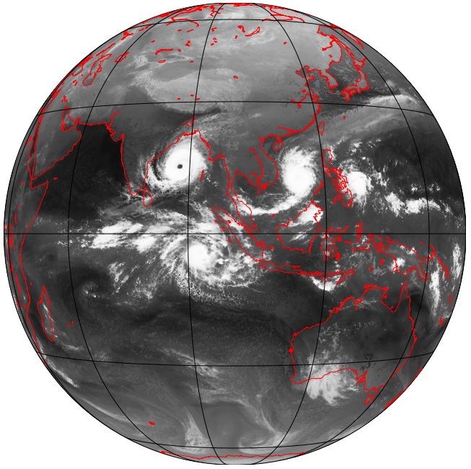
MPAS 3-km simulation results
Nick Weber
Cliff Mass

Slide 2

This project began with an evaluation of the subseasonal and seasonal prediction skill of the NOAA/NWS CFSv2 system, the operational subseasonal/seasonal forecasting system for the U.S.

Slide 3
CFSv2 model description
Global, fully coupled atmosphere-ocean-land model
T126 (~100km, ~1⁰ resolution)
4-member CFSv2 reforecast ensemble mean
Evaluated every 5 days, using 9 month runs.
Evaluated for reforecast period (1982-2010) against GDAS
Jan 1
Jan 2
Jan 3
Jan 4
Jan 5
Saha et al., 2011
9-month
3-month
45-day

Slide 4
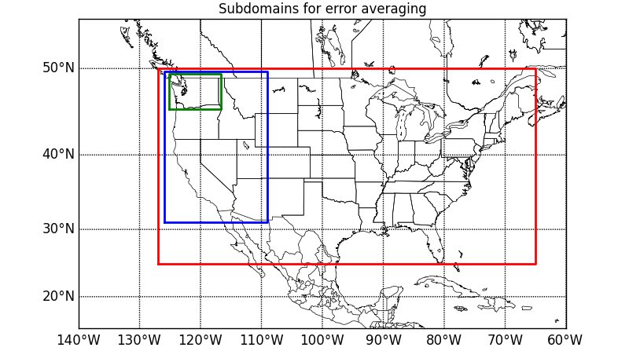
CFSv2 500 hPa skill vs lead time Verification Domains (also global)
Global
Conus
Western
WA

Slide 5
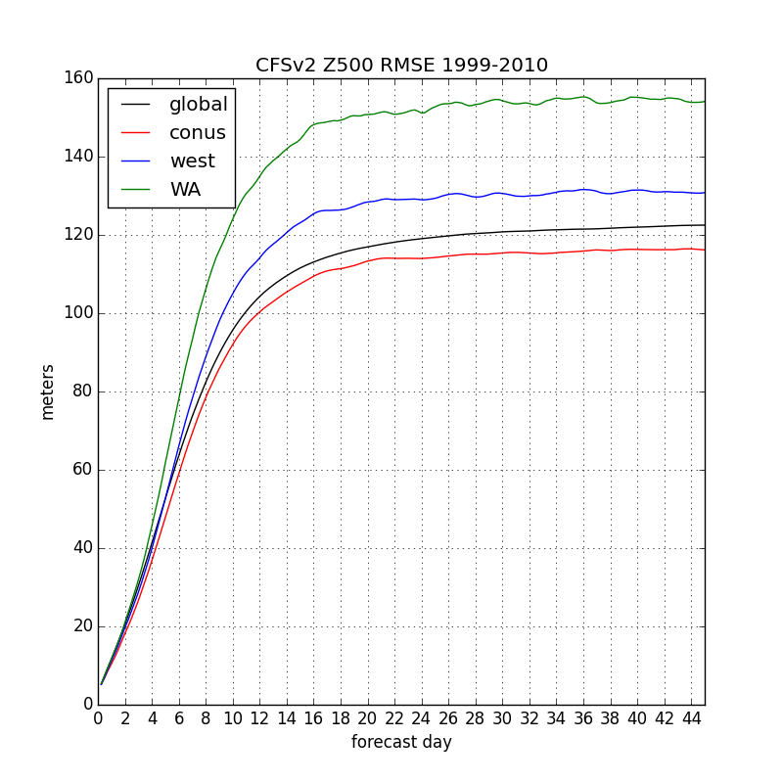
Errors Saturate After Three Weeks Minimal Skill In Third Week

Slide 6
How about CFSv2 convection? Goes bad quickly A hovmöller comparison at different lead times

Slide 7
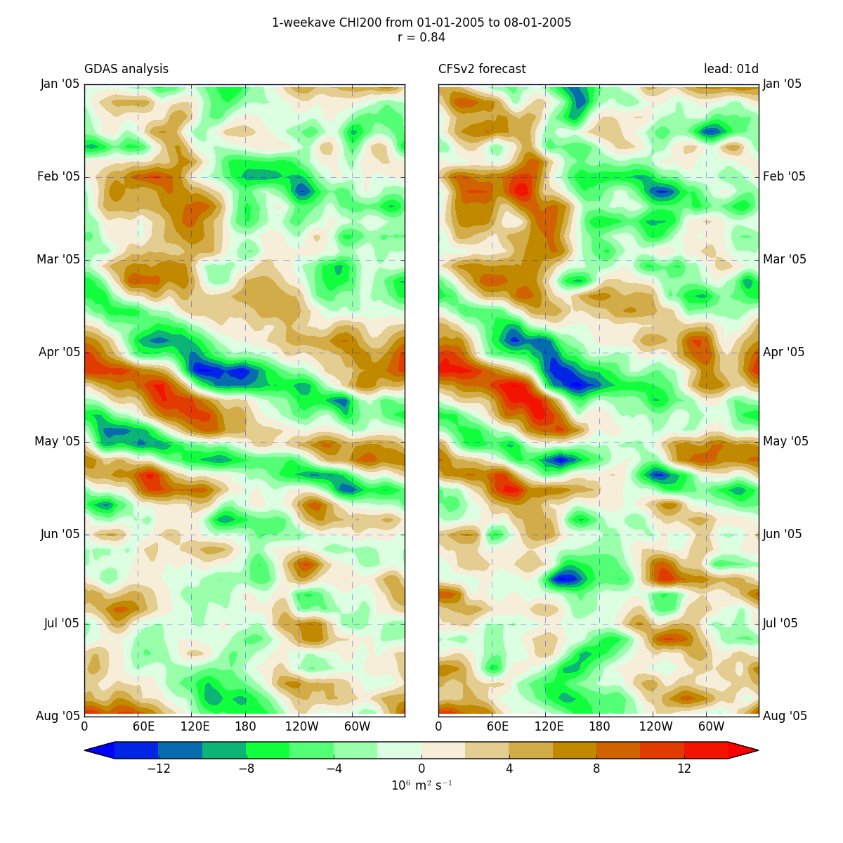
CHI200 öller: analyses vs week-1 forecasts
Spring/summer 2005
Averaged from 5S to 5N

Slide 8
CHI200 öller: analyses vs week-1 forecasts
Time period:
Spring/summer 2005
Short leads:
Clear propagating features in both the analyses and forecasts

Slide 9
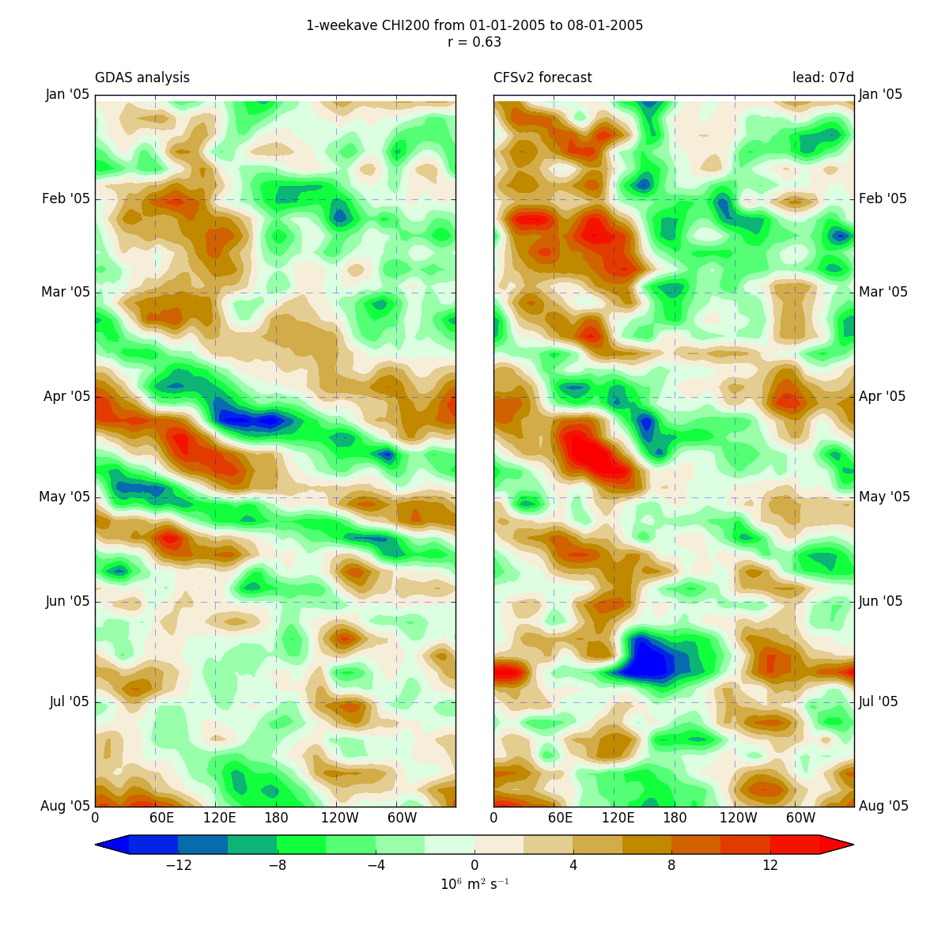
CHI200 öller: analyses vs week-2 forecasts
Time period:
Spring/summer 2005
Short leads:
Clear propagating features in both the analyses and forecasts

Slide 10
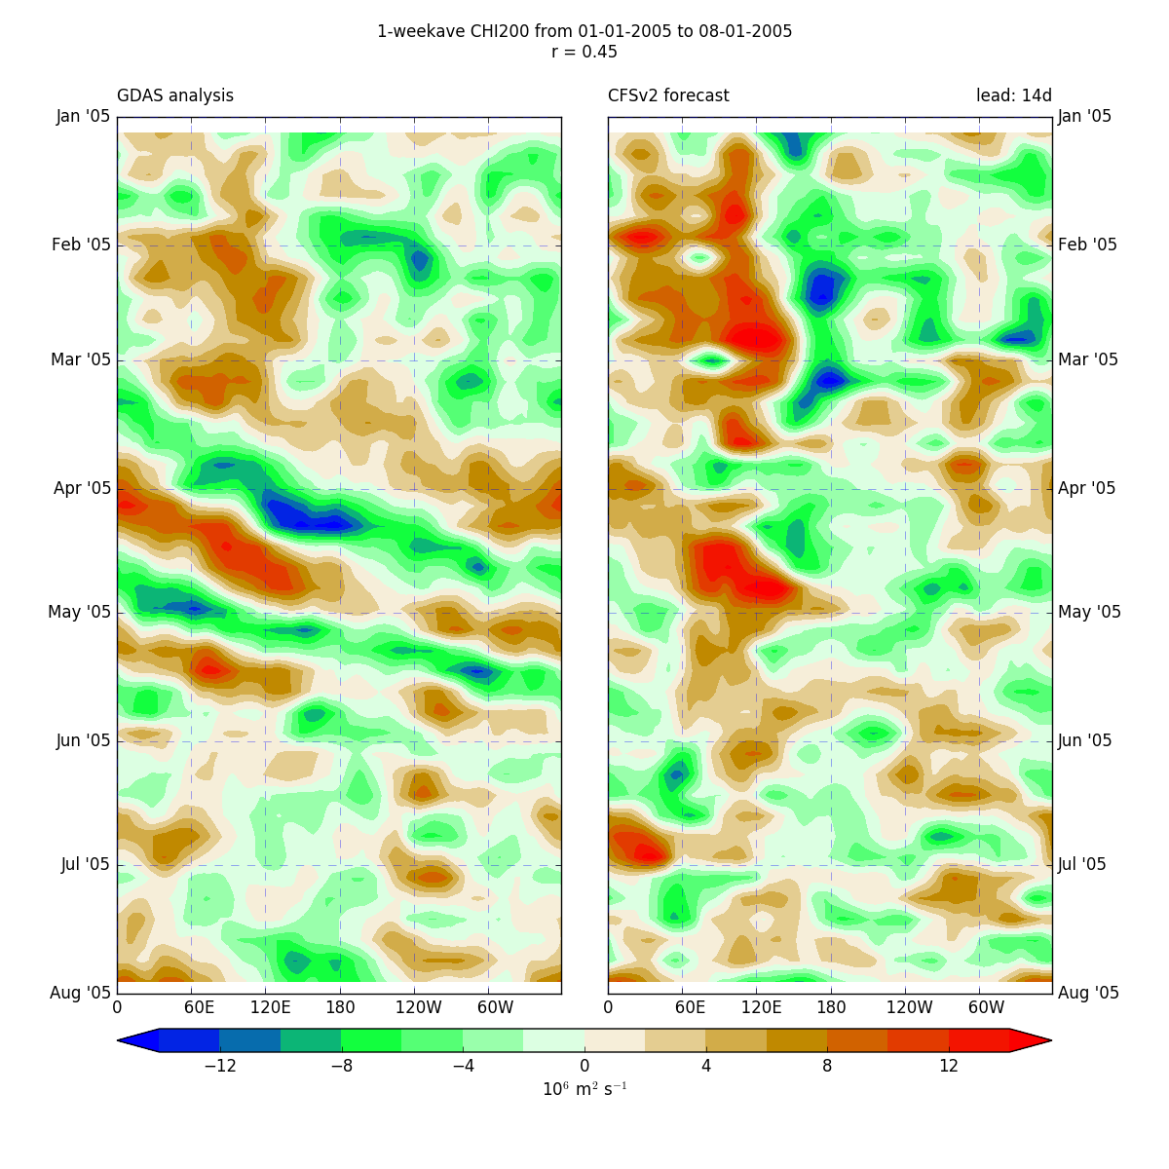
CHI200 ller: analyses vs week-3 forecasts
Time period:
Spring/summer 2005
Short leads:
Clear propagating features in both the analyses and forecasts

Slide 11
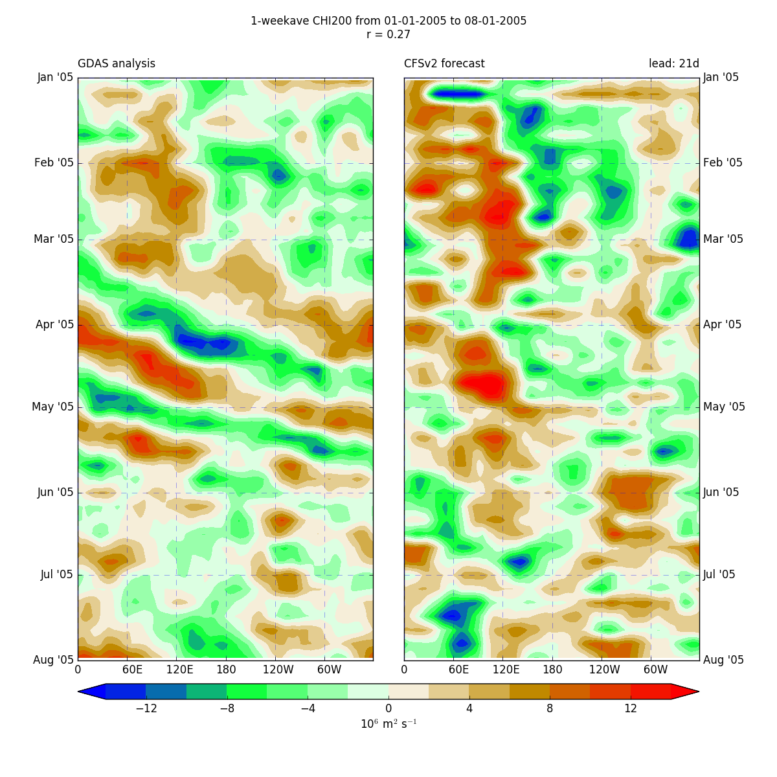
CHI200 ler: analyses vs week-4 forecasts
Time period:
Spring/summer 2005
Short leads:
Clear propagating features in both the analyses and forecasts

Slide 12
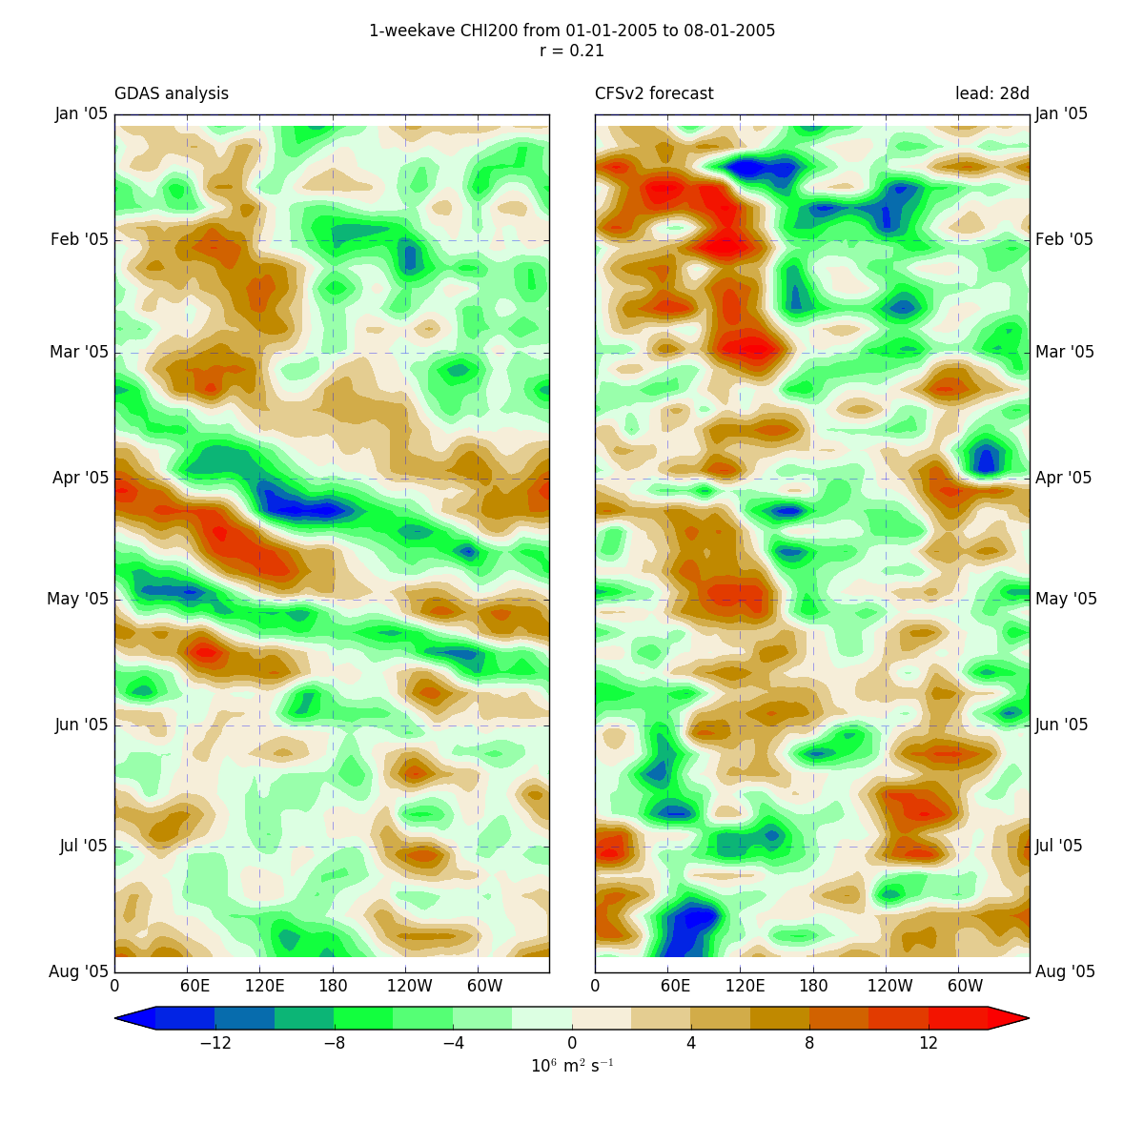
CHI200 Hovmöller: analyses vs week-5 forecasts
Time period:
Spring/summer 2005
Short leads:
Clear propagating features in both the analyses and forecasts
Long leads:
Coherent propagating structures are lost, while more stationary patterns develop

Slide 13
Improving global weather prediction from days to weeks
Convective areas have a huge impact on global circulations, with teleconnection from the tropics greatly impacting midlatitude weather systems.
Global forecast models have generally been relatively coarse, with nearly all of them parameterizing convection.
Convective parameterizations have substantial problems.
There is a deep literature showing how running models at convection-allowing resolutions (4-km grid spacing or less) can greatly improve the fidelity of model forecasts.

Slide 14
So the big question
If we ran global models at convection-allowing resolutions (say 3-km grid spacing), would global prediction improve?
Could this improve extended forecasts (out to a month).
During the past few months, we have attempted such forecasts and the results are very promising (see rest of powerpoint)
To make this operational, the big issue is computer power, which is now becoming available.

Slide 15
Subseasonal Experiments with MPAS
3-km grid spacing for the entire globe
One-month runs
Initialized with GFS FNL analyses
No cumulus parameterization
Thompson Microphysics
MYNN PBL
NOAA LSM
RRTMG Radiation
SST remains constant during the simulations

Slide 16
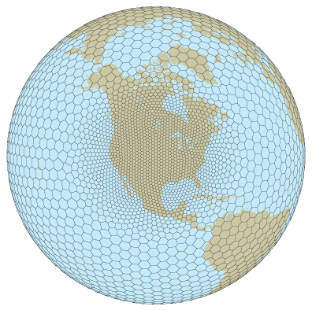
MPAS

Slide 17
Note:
Using constant SST is substantially hurting our simulations and would not be used in operational simulations.
FNL initialization are quite coarse (.5 degree).
We will compare:
TRMM analyses (REALITY)
CFSv2 operational forecasts
MPAS at 15 km resolution globally with Grell-Frietas cumulus parameterization
MPAS at 3 km resolution globally without cumulus parameterization

Slide 18
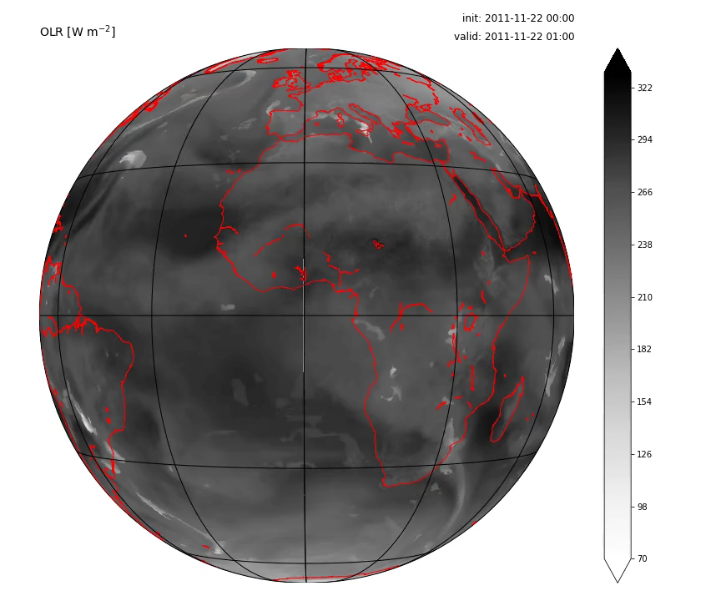
Case 1: DYNAMO MJO2 (2011-11-22)

Slide 19
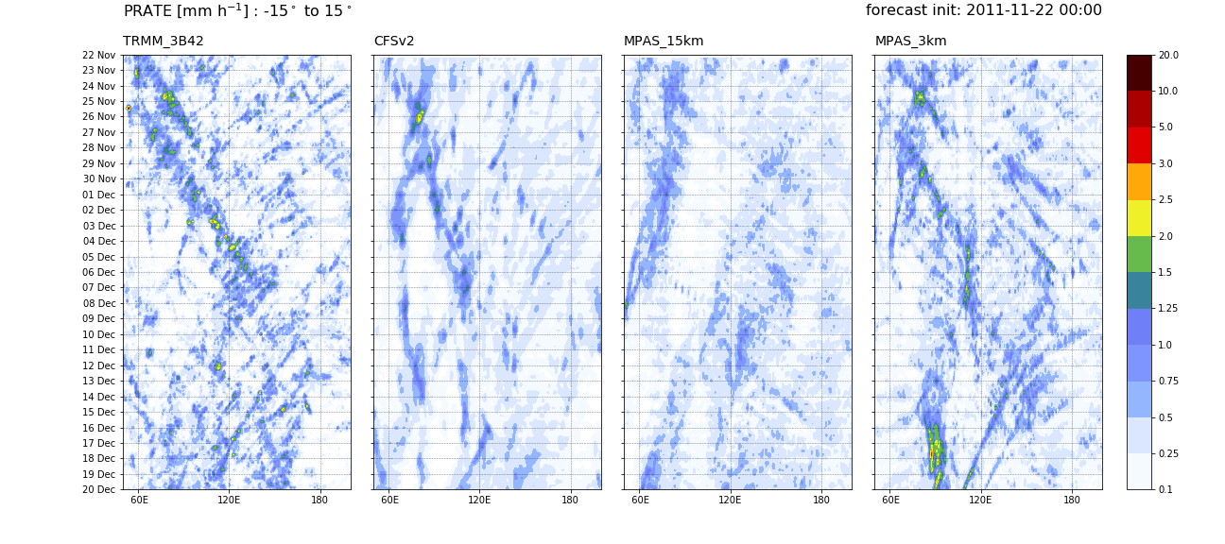
Case 1: Hovmöllers – precip. rate

Slide 20
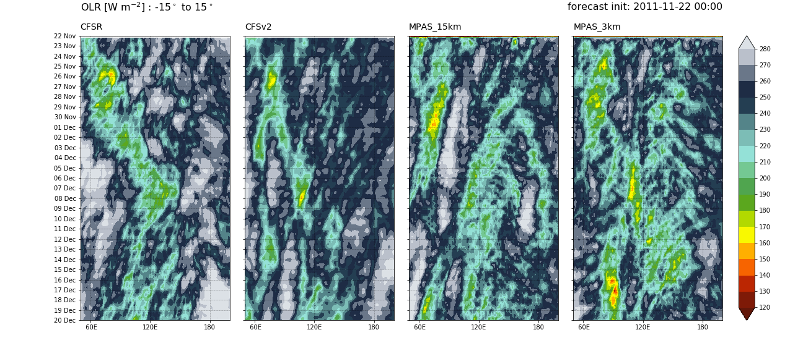
Case 1: Hovmöllers – OLR

Slide 21
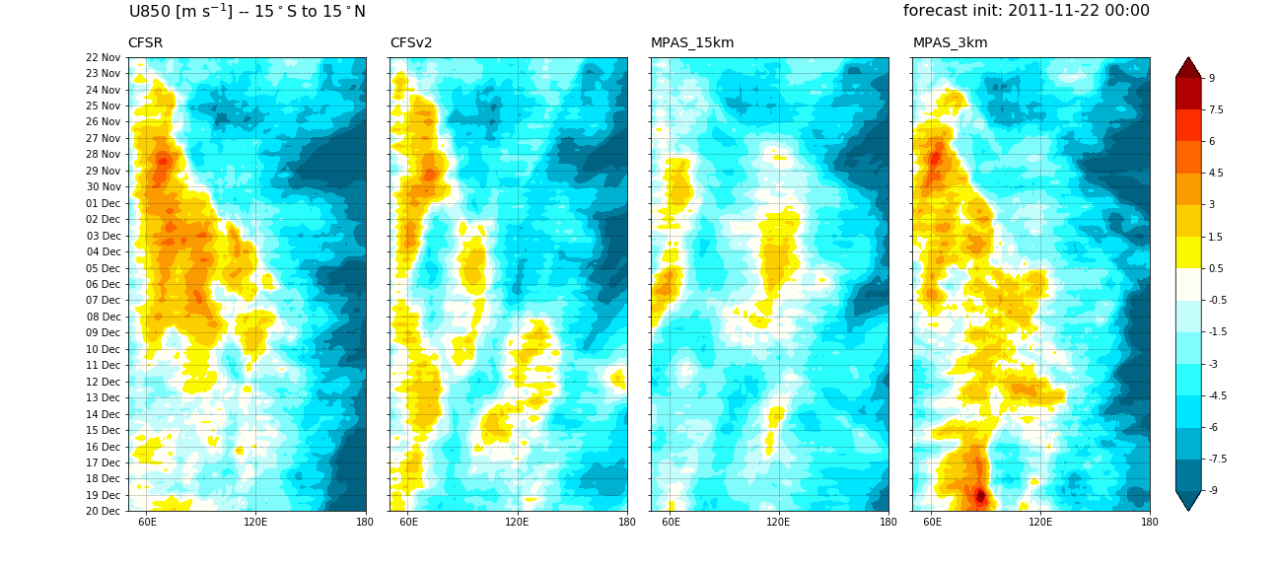
Case 1: Hovmöllers – u850

Slide 22
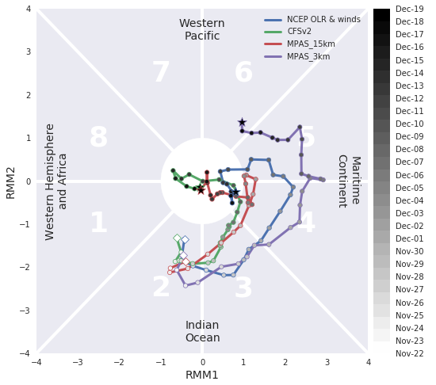
Case 1: MJO RRM indices

Slide 23
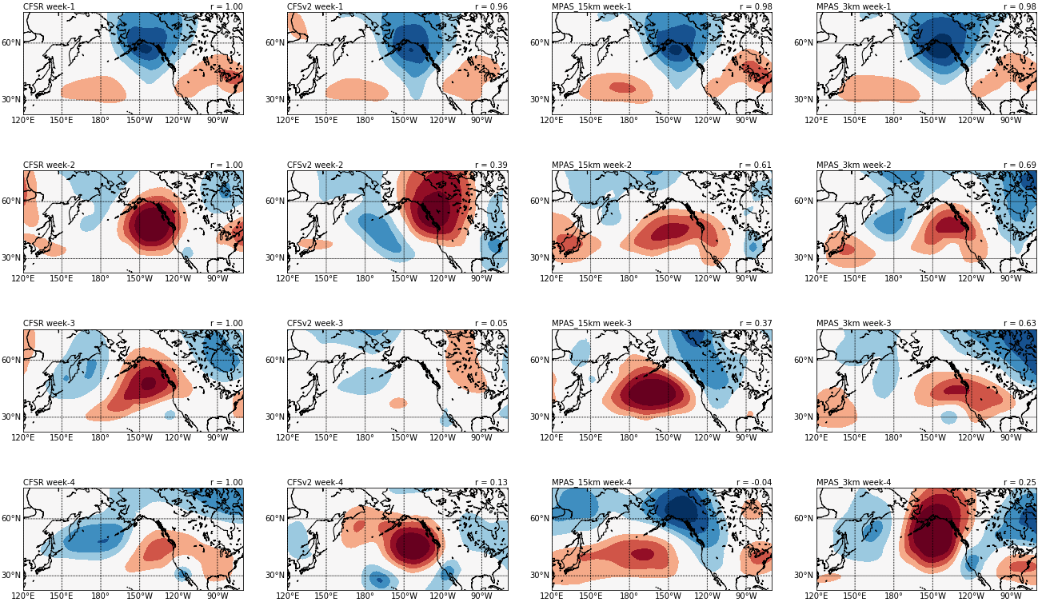
Case 1: Extratropical Z500’

Slide 24
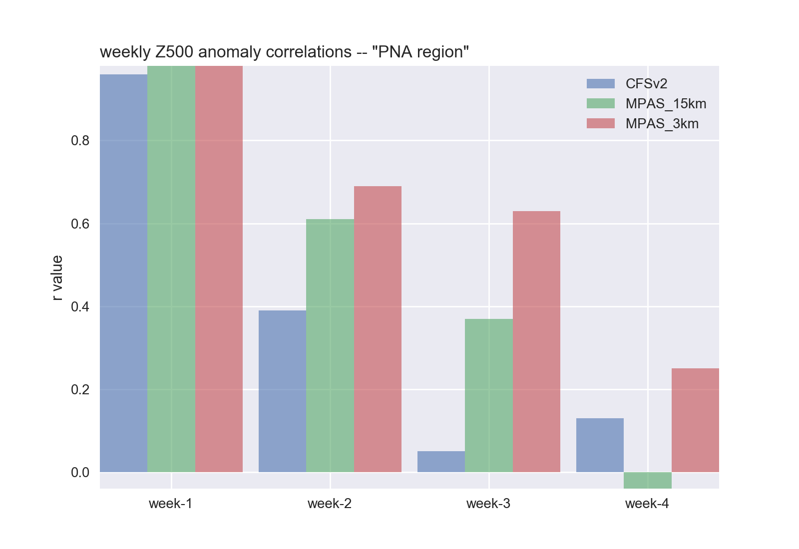
Case 1: Extratropical Z500’

Slide 25
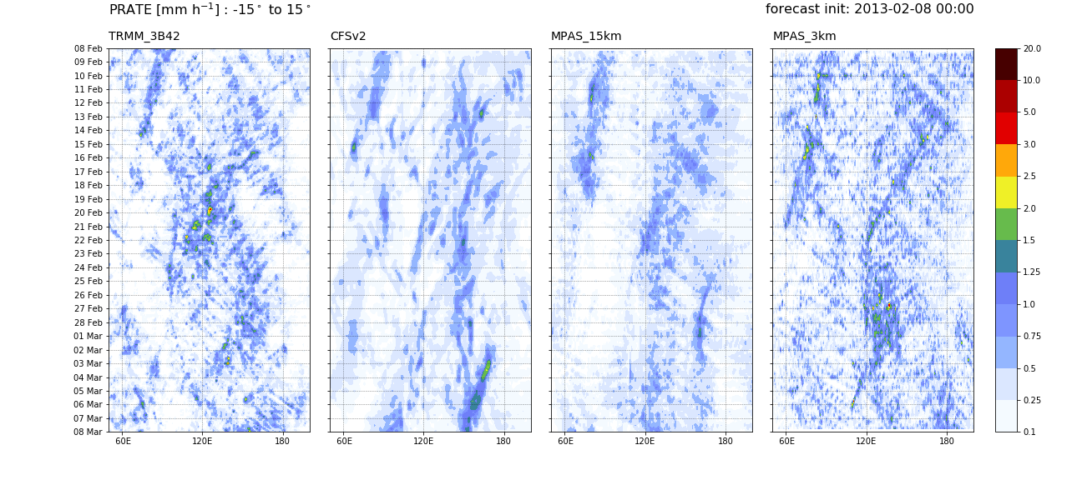
Case 2: 2013-02-08
Less successful….

Slide 26
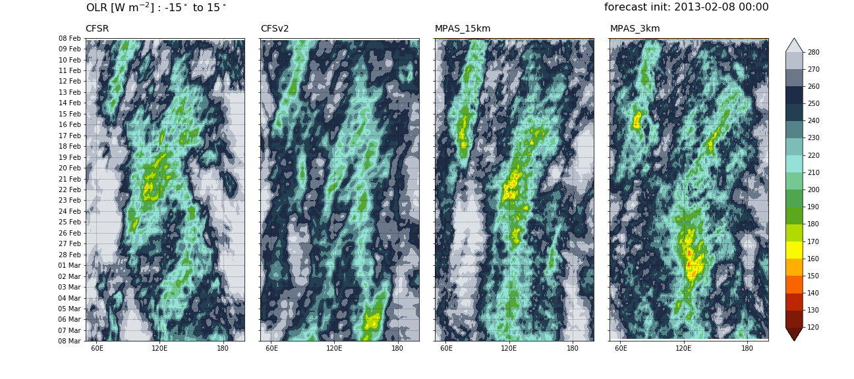
Case 2: Hovmöllers – OLR

Slide 27
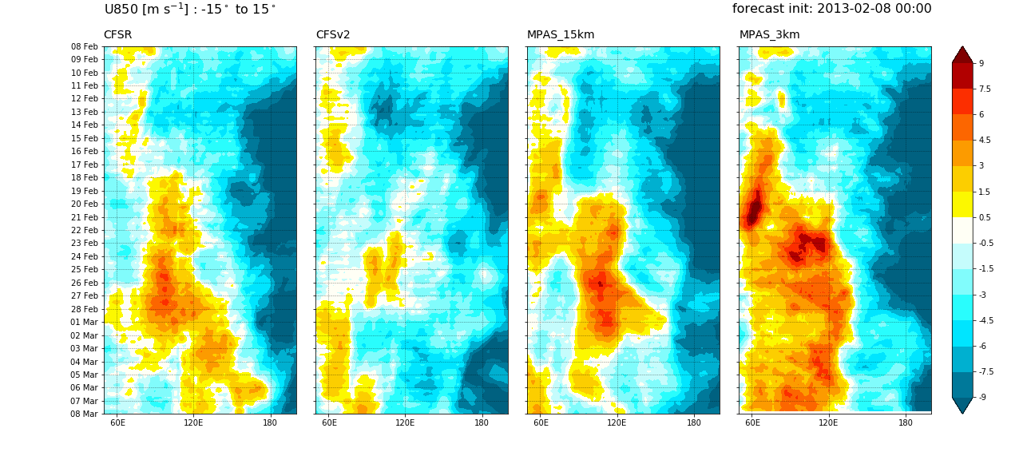
Case 2: Hovmöllers – u850

Slide 28
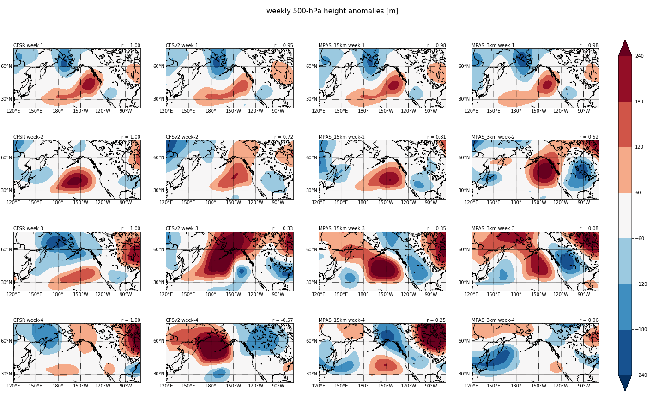
Case 2: Extratropical Z500’

Slide 29
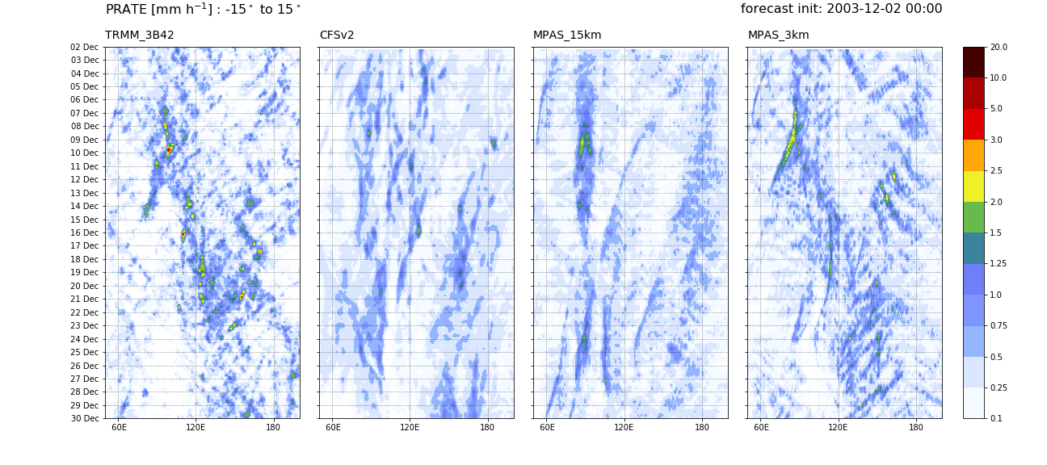
Case 3: 2013-12-02
Incredible!

Slide 30
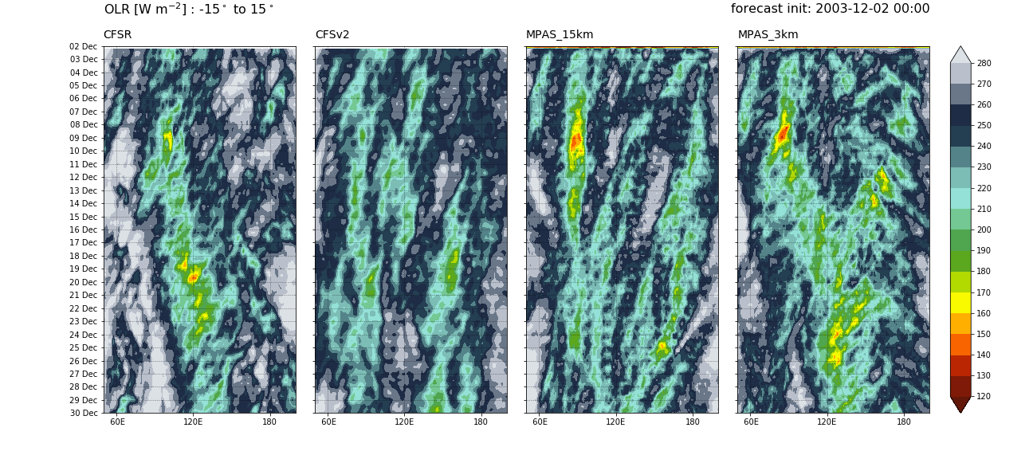
Case 3: Hovmöllers – OLR

Slide 31
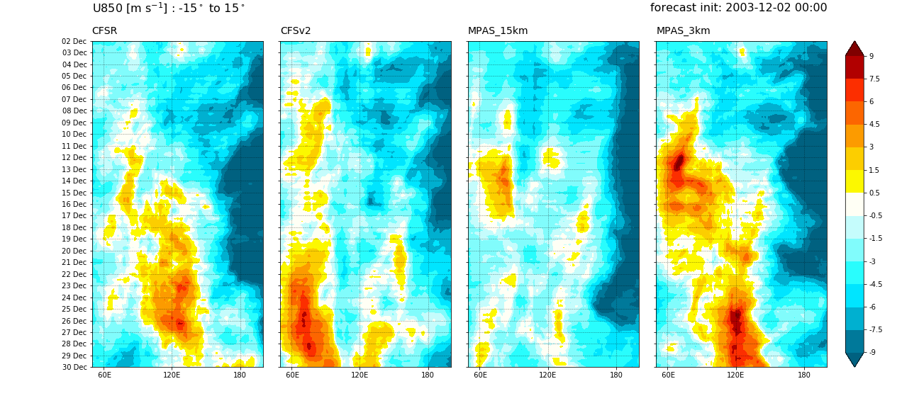
Case 3: Hovmöllers – u850

Slide 32
Case 3: MJO RRM indices

Slide 33
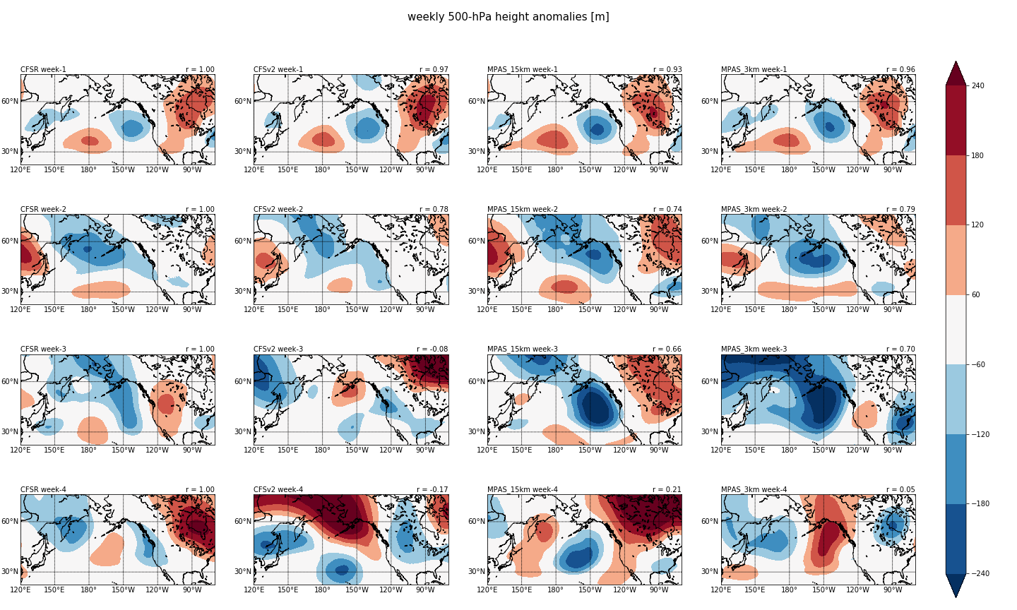
Case 3: Extratropical Z500’
No “dramatic” improvement

Slide 34
What about “mean state” characteristics?

Slide 35
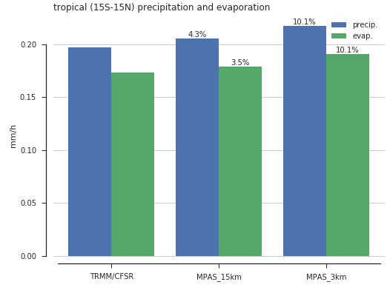
Volumetric precip. & evaporation
3-km has ~10% more tropical precip. & evap. than the obs/analysis
15-km has only a ~4% bias
Due to lack of ocean feedback?

Slide 36
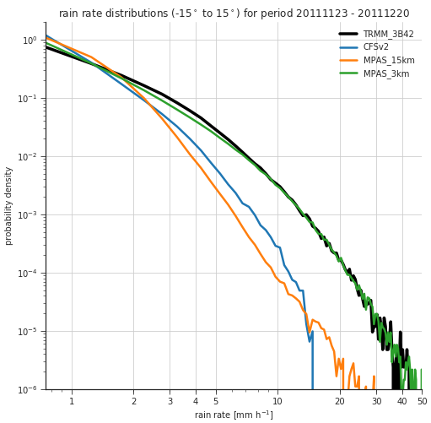
Distributions of precip. rates
3-km simulation almost perfectly matches the TRMM distribution!
Parameterized runs have too much light precip. and too little heavy precip.

Slide 37
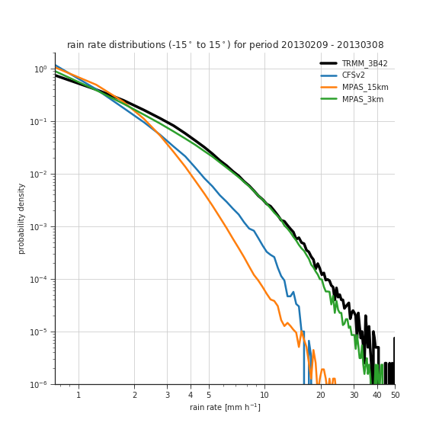
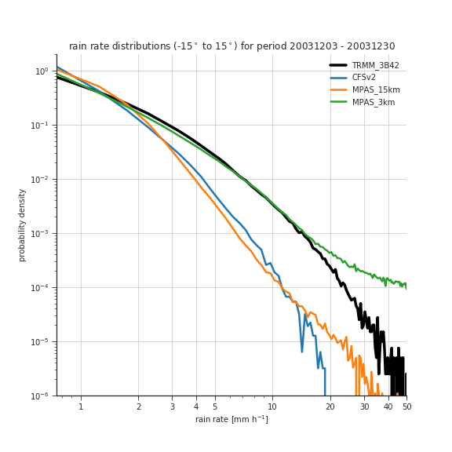
Other cases

Slide 38
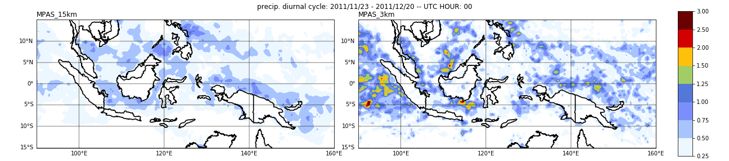
Diurnal cycle of precipitation

Slide 39
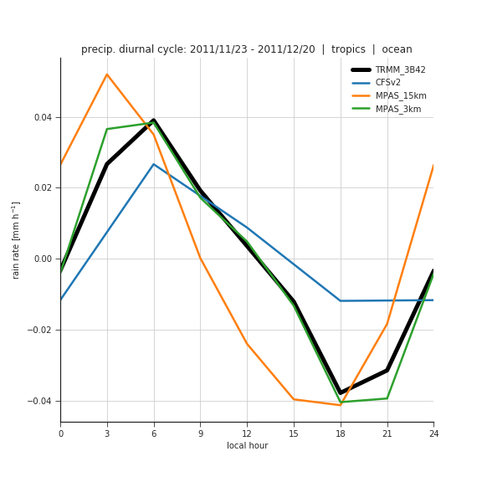
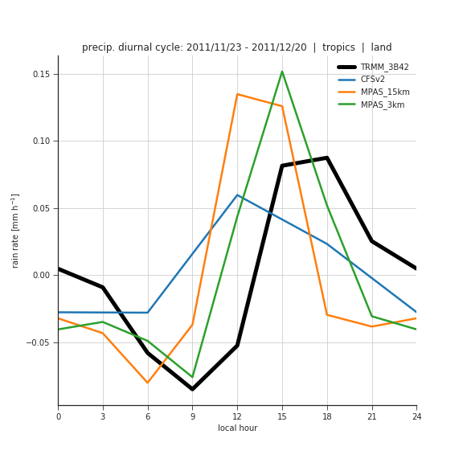
Diurnal cycle – full tropics
ocean
land
Diurnal peak timing is improved at 3km both over land and ocean
Improvement is most improved over the ocean – nearly perfect!

Slide 40
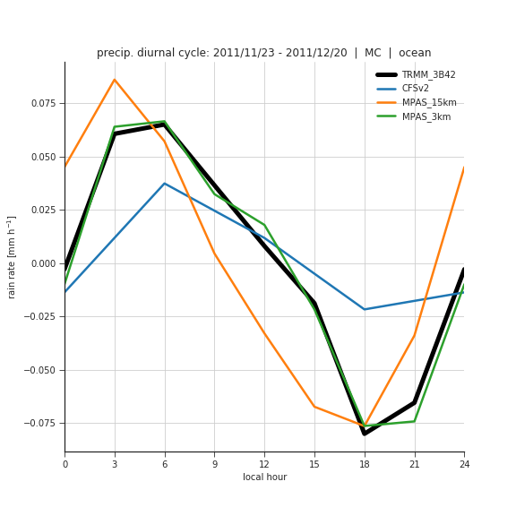
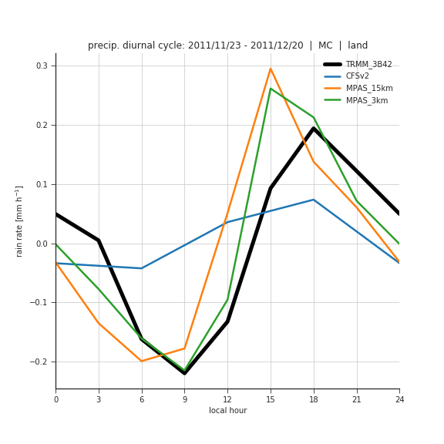
Diurnal cycle – Maritime Continent
ocean
land
Very similar story over just the Maritime Continent region

Slide 41
This work will continue
Enough computer resources to do three more one month cases.
Looks very promising.

Slide 42
The end

