Slide 1
Atmospheric Rivers and the Pacific Northwest: Flow Sensitivity and Climate Change
Cliff Mass University of Washington
USACE, Nov. 9, 2016

Slide 2
Atmospheric rivers are the big players in heavy precipitation and flooding along the U.S. West Coast

Slide 3
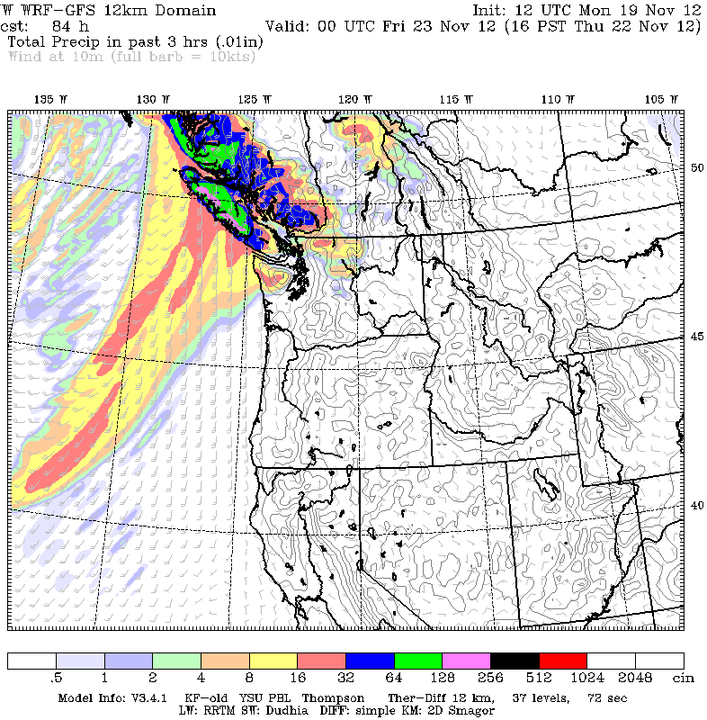
High-Resolution Models Are Quite Skillful in Simulating Their Interactions with West Coast Terrain

Slide 4
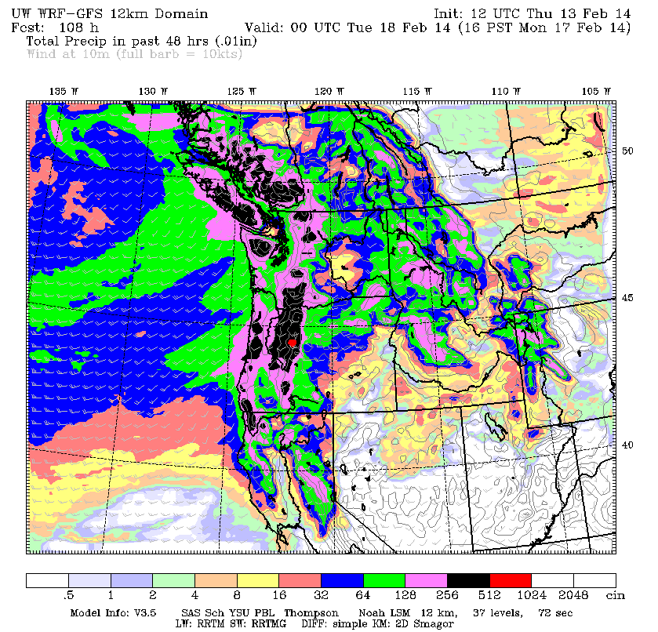

Slide 5
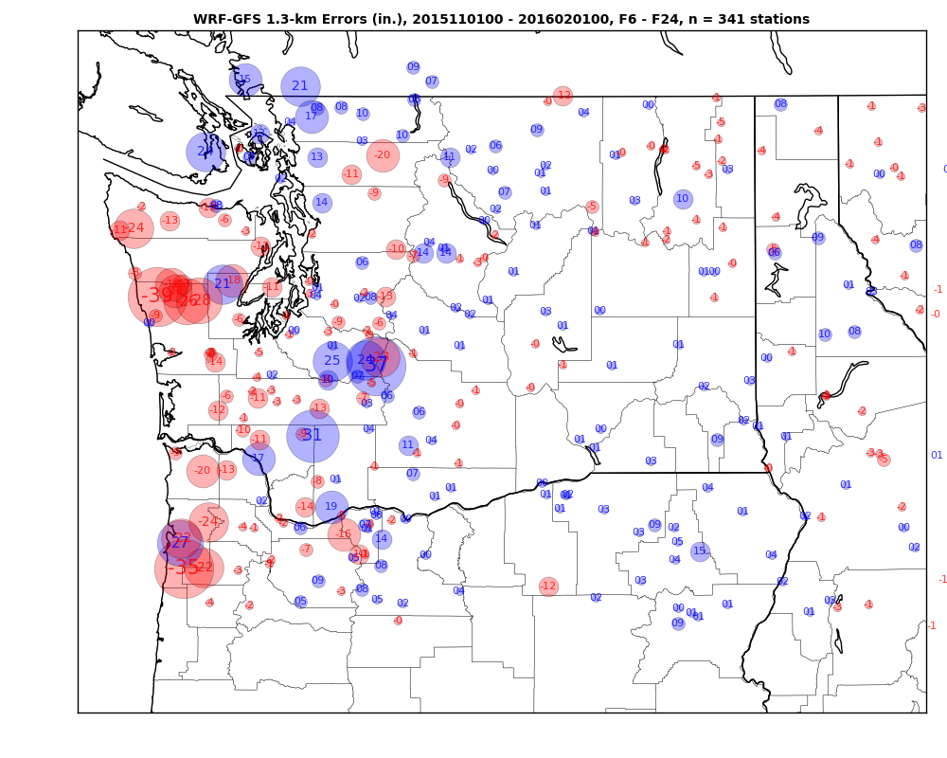
The Recent OLYMPEX field experiment (Nov-March 2016) sampled several atmospheric rivers and provided detailed evaluations of model precipitation skill.

Slide 6
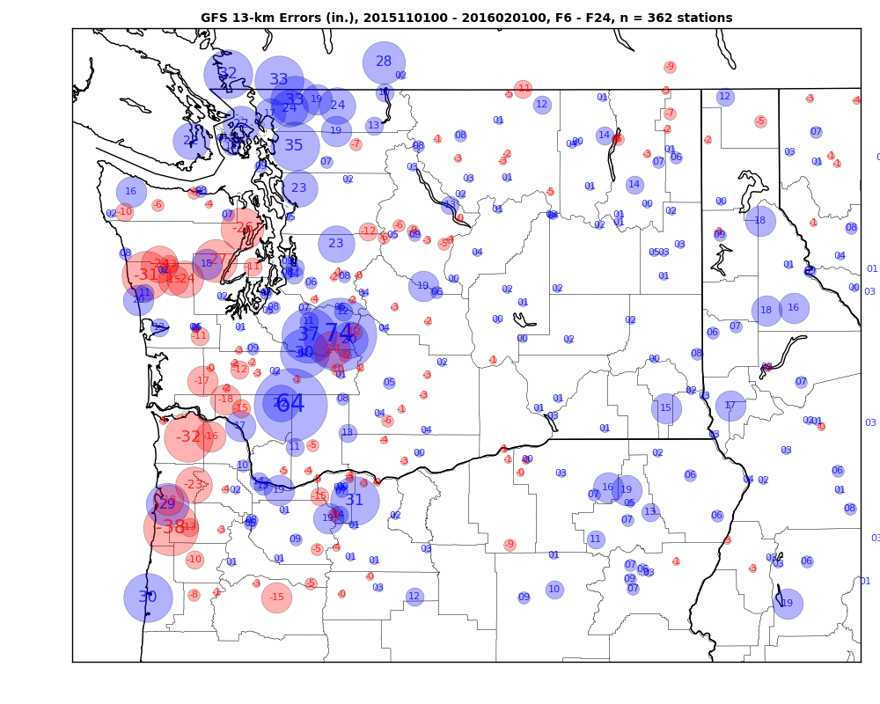
NWS GFS

Slide 7
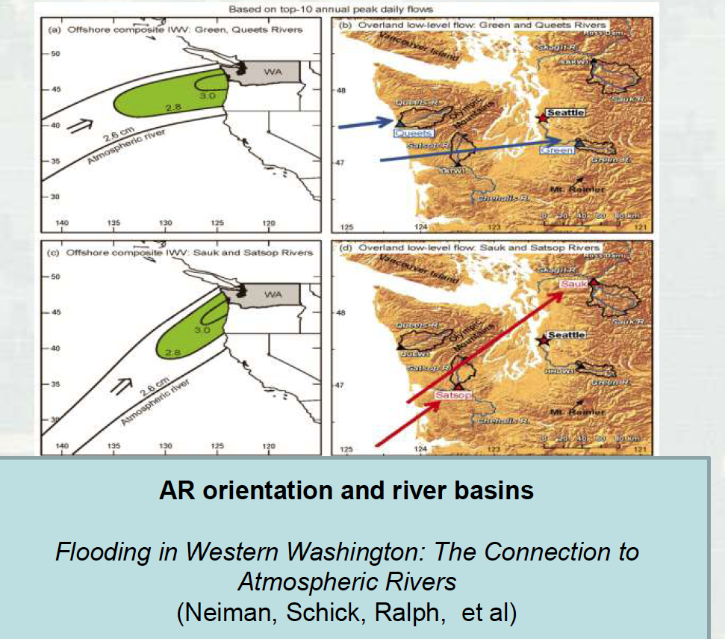
Small Changes in Direction or Orientation Can Have Large Impacts on Precipitation

Slide 8
How can we get a more quantative understand on the directional sensitivity and thus the uncertainty in precipitation over major drainages?

Slide 9
Idealized Modeling Using Real Terrain and Full-Physics WRF Model

Slide 10
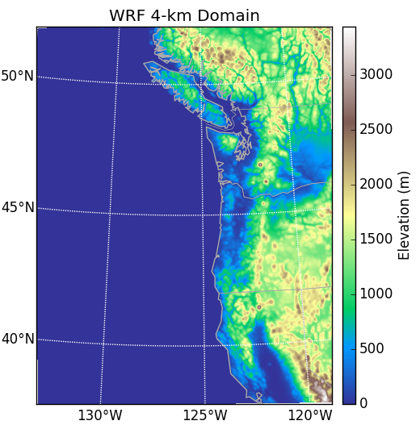
Model configuration
WRF-ARW V3.5 ¹
4-km horizontal resolution
305 x 390 grid points, 37 vertical levels
Parameterizations include:
Thompson microphysics ²
RRTMG SW and LW radiation ³
YSU PBL ⁴
Old SAS cumulus ⁵
12 second time step, 48-hour integration under constant BCs
1. Skamarock et al. 2008; 2. Thompson et al. 2008; 3. Iacono et al. 2008; 4. Hong et al. 2006; Grell et al. 1994

Slide 11
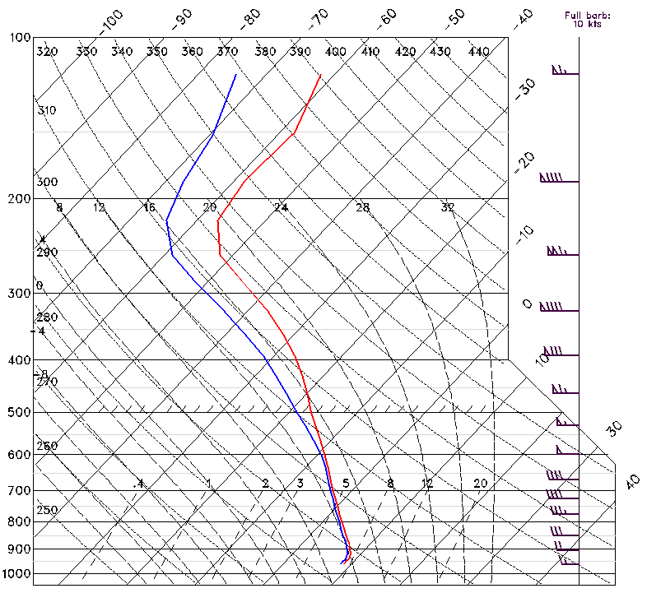
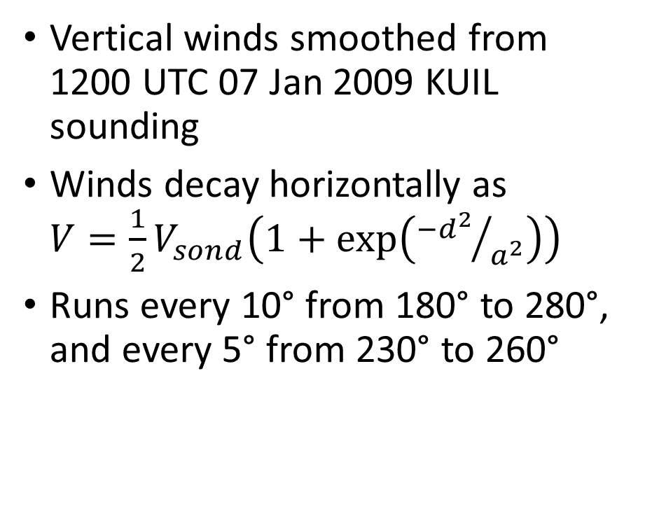
Realistic case
Vertical winds smoothed from 1200 UTC 07 Jan 2009 KUIL sounding
Winds decay horizontally as $V=\frac{1}{2}V_{sond}\left(1+\exp\left({−d^{2}}/{a^{2}}\right)\right)$
Runs every 10° from 180° to 280°, and every 5° from 230° to 260°

Slide 12
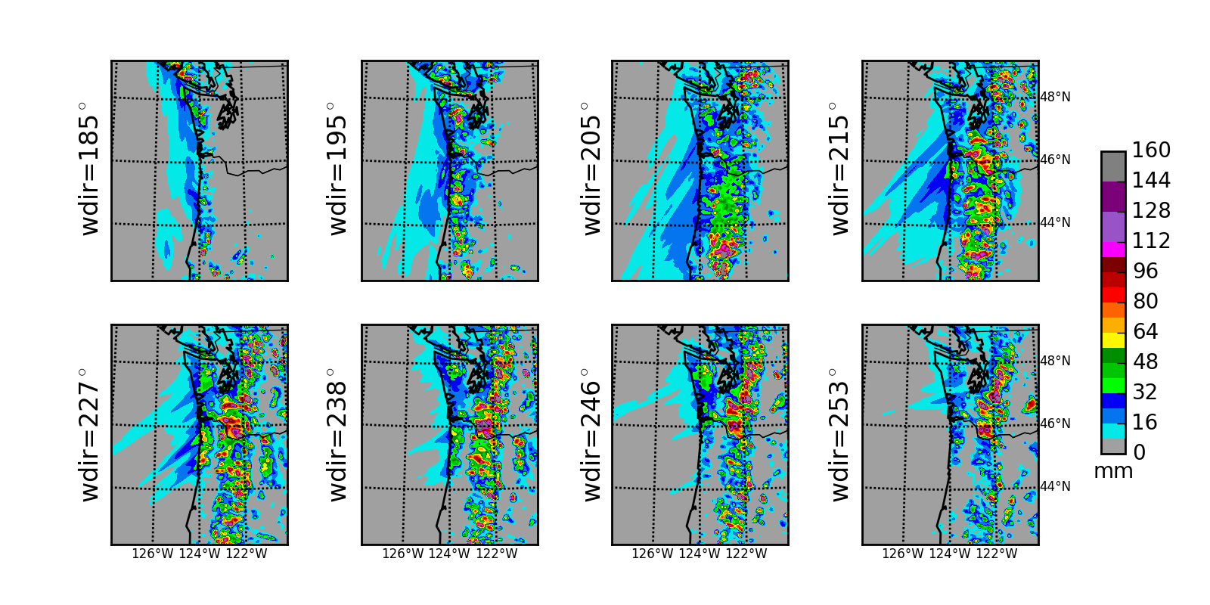
S
SSW
SW
WSW

Slide 13
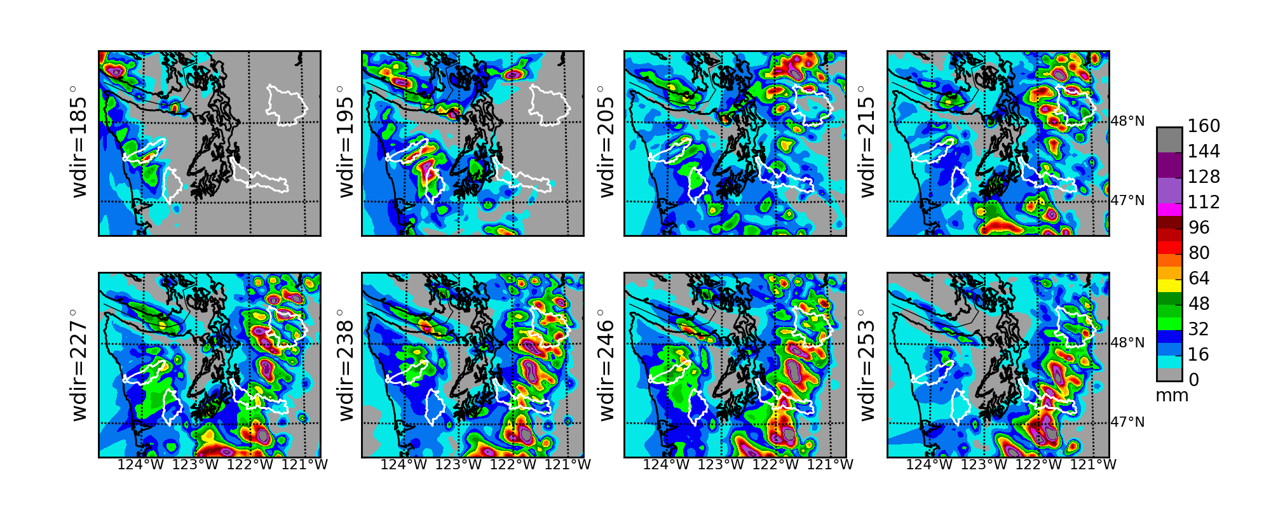
S
SSW
SW
WSW

Slide 14
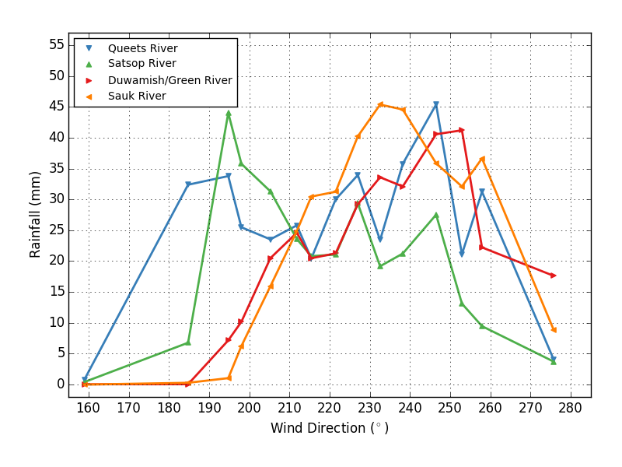
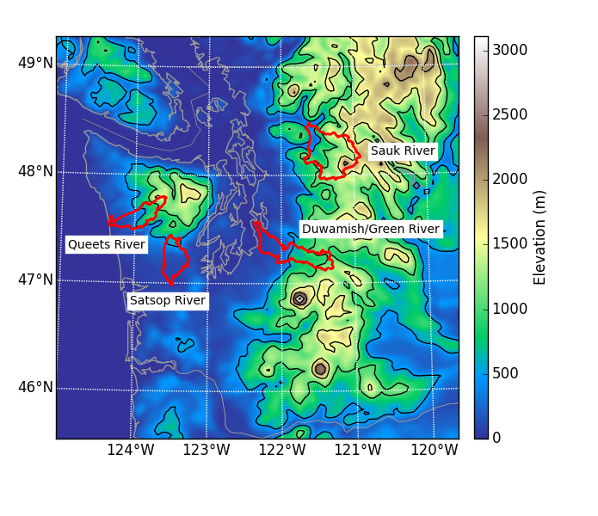

Slide 15
Comparison with literature (direction of max precipitation over watershed)-looks good
Realistic experiment:
Queets: 247°
Satsop: 195°
Sauk: 233°
Duwamish/Green: 253°
Except edge cases where flow turns onshore, highest sensitivity is 18% per degree of rotation
Neiman et al. (2011)
Queets: 247.5° (WSW)
Satsop: 202.5° (SSW)
Sauk: 225° (SW)
Duwamish/Green: 245°-275°

Slide 16
Conclusions from the idealized modeling
Olympic Mountain and Cascade Range precipitation is very sensitive to wind direction
Model results show very good agreement with previous studies regarding flow direction for heavy rainfall
Implication: small forecast errors for incoming wind direction can have big impacts on precipitation in specific drainages.

Slide 17
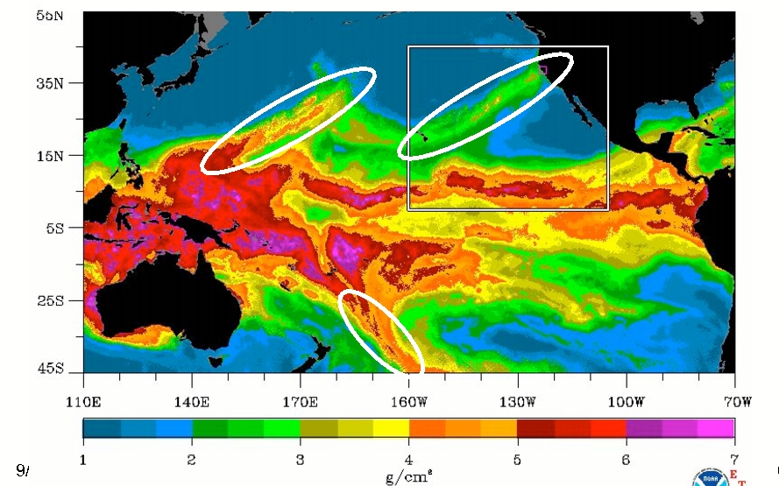
What will happen to extreme precipitation over the Northwest under global warming?
To get the answer must answer another question:
What will happen to atmospheric rivers under global warming?

Slide 18
Examining the Latest CMIP-5 GCMs
Changes in wintertime atmospheric rivers along the North American west coast in CMIP5 climate models
Michael D. Warner, Clifford F. Mass, Eric Salathé, Jr.
Geophysical Research Letters

Slide 19
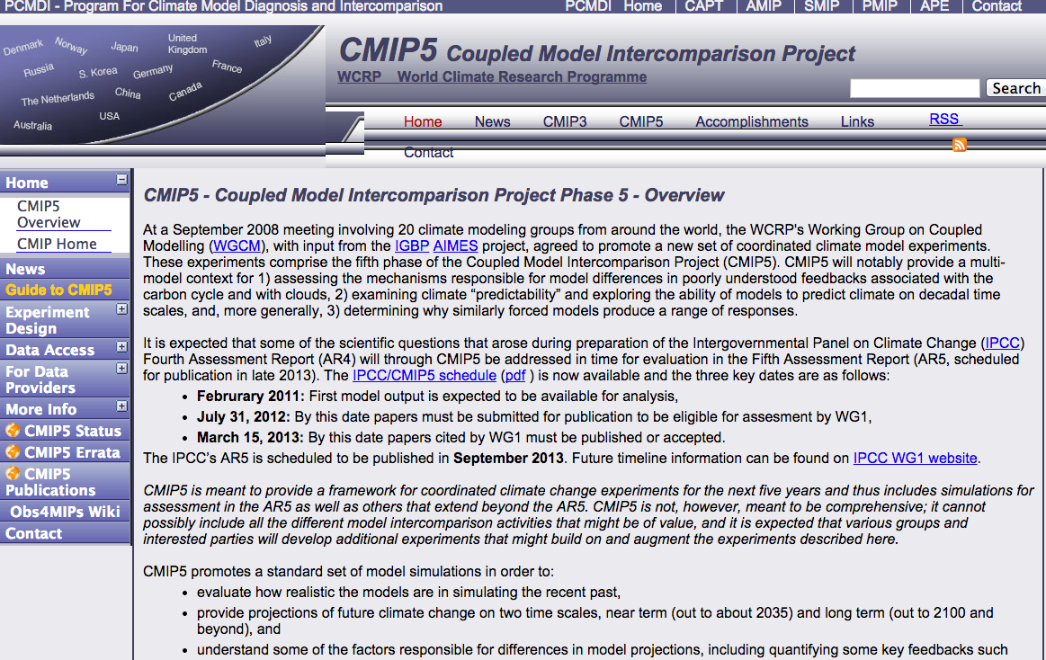

Slide 20
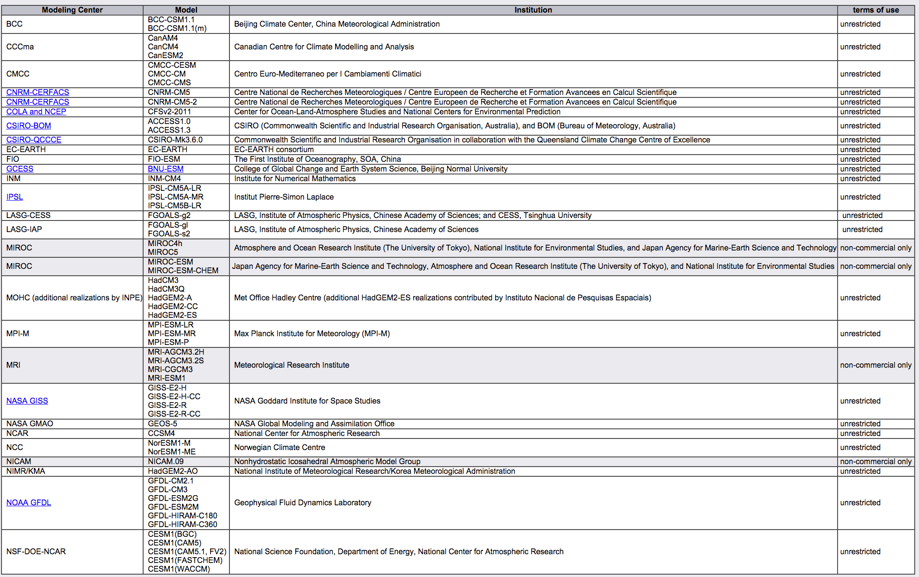
CMIP-5 Simulations: Relatively Coarse Global Coupled GCMs

Slide 21
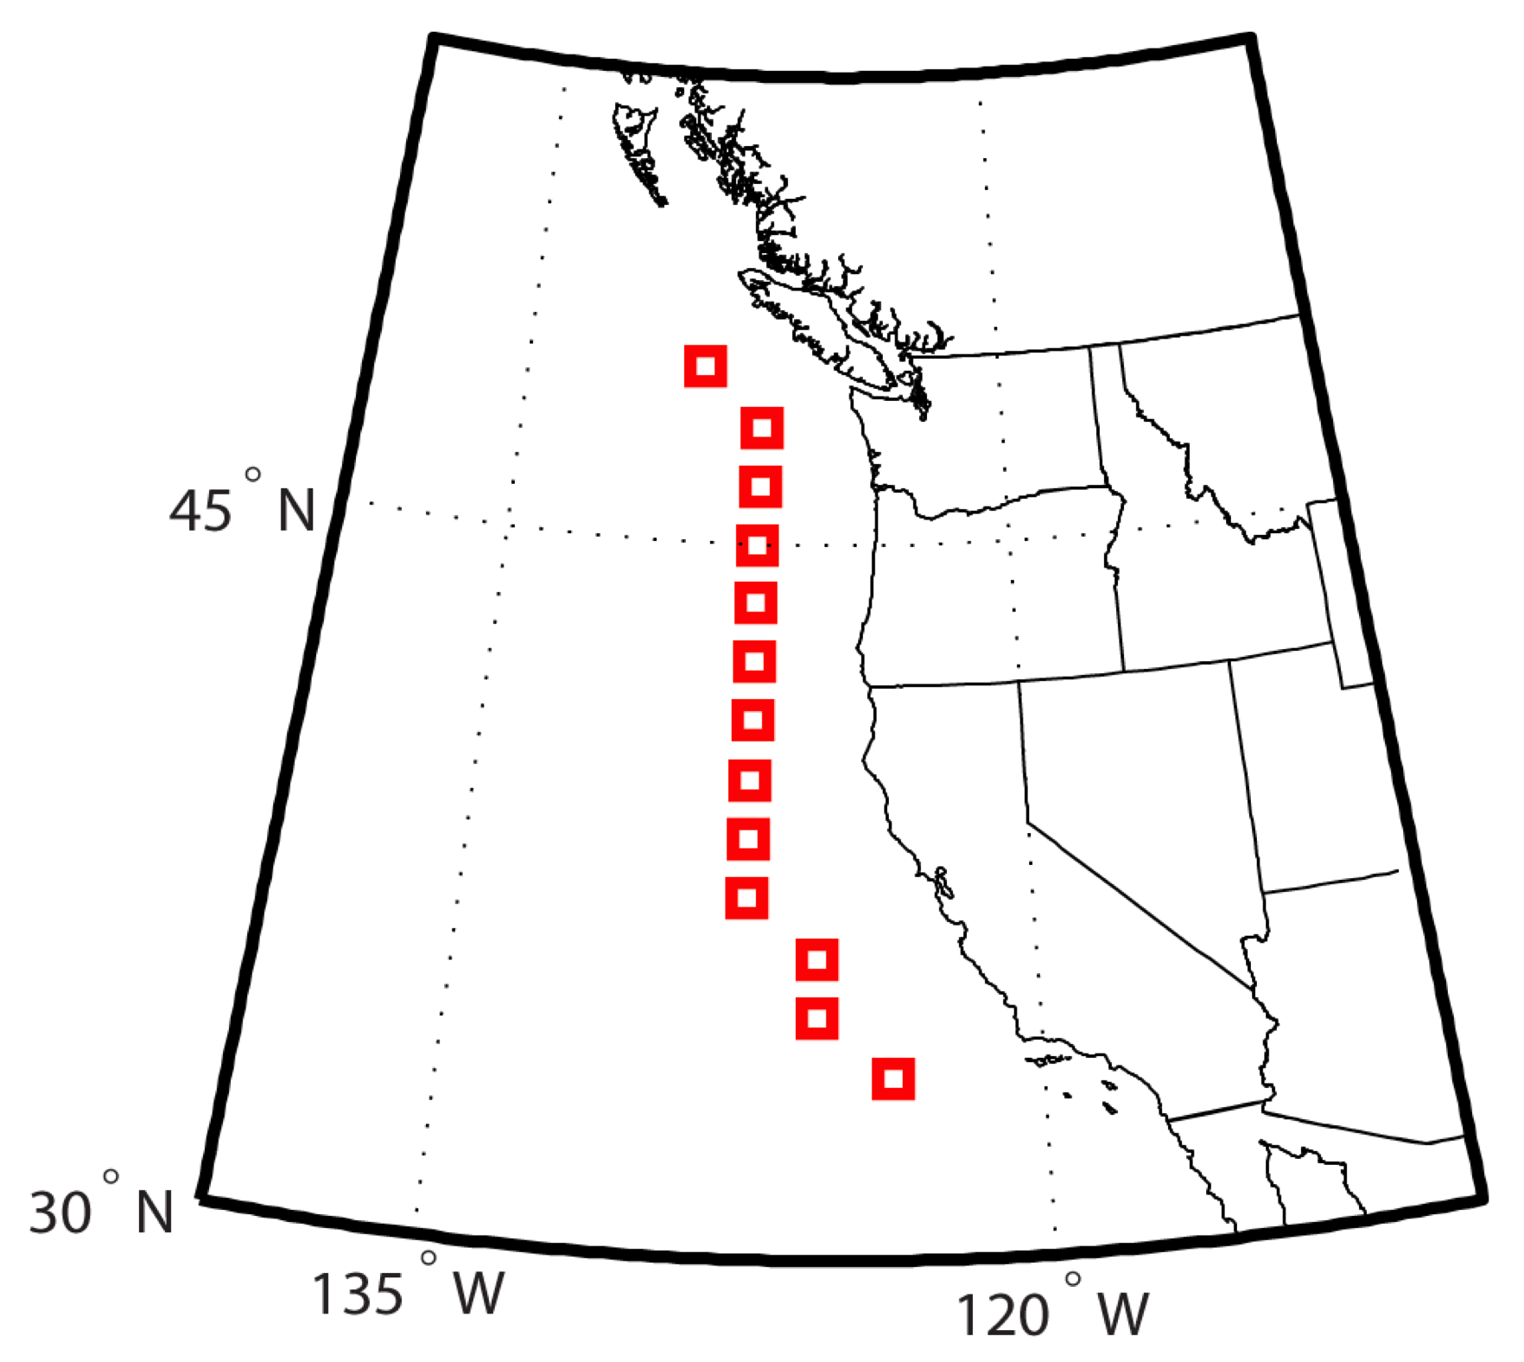
What is happening immediately offshore?

Slide 22
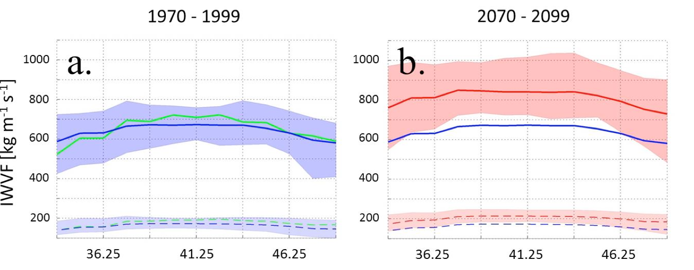
Integrated Water Vapor Flux: Closely Related to Strength of Atmospheric Rivers
Extreme (99%)
Mean
Green lines are NCEP reanalysis
Blue: CMIP-5 models (contemporary)
Red: Future CMIP-5 models

Slide 23
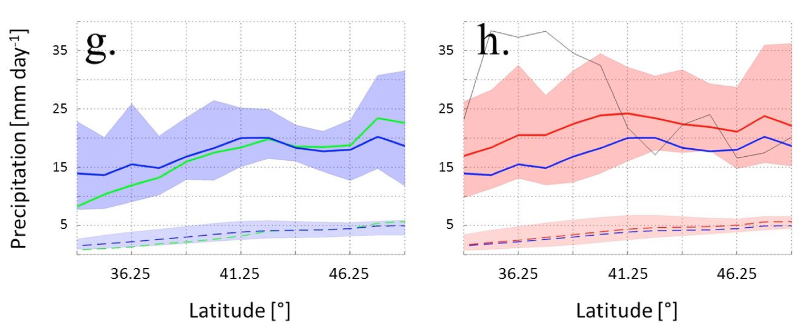
Precipitation (offshore)
1970-1990
2070-2099

Slide 24
Results
Winter-mean precipitation along the West Coast increases by 11-18% while precipitation on extreme atmospheric river days increases by 15-39% .
The frequency of days above the historical 99th percentile threshold in water vapor flux increases as much as 290% by the end of this century.

Slide 25
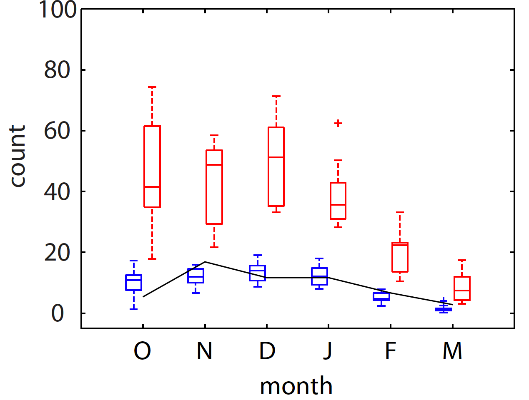
Other Results
There is a shift of heavier precipitation events to earlier in the season
10-model winter mean (October-March) climatology of AR events defined by historical (1970-1999) 99th percentile IVT and averaged over the northwest coast. Red (2070-99)) and blue (1970-99) NCEP reanalysis events are represented in black solid line.

Slide 26
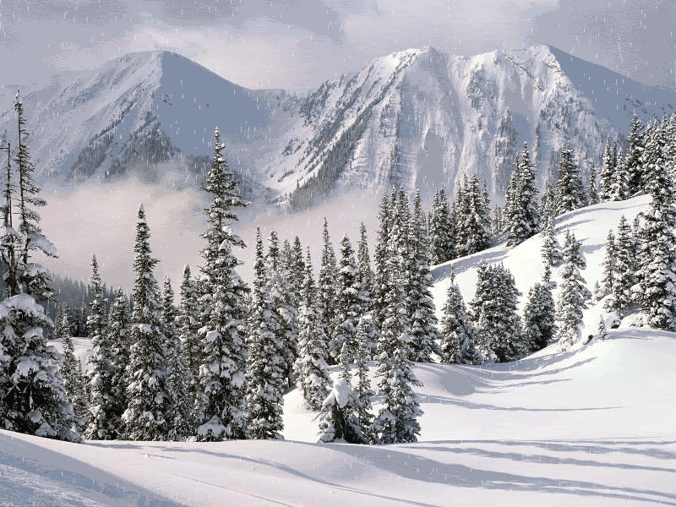
Earlier is not better
With less snow due to global warming and being earlier in the season, there will be reduced buffering or water storage in the snowpack.
Thus, heavier rainfall could lead to greater flooding on major rivers.

Slide 27
How do we get a better handle on extreme precipitation in the NW and elsewhere? Regional climate modeling using dynamical downscaling

Slide 28
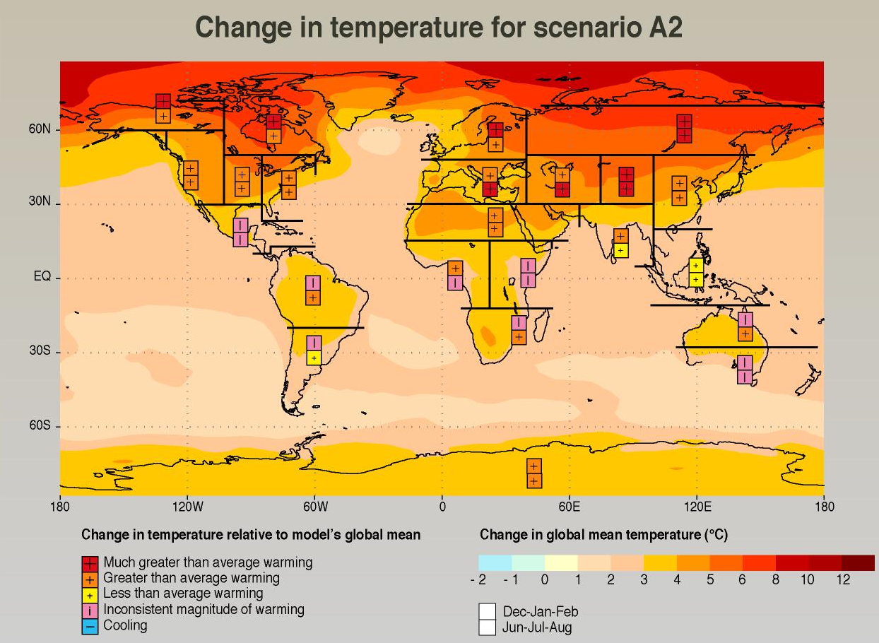
GCMs Indicate that Global Warming is NOT Expected to be Globally Uniform

Slide 29
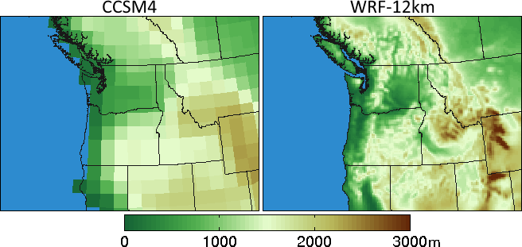
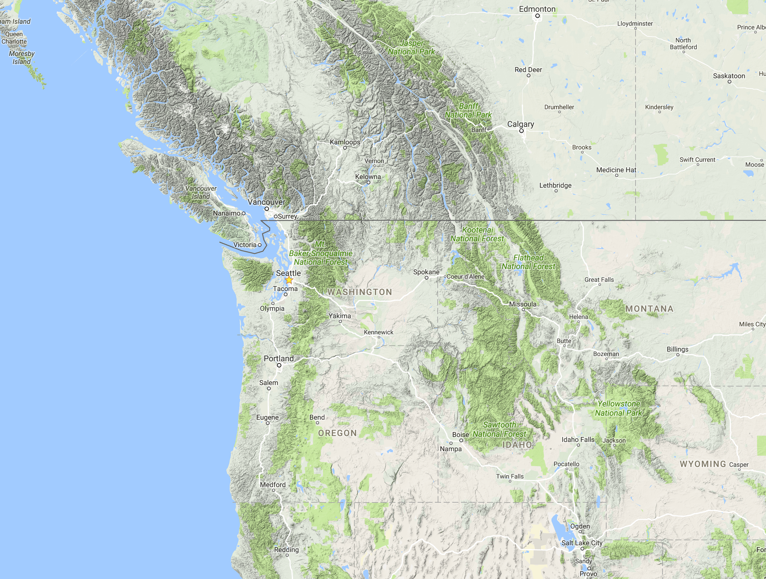
Problem: Global climate models are too coarse to simulate the effects of critical terrain/coastal interfaces. Poor for Western US precipitation
Climate Model Terrain

Slide 30
Two Main Approaches to Downscaling of GCMs
Statistical: using contemporary relationships between large scale fields (e.g., temperature or precipitation) and their high-resolution distribution.
Dynamical: using high resolution mesoscale models (a.k.a, regional climate models) with boundary conditions driven by GCMs

Slide 31
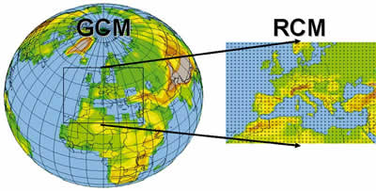
The only viable approach for determining surprises Regional Climate Modeling through dynamical downscaling

Slide 32
Dynamical Downscaling Not Statistical Downscaling
Only fully dynamical downscaling can hope to simulate the non-linearities and complexities of the future climate response.
Examples:
Location and distribution of precipitation as stability changes.
Onshore flow and coastal marine clouds enhanced by greater onshore pressure gradients
Albedo feedbacks as mountain snow melts.
Mountain wave and downslope effects

Slide 33
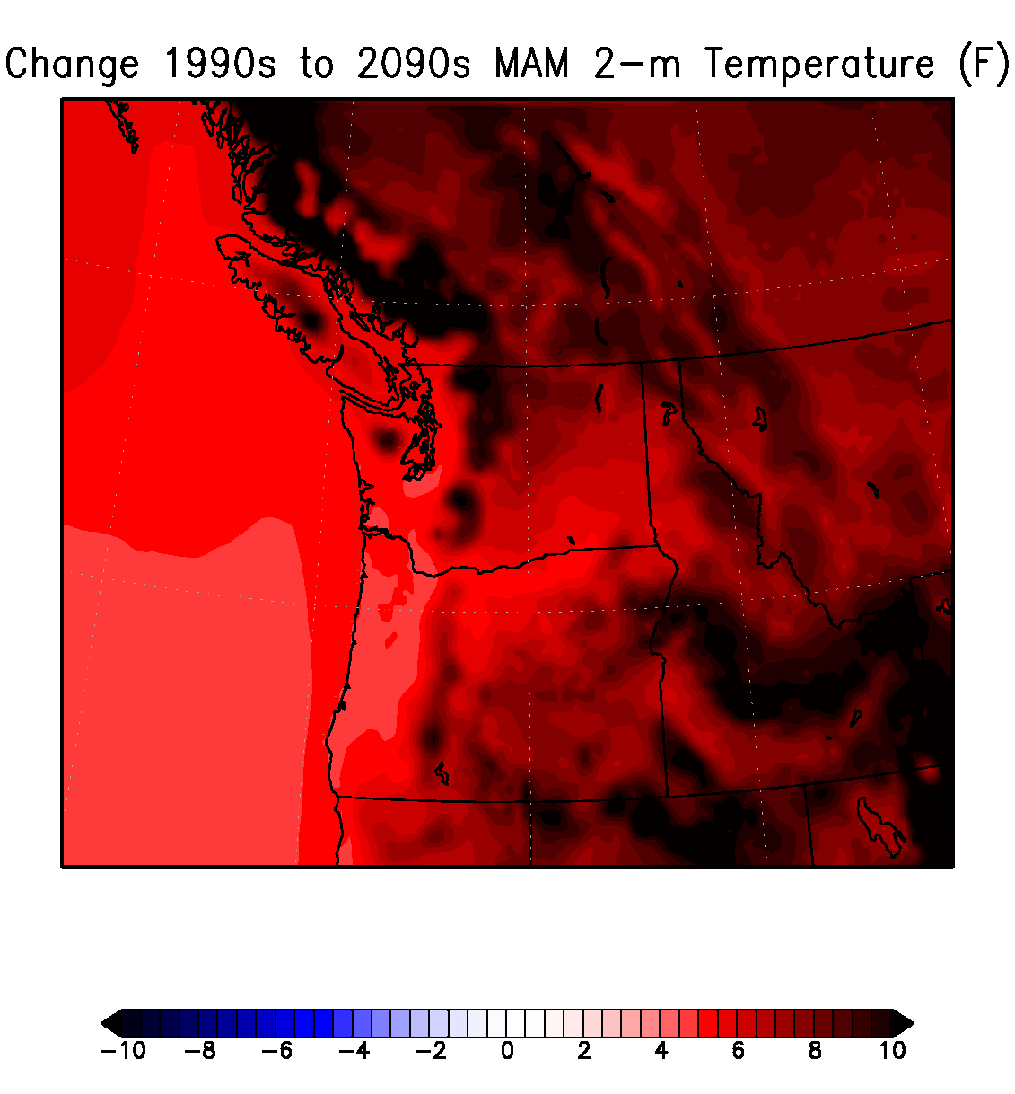
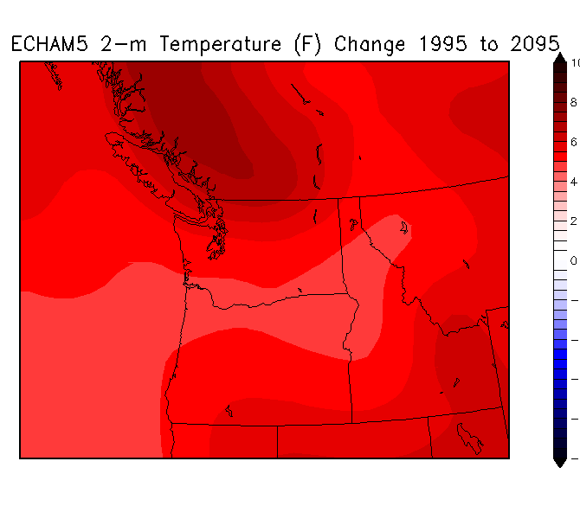
Global versus regional climate models
Regional climate model
Global model

Slide 34
But there is another issue regarding climate change, we need to downscale large numbers of GCM simulations to secure realistic variability and thus useful probabilities of what will happen.

Slide 35
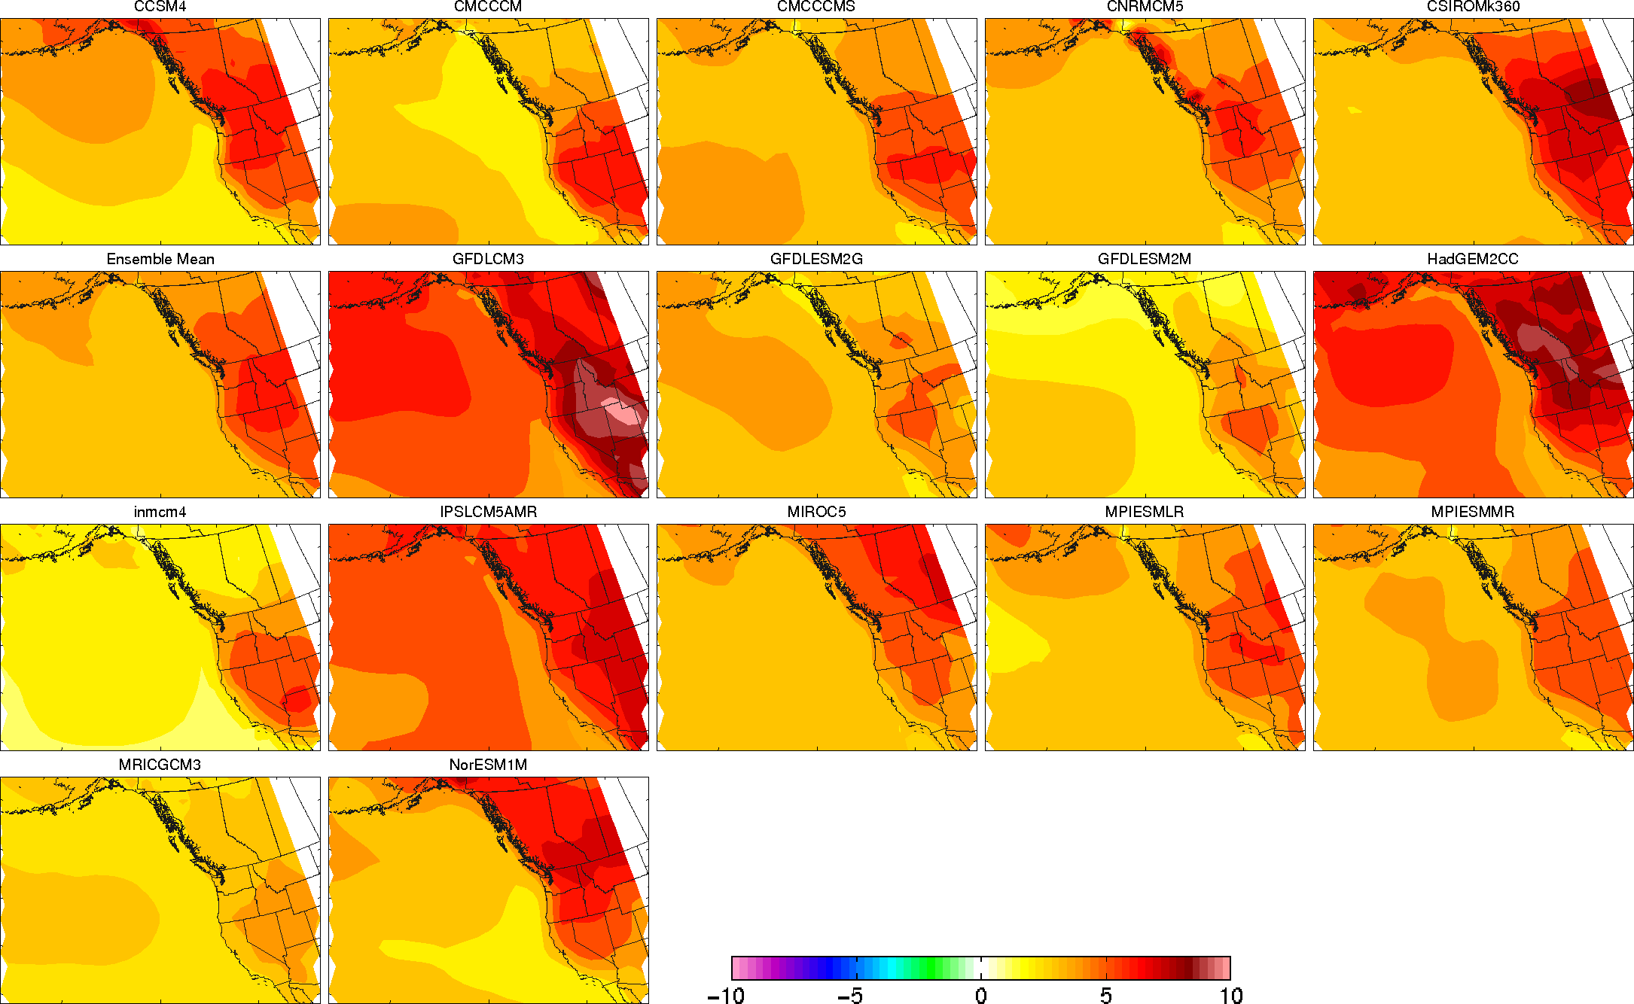
Only about 2-dozen CMIP-5 CGMs: can they be used to provide calibrated probabilities after downscaling?
Surface Temperature Change from 1970-2000 compared to 2070-2100

Slide 36
In addition to exploring the implications of a large number of global simulations , regional climate simulations must have a grid spacing of 12-15 km or less Demonstrated by over 10 years of twice-daily simulations at 36-12-4-1.3 km at the University of Washington, with objective verification

Slide 38
Example: 12-km dynamical downscaling of ECHAM5

Slide 39
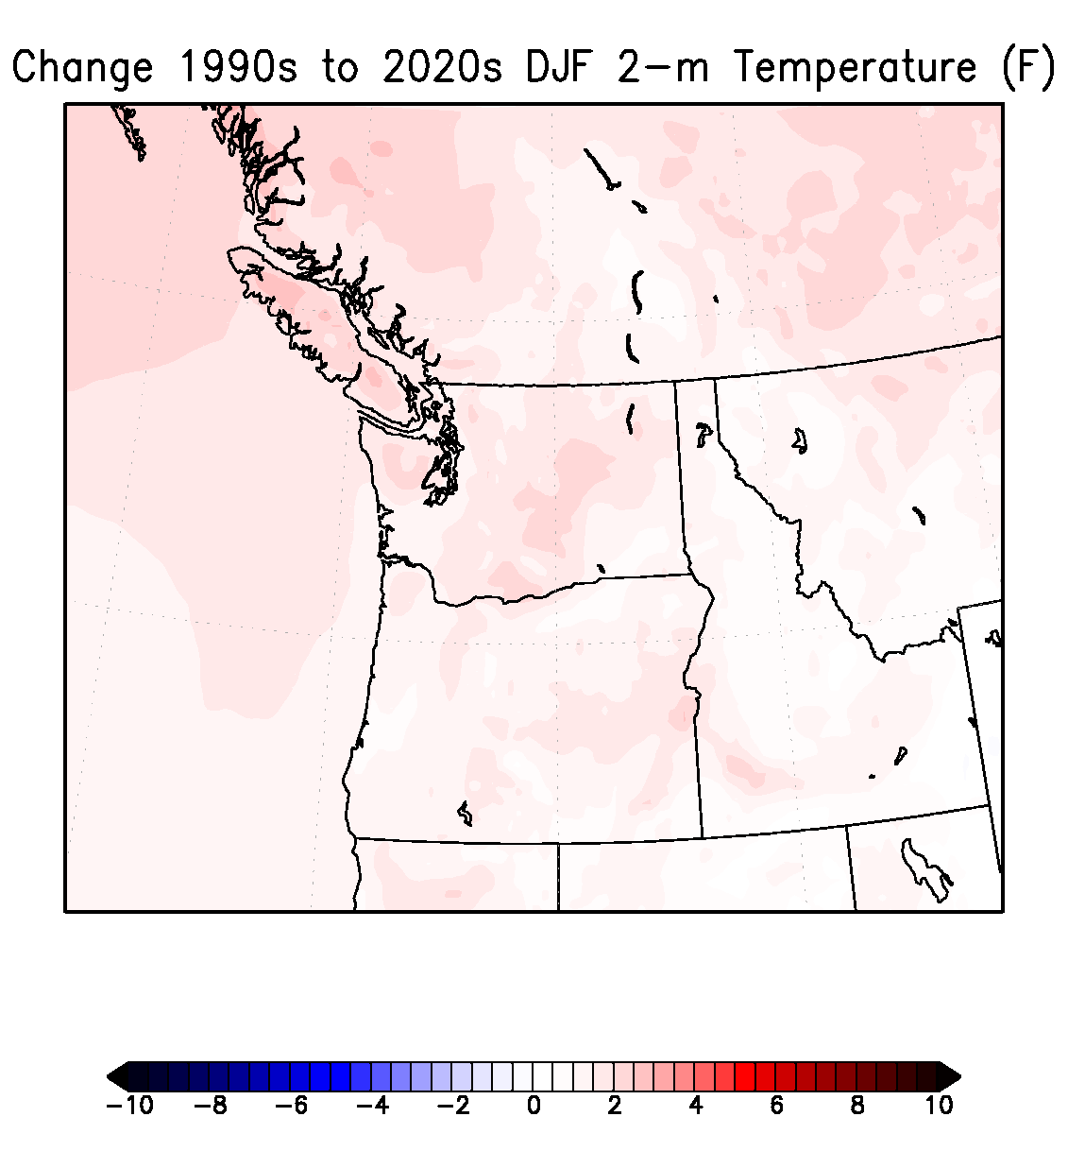
Change in Winter Surface Air Temperatures (F)
Notes:
39

Slide 40
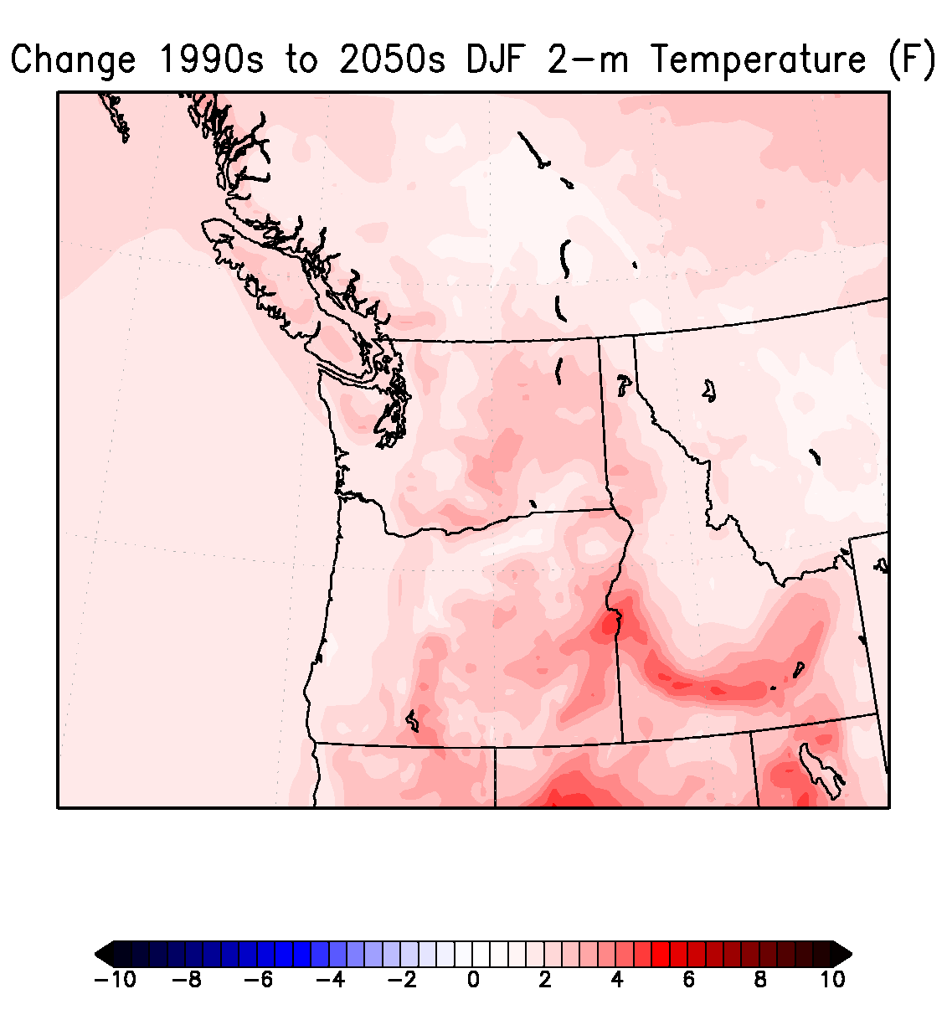
Notes:
40

Slide 41
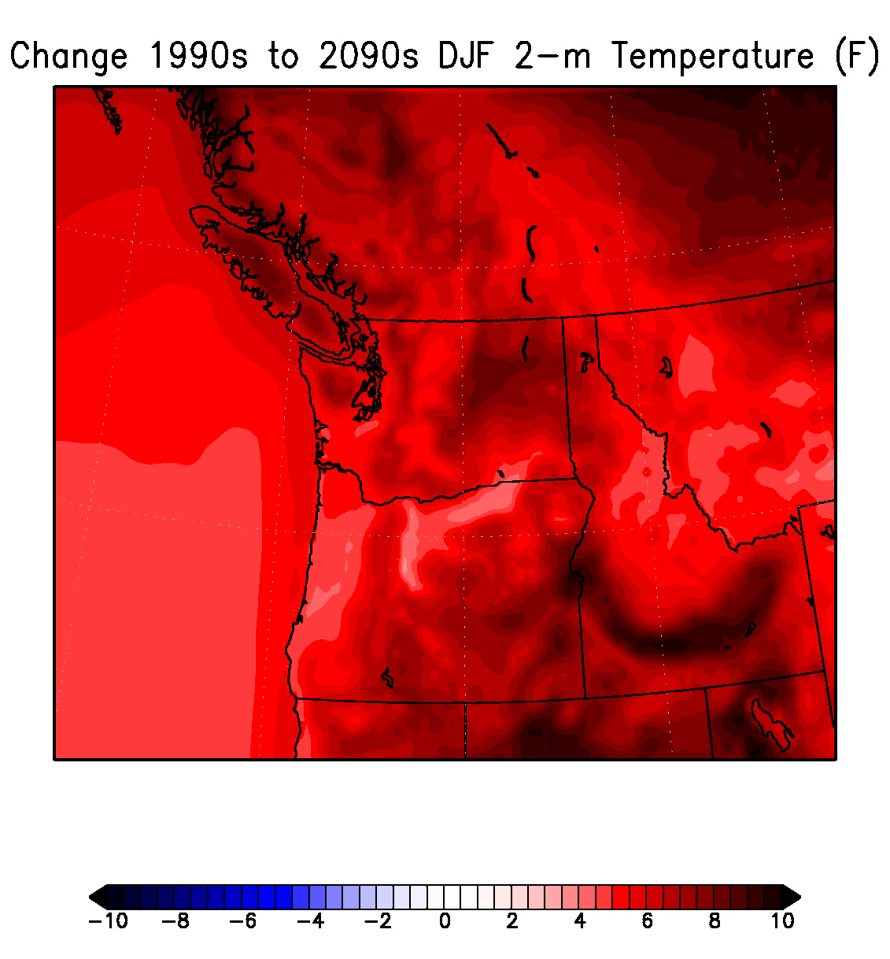
Notes:
41

Slide 42
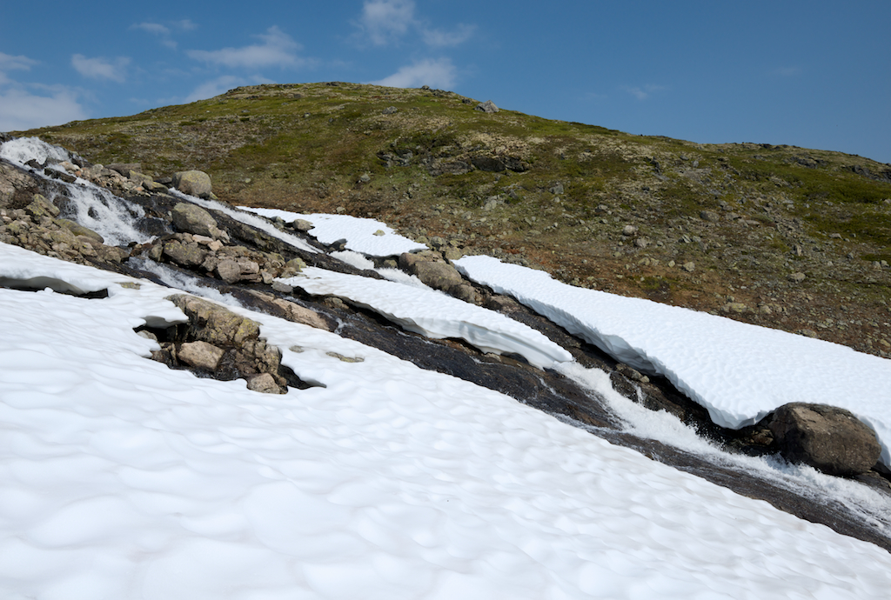
Why local hot spots? Regions of melting snow on terrain

Slide 43
An effort is underway to build a large effort to produce dozens of high-resolution dynamically downscaled runs with sophisticated postprocessing to supply high-resolution probabilistic climate projections over the region: regional climate modeling center and consortium

Slide 44
The Northwest Regional Climate Modeling Consortium: A Proposal
Combine resources of regional government entities, state and Federal agencies, foundations, academic institutions, tribes, and other to create the most robust regional climate predictions possible.
Similar to the NW modeling consortium, decisions could be make by contributing stakeholders
Everyone wants essentially the same thing: why not combine resources?

Slide 45
Tasks
Acquire or secure sufficient computer resources for regional climate downscaling and to run additional GCM simulations.
Acquire GCM runs and run/acquire additional simulations.
Run large numbers (dozens) of regional climate simulations for 199-150 years
Apply sophisticated statistical post-processing
Run ancillary modeling systems, such a hydrological models.

Slide 46
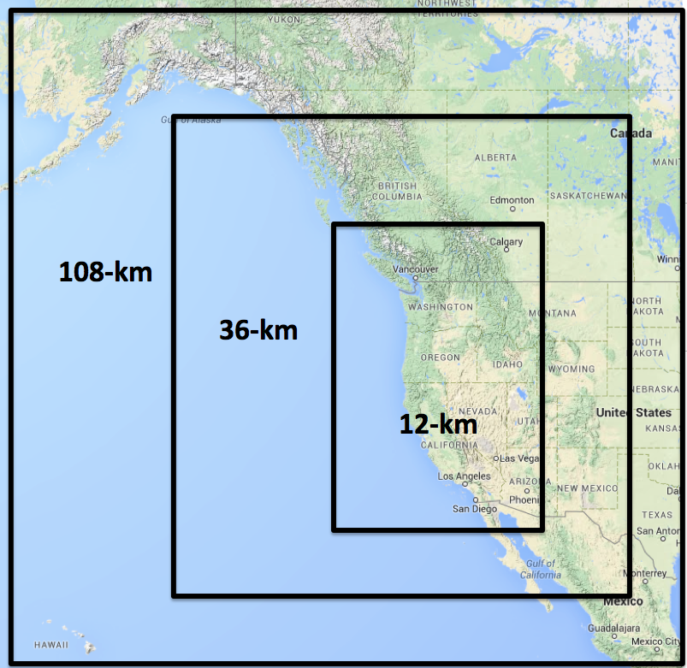

Slide 47
All Starting Now
Initial personnel funding from Amazon
Initial computer resources from Amazon
First meeting of potential stakeholder/contributor group in early December
Might USACE be interested in supporting and joining this effort?

Slide 48
The END

