Slide 1
Efficient Production of High Quality, Probabilistic Weather Forecasts
F. Anthony Eckel
National Weather Service Office of Science and Technology,
and University of WA Atmospheric Sciences
Luca Delle Monache, Daran Rife, and Badrinath Nagarajan
National Center for Atmospheric Research
Acknowledgments
Data Provider: Martin Charron & Ronald Frenette of Environment Canada
Sponsors: National Weather Service Office of Science and Technology (NWS/OST)
Defense Threat Reduction Agency (DTRA)
U.S Army Test and Evaluation Command (ATEC)

Slide 2
High Quality %
Reliable: Forecast Probability = Observed Relative Frequency
and
Sharp: Forecasts more towards the extremes (0% or 100%)
and
Valuable: Higher utility to decision-making compared to probabilistic climatological forecasts or deterministic forecasts
Compare Quality and Production Efficiency of 4 methods
1) Logistic Regression
2) Analog Ensemble
3) Ensemble Forecast (raw)
4) Ensemble Model Output Statistics

Slide 3

Canadian
Regional Ensemble Prediction System (REPS)
Model: Global Environment Multiscale, GEM 4.2.0
Grid: 0.3°×0.3° (~33km), 28 levels
Forecasts: 12Z & 00Z cycles, 72 h lead time (using only 12Z, 48-h forecasts in this study)
# of Members: 21
Initial Conditions (i.e., cold start) and 3-hourly boundary condition updates from 21-member Global EPS:
Initial Conditions: EnKF with 192 members
Grid: 0.6°×0.6° (~66km), 40 levels
Stochastic Physics, Multi-parameters, and Multi-parameterization
Stochastic Physics: Markov Chains on physical tendencies
Li, X., M. Charron, L. Spacek, and G. Candille, 2008: A regional ensemble prediction system based on moist targeted singular vectors and stochastic parameter perturbations. Mon. Wea. Rev., 136, 443–462.

Slide 4
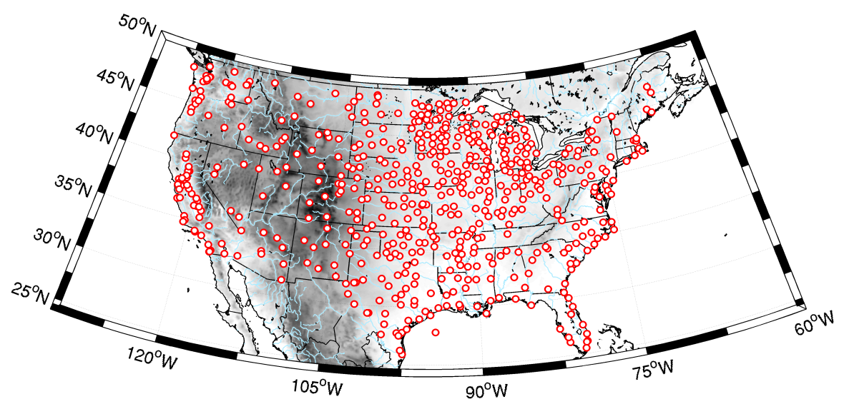
Ground Truth Dataset
Locations: 550 hourly METAR Surface Observations within CONUS
  Data Period: ~15 months,1 May 2010 – 31 July 2011 (last 3 months for verification)
  Variable: 10-m wind speed, 2-m temp.
  (wind speed < 3kt reported as 0.0kt, so omitted)
Postprocessing Training Period
357 days initially
(grows to 455 days)
1 May 2010
27 Oct 2010
23 Apr 2011
31 Jul 2011
100 Verification Cases

Slide 5
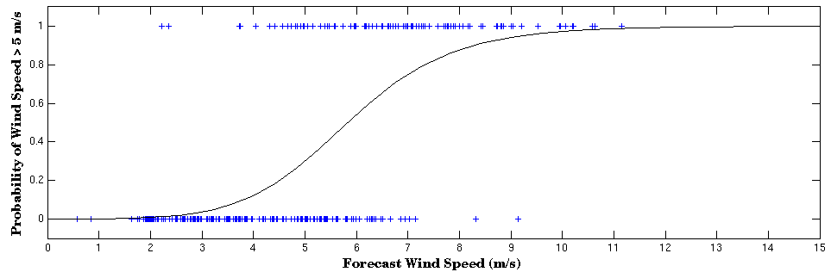
1) Logistic Regression (LR)
Same basic concept as MOS (Model Output Statistics), or multiple linear regression
Designed specifically for probabilistic forecasting
Performed separately at each obs. location, each lead time, each forecast cycle
p : probability of a specific event
x_{K} : K predictor variables
b_{K} : regression coefficients
sqrt(10-m wind speed)
10-m wind direction
Surface Pressure
2-m Temperature
6-h GEM(33km) Forecasts for Brenham Airport, TX
verifying observations
from past forecasts

Slide 6
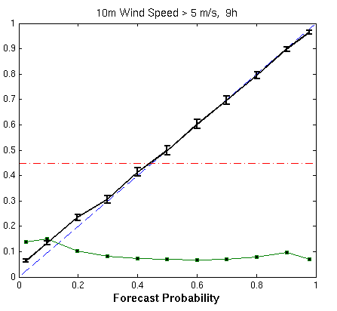
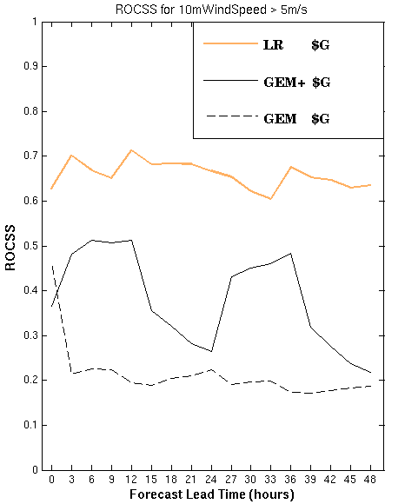
1) Logistic Regression (LR)
Reliability & Sharpness
Utility to Decision Making
Observed Relative Frequency
Forecast Frequency
Sample
Climatology
GEM deterministic forecasts (33-km grid)
GEM+ bias-corrected, downscaled GEM
$G = Computational Expense to produce 33-km GEM

Slide 7
2) Analog Ensemble (AnEn)
Same spirit as logistic regression: At each location & lead time, create % forecast based on verification of past forecasts from the same deterministic model
Delle Monache, L., T. Nipen, Y. Liu, G. Roux, and R. Stull, 2011: Kalman filter and analog schemes to post-process numerical weather predictions. Mon. Wea. Rev., 139, 3554–3570.

Slide 8
2) Analog Ensemble (AnEn)
Analog strength at lead time t measured by difference (d_{t}) between current and past forecast, over a short time window, to
σ_{f} : Forecasts’ standard deviation over entire analog training period
Using multiple predictor variables for the same predictand:
(for wind speed, predictors are speed, direction, sfc. temp., and PBL depth)
N_{v} : Number of predictor variables
w_{v} : Weight given to each predictor
Current Forecast, f
Wind Speed
Past Forecast, g
t+1
t
t+1
t−1
t
observation
from analog #7
t−1
AnEn
member #7
0 1 2 3h
0 1 2 3h

Slide 9
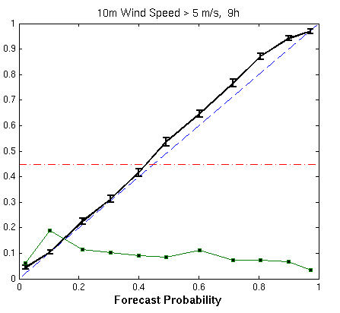
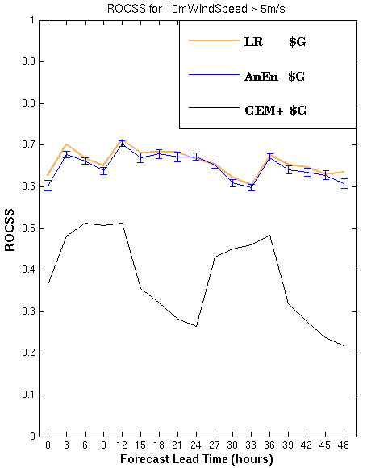
2) Analog Ensemble (AnEn)
Reliability & Sharpness
Utility to Decision Making
Observed Relative Frequency
Forecast Frequency

Slide 10
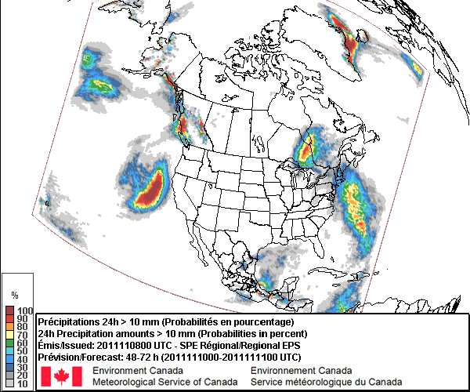
3) Ensemble Forecast (REPS raw)

Slide 11
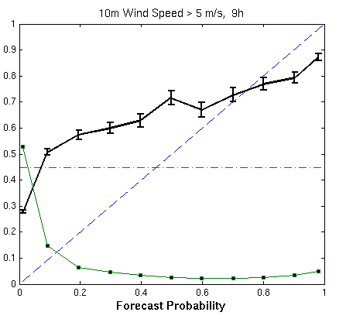
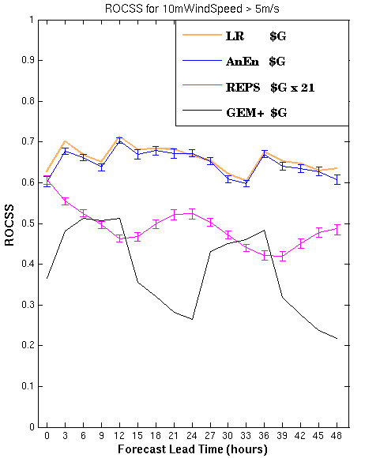
3) Ensemble Forecast (REPS raw)
Reliability & Sharpness
Utility to Decision Making
Observed Relative Frequency
Forecast Frequency

Slide 12
4) Ensemble MOS (EMOS)
Goal: Calibrate REPS output
EMOS introduced by Gneiting et al. (2005) using multiple linear regression
Here, logistic regression is used with predictors: ensemble mean & ensemble spread
Gneiting, T., Raftery A.E., Westveld A. H., and Goldman T., 2005: Calibrated probabilistic forecasting using ensemble model output statistics and minimum CRPS estimation. Mon. Wea. Rev., 133, 1098–1118.

Slide 13
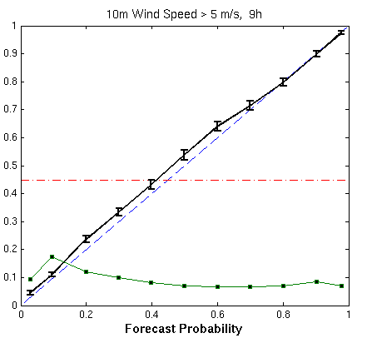
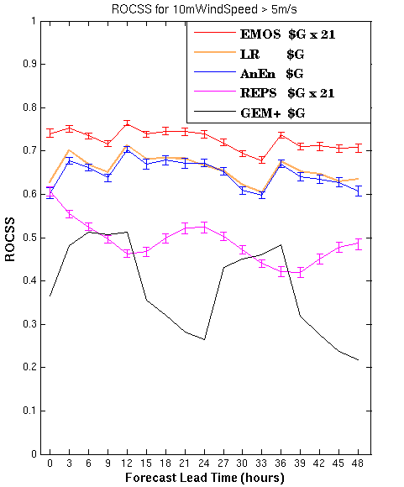
4) Ensemble MOS (EMOS)
Reliability & Sharpness
Utility to Decision Making
Observed Relative Frequency
Forecast Frequency

Slide 14
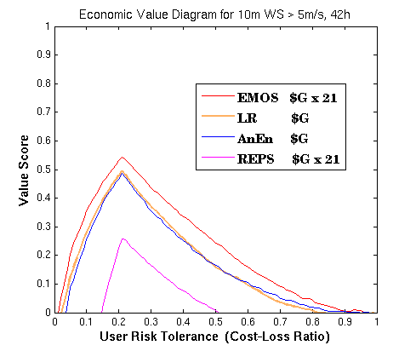
EMOS Worth the Cost?
Scenario
Surface winds > 5 m/s prevent ground crews from containing wild fire(s) threatening housing area(s)
Cost (C) Firefighting aircraft to prevent fire from over-running housing area: $1,000,000
Loss (L) Property damage: $10,000,000
Sample Climatology = 0.21
Expected Expenses (per event)
WORST: Climo-based decision
always take action = $1,000,000
(as opposed to $2,100,000)
BEST: Given perfect forecasts
0.21 * $100,000 = $210,000
Value of Information (VOI)
Maximum VOI = $790,000
for C / L = 0.1
EMOS: VOI = 0.357 * $790,000 = $282,030
LR: VOI = 0.282 * $790,000 = $222,780
added value by EMOS (per event) = $59,250

Slide 15
Options for Operational Production of %
Operational center has X compute power for real-time NWP modeling.
Current Paradigm: Run high res deterministic and low res ensemble
New Paradigm: Produce highest possible quality probabilistic forecasts
Options
Drop high res deterministic → Run higher resolution ensemble → Generate %
Drop ensemble → Run higher res deterministic → Generate %
Test Option #2
Rerun LR* and AnEn* using Canadian Regional (deterministic) GEM
Same NWP model used in REPS except 15-km grid vs. 33-km grid
Approximate cost = (33/15)^3 ≈ $G x 11 , or ½ the cost of REPS

Slide 16
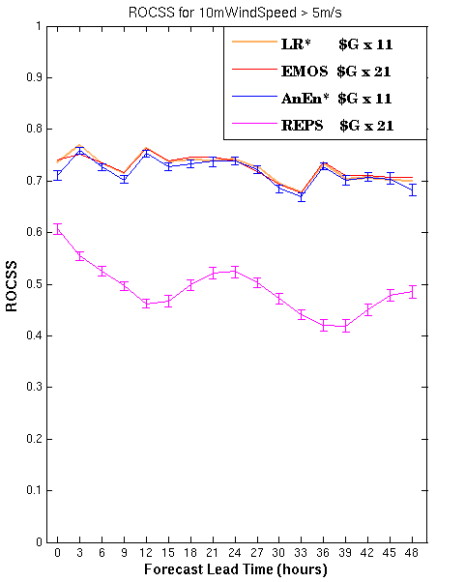
Options for Operational Production of %

Slide 17
Main Messages
1) Probabilistic forecasts are normally significantly more beneficial to decision making than deterministic forecasts.
2) Best operational approach for producing probability forecasts may be postprocessing the finest possible deterministic forecast.
3) If insistent upon running an ensemble, calibration is not an option.
4) Analysis of value is essential for forecast system optimization and for justifying production resources.

Slide 18
Long “To Do” List
Test with other variables (e.g., Precipitation)
Consider gridded %
Optimize Postprocessing Schemes
Train with longer training data (i.e., reforecasts)
Logistic Regression (and EMOS)
-- Use conditional training
-- Use Extended LR for efficiency
Analog Ensemble
-- Refine analog metric and selection process
-- Use adaptable # of members
Compare with other postprocessing schemes
Bayesian Model Averaging (BMA)
Nonhomogeneous Gaussian Regression
Ensemble Kernal Densitiy MOS
Etc…
Test hybrid approach (ex: Apply analogs to small # of ensemble members)
Examine rare events

Slide 19
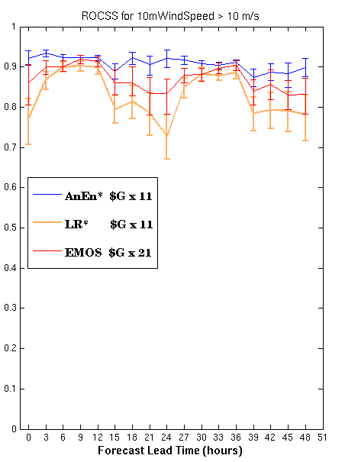
Rare Events
Decisions are often more difficult and critical when event is…
Extreme
Out of the ordinary
Potentially high-impact
Postprocessed NWP Forecast (LR* & AnEn*)
Disadvantage: Event may not exist within training data.
Advantage: Finer resolution model may better capture the possible event.
Calibrated NWP Ensemble (EMOS)
Disadvantage: Coarser resolution model may miss the event.
Event may not exist within training data.
Advantage: Multiple real-time model runs may increase chance to pick up on the possible event.
Notes:
Sample climatology 0.6 % at 12 UTC and 3.4 % at 21 UTC

Slide 20
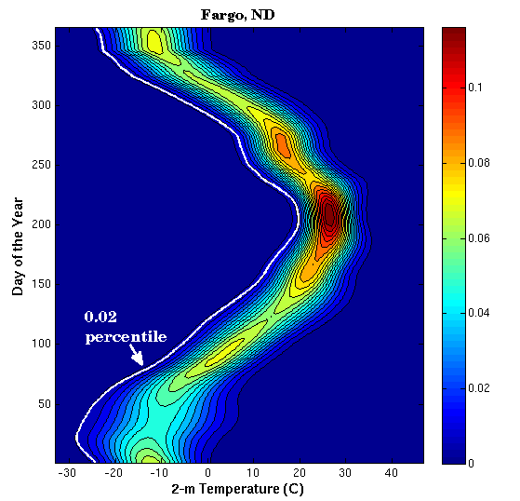
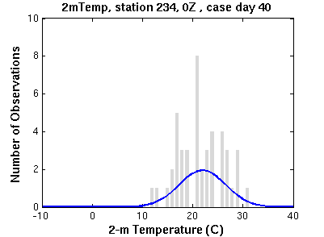
Rare Events
Define event threshold as a climatological percentile by…
Location
Day of the year
Time of day
Collect all observations within 15 days of the date, then fit to an appropriate PDF:
Fargo, ND, 00Z, 9 June (J160)
Probability

Slide 21
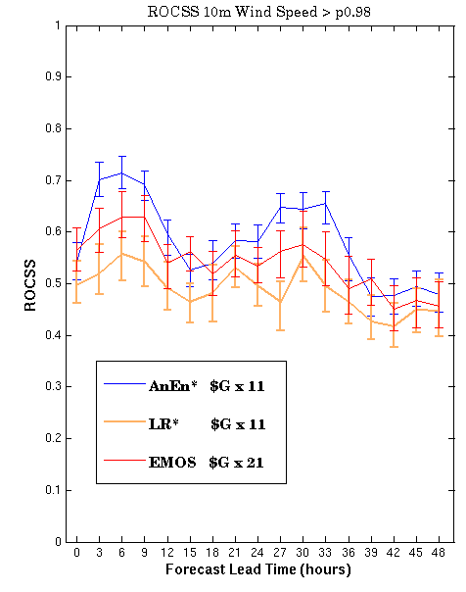
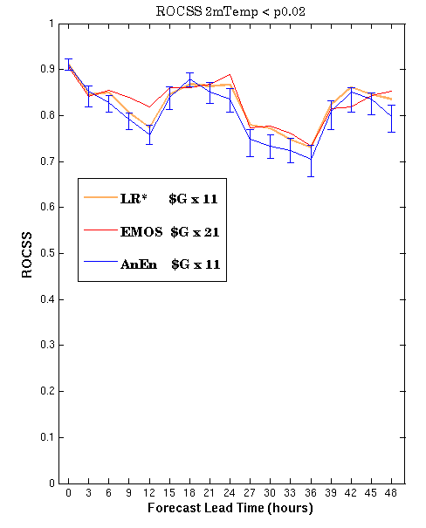
Rare Events
*

Slide 22
THE END

Slide 23
Value Score (or expense skill score)
E_{fcst} = Expense from follow the forecast
E_{clim} = Expense from follow a climatological forecast
E_{perf} = Expense from follow a perfect forecast
a = # of hits
b = # of false alarms
c = # of misses
d = # of correct rejections
= C/L ratio
= (a+c) / (a+b+c+d)

Slide 24
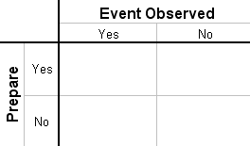
Cost-Loss Decision Scenario
(first described in Thomas, Monthly Weather Review, 1950)
Cost (C ) – Expense of taking protective action
Loss (L) – Expense of unprotected event occurrence
Probability ( p) – The risk, or chance of a bad-weather event
To minimize long-term expenses, take protective action whenever
Risk > Risk Tolerance
or
p > C / L
…since in that case, expense of protecting is less than the expected expense of getting caught unprotected,
C < L p
“Hit”
$ C
“False Alarm”
$ C
“Miss”
$ L
“Correct Rejection”
$ 0
The Benefits Depend On:
Quality of p
User’s C/L and the event frequency
User compliance, and # of decisions
Event
Temp. < 32°F
Relative Value
(from Allen and Eckel, Weather and Forecasting, 2012)

Slide 25
ROC from Probabilistic vs. Deterministic Forecasts
over the same forecast cases
ROC for sample Probability Forecasts
ROC for sample Deterministic Forecasts
A = 0.93
no resolution
zoom in
A = 0.77
A_{clim} = ½
A_{perf} = 1

