Slide 1
Temperature Prediction
ATMS 452
Spring 2023

Slide 2
Temperature Measurements
2-m
In shade
Should be over a natural vegetated surface
-too often not the case.

Slide 3
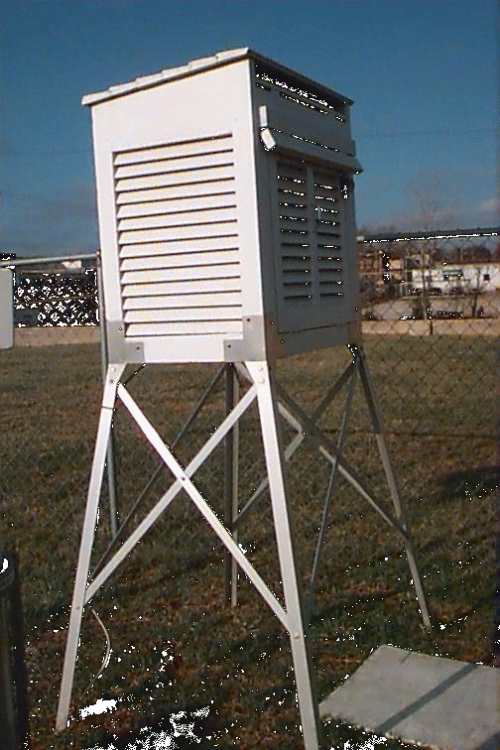
Stevenson Screen
AKA: Cotton Region Shelter
The Old Traditional Approach

Slide 4
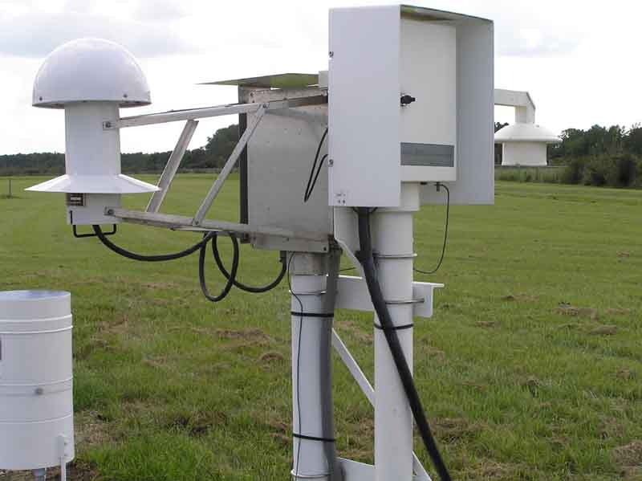
Today: ASOS Temperature/Humidity Sensor Standard NWS/FAA instrumentation
Vulnerable to fan failures

Slide 5
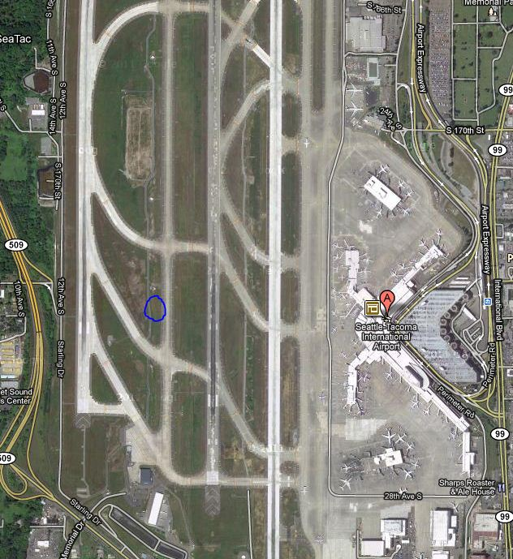
Sea Tac
Example
ASOS Typically placed
On runway
Grassy strip

Slide 6
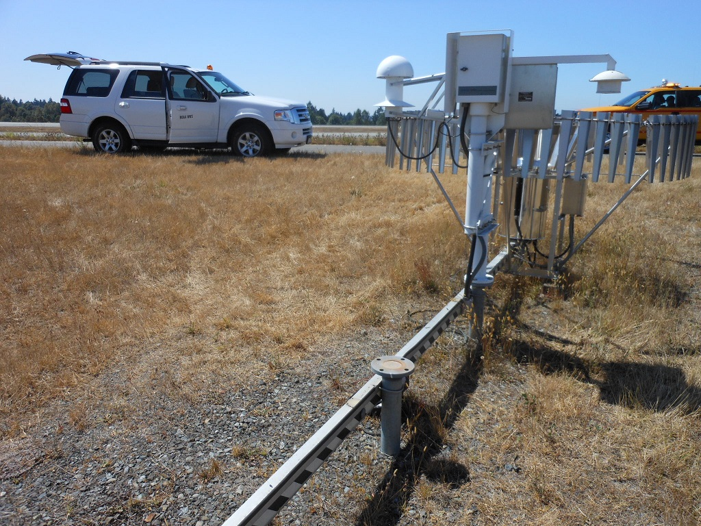
SeaTac Airport

Slide 7
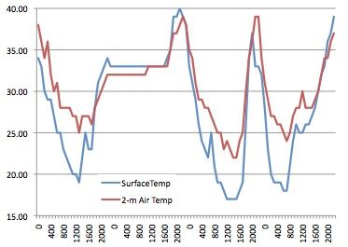
Remember: Temperature at the surface can be very different than at 2-m
Marblemont WA, December 2011

Slide 8
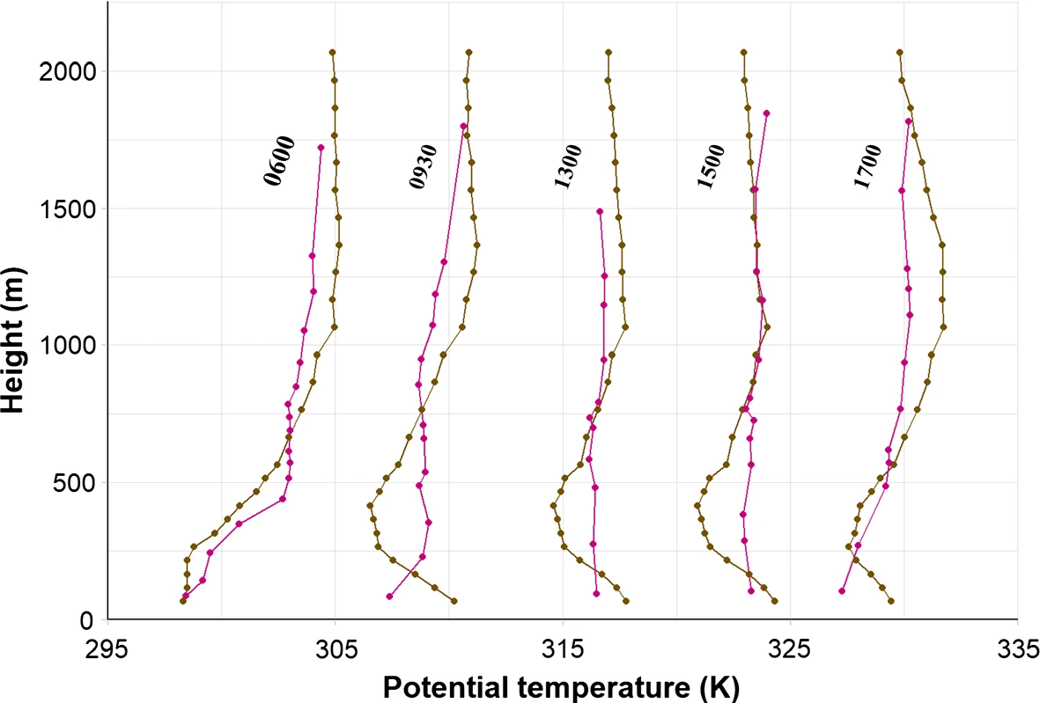
2-m versus surface temperatures
2-m air temperature is often much warmer than surface during cool, winter nights
2-m air temperature is often much colder than surface on warm, summer days

Slide 9
Why Not Simply Use Model Temps Directly?
Model surface elevation may be very different than actual surface elevation due to limited model resolution.
  Differences can be in the hundreds of meters or more in steep terrain.
  Improves as resolution increases
  Where model terrain istoo high, temps too cold

Slide 10
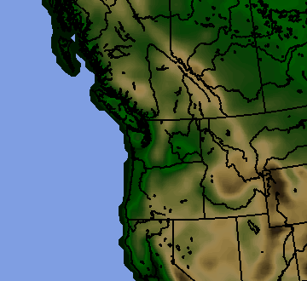
36-km terrain UW WRF

Slide 11
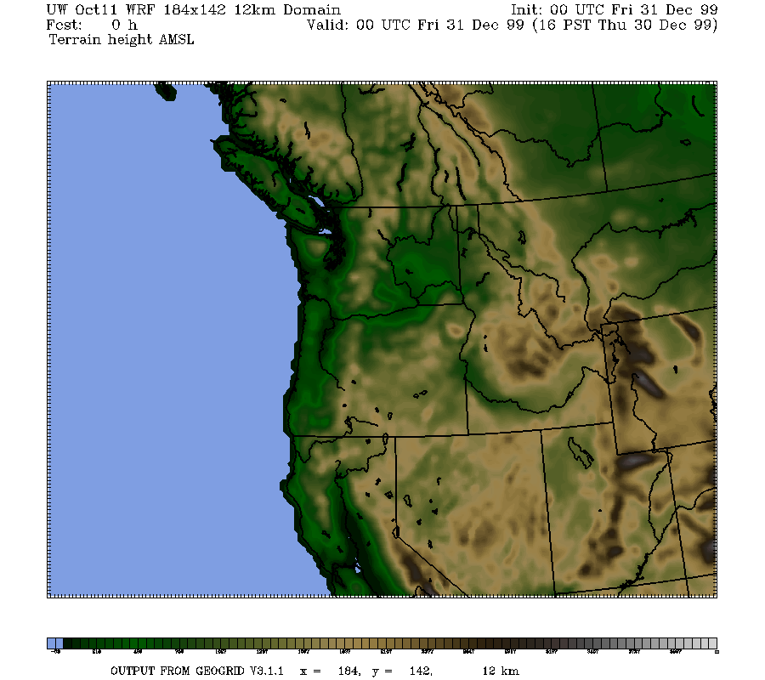
12-km

Slide 12
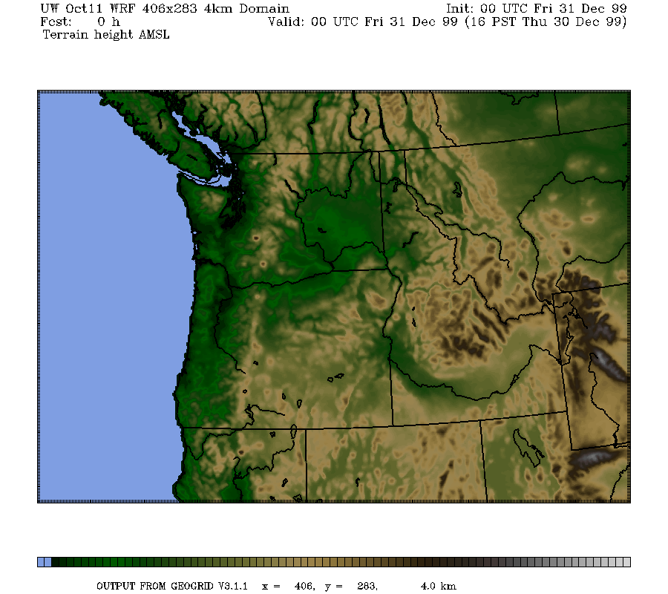
4-km

Slide 13
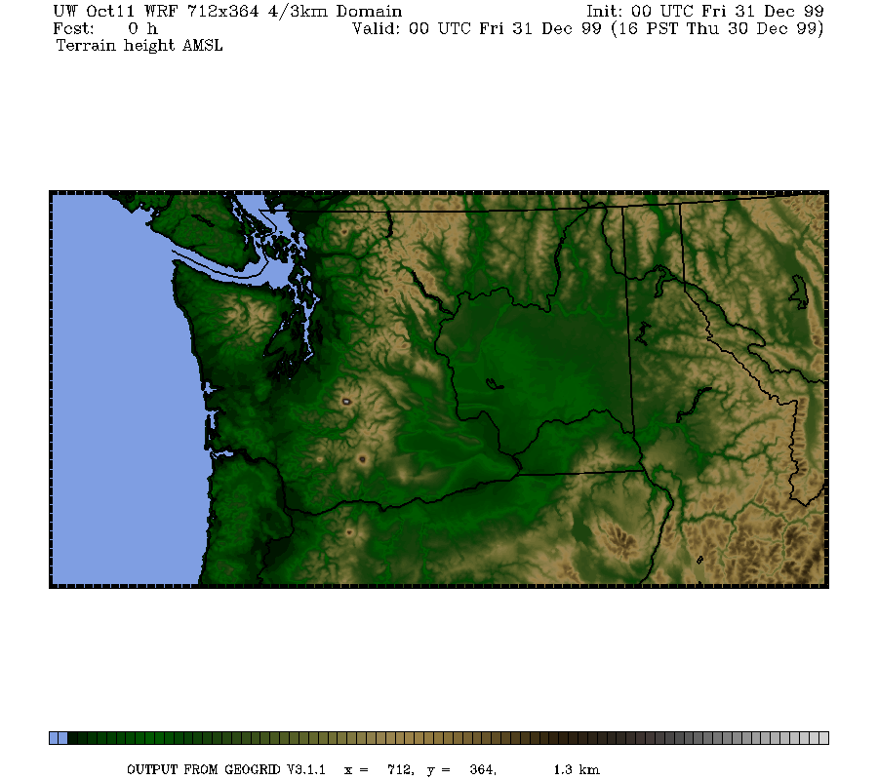
1.3 km

Slide 14
Why Not Simply Use Model Temps Directly and Go Home?
(2) Model resolution is often inadequate for properly simulating important features that influence temperature.
  Examples include the Columbia River Gorge and drainage flows in valleys
  Coastal temperature contrasts

Slide 15
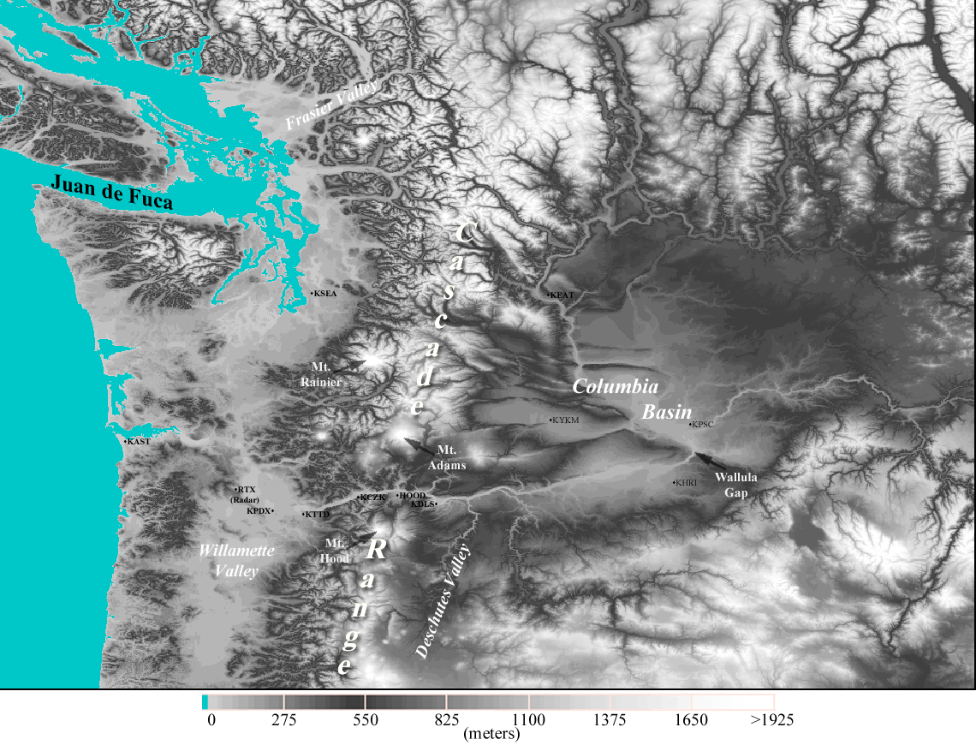
Near Sea Level Gap
On Border of WA and OR
Notes:
Use this slide to introduce where the Gorge is and the nature of the gap flow scenario.
Spend some time pointing out important features like:
The mountain barrier, the Columbia Basin and how it provides a topographically confined air shed and note how the Gorge is the only drain
Then switch gears and point out other gaps on this map (Frasier, JDF, Stampede, Chehalis) and mention important results of each
Frasier - cold outflow, Juan de Fuca - easterly gales, westerly gales, PSCZ, Chehalis - PSCZ, Stampede - downslope windstorms, CRG - Cold outflow, gales, wintry precipitation
So meteorological phenomena driven by gaps are obviously very important, especially in the PNW.

Slide 16
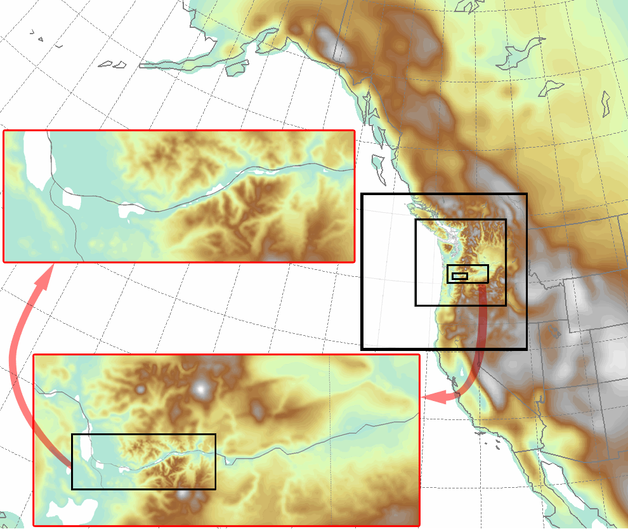
Columbia Gorge Flow Simulation
Notes:
Some leakage over McKenzie and Santiam Passes
NOTE: There are two layers of images

Slide 17
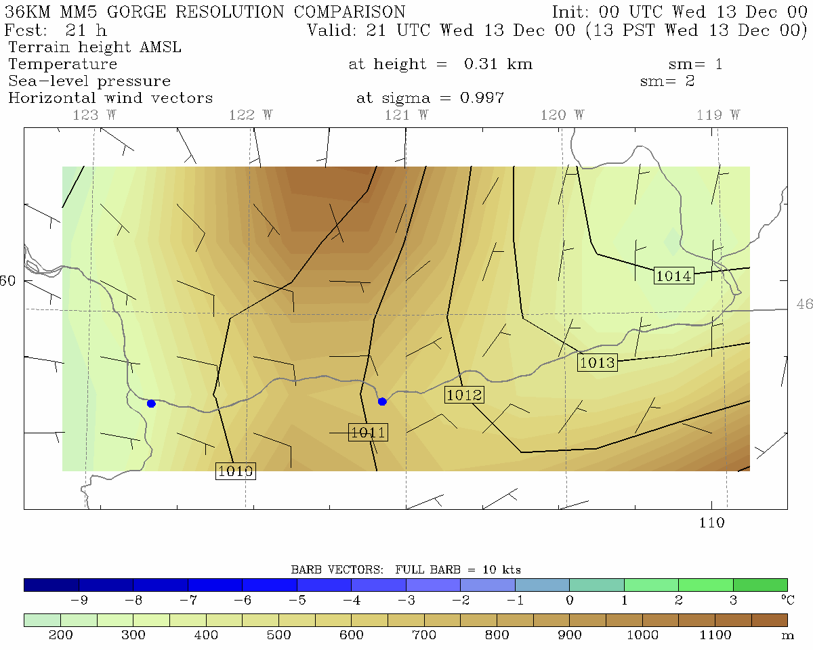
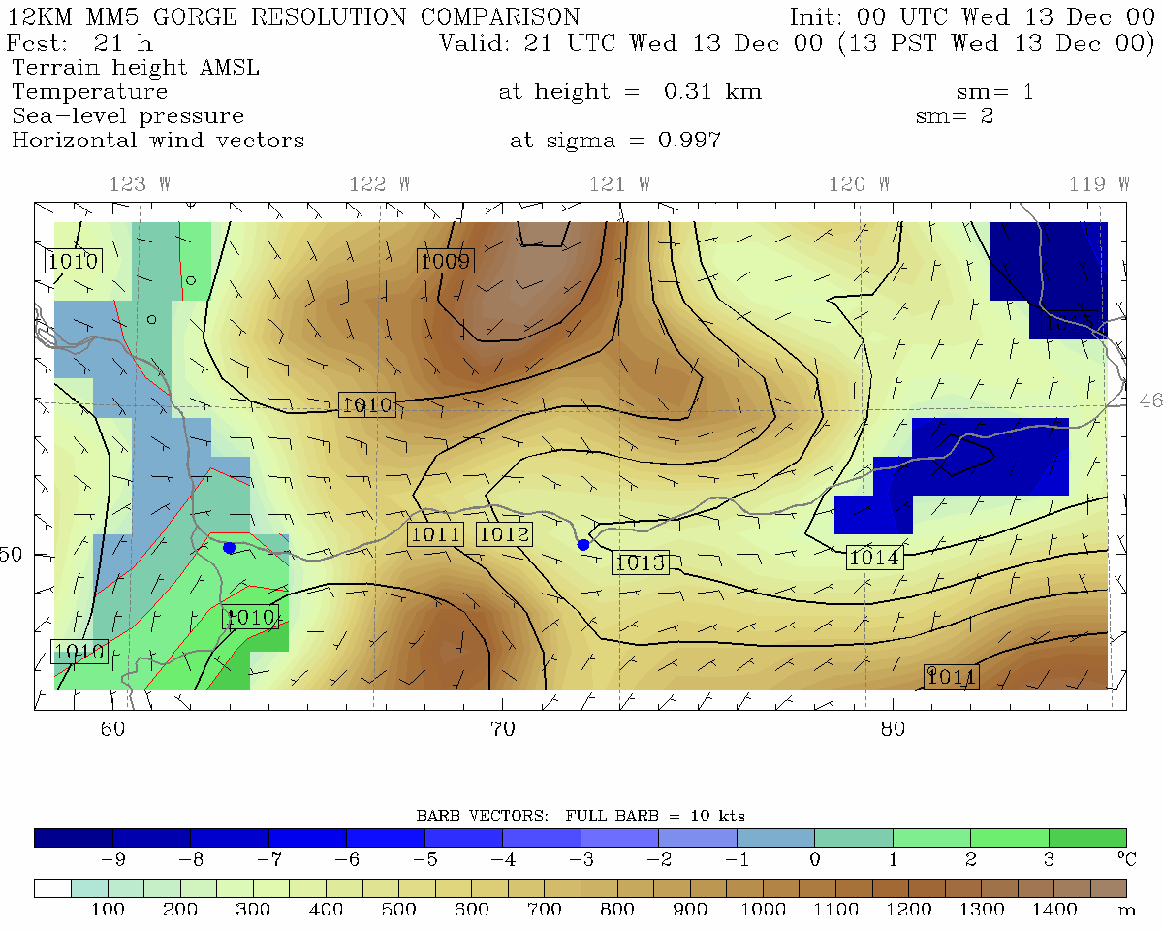
36 km grid spacing
12 km grid spacing
Portland
The Dalles
Portland
The Dalles
Pass Height = 700 m
Pass Height = 600 m

Slide 18
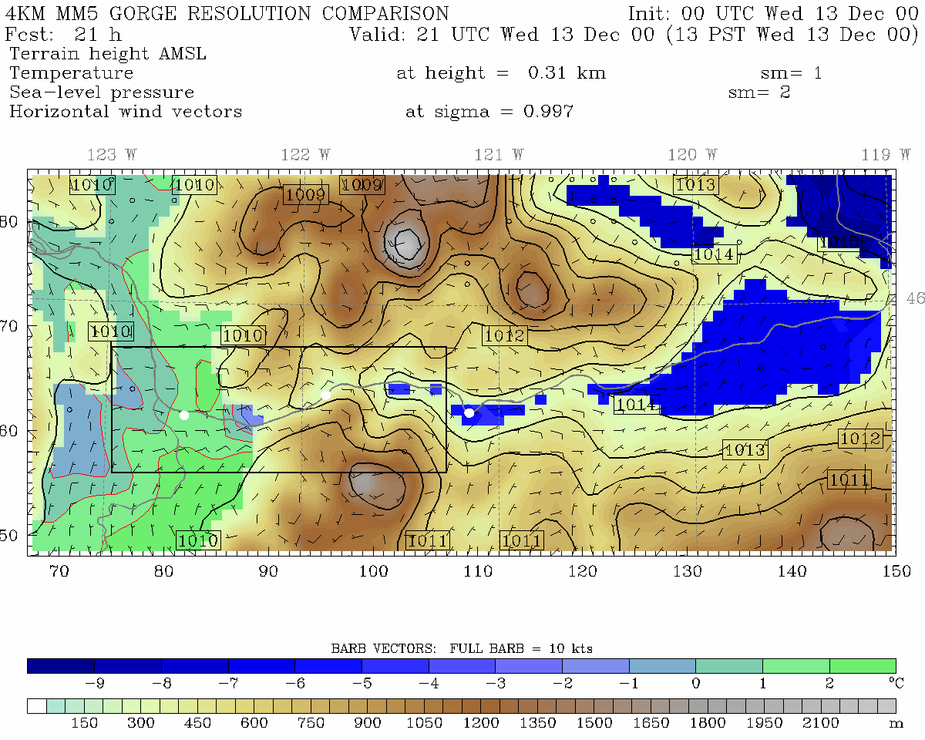
4 km grid spacing
12 km grid spacing
Portland
Cascade Locks
The Dalles
Portland
The Dalles
Pass Height = 400 m
Pass Height = 600 m

Slide 19
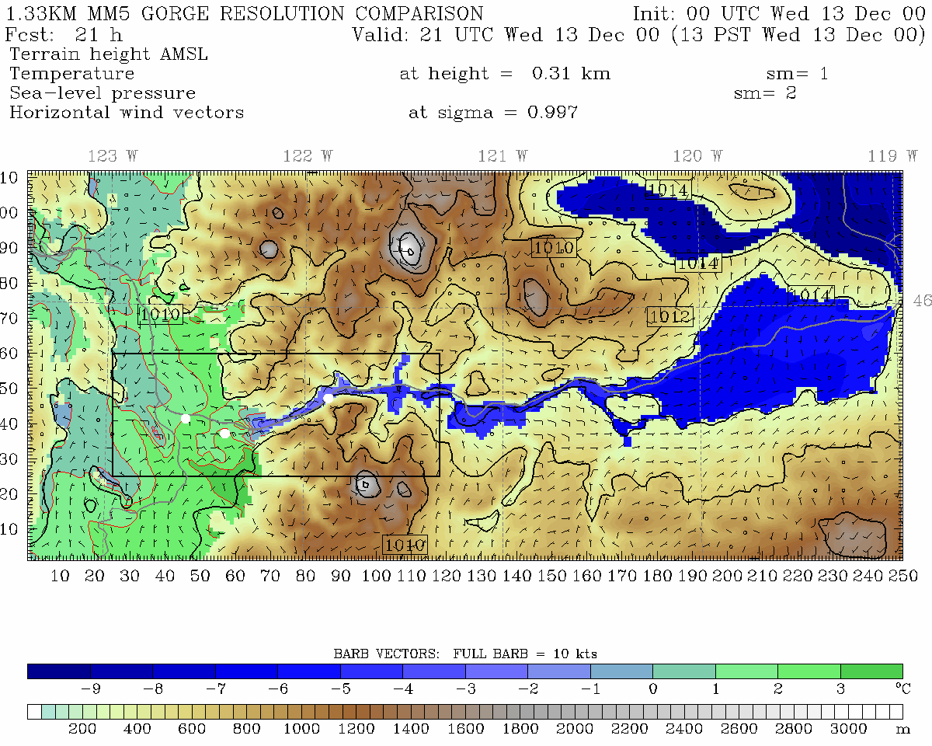
1.33 km grid spacing, Pass Height = 150 m
•
Portland
Cascade Locks
The Dalles
Troutdale
Notes:
Min pass height is at far right of domain near Cascade Locks

Slide 20
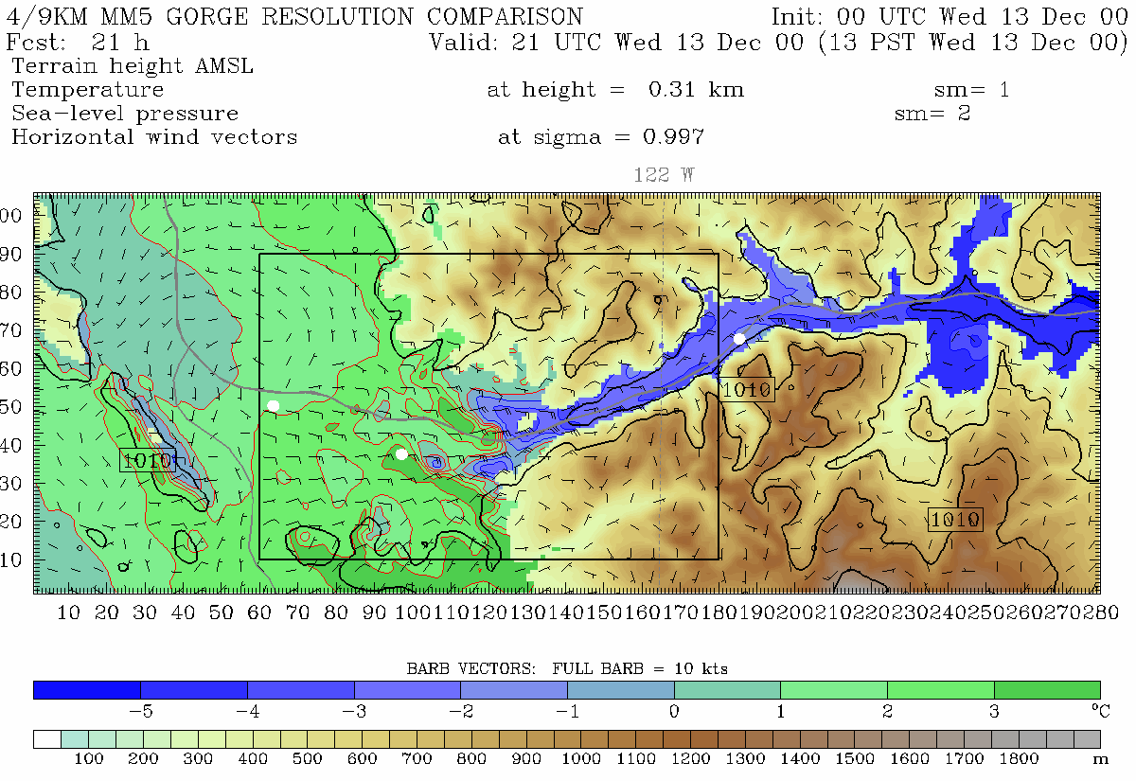
444.4 m grid spacing, Pass Height = 100 m
Portland
Troutdale
Cascade Locks
Notes:
Min pass height is at far right of domain near Cascade Locks (same place as 4/3 domain)
This plot is from 310 m. Note, vortex. See this on radar data too. Zoomed in plot will be from 150 m

Slide 21
Model temperatures may be seriously in error due to deficient model physical parameterizations
Examples: Problems in planetary boundary layer physics, radiation, surface energy fluxes, cloud and precipitation processes.
  Example 1: overmixing in PBL under stable conditions can result in the inability to maintain shallow cold air masses. Result: warm bias
  Example 2: improper soil moisture modeling (too wet or dry) can greatly influence temperatures. (too wet produces too cool temps, vice versa)

Slide 22
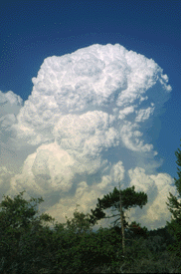
Model temperatures may be seriously in error due to deficient model physical parameterizations
Examples: Problems in planetary boundary layer physics, radiation, surface energy fluxes, cloud and precipitation processes.

Slide 23
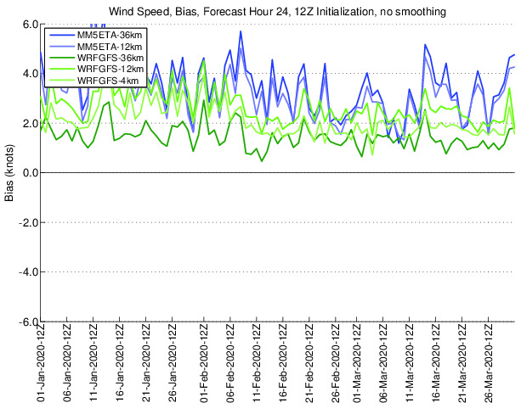
Systematic Biases
As a result of physics errors, models can have serious temperature biases, some of them are systemic (persistent and frequent).
Many systematic biases exist. (e.g wind speed)

Slide 24
PBL Problem Example:
Shallow Fog…Nov 19, 2005
Held fog in at low elevations for days
Model maintained a deep inversion, without the observed shallow mixed layer of cold air a few hundred m deep.
Model could not maintain moisture at low levels

Slide 25
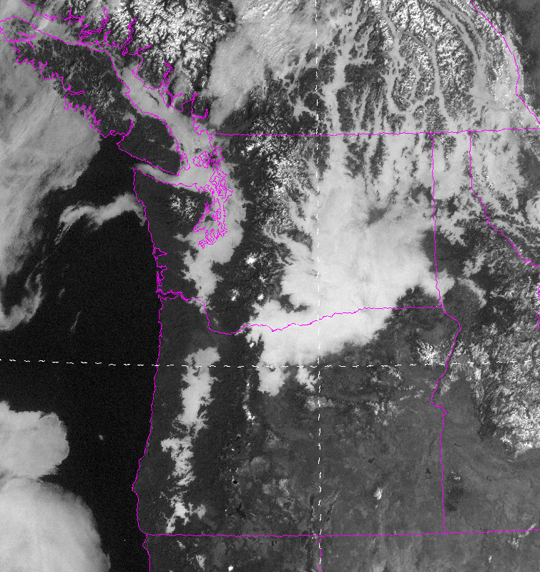

Slide 26
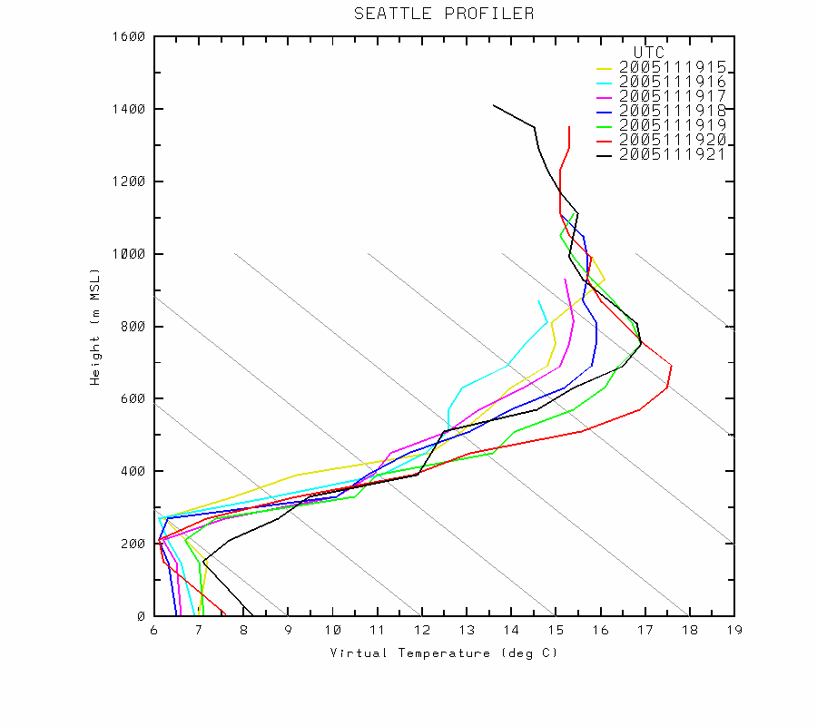
Observed Sounding

Slide 27
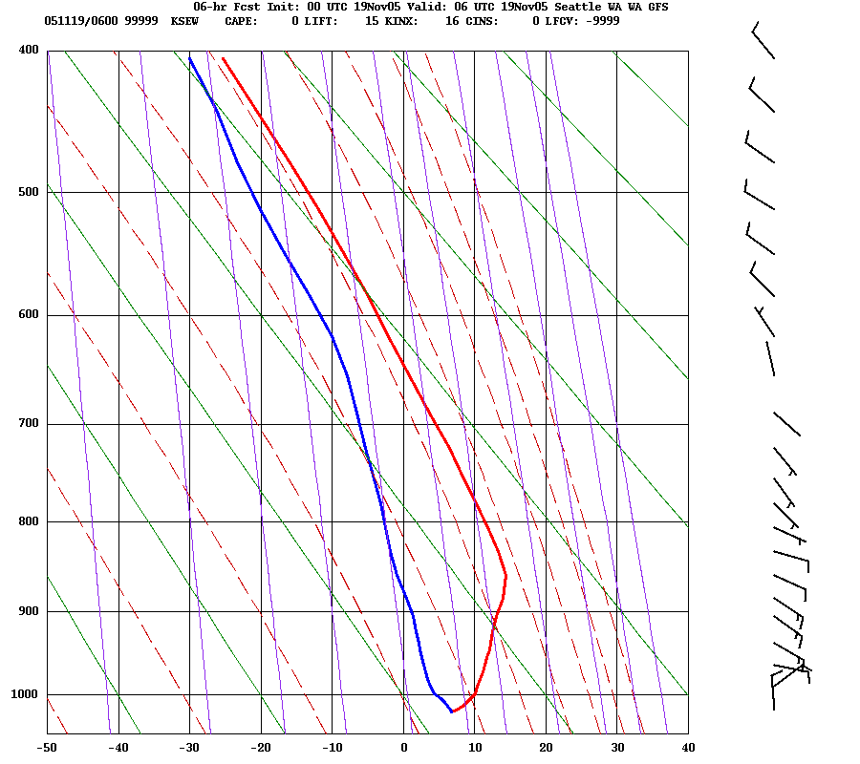
WRF Model

Slide 28
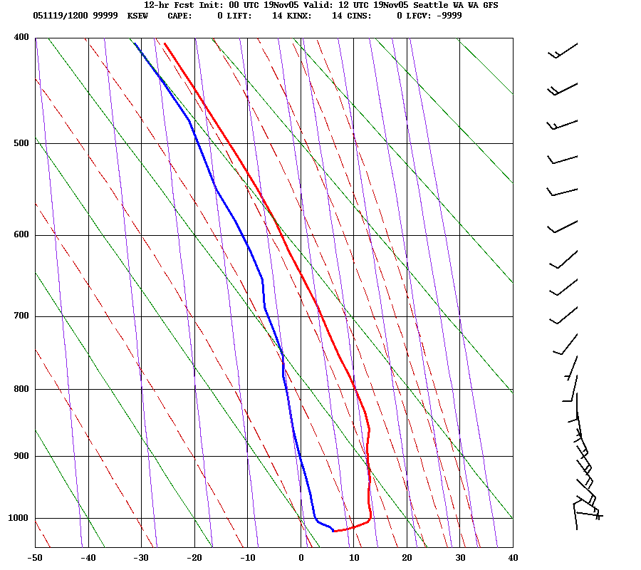

Slide 29
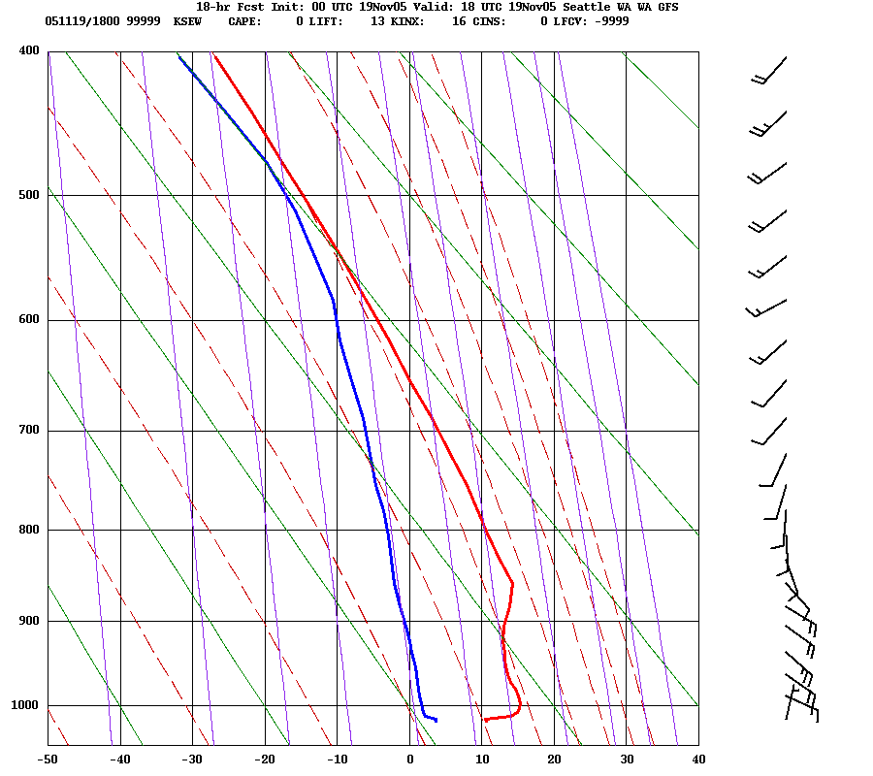

Slide 30
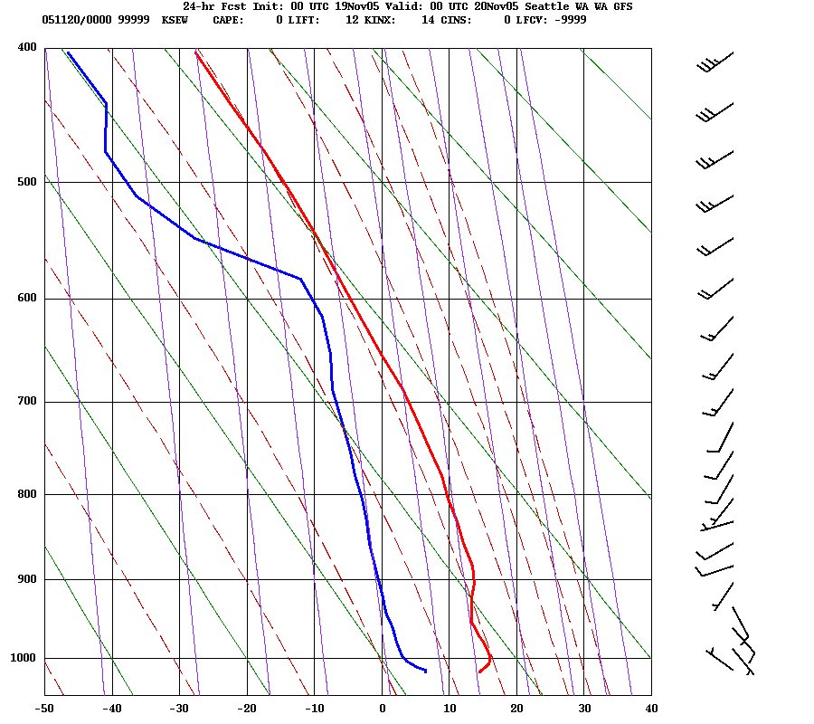

Slide 31
Other reasons why you can’t simply take the model temps
Models can also have synoptic and timing errors that can undermine temperature forecasts.
Errors in cloud distributions (which often occur) can greatly influence temperatures

Slide 32
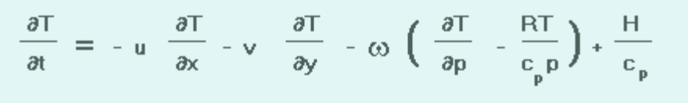
Back to Basics: First Law of Thermodynamics
Local Temperature Change =
Horizontal Advection +
Vertical Advection/adiabatic heating-cooling
Diabatic Heating and Cooling

Slide 33
Horizontal Advection
Often dominates away from terrain (level areas) and near coastlines.
Large near strong fronts
Usually largest in the lower troposphere.
Models are good at this if they have enough resolution.

Slide 34
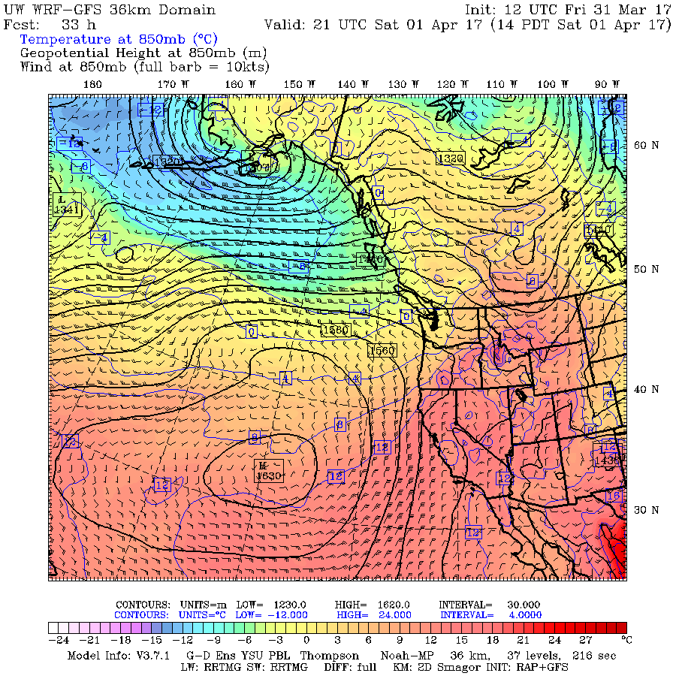

Slide 35
Adiabatic heating/cooling
Can be VERY significant near topographic barriers
Warming with downslope flow
Cooling with upslope flow.

Slide 36
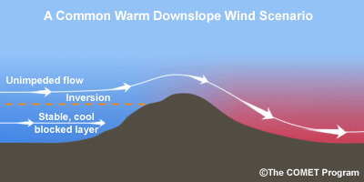
Downslope Warming
Large compressional warming during downslope flow
Often large over Cascade foothills (e.g., Cascades-North Bend), but apparent all over the world, including to the lee (east) of the Rockies--the Chinook Wind.
In Europe called the Foehn Wind.
Usually, air comes from mid-levels where potential temperature is higher than at the surface. A drop in dew point usually accompanies downslope flow.

Slide 37
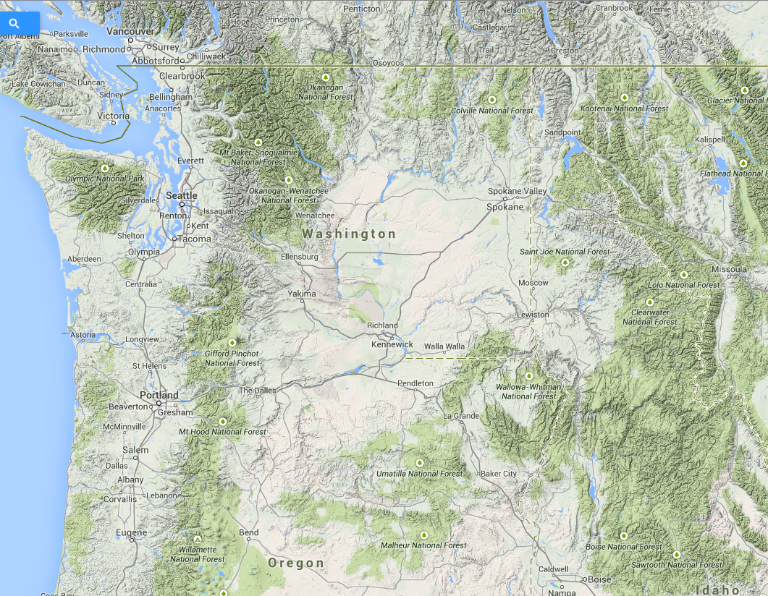

Slide 38
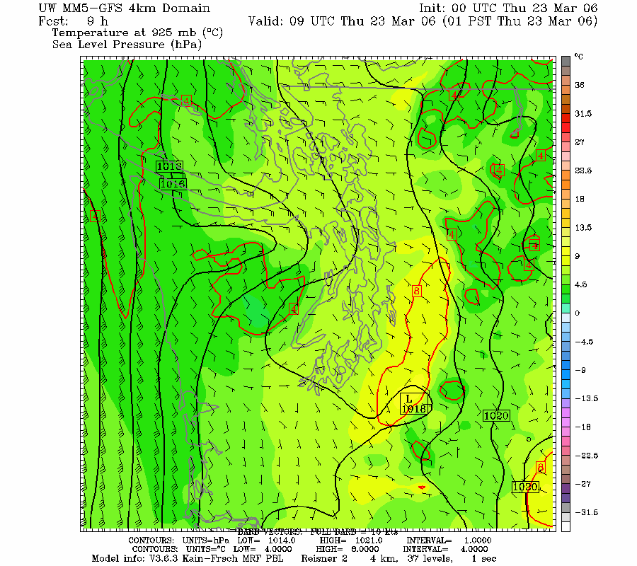

Slide 39
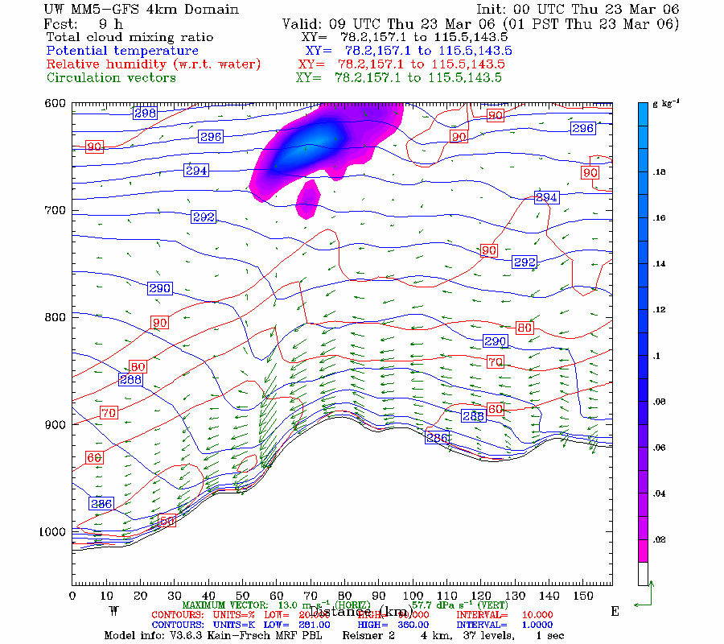

Slide 40
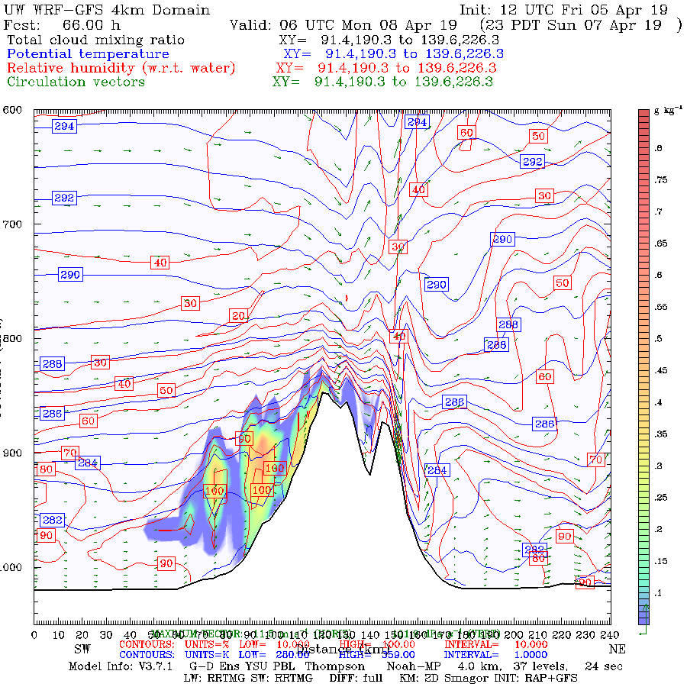

Slide 41
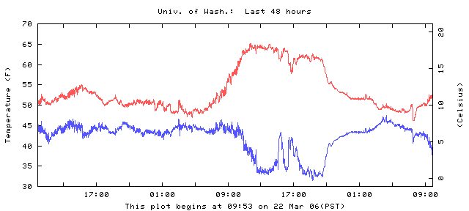
Downslope Example at the Surface
Why drop in dew point temperature?

Slide 42
The warmest temperatures are often at the bottom of the terrain slope during downslope flow

Slide 43

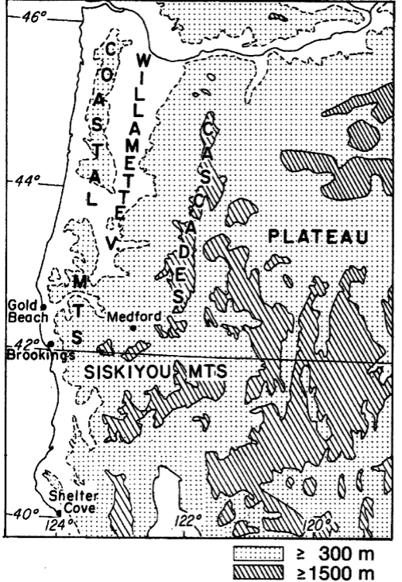
Brookings: The Classic
Northwest Example
Located in the “Banana Belt” of Oregon

Slide 44
February 27, 1985

Slide 45
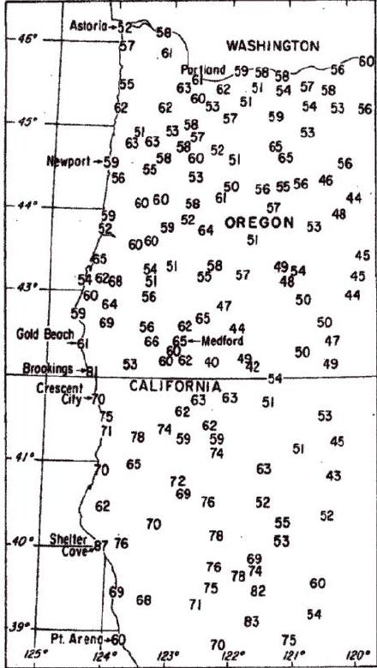

Slide 46
Another example
https://cliffmass.blogspot.com/2013/04/the-banana-belt-of-brookings-oregon.html

Slide 47
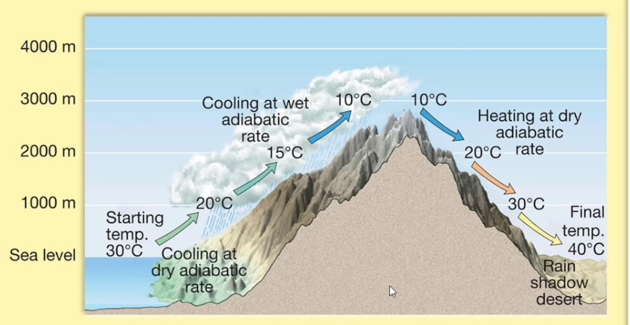
Adiabatic cooling in upslope flow is harder to see

Slide 48
Adiabatic cooling is there but harder to see, Why?
Clouds and precipitation accompanying upward motion have significant temperature effects during lifting
Adiabatic ascent leads to saturation/latent heating which results in a lesser cooling rate for rising air
  Saturated adiabatic lapse rate is smaller than dry adiabatic lapse rate.

Slide 49
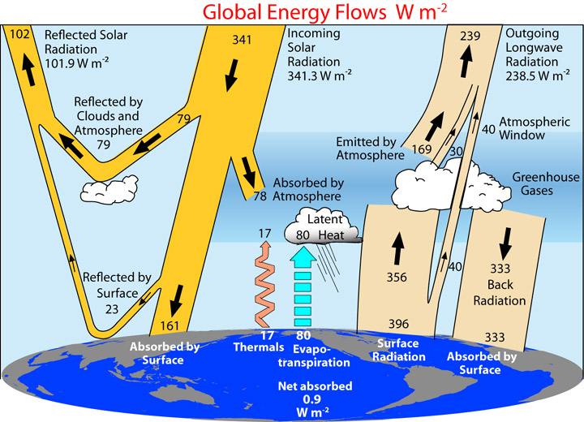
Radiation Effects on Surface Air Temps
  Direct radiational heating and cooling of the air is relatively small (except in dust/smoke layers)
  Indirectly, very large influence on air temp through modulation of ground temperature and communication into the boundary layer by turbulence.

Slide 50
Radiation Effects on Surface Air Temps
  Surface heating by the solar flux and cooling by IR flux dominate surface and near-surface temperatures.
  Clouds have a major effect on surface radiational heating/cooling.
  Smoke can too.

Slide 51

Clouds, Radiation and Surface Temps
Clouds lessen surface warming during day by reducing solar radiation, scattering solar to space.
Clouds decrease cooling at night by intercepting IR radiation and reradiating IR back to the surface.
Thin cirrus: only minor influence (1-2F cooling)
Thick altostratus: 5-10F cooling or more.

Slide 52
One can see association between changes in clouds and temperature at short-time scales

Slide 53
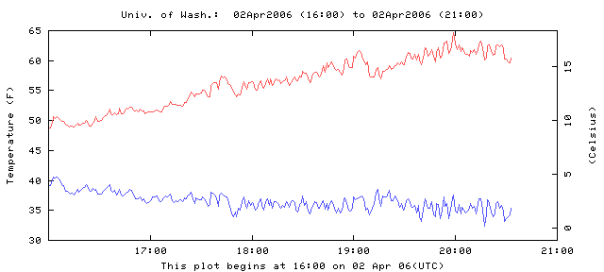
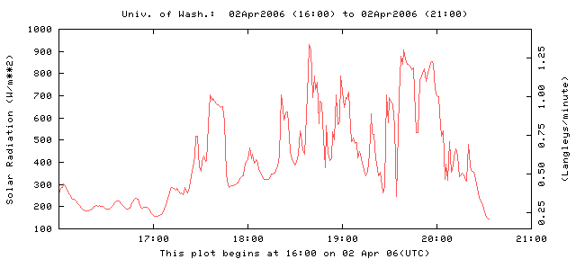

Slide 54
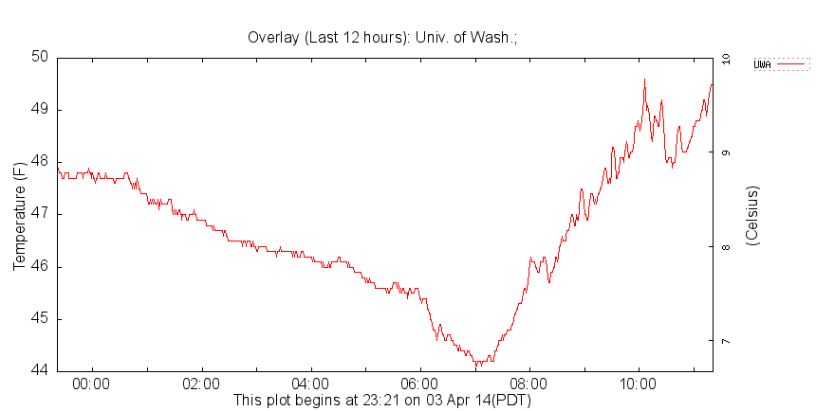
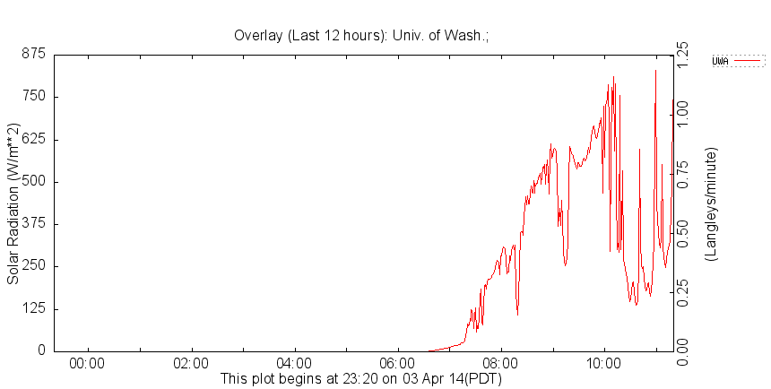
w

Slide 55
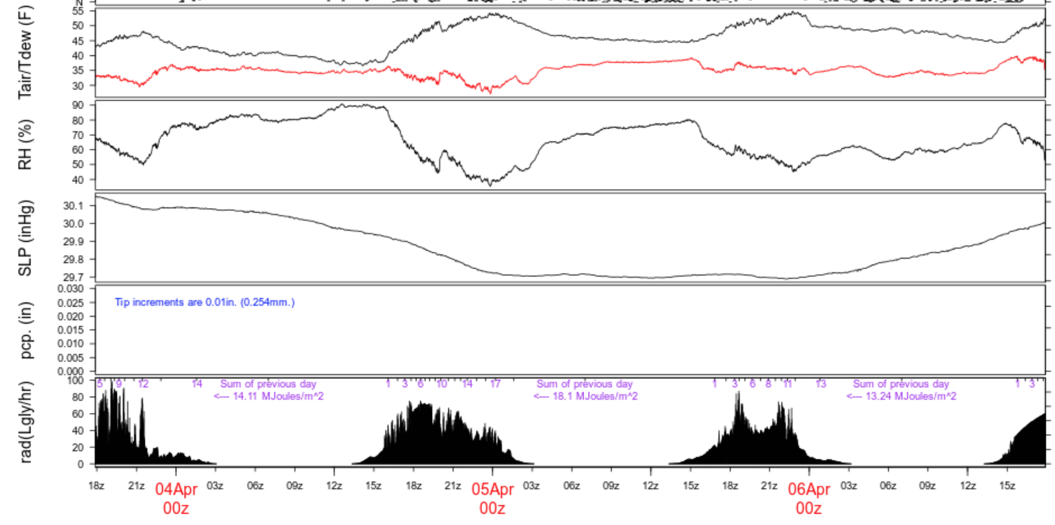

Slide 56
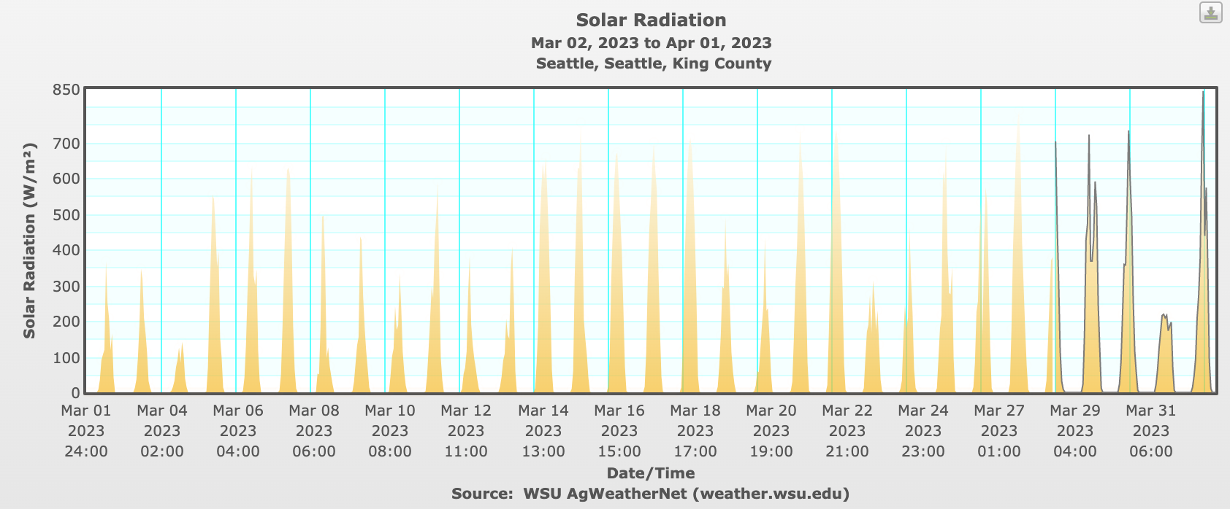

Slide 57
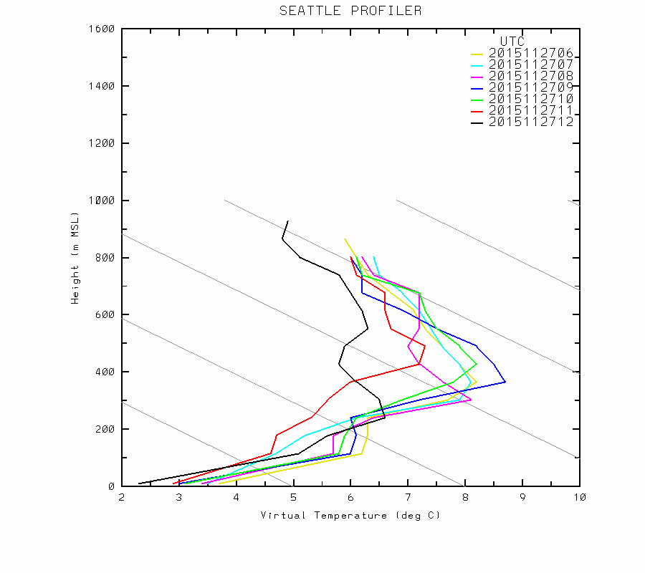
Surprising Effect of Clouds
When there are low-level inversion conditions, surface temperatures can WARM when low-level clouds move in aloft!

Slide 58
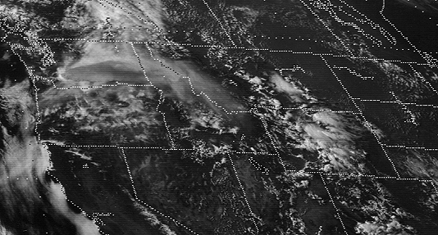
Impacts of Dust and Smoke
Mt. St Helens, 1980

Slide 59
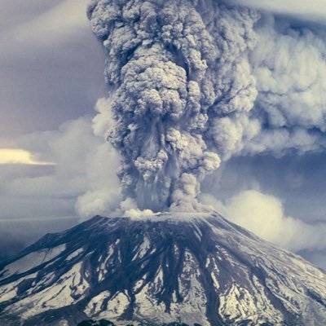
Mount St. Helens: May 1980

Slide 61
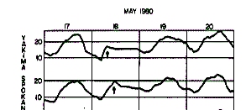
Mount St. Helens
Nothing got in, nothing got out

Slide 62

Wildfire Smoke Can Reduce Max Temps by 1-20F

Slide 63
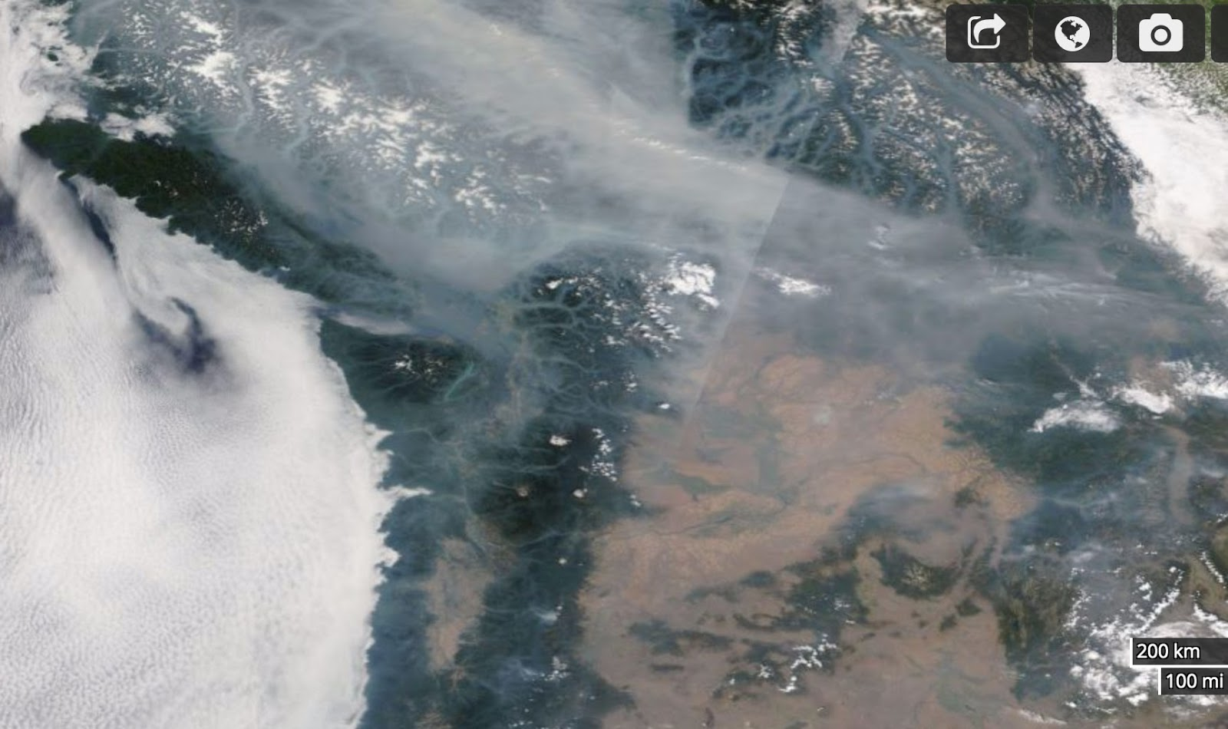
August 2017
August 9. 2017

Slide 64
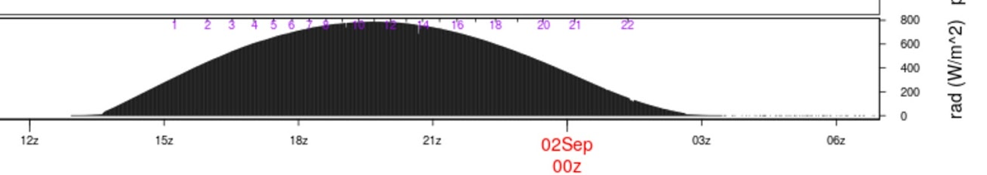
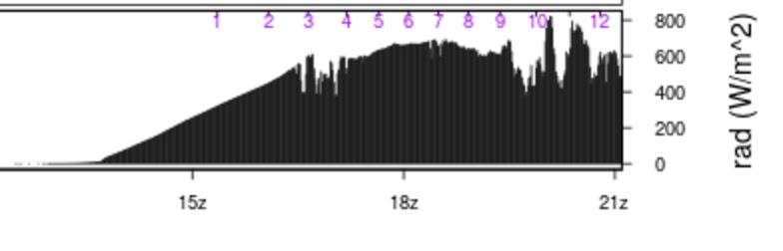
The impacts on solar radiation can be profound (25-35% drop in solar flux at surface)

Slide 65

Different between WRF forecast (no smoke) and observed
WRF
Too
WARM
With
Smoke

Slide 66

Seattle

Slide 67

Several Models Now Consider Radiative Effects of Wildfire Smoke
UW WRF has added smoke effects.
NOAA HRRR model now has smoke effects.
Not in GFS/NAM

Slide 68

IR Opacity of Air Influences Surface Temps
Increased water vapor content enhances IR opacity (H₂0 vapor is an active greenhouse gas)
Better absorption and emission in IR with more water vapor.
Less water vapor results in better surface IR cooling under clear conditions. That is why deserts cool very rapidly at night. Why Washington DC stays hot all night.

Slide 69

Air Moisture Content has a Large Impact

Slide 70

Drier Areas Have Large Diurnal Range

Slide 71


Slide 72

Turbulence Effects
Variations in lower tropospheric turbulence and mixing can have a huge impact on surface air temperatures
Strong winds produce more turbulence and thus more vertical mixing/turbulent heat fluxes
Lower vertical stability also enhances turbulence.
2-m temperature can vary with the degree of turbulence, particularly at night

Slide 73
Turbulence and Temperature
Higher temps on windy nights. Destroys or weakens inversions.
Lower temps on calm nights (with clear or nearly clear skies). Surface-based inversion. Lack of mixing down of warm air
December 24, 1983 example (next).

Slide 74

Winds in mph

Slide 75

December 24, 1983
Strong wind swath: higher temps
Low temps that night

Slide 76
Humans can create strong winds and turbulence that alter surface temperatures (wind machines in orchards)
Mixes warmer air from aloft down to the surface

Slide 77


Orchard Fans
Fans in orchards and vineyards—can save vulnerable crops

Slide 78


Slide 79


Slide 80

Phase Changes of Water
Can have a large impact on temperature and type of precipitation.
Condensation, freezing and deposition release latent heat
Evaporation, sublimation, and melting cause cooling (require or absorb heat).

Slide 81


Slide 82

Phase Change of H₂0 Have Major Energy Implications
S to L. Requires heat of fusion. 79.7 cal gm⁻¹
L to V. Requires heat of vaporization: 539 cal gm⁻¹
S to V, sum of both.
Releases energy when you go the other direction (V to L, L to S, V to S).

Slide 83


Water is the Battery of the Atmosphere

Slide 84
Evaporation at the surface
Evaporation from a wet or moist surface produces cooling and requires energy.
Much of the incoming solar radiation on a moist surface is used to evaporate H₂0, not for sensible heating.
Ratio of two expressed in the Bowen Ratio

Slide 85
Bowen Ratio
Bowen ratio=
energy used for sensible heating
energy used for evaporation and sublimation
~10 deserts,
2-6 arid regions, .
4-.8 temperate forests/grasslands, .
2 tropical rain forest,
.1 tropical ocean

Slide 86

Variations in surface moisture can produce significant temperature variations…both in time and space.
Moist areas can be 1-5F cooler than dry areas.

Slide 87

Irrigated Fields: 1-5F cooler

Slide 88

Massive Irrigation in Eastern WA

Slide 89

California
Central Valley

Slide 90

Cooling and higher humidity

Slide 91

Role of Soil Moisture in the June 2021 Northwest Heatwave

Slide 92


Slide 93


Slide 95
Evaporation of precipitation is a powerful cooling agent but generally short lived
Most of the cooling occurs during the first hour of precipitation.
Air cools to the wet bulb temperature (T_{w})
Ends when air becomes saturated.
Can produce large cooling (10-20F in very dry air)

Slide 96



Slide 97


Slide 98


Evaporation and resulting saturation on a sounding

Slide 99



Slide 100


Slide 101

Condensation (e.g., dew) on ground
Can slow cooling near ground as latent heat is released.

Slide 102

Temperature Decline is Reduced When Dew Starts to Form

Slide 103

Freezing of water releases latent heat of fusion
Used in orchards to protect sensitive buds

Slide 104


Slide 105

Melting and Sublimation of Snow Cools the Atmosphere
Can cause a drop in freezing (or melting) levels and snow levels.
Note: Freezing or melting level (0C elevation). Snow level (level at which snow has melted)—about 300 m (1000 ft) below freezing level.
Isothermal
Layer (OC)

Slide 106
Isothermal
0C

Slide 107

Melting of falling snow
Associated with a bright “band” on weather radars (melting snowflake is like a huge raindrop)
Produces an isothermal (32F) melting layer between the freezing and snow levels.

Slide 108
Melting of falling snow
Heavier precipitation produces greater cooling and lowering of freezing level
Evaporation (sublimation) into unsaturated air can also drop freezing level, but effect is short-lived.

Slide 109

Bright Band

Slide 110


Slide 111

Can see bright band on radar imagery

Slide 112

In marginal conditions, melting can bring snow level down to surface in heaviest precipitation…rain elsewhere
Locally
seen in convergence zones

Slide 113


Snohomish, WA
April 4, 2005

Slide 114

Varying Surface Properties Affect Temperature
Surface properties can have large impact on surface temperatures. Examples:
  Albedo
  Soil conductivity
  Soil/water thermal capacity
  Soil moisture

Slide 115
Snow Versus No Snow
Snow promotes cooling in four ways:
  Reflects solar, emits IR, reduces conduction of heat from below, takes energy to melt snow
10-15F cooling effect or more possible
Cold temperature records often associated with snow.
Can have intense low-level horizontal temp gradients on snow boundaries

Slide 116

colder

Slide 117

SNOW IS A COOLING MACHINE
In locations that get snow, record cold temperatures are inevitably associated with snow cover

Slide 118
Surface moisture
Moist surfaces result in cooling by evaporation
Drier surface warmer (Bowen ratio larger)
Forecaster needs to keep this in mind (often not handled well in models)
Wet surfaces can produce surface air cooling of 1-5F and a surface temperature gradient where moisture gradients exist.

Slide 119



Slide 120


Real-Time Soil Moisture Maps are Available

Slide 121
Influence of water bodies
Water has large heat capacity, with slowly changing temperature
Tend to be warmer than land surfaces during winter, cooler in summer
Creates large temperature gradients along coastal zones
As models gain resolution, doing a better job at this.

Slide 122


Slide 123

A January
Morning
6-7:30 AM

Slide 124
Summer

Slide 125
Conduction of heat from below the surface can greatly change surface temperatures

Slide 126


Bridges often are often the first (or only) places to ice up

Slide 127

Bridges
Bridges have air under them, air being an excellent insulator.
The road surface can radiate heat to space and thus the bridge deck cools rapidly.
Roadway surfaces in contract with the soil are warmed by the heat conduction from below.
The conduction of warmth is largest early in the winter season.

Slide 128

SnowWatch Temps One Morning

Slide 129

Urban Heat Island Effect
Concrete/asphalt/bricks have great thermal mass: warm up during day and release heat at night.
Also heat released by combustion
Drier surfaces in urban areas…less evaporation/evapotranspiration

Slide 130

Urban heat islands occur in our major cities

Slide 131

Urban Heat Island Example: London

Slide 132

Seattle’s urban core often 2-10F warmer than it would have been without concrete and buildings

Slide 133


New York City Area

Slide 134

IMPACTS OF LOCAL DIURNAL CIRCULATIONS ON TEMPERATURE
Sea and land breezes
Upslope and downslope flows

Slide 135

Sea/land breeze circulations

Slide 136
A sea breeze can cap or slow coastal temperature rises during mid-day by advecting cool marine air inland
Often cuts off diurnal rise during late morning/early afternoon as cool marine air moves in with the sea breeze.

Slide 138

Sea Breeze Front on the WA coast

Slide 139

Comparison of the daily temperature cycle between observations (blue dashed) and the model (red triangles) for a coastal location (Boston, MA) on 10 August 1997 impacted by the passage of a sea breeze front.

Slide 140

Same thing is true in NYC

Slide 141
Sea breezes and resultant cooling can occur on:
ocean coasts
coasts of bays
near large lakes
near large rivers
and even over land where there are differences in temperature (e.g., due to snow or soil moisture distributions!)

Slide 142

Washington State sea breezes—big influence on temperature

Slide 144

The Sound Breeze
Brings Afternoon Cooling During Summer
Over Central Sound

Slide 145

Diurnal
Slope
Winds

Slide 146
Diurnal slope winds
Can have a large influence on low-level temperatures
Importantly, drainage/downslope winds produce cooling at bottom of slopes
Example: Salt Lake City eastern suburbs downstream of gaps often cool 10-15F compared to surrounding areas.

Slide 147



Slide 148


Slide 149


Slide 150


Slide 151

Cold, dense air tends to settle into lower elevations

Slide 152

Even on the microscale

Slide 153

Mesoscale Cold Pools
Cold air can collect in mesoscale basins…such as the Columbia Basin of eastern Washington, the Willamette Valley, Central Valley of CA, and many more

Slide 154


Slide 155
Near Sea Level Gap
On Border of WA and OR
Notes:
Use this slide to introduce where the Gorge is and the nature of the gap flow scenario.
Spend some time pointing out important features like:
The mountain barrier, the Columbia Basin and how it provides a topographically confined air shed and note how the Gorge is the only drain
Then switch gears and point out other gaps on this map (Frasier, JDF, Stampede, Chehalis) and mention important results of each
Frasier - cold outflow, Juan de Fuca - easterly gales, westerly gales, PSCZ, Chehalis - PSCZ, Stampede - downslope windstorms, CRG - Cold outflow, gales, wintry precipitation
So meteorological phenomena driven by gaps are obviously very important, especially in the PNW.

Slide 156


Slide 157

Eastern
Washington
Cold
Pool
Climatology

Slide 158



Slide 159

February 3, 2022

Slide 160
Cold Pool Forecasting Issues
Models often mix out cold air too readily…resulting in warm temperature biases at low levels.
Cold pools are often capped by inversion, which can be very persistent.
Mixing out of cold pools is a difficult forecasting problem…often takes a strong synoptic system capable of mixing out the inversion overhead.

Slide 161

Gap Winds and Temperatures
Often cooler air in and immediately downstream of gaps.
Usually lower dew point as well downwind of gaps.
Local examples: Columbia River Gorge, Fraser River Valley

Slide 162
Columbia Gorge: Near Sea Level Gap
On Border of WA and OR
Notes:
Use this slide to introduce where the Gorge is and the nature of the gap flow scenario.
Spend some time pointing out important features like:
The mountain barrier, the Columbia Basin and how it provides a topographically confined air shed and note how the Gorge is the only drain
Then switch gears and point out other gaps on this map (Frasier, JDF, Stampede, Chehalis) and mention important results of each
Frasier - cold outflow, Juan de Fuca - easterly gales, westerly gales, PSCZ, Chehalis - PSCZ, Stampede - downslope windstorms, CRG - Cold outflow, gales, wintry precipitation
So meteorological phenomena driven by gaps are obviously very important, especially in the PNW.

Slide 163
1.33 km grid spacing, Pass Height = 150 m
•
Portland
Cascade Locks
The Dalles
Troutdale
Notes:
Min pass height is at far right of domain near Cascade Locks

Slide 164

T on
150 m
Surface
Portland
Troutdale
Notes:
Min pass height is at far right of domain near Cascade Locks (same place as 4/3 domain)
This plot is from 310 m. Note, vortex. See this on radar data too. Zoomed in plot will be from 150 m
Recall mesoscale plots. Good T and wind agreement.

Slide 165

Wintry precipitation at PDX
  Almost exclusively E or SE (outflow from the Gorge)
  Tendency towards E for snow and SE for freezing rain
Notes:
Some leakage over McKenzie and Santiam Passes
NOTE: There are two layers of images

Slide 166

Cold Air Moving Out of the Fraser River Valley

Slide 167

Cold Air Moving Out of the Fraser River Valley

Slide 168

Onshore Versus Offshore Flow
Onshore (cool) versus offshore (warm) flow during summer
Found all over the world (e.g., Australia, S. Africa)
Very profound in summer in coastal areas with cold water offshore

Slide 169
Question:
Here in western WA what time of year brings the largest temperature declines?
?

Slide 170

The Summer!

Slide 171

Warming then sudden cooling

Slide 172
The Reason
Changes between onshore and offshore flow.
Onshore flow is off the cool ocean (cool temps)
Offshore flow is warm during the summer (warm temps).
Known as the onshore or marine push over the NW.
Similar situation in coastal regions around the world.

Slide 173


Slide 174


Slide 175


Slide 176


Slide 177


Slide 178


Slide 179


The West Coast Thermal Trough

Slide 180

The West Coast Thermal Trough: the Most Important Warm Season Mesoscale Feature of the West Coast
An inverted pressure trough based out of the Central Valley of CA that can extend into the Pacific Northwest
925 hPa heights and temperature

Slide 181


Slide 182


Slide 183


Slide 184
Some interesting details
Warmest weather occurs on the last warm day when trough is overhead and about to move east of the Cascades
When trough is to the south, northerly flow pulls cool air in form the north.
Slow ramp up, quick decline.

Slide 185

Southerly Buster…SE Australia…just like the push

Slide 186
Each area has local weather features that influence temperature. Over Puget Sound, the key is the Convergence Zone , which can produce localized areas of cooling

Slide 187


Slide 188

Can be 10-15F cooler in convergence zone than in clear zones to north and south

Slide 189
How to approach a temperature forecast
Always be aware of climatology (min, max, average, records)
Make use of forecast funnel: synoptic scale to mesoscale to microscale
For most locations, good to start with looking at 850 hPa temperature evolution for manual forecasts.
Why? Often the first level above surface influence (for near SL stations)

Slide 190
Approach to Temp
If synoptic scale forecasts are reasonable and you have high-resolution mesoscale models available, you can start with their temperatures IF they have enough resolution for the problem you are dealing with.
When model resolution is inadequate, manually adjust near complex terrain and near coastlines
Deal with poor land use distribution (e.g., urban areas) or snow/moisture surfaces distribution

Slide 191
Approach to temperature
Keep in mind that many models have inadequate (too small) diurnal cycles
Nearly all mix too much in the vertical….thus, mix out shallow cold air in stable situations—producing a warm bias.

Slide 192

Always Keep in Mind Verification Statistics of Models

Slide 193

Errors can vary seasonally

Slide 194


Slide 195


Slide 196


Slide 197


Errors Vary Spatially

Slide 198

NBM Improves Model Forecasts

Slide 199


Slide 200


Slide 201


Slide 202
MOS and NBM (National Blend of Models) temps are hard to beat on “typical” days

Slide 203
Private Sector Temps are often better than the NWS Forecasts
Why? Better post-processing of model output

Slide 204


https://vlab.noaa.gov/web/mdl/mos-verification

Slide 205

A very good approach for warm day maxima
Full sun, no marine influence
Take 850 hPa temps down to SLP and add 1-4F to get maximum
Why does this work so well?

Slide 206

12Z sounding, SLP:1027 hPa
~16C or 61F

