Slide 1
Temperature Prediction
ATMS 452
Spring 2021

Slide 2
Temperature Measurements
2-m
In shade
Should be over a natural vegetated surface
-too often not the case.

Slide 3
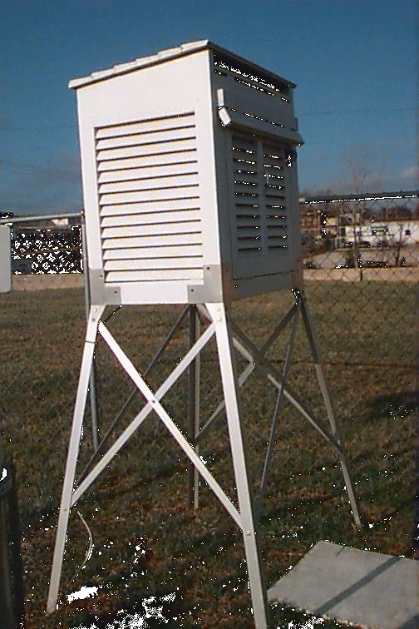
Stevenson Screen
AKA: Cotton Region Shelter
The Old Traditional Approach

Slide 4
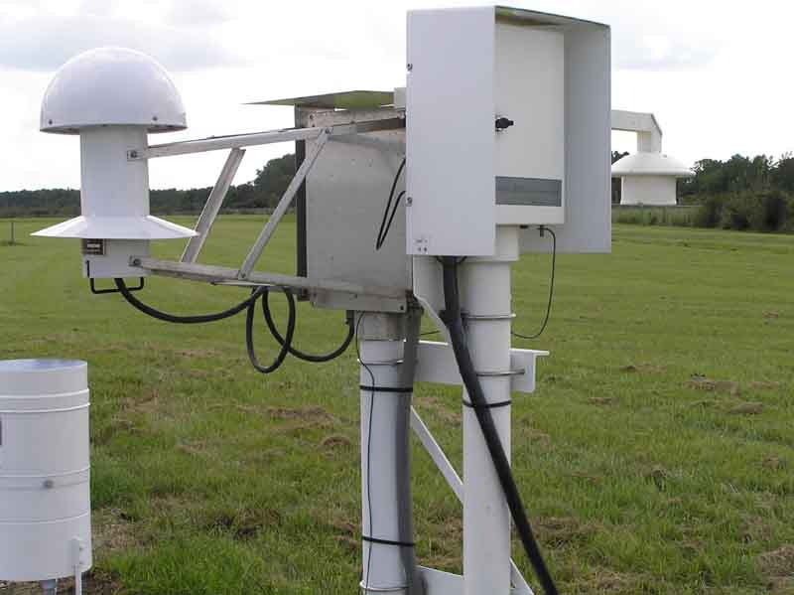
Today: ASOS Temperature/Humidity Sensor Standard NWS/FAA instrumentation
Vulnerable to fan failures

Slide 5
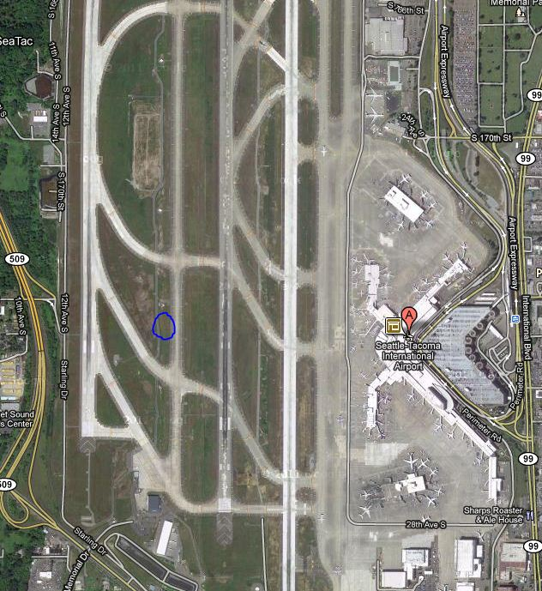
Sea Tac
Example
Typically placed
On runway
Grassy strip

Slide 6
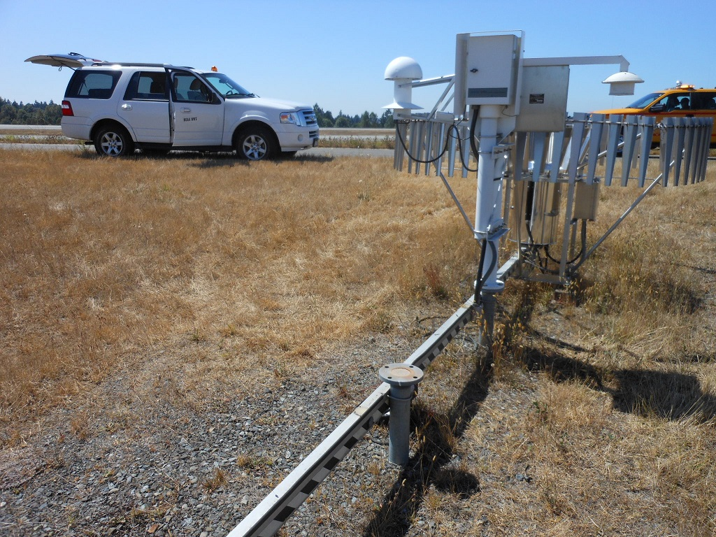
SeaTac Airport

Slide 7
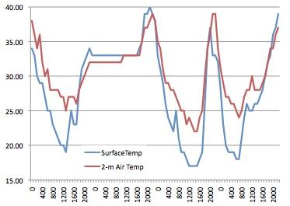
Remember: Temperature at the surface can be very different than 2-m
Marblemont WA, December 2011

Slide 8
Why Not Simply Use Model Output Directly and Go Home?
Model surface elevation may be very different than actual surface elevation due to limited model resolution.
  Differences can be in the hundreds of meters or more in steep terrain.
  Improves as resolution increases

Slide 9
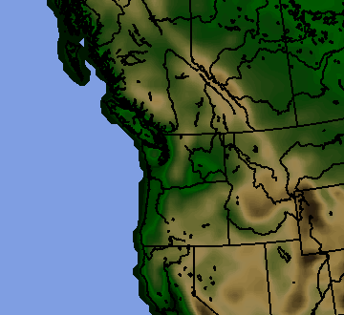
36-km terrain UW WRF

Slide 10
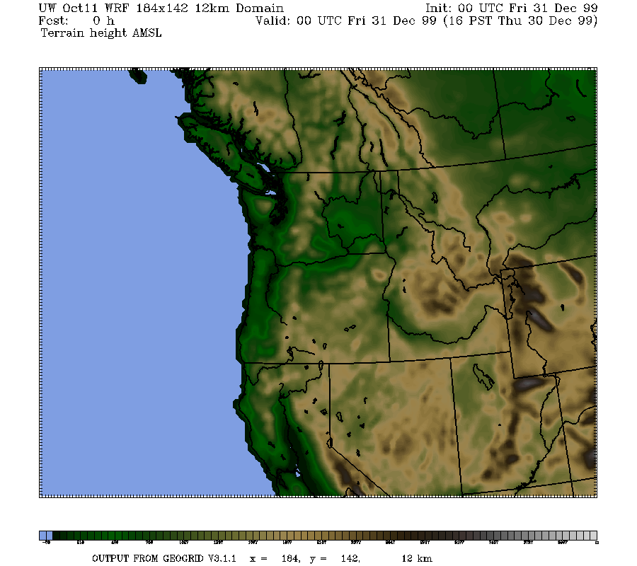
12-km

Slide 11
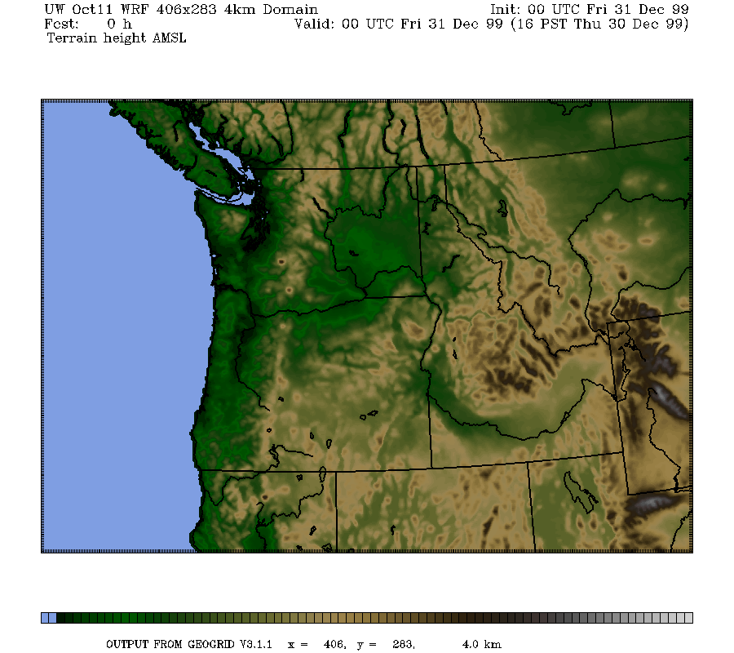
4-km

Slide 12
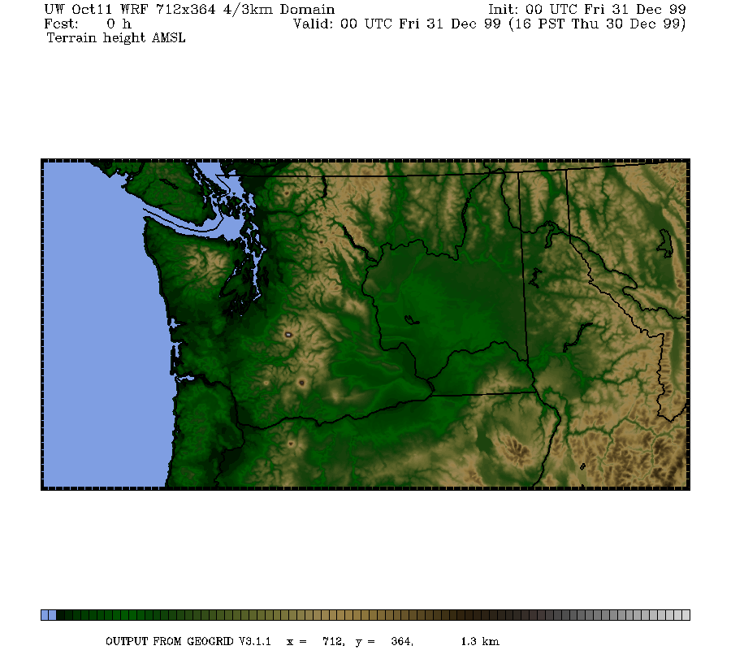
1.3 km

Slide 13
Why Not Simply Use Model Output Directly and Go Home?
(2) Model resolution is often inadequate for properly simulating important features that influence temperature.
  Examples include the Columbia River Gorge and drainage flows in valleys
  Coastal temperature contrasts

Slide 14
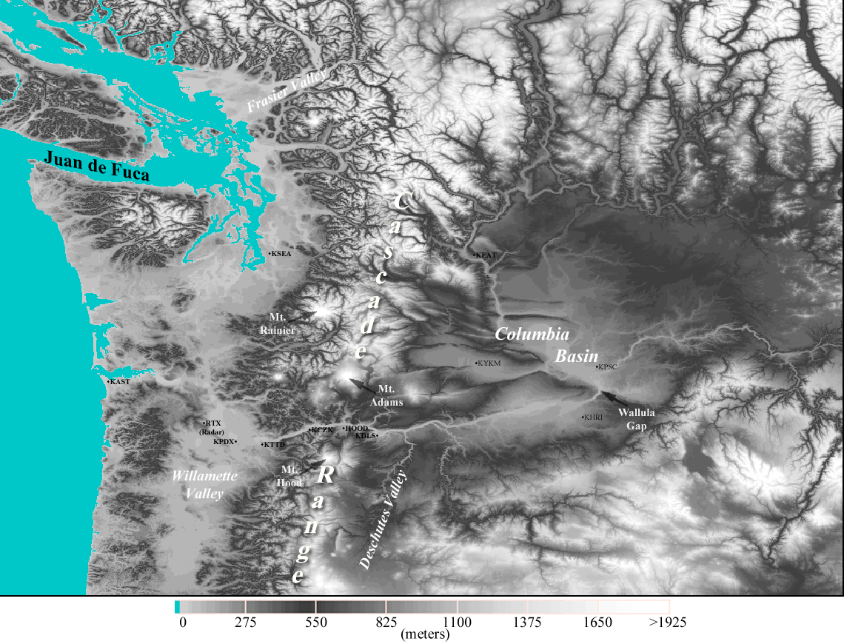
Near Sea Level Gap
On Border of WA and OR
Notes:
Use this slide to introduce where the Gorge is and the nature of the gap flow scenario.
Spend some time pointing out important features like:
The mountain barrier, the Columbia Basin and how it provides a topographically confined air shed and note how the Gorge is the only drain
Then switch gears and point out other gaps on this map (Frasier, JDF, Stampede, Chehalis) and mention important results of each
Frasier - cold outflow, Juan de Fuca - easterly gales, westerly gales, PSCZ, Chehalis - PSCZ, Stampede - downslope windstorms, CRG - Cold outflow, gales, wintry precipitation
So meteorological phenomena driven by gaps are obviously very important, especially in the PNW.

Slide 15
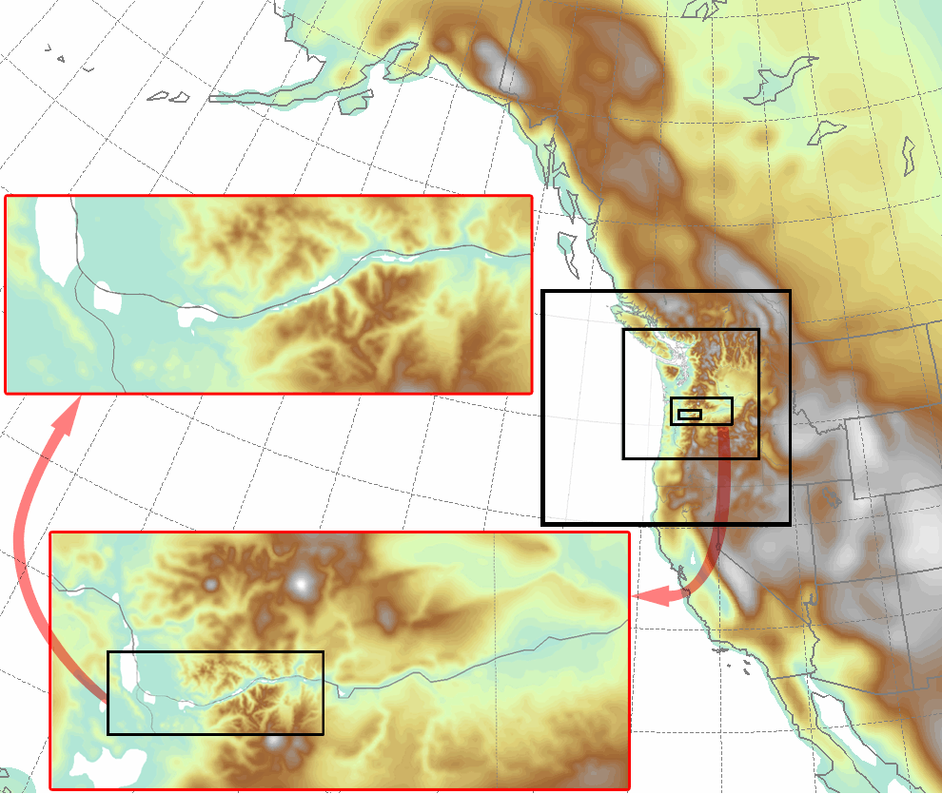
Columbia Gorge Flow Simulation
Notes:
Some leakage over McKenzie and Santiam Passes
NOTE: There are two layers of images

Slide 16
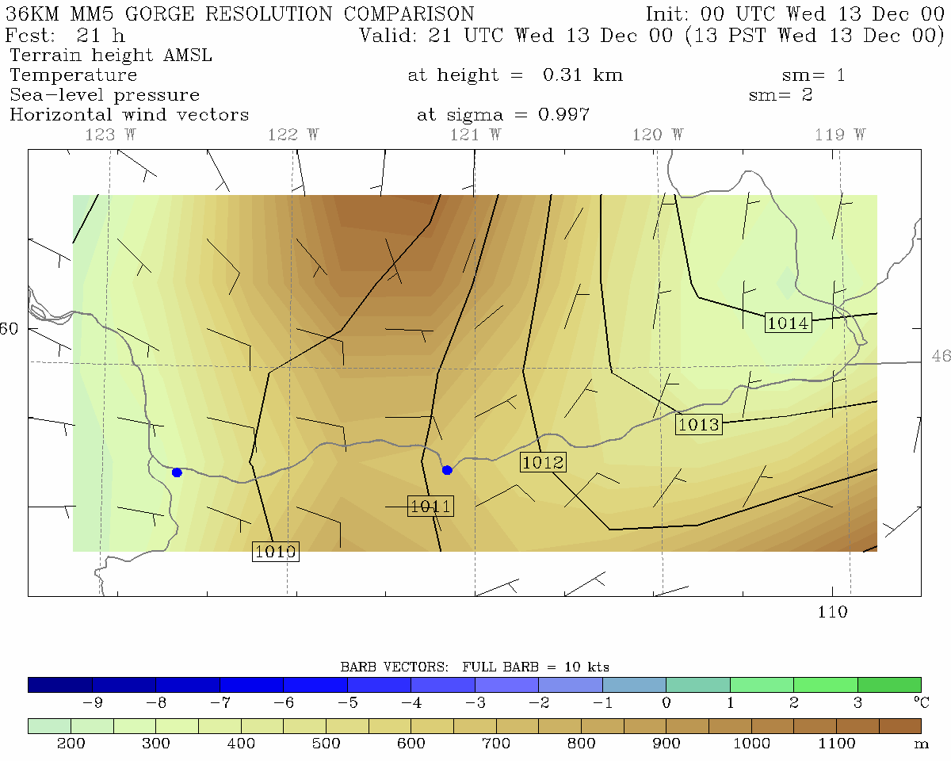
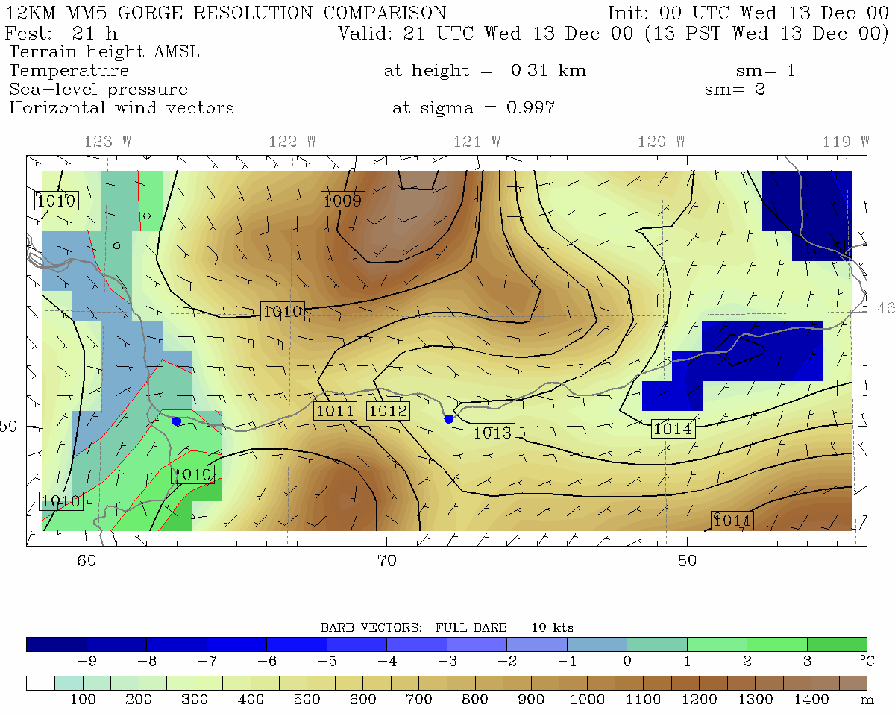
36 km grid spacing
12 km grid spacing
Portland
The Dalles
Portland
The Dalles
Pass Height = 700 m
Pass Height = 600 m

Slide 17
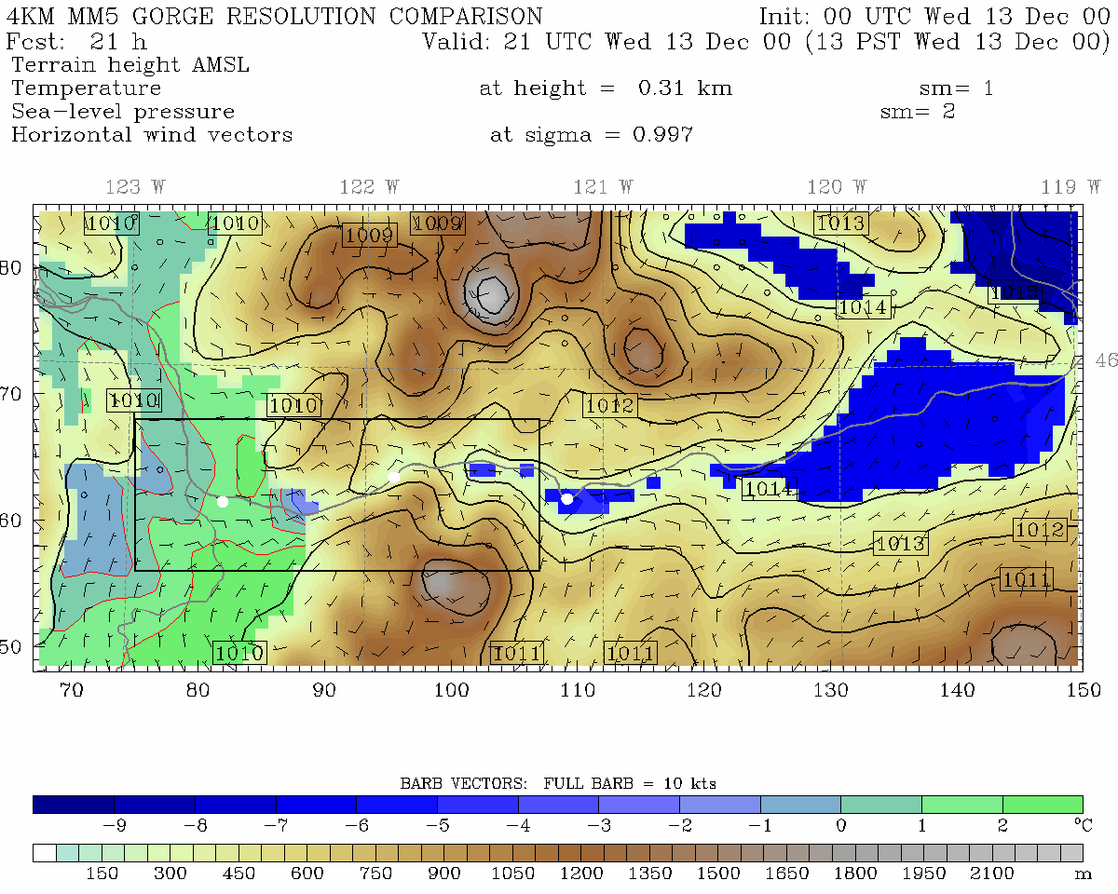
4 km grid spacing
12 km grid spacing
Portland
Cascade Locks
The Dalles
Portland
The Dalles
Pass Height = 400 m
Pass Height = 600 m

Slide 18
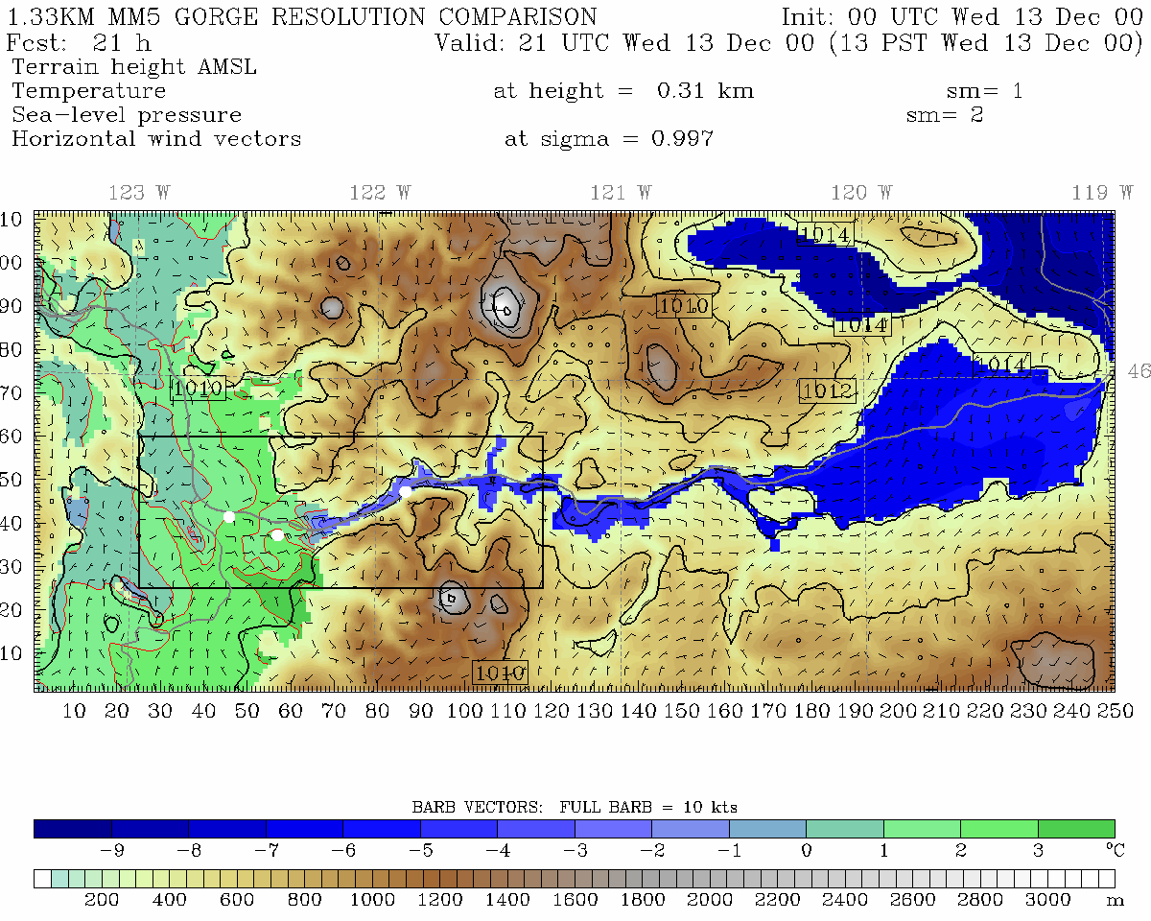
1.33 km grid spacing, Pass Height = 150 m
•
Portland
Cascade Locks
The Dalles
Troutdale
Notes:
Min pass height is at far right of domain near Cascade Locks

Slide 19
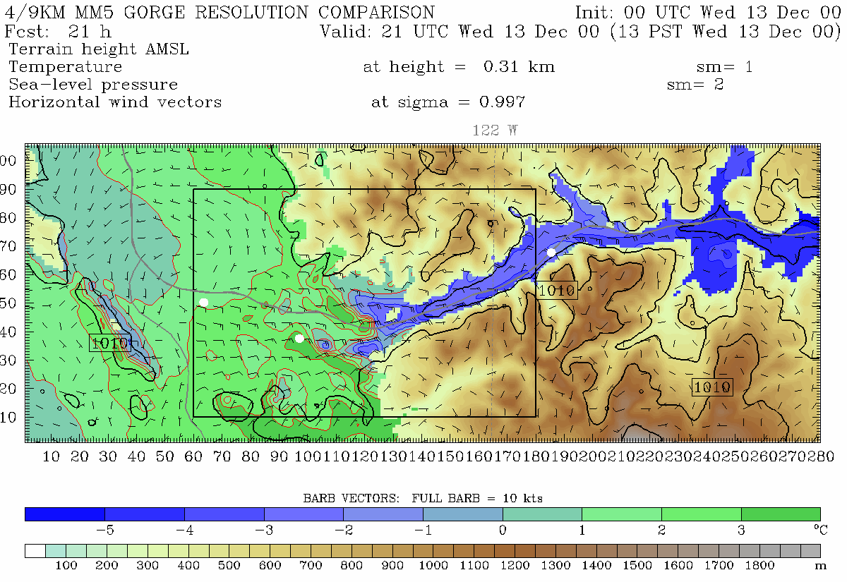
444.4 m grid spacing, Pass Height = 100 m
Portland
Troutdale
Cascade Locks
Notes:
Min pass height is at far right of domain near Cascade Locks (same place as 4/3 domain)
This plot is from 310 m. Note, vortex. See this on radar data too. Zoomed in plot will be from 150 m

Slide 20
Model temperatures may be seriously in error due to deficient model physical parameterizations
Examples: Problems in planetary boundary layer physics, radiation, surface energy fluxes, cloud and precipitation processes.
  Example 1: overmixing in PBL under stable conidtions can result in the inability to maintain shallow cold air masses. Result: warm bias
  Example 2: improper soil moisture modeling (too wet or dry) can greatly influence temperatures. (too wet produces too cool temps, vice versa)

Slide 21
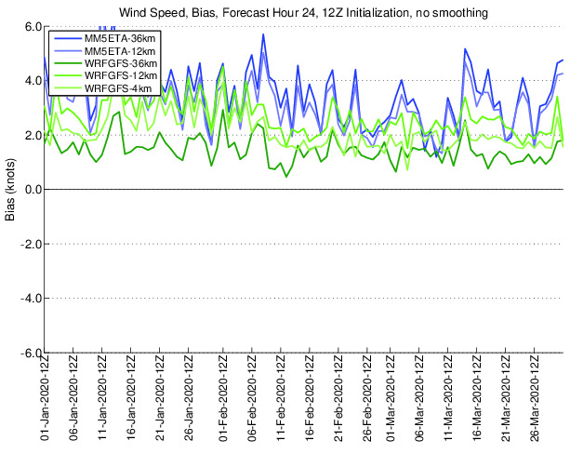
Systematic Biases
As a result of such errors, models can have serious temperature biases, some of them are systemic (highly persistent and frequent).
Many systematic biases exist. (e.g wind speed)

Slide 22
PBL Problem Example:
Shallow Fog…Nov 19, 2005
Held fog in at low elevations for days
Model maintained a deep inversion, without the observed shallow mixed layer of cold air a few hundred m deep.
Model could not maintain moisture at low levels

Slide 23
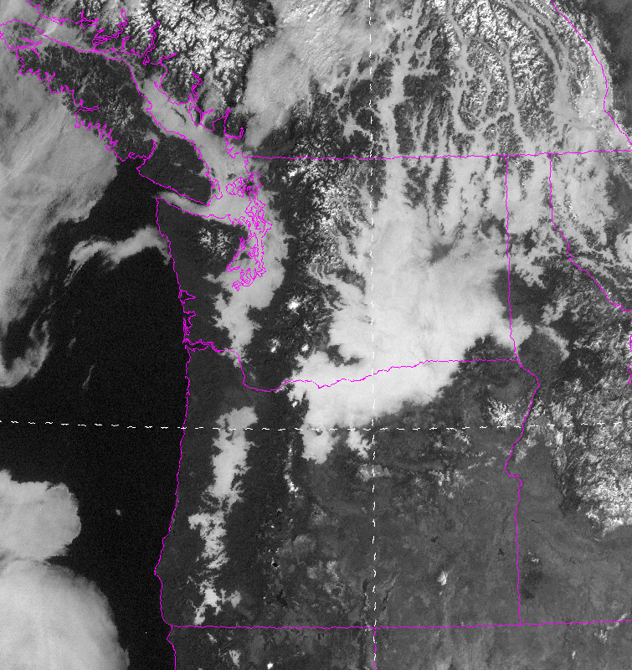

Slide 24
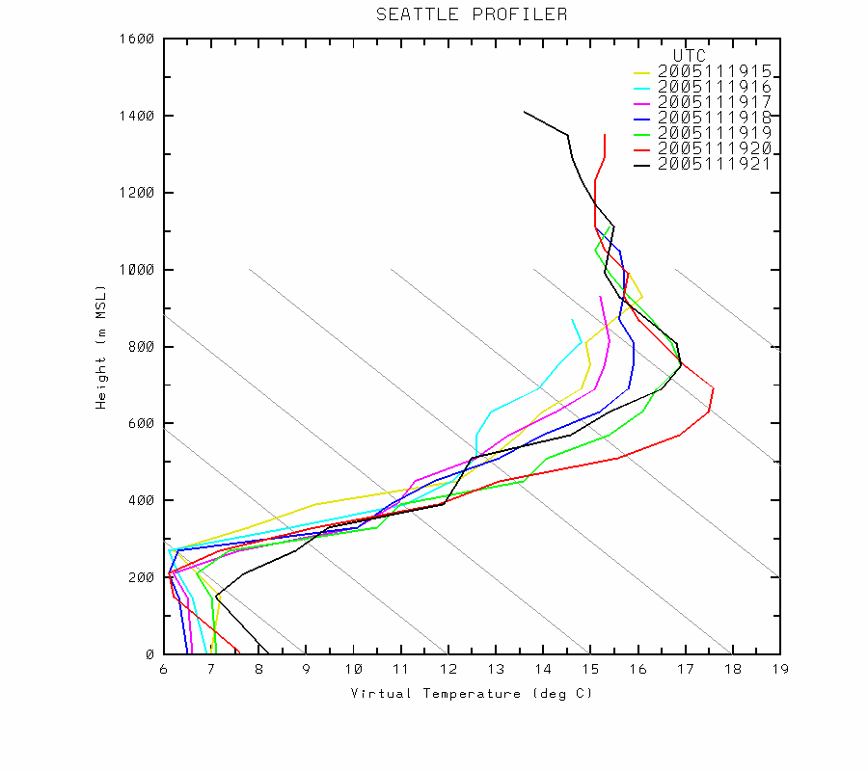
Observed Sounding

Slide 25
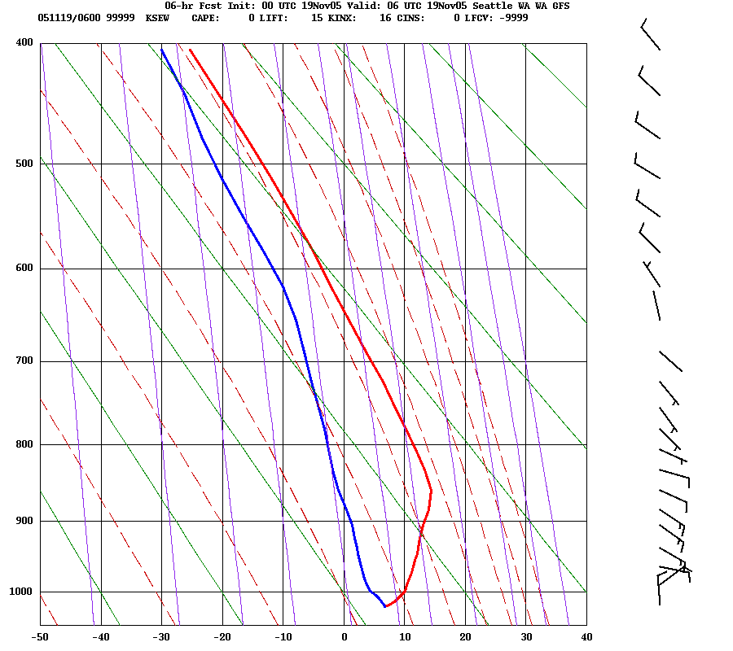
WRF Model

Slide 26
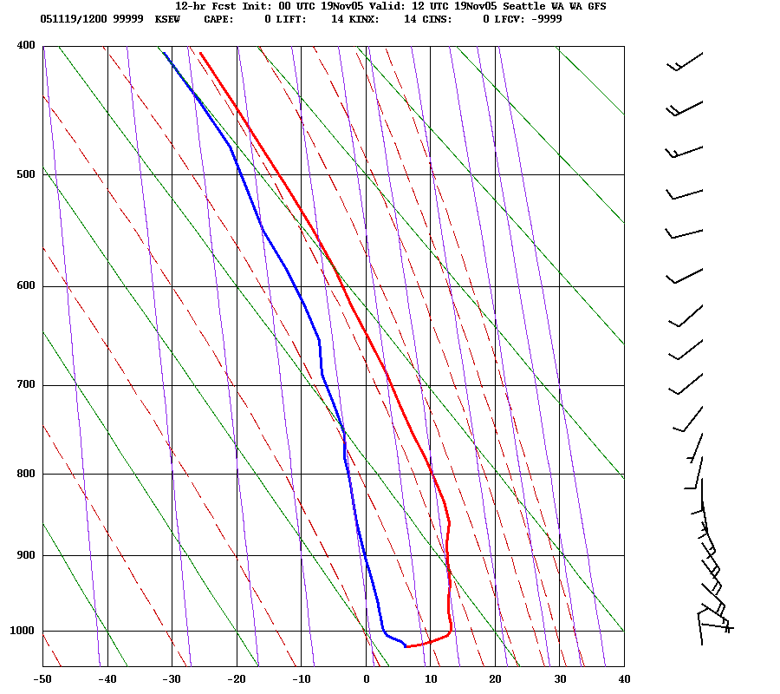

Slide 27
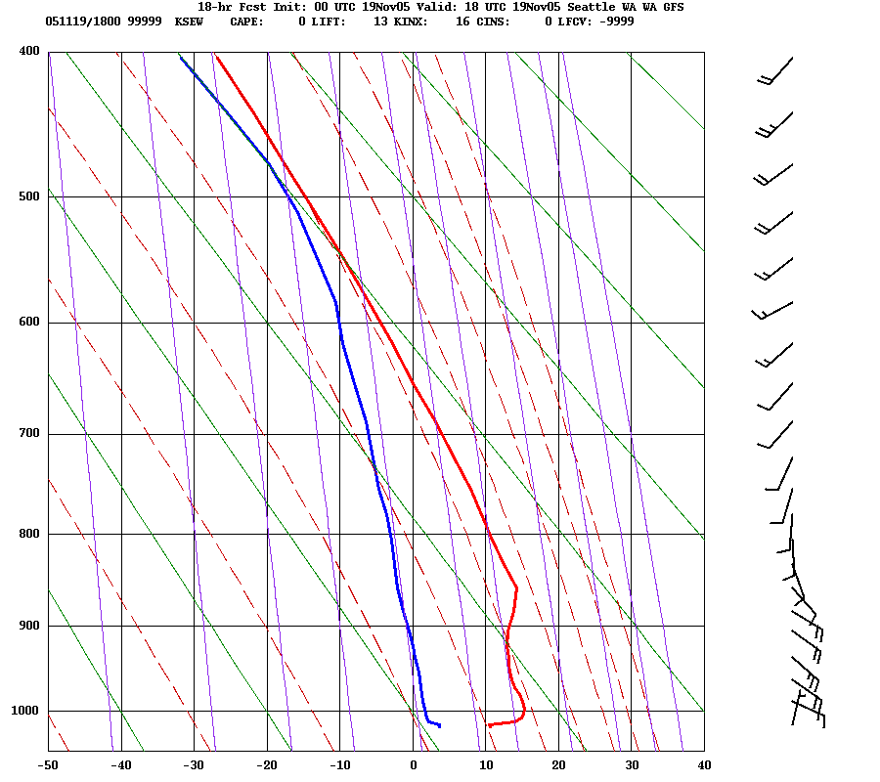

Slide 28
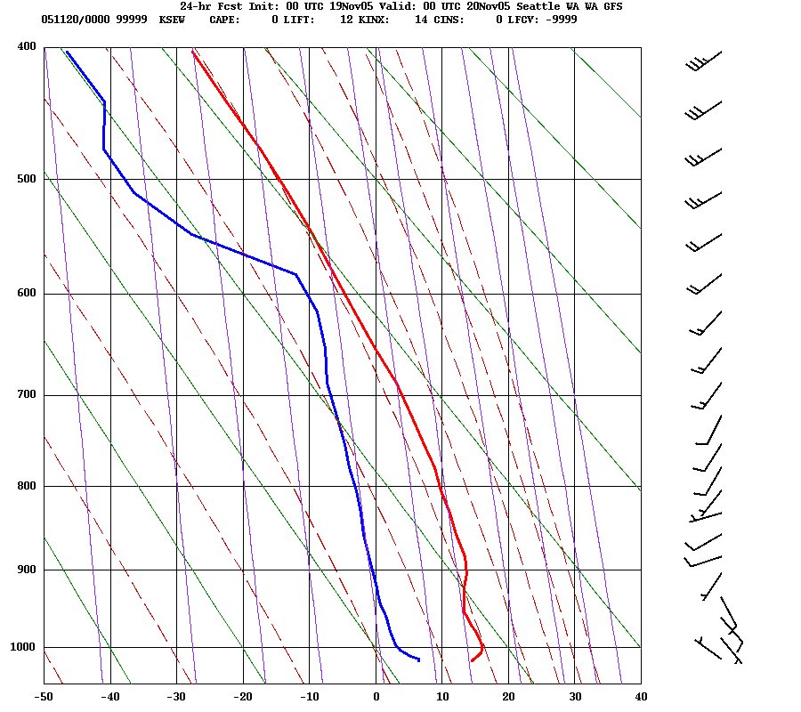

Slide 29
Other reasons why you can’t simply take the model temps
Models can also have synoptic and timing errors that can undermine temperature forecasts.
Errors in cloud distributions (which often occur) can greatly influence temperatures

Slide 30
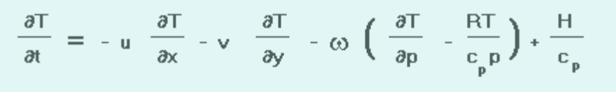
Back to Basics: First Law of Thermodynamics
Local Temperature Change =
Horizontal Advection +
Vertical Advection/adiabatic heating-cooling
Diabatic Heating and Cooling

Slide 31
Horizontal Advection
Often dominates away from terrain (level areas) and near coastlines.
Large near strong fronts
Usually largest in the lower troposphere.
Models are good at this if they have enough resolution.

Slide 32
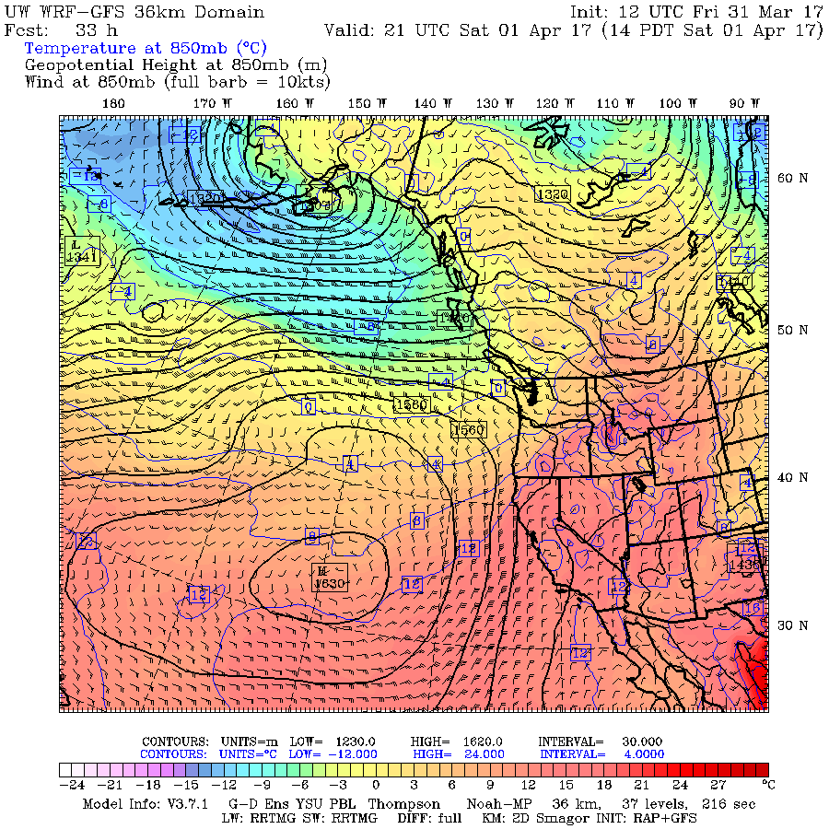

Slide 33
Adiabatic heating/cooling
Can be VERY significant near topographic barriers
Warming with downslope flow
Cooling with upslope flow.

Slide 34
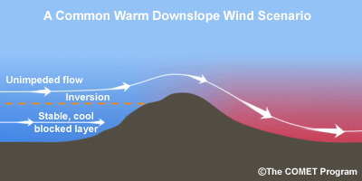
Downslope Warming
Large ompressional warming during downslope flow
Often large over Cascade foothills (e.g., Cascades-North Bend), but apparent all over the world, including to the lee (east) of the Rockies--the Chinook Wind.
In Europe called the Foehn Wind.
Usually, air comes from mid-levels where potential temperature is higher than at the surface. A drop in dew point usually accompanies downslope flow.

Slide 35
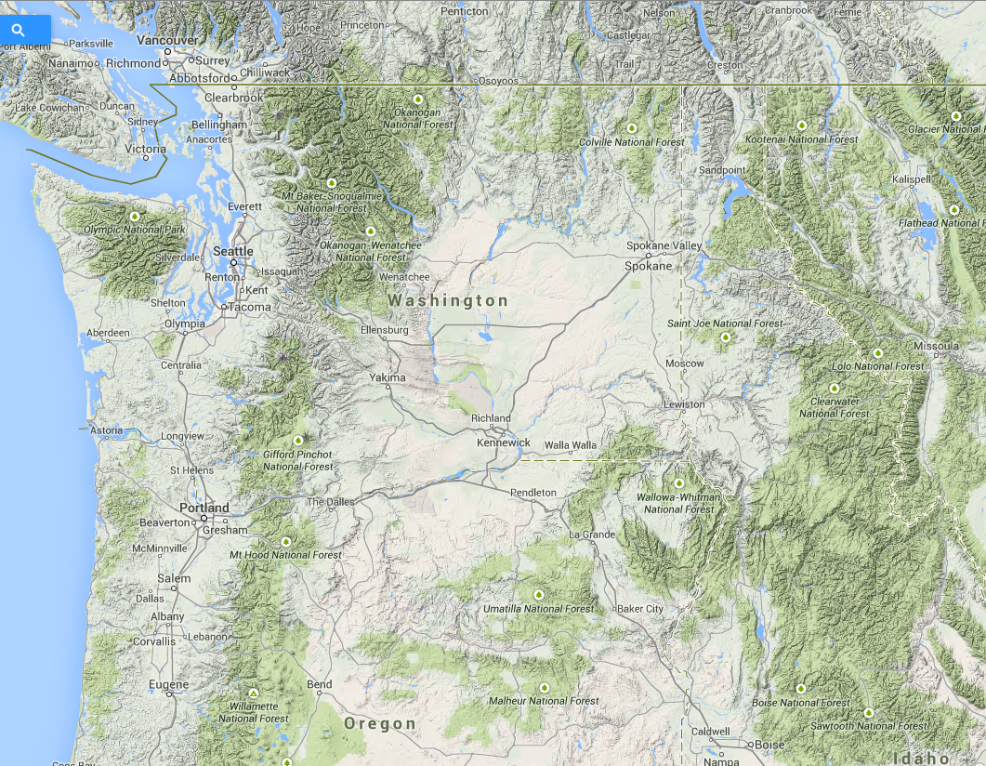

Slide 36
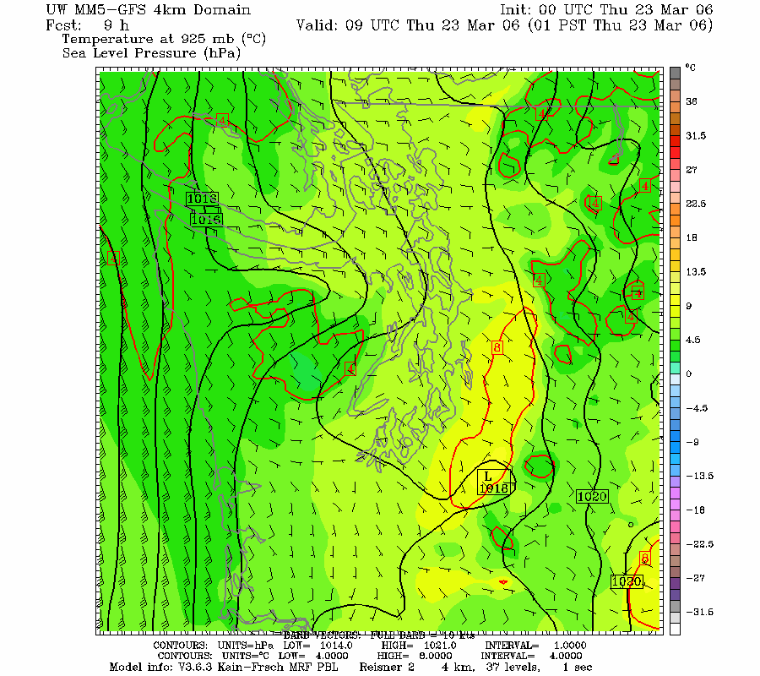

Slide 37
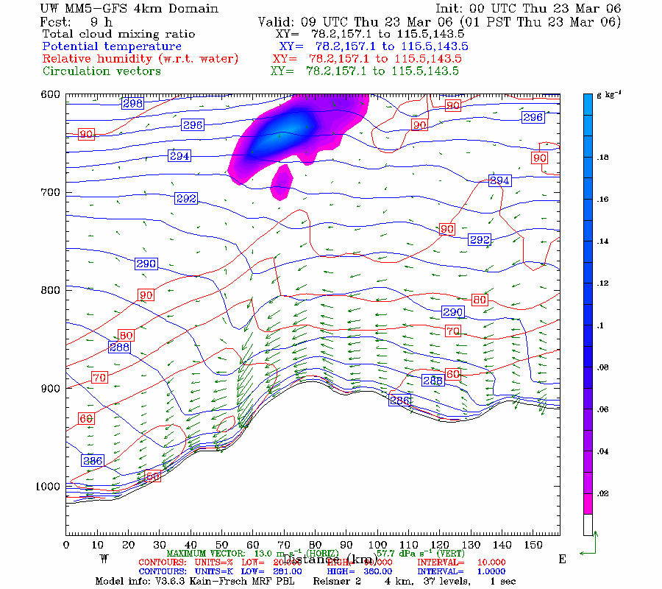

Slide 38
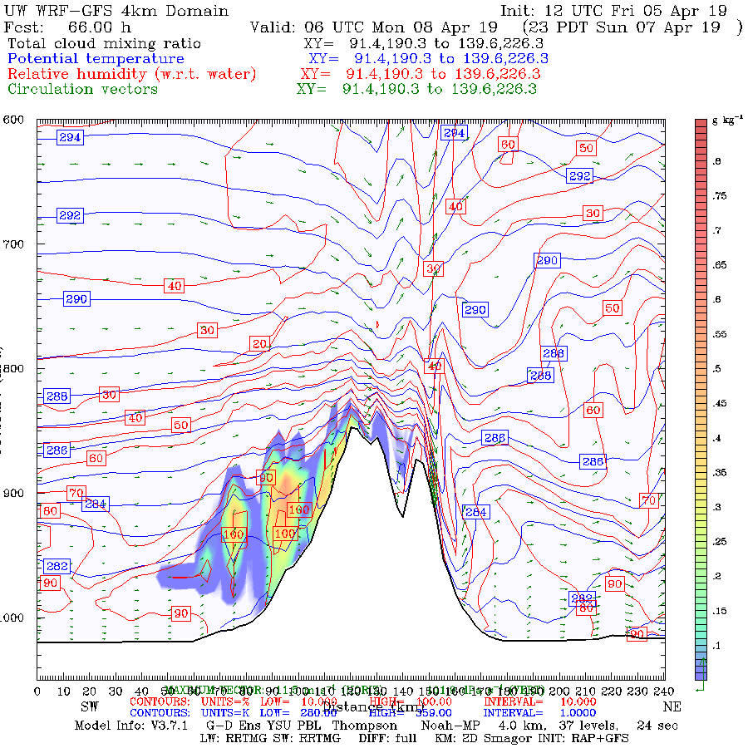

Slide 39
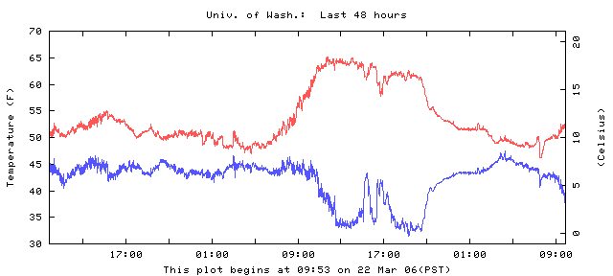
Downslope Example at the Surface
Why drop in dew point temperature?

Slide 40
The warmest temperatures are often at the bottom of the terrain slope during downslope flow

Slide 41

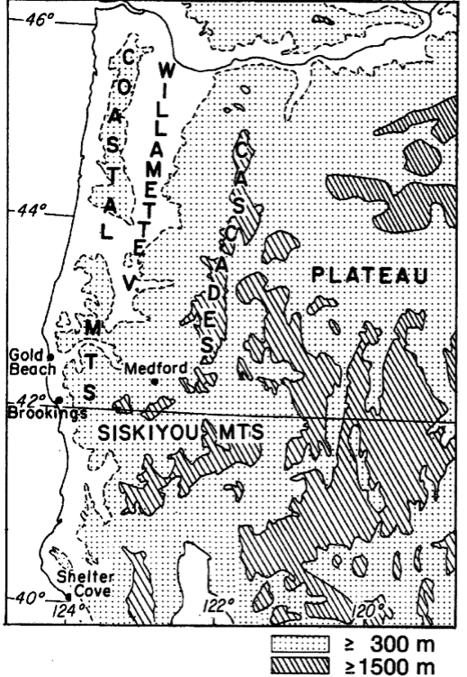
Brookings: The Classic
Northwest Example
Located in the “Banana Belt” of Oregon

Slide 42
February 27, 1985

Slide 43
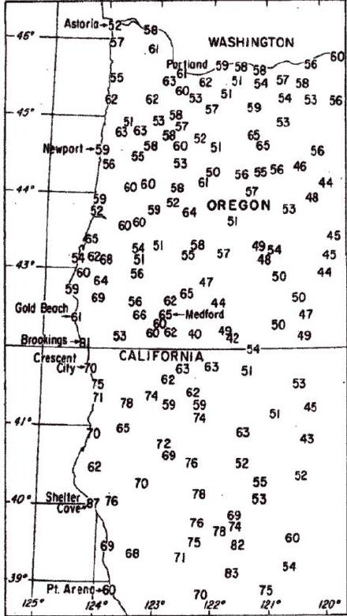

Slide 44
Another example
https://cliffmass.blogspot.com/2013/04/the-banana-belt-of-brookings-oregon.html

Slide 45
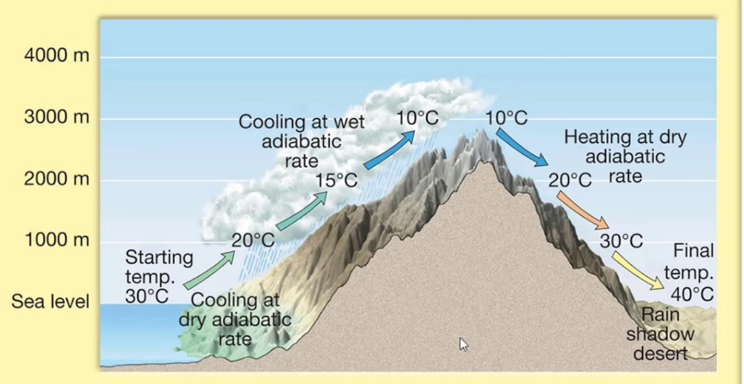
Adiabatic cooling in upslope flow is harder to see

Slide 46
Adiabatic cooling is there bu harder to see, Why?
Clouds and precipitation accompanying upward motion have significant temperature effects during lifting
Adiabatic ascent leads to saturation/latent heating which results in a lesser cooling rate for rising air
  Saturated adiabatic lapse rate is smaller than dry adiabatic lapse rate.

Slide 47
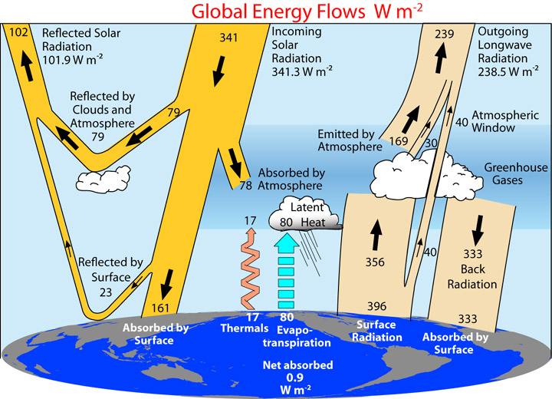
Radiation Effects
  Direct radiational heating and cooling of the air is relatively small (except in dust/smoke layers)
  Indirectly, very large influence on air temp through modulation of ground temperature and communication into the boundary layer by turbulence.
  Surface heating by the solar flux and cooling by IR flux dominate surface and near-surface temperatures.
  Clouds have a major effect on surface radiational heating/cooling.
  Smoke can too.

Slide 48
Clouds, Radiation and Surface Temps
Clouds lessen surface warming during day by reducing solar radiation
Clouds decrease cooling at night by intercepting IR radiation and reradiating IR back to the surface.
Thin cirrus…only minor influence (1-2F)
Thick altostratus--5-10F influence or more.

Slide 49
One can see association between changes in clouds and temperature at short-time scales

Slide 50
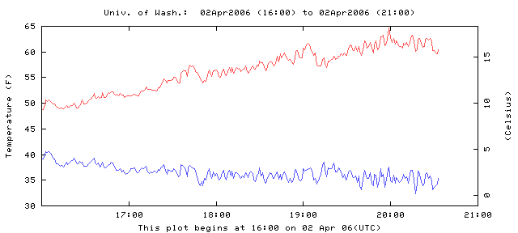
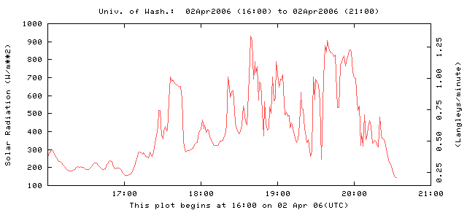

Slide 51
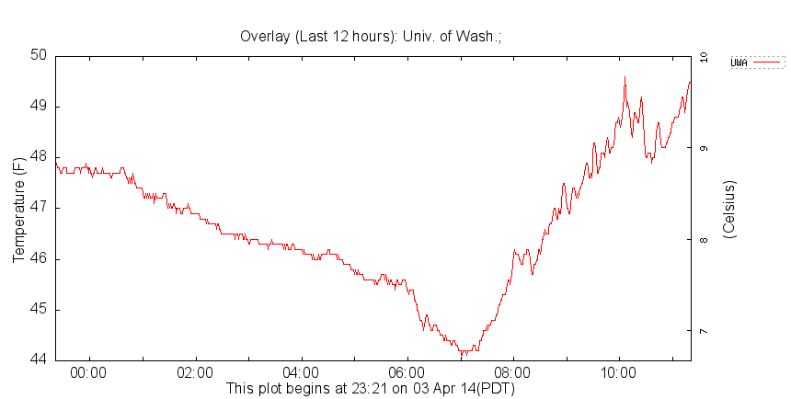
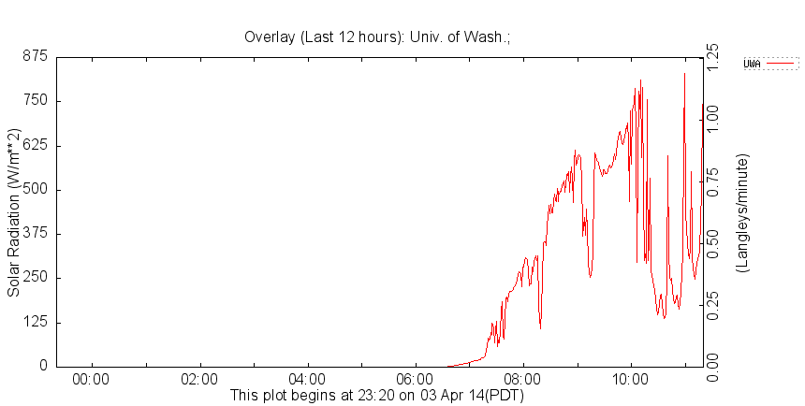
w

Slide 52
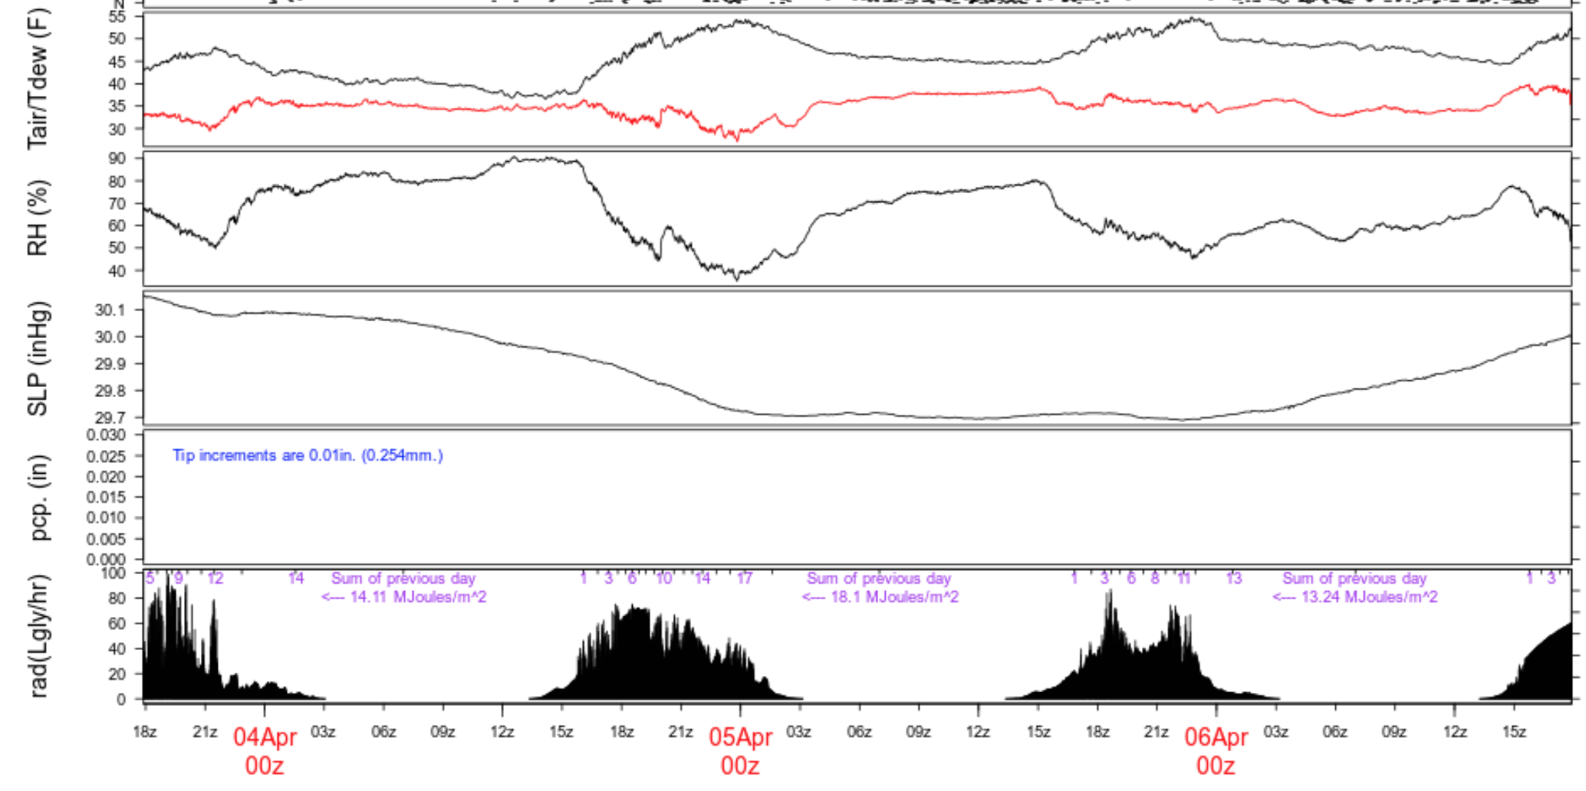

Slide 53
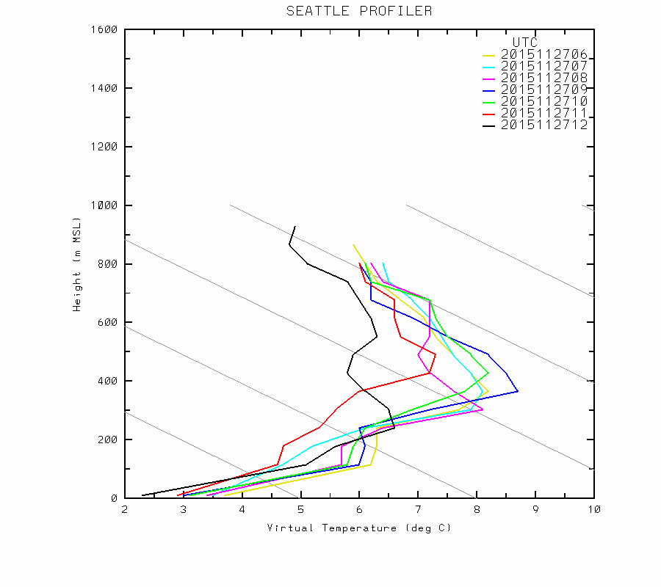
Surprising Effect of Clouds
When there are inversion conditions, surface temperatures can WARM when low-level clouds move in aloft!

Slide 54
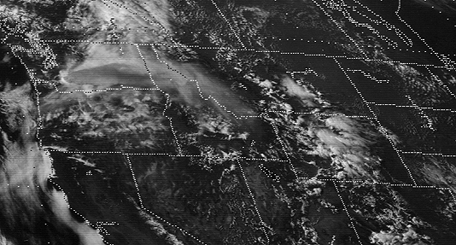
Impacts of Dust and Smoke

Slide 55
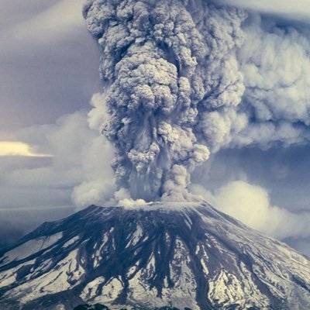
Mount St. Helens: May 1980

Slide 57
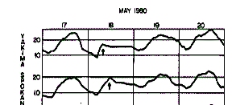
Mount St. Helens
Nothing got in, nothing got out

Slide 58

Wildfire Smoke Can Reduce Max Temps by 1-20F

Slide 59
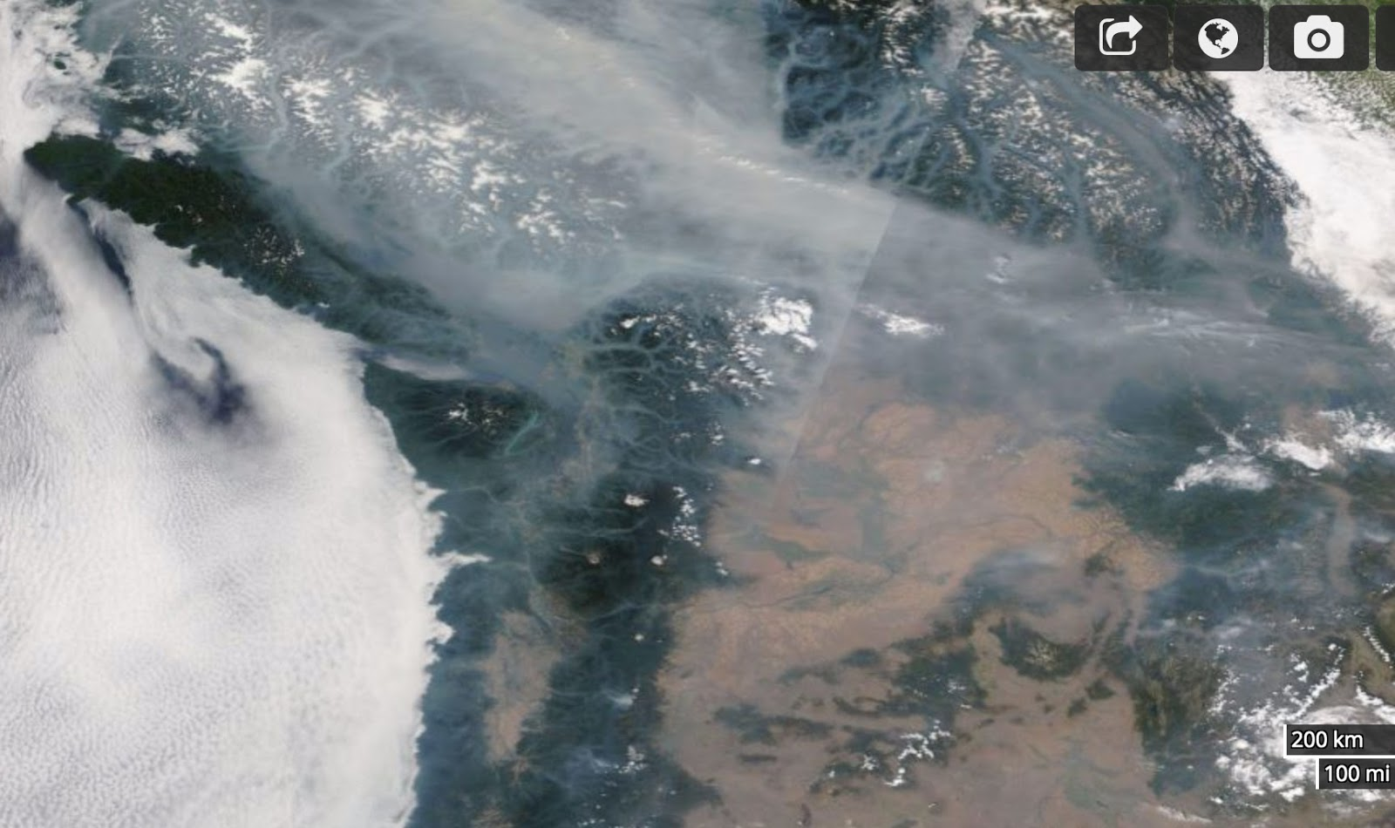
August 2017
August 9. 2017

Slide 60
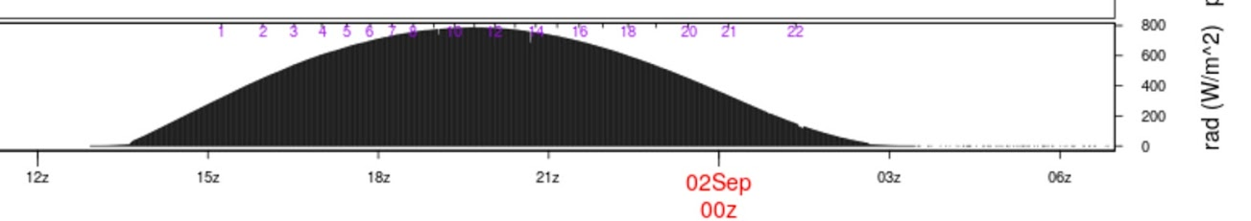
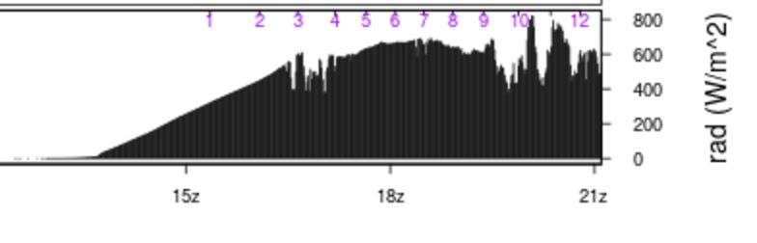
The impacts on solar radiation can be profound (25-35% drop in solar flux at surface)

Slide 61
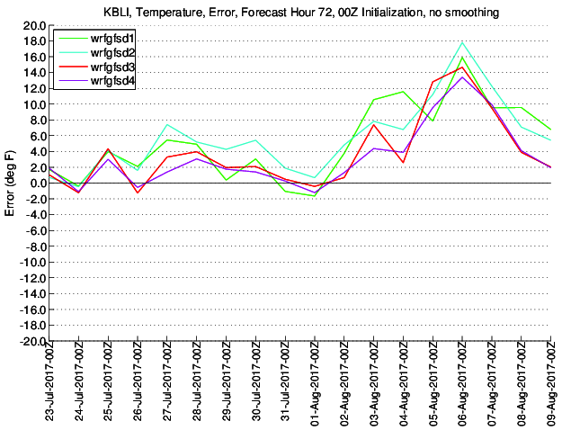
Different between WRF forecast and observed

Slide 62
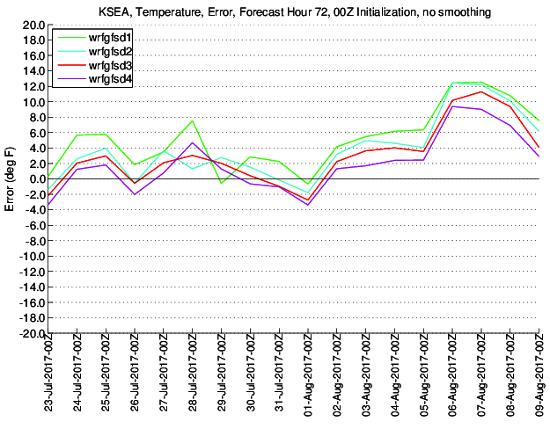
Seattle

Slide 63
IR Opacity of Air Can Influence Surface Temps
Increased water vapor content enhances IR opacity (H₂0 vapor is an active greenhouse gas)
Better absorption and emission in IR with more water vapor.
Less water vapor results in better surface IR cooling under clear conditions. That is why deserts cool very rapidly at night. Why Washington DC stays hot all night.

Slide 64
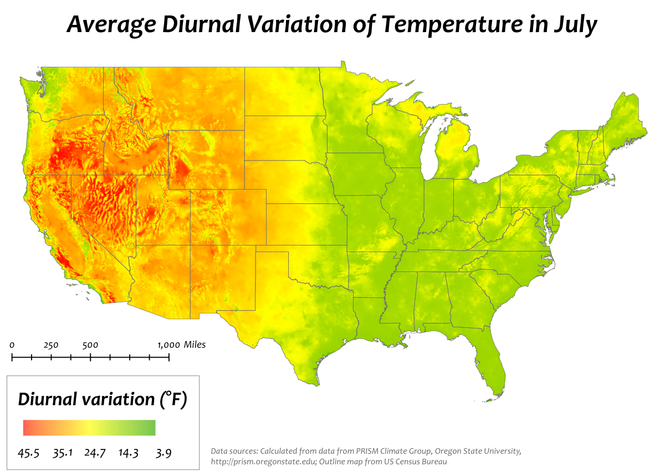

Slide 65

Drier Areas Have Big Diurnal Range

Slide 66


Slide 67

Turbulence Effects
Variations in lower tropospheric turbulence and mixing can have a huge impact on surface temperatures
Strong winds produce more turbulence and thus more vertical mixing/turbulent heat fluxes
Lower stability also enhances turbulence.
2-m temperature can vary with the degree of turbulence, particularly at night

Slide 68
Turbulence and Temp
Higher temps on windy nights. No or weaker inversions.
Lower temps on calm nights (with clear or nearly clear skies). Surface-based inversion. Lack of mixing down of warm air
December 24, 1983 example (next).

Slide 69

December 24, 1983
Strong wind swath
Low temps that night

Slide 70

Winds in mph

Slide 71
Humans can create strong winds and turbulence that alter surface temperatures (wind machines in orchards)
Mixes warmer air from aloft down to the surface

Slide 72


Orchard Fans
Fans in orchards and vineyards—can save vulnerable crops

Slide 73


Slide 74


Slide 75

Phase Changes of Water
Can have a large impact on temperature and type of precipitation.
Condensation, freezing and deposition release latent heat
Evaporation, sublimation, and melting cause cooling (require or absorb heat).

Slide 76

Phase Change of H₂0 Have Major Energy Implications
L to V. Requires heat of vaporization: 539 cal gm⁻¹ Needs energy.
S to L. Requires energy. Heat of fusion. 79.7 cal gm⁻¹
Releases energy when you go the other direction (V to L, L to S).

Slide 77
Evaporation at the surface
Evaporation from a wet or moist surface produces cooling and requires energy.
Much of the incoming solar radiation on a moist surface is used to evaporate H20, not for sensible heating.
Ratio of two expressed in Bowen ratio
Bowen ratio= energy used for sensible heating
energy used for evaporation and sublimation
~10 deserts, 2-6 arid regions, .4-.8 temperate forests/grasslands, .2 tropical rain forest, .1 tropical ocean

Slide 78

Variations in surface moisture can produce significant temperature variations…both in time and space.
Moist areas can be 1-5F cooler than dry areas.

Slide 79

Irrigated Fields: 1-5F cooler

Slide 80

Massive Irrigation in Eastern WA

Slide 81

Cooling and higher humidity

Slide 82
Evaporation of precipitation is a powerful cooling agent but generally short lived
Most of the cooling occurs during the first hour of precipitation.
Air cools to the wet bulb temperature (T_{w})
Ends when air becomes saturated.
Can produce large cooling (10-20F in very dry air)

Slide 83



Slide 84


Slide 85


Evaporation and resulting saturation on a sounding

Slide 86



Slide 87


Slide 88

Condensation (e.g., dew) on ground
Can slow cooling near ground as latent heat is released.

Slide 89

Freezing of water releases latent heat of fusion
Used in orchards to protect sensitive buds

Slide 90


Slide 91

Melting and Sublimation of Snow Cools the Atmosphere
Can cause a drop in freezing (or melting) levels and snow levels.
Note: Freezing or melting level (0C elevation). Snow level (level at which snow has melted)—about 300 m (1000 ft) below freezing level.
Isothermal
Layer (OC)

Slide 92

Melting of falling snow
Associated with a bright band on weather radars (melting snowflake is like a huge raindrop)
Produces an isothermal (32F) melting layer between the freezing and snow levels.
Heavier precipitation produces greater lowering of freezing level
Evaporation (sublimation) into unsaturated air can also drop freezing level.

Slide 93

Bright Band

Slide 94


Slide 95

Can see bright band on radar imagery

Slide 96

Melting can bring snow level down to surface in heaviest precipitation…rain elsewhere
Frequently
seen in convergence zones

Slide 97


Snohomish, WA
April 4, 2005

Slide 98

Varying Surface Properties Effects on Temperature
Surface properties can have large impact on surface temperatures
  Albedo
  Soil conductivity
  Soil/water thermal capacity
  Soil moisture

Slide 99
Snow Versus No Snow
Snow promotes cooling in four ways:
  Reflects solar, emits IR, reduces conduction of heat from below, takes energy to melt snow
Can have intense low-level temp gradients on snow boundaries
10-15F effect or more possible
Cold temperature records often associated with snow.

Slide 100


Slide 101
Surface moisture
Moist surface results in cooling by evaporation
Drier surface warmer (Bowen ratio larger)
Forecaster needs to keep this in mind (often not handled well in models)
Can produce cooling of 1-5F at surface and a surface temperature gradient where moisture gradients exist.

Slide 102



Slide 103


Real-Time Soil Moisture Maps are Available

Slide 104
Influence of water bodies
Water has large heat capacity, slowly changing temperature
Tends to be warmer than land surfaces during winter, cooler in summer
Creates large temperature gradients along coastal zones
As models gain resolution, doing a better job at this.

Slide 105


Slide 106

A January
Morning
6-7:30 AM

Slide 107
Summer

Slide 108
Conduction of heat from below can greatly change surface temperatures

Slide 109


Bridges often are often the first (or only) places to ice up

Slide 110

Bridges
Bridges have air under them, air being an excellent insulator.
The road surface can radiate heat to space and thus the bridge deck cools rapidly.
Roadway surfaces in contract with the soil are warmed by the heat conduction from below.
The conduction of warmth is largest early in the winter season.

Slide 111

SnowWatch Temps One Morning

Slide 112
Urban Heat Island Effect
Concrete/asphalt/bricks have great thermal mass: warms up during day and releases heat at night.
Heat released by combustion
Drier surfaces…less evaporation/evapotranspiration

Slide 113

Urban heat islands have developed in our major cities

Slide 114

Urban Heat Island Example: London

Slide 115

Seattle’s urban core often 2-10F warmer than it would have been without concrete and buildings

Slide 116


New York City Area

Slide 117
IMPACTS OF LOCAL DIURNAL CIRCULATIONS ON TEMPERATURE

Slide 118

Sea/land breeze circulations

Slide 119
A sea breeze can cap or slow coastal temperature rises at mid-day by advecting cool marine air inland
Often cuts off diurnal rise during late morning/early afternoon as cool marine air moves in with the sea breeze.

Slide 121

Sea Breeze front on the WA coast

Slide 122

Comparison of the daily temperature cycle between observations (blue dashed) and the model (red triangles) for a coastal location (Boston, MA) on 10 August 1997 impacted by the passage of a sea breeze front.

Slide 123

2-m air temperature and 10-m wind velocity in the afternoon of a sea breeze event on April 18, 2005. The land-sea temperature contrast drives the onshore sea breeze. Local spatial variations in sea surface temperature (SST) can leave a signature on the sea breeze, especially when complex coastlines create multiple sea breeze fronts (e.g., the sea breeze penetrating from Long Island Sound in the image above).
In our multiply-nested COAMPS simulations, nest 4 (1.33 km resolution) and nest 5 (0.44 km resolution) were enhanced to account for urban effects and to include time-varying (hourly) high-resolution SST's from Alan Blumberg's New York Harbor Observing and Prediction system (NYHOPS). The diurnal heating of the ocean surface is thus represented in our simulations. We are in the process of quantifying the impact of these effects on the sea breeze circulation for several distinct events, and evaluating the forecast skill of the system.
Same thing is true in NYC

Slide 124
Sea breezes and resultant cooling can occur on: ocean coasts coasts of bays near large lakes near large rivers and even over land where there are differences in temperature (e.g., due to snow or soil moisture distributions!)

Slide 125

The Washington State sea breezes—big influence on temperature

Slide 126

The Sound Breeze
Brings Afternoon Cooling During Summer
Over Central Sound

Slide 127
Diurnal slope winds
Can have a large influence on low-level temperatures
Importantly, drainage/downslope winds produce cooling at bottom of slopes
Example: Salt Lake City eastern suburbs downstream of gaps often cool 10-15F compared to surrounding areas.

Slide 128


Slide 129



Slide 130


Slide 131


Slide 132

Cold, dense air tends to settle into lower elevations

Slide 133


Slide 134


Slide 135

Mesoscale Cold Pools
Cold air can collect in mesoscale basins…such as the Columbia Basin of eastern Washington,the Willamette Valley, Central Valley of CA, and many more

Slide 136


Slide 137
Near Sea Level Gap
On Border of WA and OR
Notes:
Use this slide to introduce where the Gorge is and the nature of the gap flow scenario.
Spend some time pointing out important features like:
The mountain barrier, the Columbia Basin and how it provides a topographically confined air shed and note how the Gorge is the only drain
Then switch gears and point out other gaps on this map (Frasier, JDF, Stampede, Chehalis) and mention important results of each
Frasier - cold outflow, Juan de Fuca - easterly gales, westerly gales, PSCZ, Chehalis - PSCZ, Stampede - downslope windstorms, CRG - Cold outflow, gales, wintry precipitation
So meteorological phenomena driven by gaps are obviously very important, especially in the PNW.

Slide 138


Slide 139

Eastern
Washington
Cold
Pool
Climatology

Slide 140
Cold Pool Forecasting Issues
Models often mix out cold air too readily…resulting in warm temperature biases
Cold pools are often capped by inversion, which is very persistent.
Mixing out of cold pools is a difficult forecasting problem…often takes a strong synoptic system capable of mixing out the inversion overhead.

Slide 141
Gap Winds and Temperatures
Often cooler air in and immediately downstream of gap.
Usually lower dew point as well.
Local examples: Columbia River Gorge, Fraser River Valley

Slide 142
Near Sea Level Gap
On Border of WA and OR
Notes:
Use this slide to introduce where the Gorge is and the nature of the gap flow scenario.
Spend some time pointing out important features like:
The mountain barrier, the Columbia Basin and how it provides a topographically confined air shed and note how the Gorge is the only drain
Then switch gears and point out other gaps on this map (Frasier, JDF, Stampede, Chehalis) and mention important results of each
Frasier - cold outflow, Juan de Fuca - easterly gales, westerly gales, PSCZ, Chehalis - PSCZ, Stampede - downslope windstorms, CRG - Cold outflow, gales, wintry precipitation
So meteorological phenomena driven by gaps are obviously very important, especially in the PNW.

Slide 143



Portland wind distribution for all days by direction and speed
Wintry precipitation at PDX
  Almost exclusively E or SE
  Tendency towards E for snow and SE for freezing rain
Wind distribution for days with Freezing Rain
Wind distribution for days with snowfall
Notes:
Some leakage over McKenzie and Santiam Passes
NOTE: There are two layers of images

Slide 144
1.33 km grid spacing, Pass Height = 150 m
•
Portland
Cascade Locks
The Dalles
Troutdale
Notes:
Min pass height is at far right of domain near Cascade Locks

Slide 145
444.4 m grid spacing, Pass Height = 100 m
Portland
Troutdale
Cascade Locks
Notes:
Min pass height is at far right of domain near Cascade Locks (same place as 4/3 domain)
This plot is from 310 m. Note, vortex. See this on radar data too. Zoomed in plot will be from 150 m

Slide 146

T on
150 m
Surface
Portland
Troutdale
Notes:
Min pass height is at far right of domain near Cascade Locks (same place as 4/3 domain)
This plot is from 310 m. Note, vortex. See this on radar data too. Zoomed in plot will be from 150 m
Recall mesoscale plots. Good T and wind agreement.

Slide 147
Mesoscale Coastal Circulations
Onshore (cool) versus offshore (warm) flow
Here in the NW: onshore or marine pushes
Found all over the world (e.g., Australia, S. Africa)
Very profound in summer in coastal areas with cold water offshore
Question: Here in western WA what time of year brings the largest temperature declines?

Slide 148


Slide 149


Slide 150


Slide 151


Slide 152


Slide 153


Slide 154


Slide 155


The West Coast Thermal Trough

Slide 156

The West Coast Thermal Trough: the Most Important Warm Season Mesoscale Feature of the West Coast
An inverted pressure trough based out of the Central Valley of CA that can extend into the Pacific Northwest
925 hPa heights and temperature

Slide 157


Slide 158


Slide 159


Slide 160


JJA
-36h
925mb
925mb
500mb
500mb

Slide 161


JJA
-12h
925mb
925mb
500mb
500mb

Slide 162


JJA
Start
925mb
925mb
500mb
500mb

Slide 163


JJA
+12h
925mb
925mb
500mb
500mb

Slide 164


Slide 165
Some interesting details
Warmest weather occurs on the last warm day when trough is overhead and about to move east of the Cascades
When trough is to the south, northerly flow pulls cool air in form the north.
Slow ramp up, quick decline.

Slide 166

Southerly Buster…SE Australia…just like the push

Slide 167
Convergence Zones: Can Produce Localized Areas of Cooling

Slide 168


Slide 169

Can be 10-15F cooler in convergence zone than in clear zones to north and south

Slide 170
How to approach a temperature forecast
Always be aware of climatology (min, max, average, records)
Make use of forecast funnel: synoptic scale to mesoscale to microscale
For most locations, good to start with looking at 850 hPa temperature evolution for manual forecasts.
Why? First, the first level often above surface influence (for near SL stations)

Slide 171
Approach to Temp
If synoptic scale forecasts are reasonable and you have high-resolution mesoscale models available, you can start with their temperatures IF they have enough resolution for the problem you are dealing with.
Issues in complex terrain and near coastlines when resolution is inadequate.
Issues with poor land use distribution (e.g., urban areas) or snow/moisture surfaces distribution

Slide 172
Approach to temperature
Keep in mind that many models have inadequate (too small) diurnal cycles
Nearly all mix too much in the vertical….thus, mix out shallow cold air in stable situations—producing a warm bias.

Slide 173
A very good approach for warm day maxima
Full sun, no marine influence
Take 850 hPa temps down to SLP and add 1-4F to get maximum
Why does this work so well?

Slide 174

Today (12Z sounding, SLP:1027 hPa)
~16C or 61F

Slide 175
Check Out Today’s WRF Sounding
https://a.atmos.washington.edu/~ovens/loops/wxloop.cgi?mm5d3_snd_ksea+2021041212///3

Slide 176


Always Keep in Mind Verification Statistics of Models

Slide 177



Slide 178


Errors Vary Spatially

Slide 179
MOS temps are hard to beat on “typical” days

Slide 180

Temperature
MAE (°F) for the seven forecast types for all stations, all time periods, 1 August 2003 – 1 August 2004.

Slide 181
Private Sector Temps are often better than the NWS Forecasts
Why? Better post-processing

Slide 182



