Slide 1
Surface Weather Map
Also known as a
Surface Synoptic Chart
ATMS 101
Autumn 2026

Slide 2
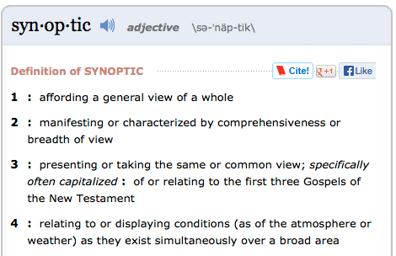
synoptic

Slide 3
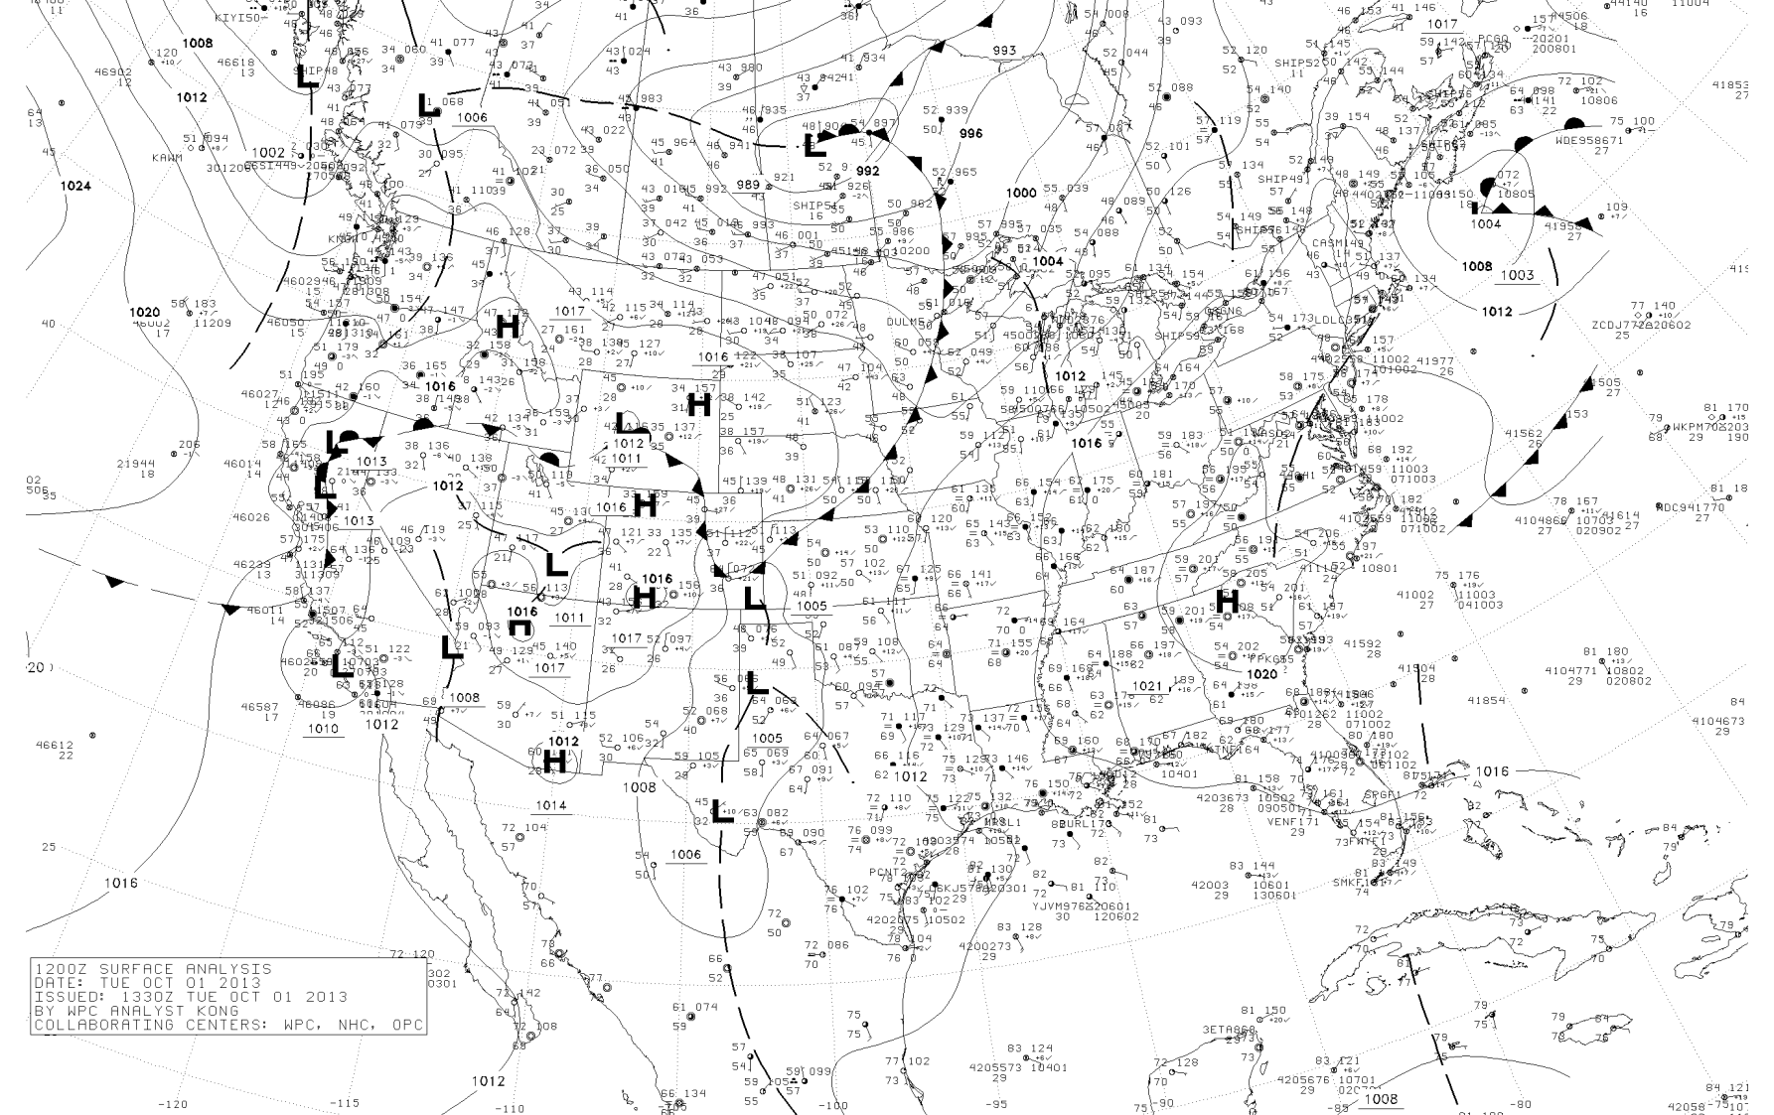
Available here: http://www.atmos.washington.edu/data/vmaproom/

Slide 4
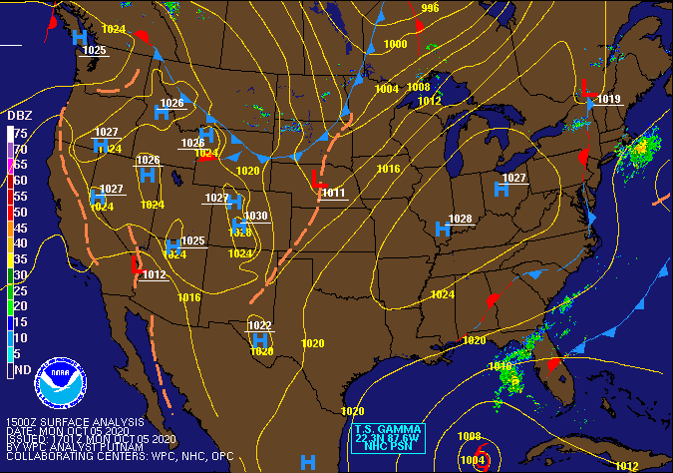
Or here: https://www.weather.gov/oun/sfcmaps

Slide 5
Why Surface Weather Maps?
Summarizes weather conditions at the surface (where we are!)
Using a progression of charts can see how surface weather evolves.
Summarizes our conceptual model of the atmosphere (e.g., fronts).

Slide 6
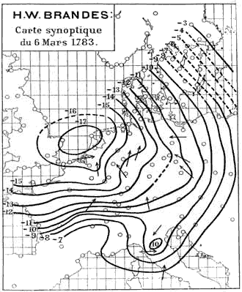
First Surface Weather Map
Created by H. W. Brandes in 1820 for March 6, 1783.
The arrows indicate wind direction and the lines show the deviation of pressure from average conditions

Slide 7
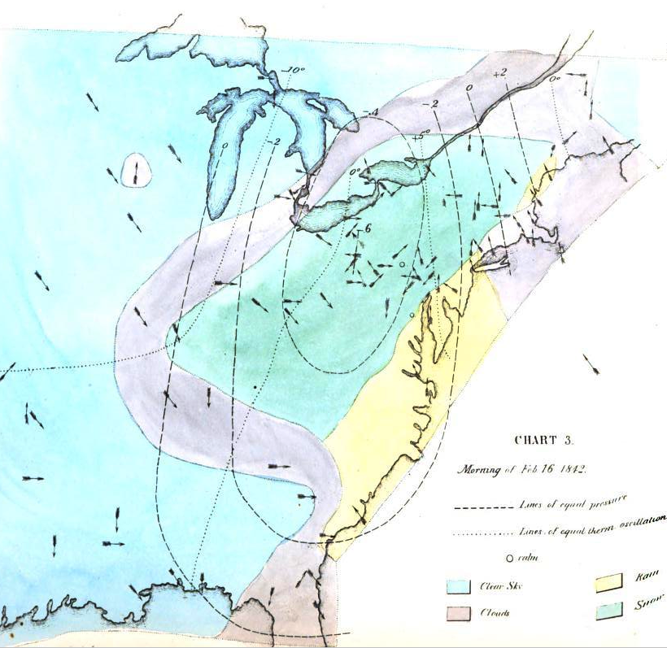
One of the weather maps created by Elias Loomis in his groundbreaking paper on the storms of February 1842.
Surface wind direction is indicated by arrows and the deviations from average pressure are shown by the dashed lines. Temperatures are indicated by dotted lines and the sky or precipitation type by the color shading. This map indicates a strong low-pressure center over the Ohio Valley, rain on the coast, and snow-laden northwesterly winds to the west.

Slide 8
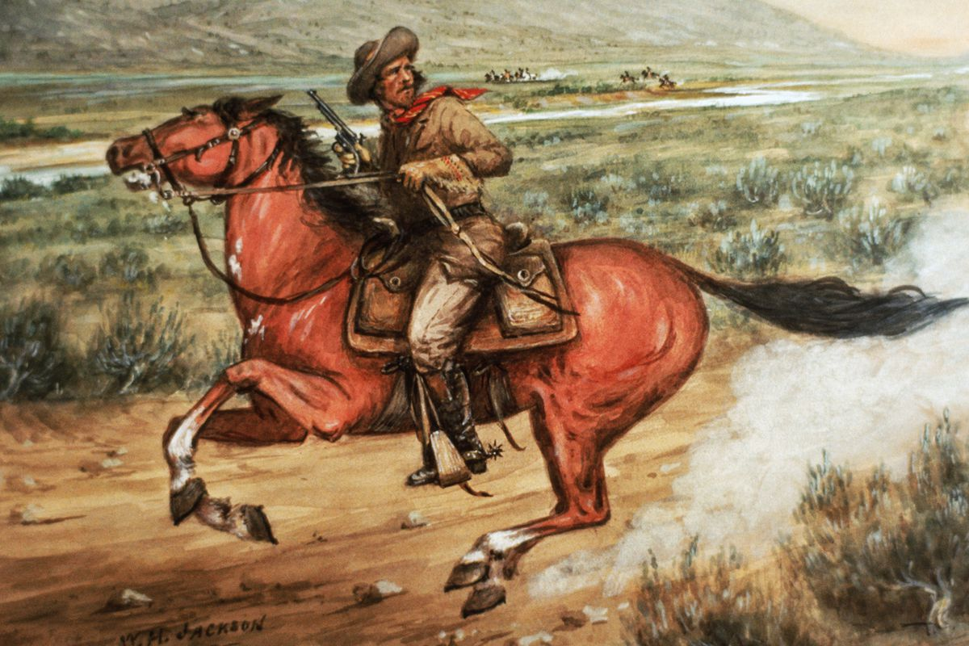
A Problem
The first weather maps could not help weather forecasting much.
Why? No way to distribute weather information quickly enough!
Created weeks later.

Slide 9
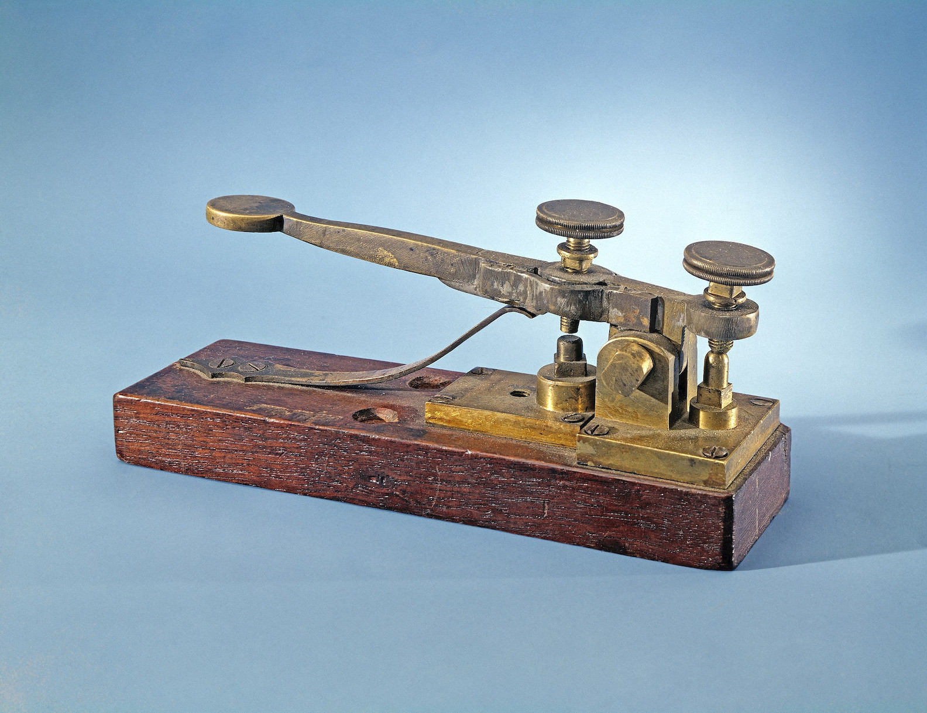
The Solution: The Telegraph (1840s)

Slide 10
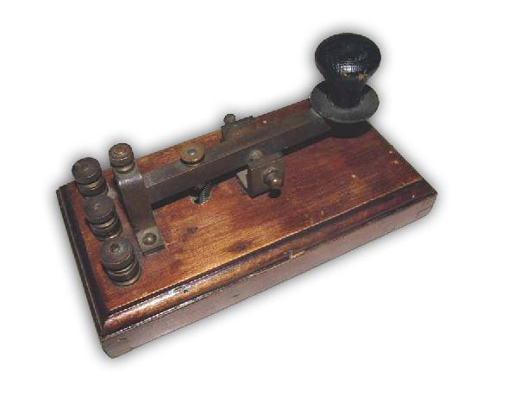
The Telegraphic Communication Revolution
By 1849, a telegraphic network in the United States transmitted daily meteorological observations for a collection of weather stations.
The internet of the 19th century

Slide 11
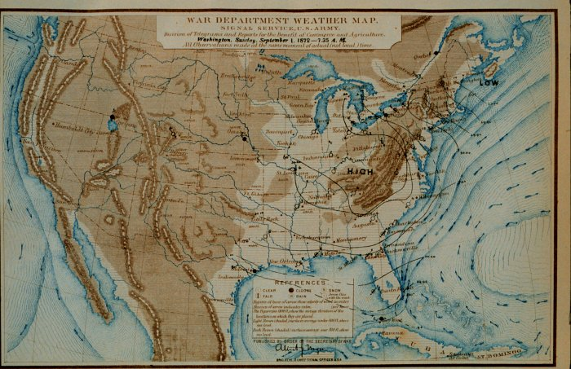
Real-Time Weather Maps
Example 1872!

Slide 12
The weather maps of the 1800s were missing something all maps have today:
FRONTS

Slide 13
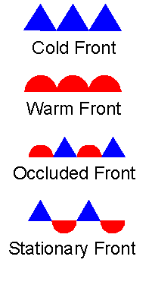

Slide 14
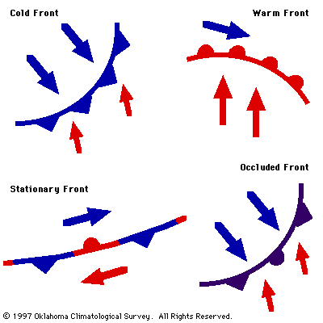
Fronts
Fronts are associated with regions of large temperature contrasts and significant weather (clouds and precipitation)

Slide 15
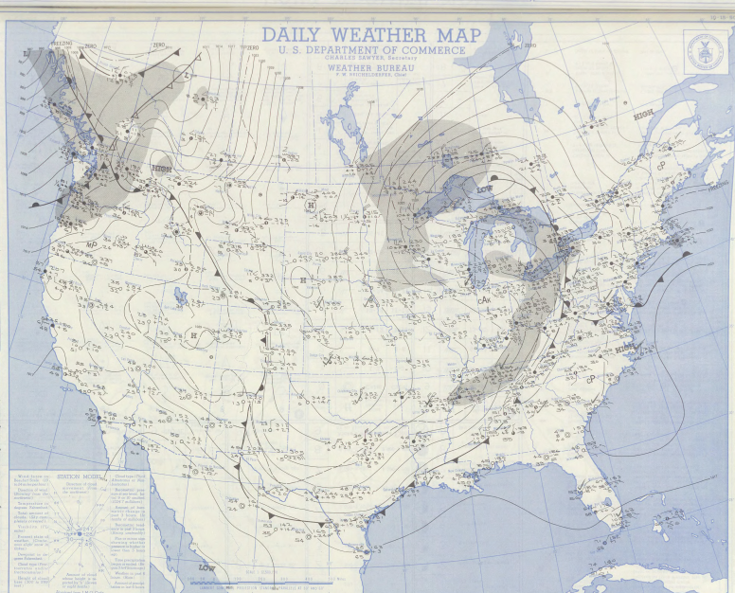
1950 Surface Weather Map: Note the Fronts

Slide 16
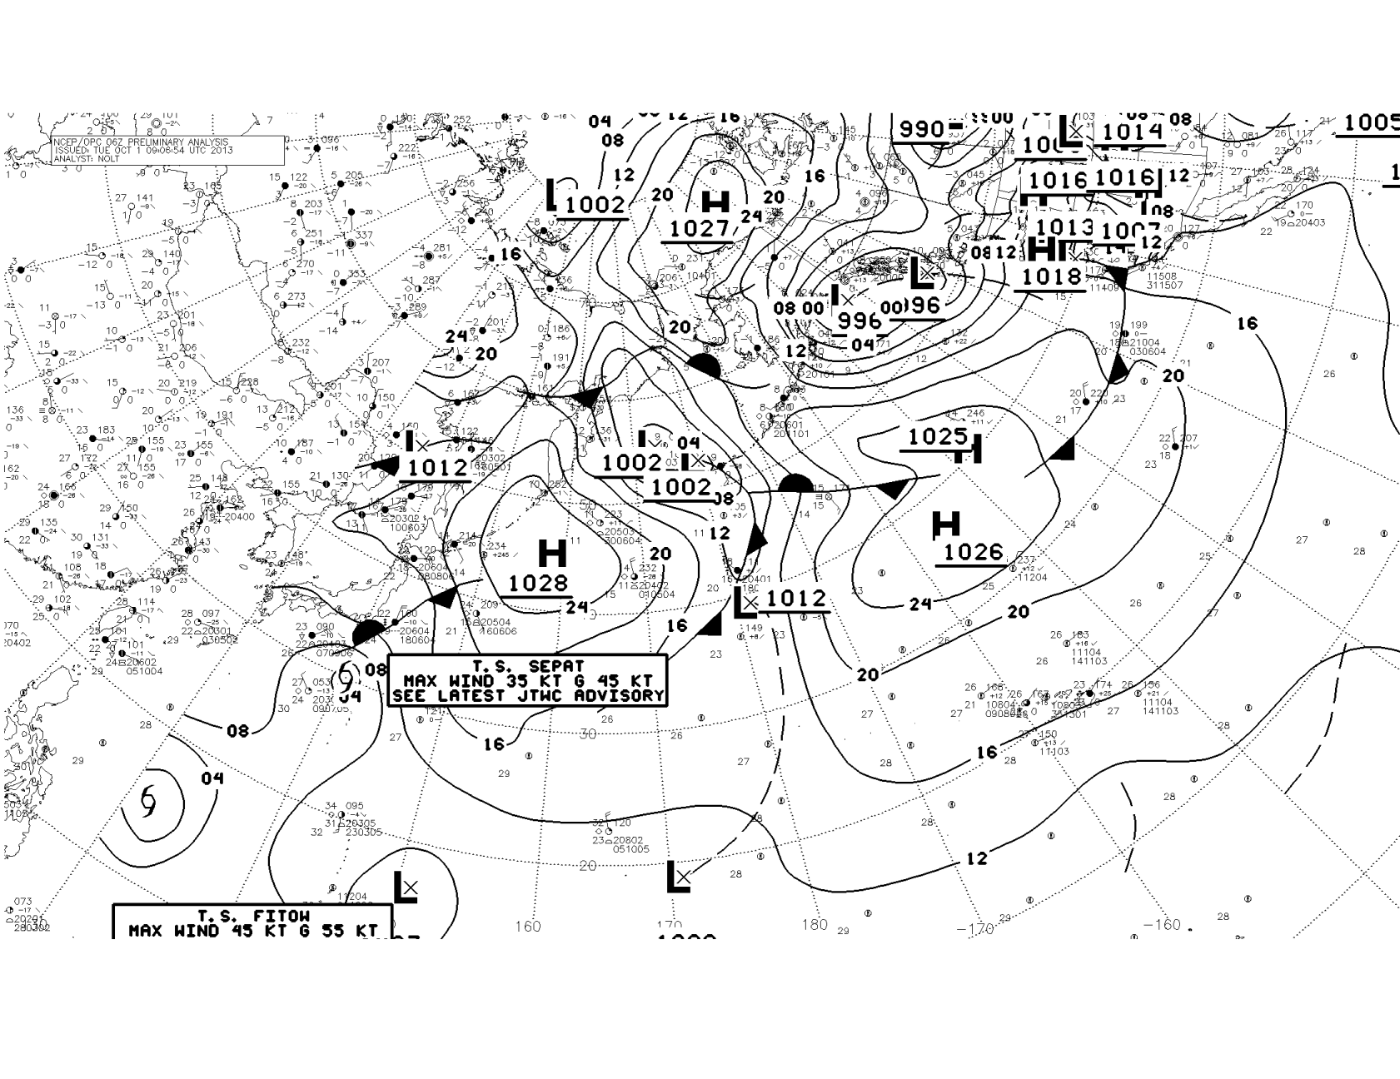
Still Used Today

Slide 17
What is on modern surface weather charts?
Station models: meteorological shorthand describing the surface observations at a location
Isobars (lines of constant sea level pressure)
Fronts and troughs (locations of low pressure)

Slide 18
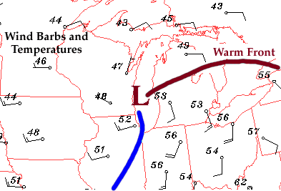
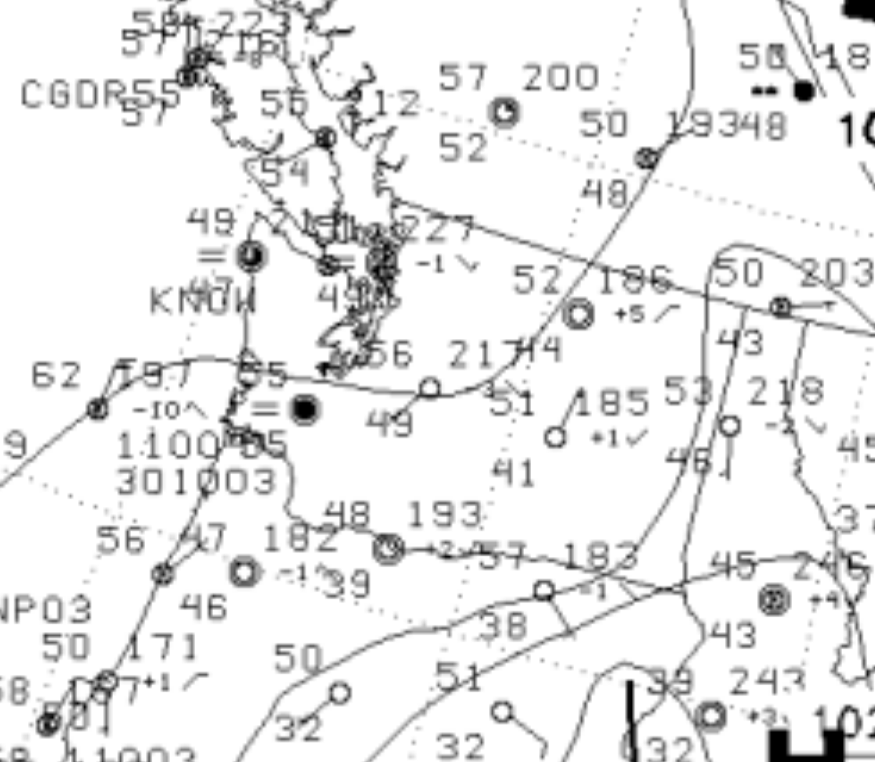
Station Models (Meteorological Shorthand) Is Found on Surface Maps

Slide 19
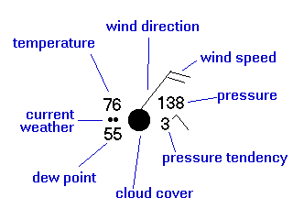
Surface observations are plotted using a station model

Slide 20
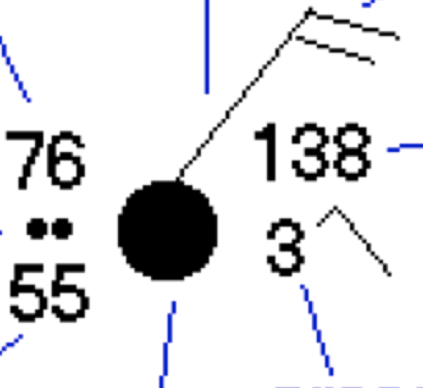
Station Model
In the U.S., the station model uses temperatures in F; other countries used C
Sea level pressure. 3 digits in tenths of a hPa (mb, hPa).
Divide by 10 and add either 9 or 10. 237 > 23.7>1023.7 hPa
When choosing between 9 and 10, use the one that gives one a reasonable pressure (hint: average (sea level pressure) SLP is around 1000 hPa)

Slide 21
Practice
198 is 1019.8 hPa, not 919.8 hPa
745 is 974.5 hPa, not 1074.5 hPa
247 is 1024.7 hPa, not 924. 7 hPa
I WILL NOT ASK YOU TO DO THIS ON AN EXAM

Slide 22
Pressure Change (tendency) over the Past 3 hr
Surface pressure change in tenths of hPa
Over past 3 hr.
3 means pressure increase of .3 hPa in last 3 hr.
Cartoon next to it.

Slide 23
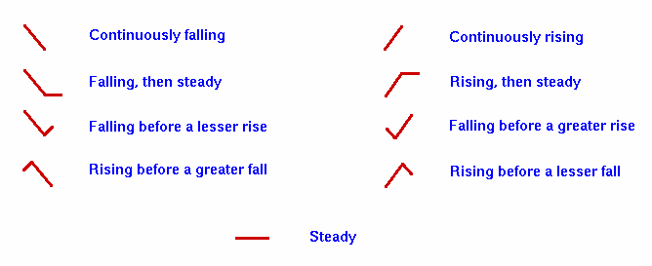

Slide 24
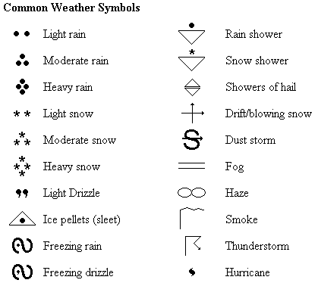
Current Weather

Slide 25
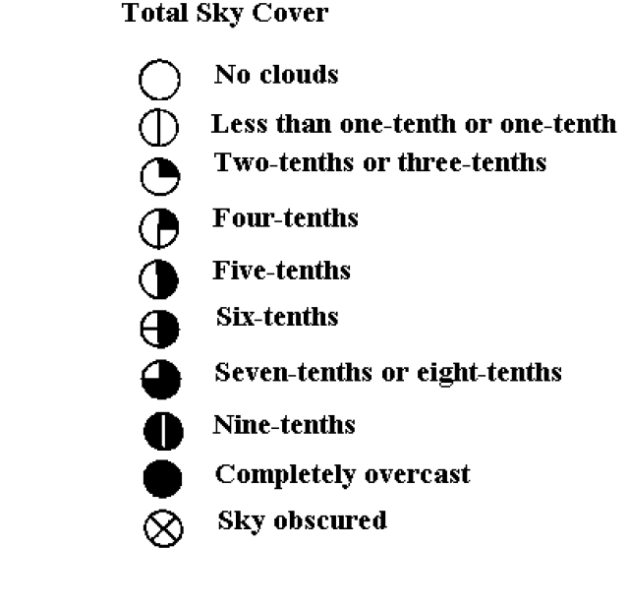
Sky Coverage

Slide 26
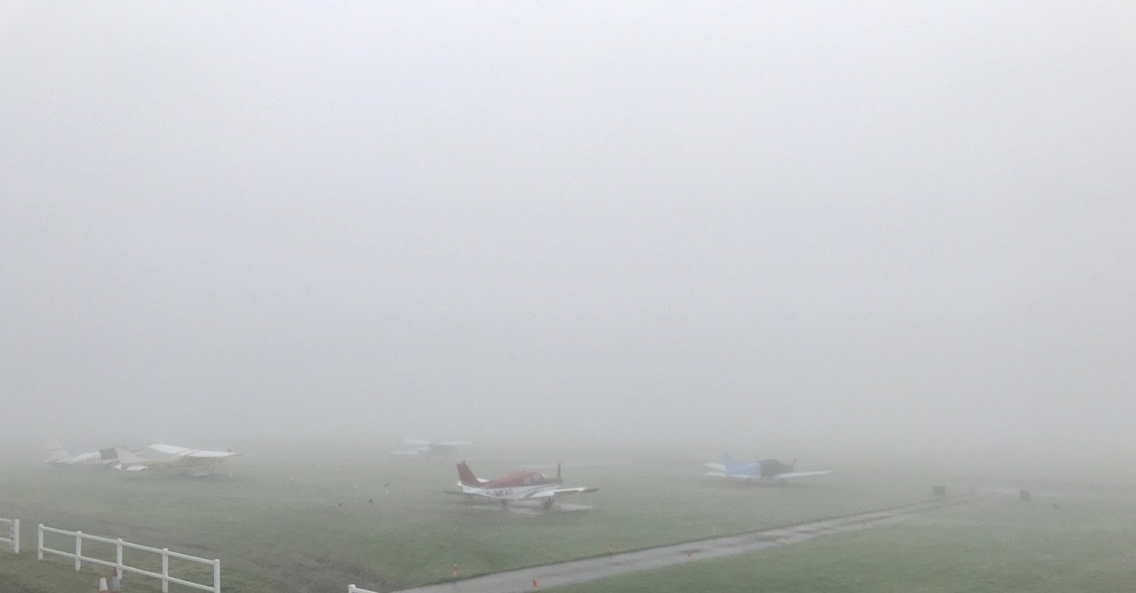
Sky obscured…you are in cloud
Can not see cloud base

Slide 27
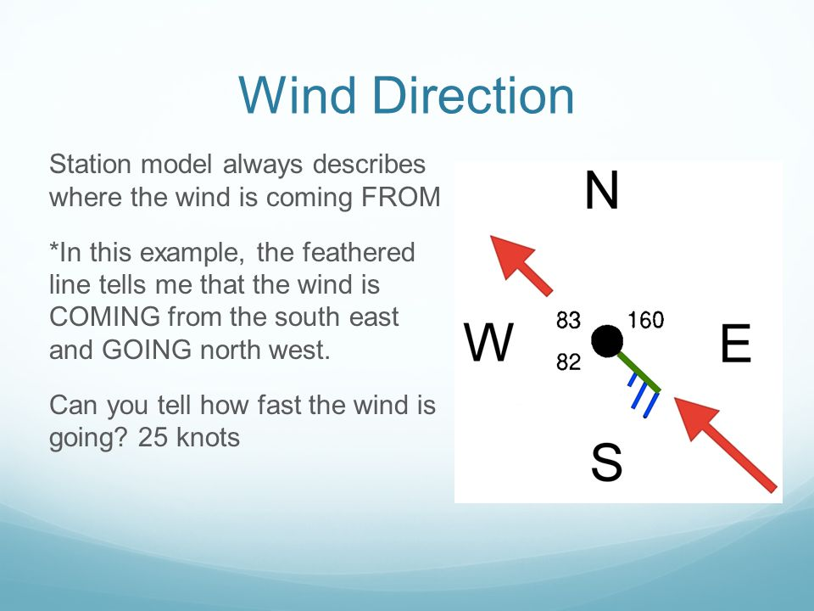
Wind Pennants or Barbs

Slide 28
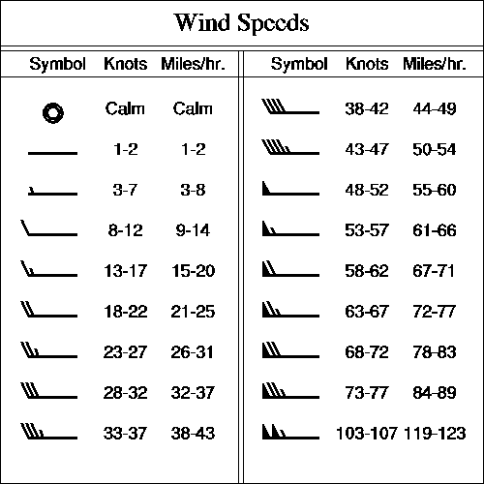
Wind Speed
Big line on tail:
10 knots
Small line on tail:
5 knots
Solid triangle:
50 knots

Slide 29
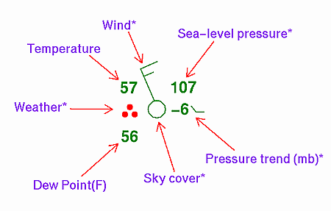
Practice

Slide 30
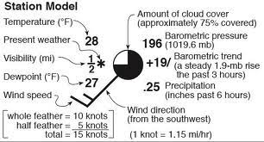
Practice

Slide 31
Station Models Give You a Quick View of Weather Conditions

Slide 32
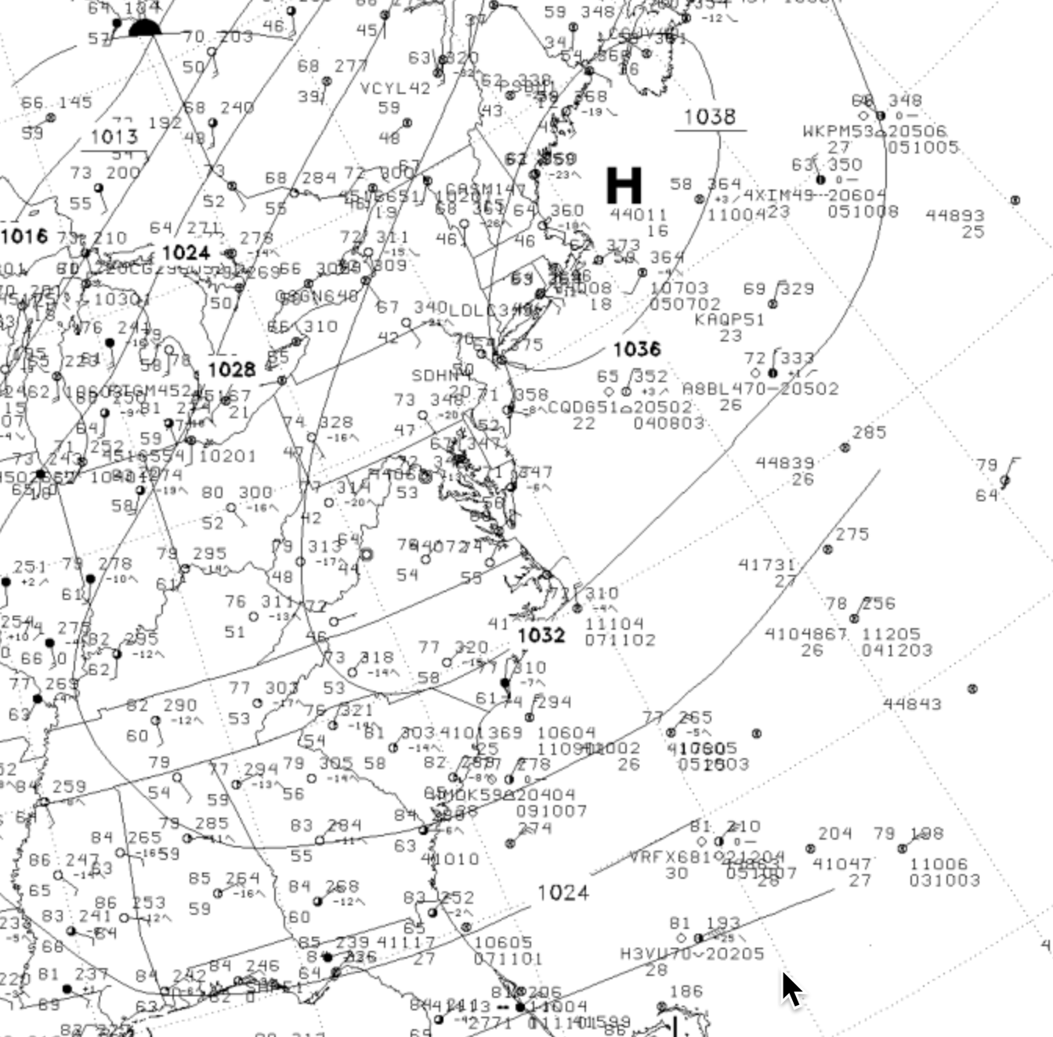

Slide 33
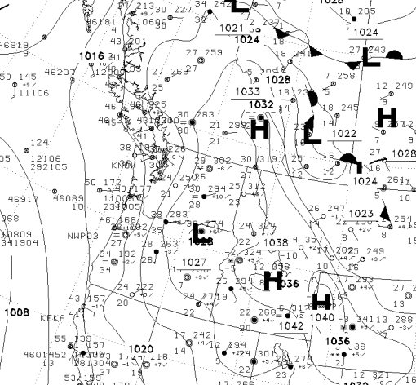

Slide 34
What kind of observations are plotted on surface charts?

Slide 35
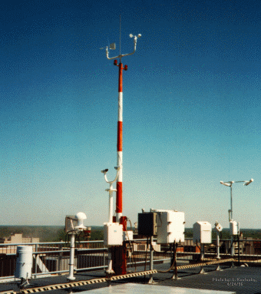
ASOS: Automated Surface Observing System:
Backbone Observing System in the U.S.: Mainly Airports

Slide 36
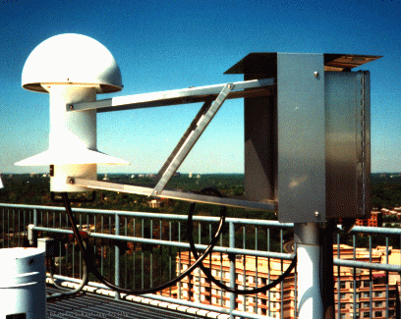
Hydrothermograph

Slide 37
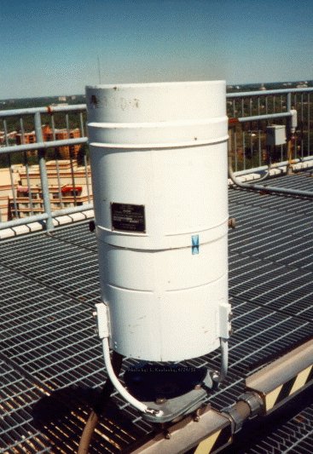
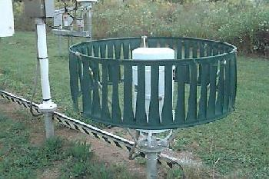
Precipitation Gauges

Slide 38
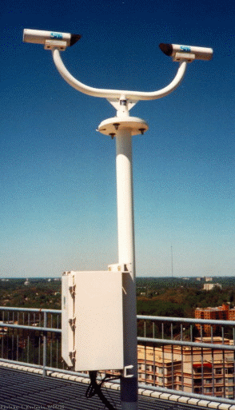
Laser Weather
Identifier

Slide 39
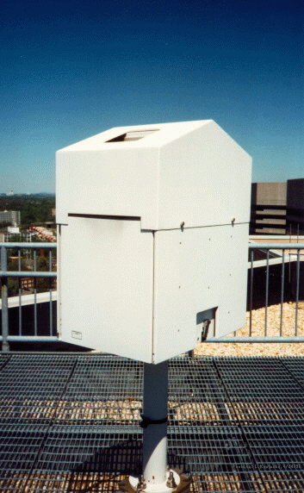
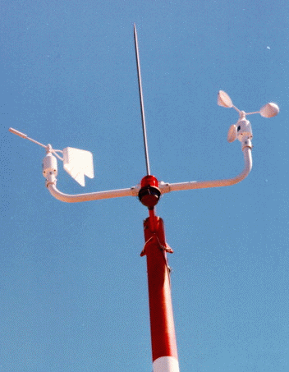
Anemometer
Wind Vane
Laser Ceilometer

Slide 40
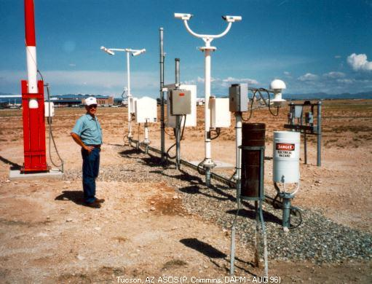
Full ASOS system in Arizona

Slide 41
Marine Reports

Slide 42
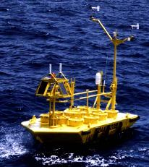
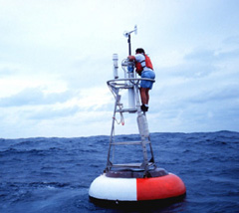
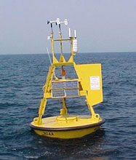
Ocean and Lake
Weather Buoys
Anchored

Slide 43
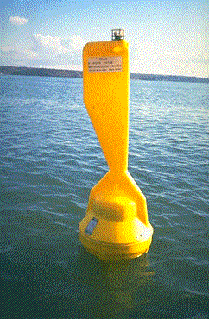
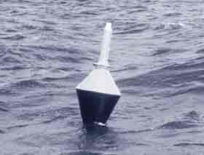
Drifting Buoys
Wind
Pressure

Slide 44
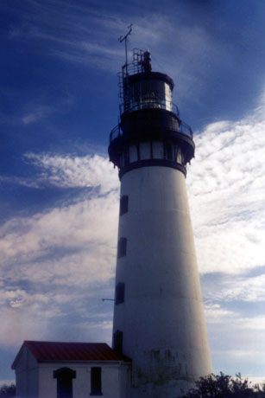
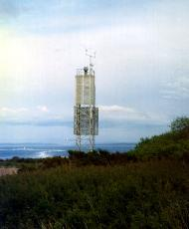
Coastal Marine (CMAN) Reports from the Coast Guard

Slide 45
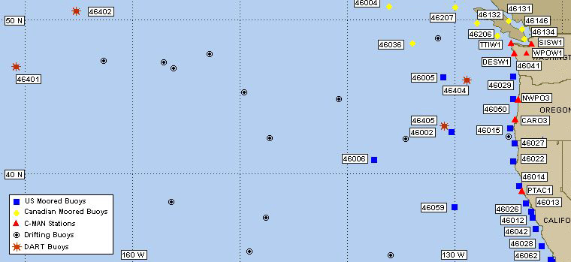
Northwest Buoy and CMAN Locations

Slide 46


Ship Reports: Marine VOS Program
Volunteers Observers--generally 6-hourly reports
Highly variable quality and frequency

Slide 47
Ship Reports in 2014

Slide 48
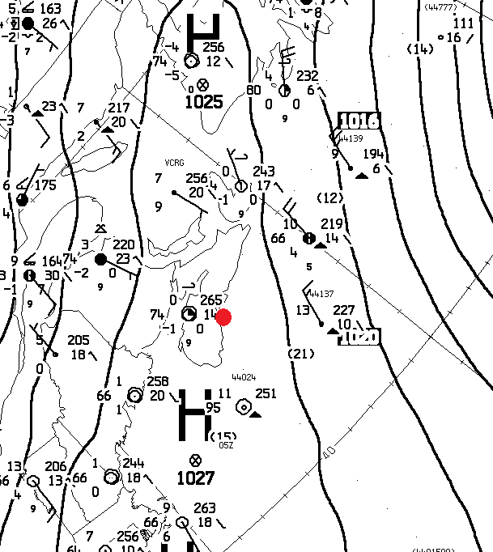
Isobars of sea level pressure are found on surface weather maps
Isobars are lines of constant or equal pressure
Everywhere along each line the sea level pressure is the same
Labeled in hPa/mb (e.g., 996, 1000, 1004, etc)

Slide 49
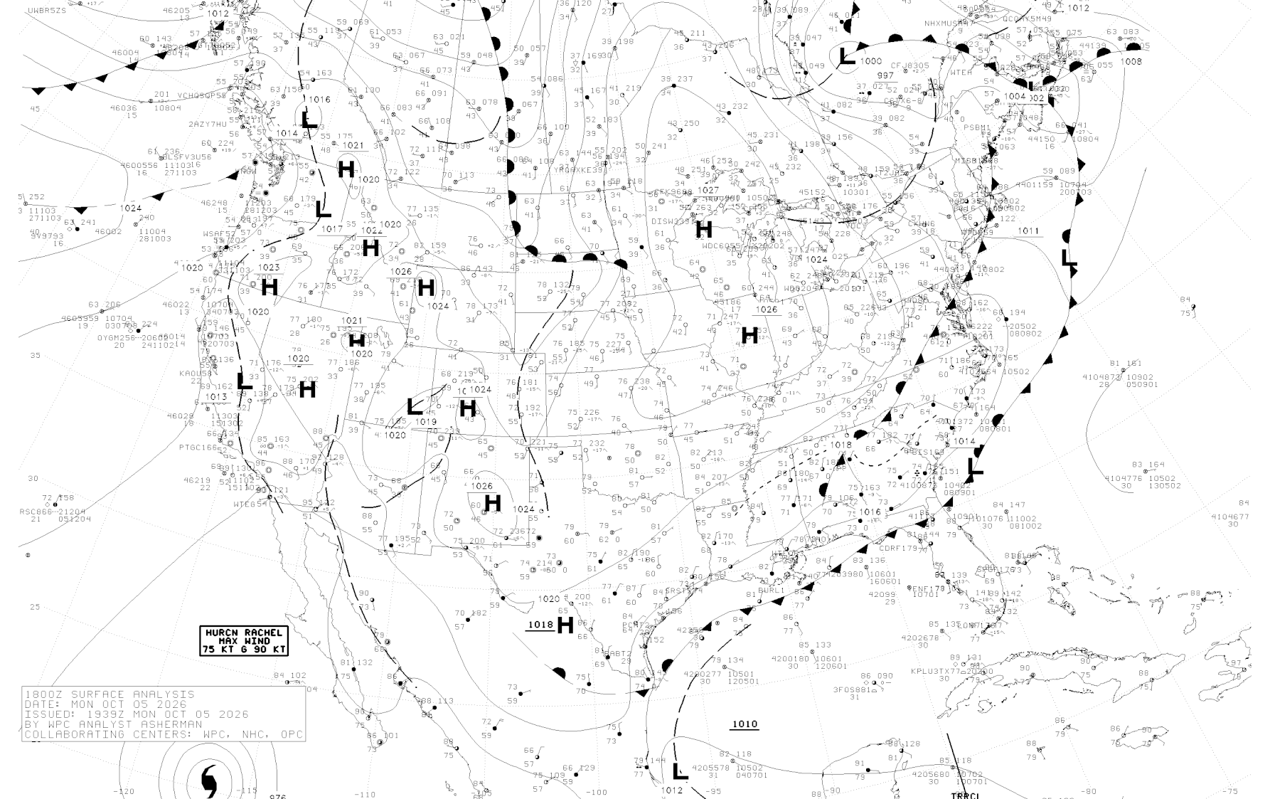
Why use sea level pressure rather than surface pressure—the pressure at the elevation of the barometer at the station?

Slide 50
Why
Pressure decreases with height!
Thus, the pressure variations on weather maps would be dominated by terrain changes if station or surface pressure was plotted.

Slide 51
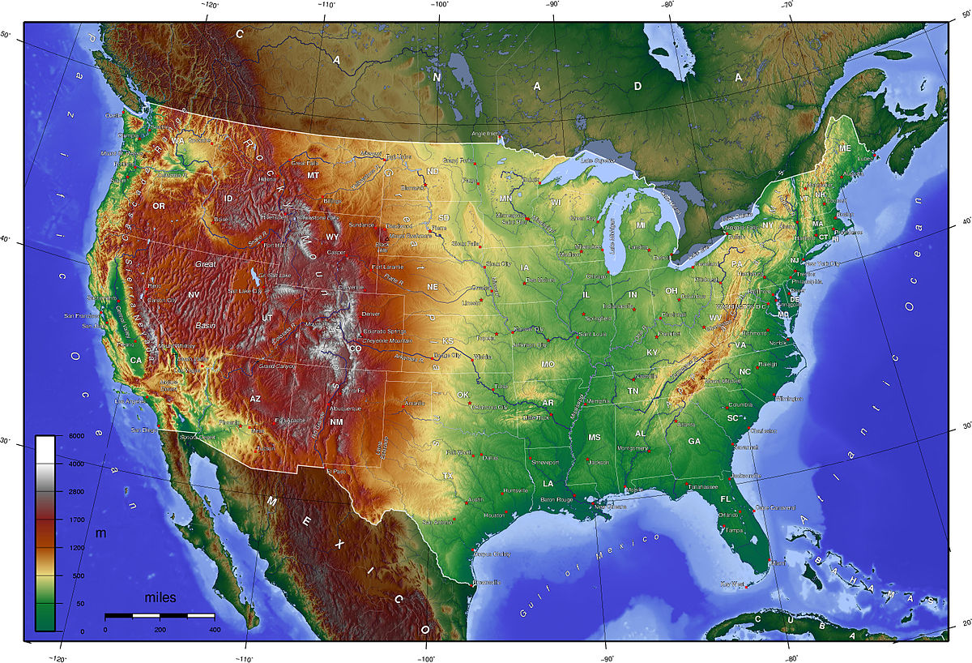
If station or surface pressure plotted
L
L
H

Slide 52
Terrain effects on pressure would swamp the meteorological signal
How to remove the terrain/elevation effects of pressure?
Solution: Adjust the station (surface) pressures to get the pressure at a standard level: sea level.
Called pressure reduction to sea level (bad name).

Slide 53
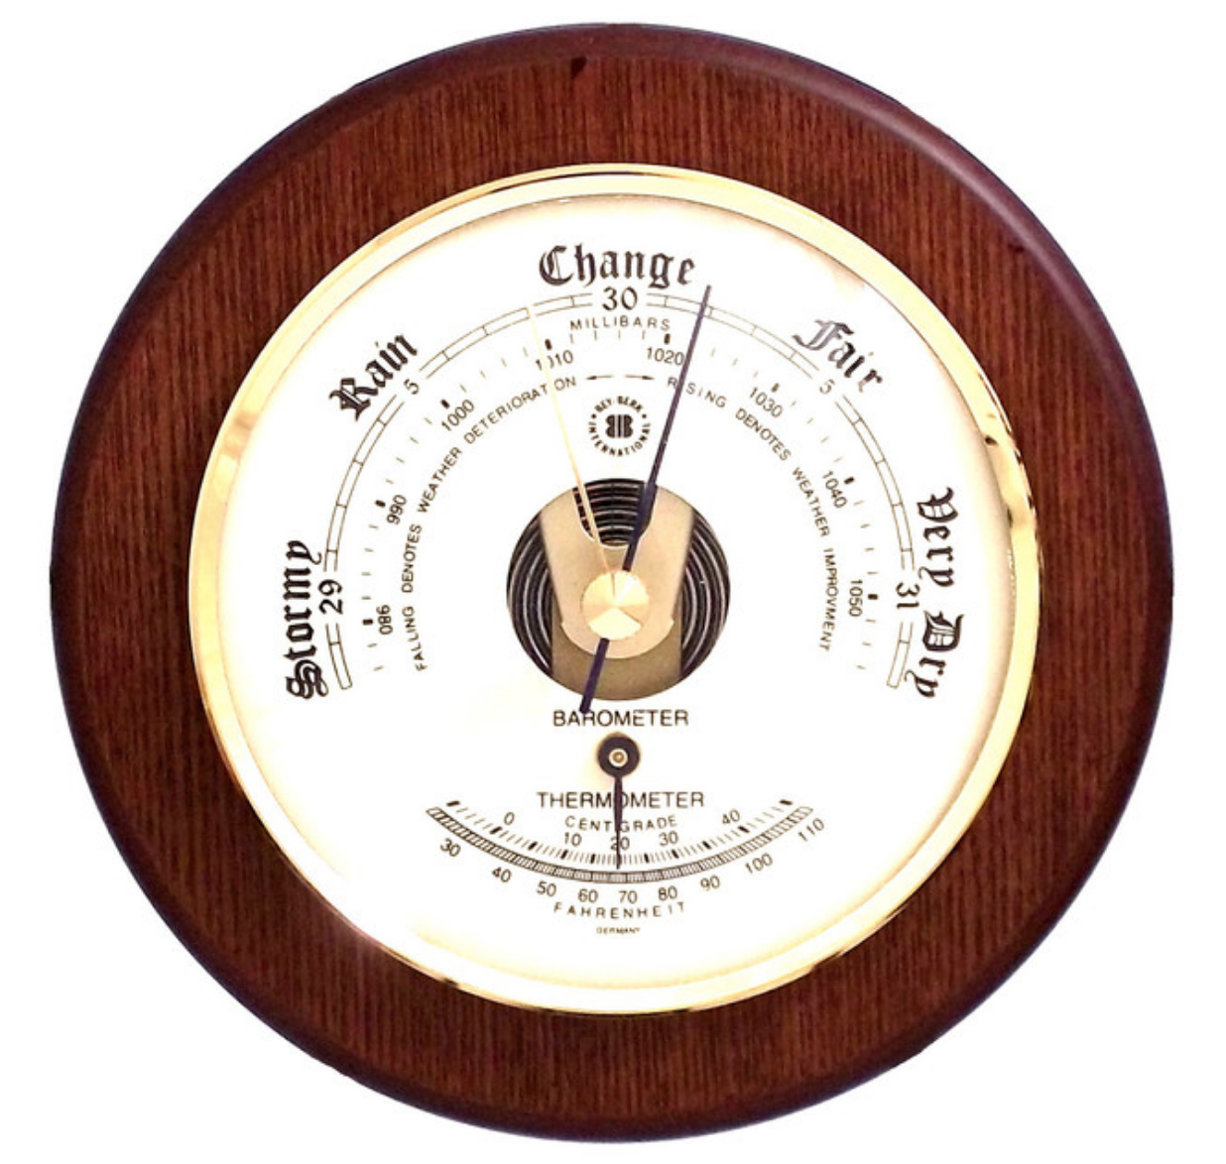
Sea-level pressure is greater than station pressure
Why? Because pressure decreases with height
Surface or station pressure
Sea level pressure
Sea Level

Slide 54
Example of converting station pressure to sea level pressure
* 1024 hPa
64 m
Sea Level
* 1032 hPa
Near sea level, pressure drops about 1 hPa for every 8 meter increase in elevation.

Slide 55
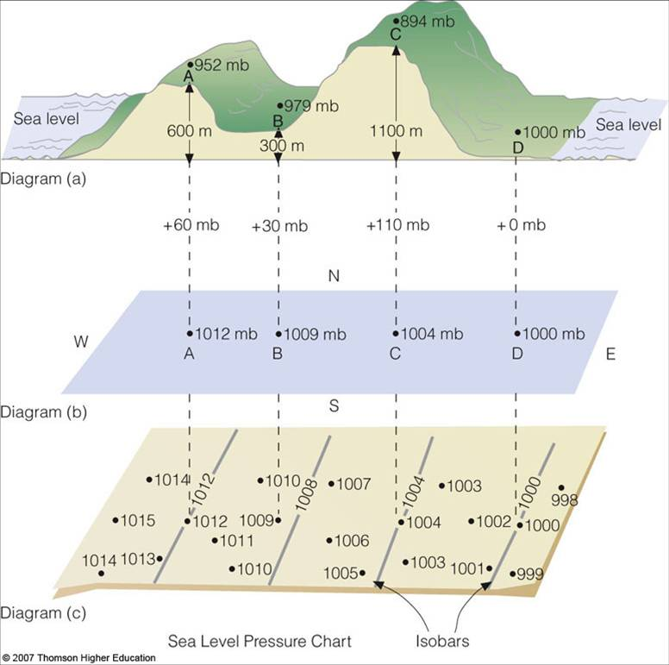

Slide 56
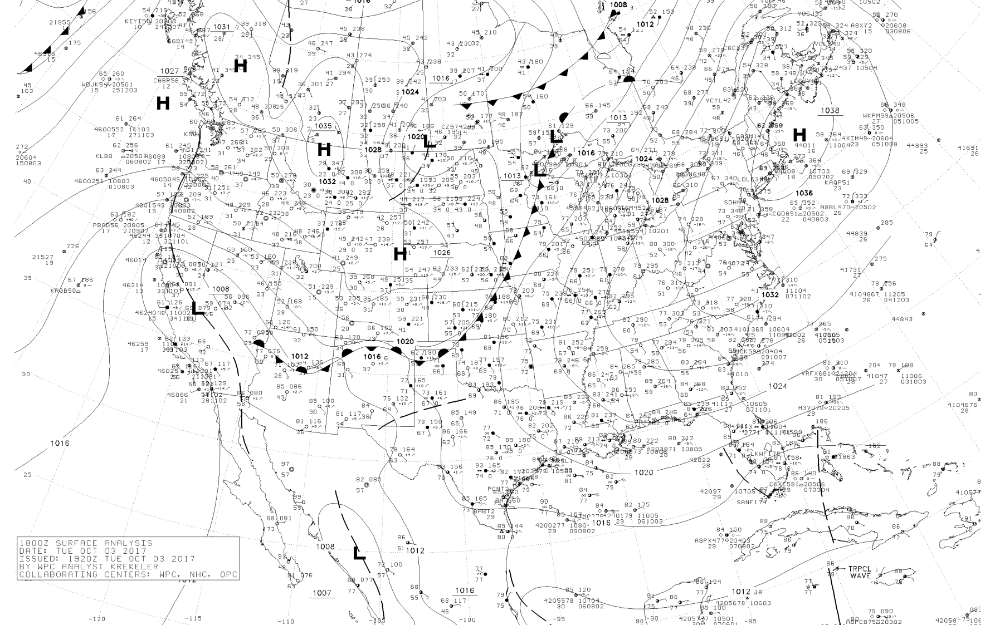
Pressure Adjustment to Sea Level
Sea level pressure is determined at all major observing locations and plotted using station models.
Next, we need to create sea level pressure maps.

Slide 57
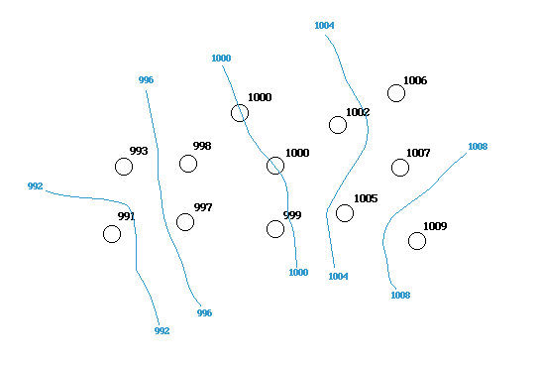
The technique is called isoplething or scalar analysis: We draw lines interpolating among observations
Isobars generally drawn every 4 hPa (e.g. 1000, 1004)

Slide 58
Once the analysis is done, put on H’s and L’s
High- “H” -high sea level pressure relative to the surroundings. Also known as a ridge. Generally associated with fair weather.
Low- “L” - low sea level pressure relative to the surroundings. Also known as a trough. Generally associated with cloudy, stormy weather.

Slide 59
An Example

Slide 60

Pressure patterns are very important because they influence winds
Strong winds are associated with large horizontal pressure differences or gradients, where pressure changes rapidly with distance.
Weak winds associated with weak pressure gradients
strong
weak

Slide 61


Slide 62

Winds and pressure relationships
Near terrain, winds tend to go directly from high to low pressure
Away from terrain, winds tend to parallel isobars, with a small angle towards lower pressure (you will learn why later!)

Slide 63
Will explain why in a few weeks
L
1016 hPa
Surface wind
1020 hPa
H
Away from terrain

Slide 64
In the northern hemisphere winds tend to blow counterclockwise around lows and clockwise around highs (opposite in the southern hemisphere)

Slide 65

Northern Hemisphere
clockwise
counterclockwise

Slide 66

Alternative Terminology: cyclonic and anticyclonic
Cyclonic flow around lows
Anticyclonic flow around highs

Slide 67

Other features on surface charts

Slide 68
What are fronts?
The tropics are warmer than the polar regions (Arctic/Antarctic).
But temperatures don’t change gradually between north and south latitudes.
There are regions of large horizontal temperature change, generally in the midlatitudes, often associated with fronts.

Slide 69


Terminology came from the “fronts” of WWI

Slide 70

Definition
A front is a boundary between relatively uniform warm air and a zone in which temperature decreases rapidly

Slide 71
Front
51 52 53 54 58 65 67 68 68
Frontal
Zone
relatively uniform cool air
relatively uniform warm air

Slide 72

Fronts and Temperature

Slide 73
Four Main Types of Fronts

Slide 74

Cold Front
Cold Front: Cold air displacing warm air

Slide 75

Warm Front
Warm air displacing cooler air

Slide 76


Stationary Front
Neither warm or cool air is winning.

Slide 77


Occluded Front
(a hybrid combination of cold and warm fronts)
More later

Slide 78

Fronts and Pressure
Fronts are found in Pressure
Troughs (low pressure)
Trough: an area of relatively low pressure

Slide 79


Slide 80

Fronts are associated with bands of clouds

Slide 81

Fronts are associated with precipitation

Slide 82


