Slide 1
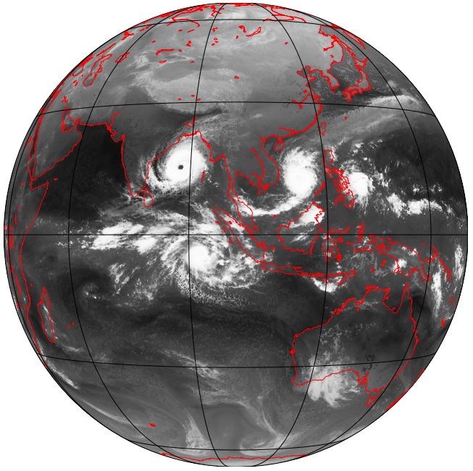
Global Convective-Allowing Modeling: The Future of Subseasonal Forecasting?
Cliff Mass
University of Wshington

Slide 2

This project began with a sobering evaluation of the subseasonal prediction skill of the NOAA/NWS CFSv2 extended-range forecasting system for the U.S.

Slide 3
CFSv2 model evaluation
Global, fully coupled atmosphere-ocean-land model
T126 (~100km, ~1⁰ resolution)
4-member CFSv2 reforecast ensemble mean
Evaluated every 5 days, using 9 month runs.
Evaluated for reforecast period (1982-2010) against GDAS
Jan 1
Jan 2
Jan 3
Jan 4
Jan 5
Saha et al., 2011
9-month
3-month
45-day

Slide 4
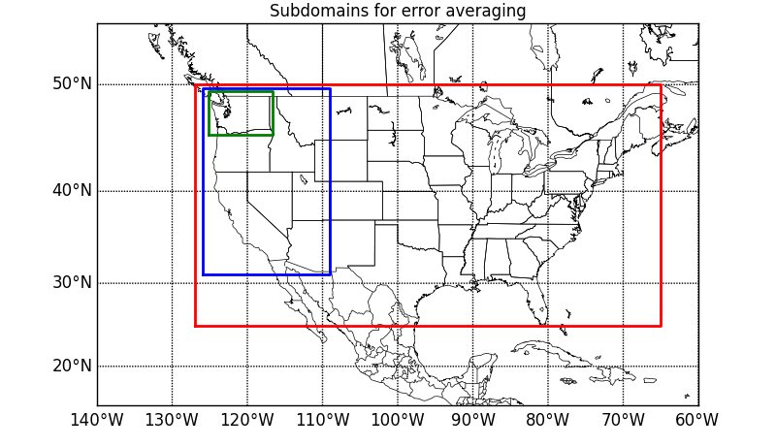
CFSv2 500 hPa skill vs lead time Verification Domains (also global)
Global
Conus
Western
WA

Slide 5
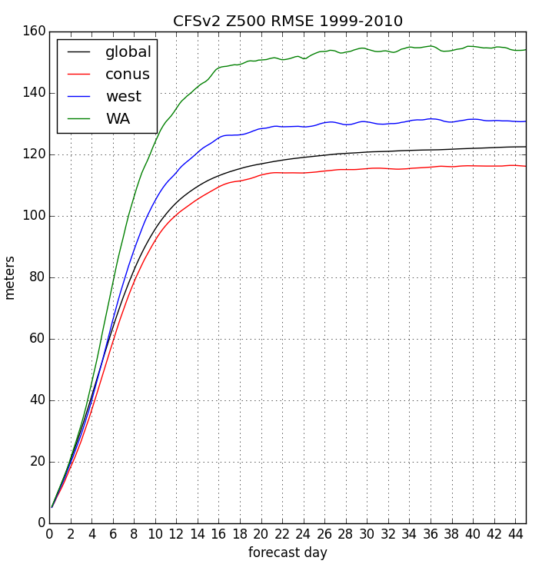
Errors Saturate After Three Weeks Minimal Skill In Third Week

Slide 6
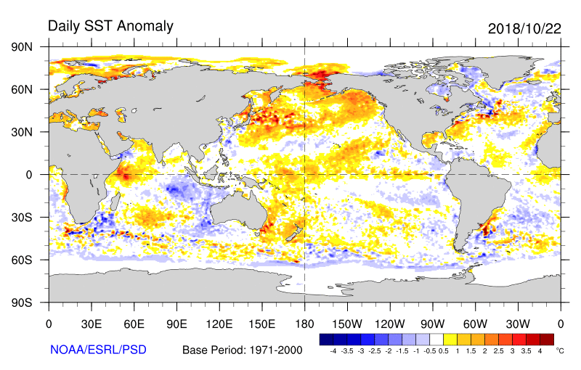
So Why Does CFSv2 Go Bad After Week Two?
Why doesn’t it retain some skill from slowly changing boundary conditions?
Like sea surface temperature, snow and sea ice distributions, soil moisture anomalies?

Slide 7
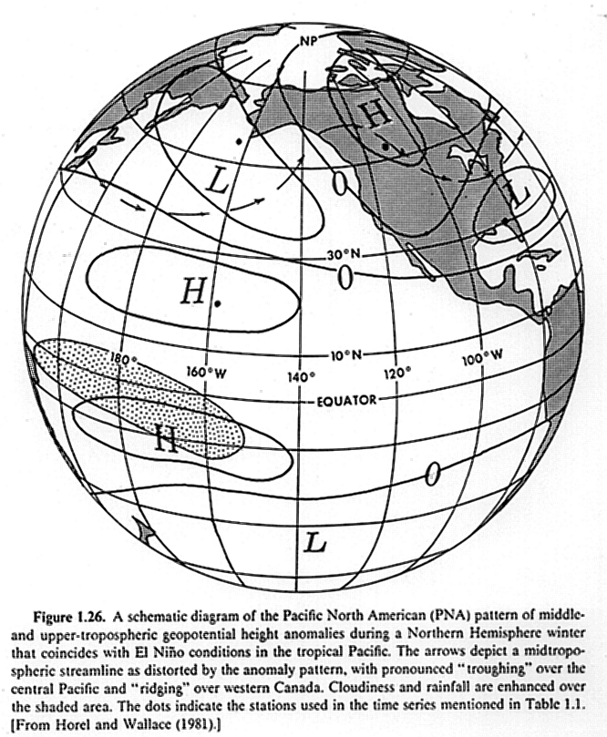
Could problems with convection be a contributor to CFS loss of skill?

Slide 8
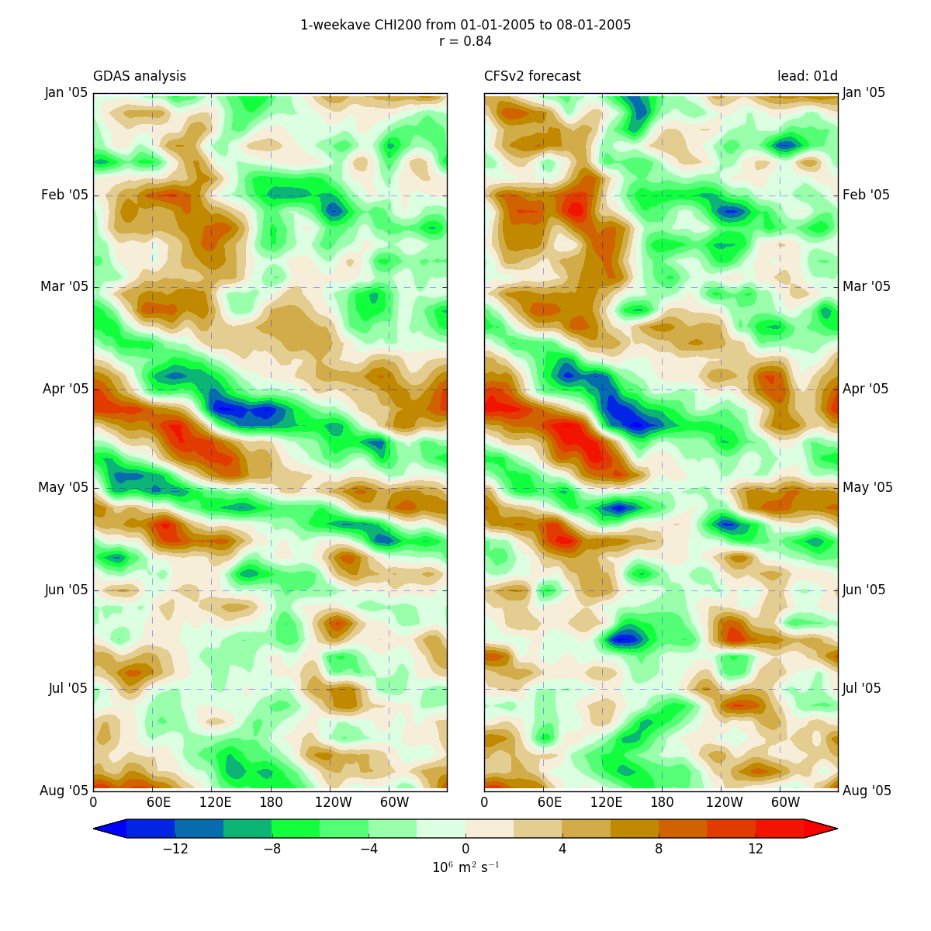
CHI200—Upper Level Divergence analyses vs week-1 forecasts
Spring/summer 2005
Averaged from 5S to 5N

Slide 9
CHI200 : analyses vs week-1 forecasts
Time period:
Spring/summer 2005
Short leads:
Clear propagating features in both the analyses and forecasts

Slide 10
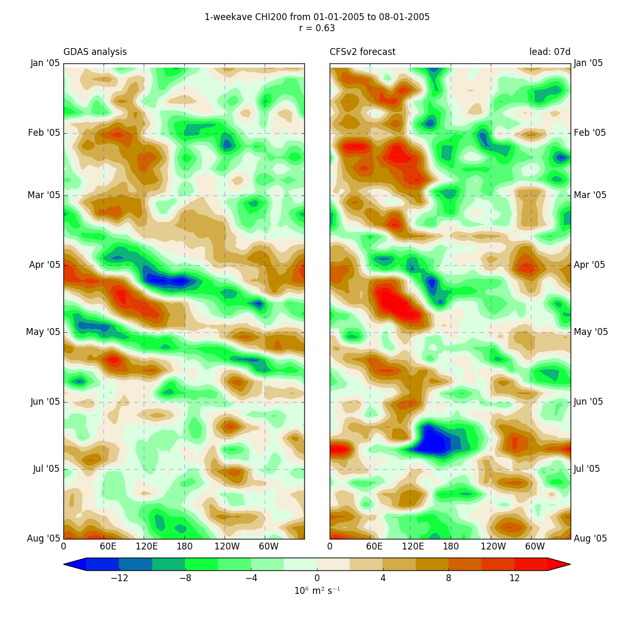
CHI200 : vs week-2 forecasts
7 day
Time period:
Spring/summer 2005
Short leads:
Clear propagating features in both the analyses and forecasts

Slide 11
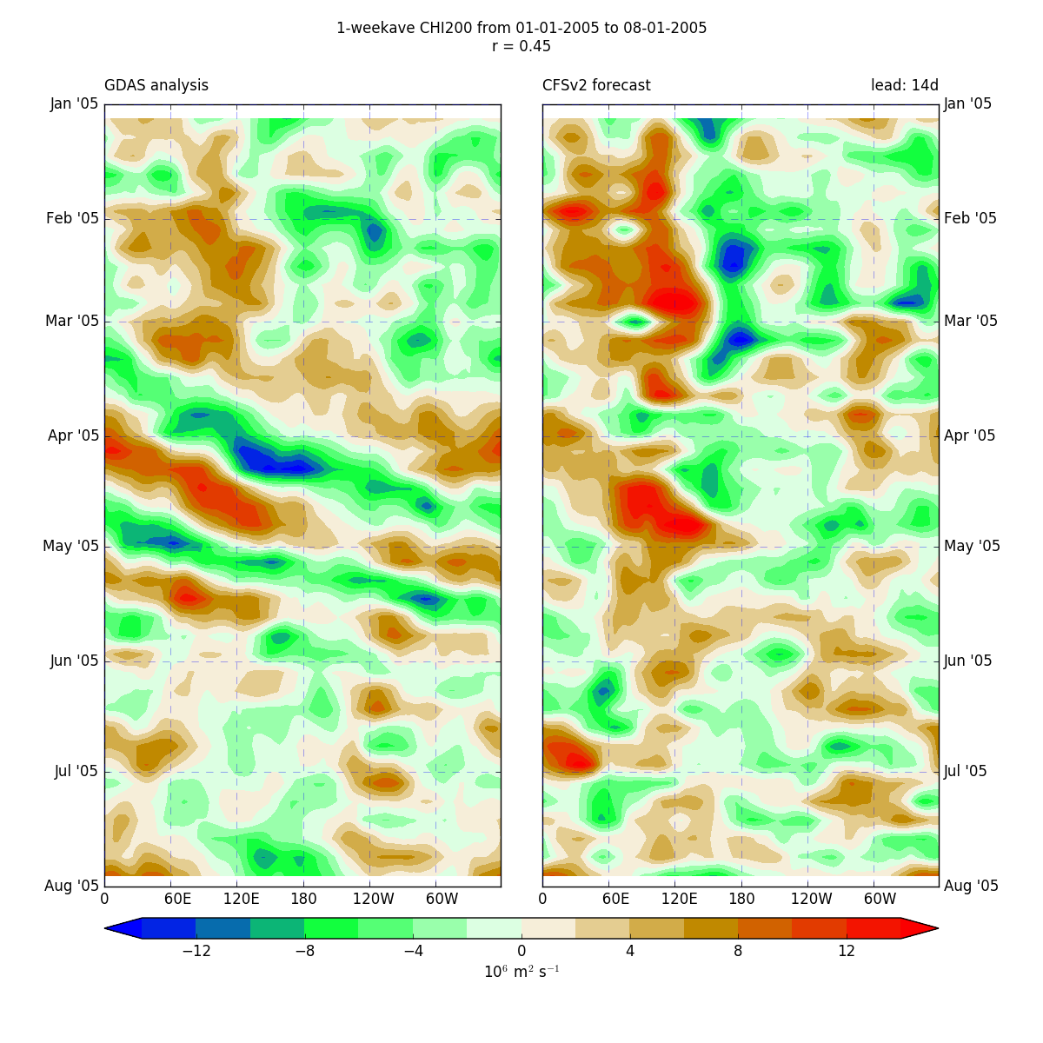
CHI200 le: analyses vs week-3 forecasts
14 day
Time period:
Spring/summer 2005
Short leads:
Clear propagating features in both the analyses and forecasts

Slide 12
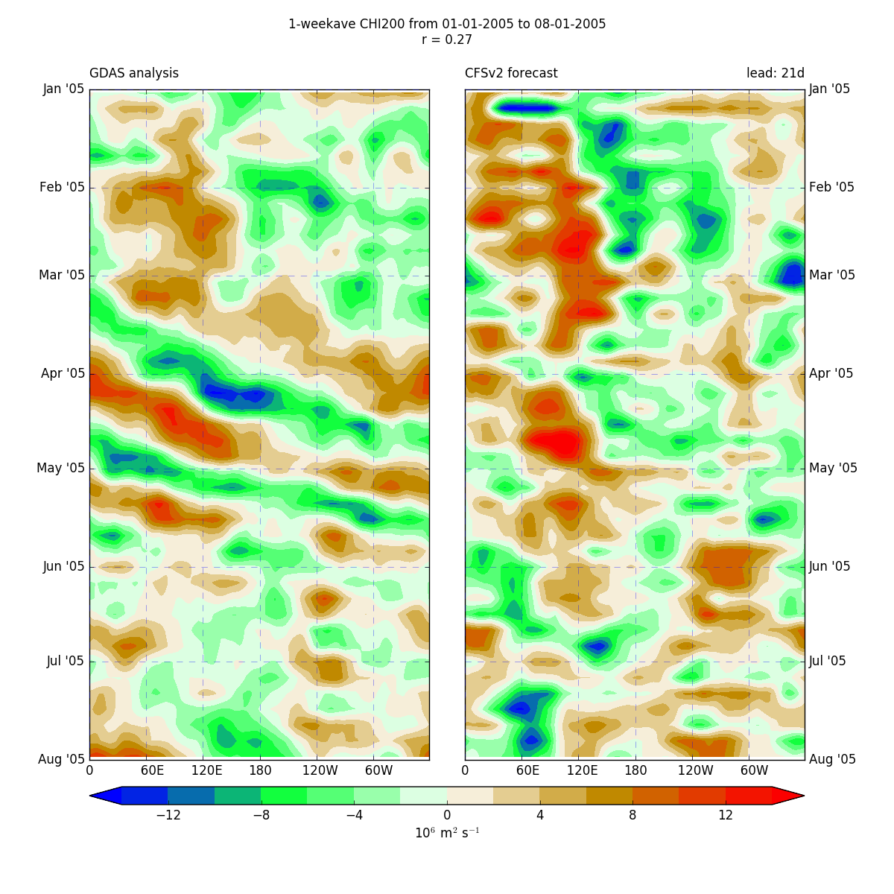
CHI200 ler: analyses vs week-4 forecasts
21-day
Time period:
Spring/summer 2005

Slide 13
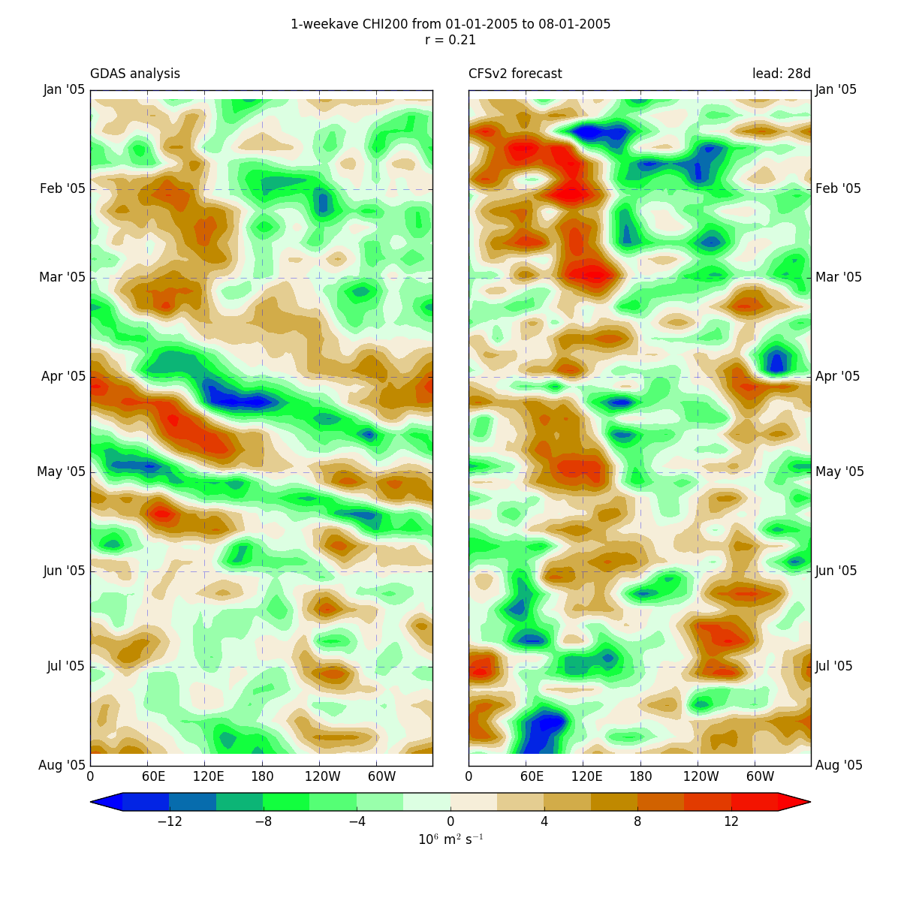
CHI200 : analyses vs week-5 forecasts
28-day
Time period:
Spring/summer 2005
Long leads:
Coherent propagating structures are lost, while more stationary patterns develop

Slide 14
Improving global weather prediction from days to weeks
Convective areas have a huge impact on global circulations, with teleconnection from the tropics greatly impacting midlatitude weather systems.
Global forecast models are relatively coarse, with convective parameterizations.
Convective parameterizations have substantial problems.
There is a deep literature showing that convection-allowing resolutions (4-km grid spacing or less) can greatly improve the fidelity of model forecasts.

Slide 15

So the big question
If we ran global models at convection-allowing resolutions (say 3-km grid spacing), would global prediction improve?
Could this improve extended forecasts (out to a month).

Slide 16

Our Big Chance to Test the Hypothesis
Got a very large allotment on NCAR’s Cheyenne Supercomputer when it went online.

Slide 17
Subseasonal Experiments with MPAS
3-km grid spacing for the entire globe
One-month runs
Initialized with GFS FNL analyses
No cumulus parameterization
Thompson Microphysics
MYNN PBL
NOAA LSM
RRTMG Radiation
SST remains constant during the simulations

Slide 18
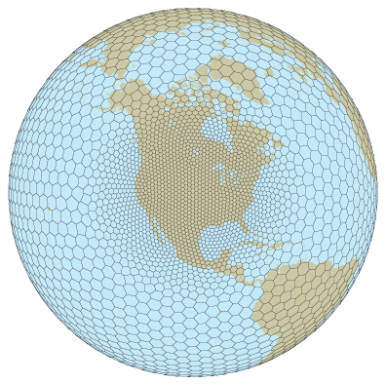
MPAS

Slide 19
Computer resources per run
Supercomputer: Cheyenne (5.34 petaflops)
Run on 512 nodes → 18,432 cores
Core hours: 2.7 million
Output: ~80TB
Notes:
“Unadjusted” core hours: 1.2M on economy queue
Had to be very selective of output variables to save space
Disk space is the primary limiting factor!

Slide 20
Note:
Using constant SST is substantially hurting our simulations and would not be used in operational simulations.
FNL initialization are quite coarse (.5 degree).
We will compare:
TRMM analyses (REALITY)
CFSv2 operational forecasts
MPAS at 15 km resolution globally with Grell-Frietas cumulus parameterization
MPAS at 3 km resolution globally without cumulus parameterization

Slide 21
Note 2
We tried just having high resolution (3-km) in tropics, grading out to 15 km in the extratropics and polar regions
Used scale-aware Grell-Freitas
Unsatisfactory results (substantial high precip bias)

Slide 22
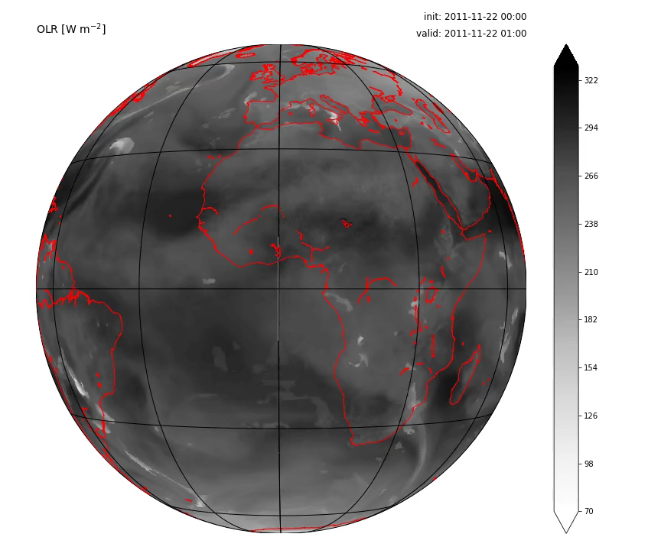
Case 1: DYNAMO MJO2 (2011-11-22)

Slide 23
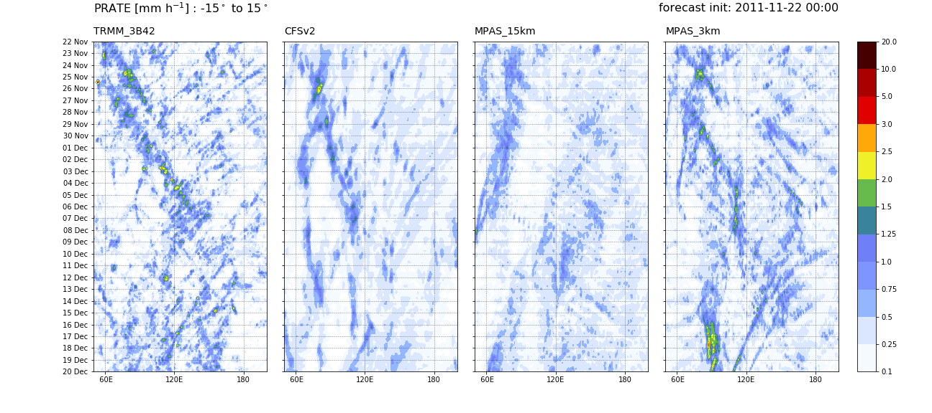
Case 1: Hovmöllers – precip. rate

Slide 24
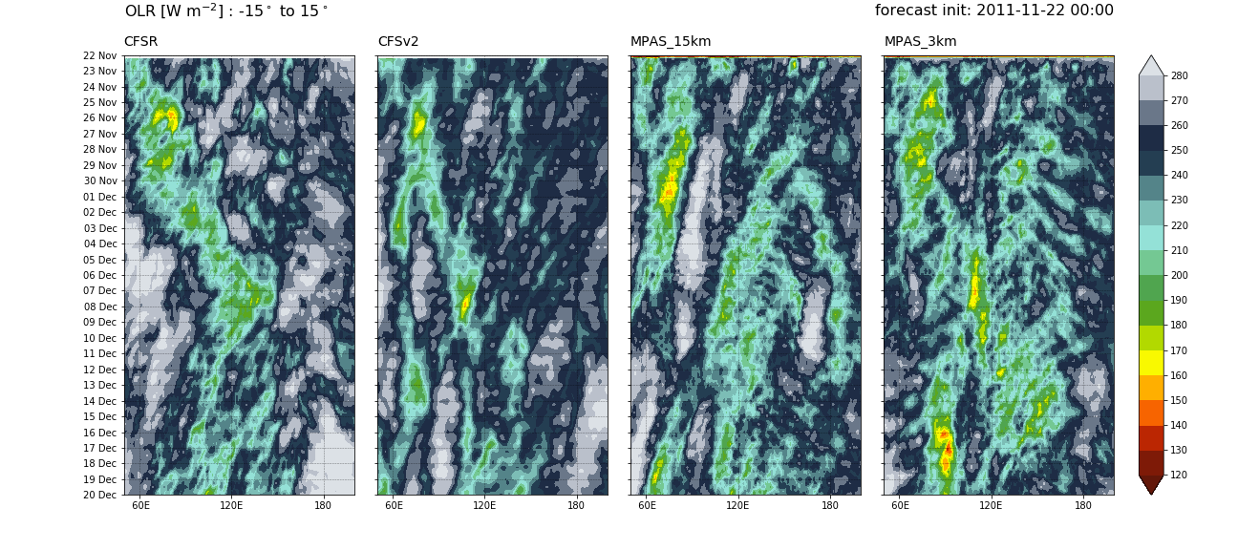
Case 1: Hovmöllers – OLR

Slide 25
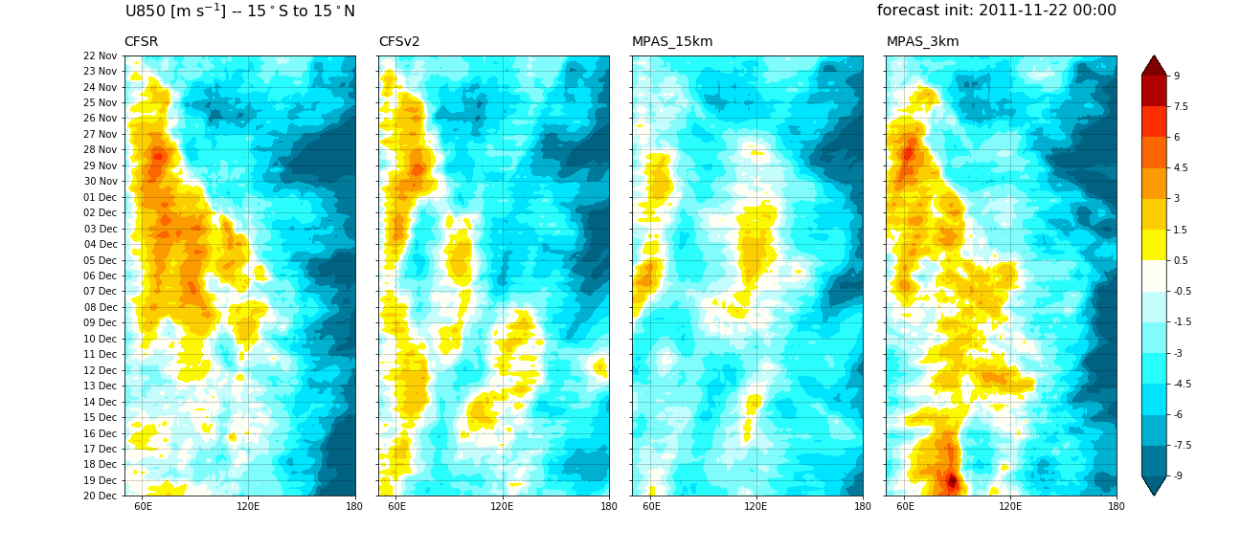
Case 1: Hovmöllers – u850

Slide 26
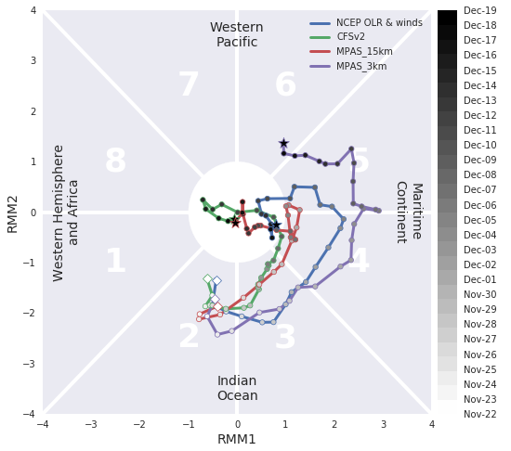
Case 1: MJO RRM indices

Slide 27
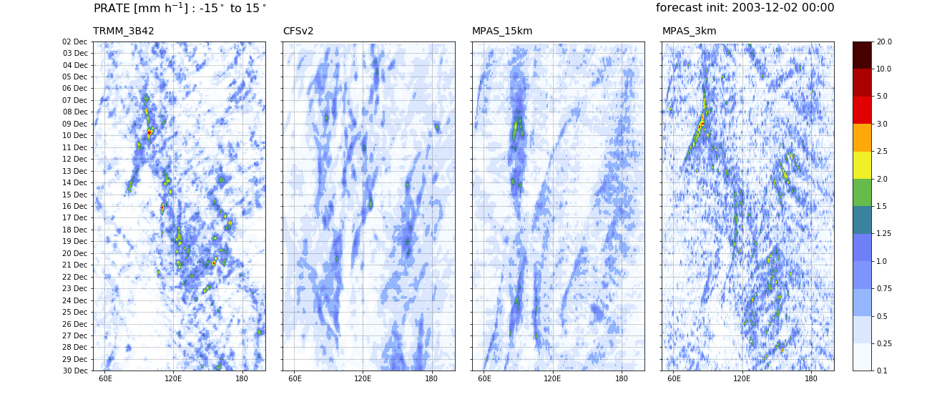
Case 3
precipitation rate
Eastward propagation only captured by 3-km simulation

Slide 28
Case 3
MJO RMM
indices:

Slide 29
Large Scale Anomaly Correlation Weekly Stats

Slide 30
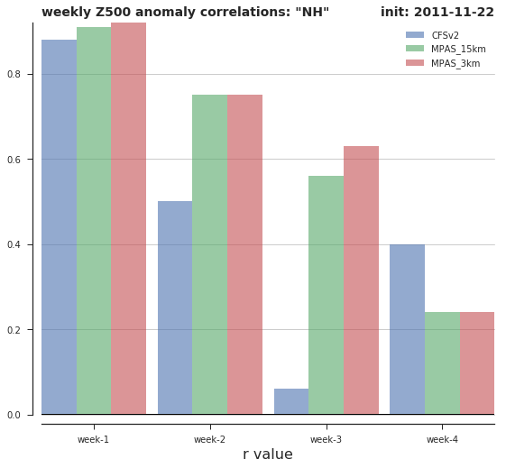
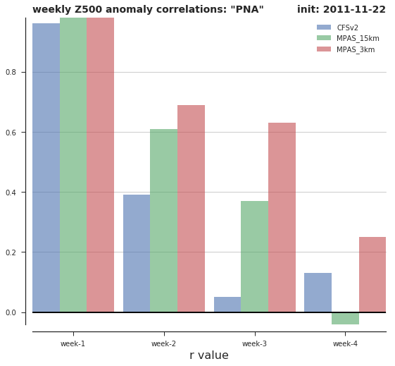
Case 1: 500 hPa AC: NH vs. PNA

Slide 31
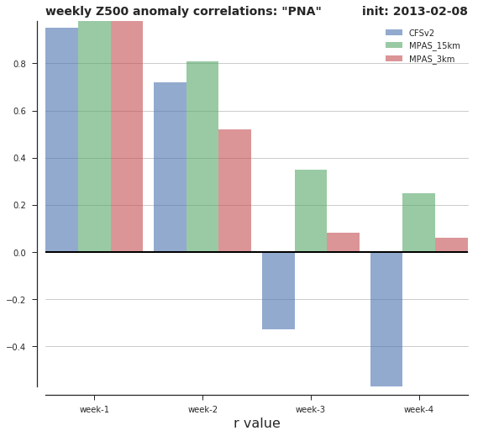
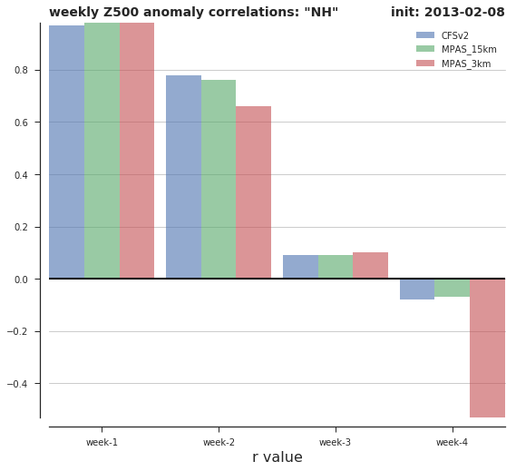
Case 2: 500 hPa AC: NH vs. PNA

Slide 32
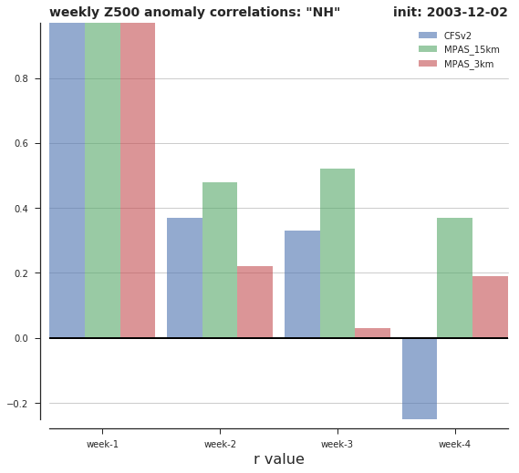
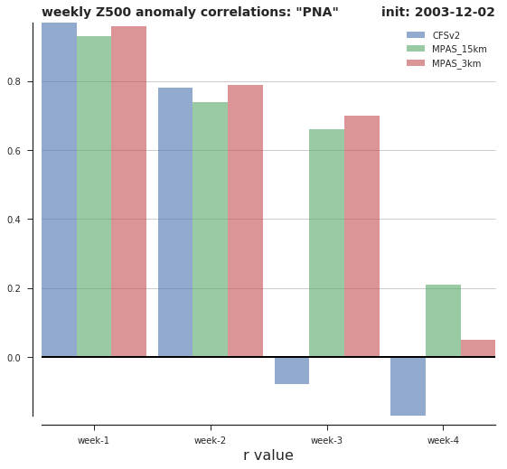
Case 3: 500 hPa AC: NH vs. PNA

Slide 33
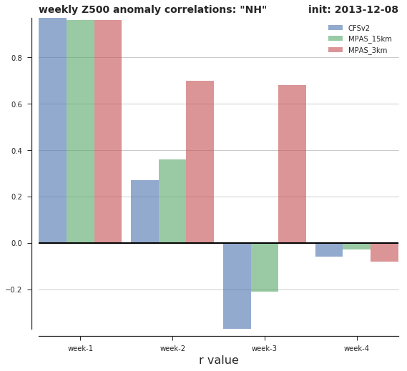
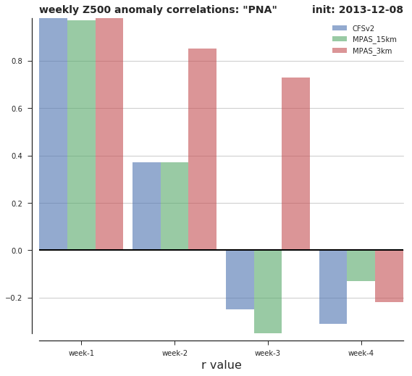
Case 4: 500 hPa AC: NH vs. PNA

Slide 34
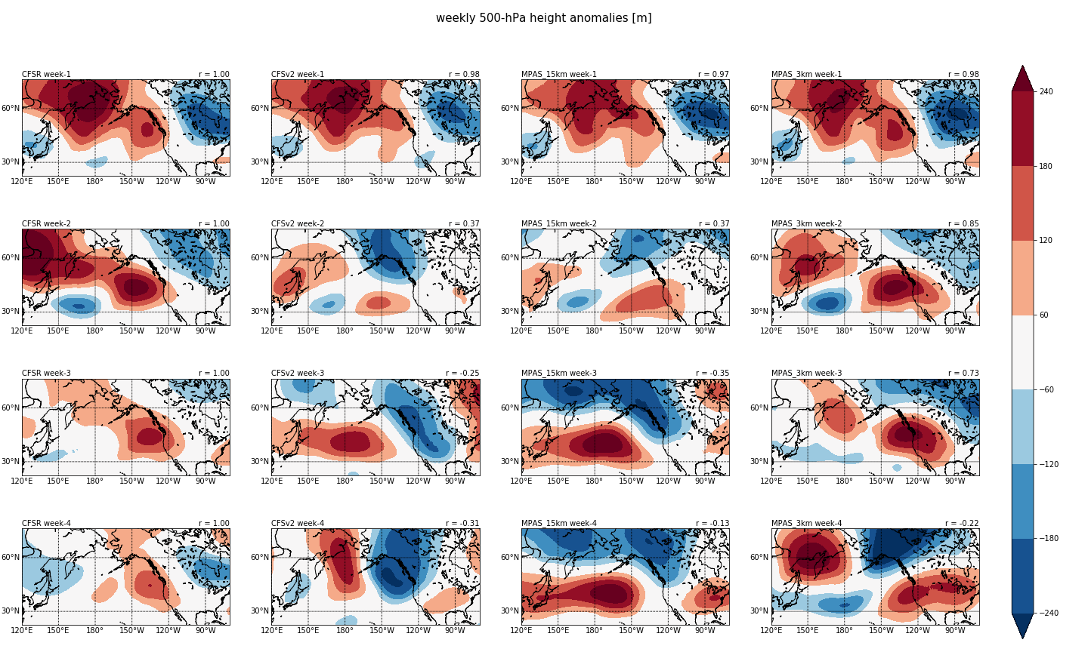
A big problem for CFS is an inability to hold on to ridges on the West Coast: Case 4 was a test for this

Slide 35
What about “mean state” characteristics?

Slide 36
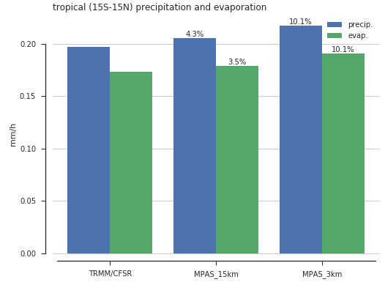
Volumetric precip. & evaporation
3-km has ~10% more tropical precip. & evap. than the obs/analysis
15-km has only a ~4% bias
Due to lack of ocean feedback?

Slide 37

But now something exciting….

Slide 38
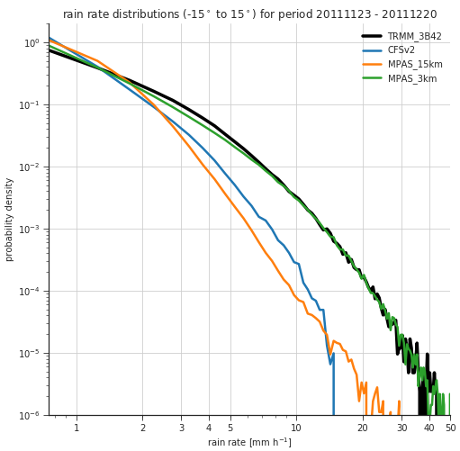
Distributions of precip. rates
3-km simulation almost perfectly matches the TRMM distribution!
Parameterized runs have too much light precip. and too little heavy precip.

Slide 39
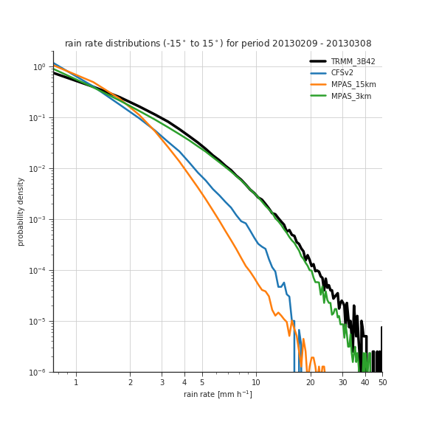
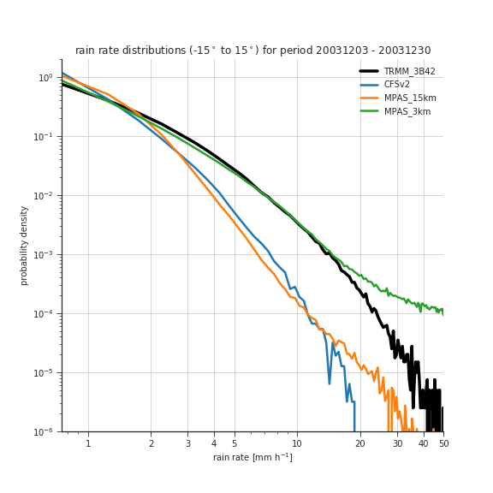
Other cases

Slide 40
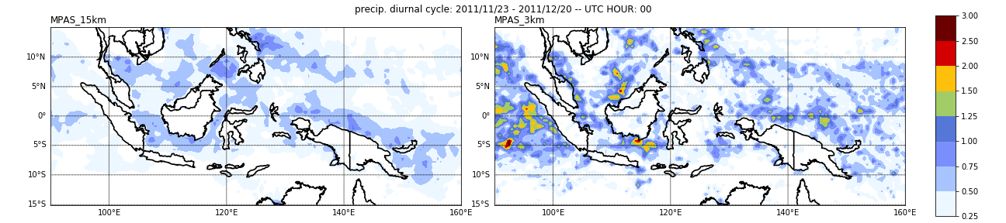
Diurnal cycle of precipitation

Slide 41
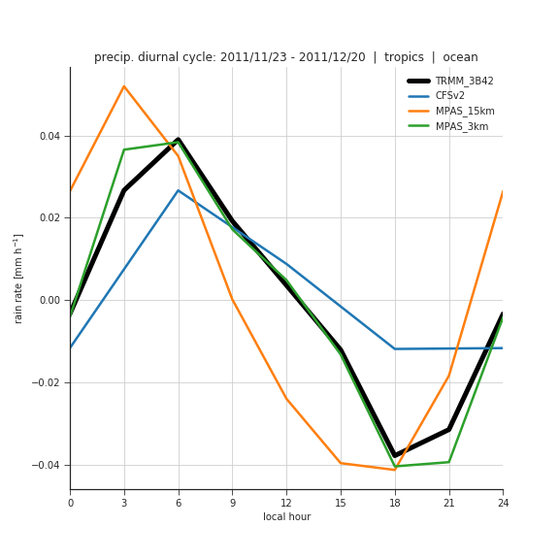
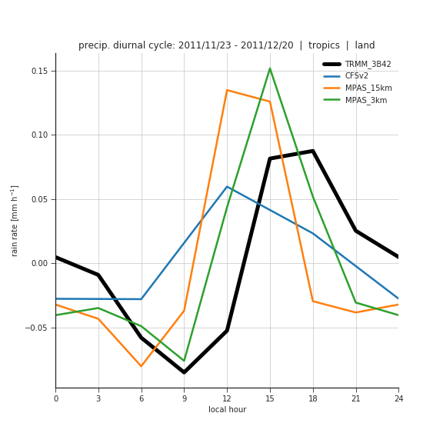
Diurnal cycle – full tropics
ocean
land
Diurnal peak timing is improved at 3km both over land and ocean
Improvement is most improved over the ocean – nearly perfect!

Slide 42
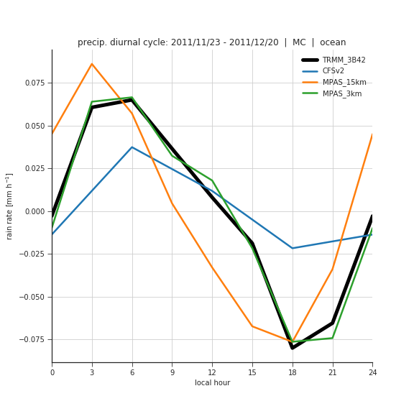
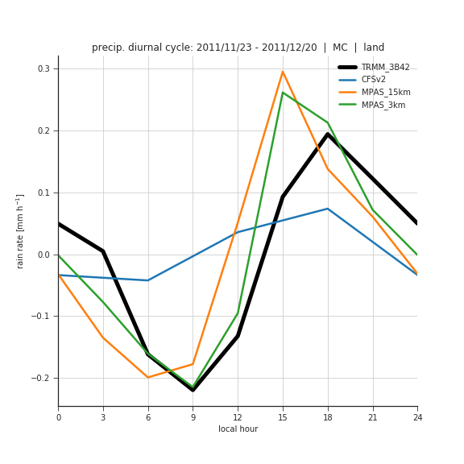
Diurnal cycle – Maritime Continent
ocean
land
Very similar story over just the Maritime Continent region

Slide 43
A major issue for CFS has been in an inability for MJO’s to get past the maritime continent
Does convection-permitted resolution help?

Slide 44
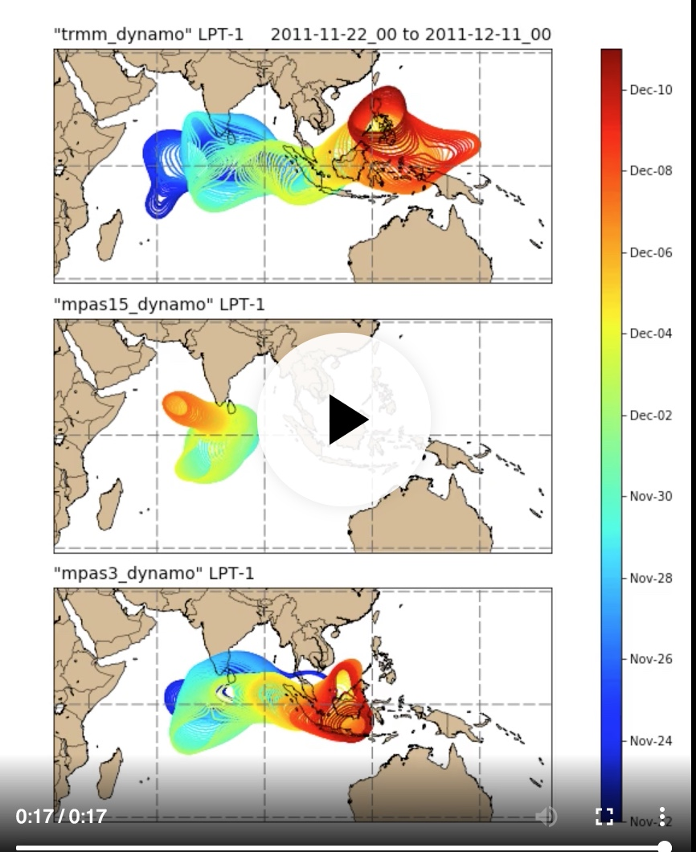
LPT (Large Scale Precipitation Tracking) Animations 14 mm/day threshold. The precipitation is accumulated over 72 hours and a 5 degree filter
https://atmos.washington.edu/~njweber2/figures_cheyenne/lpt/figures_compare_dynamo_14mm/track_lpt1-1-1/anim_tracks.mp4

Slide 45
Bottom Line
Global convection-allowing resolution appears to have many positive attributes
Improves distribution and propagation of convection in tropics
Improves subseasonal predictability
Our experiments so far have not included an interactive ocean
This may well undermine subseasonal predictability.

Slide 46
What is next?
Do experiments with FV-3: the new national global model.
Do experiments with a coupled ocean:
FV-3 will soon have MOM-6 available
MPAS coupled to CESM ocean model
More events.

Slide 47
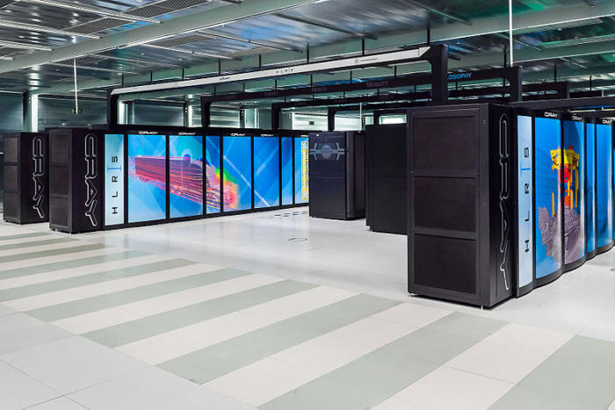
Could convection-allowing global resolution with coupled ocean models by a revolutionary advance for daily to subseasonal prediction?

Slide 48
The End

Slide 49
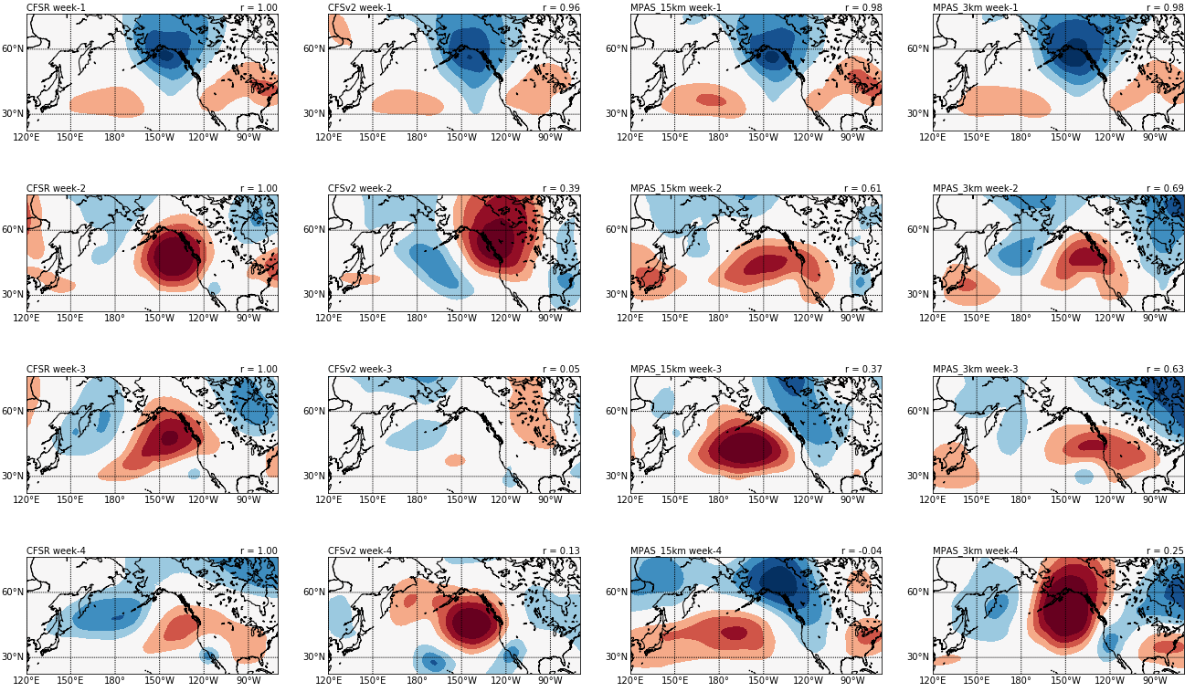
Case 1: Extratropical Z500’

Slide 50
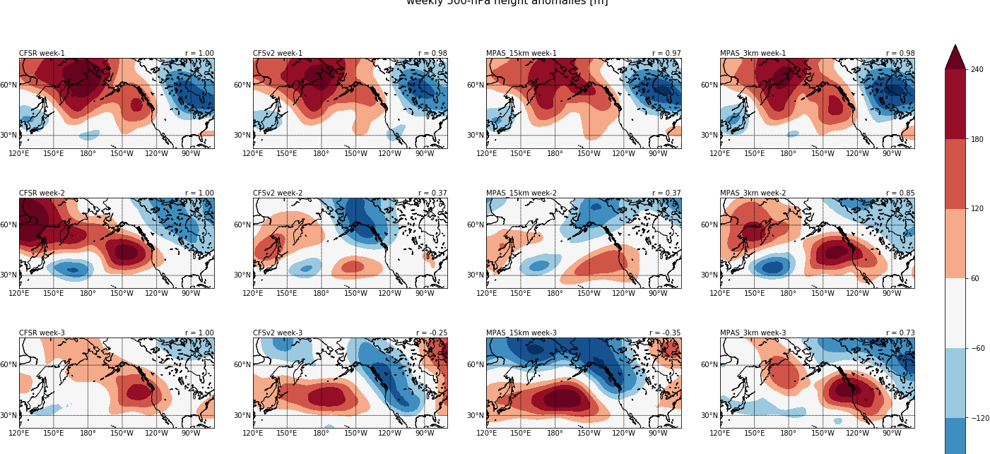
Weekly anomalies… 500 hPa

Slide 51
This work will continue
Enough computer resources to do three more one month cases.
Looks very promising.

Slide 52
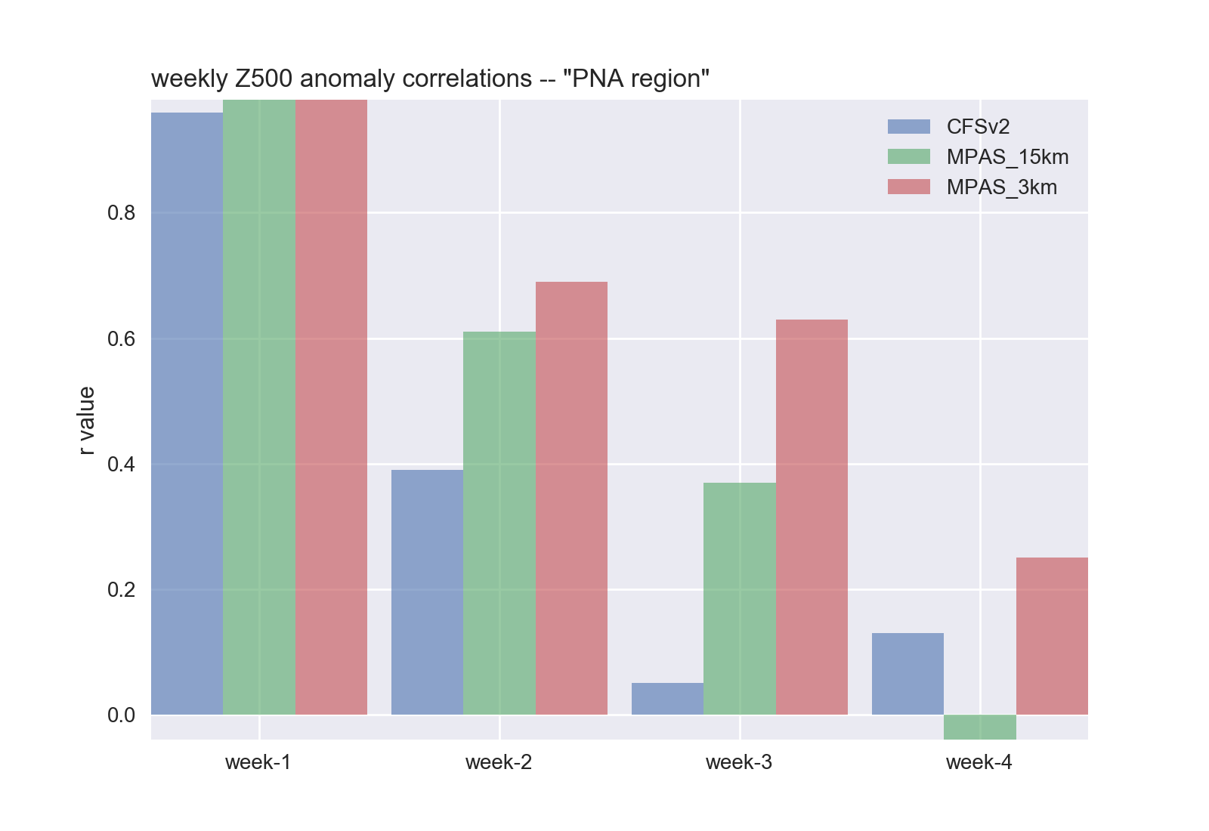
Case 1: Extratropical Z500’

Slide 53
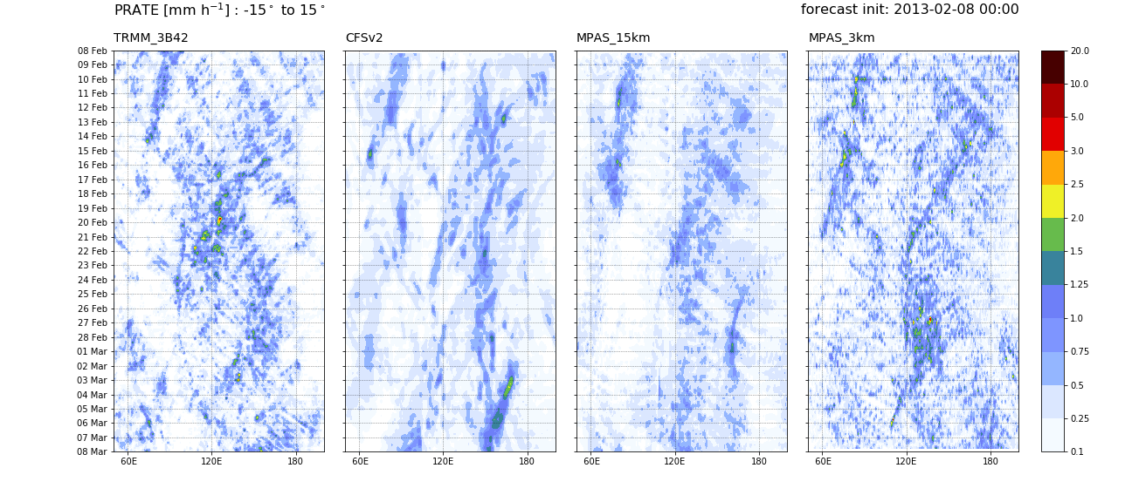
Case 2: 2013-02-08
Less successful….

Slide 54
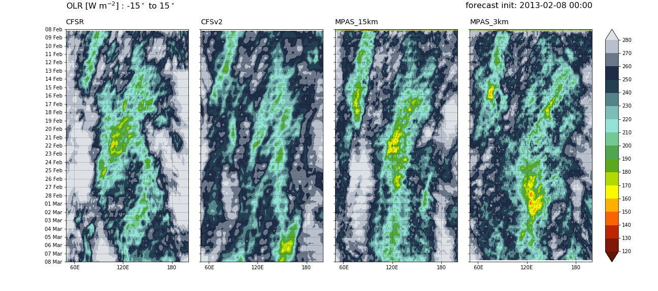
Case 2: Hovmöllers – OLR

Slide 55
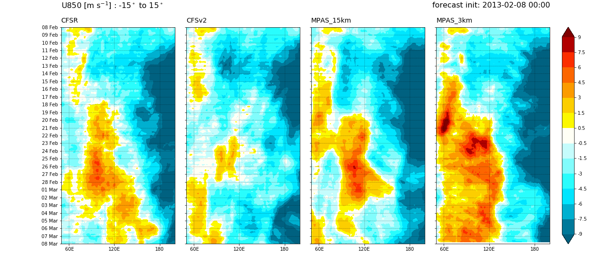
Case 2: Hovmöllers – u850

Slide 56
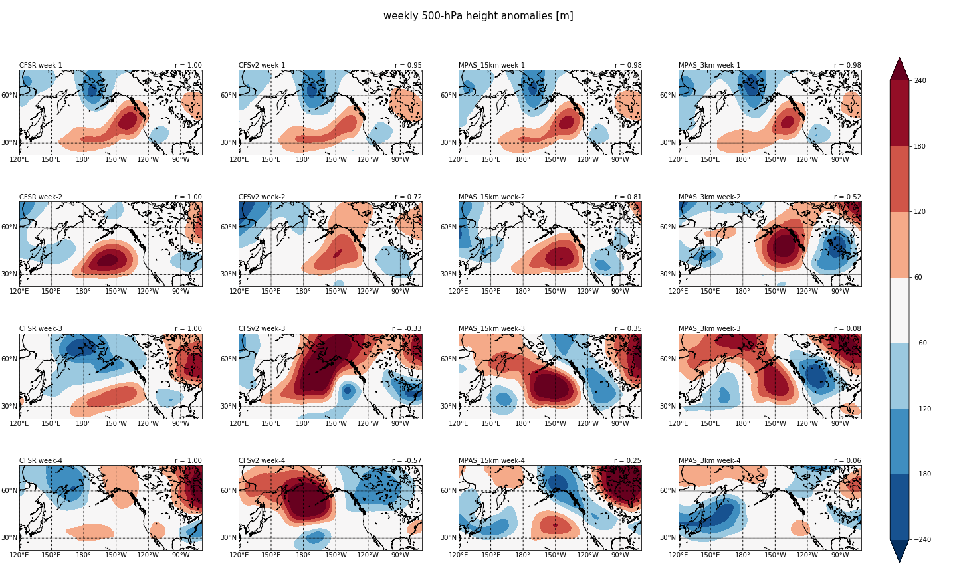
Case 2: Extratropical Z500’

Slide 57
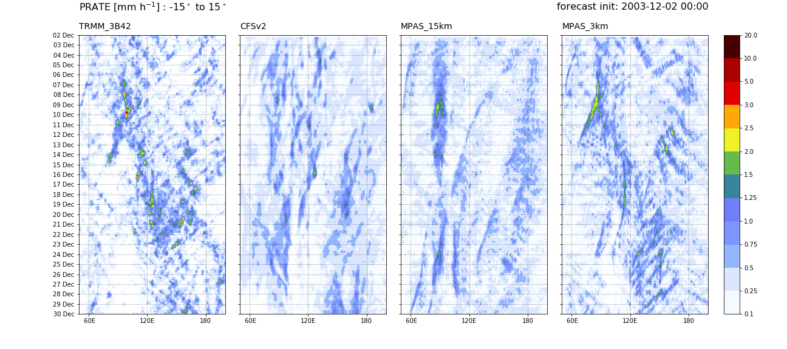
Case 3: 2013-12-02
Incredible!

Slide 58
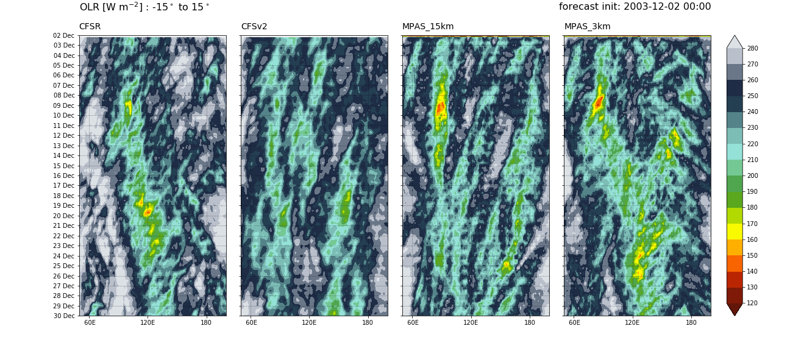
Case 3: Hovmöllers – OLR

Slide 59
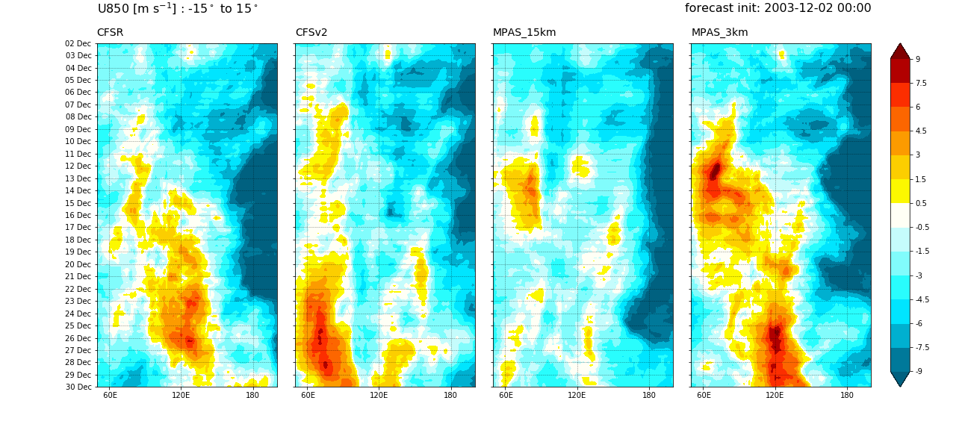
Case 3: Hovmöllers – u850

Slide 60
Case 3: MJO RRM indices

Slide 61
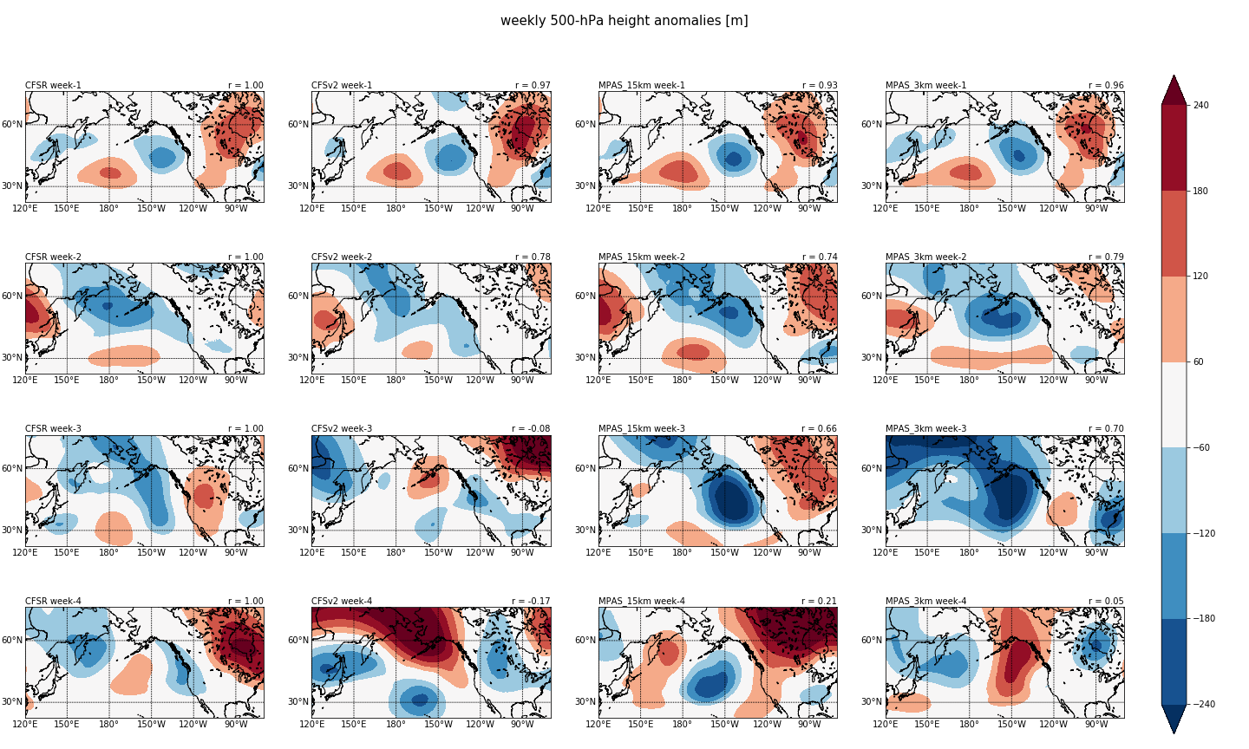
Case 3: Extratropical Z500’
No “dramatic” improvement

