Slide 1
Sea Level Pressure

Slide 2
Terminology
Station pressure: pressure measured at the elevation of the observing sensor at the surface
Surface pressure: same thing, pressure measures at the surface.
Sea level pressure: pressure adjusted (reduced) to sea level (0 elevation in meteorology)

Slide 3
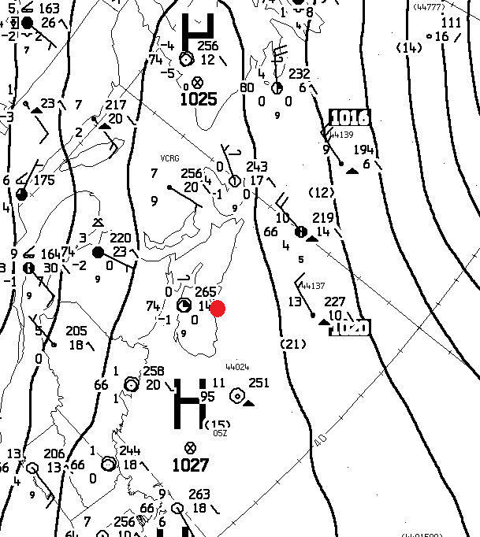
Isobars of sea level pressure are found on surface weather maps
Isobars are lines of constant or equal pressure
Labeled in hPa/mb (e.g., 996, 1000, 1004, etc.), typically every 4 hPa

Slide 4
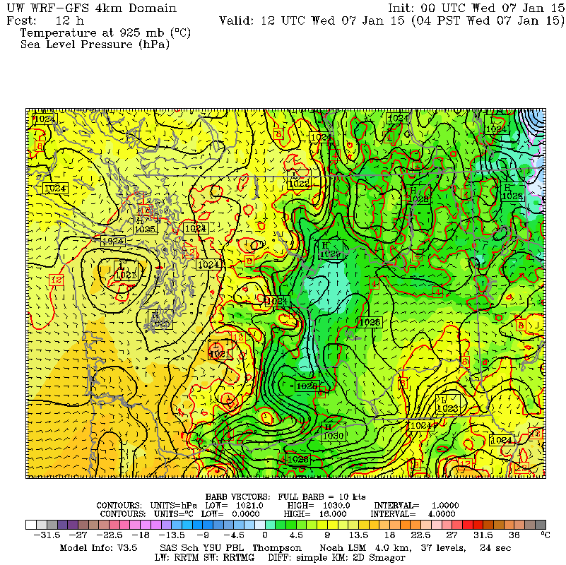
Models Can Provide Sea Level Level Pressure

Slide 5
Why use sea level pressure rather than station pressure?
The pressure variations on weather maps would be dominated by terrain changes if station or surface pressure was plotted.
But sea level pressure does have its issues, particularly in high terrain.

Slide 6
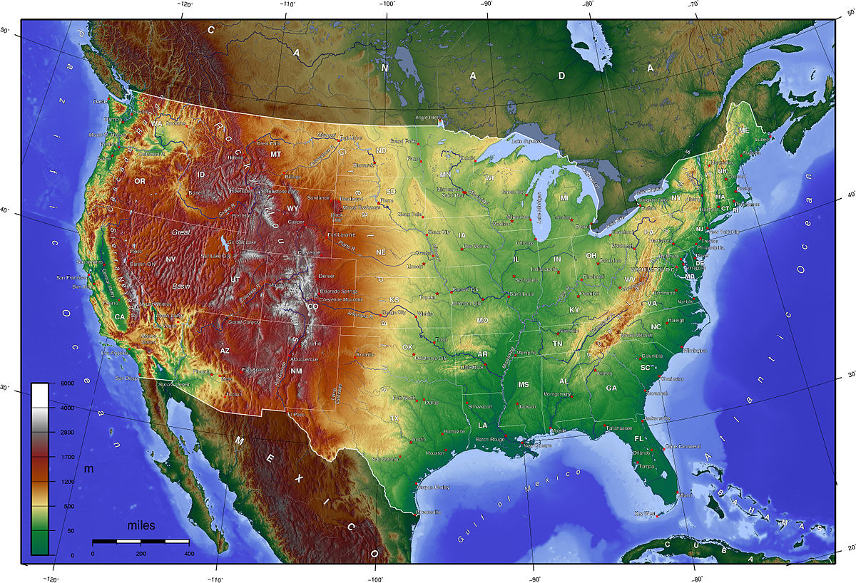
If station or surface pressure plotted
L
L
H

Slide 7
Terrain effects on pressure would swamp the meteorological signal
So why not remove the terrain effects of pressure?
Adjust the station (surface) pressures to get the pressure at a standard level: sea level.
Called pressure reduction to sea level (bad name).

Slide 8
Example of Pressure Reduction Increase pressure for station above sea level
* 1024 hPa
64 m
Sea Level
* 1032 hPa
Near sea level, pressure drops about 1 hPa for every 8 meters in elevation.

Slide 9
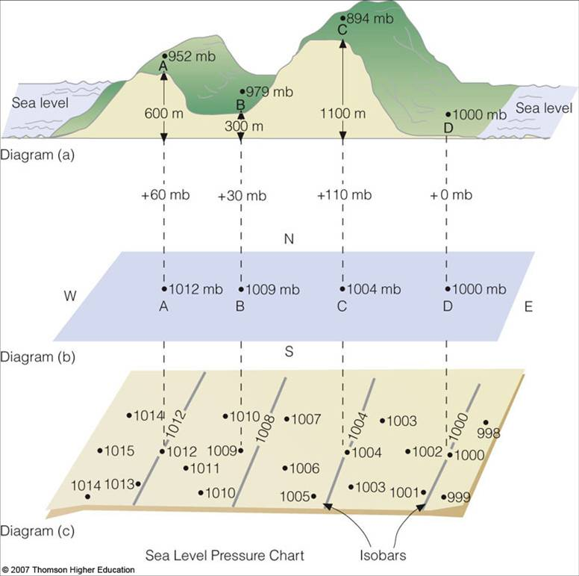

Slide 10
Pressure Reduction to Sea Level
Based on the hypsometric equation, which you should have learned in ATMS 301.
Combines hydrostatic relationship and perfect gas law
Particularly problematic for high elevation stations—will explain why
Gone through in Wallace and Hobbs

Slide 11
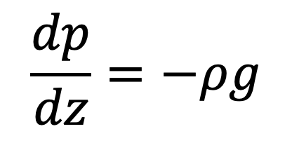
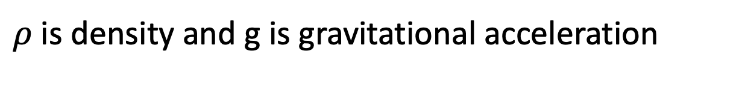
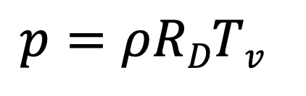
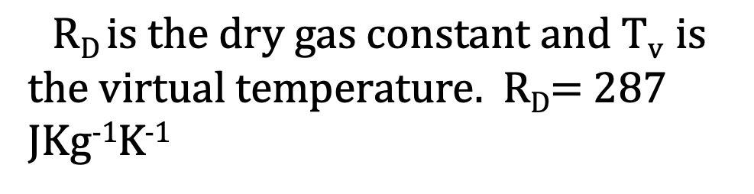
Hydrostatic Equation
Perfect Gas Law

Slide 12
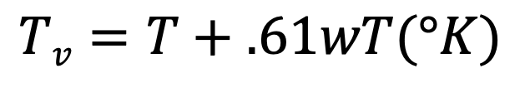
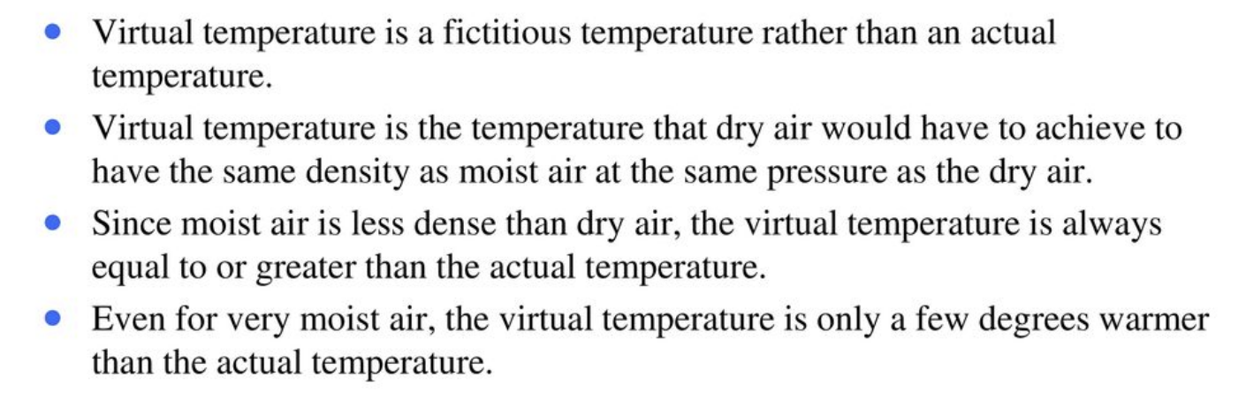
Virtual Temperature
Where w is mixing ratio (mass of water vapor/mass of dry air)

Slide 13
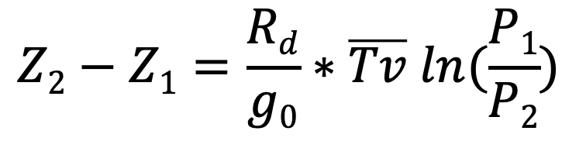

Combining the Hydrostatic, Perfect Gas Law, and Virtual Temperature Equations (see Wallace and Hobbs or here) you can derive the Hypsometric Equation
Where Z is geopotential height, P is pressure, and g_{o} is the gravity at the surface
Z₂, P₂
Z₁, P₁

Slide 14
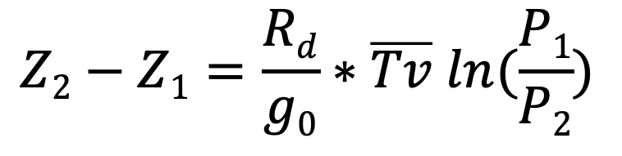
Lots of Applications! Compute geopotential heights of pressure surfaces Calculate thickness (e.g., 1000-500 hPa) Pressure reduction to sea level Altimeters and altimeter setting
Where Z is geopotential height, P is pressure, and g_{o} is the gravity at the surface
Z₂, P₂
Z₁, P₁

Slide 15
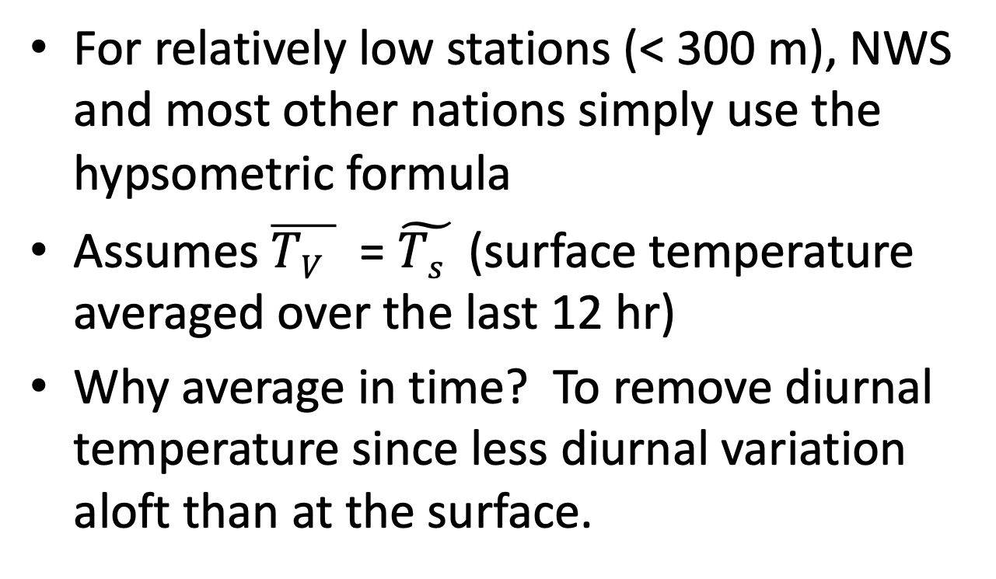
Application of Hypsometric Formula to Pressure Reduction to Sea Level
dd
(T_{s}(t) +T_{s}(t-12))/2

Slide 16
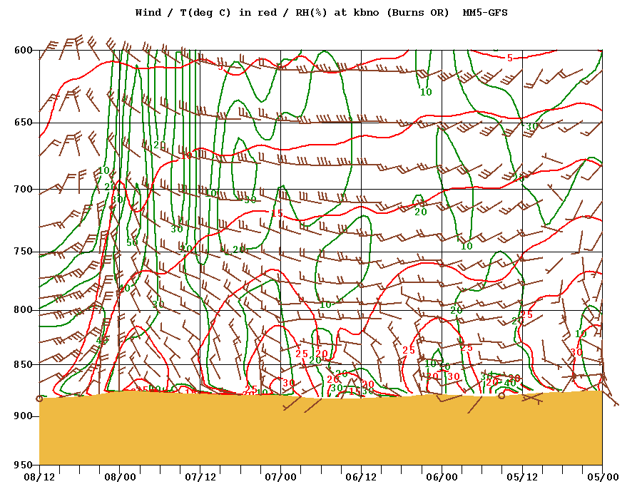

Slide 17
Pressure Reduction to Sea Level
P_{s} or P_{g}
Z_{g}
Terrain
Free
Atmosphere
P_{SL}
Z= 0
Sea level

Slide 18
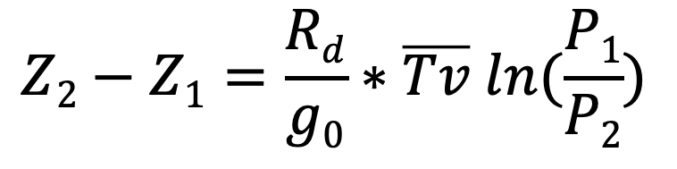
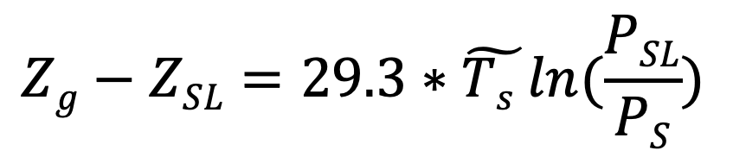

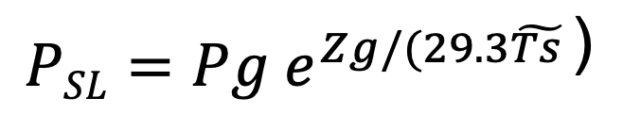
Start with hypsometric

Slide 19
Pressure Reduction to Sea Level
Above 300 meters, there are various corrections: moisture correction, plateau correction, and others.
Often problems in high terrain, particularly high valleys during cold conditions.
Cold air in high valleys does not mix out during day and is not representative of the free atmosphere.
Get CRAZY high sea level pressures.

Slide 20
Cold air
Co
Free Atmosphere

Slide 21
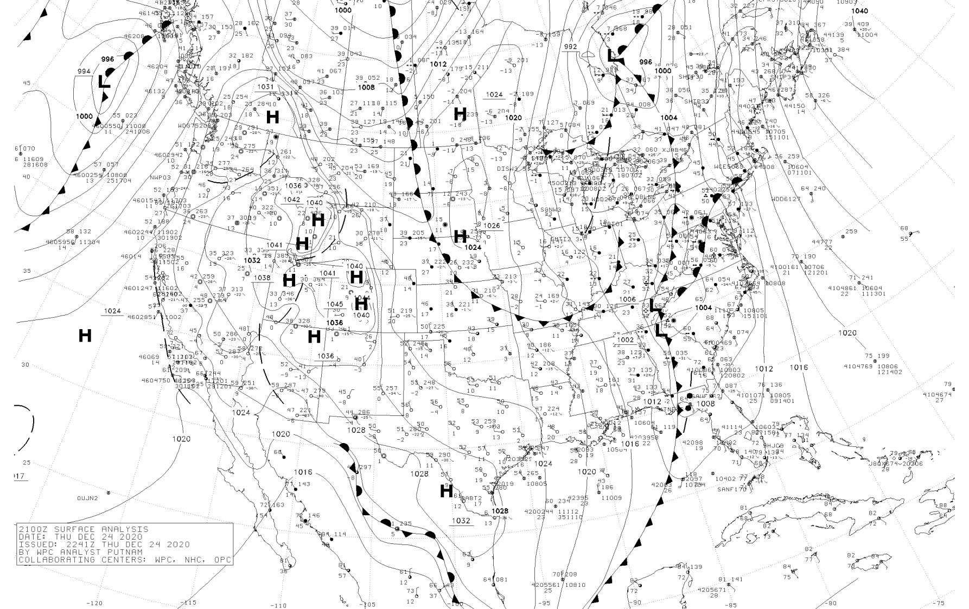

Slide 22
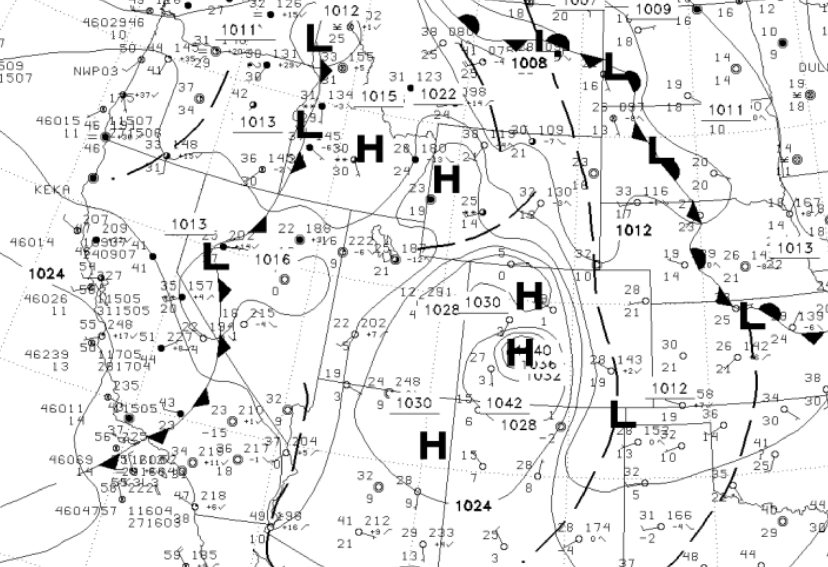

Slide 23
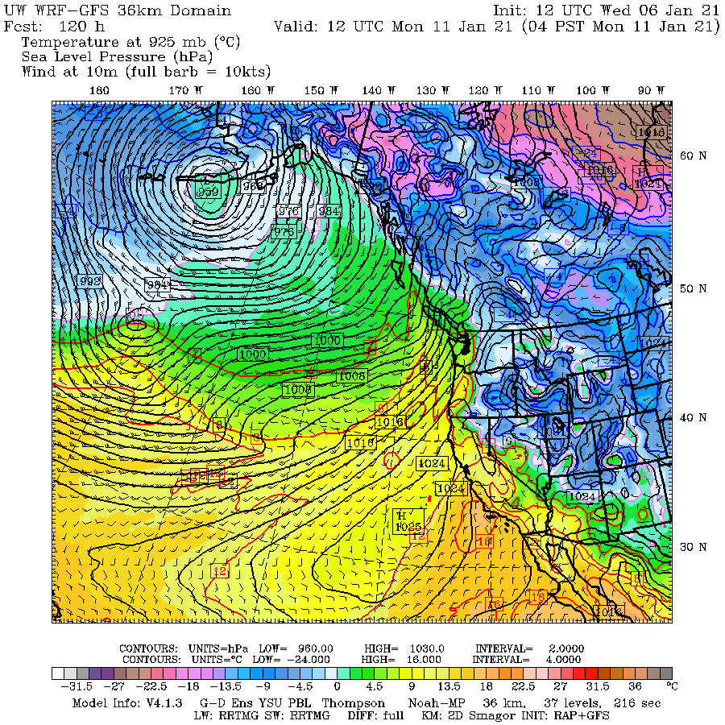
Model Pressure Reduction to Sea Level Can Have the Related Issues

Slide 25
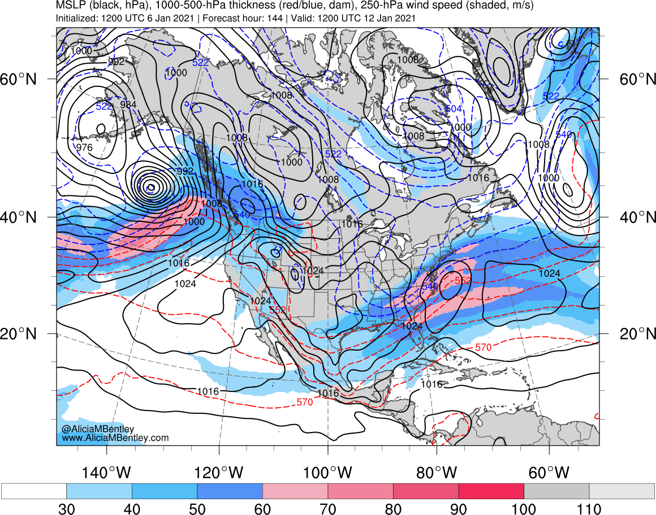

Slide 26
Both Sea Level Pressure and Station Pressure Have Substantial Diurnal Variations
Mainly due to thermal temperature variations in upper atmosphere.
Also driven by diurnal temperature changes at the surface.

Slide 27
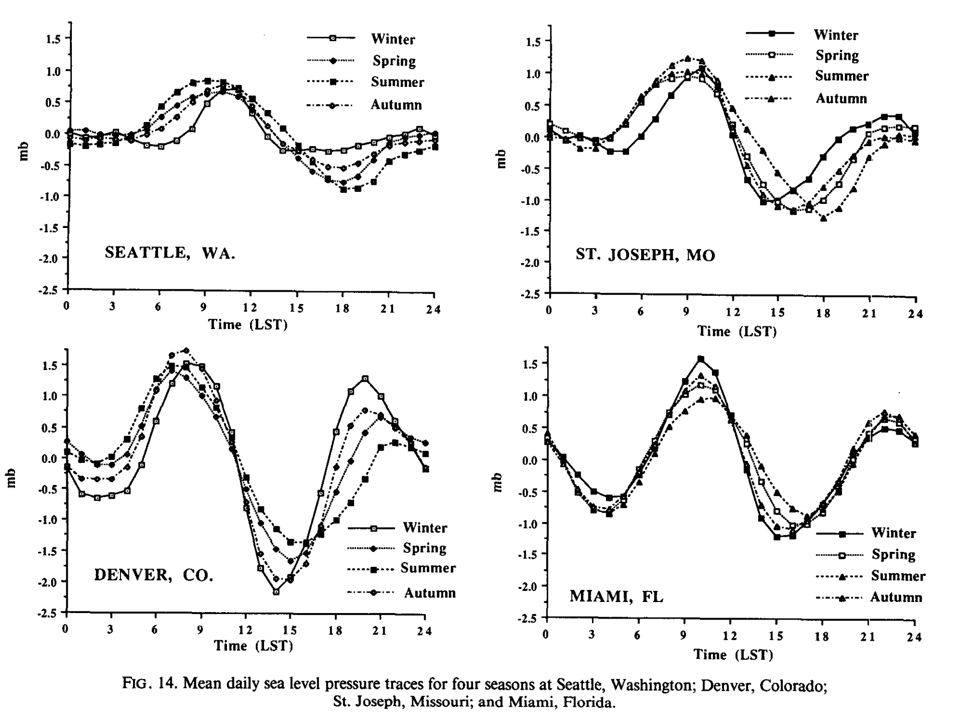

Slide 28
Diurnal (daily) SL pressure variations
Strong semidiurnal cycle (two maxima, two minima). Stronger in the tropics.
High pressure: 10 AM (primary) and 10 PM
Low pressure: 4 AM and 4 PM (primary)
Diurnal pressure changes can be large at certain times and can even mask weather system variations
Particularly in early afternoon between primary max and min.

Slide 30
Hypsometric Reduction Used by Most Numerical Models
No time averaging of the surface temperature is employed.
In order to calculate the mean temperature, the model "surface" temperature, and the standard atmosphere lapse rate (6.5 C / 1000m) are used.
This is the lapse of the U.S. Standard Atmosphere

Slide 31
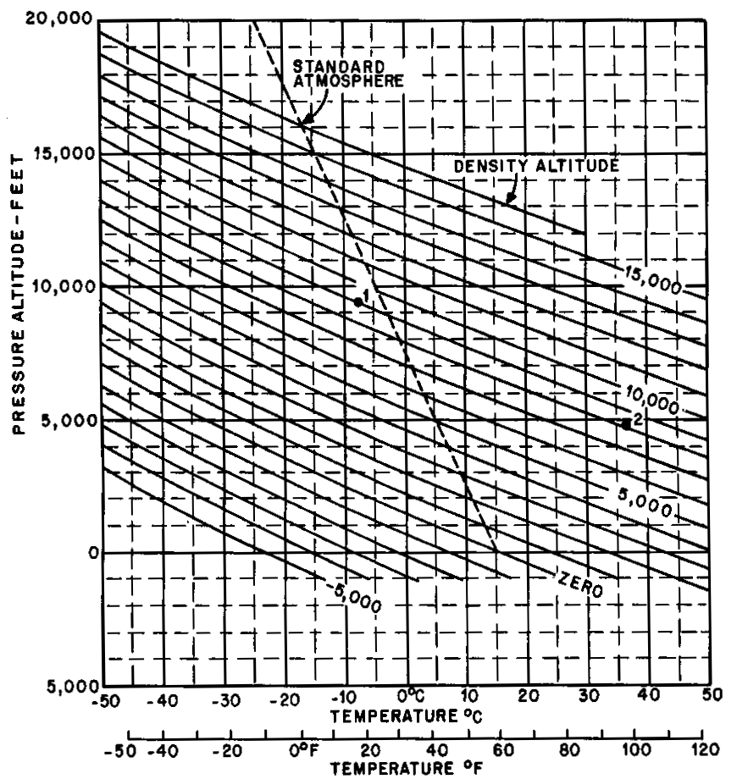
Standard Atmosphere is 6.5 C per km

Slide 32
Often the free atmosphere has a different lapse rate than assumed in terrain and that can lead to problems
Can result in fictious pressure features in model output
And the fictious pressure features change during the day.

Slide 33
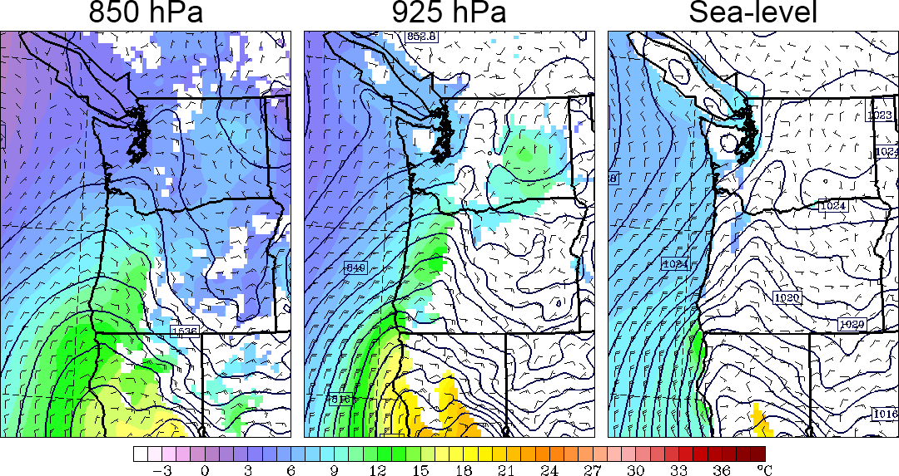
At night during warm season: results in phony troughs under terrain

Slide 34
Why?
Models usually use the U.S. Standard Atmosphere for pressure reduction (also called the Shuell Method).
During the night, as the lower atmosphere stabilizes, the free (real) atmosphere can have a smaller decrease of temperature with height than the U.S. Standard Atmosphere at low levels (smaller lapse rate).
This produces an artificial pressure gradient, with unreasonable low pressure under terrain

Slide 35
Nighttime Situation
Same pressure at 1 km
6.5C
0 C
1km
Free
Atmosphere
cooler
US Standard
Atmosphere
warmer
4 C
6.5 C
Higher SLP
Lower SLP
Thus, the model atmosphere under terrain is warmer than in the real world producing unrealistic low pressure.
Away from terrain there are no reduction issues.

Slide 36
At night during warm season: results in phony troughs under terrain

Slide 37
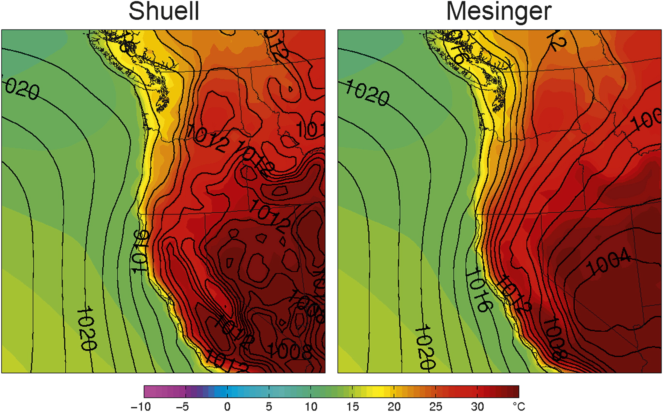
During the day, there phony trough inland at low elevations
Fig. 5. Composites of sea level pressure (solid lines, hPa) and 1000-hPa temperature (color shading, °C) using the (left) Shuell and (right) Mesinger methods for JJA at 0000 UTC.

Slide 38
Why?
During day, the real atmosphere over the Central Valley is near dry adiabatic (9.8 C per km), while over the mountains we assume U.S. Standard atmosphere valley (6.5C per km).
Becomes cooler at low levels inside the mountains…thus higher pressure.

Slide 39
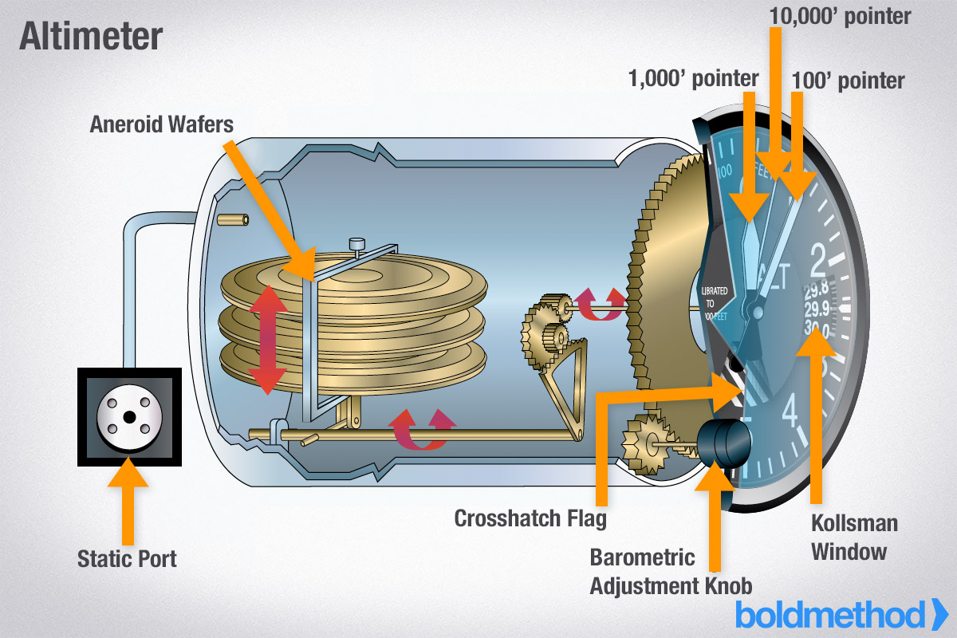
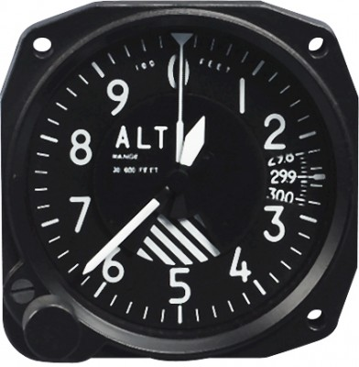
Altimeter Setting
Altimeters Used in Aircraft to Determine
Elevation Above Airports

Slide 40
Altimeter Setting Is an Alternative Form of Sea Level Pressure
In fact, it is the most frequently provided pressure measurement.
Altimeter setting is sea level pressure assuming the U.S. Standard Atmosphere temperature structure.
The altimeter setting at the arriving airport is communicated to the pilot, who puts into the altimeter.
The result is that altimeter will give the proper elevation of the runway.

Slide 41
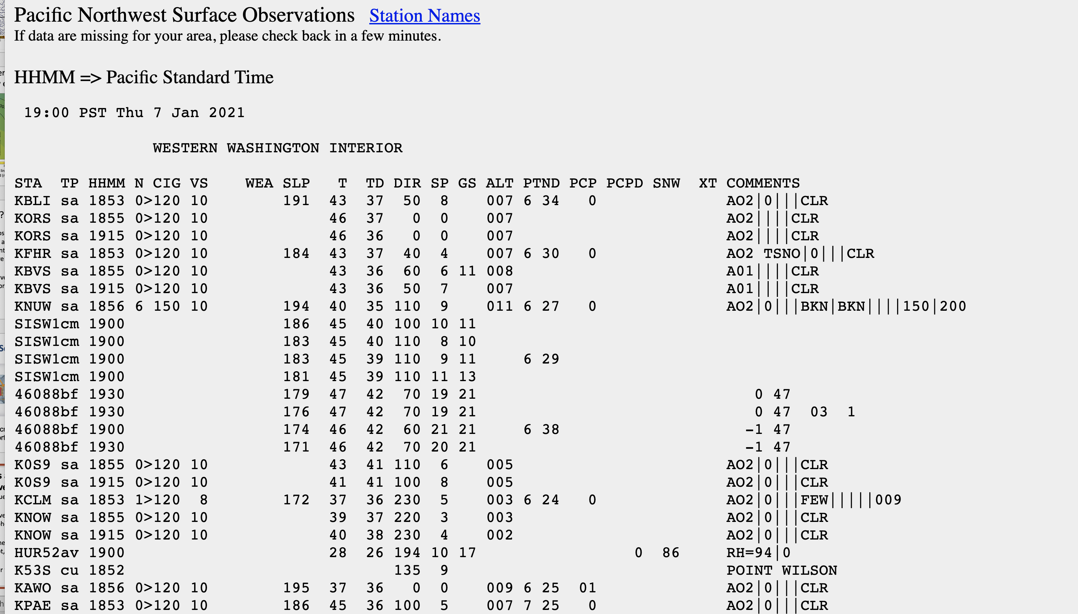
Altimeter is given in inches of mercury. (remember avg. SLP is 29.92 inches)
007 is 30.07 inch, 011 is 30.11 inches

Slide 42
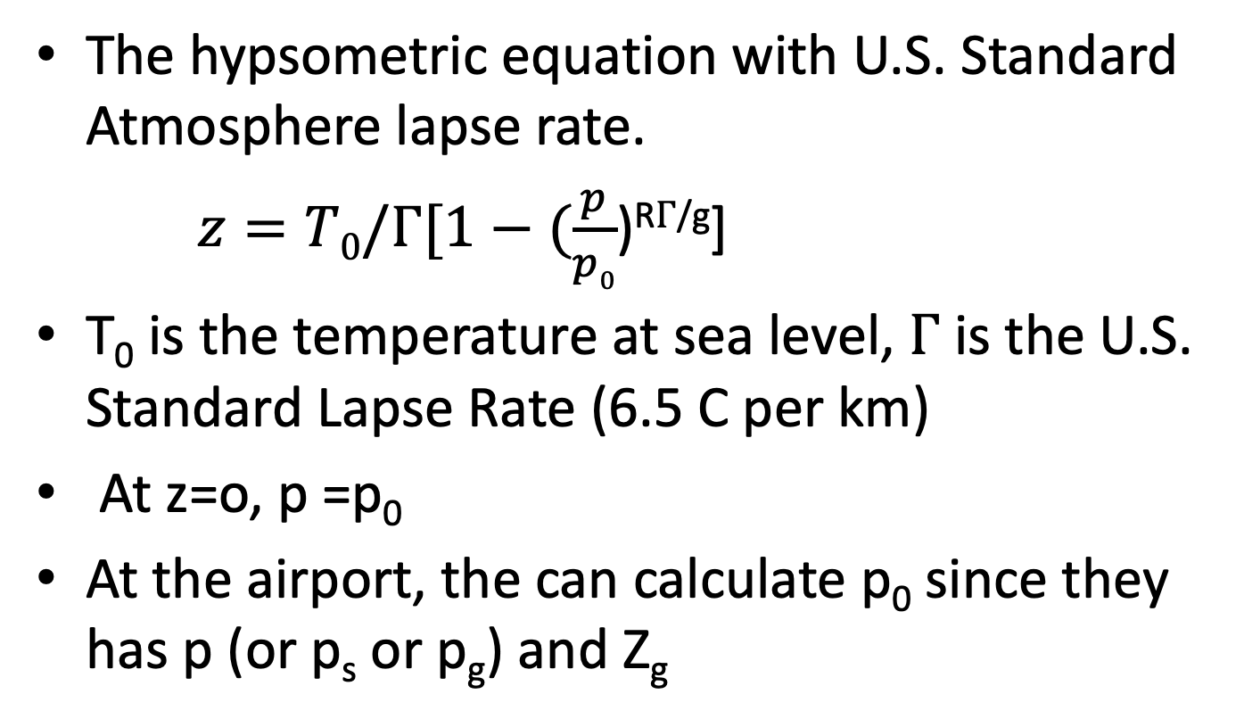

The Altimeter Equation
The hypsometric equation with U.S. Standard Atmosphere lapse rate.
$z=T0/Γ[1−(\frac{p}{p0}$)^{R}$Γ$^{/g}]
T₀ is the temperature at sea level, $Γ$ is the U.S. Standard Lapse Rate (6.5 C per km)
At z=o, p =p₀
At the airport, the can calculate p₀ since they has p (or p_{s} or p_{g}) and Z_{g}

Slide 43

Altimeter Setting
If aircraft has the updated altimeter setting (p₀) from the airport and p on the plane, it should have the right z when it lands.

Slide 44
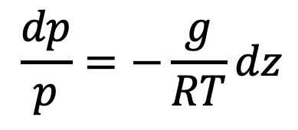
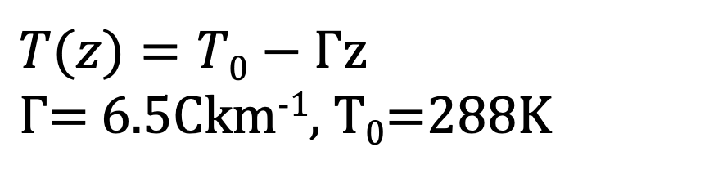
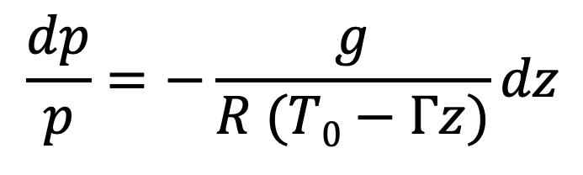
Derivation of the Altimeter Equation
Start with assumed vertical temperature structure
$T(z)=T0−Γ$z
$Γ$= 6.5Ckm⁻¹, T₀=288K
Then begin with differential form of hypsometric equation (hydrostatic and perfect gas law combined.
$$\frac{dp}{p}=−\frac{g}{RT}dz$$
$$\frac{dp}{p}=−\frac{g}{R (T0−Γz)}dz$$

Slide 45
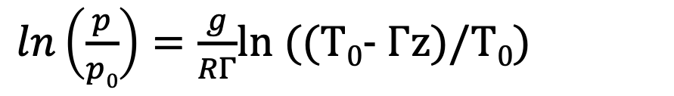
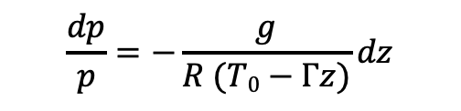
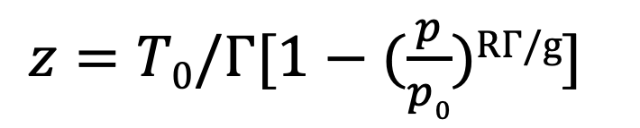
$$\frac{dp}{p}=−\frac{g}{R (T0−Γz)}dz$$
Integrating from SL to z, and P0 to p
$ln\left(\frac{p}{p0}\right)=\frac{g}{RΓ}$ln ((T₀- $Γ$z)/T₀)
$z=T0/Γ[1−(\frac{p}{p0}$)^{R}$Γ$^{/g}]
Reminder: z=0, p=p₀.
Altimeter setting is SLP calculated using the US Standard Atmosphere

Slide 46
Altimeter Setting Notes
Virtually every airport reports Altimeter Setting
In some ways is better than classic SLP because not as influenced by surface temperatures and diurnal effects.
Reported in inches of mercury (e.g., 30.06)
Not as much resolution as SLP. SLP is reported in tenths of hPa (e.g., 1013.2), while SLP to nearest .01 inch (which is ~.3hPa)

Slide 47
