Slide 1
SI and CSI

Slide 2
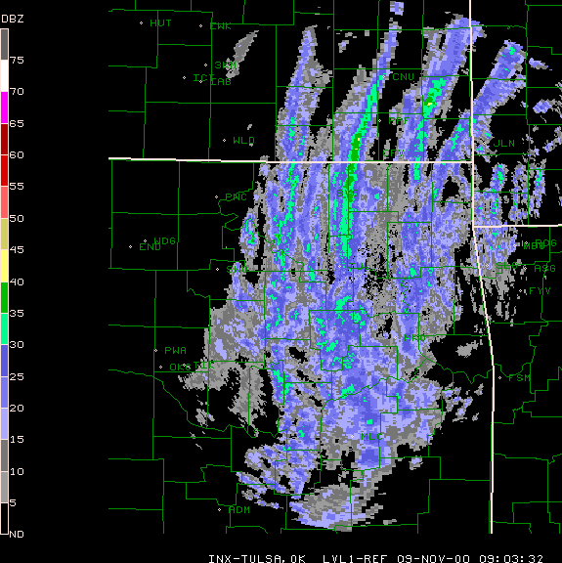

Slide 3
