Slide 1
101 Atmospheric Pressure
Autumn 2026

Slide 2
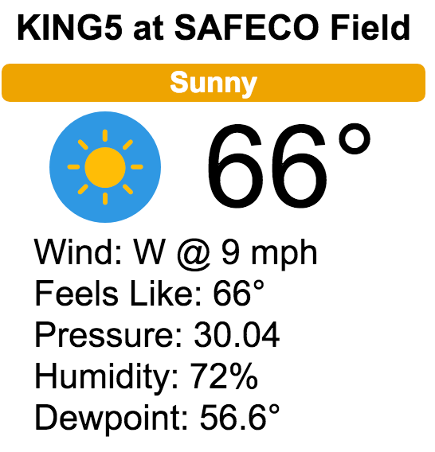
What is atmospheric pressure?
How is it measured?
Why is it important?

Slide 3
When T> 0ºK (absolute zero), atoms and molecules are moving
When they hit an object, they provide a small force to the object

Slide 4
Generally, prefer to talk about pressure rather than force
Pressure = force
area
P = F
A

Slide 5
Pressure is isotropic (independent of direction)

Slide 6
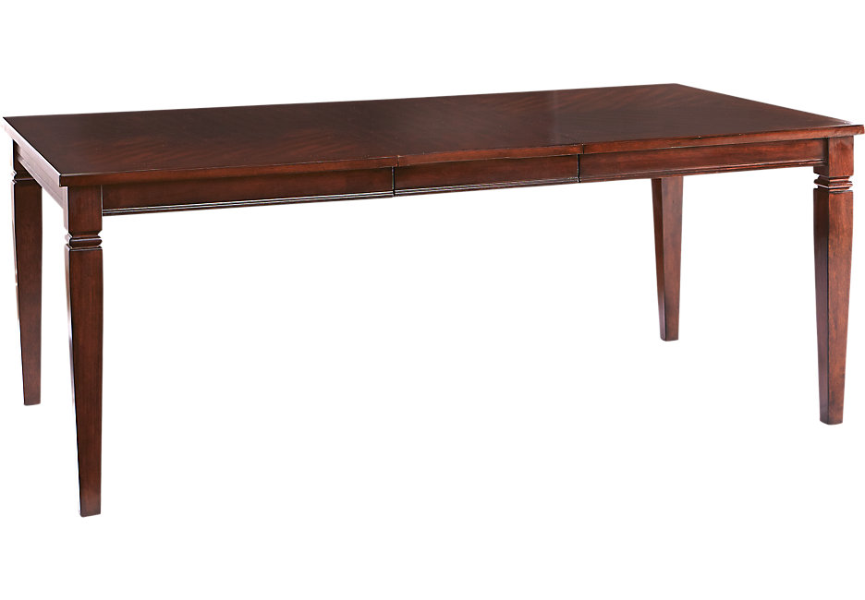
Atmospheric pressure is related to the weight of the atmosphere above the point in question
Is there atmospheric pressure under a table?
?

Slide 7
YES…because Pressure is isotropic

Slide 8
What about a tank of water with a hole in its side?
Lower p
Pressure is produced by the weight of the water above
Higher p
A good illustration of the isotropic nature of pressure

Slide 9
Pressure Units
Units of force per unit area
E.g., pounds (lb) per square inch, newtons (N) per square meter.
So, a 150 lb man standing on shoes with an area of 30 in² puts a pressure on the floor of P= 150 lb/(30 in²) = 5 lb in⁻²

Slide 10
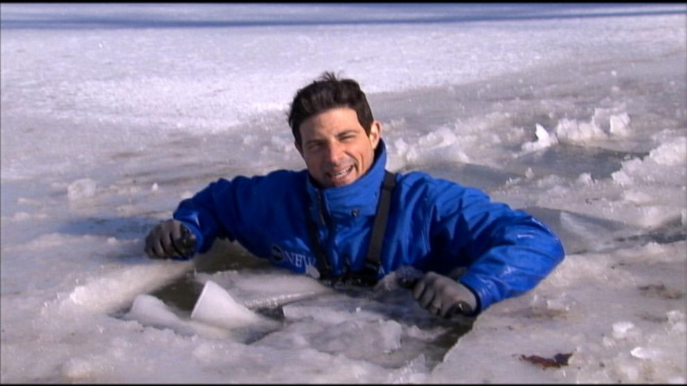
Knowing about pressure can help you avoid this

Slide 11
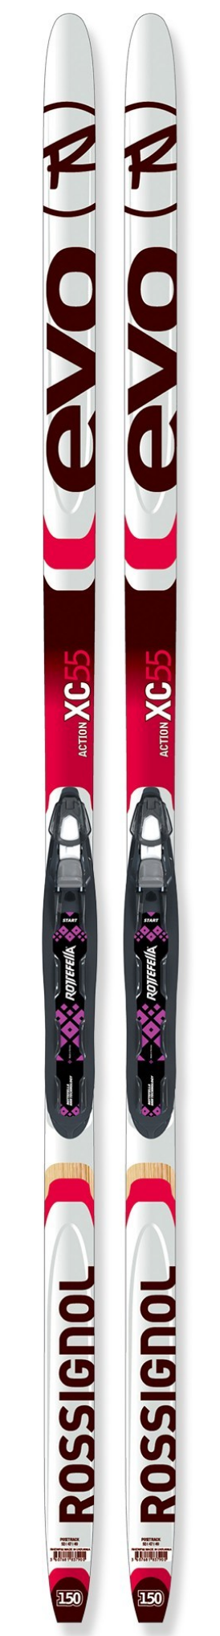
Ski Example
Two cross country skis, each with an area of 125 in²
Total area 250 in², 150 lb skier
P=F/A= 150lb/250 in² or 3/5 lb in²
Skis result in less pressure than wearing shoes (which less area)
Less chance of sinking in snow!

Slide 12
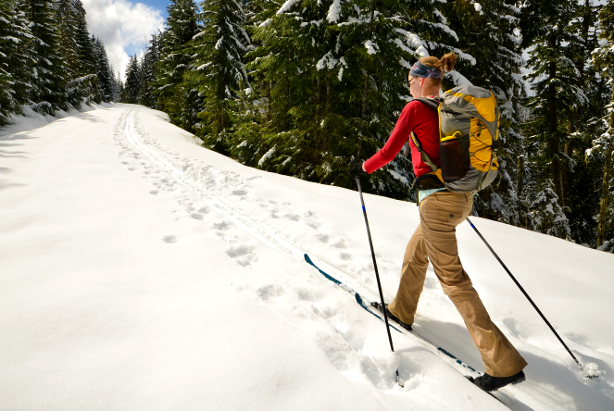
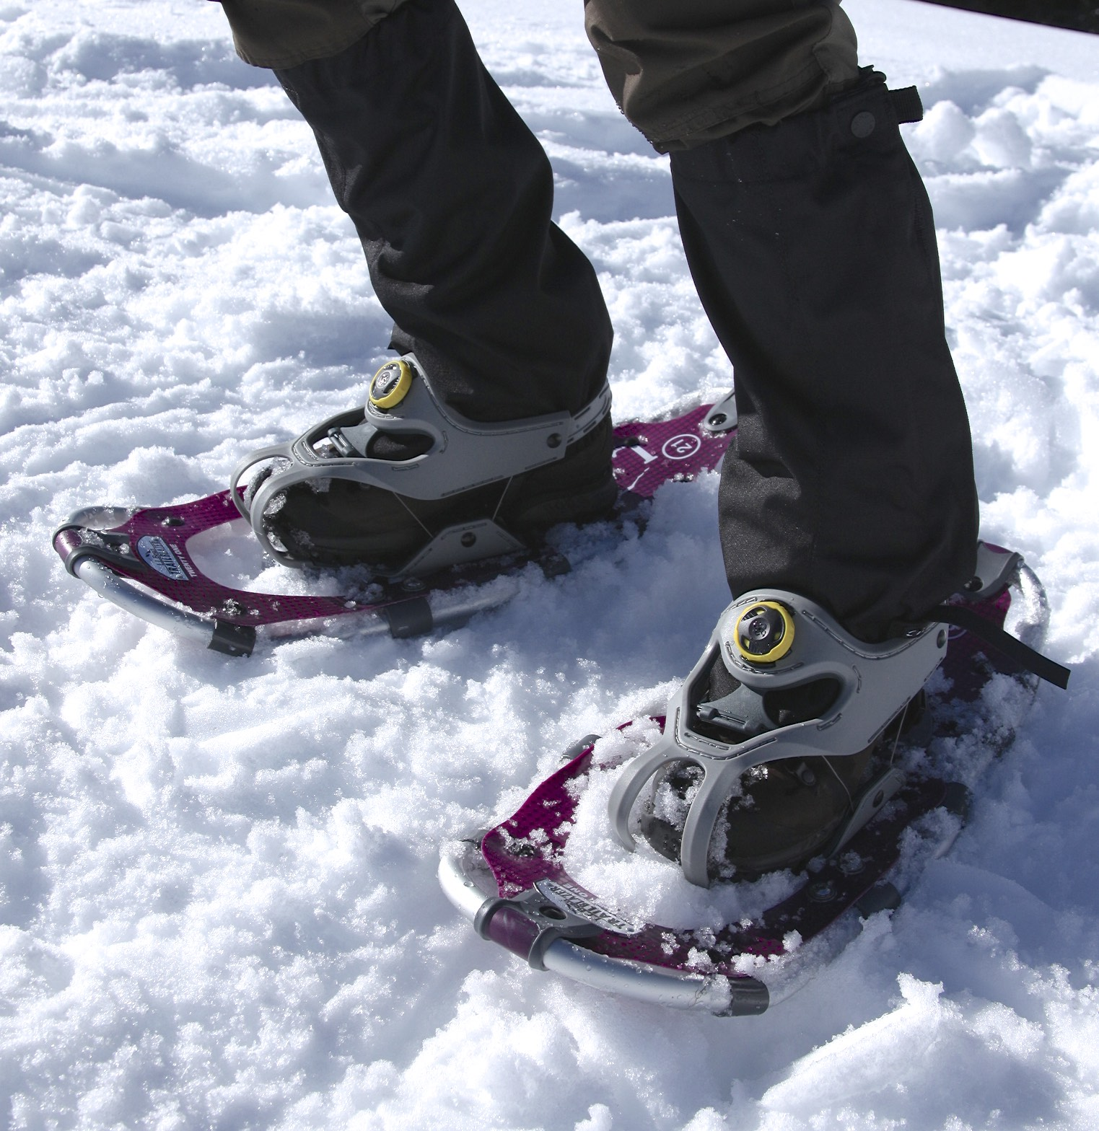
Also, the idea behind snowshoes

Slide 13
You don’t notice atmospheric pressure but it is there.

Slide 14
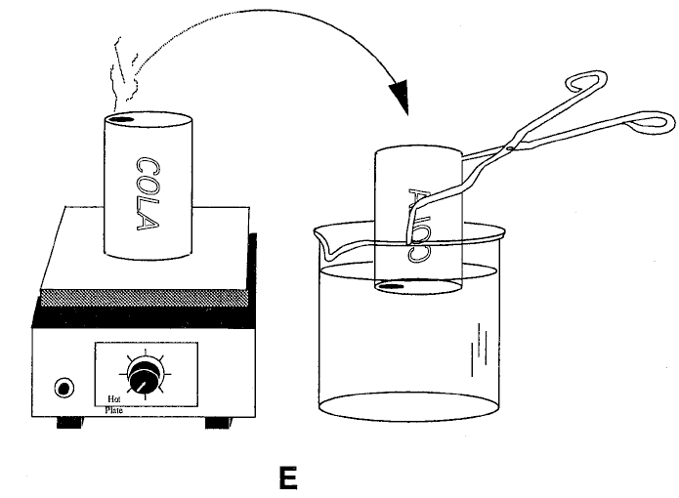
Collapsing Can Demo

Slide 15
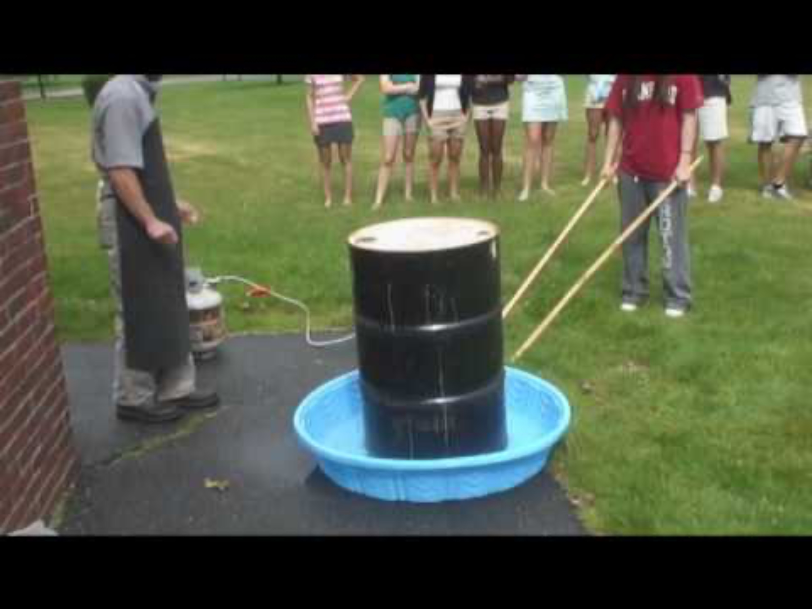
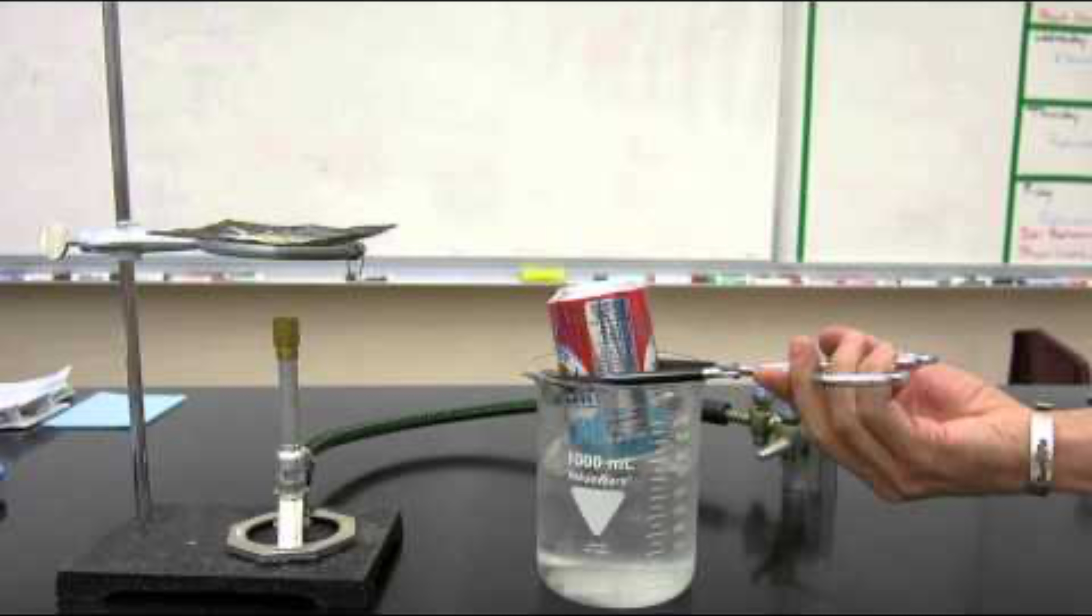
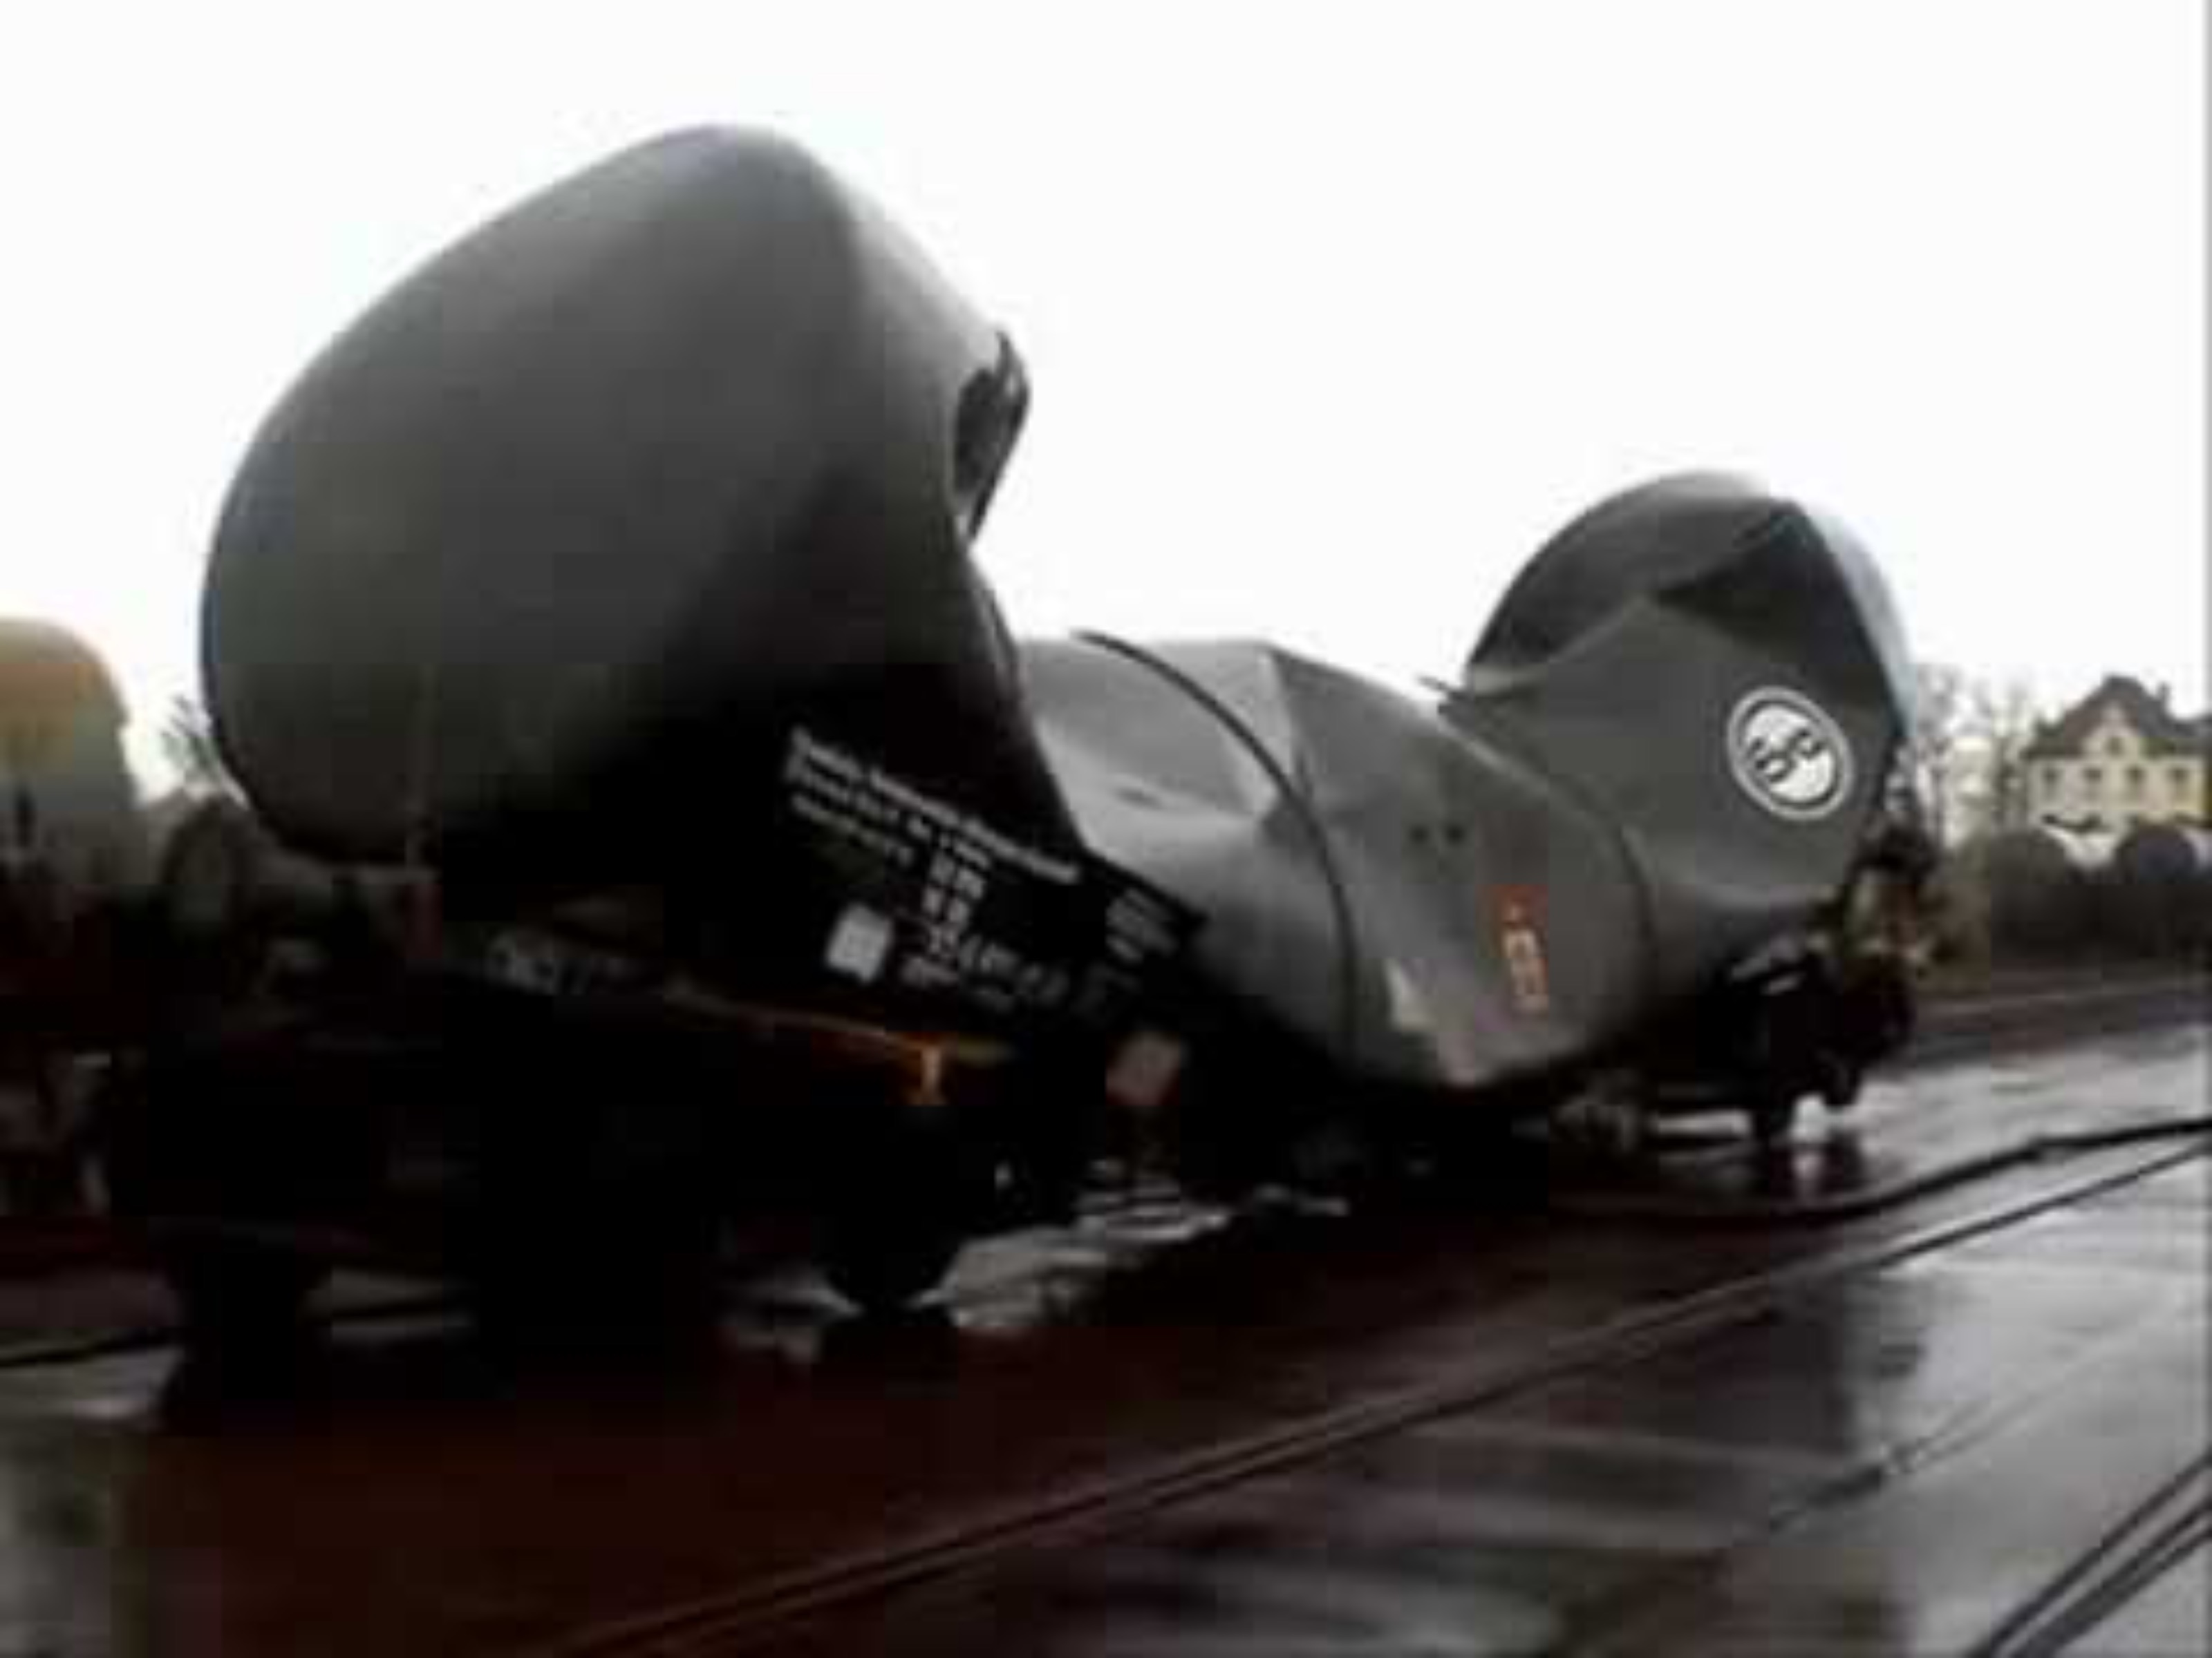
Collapsing Can
Collapsing Barrel
Collapsing Tanker Car

Slide 19
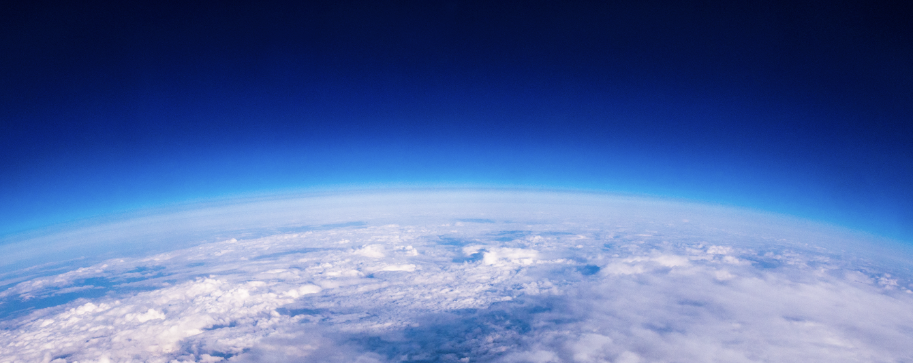
Belief it or Not
Air has Weight

Slide 20

Atmospheric pressure at any point is dependent on the weight of the air above that point
W= weight of air in the column above
P= F/A = W/A
W
A

Slide 21
Pressure decreases with height because there is less air above, so less weight aloft
P3
P2
P1
P1 > P2 > P3

Slide 22
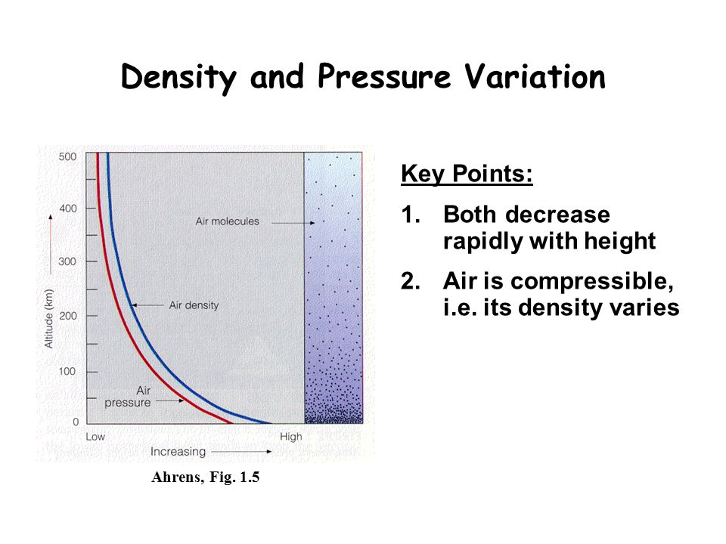
Pressure Does NOT Decrease at the Same Rate with Elevation
Falls off more rapidly near the surface

Slide 23
Why? Because the atmosphere is compressible and thus the density of air is greater near the surface

Slide 24
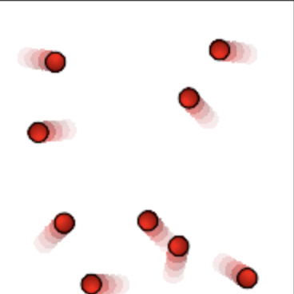
How does this fit with our discussion of pressure caused by the forces of molecules impacting on a surface?
Near the surface, air density is greater, so more molecules are available to impact a surface
The temperature is also warmer near the surface, so they are going faster.
The result: more pressure!

Slide 25
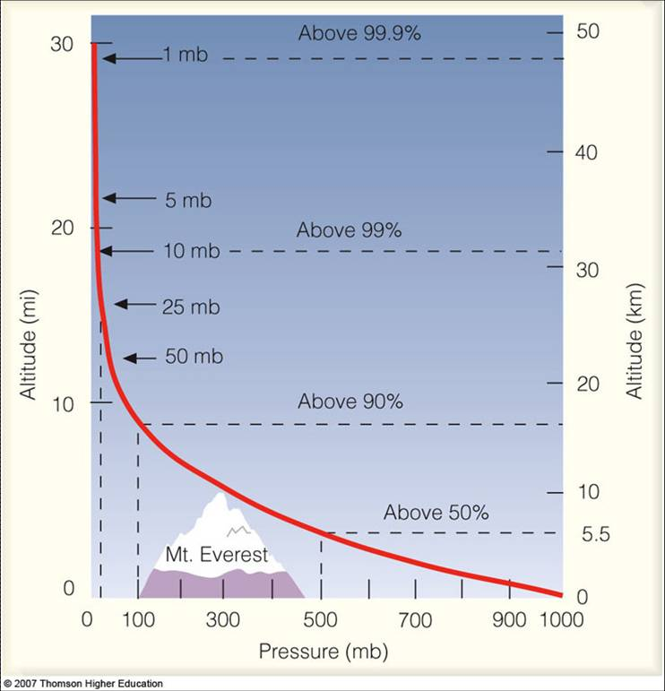

Slide 26
How do we measure pressure? With barometers.
Three types:
Mercury
Aneroid
Electronic pressure sensor

Slide 27
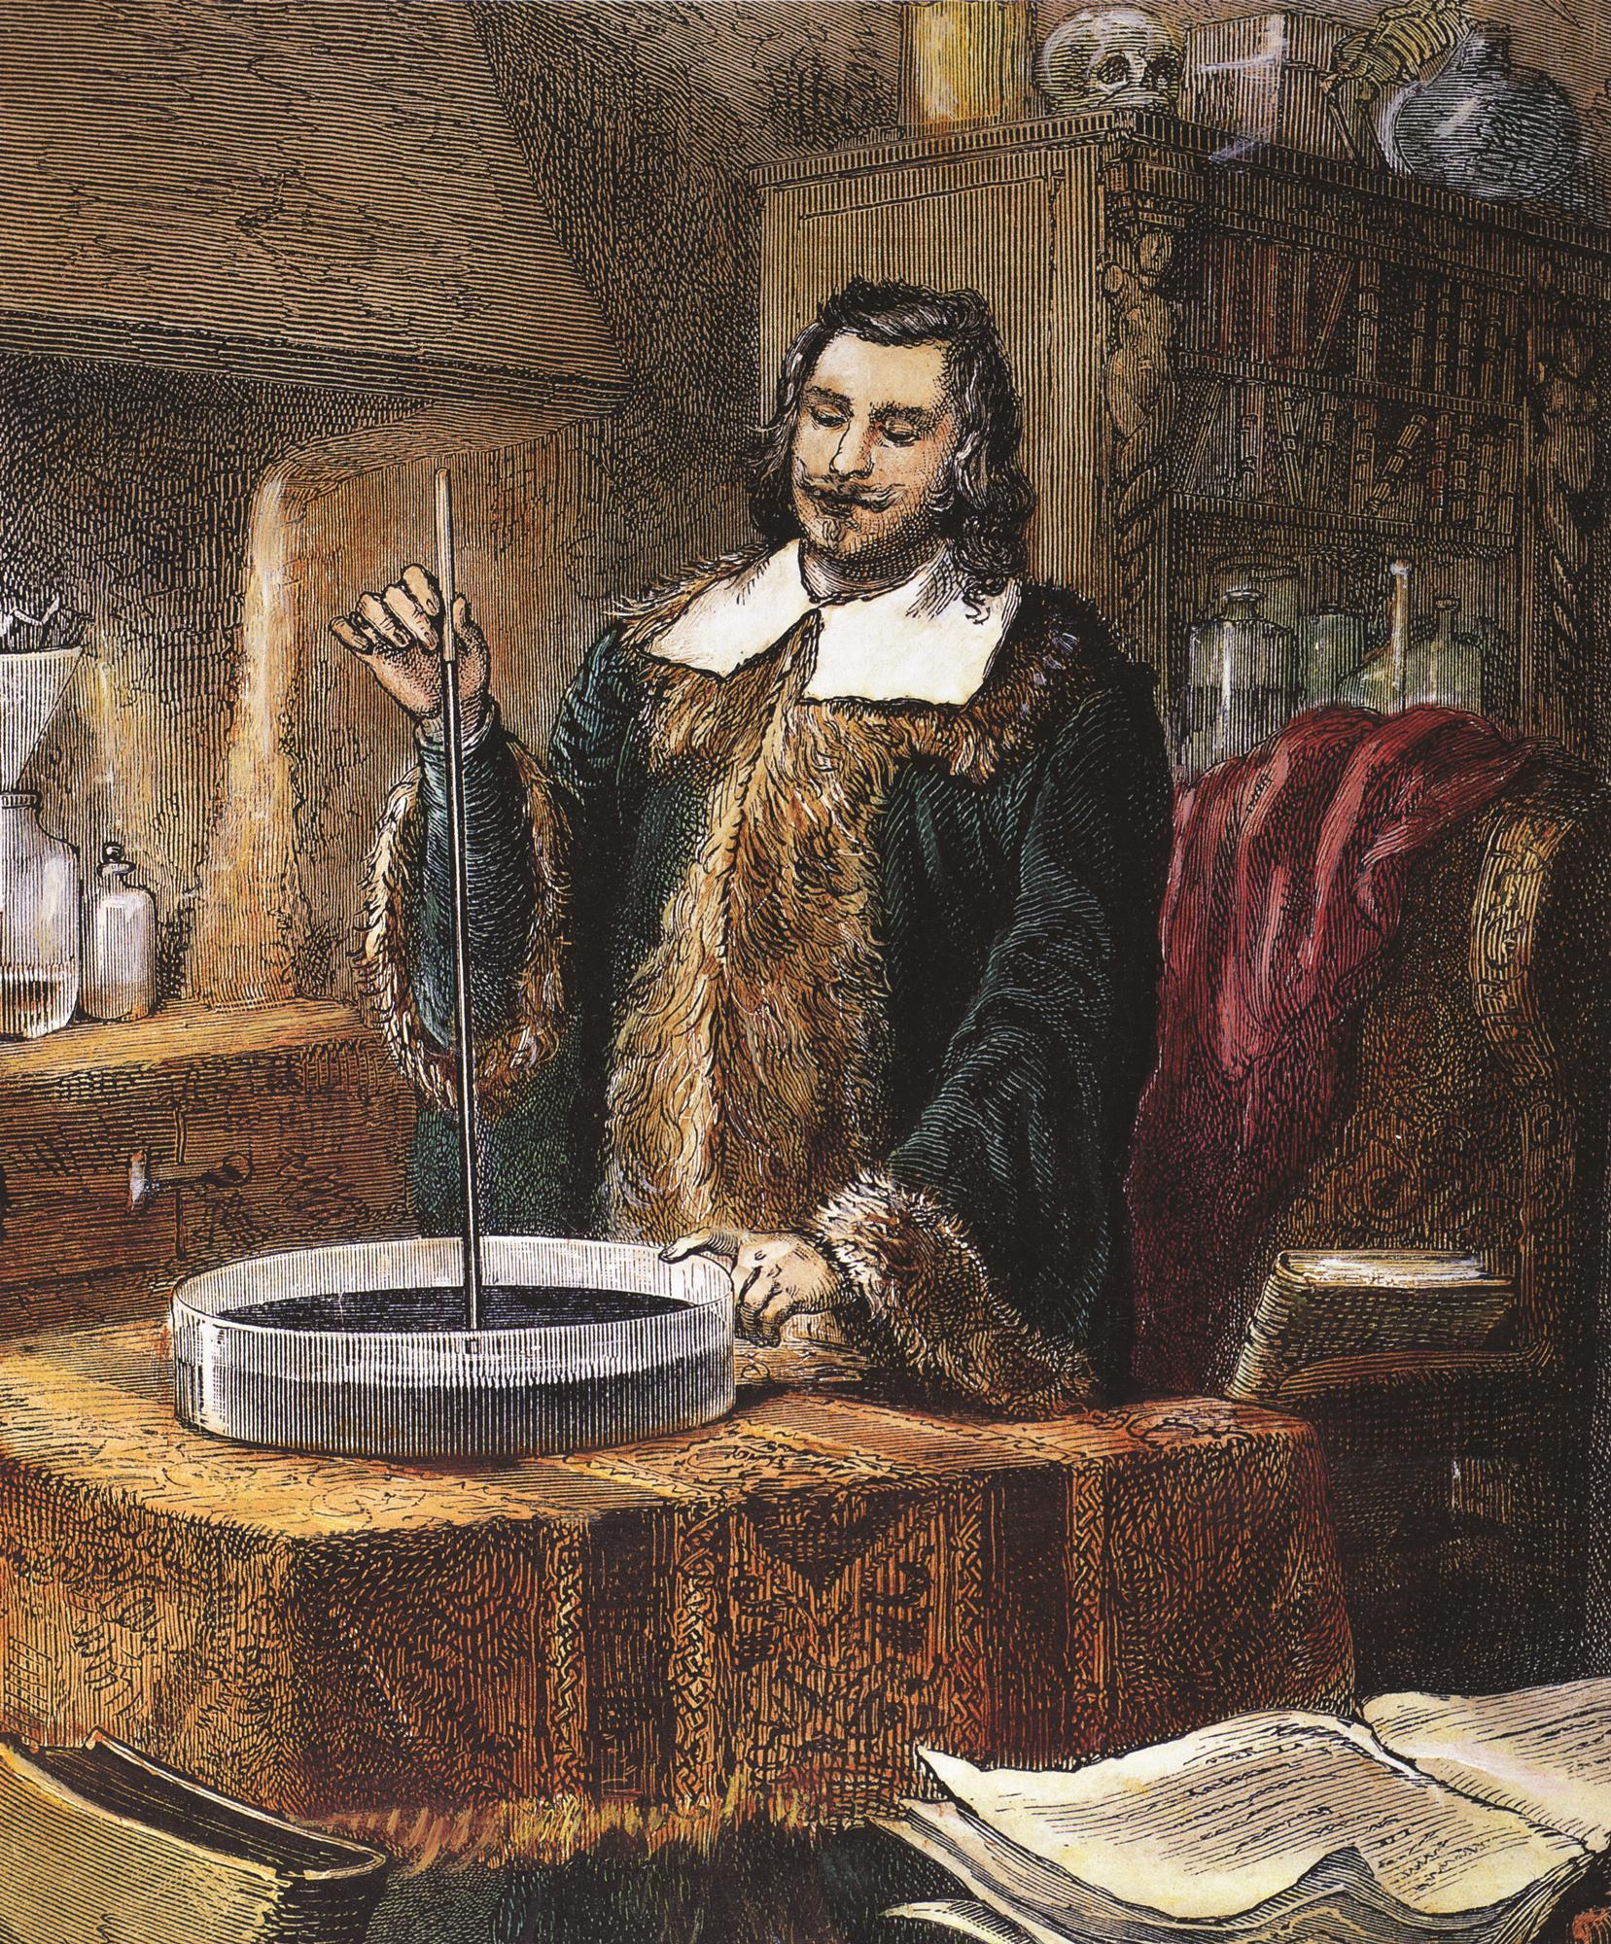
Mercury Barometers
Invented by Evangelista Torricelli, a student of Galileo, around 1645 AD
Needed a long tube, around 40 inches long, filled with mercury, placed in a dish of mercury

Slide 28
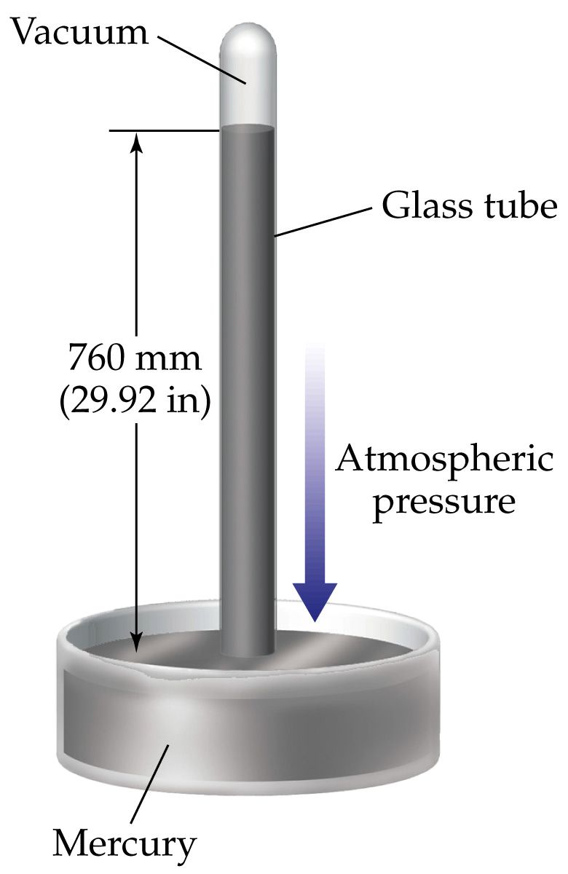
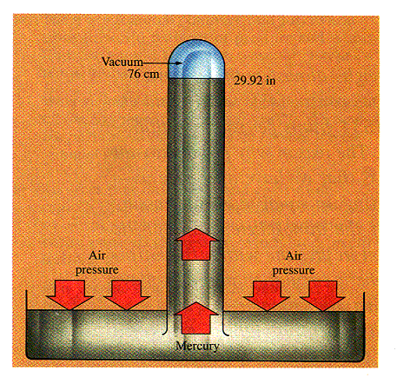
Mercury Barometer
Why doesn’t the mercury all flow out of the tube? Atmospheric pressure!

Slide 29
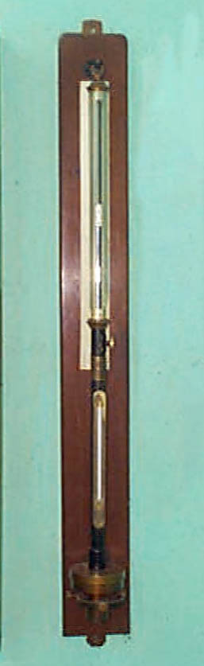
Mercury Barometer

Slide 30
Mercury Barometer
If atmospheric pressure increases, the height of the column of mercury increases, and vice versa
How high? At sea level, on average about 29.92 inches or 76 cm (one inch=2.54 cm)
So, when a TV weatherperson says the pressure is 30.06 inches…atmospheric pressure can support a mercury column that high.

Slide 31
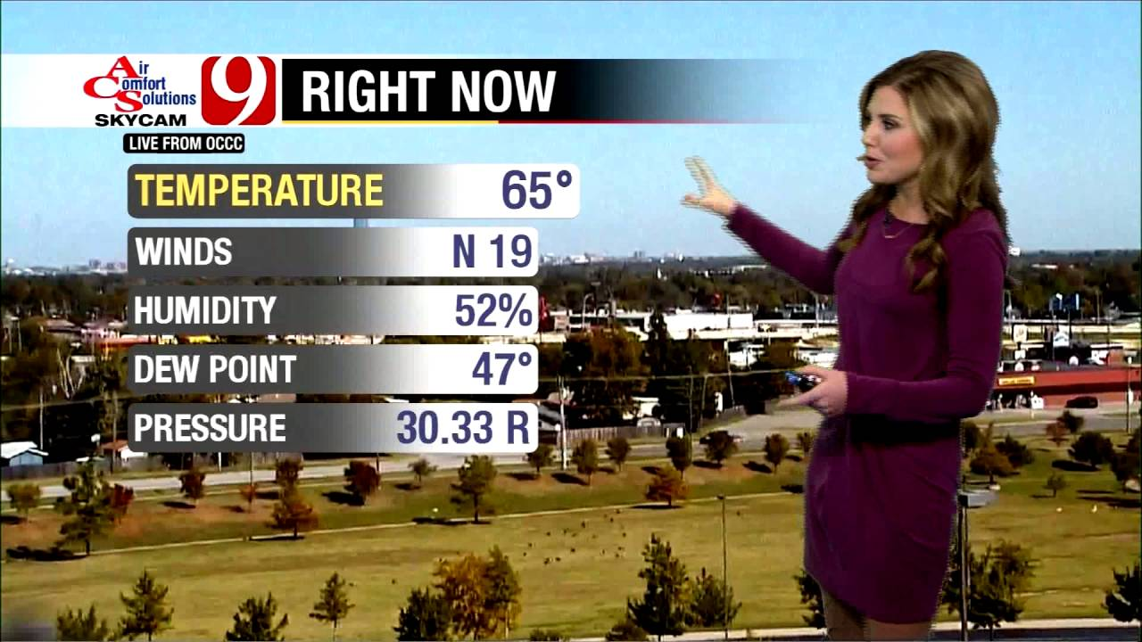

Slide 32

Reminder: mercury is dangerous…

Slide 33

Why not use water in a barometer?

Slide 34
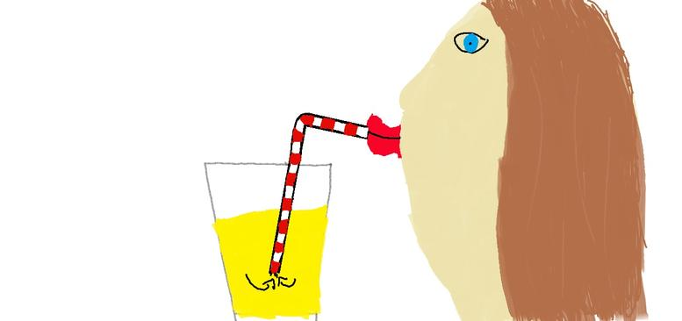
It would have to be roughly 30 ft tall!
Water is much less dense than mercury, so a much taller column of liquid is needed to balance atmospheric pressure.
Related question: what is the size of the largest straw that would work?

Slide 35
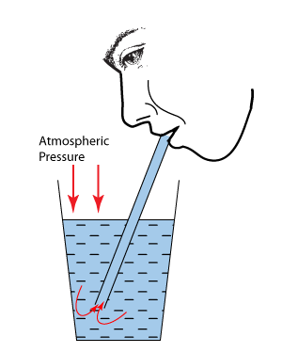
Straws use atmospheric pressure to push liquid up the straw. Thus, the straw can’t pull water up more than 30 ft in elevation

Slide 36
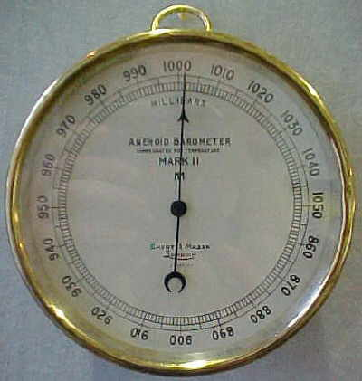
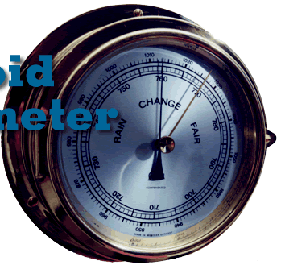
Aneroid Barometer

Slide 37
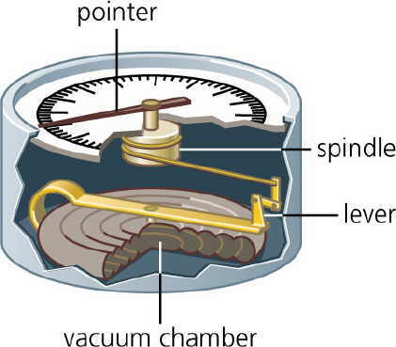
No mercury. Pressure changes the thickness of an air-tight chamber/diaphragm

Slide 38
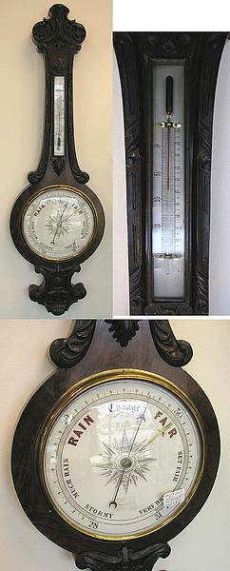

Slide 39
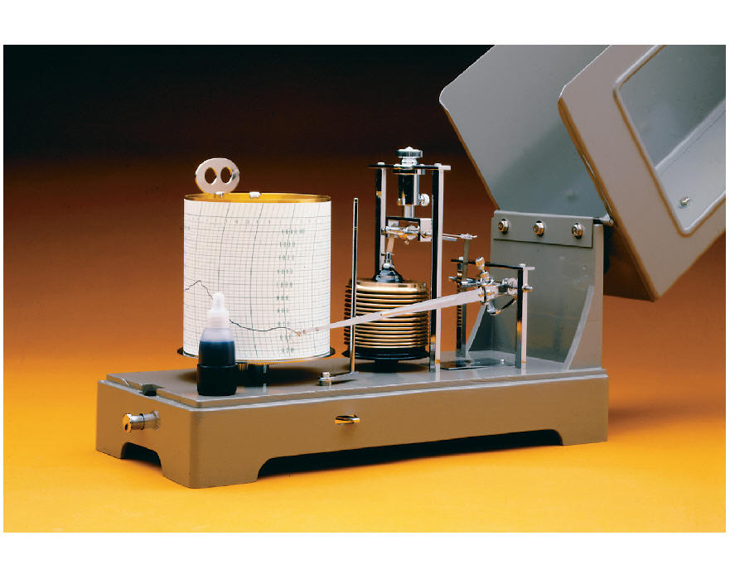
Barograph—another form of aneroid barometer

Slide 40
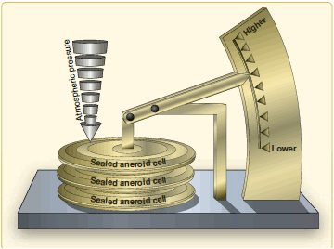

Slide 41
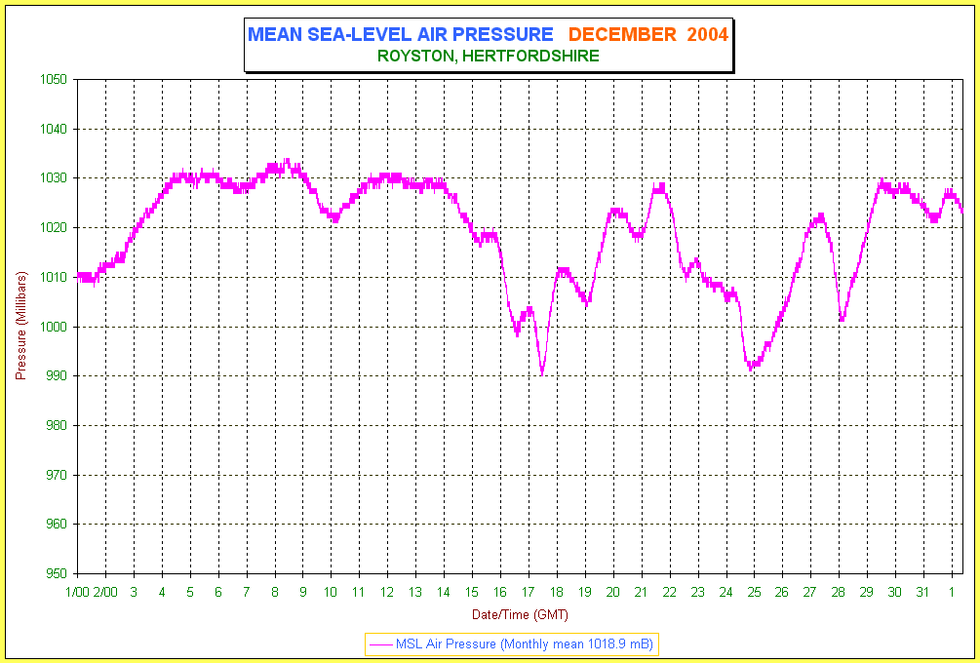
Barogram-plot of pressure in time

Slide 42
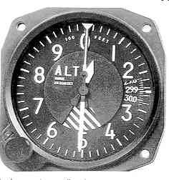
Altimeter: Aneroid Barometer Inside
An altimeter is a device that uses pressure to provide elevation.

Slide 43
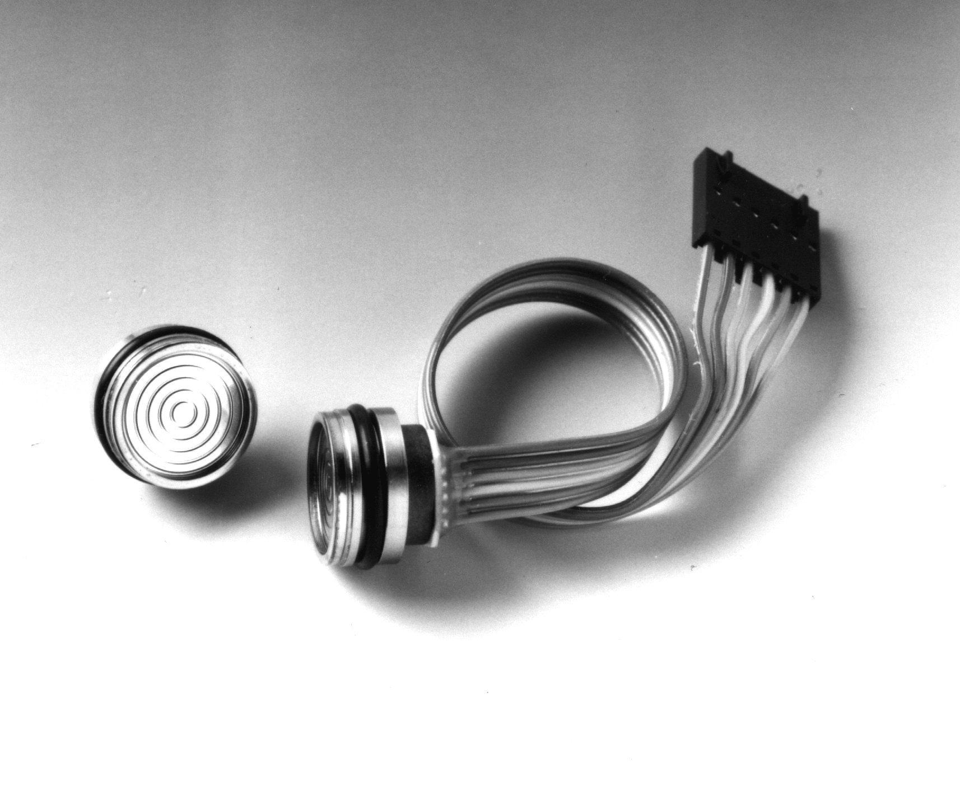
Solid State Pressure Sensor

Slide 44
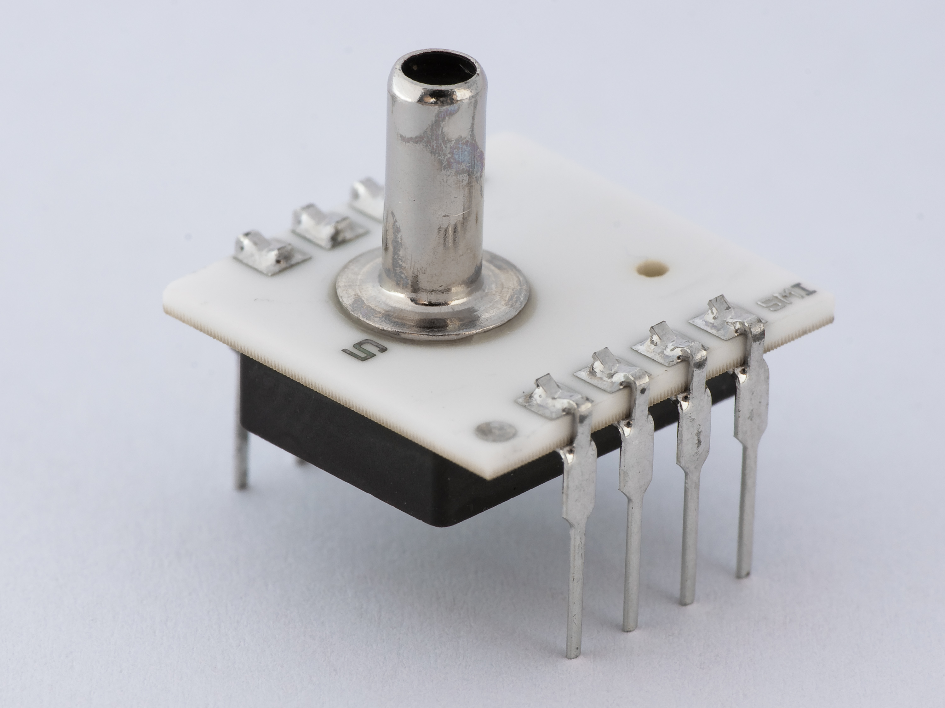
Solid State Pressure Sensor
The electrical properties of some materials are dependent on atmospheric pressure.

Slide 45
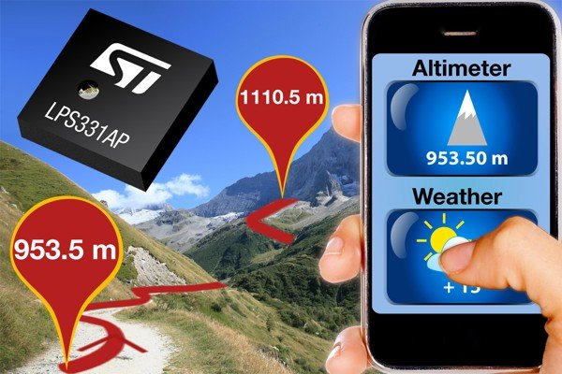
Smartphone Pressure Sensor

Slide 46


Slide 47

This app collects pressure

Slide 48
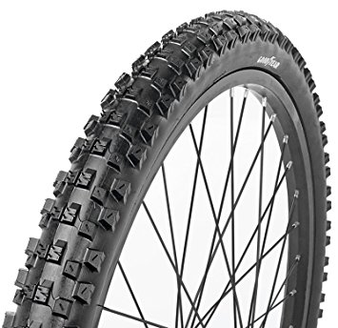
Back to Pressure Units
Remember P= F/A
So, inches of mercury are not really units of pressure.
English units: pounds (lbs) per square inch (psi).
Average sea level pressure is 14.7 lbs per inch² . Car tires, 30-35 psi. Bicycles 35-80 psi
Meteorologists DON’T USE psi

Slide 49
Pressure Units
Meteorologists use metric units.
A Newton is the unit of force in the metric system.
Meter-squared is the unit of area.
Pressure in metric units is 1 Newton per meter squared (N/m²). 1 Nm⁻² is called a Pascal.
Meteorologists frequently use hectopascals (hPa). hPa is 100 Pascals or 100 Nm⁻²
Another favorite is millibar (mb), which is another name for hectopascals. (used more in past)

Slide 50
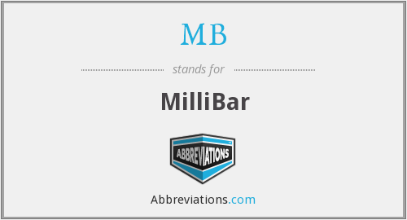
For pressure, meteorologists generally use hectopascals (hPa) or millibars (mb)

Slide 51
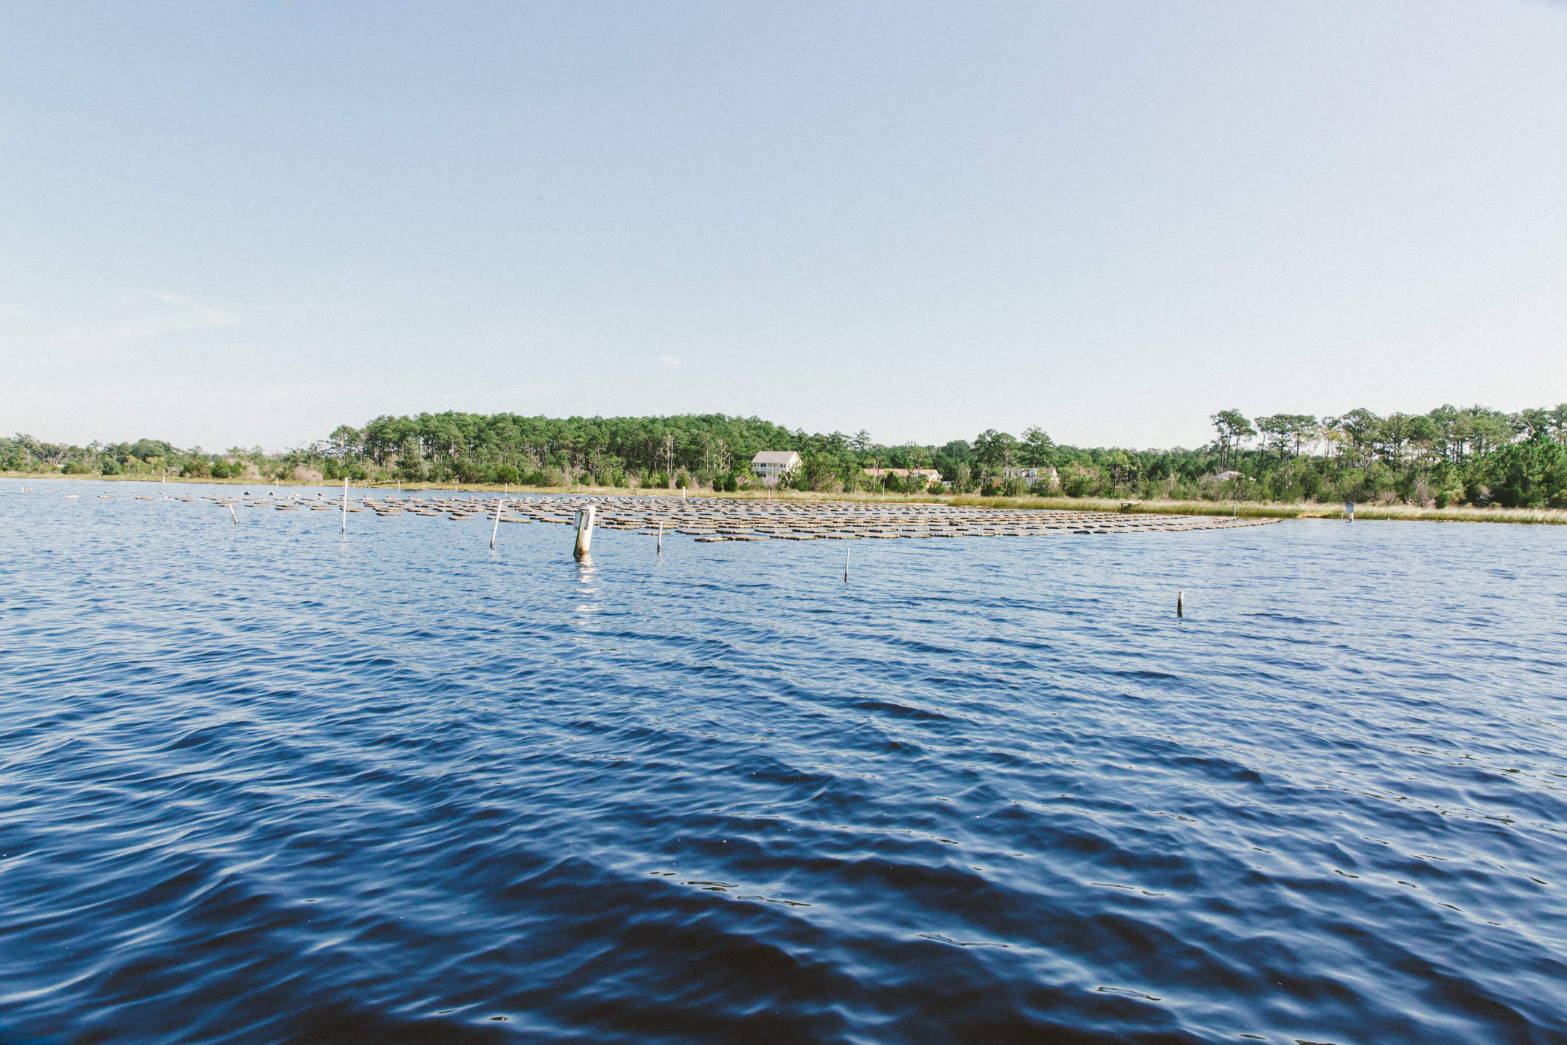
What is the typical pressure at sea level?

Slide 52
Sea level is considered zero elevation in meteorology
Mean sea level pressure=1013.25 hPa= 1013.25 millibars (mb) =14.7 lbs in⁻²
Same pressure as 29.92 inches of mercury or 76 cm of mercury or 760 mm of mercury
Meteorologists generally use hPa or mb for pressure.

Slide 53
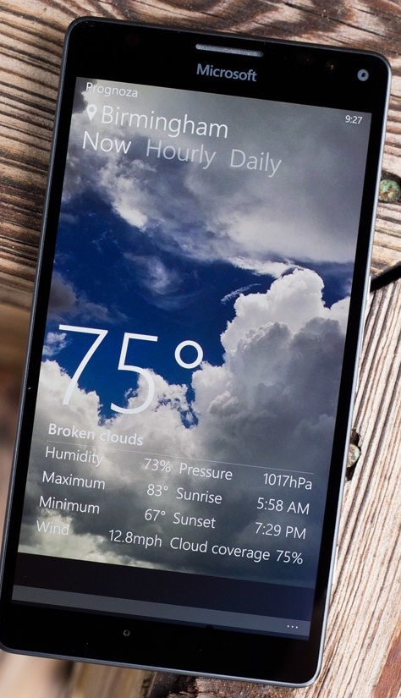
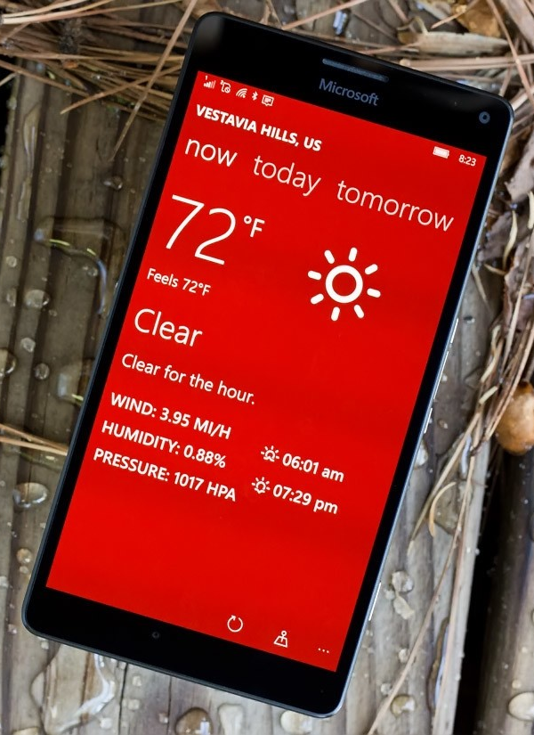
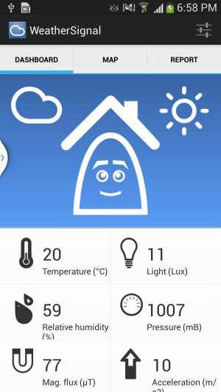

Slide 54
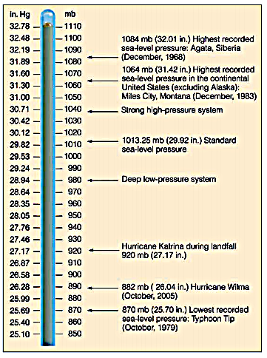
Sea Level
Pressure
Variations

Slide 55
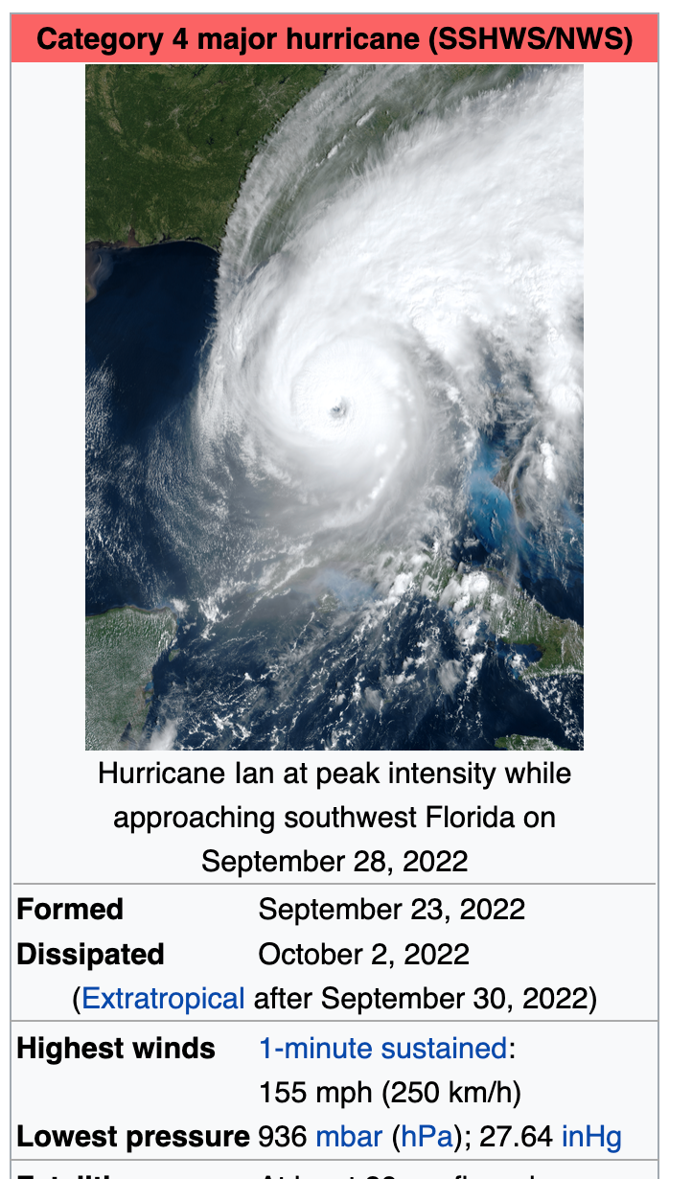
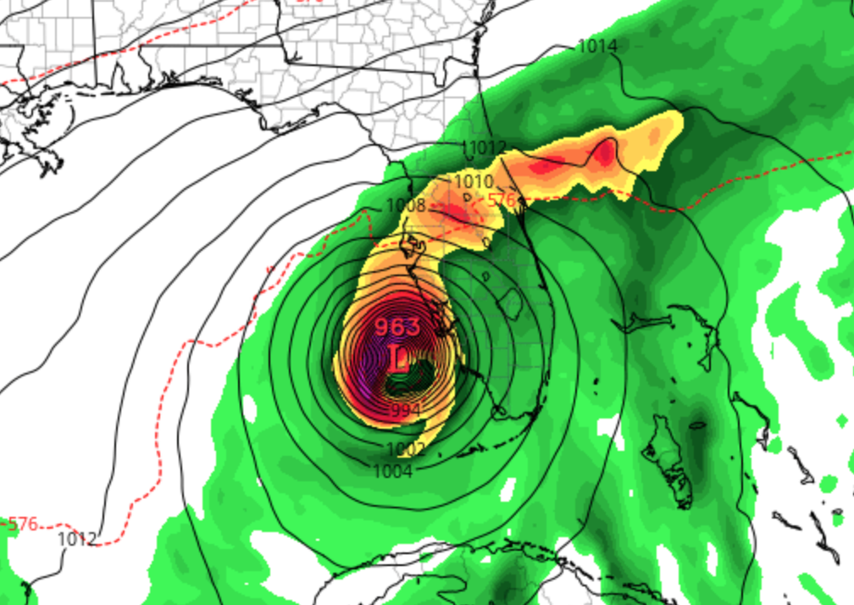
Hurricanes are associated with very low sea level pressure

Slide 56
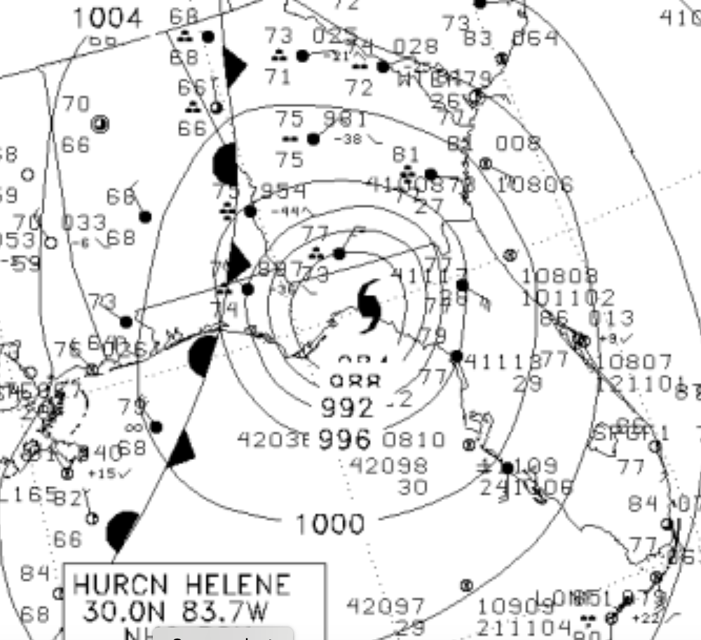
Central pressure went as low as 938 hPa

Slide 57
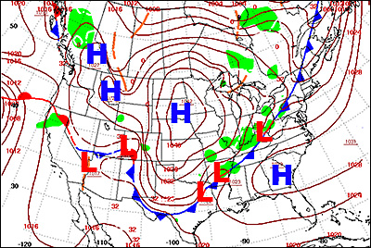
Surface weather maps analyze sea level pressure-–the pressure at mean sea level (hPa or mb)

Slide 58
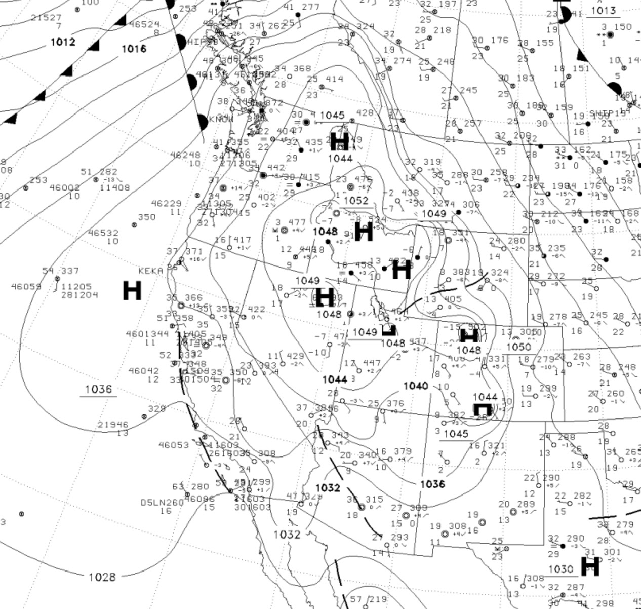
The lines are isobars” lines of equal sea level pressure

Slide 59
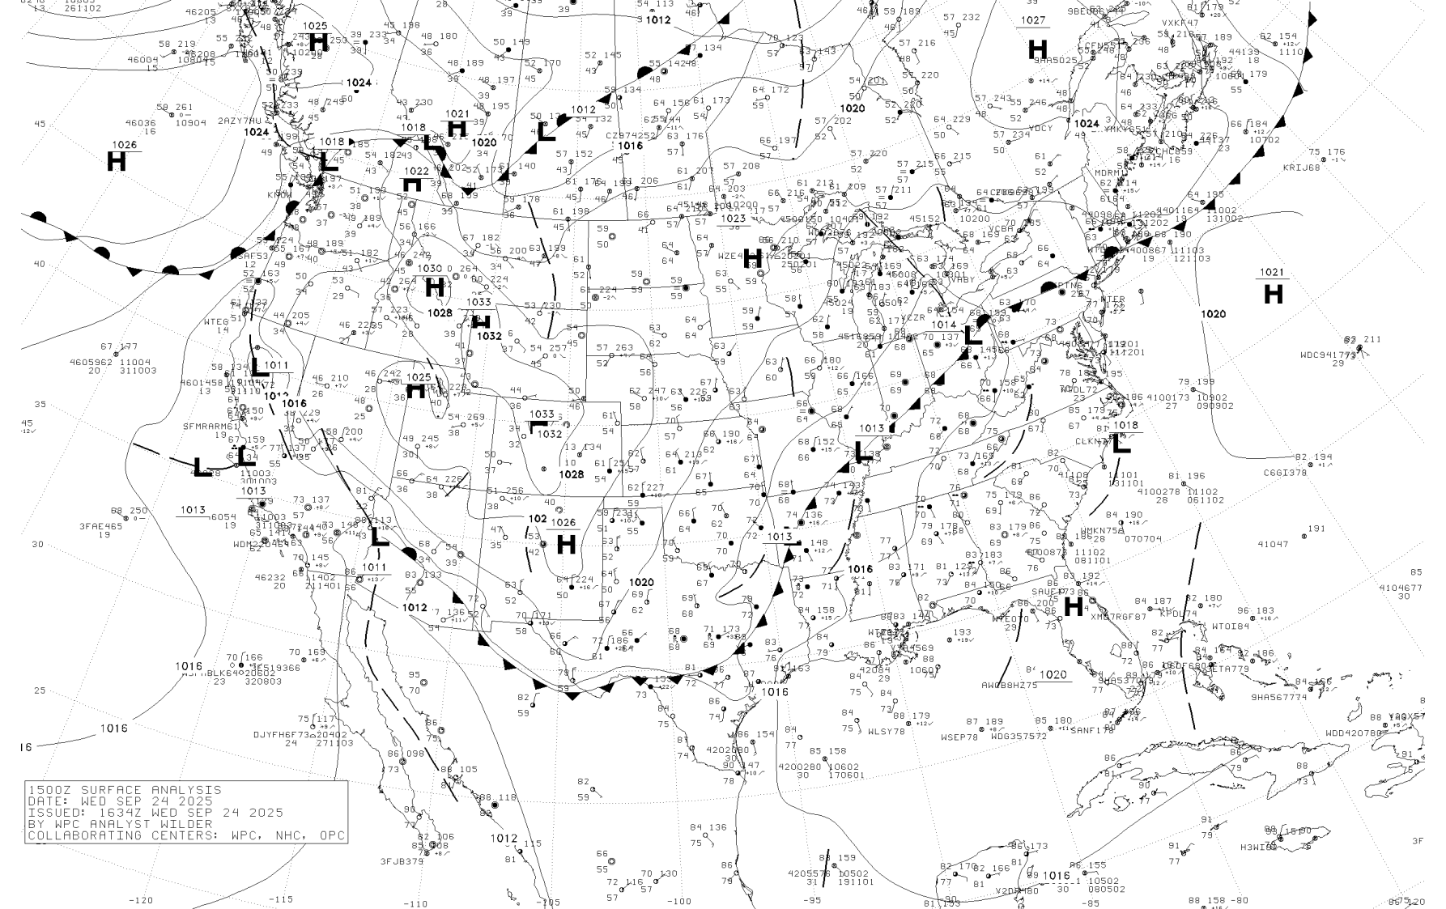

Slide 60
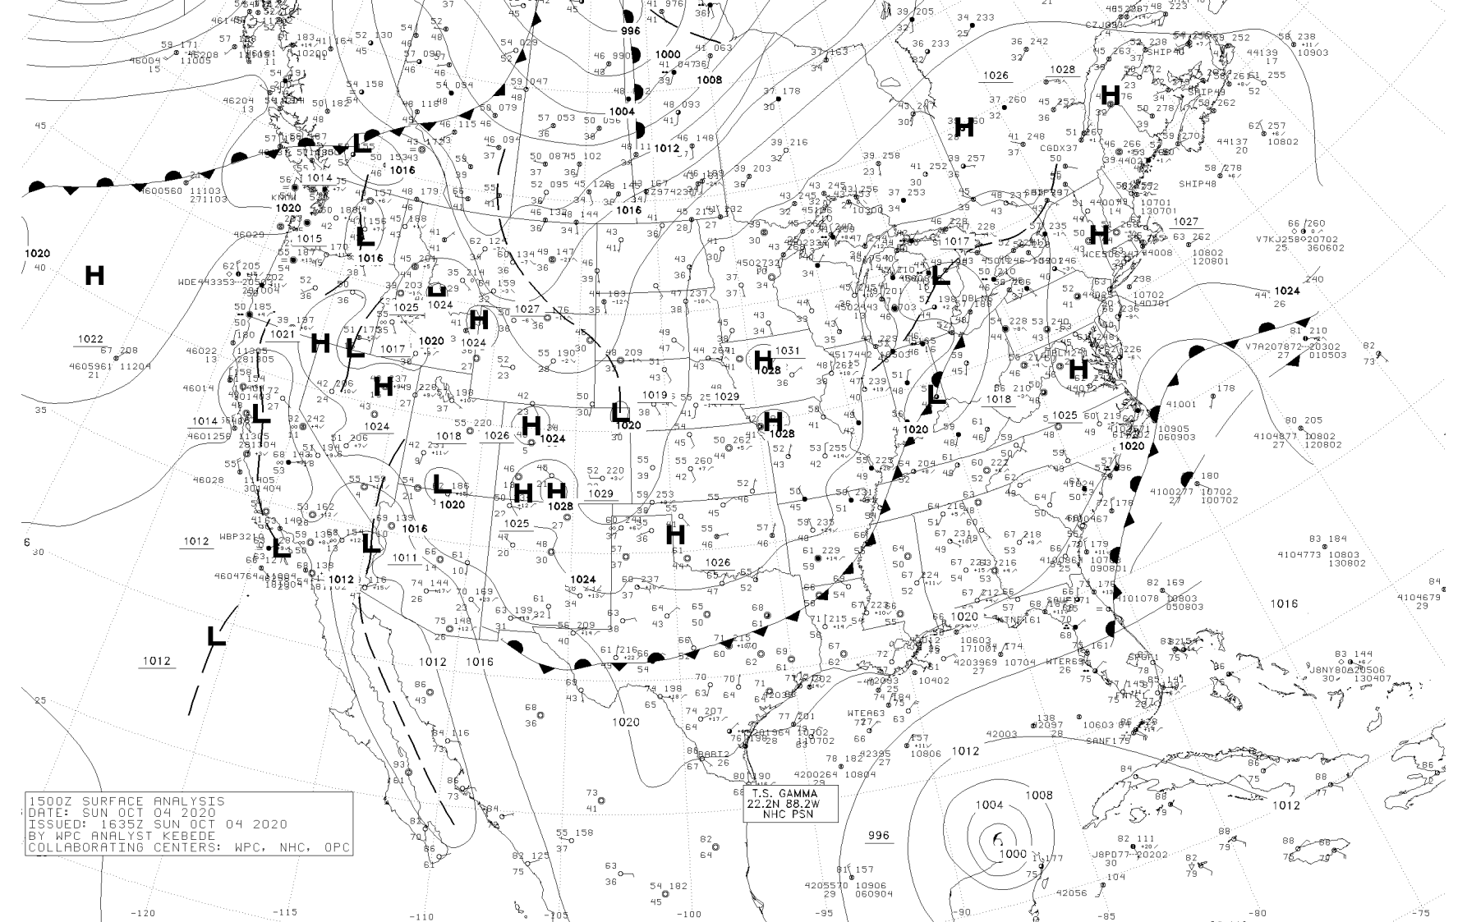
More on surface weather maps in a few days

Slide 61
Pressure Variation in the Vertical
Pressure decreases with height
  1013 hPa ~ 0 ft, 0 km ASL (Above Sea Level)
  850 hPa ~5000 ft, 1.5 km ASL
  500 hPa ~18,000 ft, 5.5 km ASL
  250 hPa ~ 34,000 ft, 10.5 km ASL
Instead of using physical height (in meters or feet) meteorologists often use pressure

Slide 62
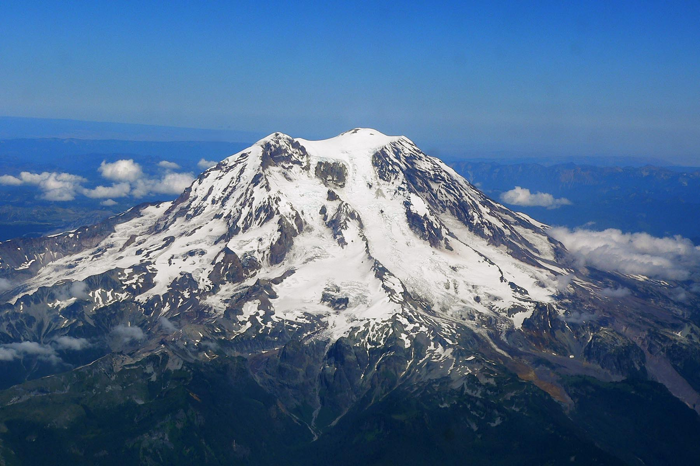
Pressures Drop with Elevation
Snoqualmie Pass ~ 900 hPa
Top of Mount Rainier ~ 600 hPa
Highest human settlement ~ 530 hPa
Jet cruising altitude ~ 230 hPa (35K ft)

Slide 63
The end

