Slide 1
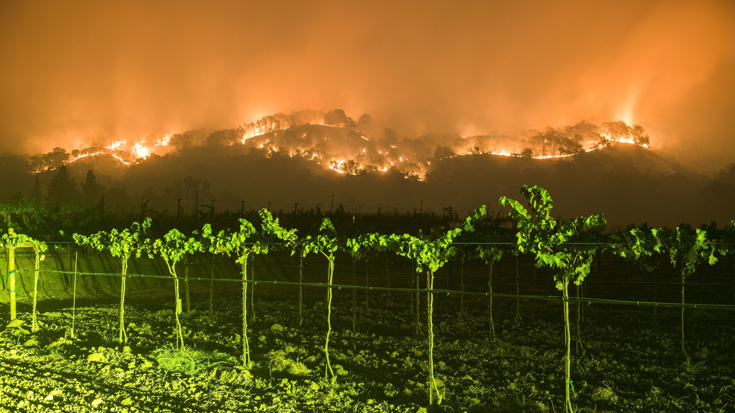
The Wine Country Fires of October 2017: A Coastal California Wildfire Event
Cliff Mass
Atmospheric Sciences

Slide 2
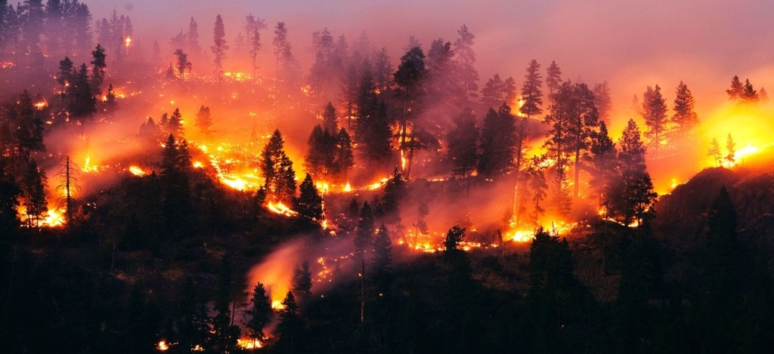
During the evening of Sunday, October 8, 2017, wildfires began in the hills above Santa Rosa, Napa, and other towns of the ”wine country” north of San Francisco

Slide 3
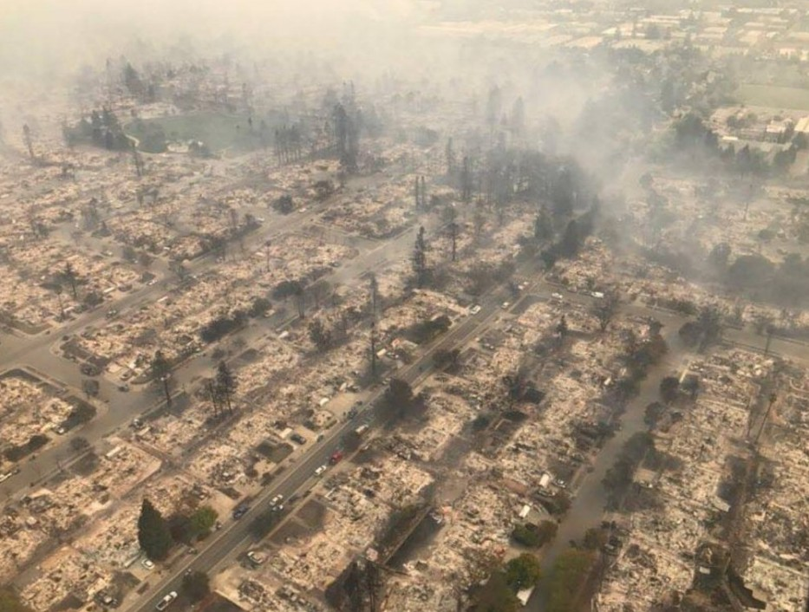
And then, pushed by strong winds, rapidly descended into populated areas

Slide 4
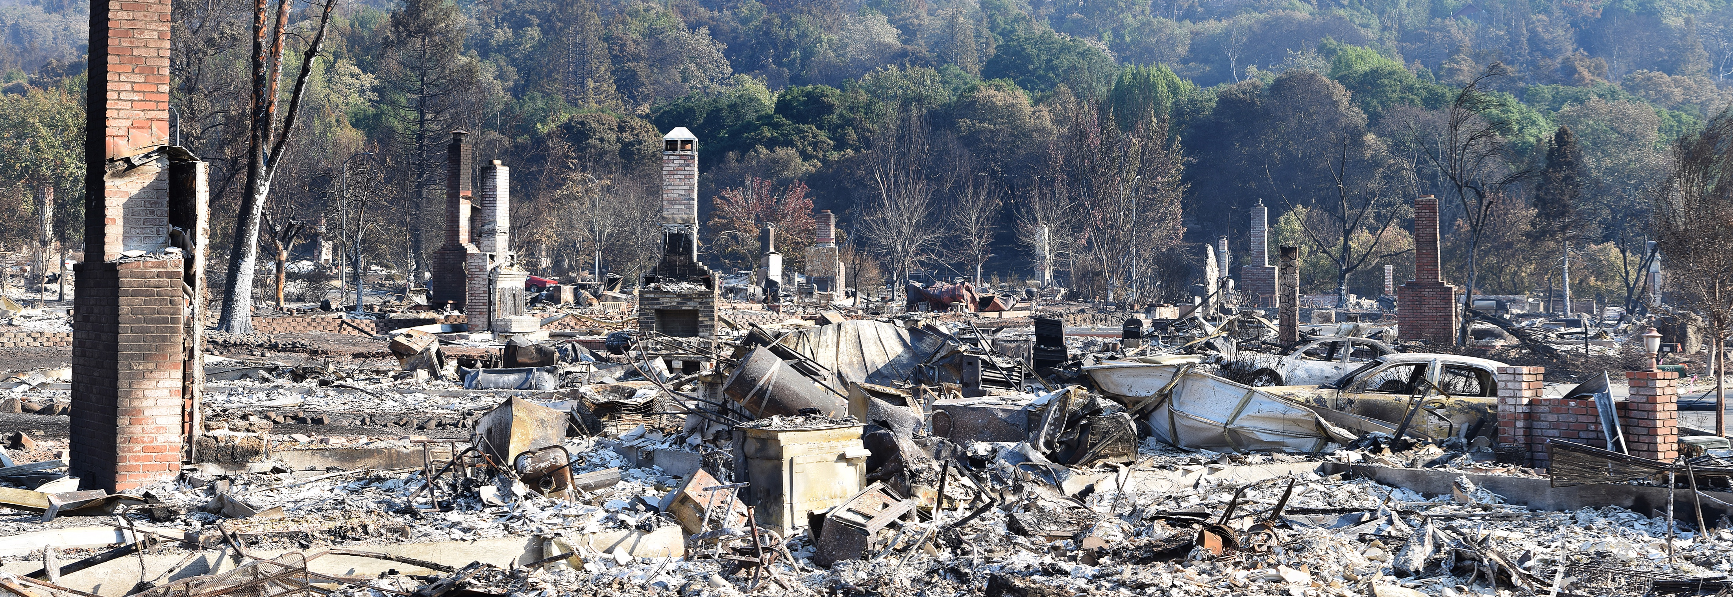

Slide 5
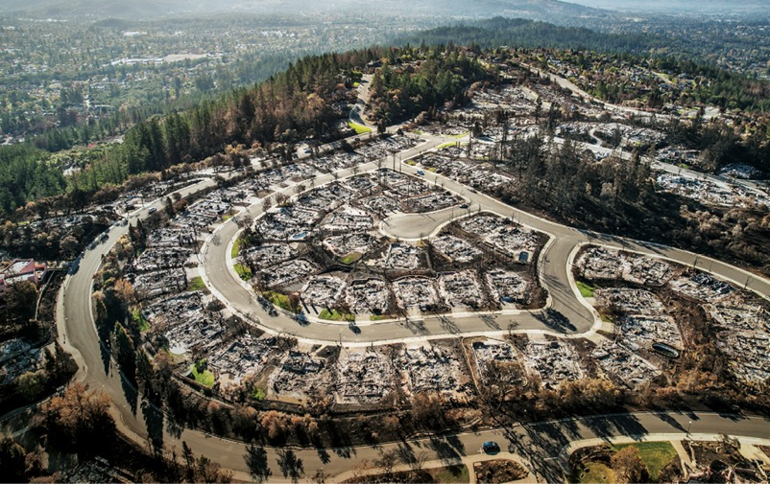
Before it was over, the “Wine Country” wildfires became the most devastating in CA history
44 died and hundreds were hospitalized
More than 9,000 structures were destroyed
Burned 245,000 acres of land
More than 10 billion in insured property loss
Total damage/loss much more.
Serious air quality degradation over the region for over a week.

Slide 6
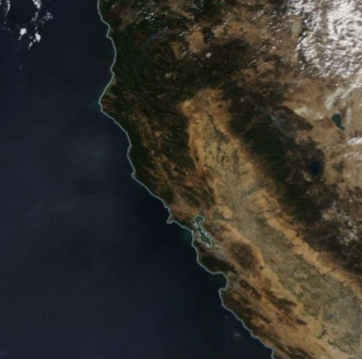
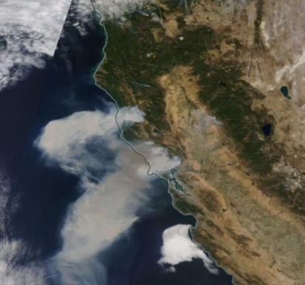
Modis Imagery: October 8 versus October 9, 2017

Slide 7
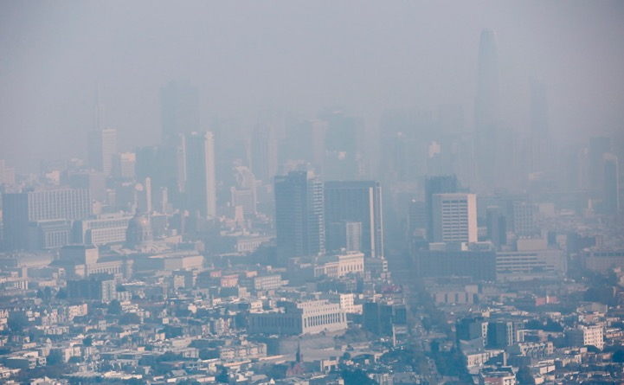
Serious Air Quality Impacts
Many Bay area AQ sites had their worst air quality on record
Air quality declined to extremely unhealthy levels for millions of people
Remained unhealthy for days.
Sickened thousands of people.
Hundreds of people ended up in Bay Area hospitals from the effects of smoke

Slide 8
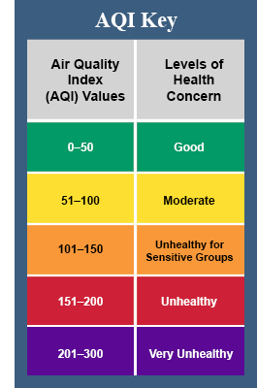
October 10

Slide 9

Some key questions
What meteorological conditions accompanied the fires?
Were these conditions predictable?
What started the fires?
Could this disaster have been prevented?
Did anthropogenic global warming play a significant role in this event?

Slide 10
The Geography of the Region

Slide 11
Major Wine Country Fires

Slide 12
Climatological Lead Up

Slide 13
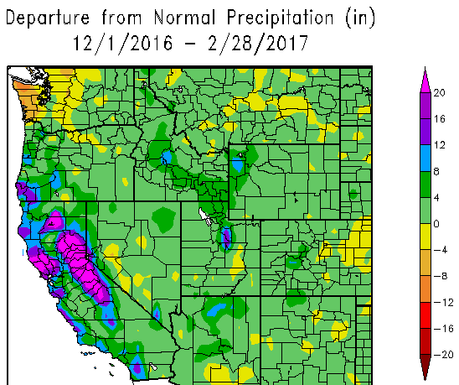
A Wet Winter Before the Fires

Slide 14
The Wet Winter Led to Luxuriant Grass Growth

Slide 15
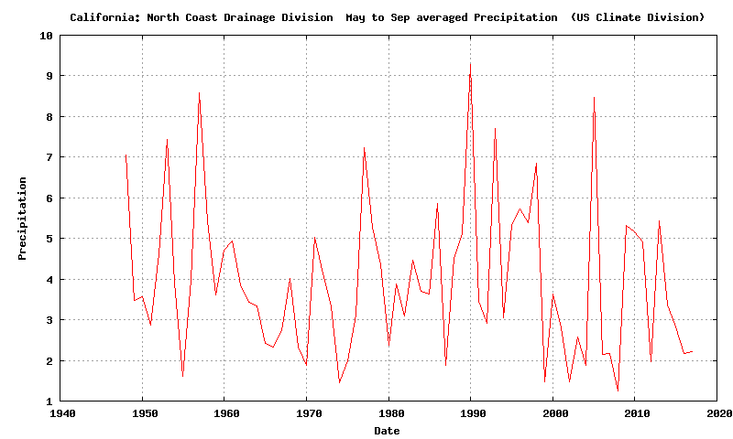
The Preceding Summer Was Typically Dry

Slide 16
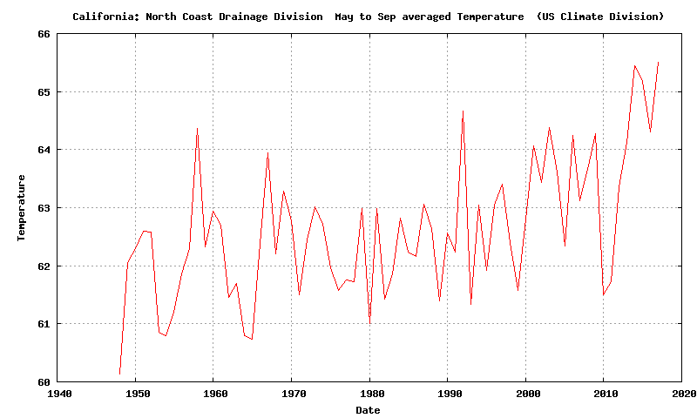
But it was warmer than normal by ~3F.

Slide 17
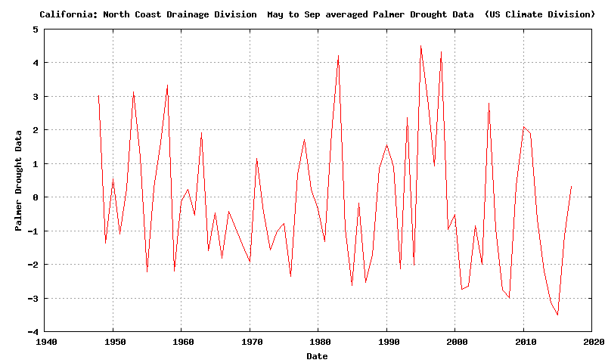
With a wet winter/spring, and a normally dry, but warmer than normal summer, the Palmer Drought Severity Index was near normal

Slide 18
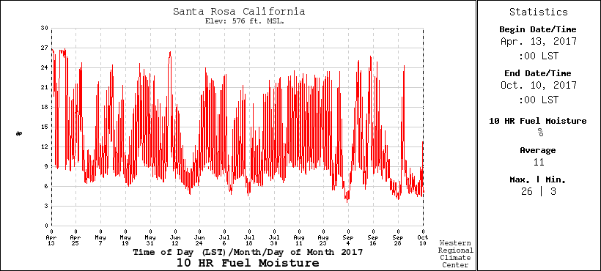
10-hour Fuel Moisture (.25 to 1 inch diameter)
Varies rapidly, drops with offshore flow. Below 10% is dangerous

Slide 19
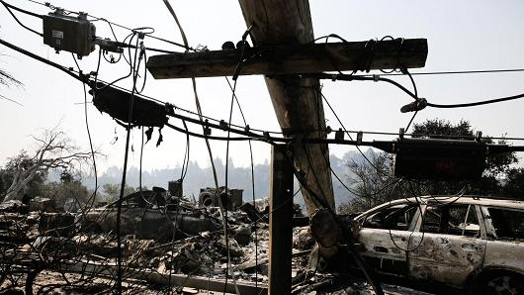
Fire Initiation
172 fire starts leading to 18 major fires
911 calls about power outages and small fires started around 9 PM October 8, just when winds accelerated
Initial investigation traced most fires to failing electrical infrastructure (downed lines, exploded transformers) resulting from strong winds

Slide 20
The Winds

Slide 21
Max Gusts During the Event (knots):
Big spatial variation with strongest winds (60-95 knots) on lee (SW) slopes of terrain

Slide 22
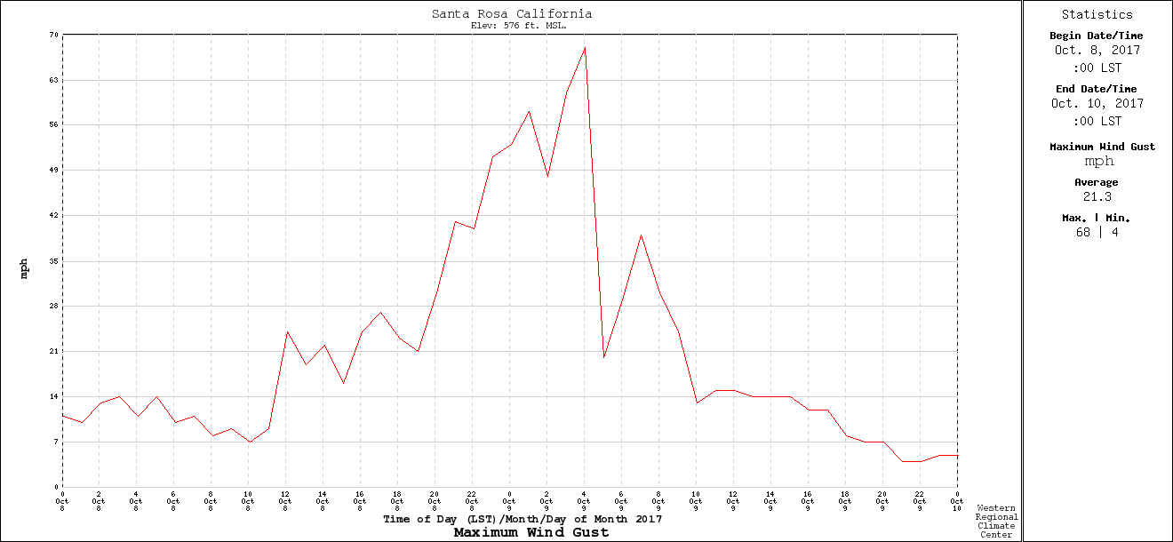
Temporal Variation: Rapid Increase and Decline
Santa Rosa RAWS
9 PM
PDT
midnite
6AM

Slide 23
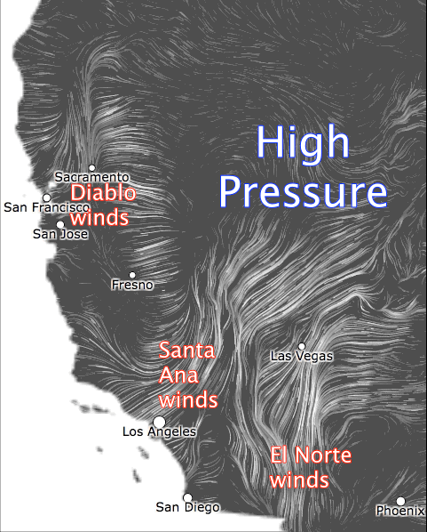
Such warm, dry offshore winds are associated with high pressure over the intermountain west
High Pressure

Slide 24
The Synoptic and Mesoscale Origins of the Strong Winds

Slide 25
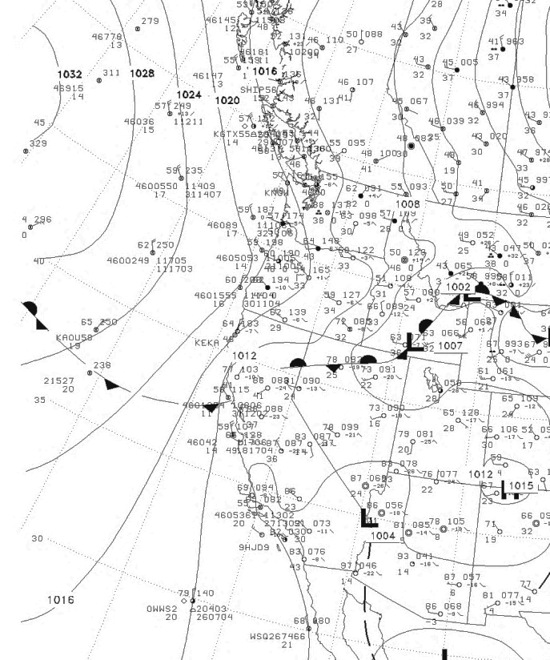
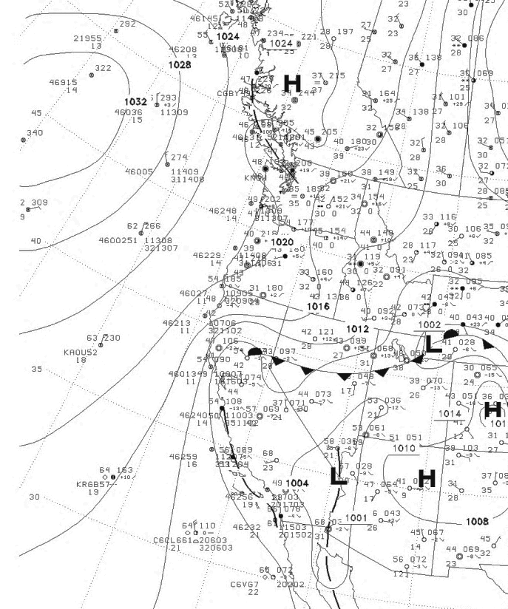
High Pressure
Built into the
Northwest and then into the Intermountain West
0000 UTC 8 October
1200 UTC 8 October

Slide 26
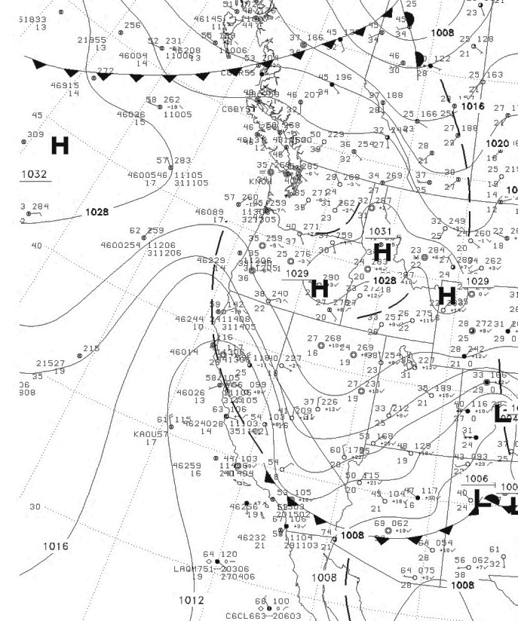
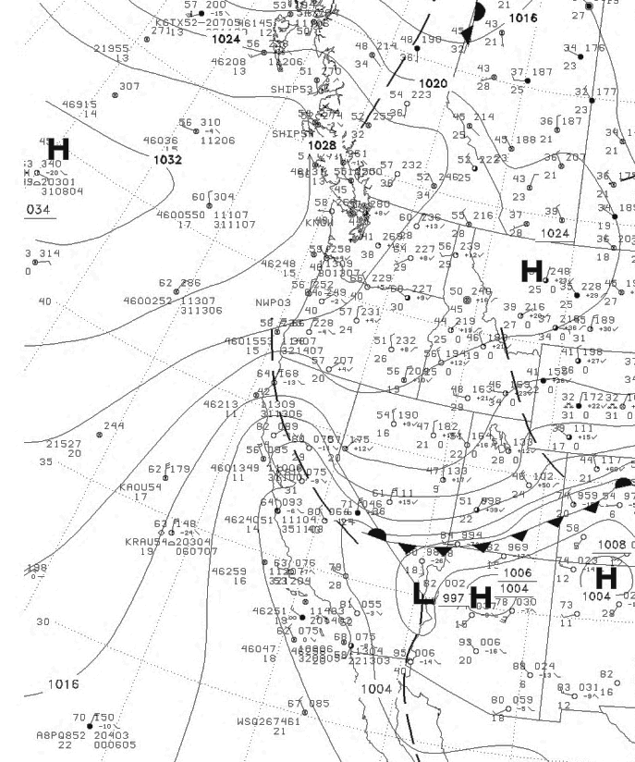
0000 UTC 9 October
1200 UTC 9 October

Slide 27
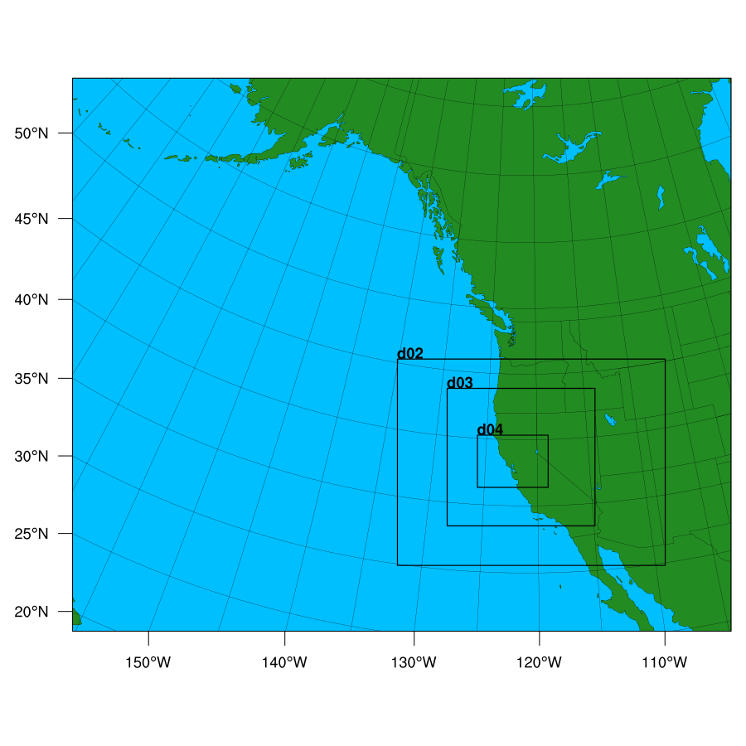
High-Resolution WRF Simulation of the Event
36-12-4-1.3 km domains
Initialized at 1200 UTC Oct. 8

Slide 28
12-km domain
9
1200 UTC 8 October

Slide 30
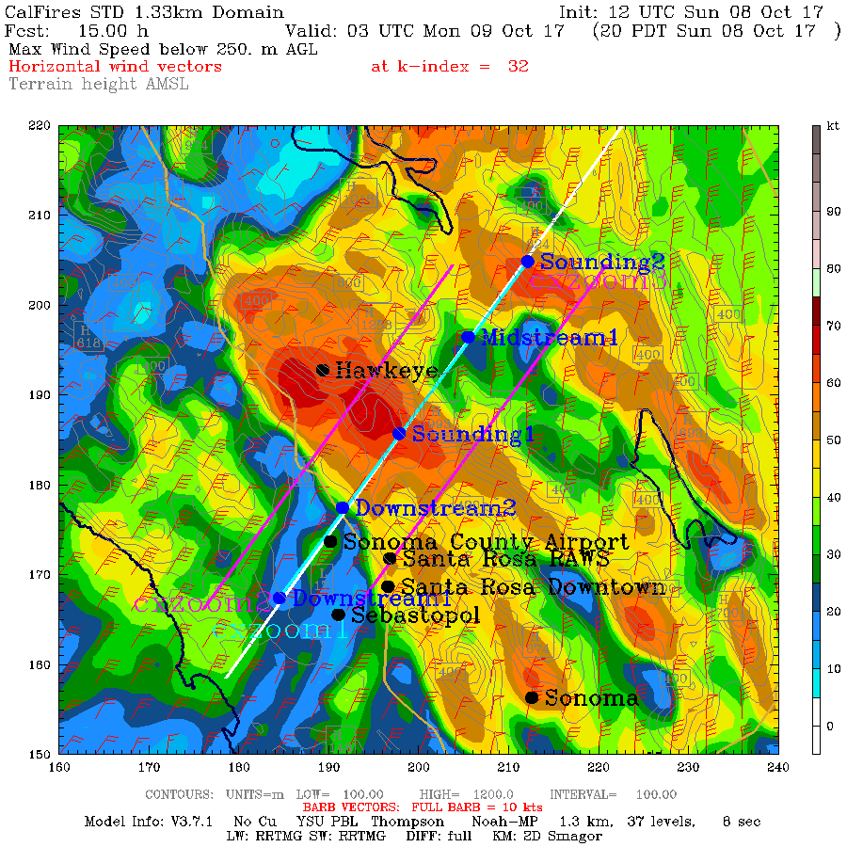
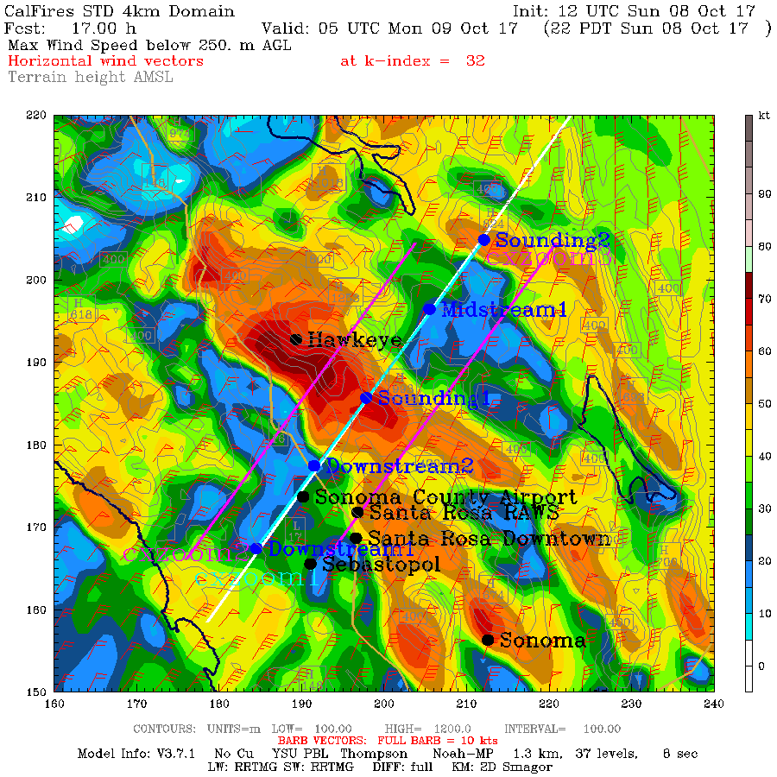
8 PM October 8
10 PM October 9

Slide 31
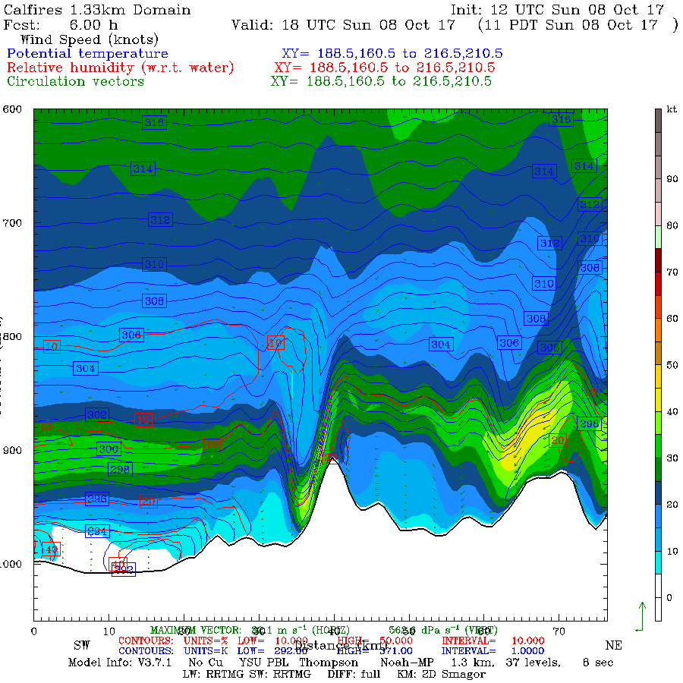

Slide 32
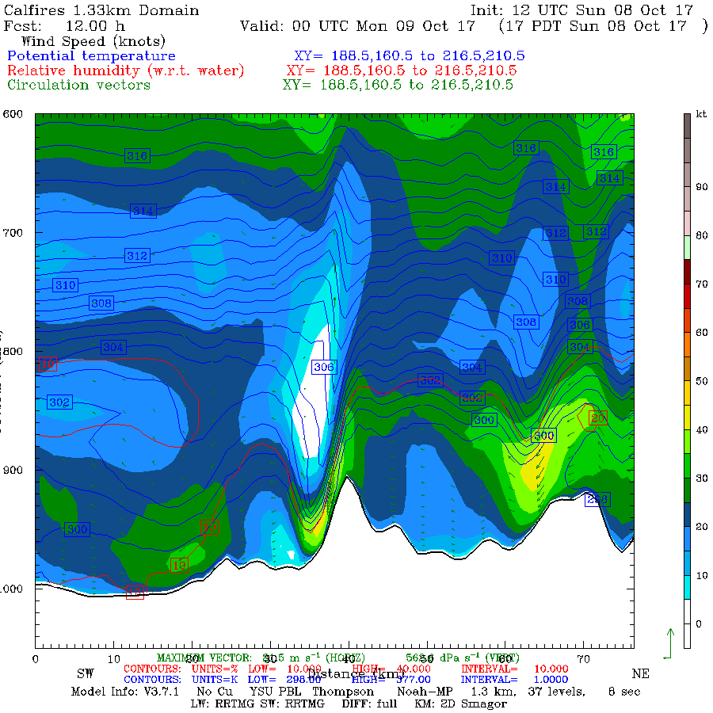

Slide 33
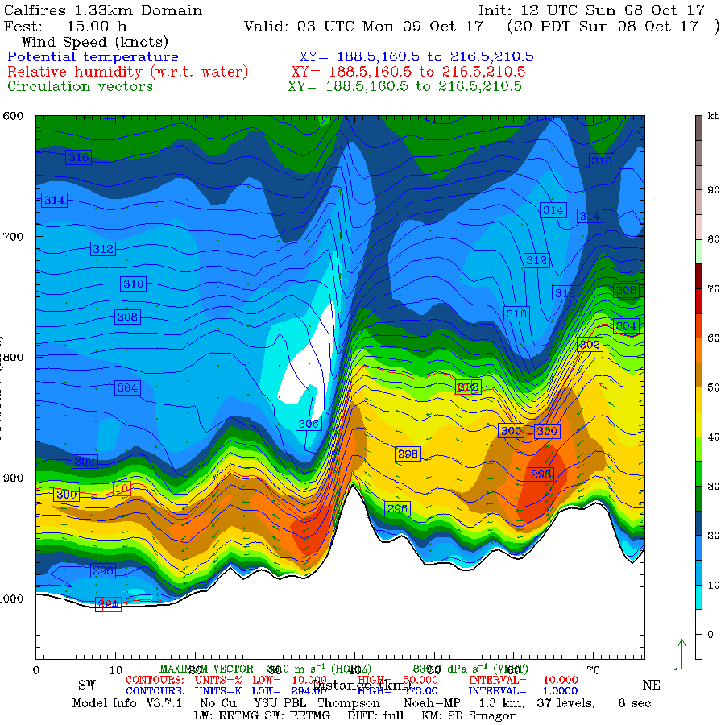

Slide 34
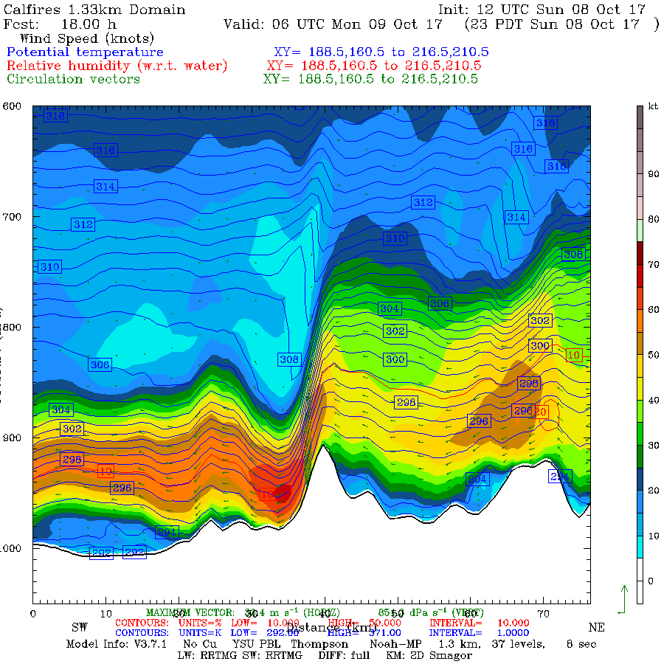
Terrain-Related
Downslope
Windstorm

Slide 35
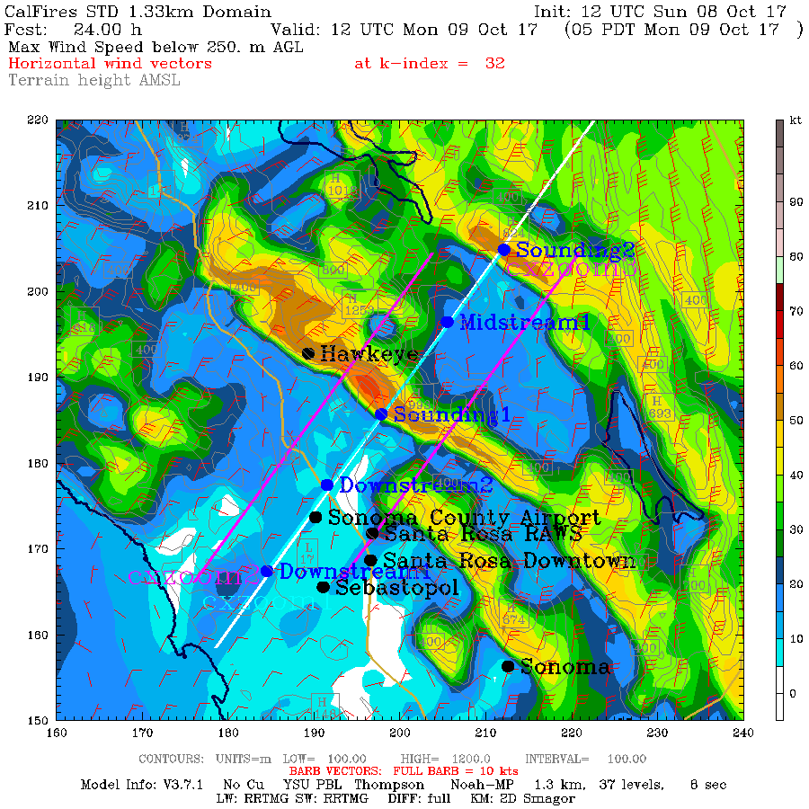
Conclusions Based On the Model Simulation
WRF model did an excellent job in duplicating the pattern and temporal evolution of the winds. Good forecast.
Strong winds were associated with a downslope wind event.

Slide 36
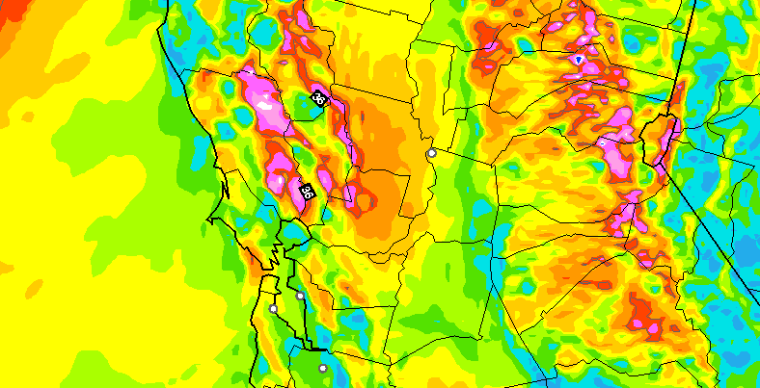
Operational Forecast Guidance Was Excellent, Even Days Out
10-h surface (10-m) wind gust forecast (kt) valid at 0700 UTC 9 October 2017. The model was initialized at 1200 UTC 8 October 2017. Wind gusts are derived by determining the highest wind speed in the lowest km.
NOAA/NWS Operational
HRRR Model
NOAA/NWS Operational
HRRR Model

Slide 37
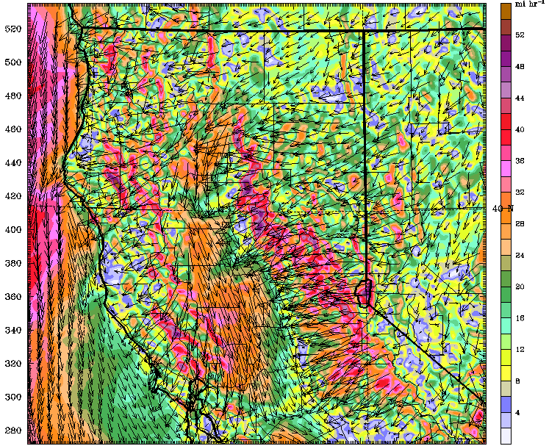
Operational CANSAC Model
30-h surface wind forecast (mph) for 0600 UTC 9 October 2017 for a run initialized at 0000 UTC 8 October 2017 from the nested 2-km domain

Slide 38
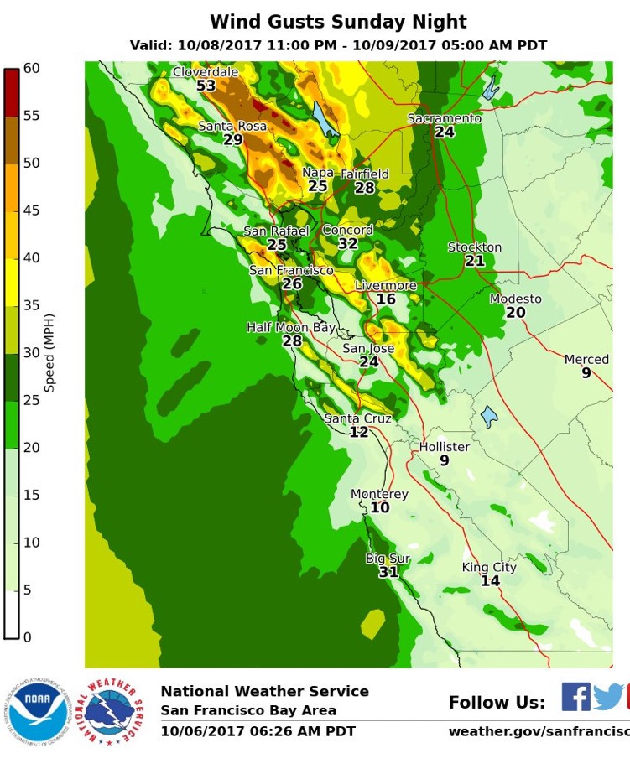
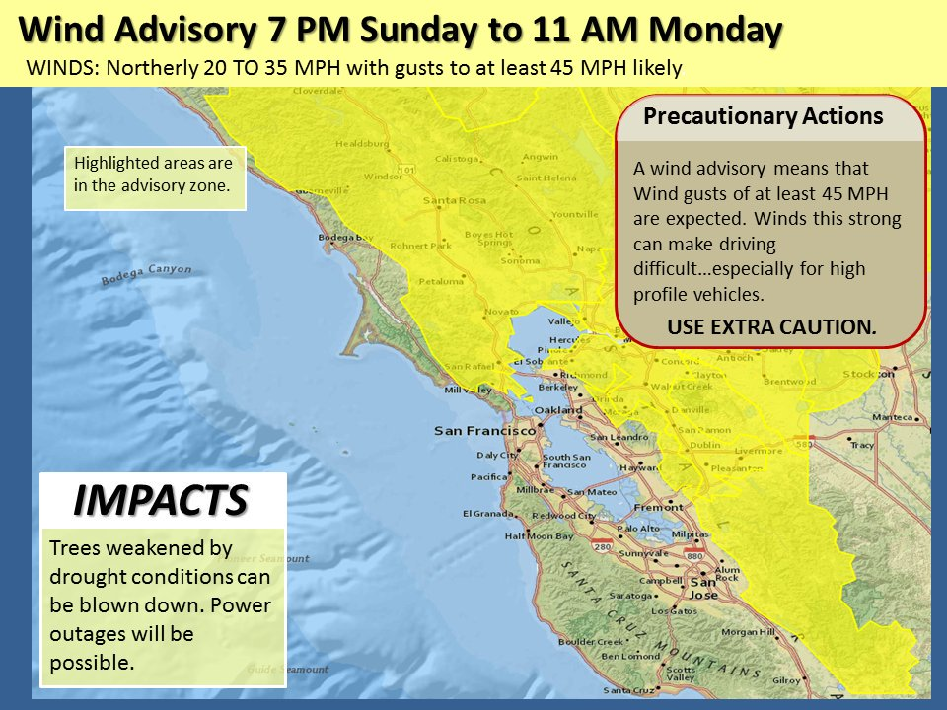
Based on these and other modeling systems, the NWS released high wind and red flag warnings—days before.
Two Days Before

Slide 39
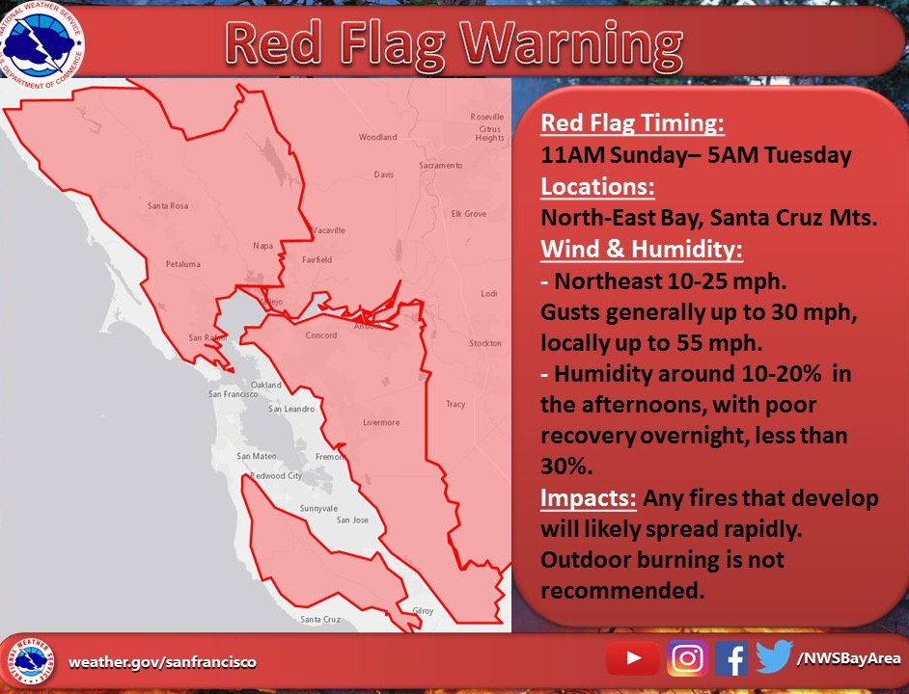

Slide 40
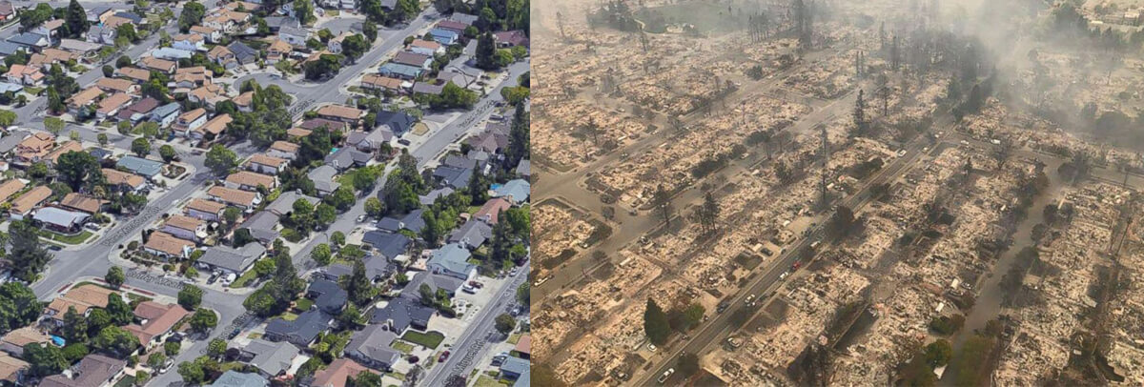
Could we have prevented the fires with better use of weather forecasts?

Slide 41
Quite possibly, yes, with pre-emptive power outages
The winds caused the fires and allowed them to explode that night.
The winds were skillfully forecast the previous day.
With such strong predicted winds, power failures/fires were inevitable.
Why not de-energize the powerlines in the hills and vulnerable areas a few hours before the winds were going to hit?
Might doing so have saved 44 lives and billions of dollars of damage?

Slide 42
Were the Wine Country Wildfires Associated with Anthropogenic Global Warming?

Slide 43
Little Evidence That Anthropogenic Global Warming Contributed to the Wildfires
The fire was initiated and supported by very strong winds.
No reason to believe that Diablo Winds are associated with global warming, in fact the opposite is probably true.

Slide 44
A key element in the severity was excessive grass growth resulting from unusually large winter precipitation
No reason to expect more central CA precipitation under global warming
Deser et al., 2012. Precipitation trends for 2010–60 [mm]. (Stippling indicates values not significant at the 95% confidence level.

Slide 45
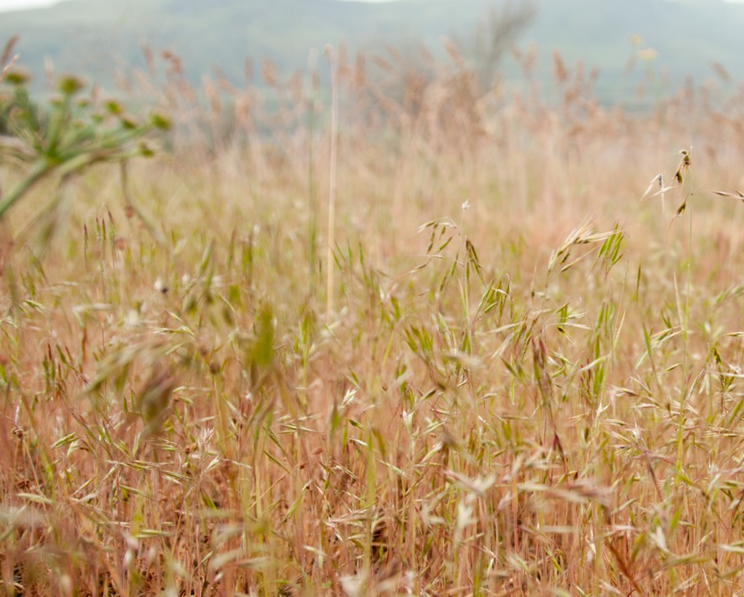
The Role of Invasive Grasses
Invasive, non-native grasses played an important role
Cheatgrass, “Bromus tectorum”
a.k.a. grassoline

Slide 46
If the temperatures were a few degrees warmer, or the summers a bit drier, it would not make a difference for coastal CA wildfires
A normal summer is warm and dry enough to allow fires.
And 1-hr and 10-hr fuels are always dry enough to burn in summer under offshore flow.
There is a deep literature, based on observed conditions and fires, that supports these points.
“The extent of preceding drought is largely irrelevant to the size of these autumn fires because of the severity of weather during the fire event”

Slide 47
No long-term trends in wildfires
No long-term upward trend in fires for coastal California
The region has a long history of fire.

Slide 48
Fire is No Stranger to the Region

Slide 49
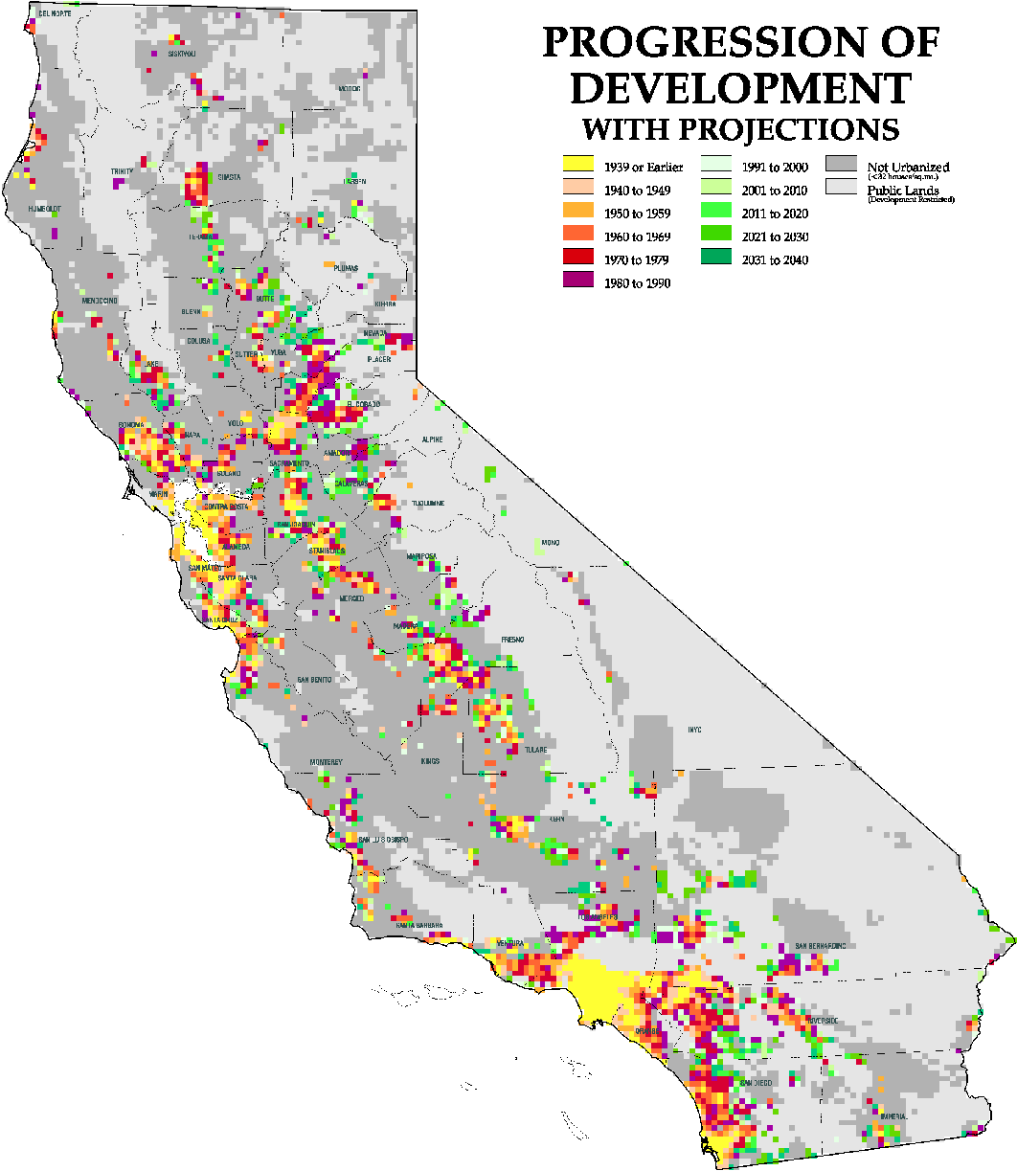
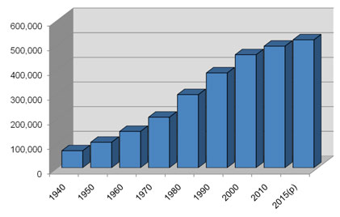
Urbanization Makes Fires More Frequent and Destructive
Sonoma County Population

Slide 50
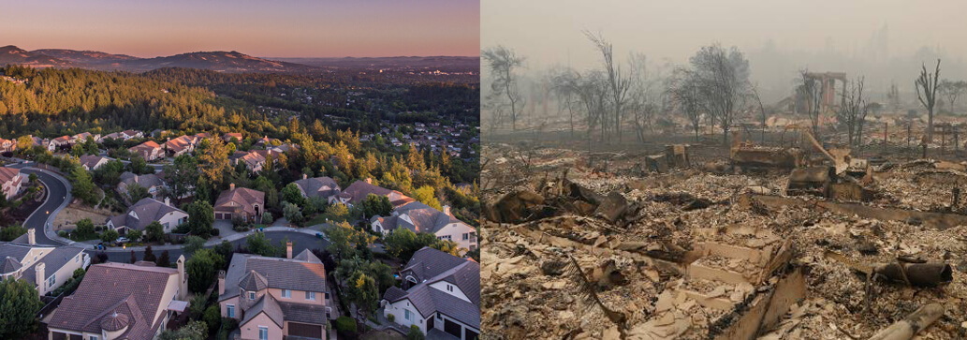
Fountaingrove Neighborhood

Slide 51
Bottom Line
There is no reason to believe that anthropogenic global warming contributed to the Wine Country fires or will enhance them in the future.

Slide 52
Dealing With the Issue
Homes and buildings must be moved out of areas that are prone to wildfire.
Can we restore wildland areas or bring back fire?
The electrical distribution system must be updated to be less prone to starting fires (e.g., underground lines, fix the recloser problem)
Societal decision makers must learn how to use improved predictions.
Better warnings and coordinated fire fighting capabilities are needed

Slide 53

The End

