Slide 1
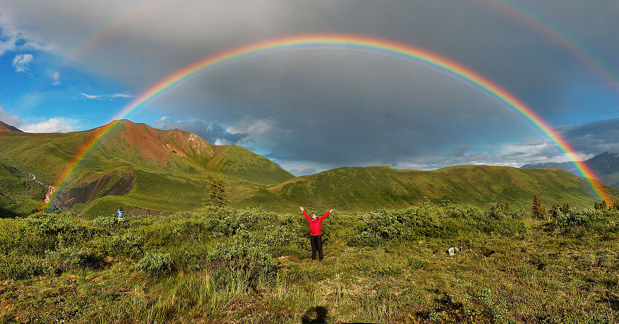
Optical Effects and Phenomena Atmospheric Sciences 101, W2020
The effects of the atmosphere and hydrometeors (e.g., rain) on visible light

Slide 2
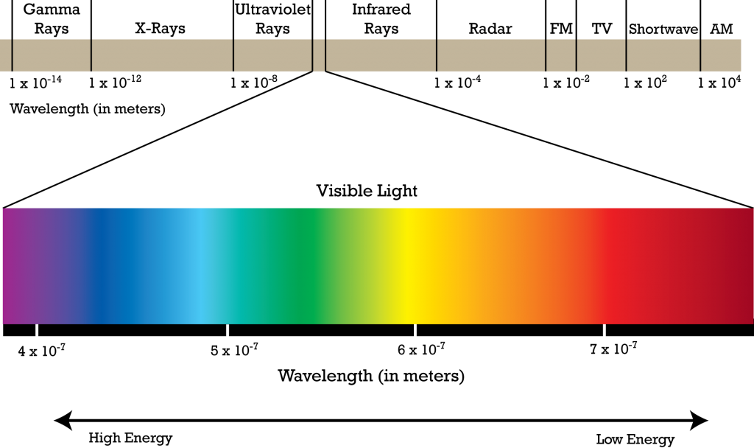
Visible light is made up of a spectrum of colors from red (long wavelengths) to violet (short wavelengths)

Slide 3
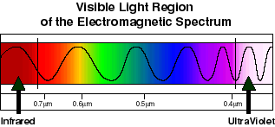
.4 to .7 microns

Slide 4
Visible light is influenced by the density of the medium through which it travels
In a vacuum, light travels at 186,000 miles per second.
Denser medium causes light to slow down

Slide 5
When light interacts with a medium, various things can happen:
Refraction
Reflection
Scattering
Absorption
Diffraction

Slide 6
Refraction
Definition: The process in which the direction of light is changed as result of the change in density of the medium through which light travels.

Slide 7
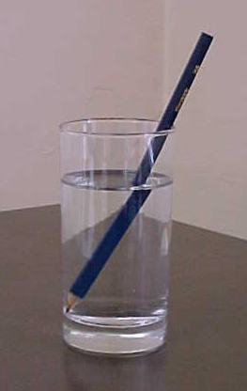
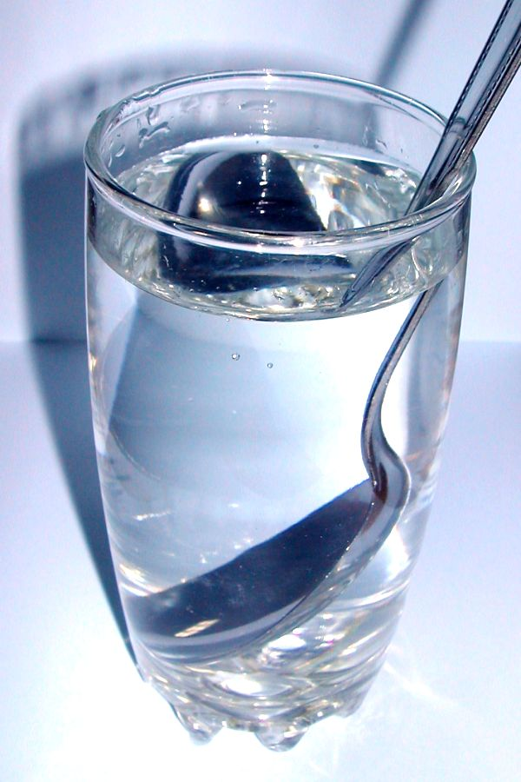
Refraction

Slide 8
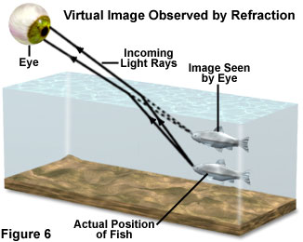
Many objects are NOT where you think they are!
The sun at sunset is another!

Slide 9
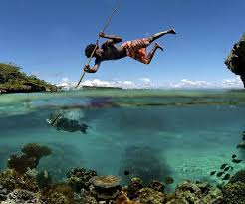
Useful information

Slide 10
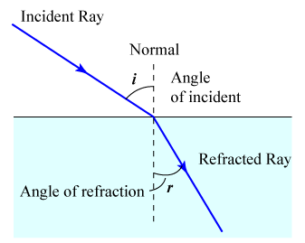
Refraction Rule
When light travels from a less dense to a more dense medium, it loses speed and bends towards the normal.
When light travels from a more dense to a less dense medium, it speeds up and bends away from the normal.

Slide 11
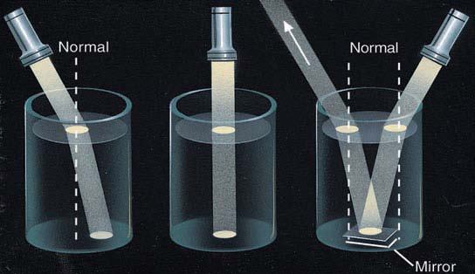

Slide 12
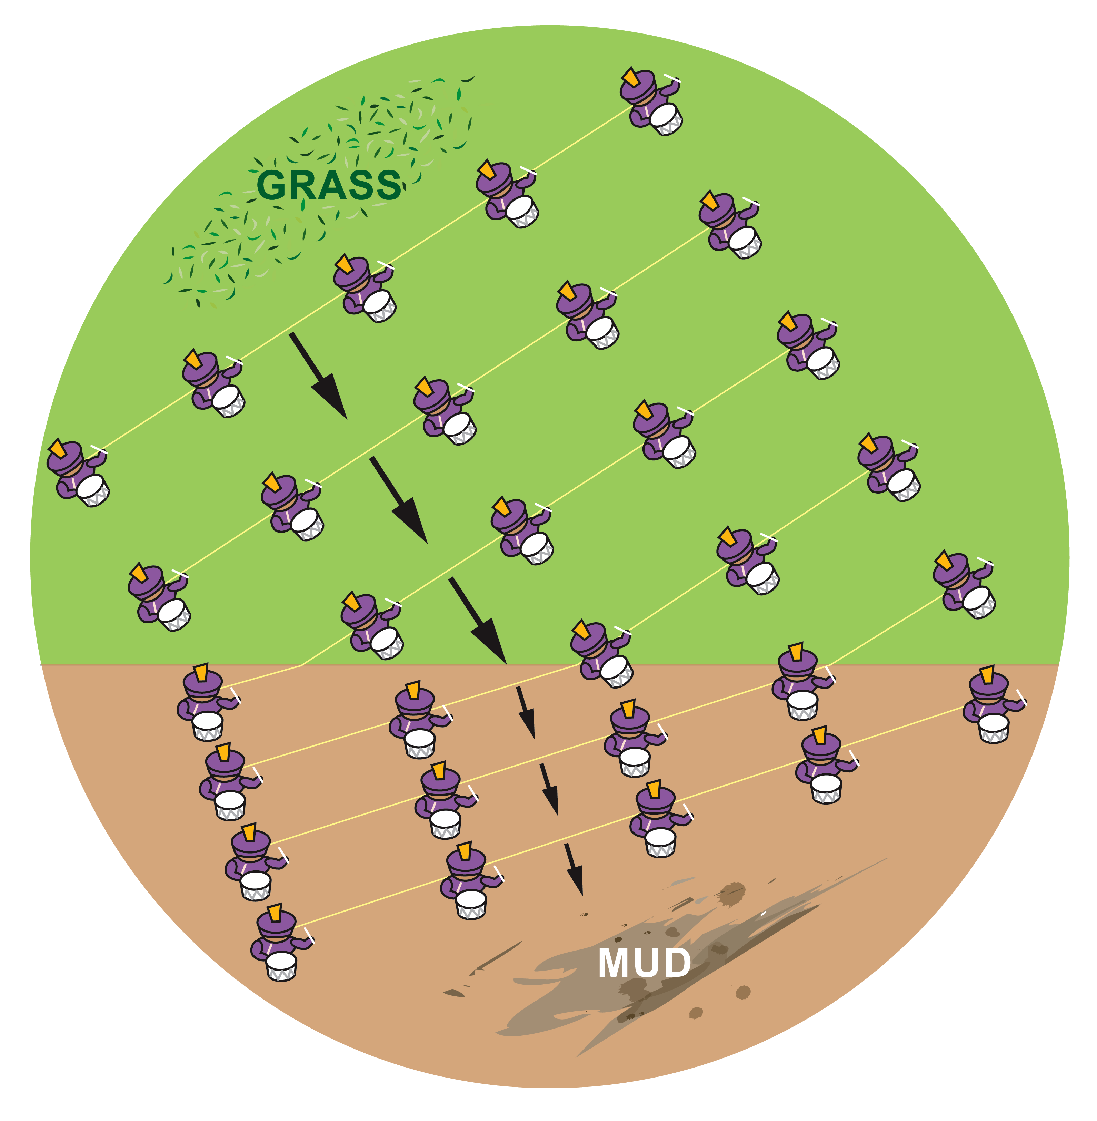

Slide 13
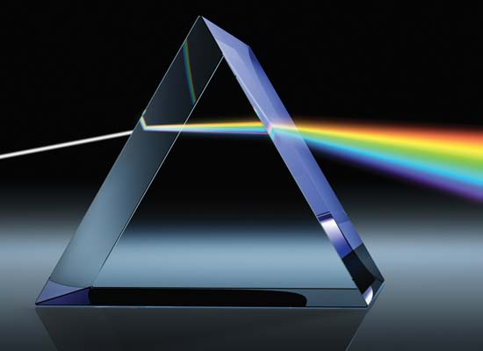
The refraction of light depends on its wavelength

Slide 14
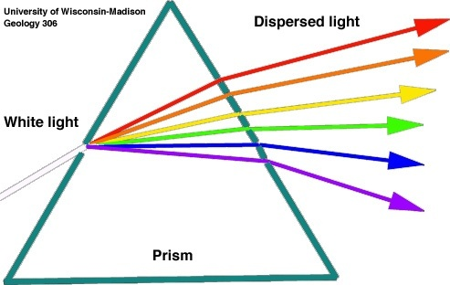
Shorter wavelengths (e.g., blue) are refracted more than longer wavelengths (e.g., red)

Slide 15
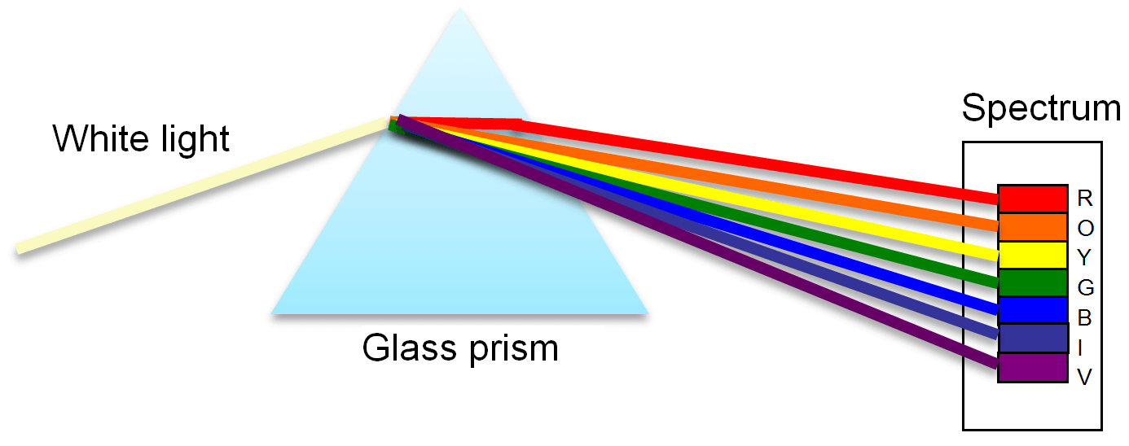
This process is called dispersion dispersion: a process in which radiation is separated into its component wavelengths

Slide 16
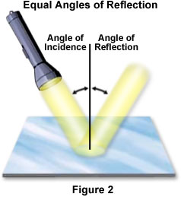
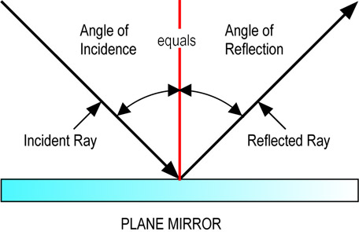
Reflection: occurs when light is incident on solid objects.
The angle of incidence equals the angle of reflection

Slide 17
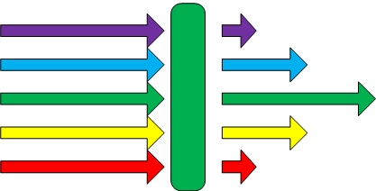
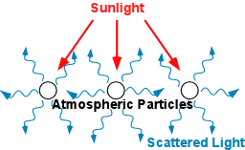
More processes
Absorption: when radiation (light) is absorbed by the medium.
Scattering: usually associated with small particles and molecules. Radiation (e.g., light) is absorbed and reemitted in the same or other direction.

Slide 18
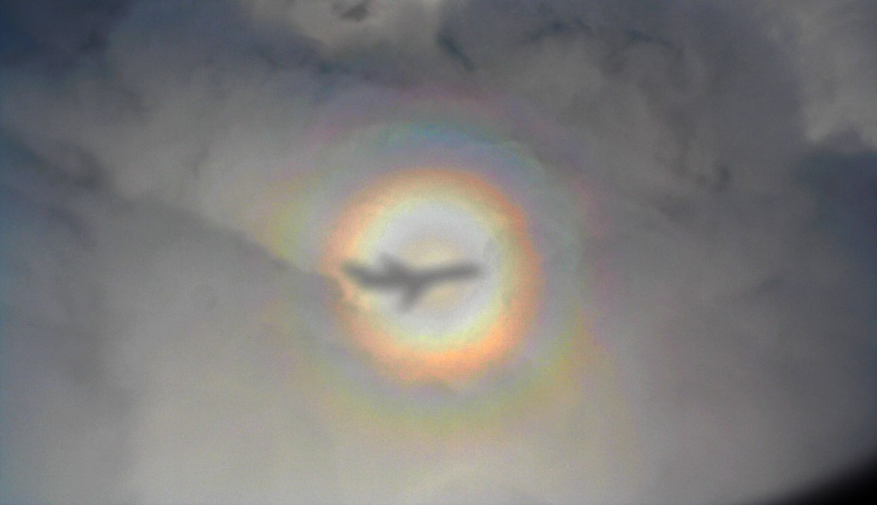
More Processes
Diffraction: a phenomenon dependent on the wave-like nature of light. Often occurs when light bends around objects. Can get dispersion.
A glory

Slide 19
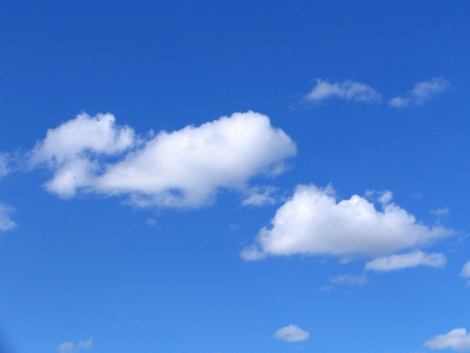
Why is the sky blue?

Slide 20


Slide 21
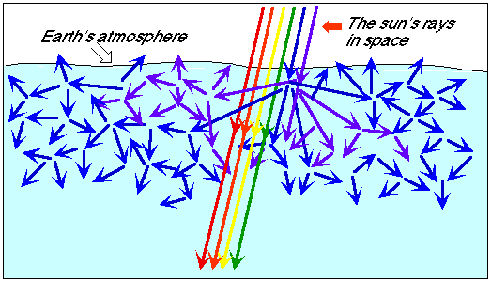
Answer: Rayleigh Scattering-which occurs when light interacts with atmospheric molecules and particles much smaller than the wavelength of light.

Slide 22
Why is the sky blue?
Rayleigh scattering occurs when visible light is scattered by air molecules that are small compared to the wavelength of light.
Visible light has a wavelength (λ) of ~ .5 microns (.5 x 10⁻⁶ m)
Molecules have a size of ~ 10⁻¹⁰ m
So λ_{visible}>> size of molecules
In Rayleigh scattering the amount of scattering depends on the wavelength of the light.

Slide 23
Rayleigh Scattering Formula Scattering ~ 1/λ⁴
Where λ is wavelength
Thus, short wavelengths (e.g., blue) are scattered more than long wavelengths (e.g., red)

Slide 24
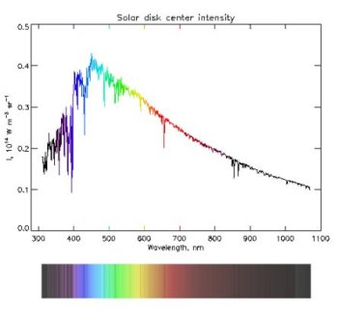
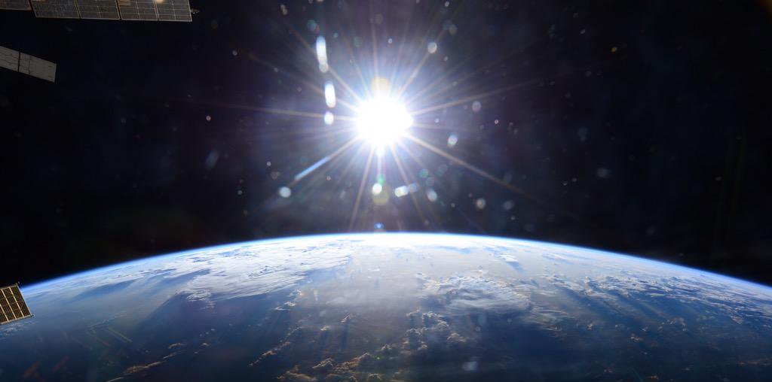
Sun’s Light Coming In (looks white in space)

Slide 25
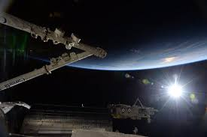

Slide 26
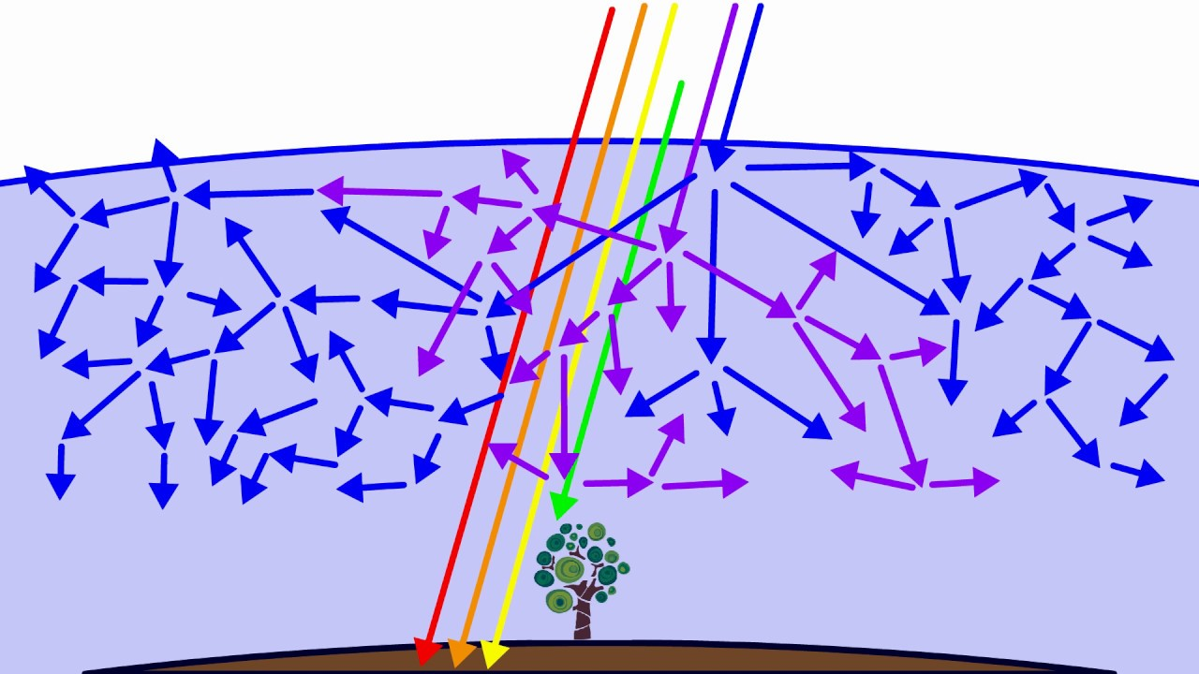
Sun’s Light Has All Wavelengths

Slide 27
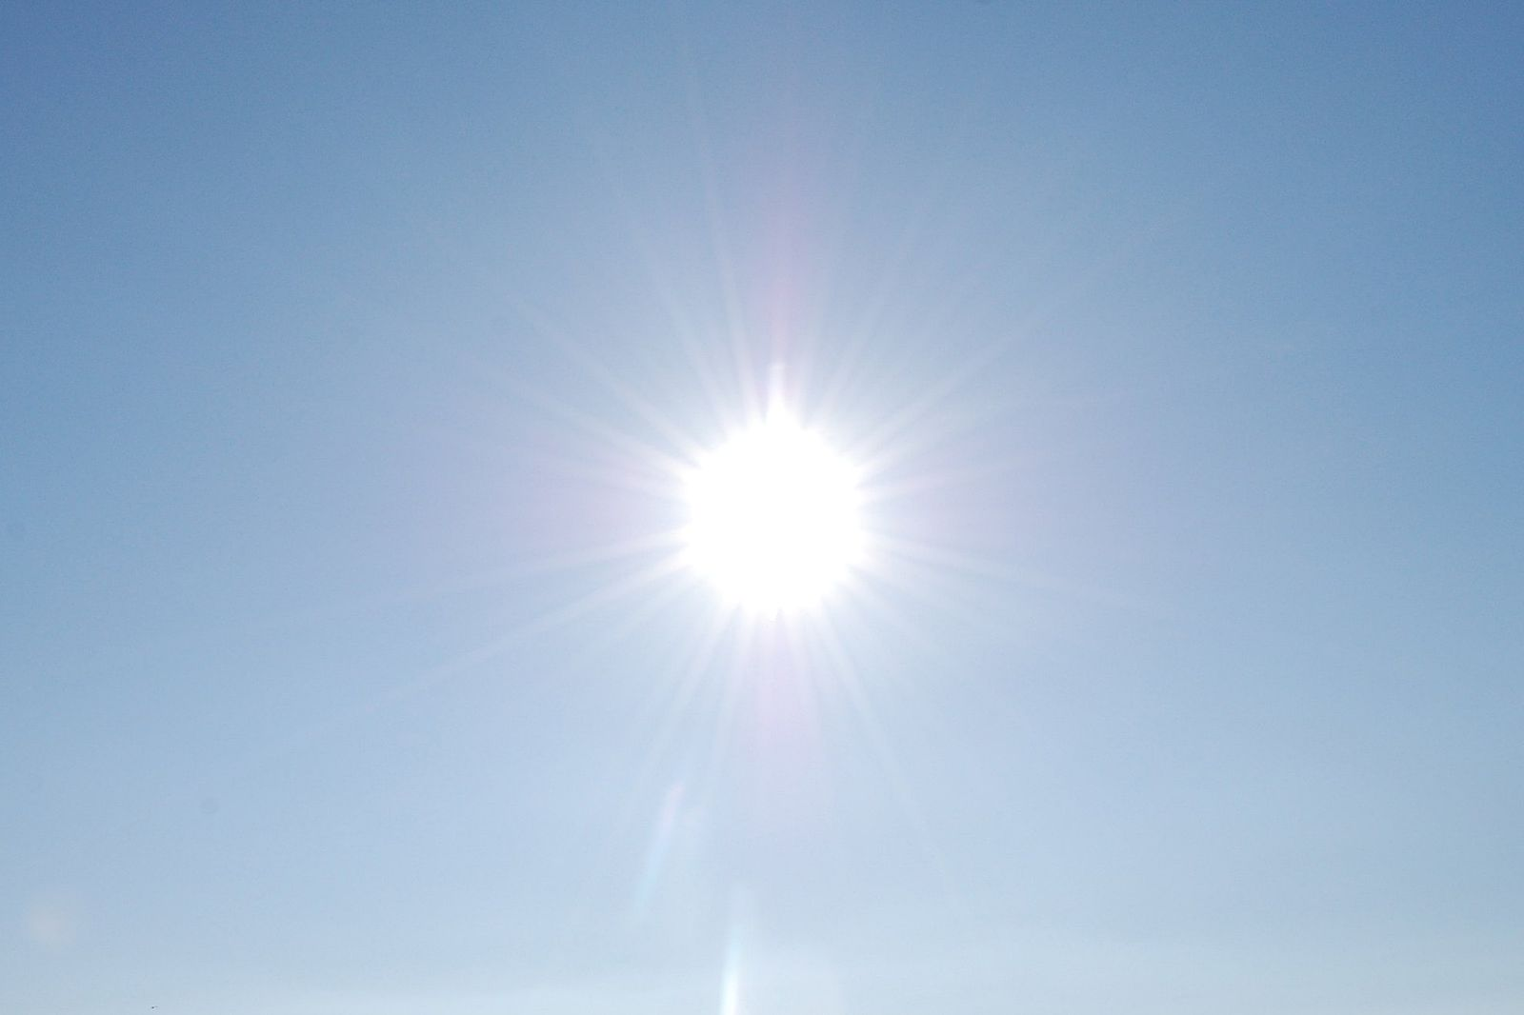
Sunlight (all wavelengths)
Blue/violet scattered
Blue/violet scattered
Red/yellow gets through

Slide 28
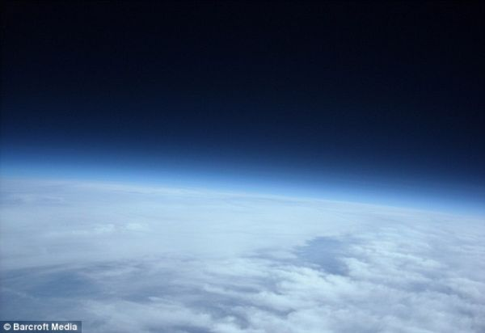
Higher in the atmosphere as density decreases, there is less scattering and the sky turns dark

Slide 29
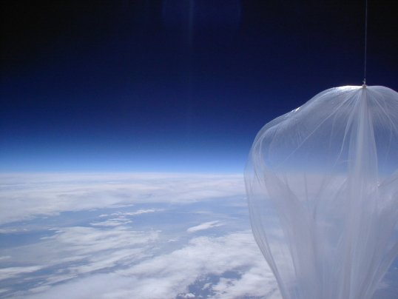

Slide 30
Short-visible light is scattered more than longer infrared light by atmospheric particles

Slide 31
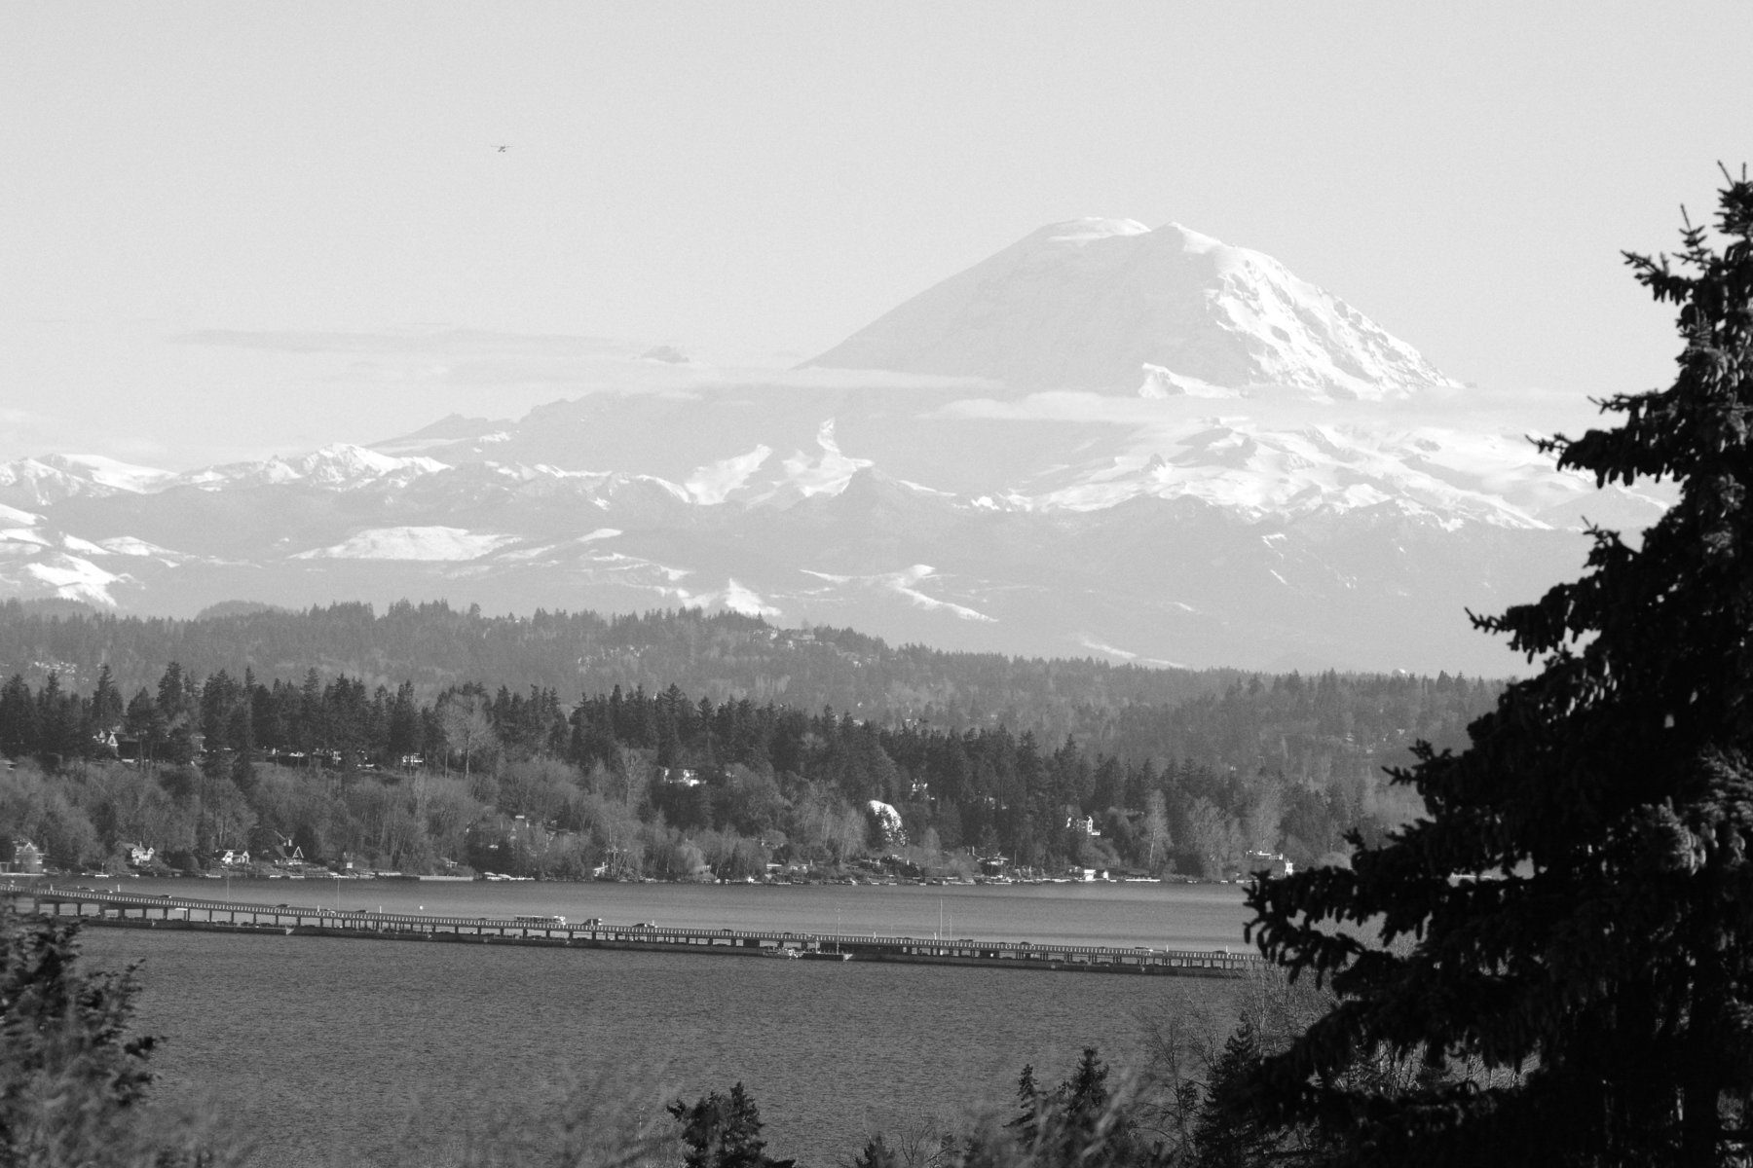
Visible

Slide 32
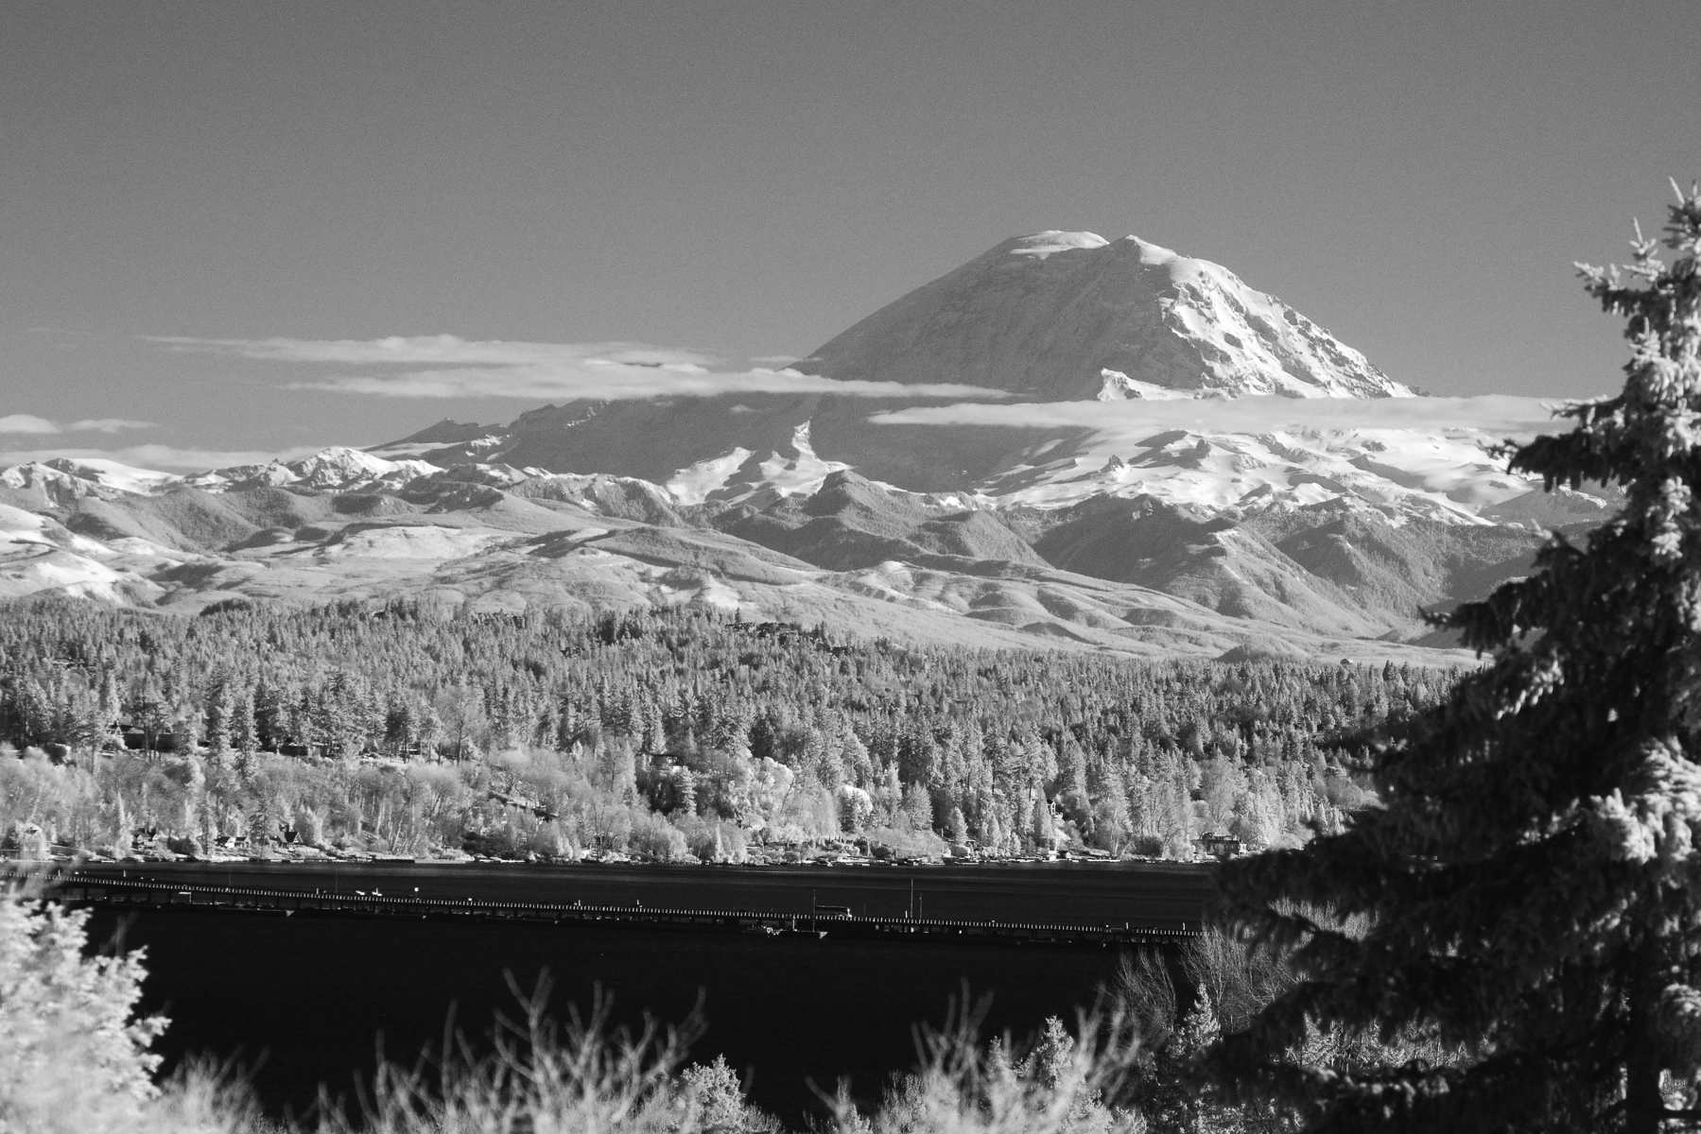
Infrared

Slide 33
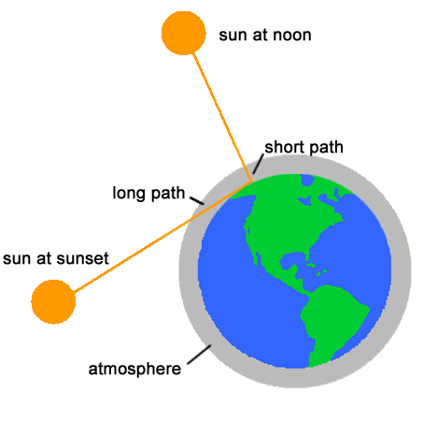
Why Red Sky and Sun at Sunset?
Answer: light goes through more atmosphere, allowing more time for shorter wavelengths to be take out—first blue, then green, then yellow, leaving red.

Slide 34
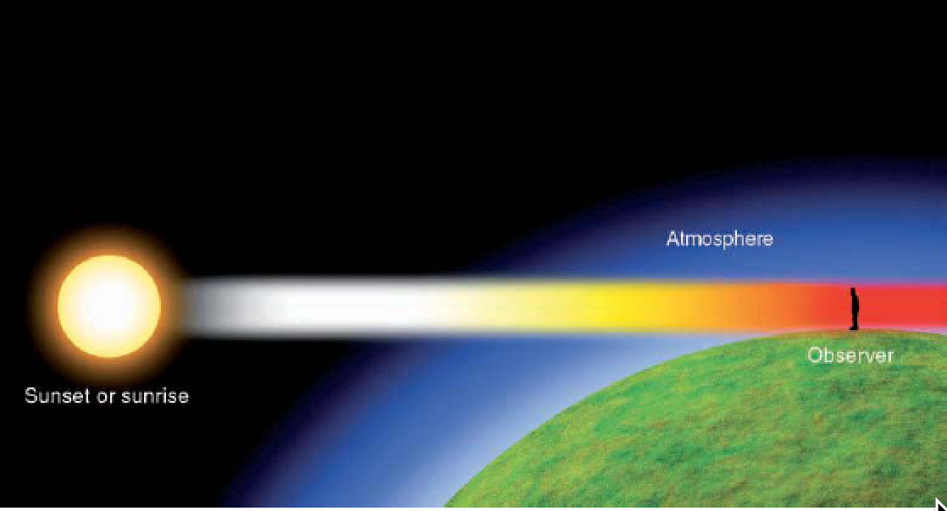

Slide 35
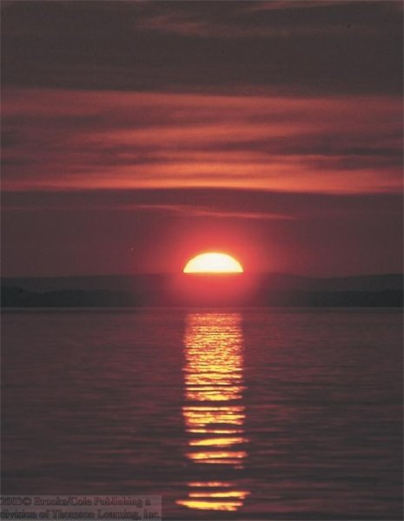

Slide 36
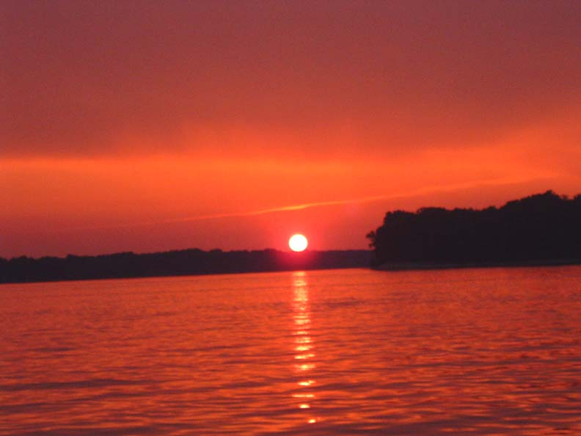

Slide 37
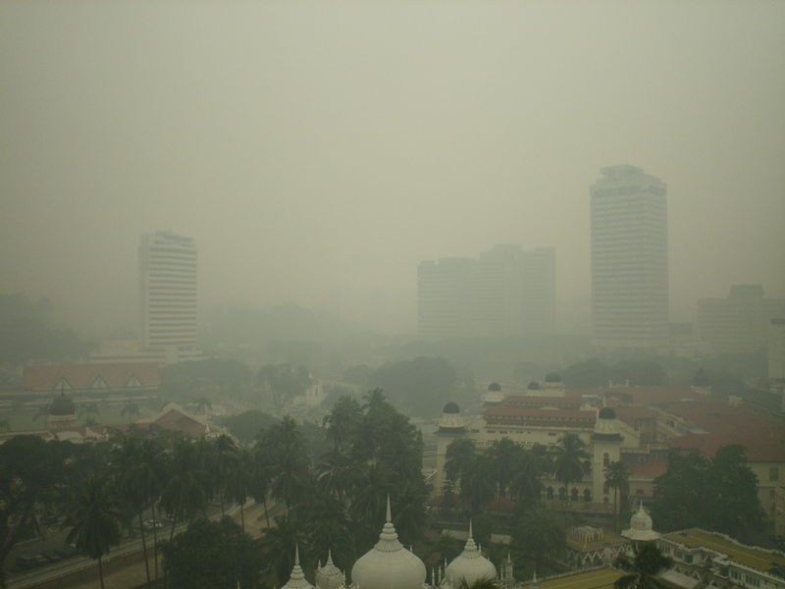
But sometimes the sky looks white. Why?

Slide 38
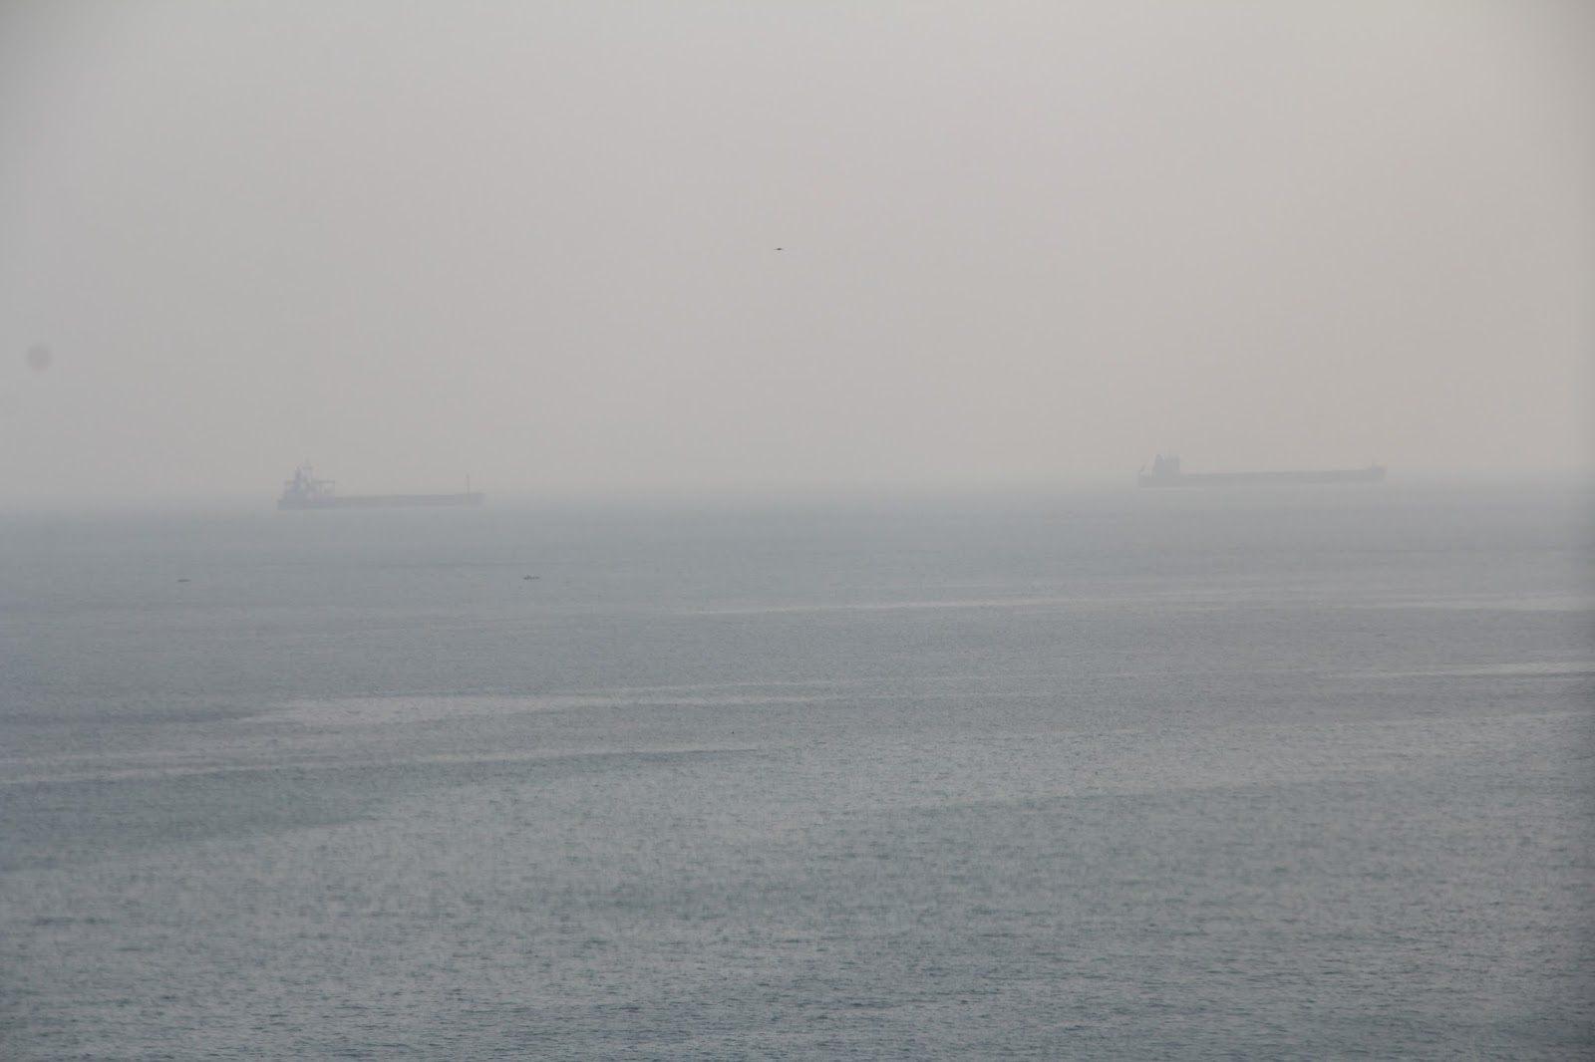

Slide 39
Mie Scattering
Occurs when atmospheric particles are roughly the same size as the wavelength of light.
Such big particles could be small water droplets, industrial pollution, smoke, or from another source.
Mie scattering is NOT wavelength dependent, so scatters all wavelengths the same.
Thus, sky has a whitish, milky look.

Slide 40
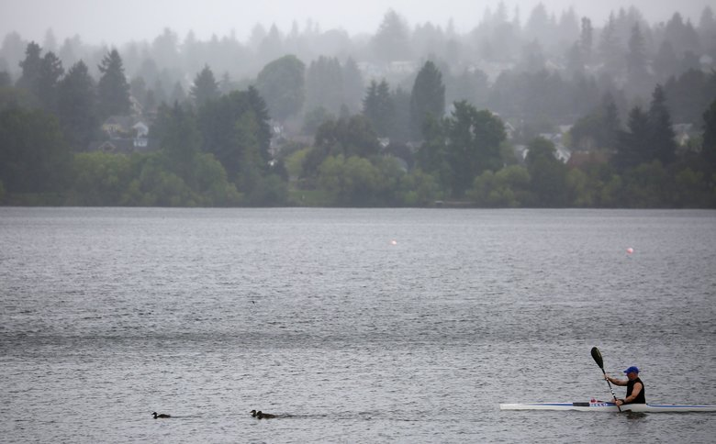
Onshore push in the NW frequently produces Mie Scattering
Large salt particles from breaking waves
Water is attracted to them.
When marine air surges in with such particles, visibility can decline and the sky can turn whitish.

Slide 41
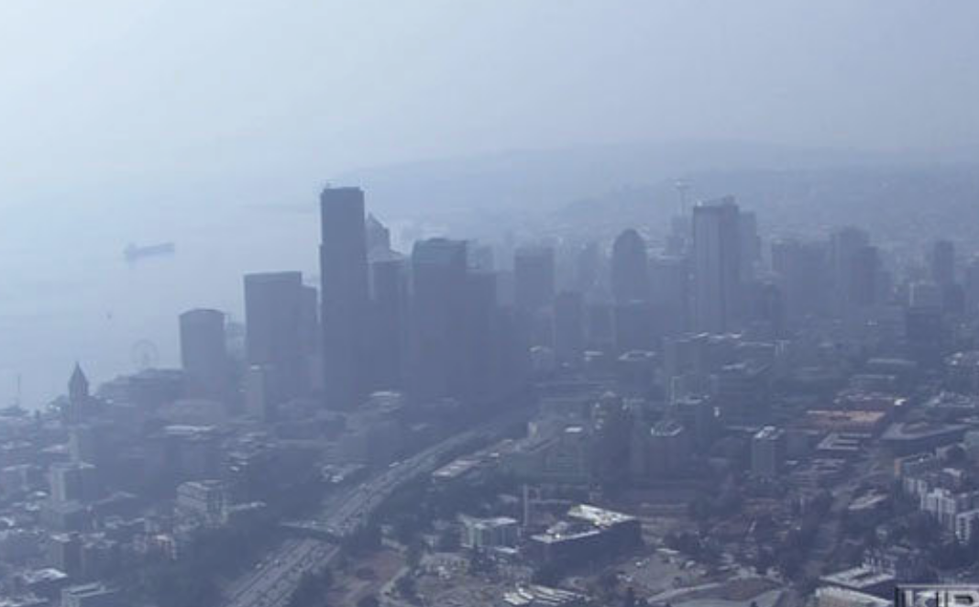
Wildfire Smoke: Again Big Particles and Mie Scattering

Slide 42
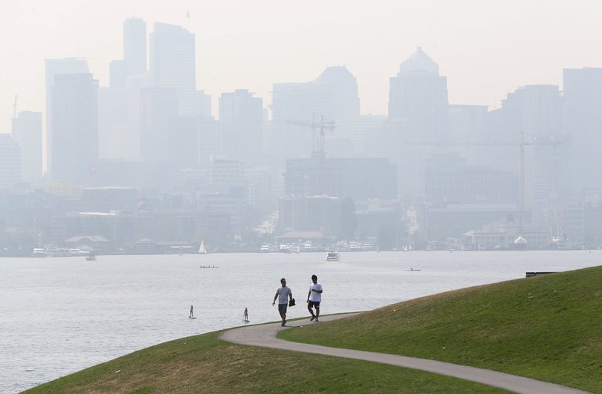

Slide 43
Rainbows
Produced by the refraction and reflection of water droplets (usually from precipitation)
One or two bows
Rumors of a pot of gold at their ends.

Slide 44
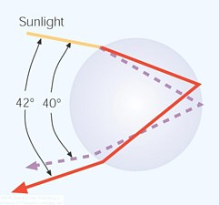
Primary Bow (two refractions and one reflection)

Slide 45
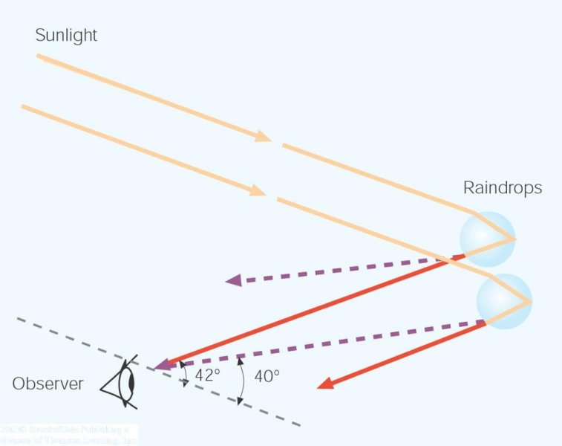
The geometry: the sun is behind you

Slide 46
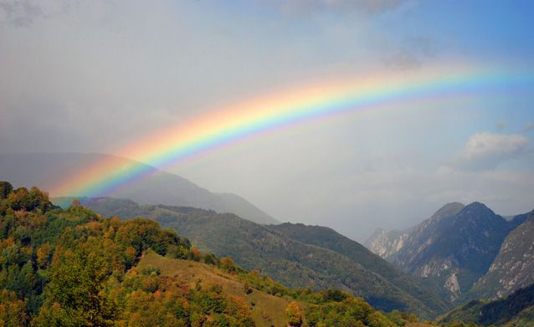
The correct color sequence of primary bow: violet (inside) to red (outside)

Slide 47
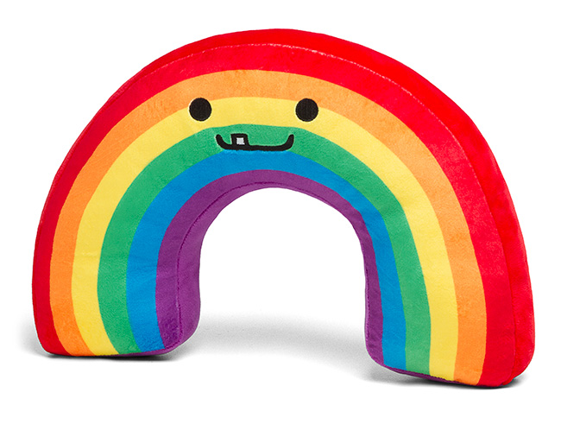
Correct!

Slide 48
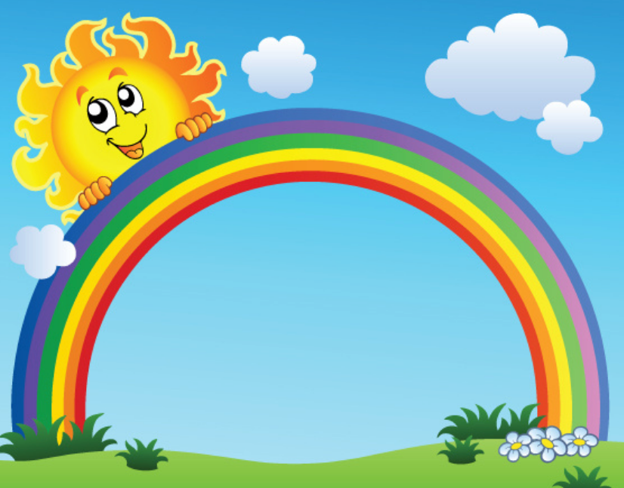
Not Correct

Slide 49
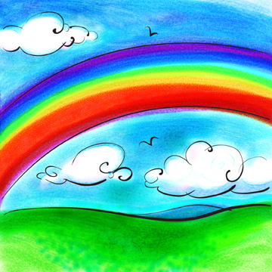
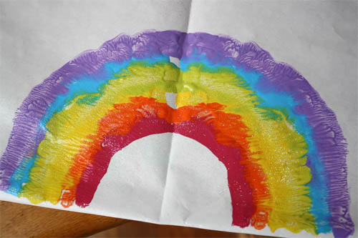
Sometimes artists get rainbows wrong

Slide 50
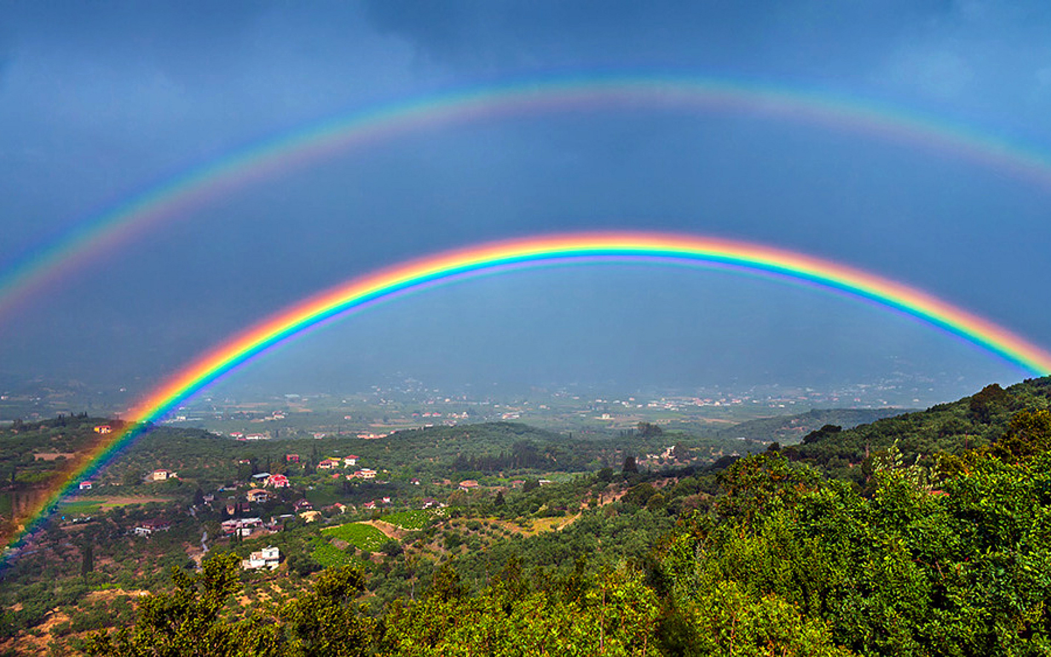
Sometimes a double rainbow

Slide 51
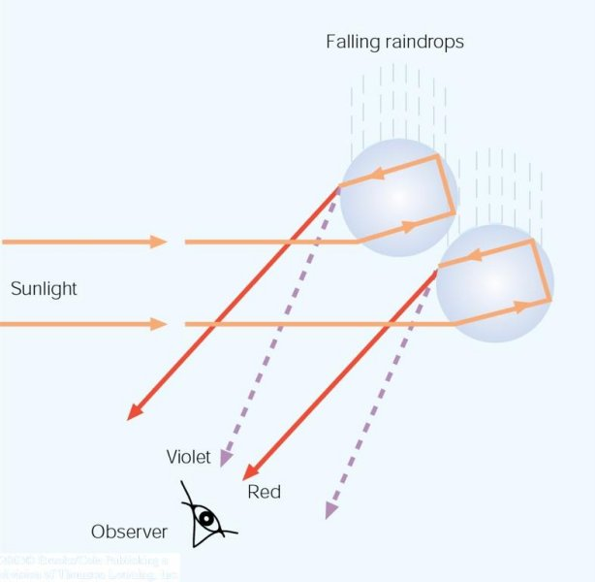
Why? When there is a second reflection off the back side of the droplet
Secondary Rainbows

Slide 52


Slide 53
Colors are reversed for secondary rainbows

Slide 54
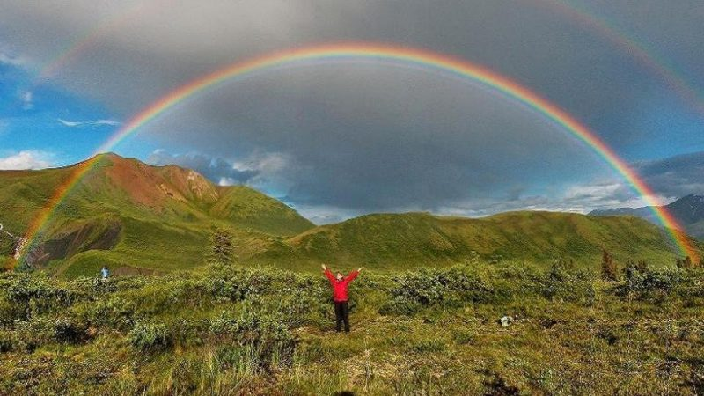
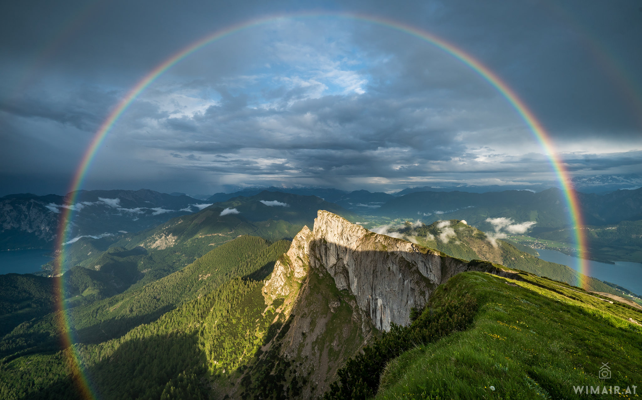
Can be a full circle if you are in the air or in mountains

Slide 55
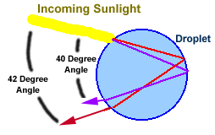


Why circular?

Slide 56

Legend: The Pot of Gold At the End of the Rainbow

Slide 57


Slide 58

Serious journalism

Slide 59

Halos

Slide 60


Slide 61

Halo
Associated with ice crystals, usually from cirrostratus clouds
Ice crystals are hexagonal (six-sided) crystals and can be in columns or plates.
Most haloes associated with columns

Slide 62

Two ways for visible light to go through ice crystals, refracting the light by either 22 or 46 degrees

Slide 63

If ice crystals are small and randomly oriented can get 22 and 46 degree halos (22 more frequent apparent)

Slide 64


Slide 65
The Sun Dog a.k.a. mock suns or parhelia

Slide 66


Slide 67


Slide 68


Slide 69

Why sun dog? Large (> 30 micron) ice crystals shaped like plates. Horizontal orientation, so no circular halo

Slide 70

Colors with sundog from dispersion during refraction in ice crystals

Slide 71
Some folks believed that halos had special meaning….

Slide 72



Slide 73
Before the Battle of Mortimer's Cross in 1461, the future King Edward IV tried to convince his troops, frightened by the appearance of three suns, that they represented the Holy Trinity and presaged a great victory. (He won).

Slide 74
Shakespeare, Henry IV, Part 3
EDWARD Dazzle mine eyes, or do I see three suns? RICHARD Three glorious suns, each one a perfect sun; Not separated with the racking clouds, But sever'd in a pale clear-shining sky. See, see! they join, embrace, and seem to kiss, As if they vow'd some league inviolable: Now are they but one lamp, one light, one sun. In this the heaven figures some event. EDWARD 'Tis wondrous strange, the like yet never heard of. I think it cites us, brother, to the field, That we, the sons of brave Plantagenet, Each one already blazing by our meeds, Should notwithstanding join our lights together And over-shine the earth as this the world. Whate'er it bodes, henceforward will I bear Upon my target three fair-shining suns.

Slide 75

Mirages
The world really is not what it appears to be!
Atmospheric mirages depend on large density differences of the atmosphere in the vertical--normally associated with a layer of cool or warm air near the surface

Slide 76

Two Types of Mirages
Inferior Mirage: objects appear lower than they actually are.
Superior Mirage: objects appear higher than they actually are.

Slide 77
Water on the Road Mirage! An Example of an Inferior Mirage

Slide 78


Slide 79


Slide 80


Slide 81


Slide 82

Associated with sunny days in which a road and adjacent air are heated. Reduced density of air near the surface

Slide 83


Slide 84

If the surface is warm enough you can even get objects turning upside down in addition to being an inferior mirage

Slide 85
Superior Mirage
Occurs when surface and nearby air is much colder than air above.
Thus, we have less dense air above more dense air near the surface.

Slide 86

Objects look bigger or higher than they should! Often associated with an inversion

Slide 87


Slide 88

Fata Morgana
Named after King Arthur’s half sister, who lived in a crystal palace beneath the water and could build fantastic palaces out of thin air.
Small (or big objects) on earth’s surface can appear as castles in the sky!

Slide 89


Slide 90


Slide 91


Slide 92


Slide 93
Superior Mirages Occur Many Times During the Summer Near Puget Sound
Puget Sound is cool (around 50F)
Warm air from land moves over it.
Some good examples are found here:
http://cliffmass.blogspot.com/2013/10/superior-mirage-watch.html

Slide 94


Slide 95

https://vimeo.com/76869403

Slide 96


Slide 97

Did a mirage take out the Titanic?

Slide 98


Slide 99



Slide 100


Slide 101

An Everyday Mirage: the Sun and the Moon
They aren’t where you think they are.
Everyday there is a superior mirage

Slide 102


Less Dense
Dense

Slide 103

When the sun is just about to set….it is already set!

Slide 104
The Green Flash
Scottish saying:
“He or she who sees the green flash will never err in matters of love”
Seen during some sunsets over water.

Slide 105


Slide 106


Slide 107

Why a green flash?
Caused by refraction and scattering.
Less Dense
More Dense
Blue-Green are refracted more…so seem higher

Slide 108
Green Flash
So as sun sets, red/yellow lost first.
Leaves green and blue.
Blue tends to be scattered out by atmospheric molecules.
Leaves green.

Slide 109
http://www.youtube.com/watch?v=lwus2nqU0SY

Slide 110

Also a cocktail

Slide 111
The END

Slide 113
Short-visible light is scattered more than longer infrared light by atmospheric particles

Slide 114
Visible

Slide 115
Infrared

