Slide 1
The Ides Of October Storm A Difficult Forecast of an Unusual Event
Cliff Mass
University of Washington

Slide 2
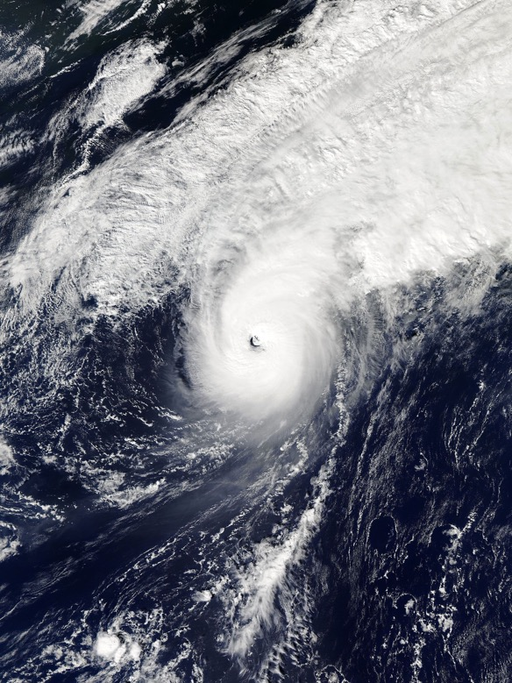
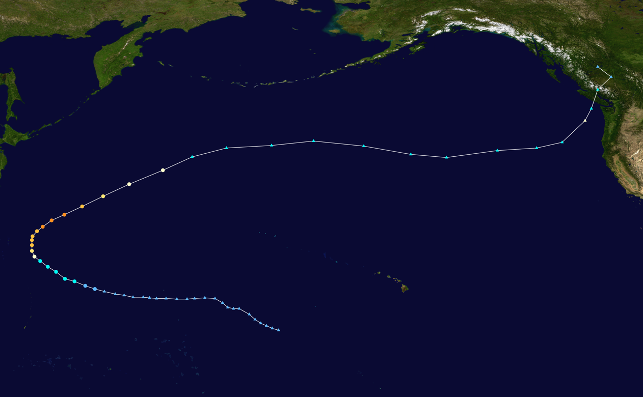
Typhoon Songda: October 3-October 16, 2016

Slide 3
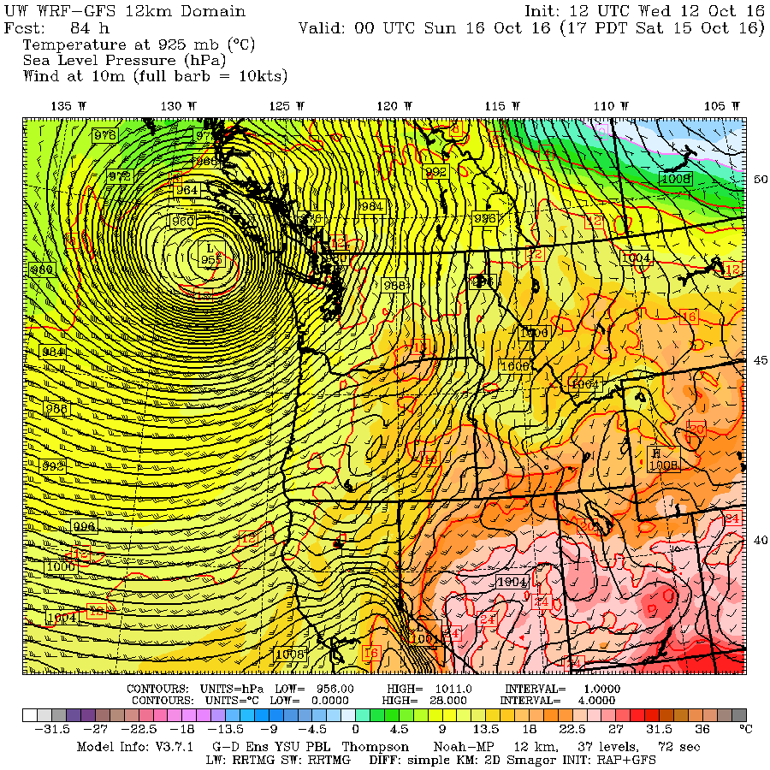
Forecasts Early in the Week Suggested the Possibility of an Extraordinary Event

Slide 4
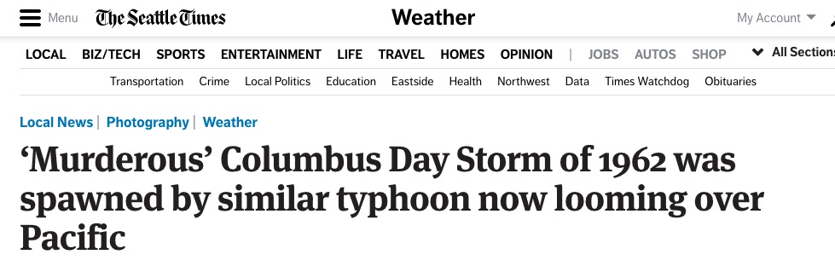
Similarities to the Columbus Day Storm Were Highlighted… Enhancing the Hype

Slide 5
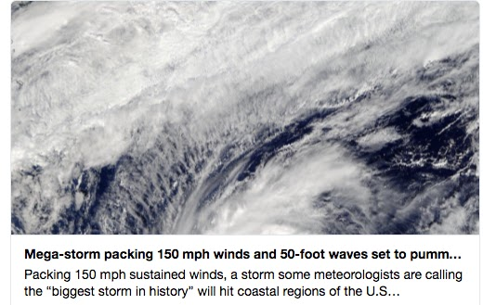
And some folks on social media went a bit wacky

Slide 6

But there was substantial uncertainties…
The storm would have to traverse the Pacific Ocean. Thousands of kilometers
Would have to undergo extratropical transition, changing its primary energy source.
Extratropical transition is well known to undermine predictability.
To get the forecast right over Seattle, needed to get the storm’s size/structure right, storm’s central pressure right, and get the path right to 50-100 km or better.

Slide 7
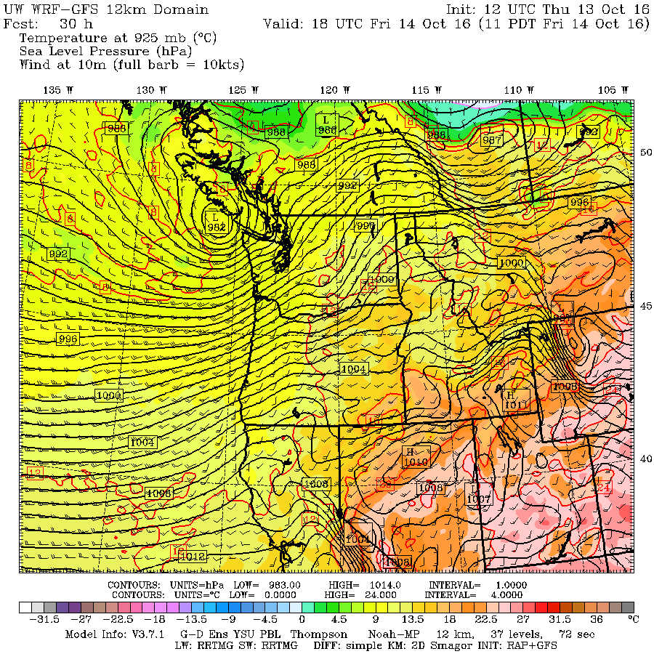
By Thursday, a very different solution was apparent. And another storm would come through on Friday
Friday’s Storm

Slide 8
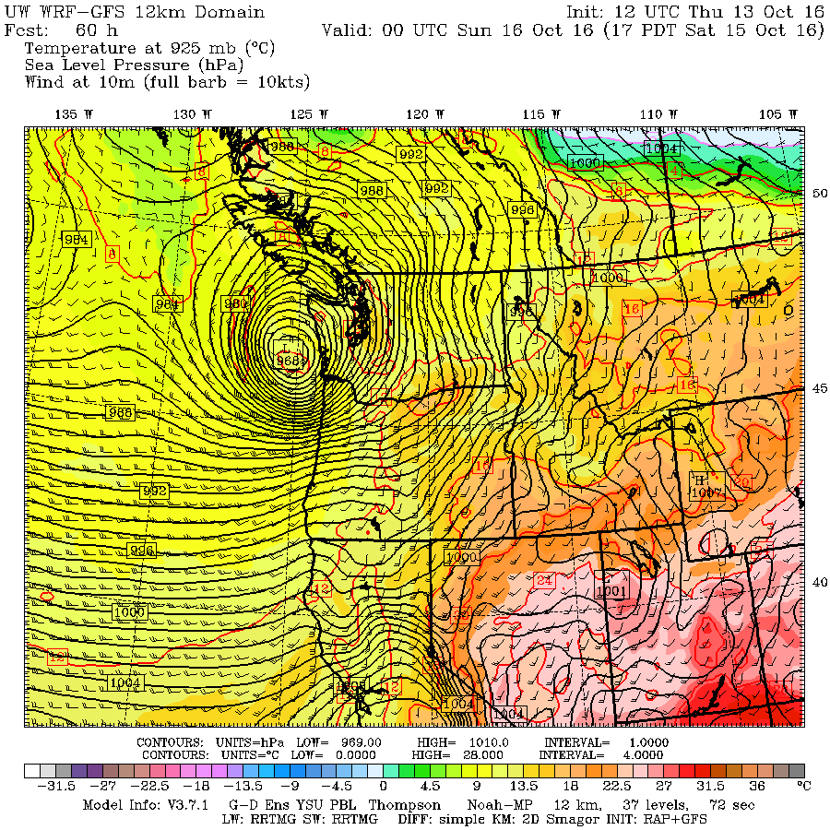
Forecast for Saturday, Initialized 4 AM Thursday

Slide 9
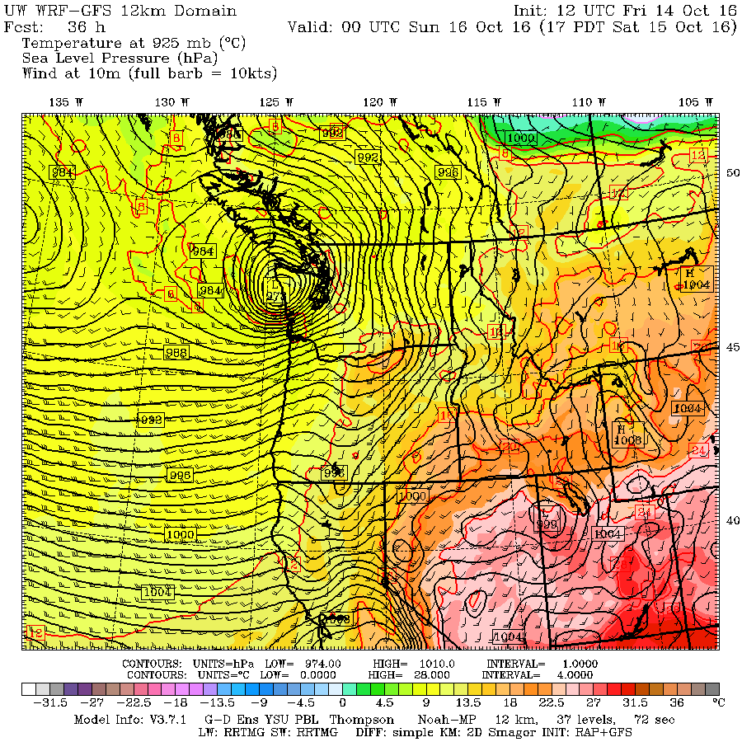
Friday’s Forecast was weaker still Very compact storm Double barrel storm.

Slide 10
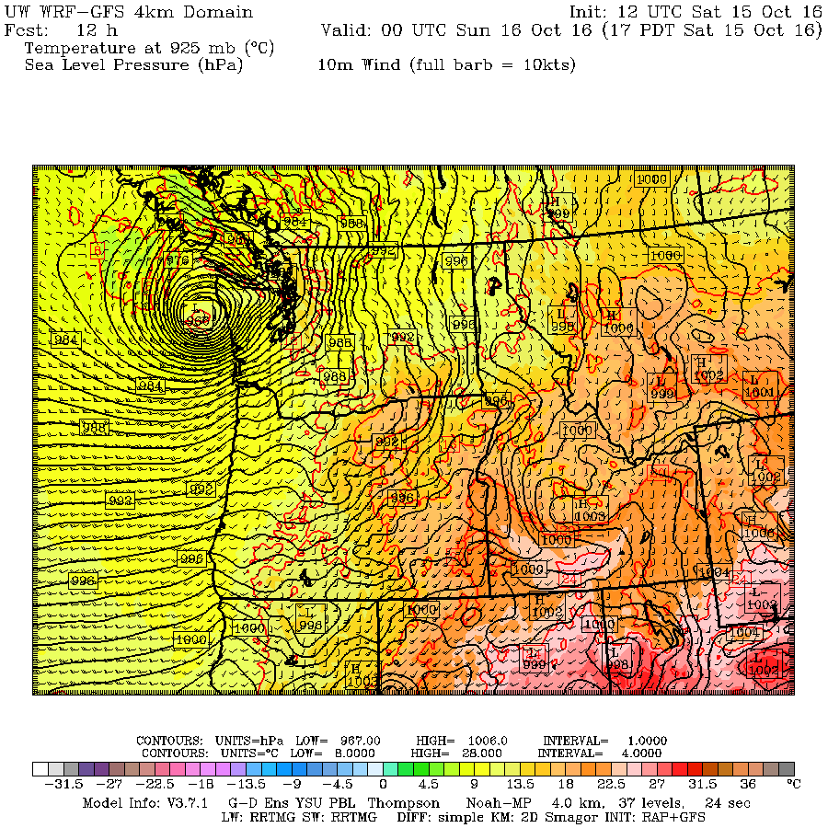
The forecast Saturday morning.

Slide 11
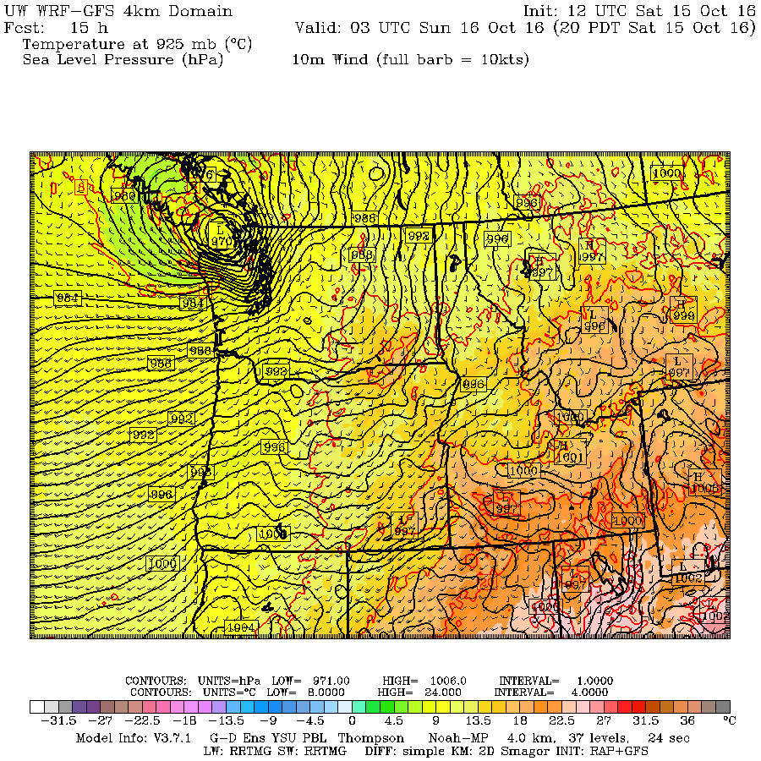

Slide 12
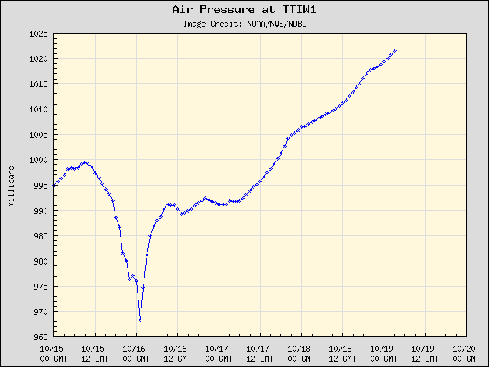
Central Pressure Verified Well

Slide 13
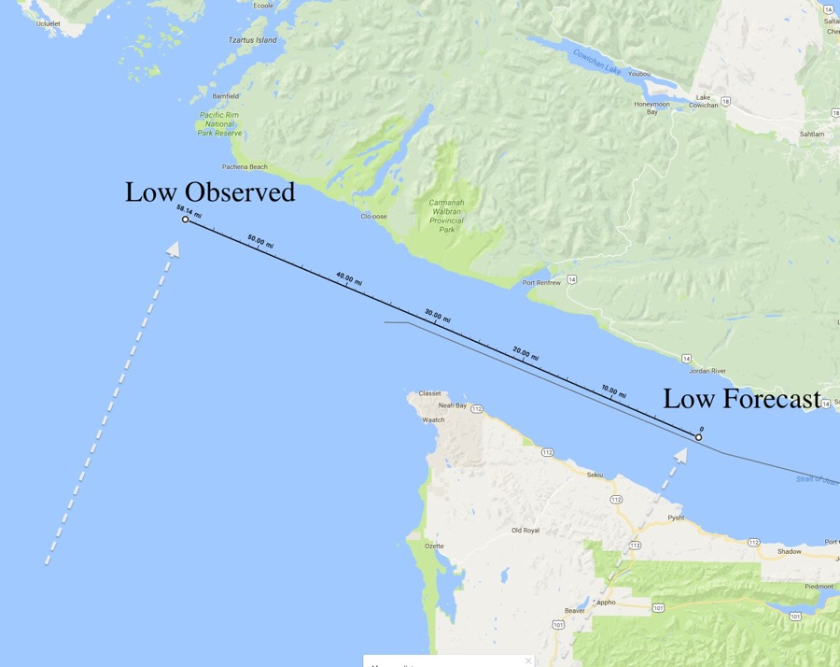
Forecast Position Error (24h)

Slide 14
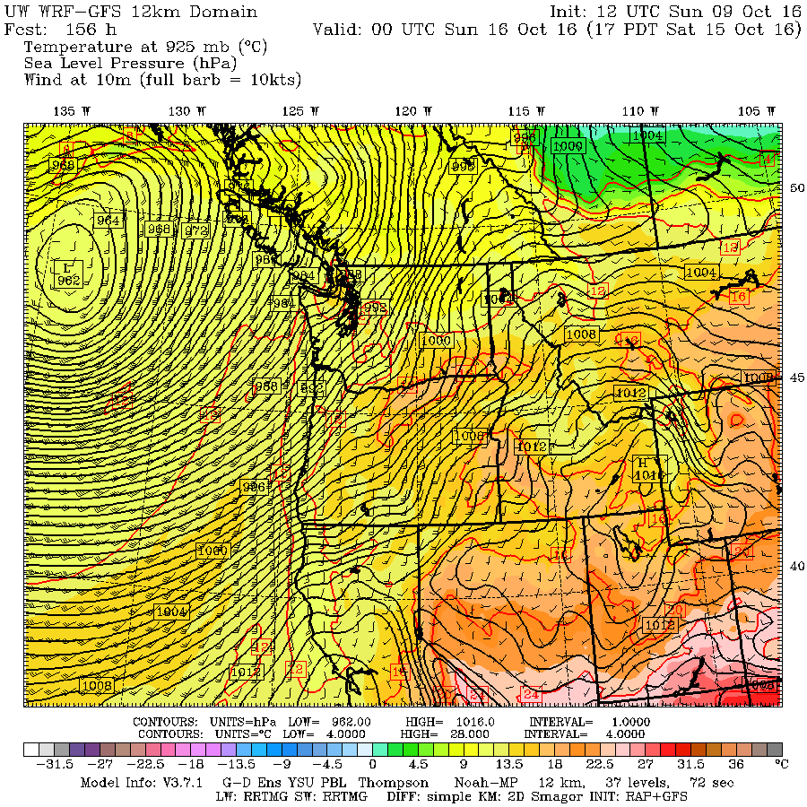
Animation of Forecasts Valid 5 PM Saturday

Slide 15
The Storm Was Amazingly Compact Which Compounded the Prediction Problems

Slide 16
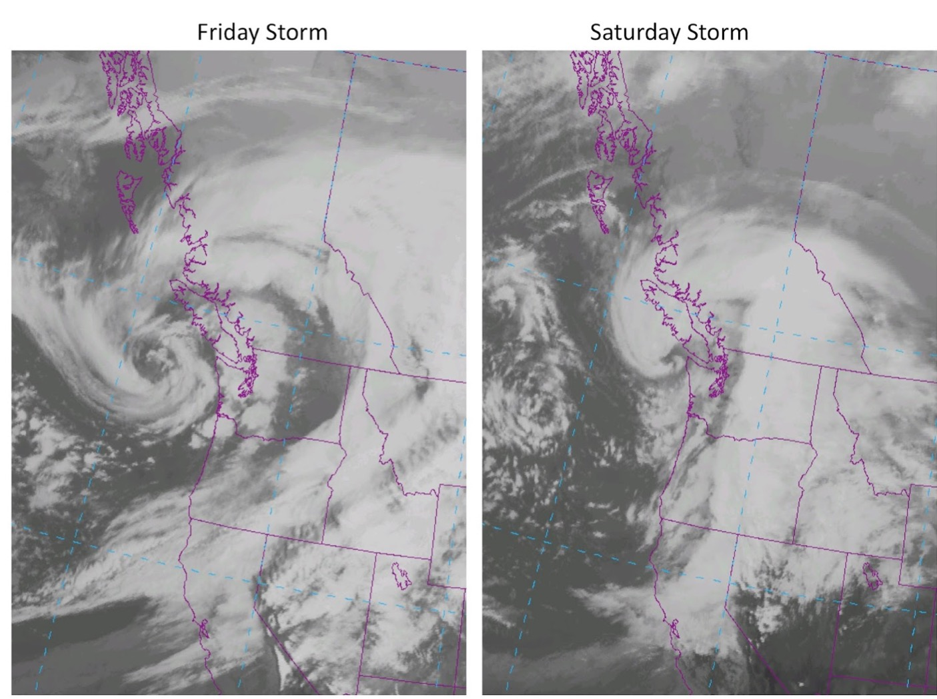

Slide 17
Amorphous Structure in the Visible

Slide 18
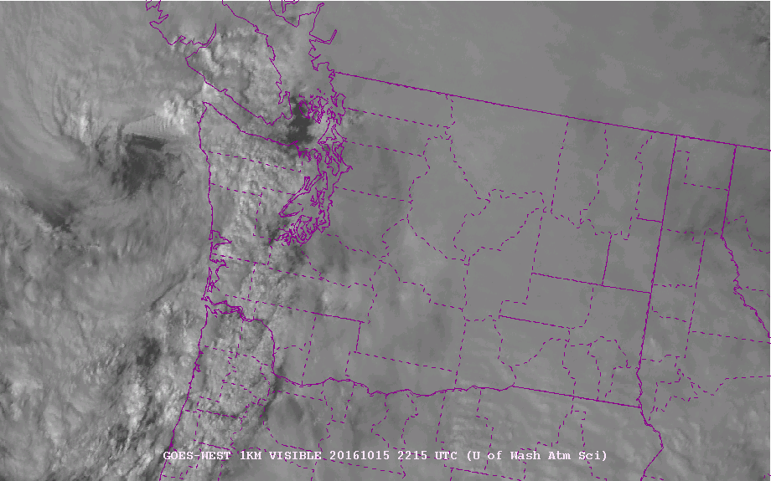
2215 UTC (3:15 PM) Saturday, Oct 15th

Slide 20
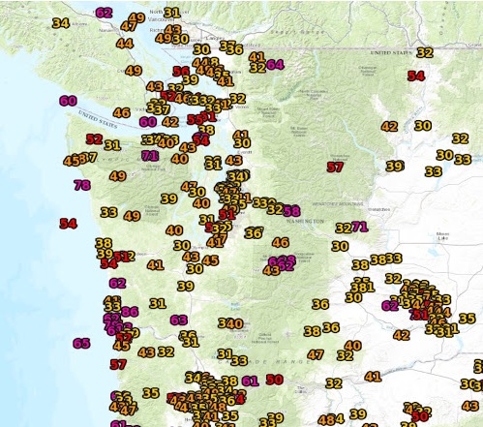
Max Wind 10 mph more and no one would have complained

Slide 21
The Langley Coastal Radar Picked it Up, But no Radar on Oregon Coast was a Problem

Slide 22
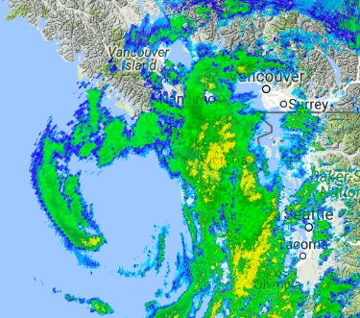
4 PM radar

Slide 23
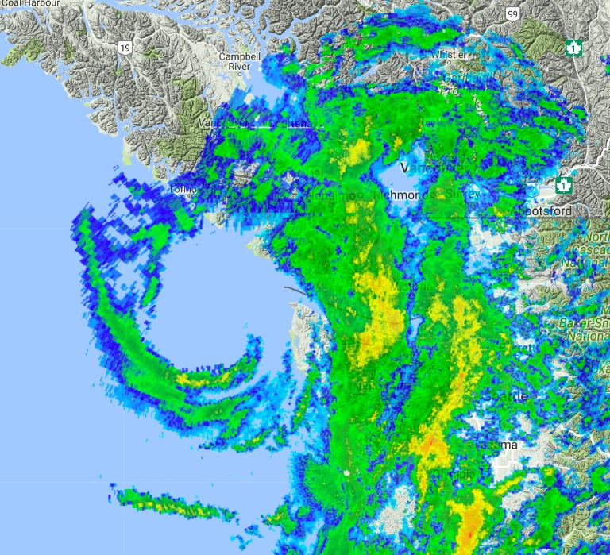
5:10 PM

Slide 24
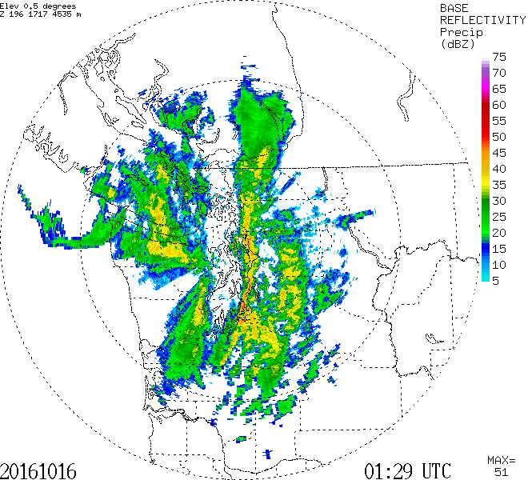
6:29 PM

Slide 25
Big Problem for the Storm: Double Low

Slide 26
Aftermath

Slide 29
The Worst Blow of All

Slide 30
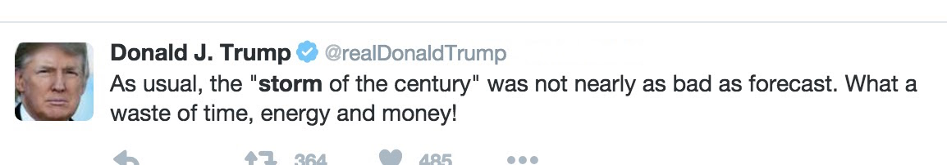

Slide 31
Bottom Line
The forecasts were very uncertain and changing until the last day.
Initial model forecasts showed potentially catastrophic storm, but the uncertainty was huge.
We did not communicate that uncertainty effectively.
By Thursday afternoon, it was clear that the storm would be considerably weaker and smaller. But still potentially damaging along the coast and parts of the interior.
We did not communicate this change effectively enough, with the media still talking about an historic storm.
By Saturday AM, it was clear that the storm would be small and intense, but not as strong as earlier thought.
The small (50 km) track error was compounded by the small size.

Slide 32
Bottom Line
The community needs to provide far more uncertainty/probabilistic information for major windstorm events.

Slide 33
The END

