Slide 1
Atmospheric Sciences 370 Observing Systems
Winter 2022

Slide 2
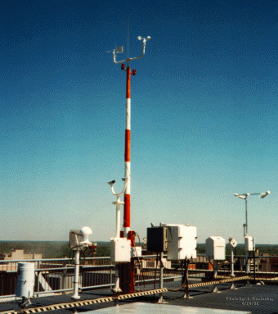
ASOS: Automated Surface Observing System
Backbone Observing System in the U.S.

Slide 3
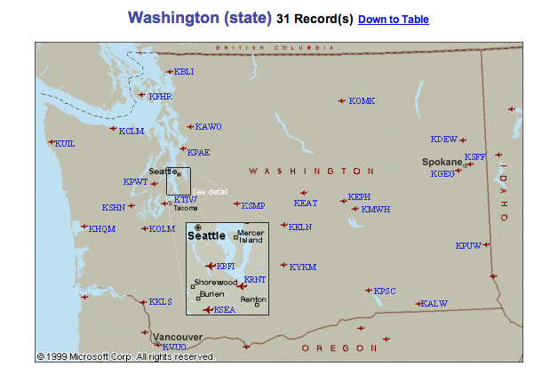
ASOS
Located at primary and secondary airports
Supported by the FAA and NWS
High quality instrumentation that is well maintained and calibrated.
Reported in METAR format (more later)

Slide 4
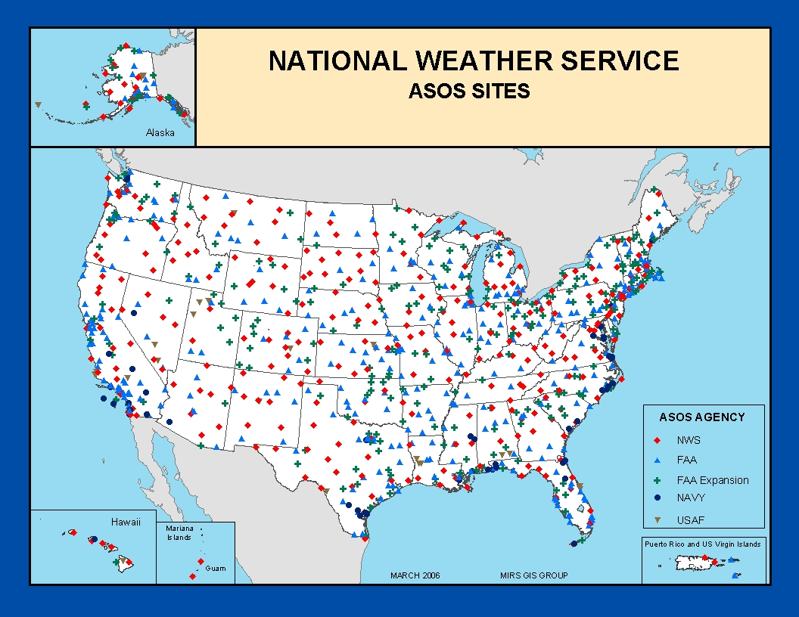

Slide 5
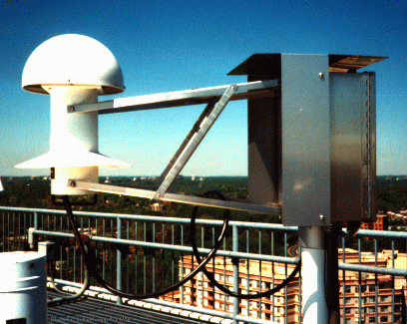
Hydrothermograph

Slide 6
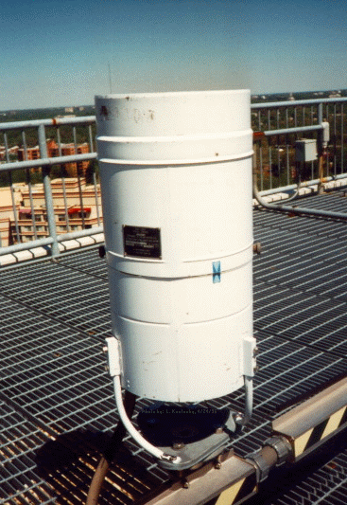
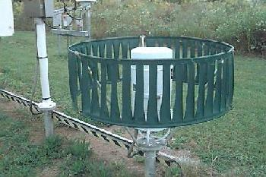
Many are shielded
Precipitation Gauges

Slide 7
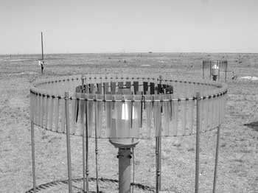
Some Even with Double Shields
Shields reduces wind and turbulent eddies around gauges than can influence catch efficiency. Largest effect on snow.

Slide 8
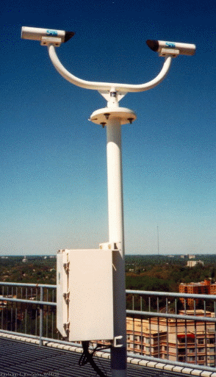
Laser Weather
Identifier
No human intervention!

Slide 9
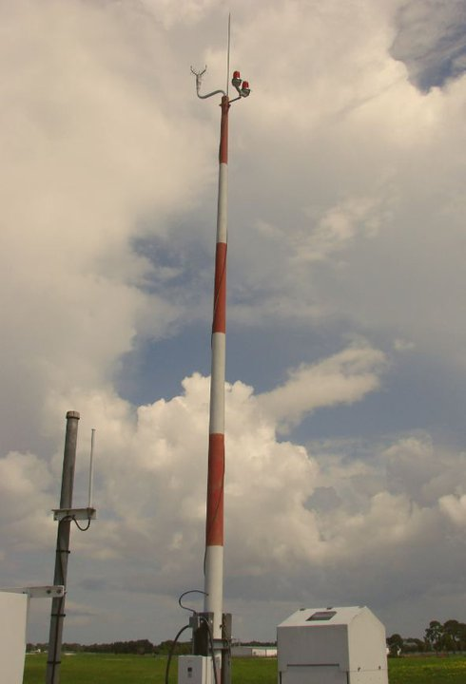
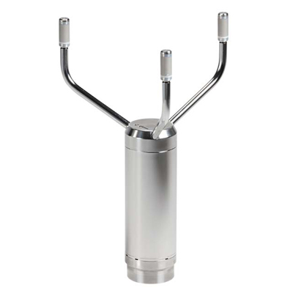
Acoustic Anemometer

Slide 10
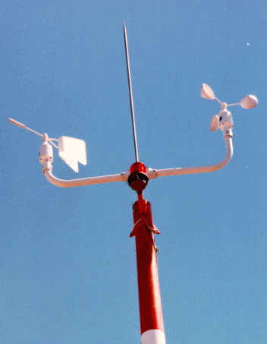
No longer used in ASOS!
Suffered from icing.
Did not measure low speeds well.
Anemometer
Wind Vane

Slide 11
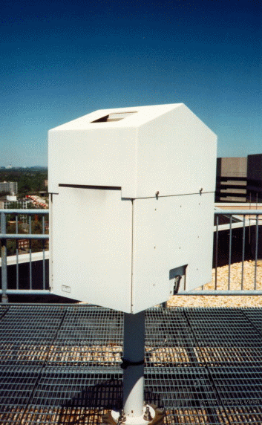
Ceiling is the height of the lowest cloud layer
Very important for aviation.
Laser Ceilometer

Slide 12
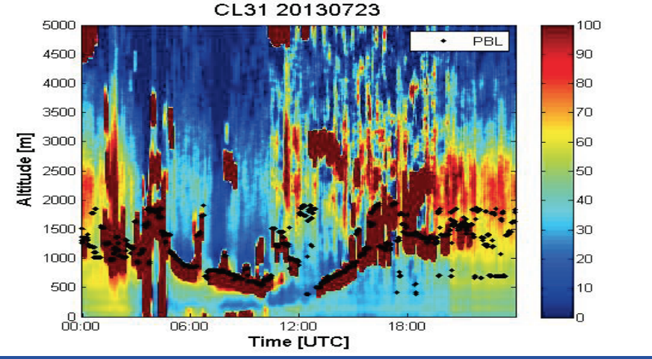

Slide 13
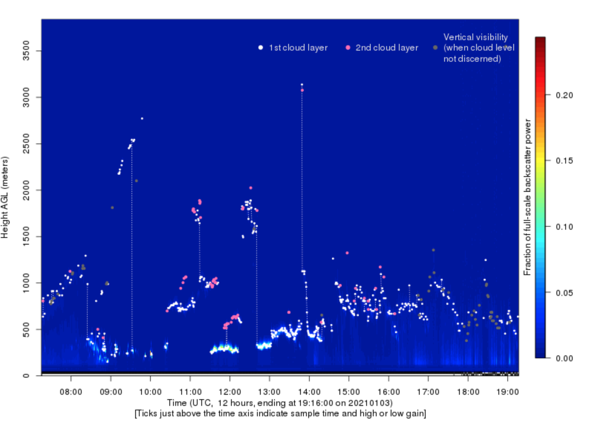
UW Ceilometer

Slide 14
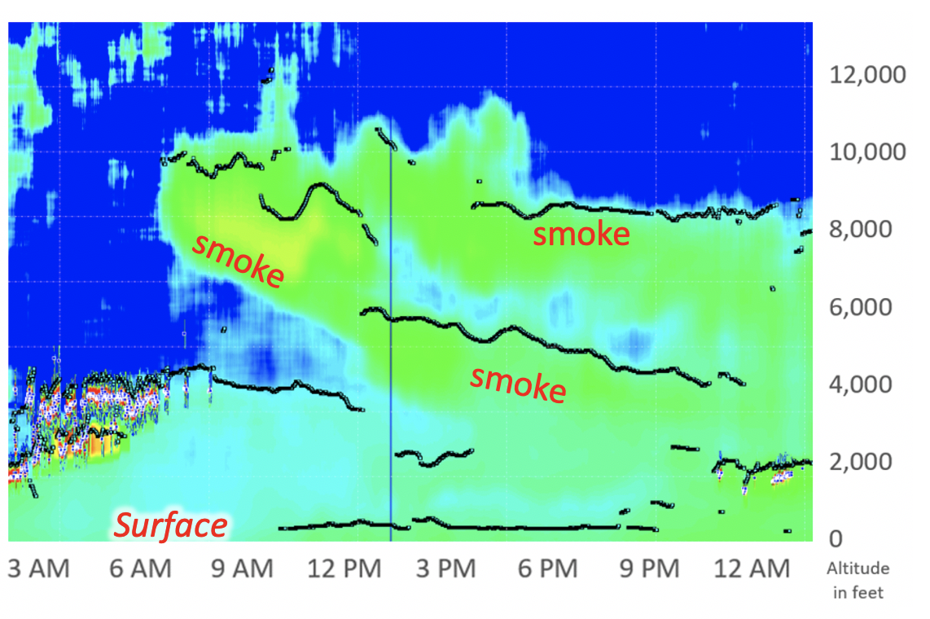
Can Sense Wildfire Smoke

Slide 15
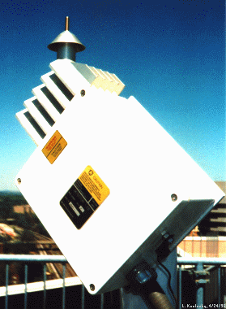
The ASOS Freezing Rain Sensor
Uses an ultrasonically vibrating probe to detect the presence of icing conditions. The vibrating frequency of the probe decreases with the accumulation of ice.

Slide 16
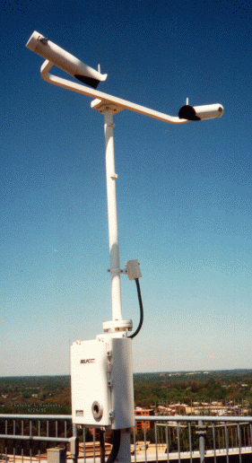
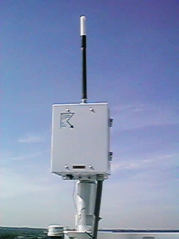
Lightning Sensor
Visibility Sensor

Slide 17
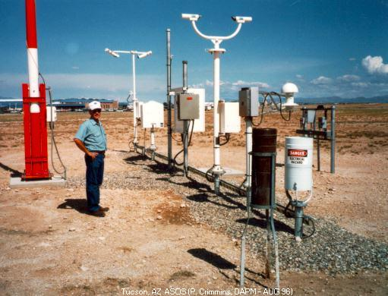
Full ASOS system in Arizona

Slide 18
METAR Format
ASOS data (and airport observations worldwide) are transmitted in METAR format.
Name came from the French words, MÉTéorologique ("Weather") Aviation Régulière ("Routine").
Example: KSEA 042353Z 11008KT 10SM FEW050 SCT070 OVC090 09/03 A2879 RMK AO2 SLP756 60001 T00940033 10117 20083 58013
Will learn more about it in Lab

Slide 19
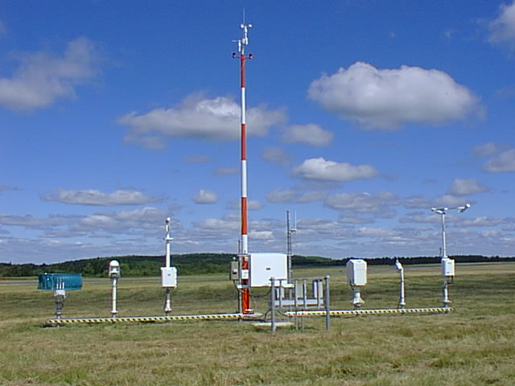
Observing Heights (ASOS and Most Official Obs)
Temperature and dew point (2-m)
Wind speed and direction (10-m)

Slide 20
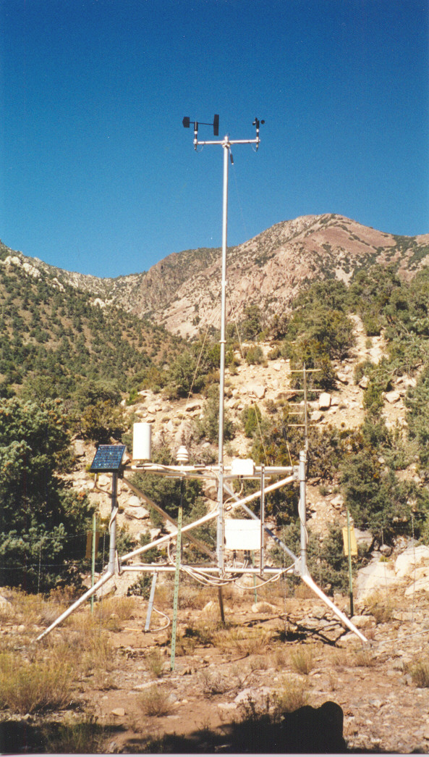
Many Other Surface Networks
Bureau of Land Management
RAWS
Agrimet
PAWS
Department of Ecology
Puget Sound Clean Air
BC Hydro
BC Olympics
Weather Underground
Many more!

Slide 21
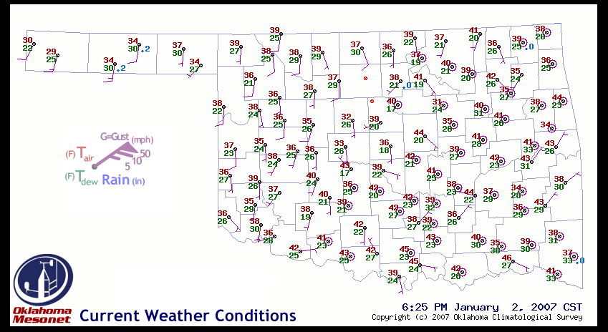
Oklahoma Mesonet

Slide 22
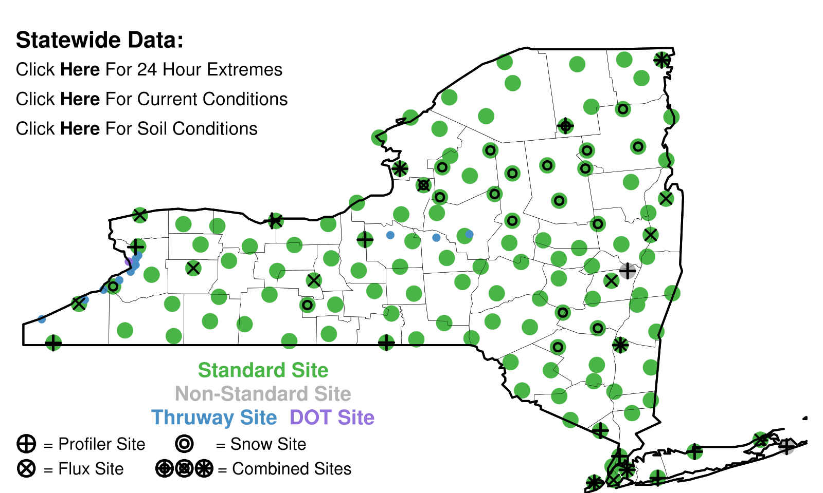
New York Mesonet

Slide 23
Networks of Networks
UW: We collect data from about 70 networks in real time over the Northwest
MesoWest: Collects about 100 networks over the western third of U.S.
MADIS: NOAA national collection of mesonets

Slide 24
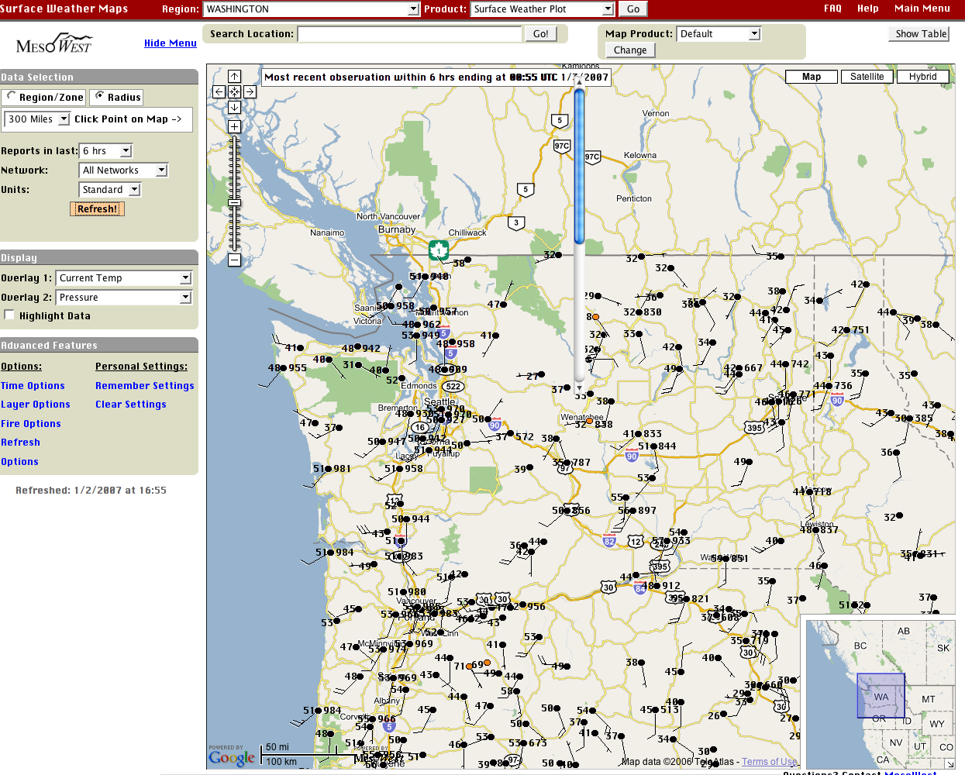

Slide 25
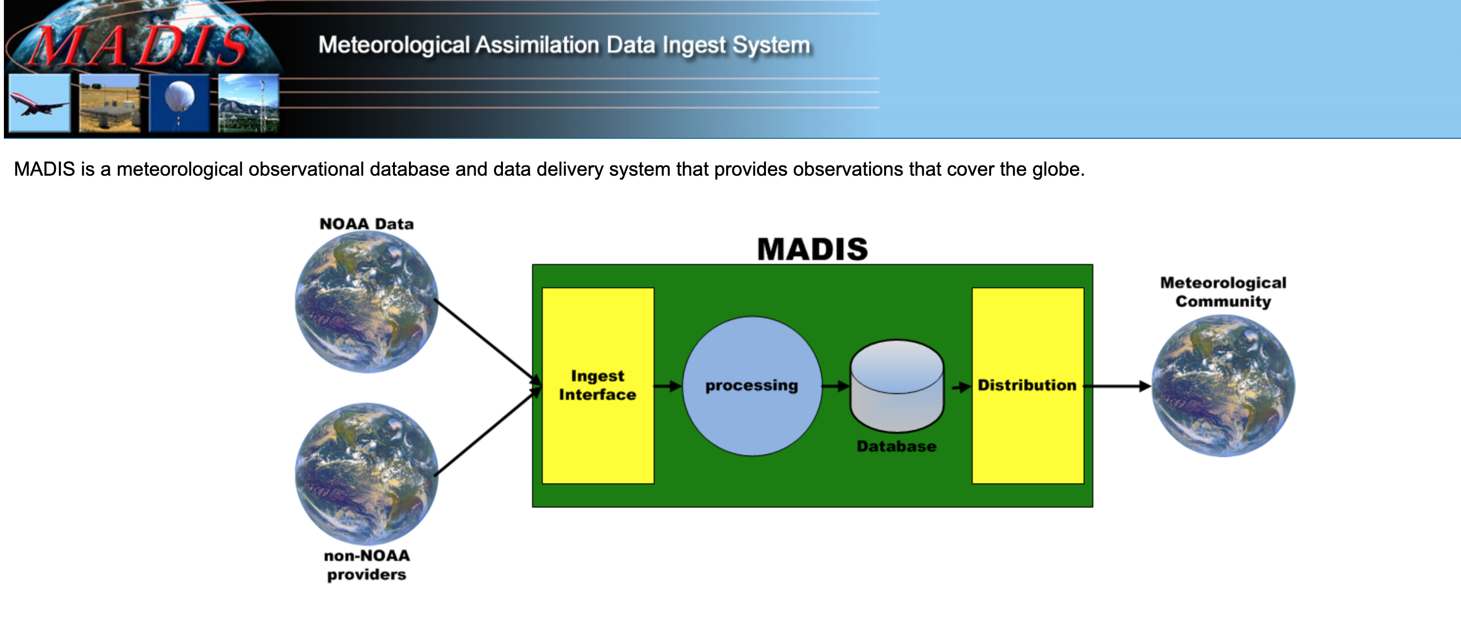

Slide 26
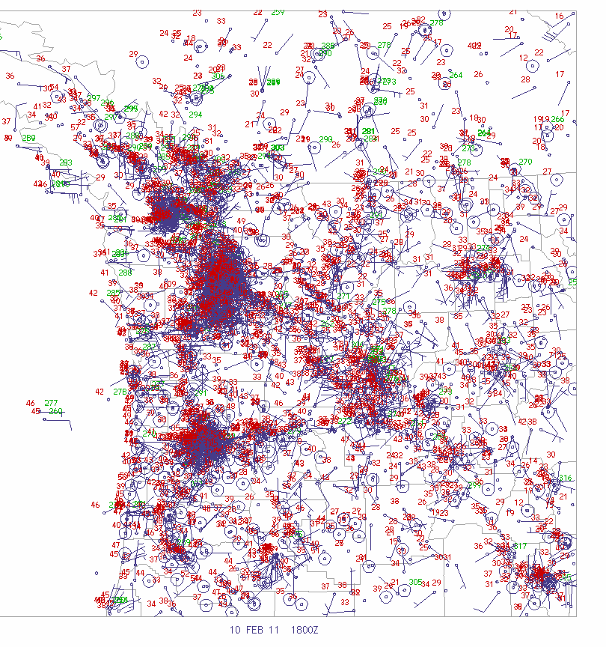
Pacific Northwest Surface Observations
3000-4000 observations per hour over WA and OR

Slide 27
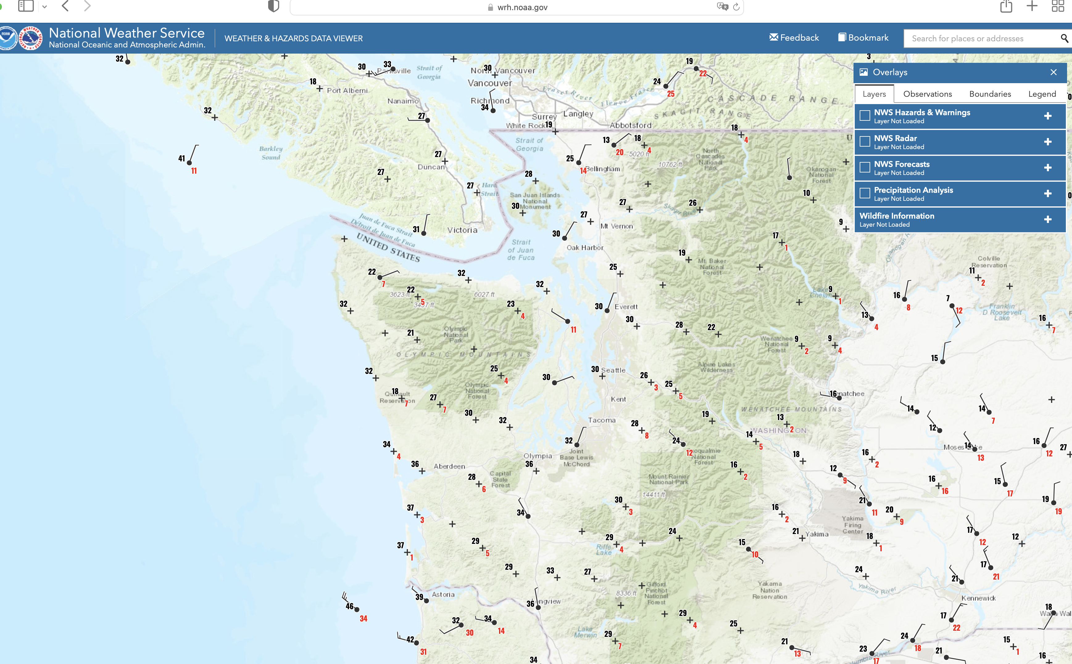
One of the best viewers of many networks: NOAA Weather/Hazards
https://www.wrh.noaa.gov/map/?obs=true&wfo=sew

Slide 28
Global Surface Observation Coverage

Slide 29
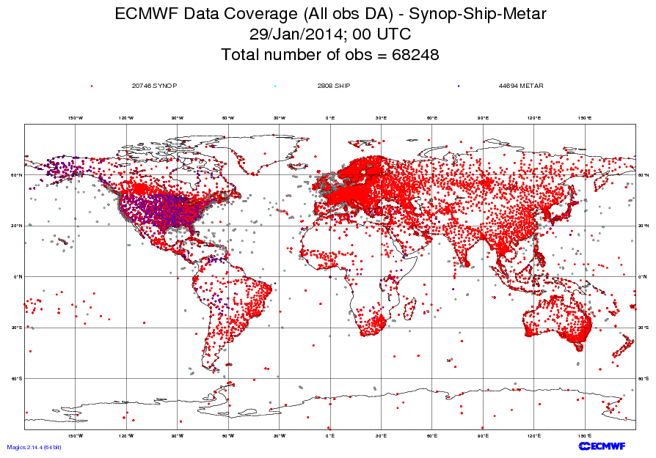
A lot more data over land/northern hemisphere

Slide 30
Marine Weather and Surface Ocean Reports

Slide 31
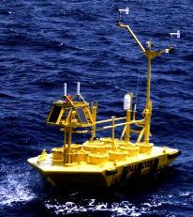
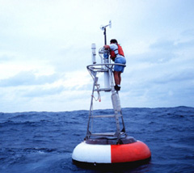
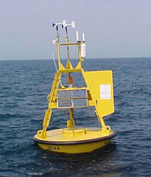
Ocean and Lake
Weather Buoys
Anchored

Slide 32
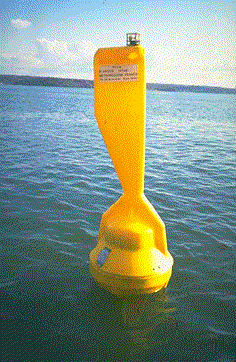
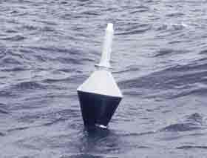
Drifting Buoys
Wind
Pressure

Slide 33
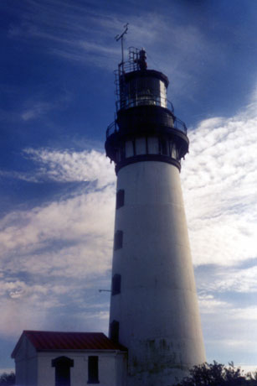
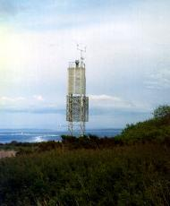
Coastal Marine (CMAN) Reports from the Coast Guard

Slide 34
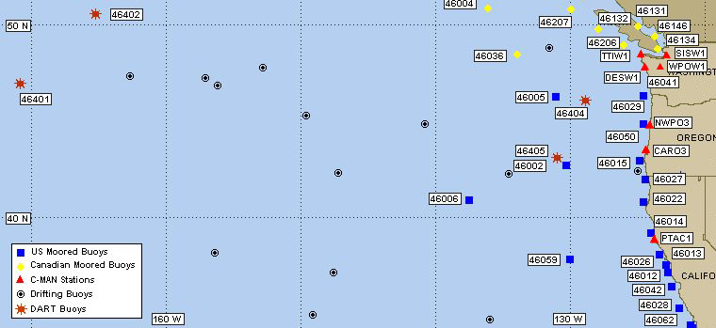
Northwest Buoy and CMAN Locations

Slide 35
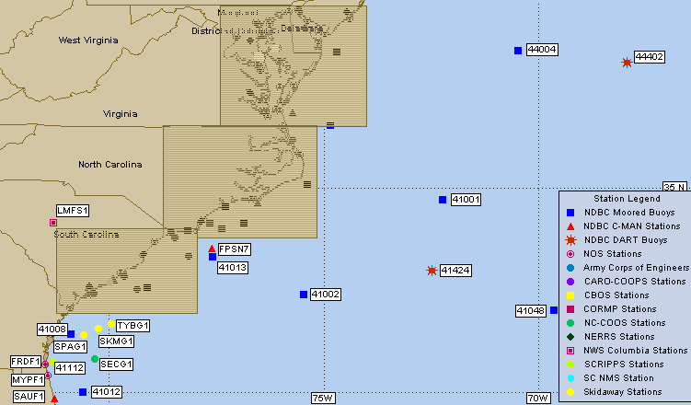

Slide 36
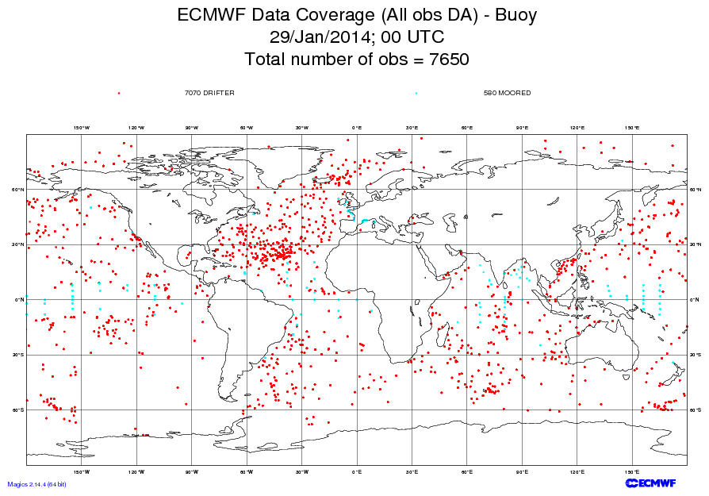

Slide 37
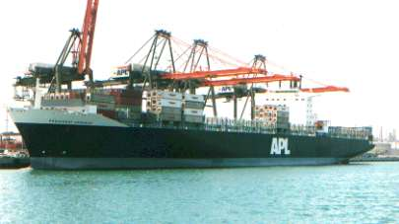

Ship Reports: Marine VOS Program
Volunteers Observers--generally 6-hourly reports
Highly variable quality and frequency

Slide 38
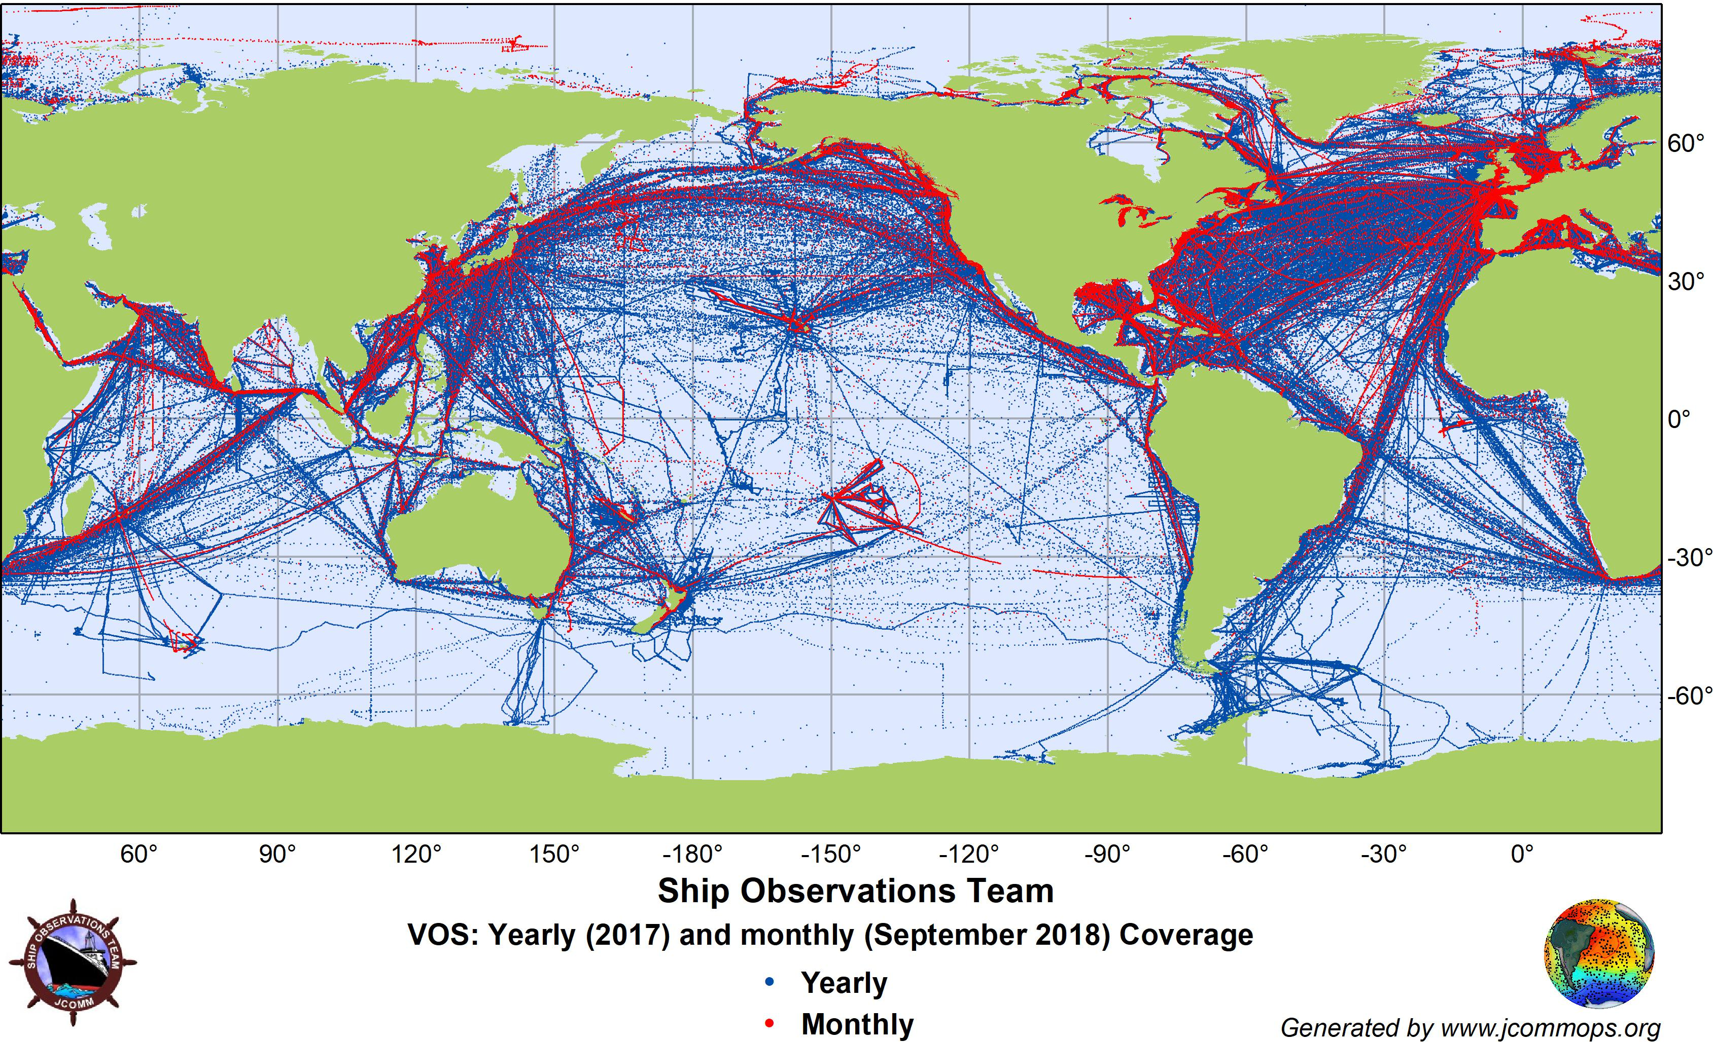

Slide 39
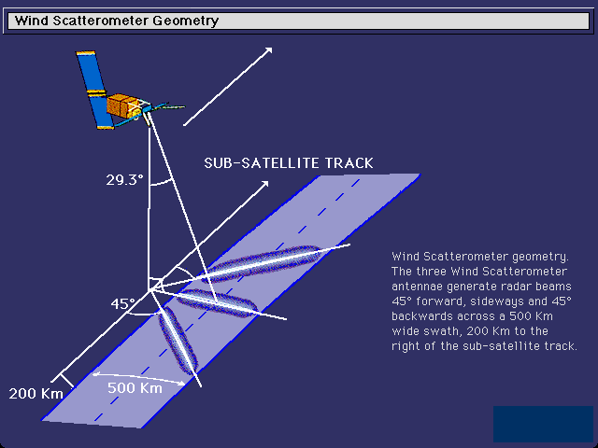
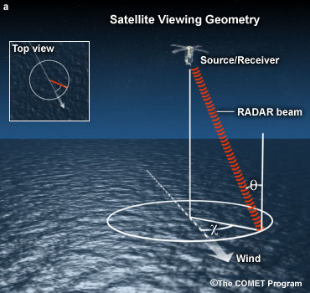
Satellite Scatterometers: Microwave Scattering Off Ocean Waves: surface wind and direction

Slide 40
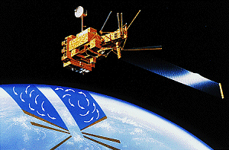
QuickScat Satellite
Bounces microwaves off the ocean surface
Capillary waves dependent on wind speed and directon

Slide 41
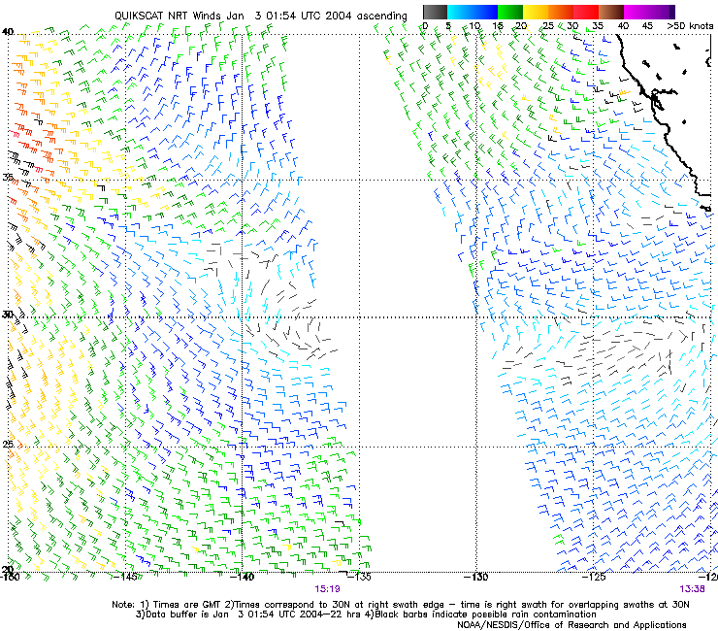
Satellite
Microwave
Scatterometer
Winds

Slide 42
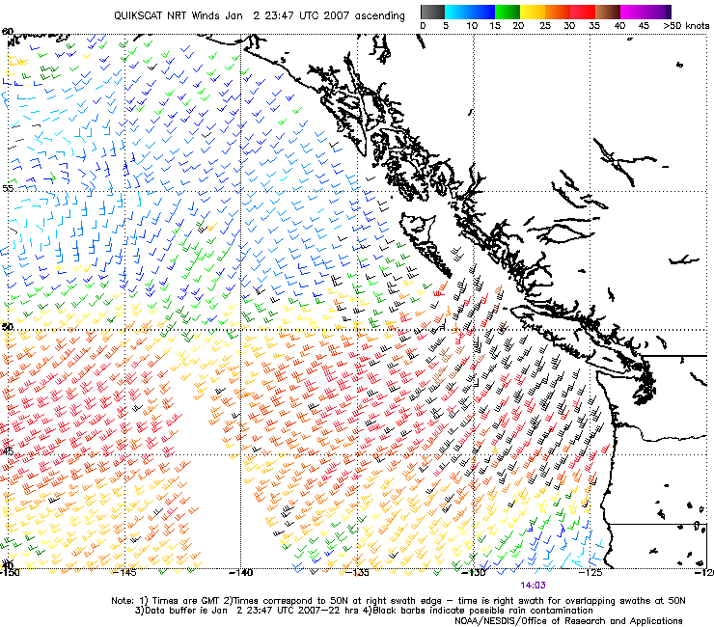

Slide 43
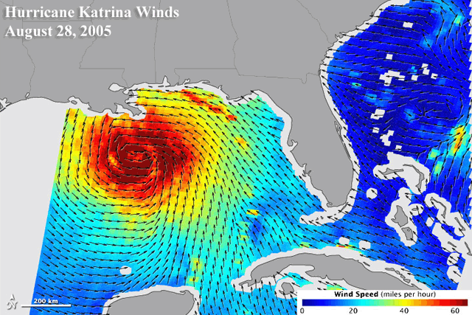
Satellite scatterometers

Slide 44
Upper Air Data

Slide 45

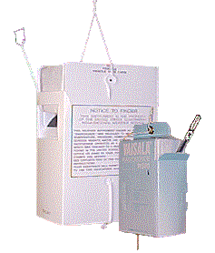
Radiosondes
First launched in 1929

Slide 46
Radiosondes
Provides temperature, humidity (relative humidity, pressure, and wind speed/direction)
Generally launched twice a day (00 and 12 UTC).

Slide 47
Radiosondes
A typical NWS radiosonde sounding ascent can last in excess of two hours.
In that time, the radiosonde can ascend to an altitude exceeding 35 km (about 115,000 feet) and drift more than 300 km (about 180 miles) from the release point.
Typical pressure at balloon burst about 5 hPa (1/200th of surface pressure).

Slide 48
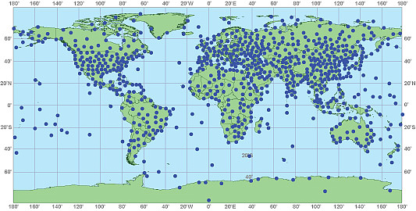
Generally twice a day at 00 and 12 UTC
About 1000 locations around the world

Slide 49
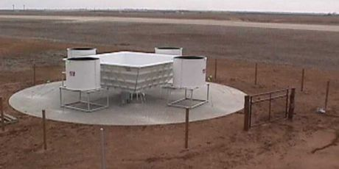
Radar Wind Profiler and RASS (Radio Acoustic Sounding System)

Slide 50
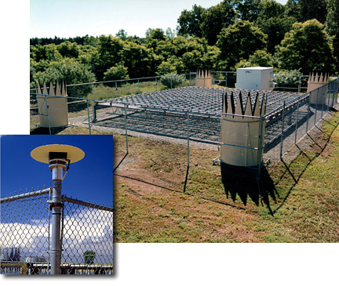

Slide 51

Seattle Profiler/RASS

Slide 52


Slide 53


Slide 54

ACARS: Aircraft Observations
Generally on wide-body aircraft
Aircraft Communications Addressing and Reporting System

Slide 55

Available at cruise altitude and ascent/descent.

Slide 56


Slide 57


Slide 58

Now getting TAMDAR data from AIRDAT/Panasonic: Commuter and Short Haul Aircraft

Slide 59


Slide 60


Slide 61

Weather Satellites Now Provide Roughly 99% of the Weather Data Going into Weather Prediction

Slide 62


Satellite Data
Geostationary and Polar Orbiting Satellites

Slide 63


GOES

Slide 64

Geostationary Image

Slide 65

Geostationary satellite see the whole hemisphere

Slide 66

Putting them together, one can monitor the entire planet

Slide 67


NOAA Polar
Orbiter Weather
Satellite

Slide 68

A polar
low
Polar Orbiters Provide a High-Resolution View

Slide 69
Weather Satellites Provide MUCH More Than Just Imagery

Slide 70

Cloud and
Water Vapor
Track Winds
Based on Geostationary Weather Satellites

Slide 71


Slide 72

Atmospheric Moisture Vectors from Satellites

Slide 73

GOES sounder unit: observes atmosphere/earth’s emissions in several wavelengths

Slide 74

Views the Earth
At many Wavelengths,
Each mainly sensing temperature at a specific layer

Slide 75

Satellite Temperature and Humidity Soundings

Slide 76

High-Resolution Infrared Radiation Sounder

Slide 77

Microwave Sounders

Slide 78
GPS Sounding
A constellation of GPS satellites orbit the earth.
A collection of other satellites can receive the GPS signal
By measuring the delay in time as the GPS signal is bent by the earth’s atmosphere, one can acquire atmospheric density information that can be used to create temperature and humidity soundings.
Can do this with fixed receivers on earth or with receivers on satellites--the COSMIC project.

Slide 79


Slide 80



Slide 81

Weather Radar
During the early 90s, the NWS installed a network of powerful Doppler Weather
radars, a.k.a.
NEXRAD
WSR88D

Slide 82

NWS Radar Sites

Slide 83
Weather Radar
Reflectivity (precipitation intensity)
Doppler Velocities (radial velocities)
Polarimetric Information (precipitation type and other information?
Much more later in class

Slide 84

Camano
Island
Weather
Radar

Slide 85

Crowdsourcing of Weather Data
Securing weather data from devices intended for other purposes.
Example: pressure data from smartphones
Example: smartphone reported weather conditons

Slide 86

Crowdsourcing of Weather Data. The Future?: Smartphone Pressures

Slide 87
Typical Observation Errors at the Surface
(Important when doing analyses!)
Sea Level Pressure
  Low-Elevation land stations +-.5 mb
  Ships +- 1-5 mb
Temperature: +-1C
Wind Speed: +-2-5 knots, very light winds often a problem—especially for classical anomemeters.
Relative Humidity: +-10%

Slide 88
Typical Radiosonde Errors
Geopotential heights:
  700 mb (hPa): 5-10 m
  500 mb 10-15 m
  300 mb 15-20 m
  100 mb 20-30 m
Temperature: +-0.5C
Wind speed: +-5%,+-10 degrees

Slide 89
Terminology
Direct versus Indirect observations
  Direct: measurement at the location of the instrument
  Indirect: remotely sensed using radiation measurements
Active versus passive remote sensing
  Active: instrument emits radiation, analyzes return
  Passive: analyzes incoming natural radiation

Slide 90
The END

