Slide 1

Why Has U.S. Numerical Weather Prediction Fallen Behind and What Can Be Done About It?
Cliff Mass
University of Washington
University of Oklahoma Presentation

Slide 2
“Mediocrity is self-inflicted”
Walter Russell

Slide 3
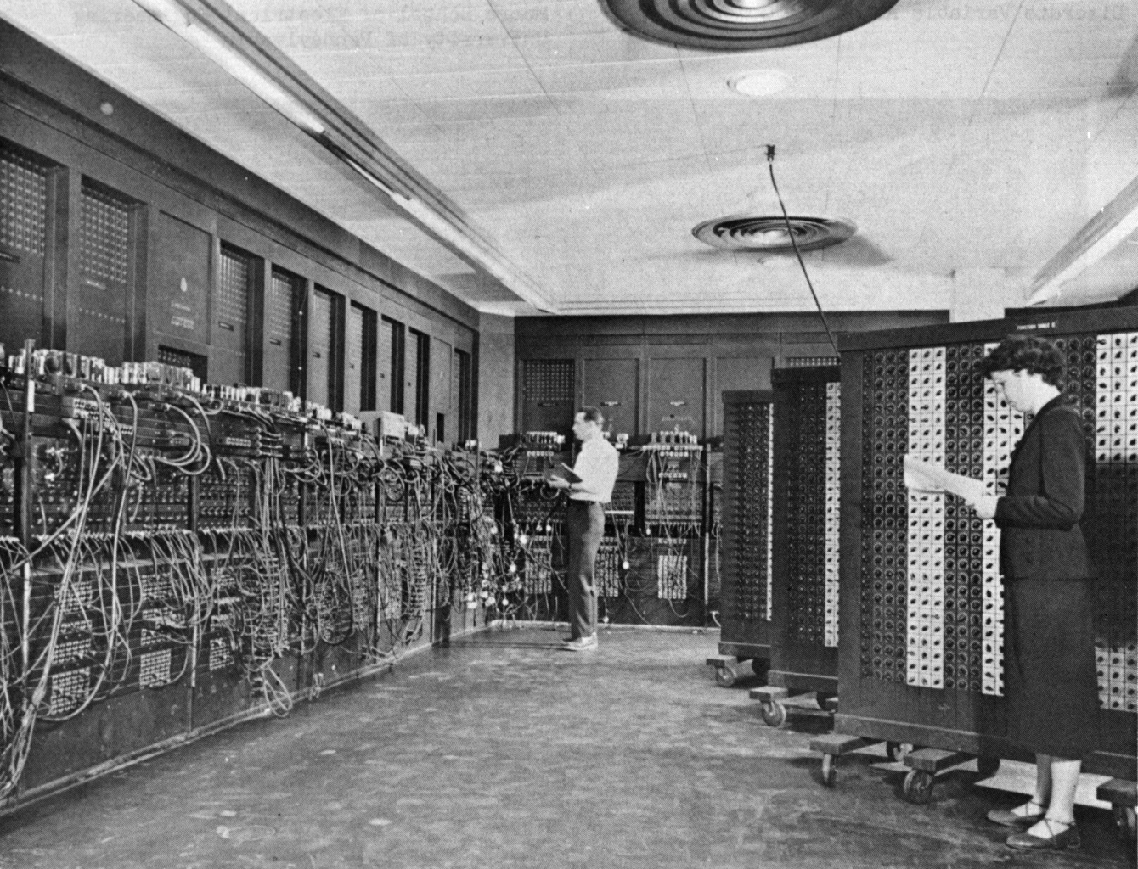
Numerical weather prediction began in the U.S. (1950)
ENIAC Computer

Slide 4
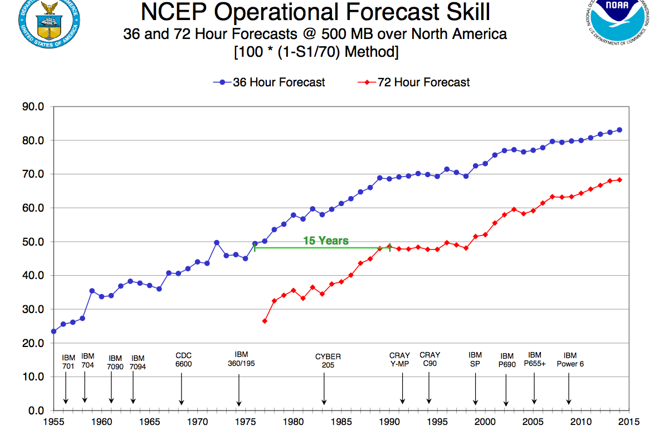
National Weather Service NWP has shown substantial improvements in forecast skill

Slide 5
A Huge Accomplishment
Complex and expensive observing systems (satellite, radar, and more)
Use of very large computers
Complex data assimilation and modeling systems with millions of lines of code
Cooperation among nations
Modeling from the molecular to the planetary scales.

Slide 6

It’s a miracle …

Slide 7
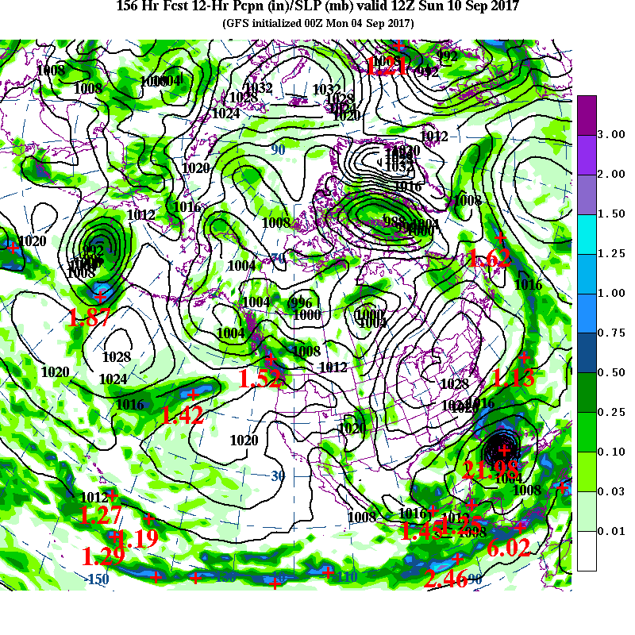
A Recent
Miracle: Hurricane
Irma
6.5 day
Forecast

Slide 8
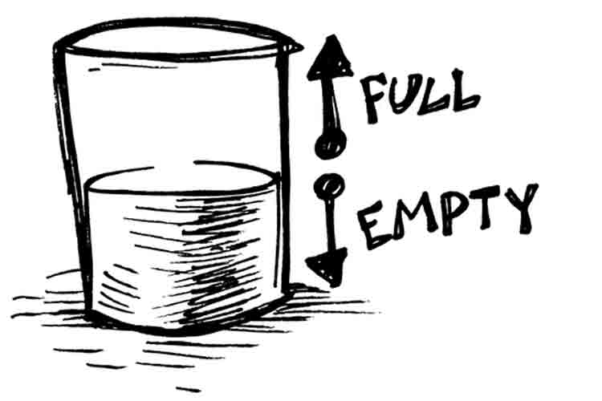
But something is wrong in U.S NWP: NOAA/NWS NCEP EMC is now in 3rd or 4th place in global prediction

Slide 9
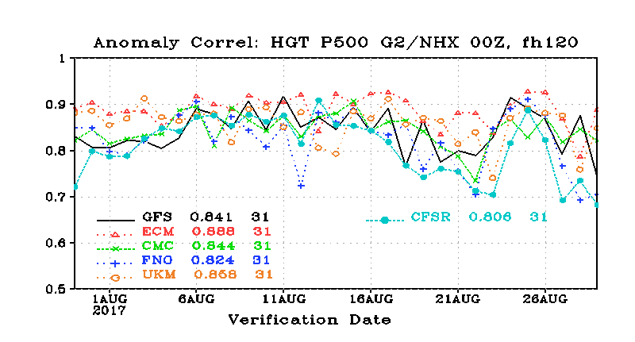
The Order: ECMWF, UKMET, CMC, NCEP
5 Days, N. Hemisphere, 500 hPa

Slide 10
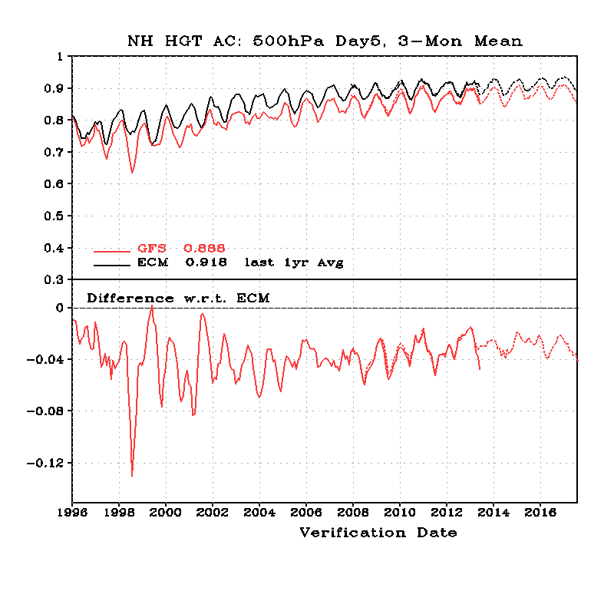
20-year Trend in NH Skill (500 hPa, Day 5)
Black-EC
Red-NCEP
NCEP
Worse
NCEP-ECMWF

Slide 11
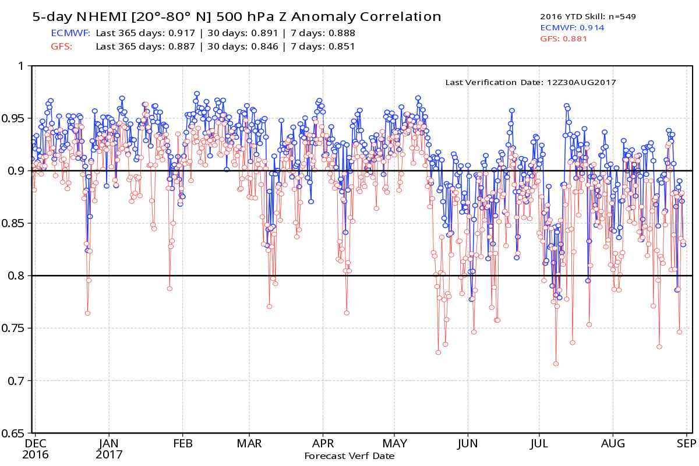
GFS Leads in Drop Outs

Slide 12
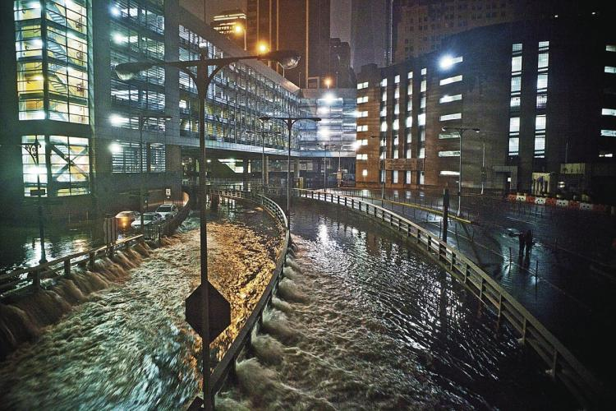
Hurricane Sandy: The Watershed Event

Slide 13
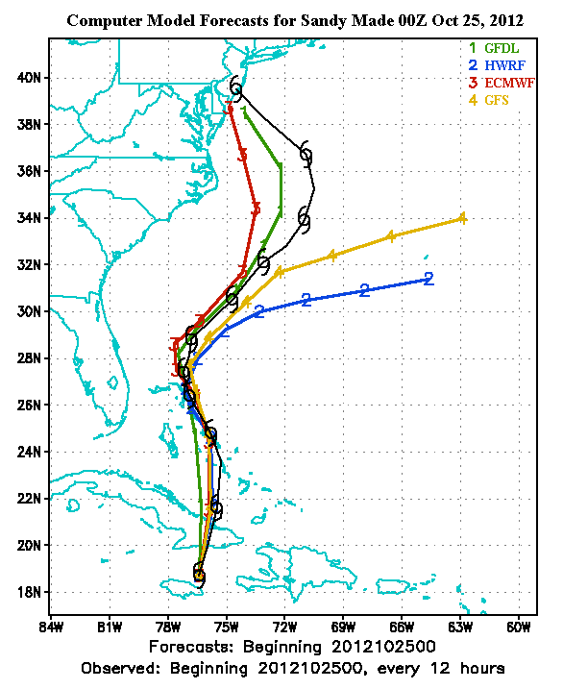
Hurricane Sandy
A week before, the ECMWF took the storm into the NE U.S, while GFS directed it out to sea.
ECMWF was right.

Slide 14
The Public and Media Noticed

Slide 15

NBC Nightly News
“we led the world during the 80s and 90’s, but we let it slip”
Al Roker, NBC News

Slide 16
And they kept on noticing…

Slide 17
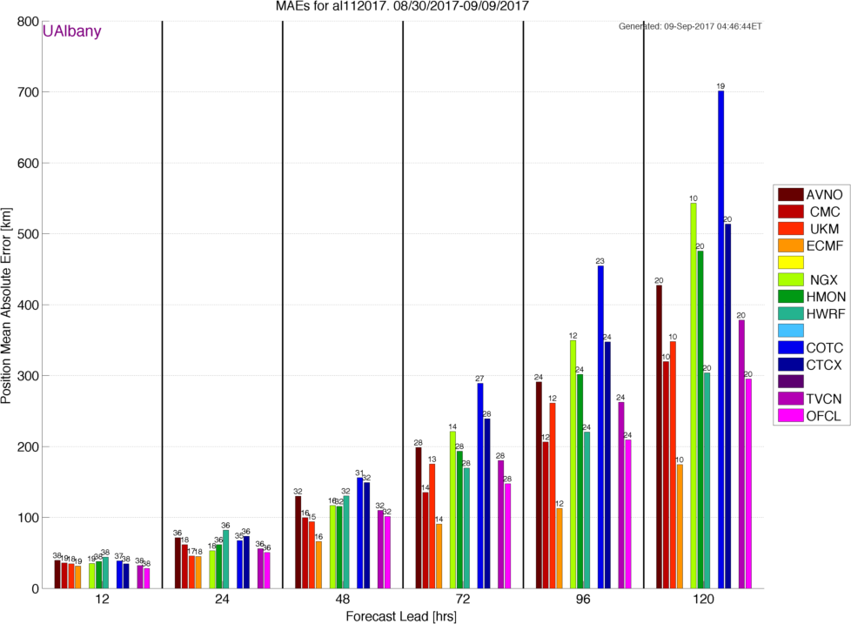
Irma: EC is Still Better
Statistics courtesy of Brian Tang, University of Albany

Slide 18
But the problems extend beyond global modeling…

Slide 19
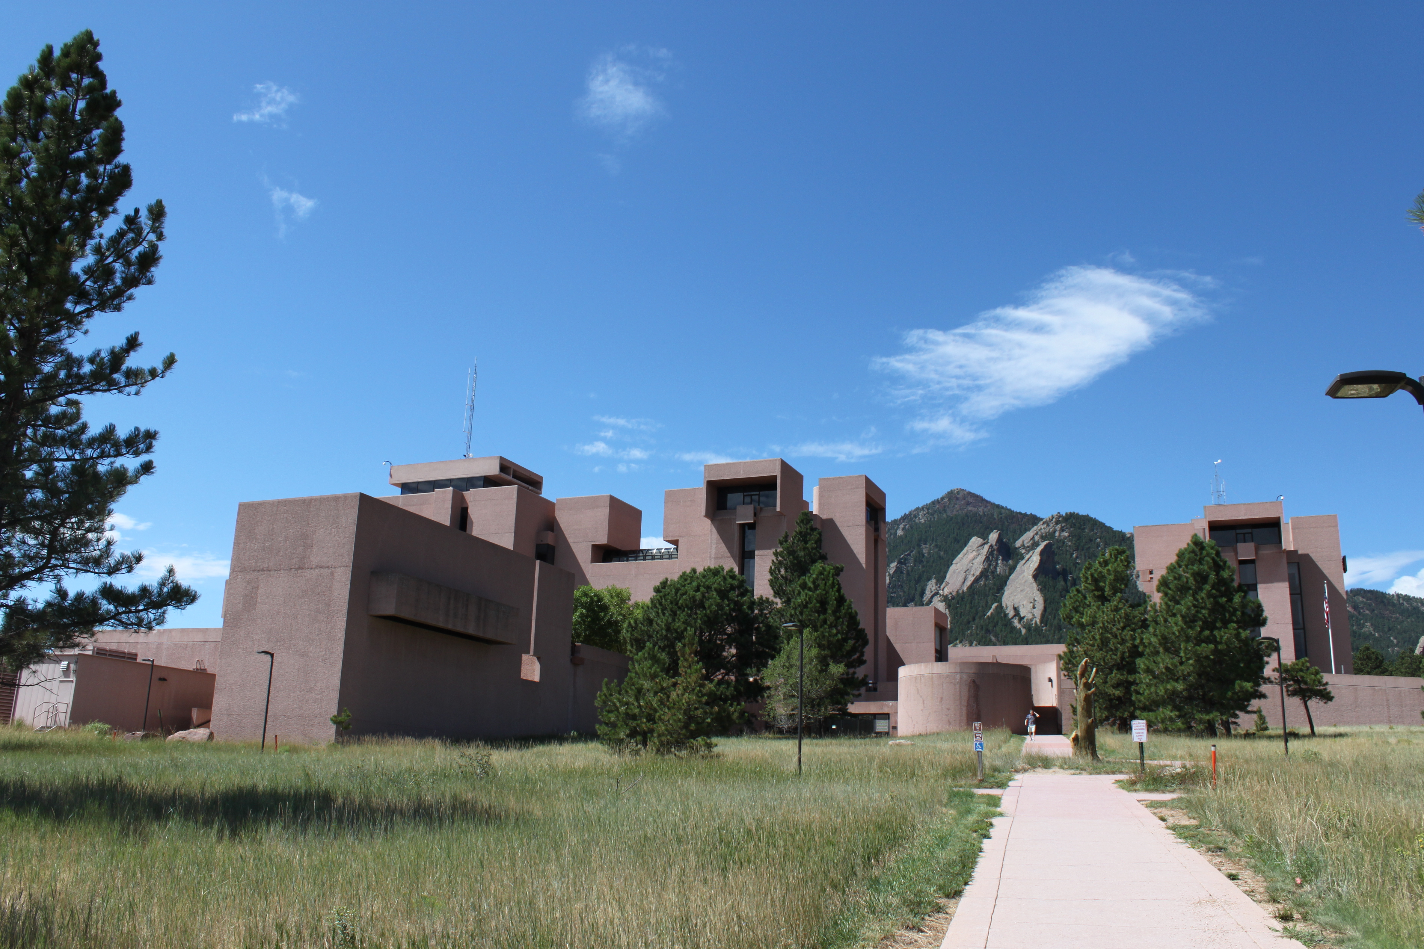

The research community and the operational communities are not working together effectively
WRF, MPAS
GFS, NMMB

Slide 20
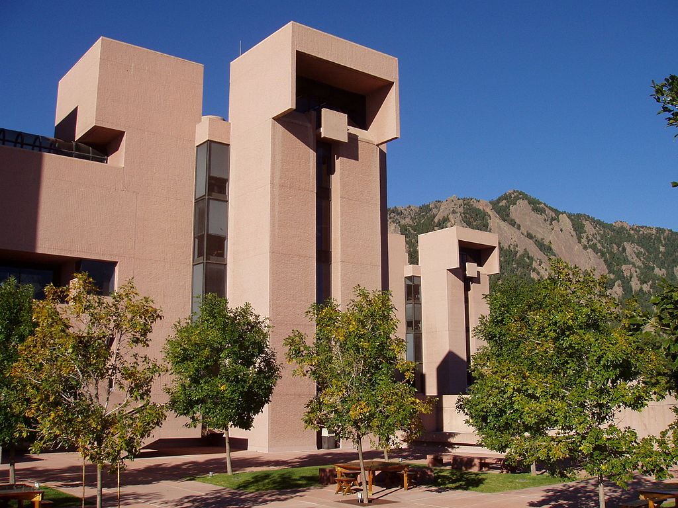
The U.S. has the largest weather research community in the world, but its contributions to U.S. operational NWP have been limited

Slide 21
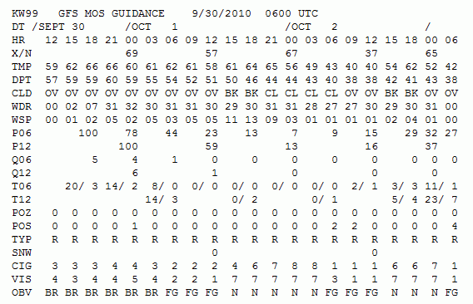
NWS Model Postprocessing Uses a Technique of the late 1960s:
Model Output Statistics (MOS)

Slide 22
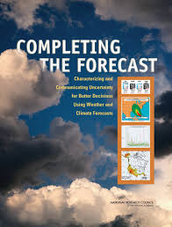
The National Weather Service Has Delayed Moving Towards High Resolution Ensembles
Over a dozen workshops and NRC reports have called for a more aggressive move towards ensembles and probabilistic prediction

Slide 23
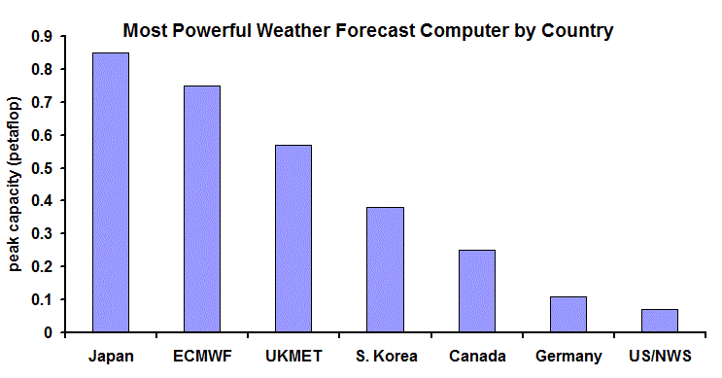
And NWS Computer Resources Have Been Under-Resourced For Years
2013

Slide 24
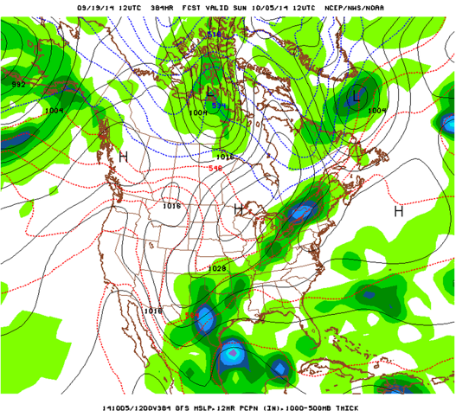
This Talk
The history of U.S. NWP
Why have we fallen behind in global prediction
Deficiencies in regional and local prediction
What can be done to fix the situation.

Slide 25
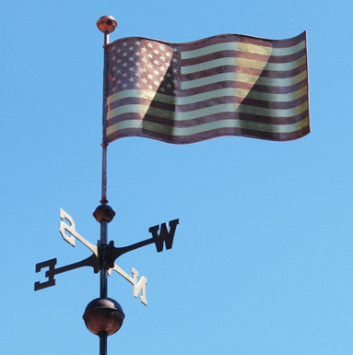
Numerical Weather Prediction (NWP) Began in the U.S.

Slide 26
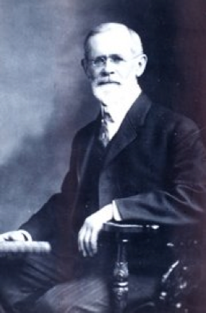
American Cleveland Abbe (1901): forecasting is a matter of solving known equations
Ol’ Probs

Slide 27
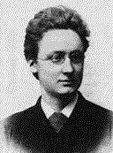
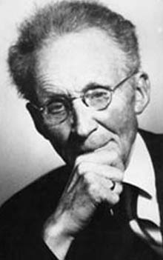
Norwegians Agreed
In 1904, Vilhelm Bjerknes suggested that the primitive equations could be used to numerically predict the future atmosphere.
NWP wasn’t practical because there was no way to do the computations quickly and 3D data not available.

Slide 28
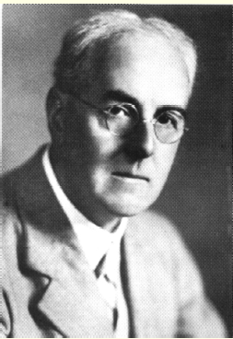
L. F. Richardson: An Insightful But Unsuccessful Attempt at Numerical Prediction
In 1922 Richardson published a book Weather Prediction by Numerical Process that described an approach to using the primitive equations: solving the equations on a grid using finite differences.

Slide 29
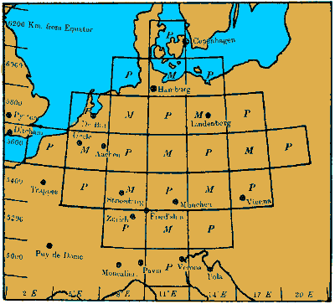
L. F. Richardson
He attempted to make a numerical forecast using a mechanical calculator
Unfortunately, the results were not good, probably because of problems with his initial conditions.

Slide 30
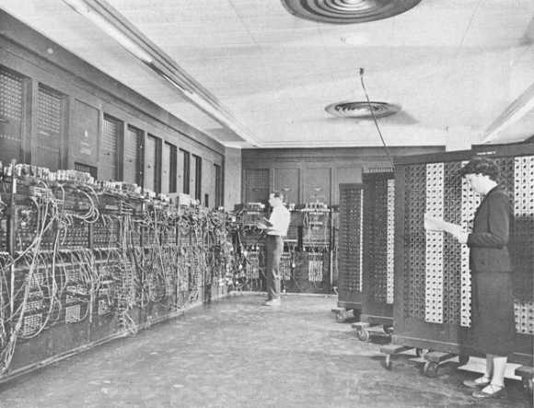
The Dream Becomes Possible (in the U.S.)
By the late 1940s there was an extensive upper air radiosonde network.
Digital programmable computers became available …the first being the ENIAC
ENIAC

Slide 31
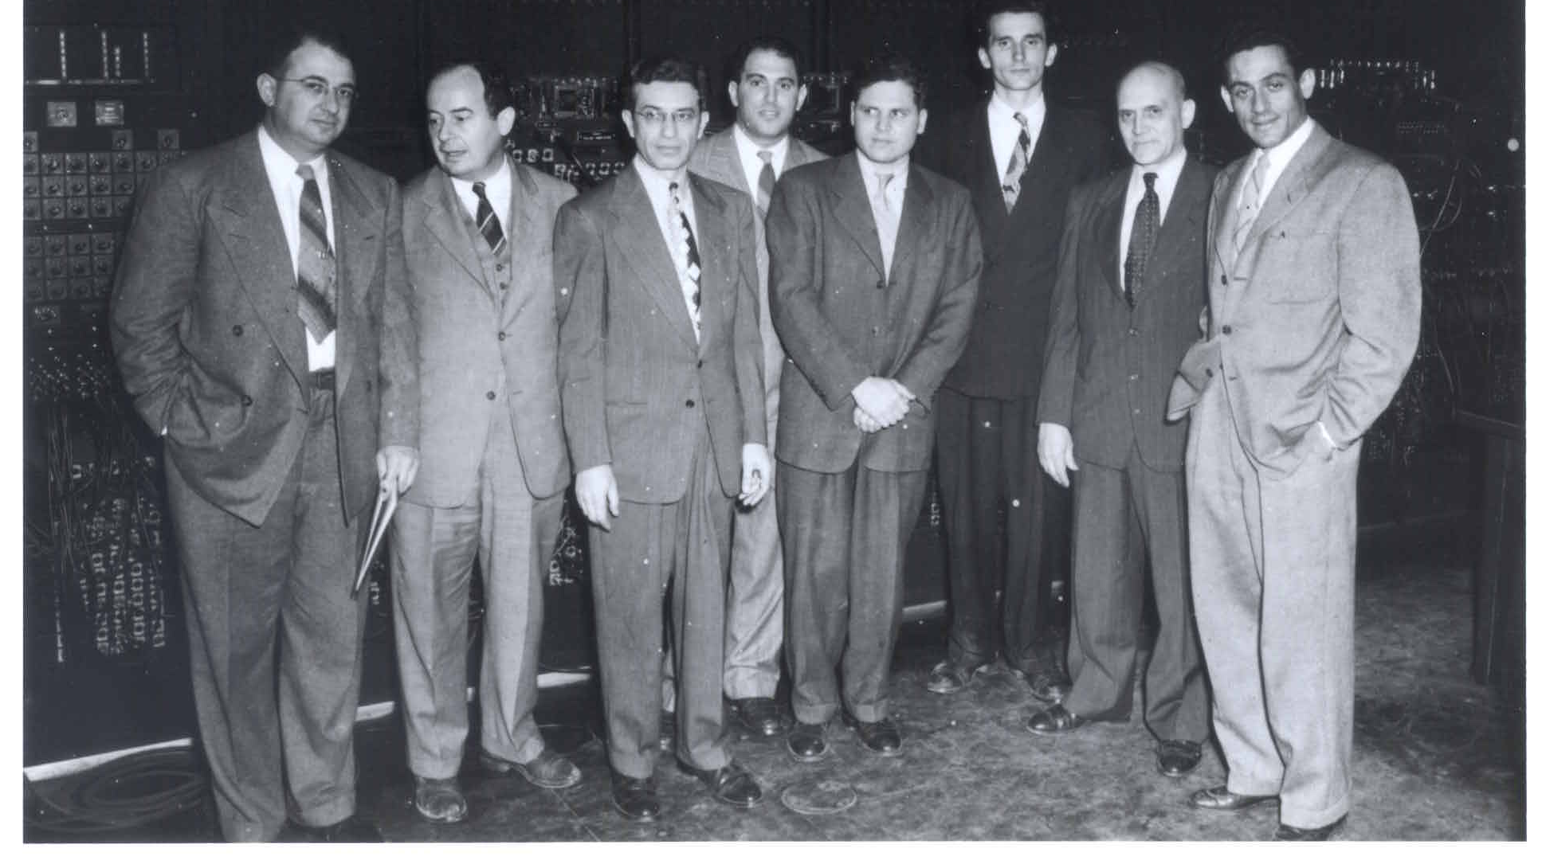
Harry Wexler, John von Neumann, M. H. Frankel, Jerome Namias, John Freeman, Ragnar Fjörtoft, Francis Reichelderfer and Jule Charney
In 1948, John von Neumann, the developer of the ENIAC, assembled a group of meteorologists at the Institute of Advanced Study in Princeton to attempt the first NWP. Headed by Jule Charney.

Slide 32
The First Successful Numerical Weather Prediction
Took place in April 1950, using the ENIAC
The prediction was for 500-hPA height over North America, using a two-dimensional grid with 270 points about 700 km apart.
One-level barotropic model.
The NWP era had begun.

Slide 33
First Numerical Weather Forecast

Slide 34
The Exciting Early Days of U.S. NWP:
Global Leadership and Close Cooperation

Slide 35
The First Decades (Limited Area Models)
1954: The Joint Numerical Weather Prediction Unit (JNWPU)- Weather Bureau, AF, and Navy—was created.
1956: First operational forecasts with barotropic model (IBM 701, 381 km)
1962: three-layer quasi-geostrophic baroclinic model (cyclogenesis!).

Slide 36
The First Decades
1966: six layer primitive equation model -381 km.
1971: Limited-area Fine Mesh model (LFM)-190 km
1978: Seven-layer primitive equation model (hemispheric)
1985: Nested Grid Model (NGM). 16 levels, 90km

Slide 37
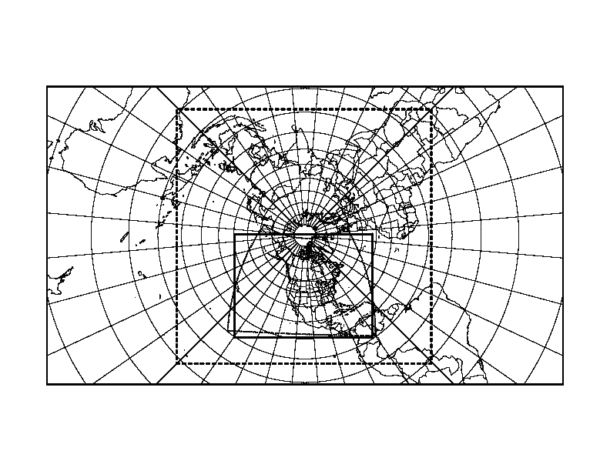
NGM Grid Structure

Slide 38
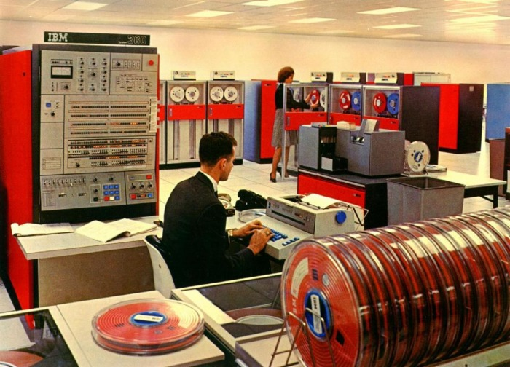
Early U.S. Global NWP
1974: Nine-layer, grid-point PE model.
1980: Global spectral model, 12 layers. R30 (~ 400km)

Slide 39
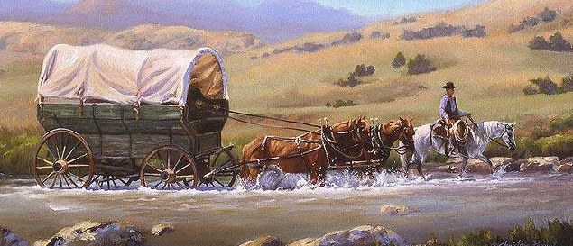
First Decades
U.S. operational NWP was dominated by the pioneers:
  Shuman, Cressman, Charney, Phillips, and others
  Creative, innovative individuals, often with close academic ties
National NWP was the only act in town (limited access to computer resources), so folks were compelled to work together.
Government agencies worked closely together

Slide 40
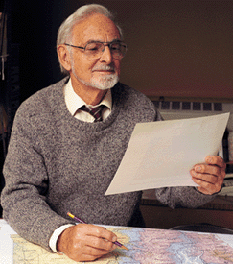
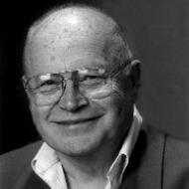
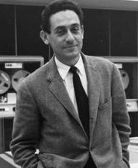
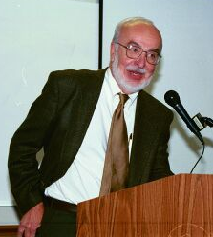
A Characteristic of the Early Decades: Close Relationship Between Gov. Agencies/Academia
Richard Reed
Norm Phillips, MIT
Bill Bonner
Jule Charney

Slide 41

And then a major competitor appears
Created in 1975 to pool European resources to produce medium range and seasonal forecasts
1979: Start of operational global prediction
Aggressive approach, entraining the best talent and advice from around the world, including the U.S.

Slide 42
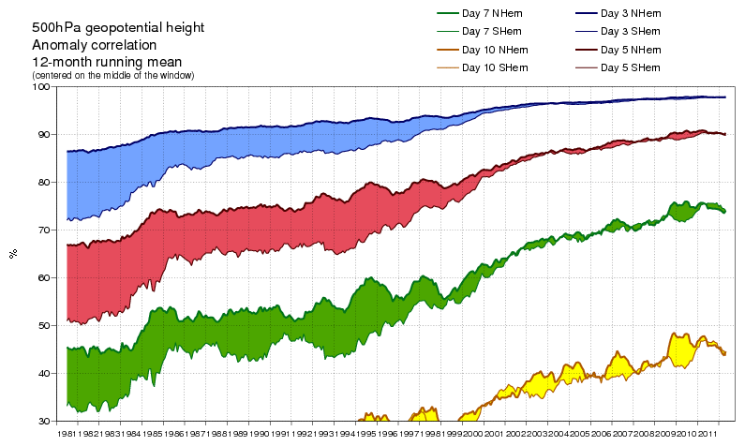
ECMWF: Strategic, Cooperative, Innovative
Able to secure state-of-the-art computers.
In 1997 moved to a more advanced data assimilation approach, 4DVAR

Slide 43
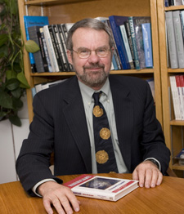
In the 1980s and early 1990s, a change of culture occurred in U.S. NWP
Computer resources became available to the academic community and model development spread outside of the NWS.
1980s: Rick Anthes and NCAR developed the MM4 mesoscale model, starting with Anthes’ hurricane model
1992: MM5: nonhydrostatic, multi-nested, FDDA, improved physics and numerics

Slide 44
A Huge Modeling Community Develops Outside of Government
A large MM5 community grew, including thousands of users around the world.
Tutorials, workshops, help desks, and more
Operational NWP developed outside NWS
The NWS did not adopt MM5. A mistake.

Slide 45

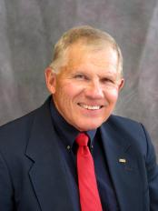
Spread of NWP: RAMS Model
RAMS, the Regional Atmospheric Modeling System, developed by Roger Pielke and Bill Cotton of Colorado State.
Similar to MM5 in many ways, but more limited in distribution.
Favorite of the air quality community

Slide 46

In 1989 NSF Sponsored the Development of ANOTHER Mesoscale Modeling System: ARPS
Directed towards storm-scale modeling
Valuable work on data assimilation for convective storms.
In general, this model has been supplanted by WRF

Slide 47

The Navy Develops a Redundant Capability
The U.S. Navy began running low-end NWP models in the 1960s (barotropic)
By the 1980s, they developed a model suite that paralleled what was run by the National Weather Service:
  NOGAPS: a global model, like the NWS Spectral. Now NAVGEM.
  NORAPS: an NGM regional model clone.
  By the mid-1990s, COAMPS, a non-hydrostatic model similar to MM5/WRF

Slide 48

Even more
The Air Force Weather Agency began running regional domains operationally (MM5).
Was running WRF under GFS, but moving to the UKMET Unified Model

Slide 49
Even Hitler Was Not Happy With This

Slide 50

Bottom Line
U.S. NWP efforts became split over many modeling systems and efforts:
  National Weather Service
  Navy
  Air Force
  NCAR/Penn State
  Oklahoma
  Colorado State
  And others: e.g., Wisconsin, Drexel, …
U.S. research and operational communities were not sufficiently engaged with each other

Slide 51

The US NWP Became an Uncoordinated Giant
Slow in progress
Inefficient with resources
USA

Slide 53

National Weather Service NWP Becomes More Bureaucratic and Isolated
By the mid-1980s most of the pioneers of NWP had left leadership roles in NWS.
The National Weather Service NWP bureaucracy had grown large and inward looking
The university community, with its own capabilities, increasingly disengaged from NWS NWP model development.
NWS
Universities

Slide 54
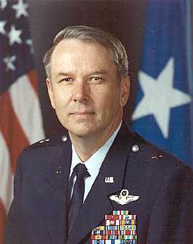
National Weather Service Turned to Military Leadership: Allowed the Ship to Drift
General Jack Kelley 1998-2004
General David Johnson 2004-2007
Colonel Jack Hayes 2007-2012
General David Johnson
NOT a meteorologist

Slide 55
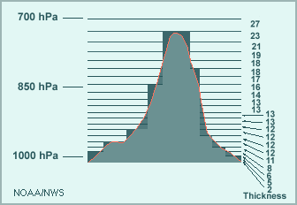
The Landmark Decision in 1993: Which Regional Model for the U.S.
ETA or MM5?
A replacement for the hydrostatic NGM was needed.
Instead of picking the popular MM5, the NWS acquired an experimental model brought to the U.S by some Yugoslavian émigrés…the Eta model

Slide 56
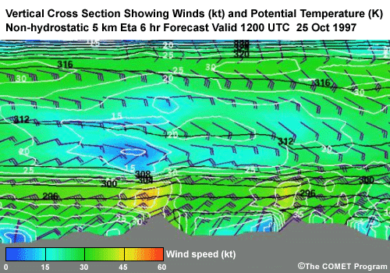
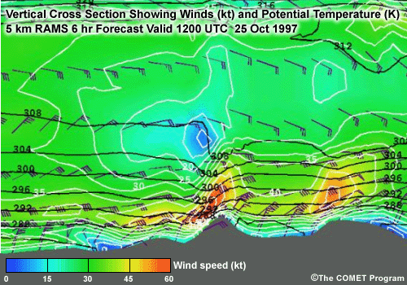
Eta: A Disaster for U.S. NWP
Problematic vertical coordinate system
Eta was unable to do mountain waves
Required excessive vertical resolution
Rejected by the academic community.

Slide 57
A Second Chance Lost:
NMM Versus WRF
By 2000, it was clear that the Eta model was inadequate and needed to be replaced.
NCAR had developed a replacement for MM5 called WRF.
After substantial talks with NCAR about WRF, the National Weather Service rejected WRF in favor of a cleaned up version of Eta (changed vertical coordinate system): NMM.

Slide 58
NMM Becomes the NWS Mesoscale Modeling System
Physics lagged WRF.
Far more diffusive than WRF
Academic community avoided it.
In a desperate move, NCEP rebranded NMM as WRF-NMM

Slide 59


Slide 60

A Key NWS Issue

Slide 61
ECMWF Surges Ahead
By the mid-1990s ECMWF pulled even with NCEP.
With more computer resources, ECMWF moved to superior data assimilation (4DVAR), higher resolution, better model physics, assimilating more observation types, and better quality control.
Their forecasts became increasingly superior.

Slide 62

NCEP Loses Key Users
Many U.S. private sector firms abandoned NCEP’s global model (GFS) for ECMWF
$ 100-200K a year charge by ECMWF
In 2015, the US Air Force announces it is abandoning GFS for UKMET office model.

Slide 63
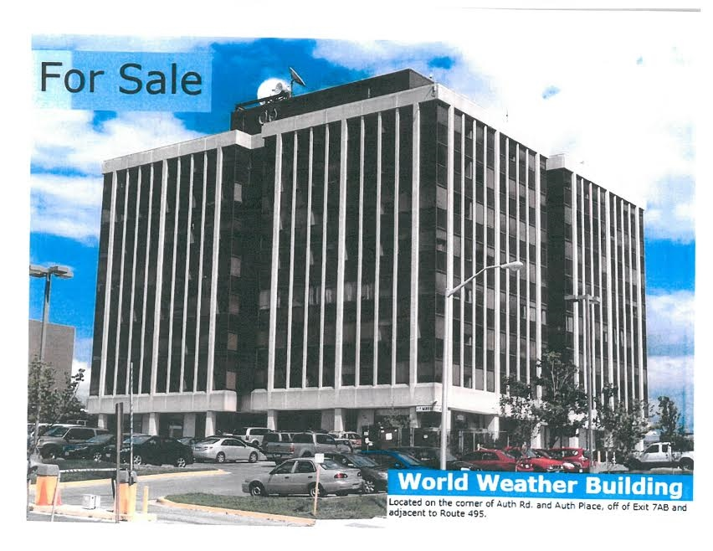
National Weather Service NWP Infrastructure Problems
The World Weather Building (home until 2014)
Decaying, cramped, no large meeting rooms
Mold/Fungus in vents
Unhealthy environment.

Slide 64
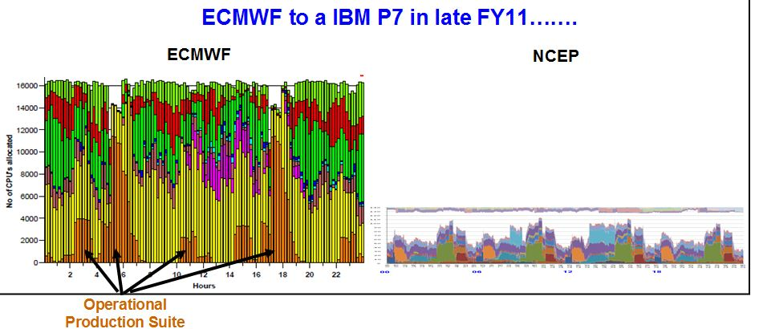
Inadequate Computing
Until recently NCEP had roughly 10% of the computer power of ECMWF for doing far more

Slide 65
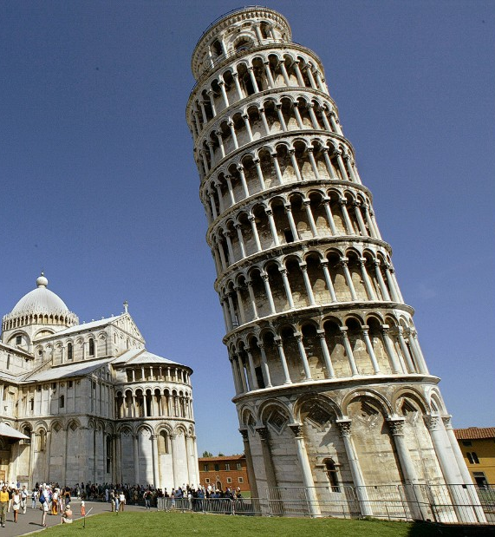
NOAA and the NWS Have Major Structural Problems

Slide 66
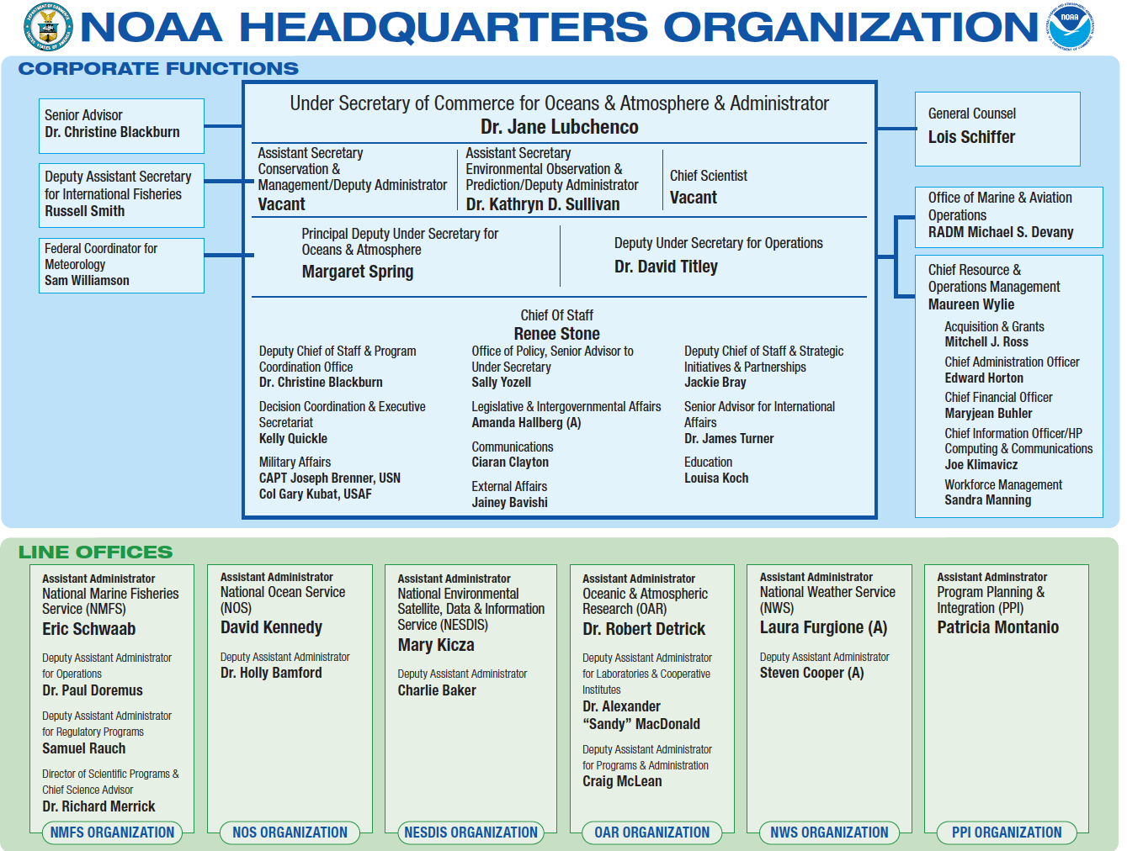
Research and Operations for NWP Separated in NOAA
NWP Research
Operational NWP

Slide 67
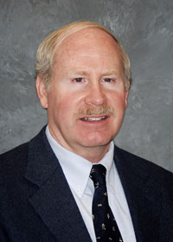
Research and Development of NWS NWP Models Done Outside NWS in NOAA Labs (ESRL, GFDL)
Individuals responsible for operation NWP (NCEP EMC) do not control the individuals developing the models.
This has led to major problems and inefficiencies.
Sandy McDonald
Past Head of ESRL

Slide 68

ESRL Developed Two Global Models That Will Never Be Used: FIM And NIM
NIM
FIM

Slide 69
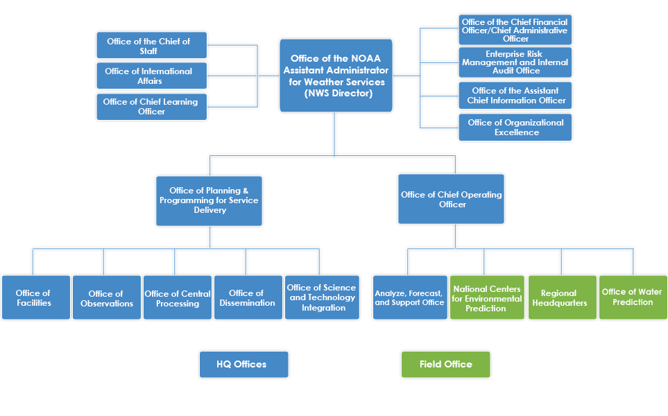
Even Worse than That!
Post Processing and Water Prediction Outside of NCEP

Slide 70
And the decisions on model development are made OUTSIDE of NCEP in the Office of Science and Technology Integration

Slide 71
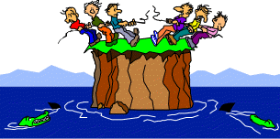
NWS/NOAA NWP Organization
ECMWF
UKMET

Slide 72
NOAA and the U.S. Government Have No Detailed Strategic Plan for U.S. NWP
Our competitors do! ECMWF, UKMET, CMC, and others.

Slide 73
US Strategic Plan

Slide 74

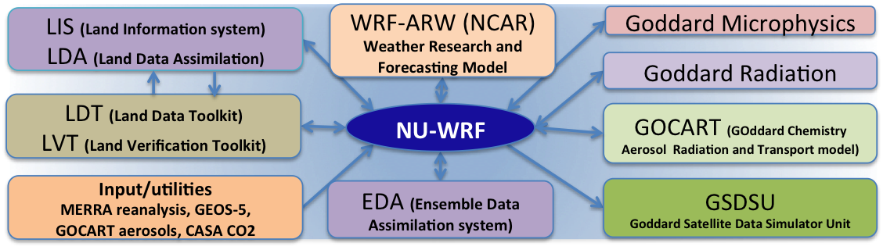
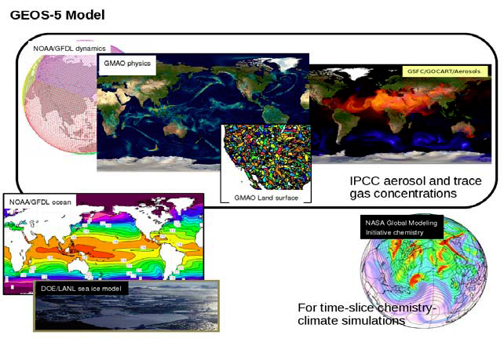
And NASA is Off Doing Its Own Thing
NU-WRF
GEOS-5

Slide 75
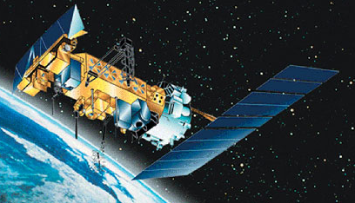
No rational observing system planning
There were concerns about a possible gap in polar-orbiter weather satellite coverage, suggesting weather forecasting skill would decline.
But no one really knew the impacts, considering changes in data assimilation and the potential for cheaper additions to other platforms such as COSMIC.

Slide 76
Rational observing system design
NOAA needs to determine the optimal collection of observations, including dropping old data sources that are no longer needed.
Rational way: Observing System Simulation Experiments (OSSEs) and Observing System Experiments (OSEs).
NOAA/NWS has done very little of this and billions of dollars of hardware have been purchased without a clear understanding of the impacts of new sensors and satellites.

Slide 77
NCEP Hurricane Modeling is a Mess
After Sandy, roughly 50 million dollars was put into HWRF.
Today, HWRF has less skillful track forecasts than EC
HWRF is being dropped for HMON
HMOM did very poorly for Irma and other storms.

Slide 78
Recent Positive Developments
New Building for US NWP and NCEP, College Park

Slide 79
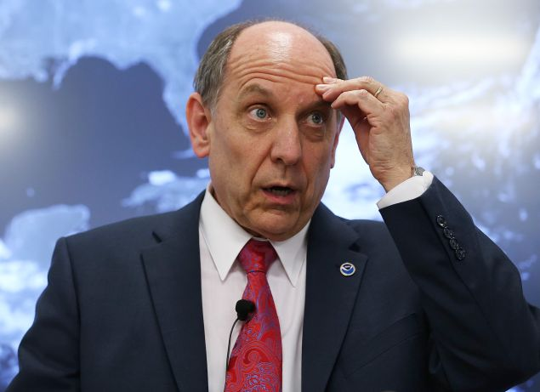
More Funds for Extramural Research
Dr. Louis Uccellini, Director, NWS
Pushed for the new building and more research funding

Slide 80
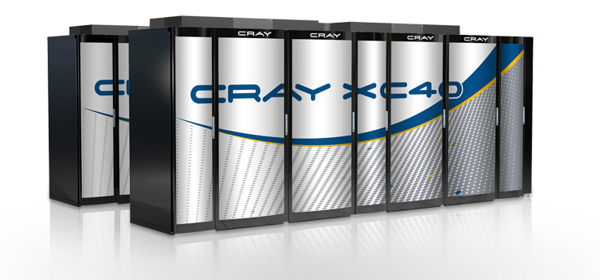
After Sandy, Congress Provided Money for a Major Computer Upgrade
Two CRAY XC-40s. Each about 2 petaflops. US and ECMWF nearly equal.

Slide 81
Next Generation Global Prediction System (NGGPS): FV-3 selected

Slide 82

The High Resolution Rapid Refresh (HRRR, 3-km): A Major Advance

Slide 83


More Open NCEP/NWS Leadership
Bill Lapenta, Director of NCEP
Fred Toepfer, NWS HQ

Slide 84
Creation of New NCEP Advisory Groups, such as UMAC

Slide 85
Weather Research and Forecasting Innovation Act of 2017

Slide 86

Some New Clouds on the Horizon

Slide 87


A Major New Player in Global Prediction: the Private Sector
The private sector has been running high-resolution regional models for a long time.
Today, some firms are running or planning to run operational global models with full data assimilation.

Slide 88

Panasonic Version of GFS Beat NCEP

Slide 89


New Non-Traditional NOAA Leadership
Barry Myers, Accuweather
Neal Jacobs, Panasonic

Slide 90

FV-3 Development is Slow, Without Establishing the Infrastructure for a Community Modeling System

Slide 91

How to fix U.S. NWP

Slide 92

NOAA Needs A Complete Organizational Restructuring of U.S. NWP Operations and Research
Need one entity responsible for NWP research and operations.
Should be in NOAA, not the NWS.
The U.S. Environmental Prediction Center
Boulder, Colorado would be an excellent location

Slide 93

Unified and Community Modeling
NOAA should have one modeling platform for all scales.
NOAA is running too many redundant modeling systems
The U.S. model must be a community model that is available to the research and private sector communities

Slide 94

Reduce the Number of Modeling Systems
The National Weather Service should drop NMM in lieu of WRF/MPAS.
The Air Force should drop UKMET and use MPAS/WRF or new FV-3.
The National Weather Service should drop NAM-RR (the NMM version of HRRR)
NASA , NCAR, NOAA, DOD should work together

Slide 95
Unify and Rationalize Large-Scale, Hydrostatic Ensembles
Currently, the NWS runs a global ensemble system (GEFS) at 33 km (21 members).
Also an SREF at 16 km (26 members). Excessive clustering.
Should drop SREF and replace by GEFS with 50 members and ~18 km resolution, with both initial condition and stochastic physics uncertainty. One hydrostatic ensemble.

Slide 96
Physics Research and Development Requires More Emphasis
Organize and FUND the research community to concentrate on key problems (e.g., PHYSICS, e.g., stable boundary layer, convection)
National coordination of research and development across agencies.

Slide 97
NCEP Should Run a Large Convection-Resolving Ensemble over the U.S. (2-4 km)
NCAR is doing this on 5000 cores. NCEP has 140,000 cores

Slide 98

NCEP Computer Resources Need to Be at Least 10-100x Larger
State of science global and region modeling for the U.S. requires far more resources than ECMWF.
New CRAY machines and GPU technology can make 50 petaflop machines available now.

Slide 99


$
ONE
THREE
=
F18: 60 million

Slide 100

Extended Range Forecasting
Currently, the NWS runs the CFS model (low resolution GFS model with coupled ocean) out to 9 months. 24 runs a day!
Little indication of skill past about 3 weeks.
Stop doing something that doesn’t work and explore convection-allowing resolution over the tropics.

Slide 101
The Problem is NOT Money

Slide 102
Optimistic
Today there is reason to be optimistic about the future of US NWP.
But major cultural/structural change is necessary both inside and outside of the NOAA.
Consolidation and more national organization is need.

Slide 103

ECMWF is not the ceiling of what is possible: the large U.S. weather community can do better

Slide 104
The End

