Slide 1
A High-Resolution Ensemble System for the Pacific Northwest
Cliff Mass and David Ovens
University of Washington
NW Weather Workshop
April 2018

Slide 2
Many of you are familiar with the UW WRF Forecasting System (https://atmos.washington.edu/mm5rt/)

Slide 3

Most use the high-resolution WRF system, where we have pushed to higher and higher horizontal resolution
… and better and better physics

Slide 4
36 km

Slide 5
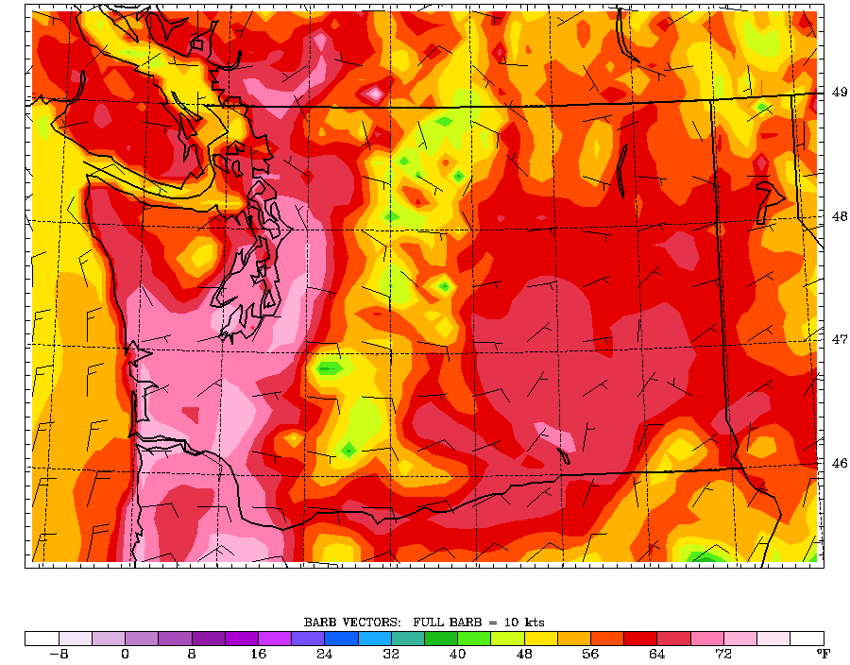
12-km

Slide 6
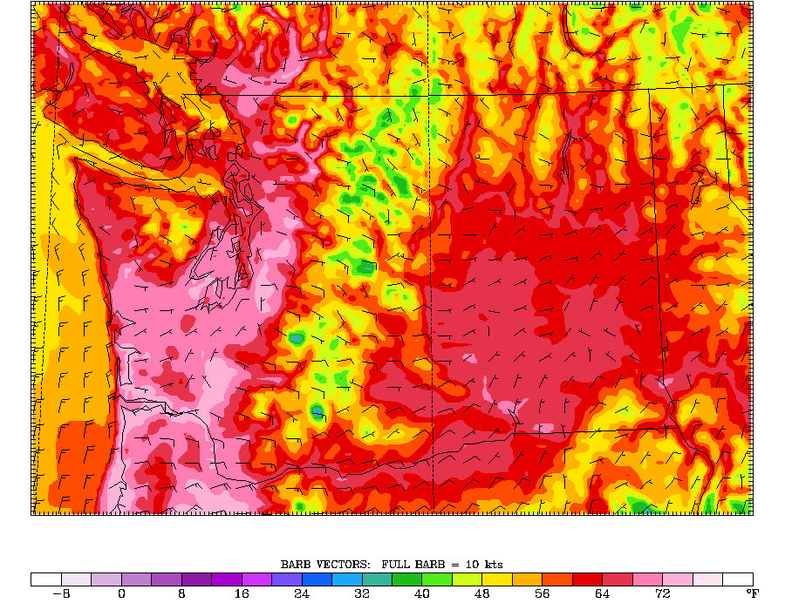
4-km

Slide 7
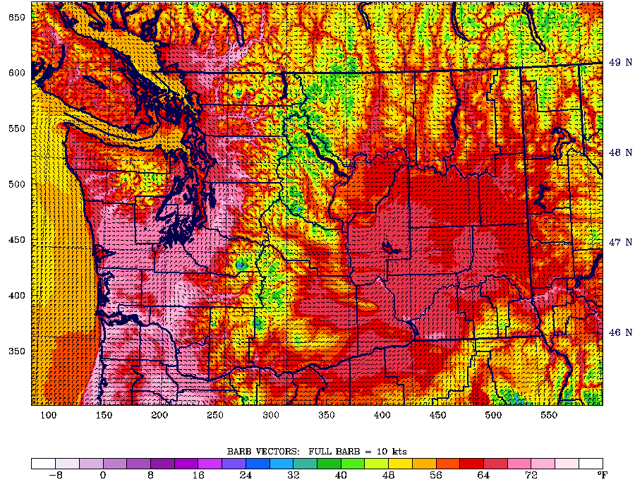
1.33 km

Slide 8

High-resolution numerical weather prediction is very important in the mountainous west, but what about the uncertainty of the forecasts?
Uncertainty in initialization
Uncertainty in physics
Need to communicate the uncertainty of the forecasts and to provide probabilities
Need to know when you can trust the high-resolution forecasts

Slide 9
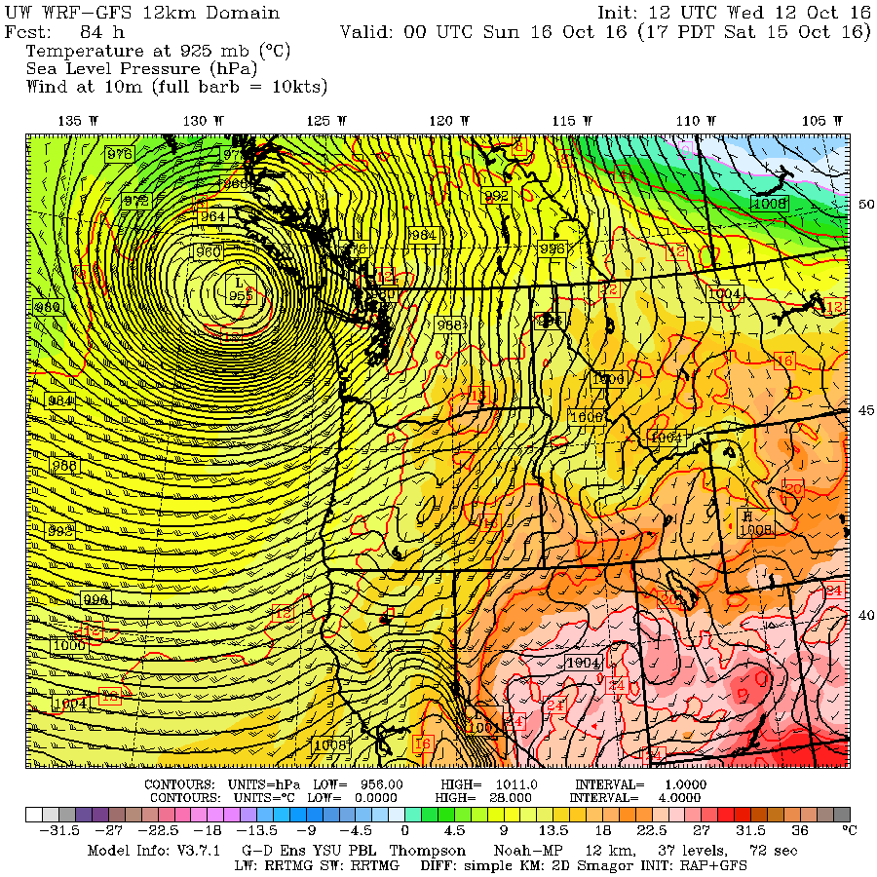
Sometimes our high-resolution system gets it wrong

Slide 10
Solution: Need a high-resolution ensemble system
Many forecasts that explore uncertainty of both the initial state and model physics.
Sufficient resolution to define local topographic effects
Enough resolution to have a chance of forecasting convection
Based on a great deal of research, need a grid spacing of 4-km or less: a convection-permitting ensemble.

Slide 11
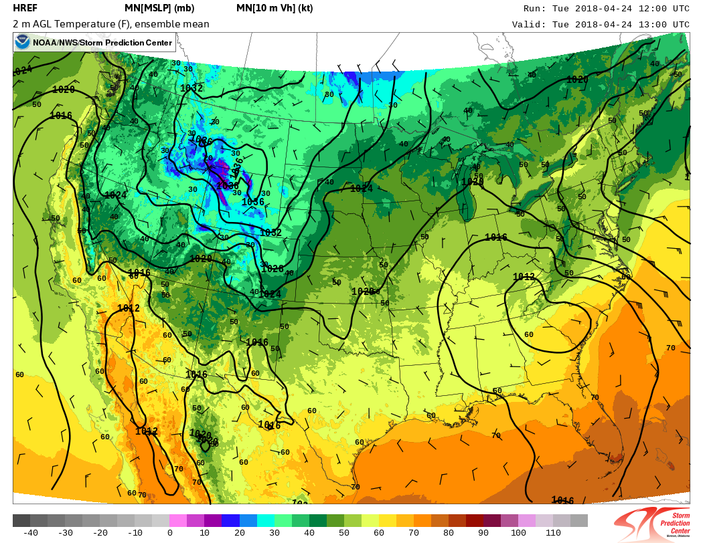
The NWS has a small (8 member), poorly constructed, ~ 3 km ensemble that barely covers the NW
No plans for a significant expansion soon

Slide 12
The UW High-Resolution (4-km) Ensemble is Operational
16 members, 0000 UTC initialization only, 72 hr forecast
10 members are randomly selected by the GFS ensemble (GEFS)
6 members are from major national systems
  UKMET (UK)
  CMC (Canada)
  JMA (Japan)
  GASP (Australian)
  TCWD (Taiwan)
  NGPS (Navy)

Slide 13
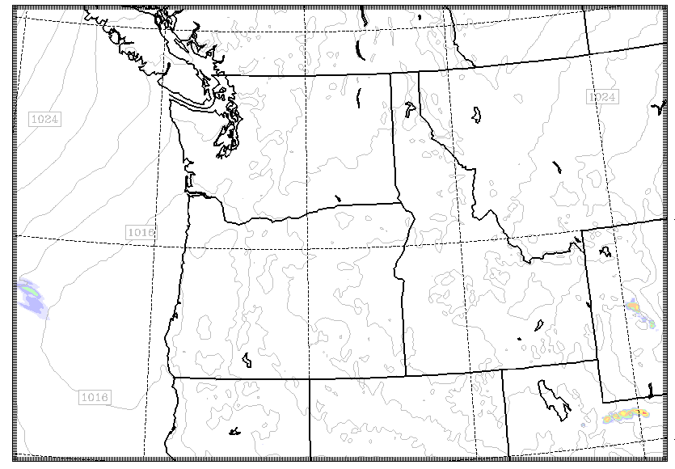
The Domain

Slide 14
The Entrance Page

Slide 15
Individual Member Plots

Slide 16
Plume Diagrams

Slide 17
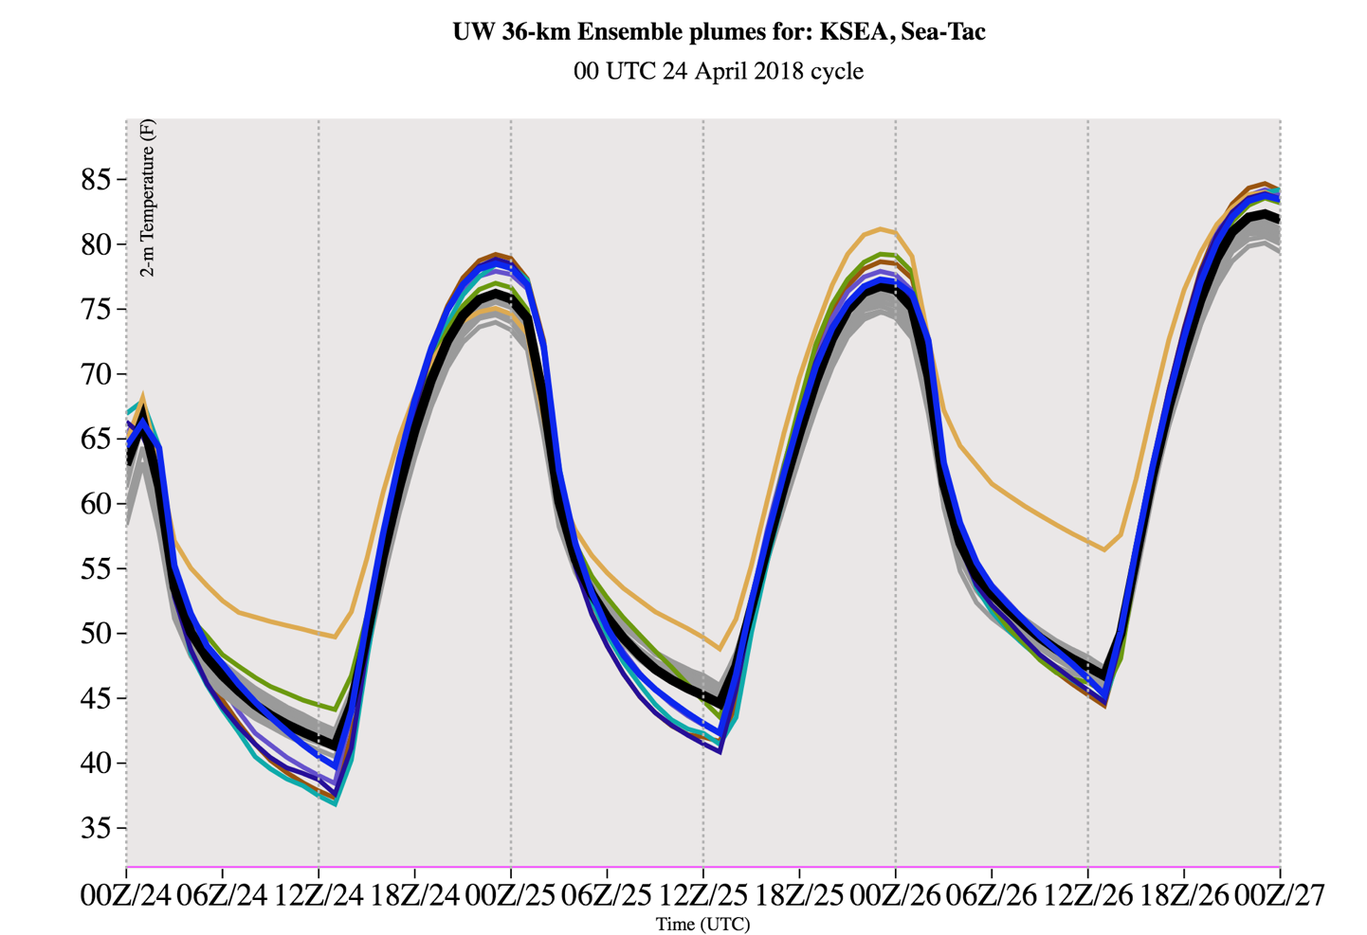
Surface
Air
Temp.

Slide 18
Ensemble Mean and
Spread

Slide 20
Or Pick What You Want!

Slide 21
Using the ensemble with the high-res. forecasts
It is very useful to compare the high-resolution run with the ensembles to see if it is an outlier.

Slide 22
Caution: More resolution can make the high-res an outlier, even when its synoptic evolution is the same as the ensemble

Slide 23
Major Expansion in June
Securing 96 more processors, which will be dedicated to the ensemble.
Adding a 1200 UTC (5 AM) cycle
Adding five more ensemble members using physics diversity…varying planetary boundary layer schemes and applying stochastic physics.
Graphics will be available more quickly.

Slide 24
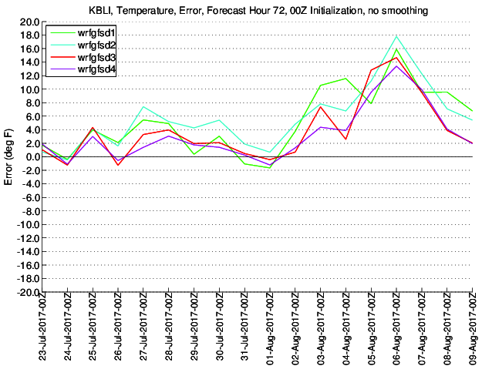
One More Thing
Adding the effects of wildfire smoke (e.g., daytime cooling) to the high-resolution and ensemble systems this summer.

Slide 25
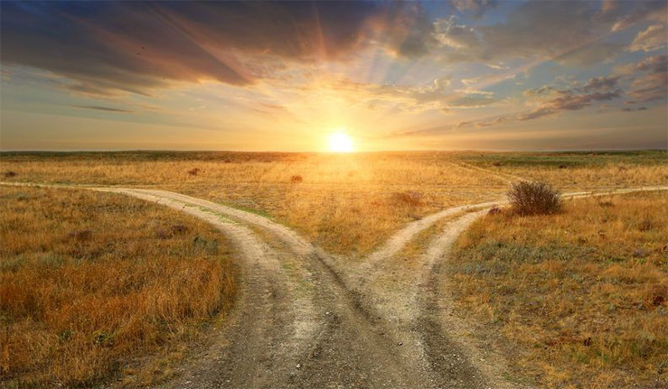
The end

