Slide 1
Update on the UW WRF Prediction System: Adding Smoke and Enhancing Ensembles
Cliff Mass and David Ovens
University of Washington
NW Weather Workshop
May 2019

Slide 2
Many of you are familiar with the UW WRF Forecasting System (https://atmos.washington.edu/mm5rt/)

Slide 3
36 km

Slide 4
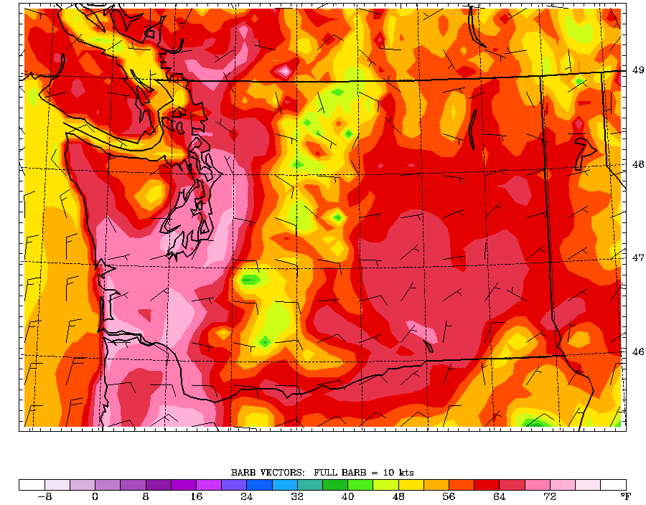
12-km

Slide 5
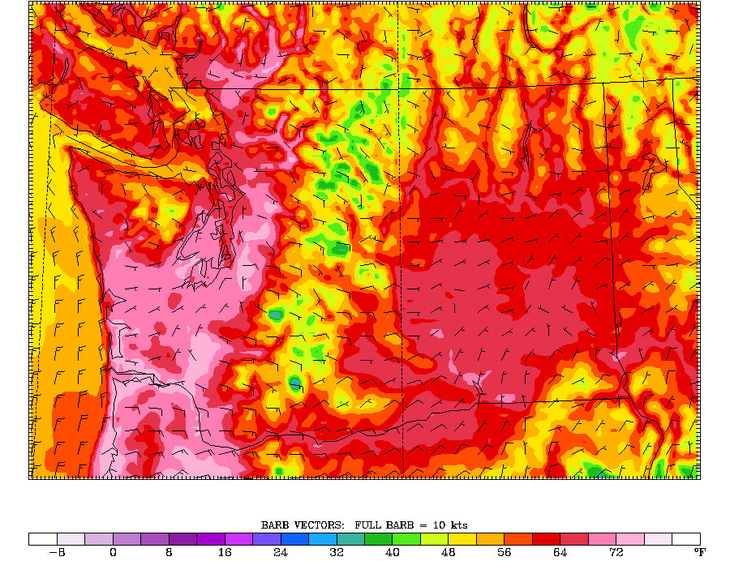
4-km

Slide 6
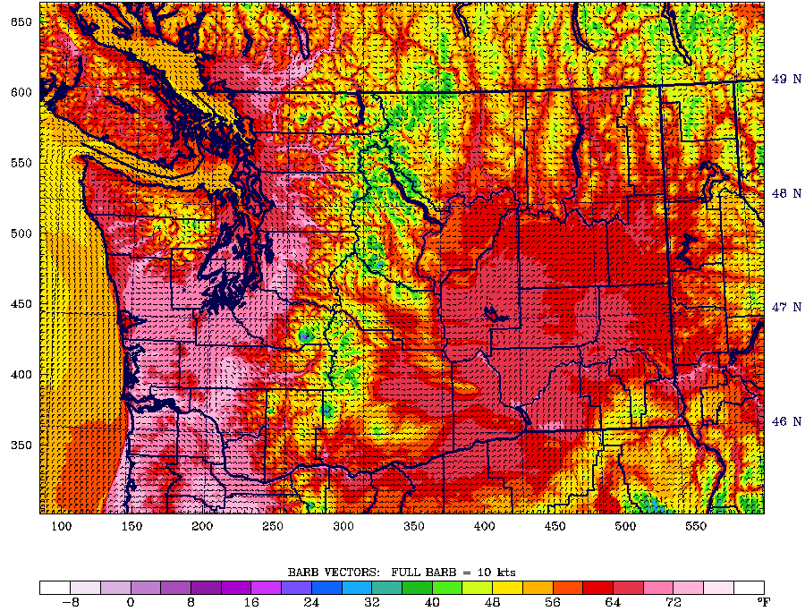
1.33 km

Slide 7
Major Improvements During the Past Year

Slide 8
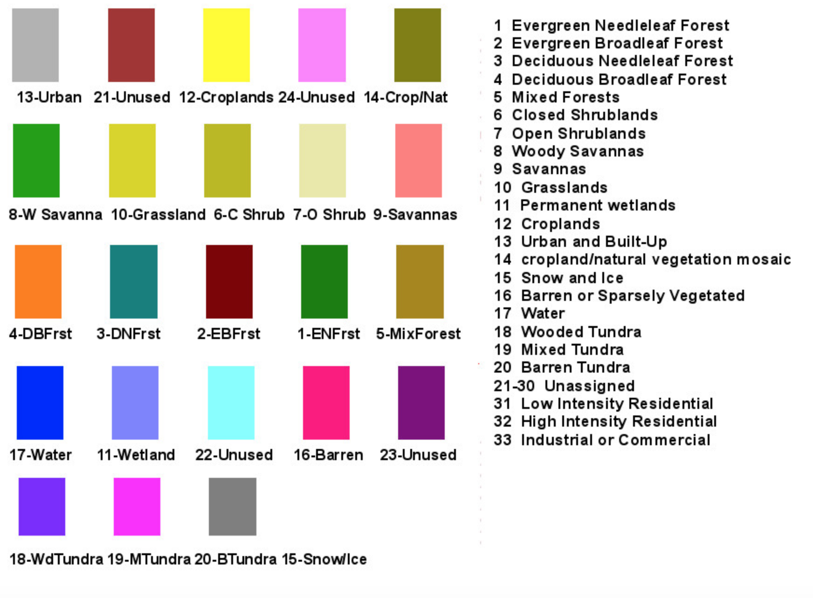
Improved Land Use in Model
Moved from 30 arcsecond vs 15 arcsecond, MODIS land use dataset
Additional manual editing of cells in Western Washington
Should improve forecasts in coastal areas

Slide 9
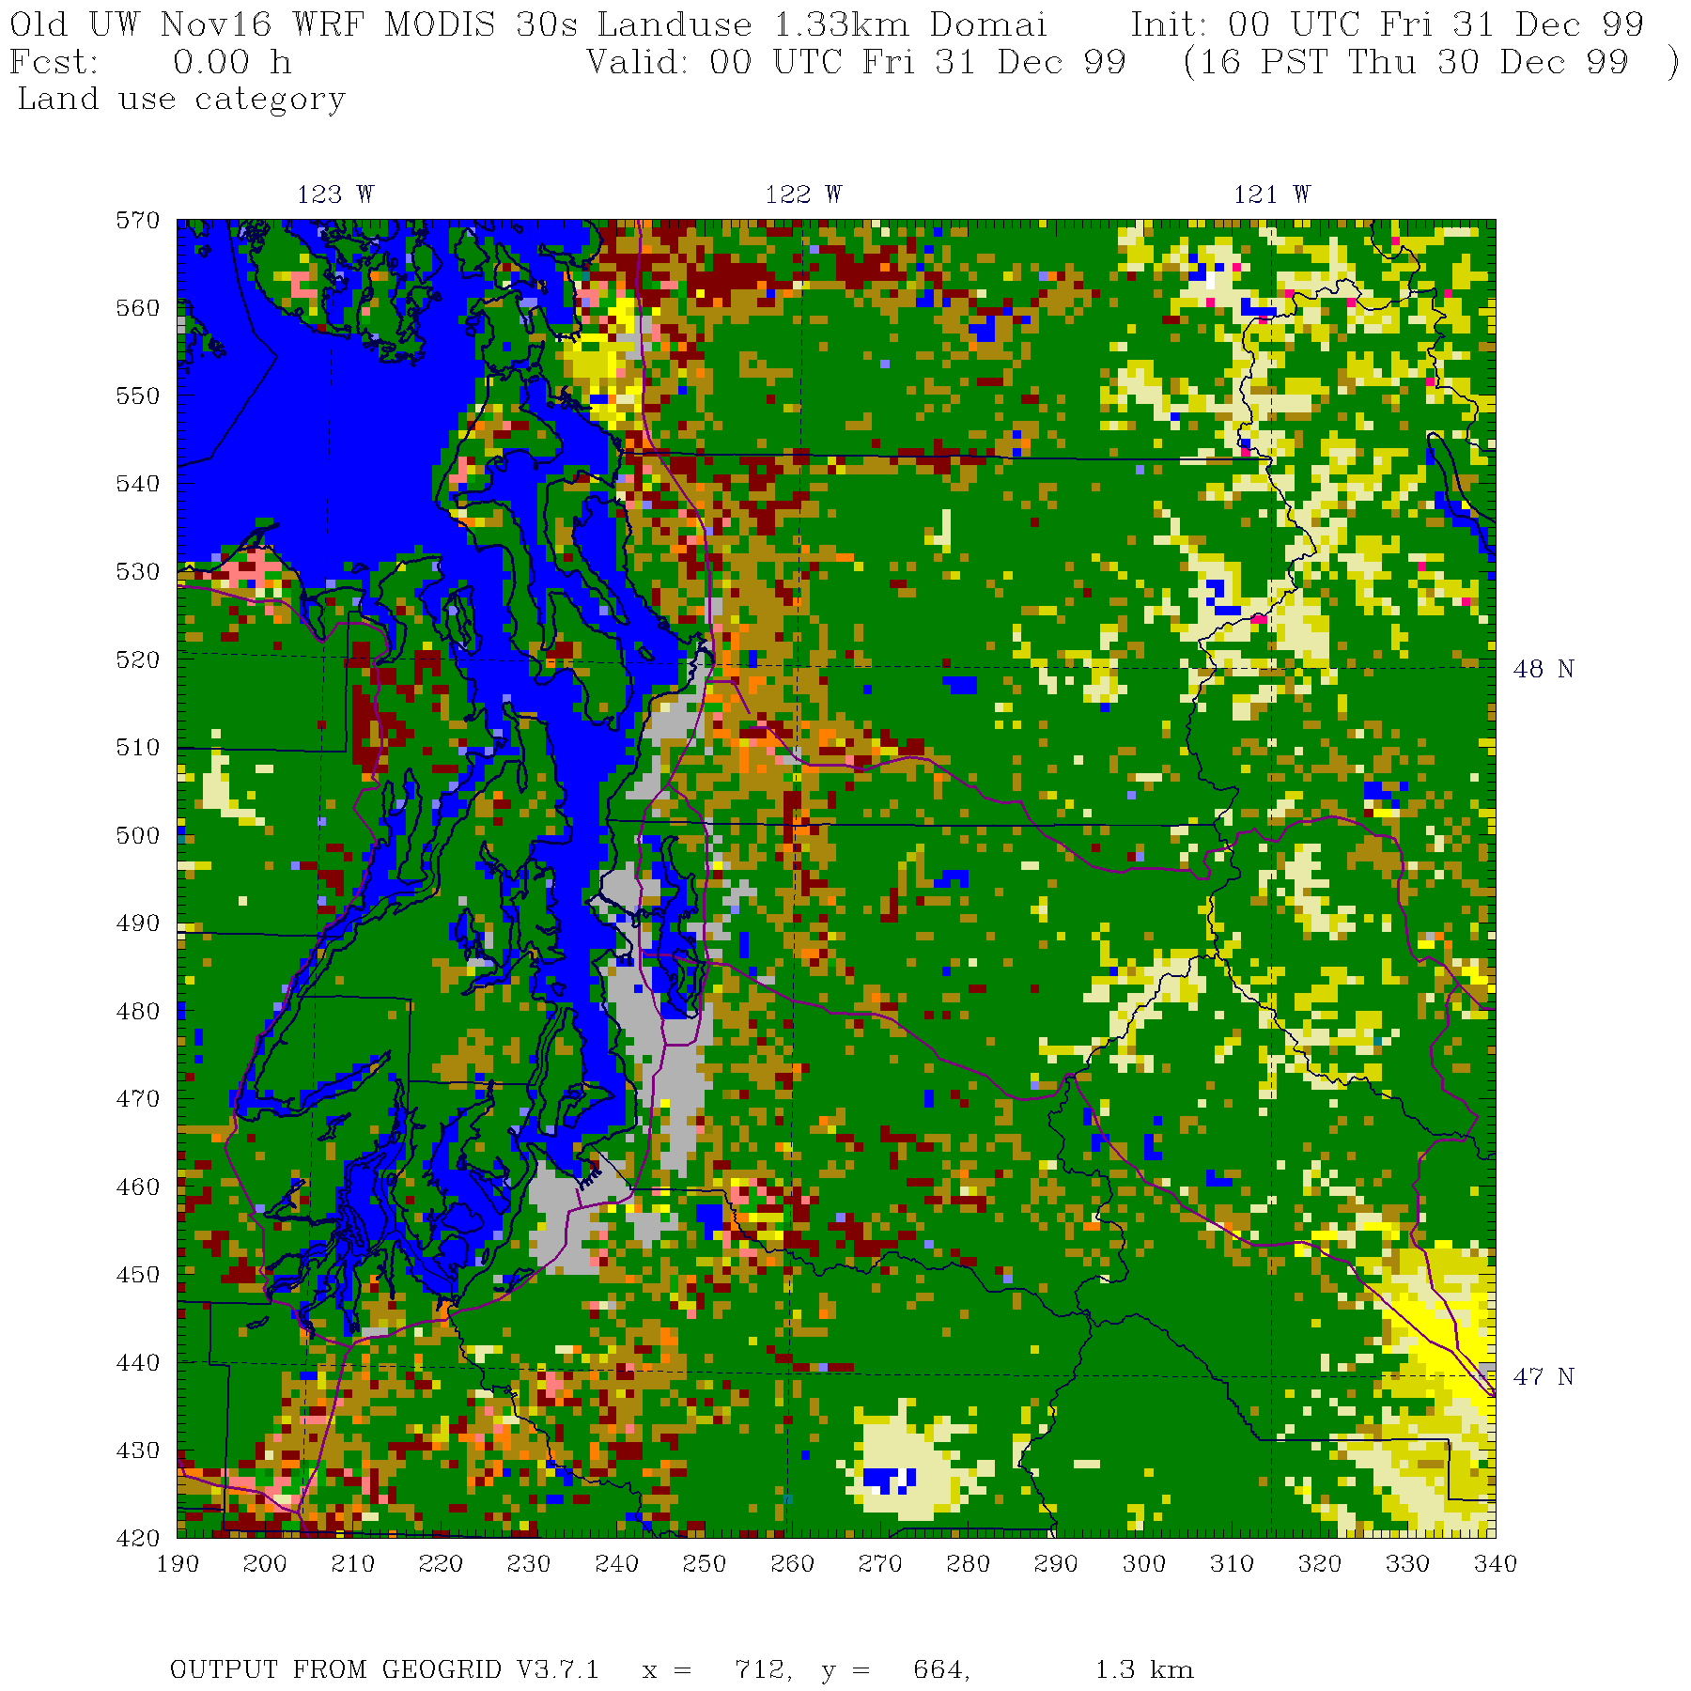

Slide 10
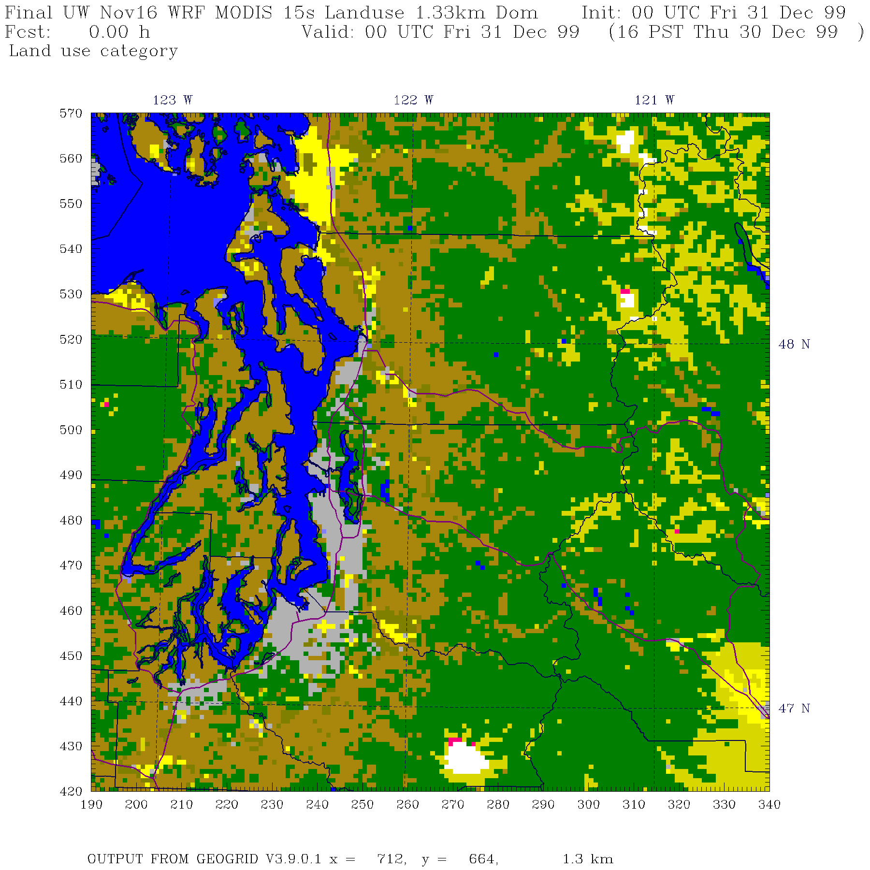

Slide 11
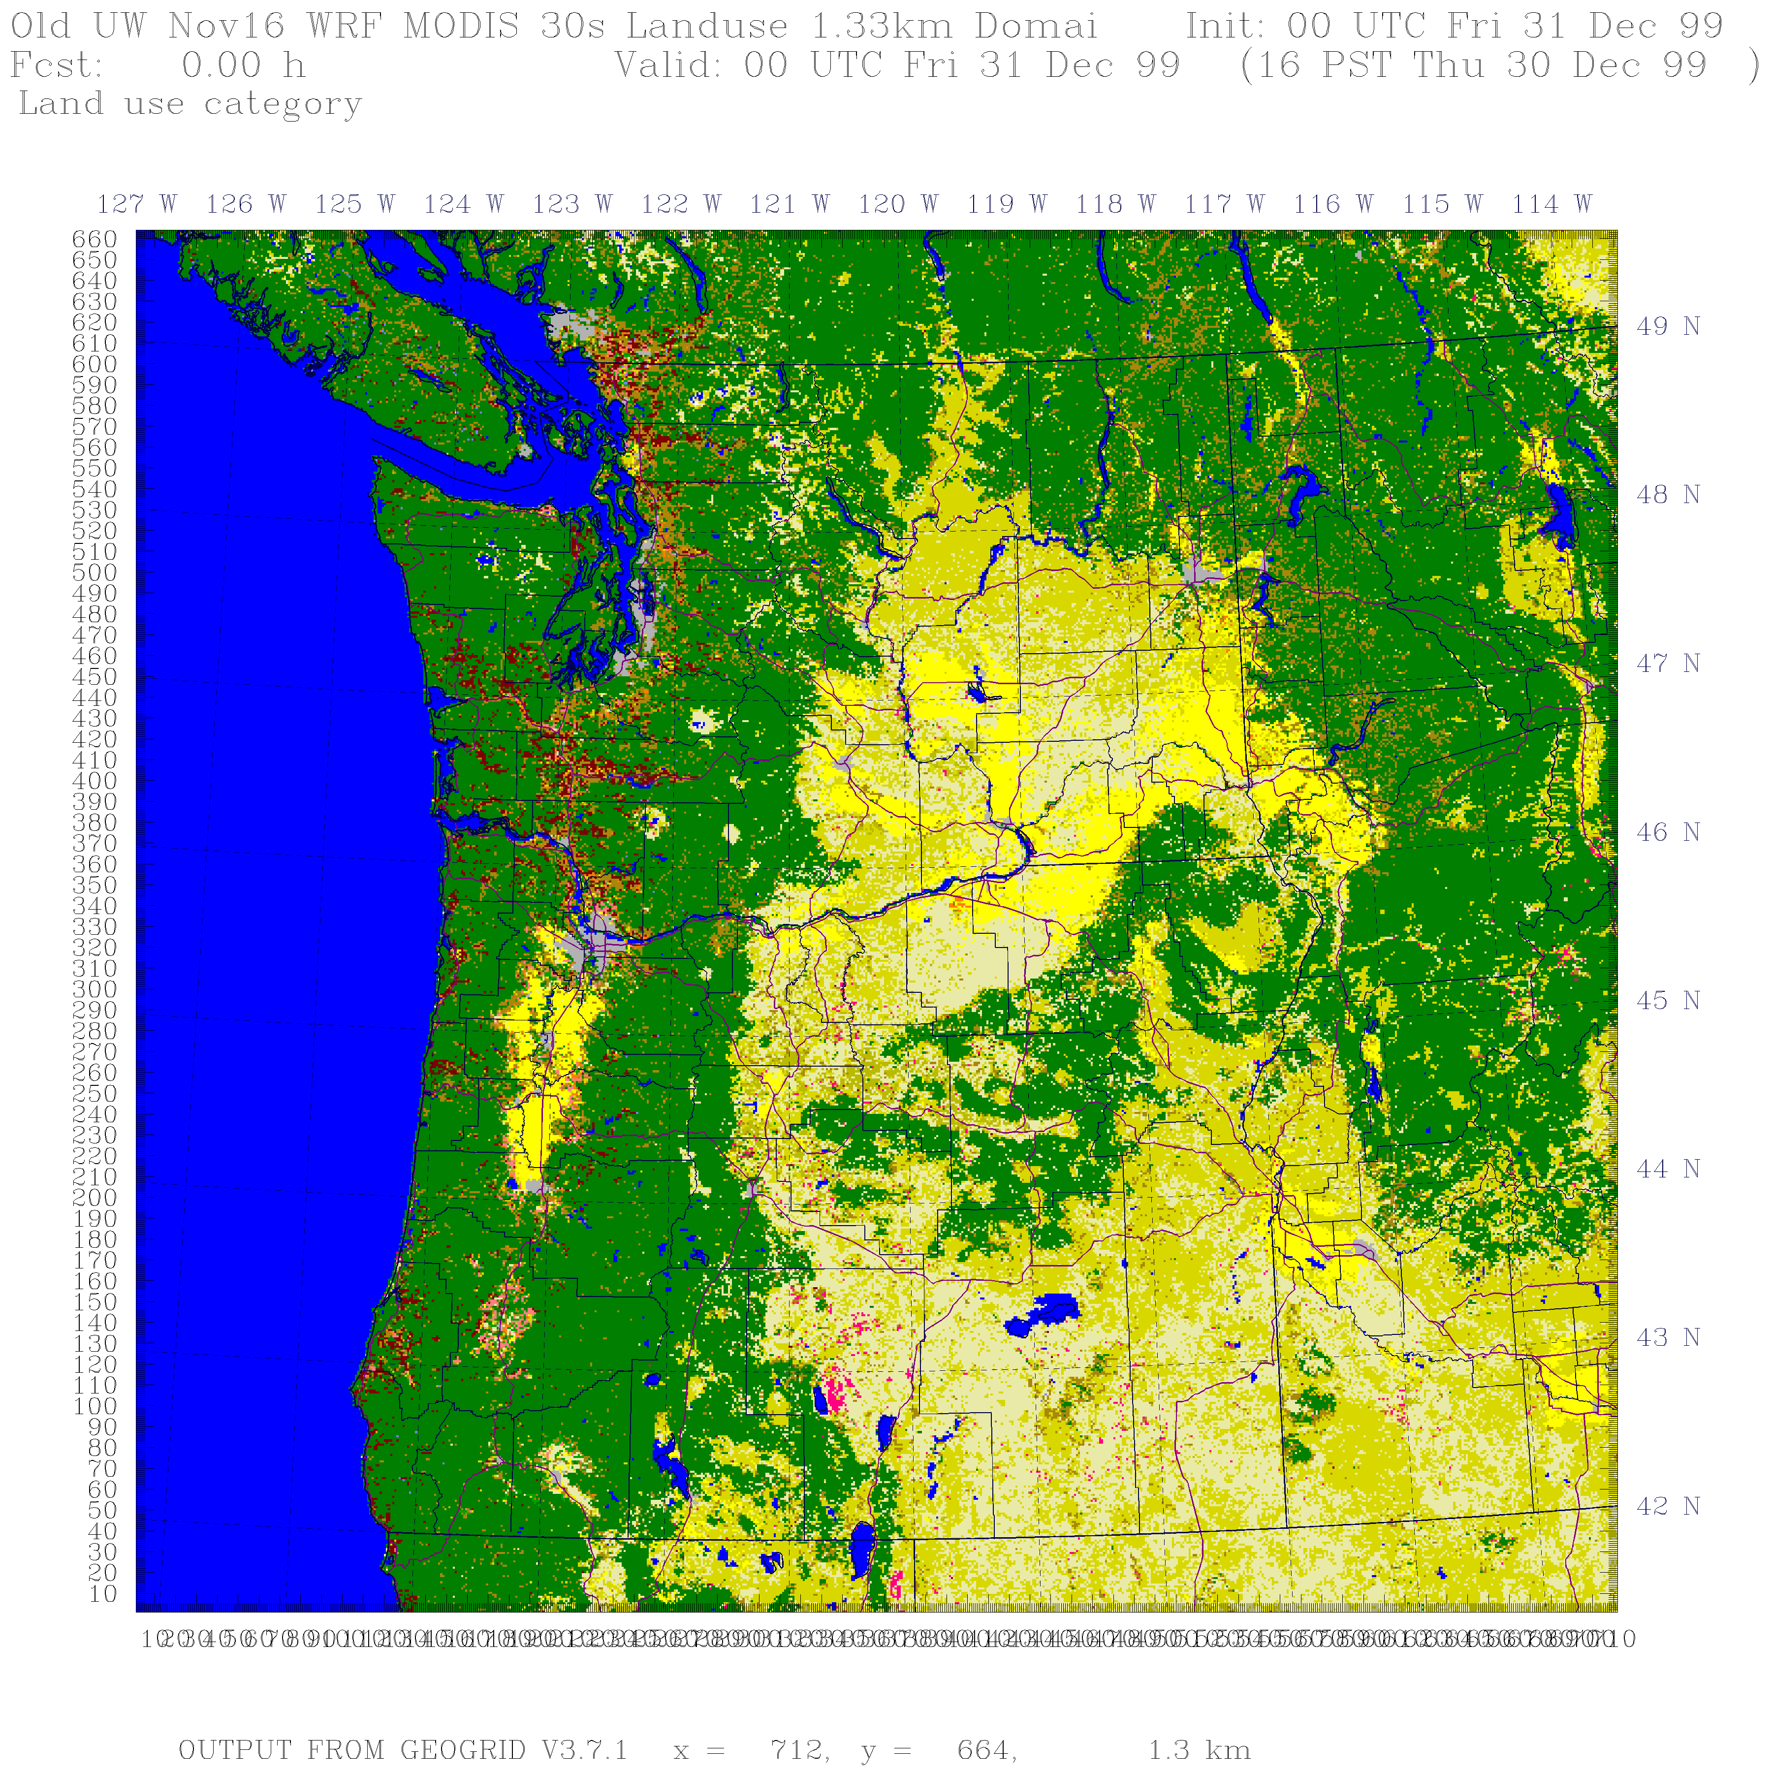

Slide 12
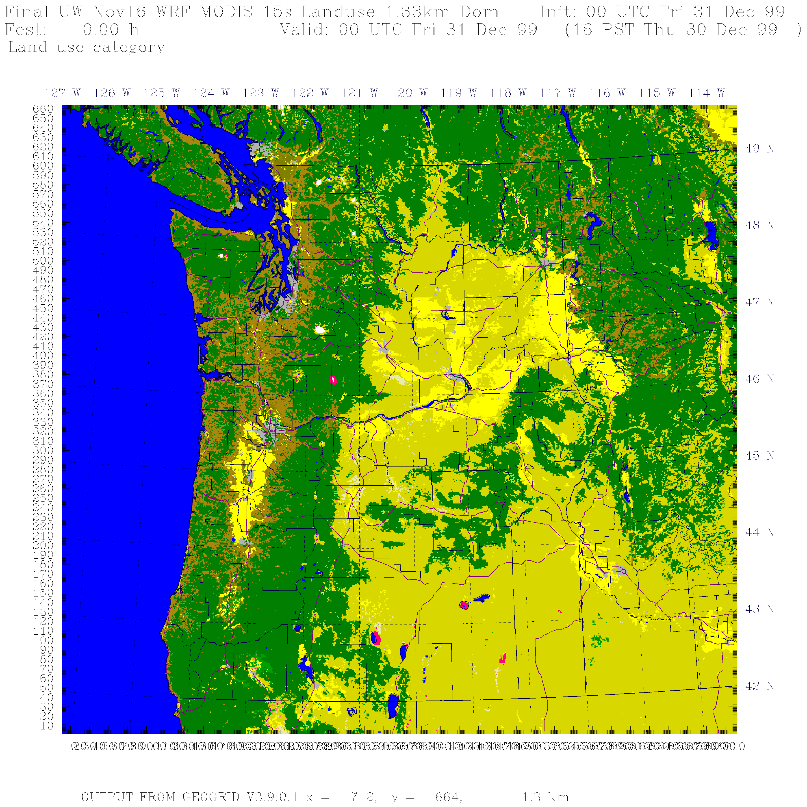

Slide 13
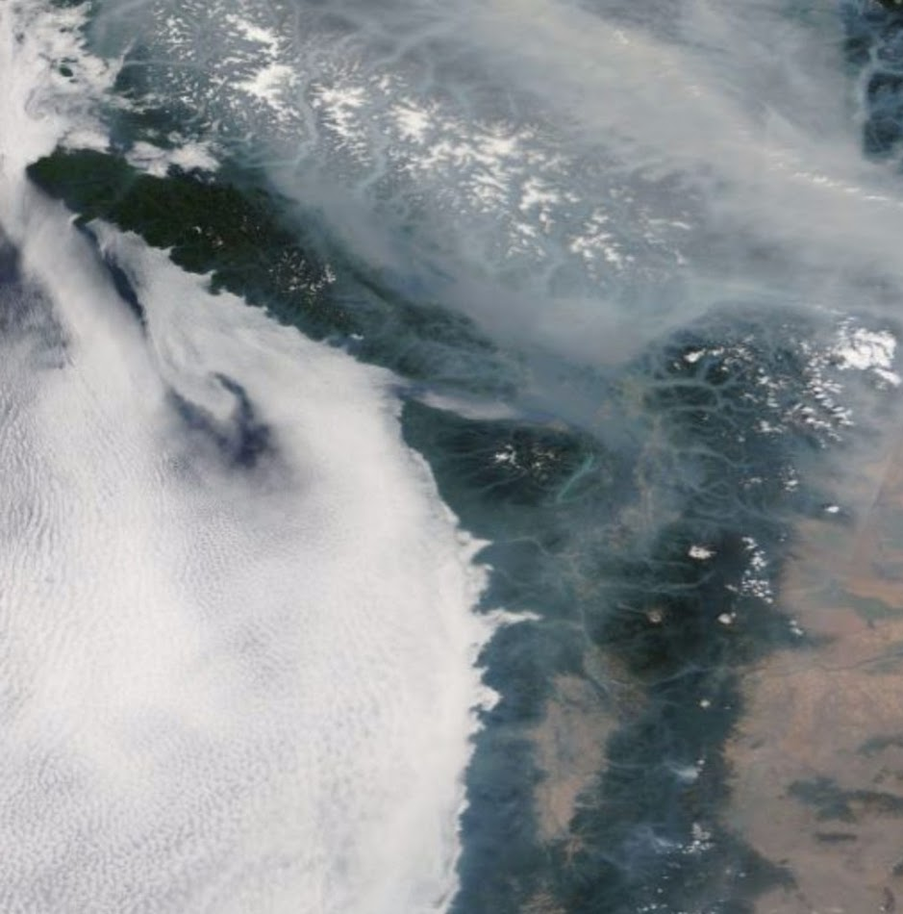
Dealing with Smoke Impacts on Surface Temperature

Slide 14
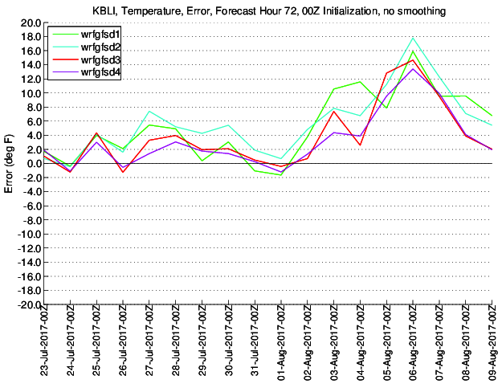
In 2017, smoke-related cooling (as high as 15F) was not captured by the UW Operational WRF System
UW WRF Temperature Error
TOO WARM
Bellingham, WA

Slide 15
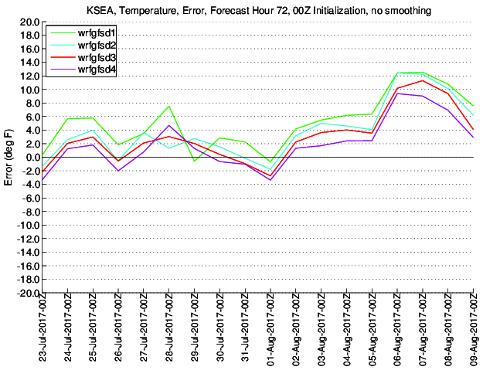
Seattle

Slide 16
Our Fix Went Operational on 8/15: Add Cooling Effects of Smoke
8/15/2018 Beginning with the 2018081600 run, all WRF-GFS domains will be using aerosol optical depth and the aerosol angstrom exponent fields from NASA's GEOS system. Three-hourly values of these parameters will be used in WRF to interact with the radiation scheme in an effort to incorporate the temperature effects of smoke.

Slide 17
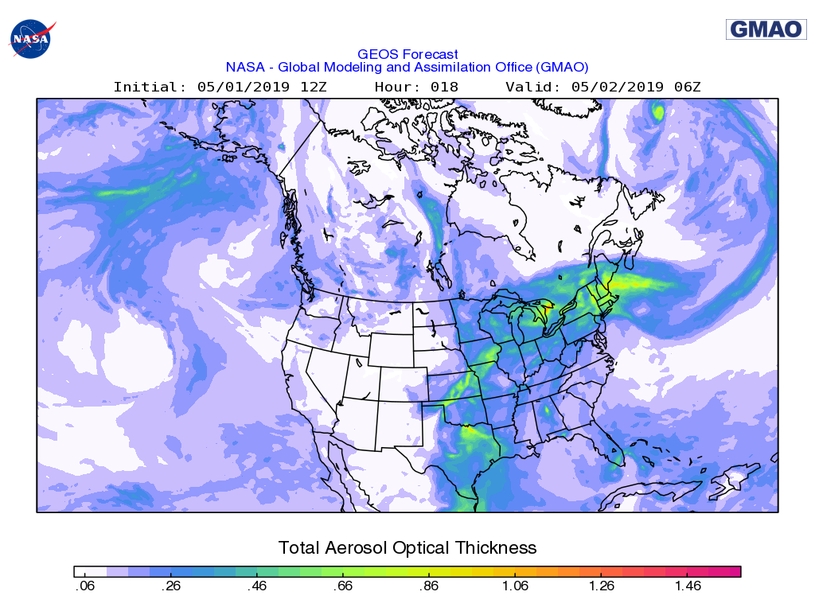
What we are doing
Turned on aerosol effects in the RRTMG radiation scheme.
Using the predicted 2-d aerosol optical depth (AOD) and the predicted 2-d aerosol Angstrom exponent from NASA's GEOS-5 system.

Slide 18
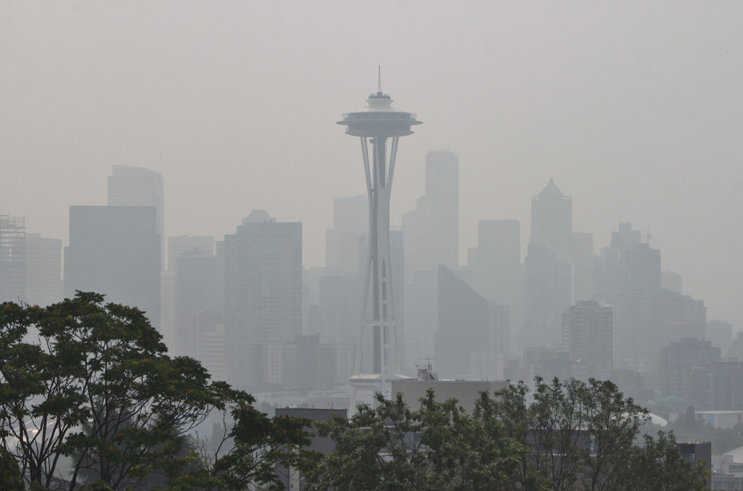
Impacts of Adding Smoke in WRF
Cools the surface during the day
Reduces daytime planetary boundary layer heights
Reduces the major warm bias we had when it was smoky (as much as 10-15F).

Slide 19
Example from last summer Crazy bad in Seattle on August 20-21.

Slide 20
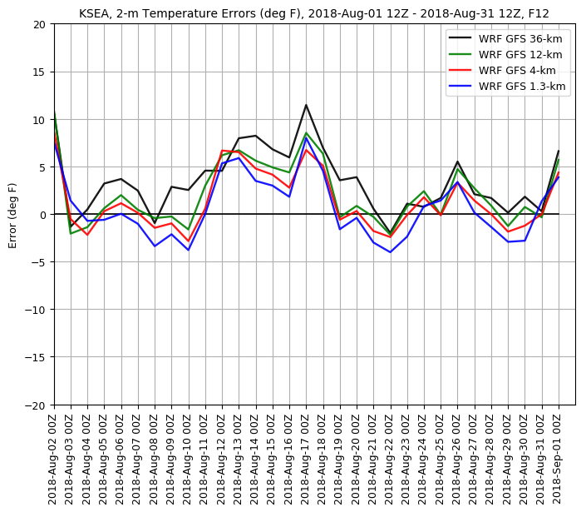

Slide 21
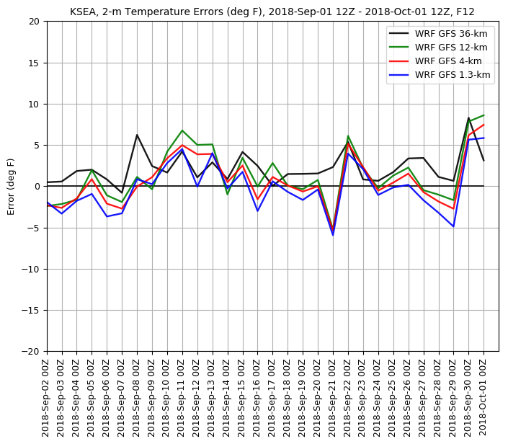
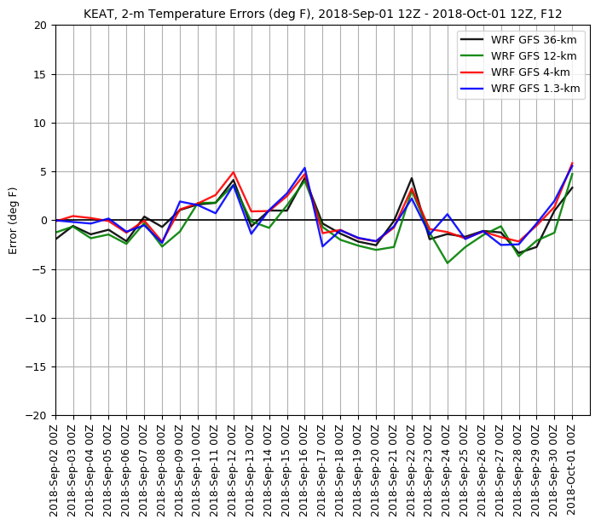

Slide 22
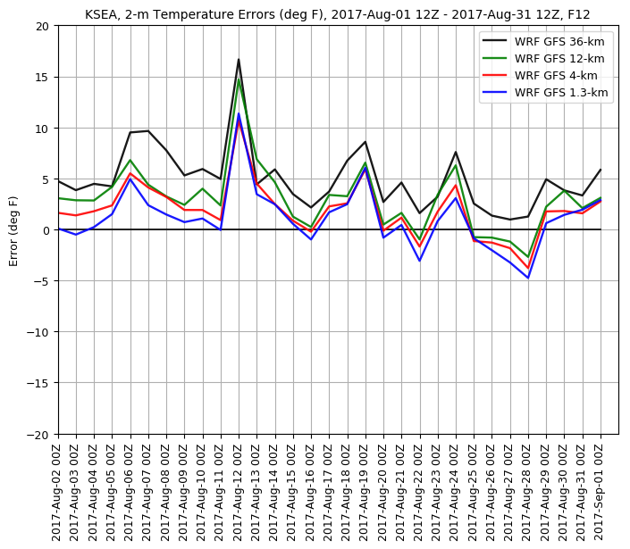
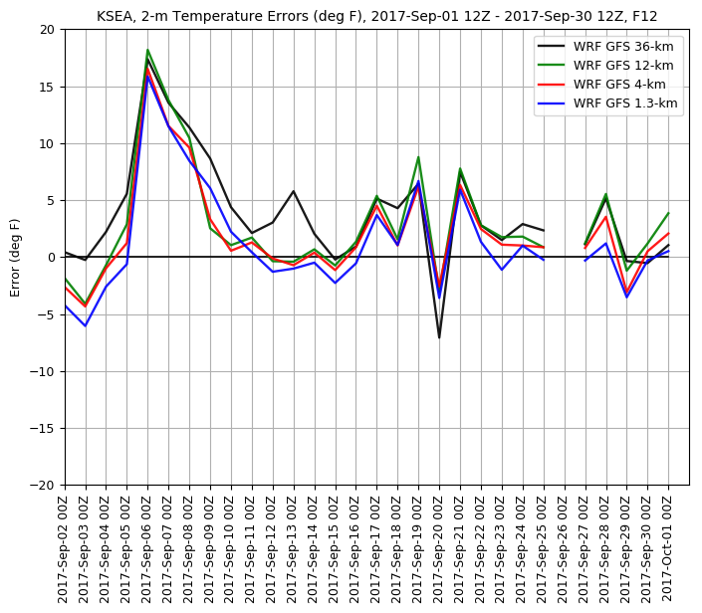
Last Year

Slide 23
Expansion and Improvement of the UW High Resolution Ensemble Forecasting System
Largest convection-allowing operational ensemble system in the U.S.
Currently running 19 WRF model forecasts at 4-km grid spacing
Both initialization and model physics uncertainty
Very useful to understand the uncertainty in the regional forecasts
Foundation to create probabilistic regional forecasts

Slide 24
The UW High-Resolution (4-km) Ensemble Has Been Expanded
19 members, 00 UTC and 12 UTC initializations, 72 hr forecast
Includes 10 members are randomly selected by the GFS ensemble (GEFS)
6 members are from major national systems
UKMET (UK)
CMC (Canada)
JMA (Japan)
GASP (Australian)
TCWD (Taiwan)
NGPS (Navy)

Slide 25
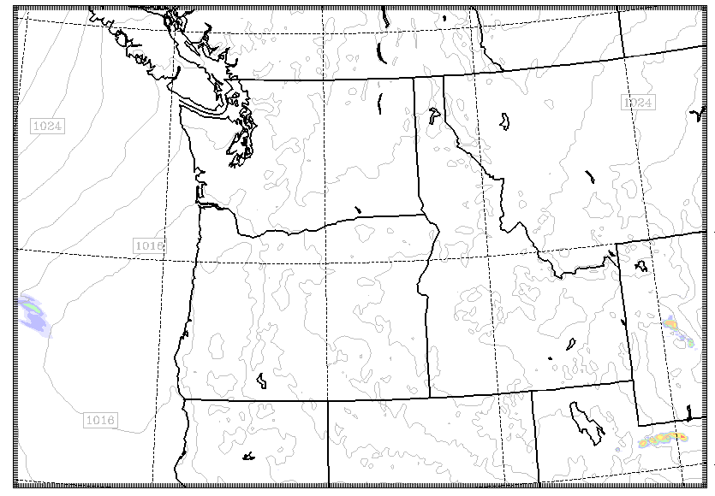
The Domain

Slide 26
The Entrance Page

Slide 27
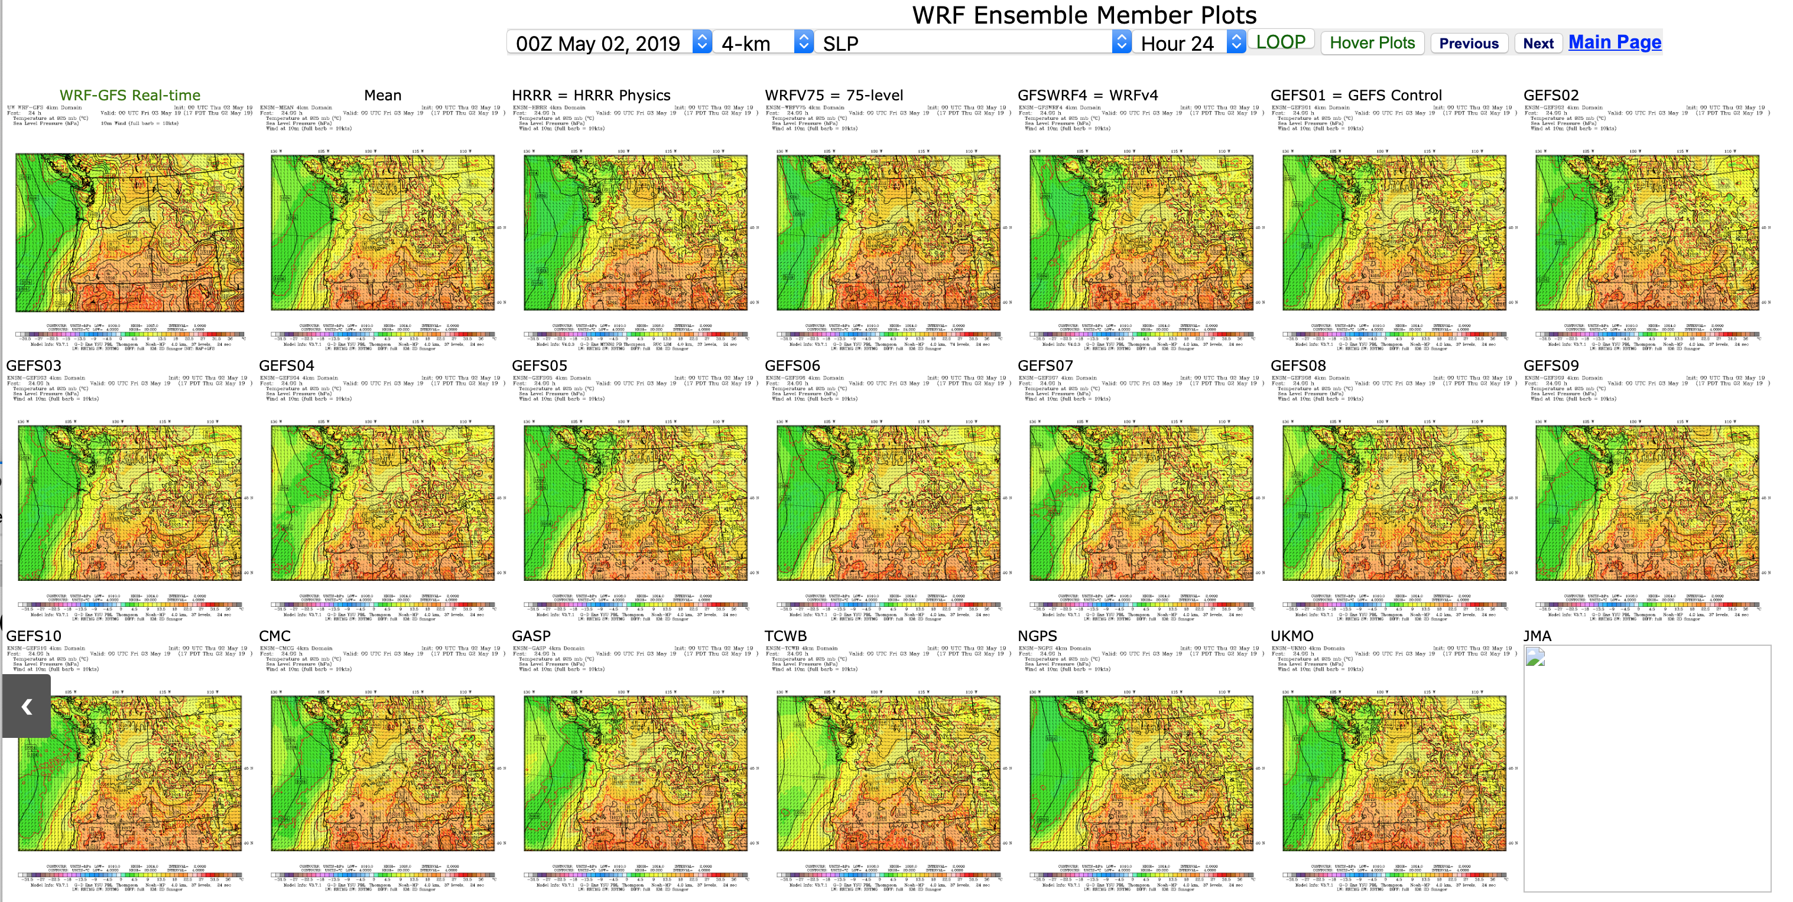
Individual Member Plots

Slide 28
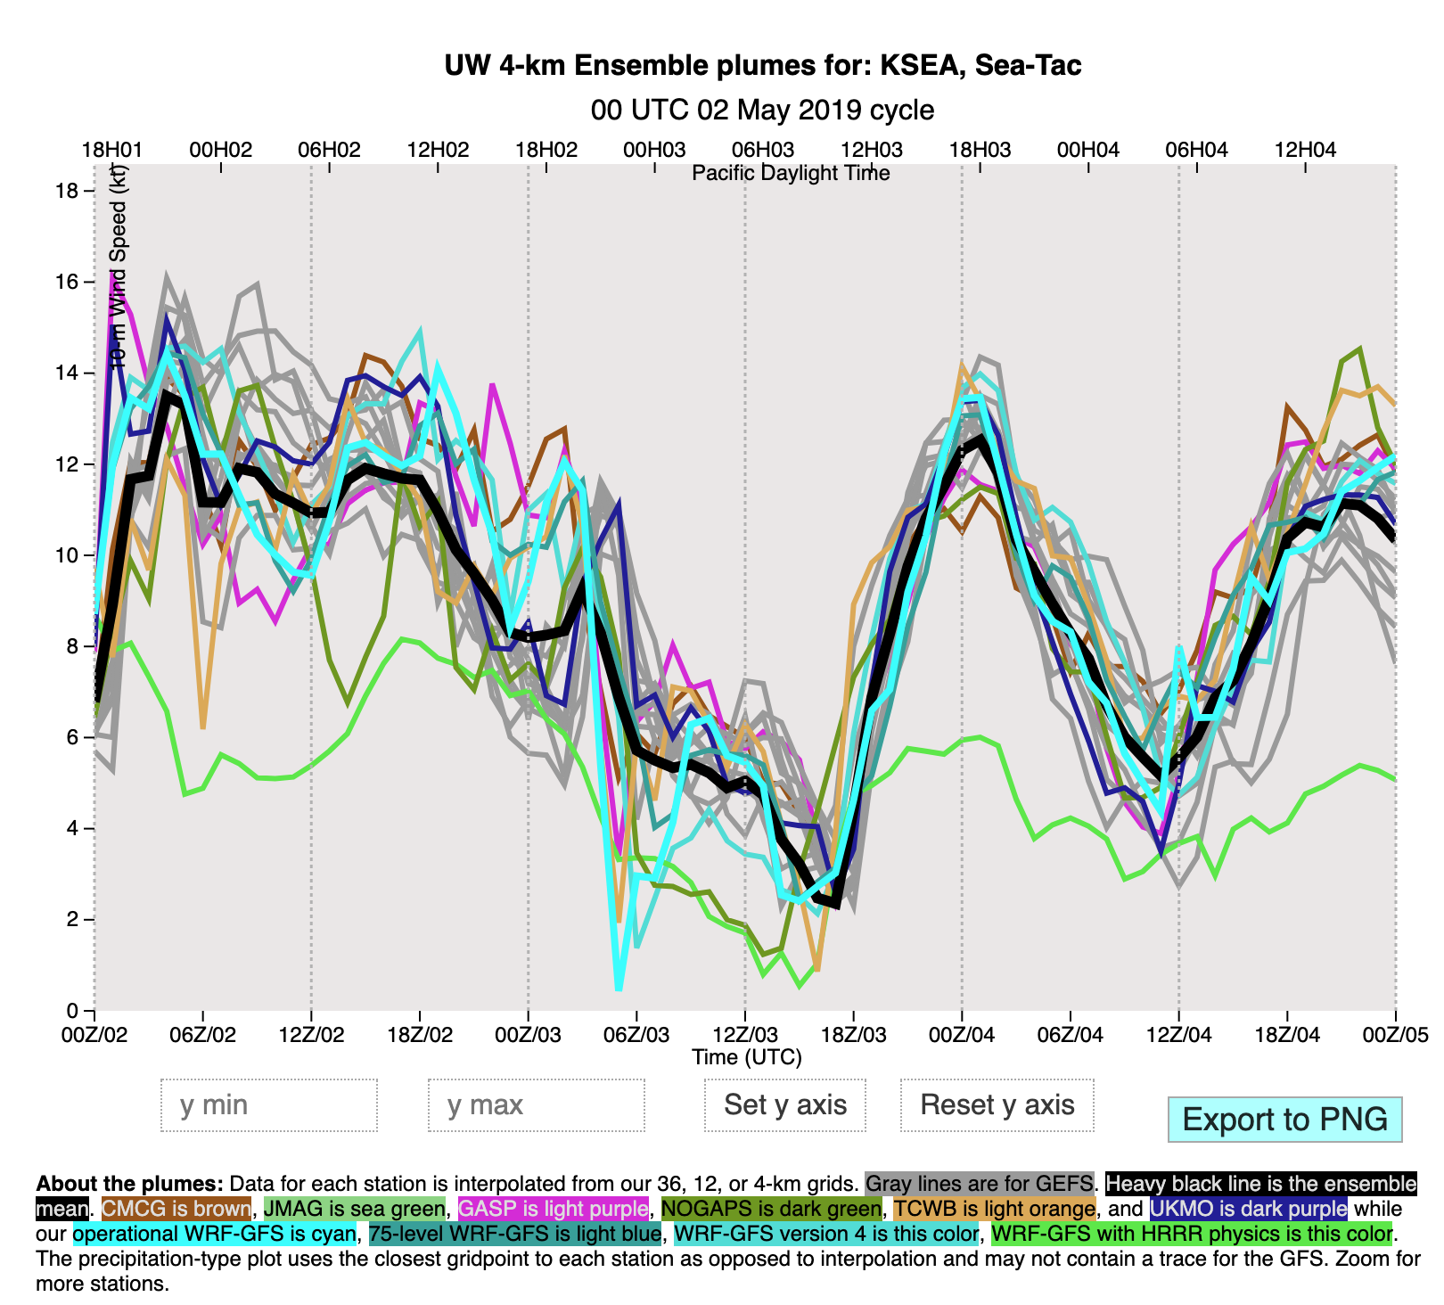
Plume Diagrams

Slide 29
Ensemble Mean and Spread

Slide 30
Or Pick What You Want!

Slide 31
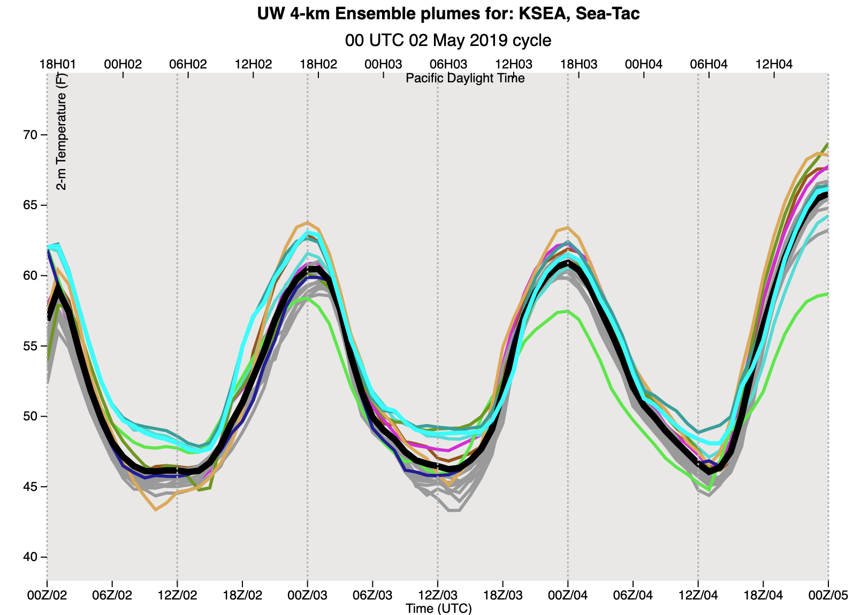
Major Recent Changes
Added 1200 UTC initialization time– so you get the full forecast ensemble twice a day.
Added new physics diversity members:
New WRF 4.0.3 with new hybrid vertical coordinate
Version using WRF 4.0.3. with the NOAA/NWS/ HRRR physics
Version with many more vertical levels and vertical resolution (75 levels)

Slide 32
Using the ensemble with the high-res. forecasts
It is very useful to compare the high-resolution run with the ensembles to see if it is an outlier.

Slide 33
Much More Coming!
More ensemble members
Ensemble Verification statistics
Calibrated probabilistic forecasts
Potential upgrade of the high-resolution system

Slide 34

The end

