Slide 1
Synoptic Control of Cross-Barrier Precipitation Ratios across the Cascade Mountains
Cliff Mass, Michael Warner, Rick Steed, and Ricardito Vargas
University of Washington.

Slide 2
The Ratio of the Precipitation that Falls on the Windward and Leeward Sides of Terrain Barriers Can Vary Substantially
A number of papers have explored the impacts of basic parameters, such as:
Upslope wind component
Moisture content
Temperature structure
Wind Shear
A small sample (Colle 2012, Smith 2001, Durran 1983)

Slide 3
Far fewer studies have examined how cross-mountain contrasts are modulated by the synoptic situation and in various portions of a passing cyclone
Siler et al. (2013) found that the intensity of the winter-mean rain shadow across the Washington Cascades was weaker in El Niño than La Niña years, and that the strongest (weakest) rain shadows occurred for warm-sector (warm-frontal) situations.
Dettinger et al. (2004) found increased windward-crest precipitation ratios after cold frontal passage compared to the warm sectors of midlatitude cyclones.
Steenburgh (2004) found less orographic enhancement during frontal passage than during post-frontal convective across Utah’s Wasatch Range.

Slide 4
Cascade Microphysical Studies
Farber (1971), Hobbs (1975) and Medina et al. (2007) described three major stages of such winter storms.
pre-frontal conditions: ice particles dominate, layered clouds reaching 7.5 to 10.5 km, and the atmosphere is stable, moist, and warm. Ice crystals can be advected far downstream to the lee of the barrier in the westerly flow aloft.
transitional stage: frontal passage aloft, the beginning of mid-tropospheric cold-air advection, and decreasing atmospheric stability. Winds become more westerly and orographic enhancement becomes more pronounced.
post-frontal stage: more convective and unstable, with cloud tops lowering as drier air floods in above approximately 600 hPa. Orographic enhancement of precipitation and clouds along the western (windward) slopes is pronounced, with substantial drying over the eastern slopes of the Cascades

Slide 5
An Example for the Washington Cascades

Slide 10
The Current Study

Slide 11
Current Study
Calculated the hourly precipitation at lines of three stations on the eastern and western side of the Cascades.
Calculated the differences between the two sides
Composited winter synoptic fields (NARR reanalysis( for situations in which:
Eastern side wetter
Similar on both sides
Modestly wetter on western side
Much wetter on western side.

Slide 12
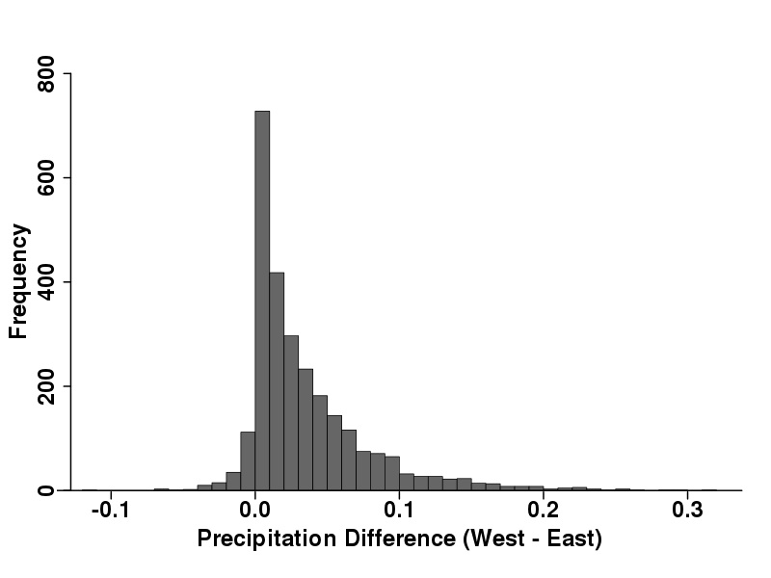

Slide 13
850 hPa (height, red) and temp (blue)

Slide 14
700 hPa Vertical Motion (blue up, red down)

Slide 15
700 hPa RH

Slide 16
Some Examples

Slide 17
Wetter East

Slide 19
Approximately Equal on Both Sides

Slide 21
Wetter West: Two Ways

Slide 24
What do these results tell us about cross mountain precipitation ratios in El Nino and La Nina Years?

Slide 26
El Nino versus La Nina Orographic Modulation
El Niño and La Niño differences can be explained be the associated synoptic configurations.
El Niño years have weaker zonal winds and thus less orographic modulation of precipitation on the north-south Cascade Range.
Lesser vertical stability of La Niña years enhances precipitation on the windward side of the barrier, where instability is quickly released on the lower windward slopes.

Slide 27
Summary
Eastern slopes of the Cascades are wetter: synoptic-scale warm advection, associated with an approaching occlusion or warm front, spreads deep, stratiform precipitation over the region. Zonal flow is relatively weak and upslope flow (southeasterlies) on the eastern side of the Cascades.
Nearly equal precipitation: similar to the wet eastern slopes configuration, but with the frontal trough positioned farther to the northeast,
results in stronger southwesterly flow on the western side of the Cascades and weaker southeasterlies on the eastern side. Synoptic structures suggests an occluded front along the Pacific coast.

Slide 28
Summary
Western slopes are modestly wetter than the eastern side: Low-level flow is westerly, increasing windward precipitation while lessening precipitation on the leeward (eastern) side. Low-level temperature advection over the coastal waters is weak, the frontal thermal ridge is absent, and the pressure trough has moved inland, suggesting early postfrontal conditions.
Western slopes are considerably : the westerly flow strengthens, enhancing the orographic effects.Can occur during two synoptic situations.
Strong subtropical ridge produces strong, moist, warm westerly/northwesterly flow nearly perpendicular to the north-south Cascades. In such a situation, a strong mt. wave enhances the cross-barrier precip. contrasts
Cold advection follows an occluded/frontal zone passage with associated veering of the coastal winds to the west-northwest, with destabilization and the release of shallow convective precipitation over the western slopes.

Slide 29
The End

