Slide 1
370midterm grades

Slide 2
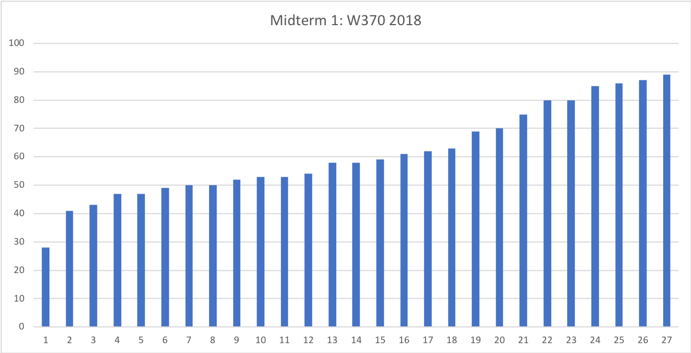
.7
2.0
3.0

Slide 3
https://studyskills.com/students/how-to-take-notes-in-class/

