Slide 1
Hurricane Michael

Slide 2
michael

Slide 3
gust

Slide 4
24hrprec

Slide 5
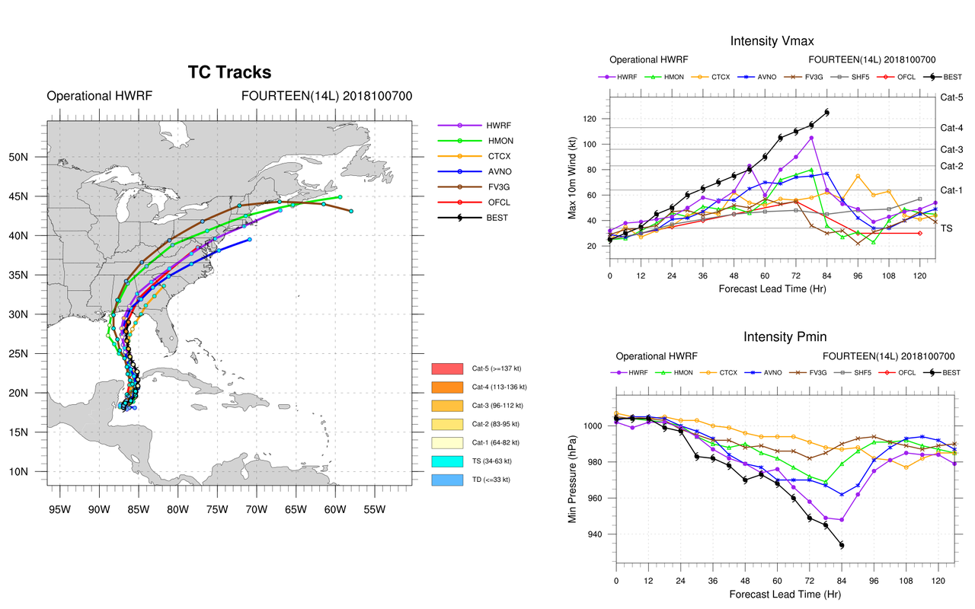

Slide 6
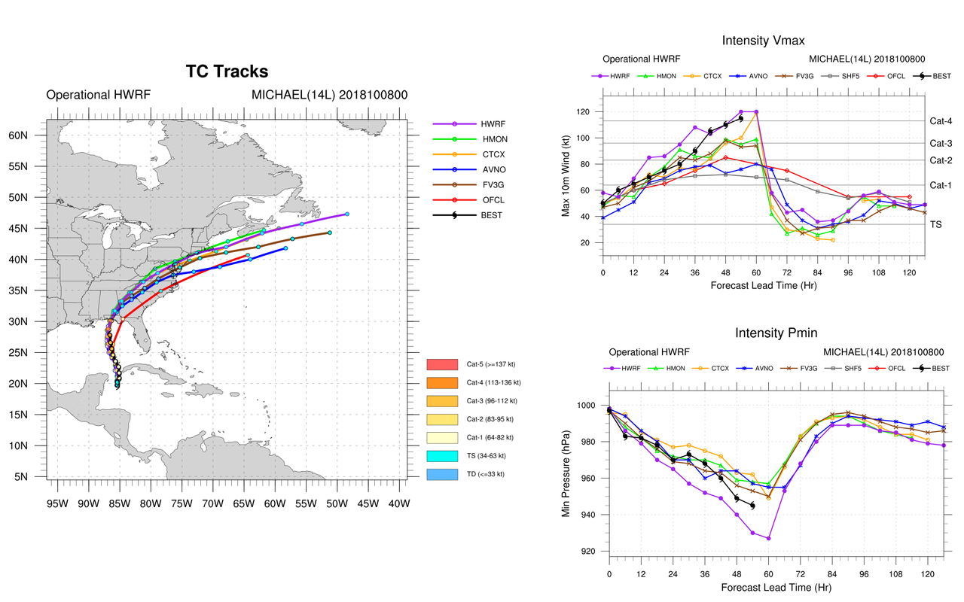

Slide 7
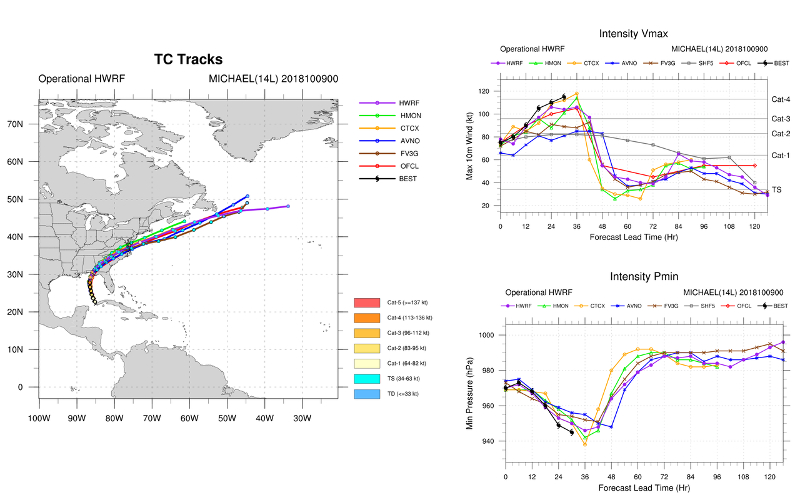

Slide 8
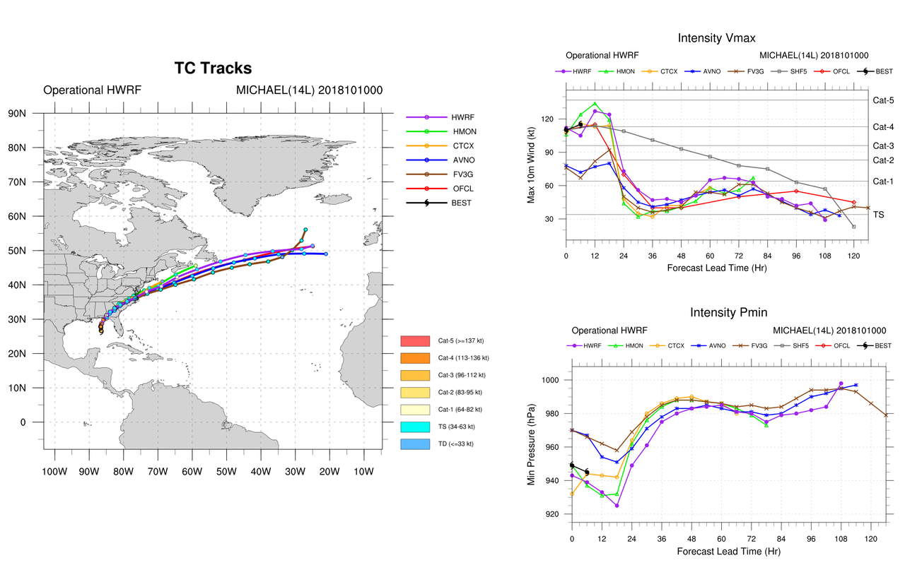

Slide 9
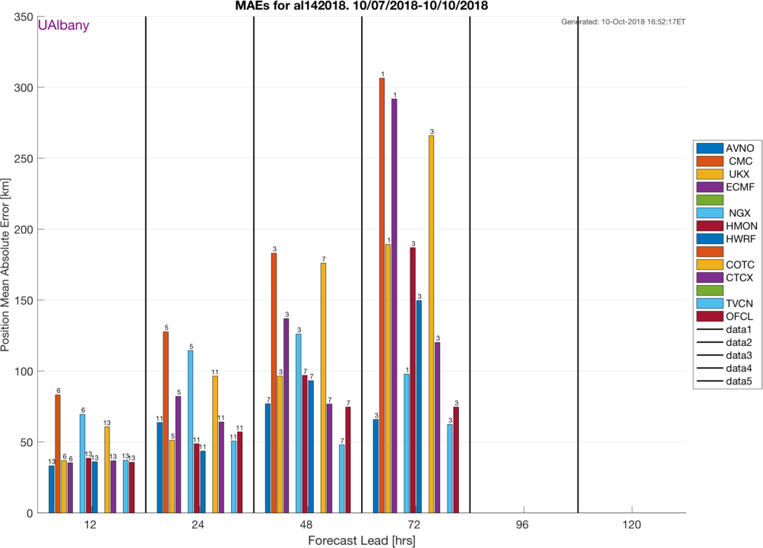

Slide 10
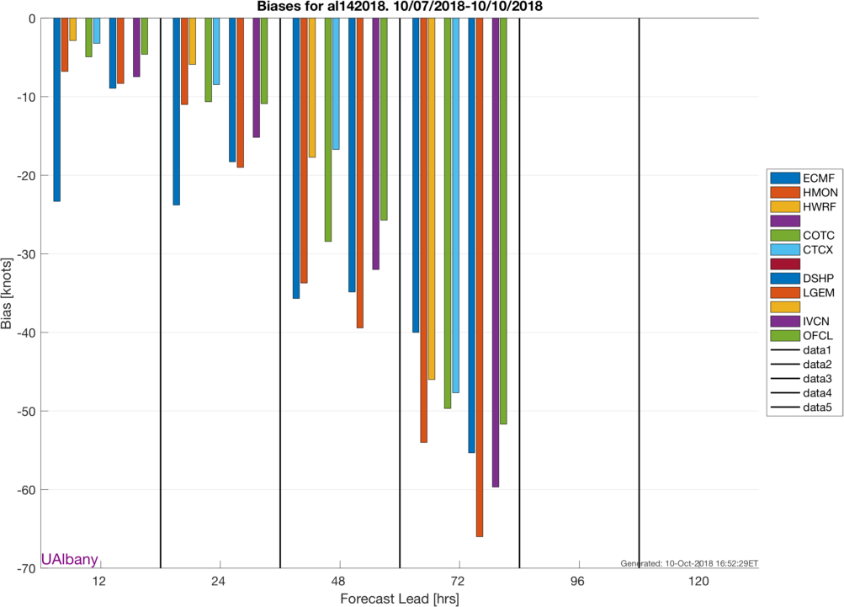

Slide 11
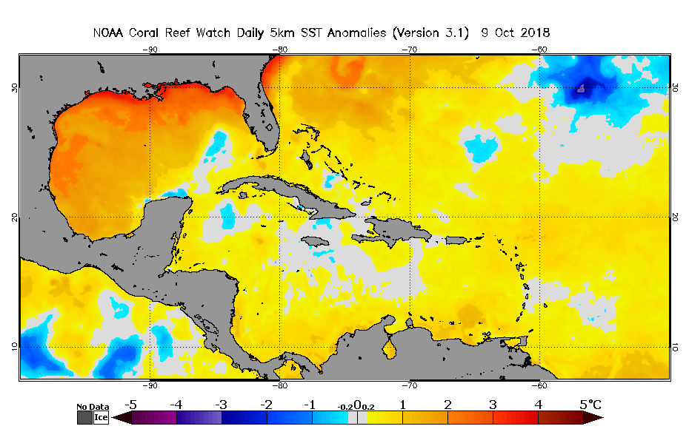
SST Anomaly…. First over cooler than normal water then 2-3C warmer near the coast

