Slide 1
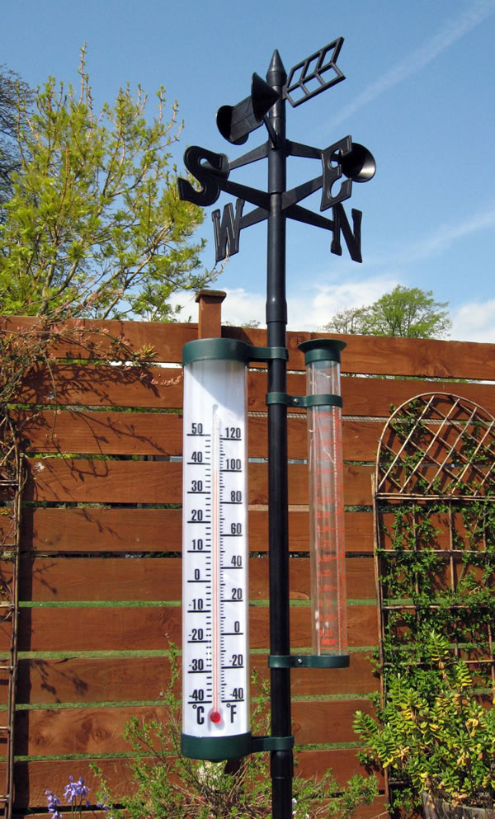
The Weather of Pacific Northwest Gardens
Cliff Mass
University of Washington
March 2019

Slide 2
The weather influencing Puget Sound and western interior gardens
Temperature: mild year round. Rarely below 25F or above 90F. Allows a wide range of plant species in our gardens.
Precipitation: moderate annual rainfall in the lowlands (35-45 in) . Big annual variations---wet winter, but dry summer.
Substantial local variations of both temperature and precipitation

Slide 3
Why mild?

Slide 4
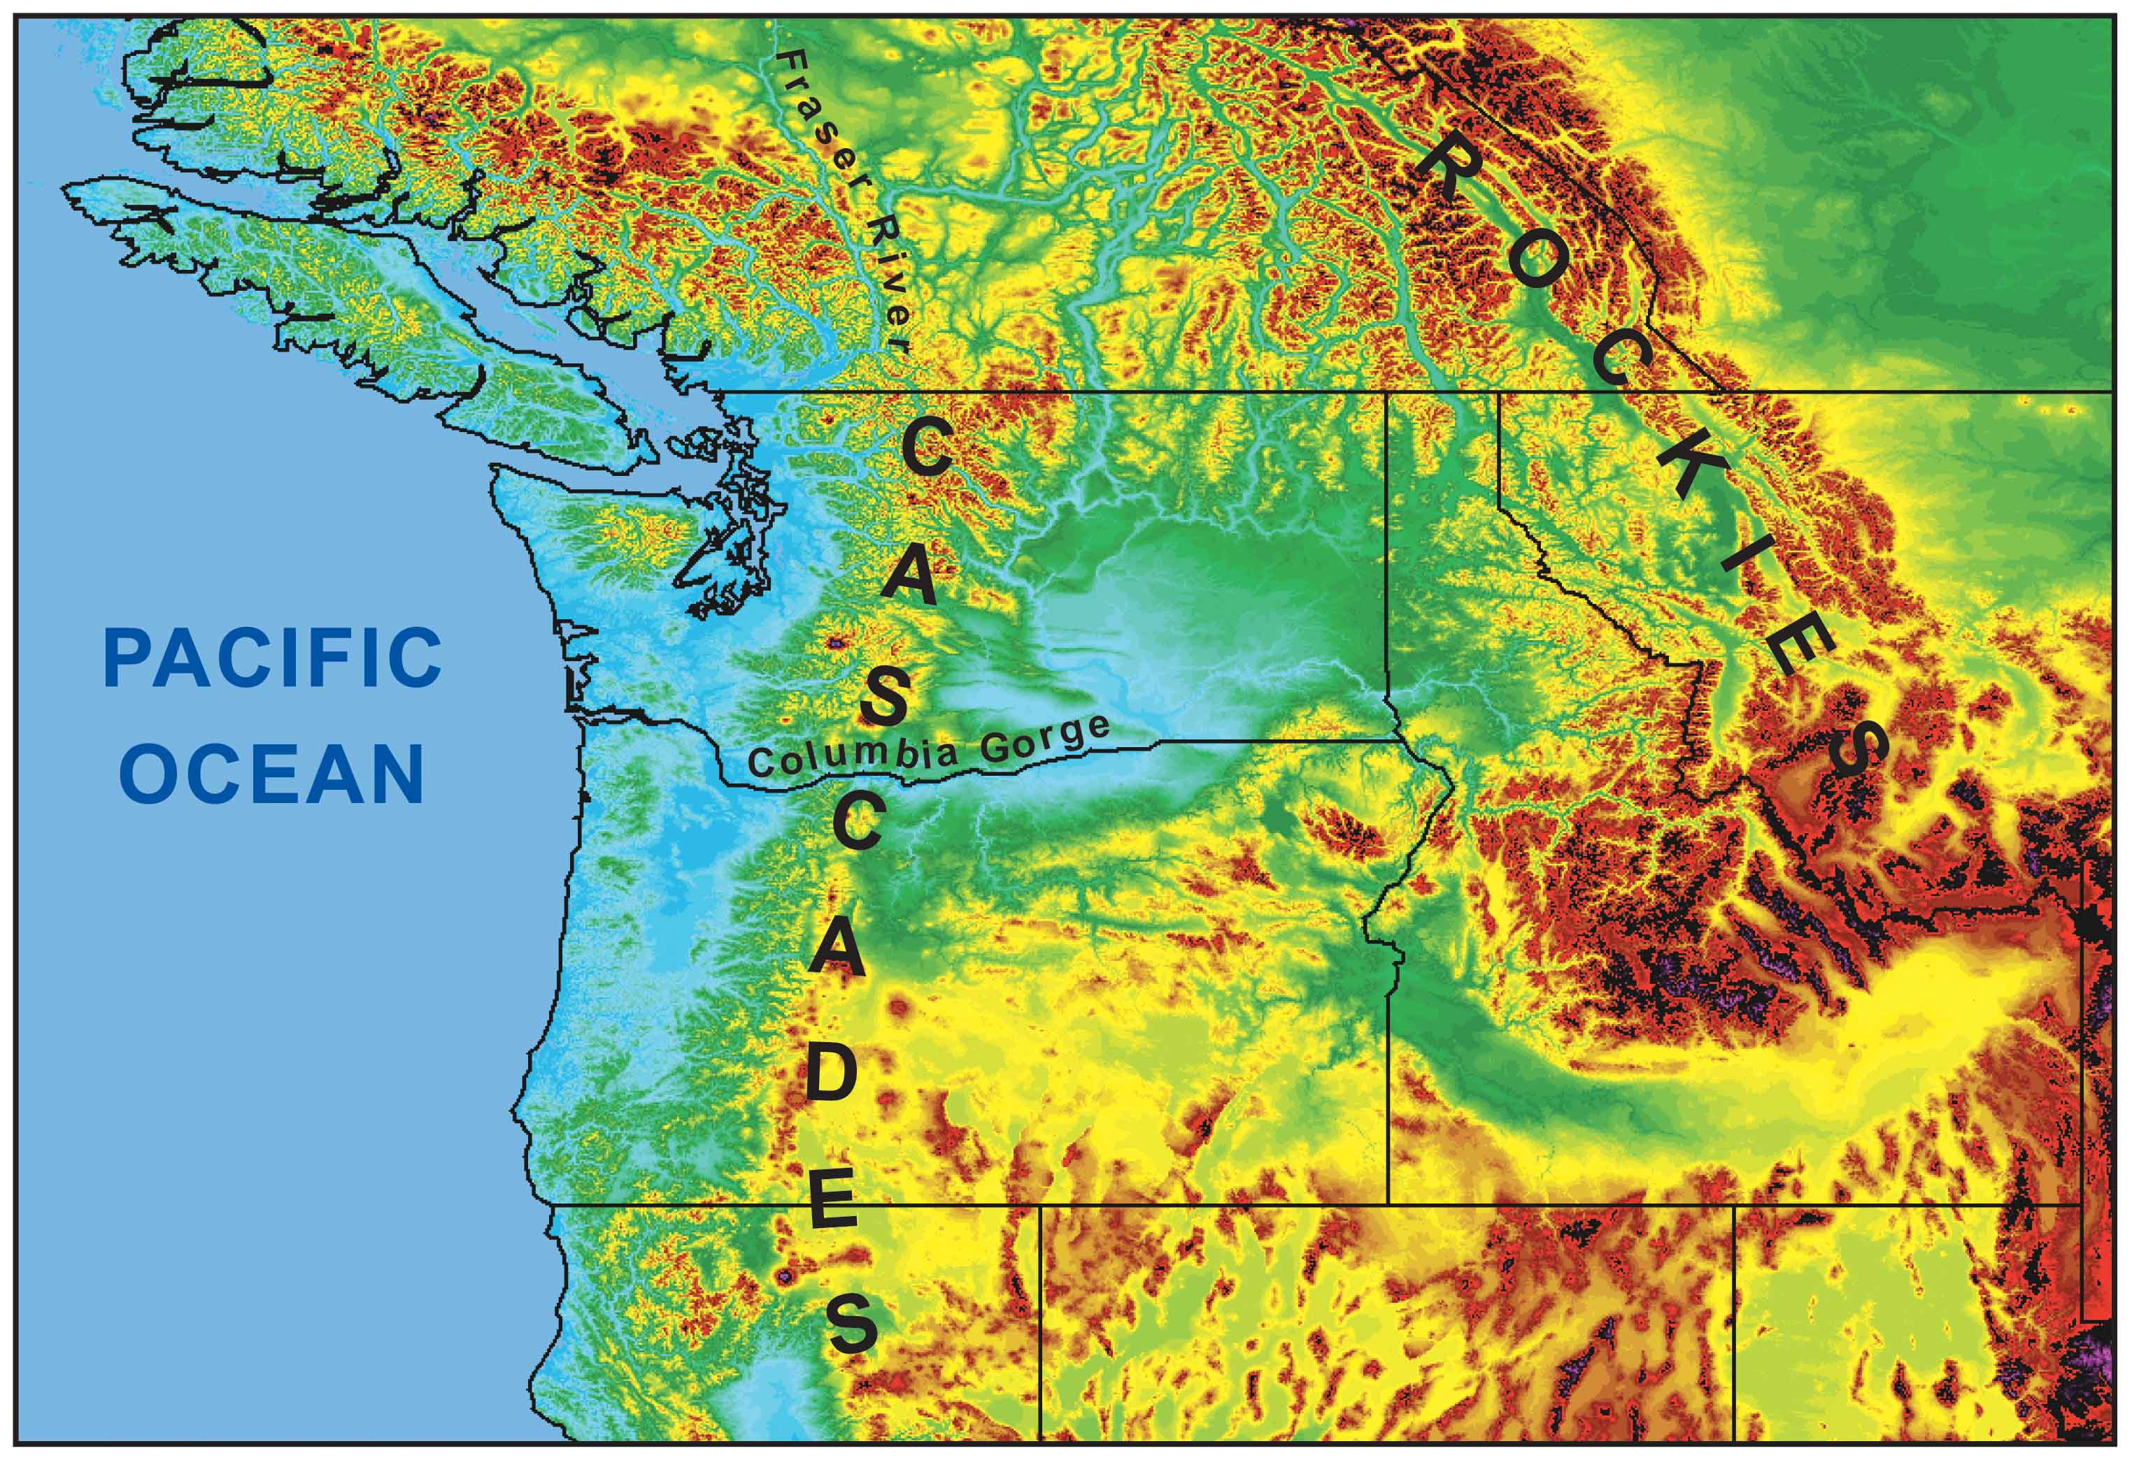
During the winter the mountains block the cold air from the interior.
Cold
Air

Slide 5
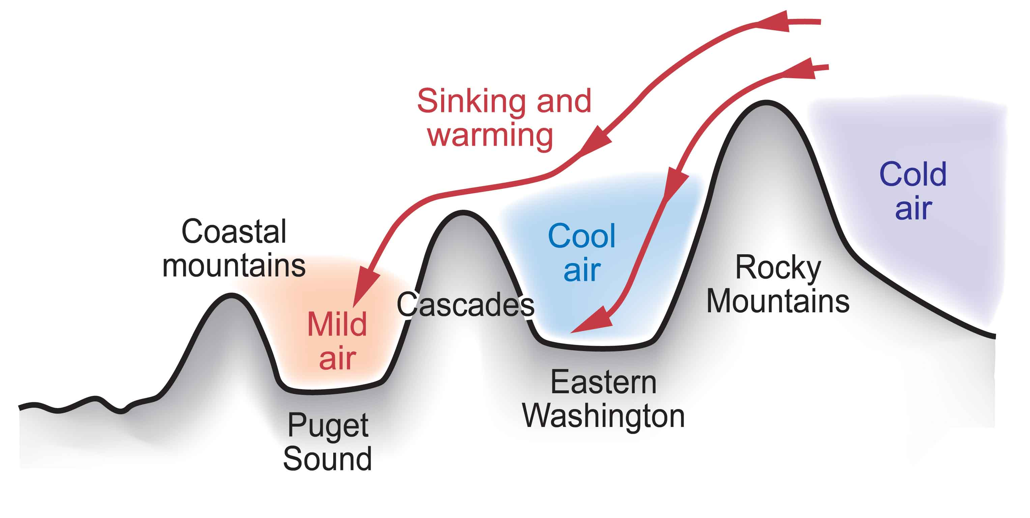
Cold Air from the Continental Interior Has a Hard Time Reaching Western Washington

Slide 6
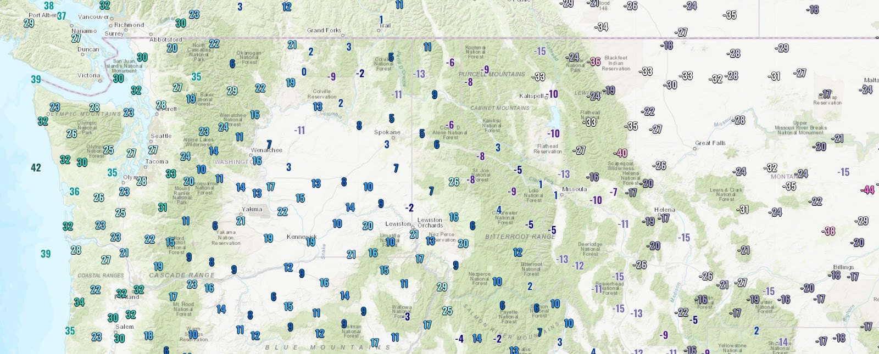
Last Sunday Was a Perfect Example

Slide 7
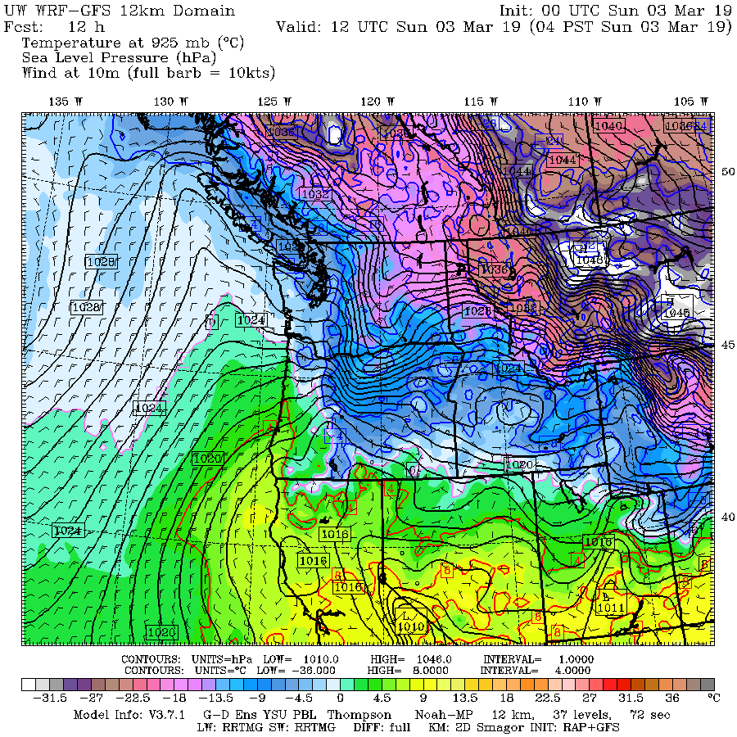

Slide 8
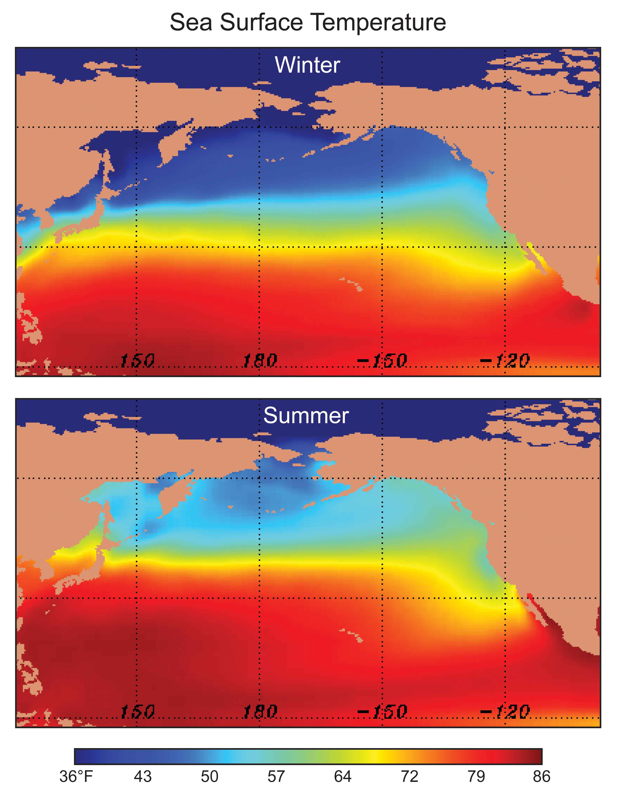
Our air and weather systems generally
move west
to east:
Thus, our
weather comes from off
the mild
Pacific

Slide 9
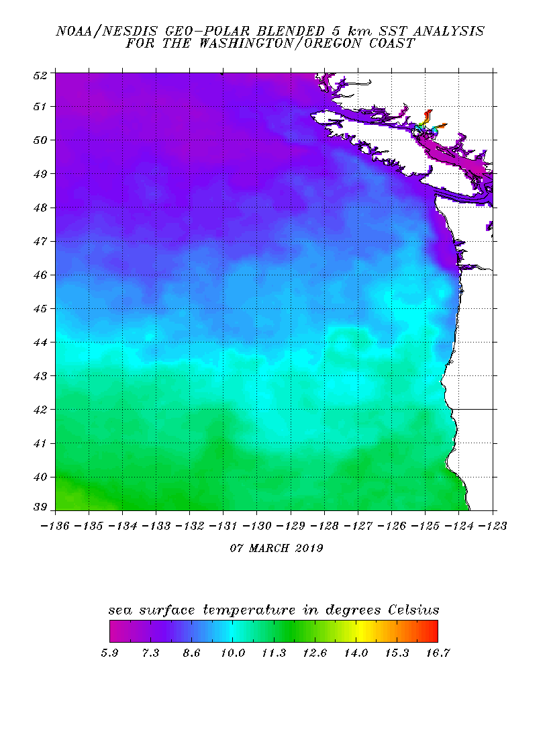
And the Pacific is relatively mild, even in mid-winter
10C is 50F

Slide 10
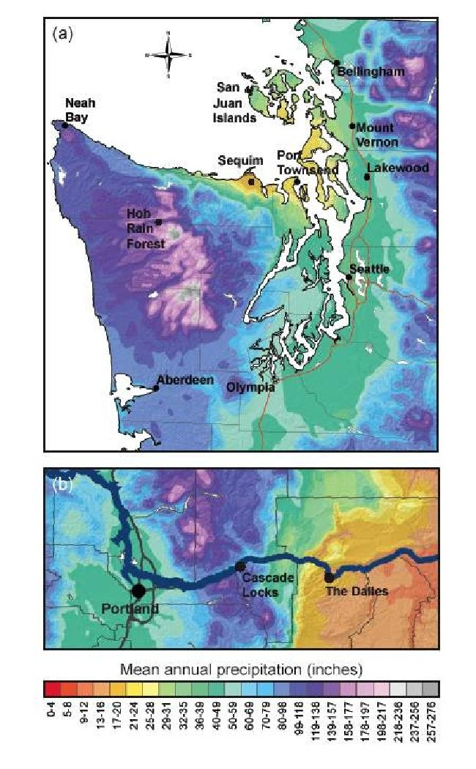
Precipitation Contrasts

Slide 11
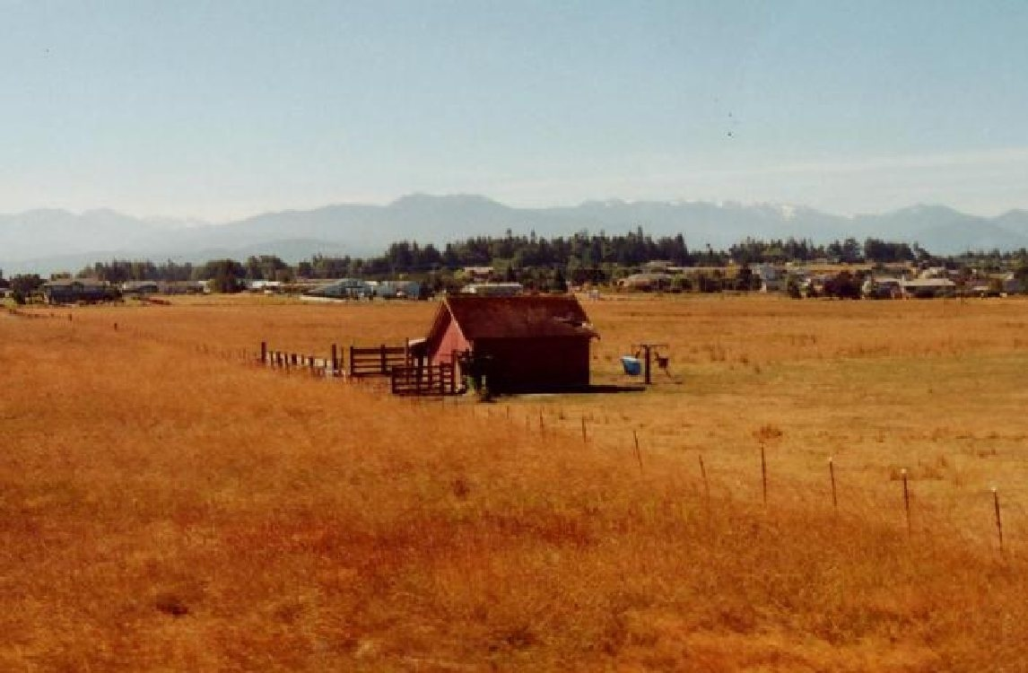
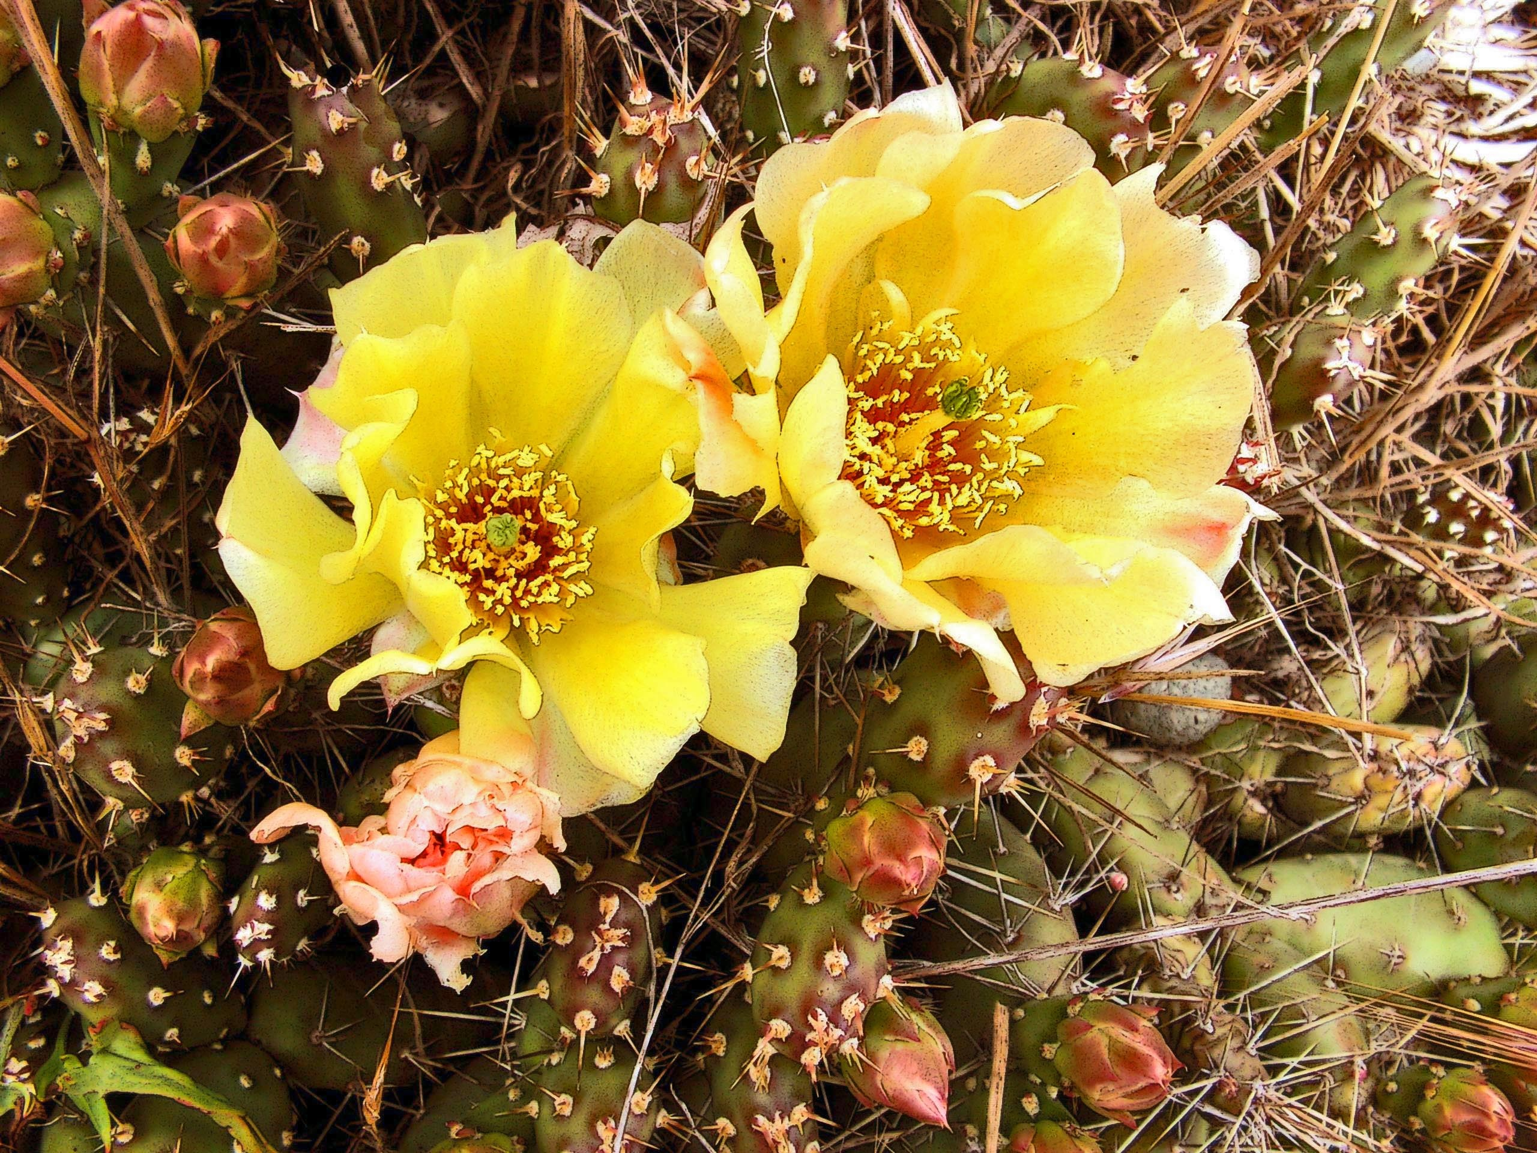
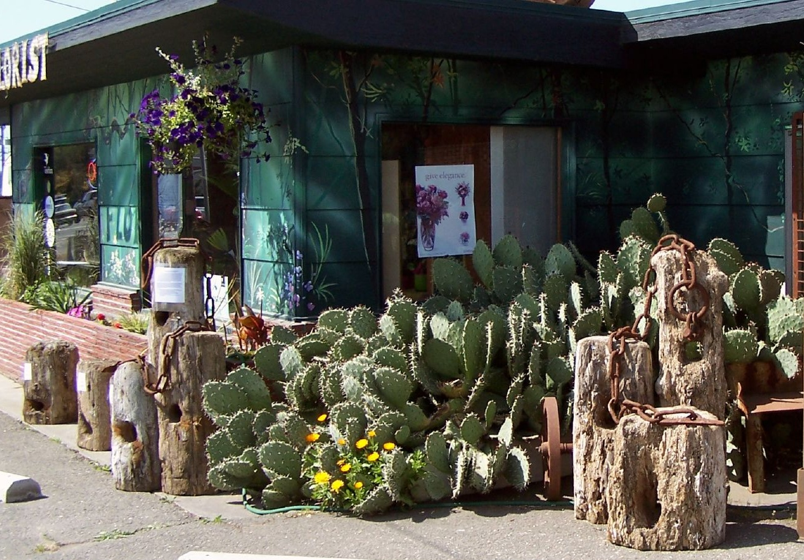
Sequim: Haven for Retirees

Slide 12
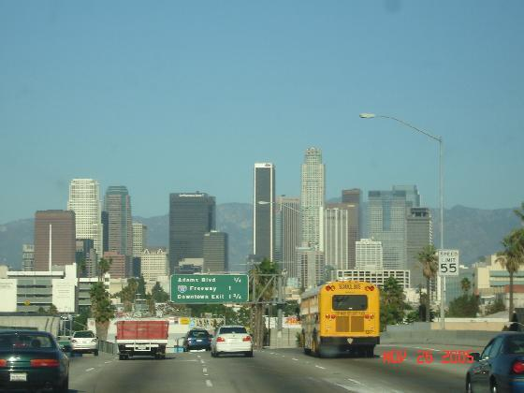
Annual Precipitation
Sequim: 15.97 inches
Los Angeles: 14.89 inches

Slide 13
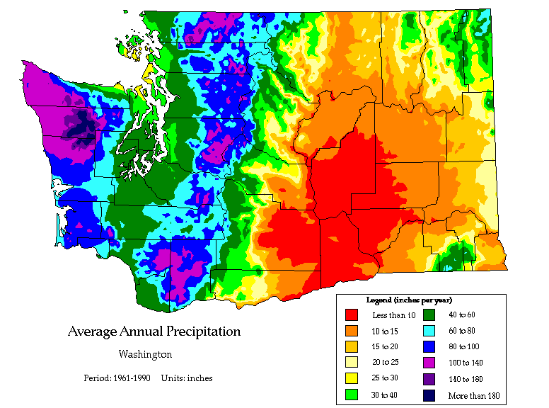

Slide 14
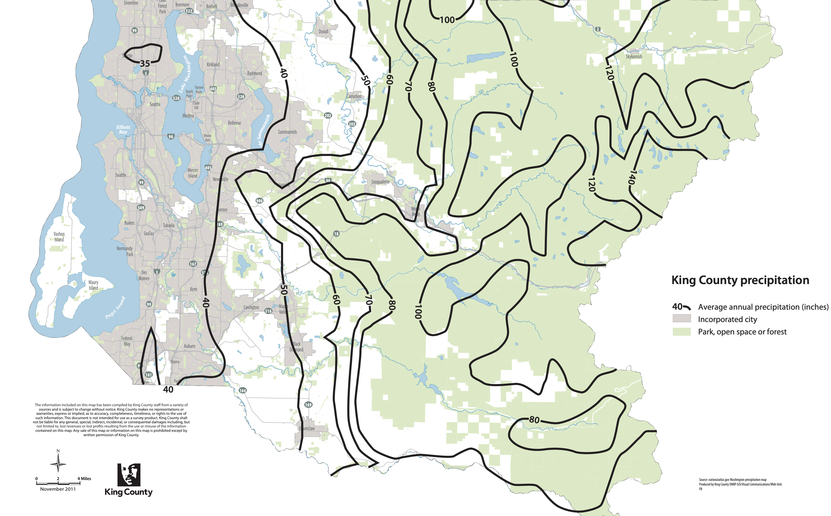

Slide 15
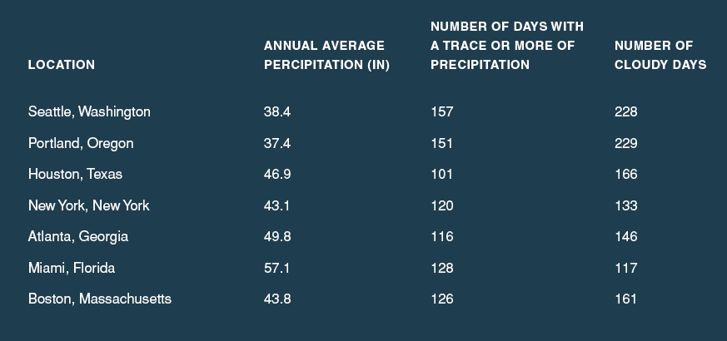
The Puget Sound area really isn’t that wet—partially because we are often in the rainshadow of the Olympics

Slide 16
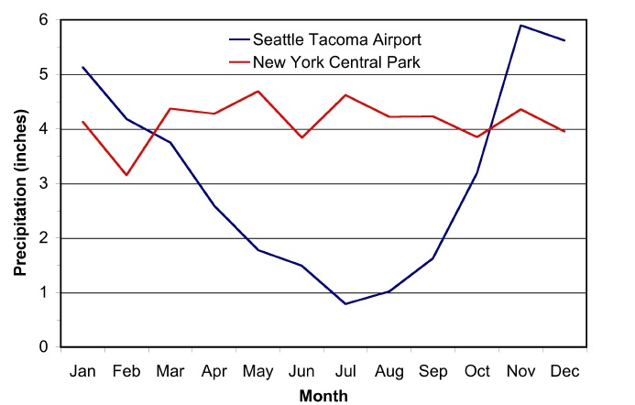
The Northwest Has a Mediterranean Climate
Moss Season
Growing Season
Moss Season

Slide 17
Why are our summers so dry?

Slide 18
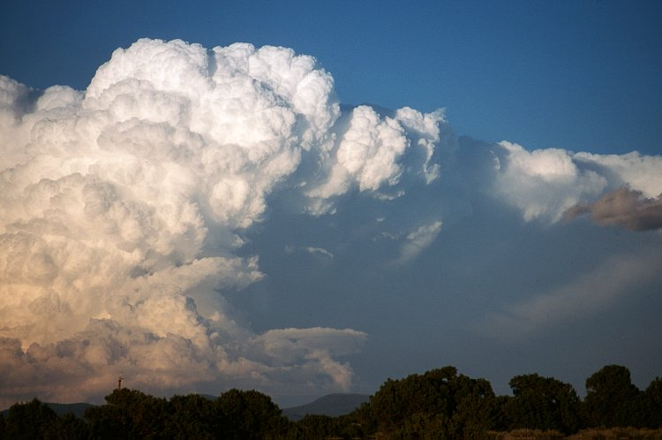
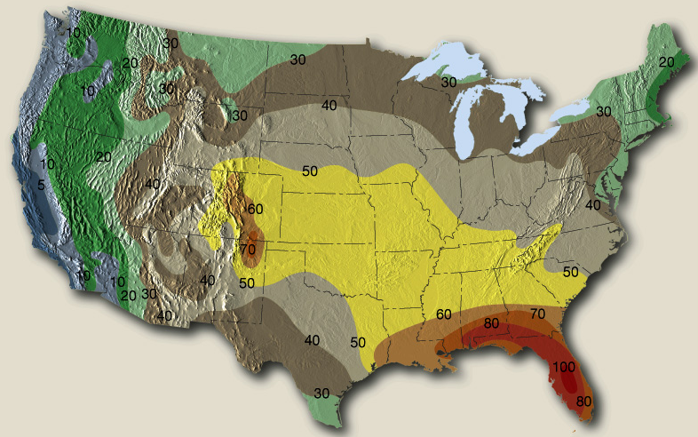
The Northwest Gets Fewer Thunderstorms Than Almost Anywhere in the U.S.

Slide 19
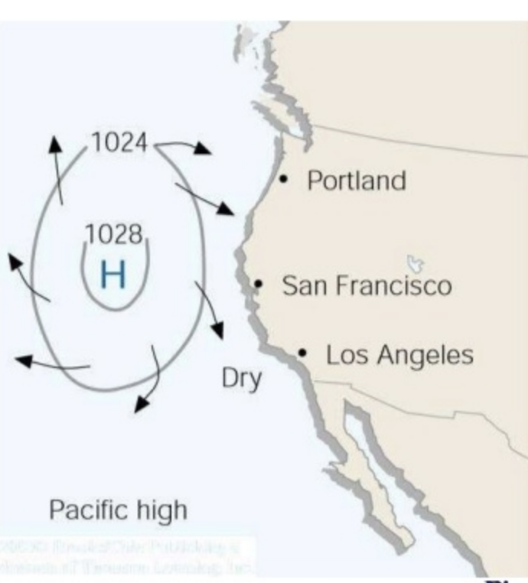
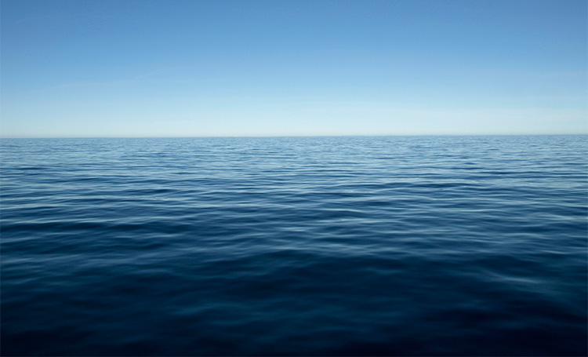
Why? High Pressure and a Cool Pacific

Slide 20
Very Strange Situation With Sport’s Facilities

Slide 21
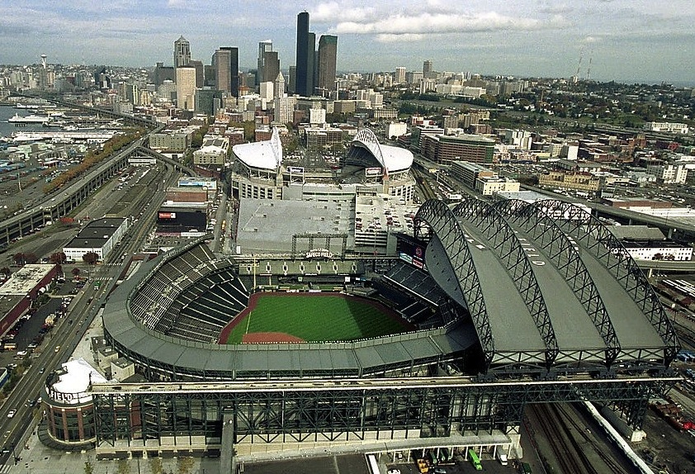
Safeco Field: 100 million dollar roof

Slide 22
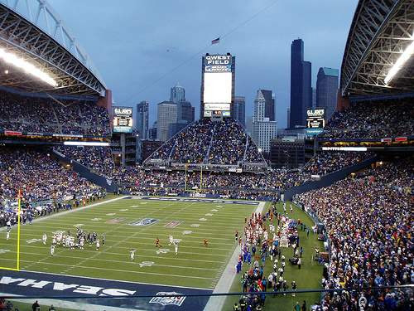
CenturyLink Field: No Roof

Slide 23
Storms of the Pacific Northwest and their impact of plants

Slide 24
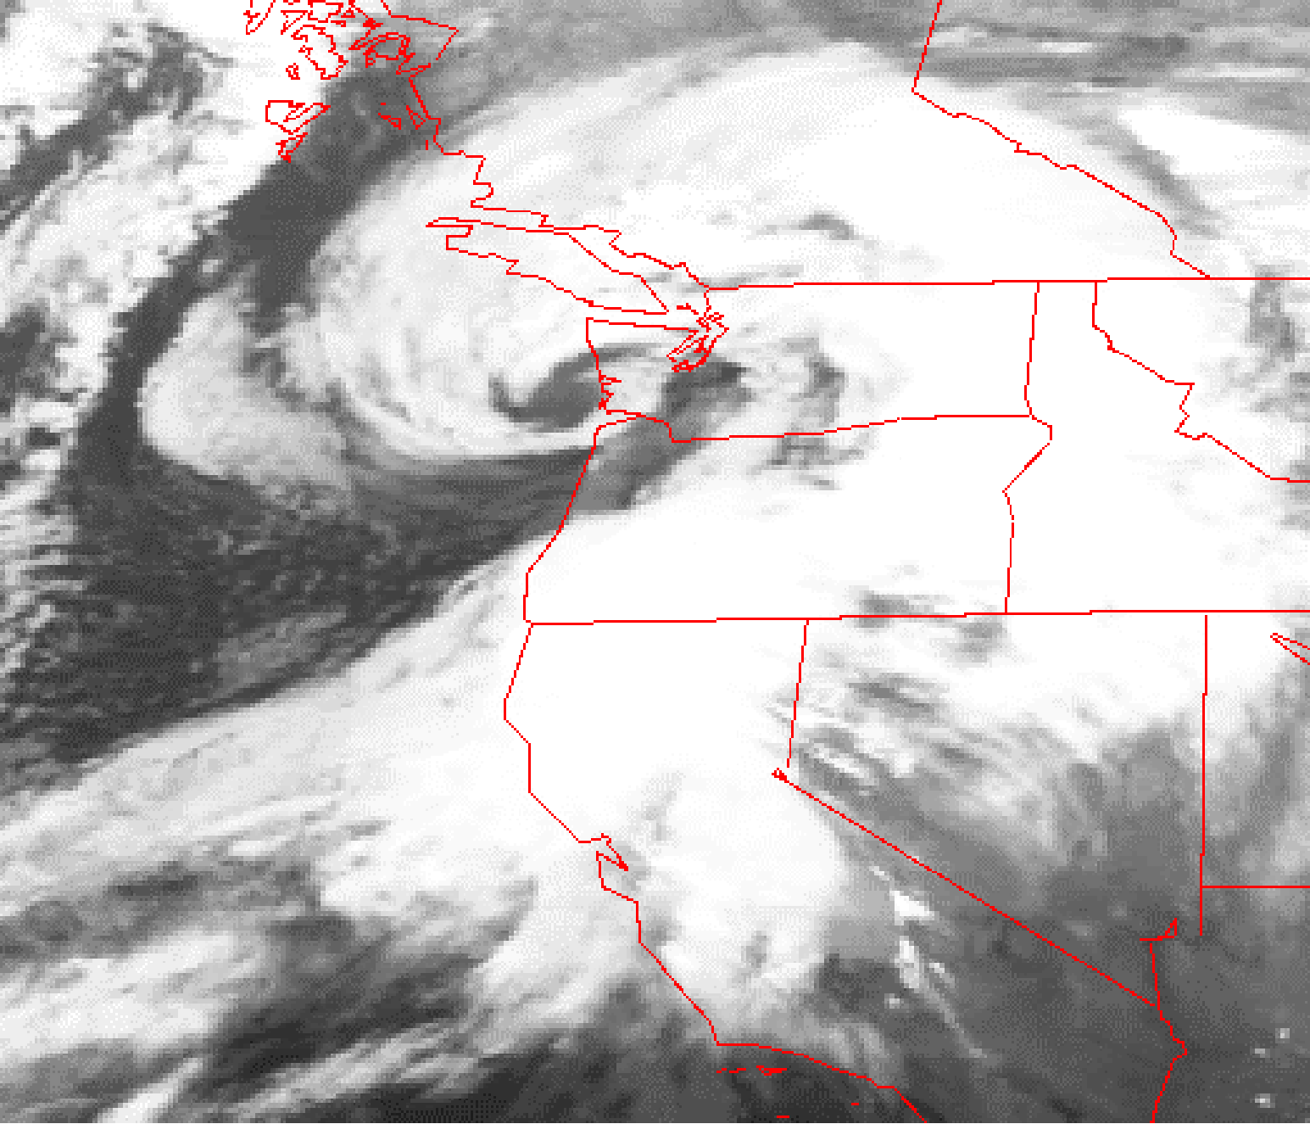
Our powerful windstorms are generally associated with strong low pressure systems, called midlatitude
cyclones
Inauguration Day Storm January 20, 1993

Slide 25
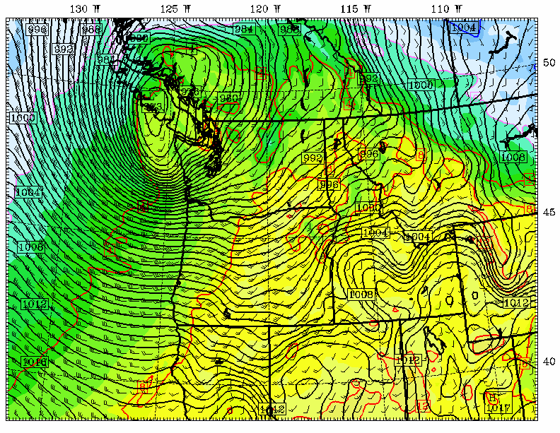
Chanukah Eve Storm: 18-h forecast for 10 PM December 14, 2006
L

Slide 26
Winter Windstorms
Typically 3-6 a winter influence Puget Sound
Winds typically gust to 35-50 mph
Every year typically one to 50-65 mph
Every ten years get to 65-75 mph

Slide 27
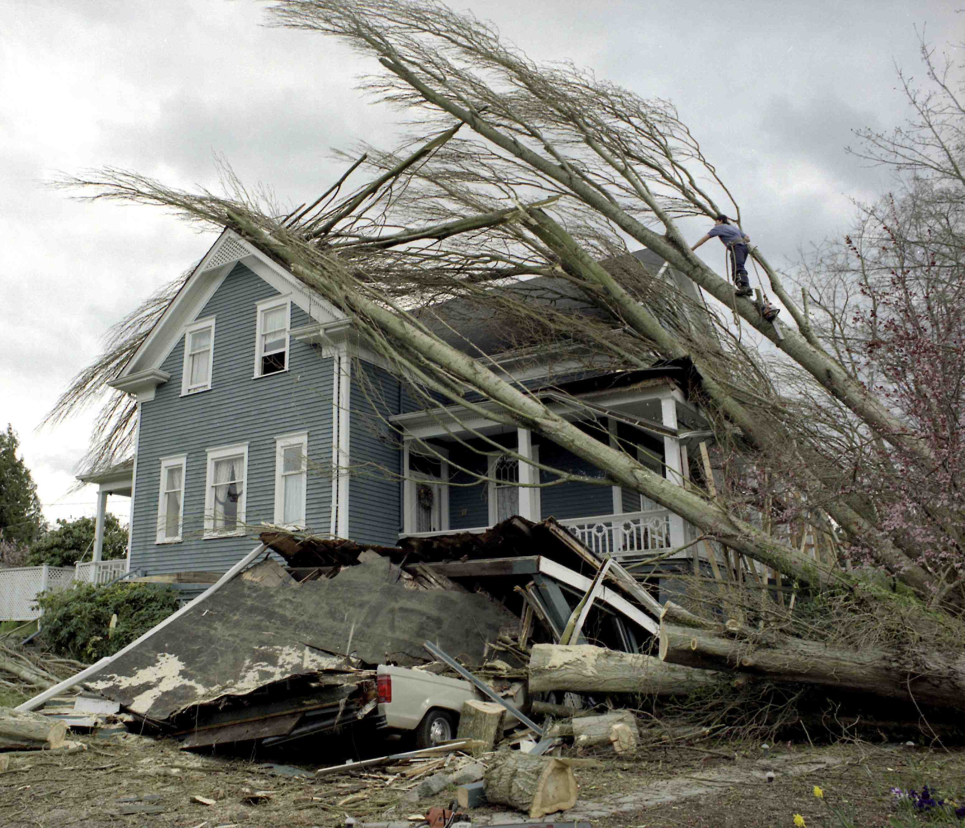
Trees—storm force multiplier

Slide 28
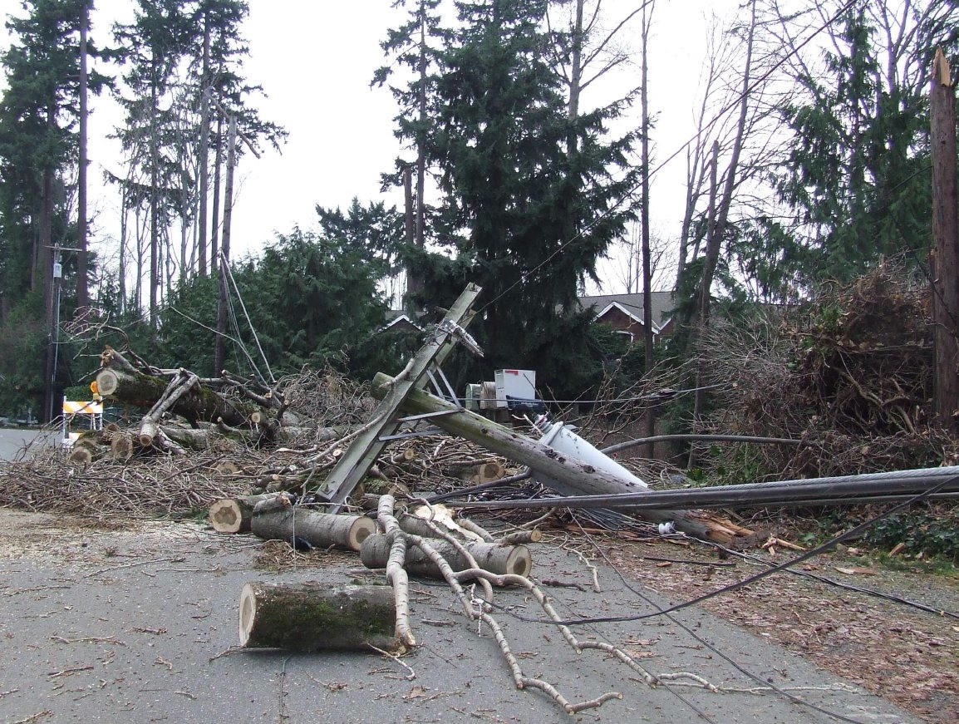
Mercer Island, December 15, 2006

Slide 29
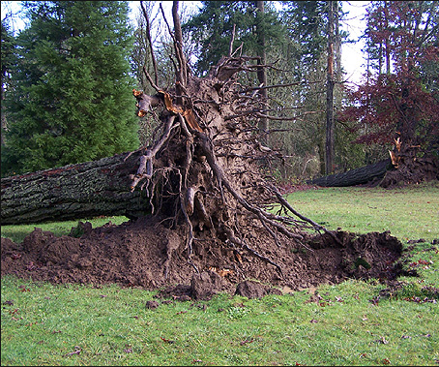
The made worse by heavy precipitation before the storm
Photo Courtesy of Wolf Read

Slide 30
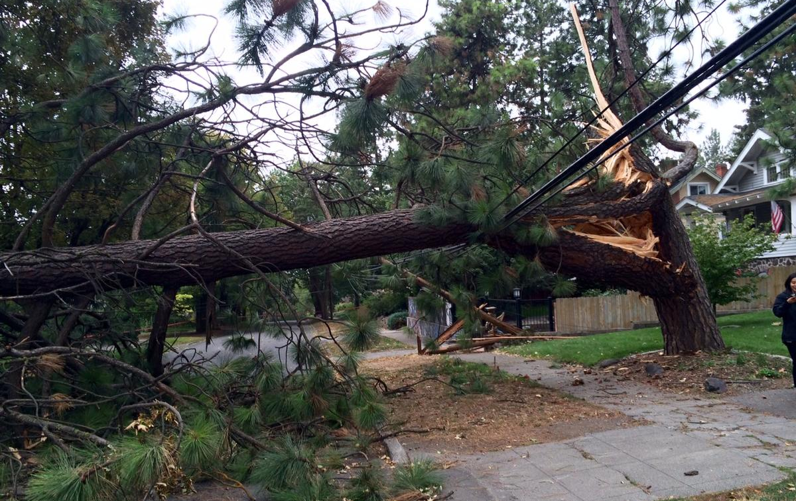
Windstorm Damage to Trees
Significant damage generally starts with gusts to 40 mph
More damage early in the season, with untested branches and leaves
Wet soil contributes to failure of tree roots.

Slide 31
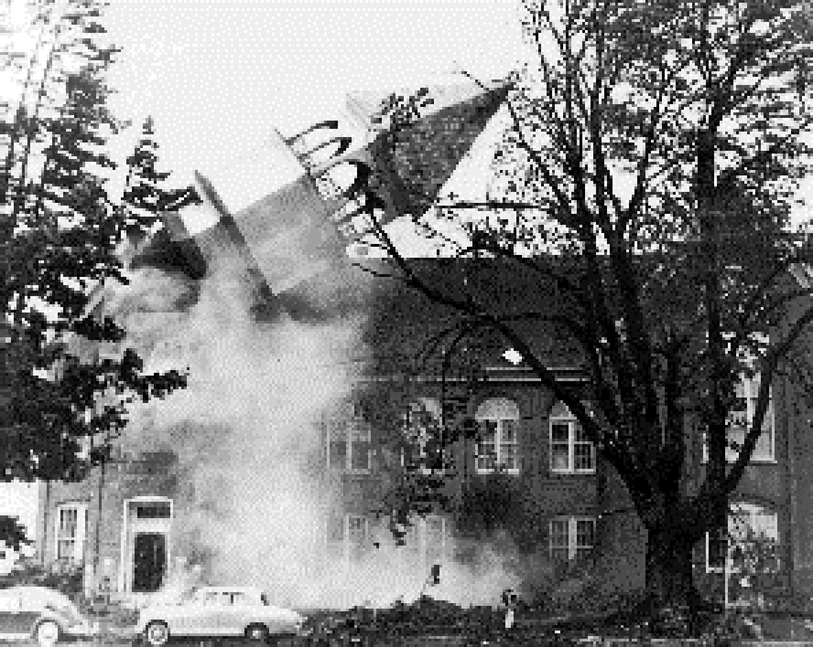
The Most Extreme Northwest Windstorm: The Columbus Day Windstorm of 12 October 1962

Slide 32
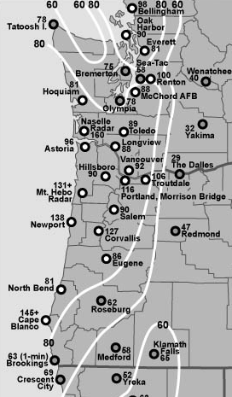
Max Winds (mph)
Columbus Day Storm 1962
Graphic courtesy of Wolf Read

Slide 33
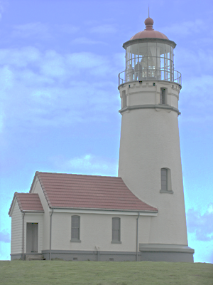
Columbus Day 1962: At Cape Blanco there were 150 mph with gusts to 179!
Cape Blanco,
Photo courtesy of
Bureau of Land
Management

Slide 34
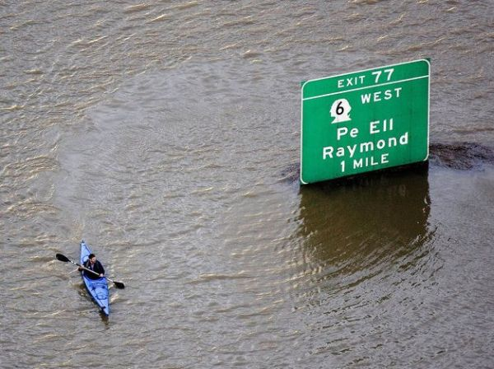
The most costly extreme weather of the Northwest is Flooding

Slide 35
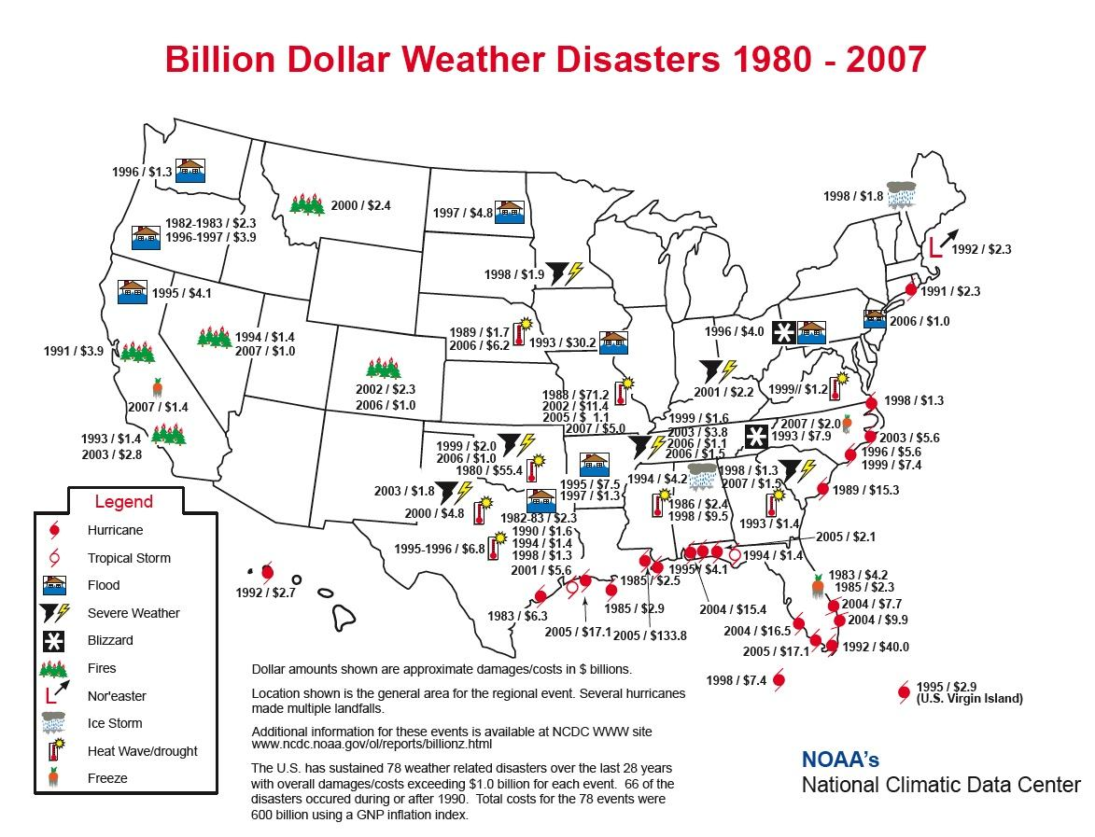

Slide 36
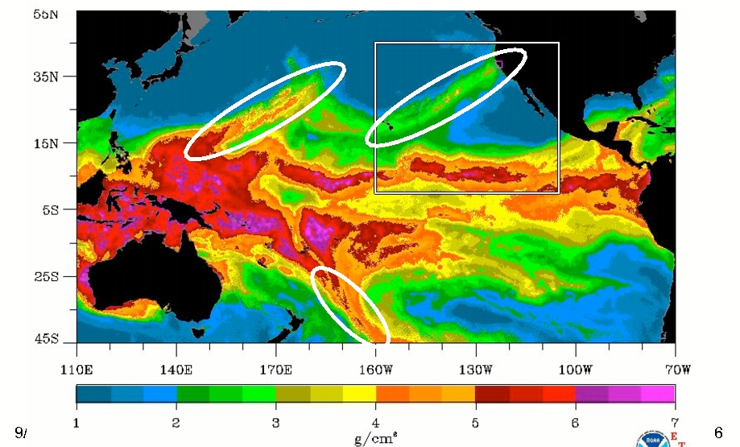
Most are associated with atmospheric rivers, a.k.a. the “Pineapple Express”
A relatively narrow current of warm, moist air from the subtropics…often starting near or just north of Hawaii.
atmospheric rivers

Slide 37
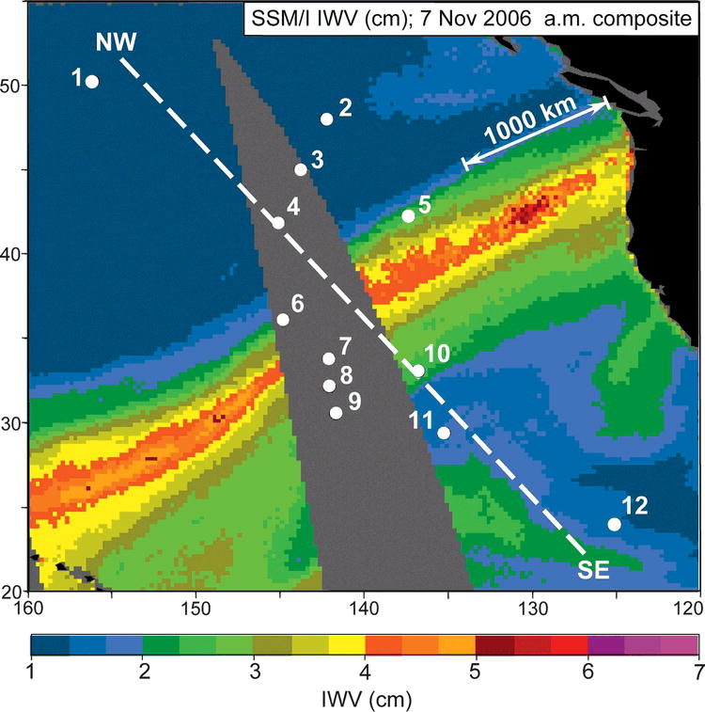
A Devastating Pineapple Express Occurred on November 6-7, 2006

Slide 38
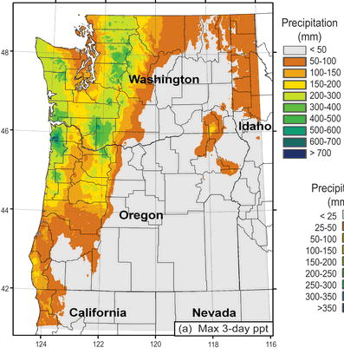
November 6-9,
2006
Dark Green: about 20 inches

Slide 39
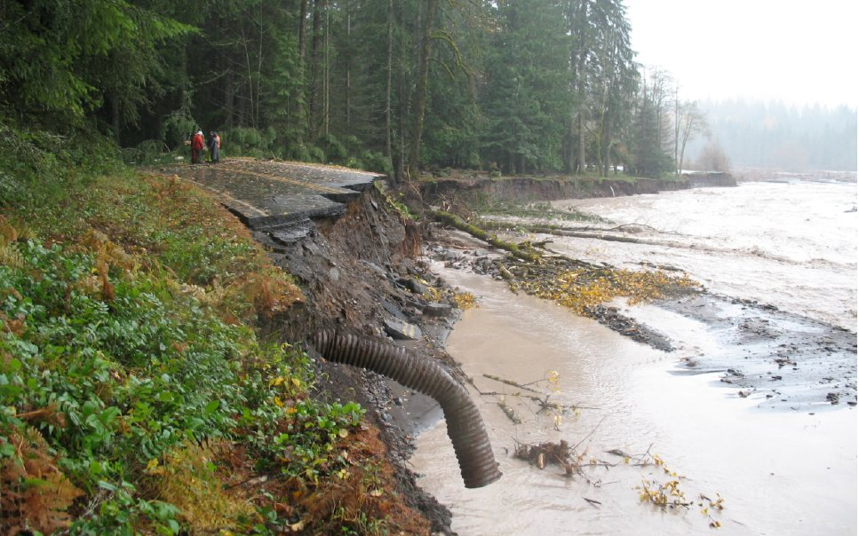
Mount Rainier National Park 18 inches in 36 hr (Nov 8, 2006)

Slide 40
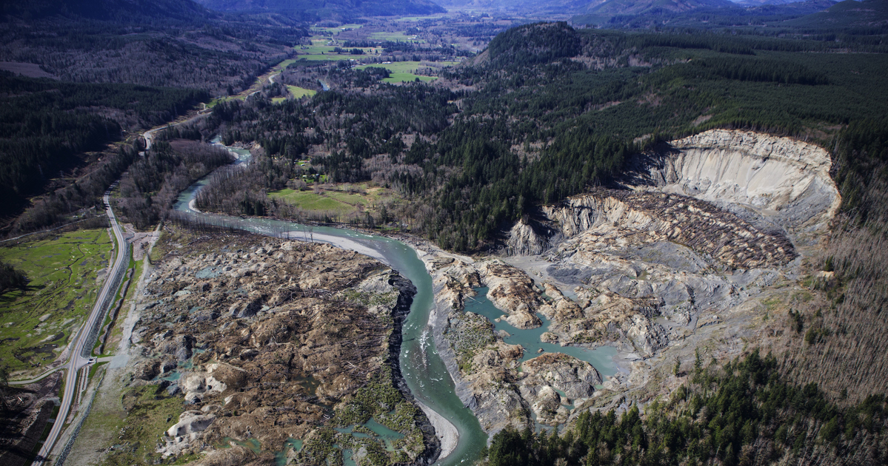
Sustained Heavy Rain Can Lead to Landslides of Unconsolidated Glacial Materials
Oso

Slide 41
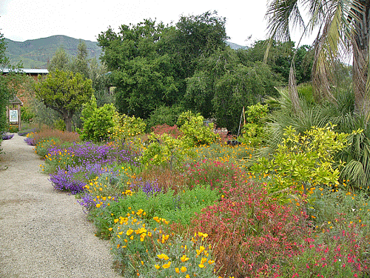
Microclimates 101

Slide 42
Microclimate: the climate of a small area

Slide 43
Microclimates are controlled by…
elevation,
topography,
proximity to water,
vegetation type,
soil type,
soil moisture,
nearby buildings,
slopes in relation to the sun,
how reflective the surface is,
… and more

Slide 44
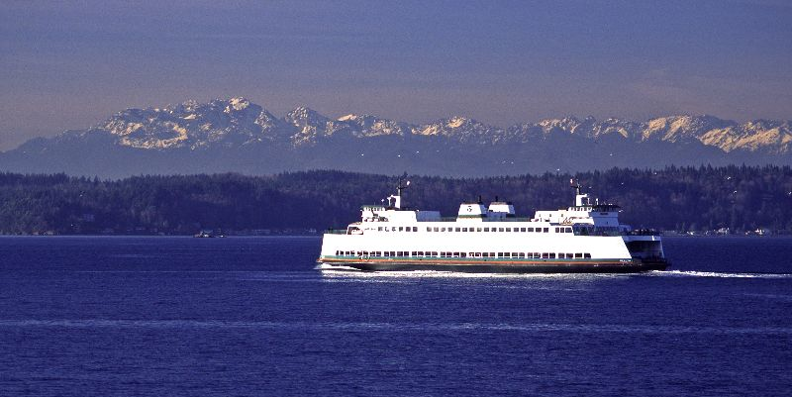
Microclimate 101
Areas near water tend to be warm during the winter and cool in summer compared to inland areas.

Slide 45
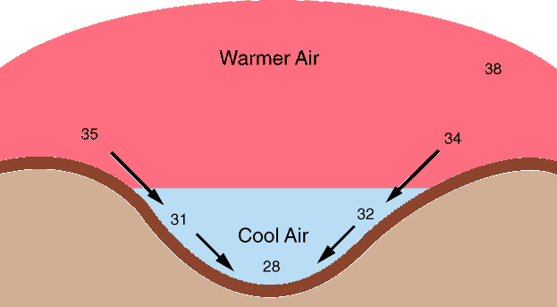
Temperatures are generally cooler in low spots on cold, cloud-free nights.

Slide 46
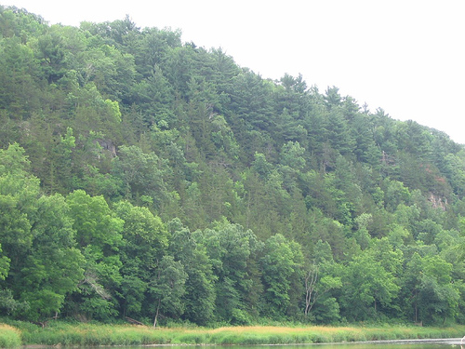
The Bottom of Vegetated Slopes Are Often Much Cooler During Summer Days-as evaporation from plants causes cooling

Slide 47
Temperatures at the level of your face can be very different than just above or at the ground

Slide 48
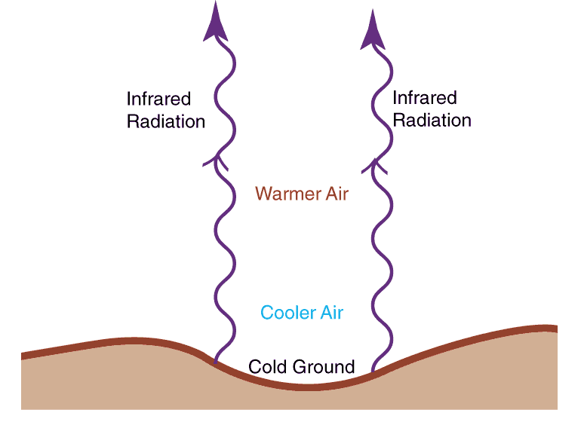
Air can be much colder near the ground on clear nights

Slide 49
Cold, Clear Nights
Temperatures can be 1-5F less at the ground than at 5-6 feet!
Areas under trees or carports cool off more slowly. Why?
Some of the infrared radiation is absorbed and reradiated back to the surface

Slide 50
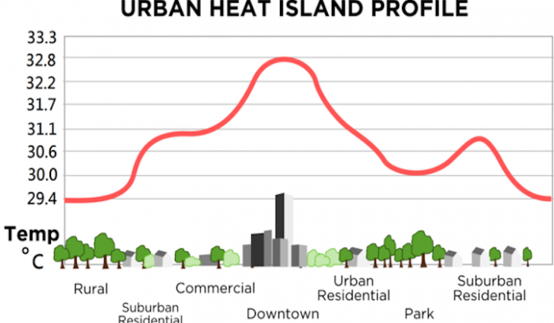
Urban Heat Island Effect

Slide 51
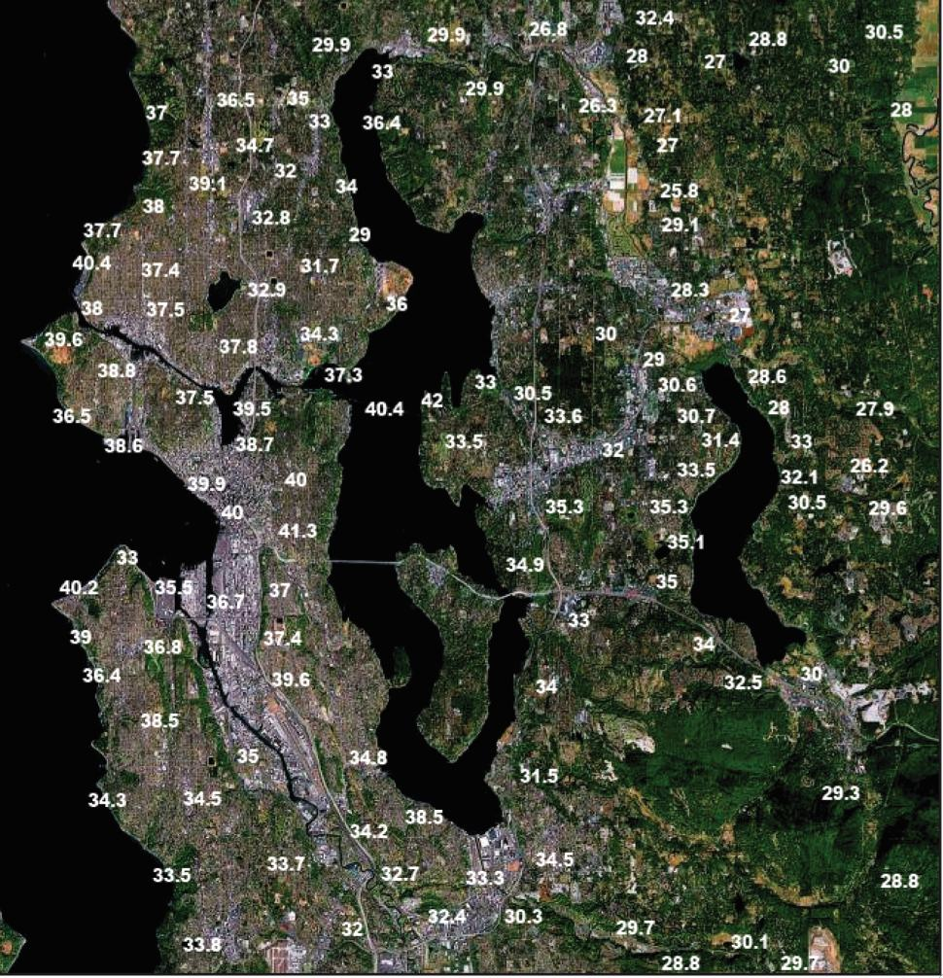
Cold, Clear Winter Night

Slide 52
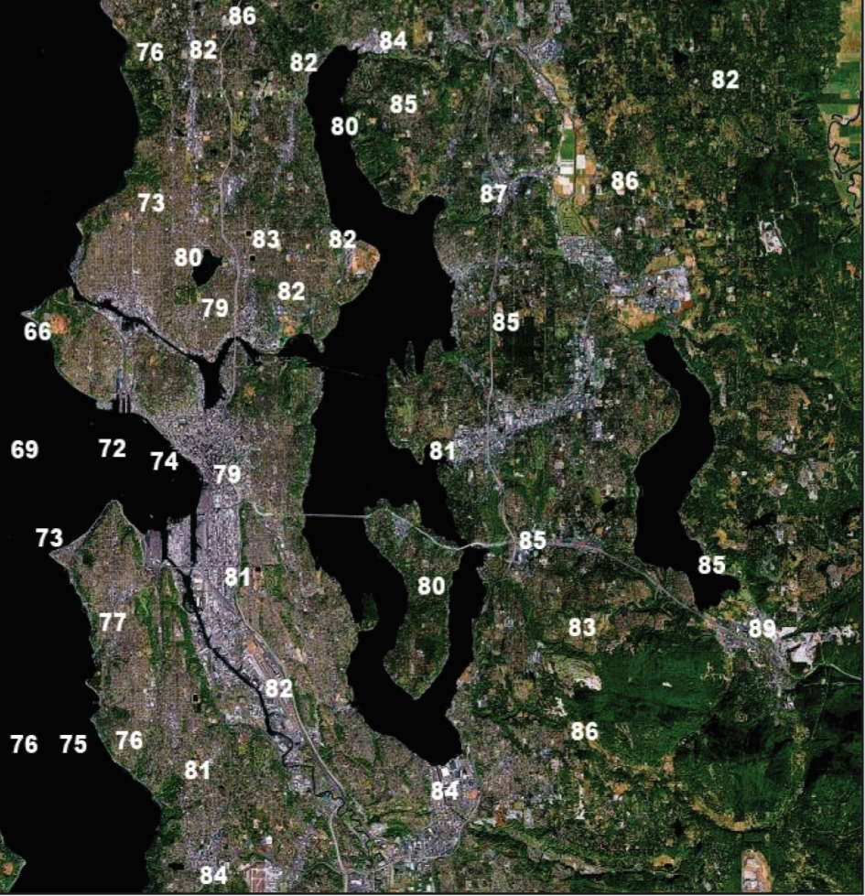
Warm, Summer Day: The opposite

Slide 53
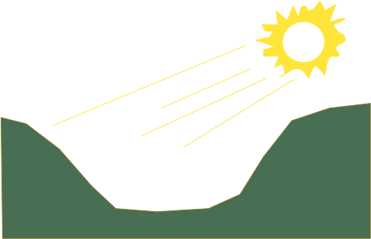
South-facing slopes are usually much warmer than north-facing slopes
North
South
Less direct rays,
thus cooler
South facing
slope

Slide 54
Warm microclimate on south sides of buildings
South
Solar Radiation
Infrared
radiation

Slide 55
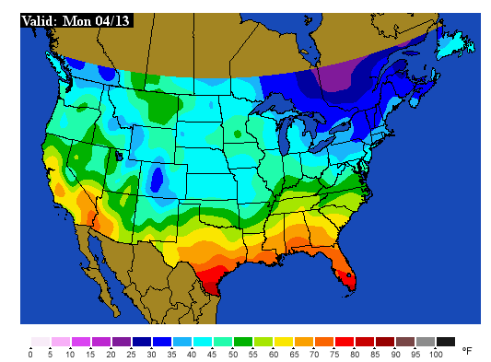
Soil Temperatures: The Inside Story

Slide 56
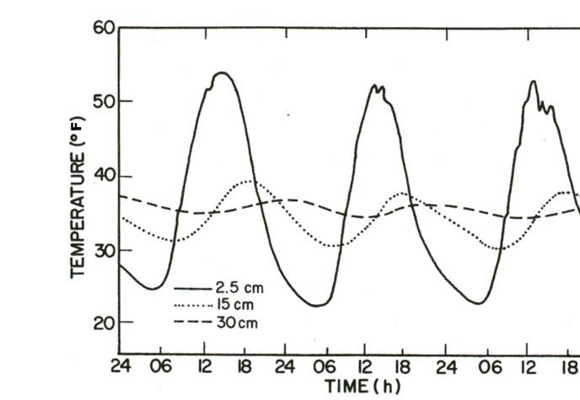
Soil Temperature Changes with Depth
Inch deep (solid), 6 inches deep (dotted), 1 ft deep (dashed)

Slide 57
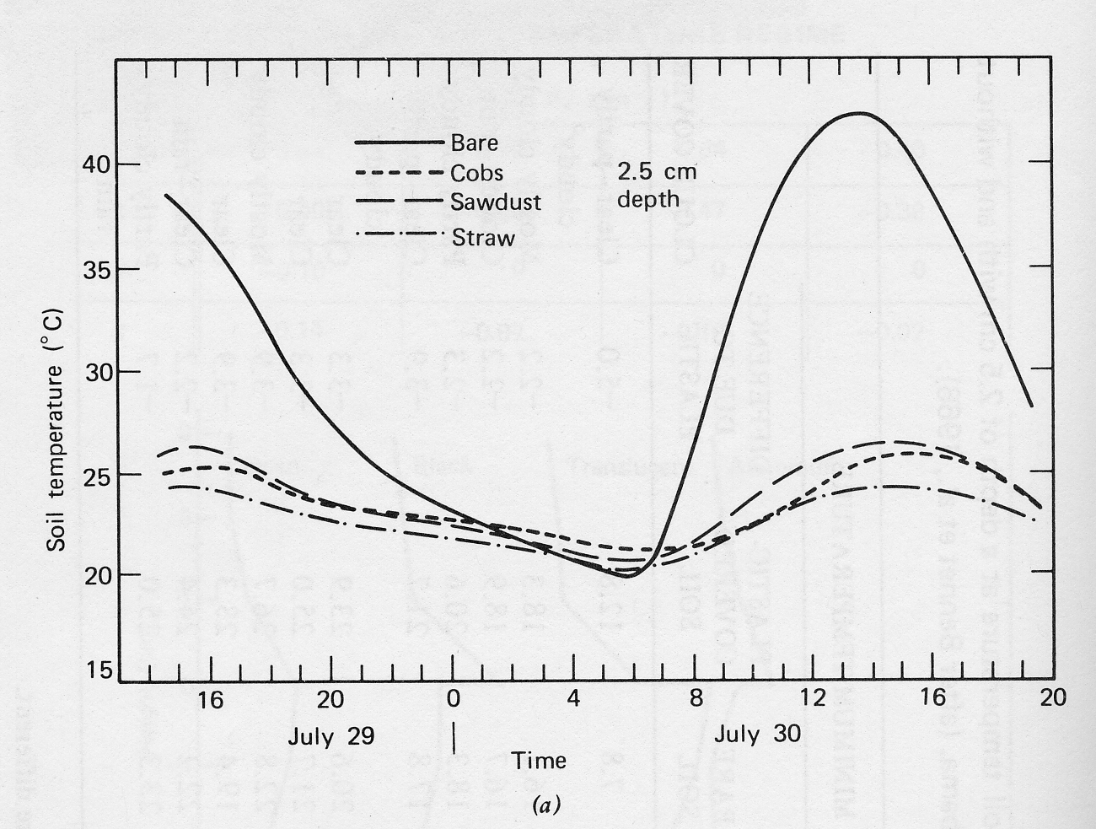
The influence of mulches: summer

Slide 58

Mulches can protect during winter

Slide 59

Mulches
So several inches of mulch can really help to protect sensitive plants from a cold wave.
Just as good as mulch…a several-inch snowfall!

Slide 60
Germination Temperatures
If the soil is too cold, germination can be delayed or fail.
My vegetable seeds planted during some Aprils never germinated for that reason.
Need to check the soil temps.
Minimum temps for:
Cucumber, pepper, eggplant 60F
Carrot, beet, parsley 40F
Bean, tomato, corn 50F

Slide 61

Good Place to Get Soil Temperatures
https://weather.wsu.edu/

Slide 62


Slide 63
The Northwest has a wide collection of local weather features

Slide 64

Puget Sound Convergence Zone

Slide 65


Slide 66
The Source of Plant-Killing Cold: The Fraser River Gap

Slide 67


Slide 68


Slide 69

December 29, 1990

Slide 70

Two major cold waves in Dec 1990

Slide 71

The Frequency of Severe Cold Waves Has Lessen During the Past Decades

Slide 72

Hardiness Zone Maps
Are VERY Approximate

Slide 73

Is this useful for a gardener?

Slide 74
Absolutely useless
Nick Bond of NOAA in Seattle evaluated the Almanac’s forecasts over several years
Found absolutely no skill. Better off flipping a coin.
Want more proof?

Slide 75


Slide 76
The End

Slide 77

December 24, 1983

Slide 78

Why Enumclaw?

Slide 79

During the warm season, the same gap produces strong winds near Ellensburg, making possible the wind farms of the area.
Wild Horse Wind Farm

Slide 80


Slide 81
Some of our local weather features are more benign--but no less interesting

Slide 82

Lenticular or Mountain Wave Clouds
Picture courtesy of Art Rangno

Slide 83

Picture Courtesy of Darlisa May Black

Slide 84

Mountain Wave Clouds

Slide 85

Wave Clouds

Slide 86

On June 24, 1947, Kenneth Arnold, flying a small plane between Chehalis and Yakima, spotted a group of “saucer-like” objects over Washington State

Slide 87
Thus was born the UFO craze that continues until this day

Slide 88

Thus was born the UFO craze that continues until this day

Slide 89

During a recent presidential debate on October 30, 2007, candidate Dennis Kucinich admitted that he saw a UFO while staying at Shirley McClain’s home.

Slide 90
What did both of these sightings have in common?

Slide 91

Both occurred over Washington State near Mount Rainier

