Slide 1
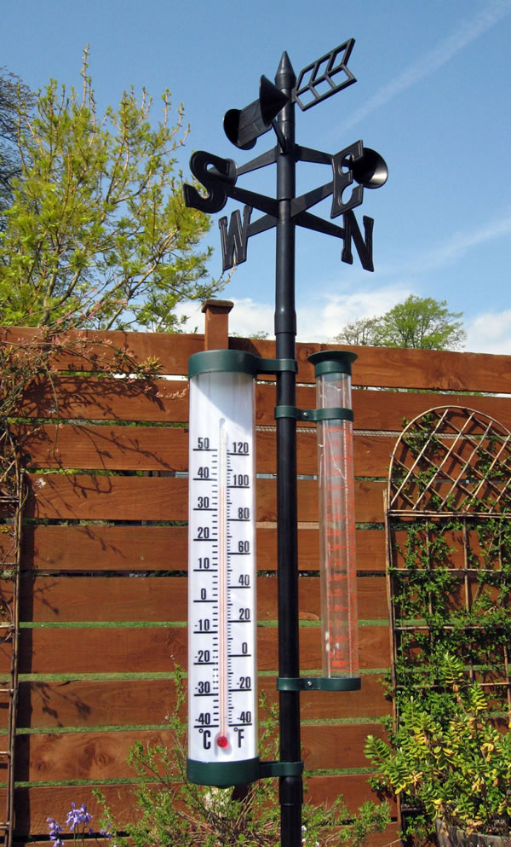
The Weather of Pacific Northwest Gardens
Cliff Mass
University of Washington
March 2019

Slide 2
Northwest Garden Weather: The Big Picture

Slide 3
The weather influencing Puget Sound and western interior gardens
Temperature: mild year round. Rarely below 25F or above 90F. Allows a wide range of plant species in our gardens.
Precipitation: moderate annual rainfall in the lowlands (35-45 in) . Big annual variations---wet winter, but dry summer.
Substantial local variations of both temperature and precipitation

Slide 4
Why mild?

Slide 5
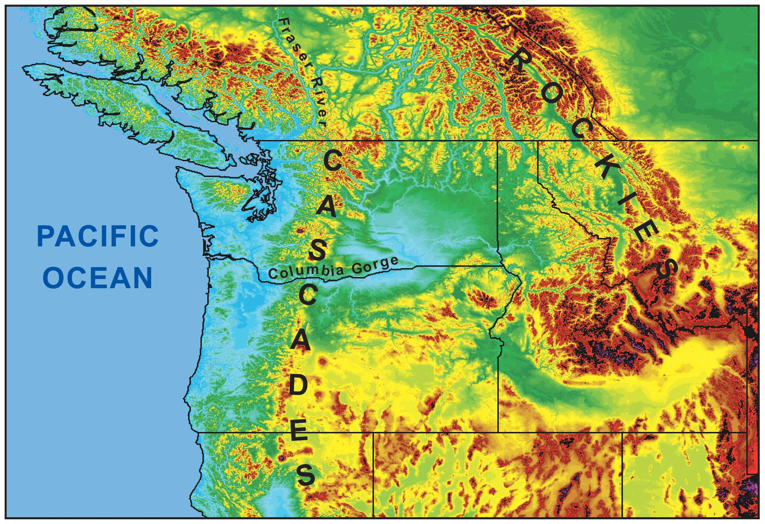
During the winter the mountains block the cold air from the interior.
Cold
Air

Slide 6
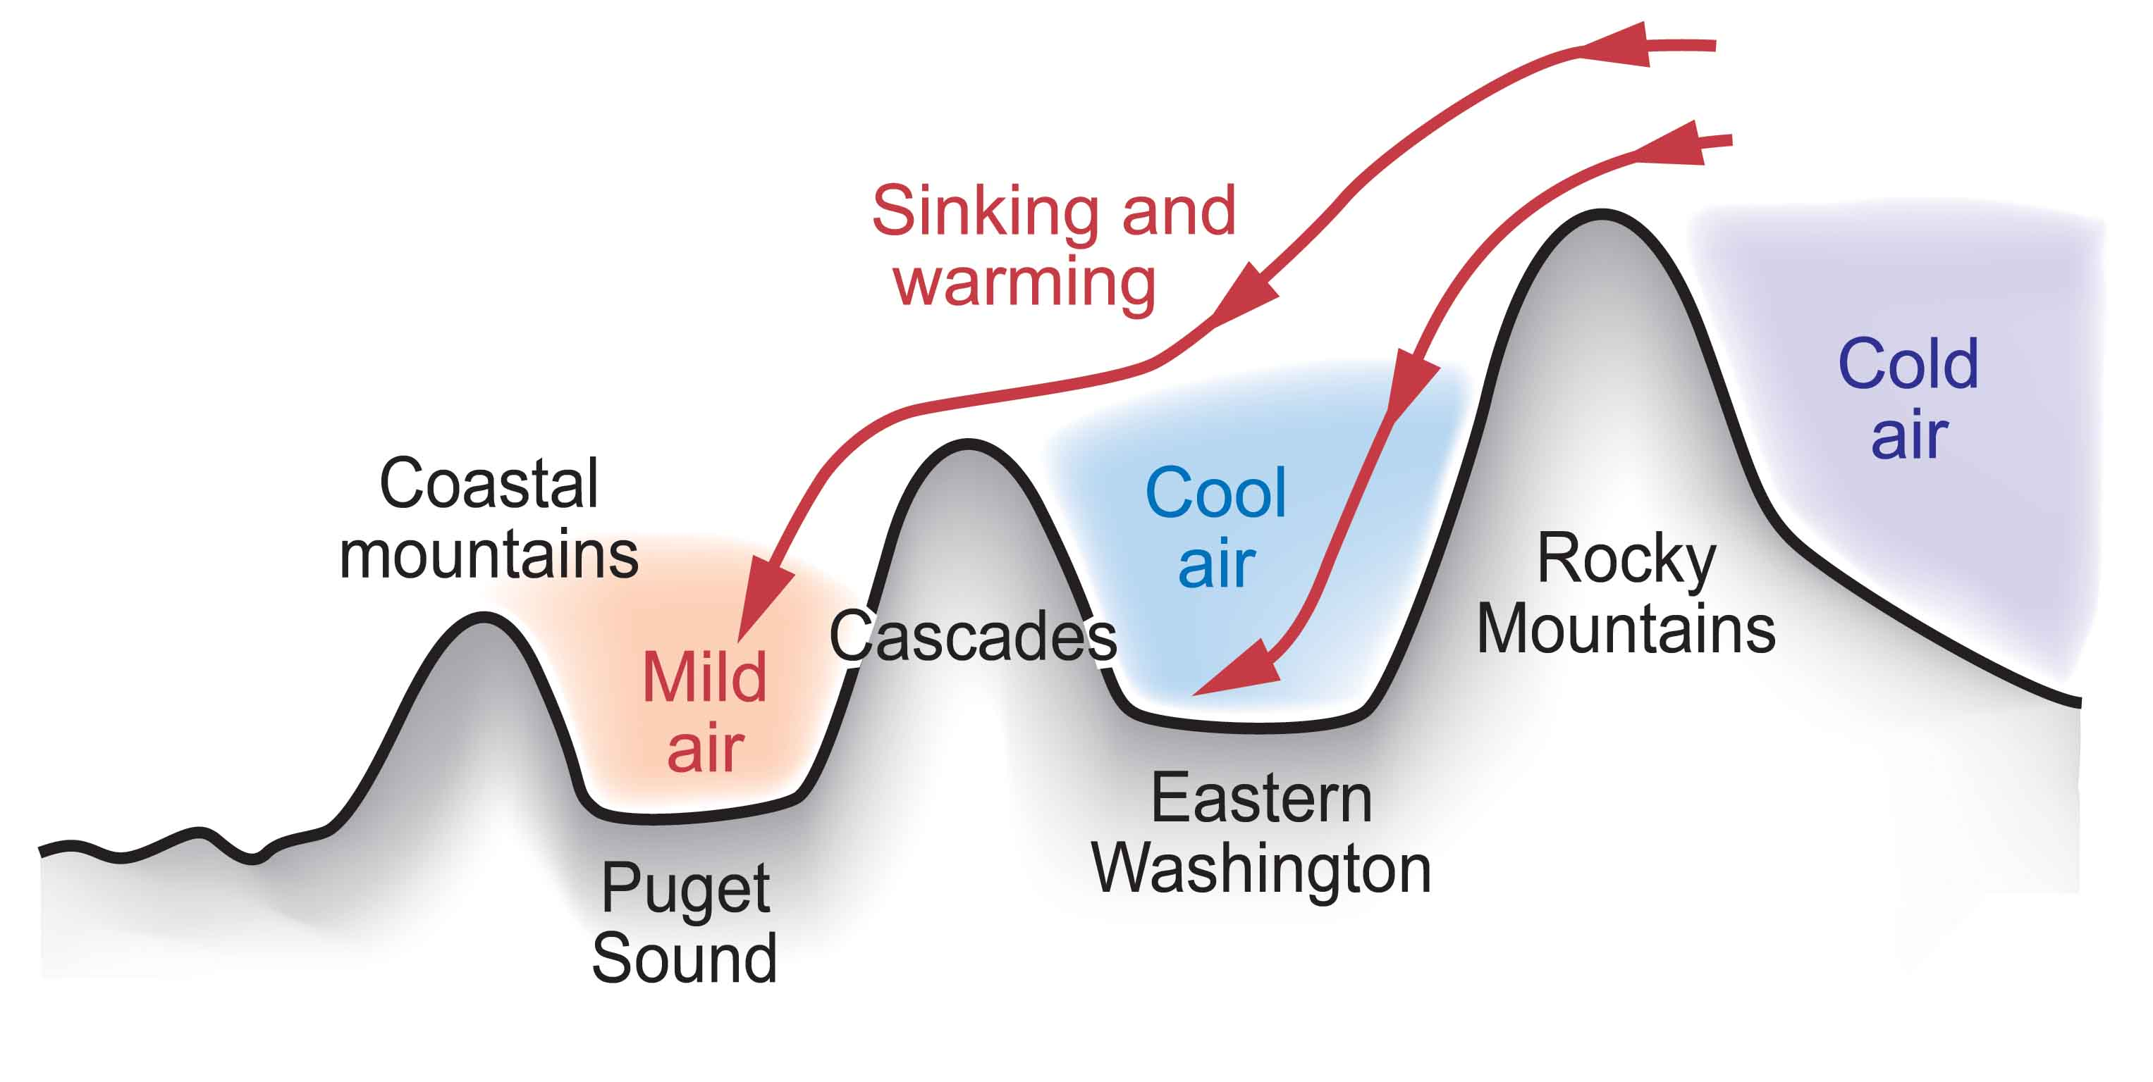
Cold Air from the Continental Interior Has a Hard Time Reaching Western Washington

Slide 7
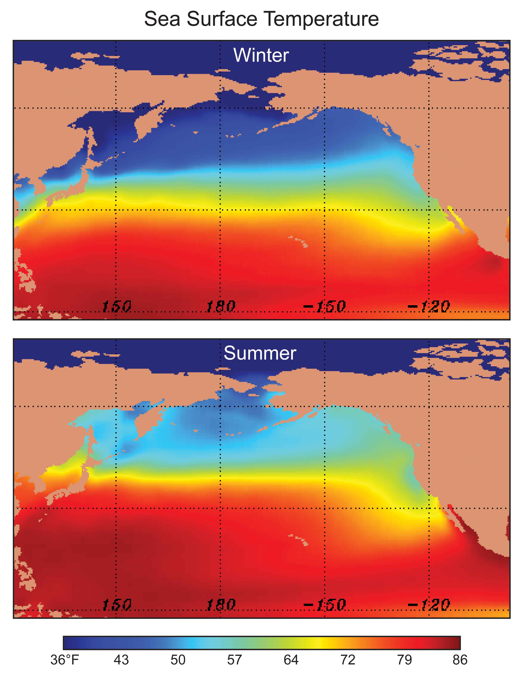
Our air and weather systems generally
move west
to east:
Thus, our
weather comes from off
the mild
Pacific

Slide 8
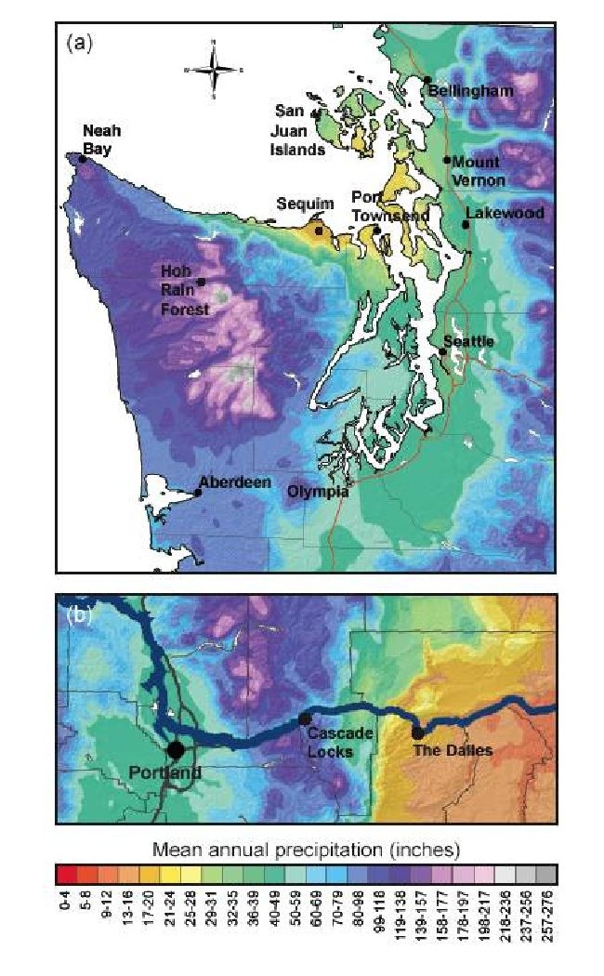
Precipitation Contrasts

Slide 9
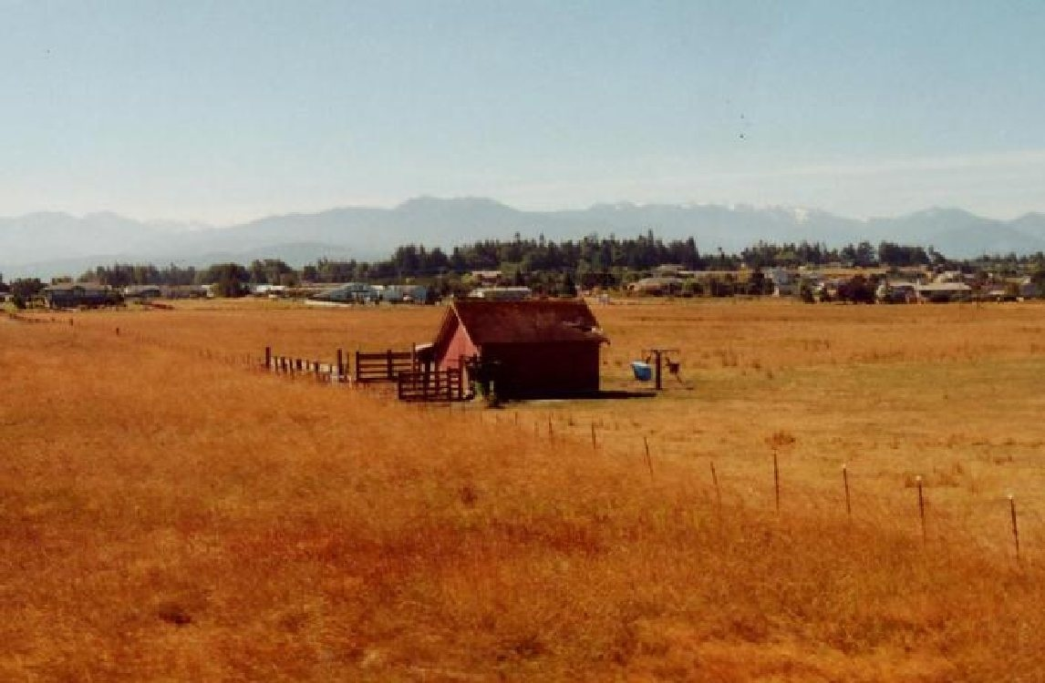
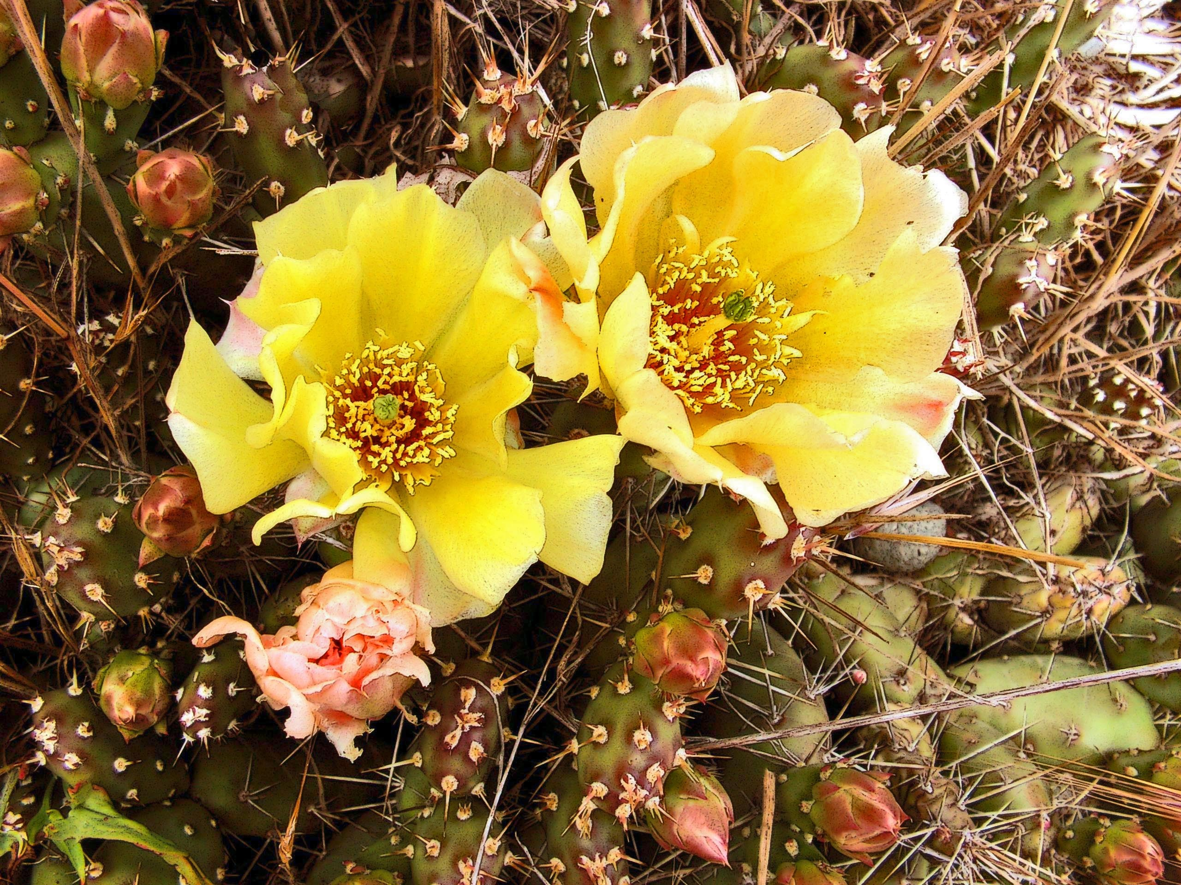
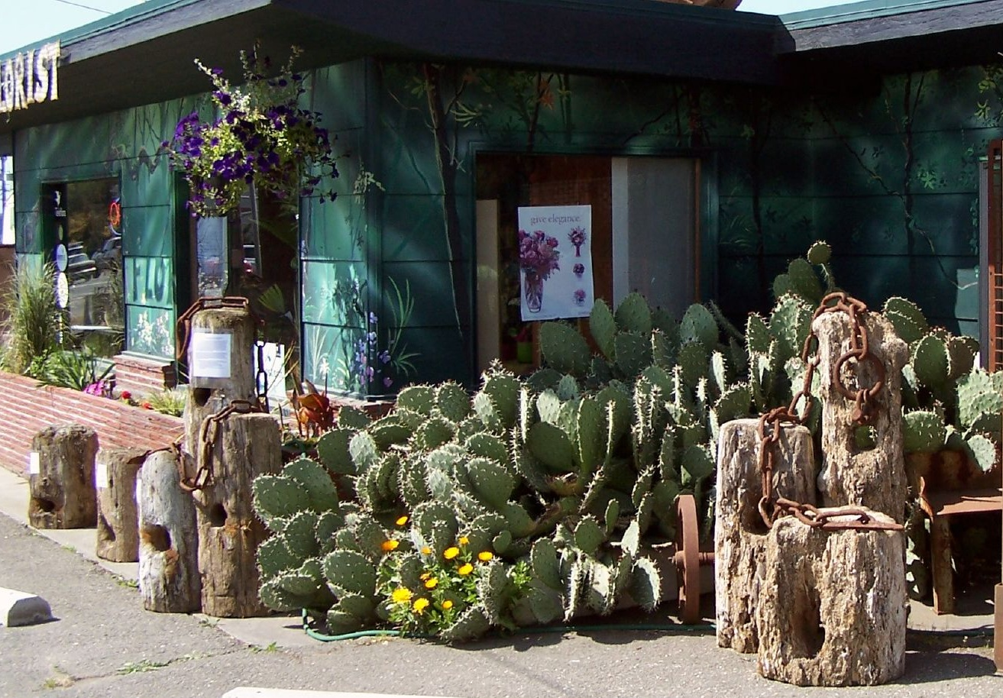
Sequim: Haven for Retirees

Slide 10
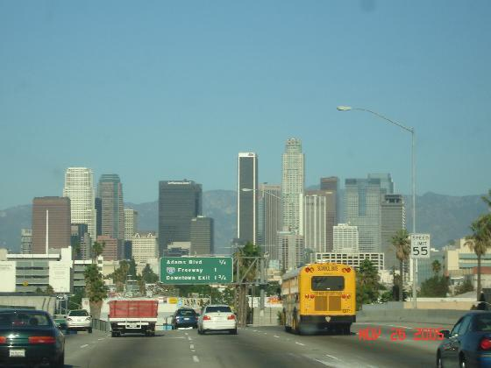
Annual Precipitation
Sequim: 15.97 inches
Los Angeles: 14.89 inches

Slide 11
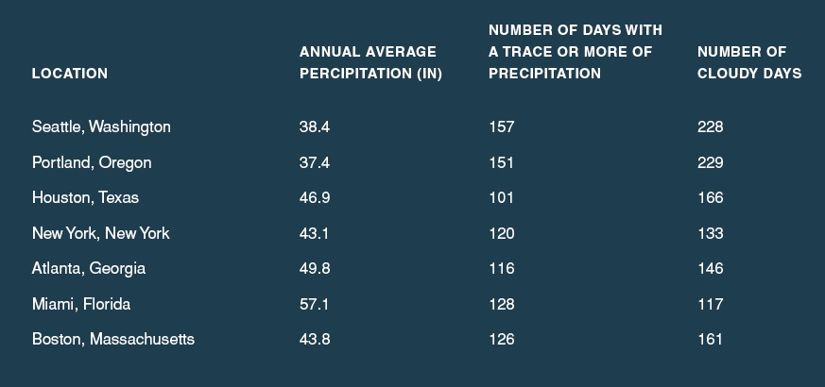
Our area really isn’t that wet—partially because we are often in the rainshadow of the Olympics

Slide 12
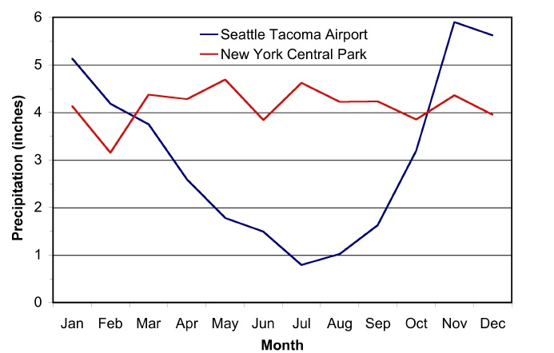
The Northwest Has a Mediterranean Climate
Moss Season
Growing Season
Moss Season

Slide 13
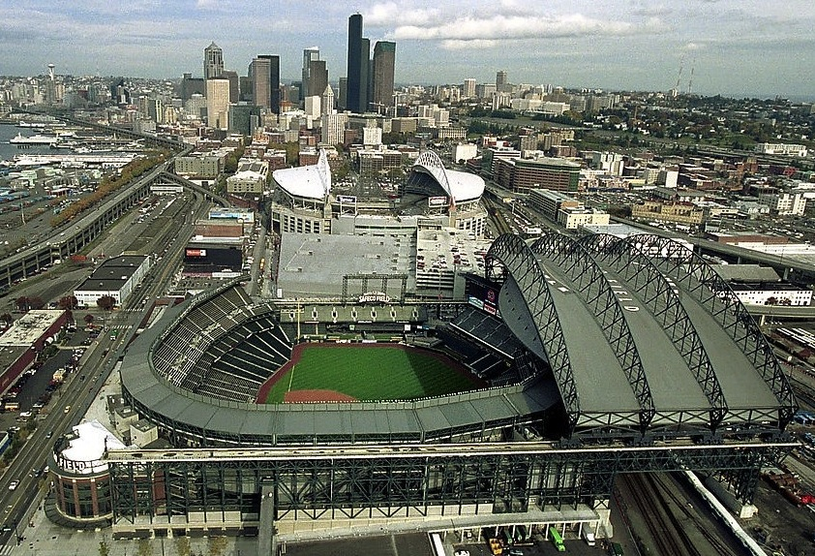
Safeco Field: 100 million dollar roof

Slide 14
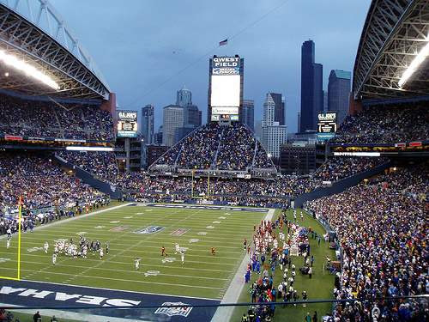
Qwest Field: No Roof

Slide 15
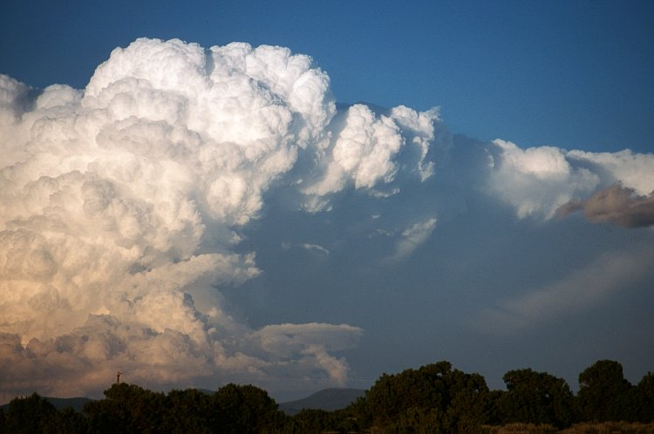
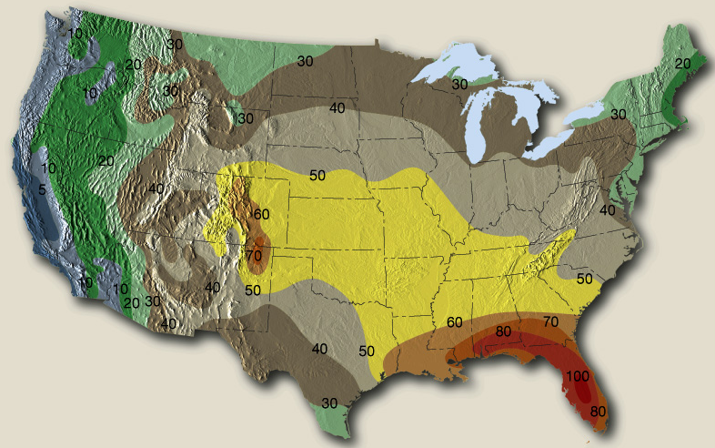
The Northwest Gets Fewer Thunderstorms Than Almost Anywhere in the U.S.

Slide 16
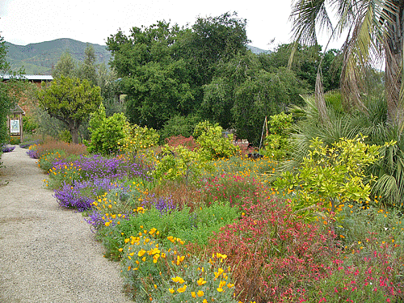
Microclimates 101

Slide 17
Microclimates are controlled by…
  elevation,
  topography,
  proximity to water,
  vegetation type,
  soil type,
  soil moisture,
  nearby buildings,
  slopes in relation to the sun,
  how reflective the surface is,
  … and more

Slide 18
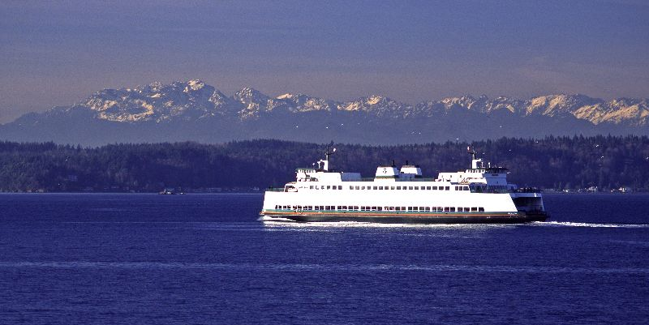
Microclimate 101
Near water it is warm in winter, cool in summer compared to land.

Slide 19
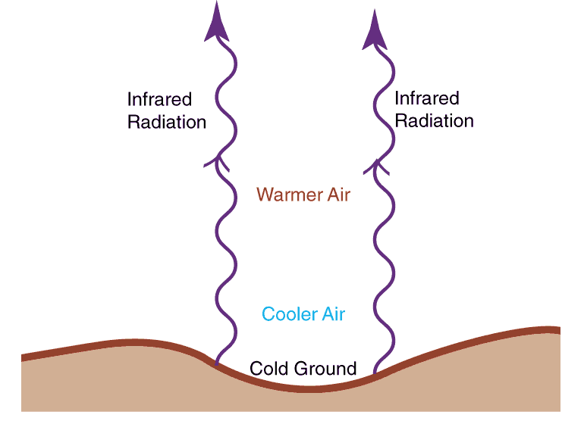
Air can be much colder near the ground on clear nights

Slide 20
Cold, Clear Nights
Temperatures can be 1-5F less at the ground than at 5-6 feet!
Areas under trees or carports cool off more slowly. Why?
Some of the radiation is absorbed and reradiated back to the surface

Slide 21
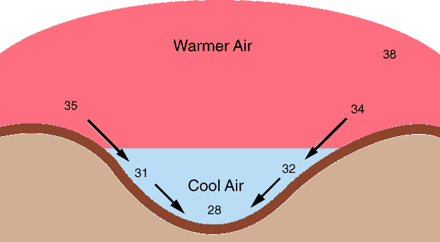
Low temperatures are generally cooler in low spots on cold, cloud-free nights.

Slide 22
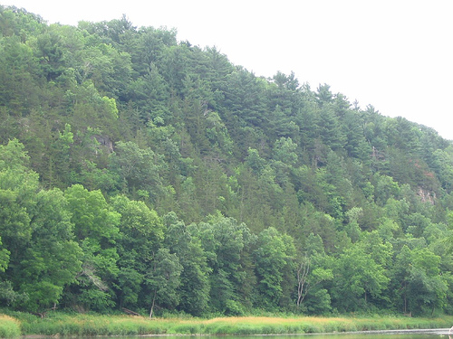
The Bottom of Vegetated Slopes Are Often Much Cooler During Summer Days-as evaporation from plants causes cooling

Slide 23
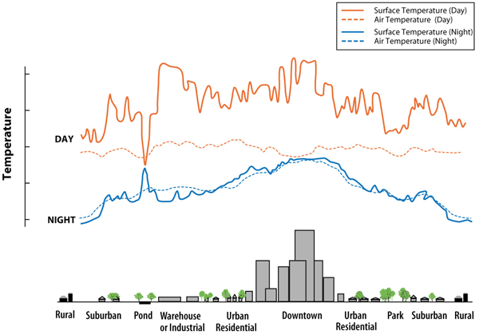
Urban Heat Island

Slide 24
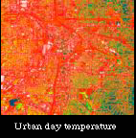
Urban Heat Island

Slide 25

South-facing slopes are usually much warmer than north-facing slopes
North
South
Less direct rays,
thus cooler
South facing
slope

Slide 26
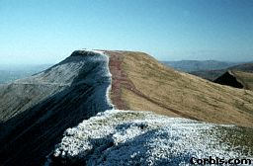
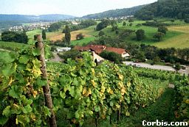
ASPECT
Sensitive crops may only be possible on south-facing slopes (e.g., grapes below); the opposing slope is pasture alone.
The right hand slope (above) is facing the sun, keeping it free of snow for longer.
GRAPES

Slide 27
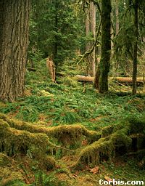
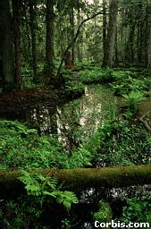
Trees reduce temperature during the day, but help retain heat during the night. Temperatures are thus more even (less extreme)
Wind speed is reduced.
Humidity levels remain high and constant due to transpiration and low evaporation rates.
Northwest forest floors with moss and marsh at ground level

Slide 28
Warm microclimate on south sides of buildings
South
Solar Radiation
Infrared
radiation

Slide 29
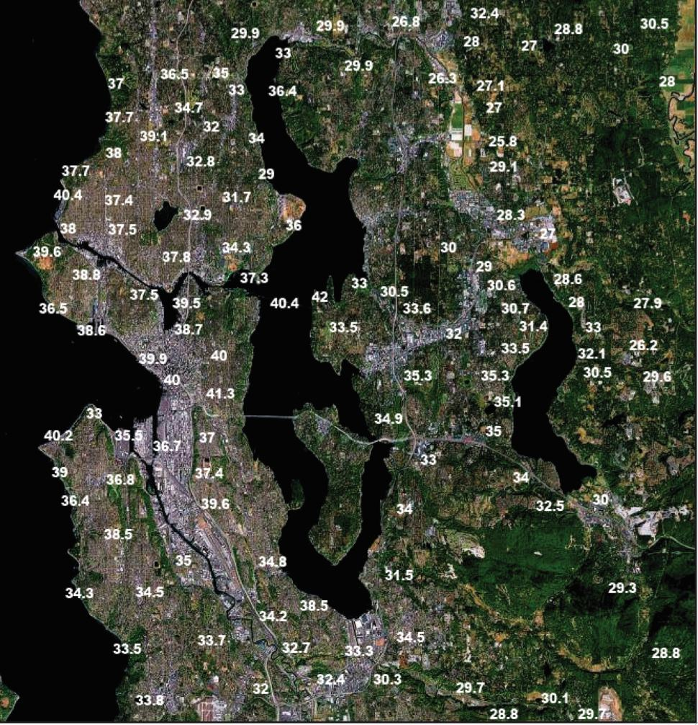
Cold, Clear Winter Night

Slide 30
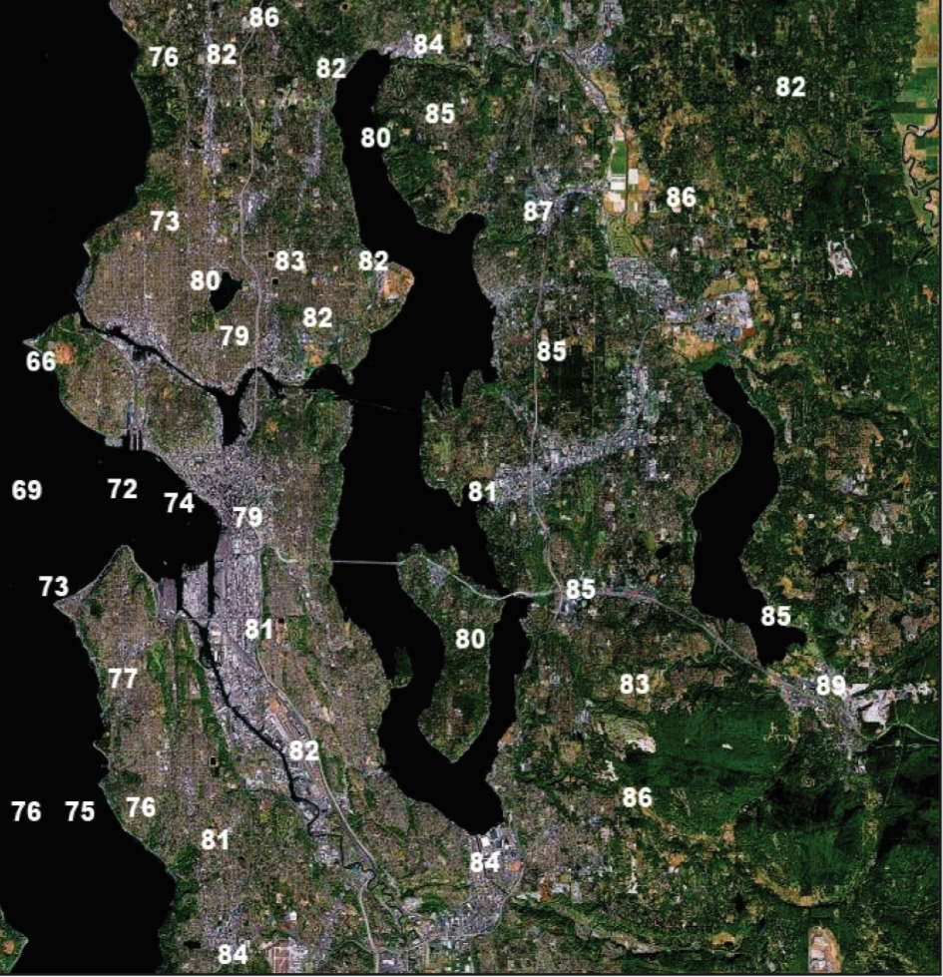
Warm, Summer Day: The opposite

Slide 31
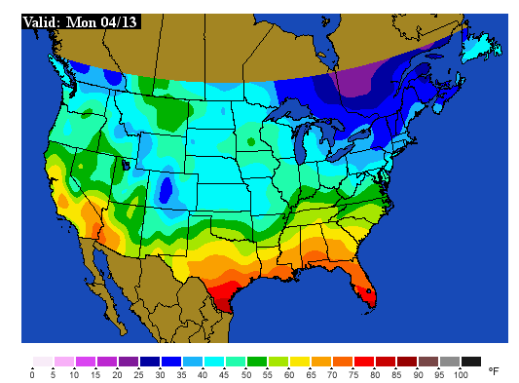
Soil Temperatures: The Inside Story

Slide 32
Germination Temperatures
If the soil is too cold, germination can be delayed or fail.
My vegetable seeds planted last April never germinated for that reason.
Need to check the soil temps.
Minimum temps for:
  Cucumber, pepper, eggplant 60F
  Carrot, beet, parsley 40F
  Bean, tomato, corn 50F

Slide 33
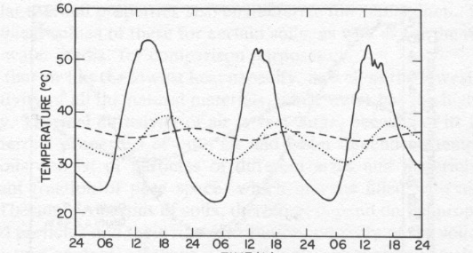
Soil Temperature Changes with Depth
Inch deep (solid), 6 inches deep (dotted), 1 ft deep

Slide 34
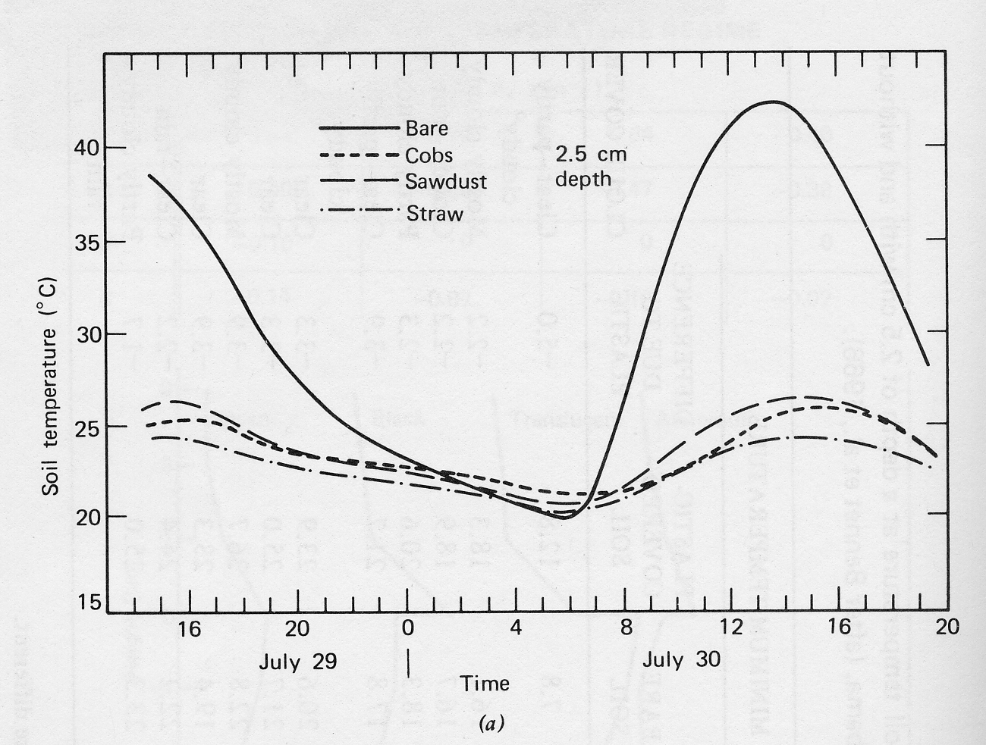
The influence of mulches

Slide 35
Mulches
So several inches of mulch can really help to protect sensitive plants from a cold wave.
Just as good as mulch…a several inch snowfall!

Slide 36
The Northwest has a wide collection of local weather features

Slide 37
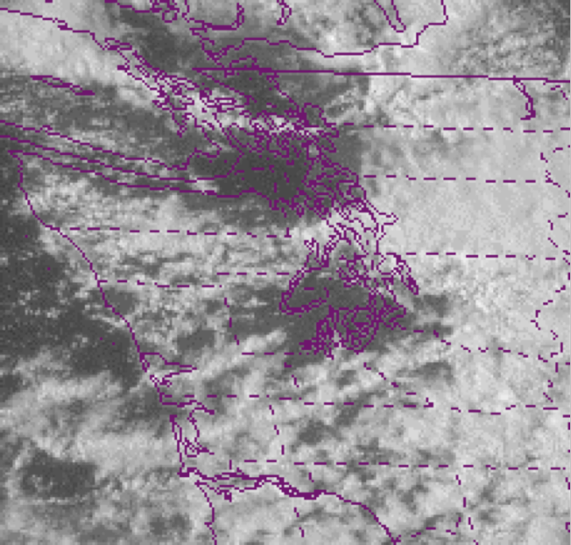
Puget Sound Convergence Zone

Slide 38
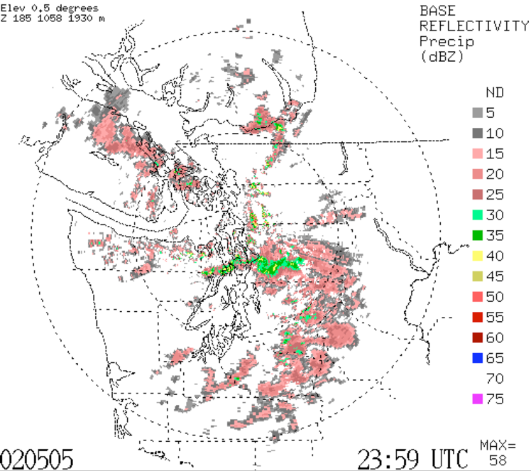

Slide 39
The Source of Plant-Killing Cold: The Fraser River Gap

Slide 40
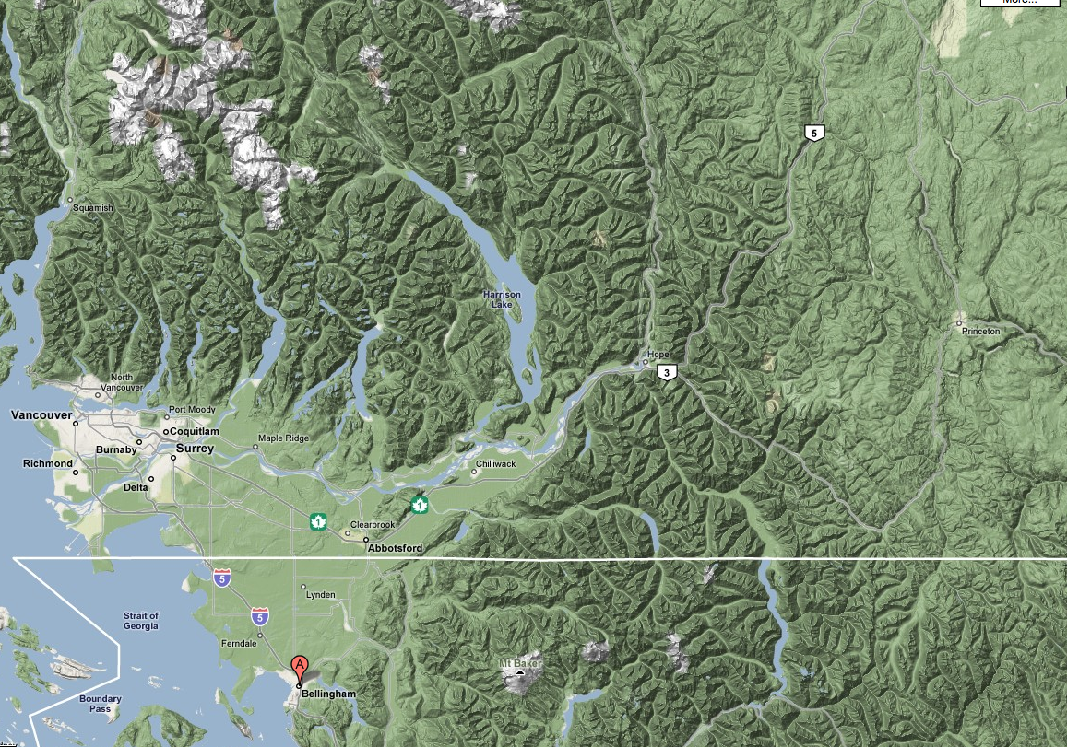

Slide 41
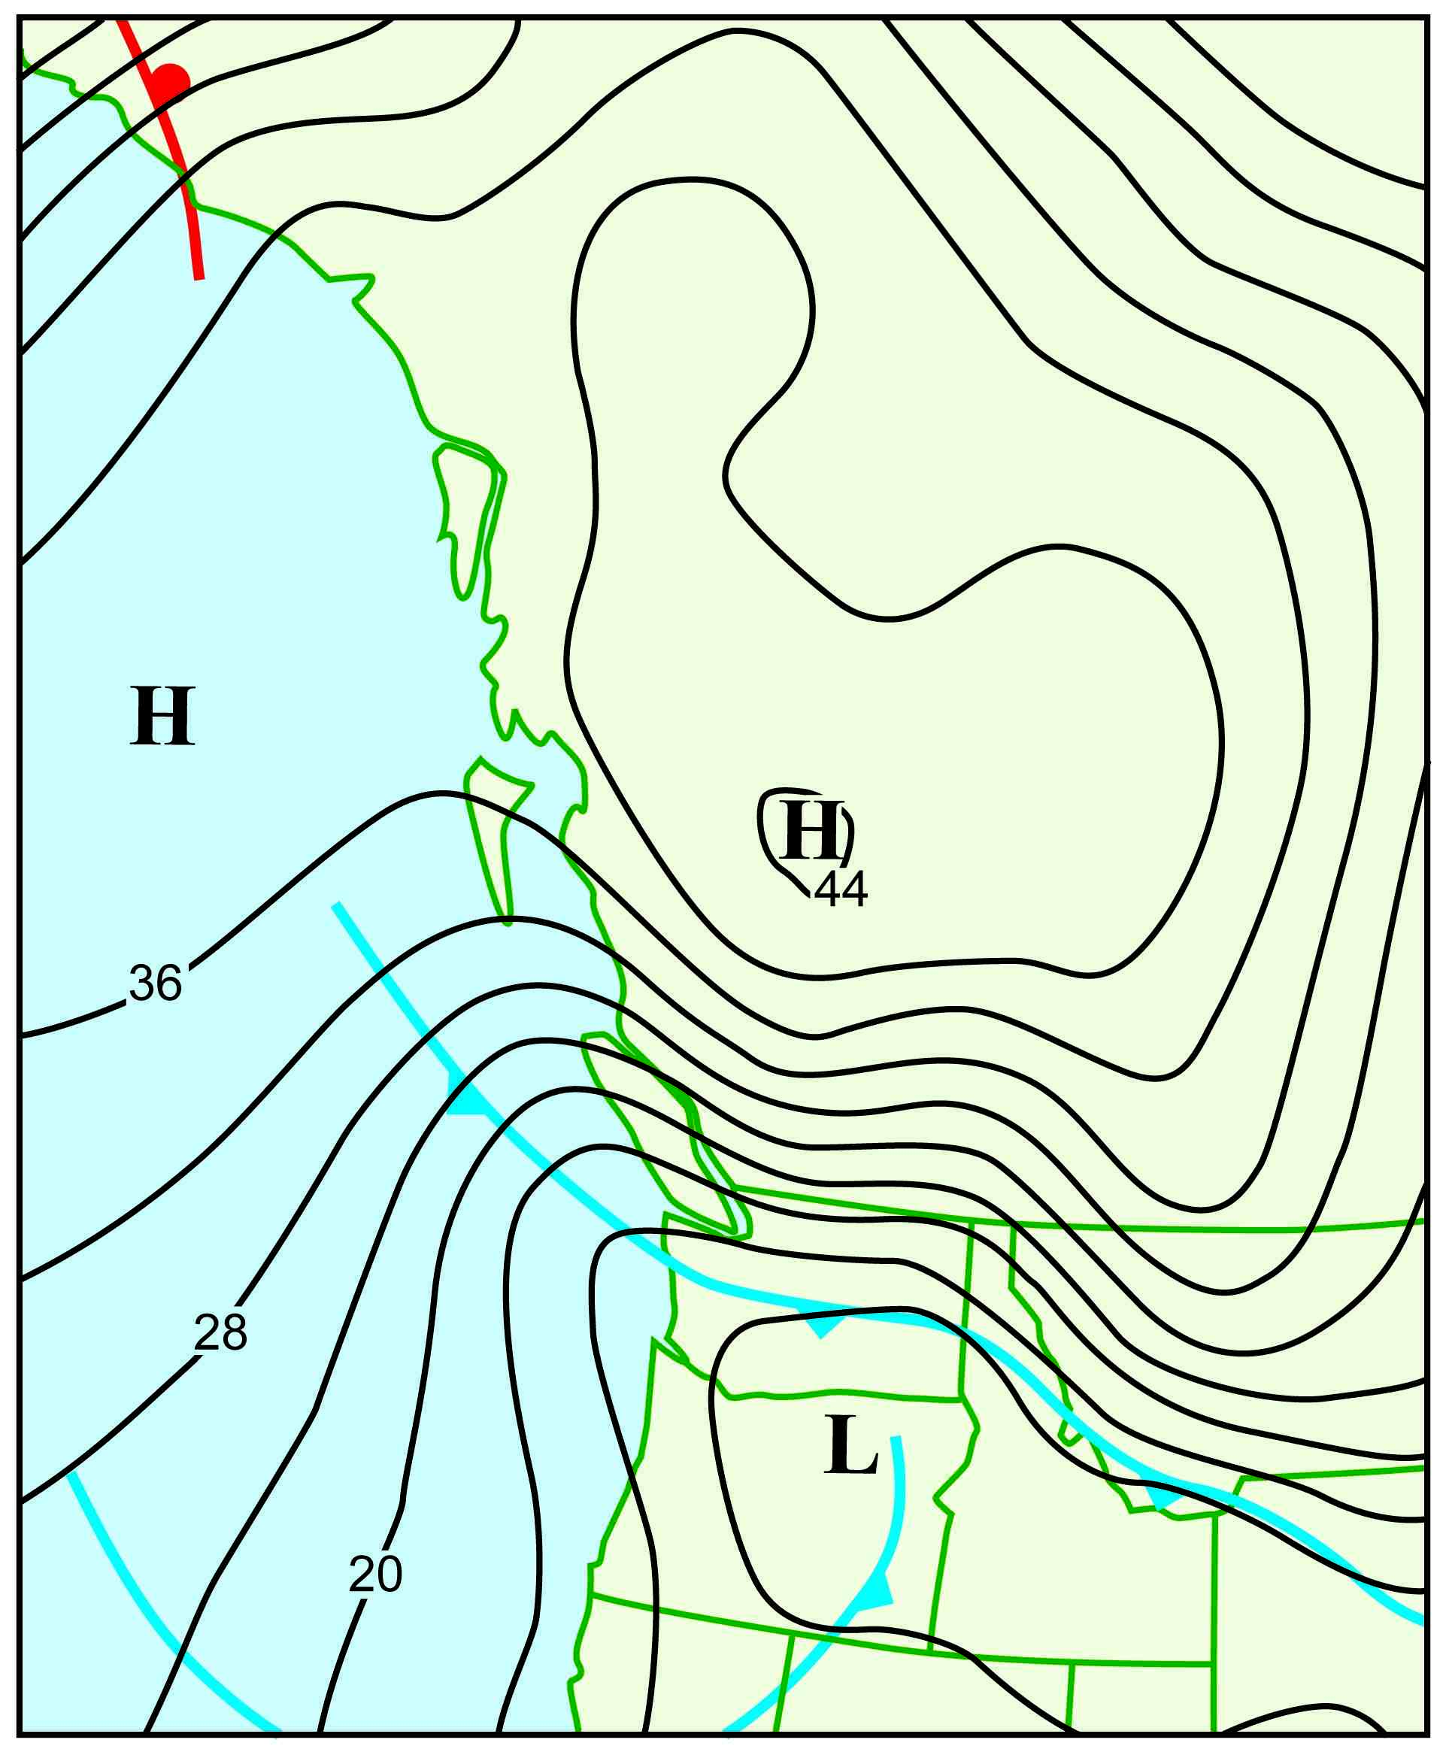

Slide 42
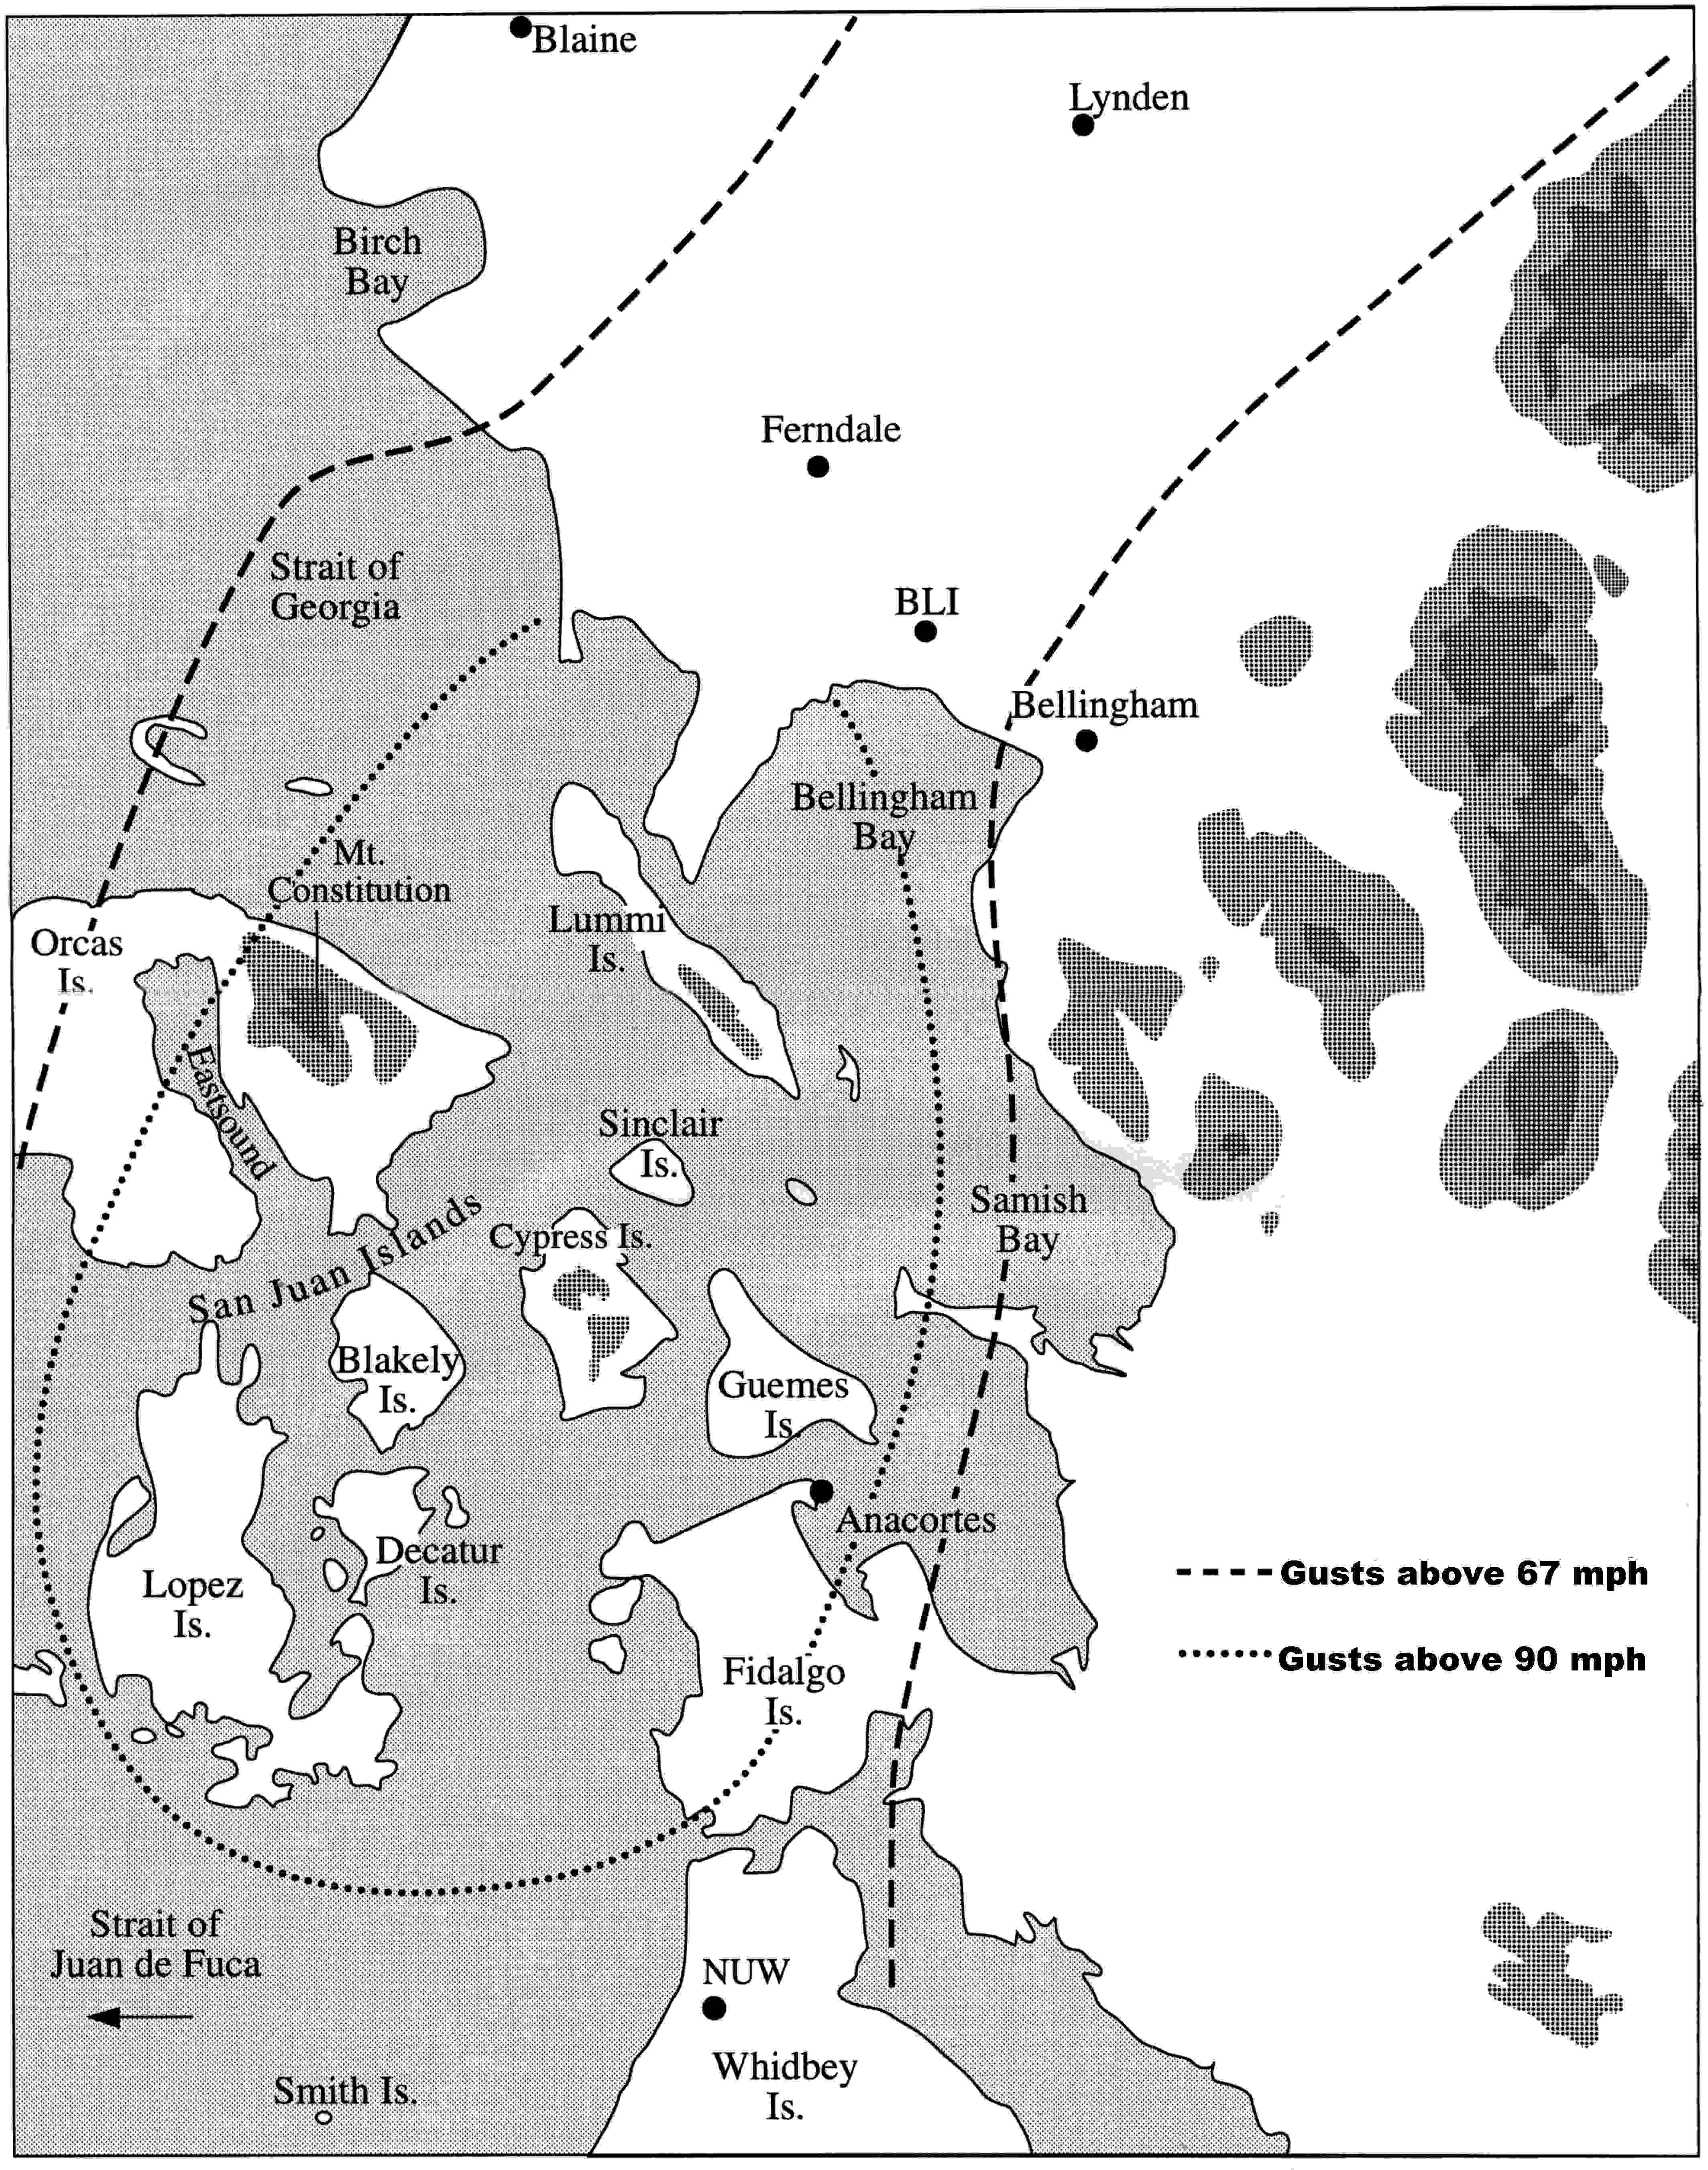
December 29, 1990

Slide 43
December 29, 1990
SeaTac hit 12º F, Everett 8º F, Tacoma 2º F and Olympia 5º F. Eastern Washington is -5º to -15º F with Yakima braking a 1968 record of -10º with -12º at 04:30 this morning.
Peak gusts from the north were around 45 mph and SeaTac, 60 mph at Alki Point, 63 at Bellingham and 70 mph+ in the Hood Canal. There were unofficial reports of 90 mph in some locations of the Central Sound.

Slide 44
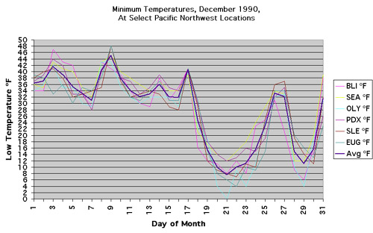
Two major cold waves in Dec 1990

Slide 45
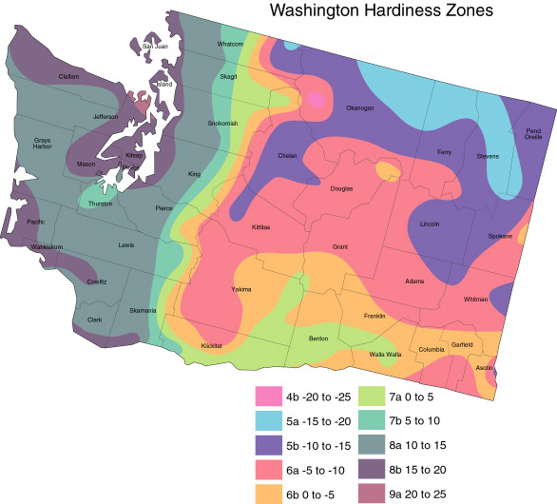
Hardiness Zone Maps
Are VERY Approximate

Slide 46
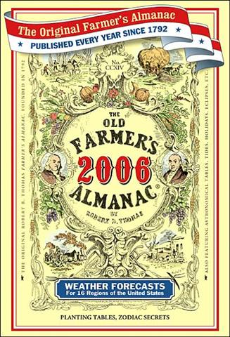
Is this useful for a gardener?

Slide 47
Absolutely useless
Nick Bond of NOAA in Seattle evaluated the Almanac’s forecasts over several years
Found absolutely no skill. Better off flipping a coin.
Want more proof?

Slide 48
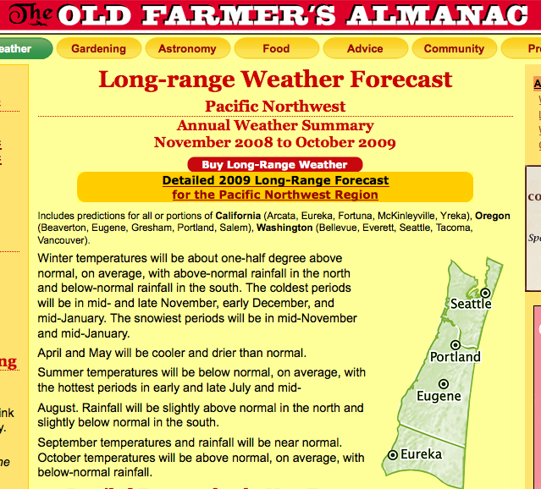

Slide 49
The End

Slide 50
Gaps in our regional mountain barriers have a huge impact on local weather

Slide 51
Notes:
51
Use this slide to introduce where the Gorge is and the nature of the gap flow scenario.
Spend some time pointing out important features like:
The mountain barrier, the Columbia Basin and how it provides a topographically confined air shed and note how the Gorge is the only drain
Then switch gears and point out other gaps on this map (Frasier, JDF, Stampede, Chehalis) and mention important results of each
Frasier - cold outflow, Juan de Fuca - easterly gales, westerly gales, PSCZ, Chehalis - PSCZ, Stampede - downslope windstorms, CRG - Cold outflow, gales, wintry precipitation
So meteorological phenomena driven by gaps are obviously very important, especially in the PNW.

Slide 52
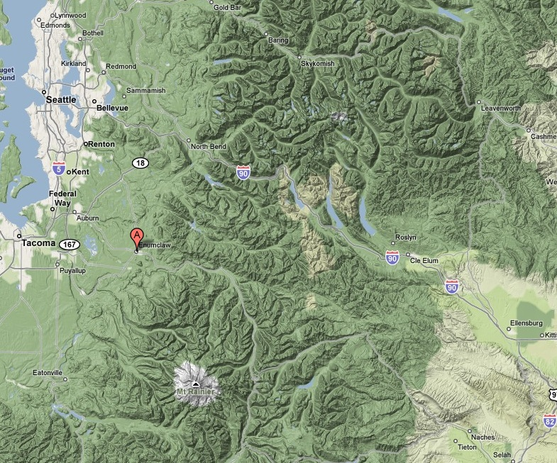
Enumclaw, Washington
“Place of evil spirits”

Slide 53
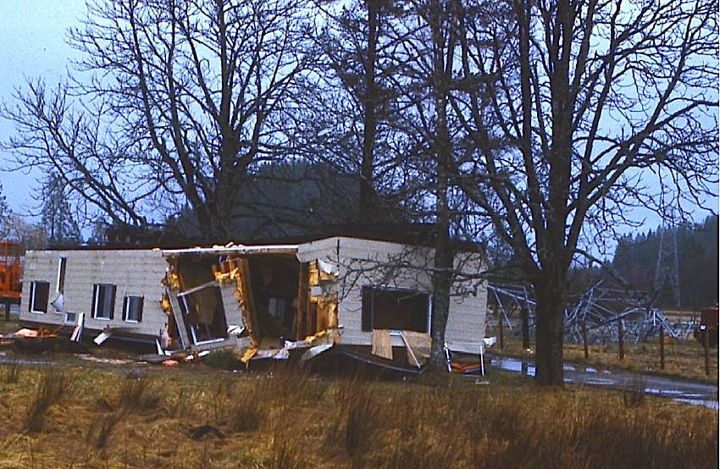
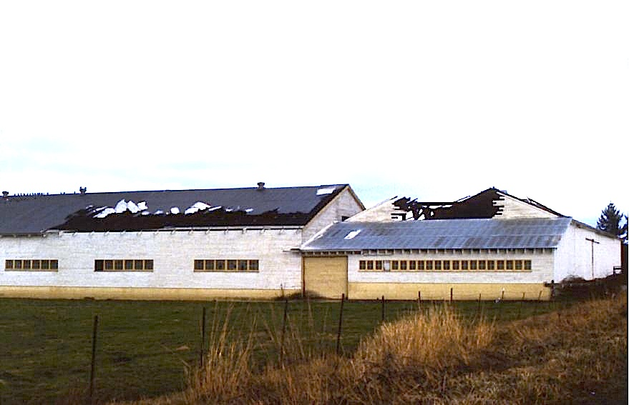
Enumclaw and nearby foothills locations can experience severe windstorms…while calm winds occur a dozen miles away
Winds over 118 mph
December 24, 1983

Slide 54
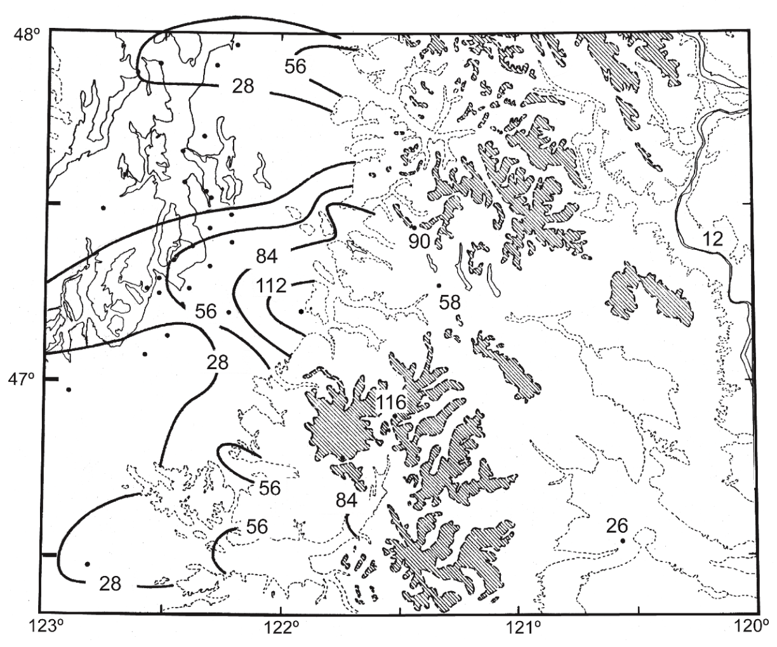
December 24, 1983

Slide 55
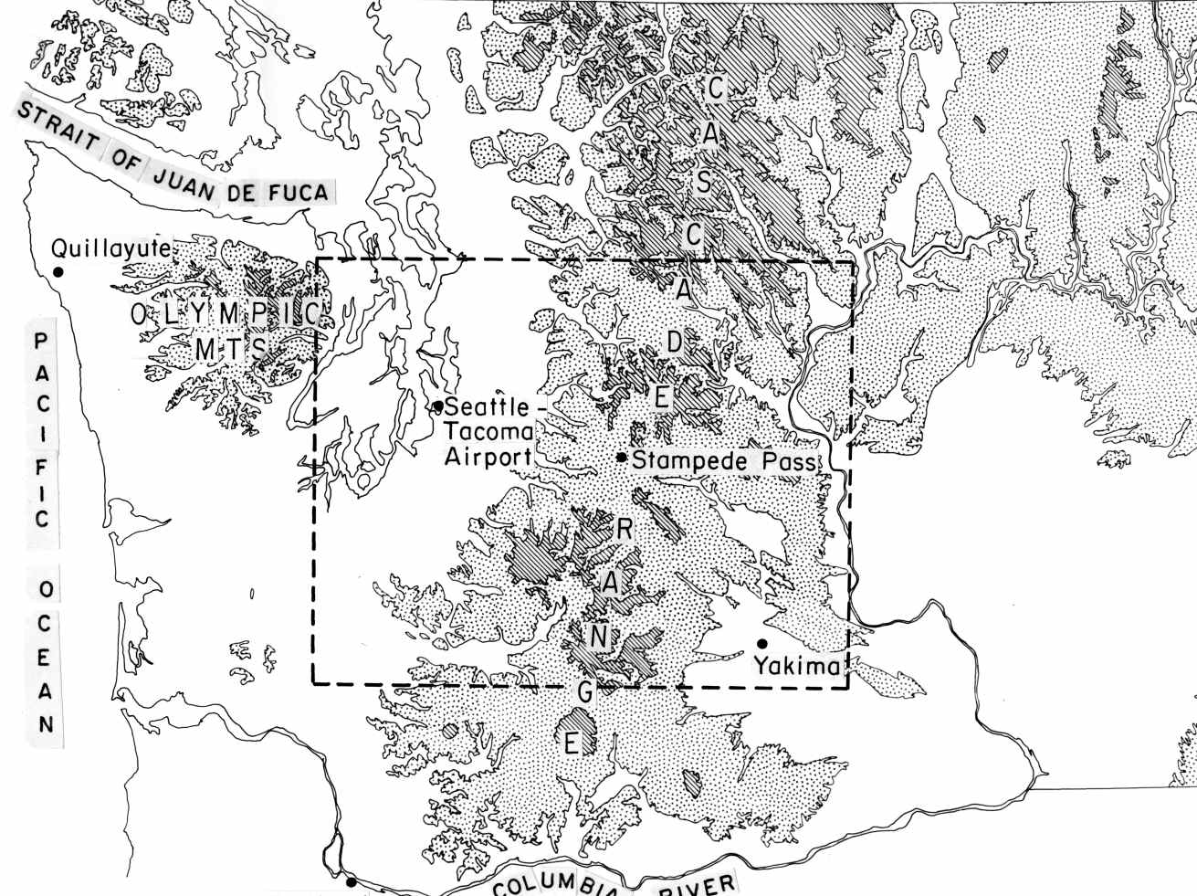
Why Enumclaw?

Slide 56
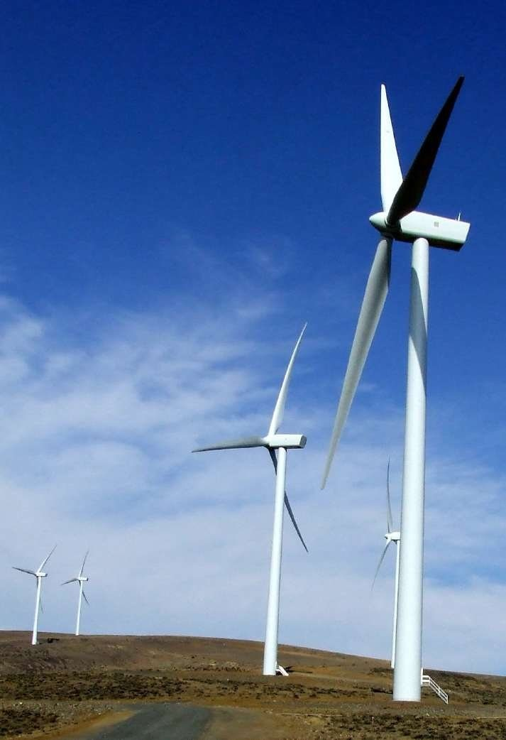
During the warm season, the same gap produces strong winds near Ellensburg, making possible the wind farms of the area.
Wild Horse Wind Farm

Slide 57
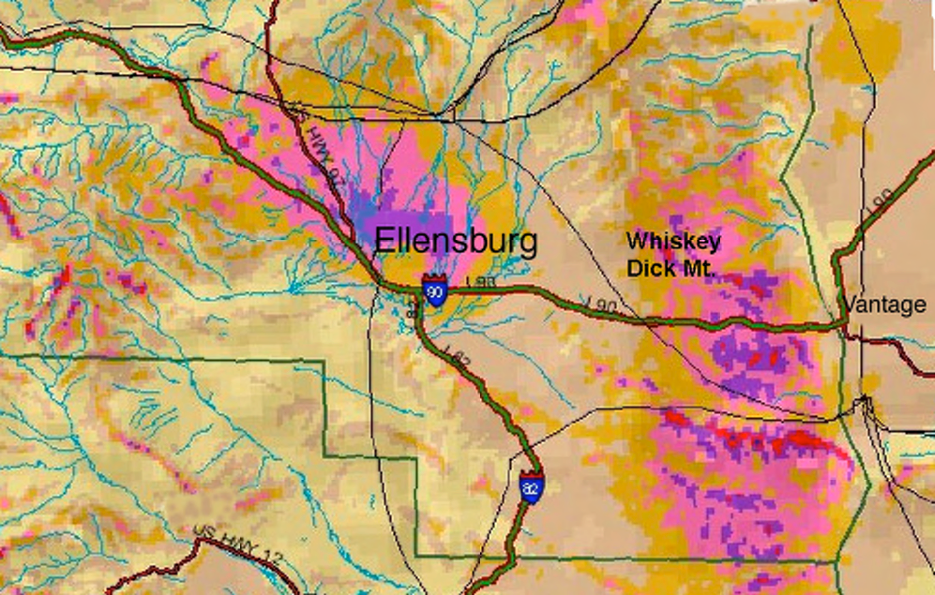

Slide 58
Some of our local weather features are more benign--but no less interesting

Slide 59
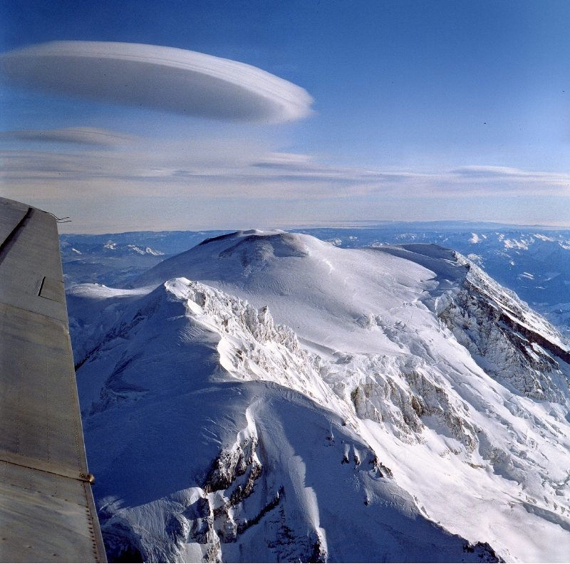
Lenticular or Mountain Wave Clouds
Picture courtesy of Art Rangno

Slide 60
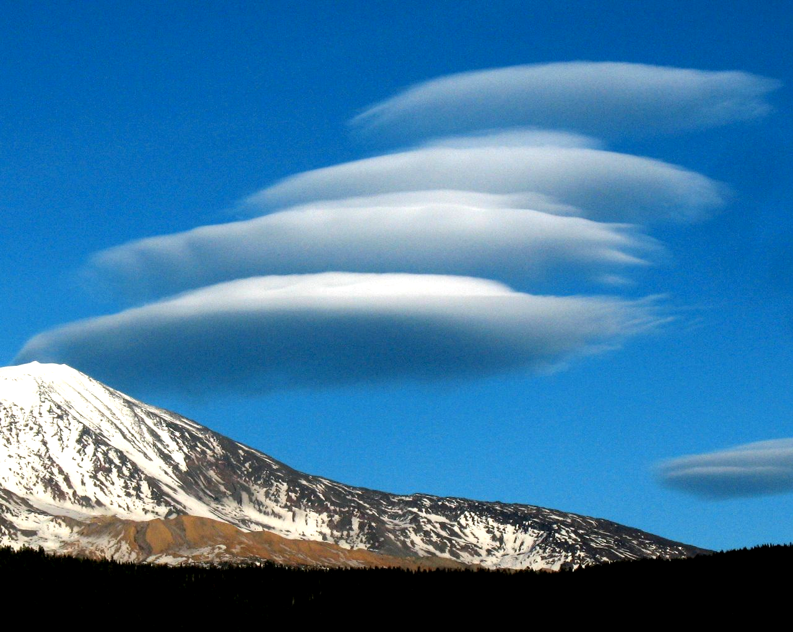
Picture Courtesy of Darlisa May Black

Slide 61
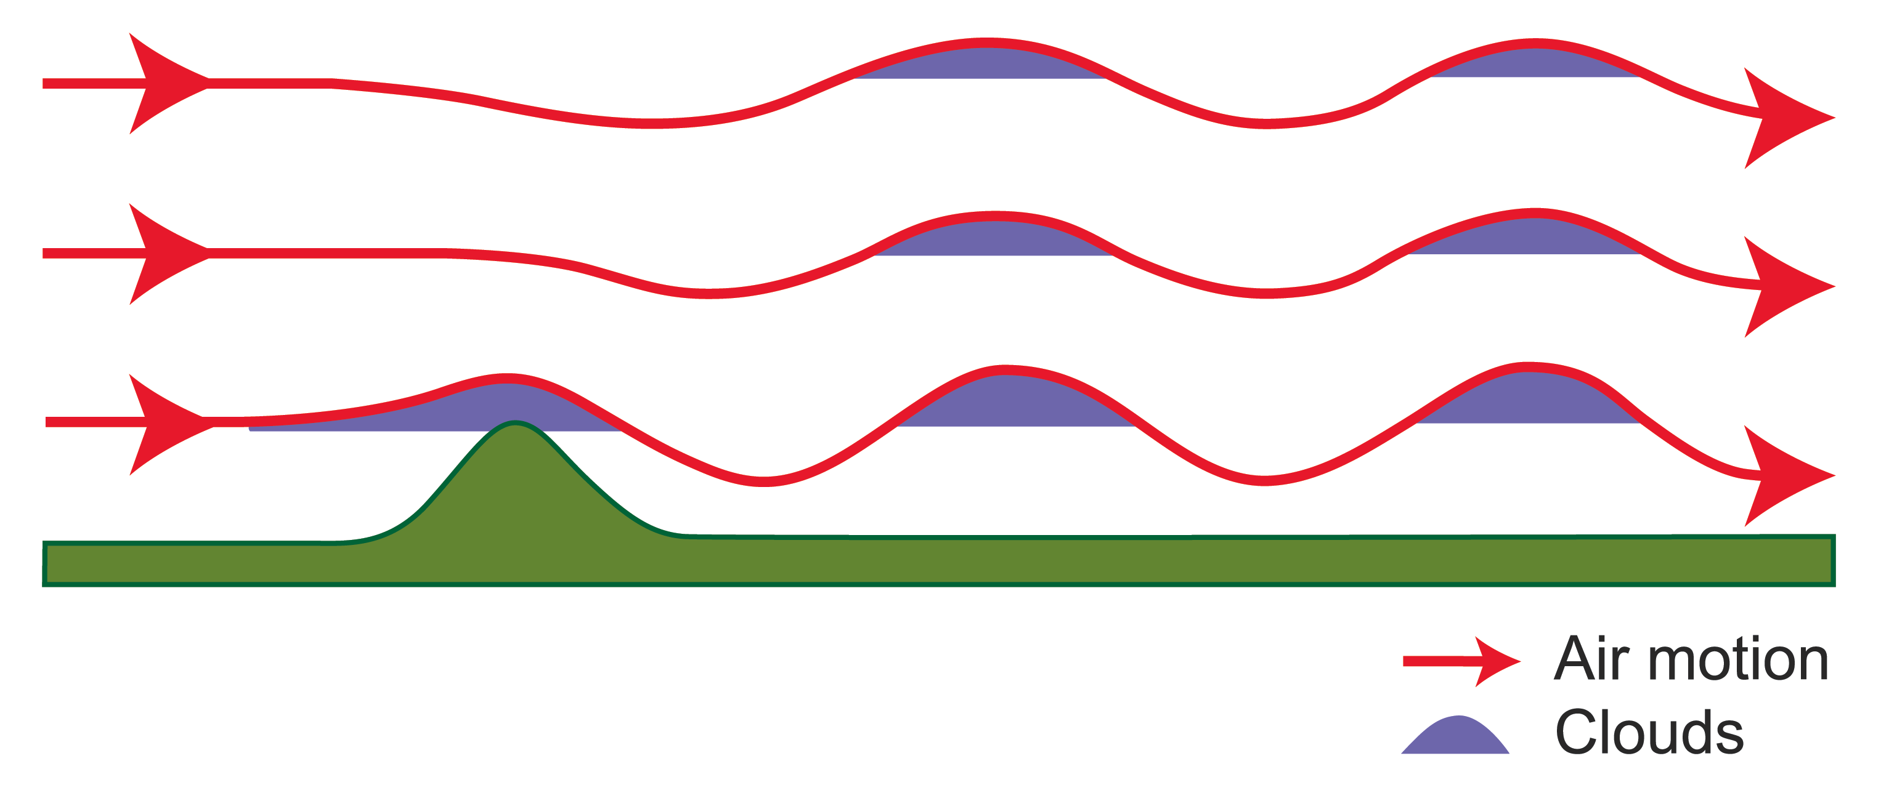
Mountain Wave Clouds

Slide 62

Wave Clouds

Slide 63

On June 24, 1947, Kenneth Arnold, flying a small plane between Chehalis and Yakima, spotted a group of “saucer-like” objects over Washington State

Slide 64
Thus was born the UFO craze that continues until this day

Slide 65

Thus was born the UFO craze that continues until this day

Slide 66

During a recent presidential debate on October 30, 2007, candidate Dennis Kucinich admitted that he saw a UFO while staying at Shirley McClain’s home.

Slide 67
What did both of these sightings have in common?

Slide 68

Both occurred over Washington State near Mount Rainier

Slide 69
The Major Storms of the Pacific Northwest

Slide 70

Our strong windstorms are generally associated with strong low pressure systems, called midlatitude
cyclones
Inauguration Day Storm January 20, 1993

Slide 71

Chanukah Eve Storm: 18-h forecast for 10 PM December 14, 2006
L

Slide 72

Mercer Island, December 15, 2006

Slide 73

The damage was extraordinary— made far worse by the heavy precipitation of the previous month.
Photo Courtesy of Wolf Read

Slide 74

The Most Extreme Northwest Windstorm: The Columbus Day Windstorm of 12 October 1962

Slide 75

Max Winds (mph)
Columbus Day Storm 1962
Graphic courtesy of Wolf Read

Slide 76

Columbus Day 1962: At Cape Blanco there were 150 mph with gusts to 179!
Cape Blanco,
Photo courtesy of
Bureau of Land
Management

Slide 77

Trees—our force multiplier

Slide 78
The most costly extreme weather of the Northwest
Flooding

Slide 79


Slide 80

Most are associated with the “Pineapple Express”
A relatively narrow current of warm, moist air from the subtropics…often starting near or just north of Hawaii.
a.k.a.
atmospheric rivers

Slide 81

A Recent Devastating Pineapple Express:
November 6-7, 2006

Slide 82

November 6-9,
2006
Dark Green: about 20 inches

Slide 83

Mount Rainier National Park
18 inches in 36 hr (Nov 8, 2006)

Slide 84
Global Warming: What will be the effects on the Northwest?

Slide 85
Some Claims
The mountain snowpack has dramatically declined during the last several decades.
The number of local heavy rain and windstorm events will increase under global warming.
The Northwest climate is particularly sensitive to global warming.
Global warming is a theory we don’t have to worry about. Just a normal cycle.
It appears that none of these are true.

Slide 86

The Problem: greenhouse gases are increasing

Slide 87

Picture courtesy of the National Park Service

Slide 88

Climate Model Output for 2100
Notes:
88

Slide 89

Change in Winter Surface Air Temperature (°C) for 1979-2008
-1.4
-1.2
-1.0
-0.8
-0.6
-0.4
-0.2
0.0
+0.2
+0.4
+0.6
+0.8
+1.0
+1.2
+1.4
Air Temperature Trend (1979-2005)
Notes:
89

Slide 90

Cascade snowpack hasn’t changed in the last 30 years

