Slide 1
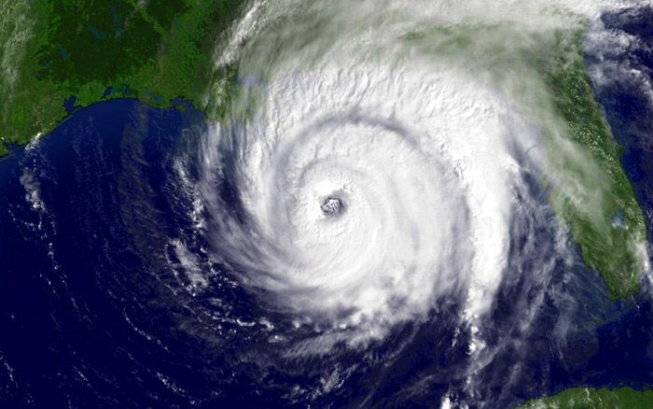
Hurricanes

Slide 2
Definition
A tropical cyclone with sustained one-minute winds of at least 74 mph (64 knots), at an elevation of 10 meters.
Derived from the Spanish word "huracan" , which was most likely inspired by Hunraken, the name for the ancient Mayan storm god or Hurakan, the Quiche god of thunder

Slide 3
Hurricane Facts
They are tropical cyclones (low pressure areas) with sustained winds at least 64 knots (74 mph). Strongest hurricane on record (Camille) had winds exceeding 200 mph.
Typically 500-1000 km in diameter (smaller than midlatitude cyclones).
Can be associated with heavy rains (10-20 inches!), tornadoes, and storm surges on the coast.
Also called typhoons and tropical cyclones

Slide 4
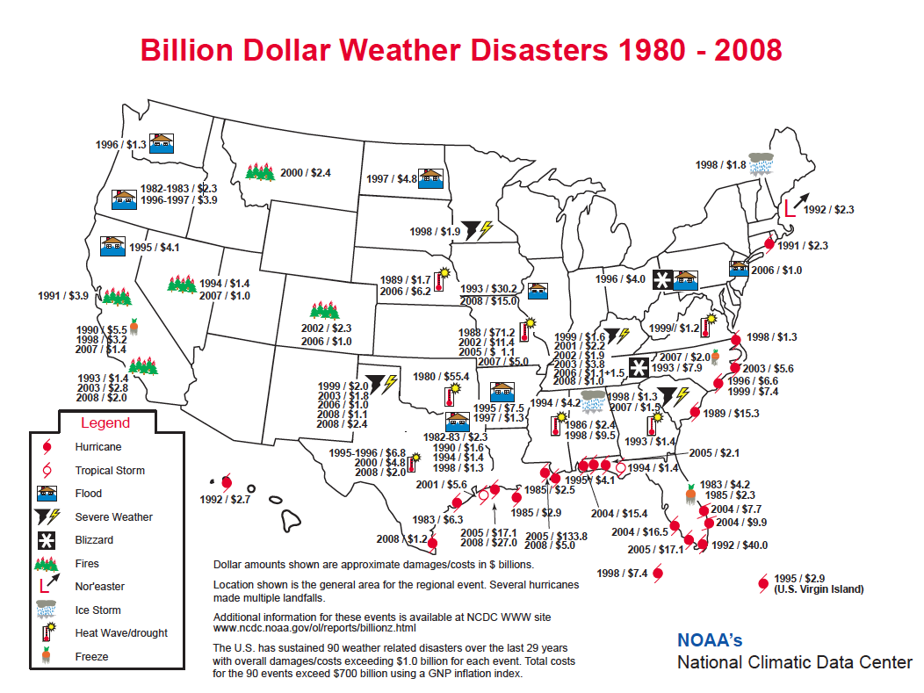

Slide 5
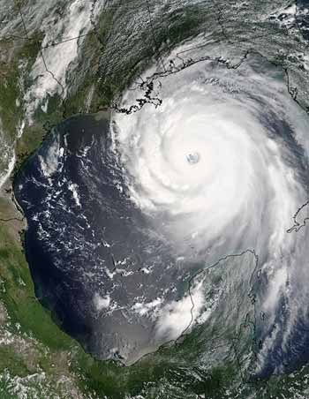
Katrina
1833 deaths
125 billion in damage
Most destructive hurricane in U.S. history

Slide 6
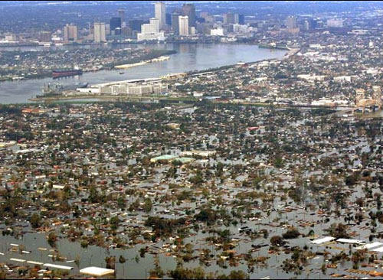
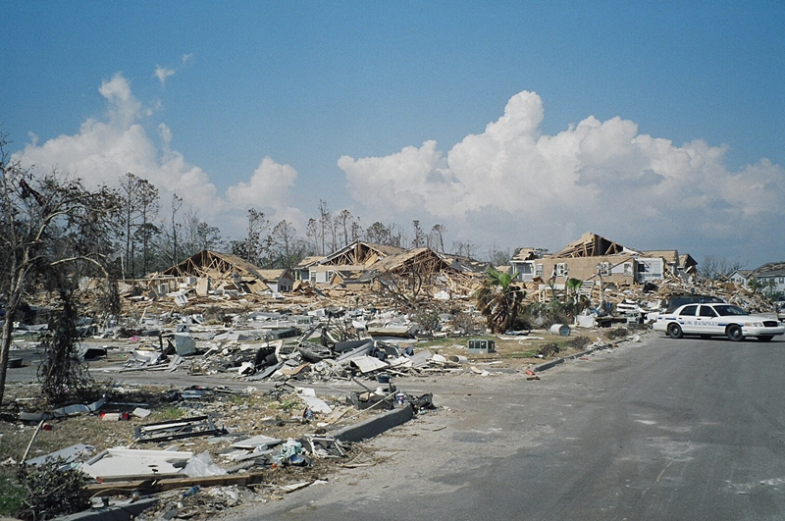

Slide 7
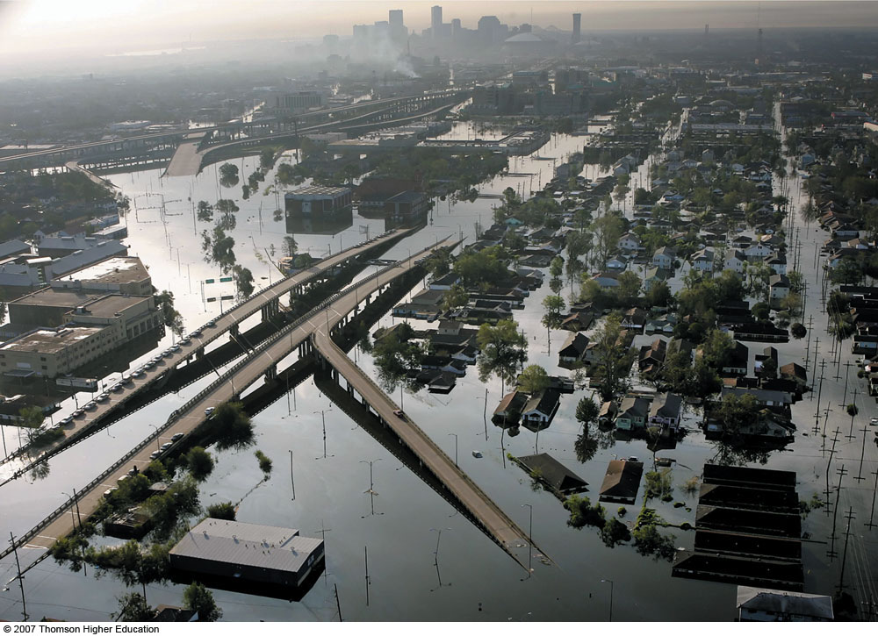
Fig. 11-24, p. 320
Notes:
Figure 11.24: Flood waters inundate New Orleans, Louisiana, during August, 2005, after the winds and storm surge from Hurricane Katrina caused several levee breaks.

Slide 8
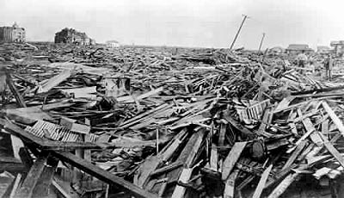
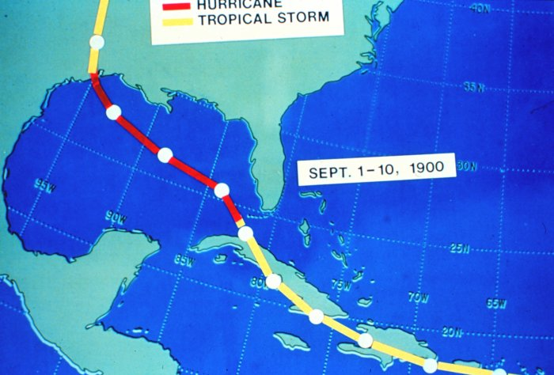
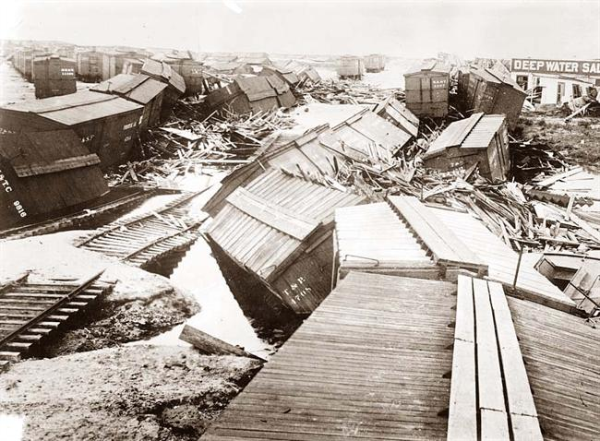
1900 Galveston, TX Hurricane: The Greatest Loss of Life of Any U.S. Meteorological Event (8000 died)

Slide 9
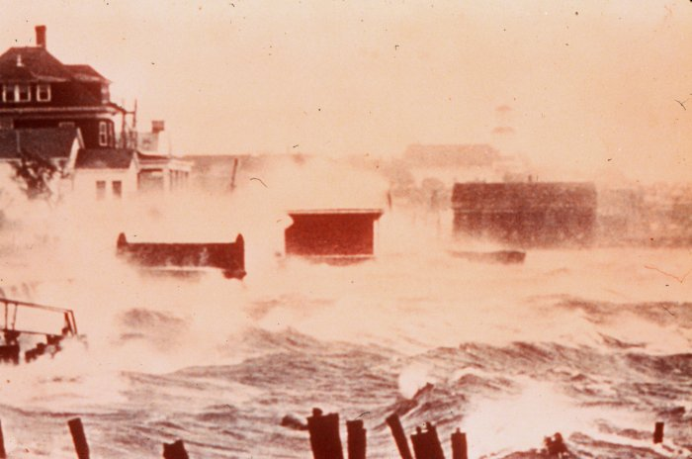

Slide 10
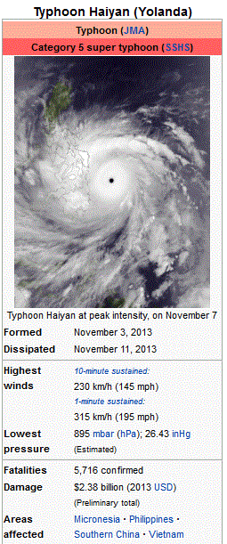
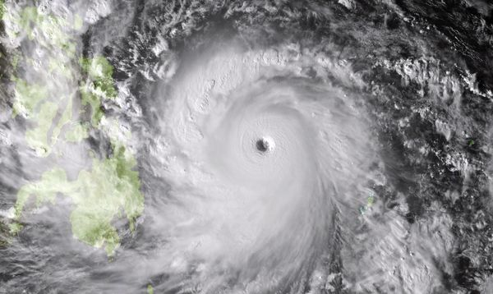
Typhoon Haiyan

Slide 11
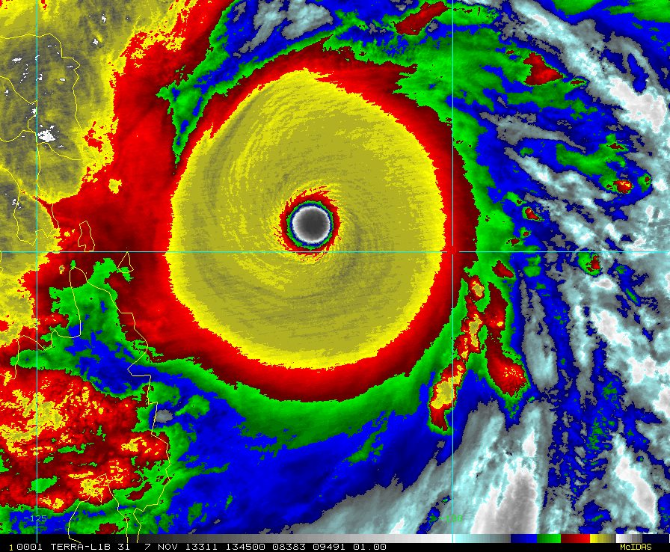

Slide 12
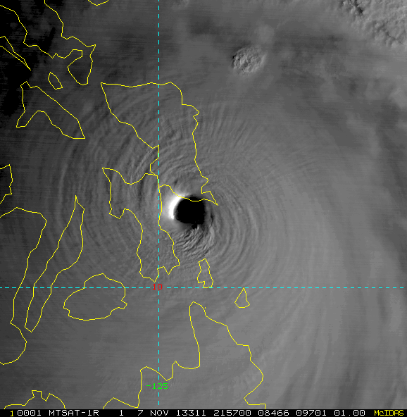

Slide 13
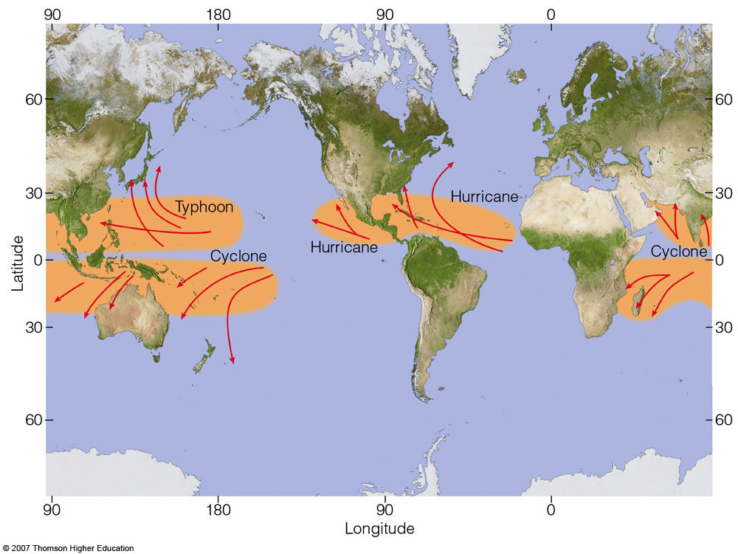
Not on the equator!
Fig. 11-10, p. 307
Notes:
Figure 11.10: Regions where tropical storms form (red shading), the names given to storms, and the typical paths they take (red arrows).

Slide 14
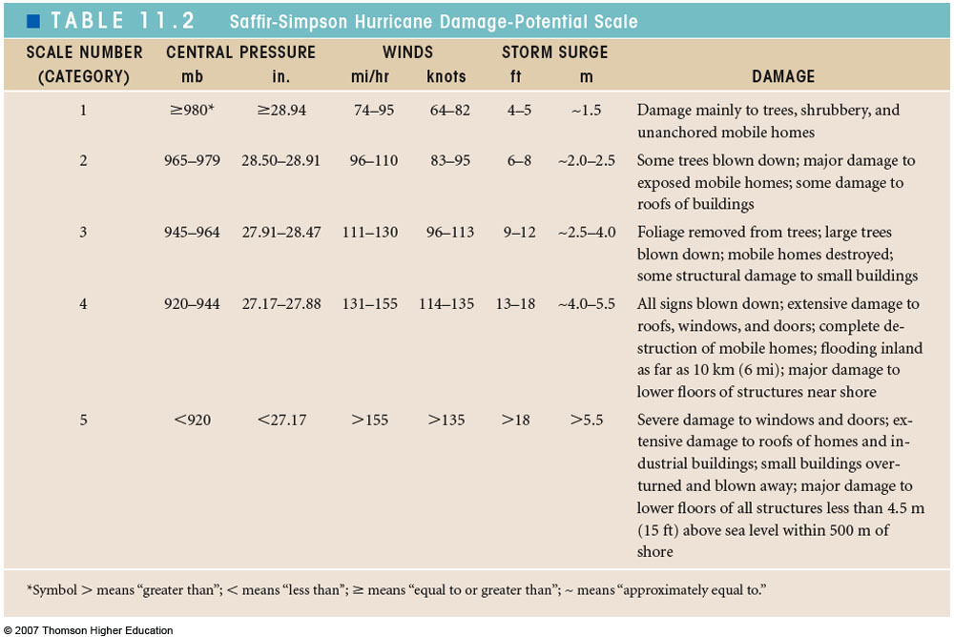
Saffir-Simpson Hurricane Category
Table 11-2, p. 313

Slide 15
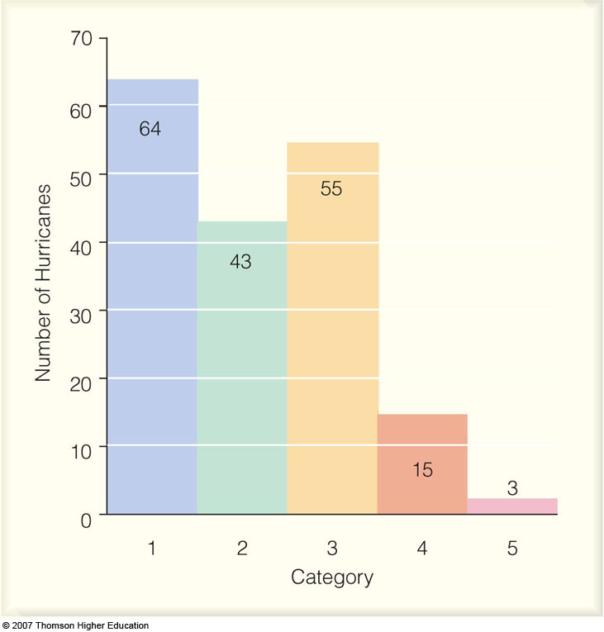
Fig. 11-16, p. 313
Notes:
Figure 11.16: The number of hurricanes (by each category) that made landfall along the coastline of the United States from 1900 through 2005. All of the hurricanes struck the Gulf or Atlantic coasts. Categories 3, 4, and 5 are considered major hurricanes.

Slide 16
Experience a hurricane
http://www.youtube.com/watch?v=H9VpwmtnOZc
http://www.youtube.com/watch?v=6LPM-0xiVvM
http://www.youtube.com/watch?v=UeM-cjTEEA8&feature=related

Slide 17
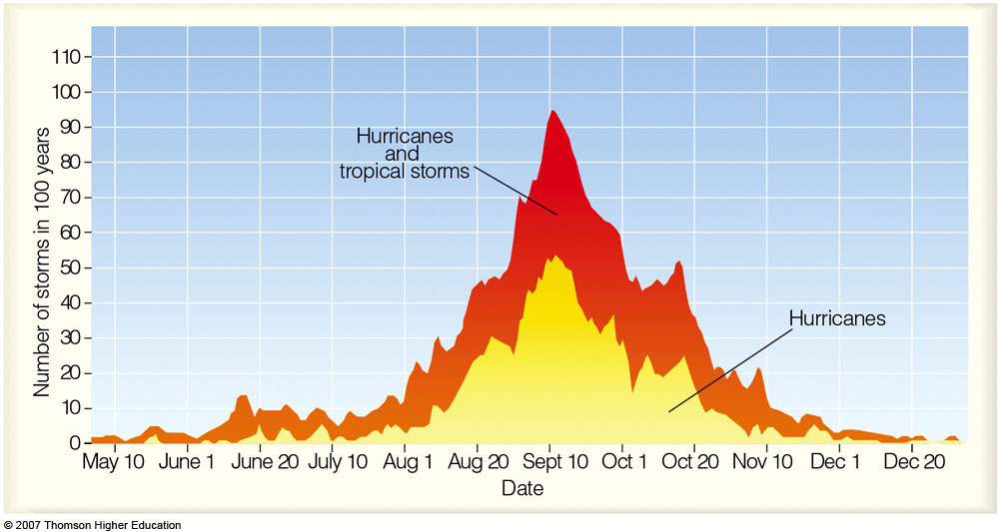
Atlantic Basin Hurricanes and Tropical Storms
Notes:
Figure 11.7: The total number of hurricanes and tropical storms (red shade) and hurricanes only (yellow shade) that have formed during the past 100 years in the Atlantic Basin—the Atlantic Ocean, the Caribbean Sea, and the Gulf of Mexico.

Slide 18
Hurricane Structure

Slide 19
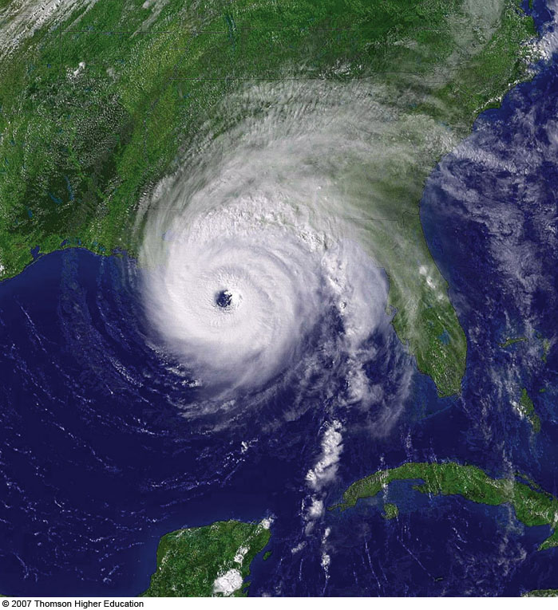
Major Features:
Eye (nearly clear)
Eye Wall Rainband
Spiral Rainbands
Fig. 11-20, p. 317
Notes:
Figure 11.20: Visible satellite image of Hurricane Ivan as it makes landfall near Gulf Shores, Alabama, on September 15, 2004. Ivan is a major hurricane with winds of 105 knots (121 mi/hr) and a surface air pressure of 945 mb (27.91 in).

Slide 20
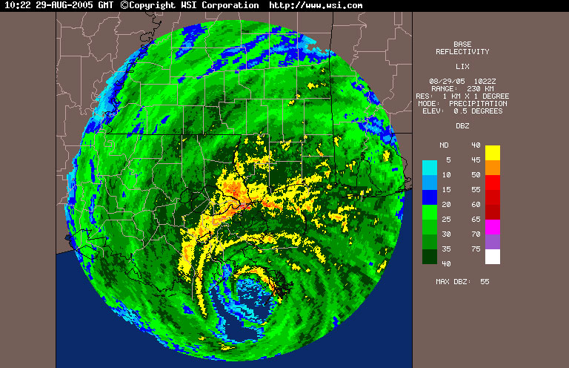

Slide 21
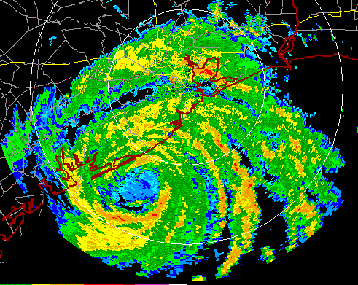

Slide 22
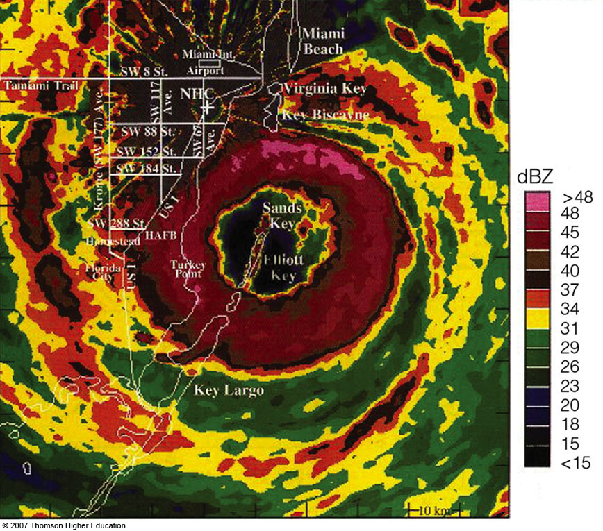
Fig. 11-18, p. 316
Notes:
Figure 11.18: Color radar image of Hurricane Andrew as it moves on shore over south Florida on the morning of August 24, 1992. The National Hurricane Center (NHC) is located about 30 km (19 mi) from the center of the eye.

Slide 23
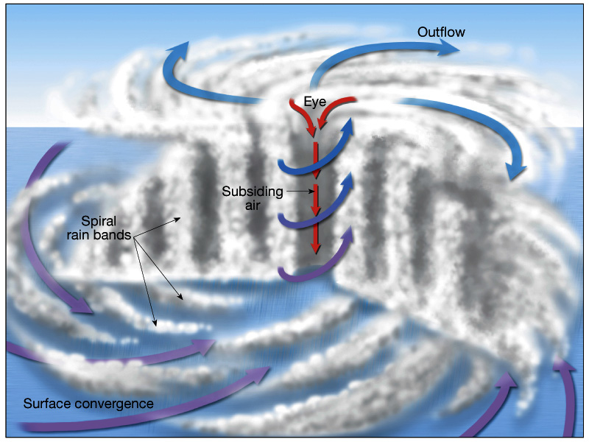

Slide 24
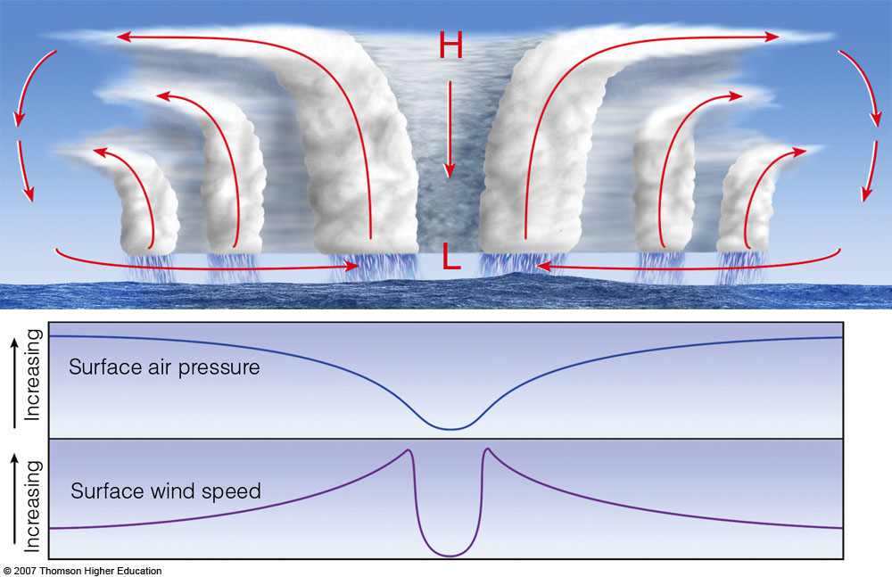
Fig. 11-8, p. 305
Notes:
Figure 11.8: The top diagram shows an intensifying tropical cyclone. As latent heat is released inside the clouds, the warming of the air aloft creates an area of high pressure, which induces air to move outward, away from the high. The warming of the air lowers the air density, which in turn lowers the surface air pressure. As surface winds rush in toward the surface low, they extract sensible heat, latent heat, and moisture from the warm ocean. As the warm, moist air flows in toward the center of the storm, it is swept upward into the clouds of the eyewall. As warming continues, surface pressure lowers even more, the storm intensifies, and the winds blow even faster. This situation increases the transfer of heat and moisture from the ocean surface. The middle diagram illustrates how the air pressure drops rapidly as you approach the eye of the storm. The lower diagram shows how surface winds normally reach maximum strength in the region of the eyewall.

Slide 25

Eye slopes outward

Slide 26
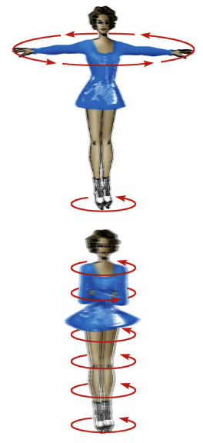
In much the same way an ice skater spins more quickly as her arms are tucked close into her body, a hurricane also spins at a faster pace near the center than near the outer edge.

Slide 27
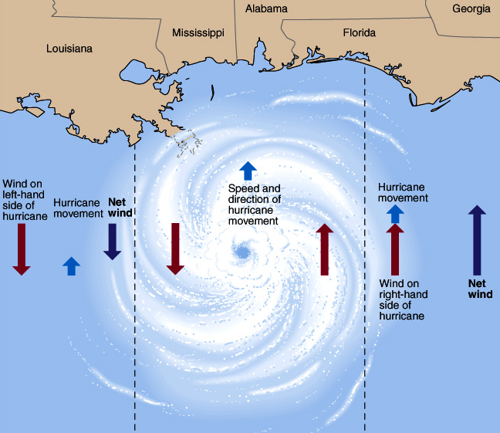
Destruction most intense on right side of cyclone (wind + storm speed)
Notes:
27

Slide 28
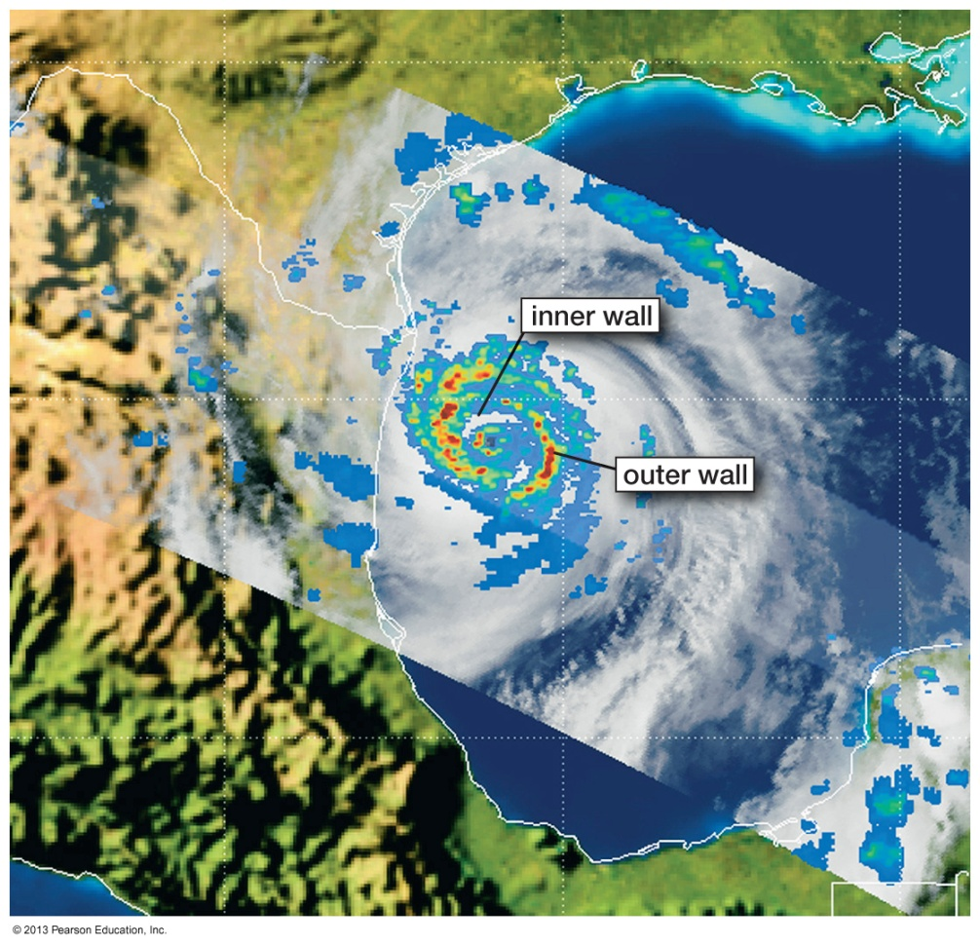
Eye wall replacement
A shrinking eye indicates storm intensification.
Some intense hurricanes develop double eye walls, as rain bands contract and intensify.
Eye wall replacement leads to weakening of the hurricane winds, followed by renewed strengthening.

Slide 29
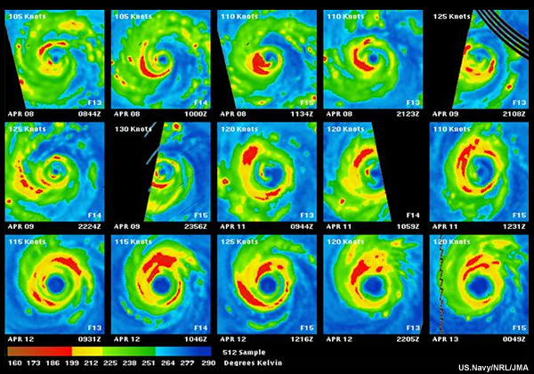

Slide 30
The Greatest Damage and Loss of Life from Hurricanes is Near the Coast Associated with Storm Surges

Slide 31
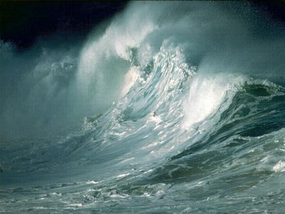

Slide 32
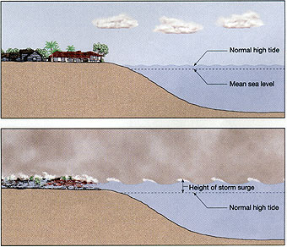

Slide 33
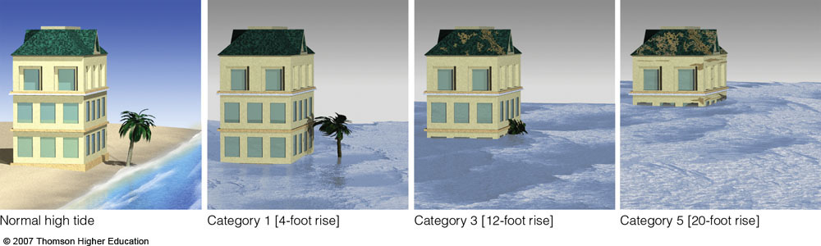
Fig. 11-15, p. 312
Notes:
Figure 11.15: The changing of the ocean level as different category hurricanes make landfall along the coast. Notice that the water typically rises about 4 feet with a Category 1 hurricane, but may rise to 22 feet (or more) with a Category 5 storm.

Slide 34
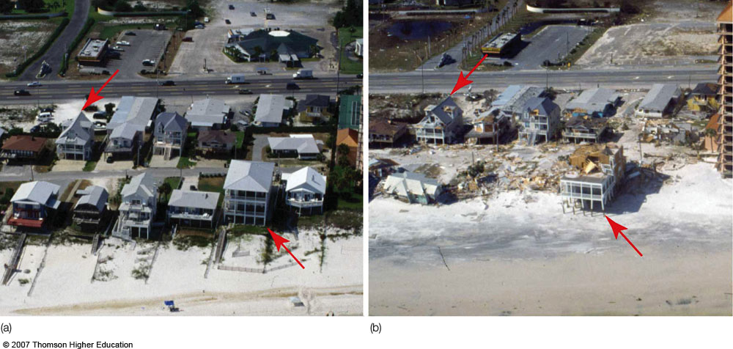
Before and after Hurricane Iva, Sept 2004, coastal Alabama
Notes:
Figure 11.21: Beach homes along the Gulf coast at Orange Beach, Alabama (a) before, and (b) after Hurricane Ivan made landfall during September, 2004. (Red arrows are for reference.)

Slide 35
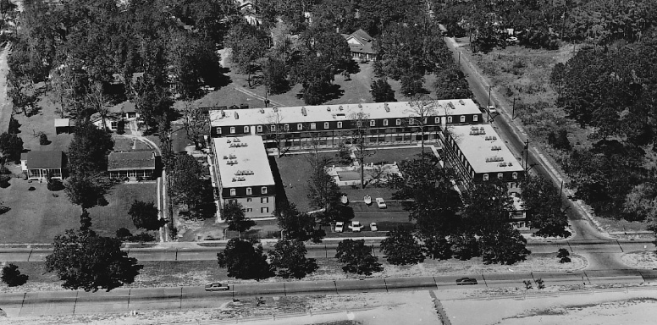
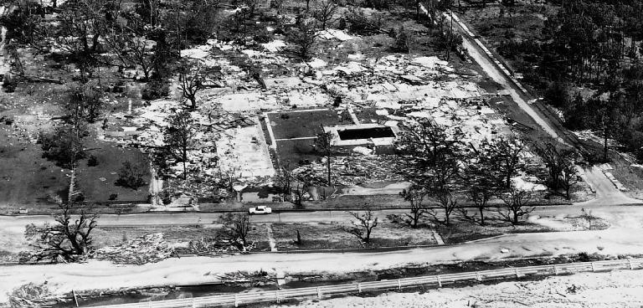
Before a hurricane…
After a hurricane.

Slide 36
Storm Surge
Produced by the storm pushing water up on the coast AND
By the low pressure of the hurricane.

Slide 37
Storm Surge Video
http://www.youtube.com/watch?v=nV6Qtrt2CNQ&feature=fvsr
http://www.youtube.com/watch?v=l9vDSWugz08

Slide 38
What is the energy source of Hurricanes?

Slide 39
Hurricanes
Hurricanes get their energy from the warm, waters of the tropics.
Require the water surface to be at least 80F
Also need moist air through depth and weak wind shear.
Generally develop as a weak tropical disturbance moves over the oceans.

Slide 40
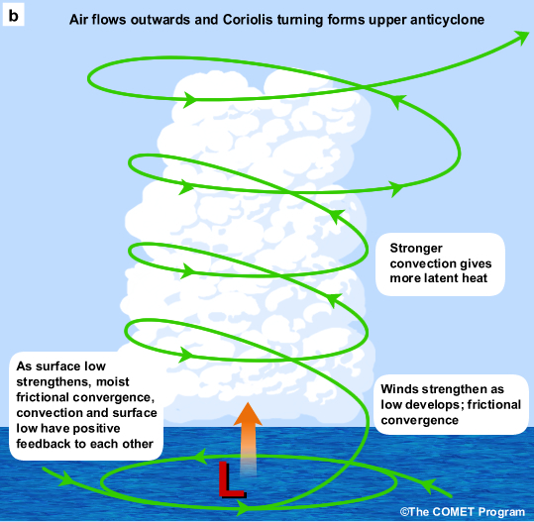
Revving Up a Hurricanes: Two Positive Feedbacks Involving Warm Water
Convergence-Convection (CISK—Conditional Instability of the Second Kind)
Surface flux-Convection (WISHE—Wind Induced Surface Heat Exchange)

Slide 41
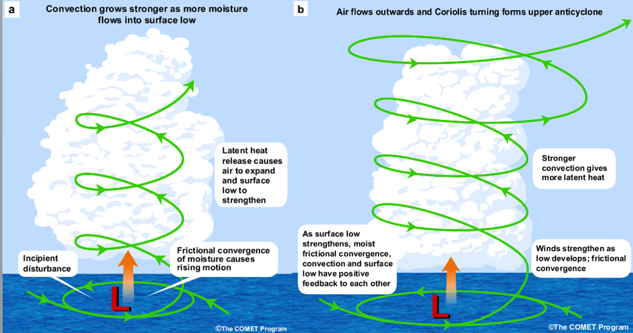
CISK

Slide 42
Hurricane Origin

Slide 43
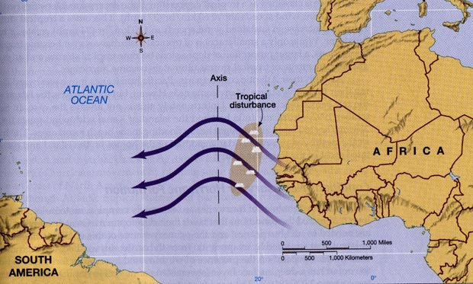
Many Atlantic Hurricanes Begin as Tropical Waves Over Africa

Slide 44
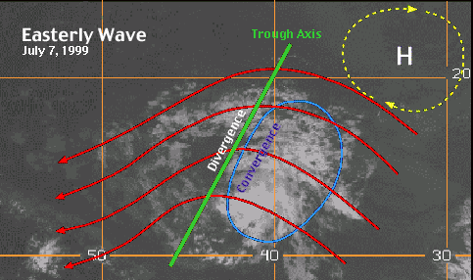

Slide 45
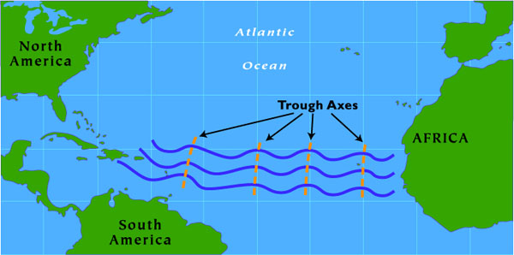
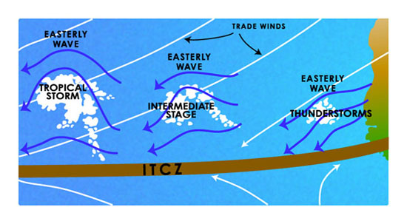

Slide 46
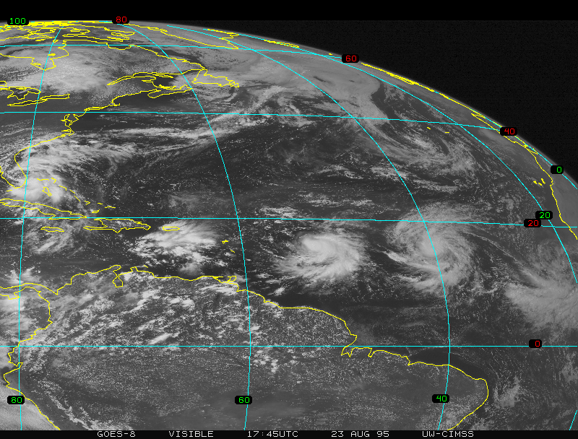

Slide 47
Hurricane Prediction: A Mixed Report
During the past thirty years there has been a substantial improvement in hurricane track forecasts as computer models improved and more data became available to describe their environment.
Over the same period only minimal improvement is hurricane intensity forecasts.

Slide 48
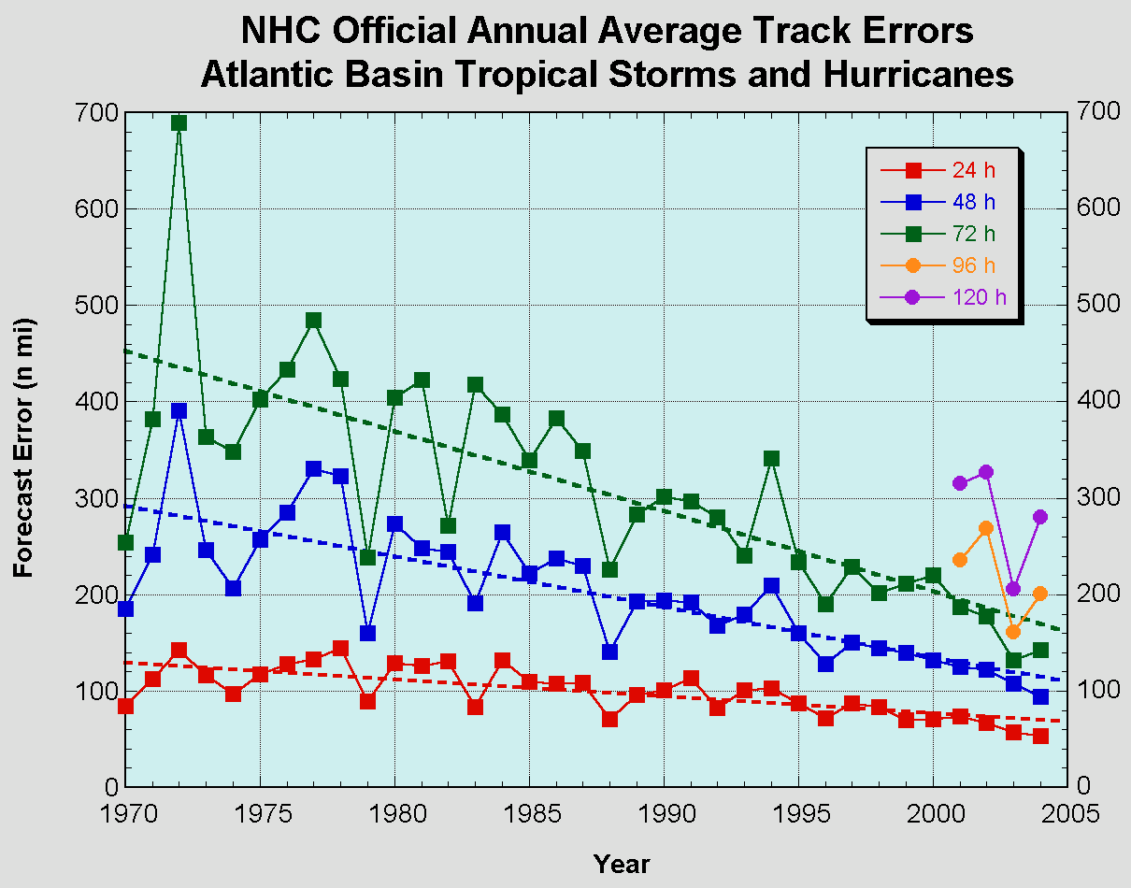

Slide 49
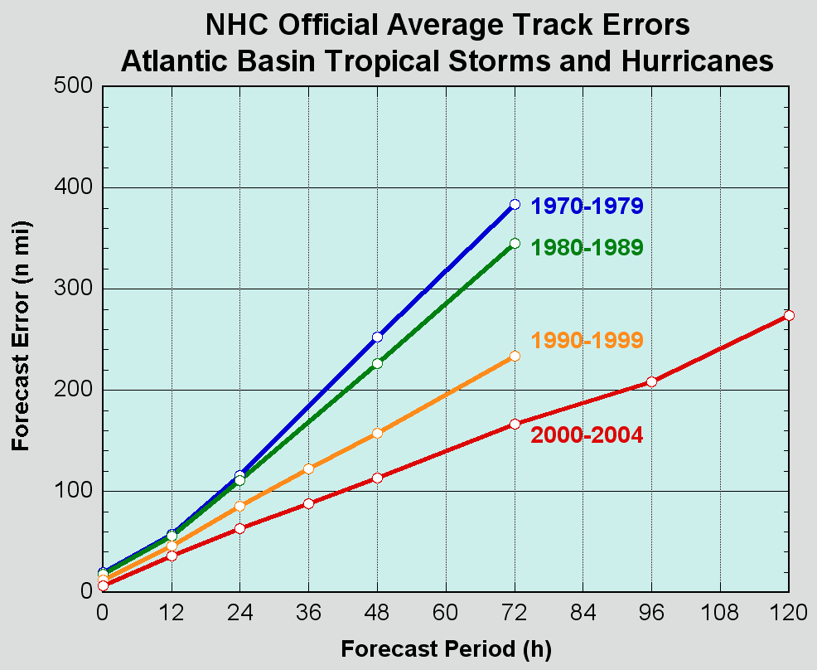

Slide 50
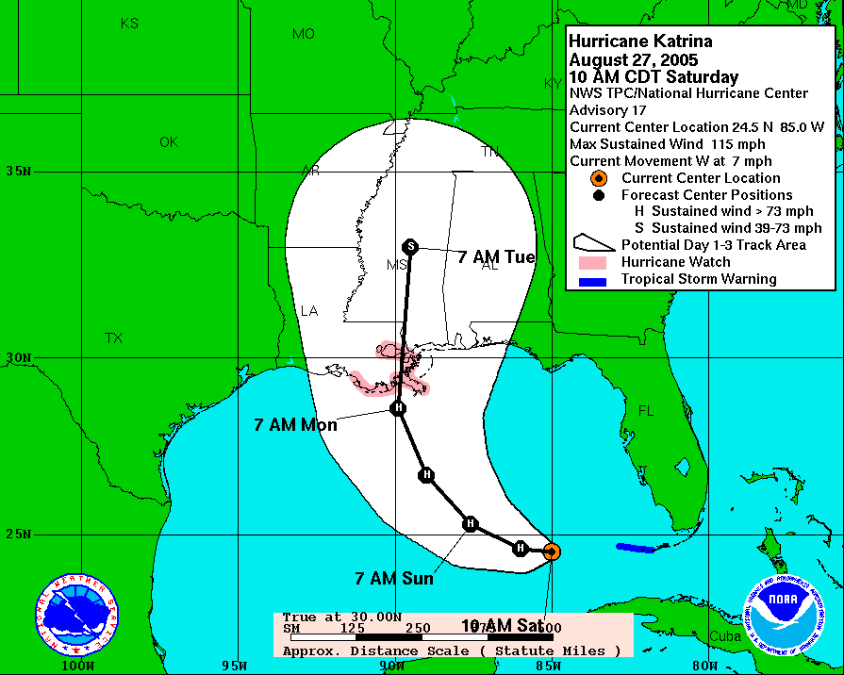
Katrina
48-h Before: Virtually a Perfect Forecast of Track

Slide 51
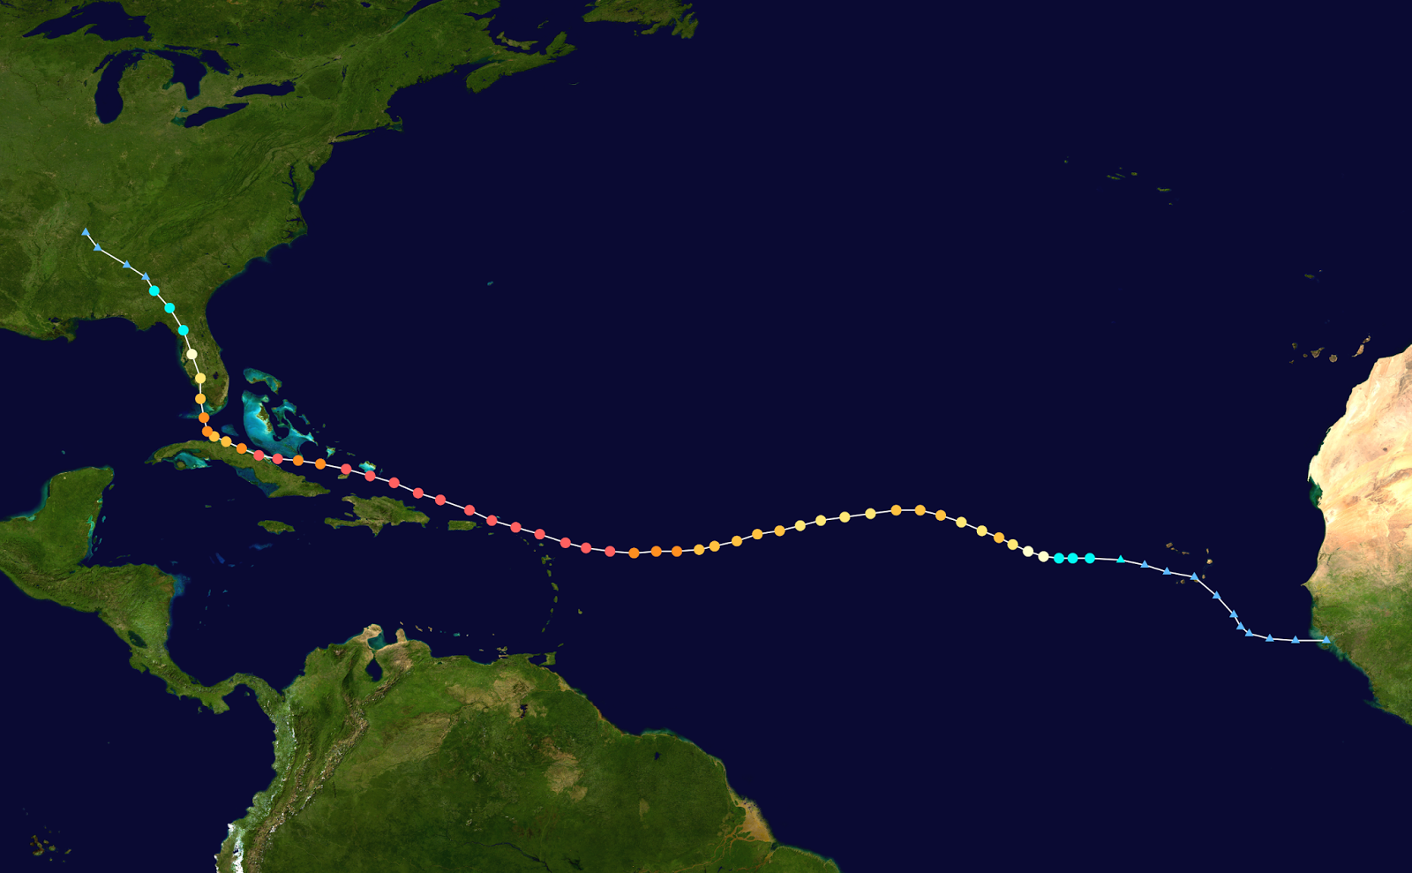
Hurricane Irma 2017 Tour de Force

Slide 52
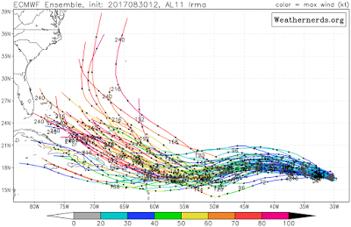
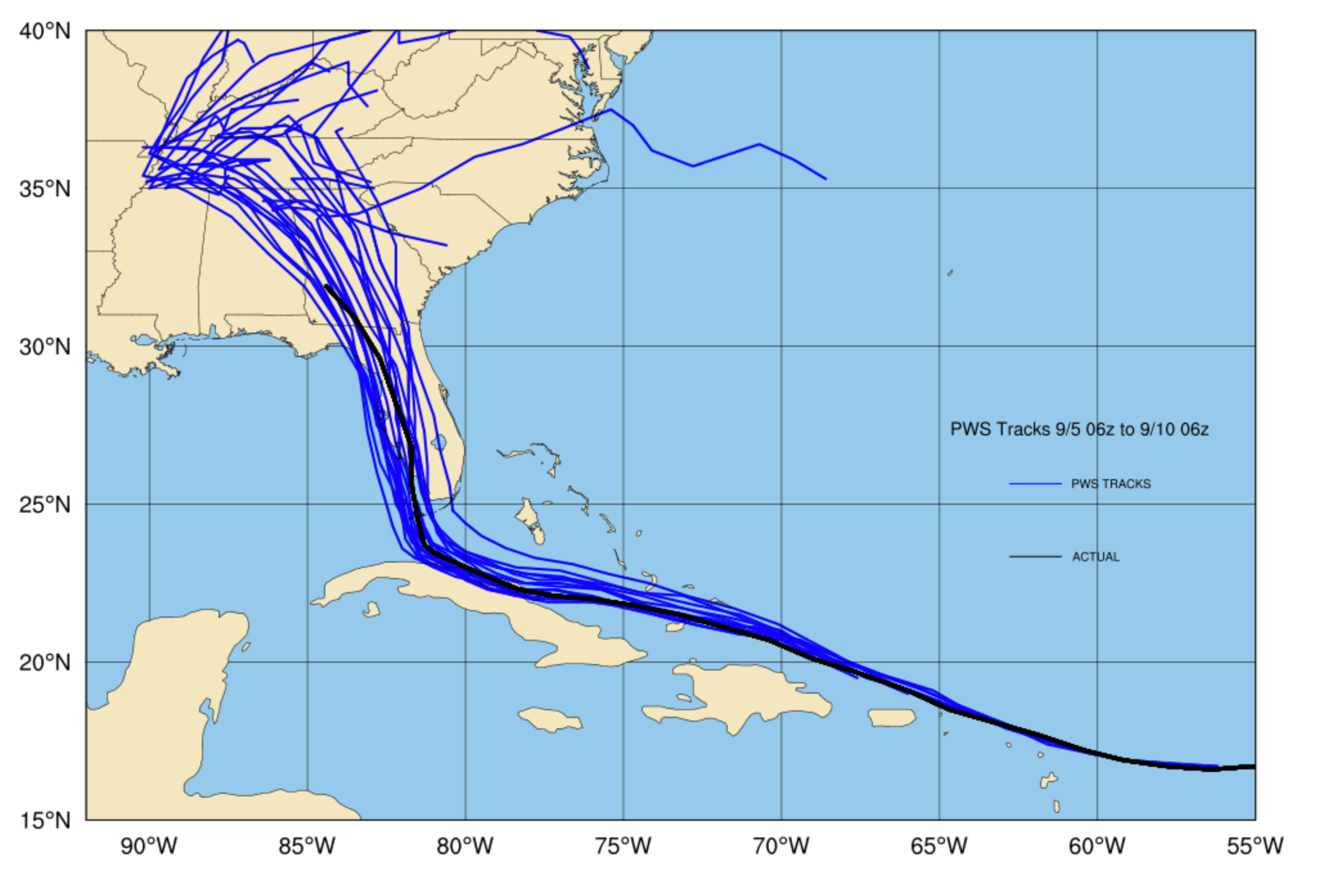

Slide 53
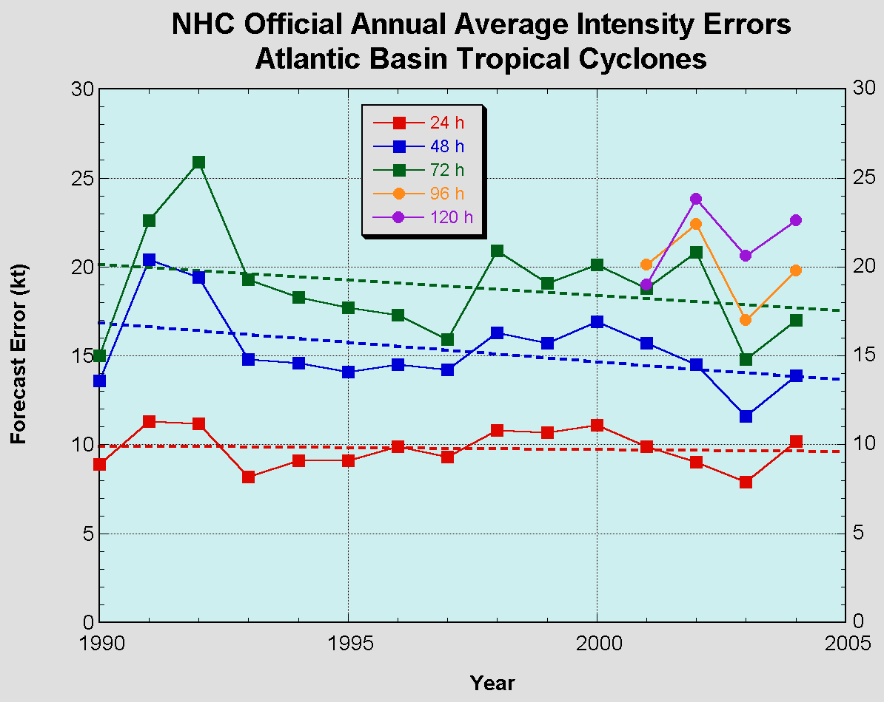

Slide 54
Hurricane Predictions are Enhanced by In-situ Aircraft Observations in and Around Hurricanes

Slide 55
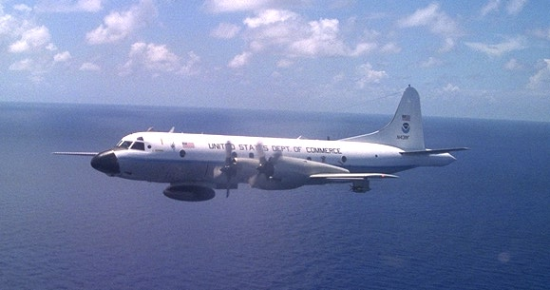

NOAA P3
“Hurricane Hunter”
Aircraft

Slide 56
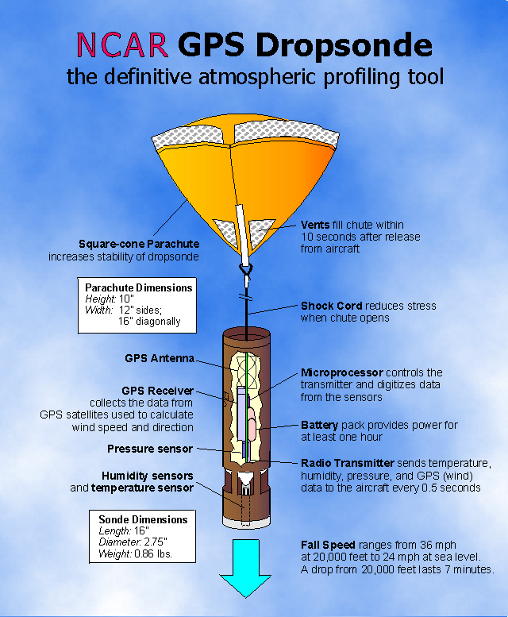


Slide 57

Gulfstream IV-SP (G-IV) is a high altitude, high speed, twin turbofan jet aircraft

Slide 58


New Technology

Slide 59


Substantial Promise
The use of higher resolution prediction and better data around and in hurricanes should result in better intensity predictions.
15-km grid spacing
1.67 km grid spacing

Slide 60

U.S Hurricane Headquarters

