Slide 1
Informal Glaciology Talk
Climate Change and Wildfires
Cliff Mass
Atmospheric Sciences

Slide 2
Side Topic: Ensemble-Based Regional Climate Modeling over the Northwest
To understand climate change over the western U.S., one needs enough resolution to get the mesoscale meteorology halfway correct
Global climate models have grid spacing of 100-200 km. Not good enough
We have some experience in dynamically downscaling global models using the WRF model, run at 12-15 km resolution for 100 years
Now doing it for an ensemble of many runs, driven by CMIP-5 GCMS.

Slide 3
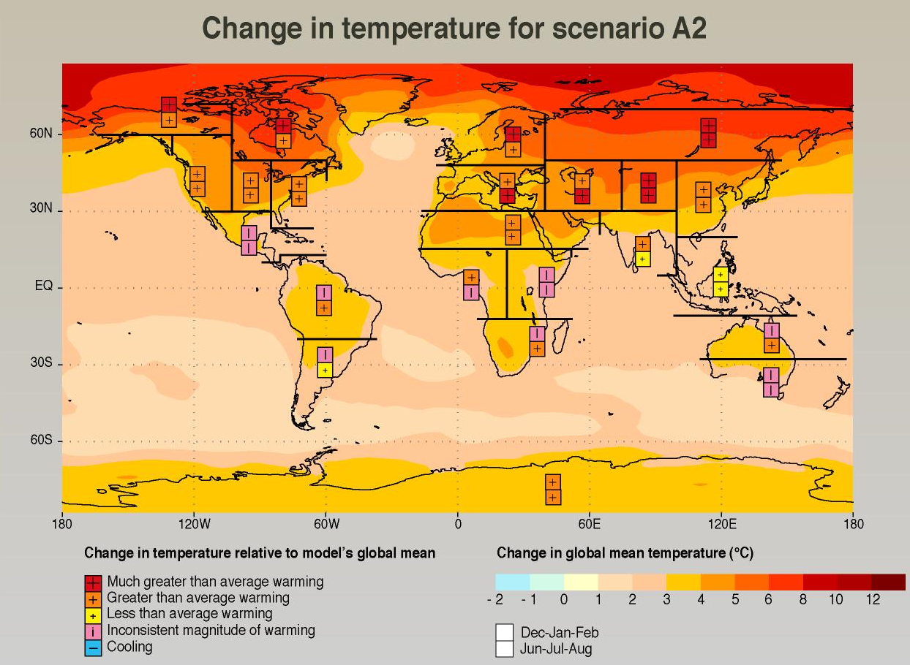
Most climate impacts evaluation is based on GCM’s with grid spacing of 100-150 km

Slide 4
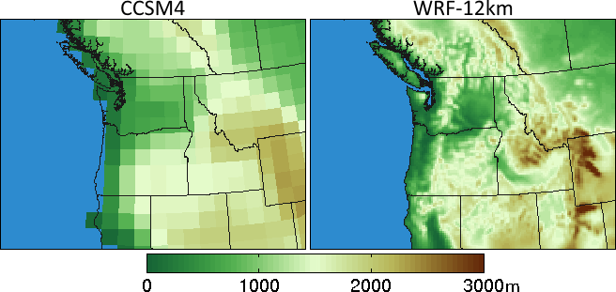
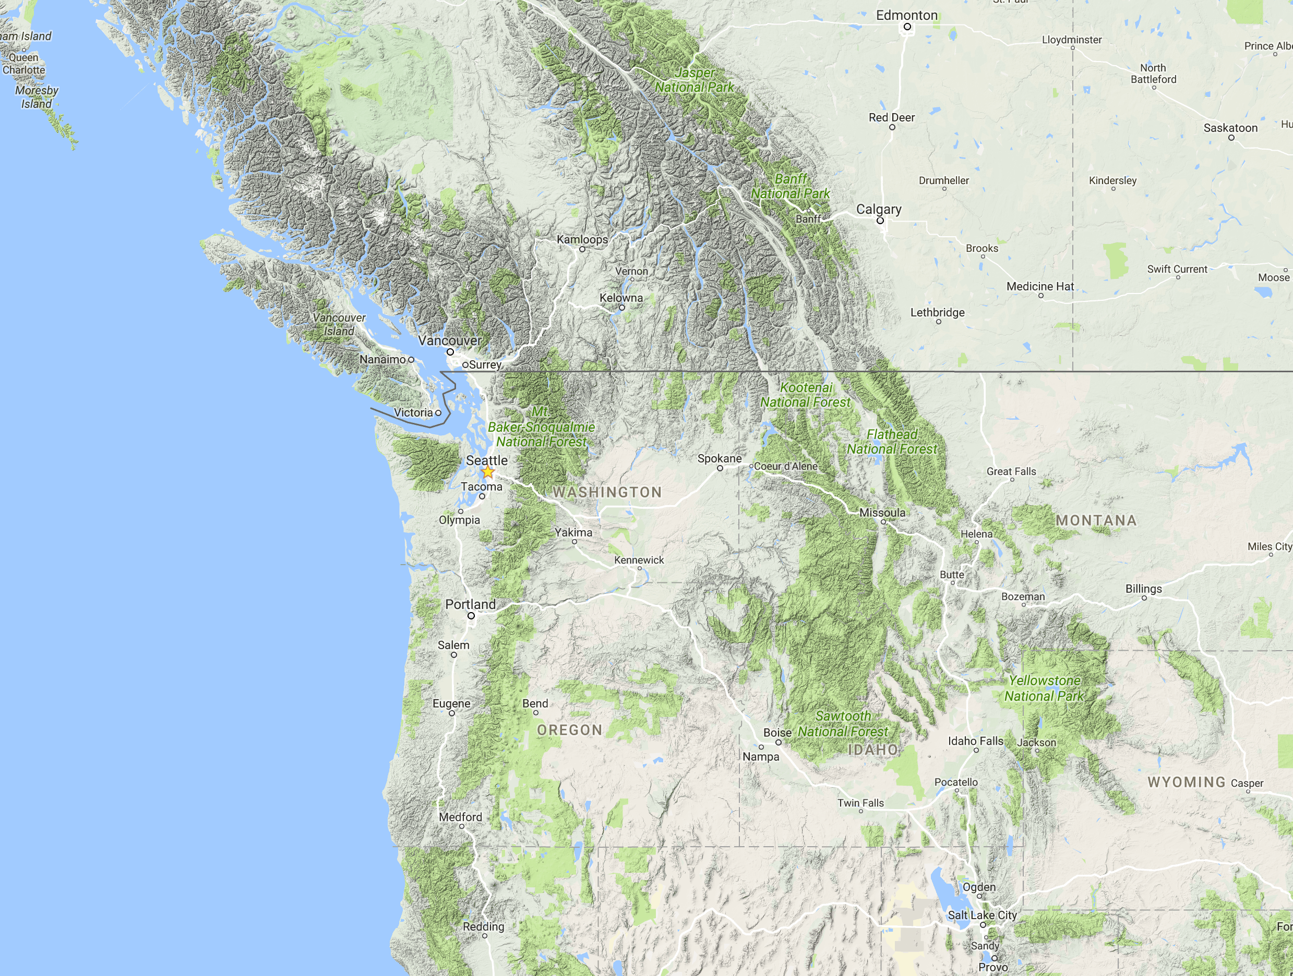
Too coarse to simulate the effects of critical terrain/coastal interfaces or mesoscale features
Climate Model Terrain

Slide 5
Might unresolved mesoscale circulations alter the global warming story locally?
Terrain-forced mesoscale circulation can have a complex, non-linear relationships with changing synoptic flow.
Also interactions with land use and land/water interfaces
Other complexities with the relationship of convection and changing large-scale flows.

Slide 6
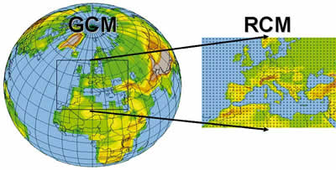
Two Main Approaches to Downscaling GCMs to Secure Mesoscale Impacts
Statistical: using contemporary relationships between large scale fields (e.g., temperature or precipitation) and their high-resolution distribution.
Dynamical: using high resolution mesoscale models (a.k.a, regional climate models) with boundary conditions driven by GCMs

Slide 7
Dynamical Downscaling Not Statistical Downscaling
Only fully dynamical downscaling can simulate the non-linearities and complexities of the mesoscale response to global warming.
Examples:
  Location and distribution of precipitation as stability changes.
  Onshore flow and coastal marine clouds enhanced by greater onshore pressure gradients
  Albedo feedbacks as mountain snow melts.

Slide 8

Some surprises based on currently available GCMs and a limited number of high-resolution dynamically downscaled runs

Slide 9
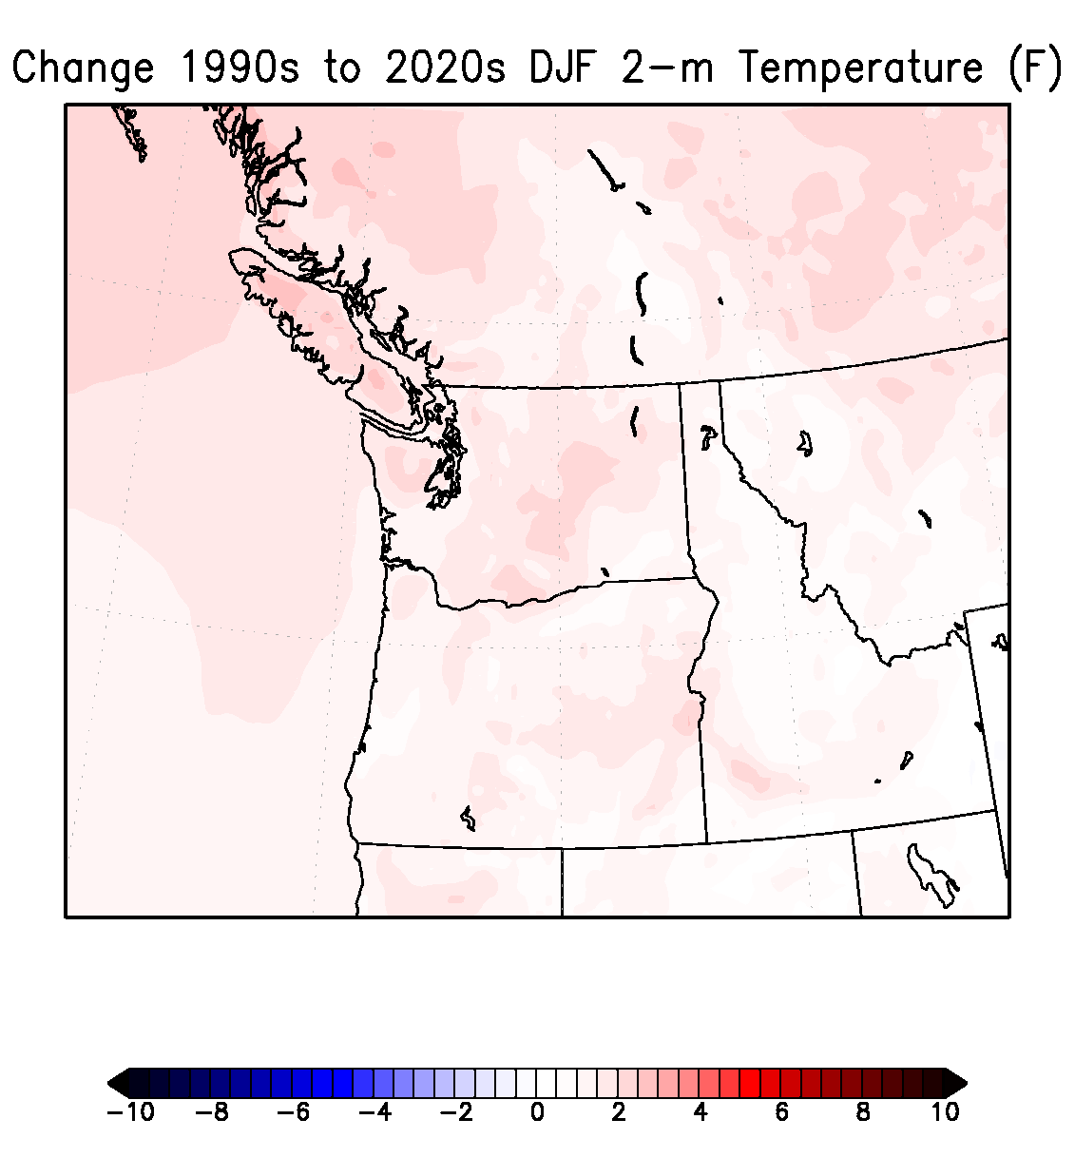
12-km RCM downscaling of
ECHAM5 GCM
Change in Winter Surface Air Temperatures (F)
Notes:
9

Slide 10
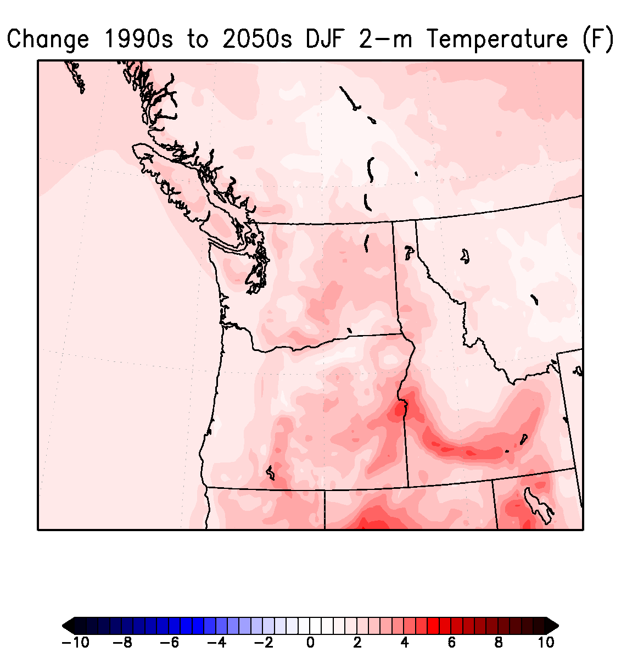
Notes:
10

Slide 11
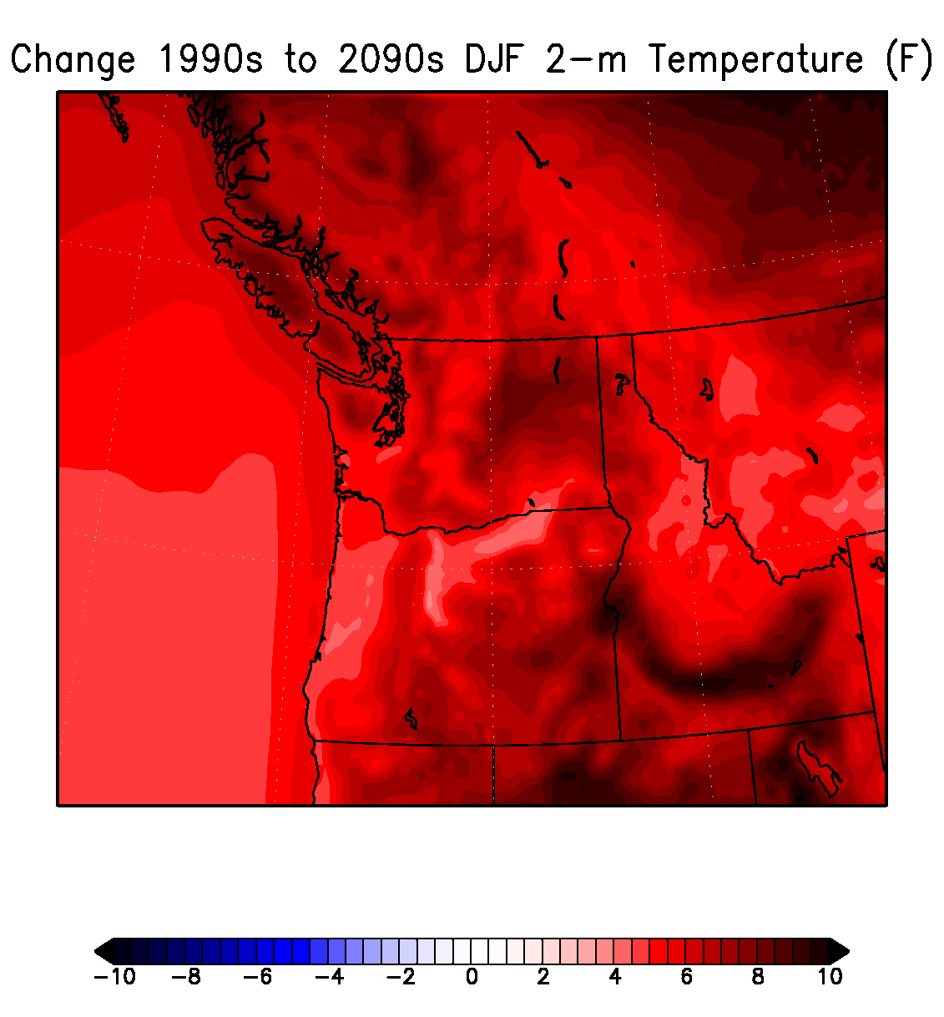
Notes:
11

Slide 12
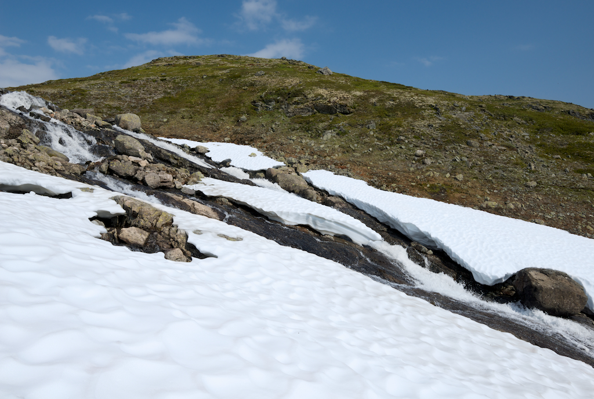
Why local hot spots?
Regions of melting snow on terrain

Slide 13
A major surprise: synoptic deamplification and its effects on downslope flow off terrain, offshore flow, and heat waves

Slide 14
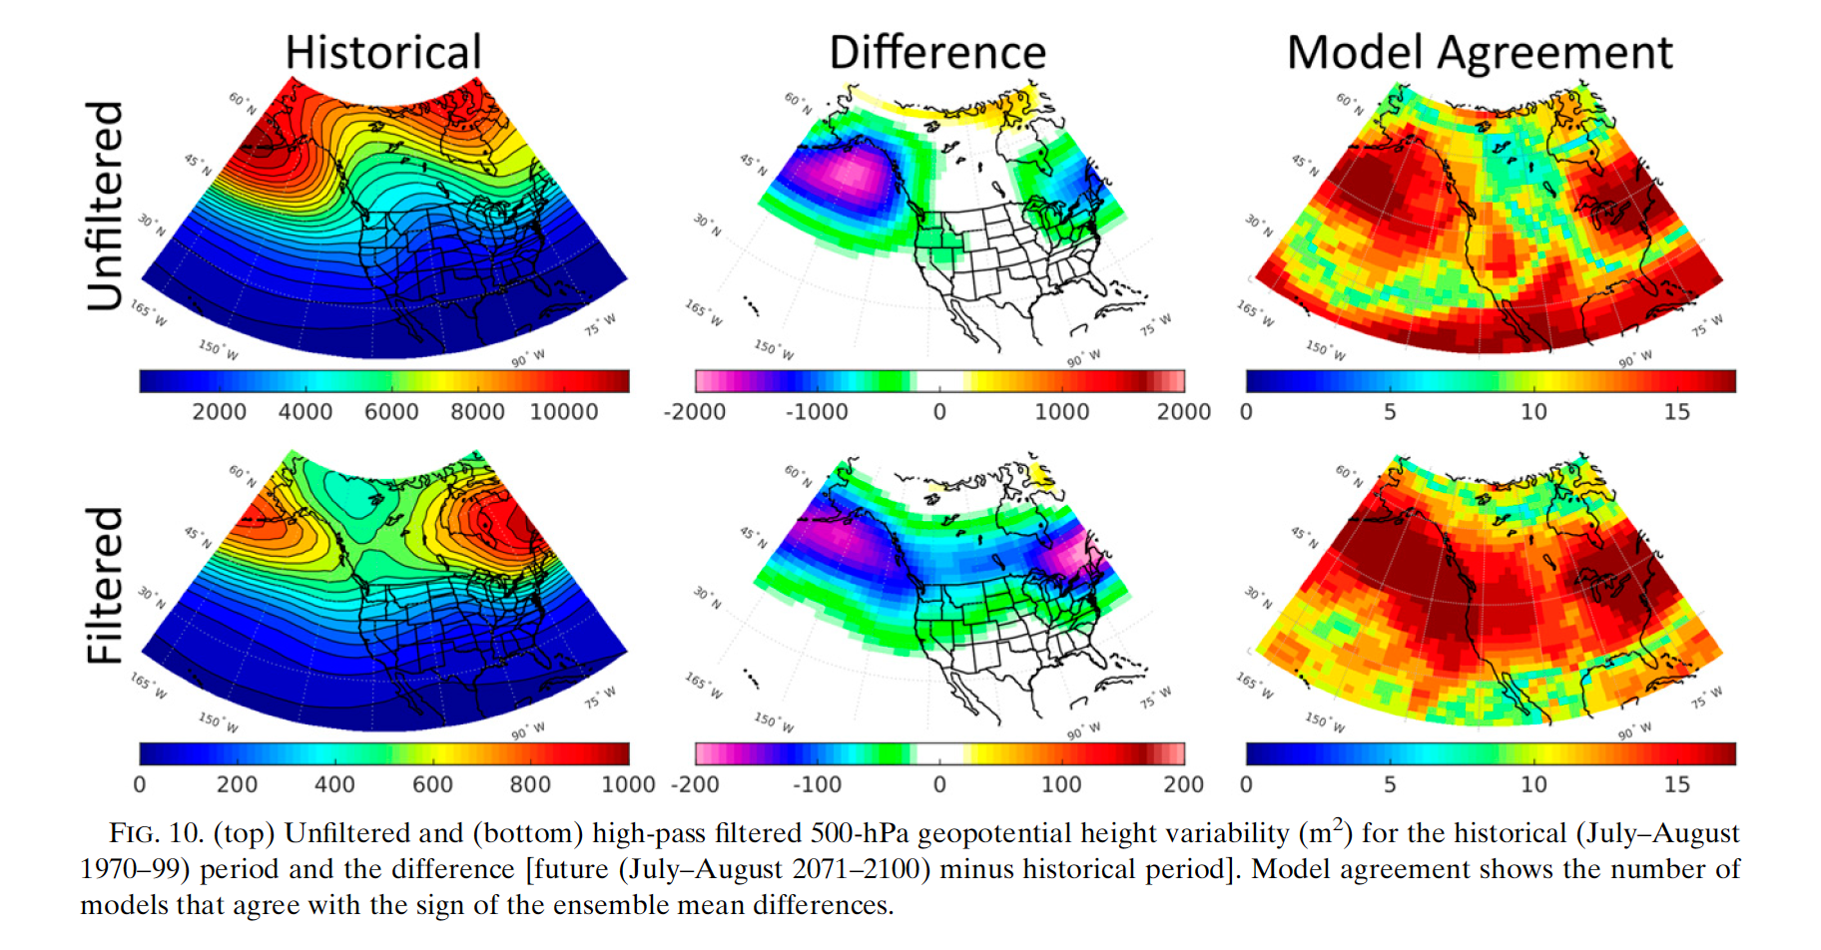
CMIP5 simulations indicate a robust deamplification of summer synoptic amplitude

Slide 15
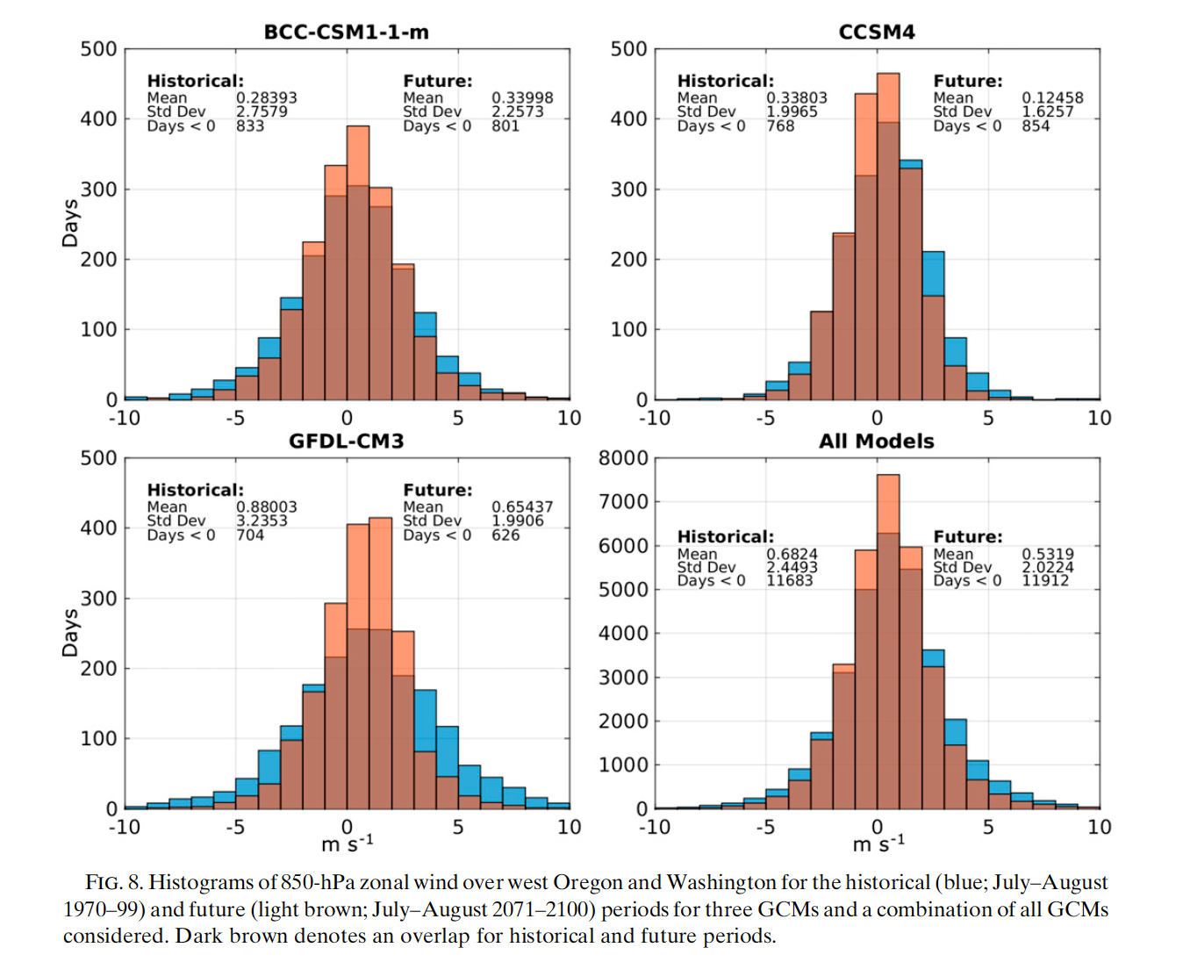
Impact: LESS extremes in onshore/offshore flow (850 hPa shown)
Zonal Wind Histogram
Western Oregon/WA
Blue=1970-1999
Light brown=2070-2099
Dark brown=overlap

Slide 17
Global warming deamplification of summer synoptic amplitude works AGAINST downslope/offshore flow forced heat extremes
Weaker maxima for offshore flow works against high temperature extremes over western WA/OR
Very significant on the coast where offshore flow is most critical for heat waves.
Major implication for wildfires.

Slide 18
Let’s Examine the Impacts Using a High-Resolution Regional Climate Model (WRF, 12-km)

Slide 19
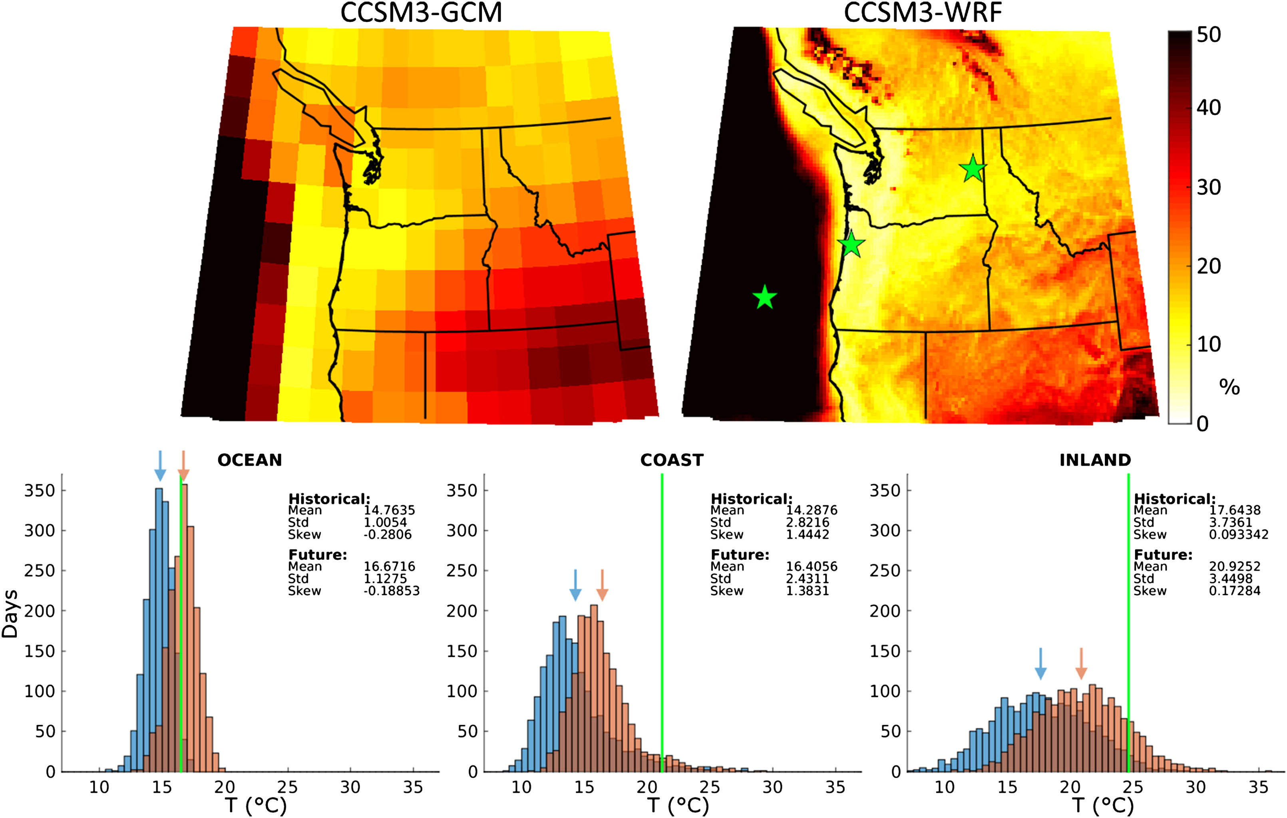
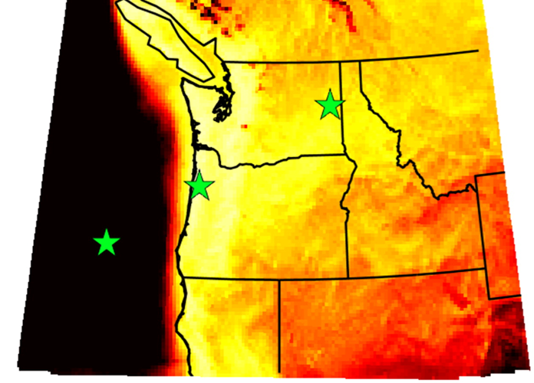
Mesoscale Location Makes All the Difference for How Extreme Temperatures Will Change
1970–99 and 2040–69 (CCSM3 Model)

Slide 21
Very Warm Tails Don’t Change Much

Slide 22
The extremes do increase substantially inland from GW

Slide 23
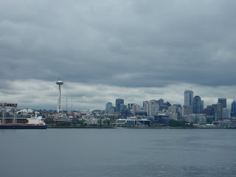
Surprise! More Low Clouds during spring west of Cascades

Slide 24
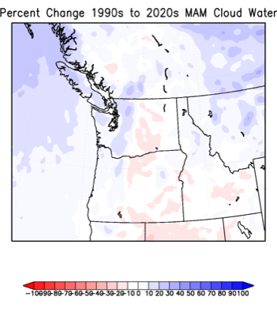
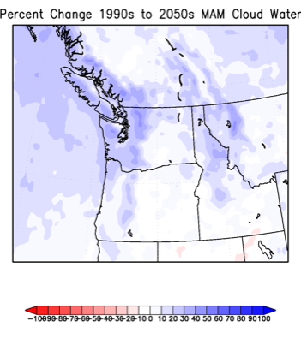
March-April-May Changes

Slide 25
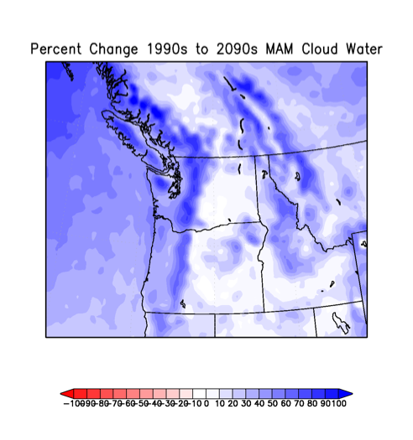

Slide 26
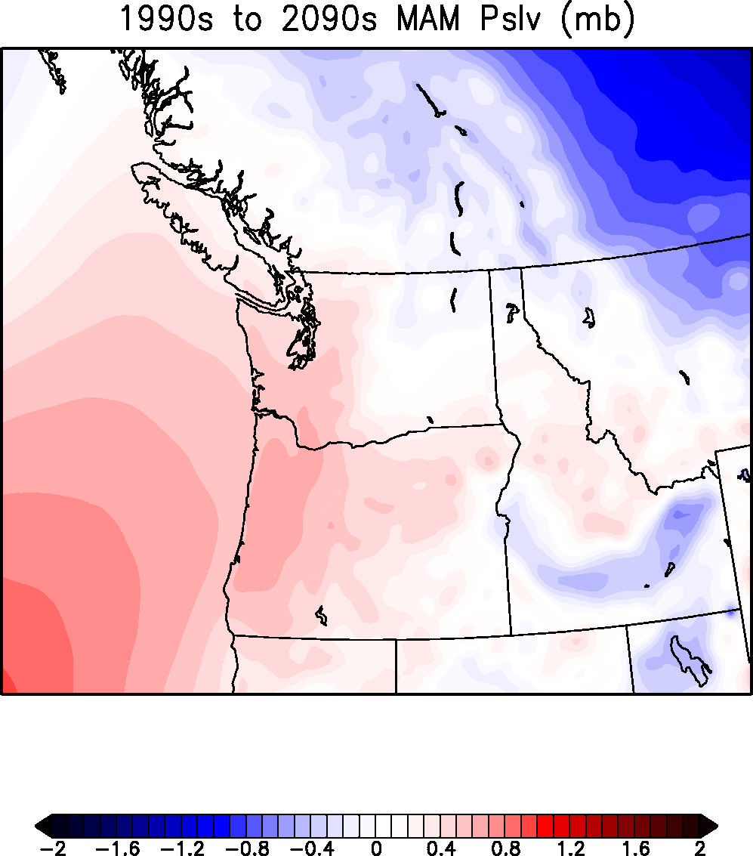
Why more clouds in spring?
The interior of the continent warms up more/faster than the eastern Pacific, resulting preferential hydrostatic pressure declines over the interior.
GCMs enhance eastern Pacific anticyclone
Enhanced onshore pressure difference pushes marine air inland.

Slide 27
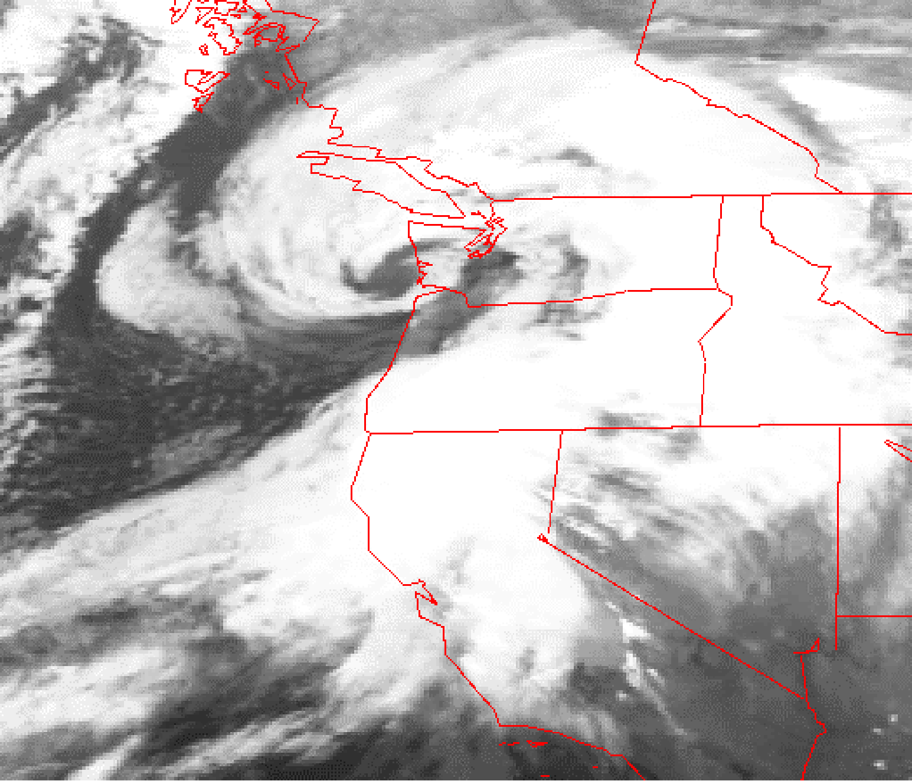
Only dynamical downscaling can tell us whether Pacific windstorms will bring strong peak winds under GW
The Inauguration Day Storm
1993

Slide 28
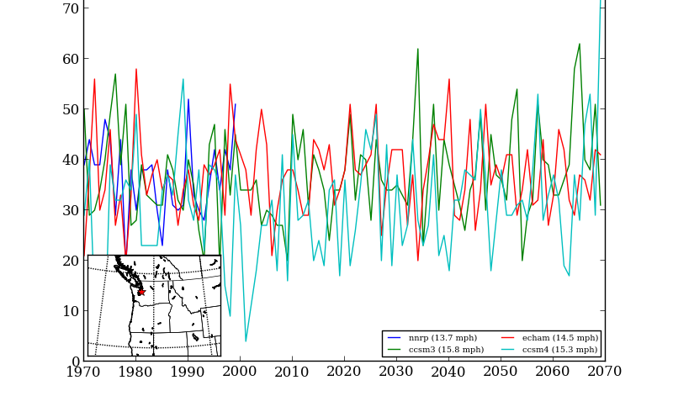
It appears the answer is no.
Number of times per year winds exceed a high-wind threshold (DJF) at Seattle for several RCM simulations

Slide 29
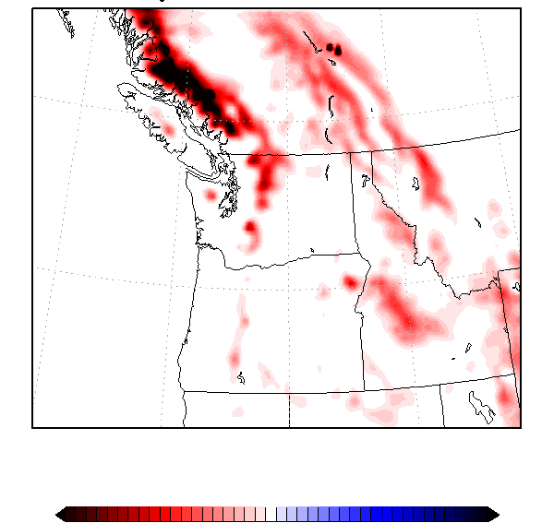
But warming will result in more precipitation falling as rain rather than snow
Change in Snowpack from 1990 to 2090
-40%
0%
+40%

Slide 30
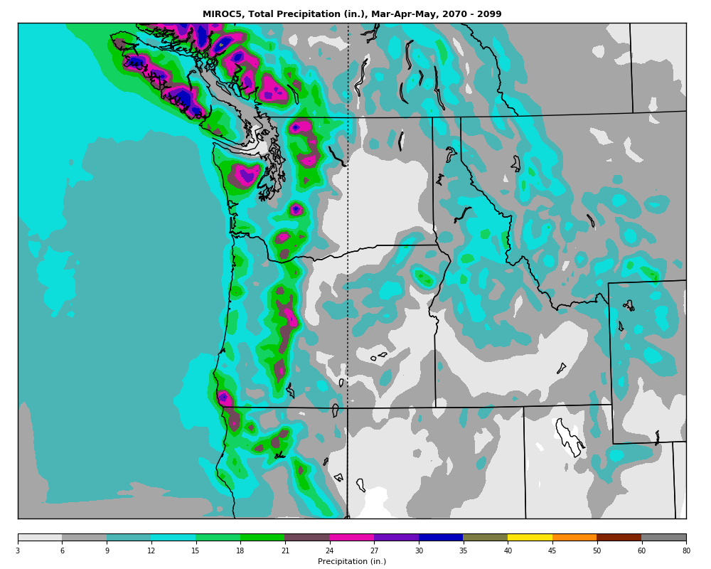
Now Completing a Large Ensemble of Regional Climate Runs (12-km over NW)

Slide 31
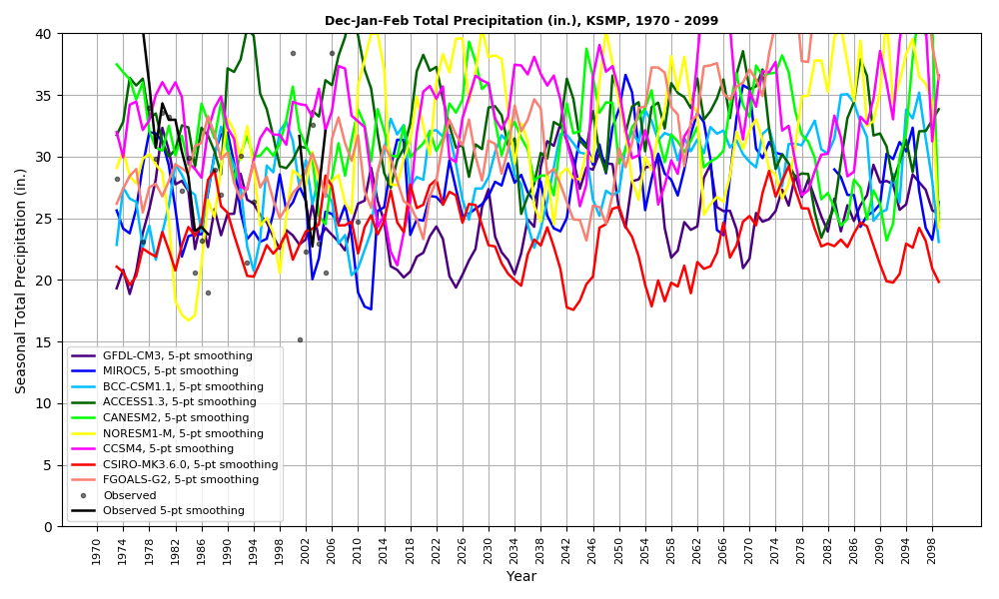

Slide 32
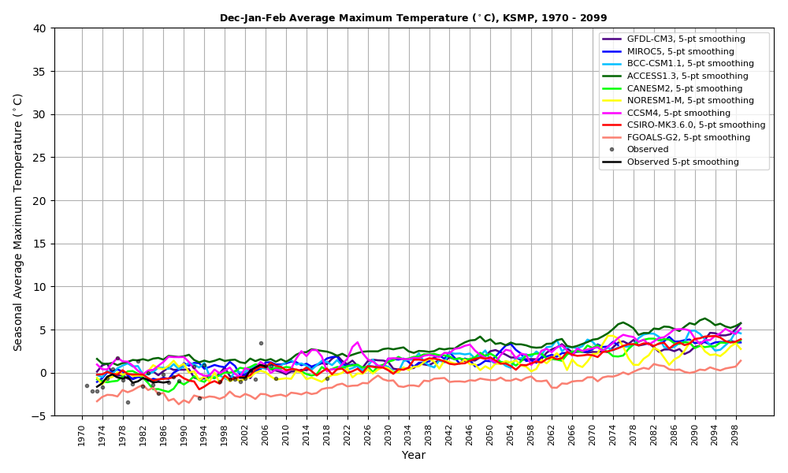

Slide 33
California Wildfires and Climate Change

Slide 34
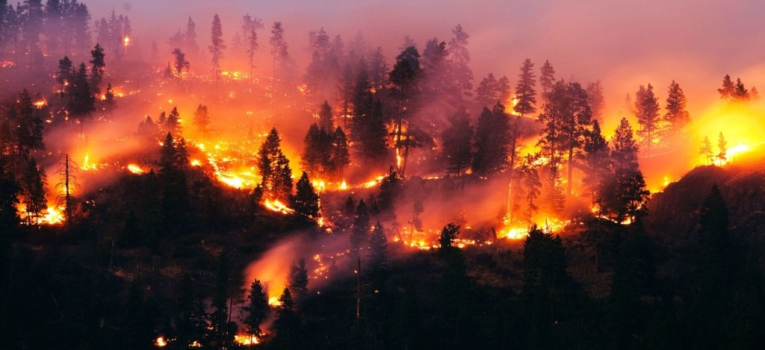
During the evening of Sunday, October 8, 2017, wildfires began in the hills above Santa Rosa, Napa, and other towns of the ”wine country” north of San Francisco

Slide 35
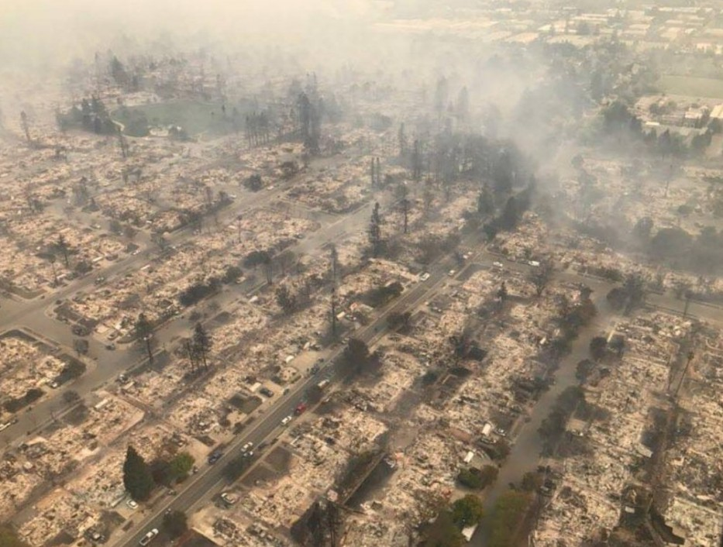
And then, pushed by strong winds, rapidly descended into populated areas

Slide 36
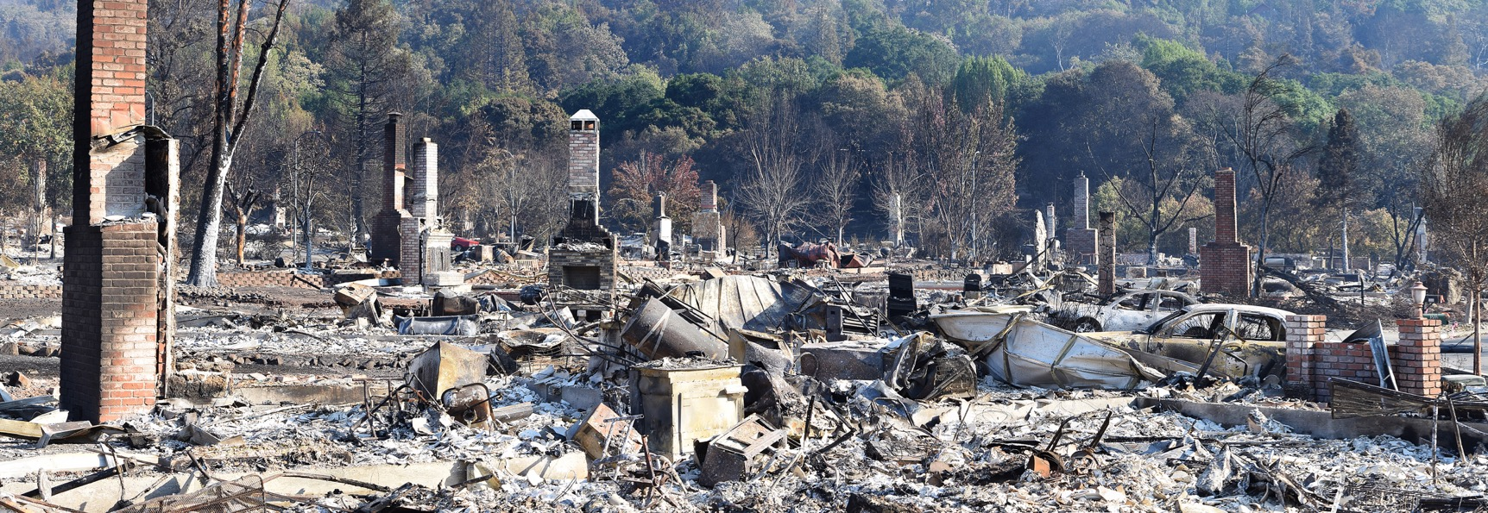
The Fountaingrove Neighborhood

Slide 37
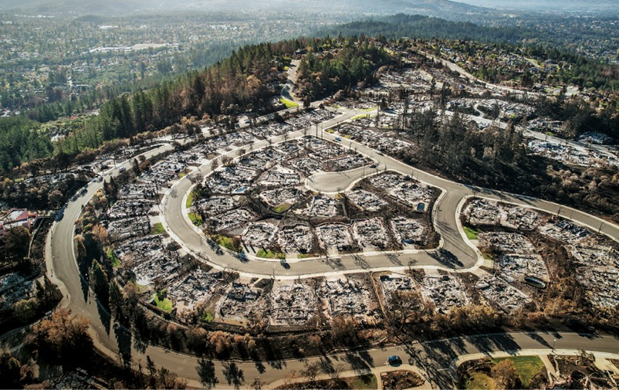
Before it was over, the “Wine Country” wildfires became the most devastating in CA history
44 died and hundreds were hospitalized
More than 9,000 structures were destroyed. 21,000 damaged.
Burned 245,000 acres of land
More than 10 billion in insured property loss
Total damage/loss much more.
Serious air quality degradation over the region for over a week.

Slide 38
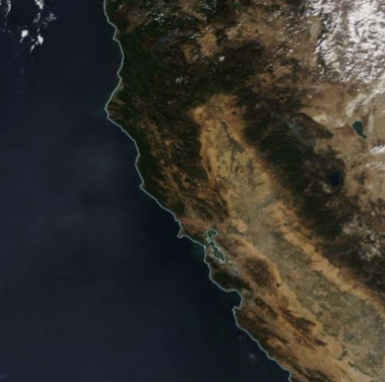
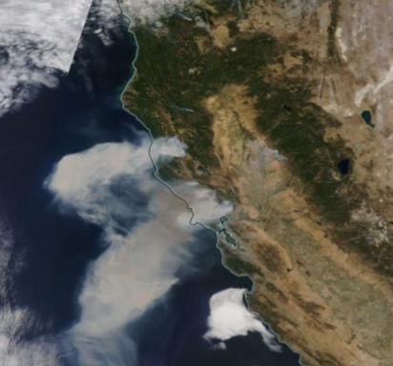
Modis Imagery: October 8 versus October 9, 2017

Slide 39
Climatological Lead Up

Slide 40
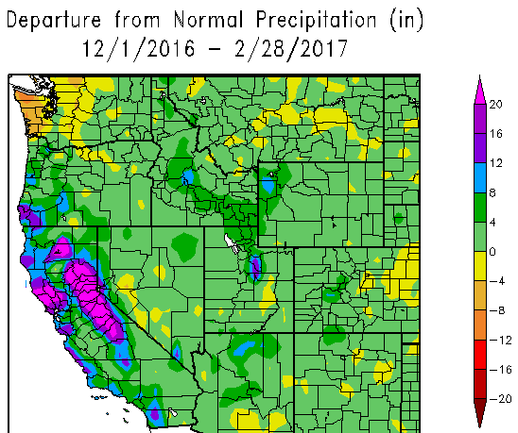
A Very Wet Winter Before the Fires

Slide 41
The Wet Winter Led to Luxuriant Grass Growth

Slide 42
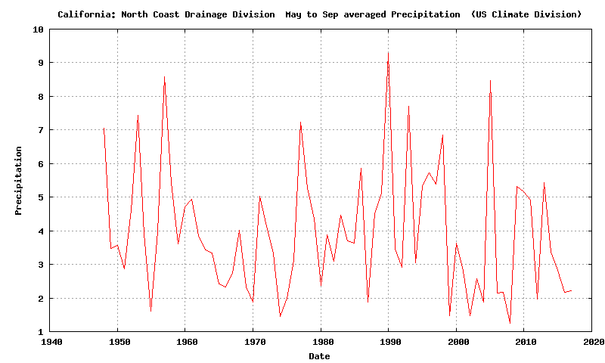
The Preceding Summer Was Typically Dry
Division Data: North Coast Drainage

Slide 43
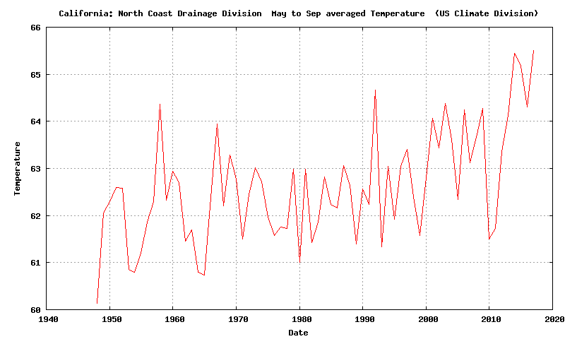
But it was warmer than normal by ~3F.

Slide 44
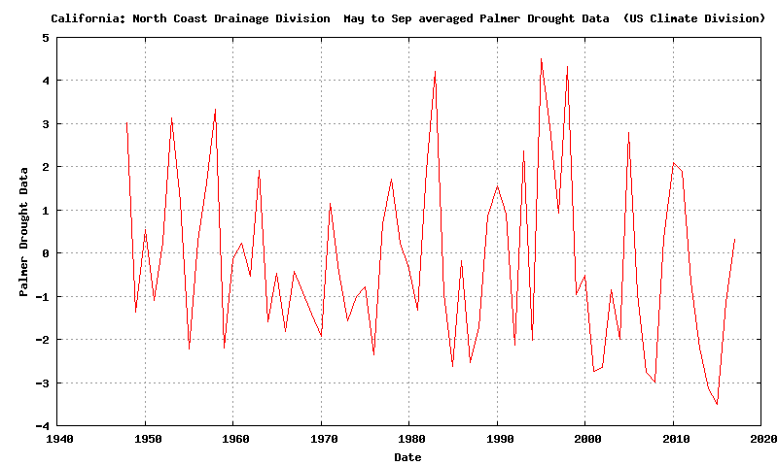
With a wet winter/spring, and a normally dry, but warmer than normal summer, the Palmer Drought Severity Index was near normal

Slide 45
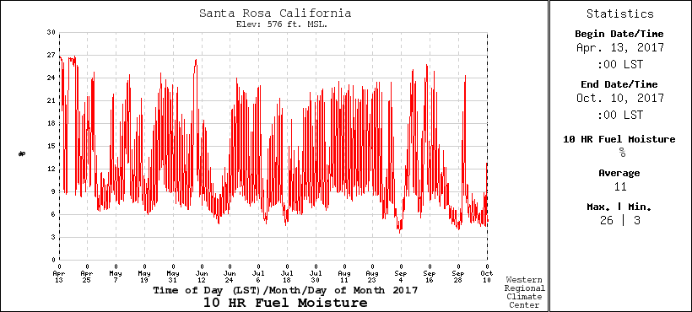
10-hour Fuel Moisture (.25 to 1 inch diameter)
Varies rapidly, drops with offshore flow. Below 10% is dangerous

Slide 46
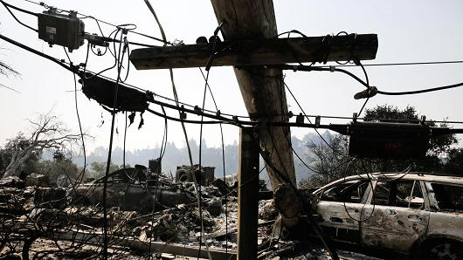
Fire Initiation
172 fire starts leading to 18 major fires
911 calls about power outages and small fires started around 9 PM October 8, just when winds accelerated
Initial investigation traced most fires to failing electrical infrastructure (downed lines, exploded transformers) resulting from strong winds

Slide 47
The Winds

Slide 48
Max Gusts During the Event (knots):
Big spatial variation with strongest winds (60-95 knots) on upper lee (SW) slopes of terrain

Slide 49
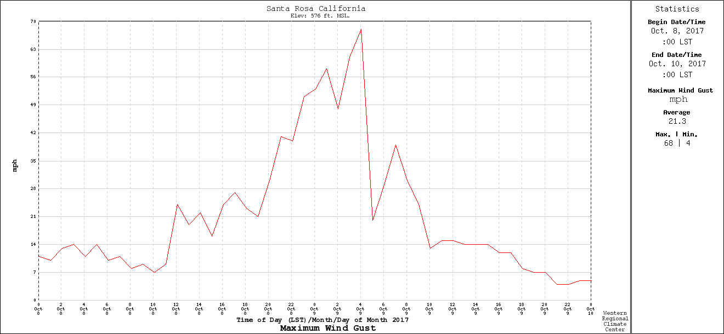
Temporal Variation: Rapid Increase and Decline
Santa Rosa RAWS
9 PM
PDT
midnight
6AM

Slide 50
Were the Wine Country Wildfires Associated with Anthropogenic Global Warming?

Slide 51
Little Evidence That Anthropogenic Global Warming Contributed to the Wildfires
The fire was initiated and supported by very strong winds.
No reason to believe that Diablo Winds are associated with global warming, in fact the opposite is probably true.

Slide 52

The Role of Invasive Grasses
Invasive, non-native grasses played an important role
Cheatgrass, “Bromus tectorum”
a.k.a. grassoline

Slide 53
If the temperatures were a few degrees warmer, or the summers a bit drier, it would not make a difference for coastal CA wildfires
A normal summer is warm and dry enough to allow fires.
And 1-hr and 10-hr fuels are always dry enough to burn in summer under offshore flow.
There is a deep literature, based on observed conditions and fires, that supports this conclusion.
“The extent of preceding drought is largely irrelevant to the size of these autumn fires because of the severity of weather during the fire event”

Slide 54
No long-term trends in wildfires
No long-term upward trend in fires for coastal California
The region has a long history of fire.

Slide 55
Fire is No Stranger to the Region

Slide 56
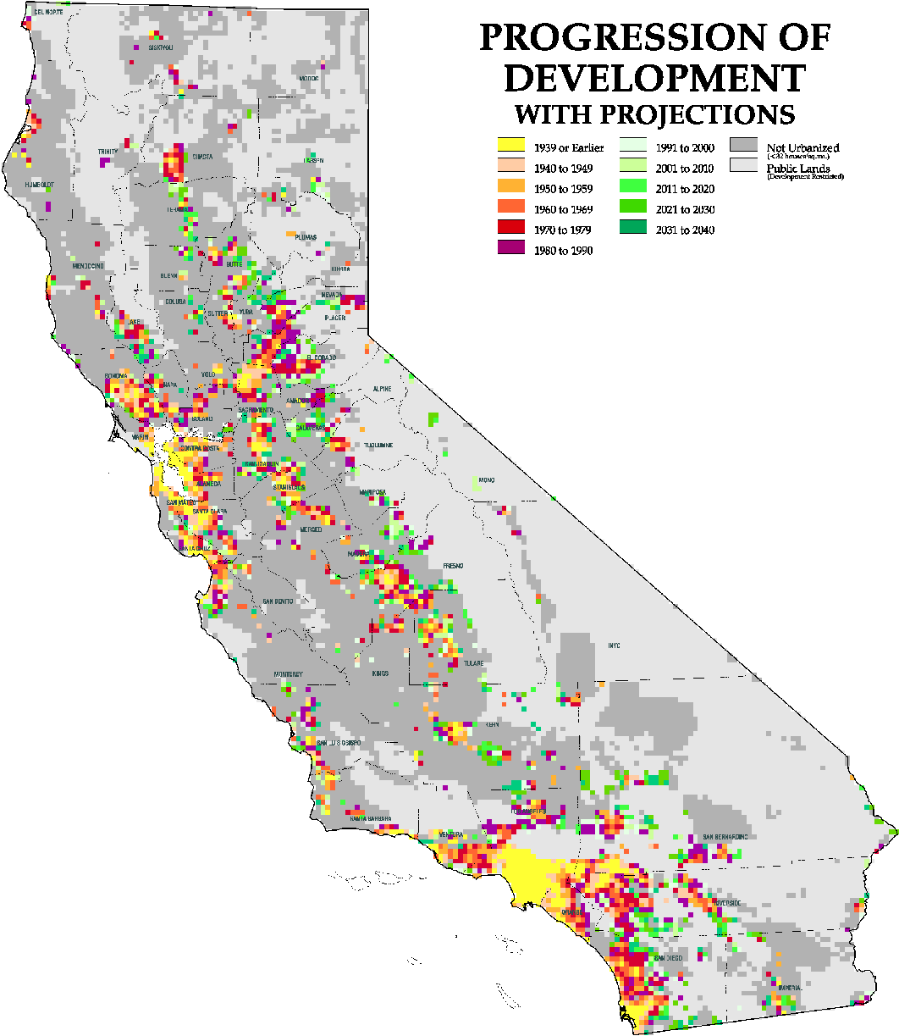
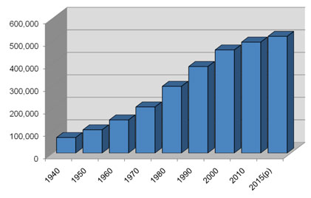
Urbanization Makes Fires More Frequent and Destructive
Sonoma County Population

Slide 57
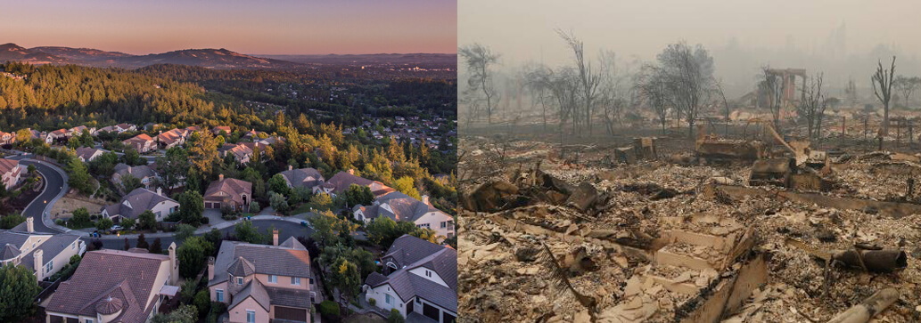
Fountaingrove Neighborhood

Slide 58
Bottom Line
There is no evidence that anthropogenic global warming contributed to the Wine Country fires or will enhance them in the future.

Slide 59
Dealing With the Issue
Homes and buildings must be moved out of areas that are prone to wildfire.
Restore wildland areas or bring back fire?
The electrical distribution system must be updated to be less prone to starting fires (e.g., underground lines, fix the recloser problem)
Societal decision makers must learn how to use improved predictions.
Better warnings and coordinated fire fighting capabilities are needed

Slide 60
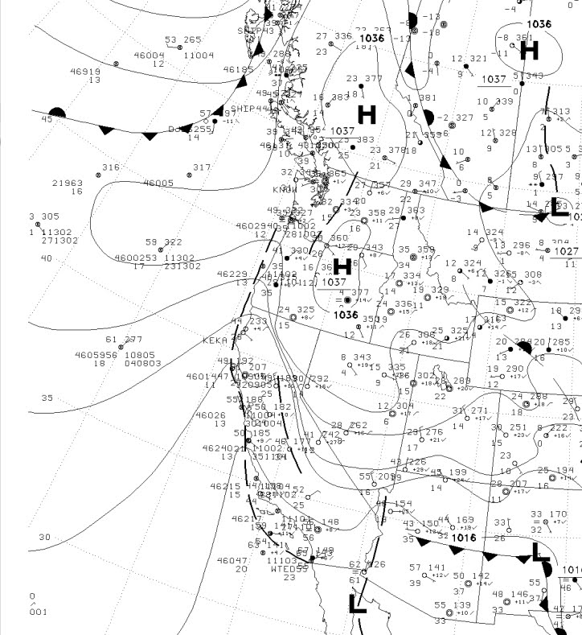
November 8th Fires
Again, strong offshore winds after summer dry season initiated major fires
Camp Fire started by PGE powerlines
Global warming or not, the fuels would have been dry enough to burn.

Slide 61
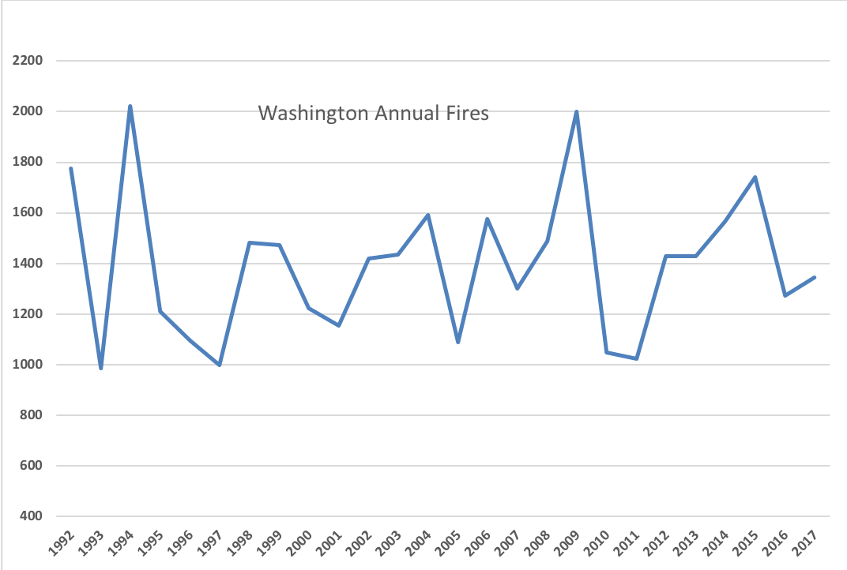
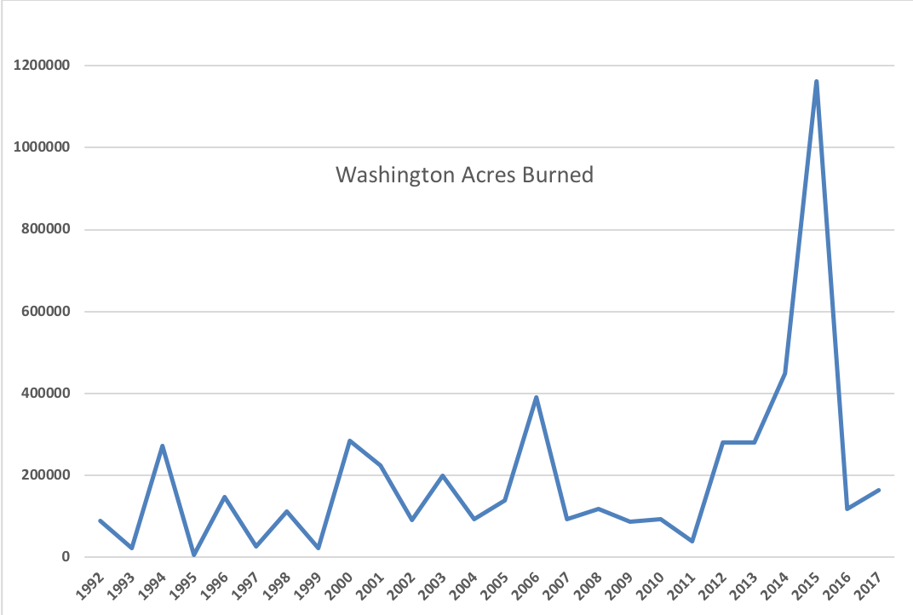
Washington Wildfires: Small GW Contribution

Slide 62
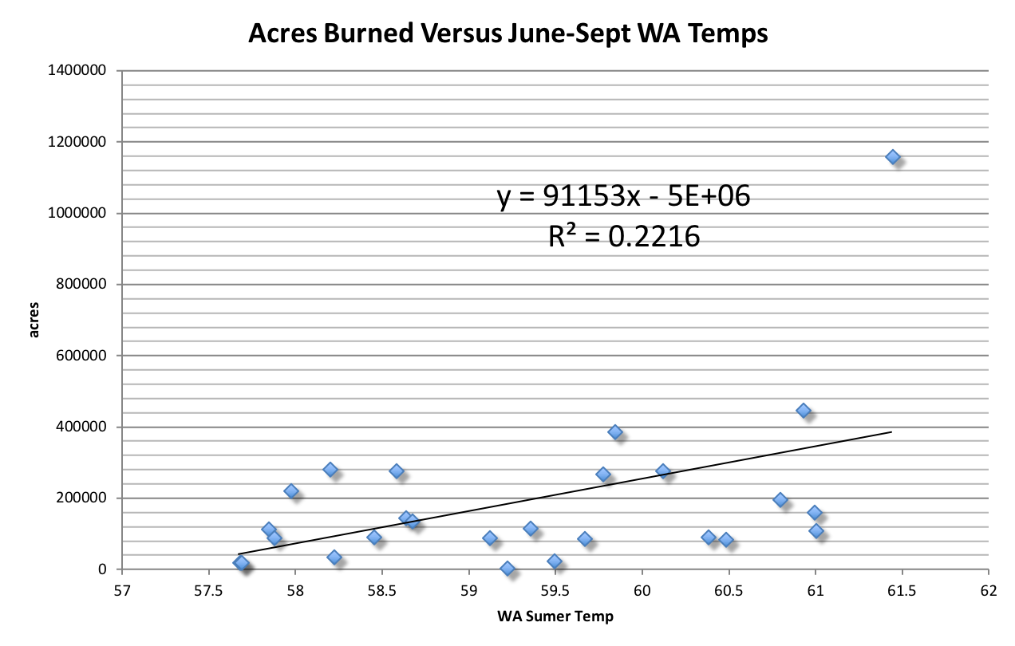
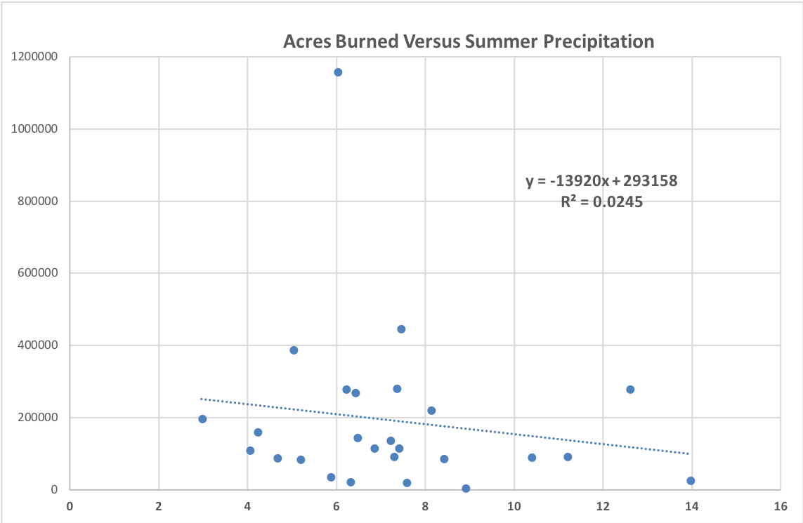

Slide 63
Global Warming and Fires
Many confounding effects:
  Nearly a century of fire suppression
  Poorly managed east-side forests
  Influx of highly inflammable cheat grass
  Increased human initiation of wildfires
  Increased human vulnerability because of massive instruction in wildlands
Only small amount of warming so far
Big impacts of GW in our future.

Slide 64

The End

