Slide 1
Global Scale Winds Also known as the General Circulation of the Atmosphere
Atmospheric Sciences 101
Winter 2019

Slide 2
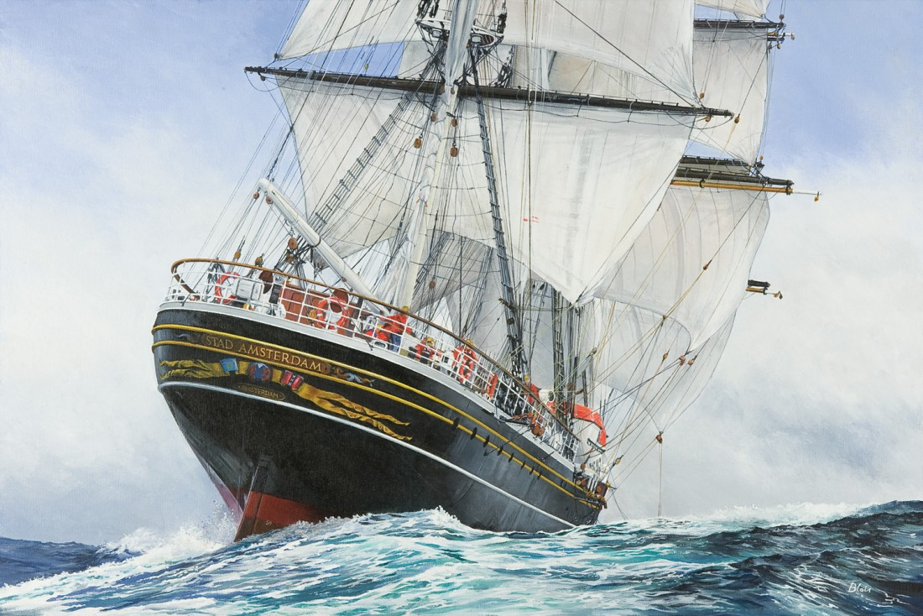
During the age of discovery (1400s-1600s) there was a lot of interest in the large scale wind patterns of the atmosphere

Slide 3
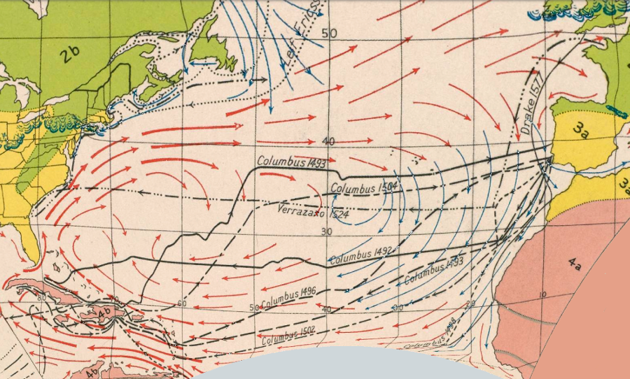
For good reason

Slide 4
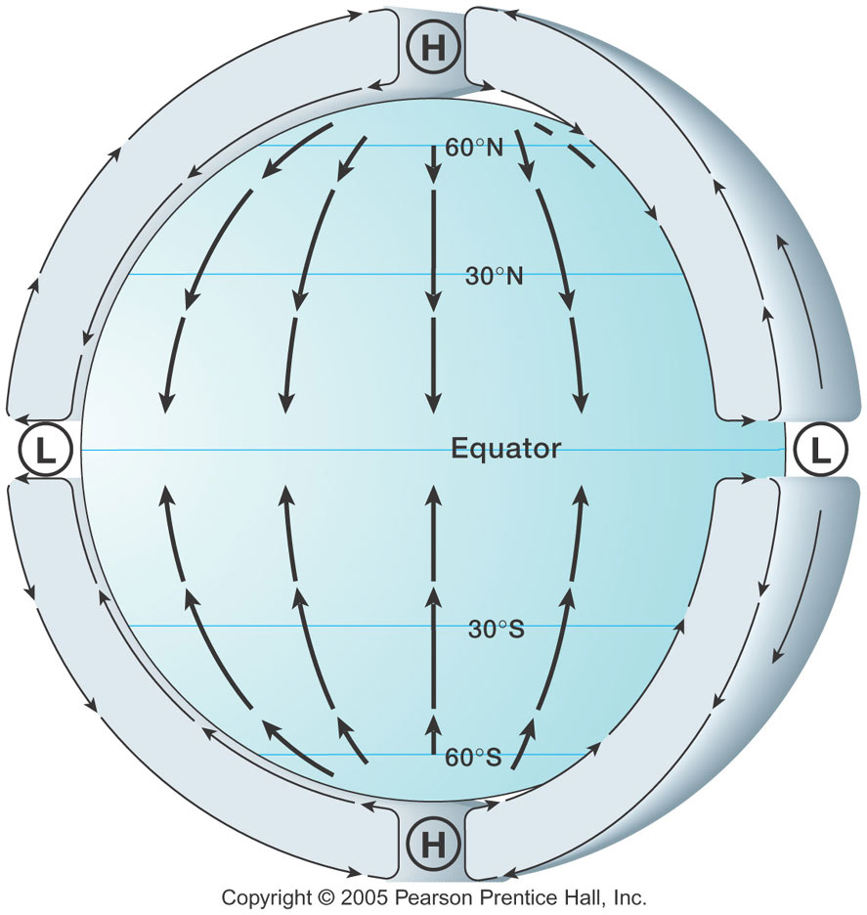
Hadley Cell
Edmond Halley
And George
Hadley,
Early 1700s

Slide 5
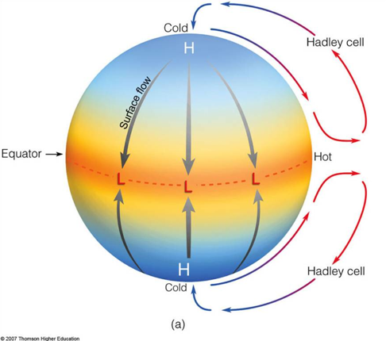
Early Ideas about the Hadley Cell

Slide 6
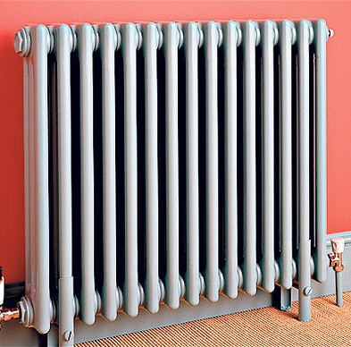
Thinks about the circulation in a room with a heater and window
window
Cooling
Heating

Slide 7
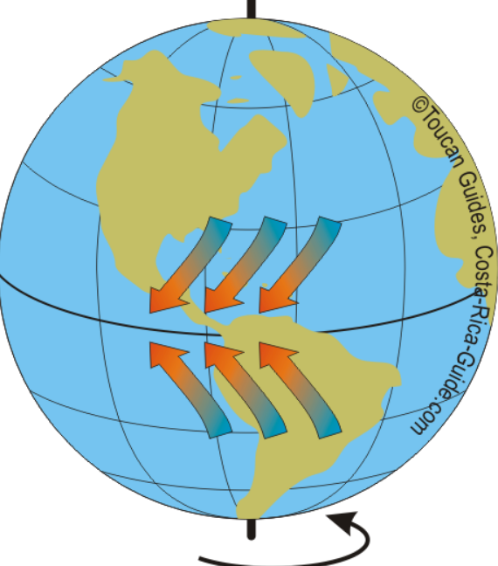
But early mariners were aware that the trade winds blew from the east in the tropics

Slide 8
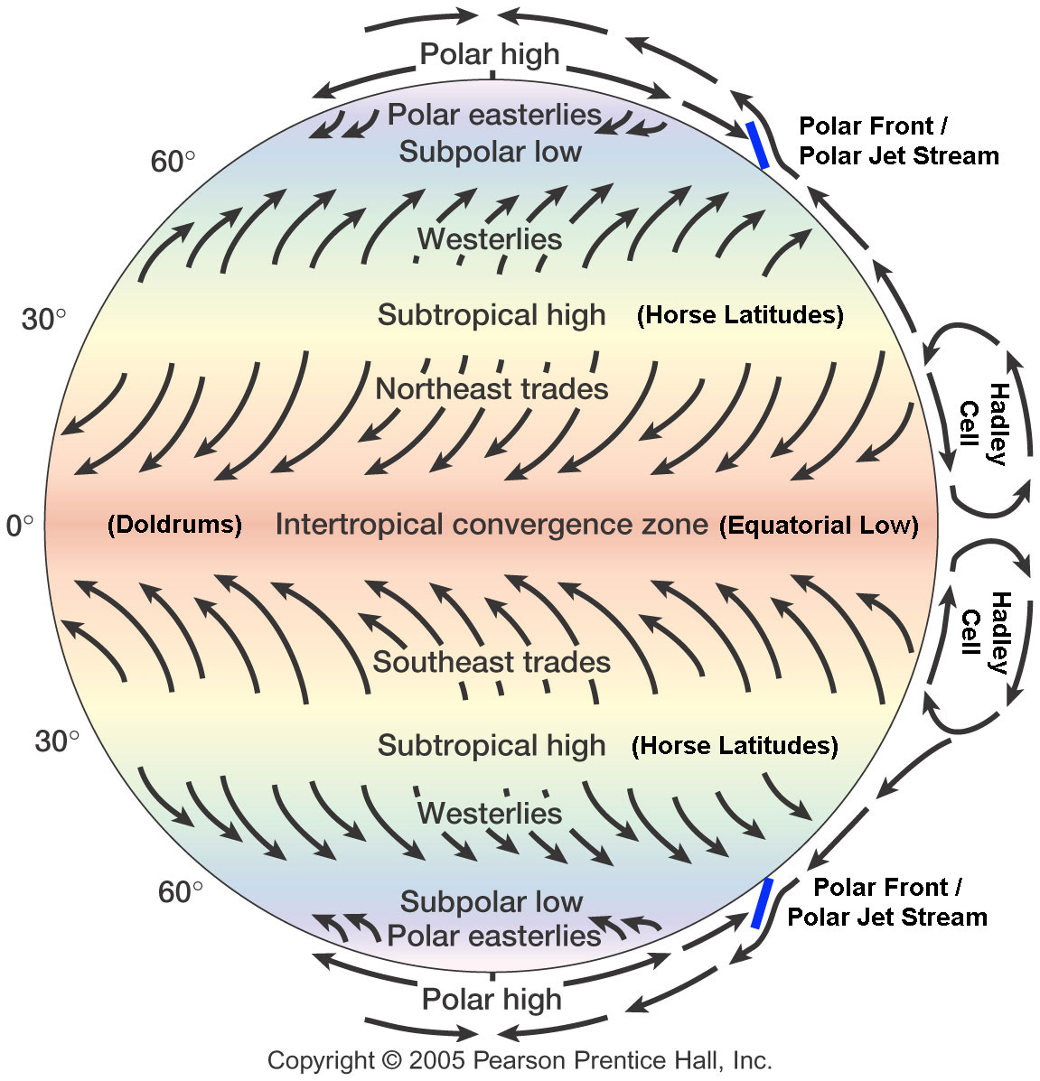
And they were right! Why?

Slide 9
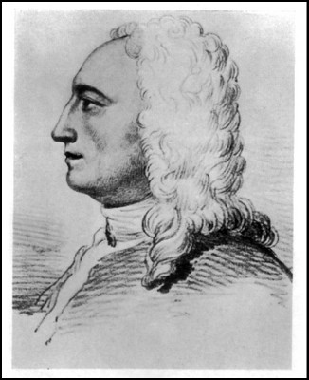
George Hadley in 1735 suggested that the easterly flow was due to what became known as the Coriolis Force, which acts to the right of flow direction in the northern hemisphere

Slide 10
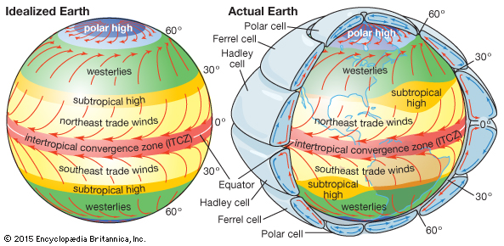
The real global atmosphere is a bit more complicated, with westerly flow in the midlatitudes

Slide 11
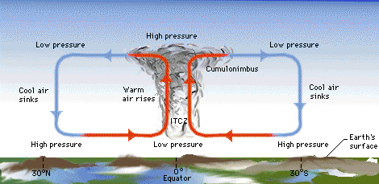
Intertropical Convergence Zone (ITCZ)
Associated with convergence between the NE and SE trades
Not necessarily on the equator (generally north of it)
Also known as the doldrums

Slide 12
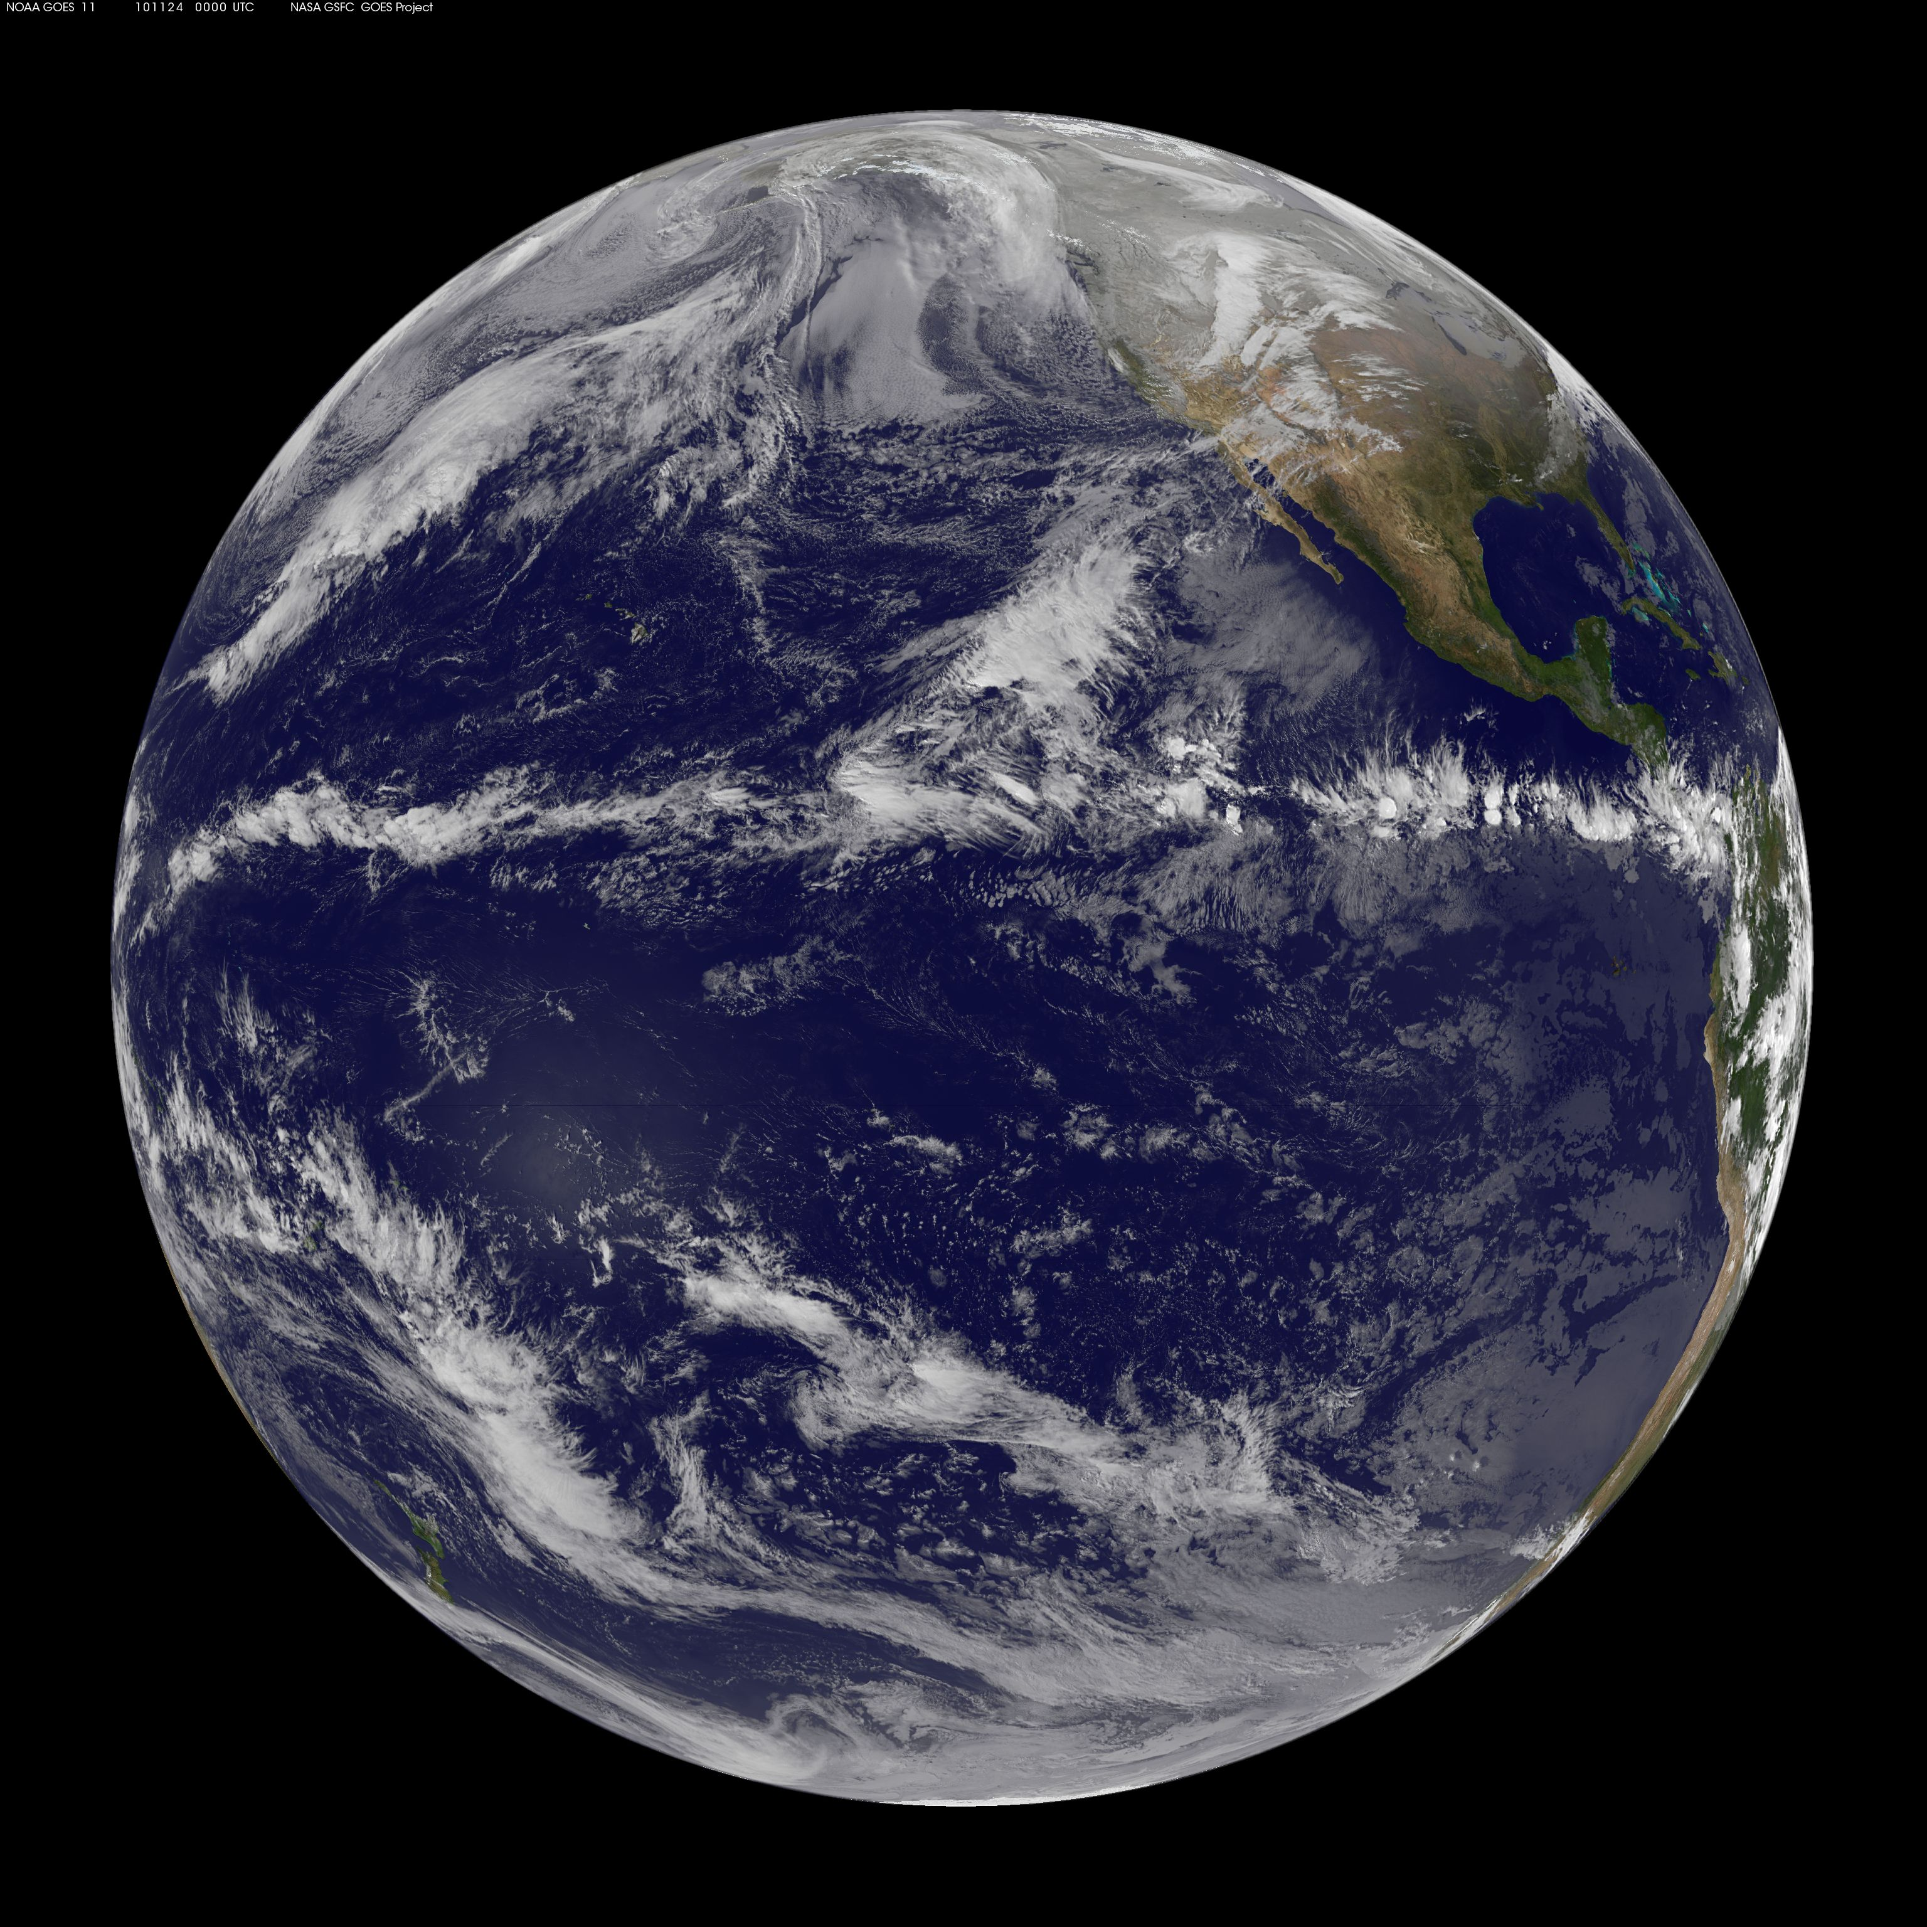

Slide 13
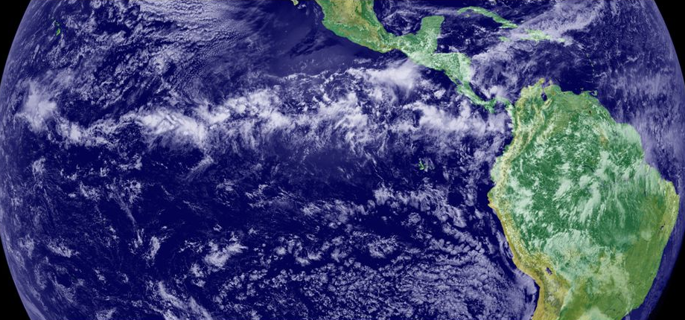

Slide 14
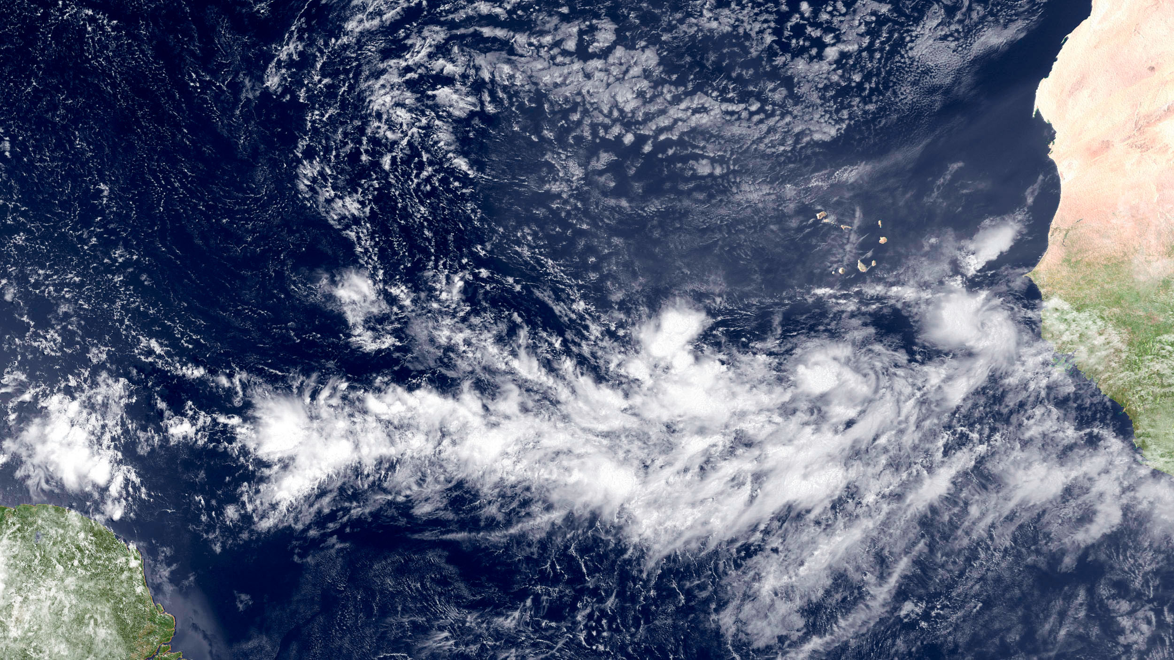
ITCZ composed of cloud clusters (cumulonimbus cells with cirrus outflow)

Slide 15
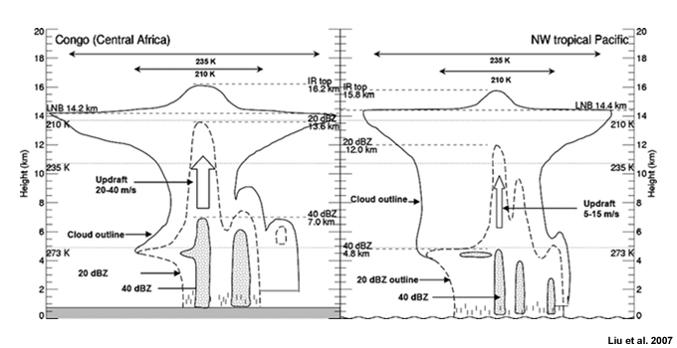
Cloud Cluster Structure

Slide 16
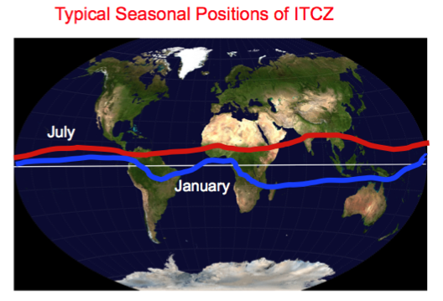
NOT Necessarily on the Equator

Slide 17
The Actual Hadley Cell is Limited to within 30°of the equator

Slide 18
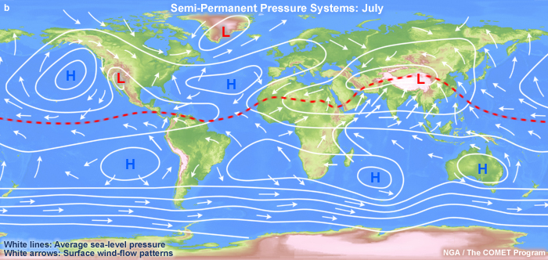
Descending branch of tropical Hadley cell is associated with subtropical highs

Slide 19
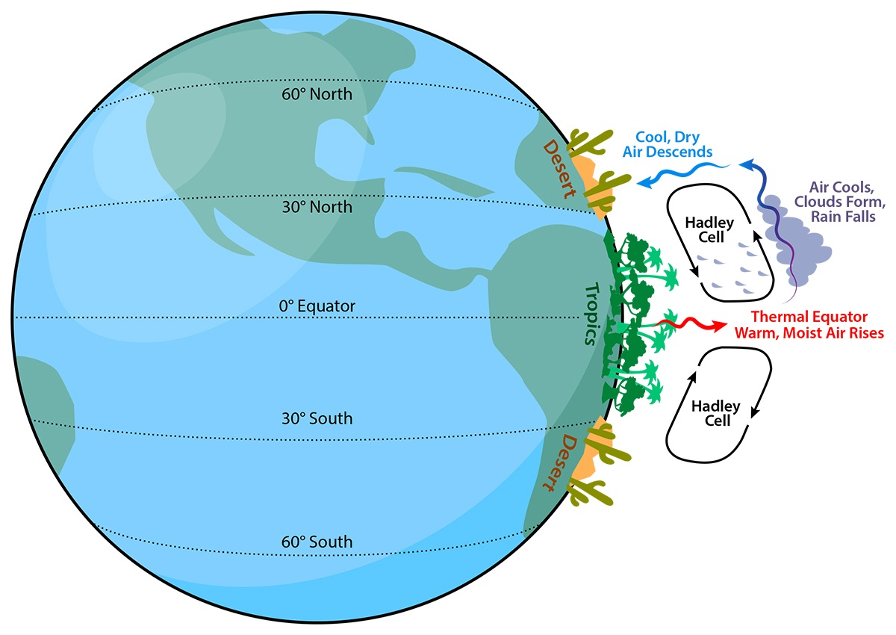
Subtropical Highs are associated with descending air, dry conditions around 30N and 30S

Slide 20
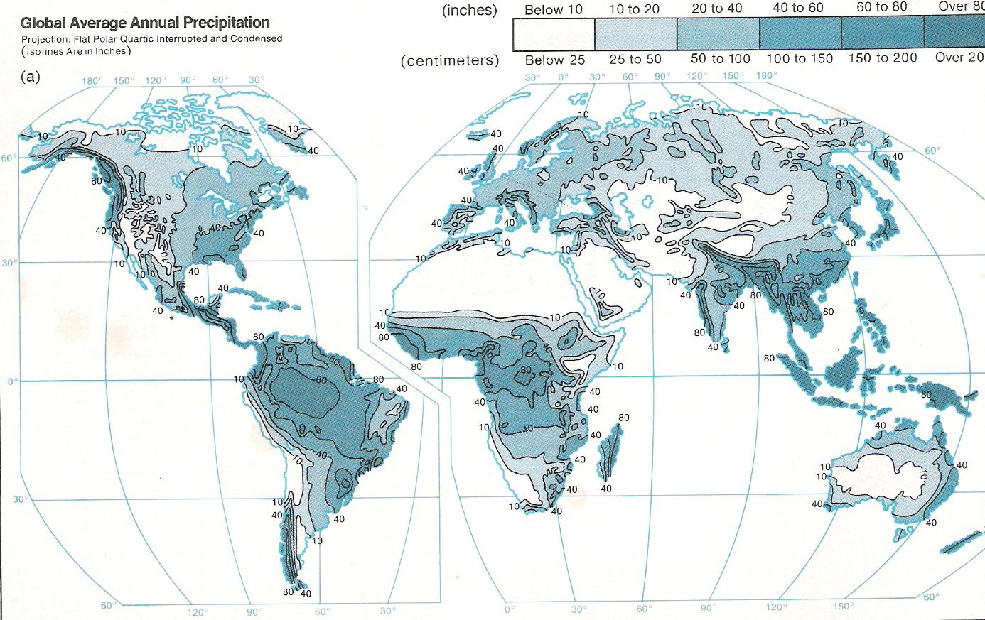
Many desert/arid areas in descending branch

Slide 21
North of the subtropical highs there are the midlatitude westerlies and the Ferrel Cell

Slide 22
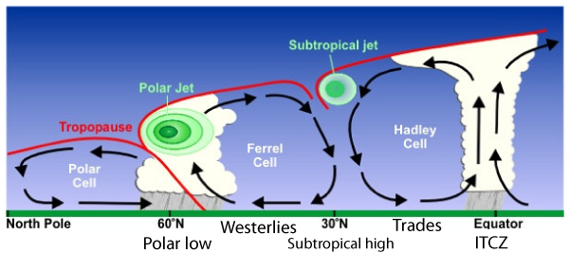
Ferrell Cell and Two Jet Streams and the Polar Cell

Slide 23
The Midlatitude Jet Stream
A long, narrow current of strong winds in the midlatitudes that is generally found in the upper troposphere and lower stratosphere (roughly 25,000-35,000 ft, 400-250 hPa).
First became obvious during WWII as high flying aircraft was sped up and slowed down on their missions.
Strongest can exceed 200 mph. Nearly always from the west in midlatitudes

Slide 24

B-29s flying westward to Japan

Slide 25
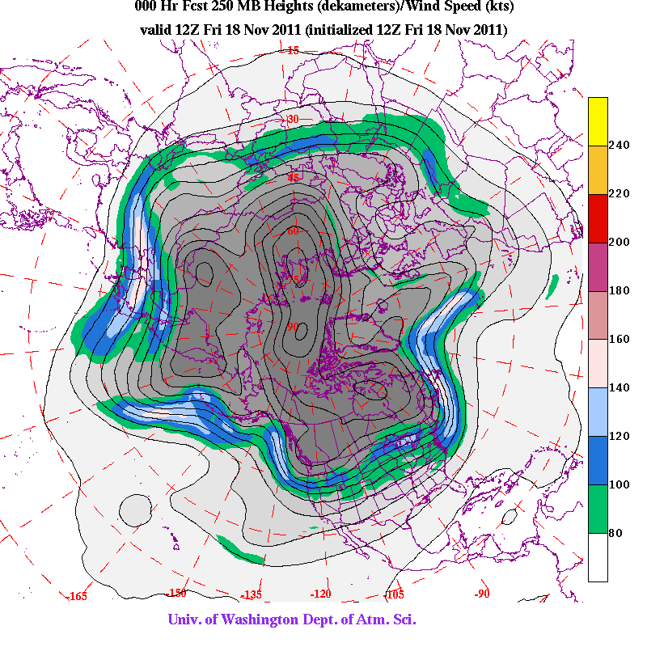
Jet Streams are NOT uniform

Slide 26
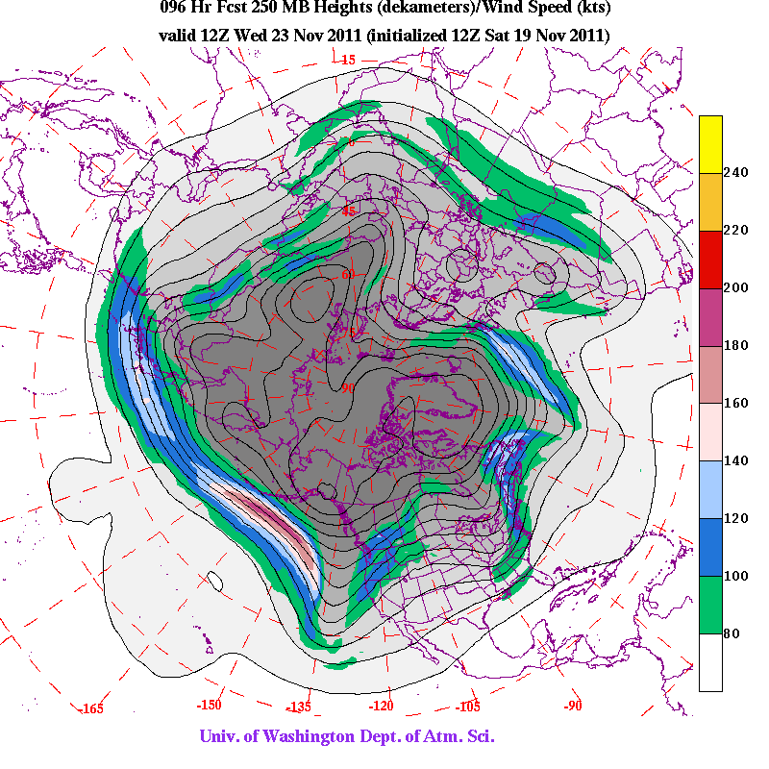

Slide 27
Why Do We Care About the Jet Stream?
Knowing the location of jet streams can aid in weather forecasting. The path of jet streams steers storm systems at lower levels in the atmosphere.
The main commercial relevance of the jet streams is in air travel, as flight time can be dramatically affected by either flying with the flow or against the flow of a jet stream.
Clear-air turbulence is could be found in a jet stream's vicinity. It can cause aircraft to plunge and is a potential hazard to aircraft passenger safety.

Slide 29
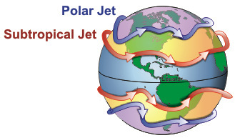
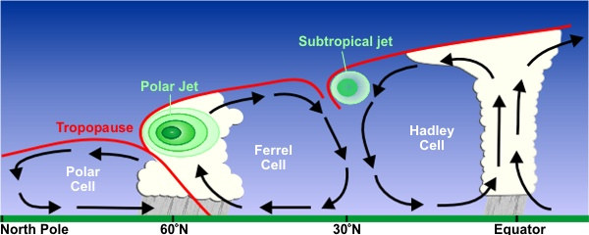
Two jets: the polar (or midlatitude) jet and the subtropical jet
10-16km
7-12km
http://www.srh.noaa.gov/jetstream//global/jet.htm

Slide 30
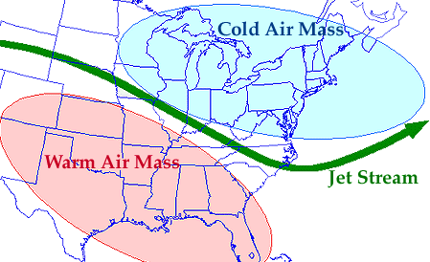
Jet Streams Associated with Horizontal Temperature Gradients

Slide 31
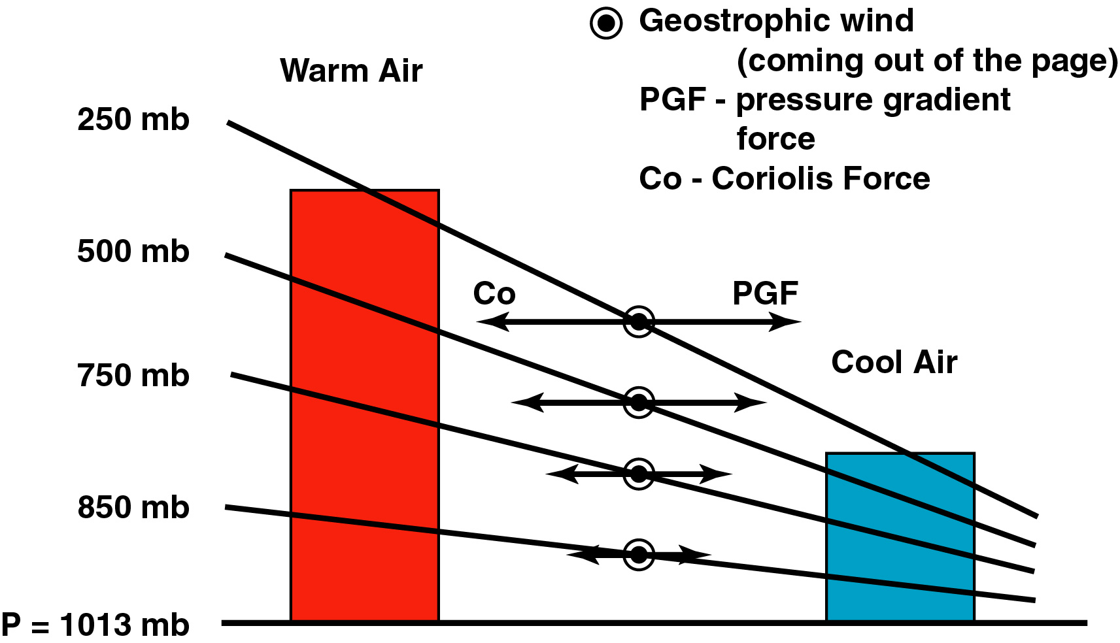
Temperature Gradients Produce Pressure Gradients
south
north

Slide 32
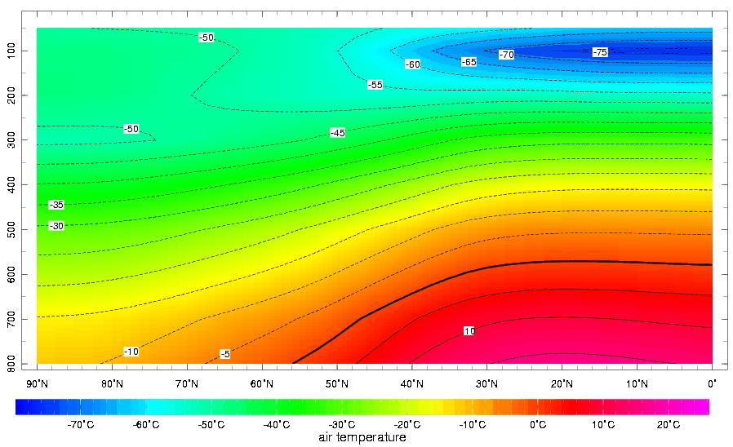
Main tropospheric temperature gradient is largest in the midlatitudes

Slide 33
Midlatitude Jet Stream Facts
Strongest in winter. Why? Horizontal temperature gradients are largest then
Jet stream weakens and moves northward during the spring and summer. Why? Temperature gradients weaken and more northward during spring.
Strongest jets streams on average where the largest temperature gradients occur: western Pacific and western Atlantic in the midlatitudes.

Slide 34
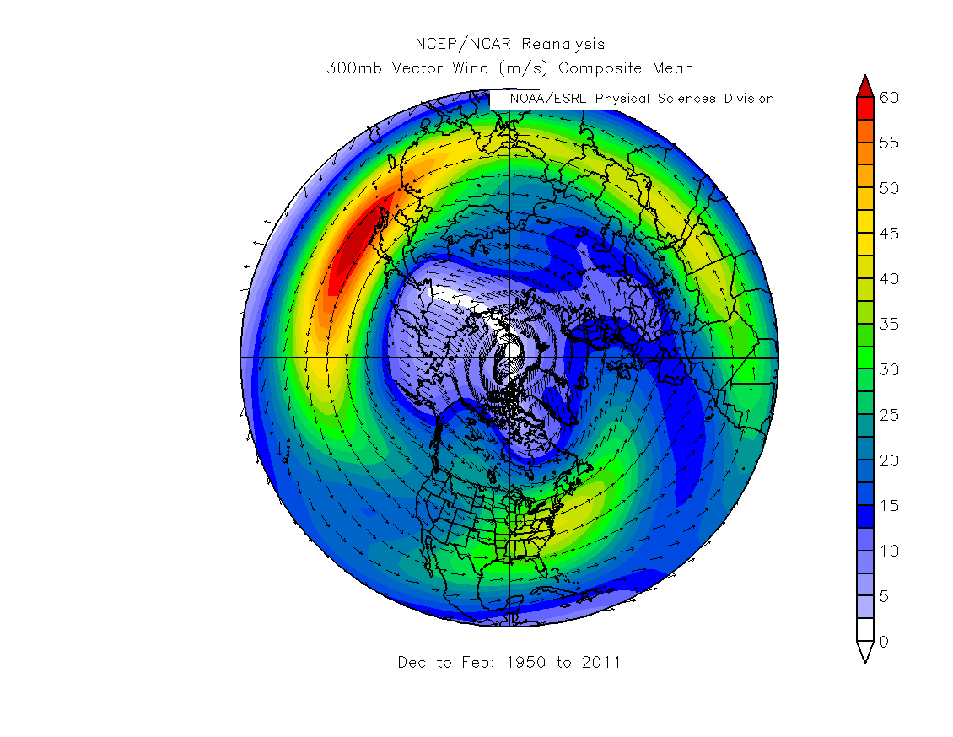

Slide 35
Monsoons
A monsoon is a term from Arabic: "Mausin," or "the season of winds."
This was in reference to the seasonally shifting winds in the Indian Ocean and surrounding regions, including the Arabian Sea.

Slide 36
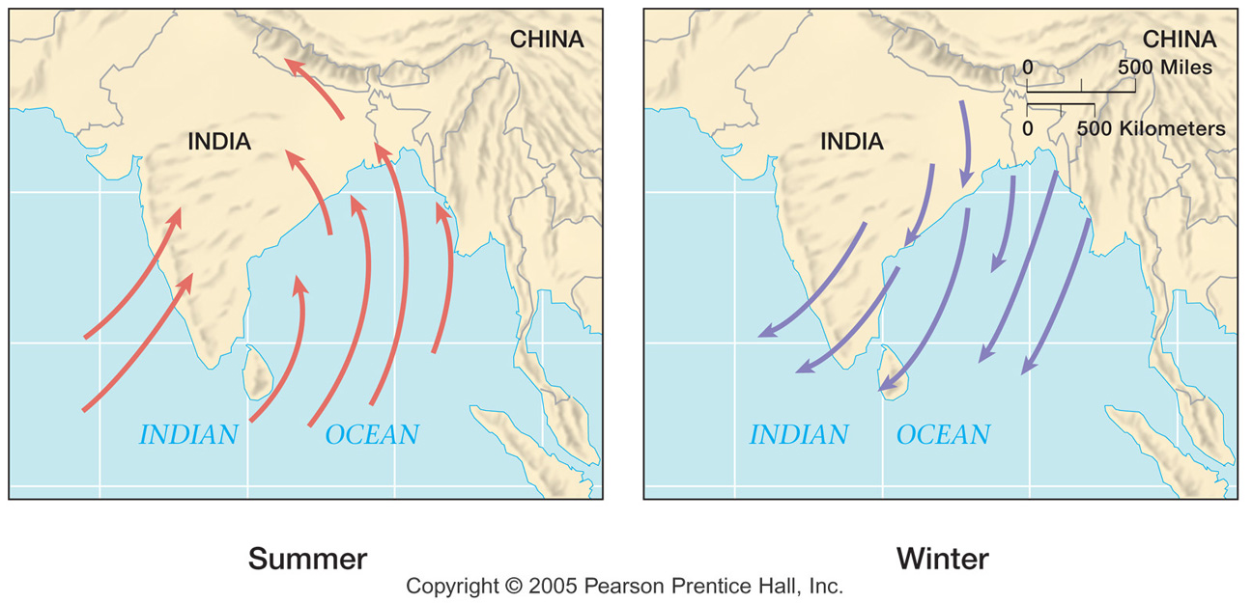
Indian Monsoon

Slide 37
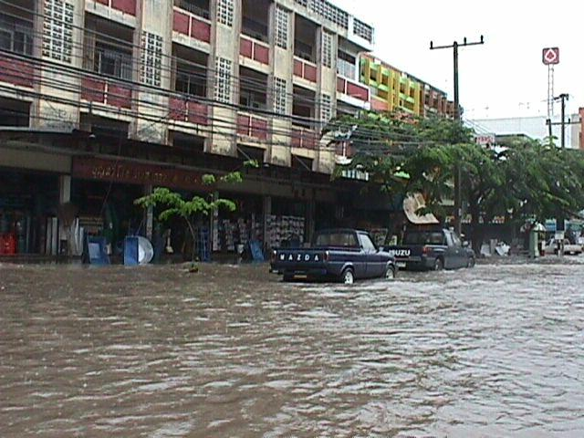
Indian Monsoon Brings Heavy Rain to the Indian Subcontinent in Summer

Slide 38
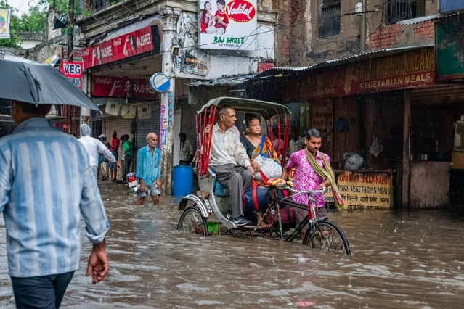

Slide 39
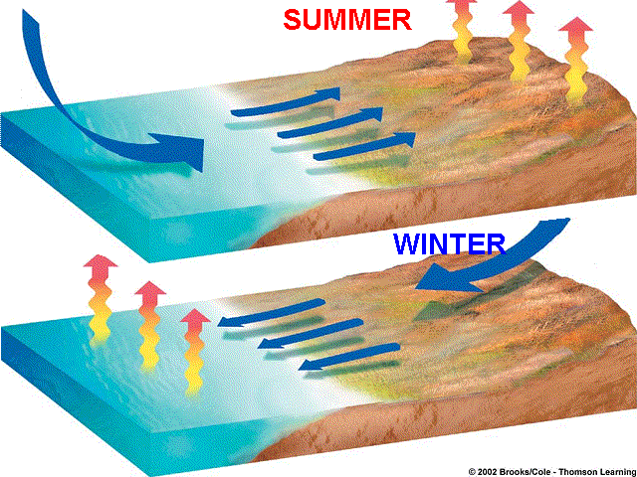
Like Giant Sea Breeze

Slide 40
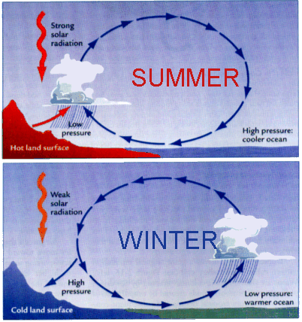
Monsoon Origin

Slide 41
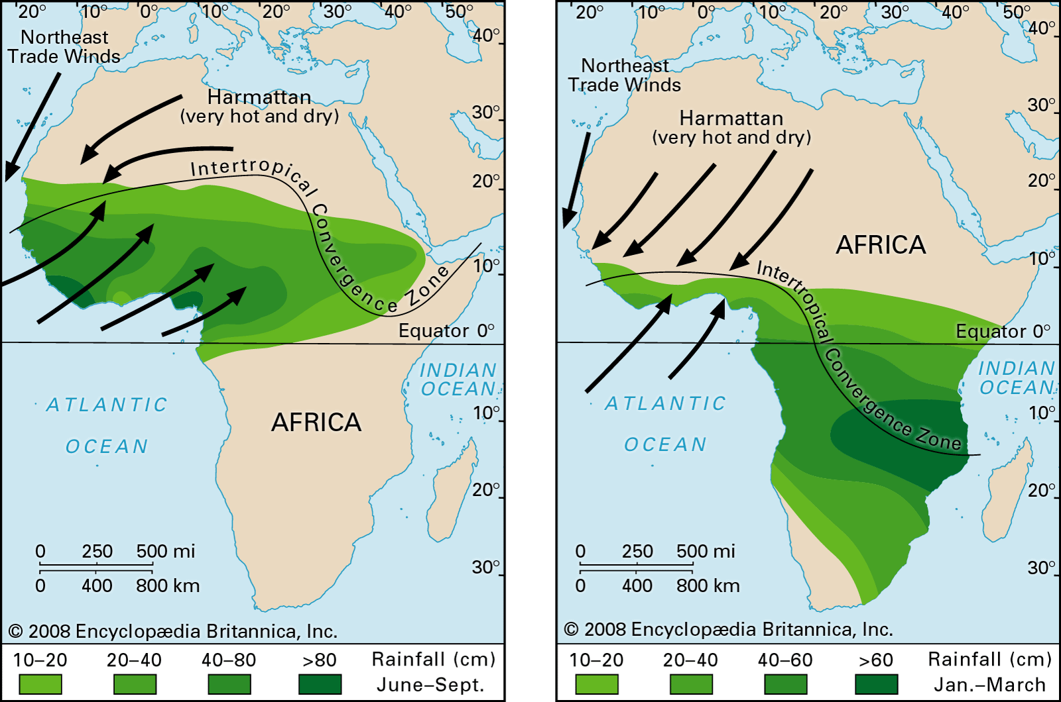
West African Monsoon

Slide 42
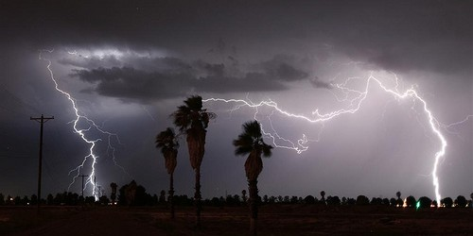
Southwest U.S. Monsoon North American Monsoon

Slide 43
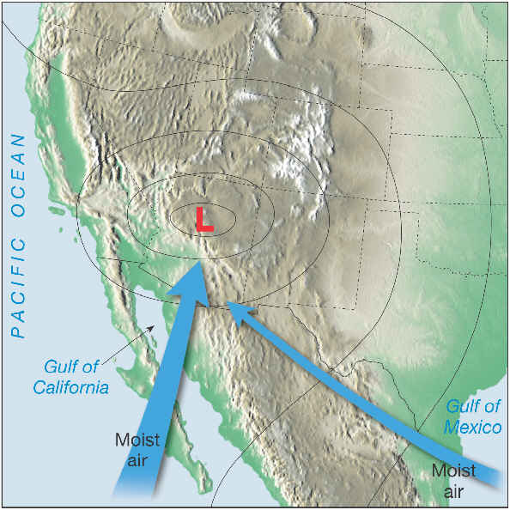

Slide 44
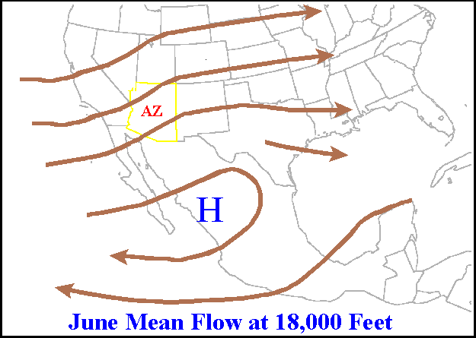

Slide 45
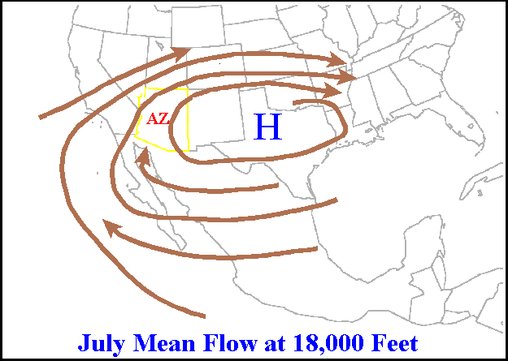

Slide 46
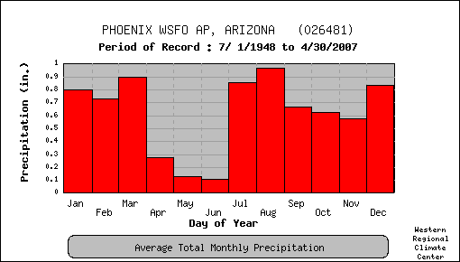
Phoenix is wetter than Seattle in July!

Slide 47
https://vimeo.com/297875063

Slide 48
Air Masses
Air Mass: an extremely large body of air whose temperature and moisture are horizontally fairly uniform.
Large: dimensions of thousands of kilometers (e.g., a cold, dry air mass over Siberia)
Source regions: regions where air masses form. Generally large flat areas of relatively uniform characteristics.

Slide 49
Source Regions
Air masses often form under light winds and high pressure, but not always.
The longer air stays in the source region the more likely it is to acquire the characteristics of the surface below
IR radiation
Arctic Air Mass
WARMER
VERY STABLE
Dry
Because
Cold
Light
Winds
SNOW
COLD

Slide 50
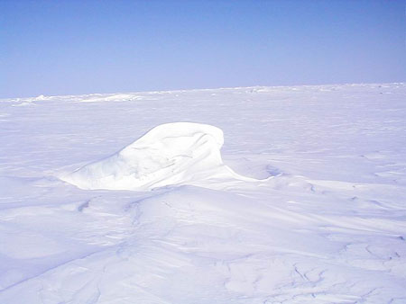
Source Region of Arctic Air Mass

Slide 51
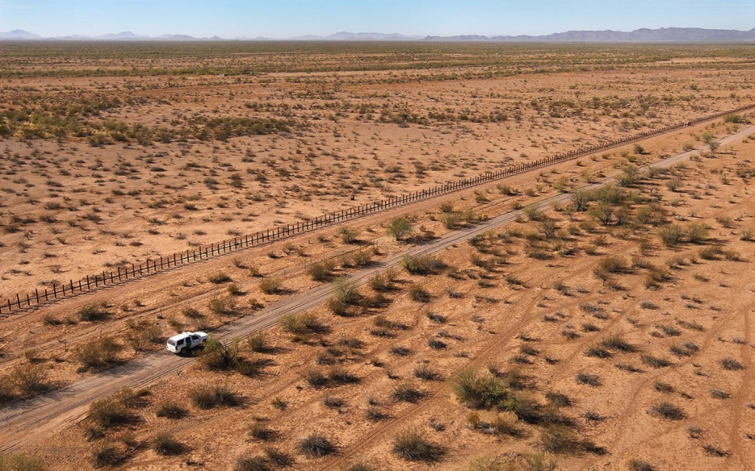
Air Mass Source Regions
Another example: large desert regions producing warm, dry air masses
Midlatitudes are poor source regions because surface temperature and moisture vary considerably.

Slide 52
Air Mass Classification System
P: air from polar region
T: from warm, tropical region
c: continental (land source-dry)
m: maritime source (moist)
Can combine these into the four basic air mass categories

Slide 53
Air Mass Classification
 | Polar (P) | Tropical (T)
Continental (c) | cP Cold, dry, stable | cT Hot, dry, stable aloft, unstable near the surface
Maritime (m) | mP cool, moist unstable | mT Warm, moist often unstable

Slide 54
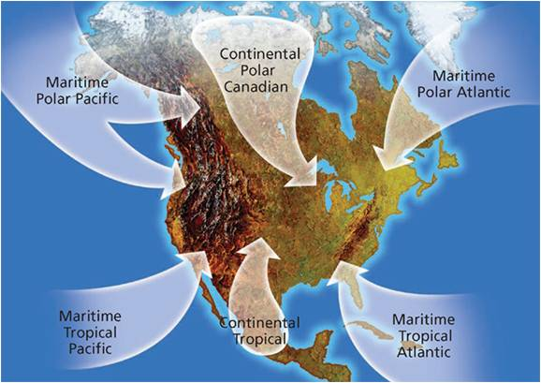

Slide 55
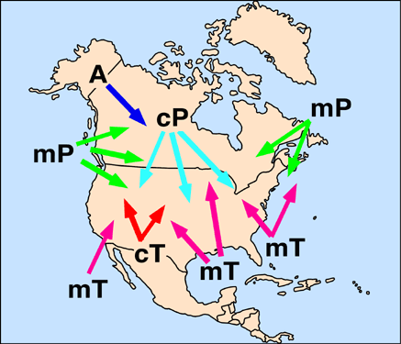

Slide 56
Continental Polar
Associated with bitter, cold weather
Little moisture
Originates over northern Canada, Alaska, Siberia
Slowly moderates as moves southward
Associated with high pressure and sinking air
Skies often clear.

Slide 57
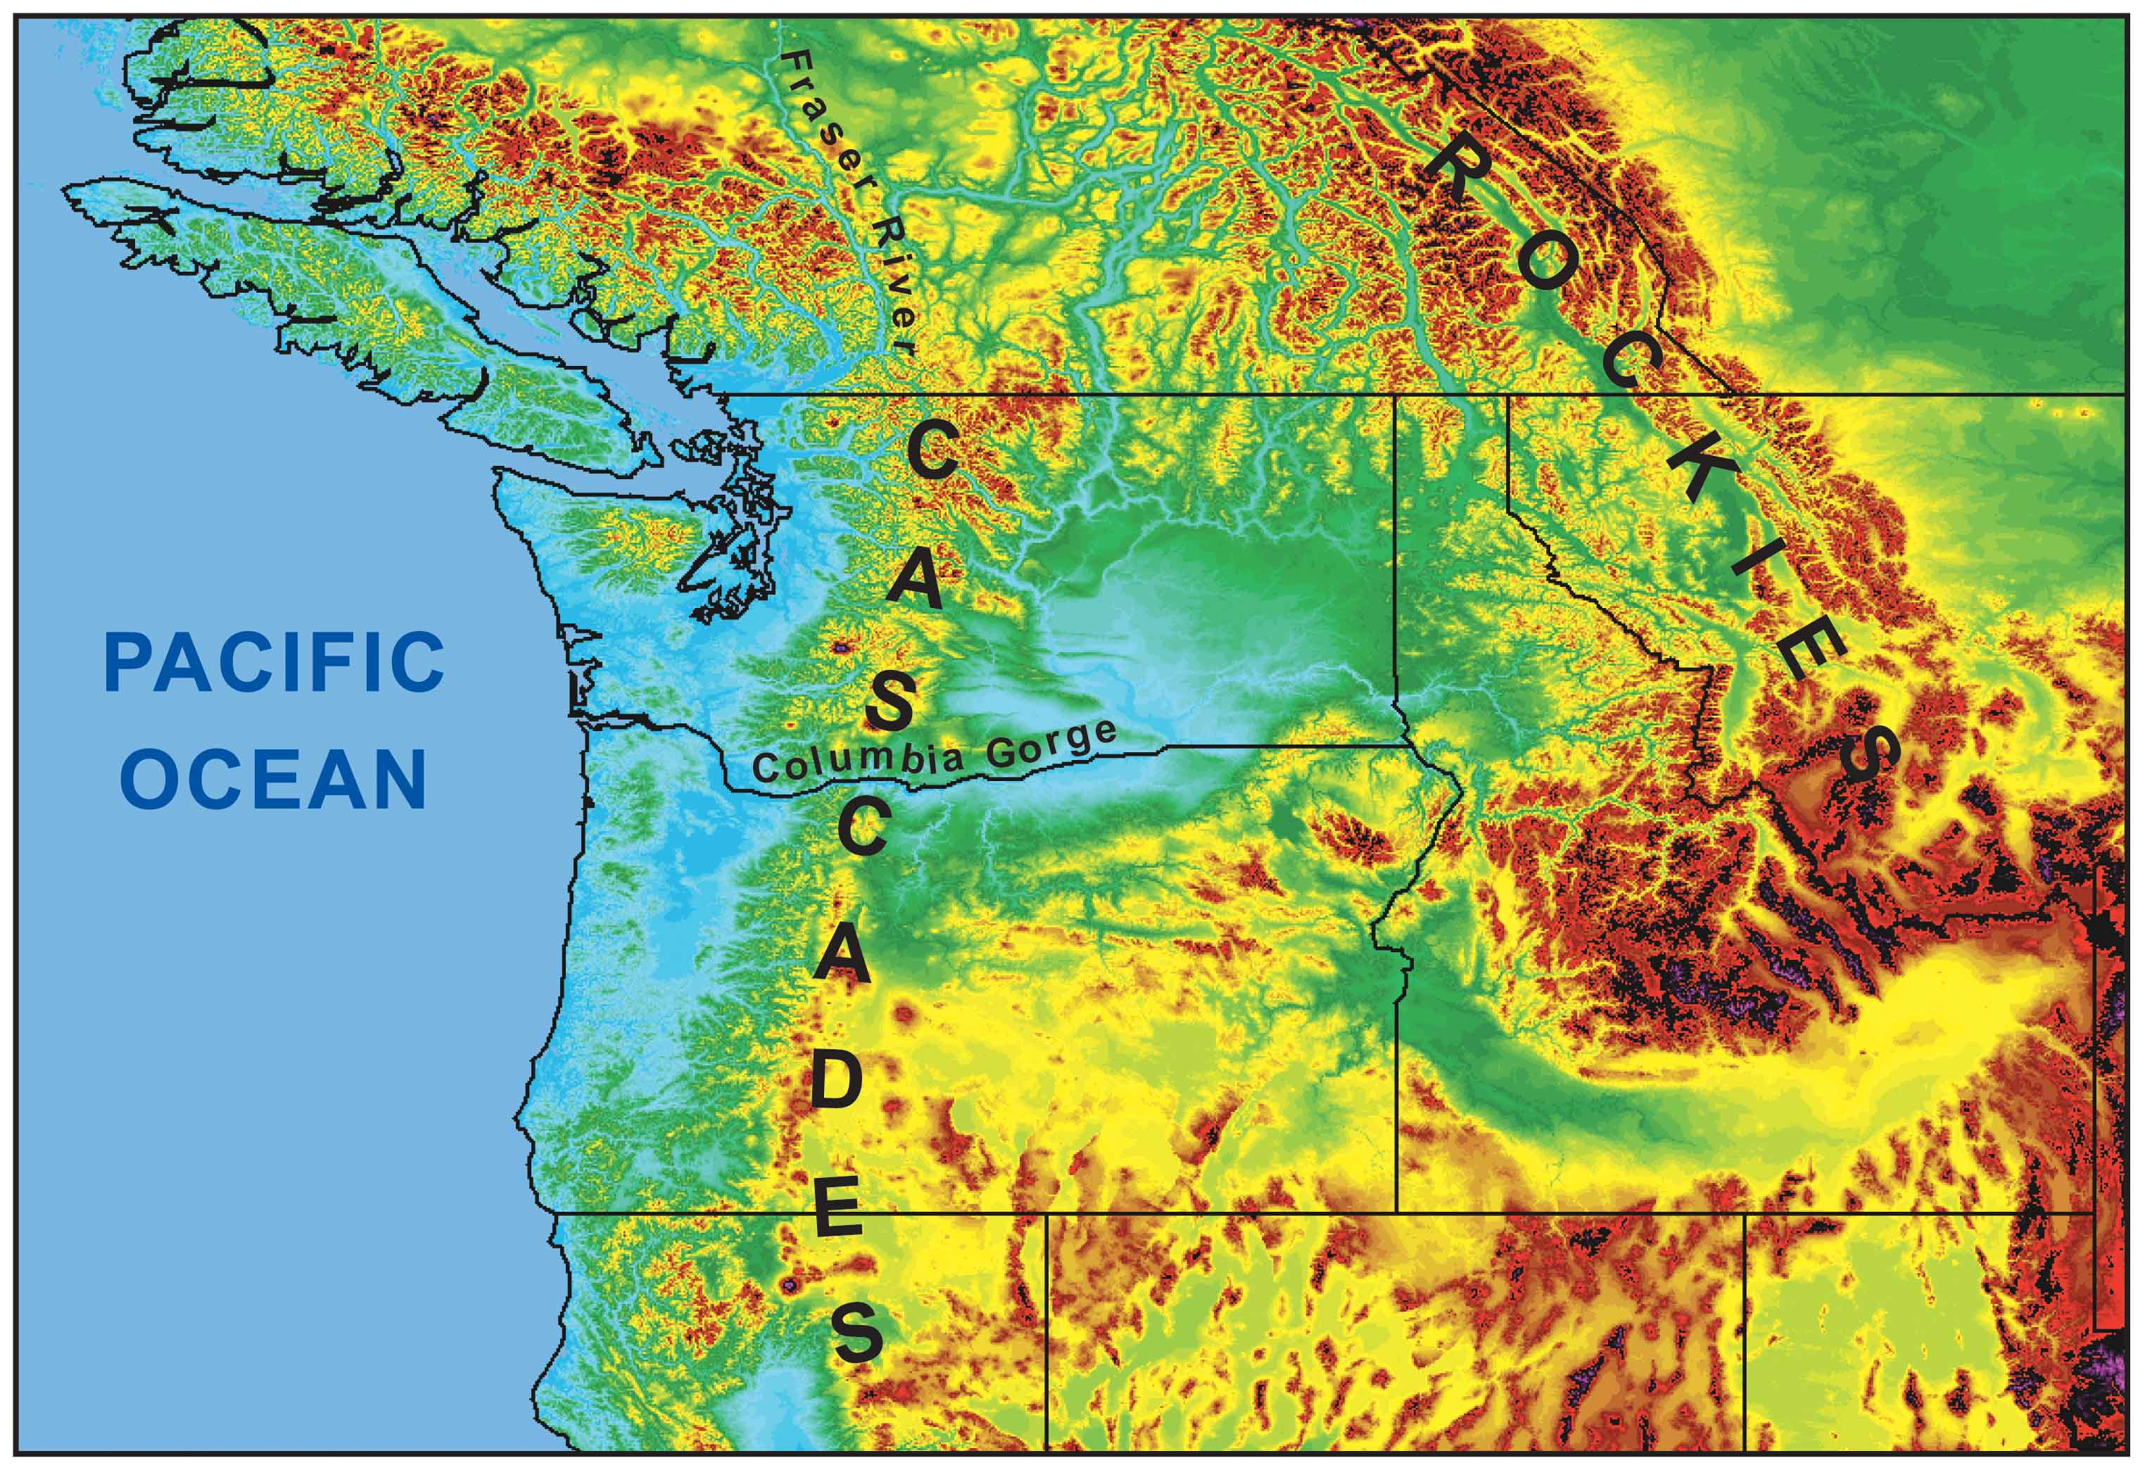
Continental Polar Air Rarely Gets into Western Washington. Why?

Slide 58
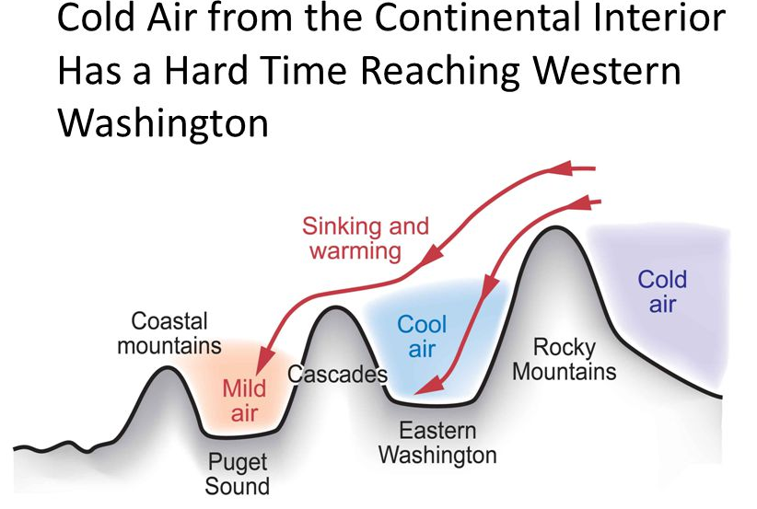
The Mountains!

Slide 59
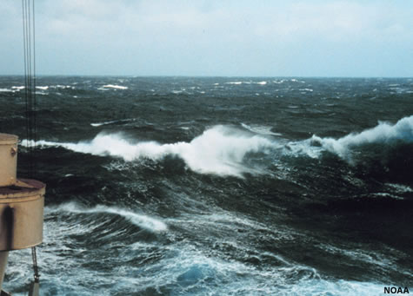
The conversion of cP air into mP air
When cP air moves over warm water it can rapidly warm and moisten.
Becomes unstable at low levels
Cloud streets of cumulus and cumulonimbus

Slide 60
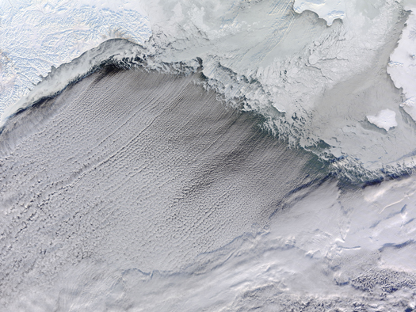
Bering Sea Cloud Streets

Slide 61
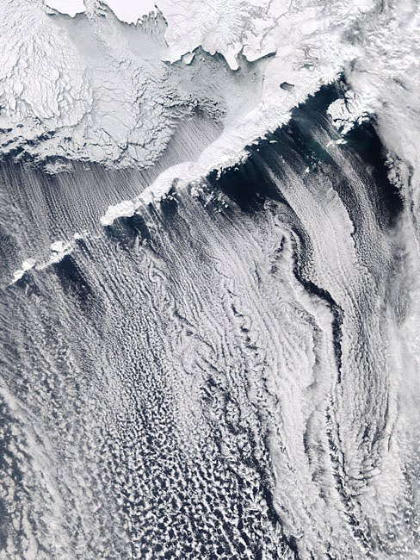

Slide 62
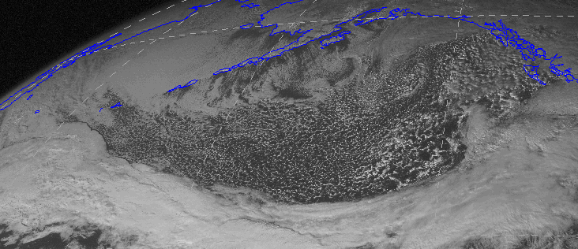
mP is the number one air mass in Seattle during the cool season

Slide 63

Maritime Tropical
Warm and moist.
Originates over tropical and subtropical oceans

Slide 64
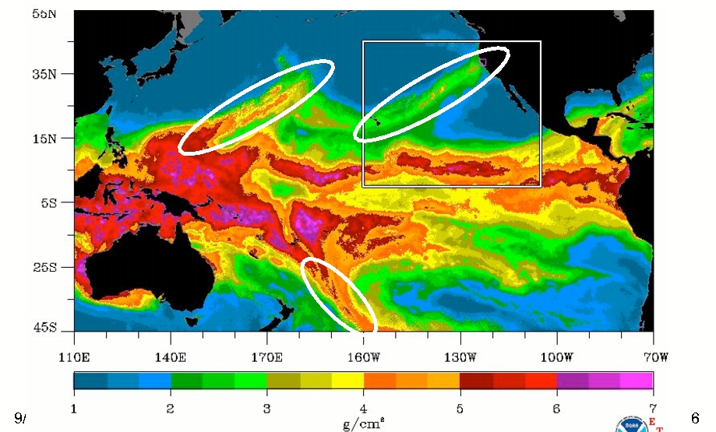
Maritime Tropical
Relatively rare over the Northwest, but we CAN get it during Atmospheric River events

Slide 65
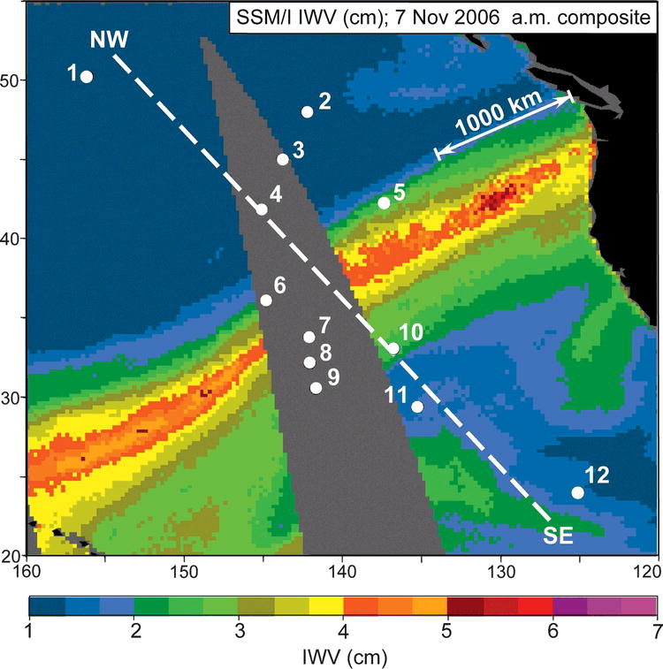
Local Version: The Pineapple Express: November 6-7, 2006

Slide 66

Atmospheric Rivers

Slide 67

AR Local Impact

Slide 68

The eastern U.S. ”enjoys” mT nearly all summer

Slide 69


Slide 70

The mT source region: the Gulf of Mexico and southern Atlantic

Slide 71

Continental Tropical

Slide 72
Continental Tropical
Usually originates over large arid regions in the subtropics
Associated with high pressure and sinking air aloft
Examples: the Sahara and northern Mexico/SW U.S.
Tends to be unstable at low levels due to heating at the surface
Often associated with drought

Slide 73


Slide 74
Another reason we care about air masses: lots of meteorological action at their boundaries ….such as fronts

