Slide 1


Slide 2
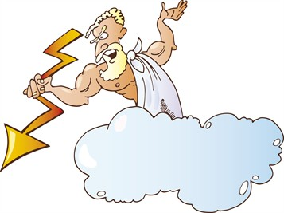
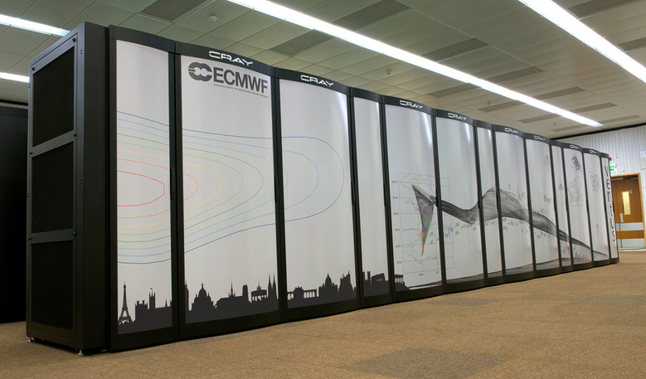
Weather Forecasting
From Superstition to Supercomputers
Cliff Mass
University of Washington

Slide 3
Weather Forecasting is unique among areas of science and technology

Slide 4

Nations Exchange Weather Data Even During Cold and Warm Wars

Slide 5

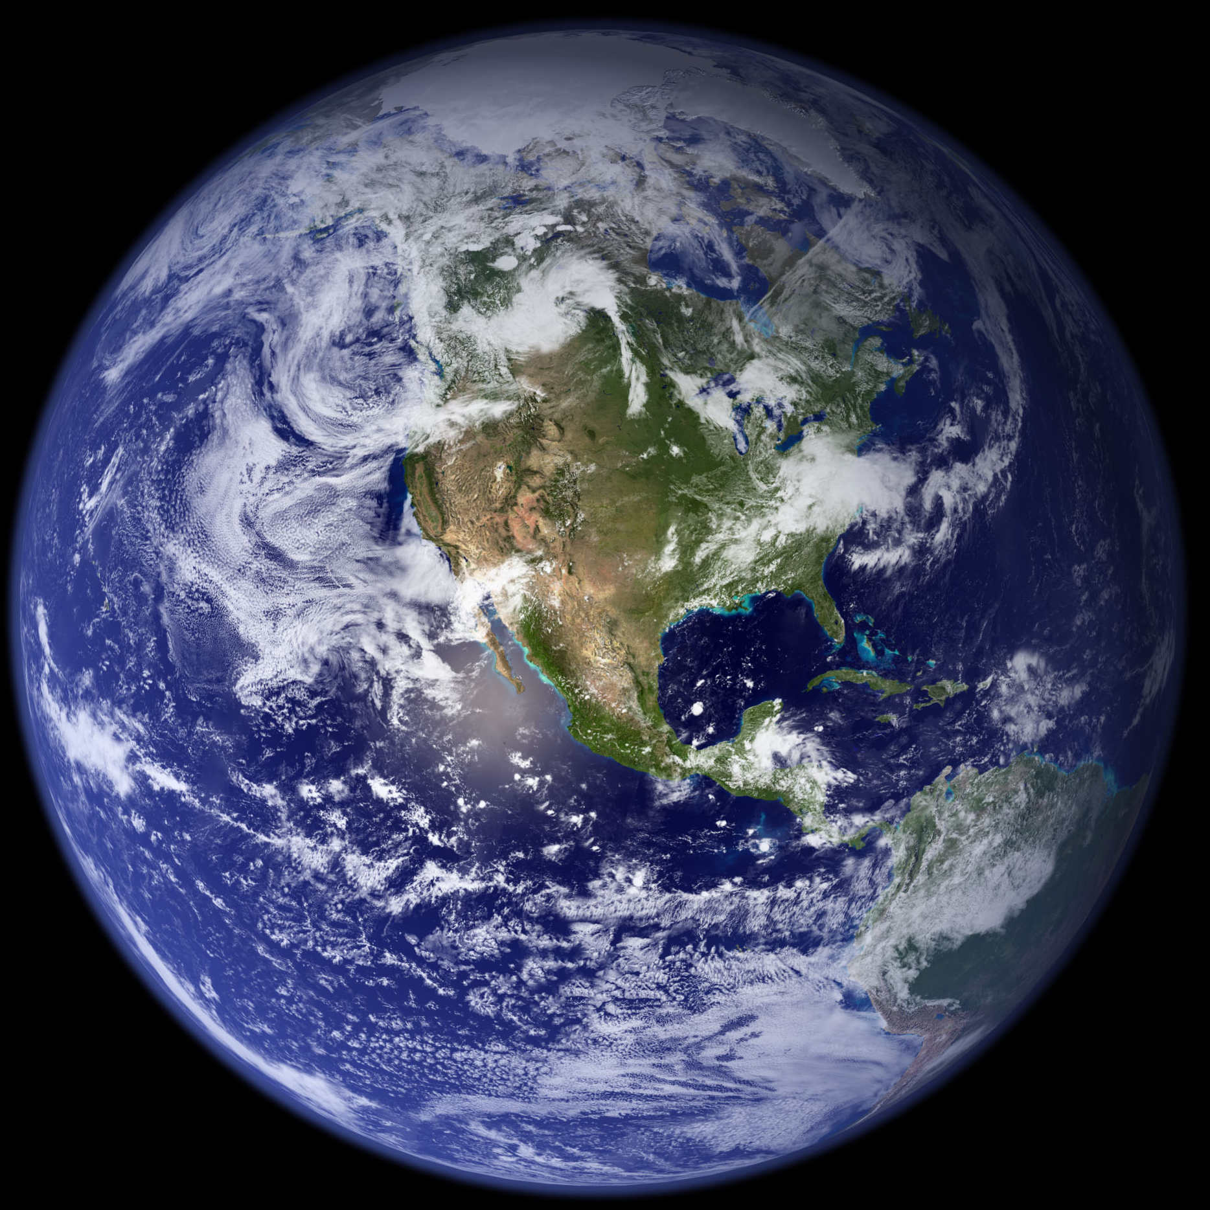
Weather Prediction Covers A Huge Range of Scales from the Microscopic to the Planetary
microns: millionths of a meter
thousands of kilometers
Cloud Condensation Nuclei

Slide 6
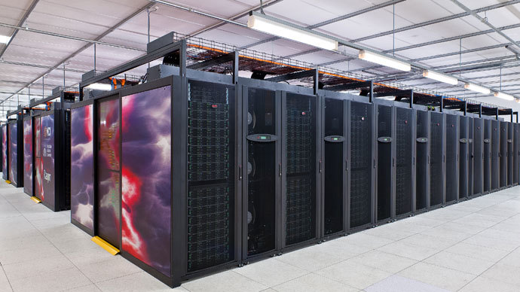
It Uses the Most Powerful Computers on the Planet

Slide 7
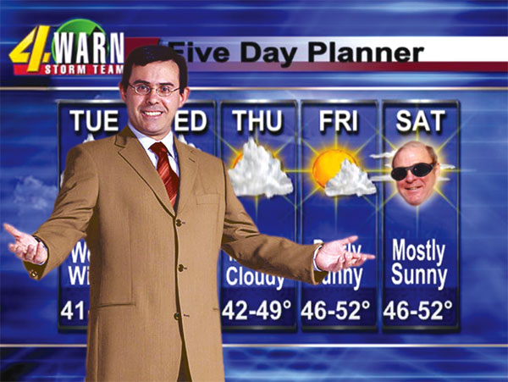
Weather Forecasting is the Only Science Represented on EVERY TV Newscast

Slide 8

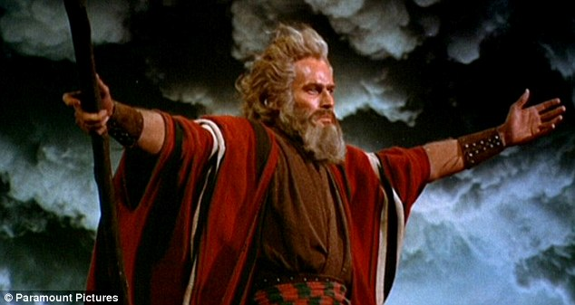
Weather Prediction Reflects a Deep Sense of Connection with the Natural Environment and Often Overlaps with Religion

Slide 9
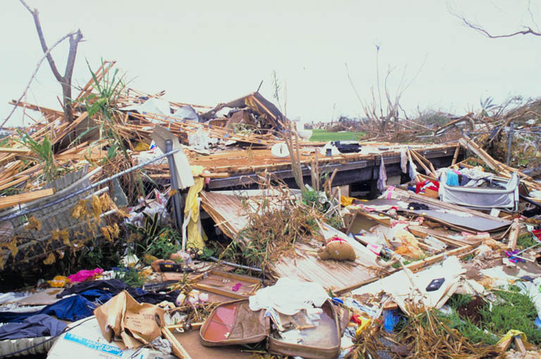
Conservatively estimated to save hundreds of thousand of lives and trillions of dollars per year

Slide 10
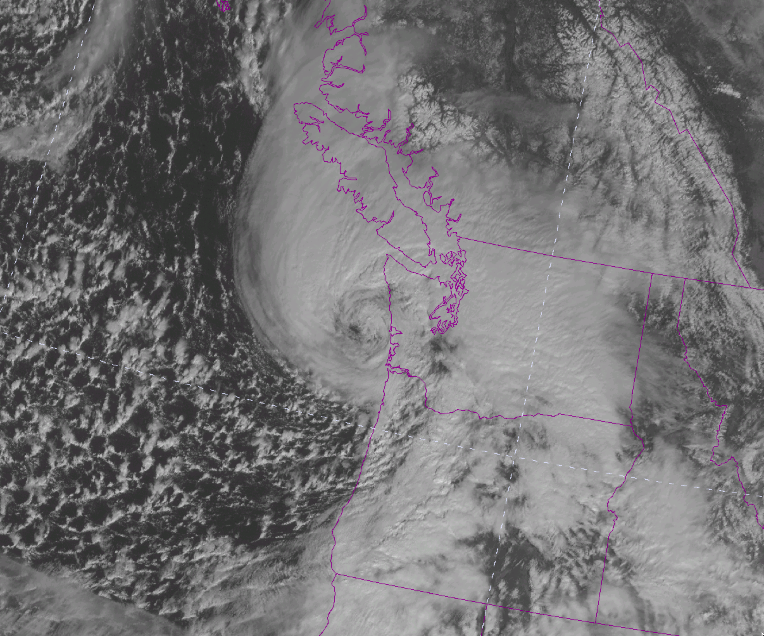
Consider Sunday’s Storm
11:30 AM
Sunday
March 13,
2016

Slide 11
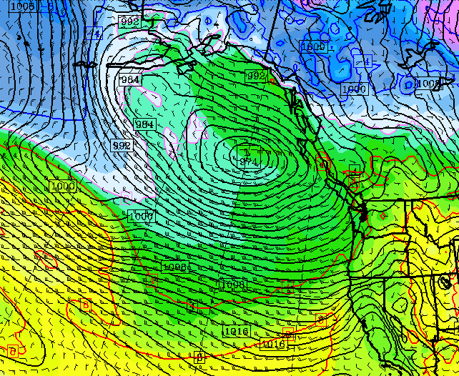
24h before: there was only a weak disturbance thousands of miles away

Slide 12
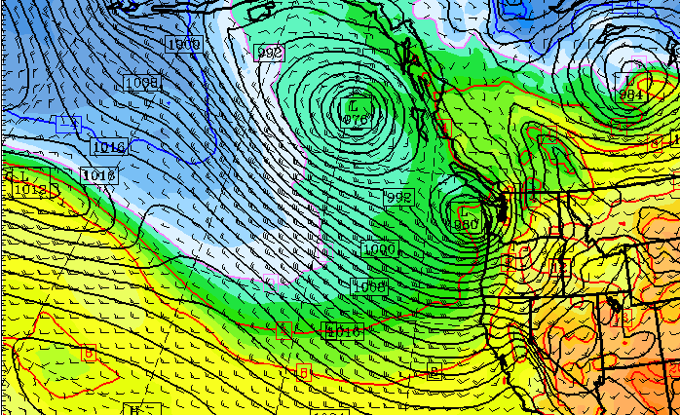
But a day later, a small intense low was predicted

Slide 13
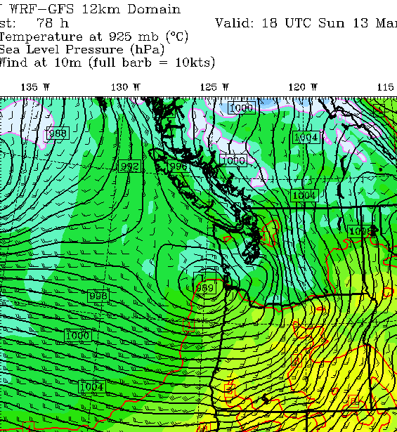
Forecast even three days before

Slide 14

It’s a miracle …

Slide 15
This talk will tell the story of weather prediction
… From its roots in observing the sky and folklore
…Through the development of computer-base forecasting
…To its application to predicting future climate

Slide 16
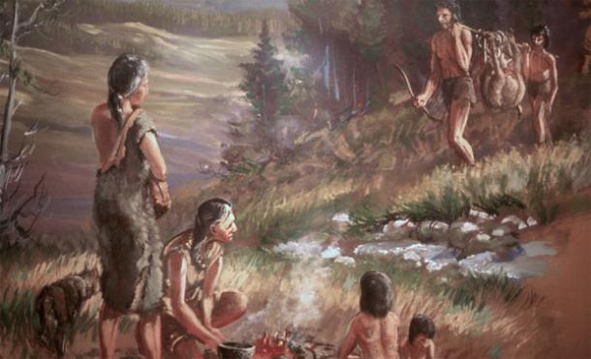
Weather forecasting is as old as our species

Slide 17
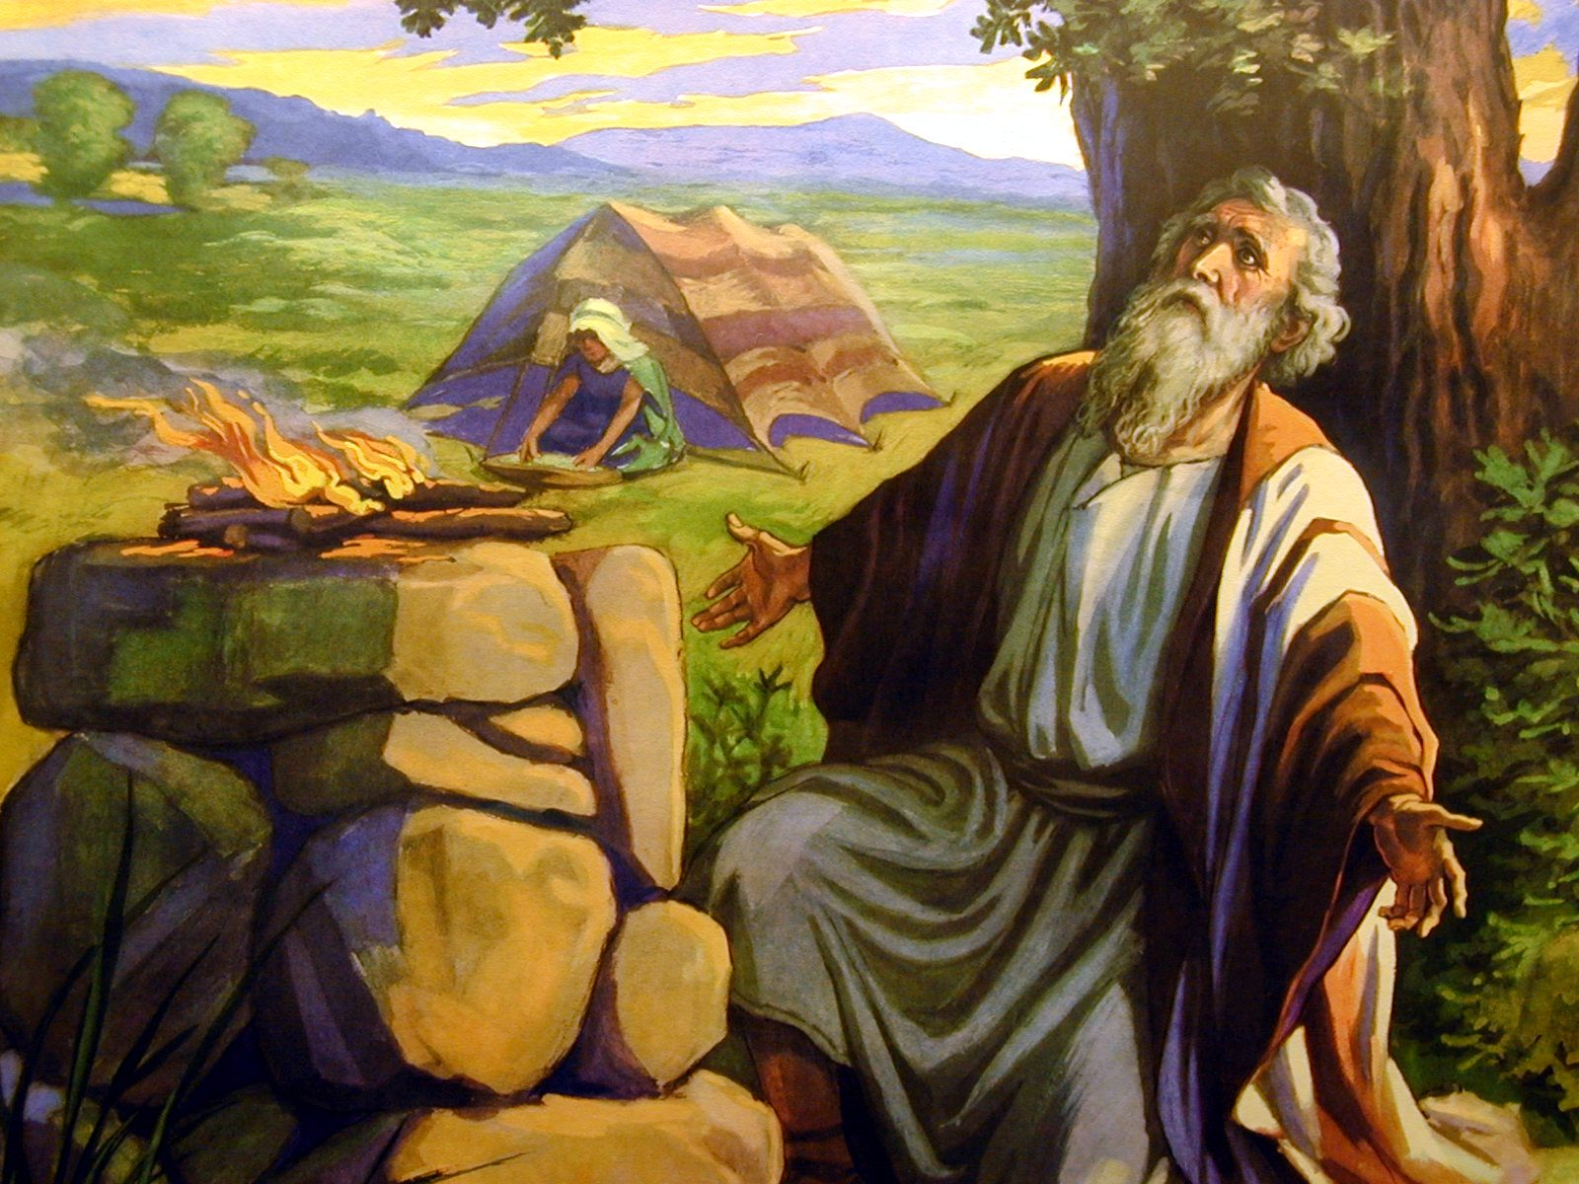
Our ancestors were keen observers of the sky and a practical weather forecasting ideas developed
Book of Job (37:22) states, “Fair weather cometh out of the north”
Which is true for many midlatitude locations where northerly flow is typically cool and dry.

Slide 18
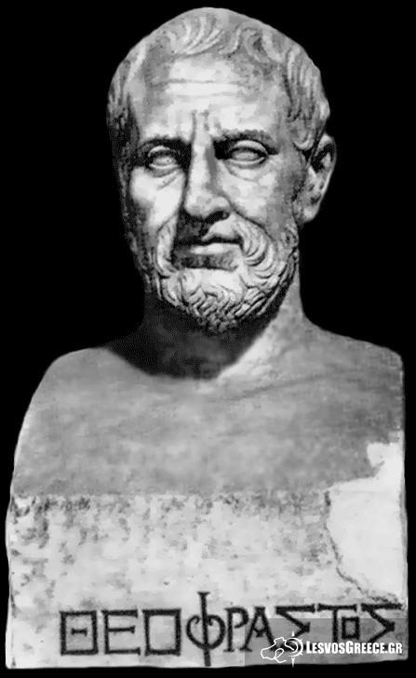
Ancient Greek Weather Advice
In Meteorologica, Aristotle suggested that a close examination of the sky could provide useful forecasts.
One of Aristotle’s pupils, Theophrastus of Ereos, wrote a volume On Weather Signs, which had many correct insights.

Slide 19
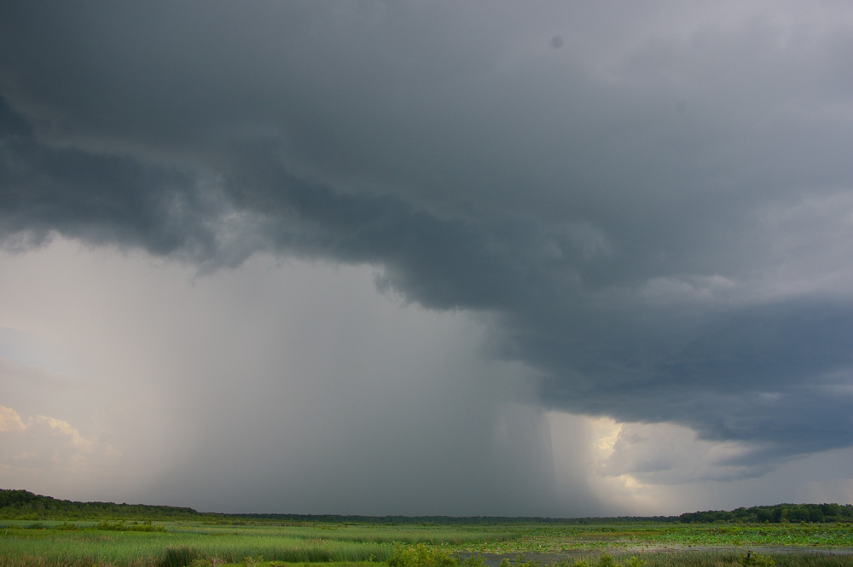
Theophrastus Example
“If the breezes come from the east or south, rain is indicated; if from the west or north, cold weather.” (generally true)

Slide 20
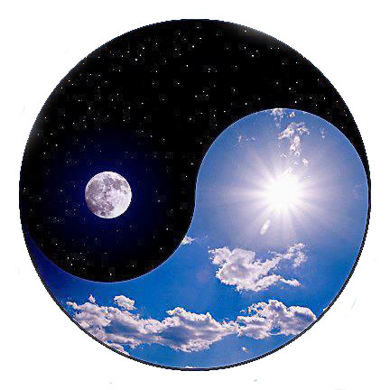
Many Ancient Forecasters Believed in Meteorological Yin and Yang
If ones season is warm, the next will be cool
If one is wet, the next will be dry.
Many people still believe this.
If the autumn is unusually fine, the succeeding spring is generally cold
(Theophrastus)

Slide 21

Ancient And Pre-Modern Societies Summarized Forecasting Wisdom in Proverbs
"Red sky at night, sailor's delight. Red sky in the morning, sailor take warning.”
"Clear moon, frost soon.”
"Halo around the sun or moon, rain or snow soon."

Slide 22
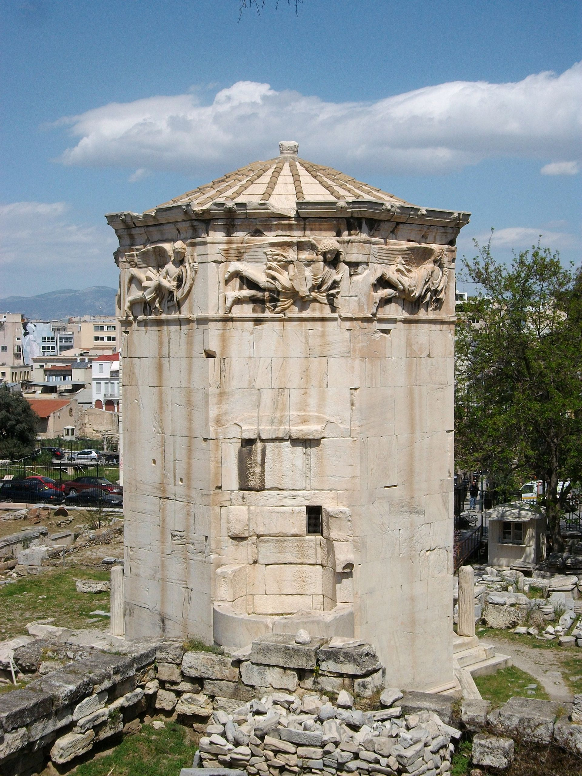
Ancient Weather Instruments
Wind vanes were perhaps the most ancient meteorological instruments.
Mesopotamian and Sumerian documents, dating back nearly 4,000 years, describe primitive wind vanes, and streamers.
Tower of the Winds, 50 BCE

Slide 23
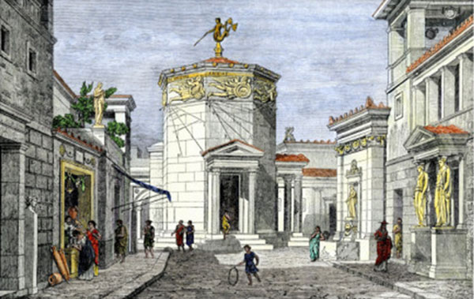
Tower of the Winds

Slide 24
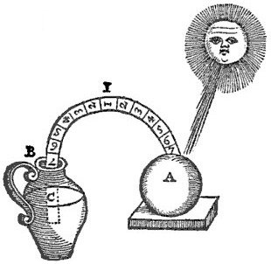
Ancient Weather Instruments
Bowls were used as rain gauges
First thermometer (Philo of Byzantium, 240 BC)
Philo’s
Thermometer

Slide 25
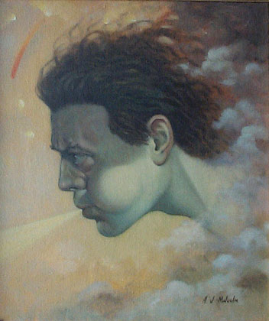
Prior to the Modern Times, Weather Prediction and Control Were Intimately Linked
Gods and deities controlled the weather, and information about the future might be secured by interpreting signs provided by gods
Or you could supplicate them to change the weather.
Aeolus

Slide 26
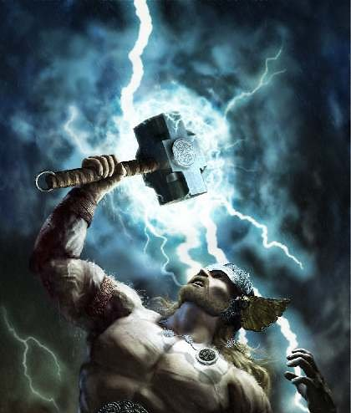
Norse God (and movie star) Thor
God of thunder, lightning, and storms
A big weather hammer was his secret

Slide 27
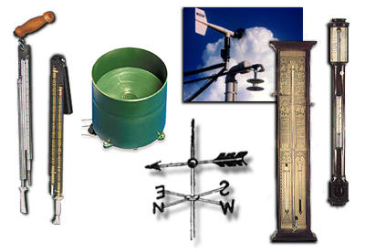
The Transition To Modern Weather Forecasting
Step 1: You need weather instruments with sufficient accuracy and reproducibility.

Slide 28

1450-1750
The Rise of Weather Instruments
Around 1600 A.D., a number of experimenters, including Galileo Galilei, developed air-water thermoscopes
A tube and bulb was inserted into water; as temperature changes, the water level changes in the tube

Slide 29
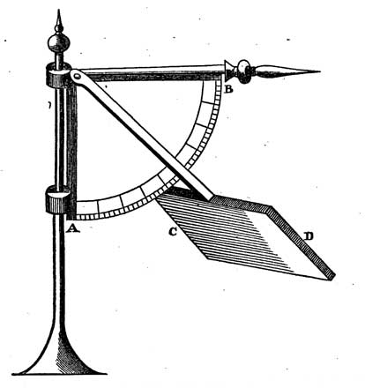
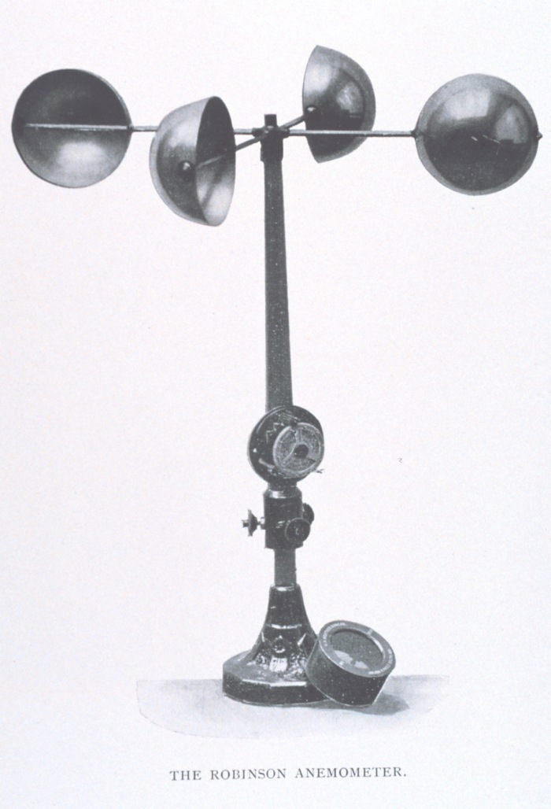
Robert Hooke (1660) Invented the Anemometer to Measure Wind Speed
Hooke, 1660
Anderson, 1840

Slide 30
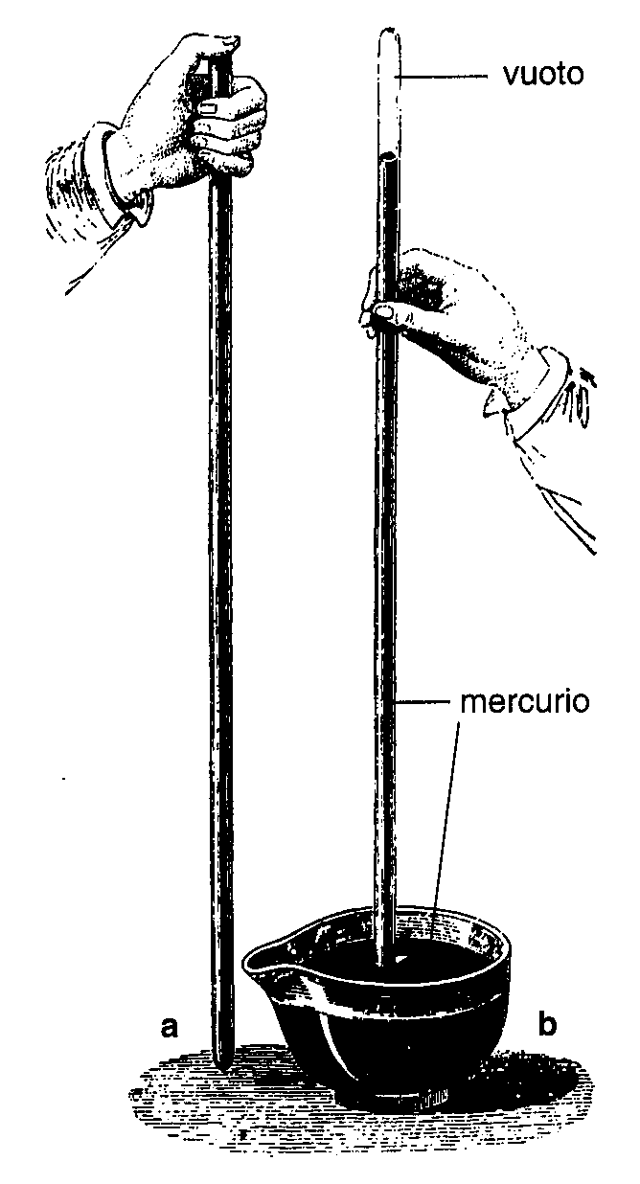
Torricelli Devised the Mercury Barometer to Measure Pressure (1644)

Slide 31
But there was a problem… the absence of universal scales for basic weather parameters such as temperature

Slide 32
Solutions for Temperature
In 1665 Christian Huygens suggested using the freezing and boiling points of water as standards
1724 Daniel Fahrenheit proposed a scale with 32F for freezing and 212F for boiling and used this scale in the first mercury thermometers.
In 1742 Anders Celsius introduced the temperature scale using 0 and 100°C for freezing and boiling points.

Slide 33
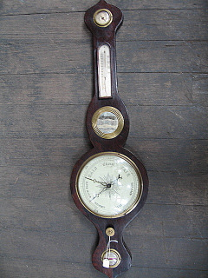
By the late 1700’s everything was in place: decent instruments and universal scales
The weather observing revolution was about to begin
Observing the weather became the high-tech craze of the period

Slide 34
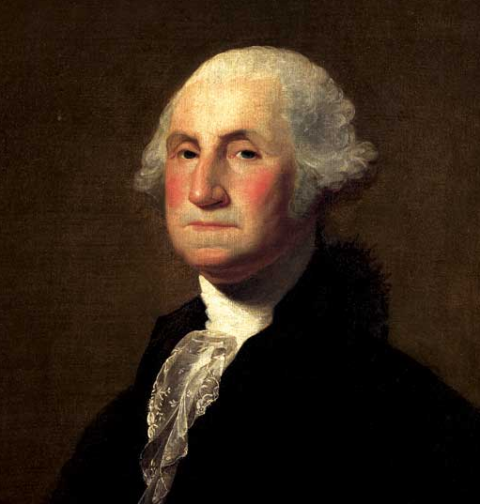
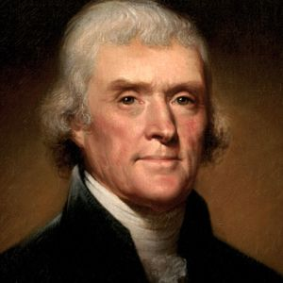
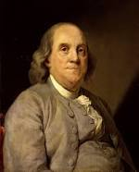
Early Weather Hobbyists
Thomas Jefferson maintained a nearly unbroken record of weather observations between 1776 and 1816. Four weather observations on July 4, 1776!
George Washington collected daily weather observations until only a few days before he died.

Slide 35
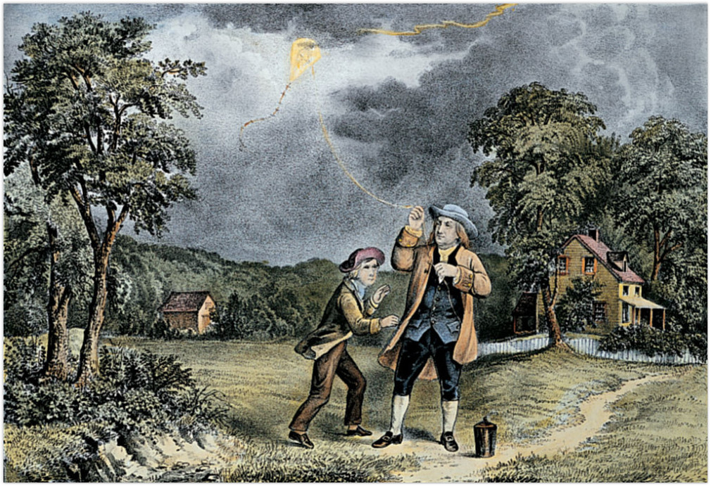
Franklin Foresaw Modern Weather Prediction

Slide 36
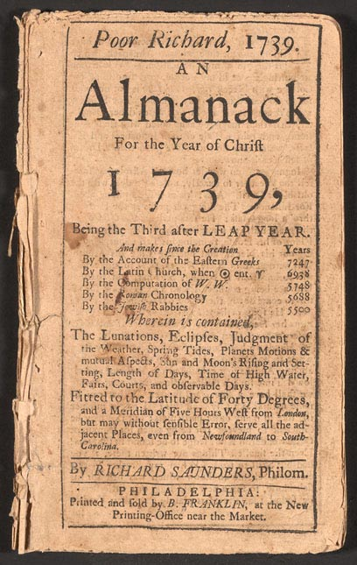
Ben Franklin, the Weather Forecaster
Franklin concluded, based on the visibility of a 1743 lunar eclipse at various locations, that the storm moved to the northeast.
Thus, it might be possible to predict storm movement if information could move faster than the storms.
Produced some of the first recorded weather forecasts in Poor Richard’s Almanac

Slide 37
The Weather Observing Craze
More and more people took weather observations in the late 1700s and early 1800s
Folks mailed weather observations to each other and the first weather networks were were begun
Example: 1792 the Mannheim (or Palatine) network included 39 stations from France, Germany, Italy, Scandinavia, Poland and Russia.

Slide 38
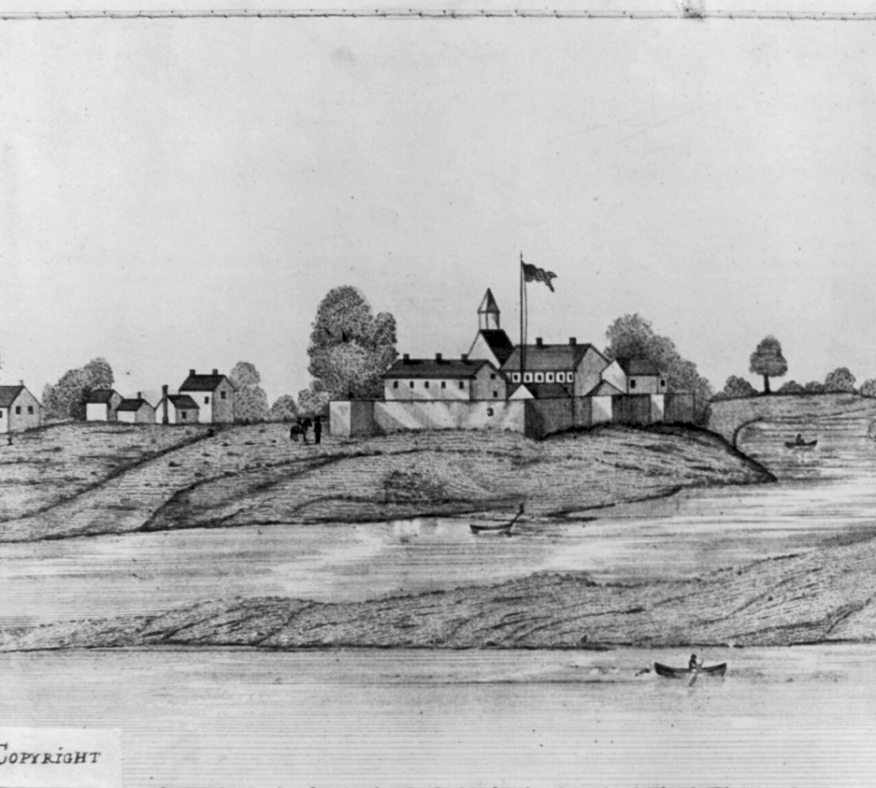
The U.S. Government Gets Involved
In 1816 all U.S. army surgeons were required to take three observations daily.
Other American networks were organized under the auspices of the U.S. Navy and the Smithsonian Institution

Slide 39
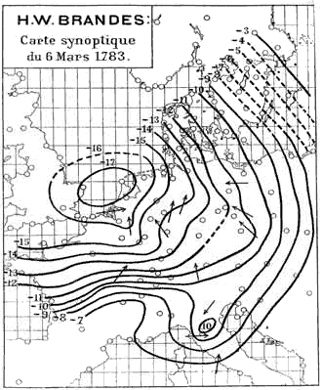
The First Weather Map (1820)
Created by H. W. Brandes for March 6, 1783.
The arrows indicate wind direction and the lines show the deviation of pressure from average conditions

Slide 40
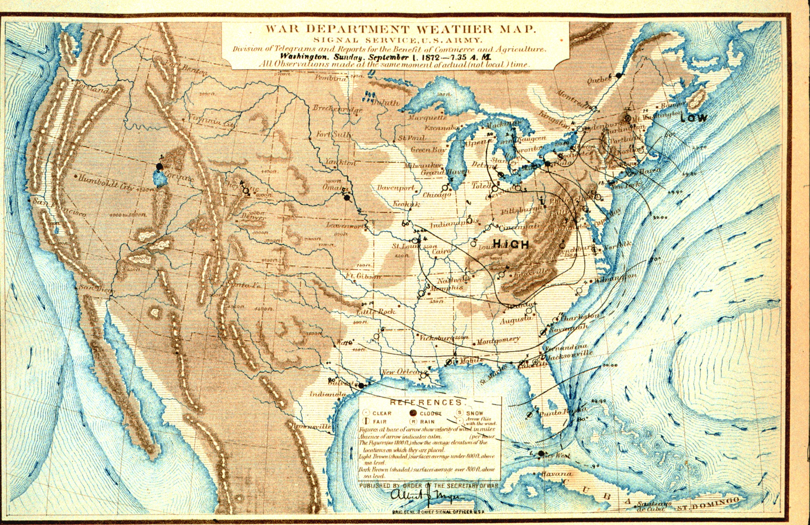
The Advent of Operational Weather Forecasting

Slide 41

There were lots of weather observations but their value was limited
Without a means for rapid communication, weather maps were created weeks or months after the observations were taken.
Weather forecasting was limited to the "local method," in which local surface and cloud observations were combined with past experience.

Slide 42
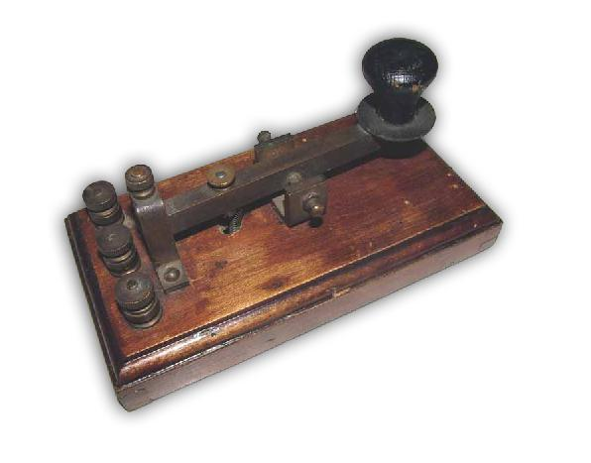
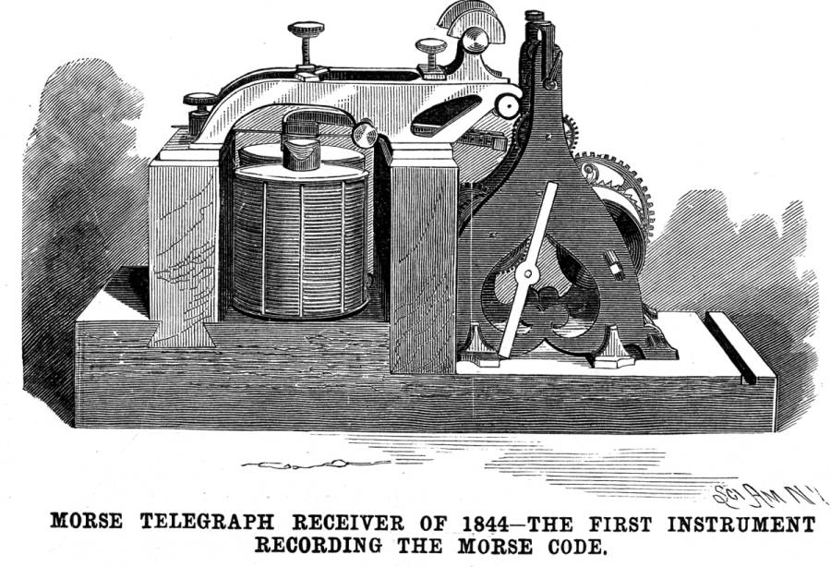
The Telegraph Changes Everything
The first practical electrical telegraph was built by Samuel Morse and Alfred Vail in 1837
In 1844, the “what hath God wrought?” message transmitted between Baltimore and Washington, D.C.
The Internet of the 1840s

Slide 43
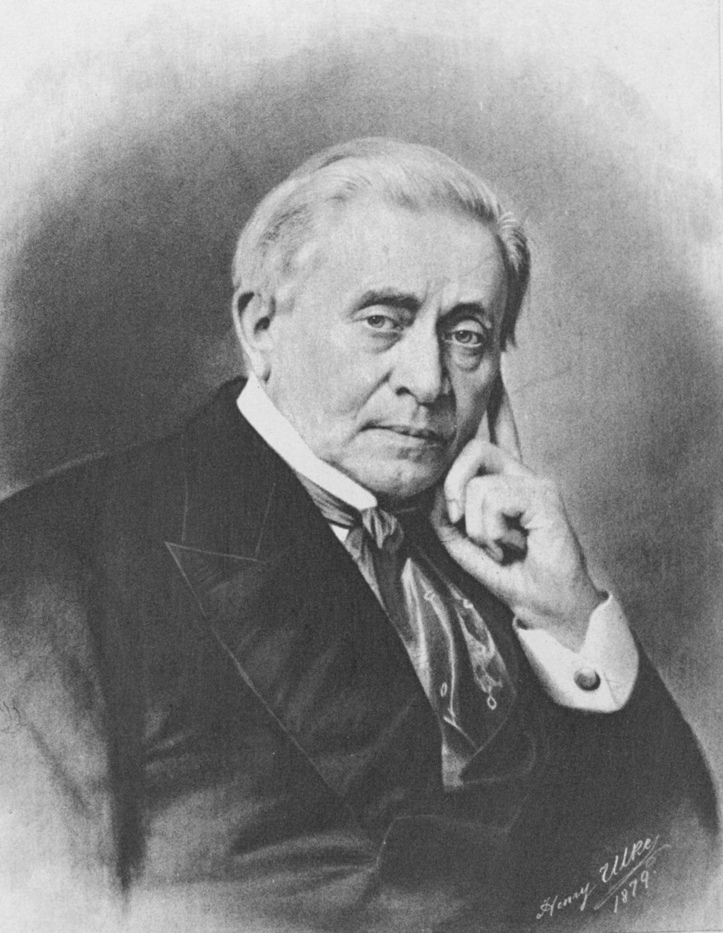
It was immediately recognized that the telegraph made weather prediction possible
Joseph Henry in 1847 provided the vision:
“… extended lines of telegraph will furnish a ready means of warning the more northern and eastern observers to be on the watch for the first appearance of an advancing storm.”

Slide 44
The Weather-Telegraph Revolution
In 1849, the Smithsonian created a network of roughly two-dozen telegraph operators, with daily weather reports from around the nation.
A weather map, updated daily and based on telegraphic reports, was posted in the lobby of the Smithsonian Institution and Washington Evening Star newspaper published it in each issue.

Slide 45
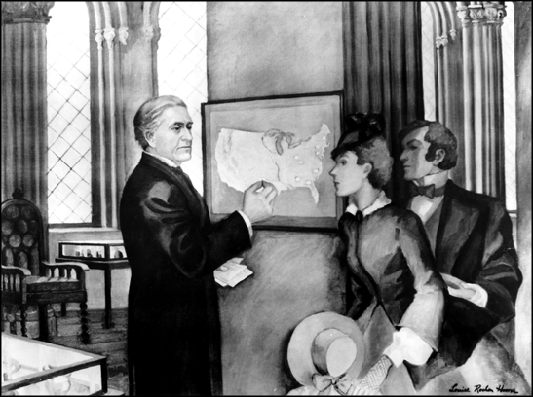
Smithsonian Weather Display 1858

Slide 46
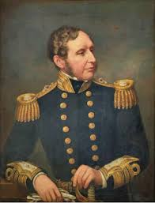
Operational Weather Prediction Begins
With telegraphic weather information, governments around the globe began to establish operational meteorological services.
In 1854 Admiral Fitzroy, famed captain of Darwin's ship the Beagle, was appointed head of the new British Meteorological Service
1861 began issuing daily forecasts and storm warnings.
Admiral Robert Fitzroy
Created “weather forecast”

Slide 47
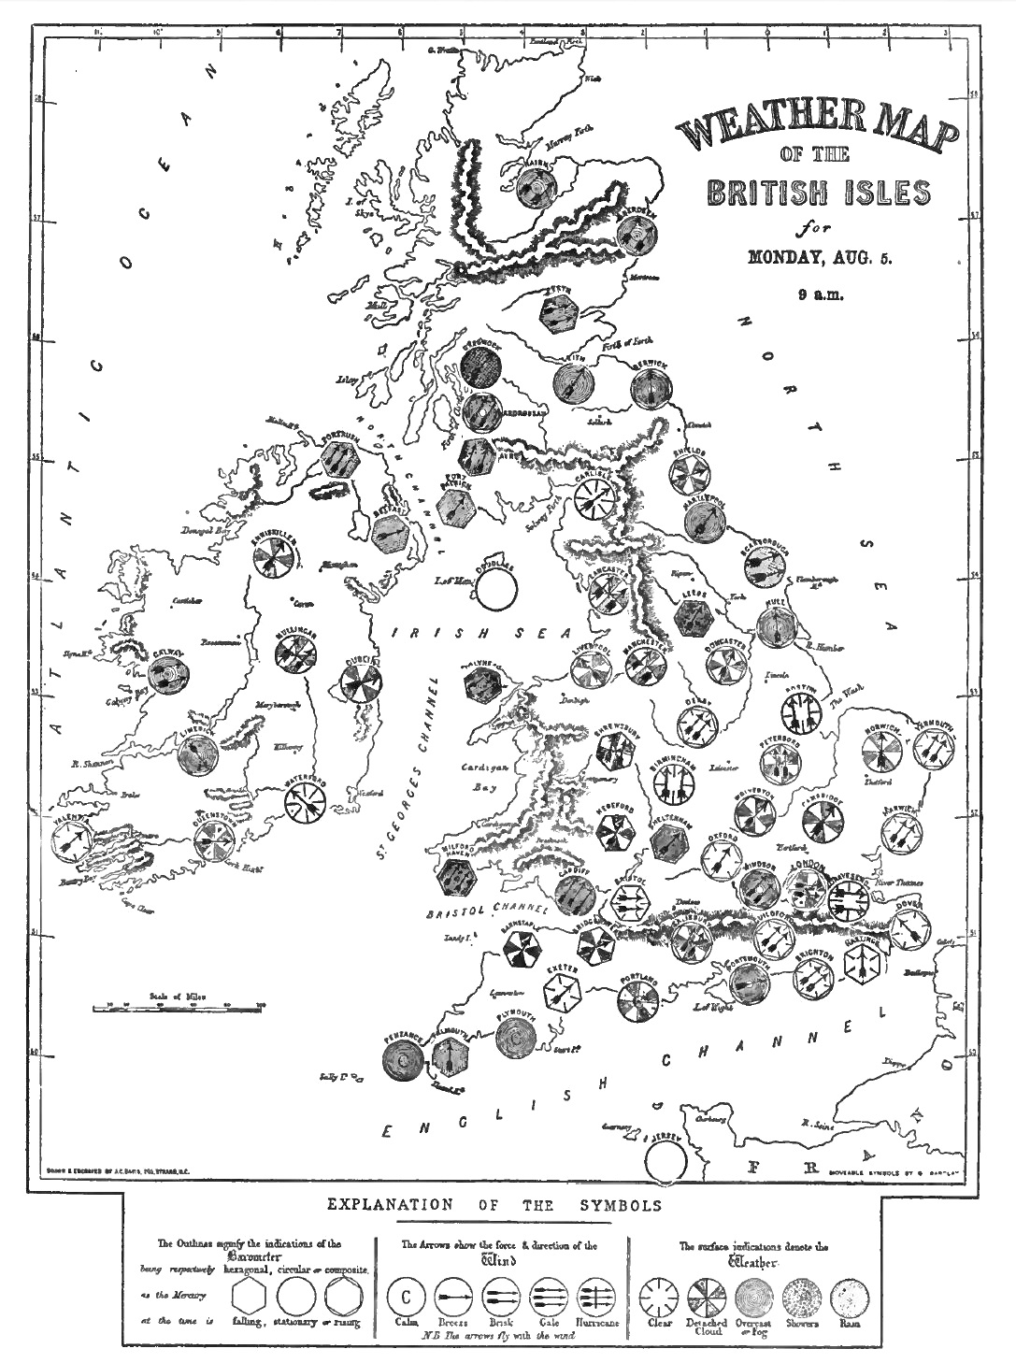
Push Back
The scientific establishment saw weather forecasting as inconsistent with proper scientific inquiry.
Fishing fleet owners objected to storm warnings, which kept ships in port.
A committee of the British Royal Society recommended that storm warnings and daily forecasts be discontinued, and in December 1866 they were terminated.
1861 Weather Map

Slide 48
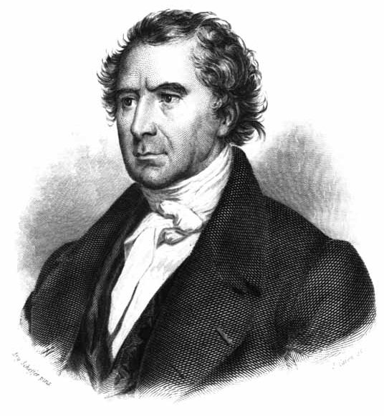
French physicist François Arago, the Director of the Paris Observatory
  “Whatever may be the progress of sciences, never will observers that are trustworthy, and careful of their reputation, venture to foretell the state of the weather.”

Slide 49
Forget Europe: The U.S. Moves Ahead
Meteorologist Cleveland Abbe, released the first U.S. public weather forecast on September 1, 1869 for Cincinnati, Ohio
In 1870, President Ulysses S. Grant authorized the establishment of a new national weather service located within the Signal Service of the U.S. Army
Ol’ Probs

Slide 50
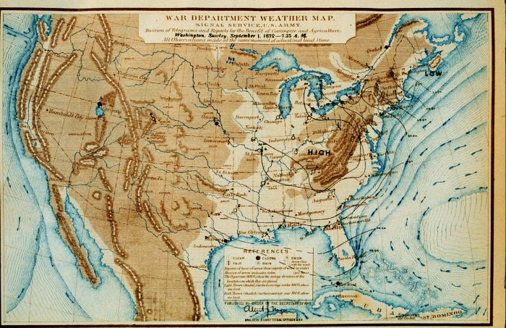
(1872) U.S. Operational Weather Maps

Slide 51
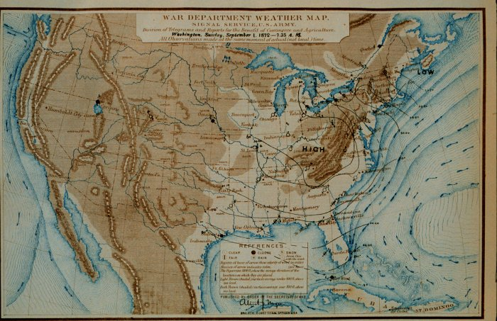
1880’s Forecasting Technology
L
L
L
Yesterday
Today
Tomorrow

Slide 52
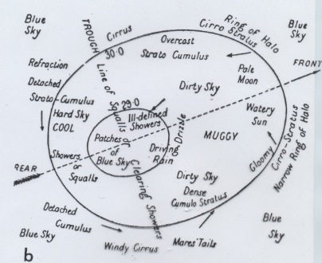
1890’s Atmospheric “Model”

Slide 53
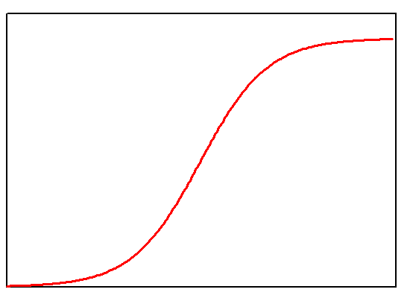
Forecast Skill Plateaus
Forecasting skill increased during the 1870s and 1880s as more observations became available.
Little understanding of the evolution of weather systems.
By the turn of the century, predictive skill had leveled off.

Slide 54
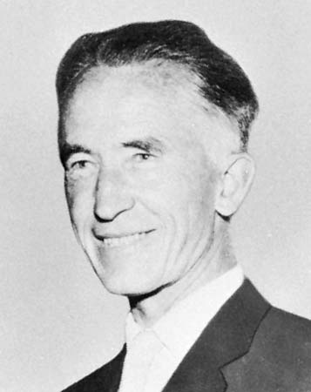
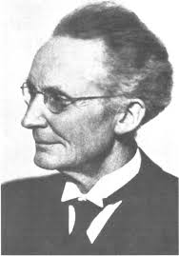
Norwegians to the Rescue
Jacob Bjerknes
Vilhelm Bjerknes

Slide 55
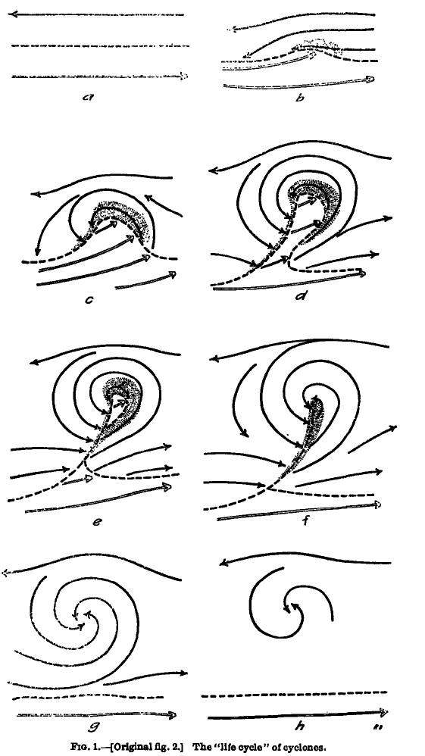
Concept of Evolution of Cyclones
Bjerknes and Solberg
1922

Slide 56
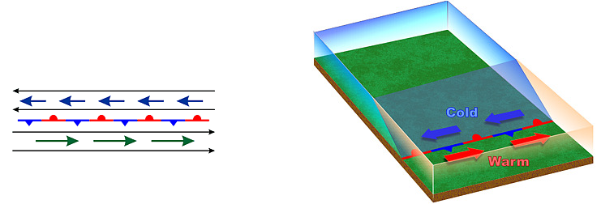
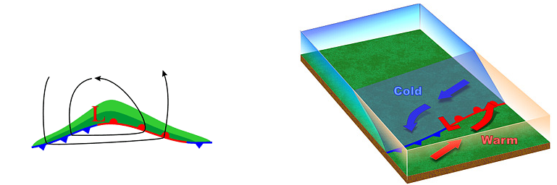
Stationary Polar Front
Wave Forming on Polar Front

Slide 57


Wave Amplifies
Occlusion as Cold Front Catches Up to Warm Front

Slide 58

Norwegian Contribution
Now meteorologists had some idea how weather systems evolved in time.
Major aid to weather prediction.
But still was basically qualitative.

Slide 59

A Lack of Upper Air Observations Was Undermining Weather Prediction
The atmosphere is three dimensional and what happens aloft matters.
In 1920 very sparse upper air observations:
  Mountain stations
  Kites and pilot balloons
  Limited aircraft observations.

Slide 60

Navy bi-plane with meteorgraph on starboard wing strut, taking meteorological measurements for pressure, temperature, and humidity

Slide 61

Weather Kite

Slide 62

Pilot Balloons Provided Winds Aloft

Slide 63

The Big Breakthrough: The Radiosonde
A radiosonde is a portable weather station lofted by a balloon.
Sends observations back by radio.
The first instrument launched on January 7, 1929.

Slide 64

Radiosonde Data Changes Weather Prediction
Gave a 3D picture of what was happening aloft
Upper level disturbances and how they influence weather
Jet streams as the transport mechanism for storms
Upper-level flow steered storms, and thus predicted storm movement.

Slide 65

Upper
Level
Chart

Slide 66

The Development of Numerical Weather Prediction (NWP)

Slide 67

The Equations Are Revealed
During the 19th century, all the basic equations describing the physics of the atmosphere became known.
  Conservation of momentum
  Conservation of energy
  Conservation of mass
  Conservation of water

Slide 68

The “Primitive” Equations

Slide 69


The Idea is Born
In 1904, Vilhelm Bjerknes suggested that the primitive equations could predict the future atmosphere.
But NWP wasn’t practical because there was no way to do the computations quickly and 3D data for starting the forecasts did not exist.

Slide 70
How it works…
One of the equations used to predict the weather is Newton’s Second Law:
F = ma
Force = mass x acceleration
Mass is the amount of matter
Acceleration is how velocity changes with time
Force is a push or pull on some object (e.g., gravitational force, pressure forces, friction)

Slide 71

This equation is a time machine!

Slide 72
Predicting the Future
F = ma
If we can observe the atmosphere, we know m, the amount of mass
We also can calculate all the forces, F (such as forces due to differences in pressure)
Thus, we can calculate the acceleration, a.
Acceleration is the change of velocity in time.
THUS WE KNOW THE FUTURE!

Slide 73

L. F. Richardson: An Insightful But Unsuccessful Attempt at Numerical Prediction
As a Quaker ambulance driver in WWI he worked on the problem.
In 1922 Richardson published a book Weather Prediction by Numerical Process that described an approach to using the primitive equations: solving the equations on a grid

Slide 74

L. F. Richardson
He attempted to make a numerical forecast using a mechanical calculator
Unfortunately, the results were not good, probably because of problems with his initial conditions.

Slide 75

L. F. Richardson
He imagined a giant theater filled with human calculators…
So NWP had to wait until a way of doing the computations quickly was developed and more data…especially aloft… became available.

Slide 76
The Dream Becomes Possible
By the mid to late 1940’s there was an extensive upper air radiosonde network. Thus, a reasonable 3-D description of the atmosphere was possible.
Also during this period digital programmable computers were becoming available …the first being the ENIAC

Slide 77

The Eniac

Slide 78
The First Successful Numerical Weather Prediction
Took place in April 1950, using the ENIAC
The prediction was for 500-mb height over North America, using a two-dimensional grid with 270 points about 700 km apart.
The results were clearly superior to human subjective prediction.
The NWP era had begun.

Slide 79

First Numerical Weather Forecast

Slide 80


Terminology: A Weather Model is a system comprised of the atmospheric equations and a means to solve them.

Slide 81

Most Weather Forecast Models Solve the Equations on a 3D Grid

Slide 82
Faster Computers Drove Better Weather Prediction
Resolution increases (distance between grid points decrease): 1958: 380 km, 1985: 80 km, 1995: 40 km, 2000: 22 km, 2002: 12 km, 2008: 4 km
Better description of physical processes. Like clouds and radiation.
Better use of observations: called data assimilation

Slide 83


Slide 84

NGM, 80 km,
1995

Slide 85

1995

Slide 86

2007-2008
4-km grid spacing

Slide 87

1.3 km grid
spacing

Slide 88

But there was another revolution… in weather observations, with weather satellites taking the lead
There was little data over most of the planet (oceans, polar regions)
Storms could approach the coast without warning and numerical modeling was crippled by lack of data.
1938 Hurricane

Slide 89


TIROS-1: The First Weather Satellite

Slide 90

First
Weather
Satellite
Image

Slide 91

Starting in 1974,
NOAA GOES Satellite

Slide 92

Weather Satellites Now View the Entire Planet

Slide 93


Better than Star Trek!

Slide 94

Cloud Track Winds

Slide 95

Satellite Sensors Provide Thousands of High Quality Vertical Soundings Daily over the Pacific

Slide 96

Every part of the planet is observed nearly continuously by weather satellites
NO MORE SURPRISE STORMS

Slide 97

Because of weather satellites, forecast skill is the same in the northern and southern hemispheres

Slide 98

Weatherman Jokes Are No Longer Appropriate

Slide 99
But one prominent politician doesn’t believe forecasts have improved
Hint: His hair is susceptible to the wind

Slide 100




Slide 101

Weather Radar Reveals the Inside of Storms and More

Slide 102


Radar was first used operationally in WWII by the British to track German planes
But heavy precipitation got in the way!

Slide 103


After WWII Meteorologists Experimented with Military Radars

Slide 104

Hurricane Radar Image

Slide 105


In the late 1950’s a meteorological radar network was established in the U.S.

Slide 106


In the late 1980s,
the NWS put in a network of Doppler weather radars

Slide 107

Hook Echo of Supercell Thunderstorm with Tornado

Slide 108

Our Last Storm from the Langley Hill Radar

Slide 109

The Future of Weather Prediction

Slide 110

A Fundamental Problem
The way we have been forecasting has been essentially flawed.
The atmosphere is a chaotic system, in which small uncertainties in how we start the forecast (the initialization) have large impacts on the forecasts.
Not unlike a pinball game….

Slide 111

A Fundamental Problem
Similarly, there are uncertainties in processes, like the development of clouds and precipitation, which produce uncertainty in forecasts.
Thus, all forecasts have uncertainty.
The uncertainty generally increases in time.

Slide 112
This is Ridiculous!

Slide 113

Forecast Probabilistically
Weather forecasters need to tell users about the uncertainties in the forecast.
Give forecasts in terms of probabilities.
There is an approach to handling this issue that is being developed by the forecasting community…ensemble forecasts

Slide 114

Ensemble Prediction
Instead of making one forecast…make many…each with a slightly different initializations or different model physics.
Possible to do this now with the vastly greater computation resources that are available.

Slide 115


Slide 116
Ensemble Prediction
Ensemble can give probabilities.
The ensemble mean is more accurate than any individual member.
Ensembles will dominate forecasting in the future.

Slide 117


Communication: From TV to Smartphones
Over a thousand weather apps are now available for smartphones

Slide 118

And smartphones can take observations
Many of them have high quality pressure sensors
iPhone 6 and Samsung Galaxy among others.
1 billion phones with pressure sensors by the end of 2016

Slide 119

Predicting Climate Change
Essentially the same models used for weather prediction.
Run for decades or centuries at lower resolution
Allow atmospheric gases to change in time
Needs ocean and hydrological models as well.

Slide 120

Climate Model Output for 2100
Notes:
120

Slide 121

Now beginning to run regional climate models at high resolution

Slide 122

Full Circle
We have become the weather gods

Slide 123

The End

