Slide 1
Consortium Meeting Feb 18, 2016
Cliff Mass and David Ovens

Slide 2
Nov15 Configuration
Started 12Z 3 November 2015
WRF version 3.7.1 (the latest)
Noah-MP land surface model
Grell-Freitas ensemble scheme for cumulus convection
MODIS land-use. We initially also included MODIS lakes, but WSU were not able to use the output.

Slide 3
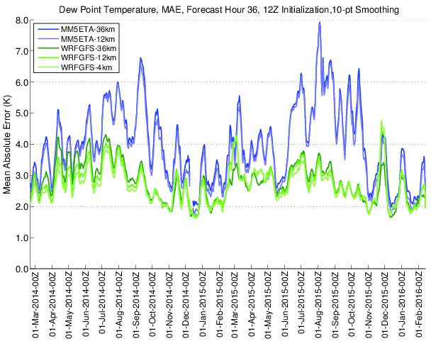
Overall verifications are fine

Slide 4
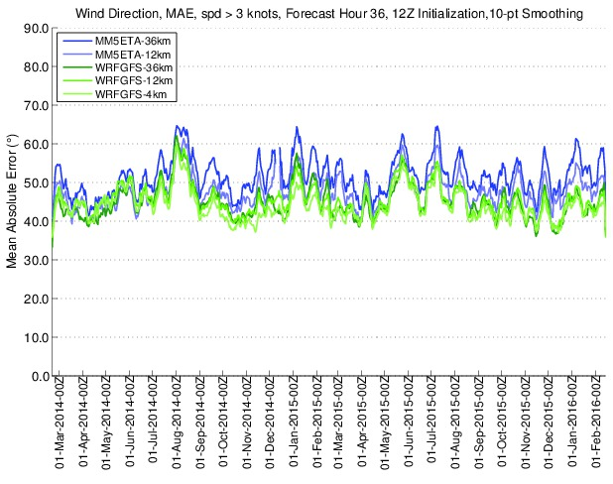

Slide 5
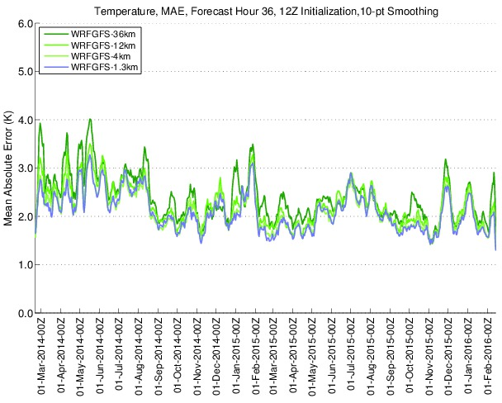

Slide 6
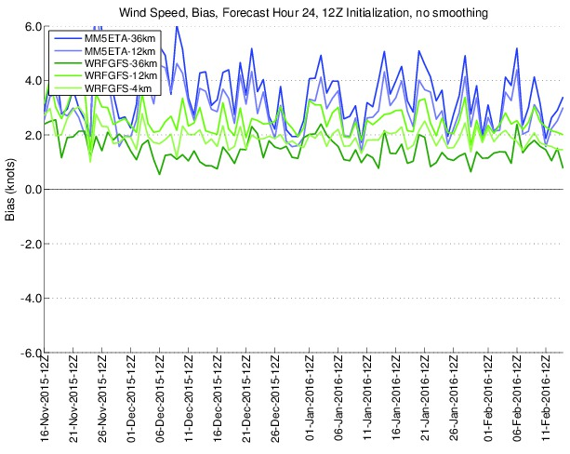
Clear, we still have too strong winds for low wind speed situations

Slide 7
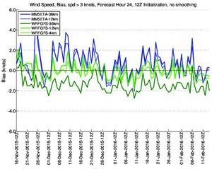

Slide 8
Need to work on putting back in a version of the surface drag parameterization Also testing other PBL schemes in the next version of WRF.

Slide 9
Other problem: stability.
The NOAA MP Land Surface Model and our RAP initialization is causing some 00 Z runs to fail
Our automated system fixes it after 15 minutes
We need to get to the bottom of it or drop MP after snow season is done.

Slide 10
06z run
After extensive evaluation, it is clear this is not a good option

Slide 11
6Z Test Cases
http://www.atmos.washington.edu/~ovens/6ztests
Cases Run, standard verification statistics and graphics:
Nov 8, 2014 stagnation
Nov 17, 2014 stagnation
Dec 26, 2014 stagnation
Feb 20, 2015 Walla Walla ventilation
Feb 27, 2015 Walla Walla ventilation
Jul 7, 2015 Pgt Snd wildfire smoke
Aug 21, 2015 aerosols (climatological aerosols only)
Aug 24, 2015 aerosols (climatological aerosols only)
Oct 13, 2015 Walla Walla ventilation

Slide 12
http://www.atmos.washington.edu/~ovens/6ztests/

Slide 13
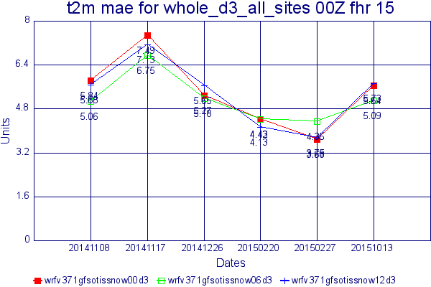

Slide 14
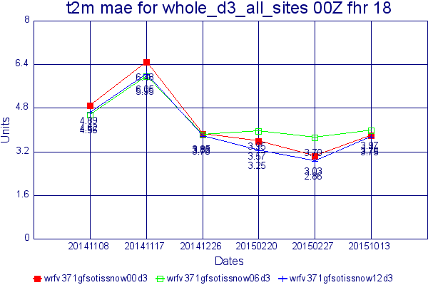

Slide 15
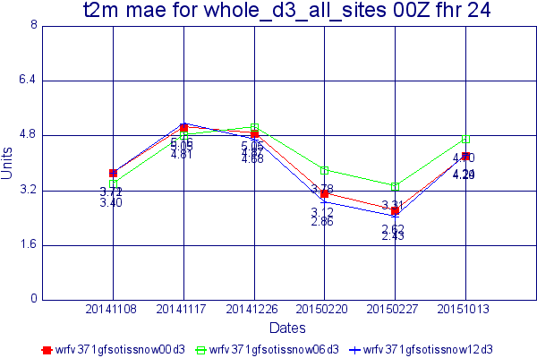

Slide 16
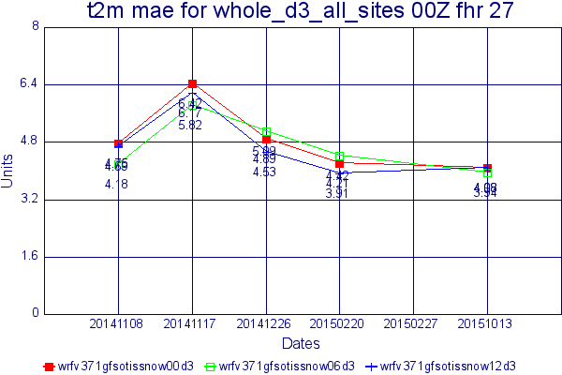

Slide 17
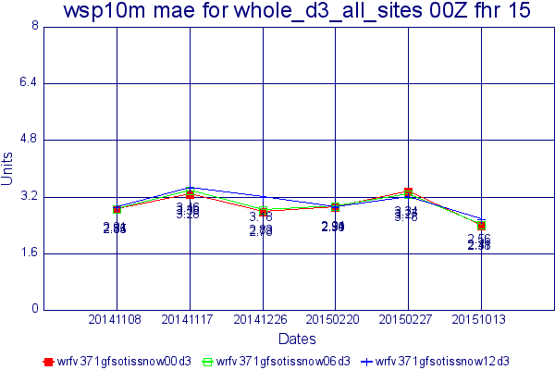

Slide 18
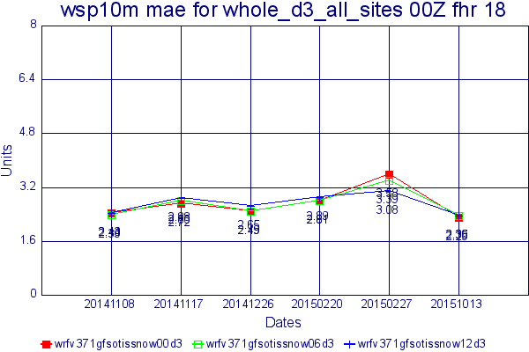

Slide 19
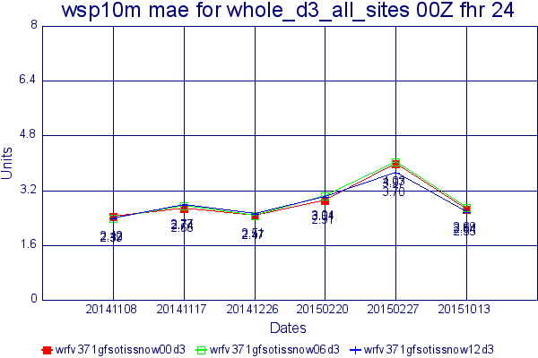

Slide 20
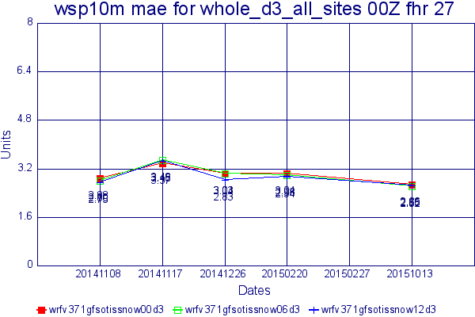

Slide 21
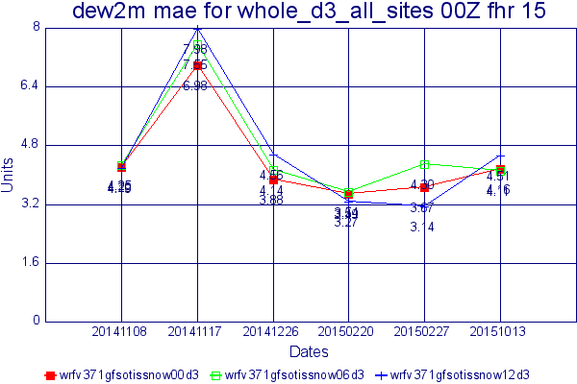

Slide 22
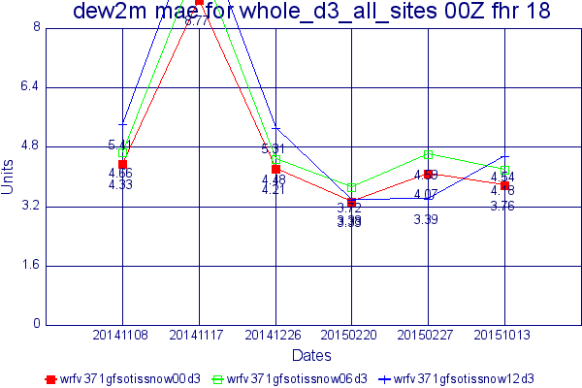

Slide 23
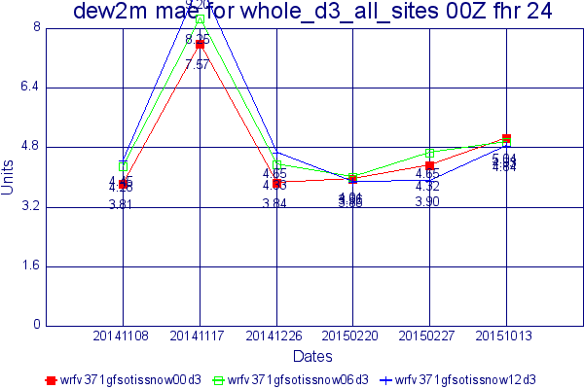

Slide 24
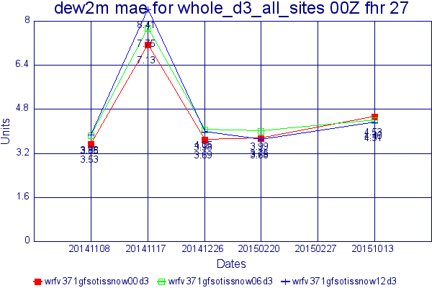

Slide 25
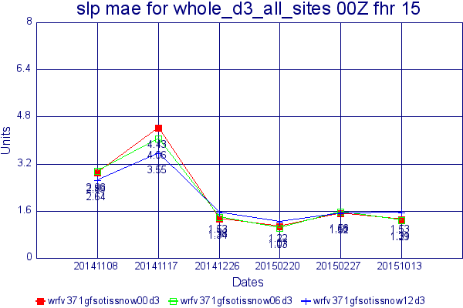

Slide 26
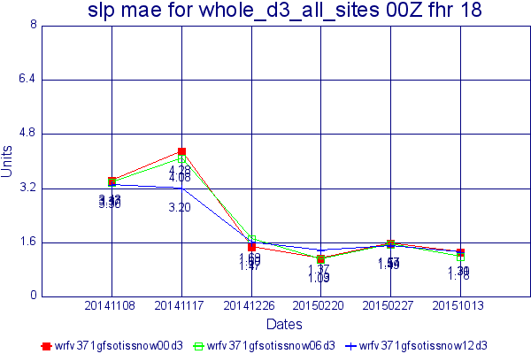

Slide 27
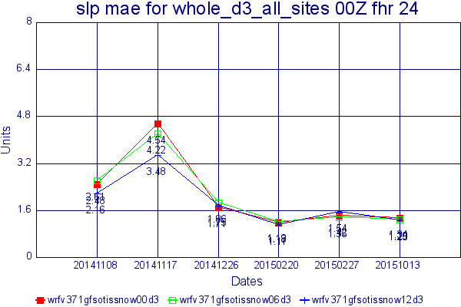

Slide 29
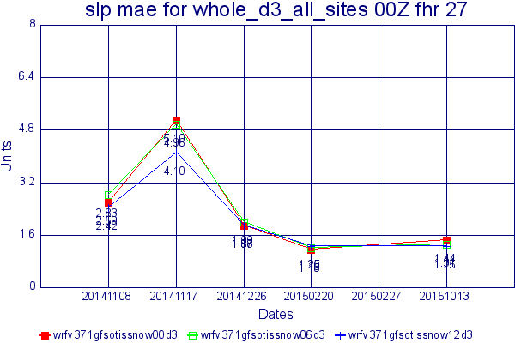

Slide 30
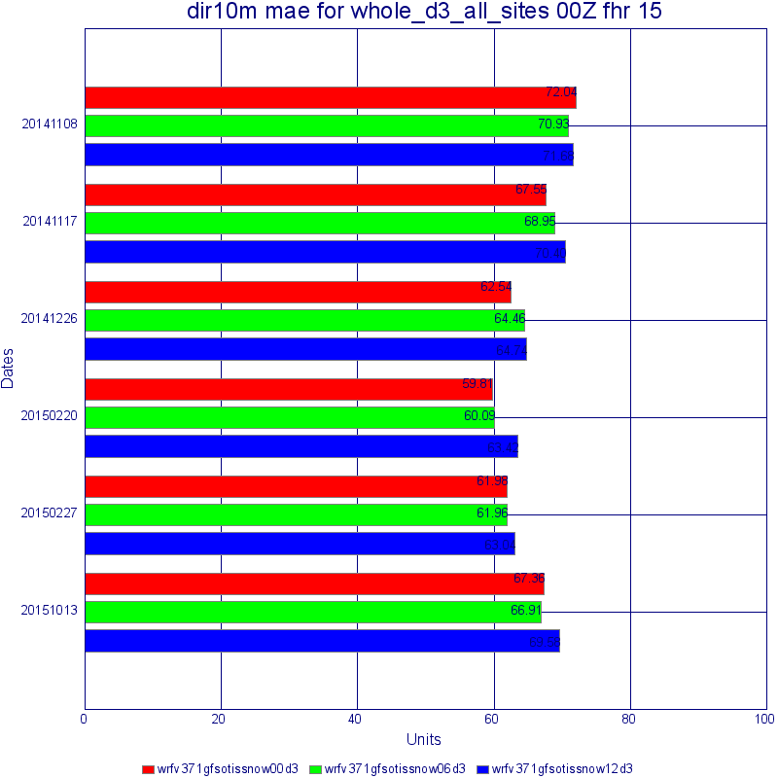

Slide 31
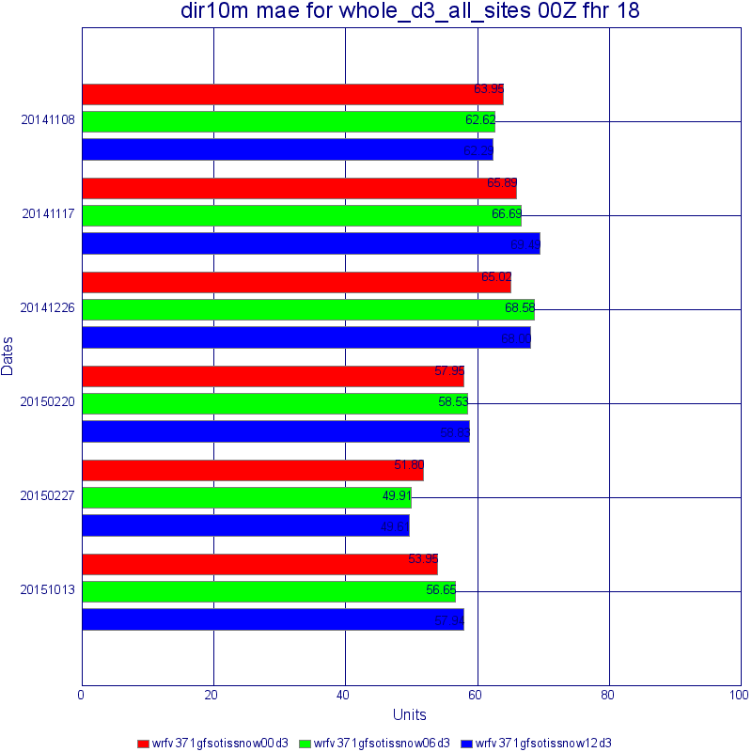

Slide 32
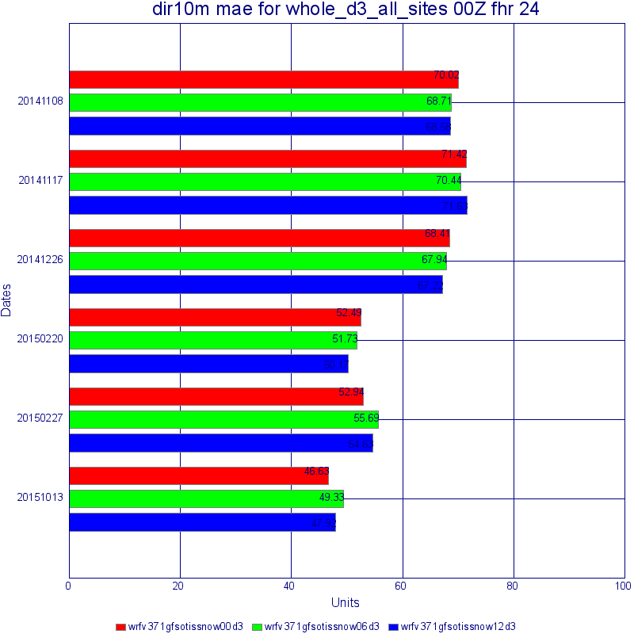

Slide 33
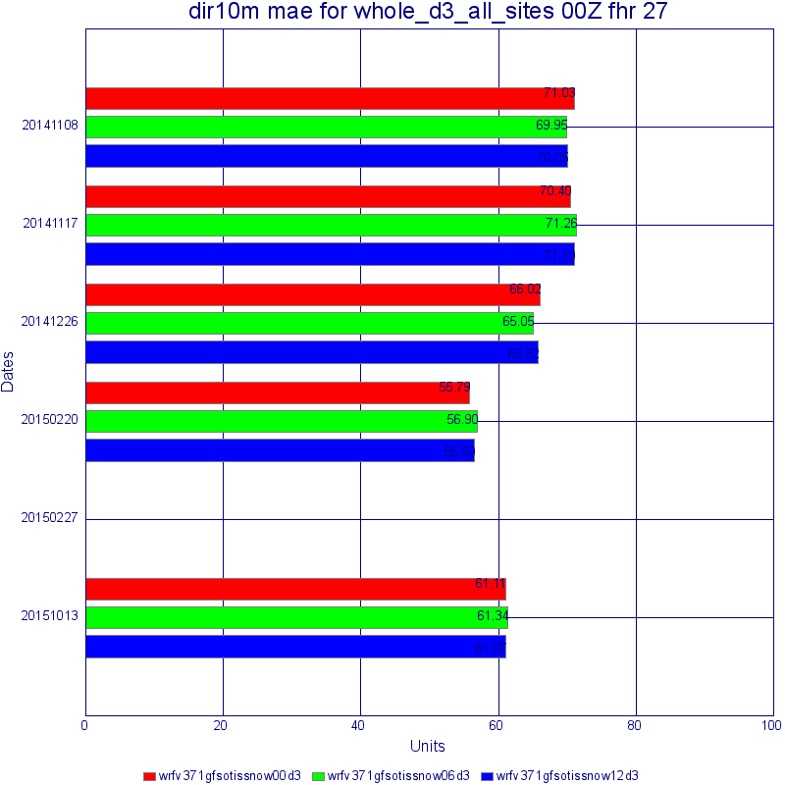

Slide 34
Nov 8 stagnation
4km forecast
Valid 00Z (cf 24 and 18hr forecast)

Slide 35
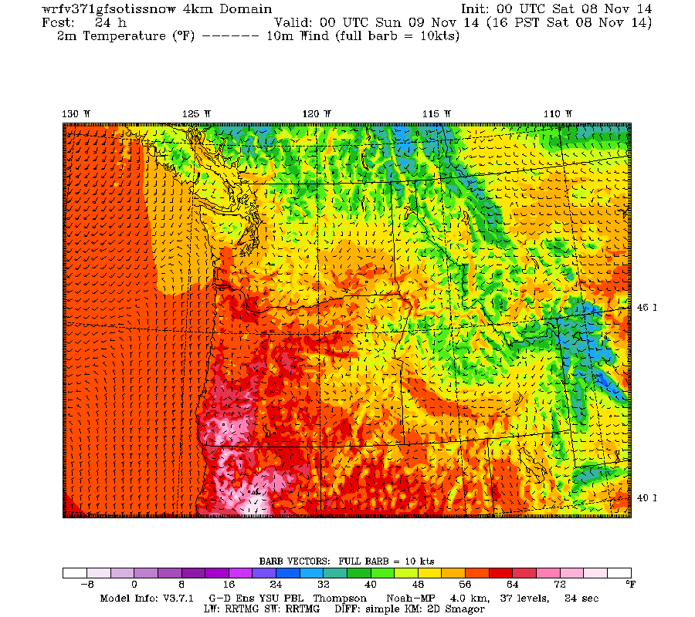

Slide 36
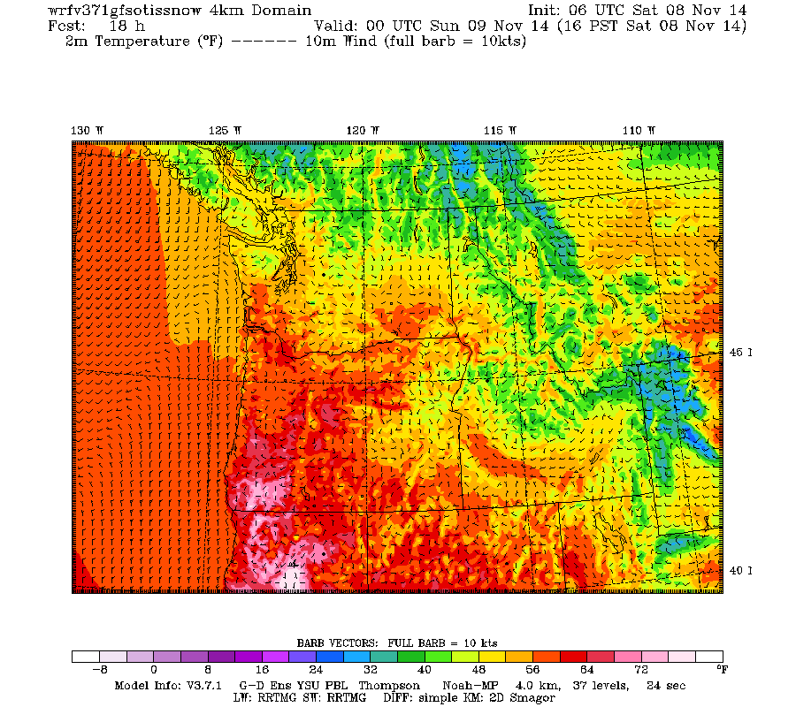

Slide 37
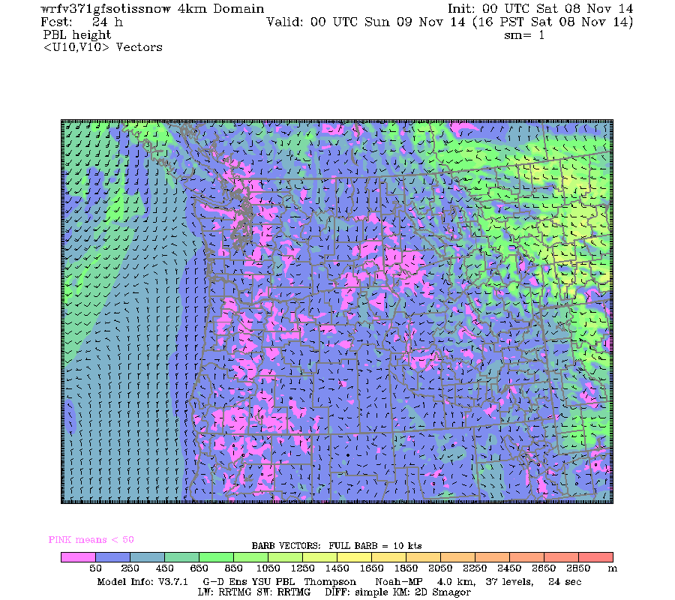

Slide 38
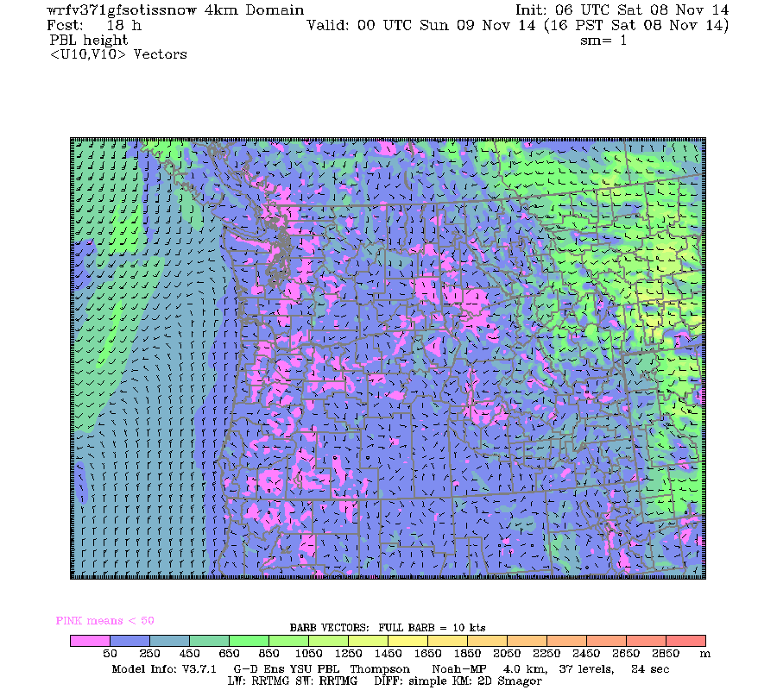

Slide 39
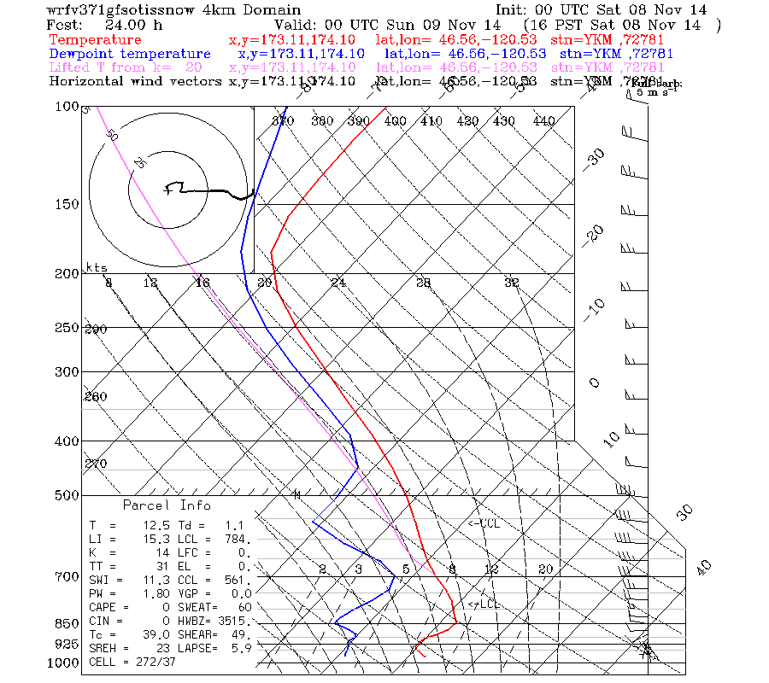
Yakima Sounding

Slide 40


Slide 41
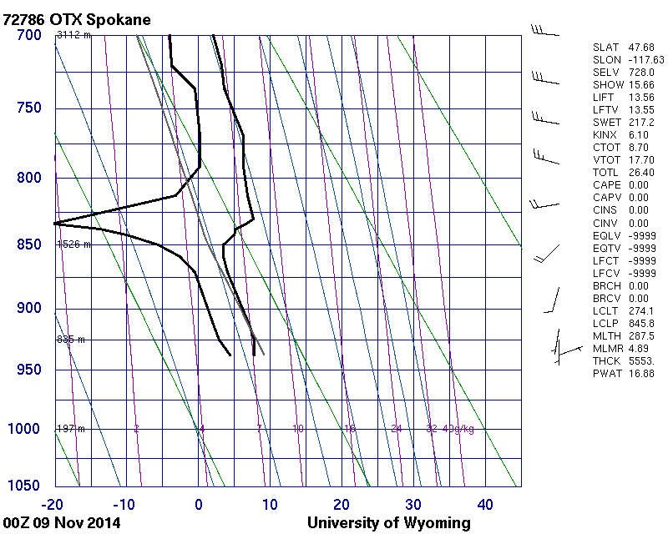

Slide 42
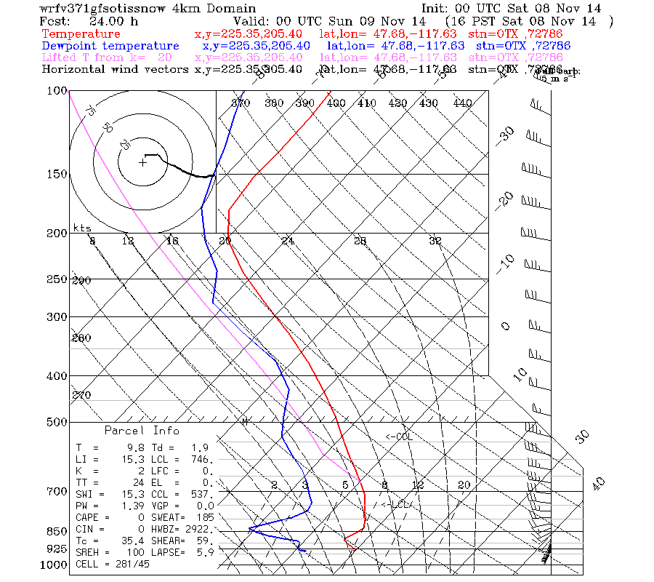

Slide 43


Slide 44
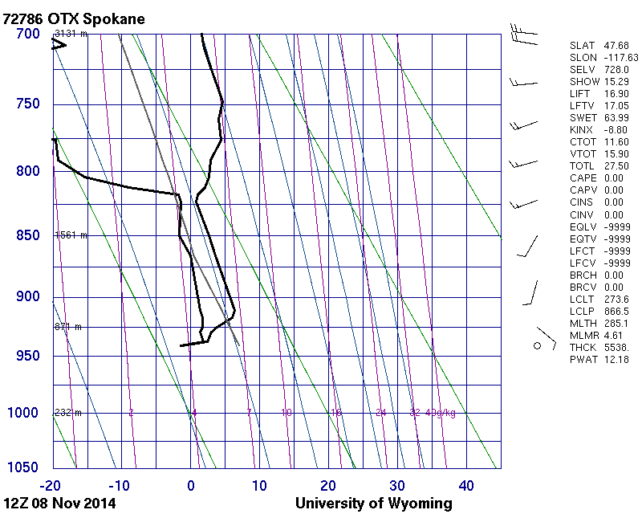

Slide 45
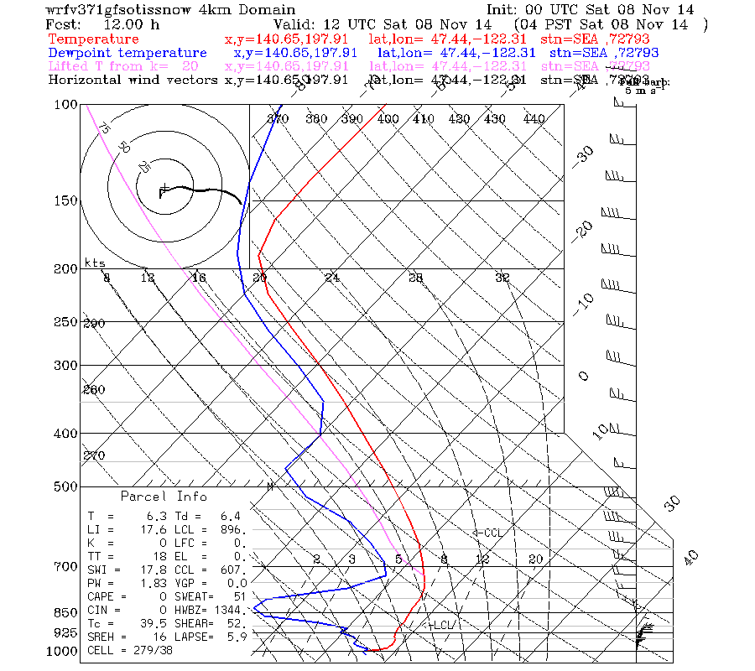

Slide 46
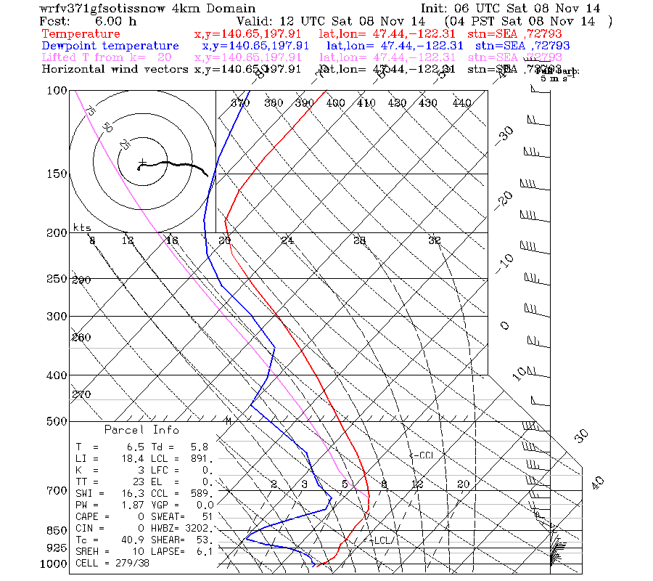

Slide 47
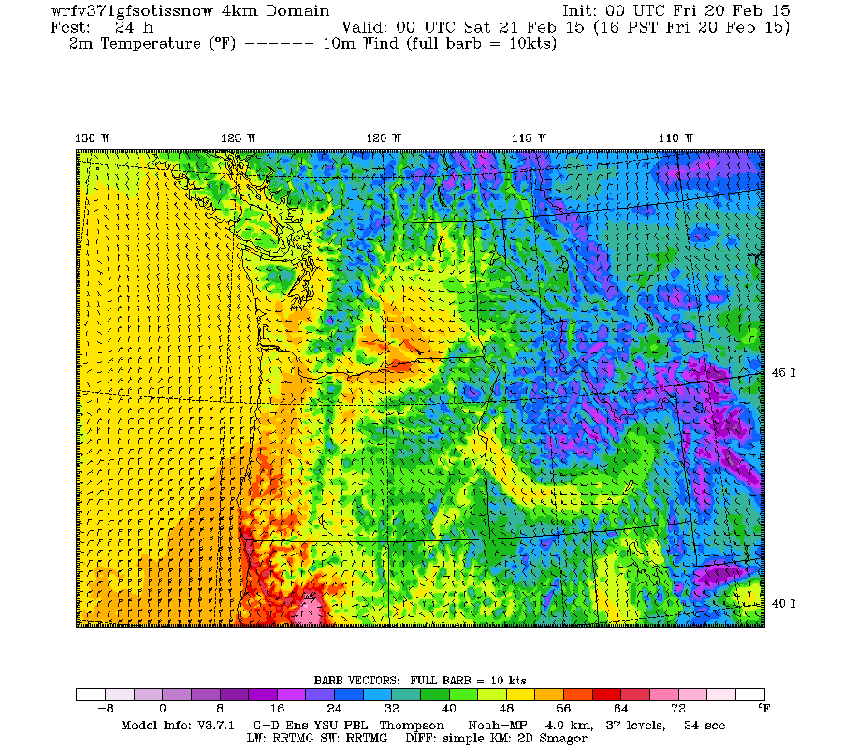
Feb 21 2015

Slide 48


Slide 51
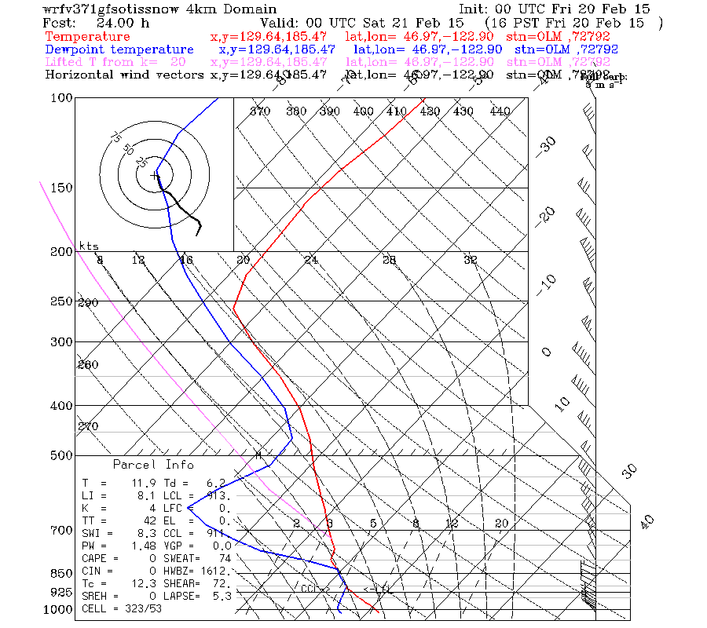
Olympia Sounding

Slide 52
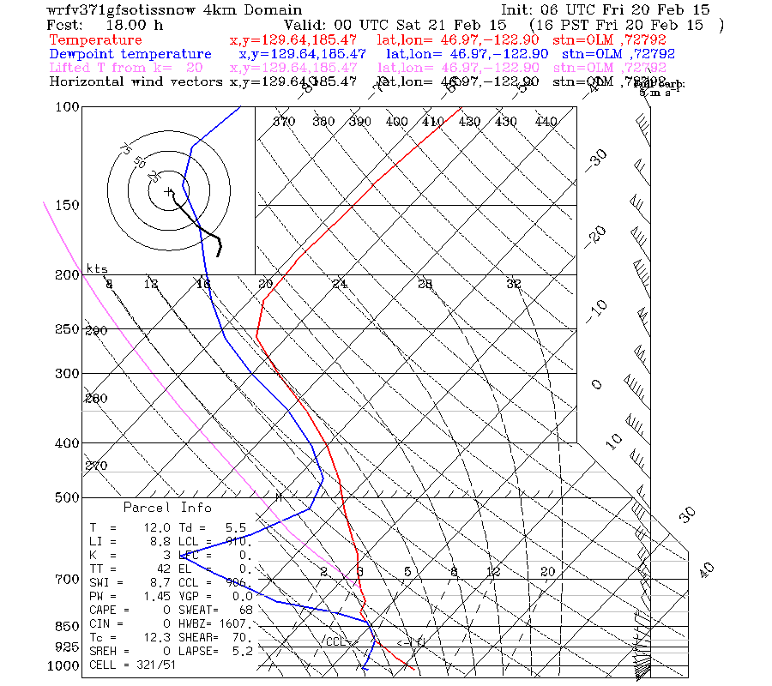

Slide 53
06z Conclusions
06z run offers no significant or consistent improvement over 00Z
Has disadvantages:
no manual supervision (middle of night)
would result in less time separation between the ultra-high res runs (1.3km)
No radiosondes at that time

Slide 54
Requested products and changes
Trajectory products

Slide 55
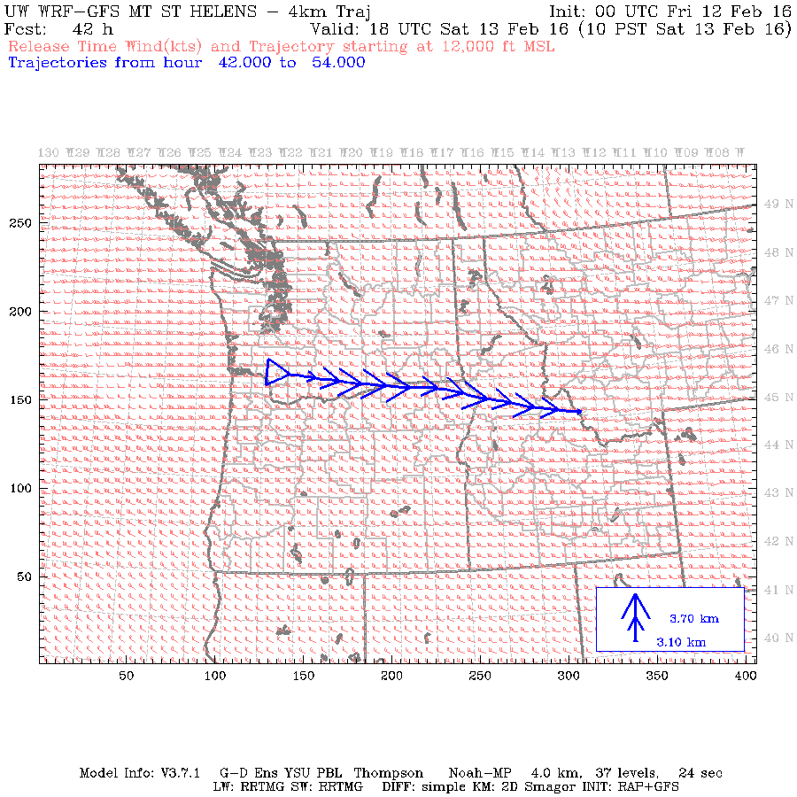
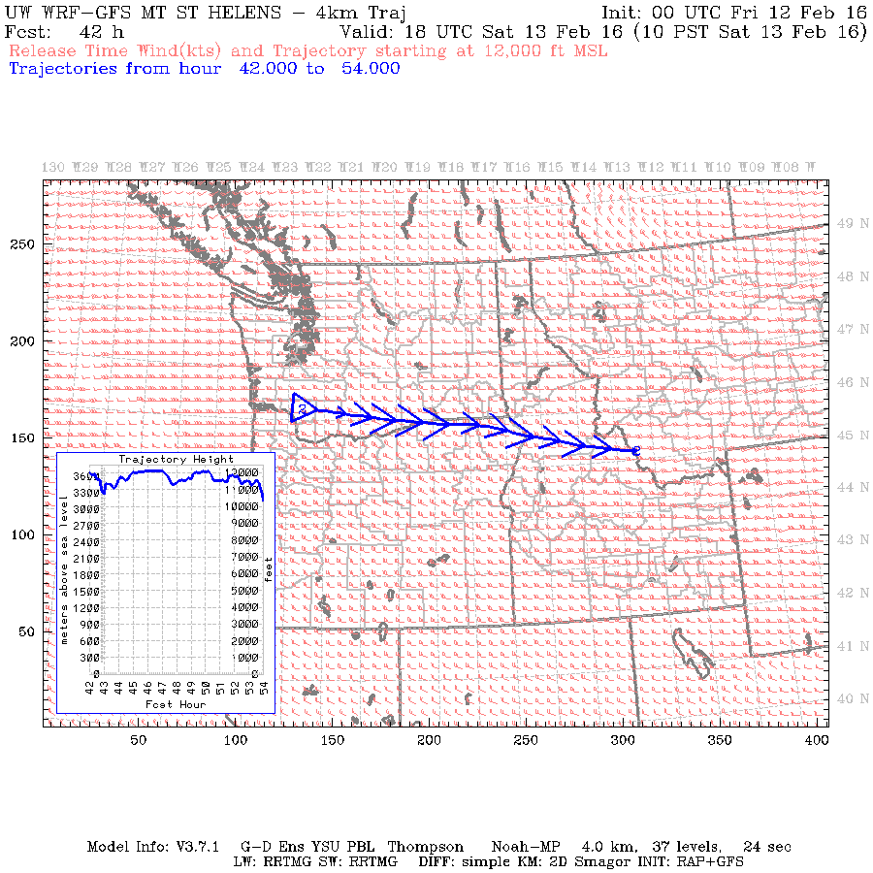
Trajectories
Old
New, option 1 (size of arrows varies with height)—now operational

Slide 56
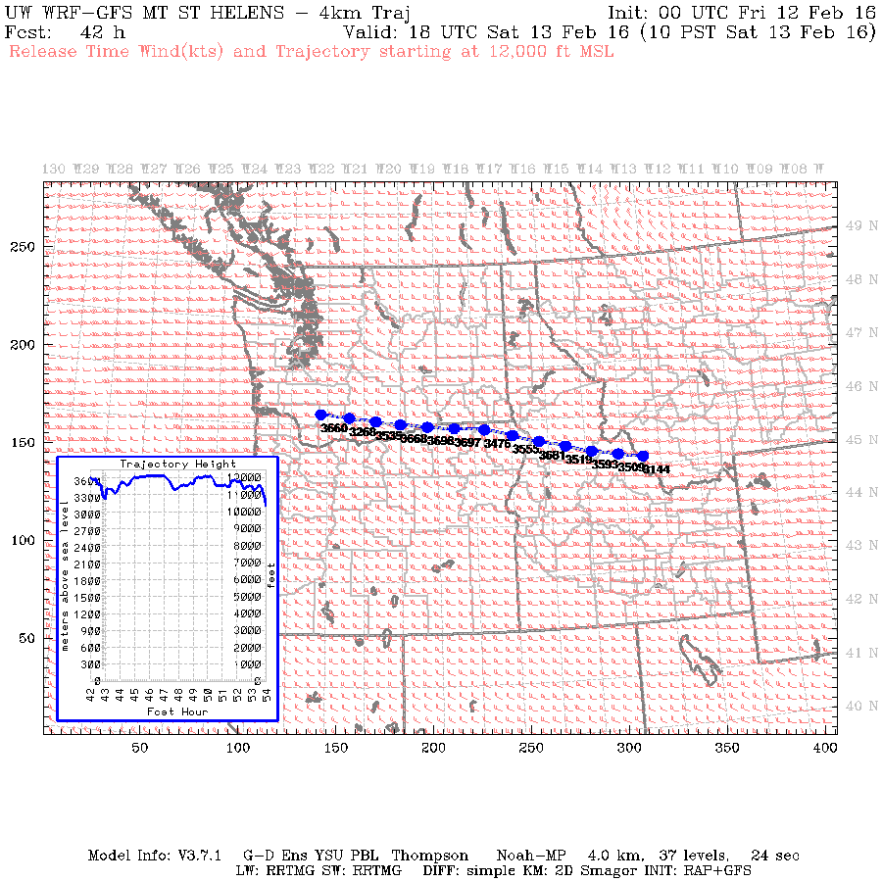
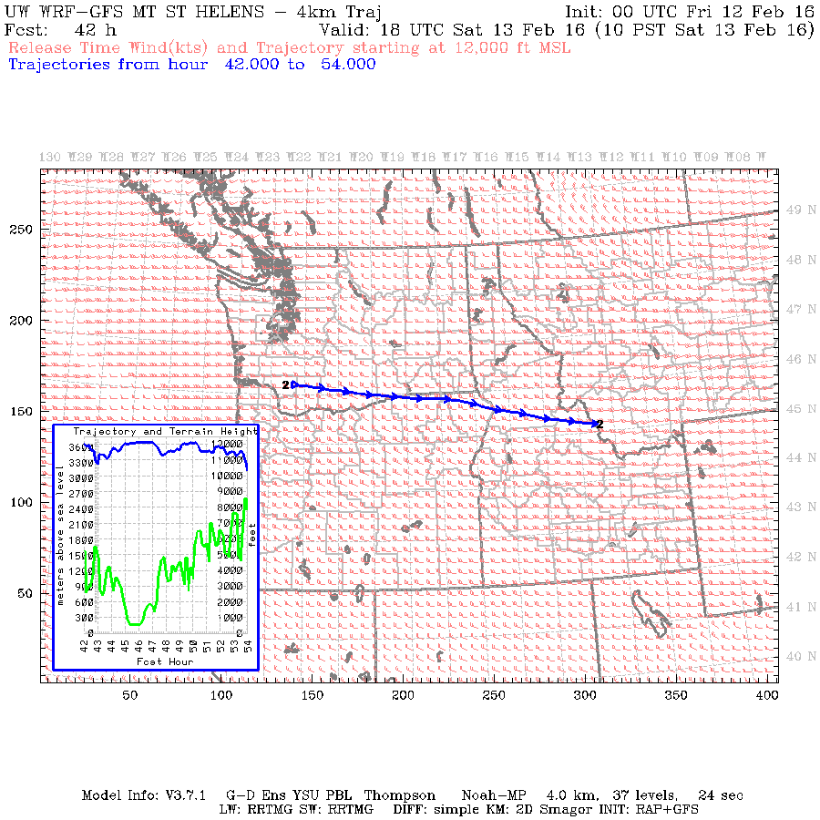
Trajectories
New, option 2 (filled circles and text shows height)
New, option 3 (fixed, smaller arrow size plus green terrain ht)

Slide 57
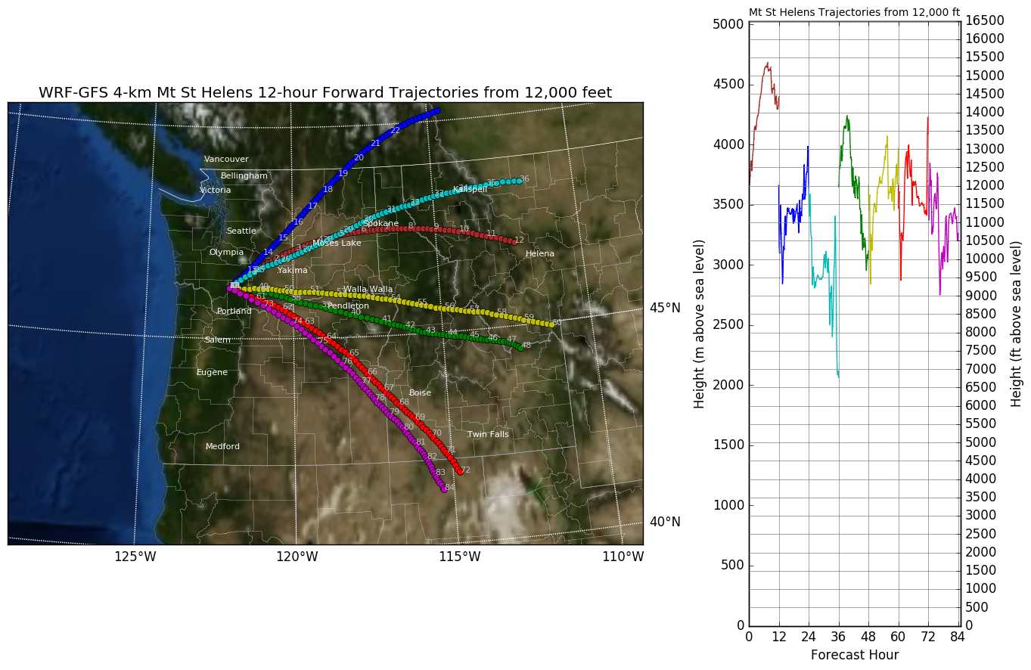
Trajectories, more possibilities
Can display multiple, color-coded trajectories on a single plot.

Slide 58
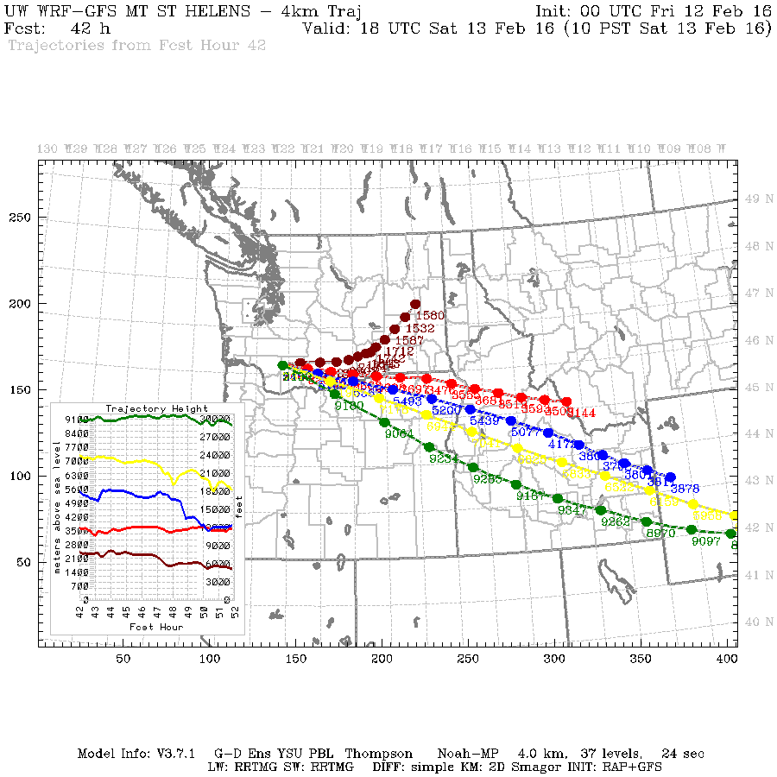
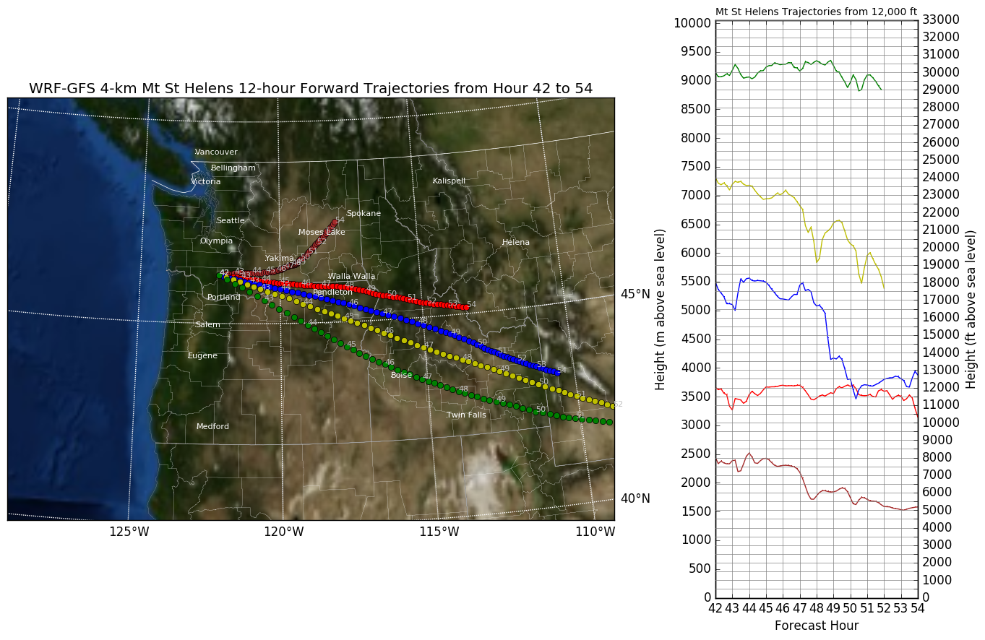
Trajectories, more possibilities
Can display multiple, color-coded trajectories on a single plot.

Slide 59
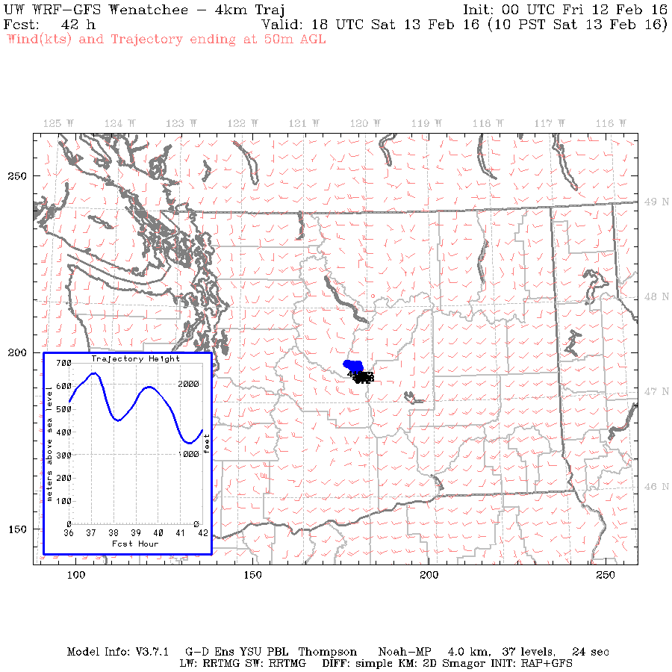
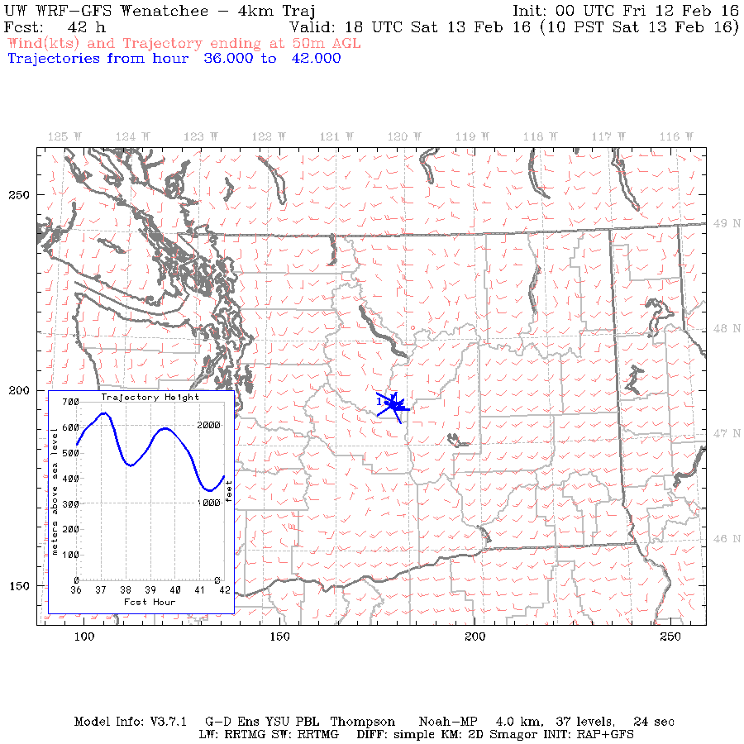
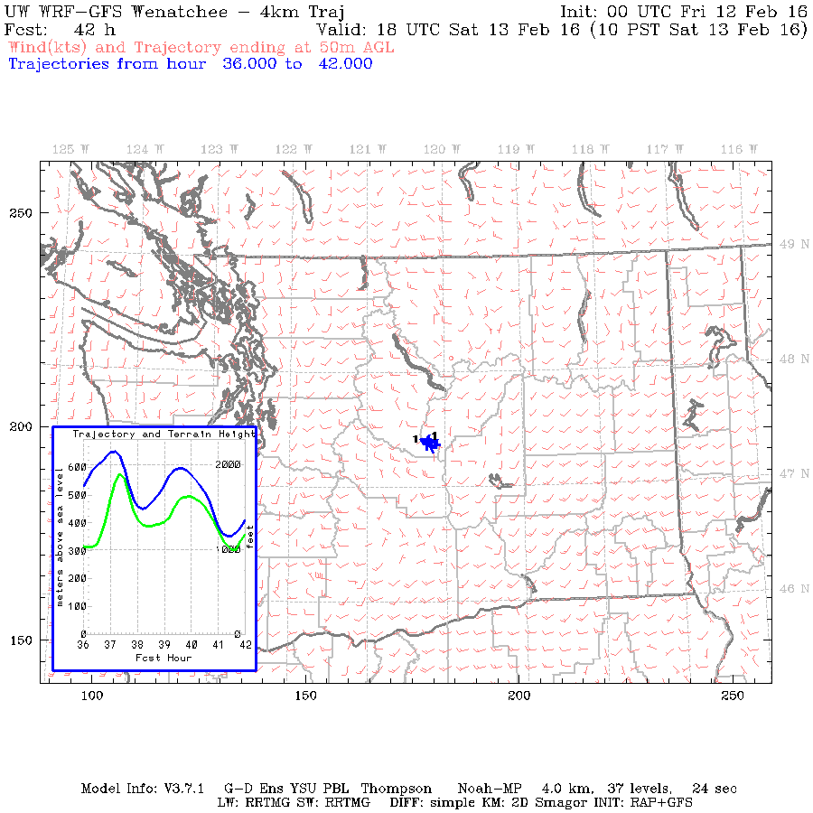
Problem Trajectories
little horizontal movement
New, option 1 (size of arrows varies with height)
New, option 2 (filled circles and text shows height)
New, option 3 (fixed, smaller arrow size plus green terrain ht)

Slide 60
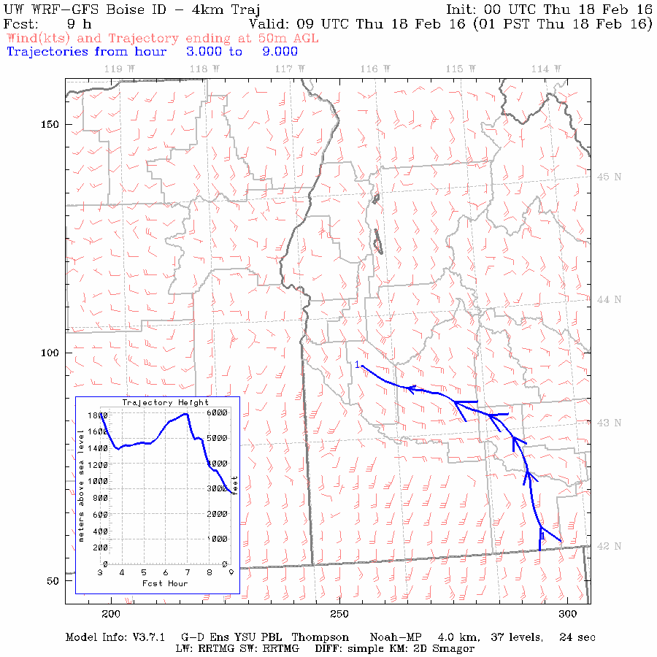
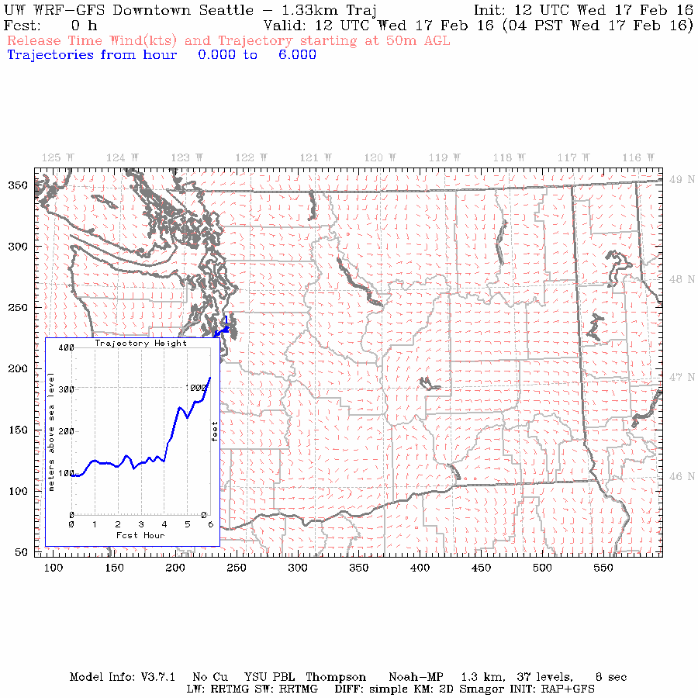

Problem Trajectories
height inset can hide trajectory
Lower left
Lower left ok
Lower right bad
Notes:
This is a new slide that addresses something Rob Elleman pointed out. We can change the location of the height inset, but each location has its problems.

Slide 61


Sounding, Time-height, and Meteogram Generators Fixed
Links updated
Time-heights and meteograms can still take 60-70 seconds.

Slide 62



Sounding, Time-height, and Meteogram Generators Fixed
Links updated

Slide 63


Time-Independent Web Page Promotion to Main Link
Old
New

Slide 64
Less display hours default…but you can add them

Slide 65
Additional Graphics Requests Accomplished
Meteograms: switched to read from left to right.
850-mb wind plots for Nez Perce tribe.
All links switched from MM5 to WRF.
Graphics definitions added on air quality pages.

Slide 66
The EnKF Effort is has advanced and has a new web page.

Slide 67
EnKF System
Regional analysis every 3 hours
Will eventually move to 1 hour
Based on 42 member ensemble based on GFS ensemble
Will add forward forecasts as well.
The question: can we produce a superior analysis than NOAA using far more data assets (e.g., TAMDAR, smartphones)?

Slide 68
Adding smoke to WRF
We have begun work on this
Ran WRF with climatological aerosols
Need to secure a real-time aerosol information source
Priority for next few months.

Slide 69
Priorities
Fix NOAA MP issue
Add smoke
Put in subgrid drag parameterization for low wind speeds.
Improve 4/3 km graphics for readability
Real-time EnkF system

Slide 70
The end

Slide 71
Trajectories Summary
Heights added, with options:
Height above mean sea level
Height above ground level
Height above mean sea level plus height of terrain
Can display arrows or filled circles
Can vary color of trajectory based on:
Forecast time
Height
Trajectory number
Can display multiple trajectories on single plot
Height inset limited to one location in plot
lower left sometimes hides back trajectories
lower right sometimes hides forward trajectories
Notes:
Added the last bullet item and its 2 sub-categories. Getting feedback from users on what they want would be good.

Slide 72
Sounding, Time-height, and Meteogram Generators “fixed”
Links updated

Slide 73
Sounding, Time-height, and Meteogram Generators “fixed”
Links updated
Time-heights and meteograms can still take 60-70 seconds.

Slide 74
Time-Independent Web Page Promotion to Main Link
implemented Feb 17
Old
New
Notes:
Added implementation date to this page.

Slide 75
Additional Graphics Requests Accomplished
Meteograms: switched to read from left to right.
850-mb wind plots for Nez Perce tribe.
All links switched from MM5 to WRF.
Graphics definitions added on air quality pages.

Slide 76
Graphics Requests Still to be Done
Air Stagnation Advisory
Multiple definitions based on individual WFO criteria is hard and potentially confusing. Why not separate plots for each WFO?
GIS-derived zone information is not on a projection that any of our software can use.
Observed soundings changes will require switching to a new plotting package. Mark Albright has begun work on this.
Low stable layer, work has begun.
Notes:
Just added that I’m now working on the low stable layer graphic.

Slide 77
Questions about Additional 6z tests
Many requests involve data sources not normally used in our verification processes: TAMDAR data, PBL height, transport wind speed and direction (as opposed to 10m wind)
Verification code not designed for those parameters.
Data is not in our database.
Unfamiliar with the data quality or, as with PBL height, if it exists in a useful form.
Some requests span multiple days, such as 11/27/2015 – 12/05/2015. We verify from an initialization time (0Z, 6Z, 12Z) to a given forecast hour (12, 24, 27, up to 84). For a span of days like this, can you provide initialization times and specific forecast hours? For example, all 24-hour forecasts from the 0Z compared to 18-hour forecasts from the 6Z and 12-hour forecasts from the 12Z.
A request was made to difference the model from the verification. At present, we are set up to do point-based verification, not grid based.

Slide 78
Questions about Additional 6z tests, continued
Many users want regional, or site-specific verifications for their cases. This can be done, but was omitted in the initial cut because it was felt that domain-wide verification was the most useful in determining the utility of 6Z runs.
Seattle City Light and Seattle Public Utilities:
August 16, 2015 rain event: do we mean 8/15/2015? Archived radar shows no rain in Seattle area on the 16th.
Would need to get SPU data in order to verify forecast rainfall, wind speed, wind gust, wind direction.
Puget Sound Clean Air:
Want histograms of low wind speeds broken down at 0.2 knot increments for specific sites. Not part of standard verification, but could be done.

