Slide 1
Dew, Frost and Fog
Atmospheric Sciences 101
Autumn 2023

Slide 2
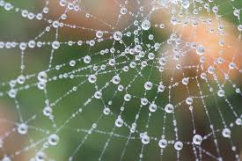
Dew
Condensation on the surface when surface temperature falls to the dew point temperature
Often occurs on cold, clear nights in areas open to the sky.
On such nights, the surface emits infrared radiation to space, cooling surface to the dew point

Slide 3
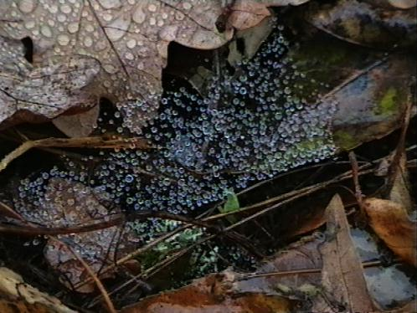

Slide 4
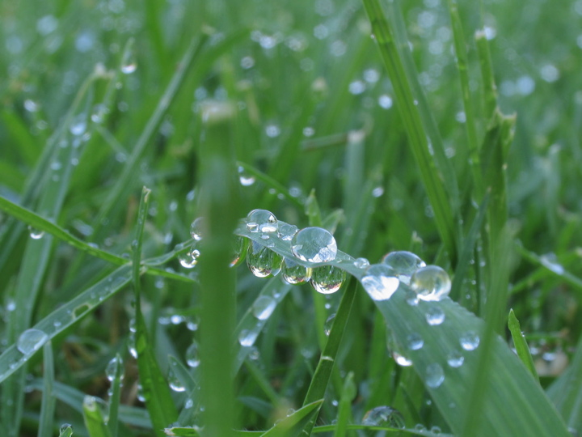

Slide 5
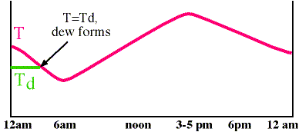
Temperature drops, dew point remains constant until dew forms

Slide 6
Dew
Often associated with periods when high pressure is overhead
High pressure areas are associated with clear skies and calm or weak surface winds.
Why are weak winds good for dew? Less mixing of warmer air from above!

Slide 7
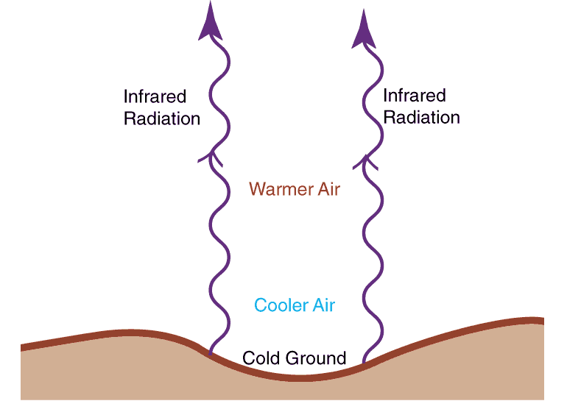
Clear Skies Allow Infrared Radiation Cooling from the Surface
Surface cools more effectively than the atmosphere
Cooling near the surface can produce an inversion

Slide 8
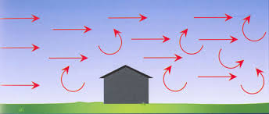
Winds can mix warmer, drier air down to the surface: bad for dew!

Slide 9
Cars in the open often get covered with dew
Cars in a carport gather little dew
Why?

Slide 10
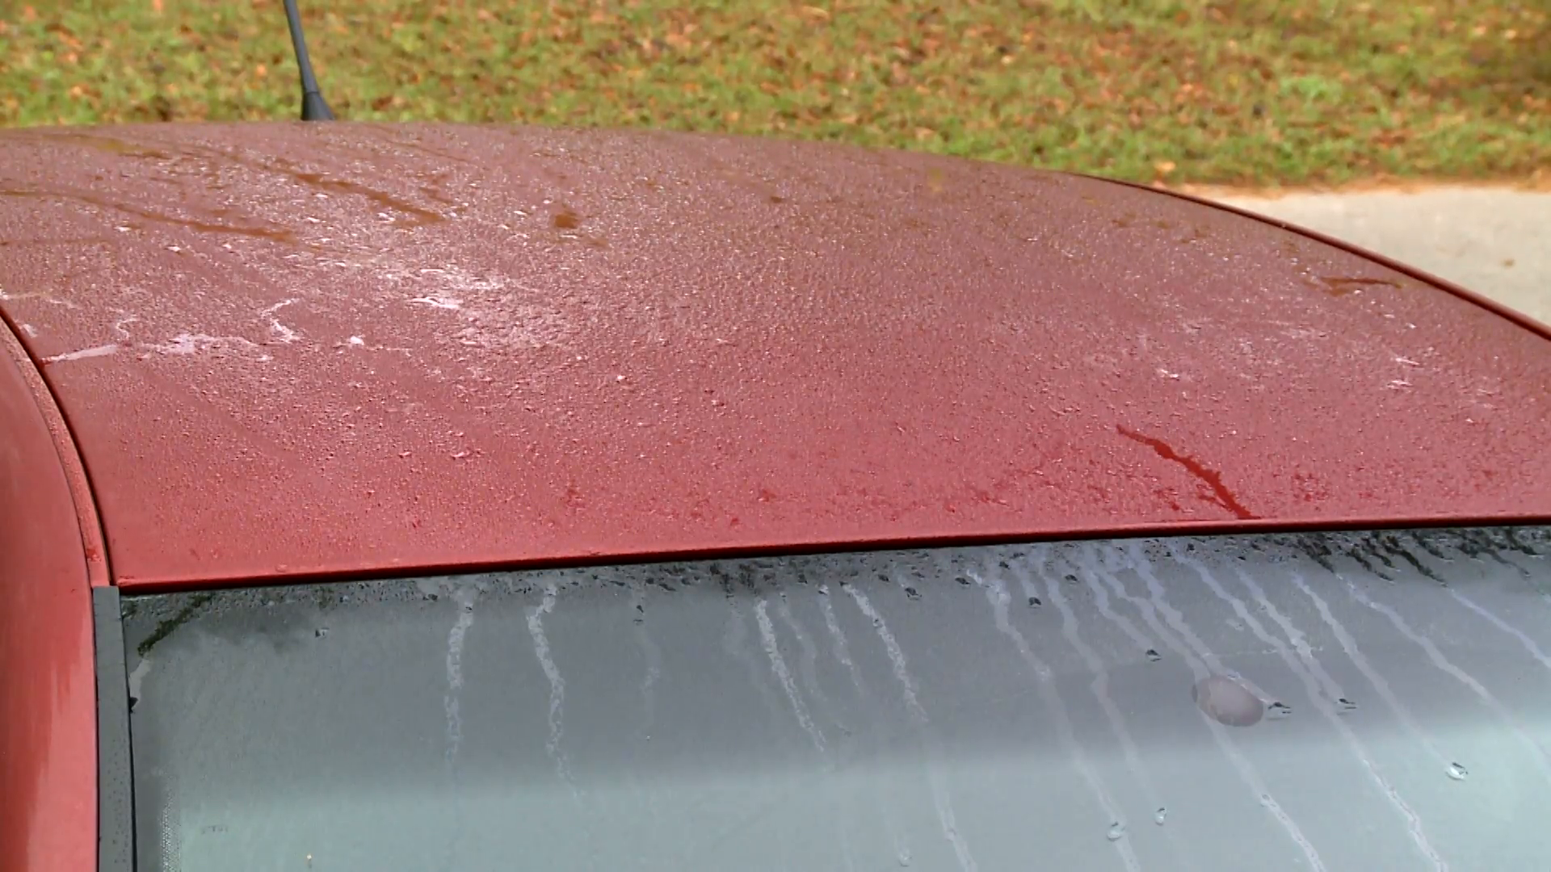

Slide 11
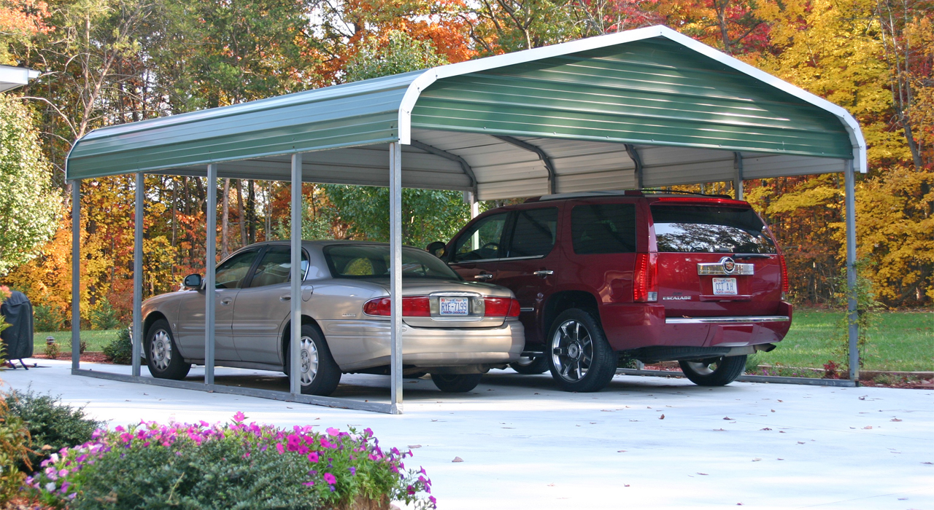

Slide 12
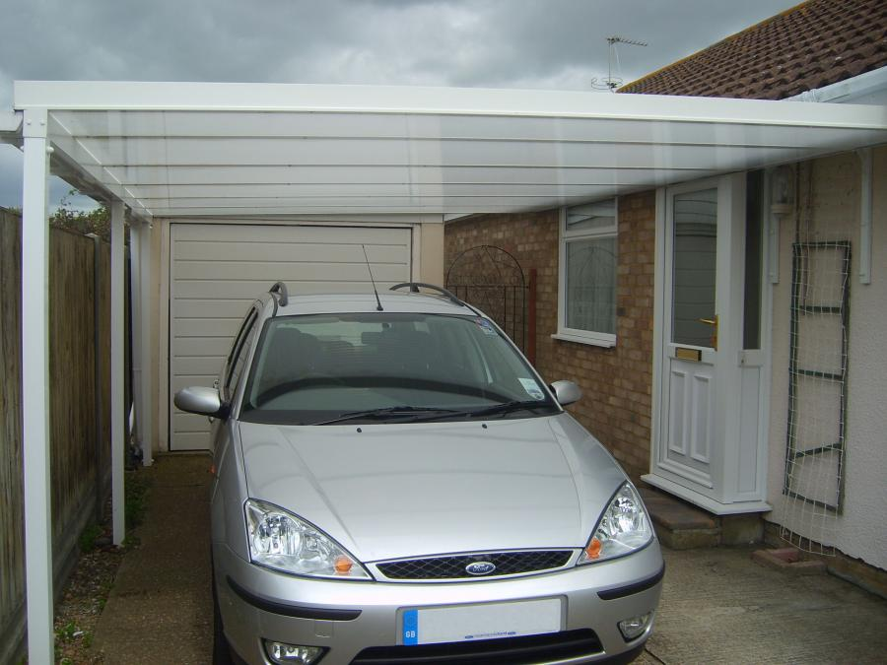
Dew Protection: Roof Lessens Infrared Cooling to Space

Slide 13
More Dew Facts
More dew after a moist period or in moist areas. Why? Higher dew point!
So easier for temperature to drop to the dew point temperature.
Dew releases the latent heat of condensation and reduces temperature drops after it starts to form

Slide 14
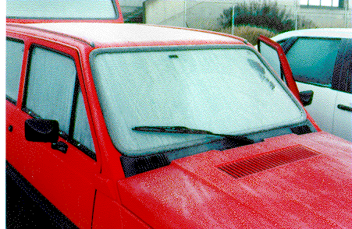
Frost

Slide 15
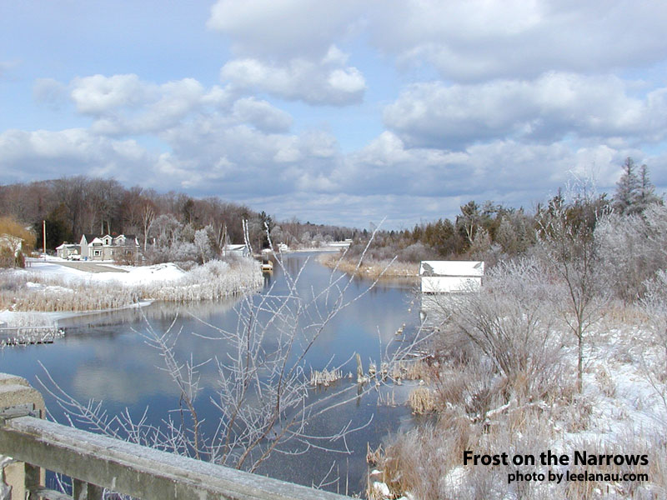

Slide 16
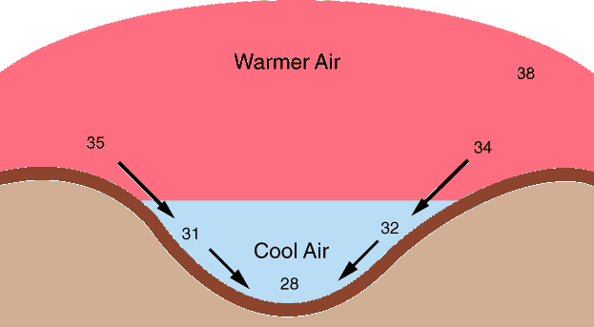
Frosty Facts
Frost forms by the process of deposition, with water vapor going directly to ice (frost)
Frost forms as the air temperature drops to the dew point, when the dew point is at or below 0C (a.k.a. frost point)
Frost tends is most frequent in low-lying areas, since cold air is denser than warm air and flows to low spots.

Slide 17
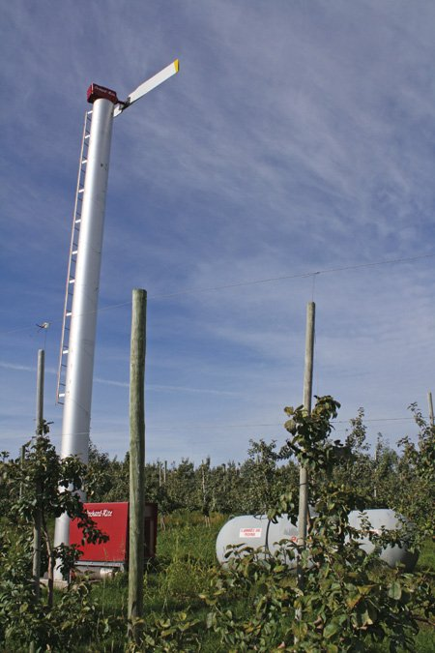
Frost is a problem for orchards in eastern Washington
Damages sensitive buds
Ways to attack the problem:
  Fans
  Heaters
  Spraying water

Slide 18
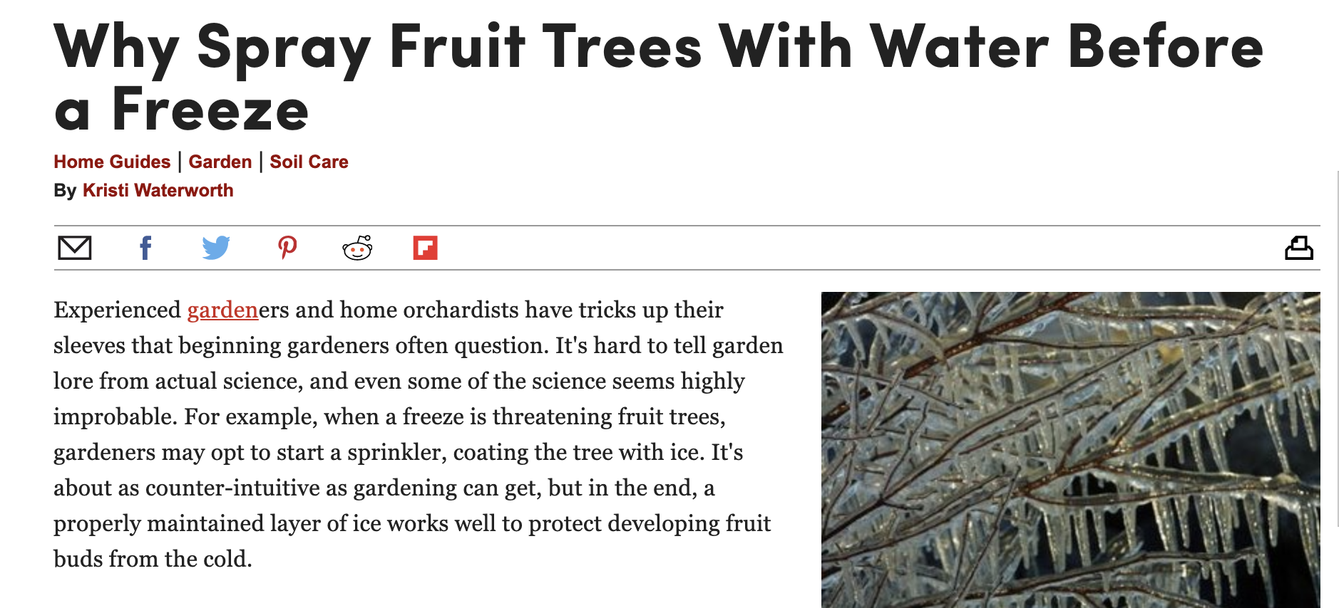
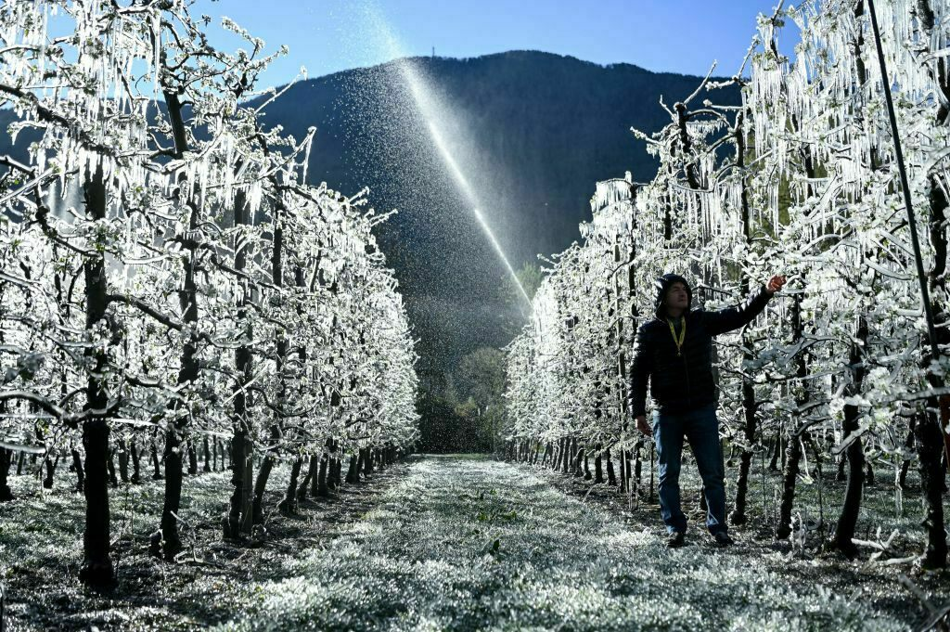
Why does spraying water help in cold weather?

Slide 19
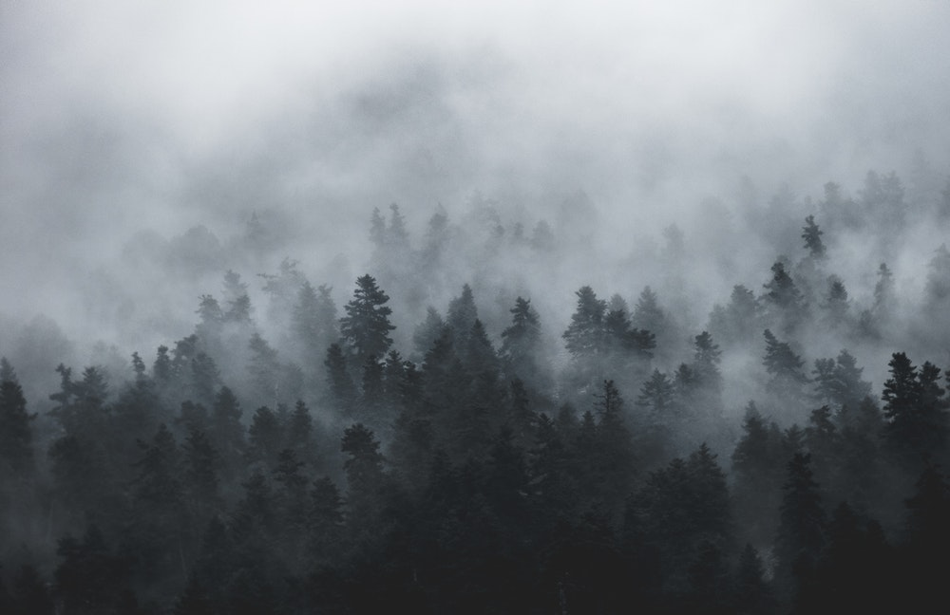
FOG

Slide 20
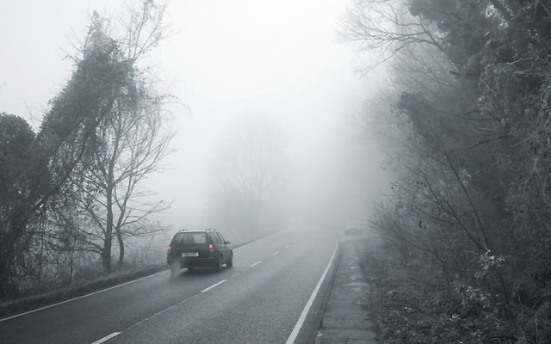
Fog is a cloud intersecting the ground
Can be made of liquid water droplets or ice crystals (ice fog)
Can get fog in three ways:
  Cooling air to the dew or frost points
  Adding moisture to the air (increasing dew point)
  Mixing different air masses that are not saturated, but are when mixed

Slide 21
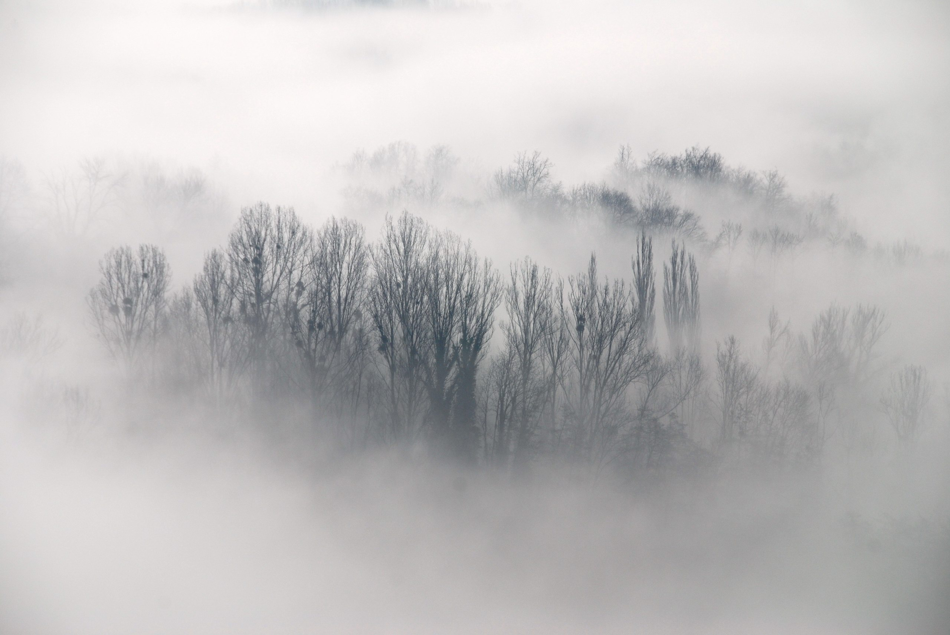
Types of Fog
Radiation
Advection
Upslope
Frontal
Steam fog

Slide 22
Radiation Fog
Associated with clear or nearly clear conditions, light winds, moist layer near the ground
Earth radiates infrared radiation to space and cools the surface
Light turbulence mixes cool air from surface into lower atmosphere, which cools to the dew point

Slide 23
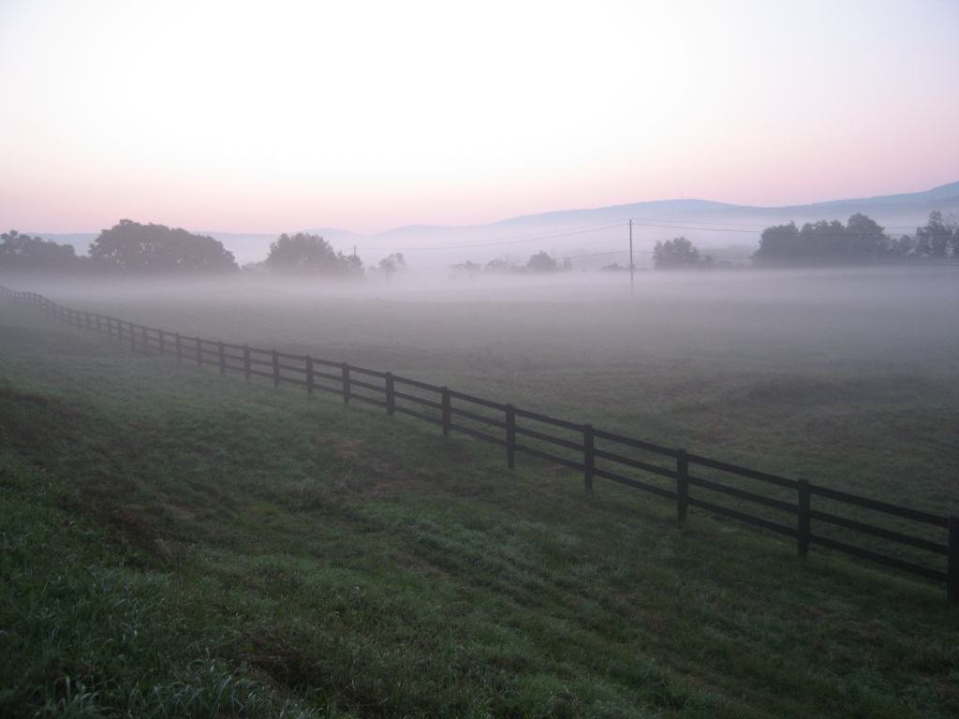
When there is little wind

Slide 24
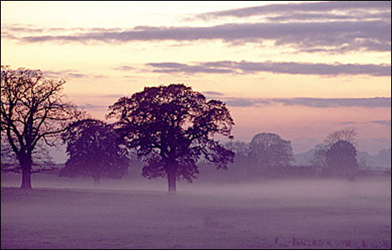
If winds are very light: Ground Fog

Slide 25
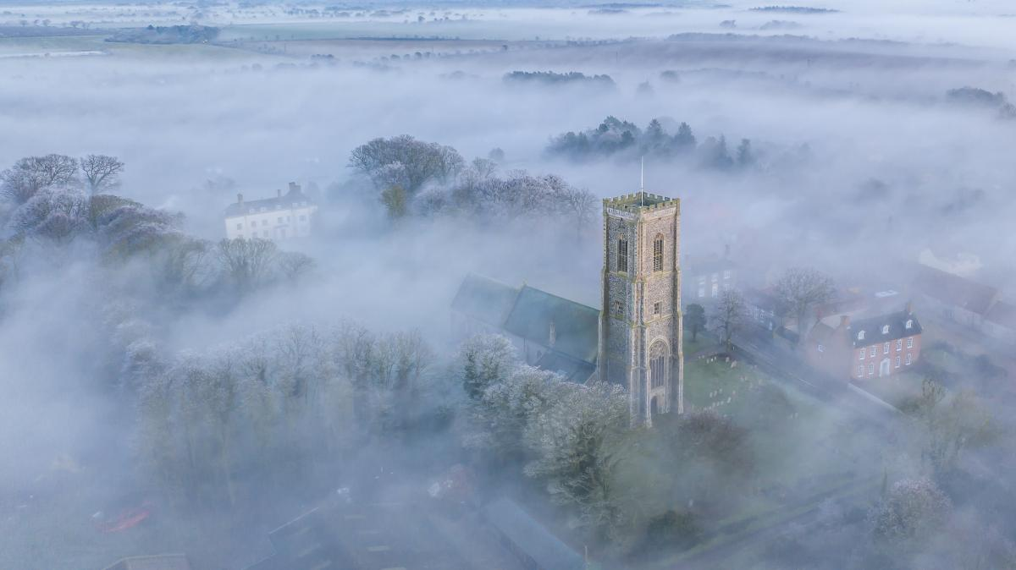

Slide 26
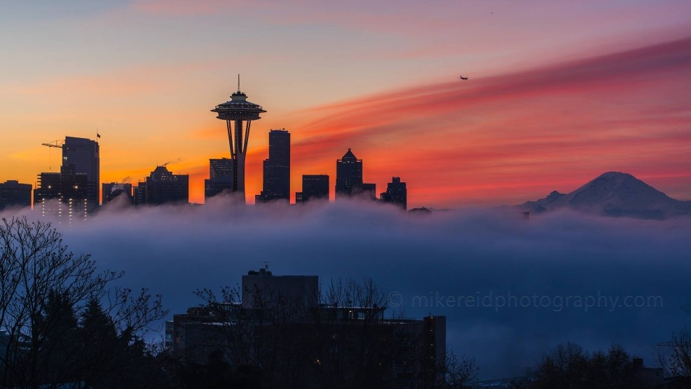
More wind mixing gives deeper fog

Slide 27
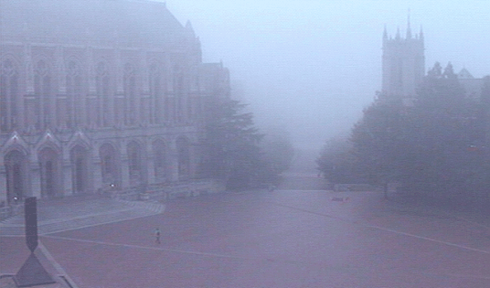

Slide 28
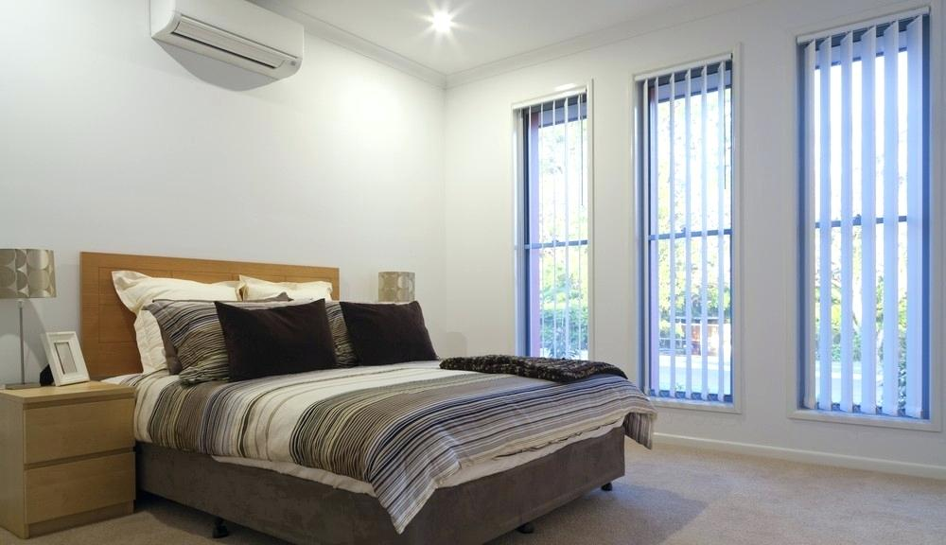
Radiation Fog
Light winds (2-7 knots) ideal. Why? Just the right amount of mixing. Too strong winds mixes too much dry warm air to the surface.
Like trying to cool a big house with a small AC

Slide 29
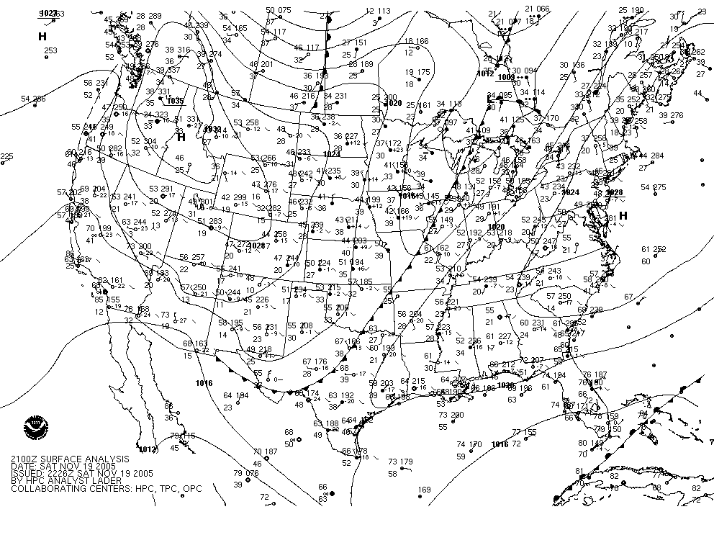
Fog often associated with high pressure (which is associated with clear skies, light winds)

Slide 30
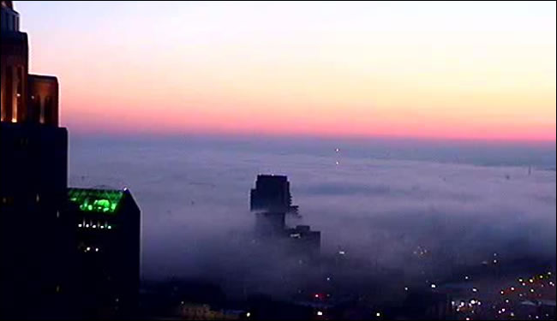
Radiation Fog is the Major Fog Here in the Northwest

Slide 31
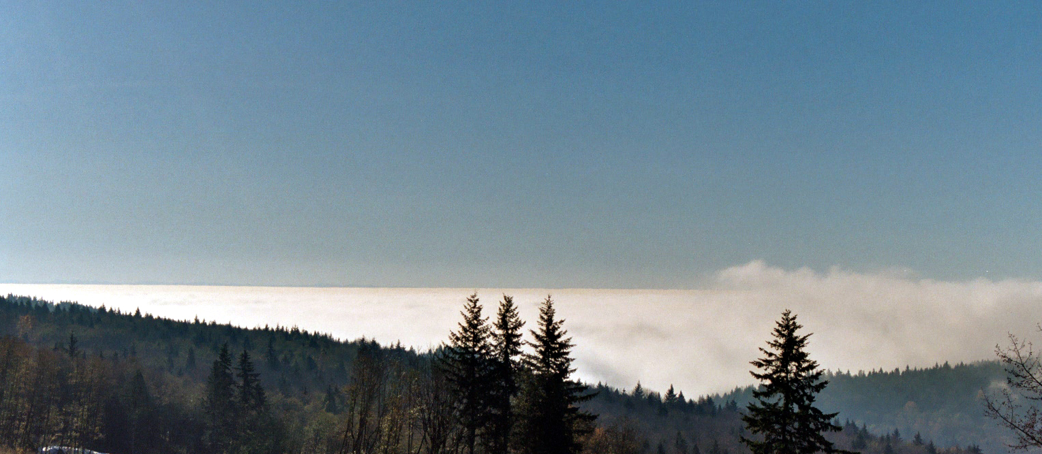
How deep?
Radiation fog can range from a few inches (ground fog) to a few hundred meters in depth

Slide 32
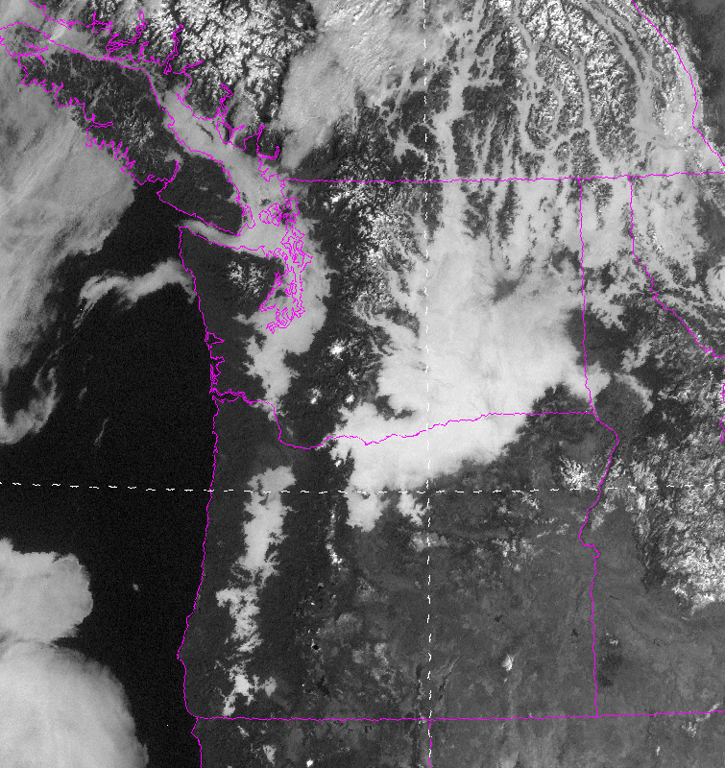
Fog from space

Slide 33
When is the foggiest time of the year here in the Northwest away from the Pacific?

Slide 34
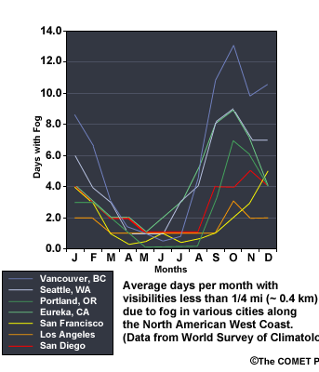
Early fall.
Why?

Slide 35
The Answer
Early Fall
  Lengthening nights (more time to cool)
  Still clear or partly cloudy (good radiational cooling)
  Surface is moister than in mid-summer
  Atmosphere is relatively stable (atmosphere is still warm, surface cooling)

Slide 36
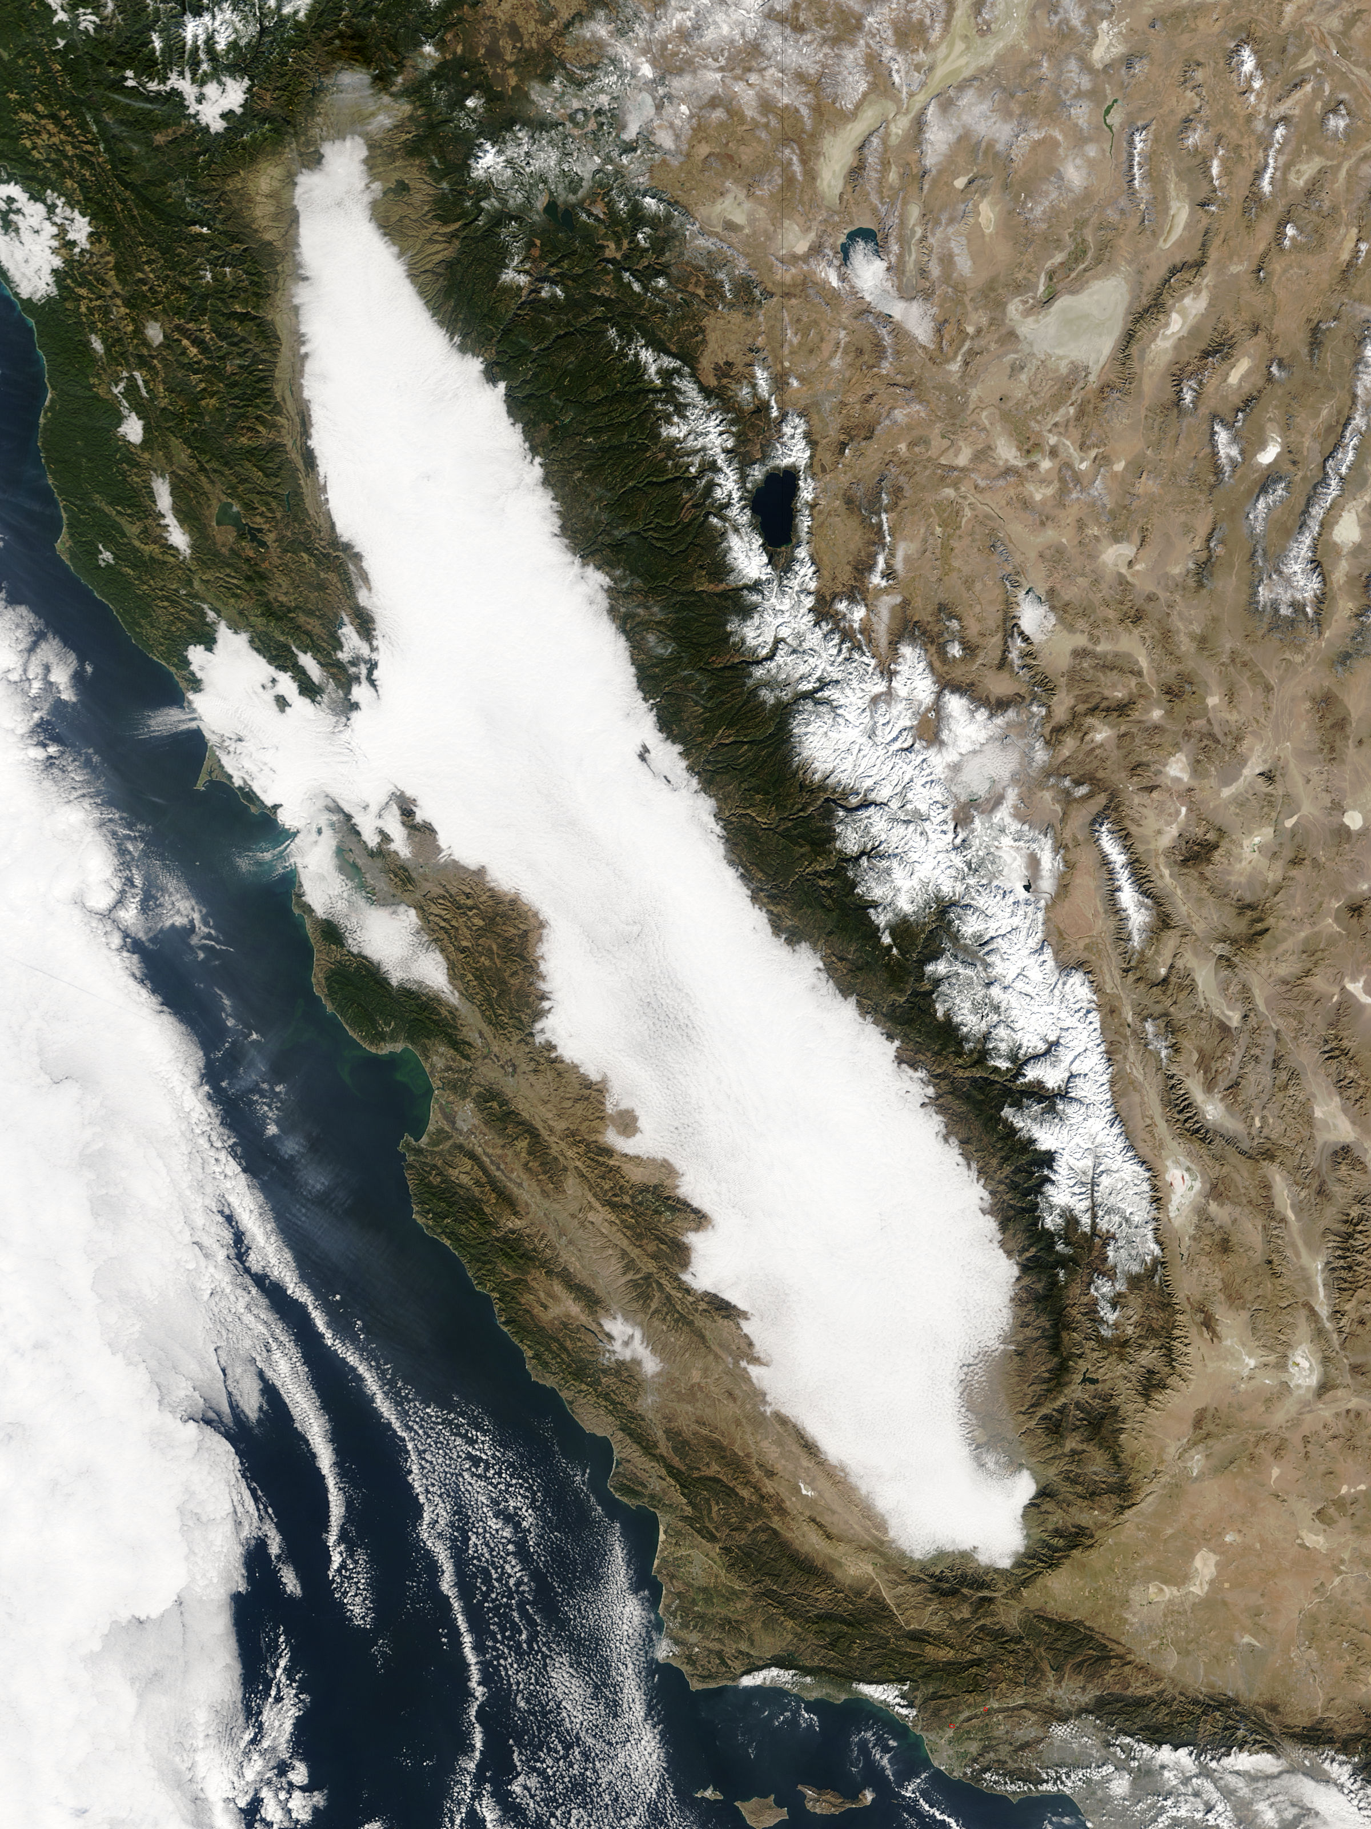
Radiation Fog Can Fill the Central
Valley of
CA
Tule Fog

Slide 37
Advection Fog
advection: the horizontal transfer of any atmospheric property by the wind

Slide 38
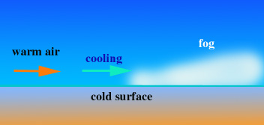
Warm air is advected over a cool surface

Slide 39
Advection Fog
Occurs when warm, moist air moves over a cooler surface
Frequently observed along the West Coast in summer. There is cold water just offshore during late spring into fall.
When warm, moist air from the Pacific goes over cool coastal water, can get saturation and fog.

Slide 40
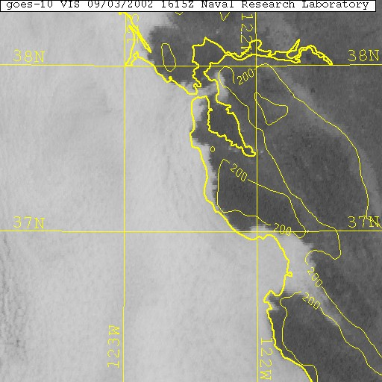

Slide 41
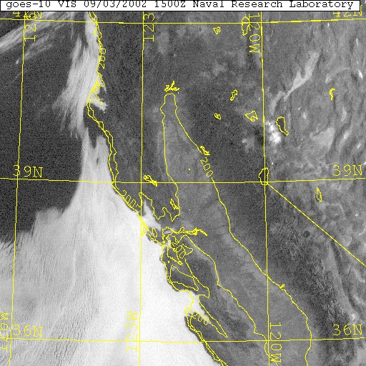

Slide 42
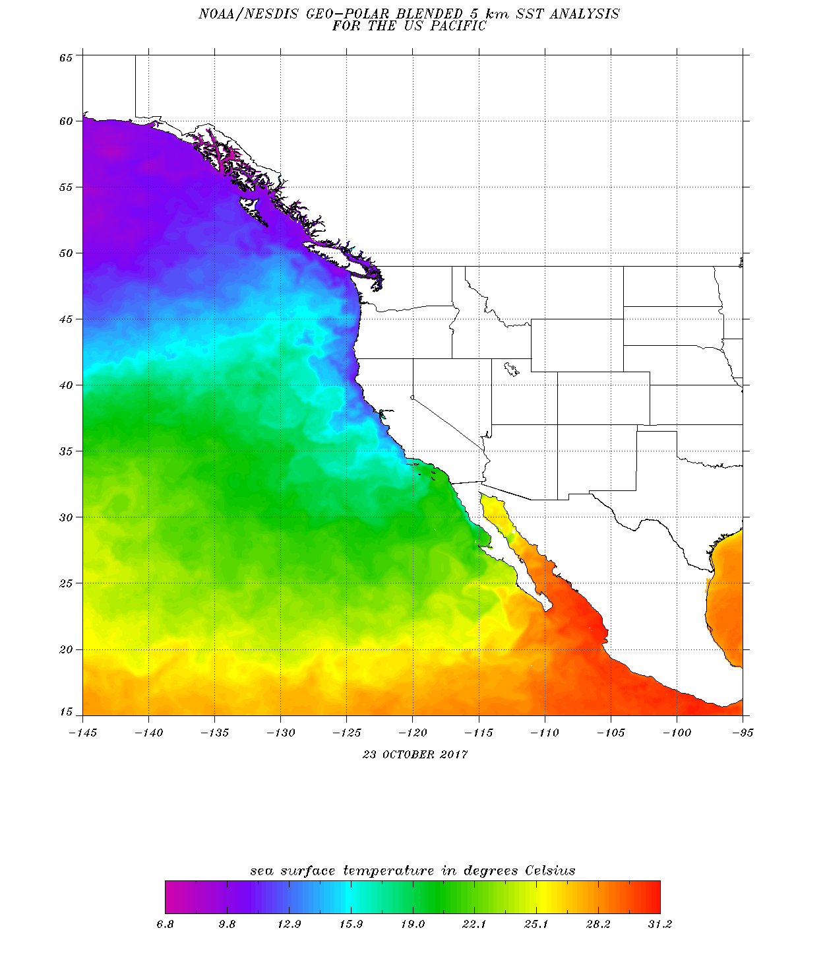
Sea
Surface
Temps
(October 2017 shown)

Slide 43
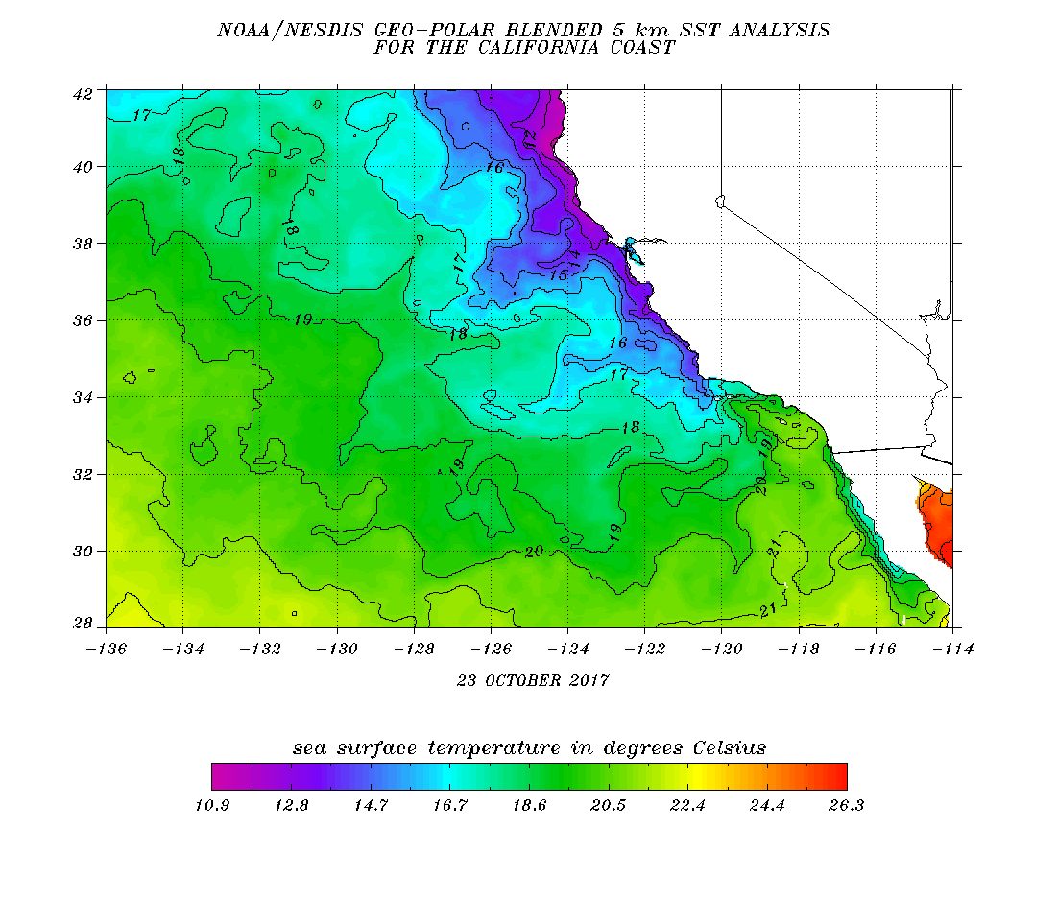

Slide 44
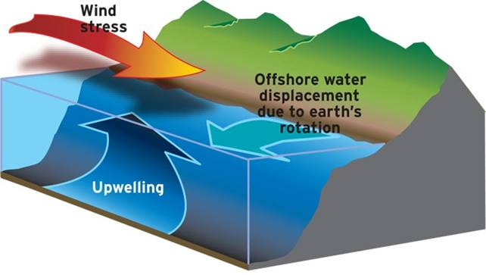
Why is the Pacific Ocean cool along the coast?
Upwelling of colder subsurface water when there are northerly winds along the coast

Slide 45
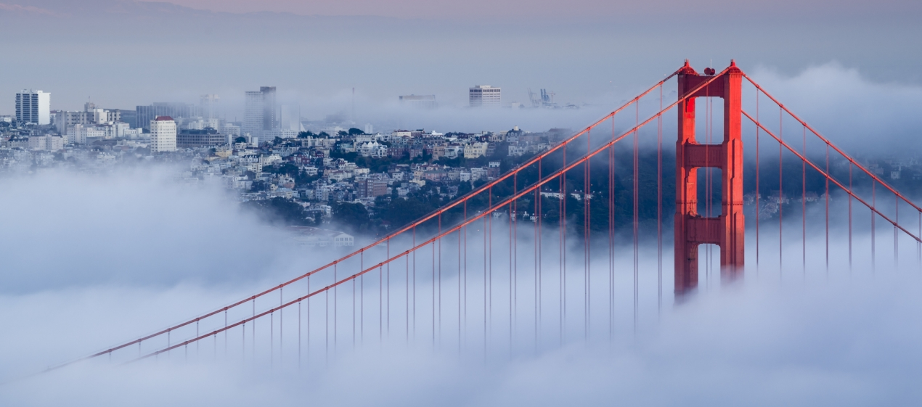
Golden Gate Bridge Fog is Classic Advection Fog

Slide 46
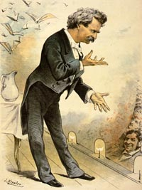
Mark Twain Quote
“The coldest winter I ever spent was a summer in San Francisco.”

Slide 47
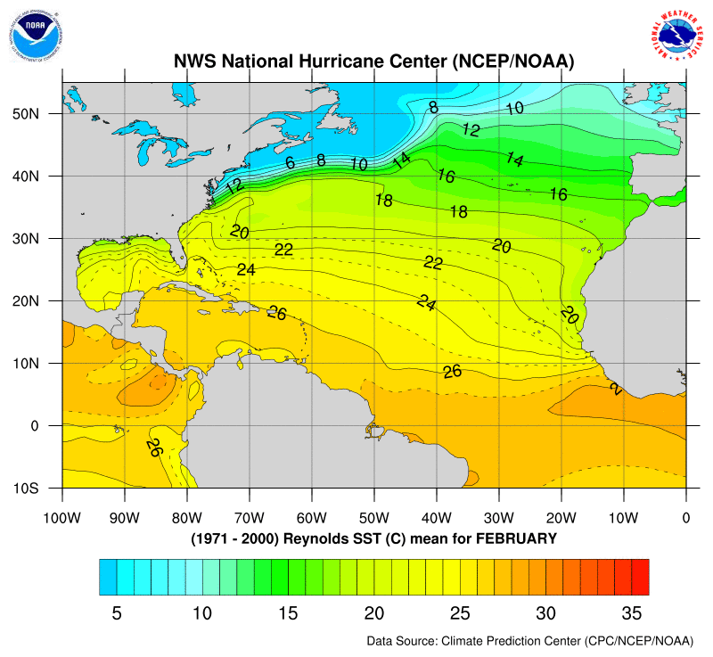
Also Advection Fog Along the Northeast Coast
Coastal New England has fog due to cold water along the coast and the warm Gulf Stream to the south
Warm, moist air moves northward over the Gulf Stream.

Slide 48
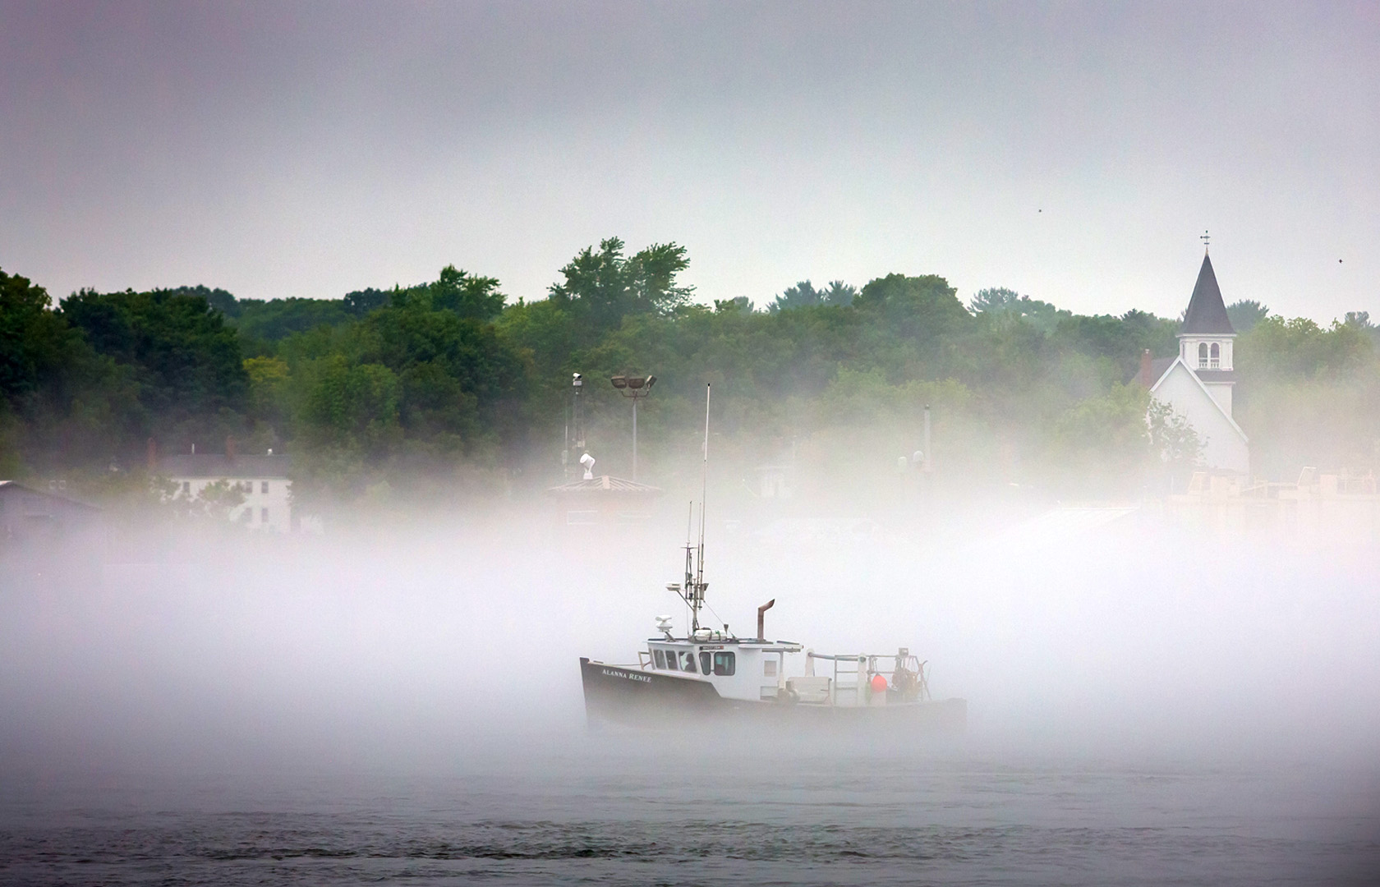
New England Advection Fog

Slide 49
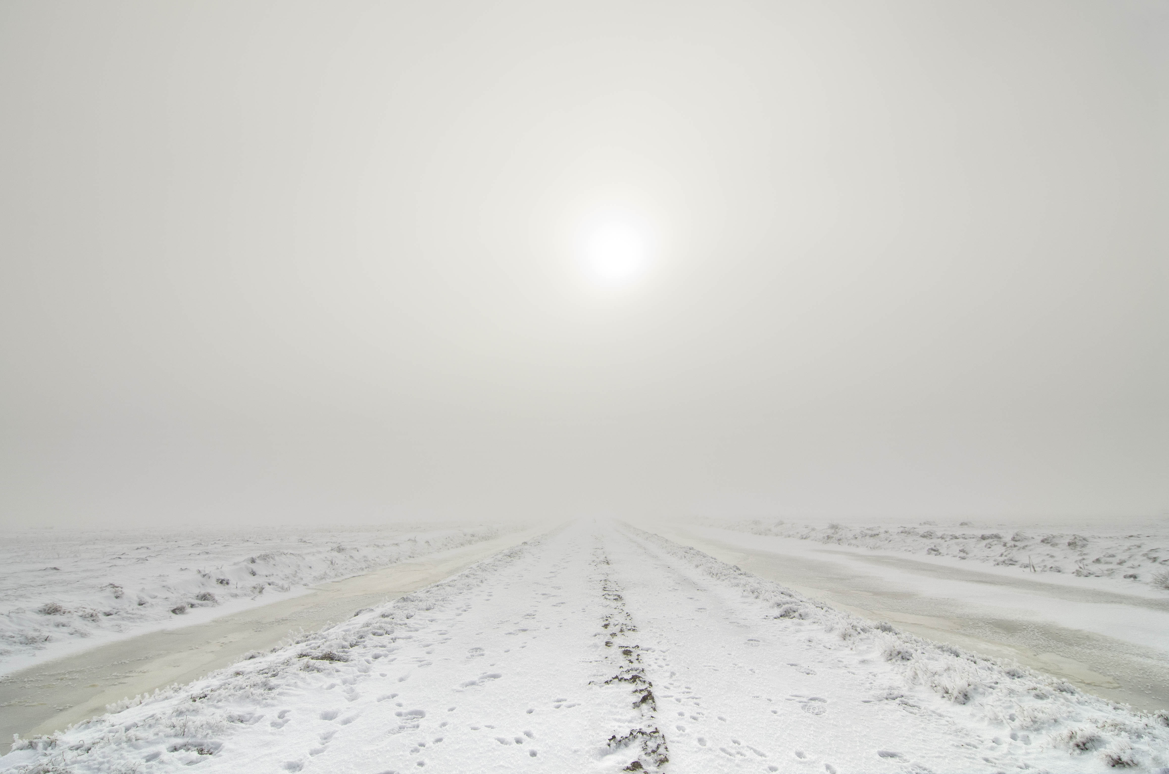
Advection fog over snow: warmer air over a colder surface

Slide 50
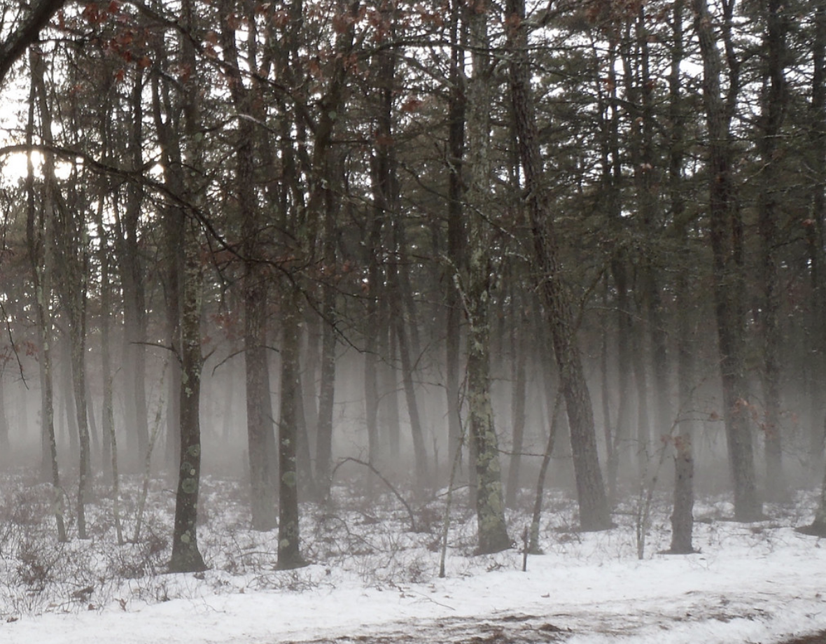
Advection fog over snow

Slide 51
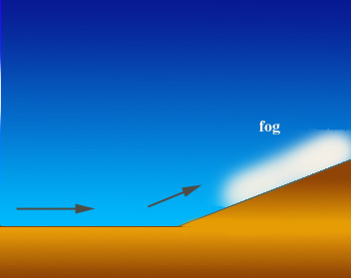
Upslope Fog
Air cools to saturation as it rises

Slide 52
Upslope Fog
Air moving up a slope cools adiabatically resulting in saturation and fog
Bad for skiers.

Slide 53
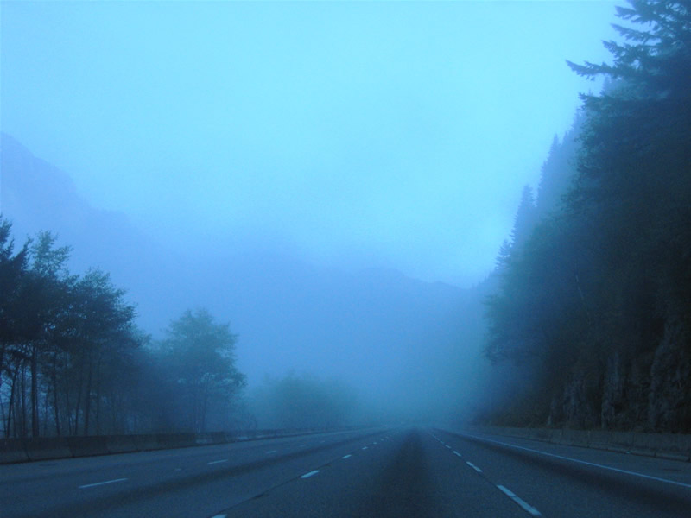
Upslope Fog: Snoqualmie Pass

Slide 54
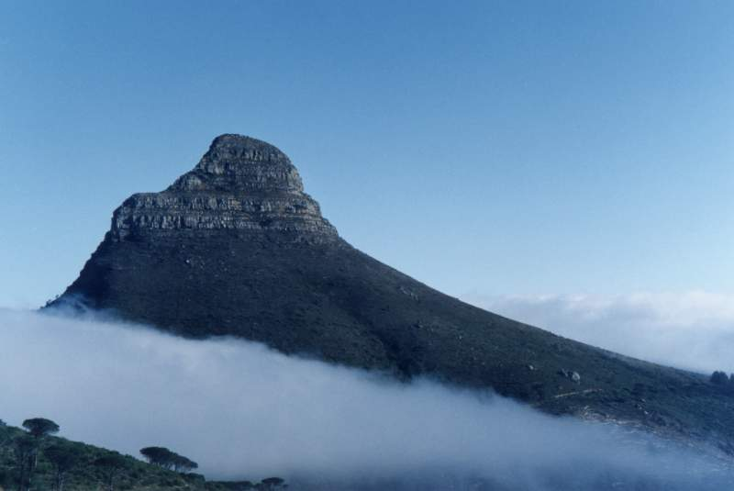

Slide 55
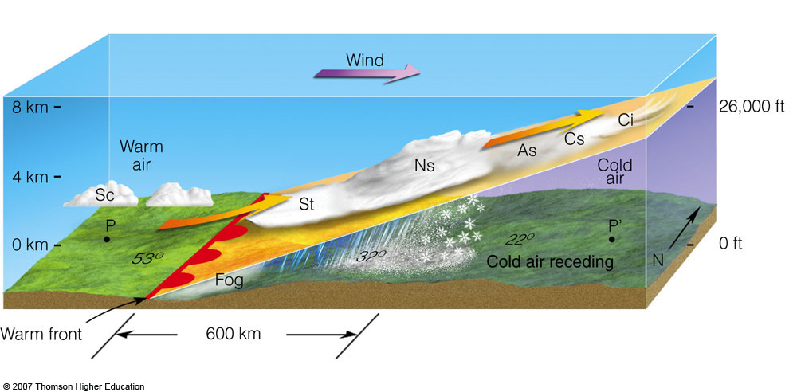
Frontal Fog: Particularly north of warm fronts

Slide 56
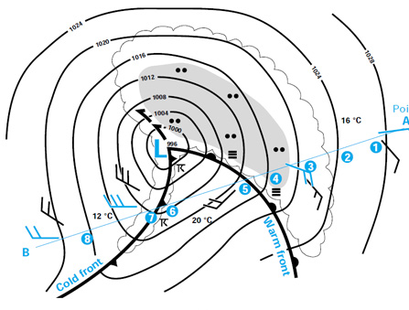
Frontal Fog
Precipitation falls into cool air, adding moisture and bringing the air to saturation.
Often found north of surface warm fronts.

Slide 57
Frontal Fog: adding moisture to cool air until is saturates

Slide 58
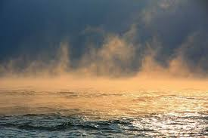
Steam Fog

Slide 59
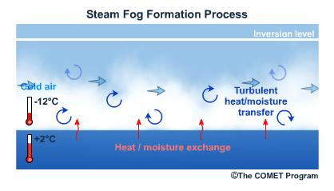
Cool, dry air mixing with warm, moist air near the surface

Slide 60
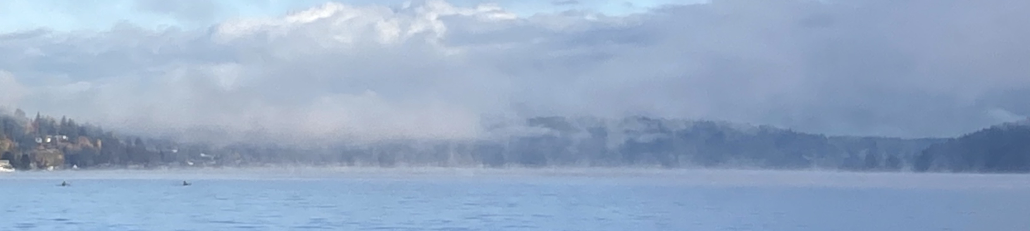
Steam Fog
Often associated with very cold air passing over warm water
A difference of 15-20F or more is needed between the water and air temperatures.

Slide 61



Slide 62


Slide 63


Slide 64


Slide 65


Slide 66
Where are the foggiest locations in the U.S.?

Slide 67

Average Number of Days with Dense Fog
Radiation fog
Advection fog
Upslope fog
Advection fog

Slide 68


Foggiest Place in U.S.: Cape Disappointment
106 days per year of heavy fog (<=.25 mile visibility)

Slide 69

Other fog facts
Fog tends to burn off from the edges
Fog accumulates in valleys and low areas
During the day, fog can lift into stratus

Slide 70
Local Fog Issues
SEA TAC is fogged in more than Boeing Field
MUCH less fog in Portland

Slide 71
Reason: SeaTac is on a hill
Fog Stratus
SEA
BFI

Slide 72

Portland has a lot of dry, easterly wind during winter: bad for fog
Troutdale
Notes:
Also note increased wind speed near CZK. Possible where the flow becomes supercritical. Also possibly Venturi.

Slide 73

Fog and Black Ice

Slide 74


Roadway Icing: Often called “Black Ice”
Dozens of people in WA state are killed by roadway icing each year. Many hundreds injured.

Slide 75

Biggest Threat: Fog Moving Over Cold Road
Typically, starts with a clear, cold night with light winds in which the surface rapidly cools.
A light frost occurs on the roadway, with nearby fog forming over a moist surface.
The fog drifts over the road depositing a thick coating of ice.

Slide 76

Be Worried…Very Worried

Slide 77
Roadway Icing 101: Temperature Facts
Air temperatures are generally measured at 2 meters (roughly 6 ft) above the surface.
Car thermometers measure temperatures a few feet above the road.
Temperatures at the surface can be cooler than air temperature a few feet above the surface during winter nights

Slide 78

Surface Temperature
On cold nights the ground temperature can be 2-6F colder than the official air temperature or your car thermometer temperature.
Thus, once the air temperature drops below roughly 36-37F, you should be careful.

Slide 79

Is ”Black Ice” Really Black?
No, it is nearly clear.

Slide 80


Roadway Icing is Particularly Bad on Bridges

Slide 81

Why bridges so problematic? Insulating air under the bridge
No conduction of heat from ground into bridge

