Slide 1
Consortium Meeting
02/05/2014

Slide 2
TAMDAR DATA

Slide 3
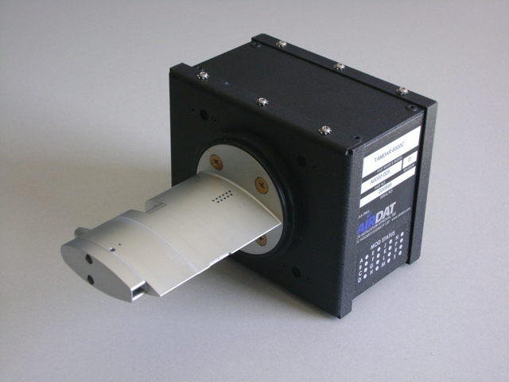
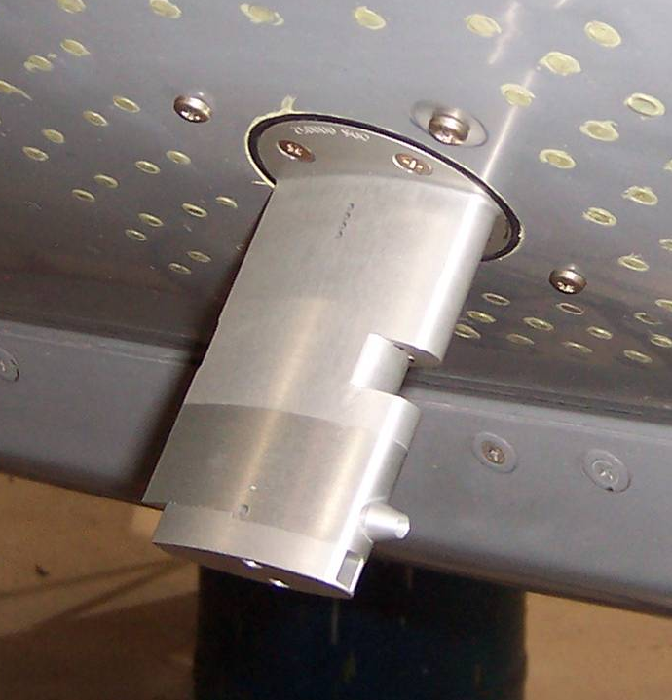
THE TAMDAR SENSOR
Measures and reports:
Ice presence
Static pressure and pressure altitude
Air temperature (Mach corrected)
Relative humidity
Indicated and true airspeed
Winds aloft
Turbulence (EDR, median and peak)
GPS lat/long/alt/time
Reports every 10 hPa

Slide 4
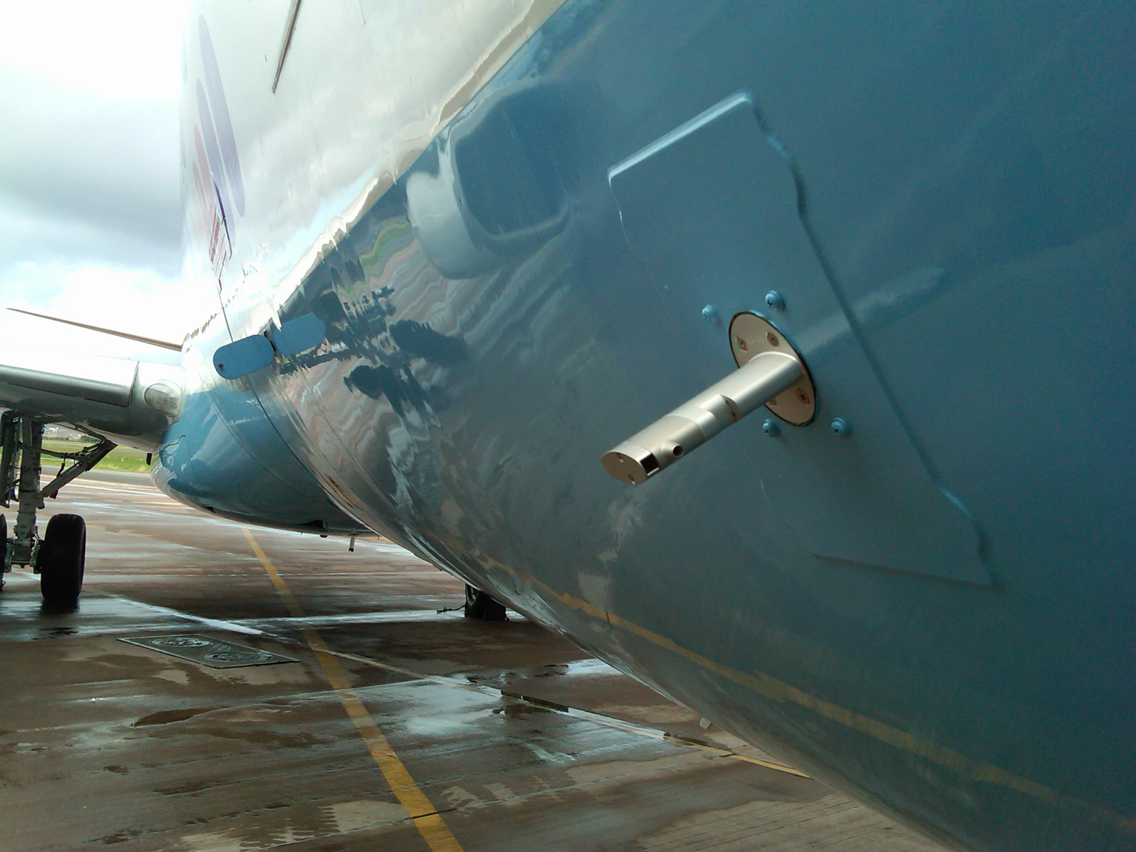

Slide 5
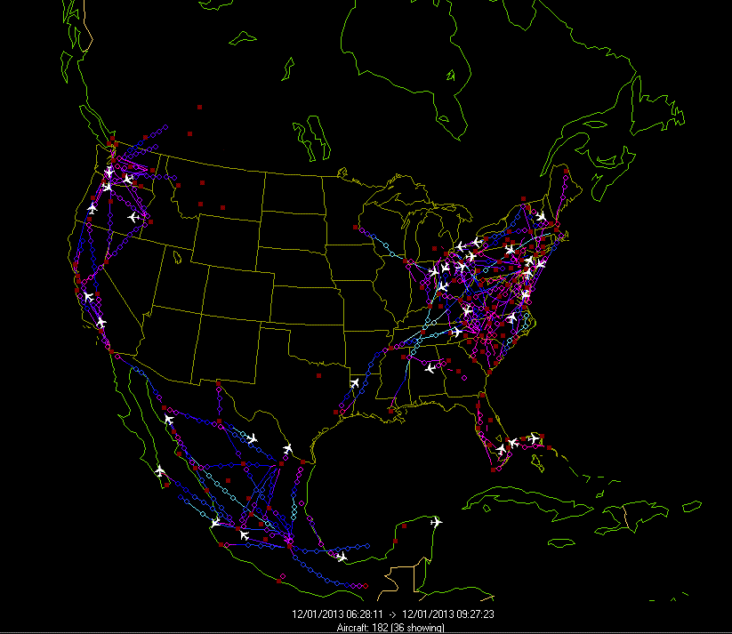
Now getting TAMDAR data from AIRDAT/Panasonic: Commuter and Short Haul Aircraft

Slide 6
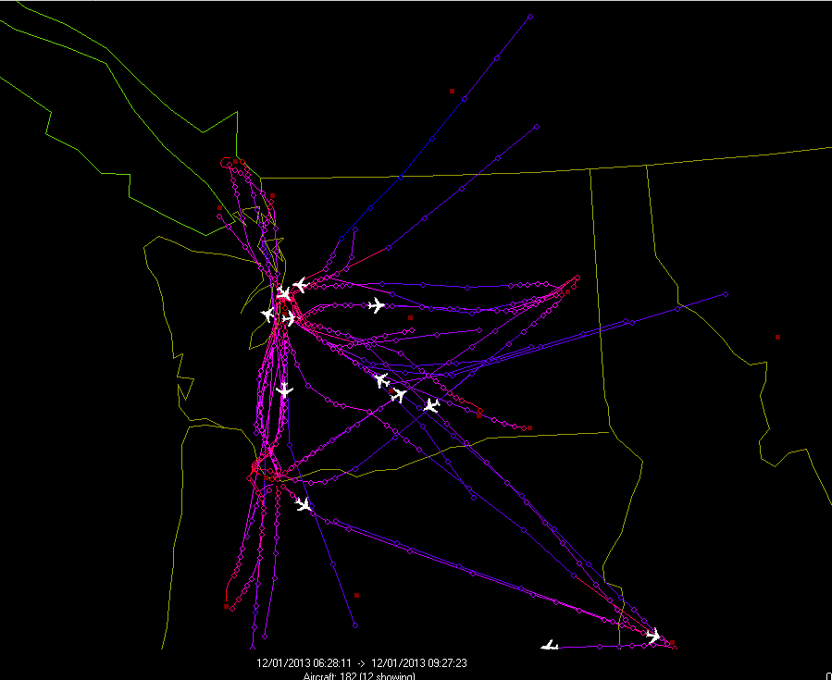

Slide 7
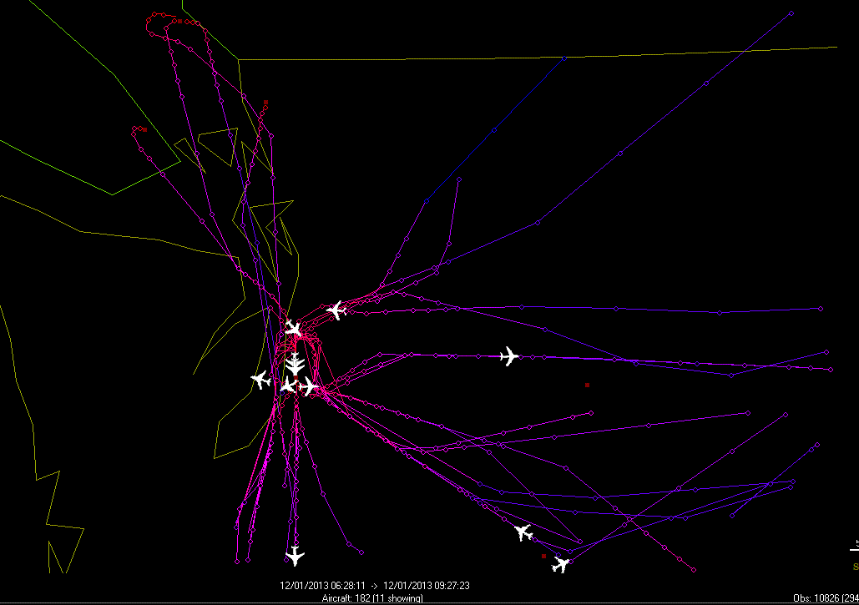

Slide 8
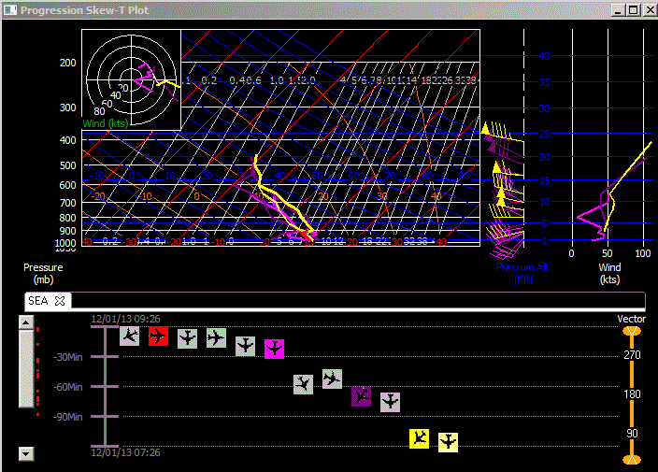

Slide 9
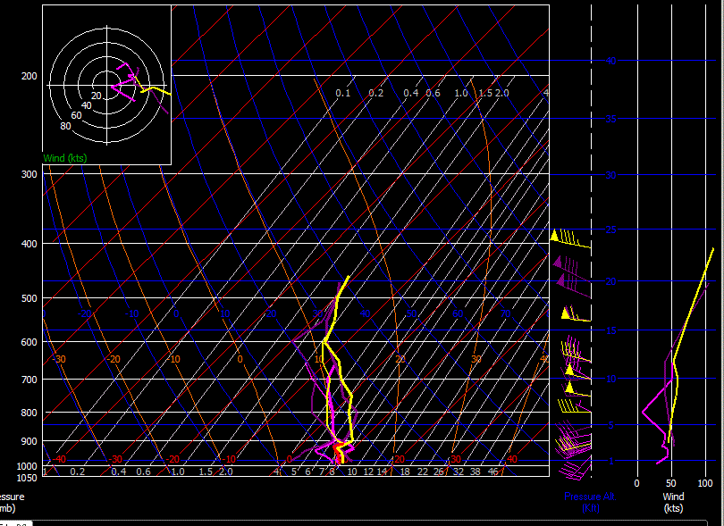

Slide 10
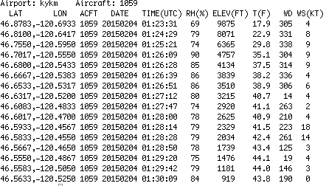
Sample Data

Slide 11
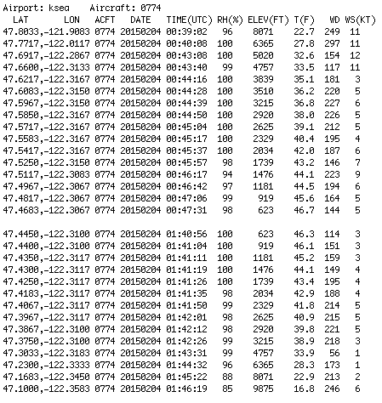
Seattle…in and out

Slide 12
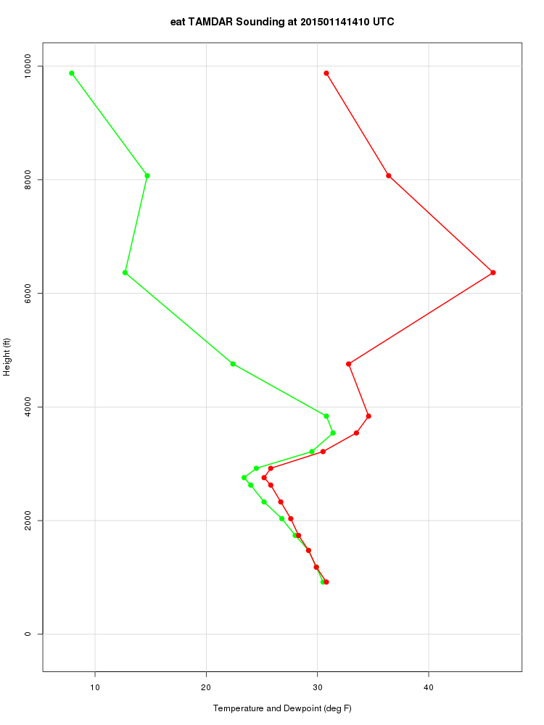
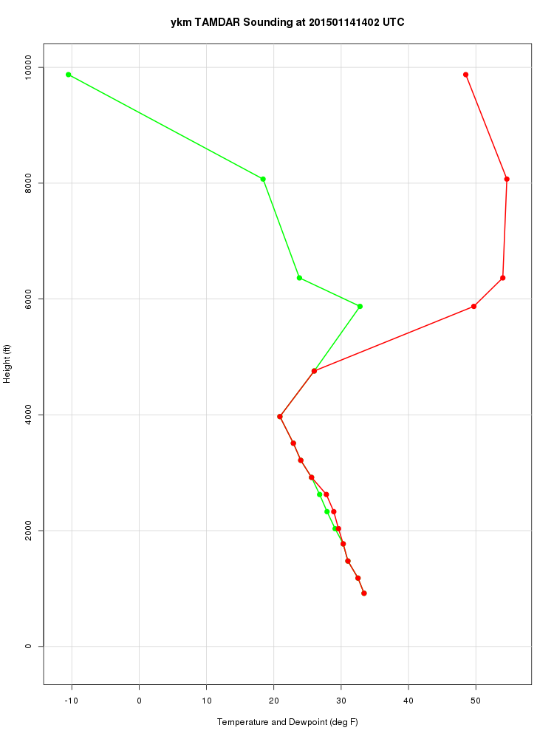

Slide 13
TAMDAR Locations in the NW
Seattle
Portland
Wenatchee
Yakima
Pasco
Walla Walla
Pullman
Redmond, Oregon
Eugene
Lewiston
Port Angeles

Slide 14
Access
We are getting this for free but Panasonic wants it absolutely protected.
Consortium members with UW computer accounts can access today.
We have asked Panasonic to allow the consortium to see if, they seem ok with this as long as it was protected and not generally available. NO SHARING.
If this is acceptable to consortium, then will set up a password protected site for access.

Slide 15
Since last meeting: major computer upgrades
SAGE was completely refreshed
  8 Twenty core nodes (2 x 10 cores), each with 64 GB ram
  Head node has 128 GB RAM and SSD drive
  Other nodes have 2 TB disk
  The machine is roughly twice as fast as old one (1.84).
  Three years of warranty
Additional disk space (12 four TB disks= 40 TB useable additional space). Can age off some old disks.

Slide 16
Major Upgrade to WRF modeling system (Jan. 29, 0000 UTC run)
Tested dozens of combinations of upgrades and parameterizations for all seasons.
Upgrade to new version of WRF (3.5.1 to 3.6.1)
Moved from the NOAH to NOAH MP land surface model. NOAH MP (multi-physics) has much more sophisticated treatment of surface and hydrological processes. Particularly helpful when snow is on the ground.

Slide 17
Noah-MP (Niu et al., 2011) (multi-physics)
Noah-MP contains a separate vegetation canopy defined by a canopy top and bottom with leaf physical and radiometric properties used in a two-stream canopy radiation transfer scheme that includes shading effects.
Noah-MP contains a multi-layer snow pack with liquid water storage and melt/refreeze capability and a snow-interception model describing loading/unloading, melt/refreeze, and sublimation of the canopy-intercepted snow.
Multiple options are available for surface water infiltration and runoff, and groundwater transfer and storage including water table depth to an unconfined aquifer.
Horizontal and vertical vegetation density can be prescribed or predicted using prognostic photosynthesis and dynamic vegetation models that allocate carbon to vegetation (leaf, stem, wood and root) and soil carbon pools (fast and slow).

Slide 18
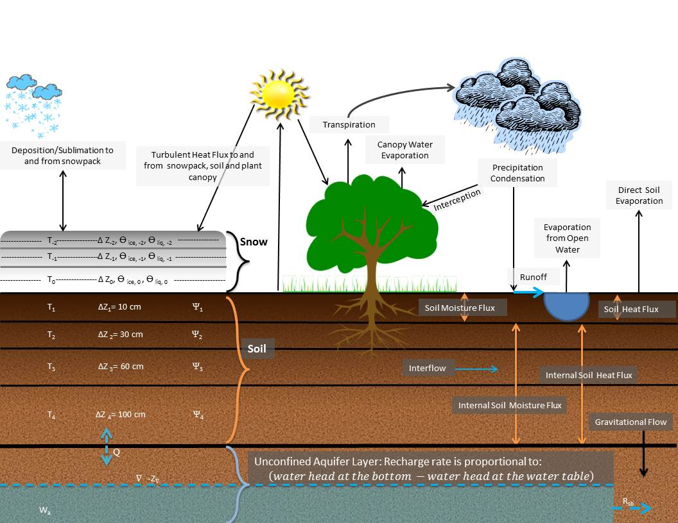
NOAH MP Schematic

Slide 19
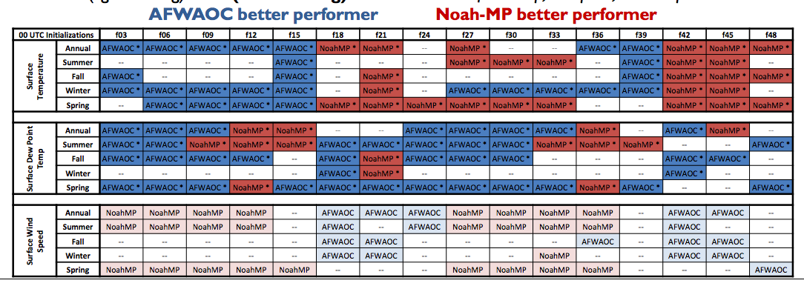
Air Force Tests (they also use YSU PBL, but different convective scheme and microphysics)
Our results also were mixed, but positive modestly outweighed negatives…more in a second

Slide 20
RAP Initialization
We have been initializing with the GFS model grids (1 or .5 degree resolution). Little mesoscale detail, so model would have to spin things up.
Furthermore, we were using the grids from a very different modeling system, again resulting in spin-up issues.

Slide 21
RAP Initialization
In the new system we use the initialization from the 13-km Rapid Refresh model that is based on WRF.
Less difference in modeling system results in less spin up
Much more mesoscale detail.
Better initialization of clouds and boundary layer structures.
Rapid Refresh uses all available mesoscale data sources

Slide 22
Results without RAP initialization for old and new system

Slide 23
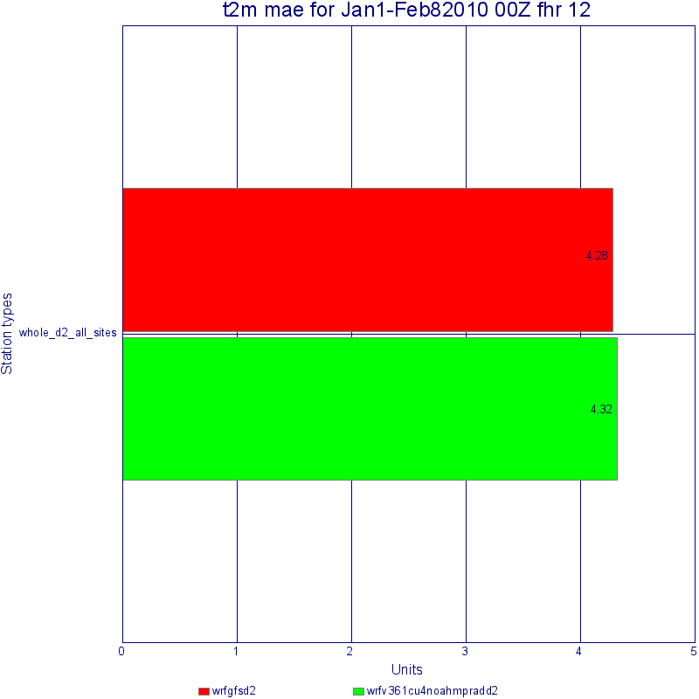
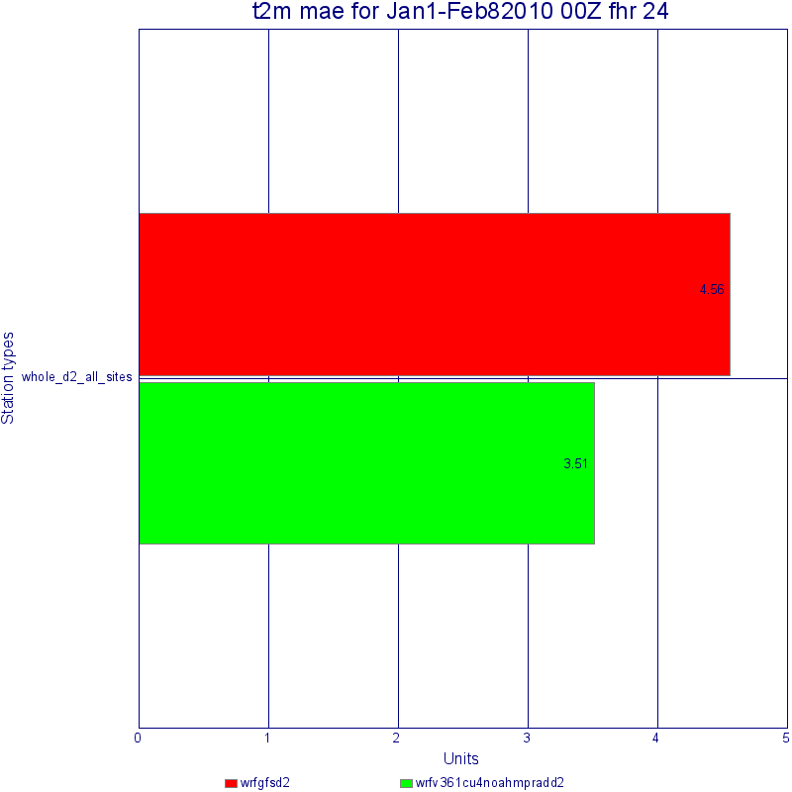
Winter 2 m temp-00z
Much better
Slightly worse

Slide 24
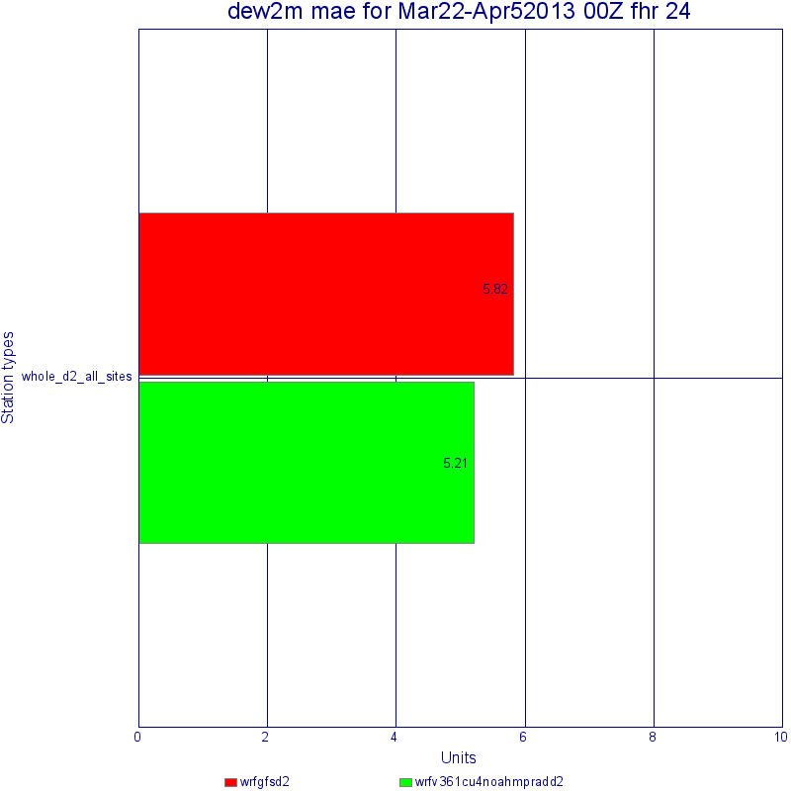
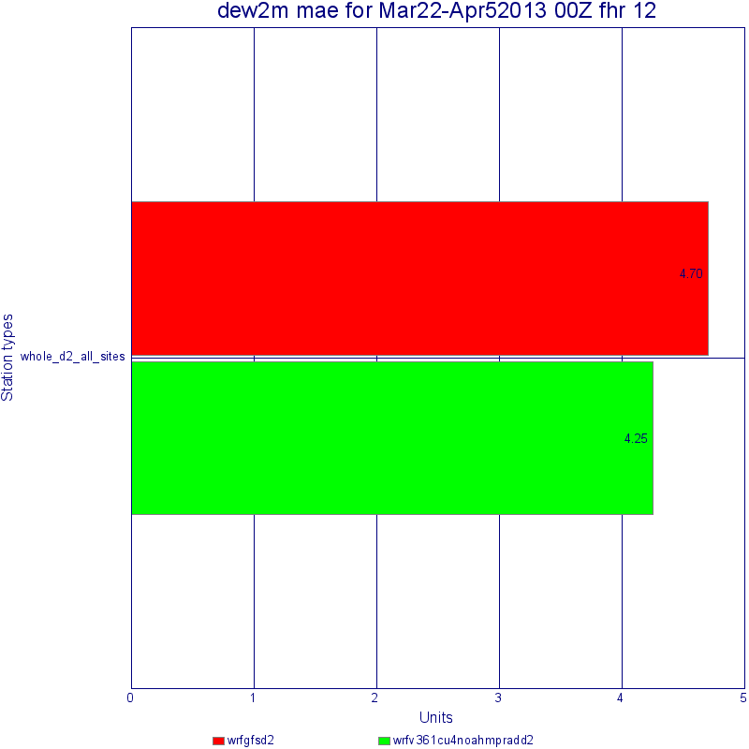
Dew point spring

Slide 25
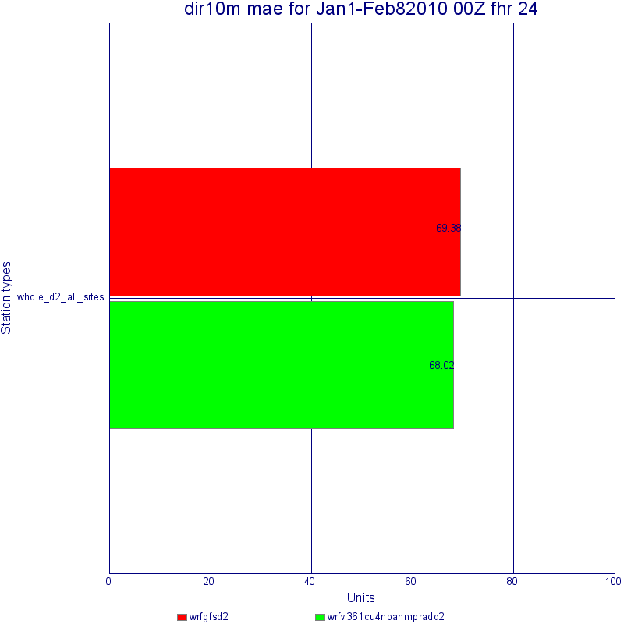
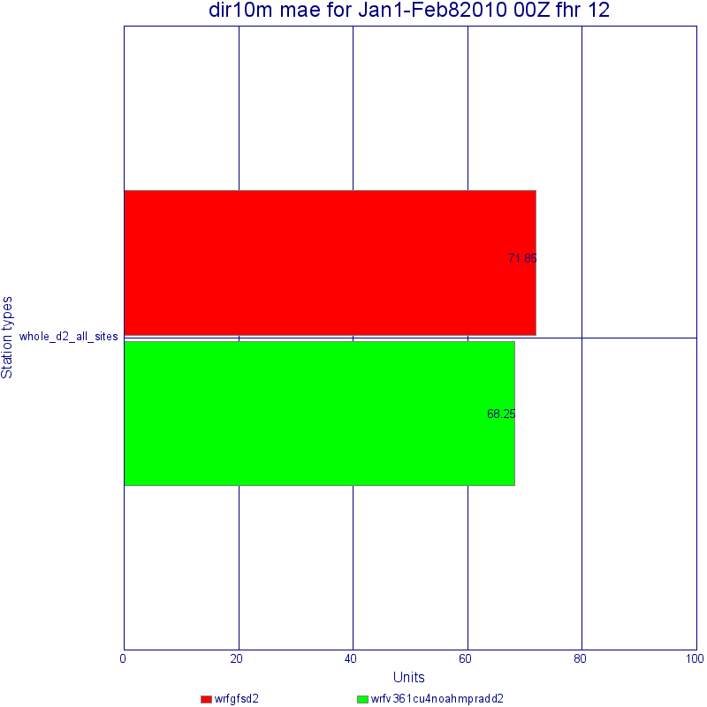
Wind Direction

Slide 26
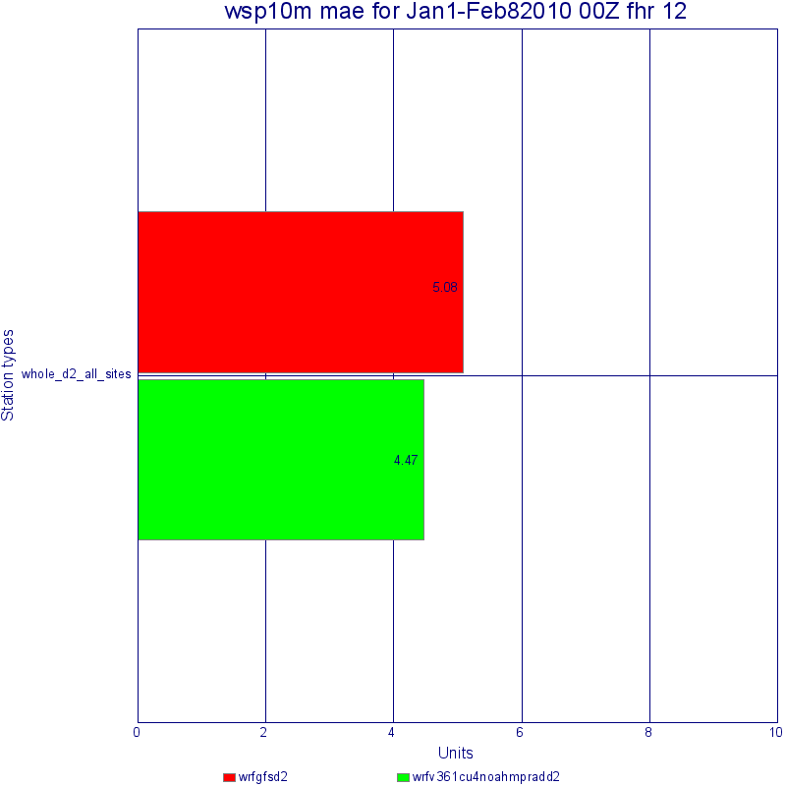
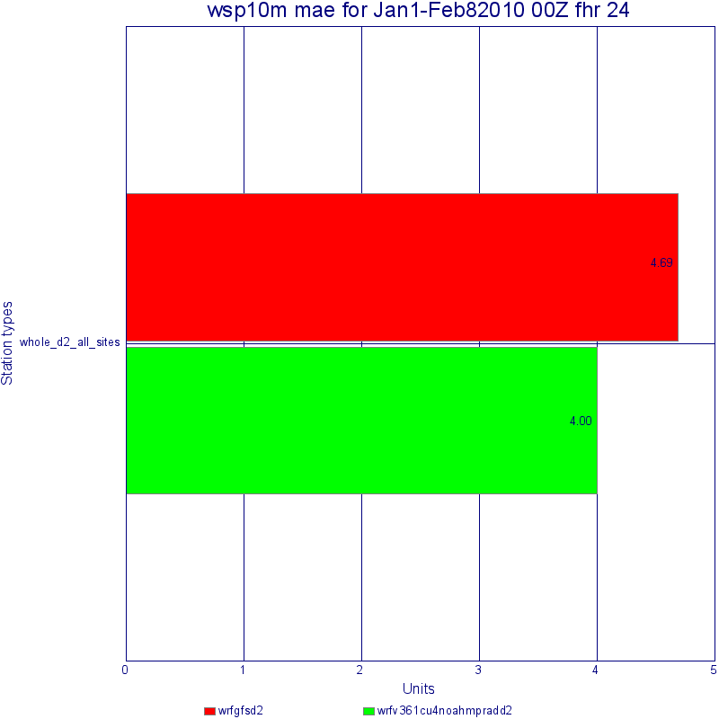
Wind Speed

Slide 27
Total System Change Comparisons

Slide 28
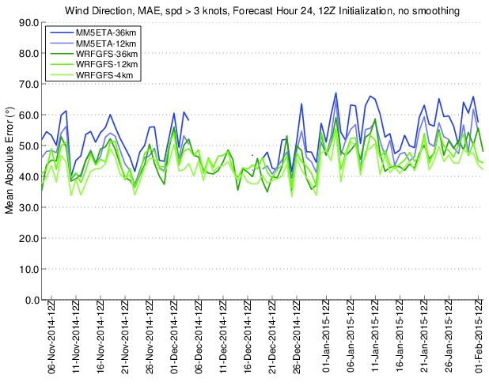
No Sign of Troubles

Slide 29
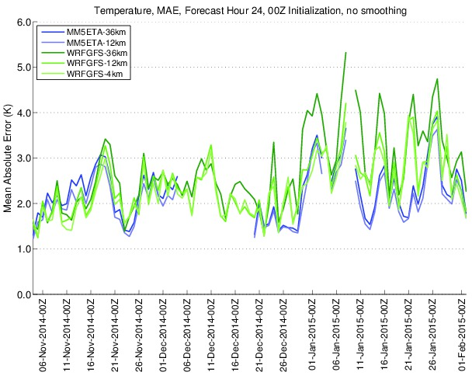

Slide 30
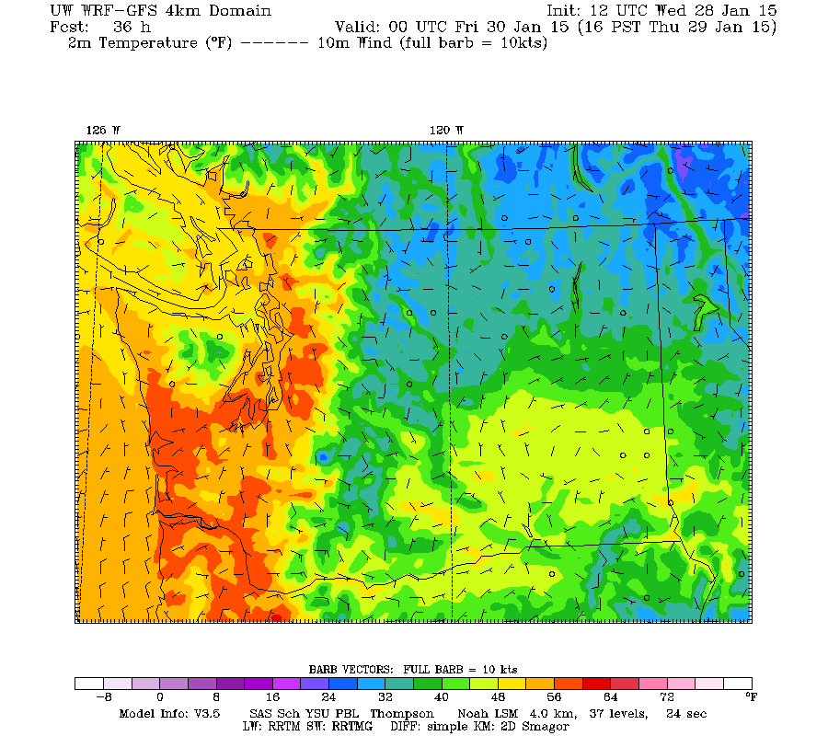
00Z Temp Old

Slide 31
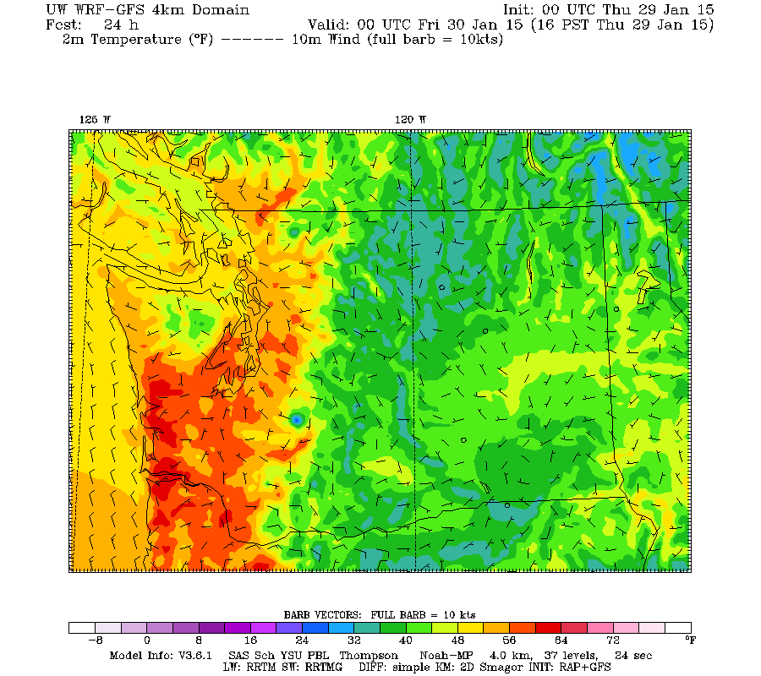
00z temp-new (better)

Slide 32
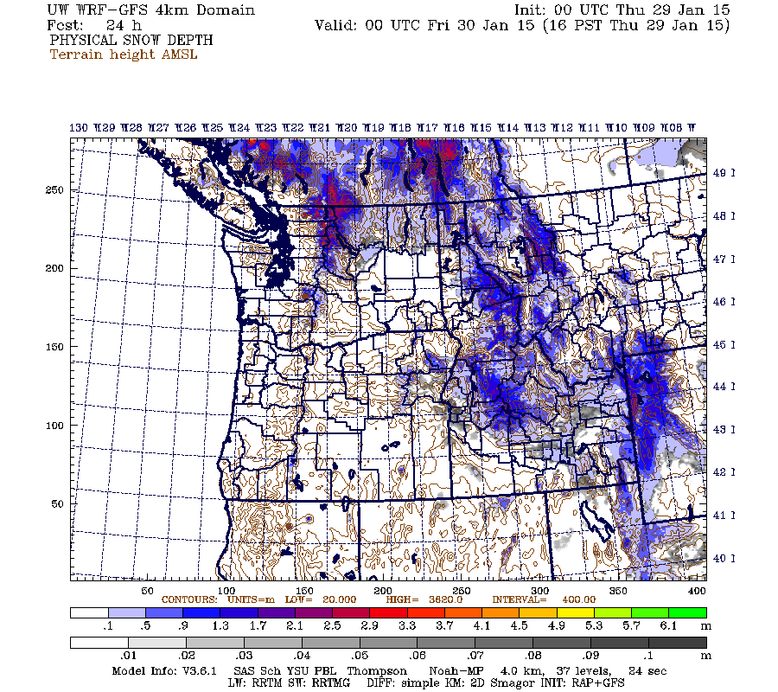

Slide 33
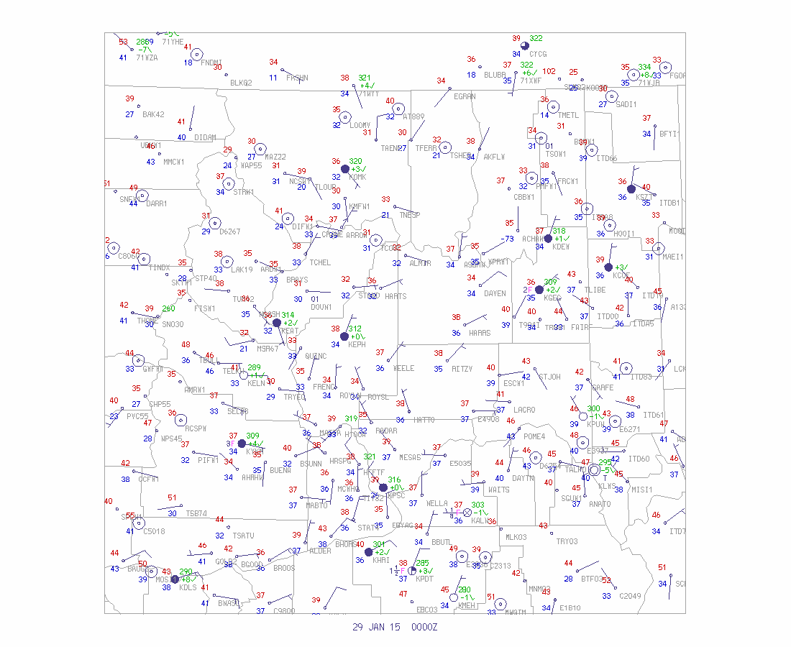
New Version is Better

Slide 34
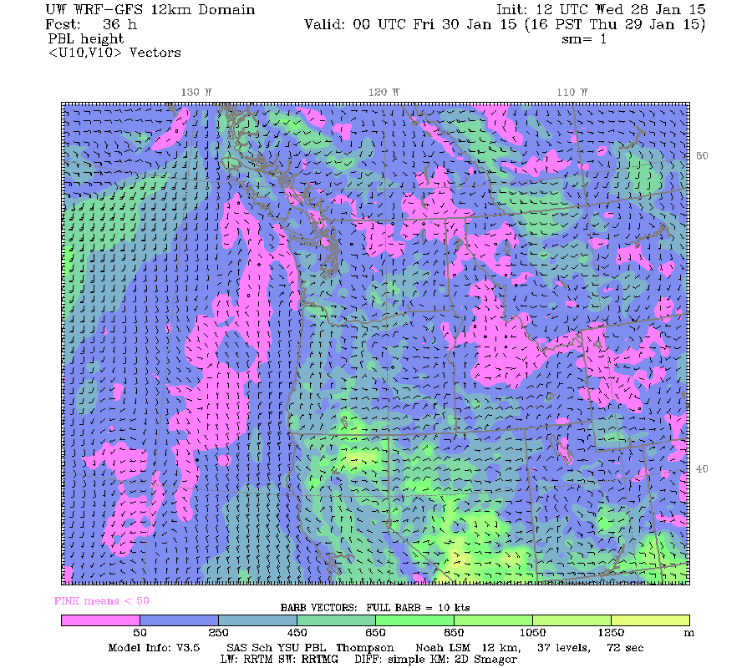
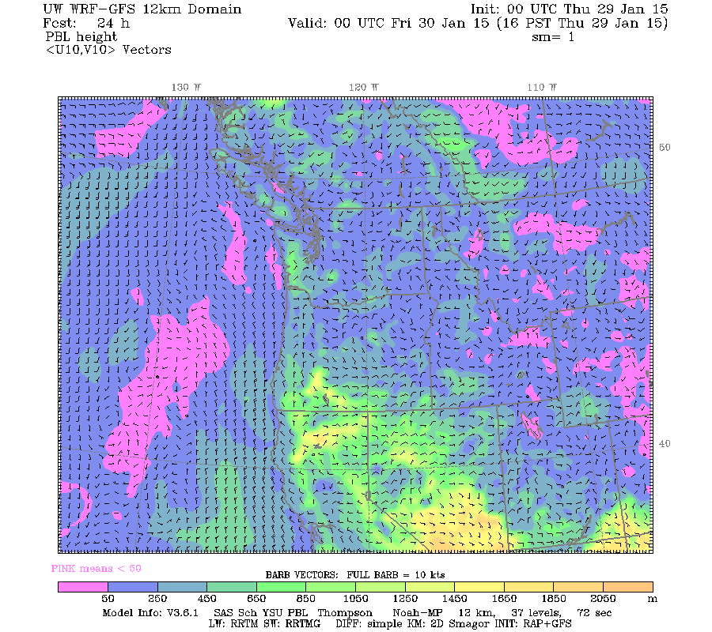
Changes PBL heights during day--higher
New
Old

Slide 35
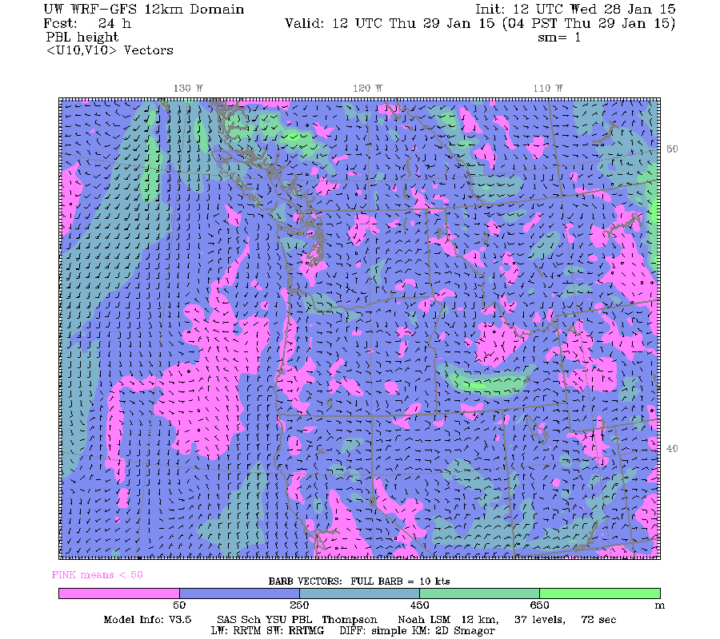
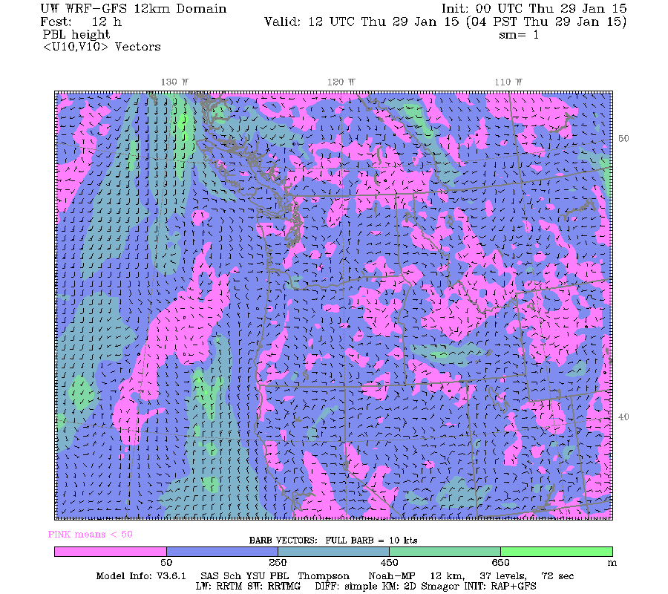
Opposite situation at night ...new system has more cooling at low levels and lower pbl over snow
Old
New

Slide 36
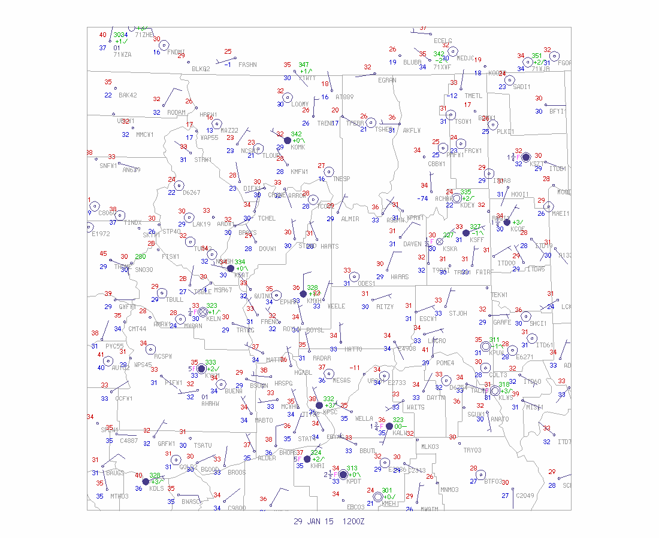

Slide 37
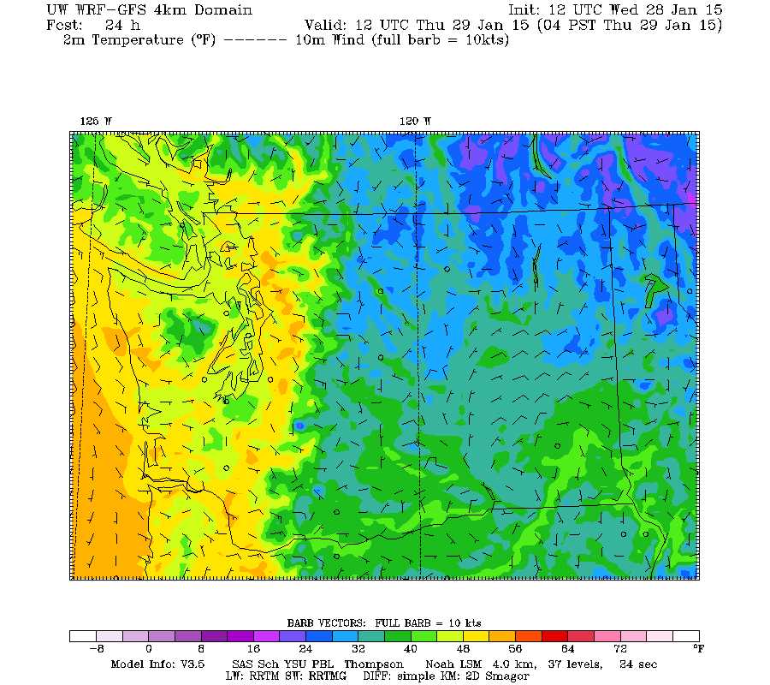
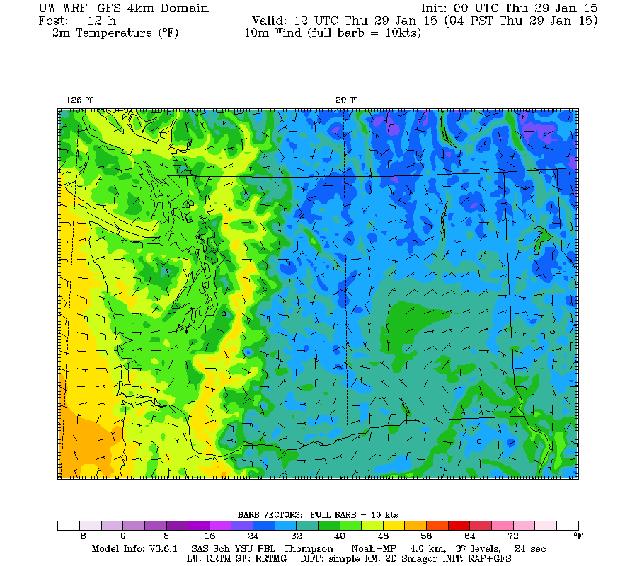
Old
New
Big Differences over Puget Sound
Which is right?

Slide 38
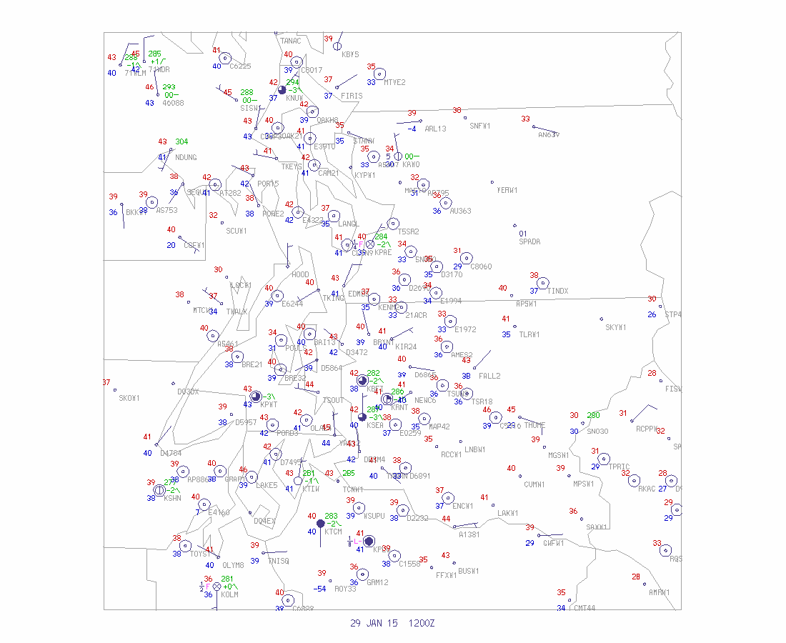

Slide 39
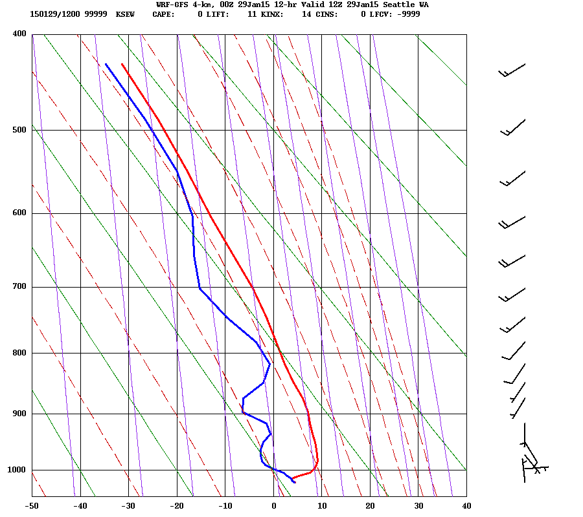
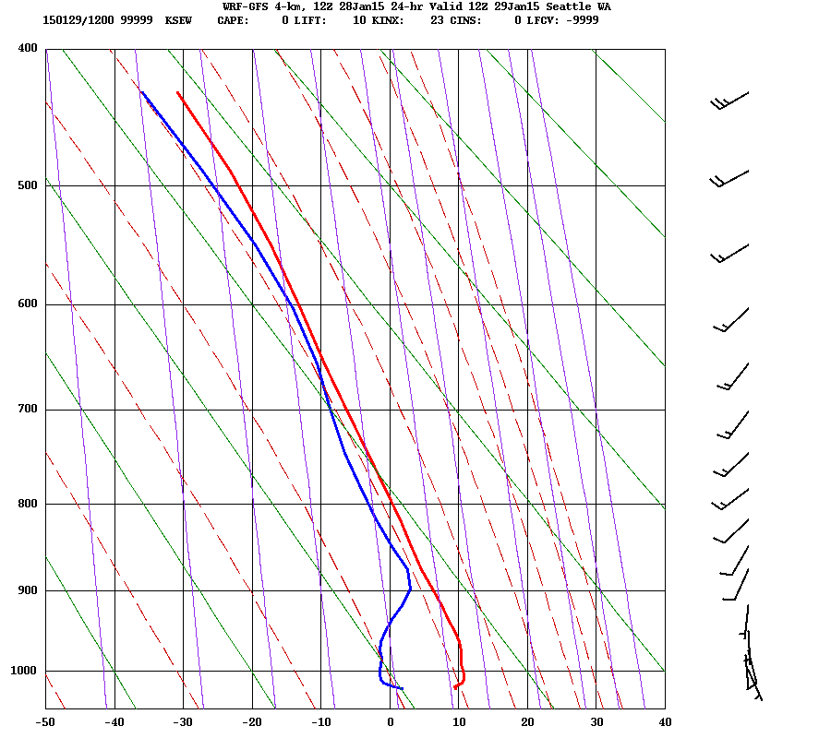
Seattle Sand Point Soundings
Old
New

Slide 40
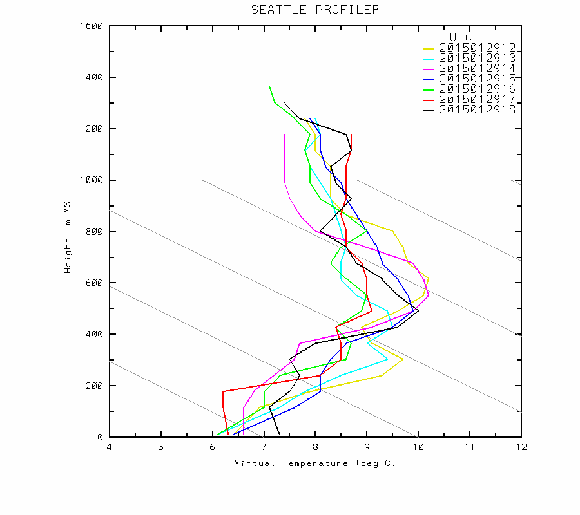
Inversion and fog was reported in area

Slide 41
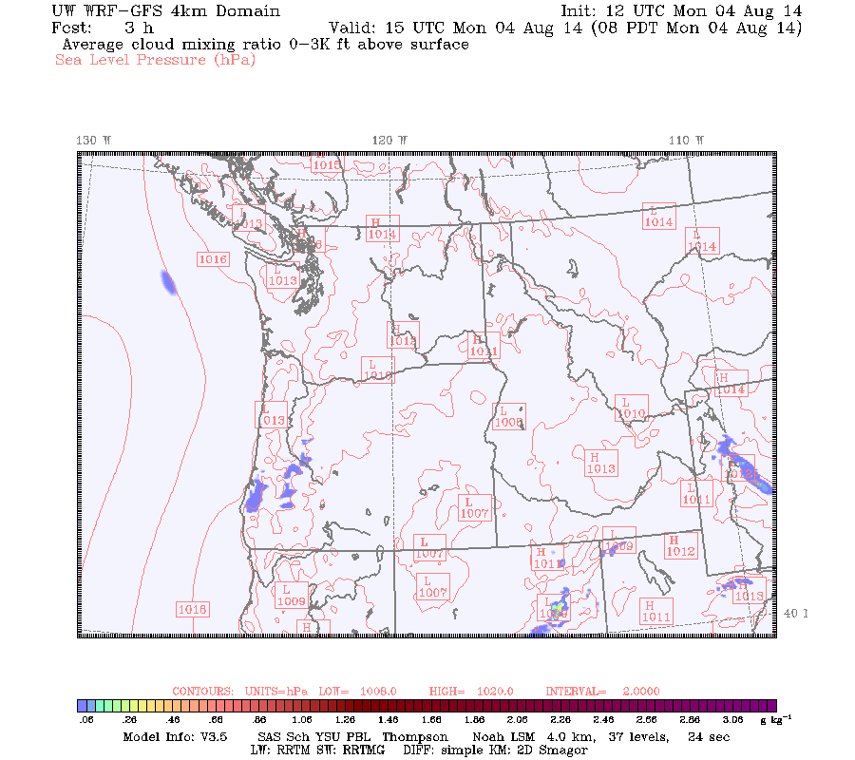
New System Starts with much better clouds

Slide 42
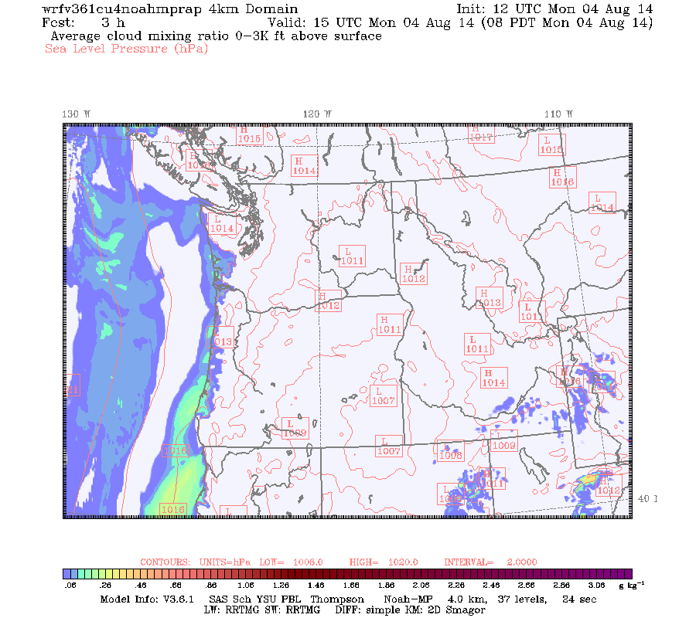
New

Slide 43
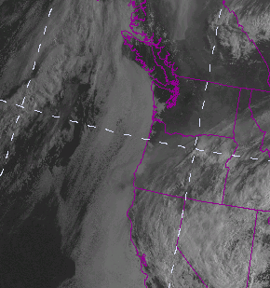

Slide 44
There is a cost to the NOAH MP LSM
30 minute slower finish for 4 –km
1 hr 15 min slower finish for 1.3 km

Slide 45
PBL Spin Up Issue

Slide 46
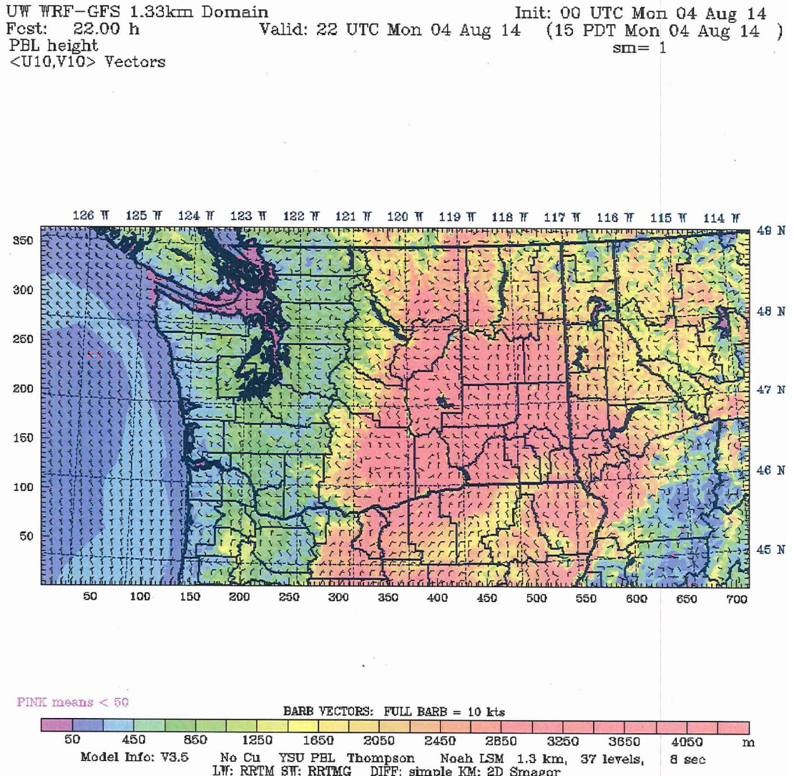

Slide 47
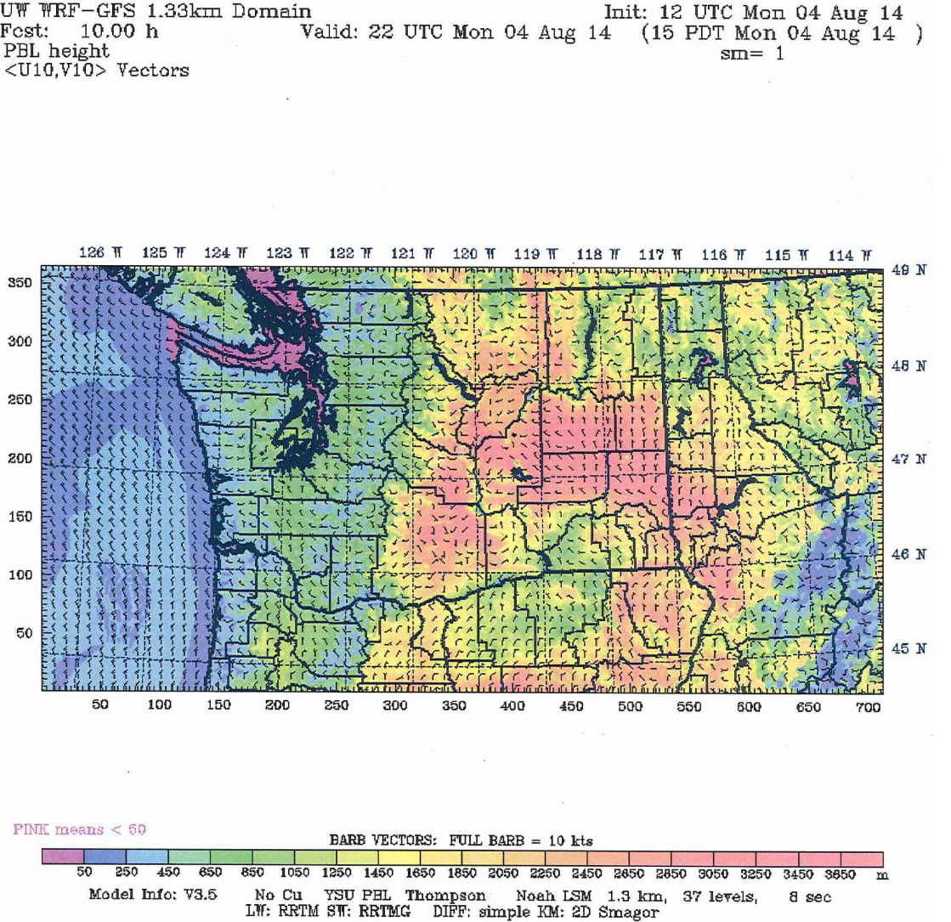

Slide 48
New RAP initialization/NOAH MP should help

Slide 49
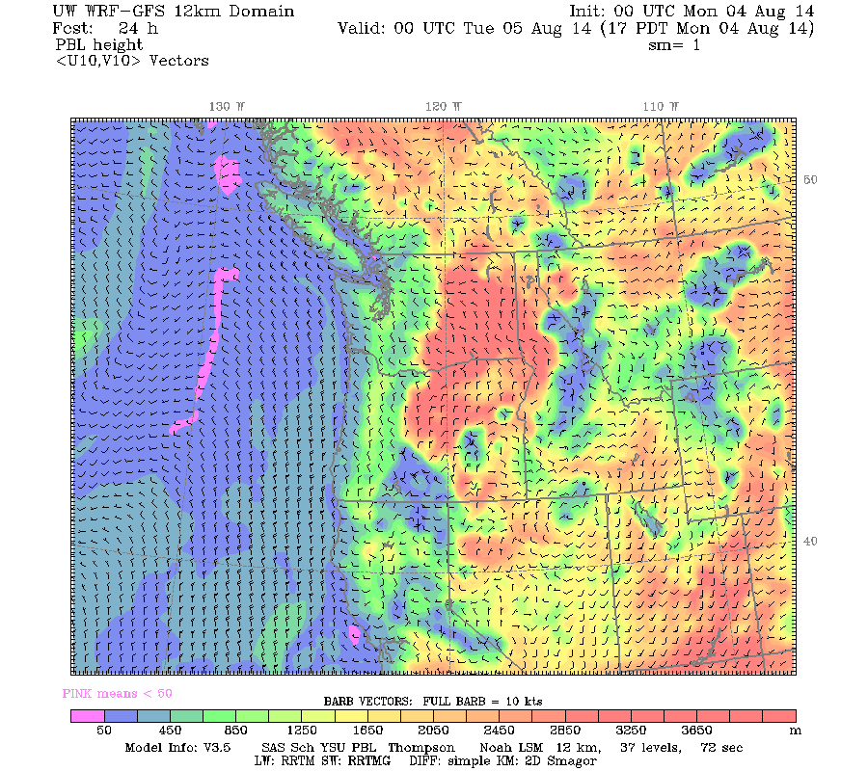
Old

Slide 50
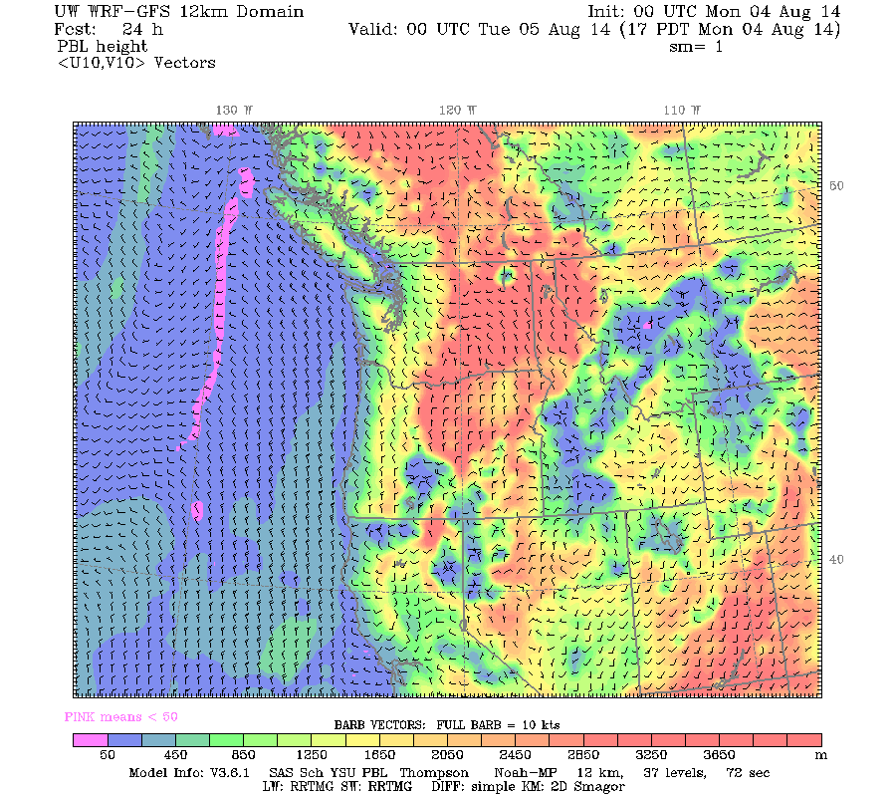
New

Slide 51
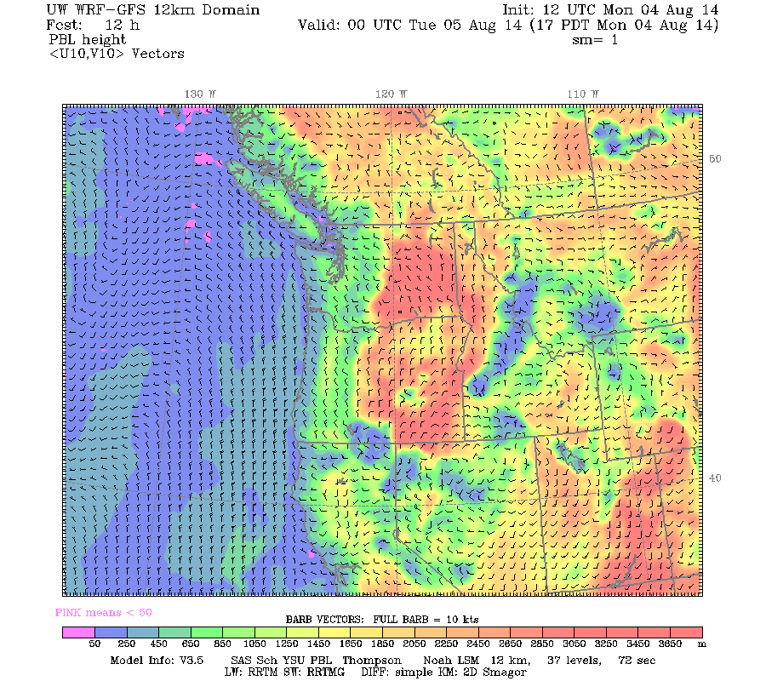
Old

Slide 52
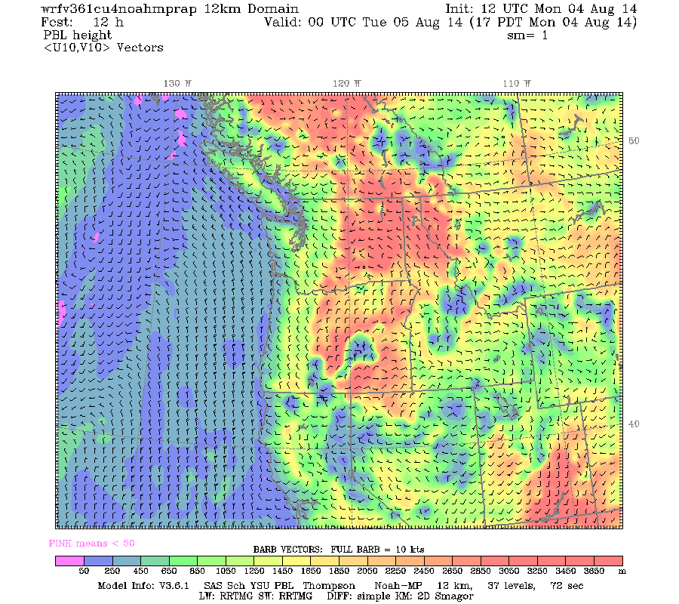
New

Slide 53
Another Upgrade
Two weeks ago GFS was upgraded, including increasing resolution to 13 km.
We will experiment with the acquisition of use of these high-resolution grids for boundary conditions.

Slide 54

Bufkit
Dave is close with this and will have bufkit format data available within the next few weeks.

Slide 55
Better Graphics
Next major priority
Need to be able to see details at the highest resolutions
Variety of approaches, including Google maps interface.

Slide 56
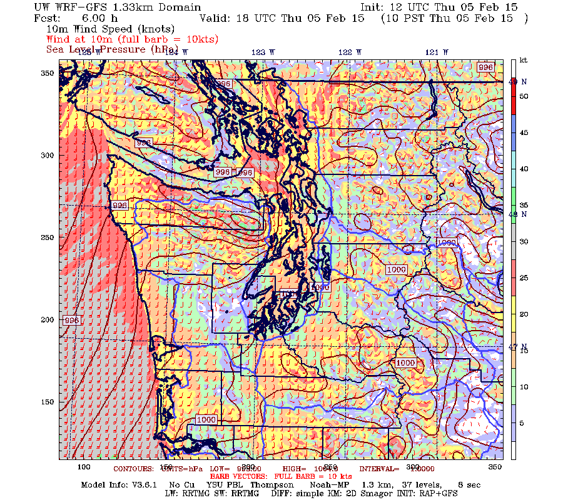

Slide 57
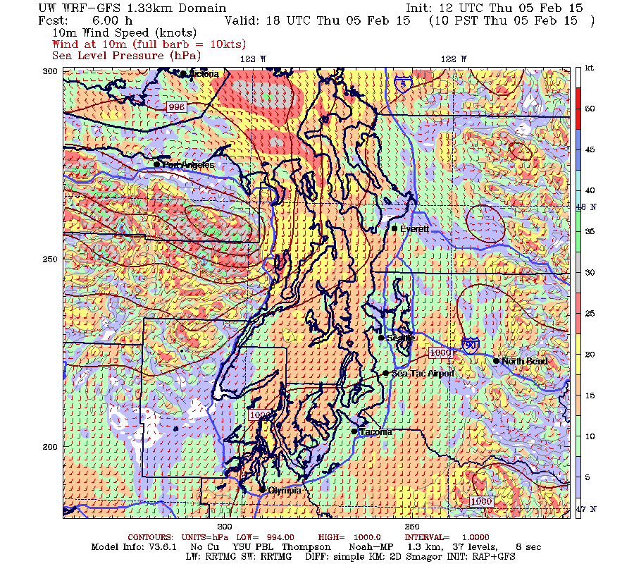

Slide 58


Switch to 06/18?
Minimal
Skill
Difference
Of GFS

Slide 59
The End

