Slide 1
Northwest Modeling Consortium
Cliff Mass
February 2, 2017

Slide 2
New Hardware
With Forest Service support increased SAGE to 432 cores
Had problems with some of the new nodes (bad motherboard, intermittent memory failure)
Problems with switch
Bad hardware was replaced.
Replaced the switch (which seems to have increased speed)
Lots of issues with sensitivity to numbers of processors used.

Slide 3
New Expanded Domain is Operational
Current timing is FASTER than before (about 30-60 minutes faster)
Extra processors weren’t enough, had to use nest down
Run 36-12-4 km first and ONLY ONCE.
Save output every ten minutes for use in boundary conditions in 4/3 km
Run 4/3 km as a single domain (MUCH FASTER)
Compared to running in traditional (slower) way….no significant difference.
Could be expanded if more cores (e.g., all of Idaho).

Slide 4
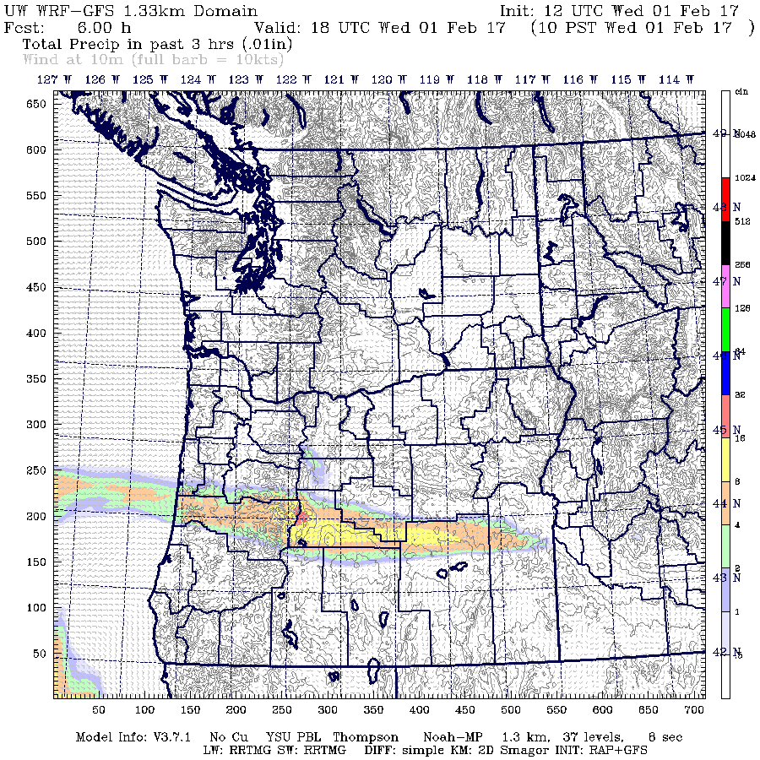
New 4/3 km Domain 10/31/17

Slide 5
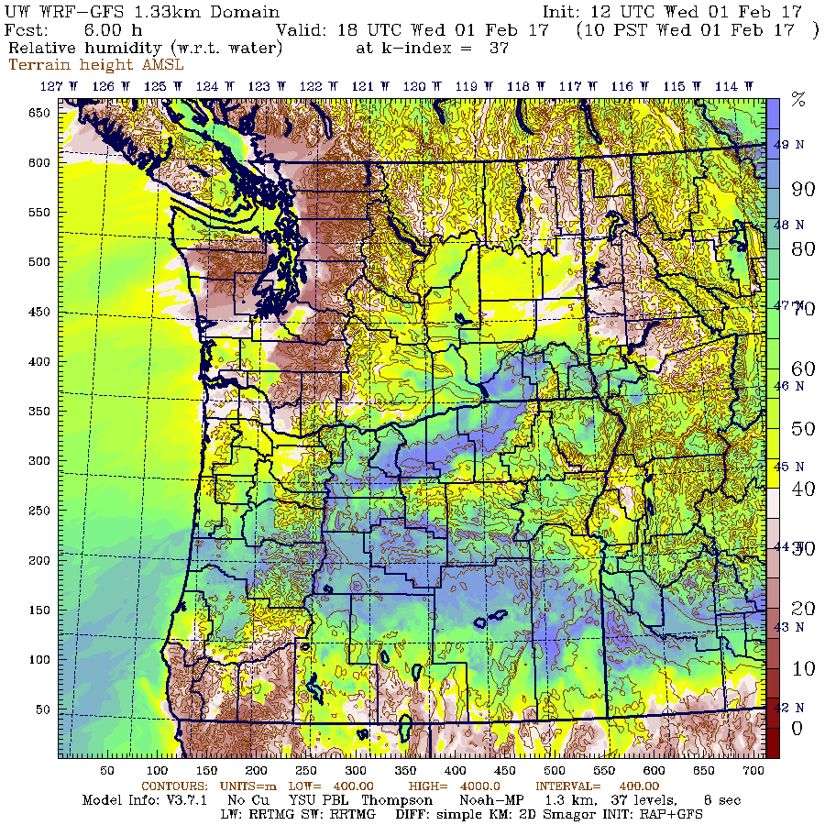

Slide 6
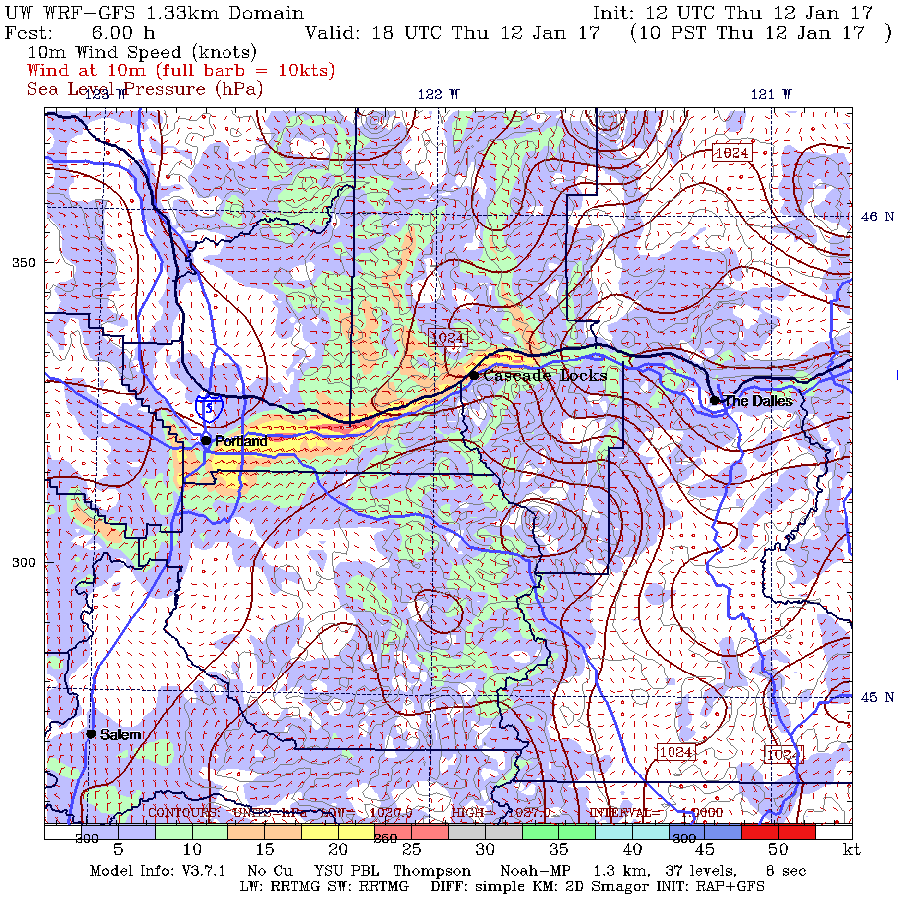

Slide 7
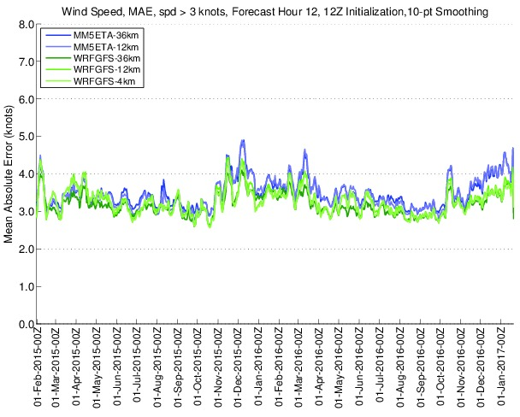
Verification System Shows No Problems

Slide 8
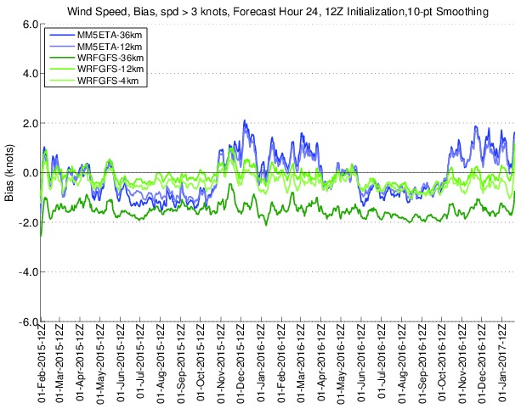

Slide 9
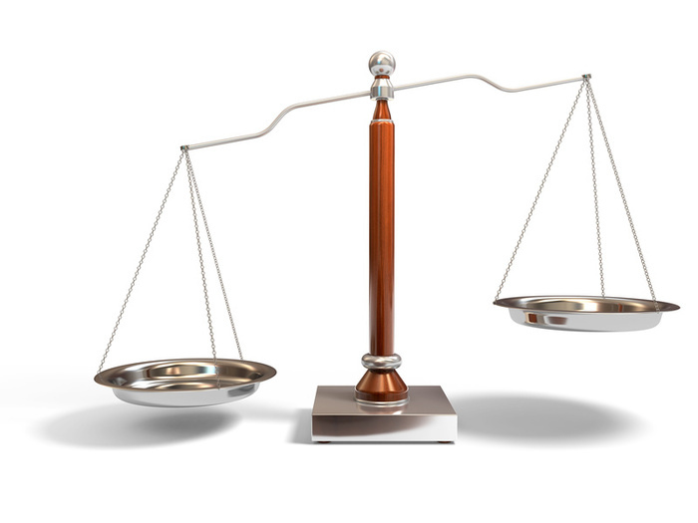
The Balancing Act
Reliability versus cutting edge physics
Best general skill versus skill for specific issues (e.g., stable boundary layer)
Generally, have tried to optimize reliability and general skill, but perhaps need to alter the balance.
Believe we should optimize more for stable boundary layer—important for stagnation, freezing rain, snow, gap winds

Slide 10
Dealing with the stable boundary layer over-mixing problem
An enduring issue has been is the mixing of warm air down into cold layers near the surface.
Higher horizontal resolution has not solved this.
Greater vertical resolution near the surface has not fixed this.
Some boundary layer schemes are a bit better, but the problem remained.

Slide 11
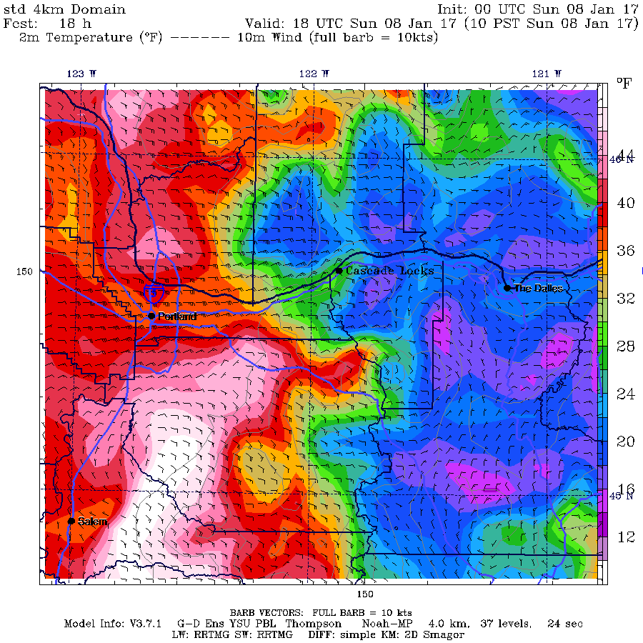
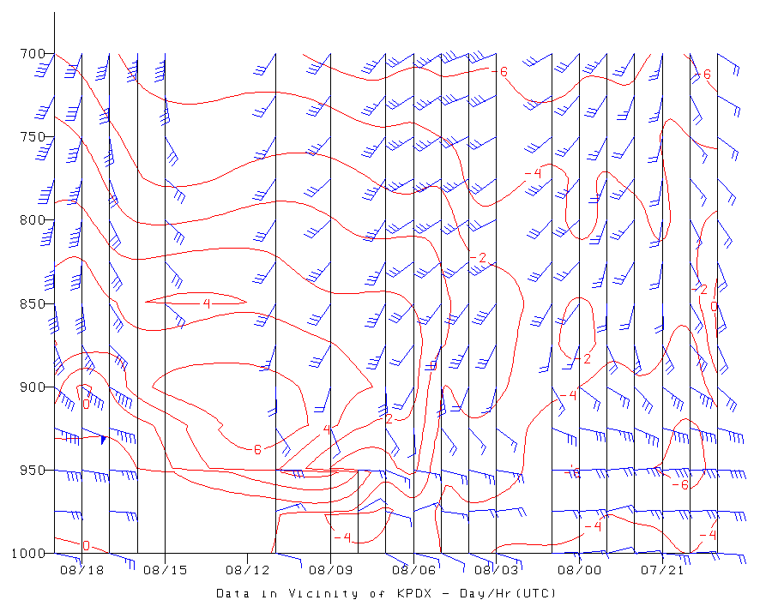
Classic Example: cold air in Columbia Gorge

Slide 12
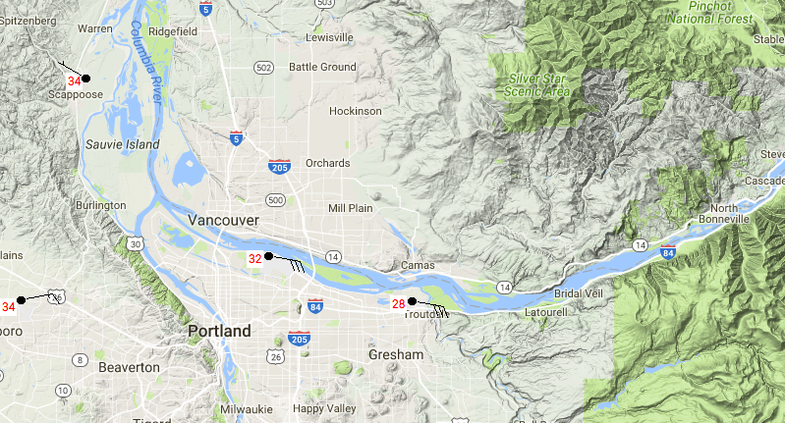
Reality

Slide 13
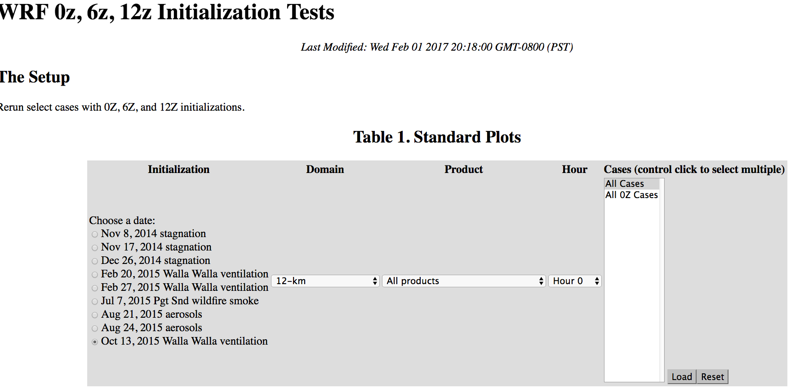
Range of Cases Showed Overmixing of Air in Valleys During Stagnation Events

Slide 14
New Direction (Reducing Diffusion)
Three types of diffusion in WRF:
Diffusion inherent in finite differencing (can’t remove)
Diffusion used to deal with horizontal variations in PBL (second order): diff_opt in namelist
Sixth order diffusion used to take out fine scale noise (available starting in 2007)

Slide 15
diff_opt=0 No second order diffusion diff_opt=1 Diffusion along model surface diff_opt=2 Horizontal diffusion Default is 1 and we had been using that based on stability issues.

Slide 16
Difference between diff_opt 1 and 2
mixing
diff_opt=1
Horizontal diffusion acts along model levels
Simpler numerical method with only neighboring points on the same model level

Slide 17
Difference between diff_opt 1 and 2
diff_opt=2
Horizontal diffusion acts along model levels
Numerical method includes vertical correction term using more grid points

Slide 18
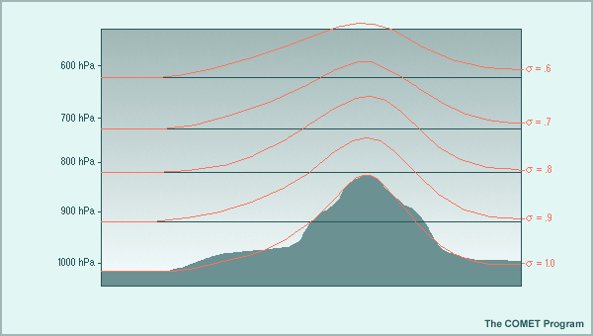
Mixing along model surfaces can mix in the VERTICAL when model surface are tilted…as they are in terrain
Worse at high resolution
Worse in gaps and valleys

Slide 19
diff_6th_opt
ARW only
6th order optional added horizontal diffusion on model levels
Used as a numerical filter for 2*dx noise
Suitable for idealized and real-data cases
Affects all advected variables including scalars
diff_6th_opt
0: none (default)
1: on (can produce negative water)
2: on and prohibit up-gradient diffusion (better for water conservation)
diff_6th_factor
Non-dimensional strength (typical value 0.12, 1.0 corresponds to complete removal of 2*dx wave in a time-step)

Slide 20
Bottom line: we have found that diffusion of both kinds (2nd order and 6th order) are causing substantial vertical mixing in stable PBL situations.

Slide 21
Testing: Gorge Jan cases, Poor Ventilation Cases, Multi-week summer and winter periods

Slide 22
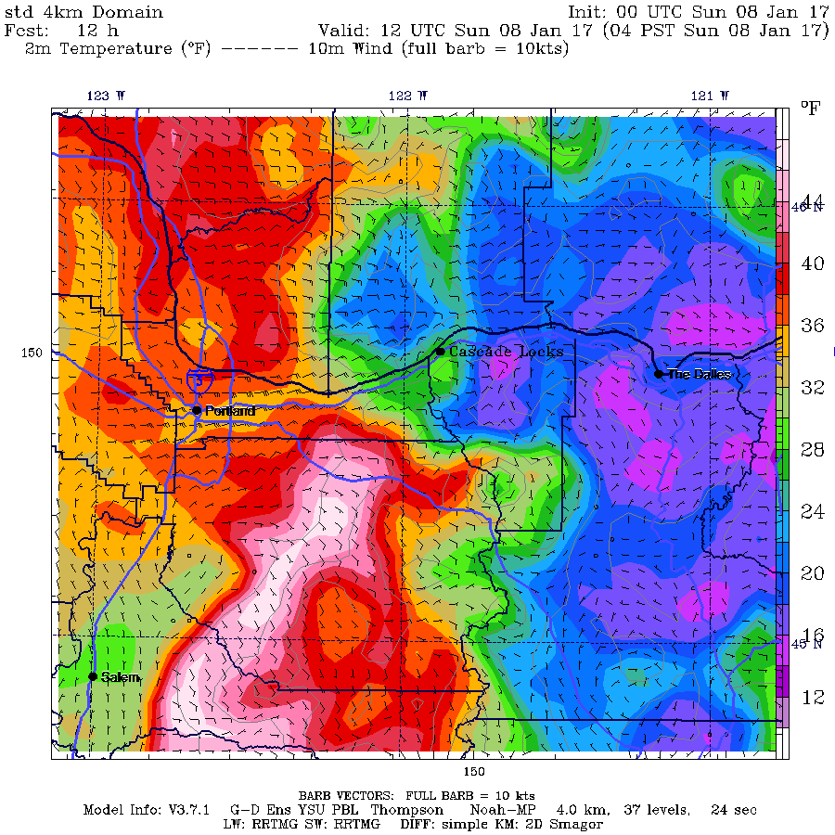

Slide 23
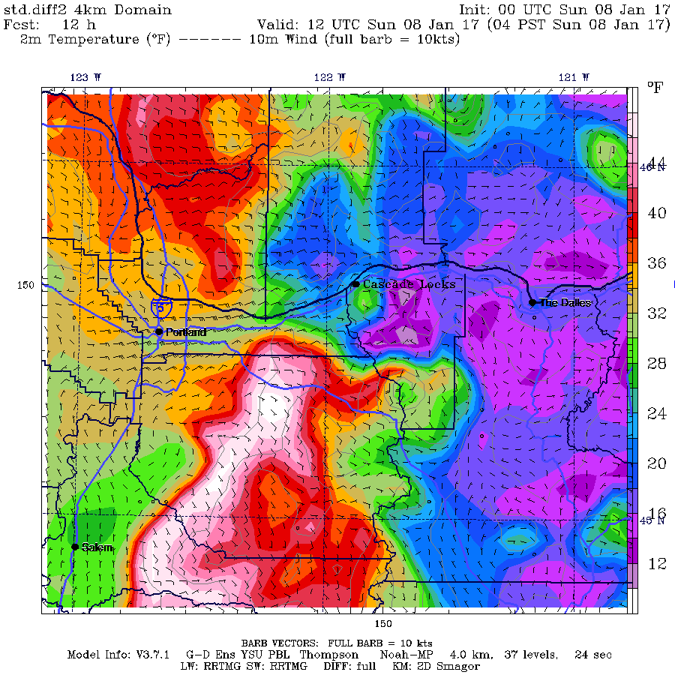

Slide 24


Slide 25
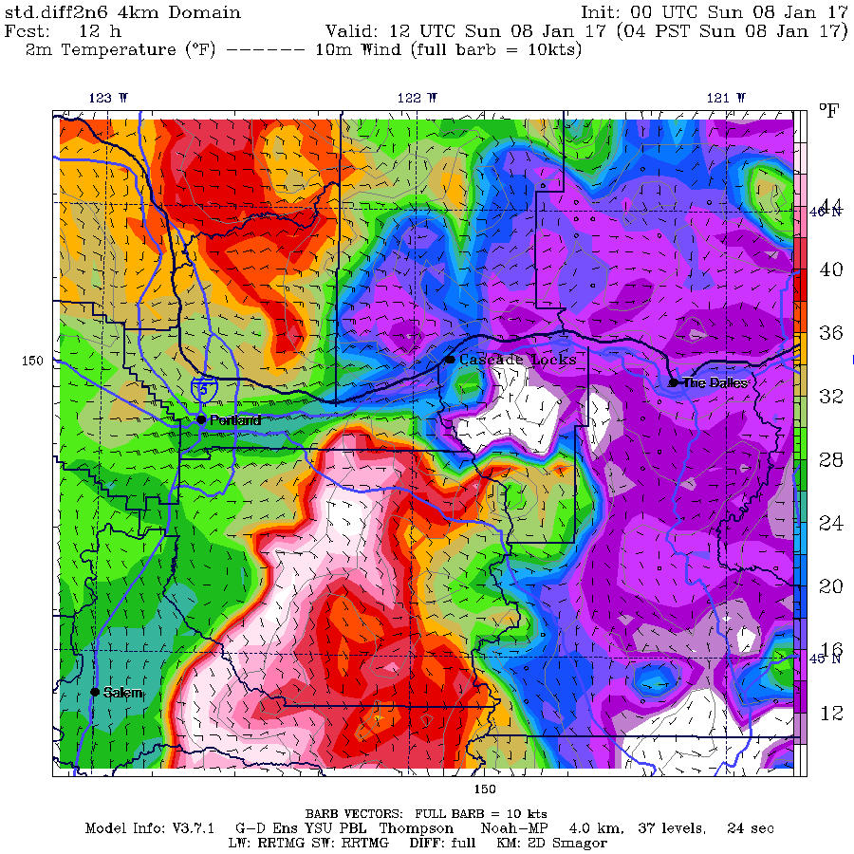

Slide 26
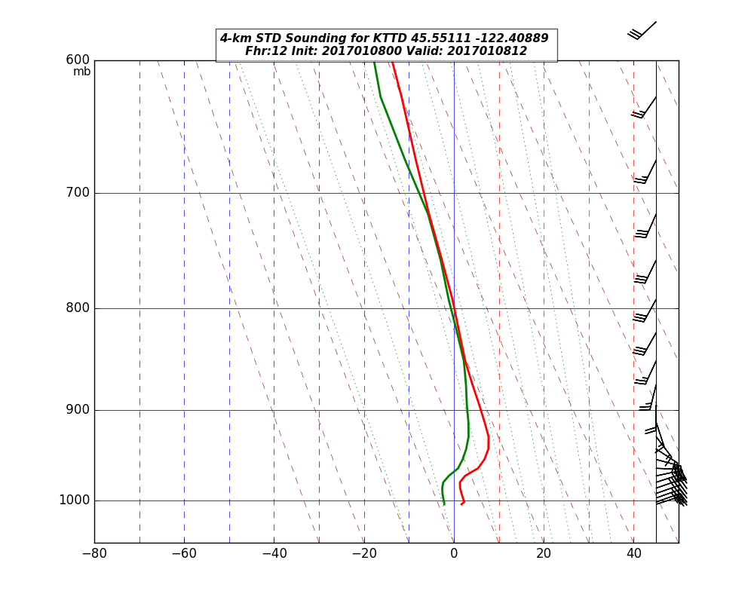

Slide 27
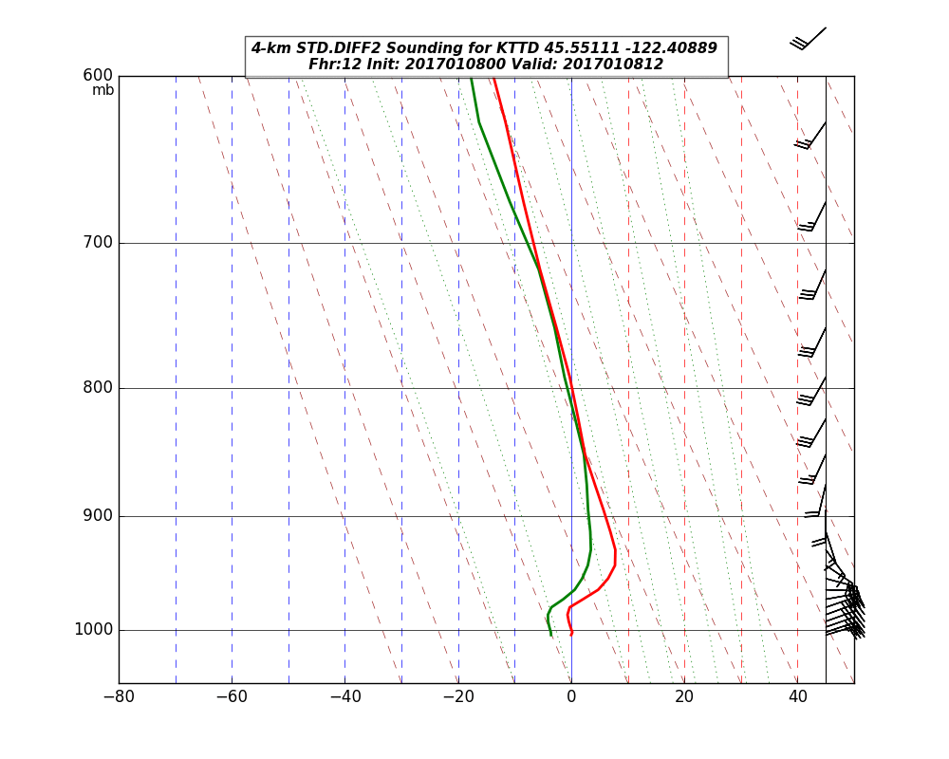

Slide 28
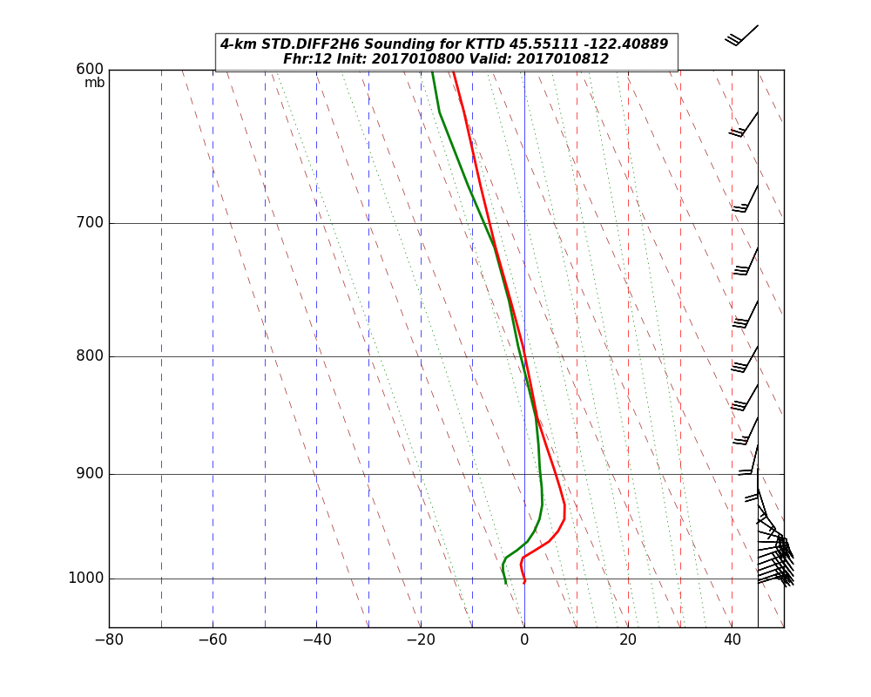

Slide 29


Slide 30
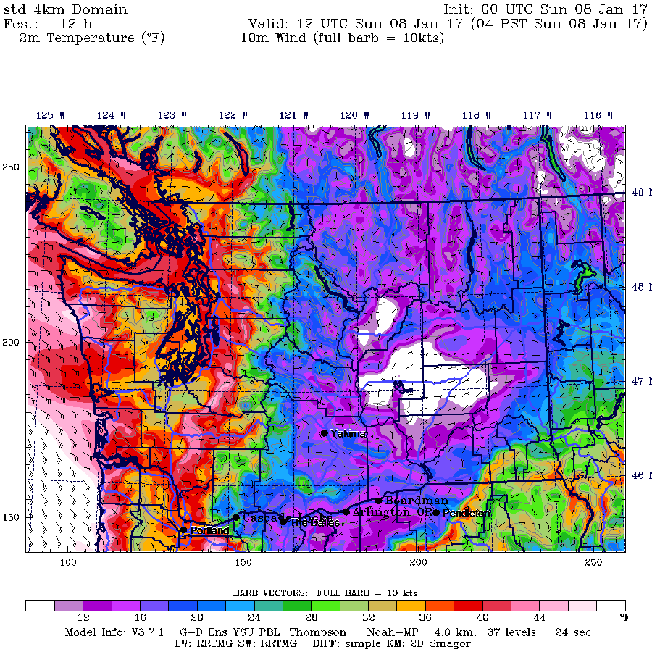

Slide 31
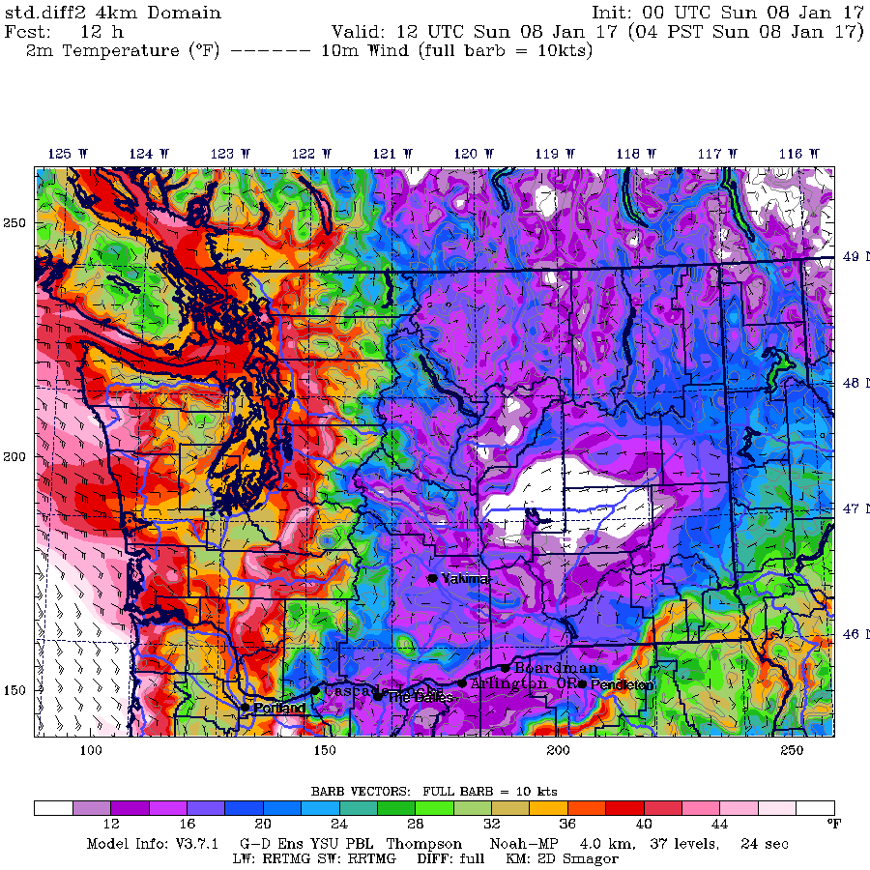

Slide 32


Slide 33
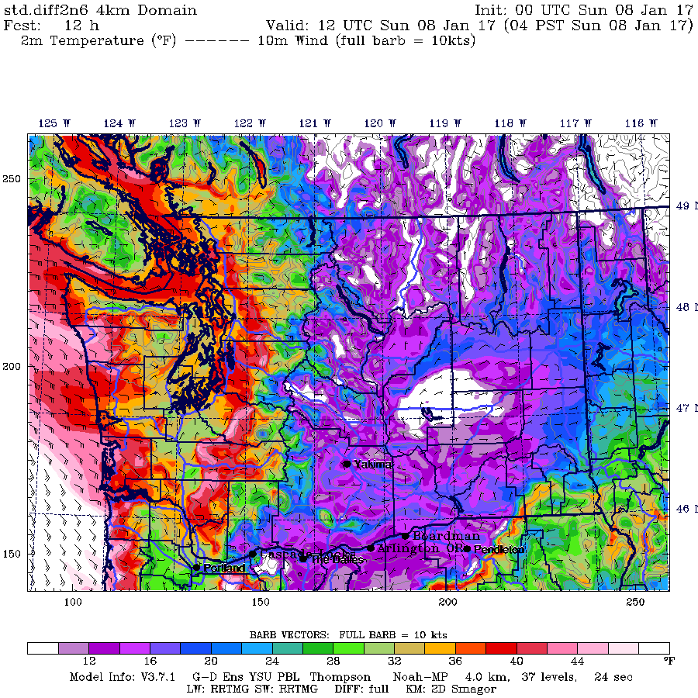

Slide 34
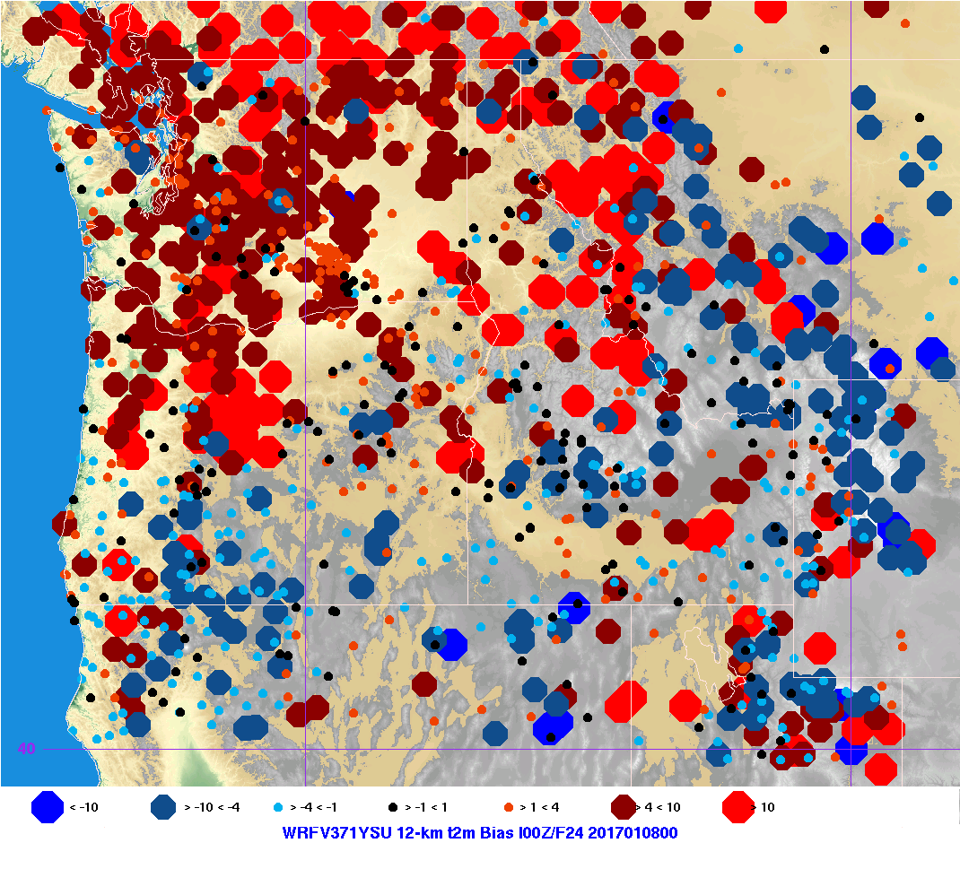

Slide 35
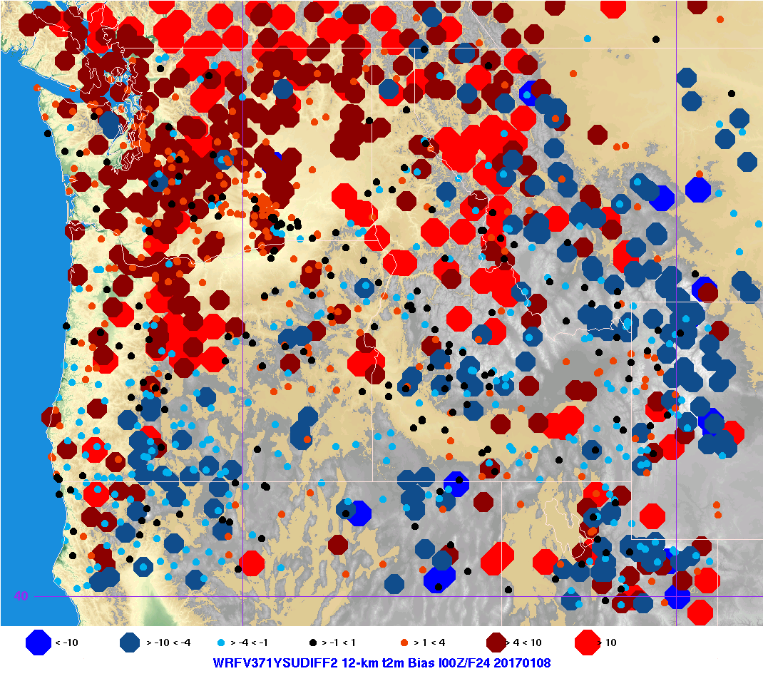
Verification

Slide 36
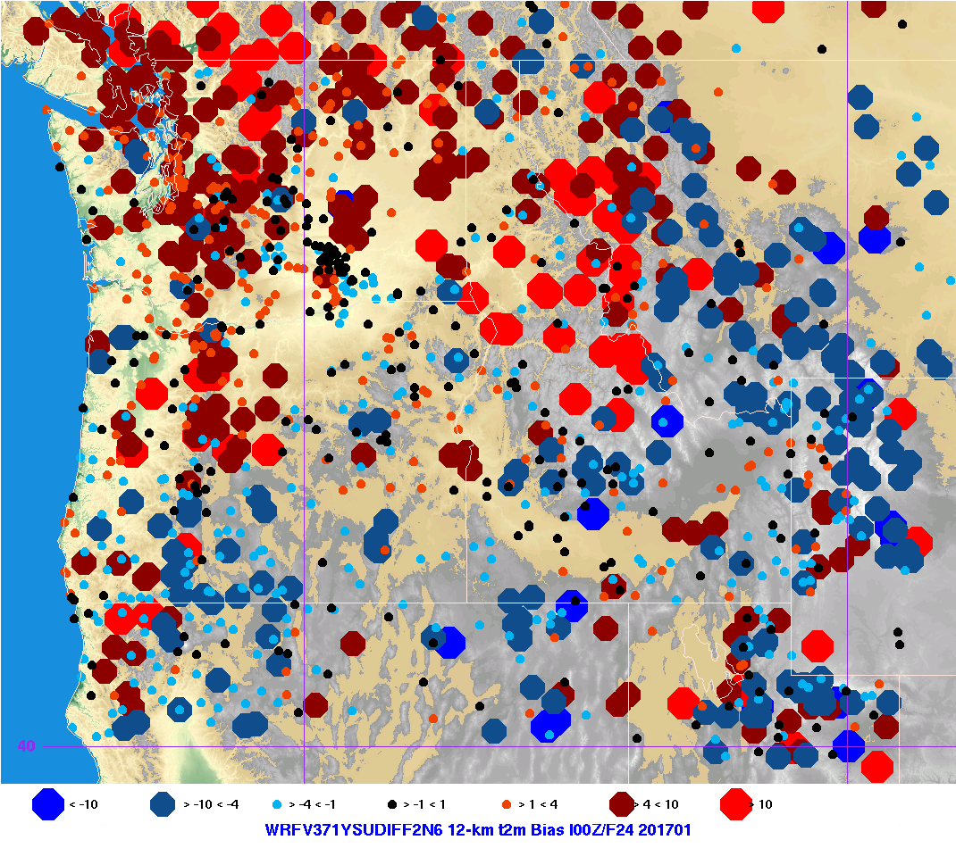
Verification

Slide 37
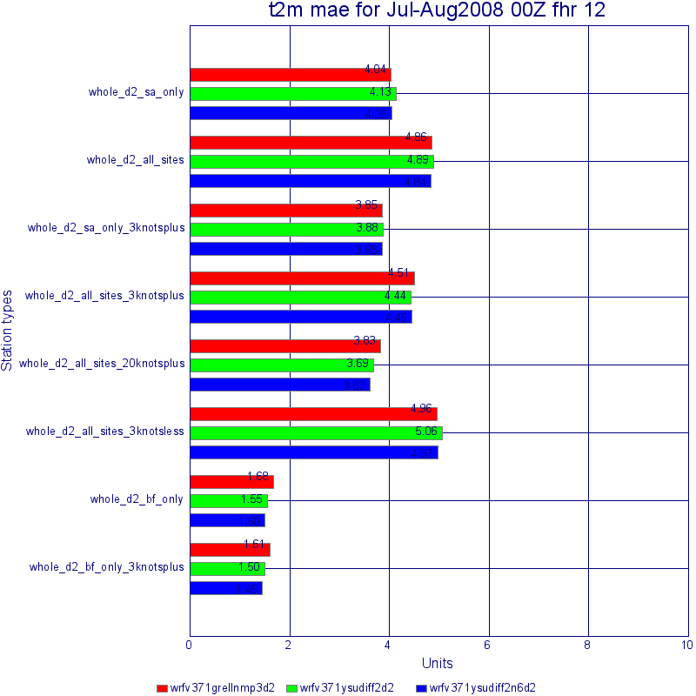
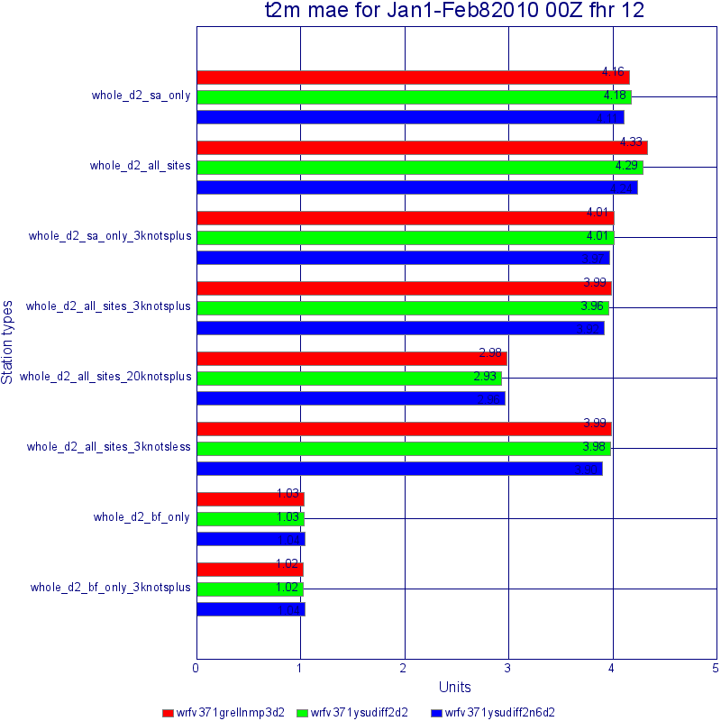

Slide 38
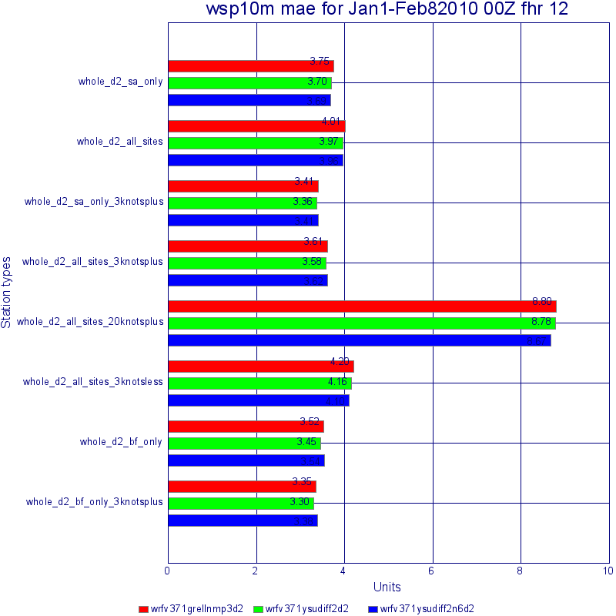
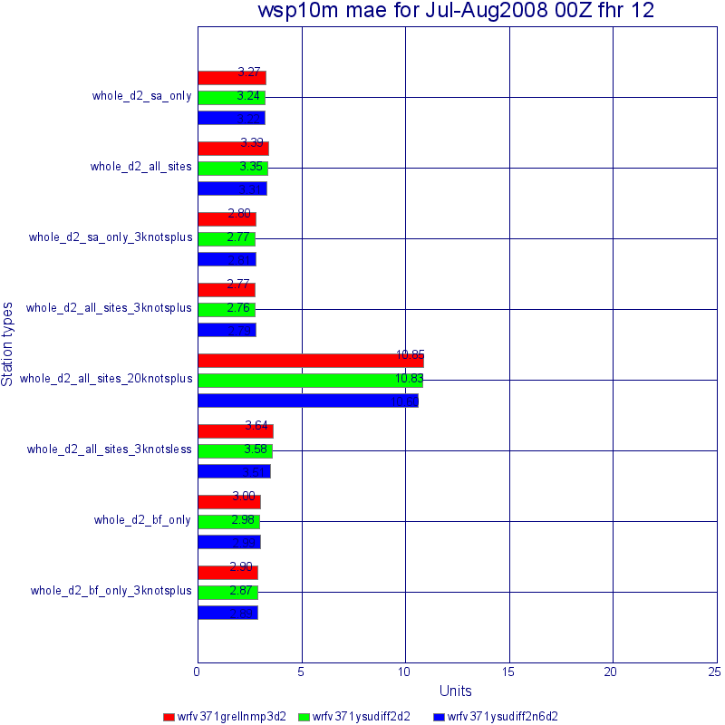

Slide 39
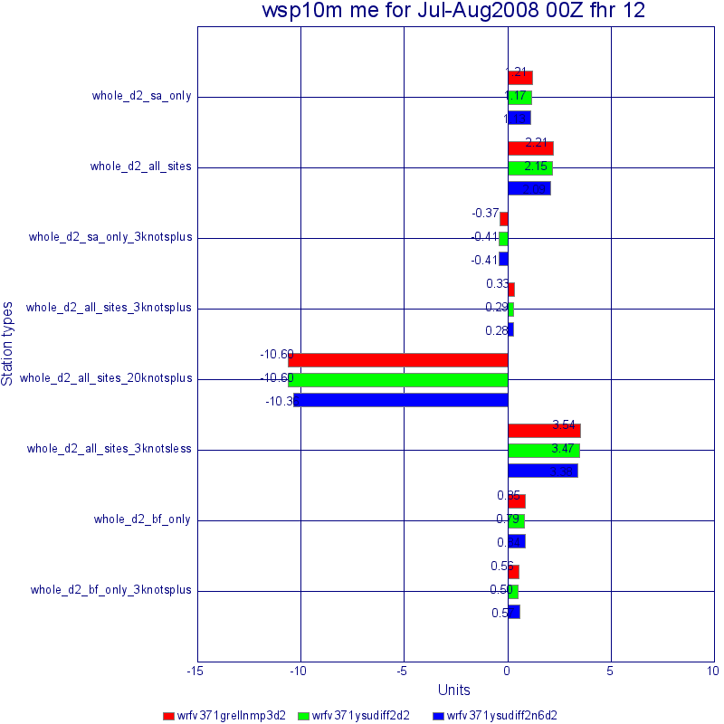
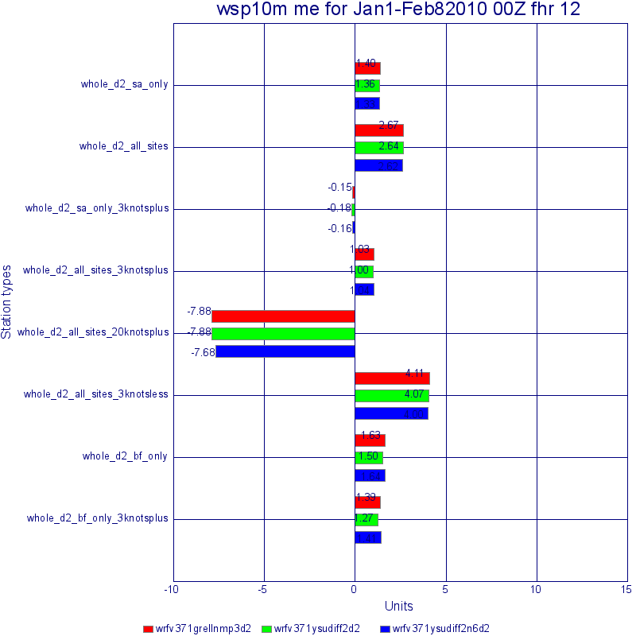

Slide 40
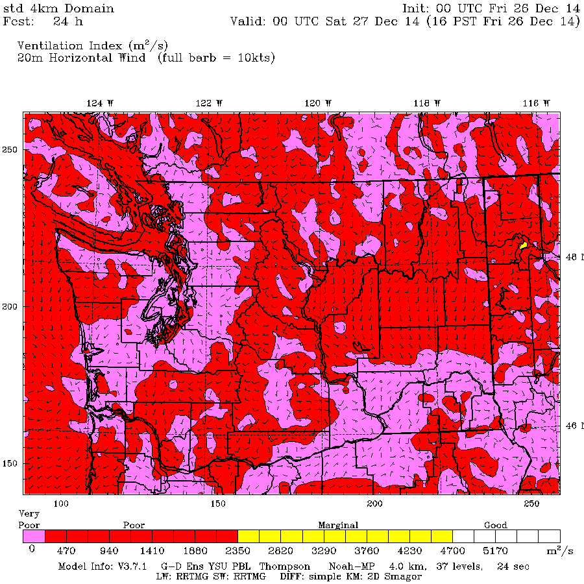

Slide 41
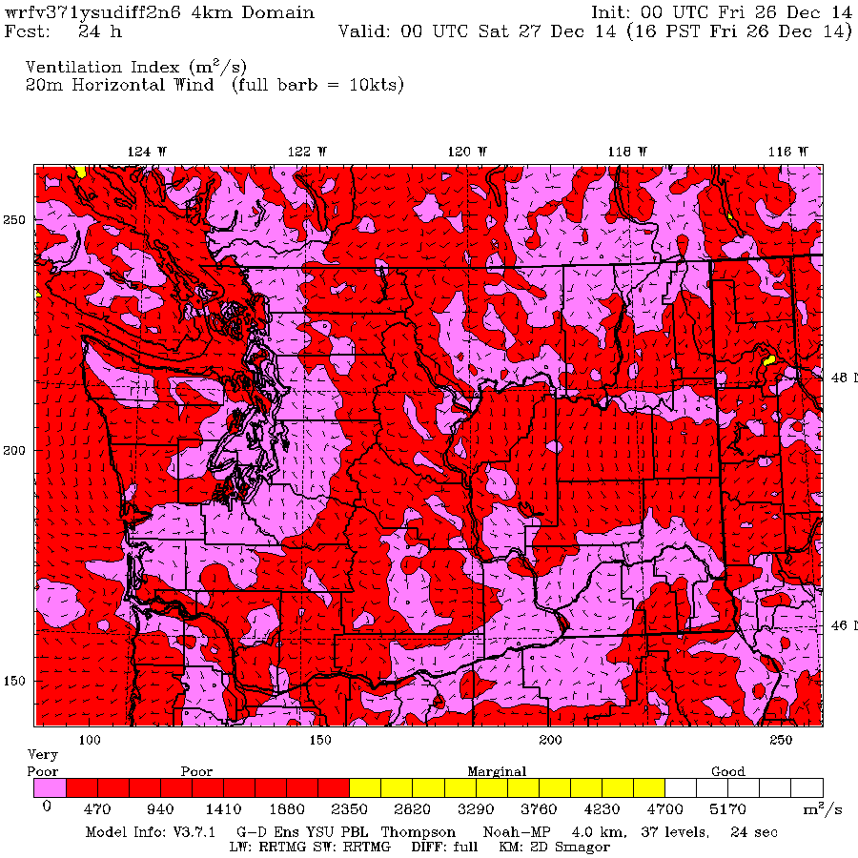

Slide 42
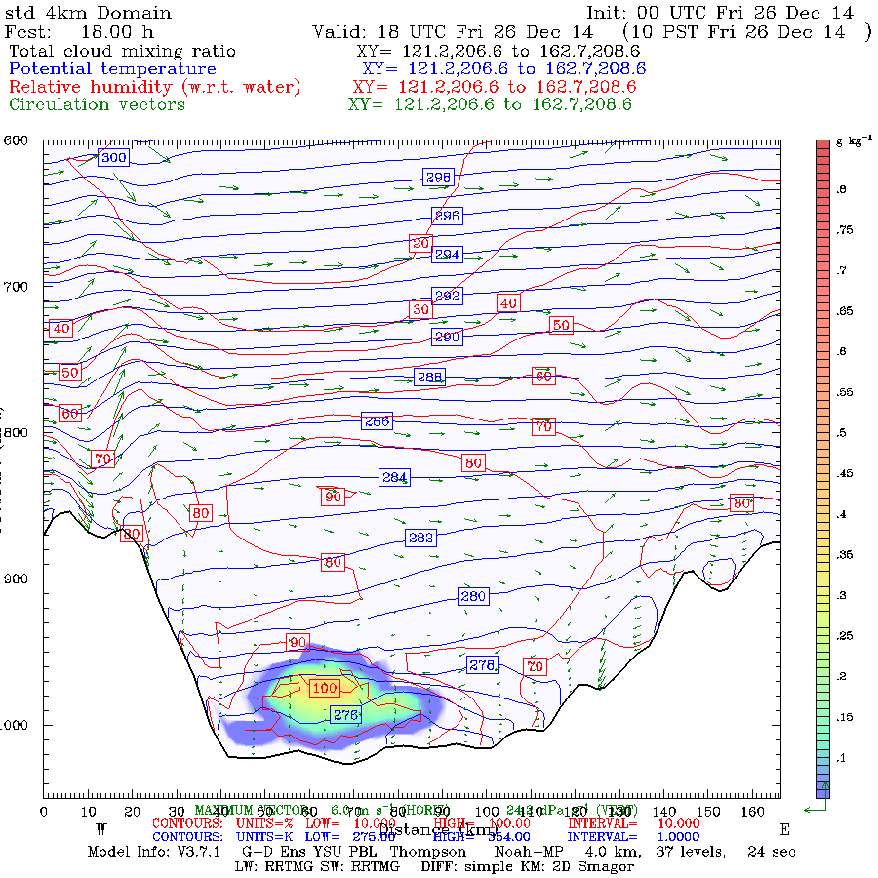

Slide 43
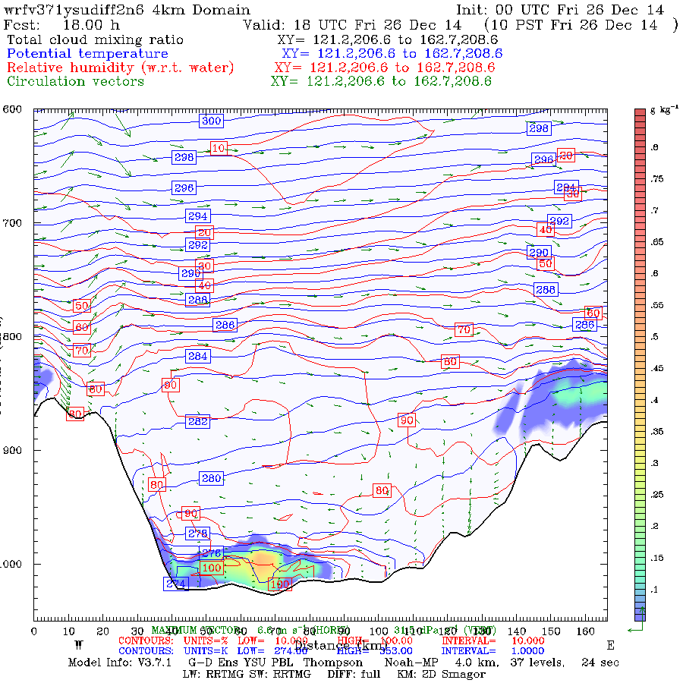

Slide 44
Recommendation
Move to diff=2
Turn off 6-order diffusion
If unexpected problems develop, bring back weakened 6th order diffusion.

Slide 45
More
We also tested a wide range of PBL schemes.
Some preserved stable layers better than YSU, which we are using, but their overall verification scores were worse.
Will continue testing and bring the results to the next consortium meeting.
Also want to start working on the mesoscale ensemble, starting with UKMET, CMC, and perhaps Panasonic.

