Slide 1
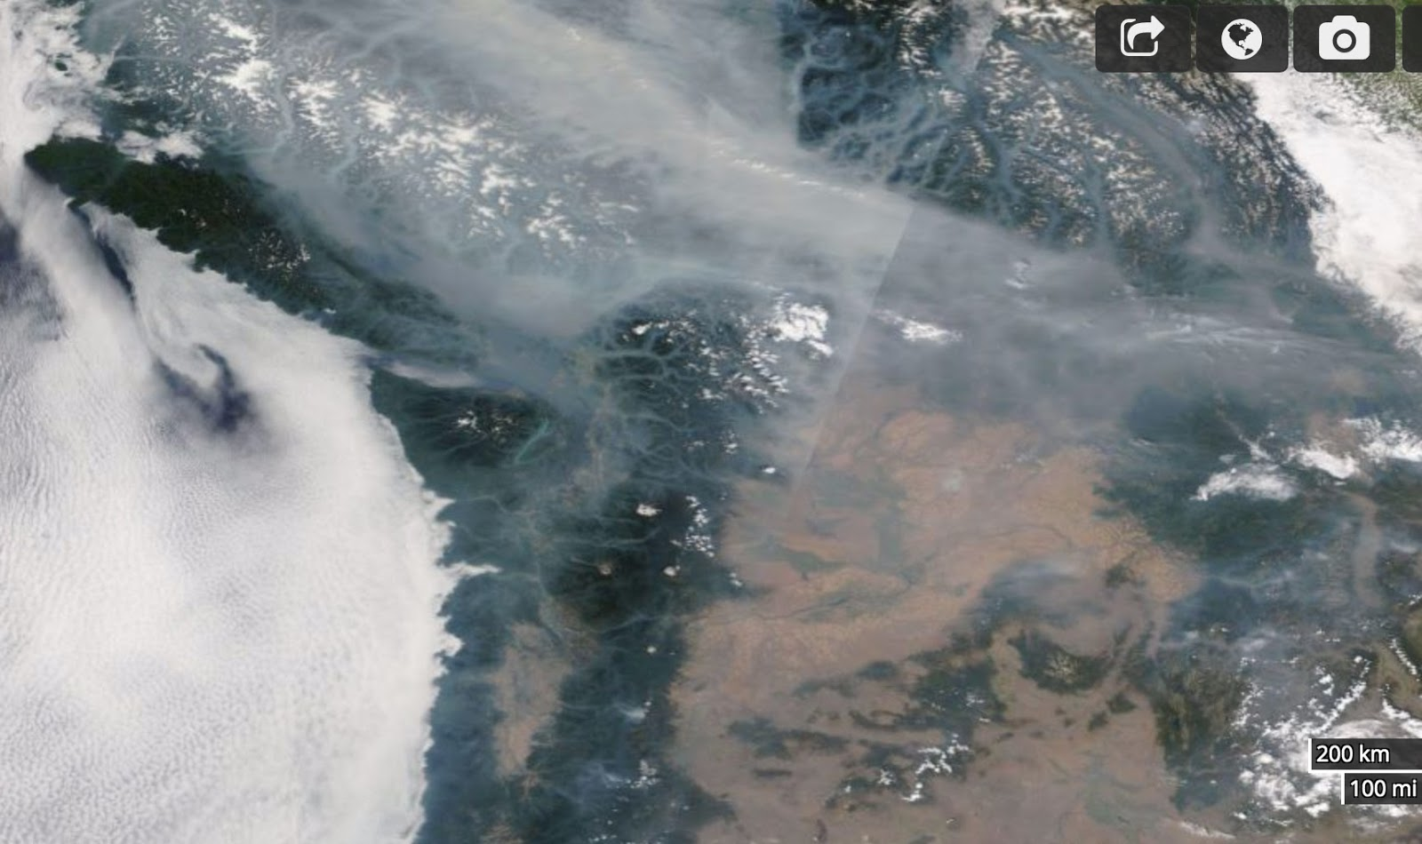
Consortium 6/18
Cliff Mass and David Ovens

Slide 2
During the summer of 2017, dense veils of wildfire smoke covered the western U.S. for weeks

Slide 3
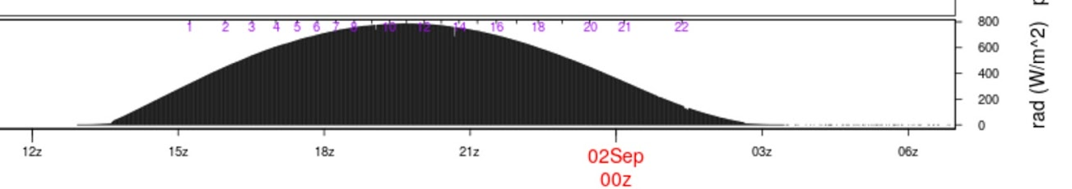
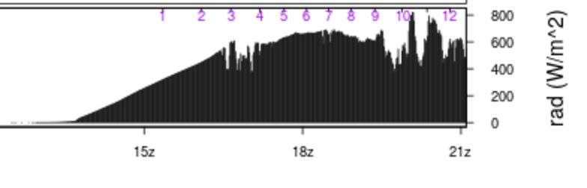
The impacts on solar radiation were profound (e.g., 25-35% drop in solar flux at surface in Seattle)

Slide 4
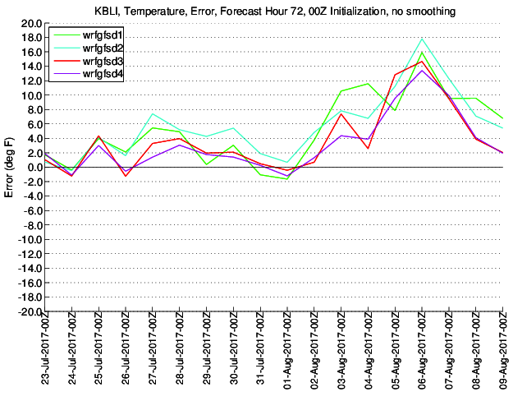
The result was substantial cooling (as high as 15F) that was not captured by the UW Operational WRF System
UW WRF Temperature Error
Bellingham, WA

Slide 5
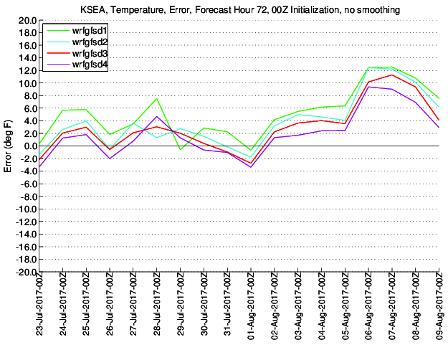
Seattle

Slide 6
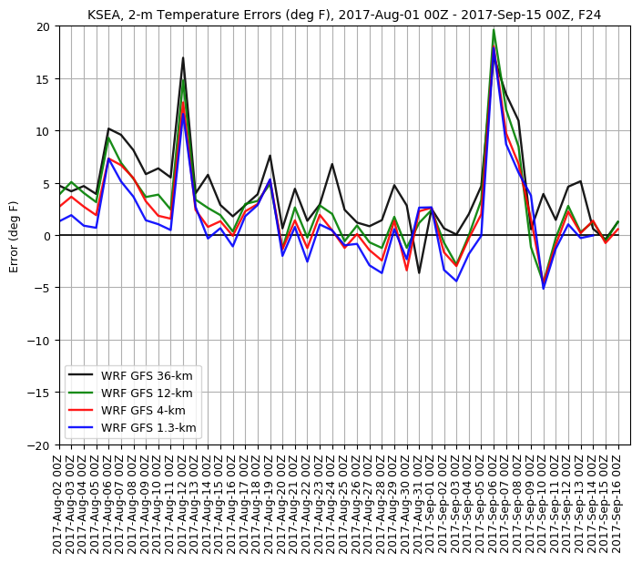
Seattle August 2- Sept 16

Slide 7
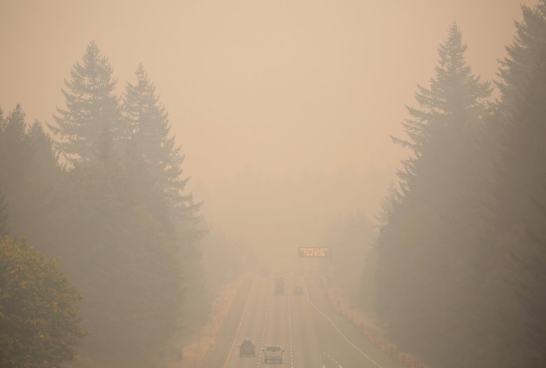
Errors in the WRF system
Large temperature errors where smoke was dense
Messing up boundary layer depth forecasts.

Slide 8

But how?
Didn’t want to run WRF-CHEM
Didn’t want to bother getting fire inventory and doing emissions modeling.
In the first cut, wanted to avoid explicit modeling of the 3D nature of the smoke, just deal with the reduction of solar radiation to the surface.

Slide 9

A simple approach
Secure a 2D field of smoke-related aerosol optical depth at initialization and forecast times.
Plug it into the RRTMG radiation scheme in WRF.
Thus, add smoke into our model with little overhead.
Go home and get a class of wine.
BUT DOES THIS WORK?

Slide 10
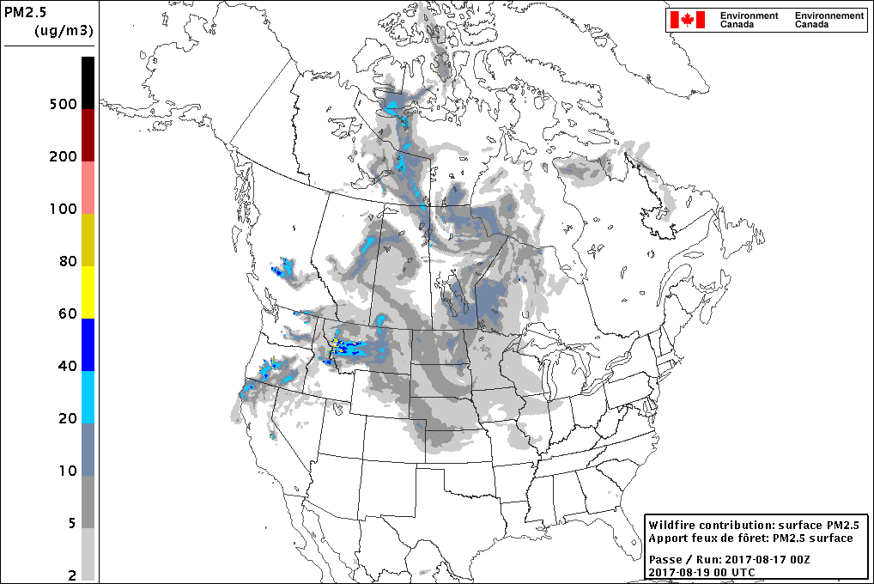
Complication
Significant differences between various smoke prediction systems. (Canadian, Bluesky, ESRL HRRR)
Most are only available for a few days out (72hr, which means would only have 60hr)
All based on fire sources, not remote sensing of smoke

Slide 11
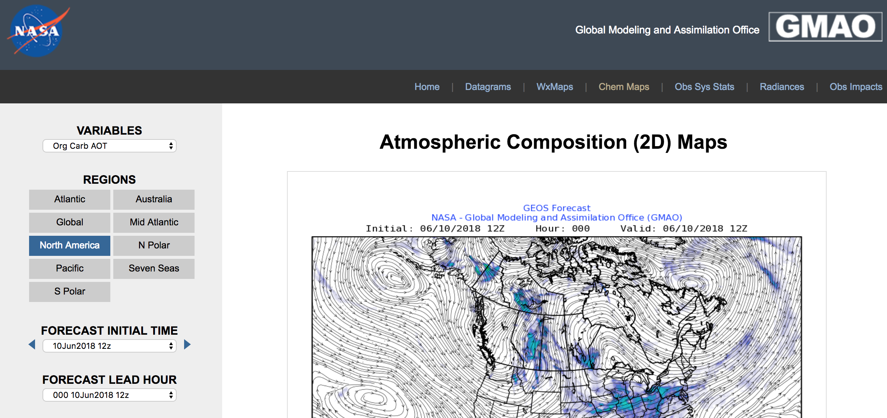
Compromise: Use the NASA GEOS FP System
Four times a day
Initialization and forecasts are available
~30 km horizontal grid spacing
Aerosol optical depth and angstrom exponent available

Slide 12
Experimental set up
4-km domain
GEOS 3-hourly aerosol optical depth initial conditions and forecast.
GEOS 3-hourly aerosol angstrom exponent (how optical depth changes with wavelength)
Fixed single scattering albedo = 0.85
Fixed aerosol asymmetry parameter = 0.9

Slide 13
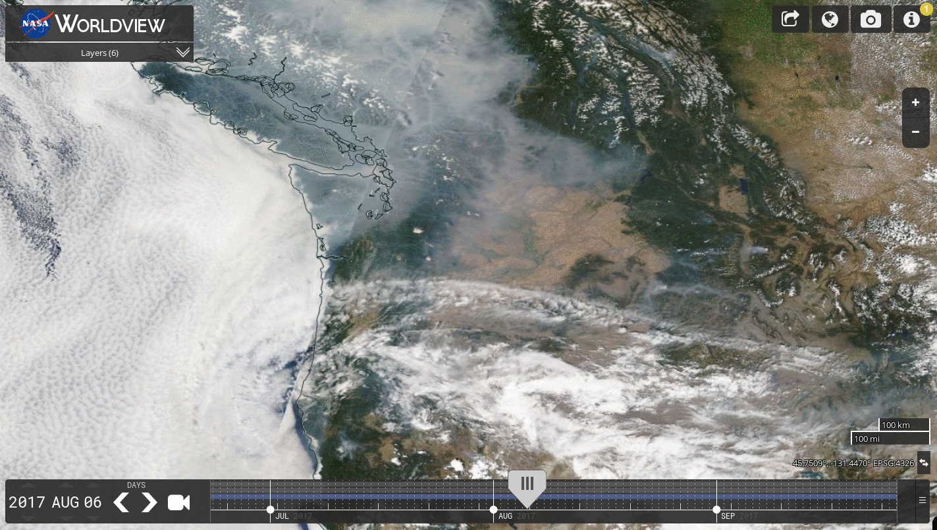
Two Events: August 6-7

Slide 14
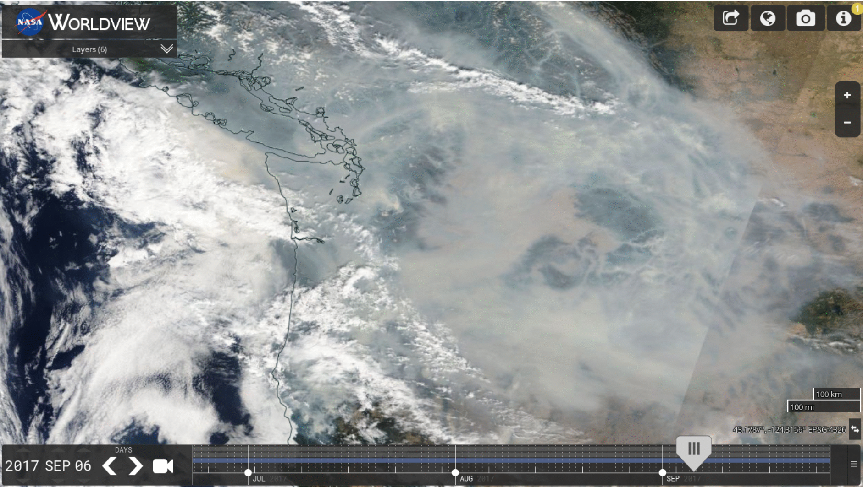
September 6-7, 2017

Slide 15
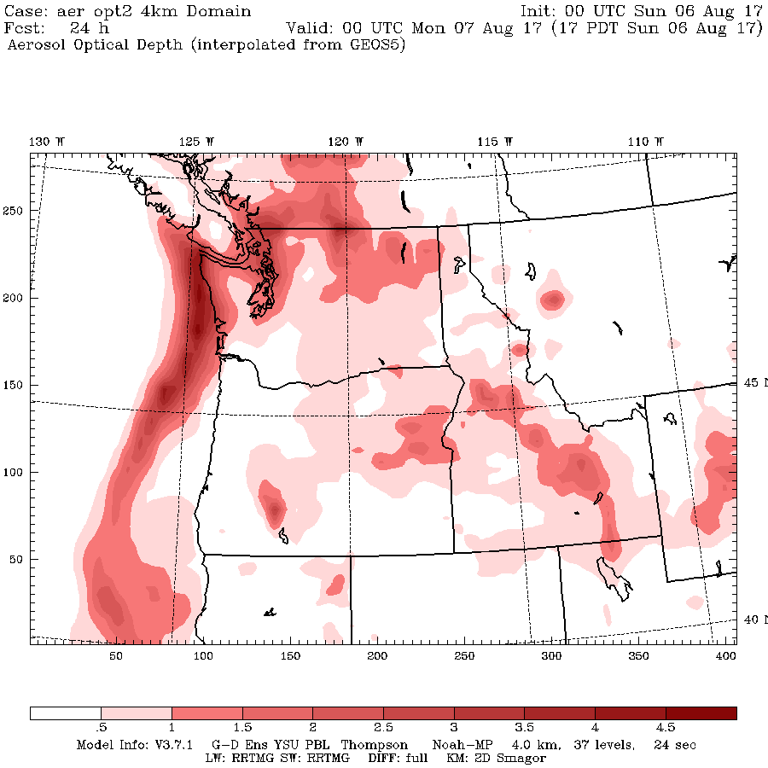
GEOS 5 AOD, 0000 UTC 7 August 2017

Slide 16
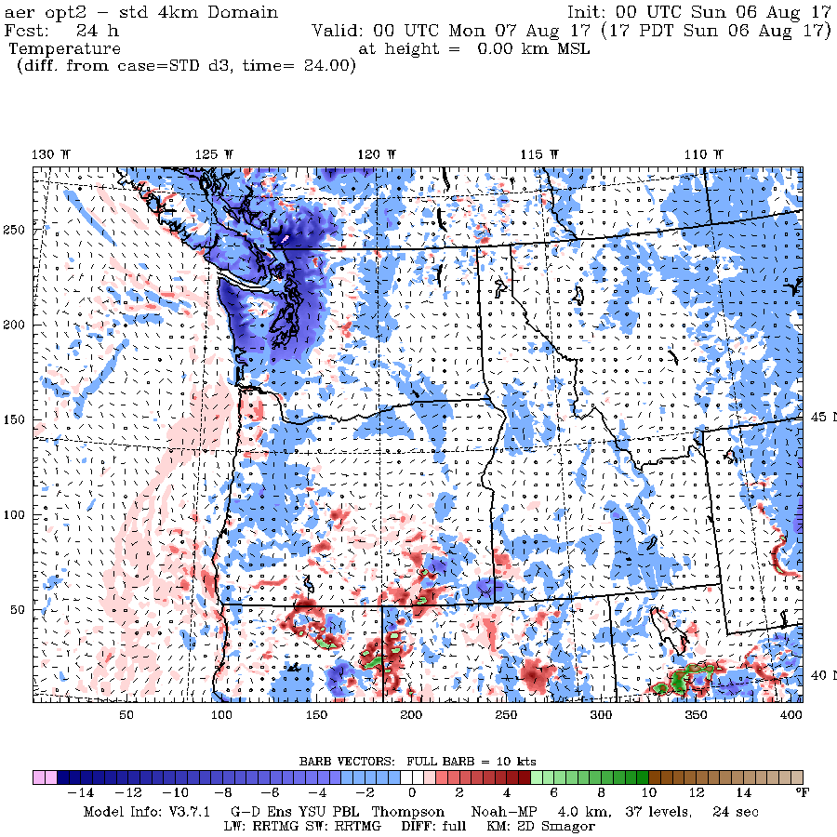
Temperature Impact (°F)

Slide 17
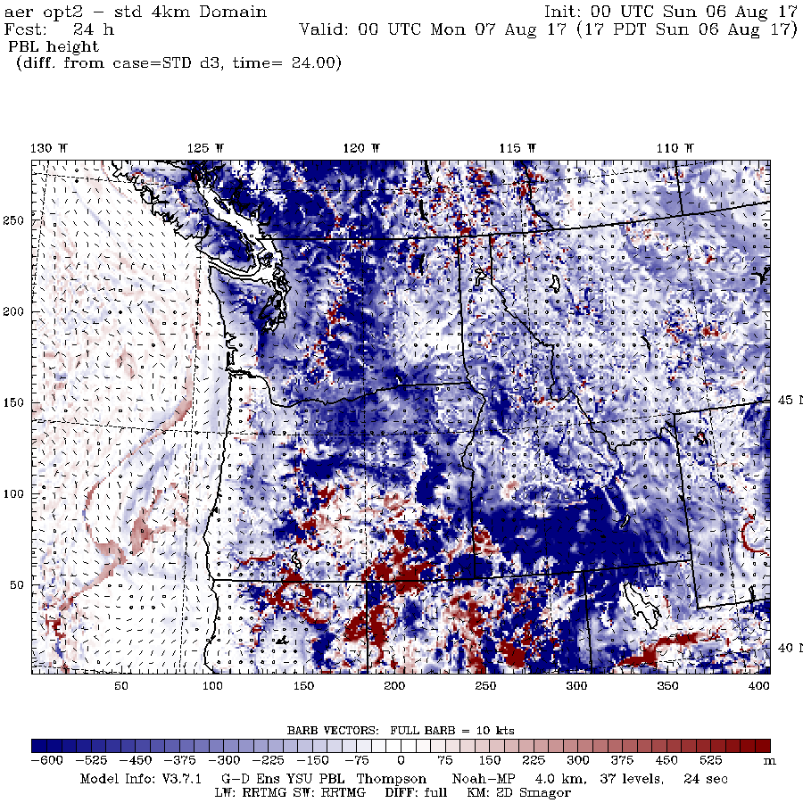
Change in PBL Height

Slide 18
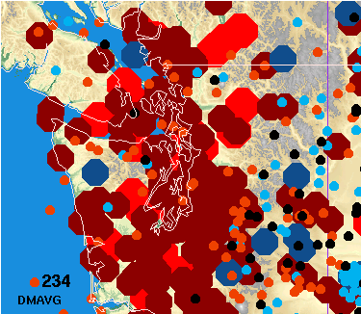
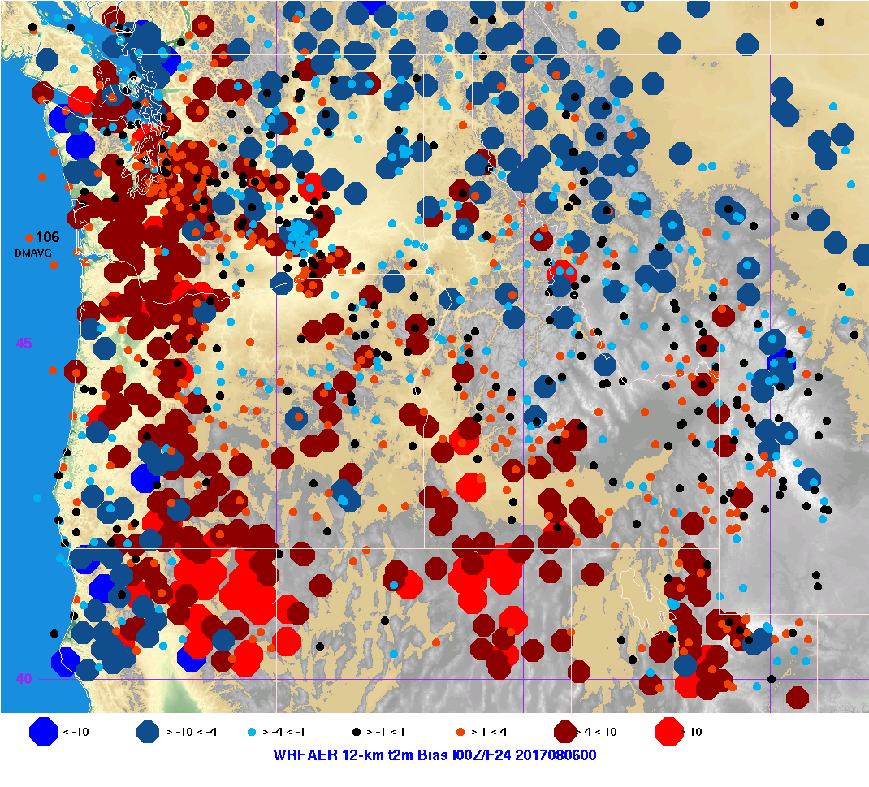
Change in temperature bias
No smoke
With smoke

Slide 19
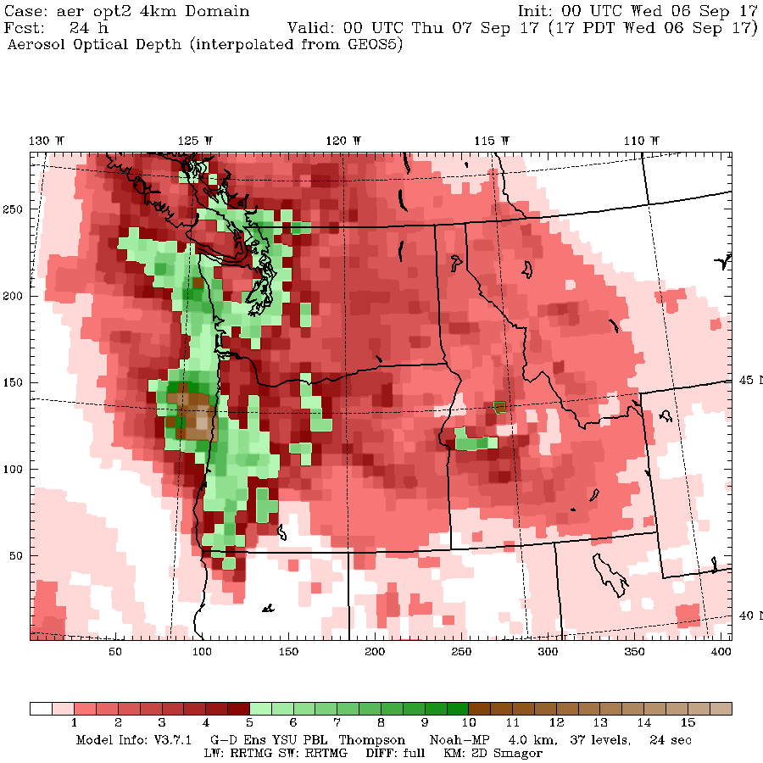
0000 UTC 7 September

Slide 20
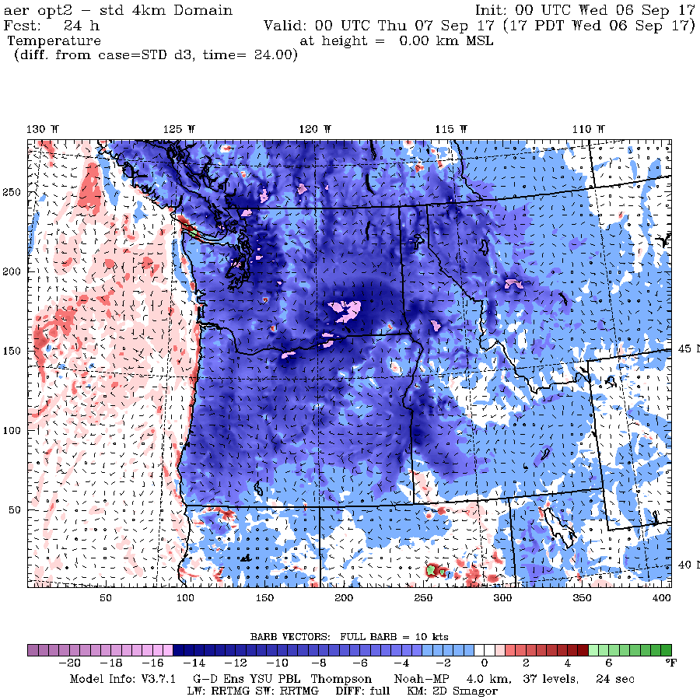
Temp Change

Slide 21
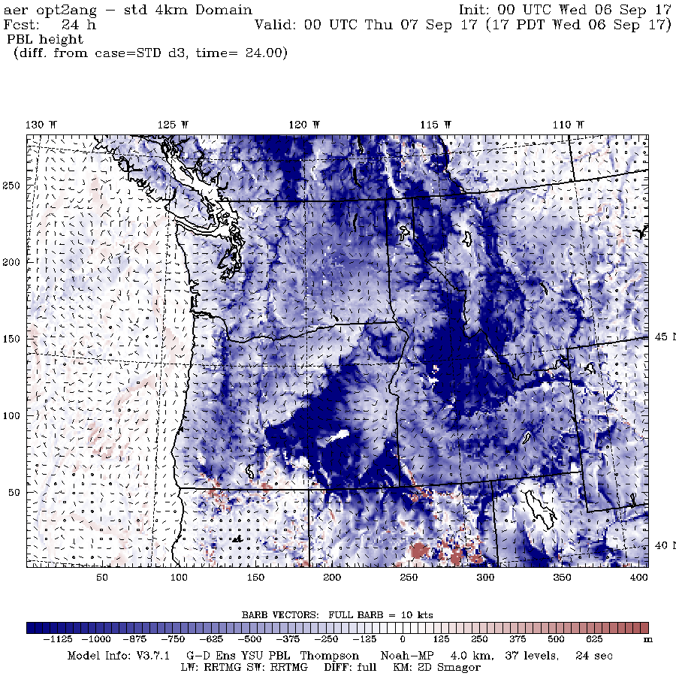
Change in PBL Height

Slide 22
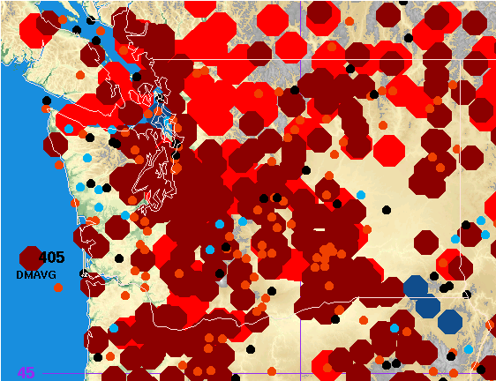
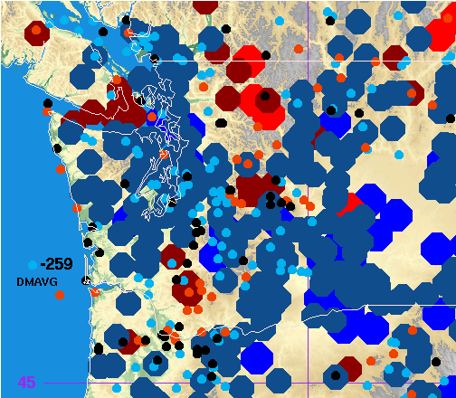
No smoke Smoke

Slide 23
Appears Viable But Still More Work
Replace with smoke related single scattering albedo
Replace with snow related aerosol asymmetry factor
Testing with more cases
Perhaps needs some empirical calibration
Go operational on July 1 or July 15.

Slide 24
Another approach that may be better
Presented this approach at WRF meeting
George Grell, lead of WRF Chem, offered to help using WRF chem
There is a version with just smoke and no chemistry
There are emission grids available.
Would give us full three-dimensionality to the smoke

Slide 25
High-Resolution Ensemble Upgrade
Now acquiring 192 more cores that will be dedicated to the ensembles
Ordered on June 1, hopefully delivery during the next week.
Expand ensemble to 00 and 12 UTC. Should be able to secure 20-25 members per cycle.
In place this summer.
Side note: NOAA/NWS efforts not going anywhere fast on high-resolution ensembles.

Slide 26
Possible Future System Upgrades
Going to WRF 4.0
Adding vertical levels (say from 38 to 50)
Going to hybrid vertical coordinate
Evaluating new physics schemes, including PBL.

Slide 27
The End

