Slide 1
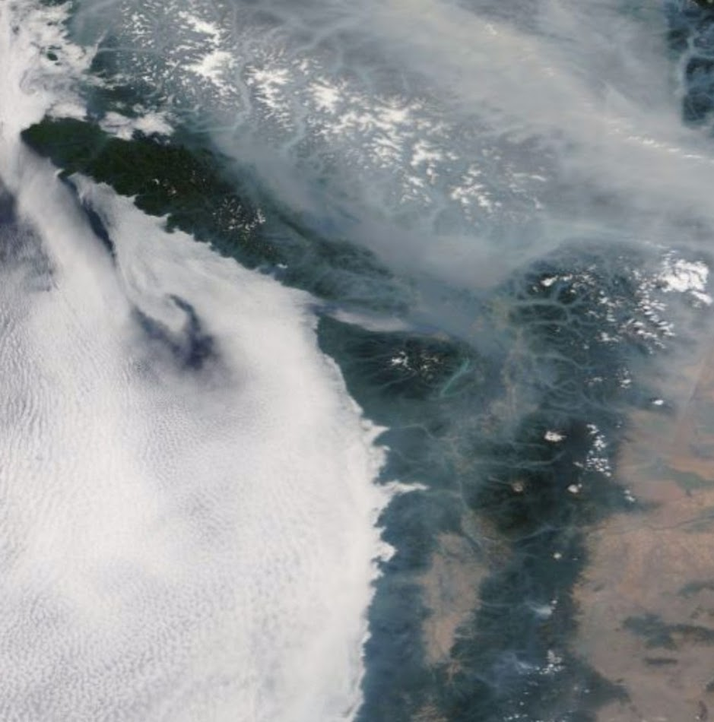
Consortium February 2019
Cliff Mass and David Ovens

Slide 2
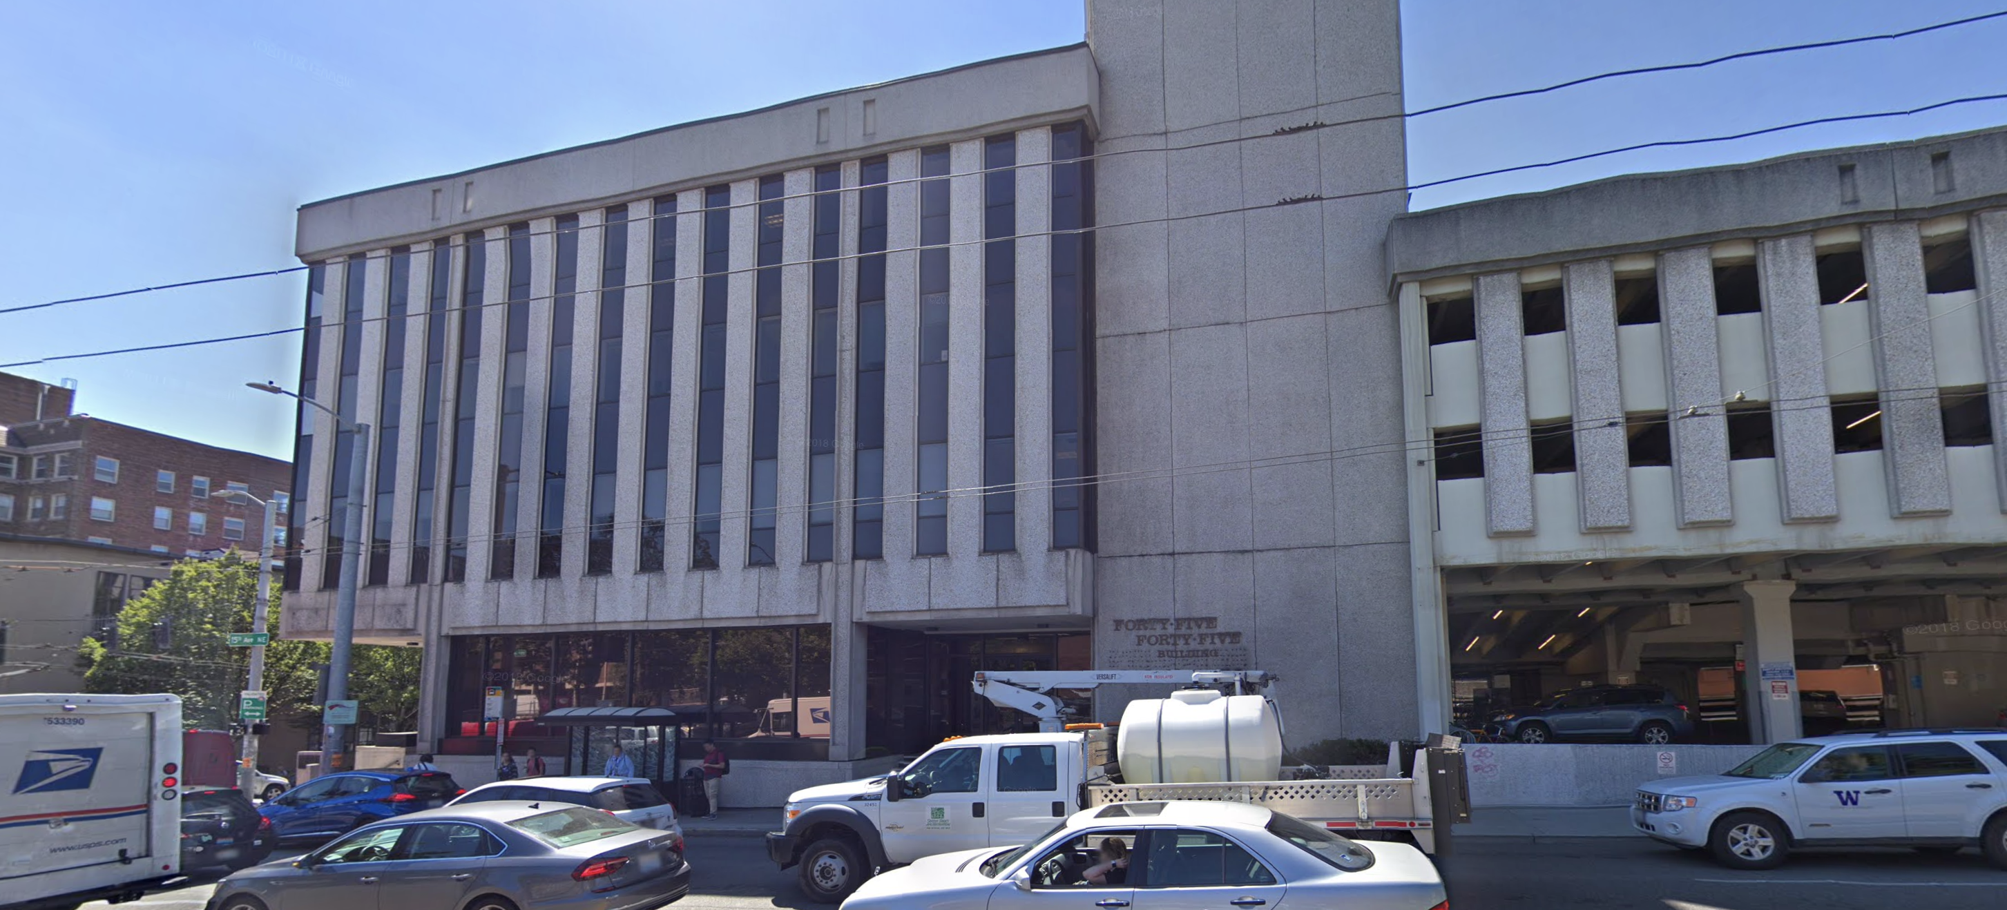
Computers Moved and Everything Stable

Slide 3
Some Problems Resolved
Problem Node Fixed and Returned Into Cluster
Government shut-down issues fixed (we lost our feed for the NOAA/NWS RAP grids)
The latter degraded our initial conditions and ability to start with low clouds in eastern WA.
Now back to normal
Fixed and updated the meteogram, time-height, and sounding generators.

Slide 4
Ensemble Expansion: Initial Stage Complete: Both 0000 and 1200 UTC Cycles Operational
4-km deterministic from operational GFS
10 members from the GFS ensemble system (GEFS)
5 additional members driven by Canadian, UKMET, Australian, Japanese, and Navy Global Models
All ready by approximately 8 AM, 8 PM

Slide 6
Stage 2: Expansion
During the next few months, we will add physics uncertainty, using stochastic physics options.
Will also add a run with more vertical layers.
Will start with 5 additional runs each cycle.
Create new, ensemble-based products.

Slide 7
Improved Land Use in Model
Moved from 15 arcsecond vs 30 arcsecond, MODIS landuse dataset
To improve it further, Dave completed some additional manual editing of cells in Western Washington

Slide 8
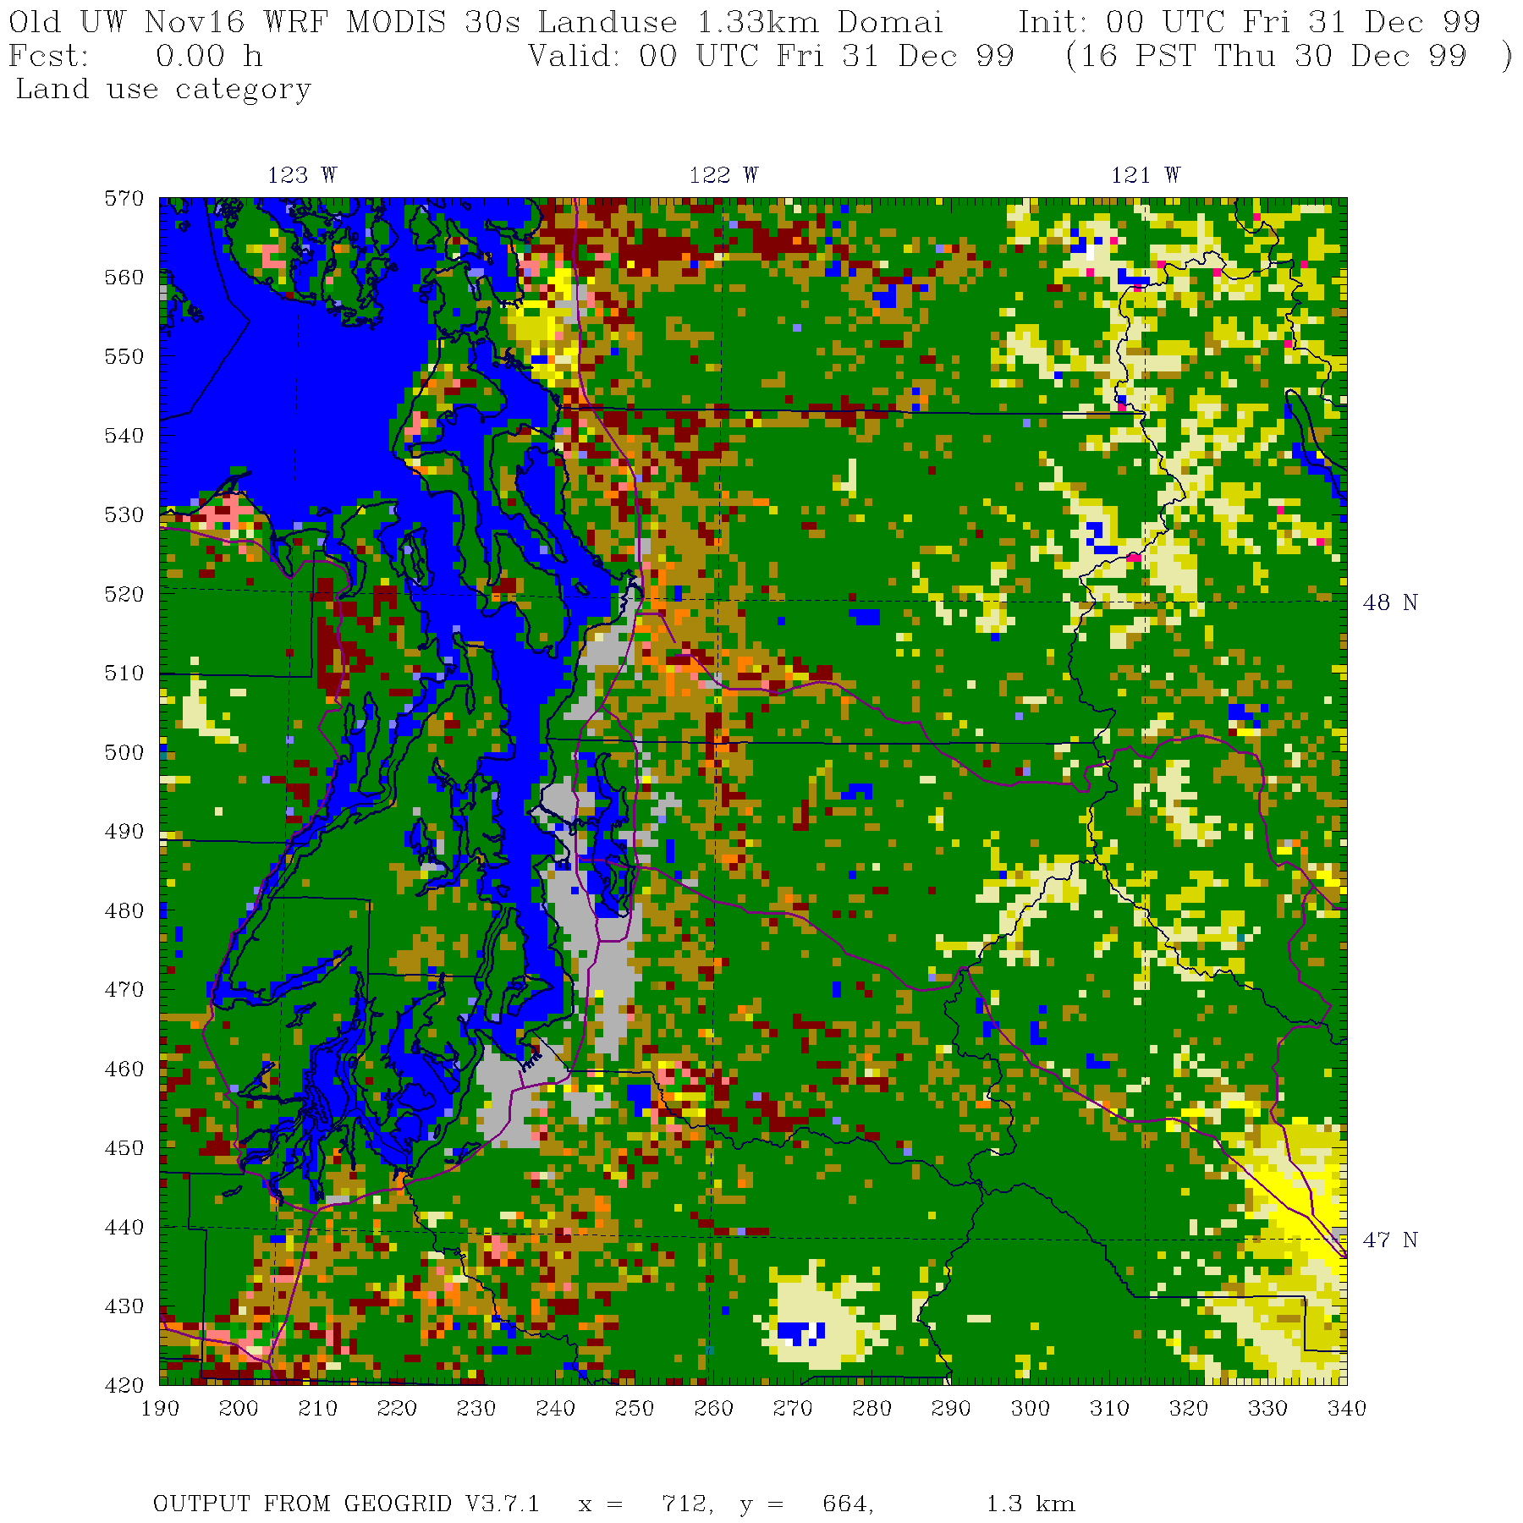

Slide 9
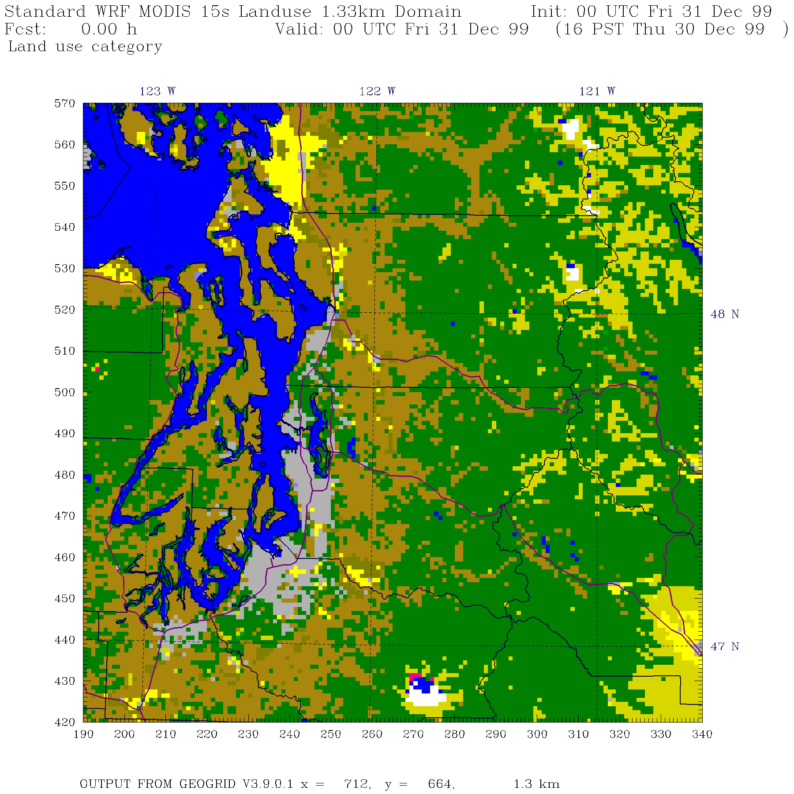

Slide 10
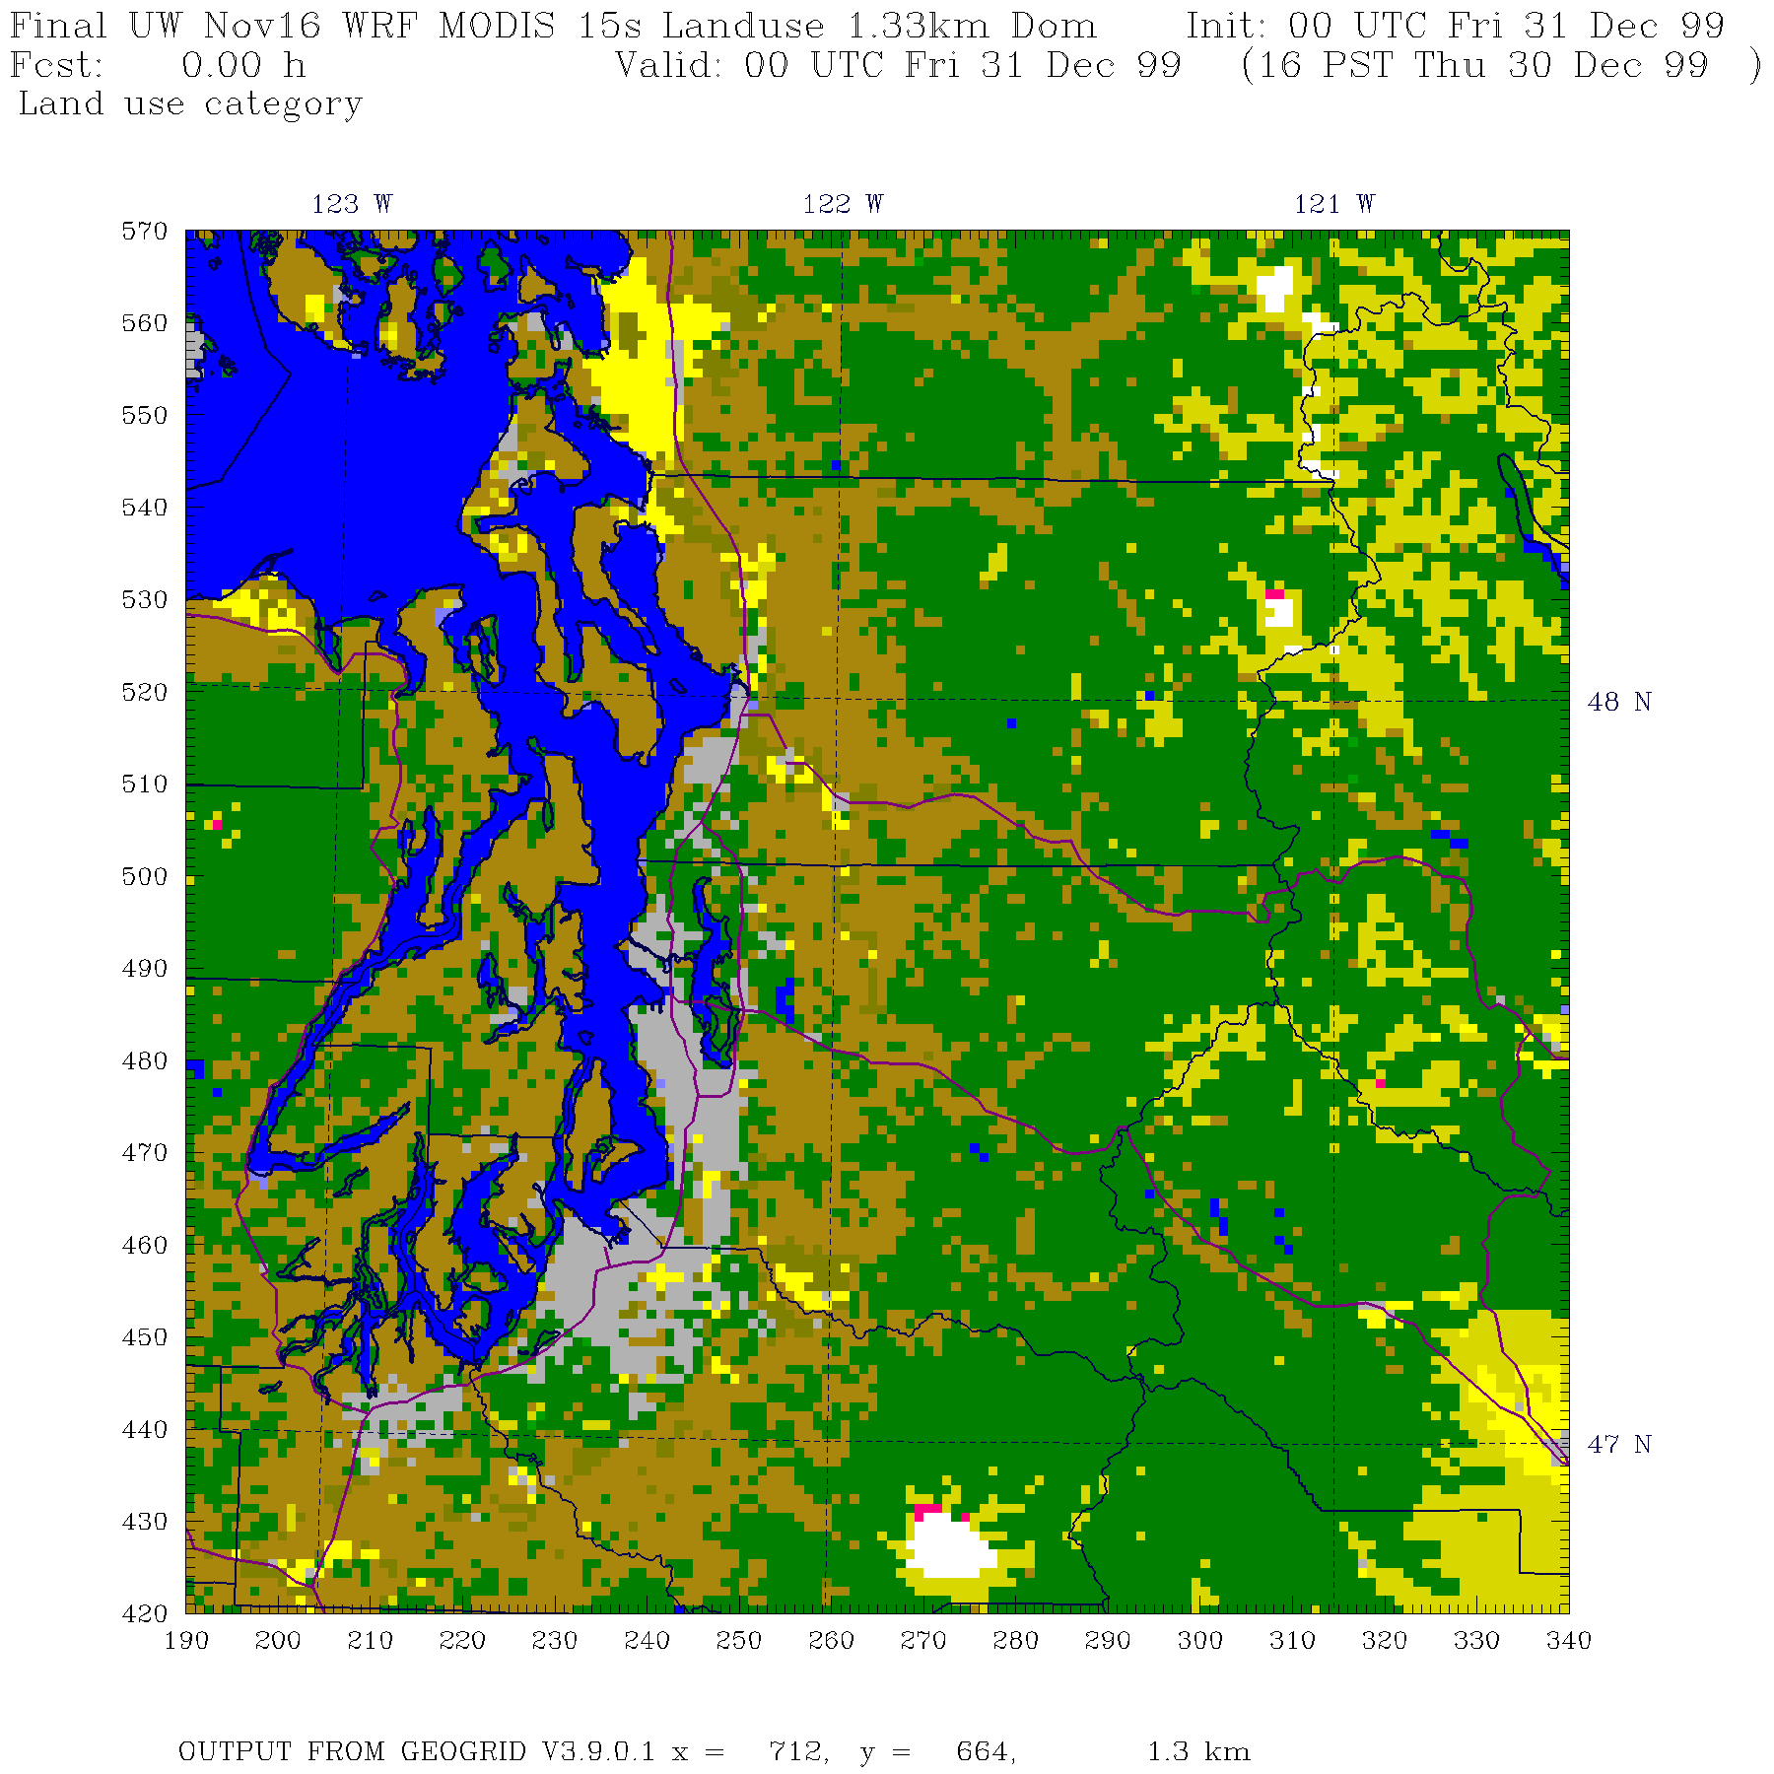

Slide 11
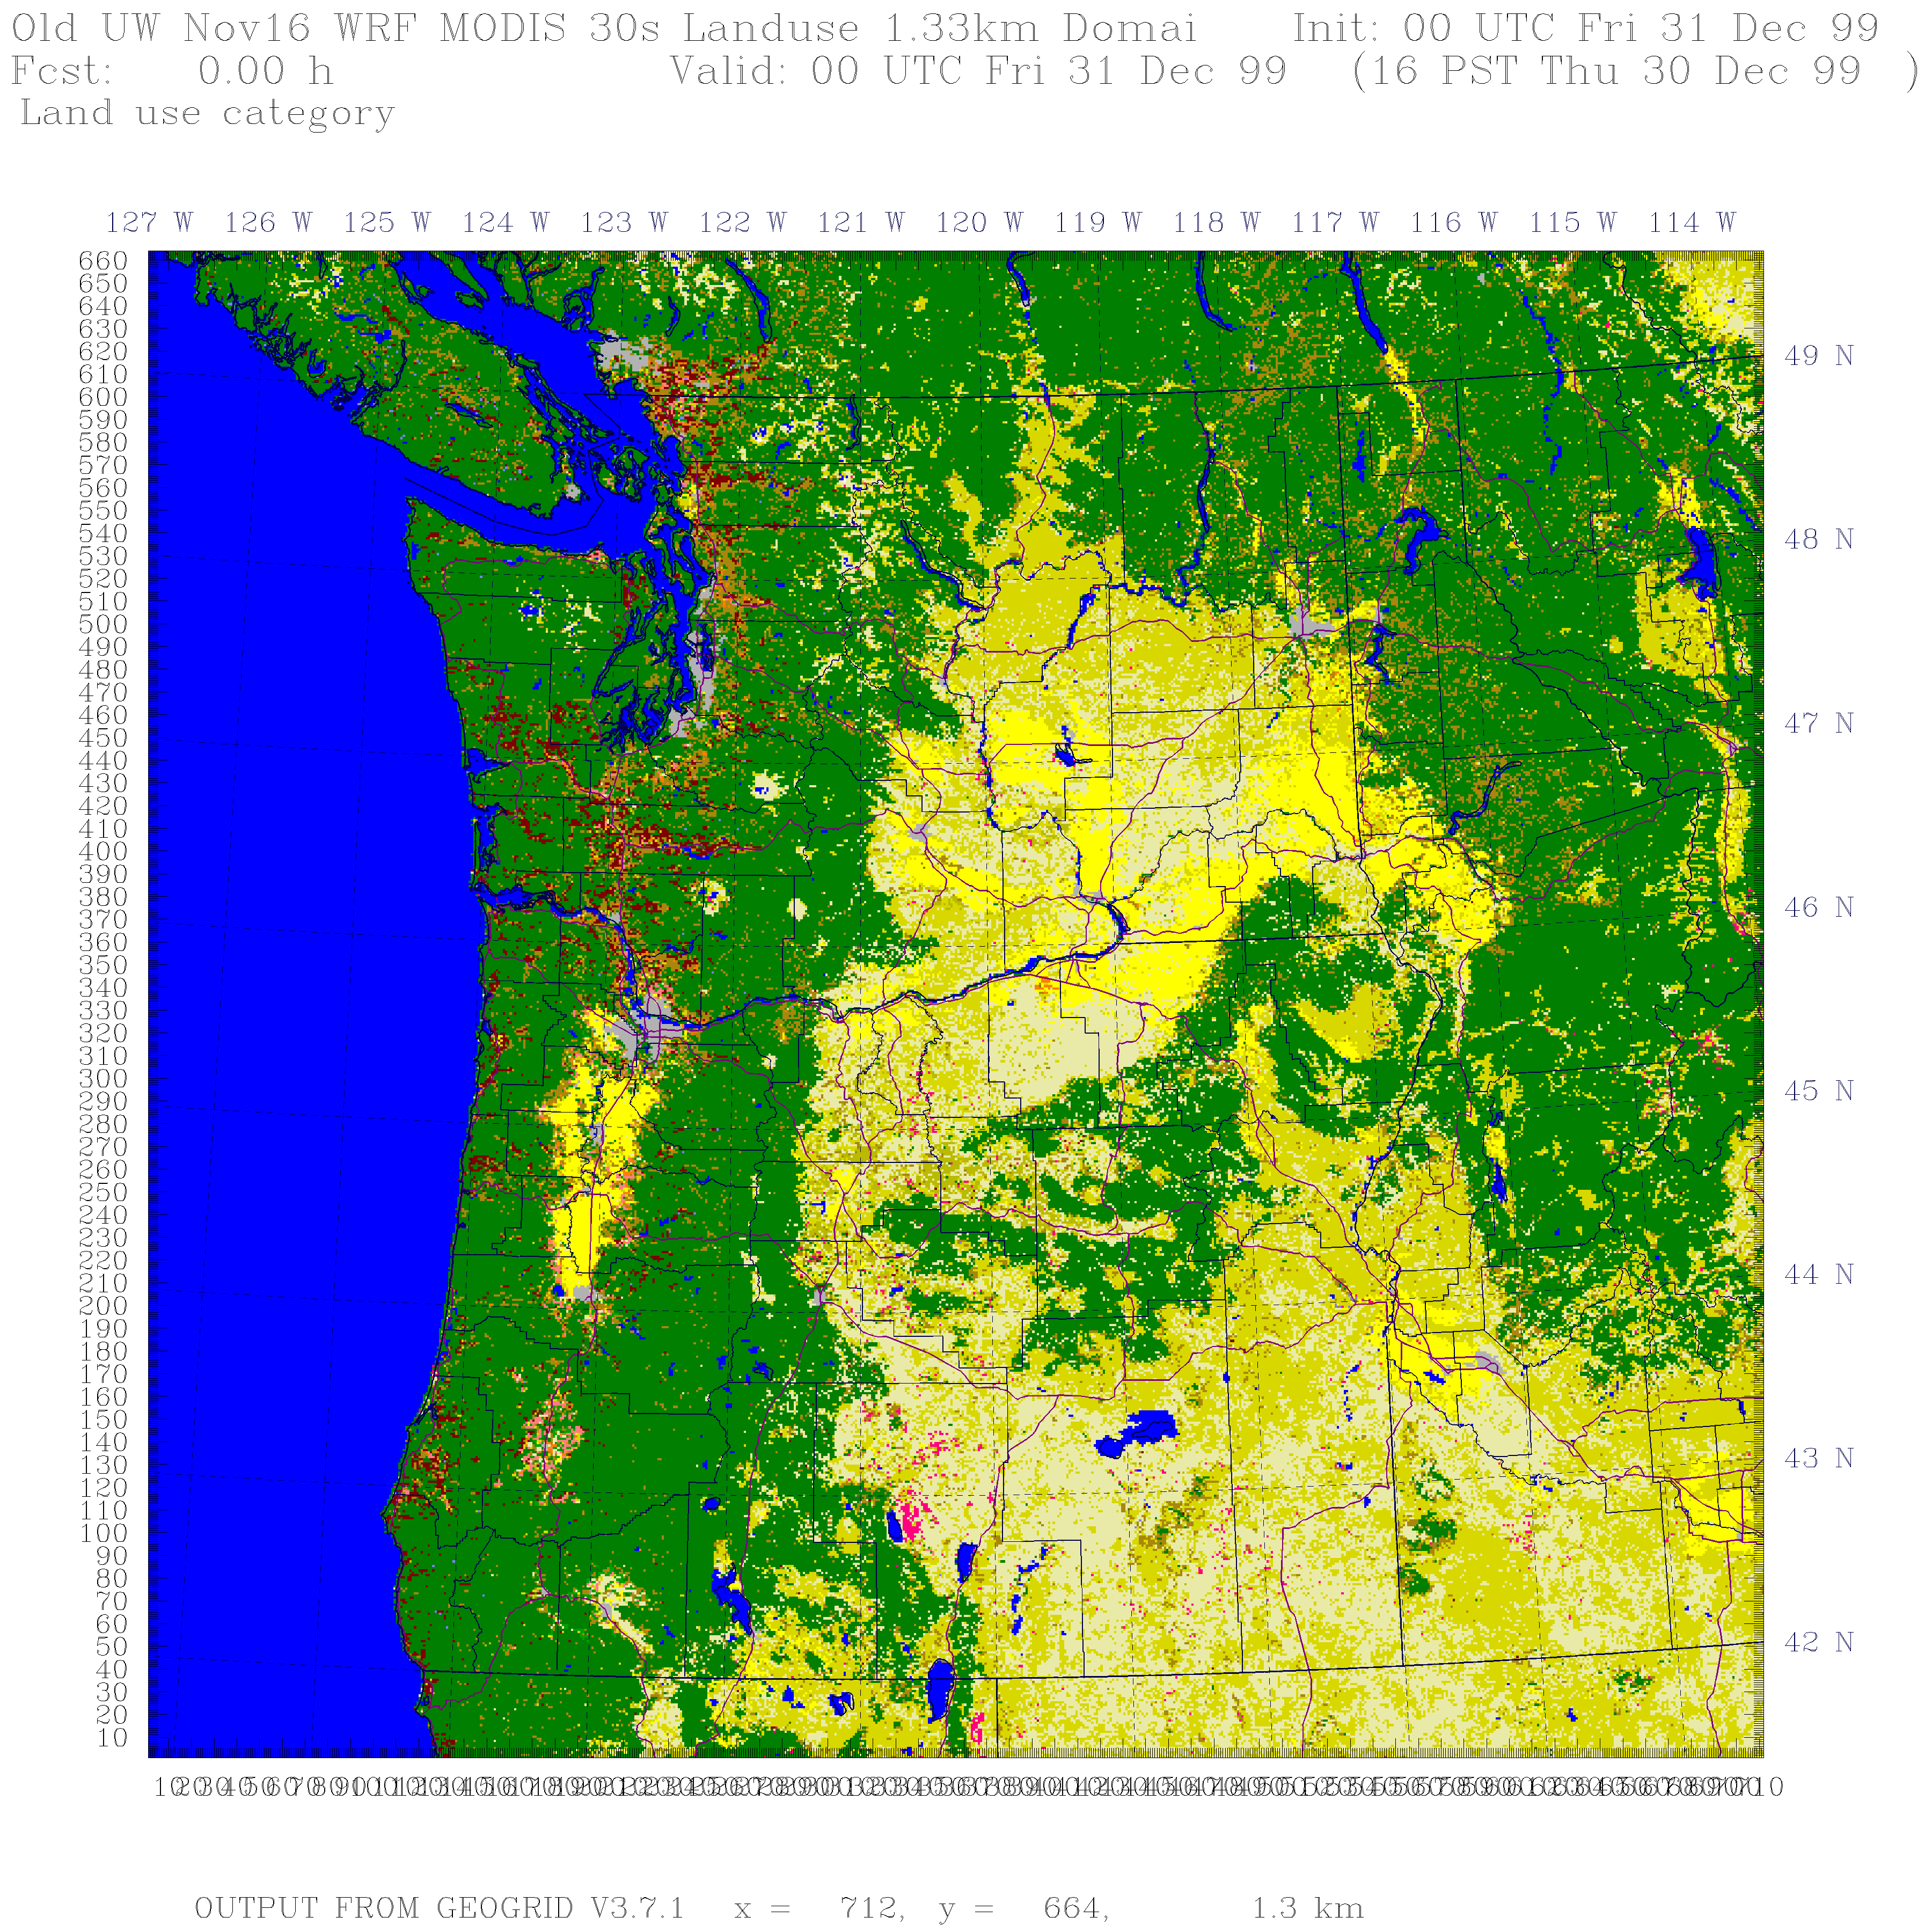

Slide 12
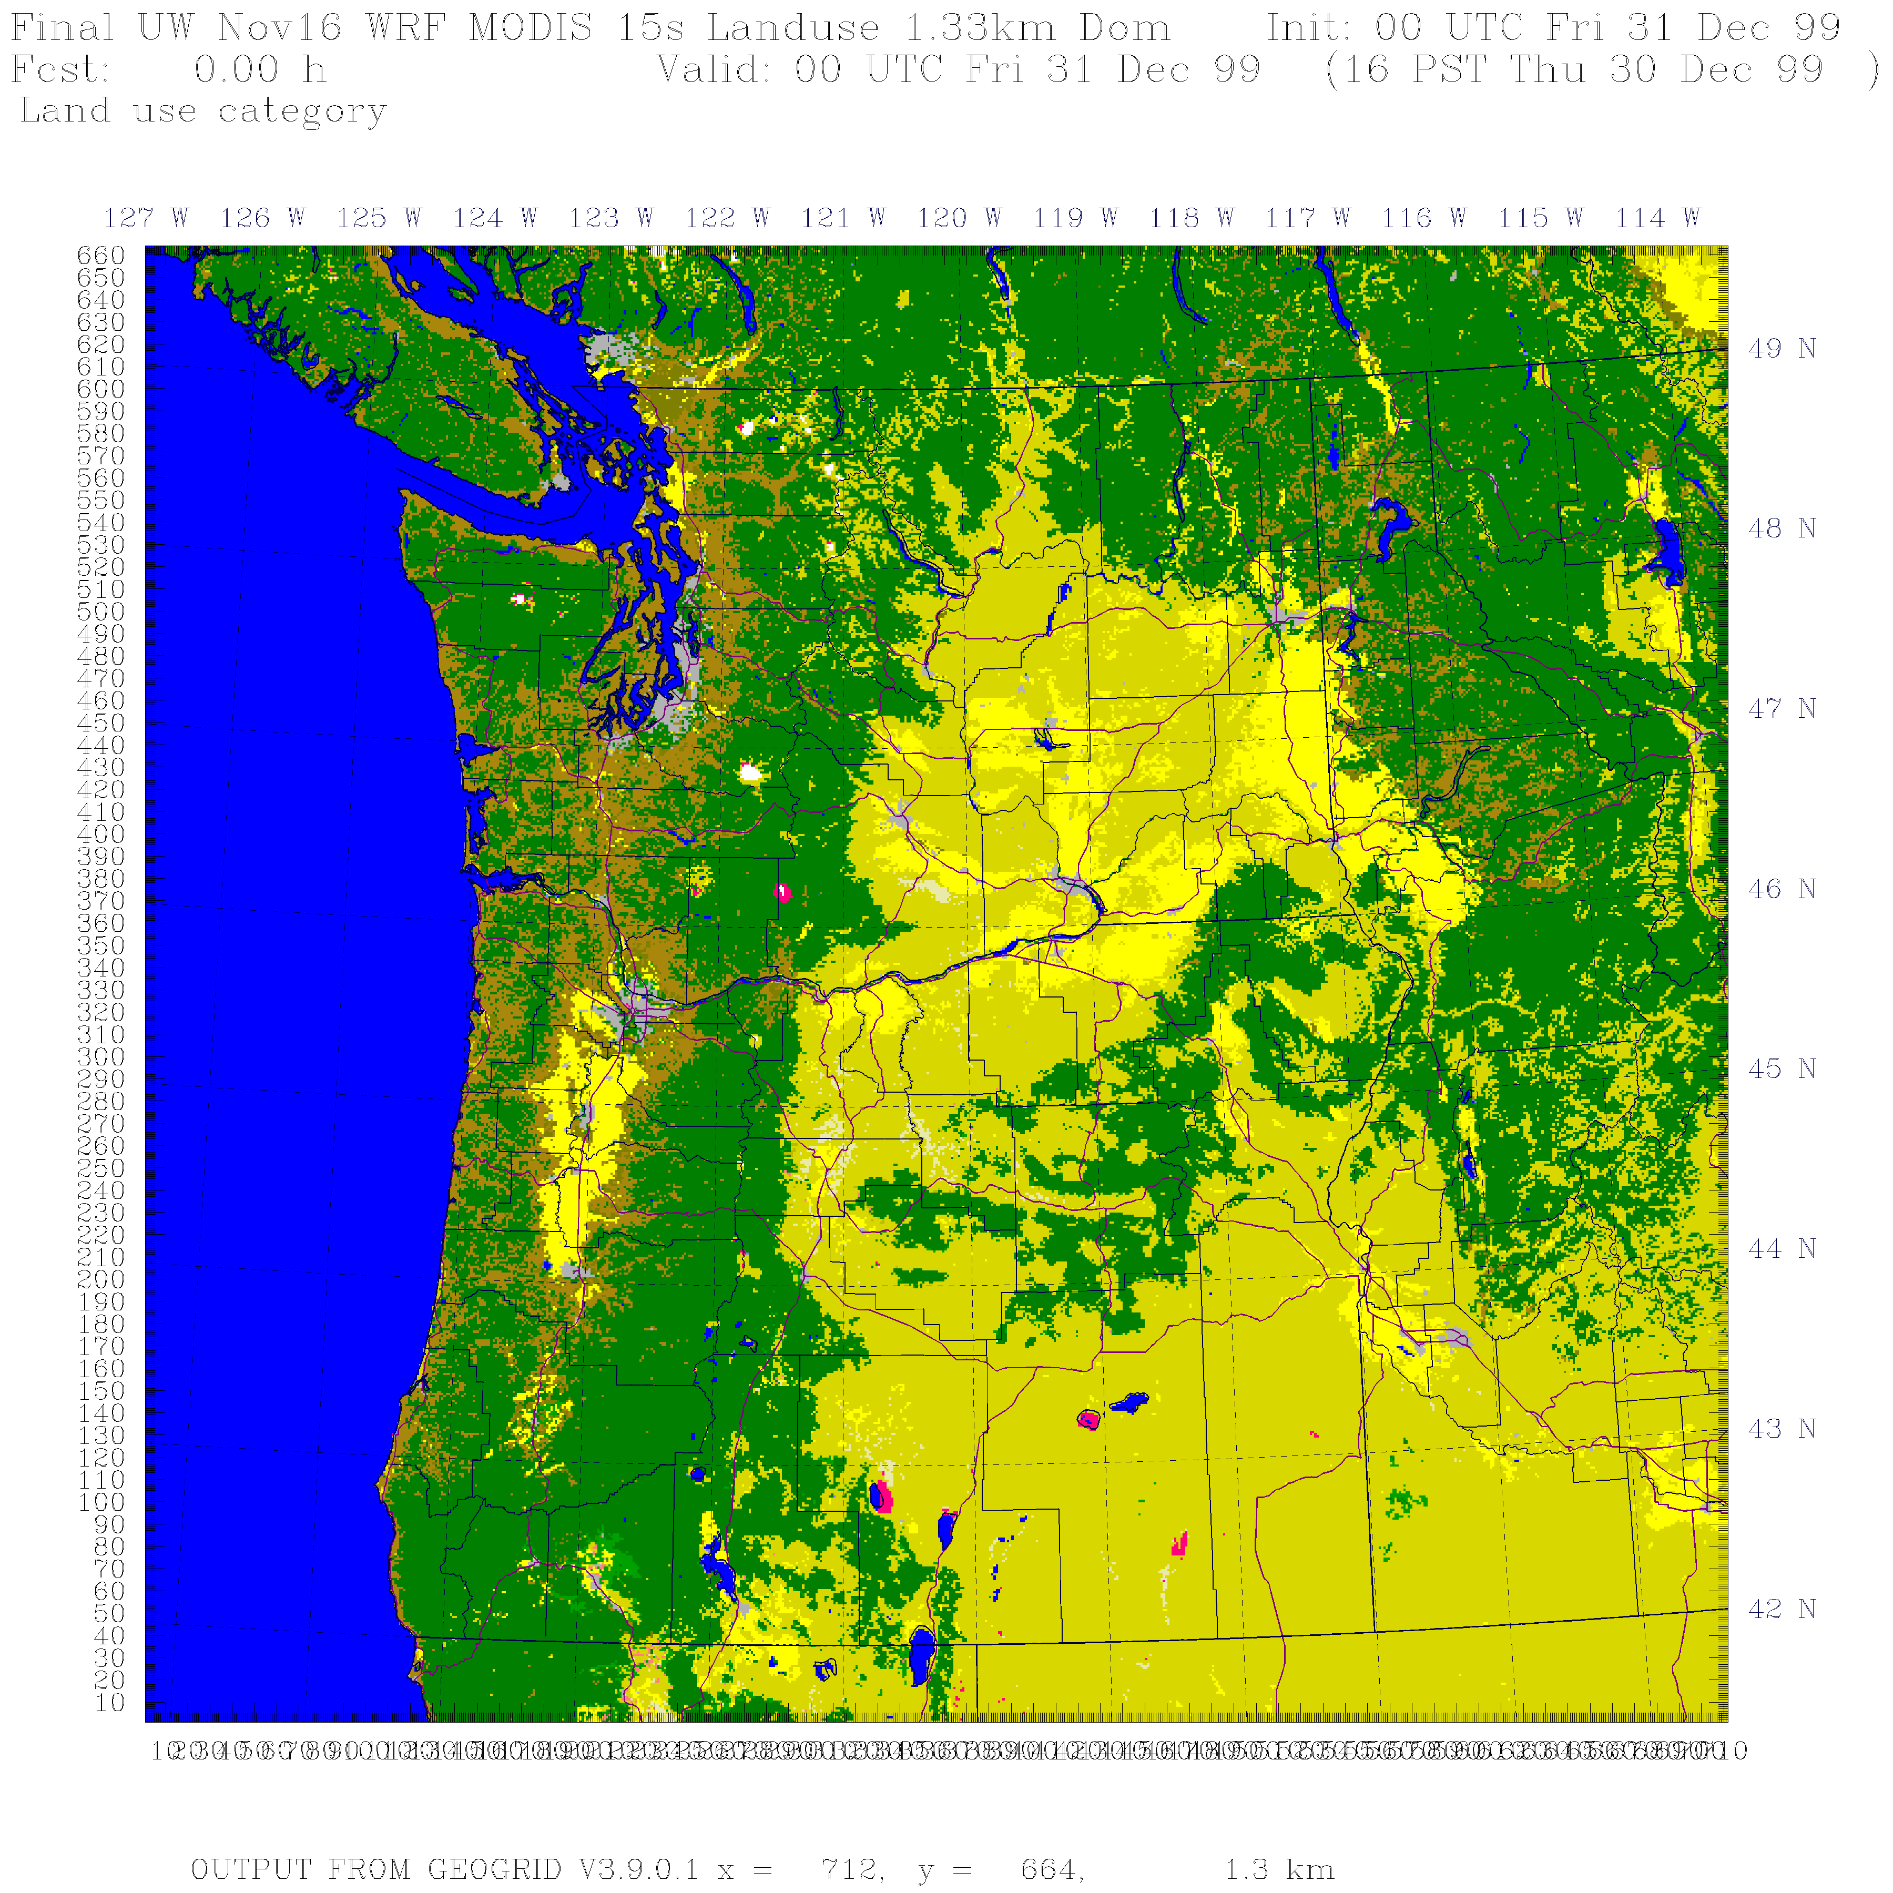

Slide 13
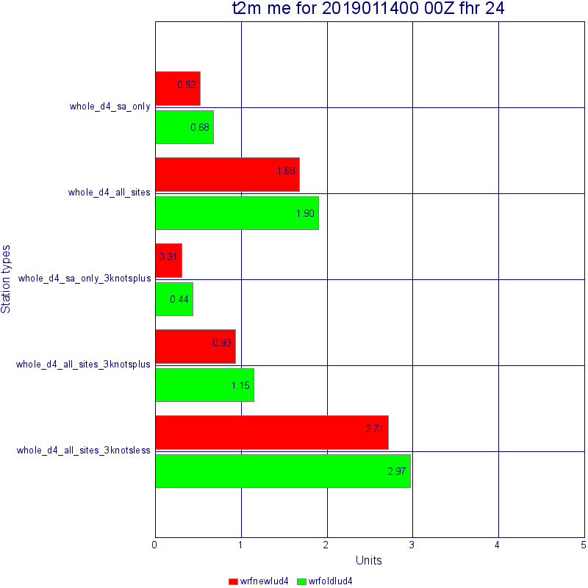
Does Improve Land use Improve Forecasts? One Case

Slide 14
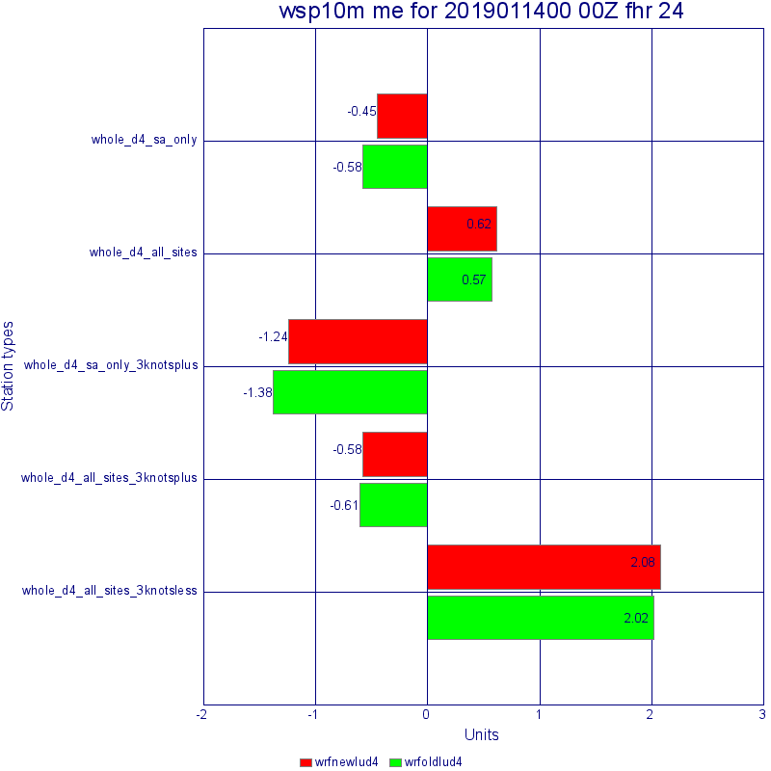

Slide 15
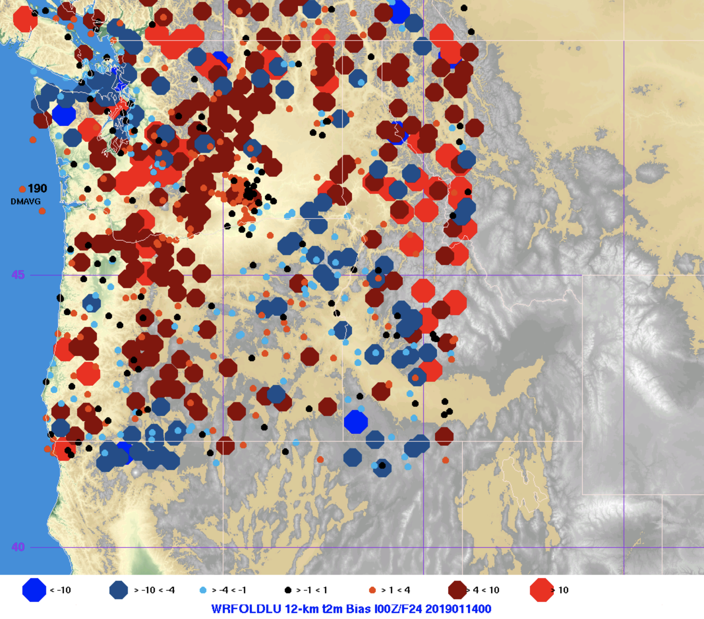
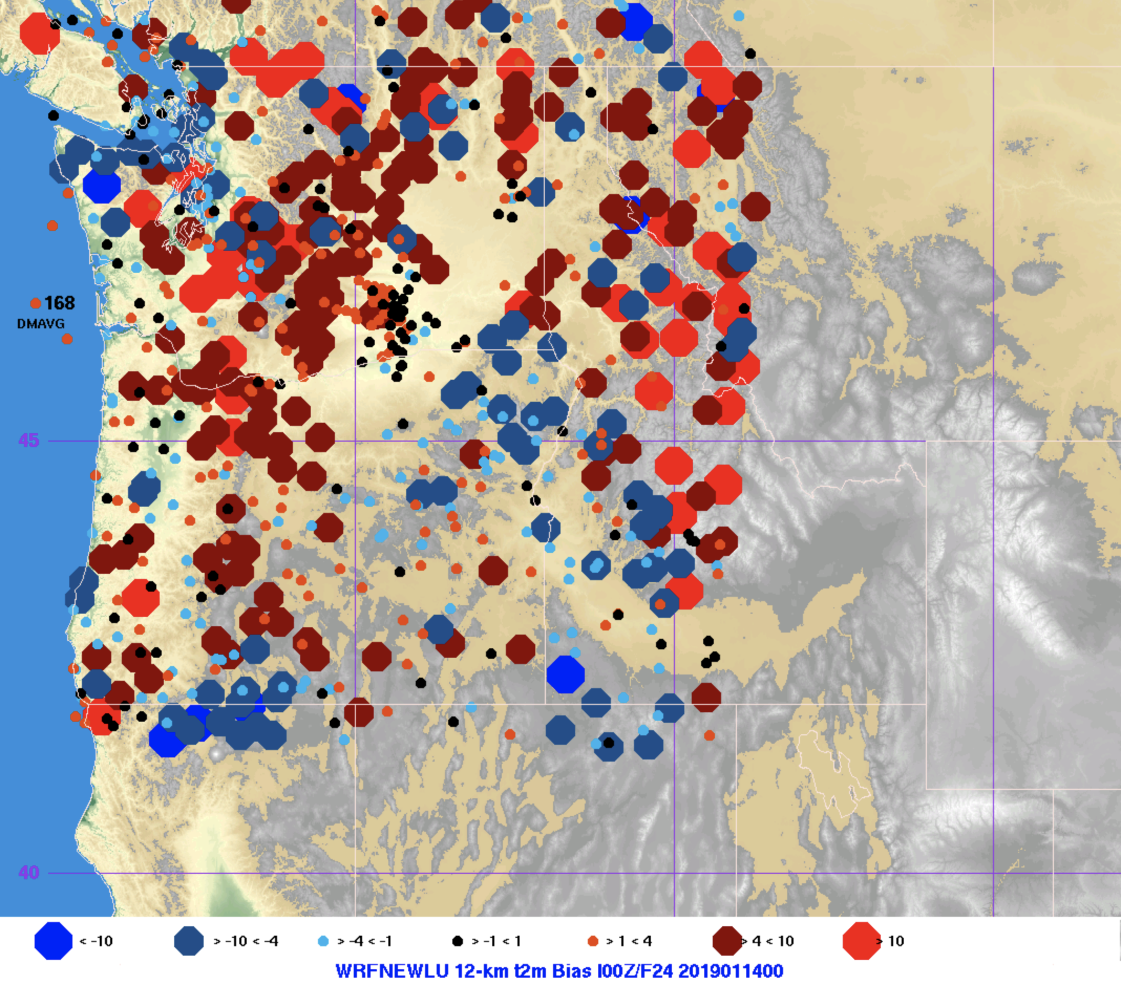

Slide 16
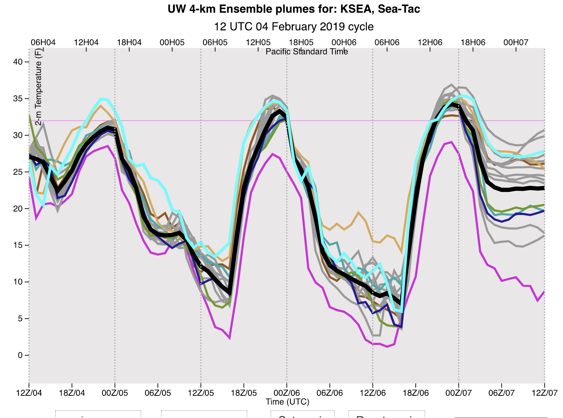
We got a problem that needs to be fixed: too intense inversions and too cold over snow in western WA during the morning

Slide 17
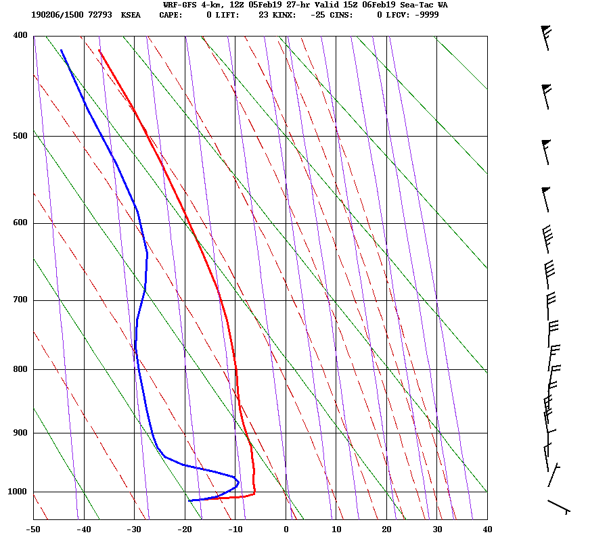
Will diagnose and fix this issue asap

Slide 18
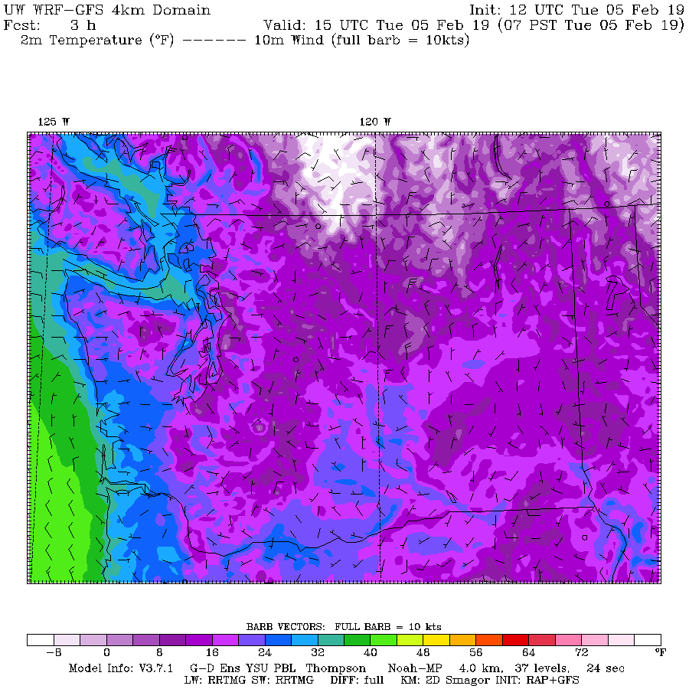

Slide 19
Major Model Update
Move from 3.7.1 to 4.0.3
Lots of bug fixes and improvements
Is about 5% faster
Change to hybrid vertical coordinate system
Less spurious upper tropospheric noise

Slide 20
WRF Hybrid Coordinate System
The previous sigma-p vertical coordinate distorts surfaces above terrain.
Can produce upper tropospheric noise,
The hybrid system flattens out the surfaces aloft, damping the orographic signal.

Slide 22
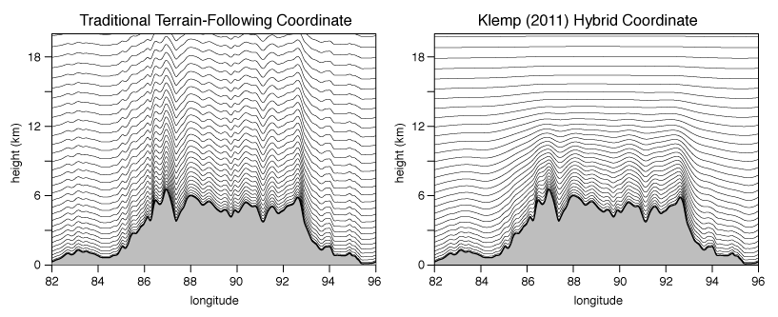

Slide 23
3.7.1 versus 4.03
3.7.1 is now 3 years behind
We tested 3.8 and 3.9 extensively and there was no significant improvements.
Now testing 4.0.3 extensively with the new hybrid coordinate system.
If it is at least at good and at least as stable, we should probably switch, at the very least for the speed-up potential

Slide 24
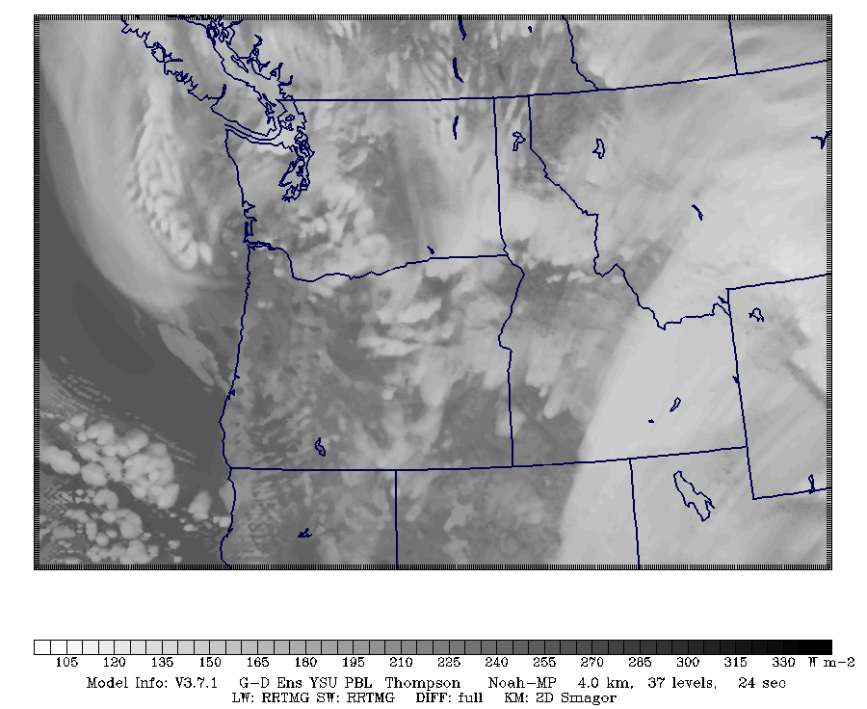
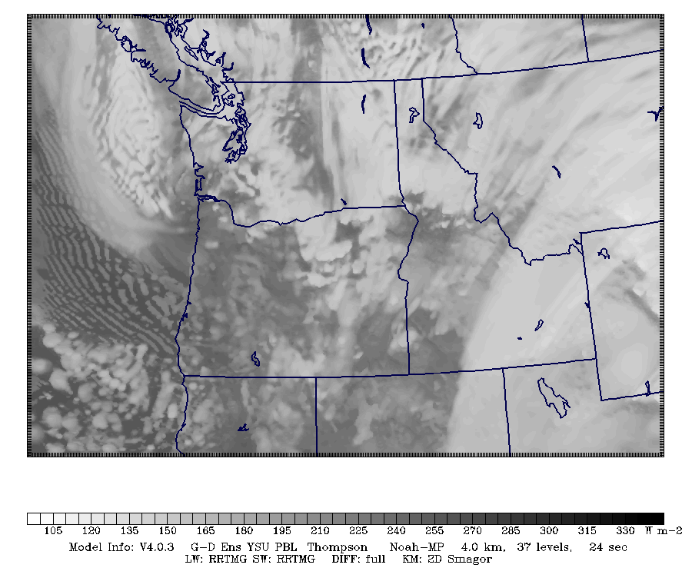
Convection Seems to Be Revved Up More
3.7.1
4.0.3

Slide 25
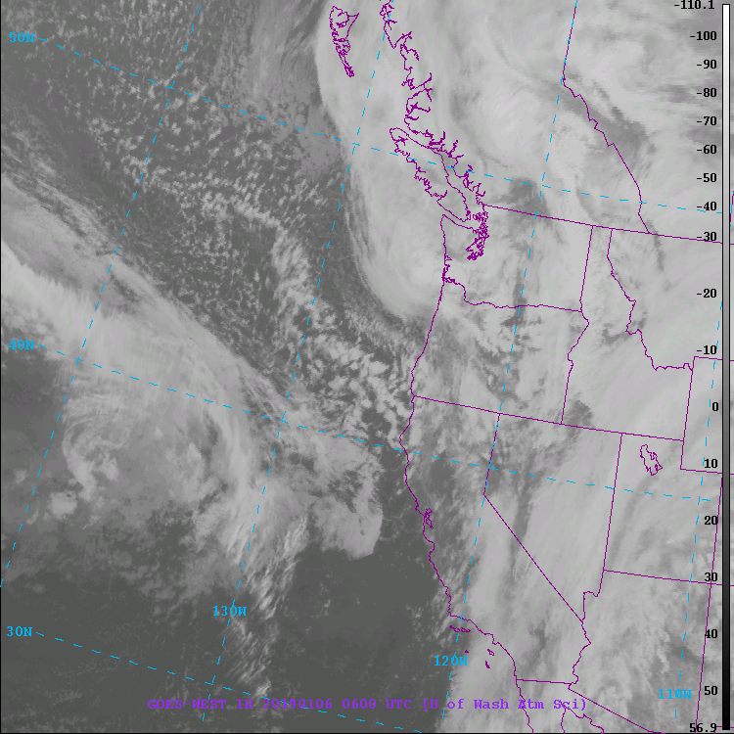

Slide 26
The End

