Slide 1
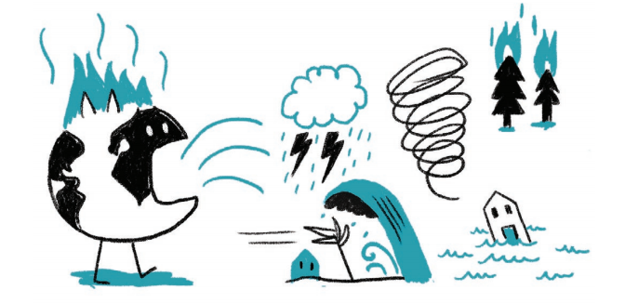
Explaining Extreme Weather Events: Challenges in Climate Communication
Cliff Mass
Atmospheric Sciences

Slide 2
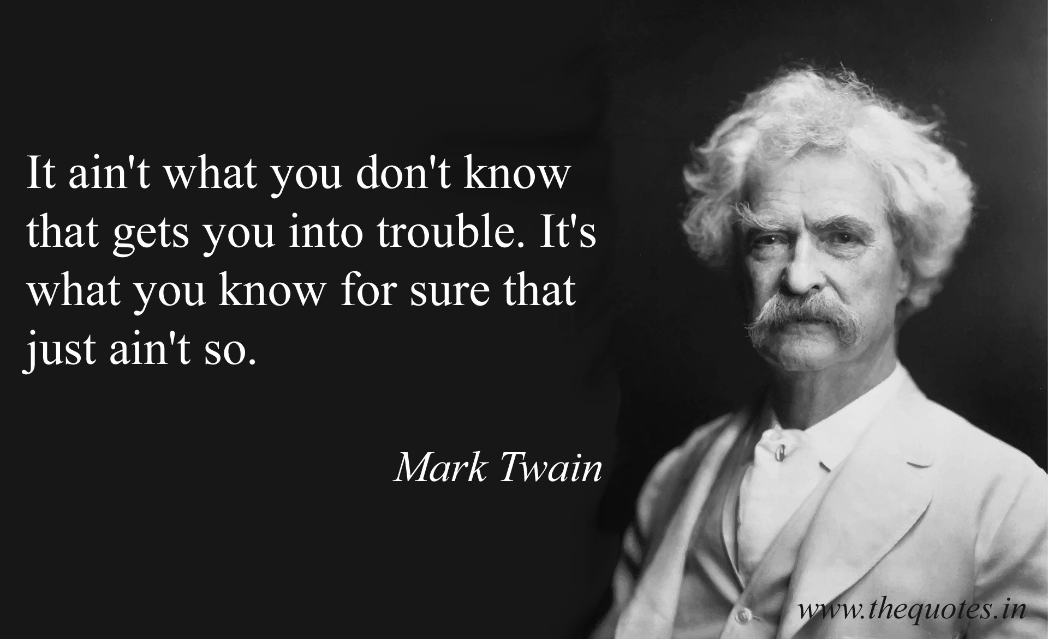

Slide 3
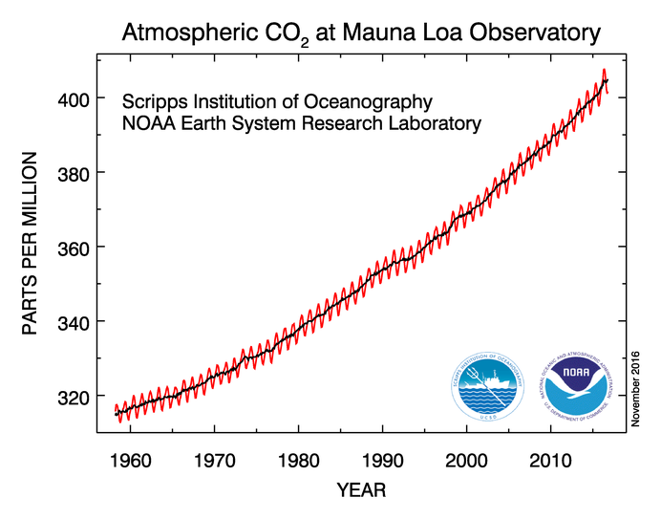
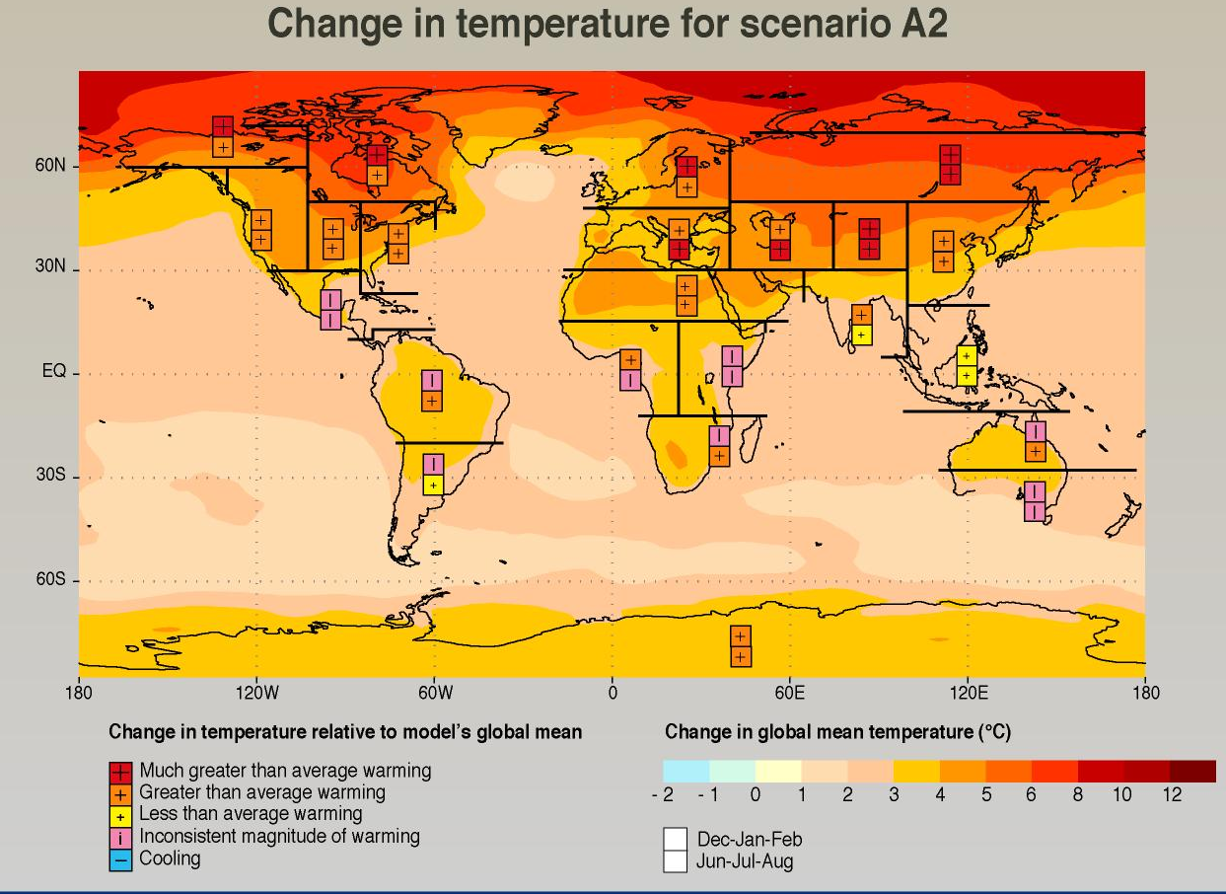
Anthropogenic Emissions of Greenhouse Gases Will Have Large Impacts on the Earth’s Climate During this Century

Slide 4
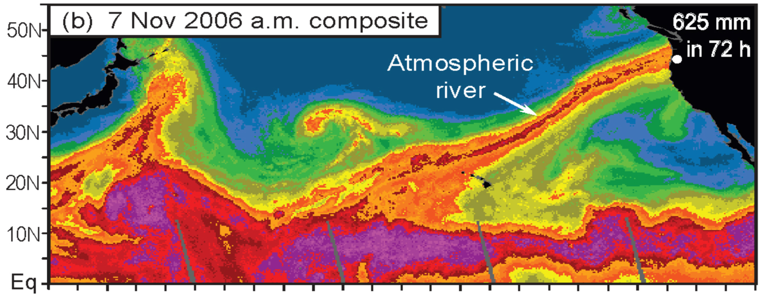
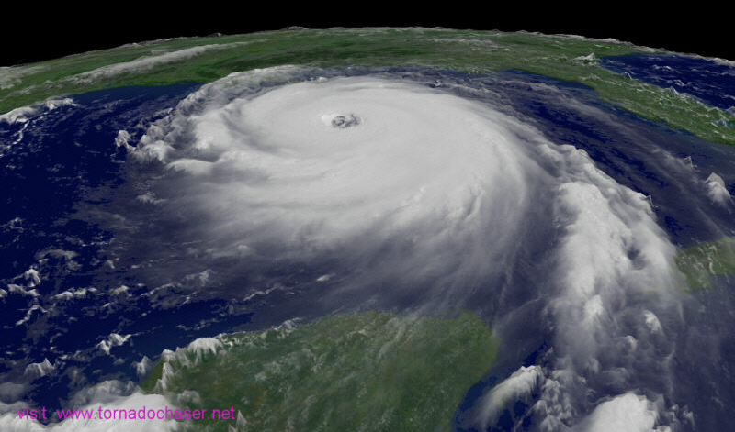
These impacts will include enhancement of some extreme weather events
For example:
Stronger atmospheric rivers striking the West Coast
Greater flooding on NW rivers
The strongest hurricanes will get stronger

Slide 5

Unfortunately, there are serious problems in communicating the current and future implications of climate change on extreme weather.
Hype and exaggeration of current and future impacts by many in the media, non-governmental organizations, some politicians, and even a few activist scientists.
Dismissal of potential impacts of greenhouse gases by some some conservative media and advocacy groups.
Inaccurate information is being communicated to the public by BOTH the left and the right.

Slide 6
A misinformed public now has many mistaken beliefs about the current impacts of greenhouse gas increases on extreme weather

Slide 7
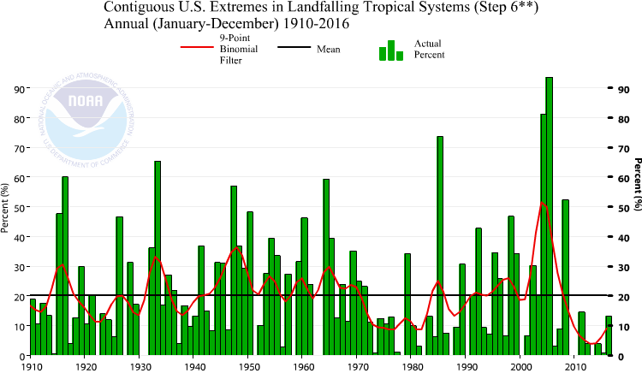
Actual Hurricane Trends: No Increase in Land-falling Hurricanes

Slide 8
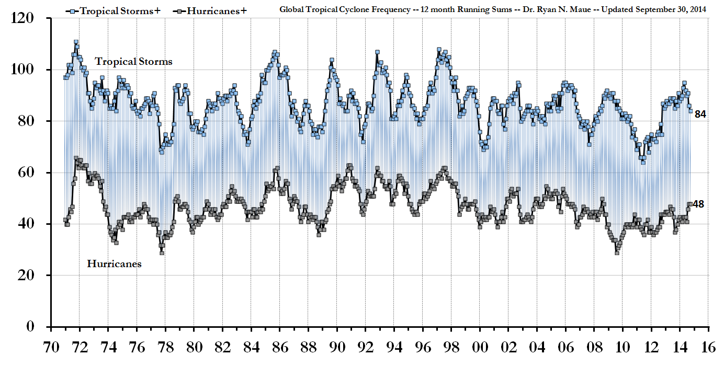
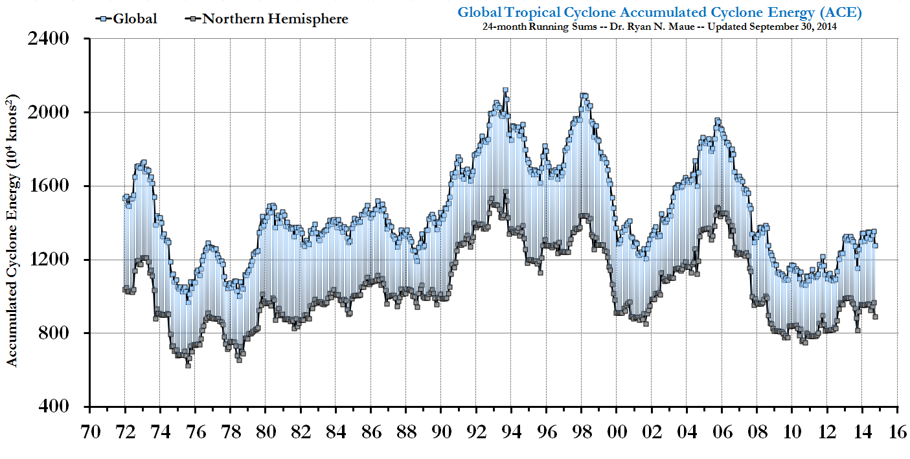
Global Tropical Cyclone
Frequency
No upward
trend
in cyclone
frequency or intensity
Global Cyclone Energy

Slide 9
No evidence or modeling results suggest that Hurricane Sandy had anything to do with climate change

Slide 10
The Media Hype and Enhanced Communications Have Convinced Folks That Extreme Weather Has Generally Increased

Slide 11
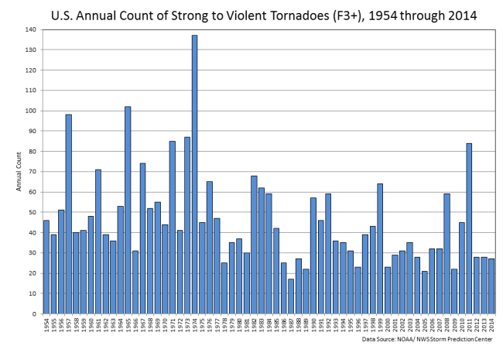
Reality: no increase in hurricanes, no increase in strong tornadoes, and more

Slide 12
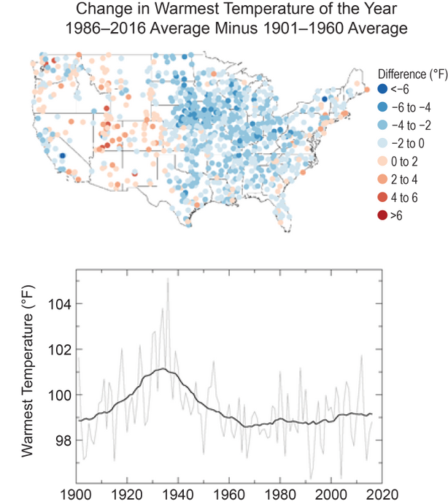
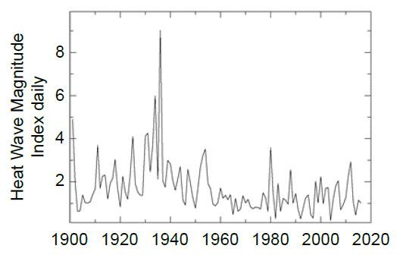
Heat Waves: Less of a Trend Than Suggested by Some
Observed changes in the warmest daily temperatures (°F) of the year in the contiguous United States. Maps (top) depict changes at stations; changes are the difference between the average for present-day (1986– 2016) and the average for the first half of the last century (1901–1960). Time series (bottom) depict the area-weighted average for the contiguous United States.

Slide 13
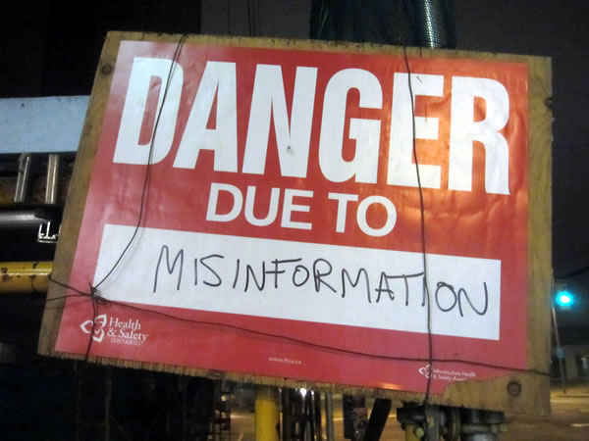
And there is plenty of misinformation on the other side….

Slide 14
“The sun has driven a major portion of the 20th century temperature change.
The surface warming that should be occurring from human-made actions, which is predicted to be accompanied by low troposphere warming, cannot be found in modern records from balloon and satellite platforms.
The recent surface warming trend may owe largely to changes in the sun's energy output.”

Slide 15
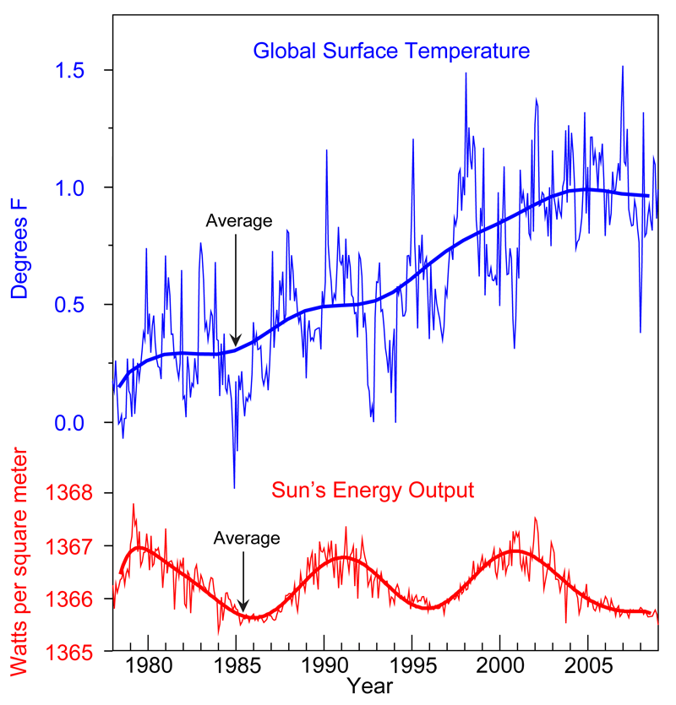
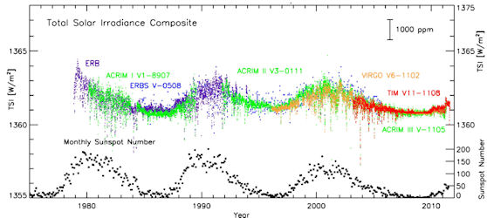
The Truth: Solar Variability is Too Small to Explain Anything

Slide 16
“Here, we find that at the global scale, climate models are on the verge of failing to adequately capture observed changes in the average temperature over the past 10 to 30 years”

Slide 17
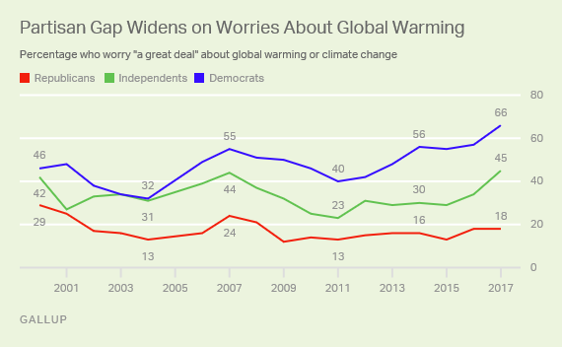
With the left-oriented media hyping current impacts and the right-oriented medium playing them down, the partisan divide is growing

Slide 18
Statistical Misrepresentation by GW Activists
Often GW activists will talk about temperature (or some other parameter) exceeding a threshold and how that will change with GW.
They describe that threshold being exceeded X times more often. (X is usually a large number)
Sounds very scary.
But because of the nature of the tails of distributions, the change in actual impacts may be very small.

Slide 19

Consider a mean temperature of 75F and an increase by 1F. Gaussian distribution.
The probability of exceeding 85F increases by 3.14 times! Yikes!

Slide 20
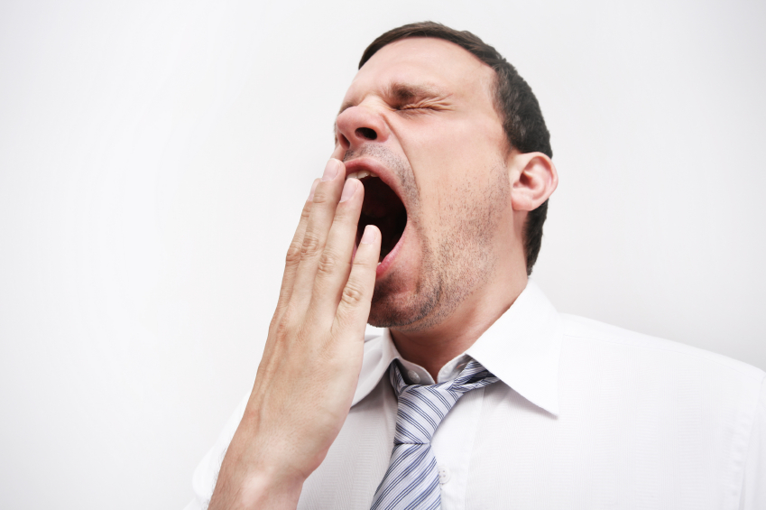
But consider the real increase in threat
Increase probability of exceeding 85F by .1%. One tenth of one percent. Not so scary.

Slide 21

There is a lot of these statistical games going on
This trend has continued in 2011 and 2012, with the number of intense heat waves being almost triple the long-term average.
We estimate that there is at least a 175 times increase in likelihood of hot March months because of the human influence on the climate.

Slide 22

Some Recent Examples of Exaggerated Claims for Climate-Related Extremes

Slide 23
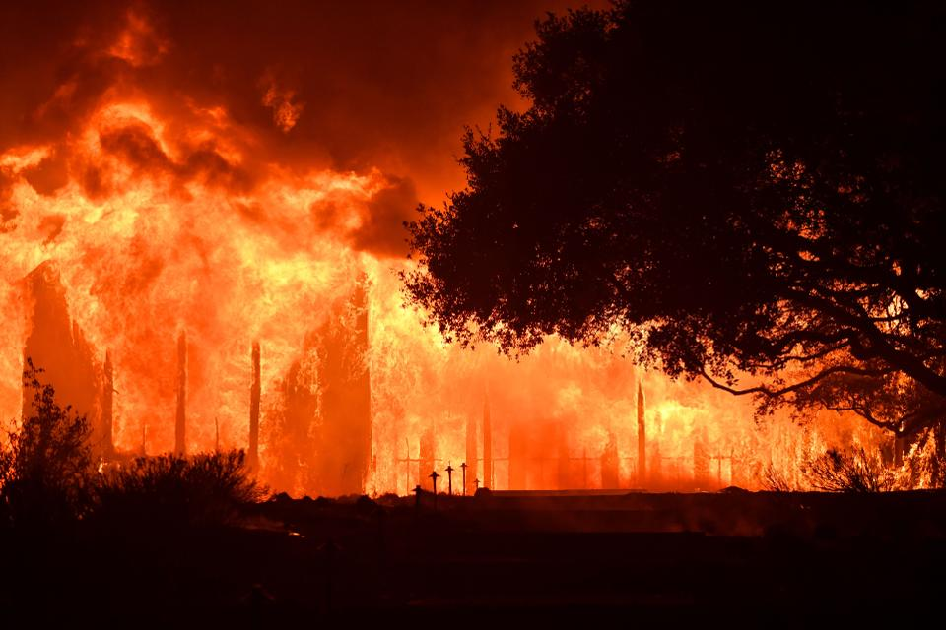
Northern California Wildfires

Slide 24
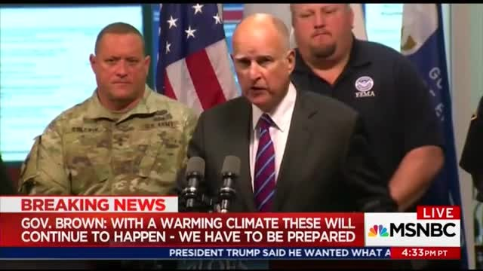
“That’s the way it is with a warming climate, dry weather and reducing moisture,” Brown warned. “These kinds of catastrophes have happened, they’ll continue to happen, and we have to be prepared to do everything we can to mitigate.”

Slide 25
The media and advocacy groups claim a direct connection between the fires and global warming

Slide 26
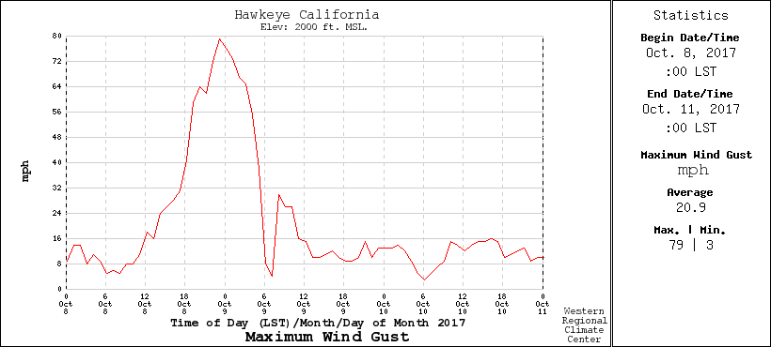
Global Warming Had Little to Do With The Oct 8/9 Fires
Deep literature showing a lack of connection between prior warm/dry conditions and fires over the CA coastal area.
Fires occurred after the long warm/dry CA summer. Fuels (grasses) would be dry no matter what.
Very strong winds initiated and stoked the fire. No evidence such winds are encouraged by GW. Probably the opposite.
A very wet winter enhanced grasses. Not expected under GW.
Number of large fires, US National Assessment

Slide 27
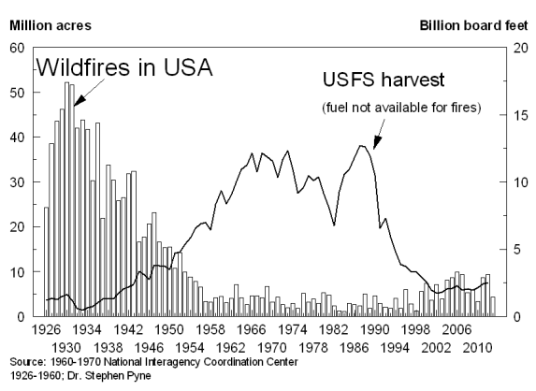
More fires in the early 20th century followed by suppression

Slide 28
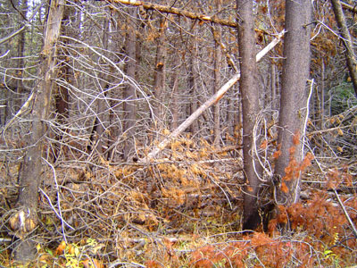
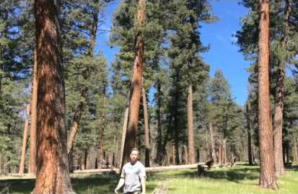
Increasing Risk of Major Wildfires in the West
Climate change is a small part of this.
Suppression has produce unhealthy forests with lots of fuels ready to burn.
Now
Original

Slide 29
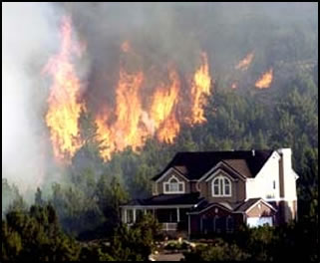
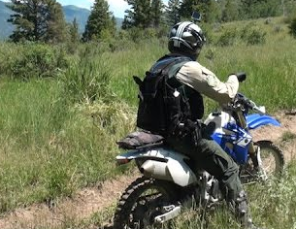
Increasing Wildfire Risks
Huge increases of population in the urban/fire interface
Large increase of recreation use of forests.

Slide 30

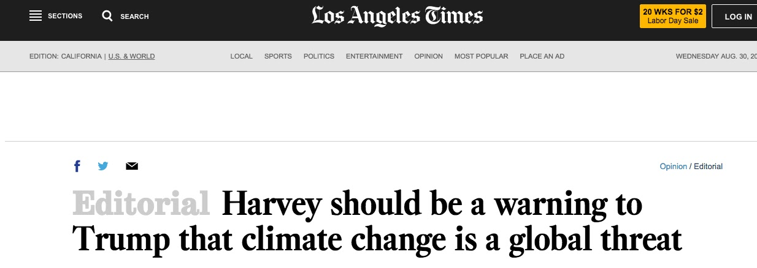
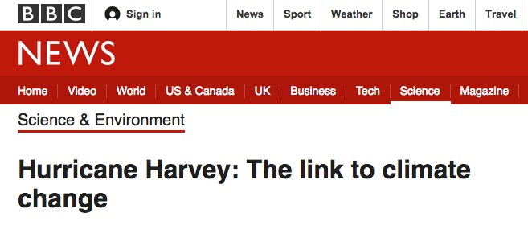
Hurricane Harvey: Heavy Precipitation Causing Massive Flooding in Houston. The media and others point to global warming

Slide 31
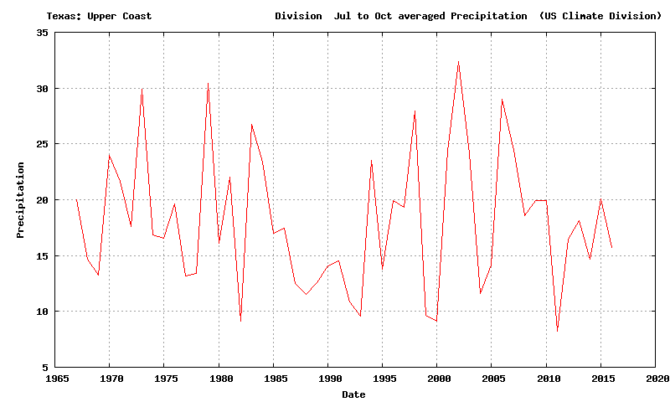
But Global Warming Could NOT Have Been the Real Cause of this Disaster
The key reason Houston got so much precipitation was because Harvey stalled for days. No connection with GW.
Gulf temperatures were only about .5C about normal, which only would enhance precipitation by around 3%
There is no long-term upward trend in precipitation Houston

Slide 32
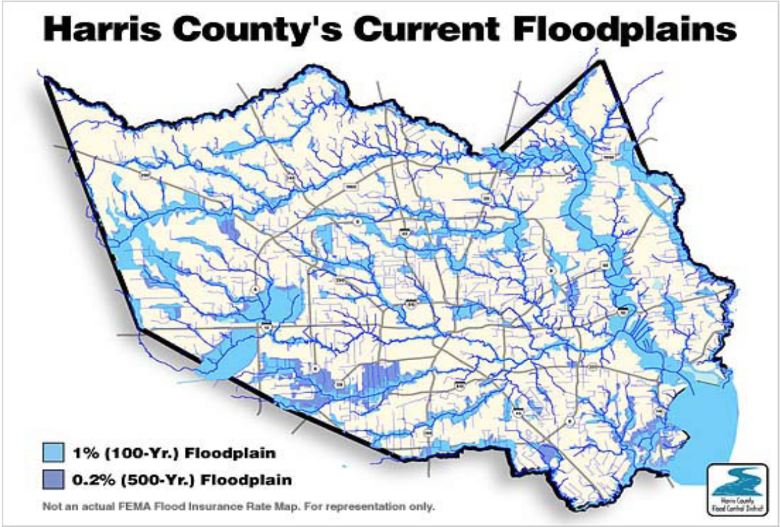
The Real Issue: Mismanagement of Houston’s Development
Irresponsible development of previous swamps
Inadequate planning for drainage
Multiple floods during the past years as development proceeded.

Slide 33



An Industry for Exaggerating or Miscommunicating Climate Change Has Developed on Both Sides

Slide 34
The Danger of Exaggerated Claims: Reality Can Undermine Scientific Credibility Example: The Disappearing Snowpack
A number of politicians, some climate groups, and even some local scientists talked about a 50 percent decline of Cascade snowpack from 1950-1995, with global warming identified as the probable cause.
Local politicians, like Mayor Nickels, wrote op-ed pieces about the threat, predicting a rapid decline in Cascade snowpack (2007).
Reality: NW snowpack has not declined during the past several decades.

Slide 35
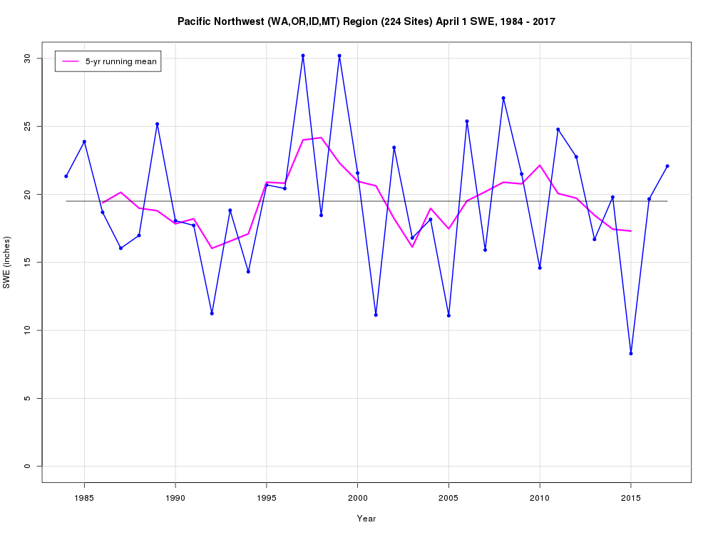

Slide 36
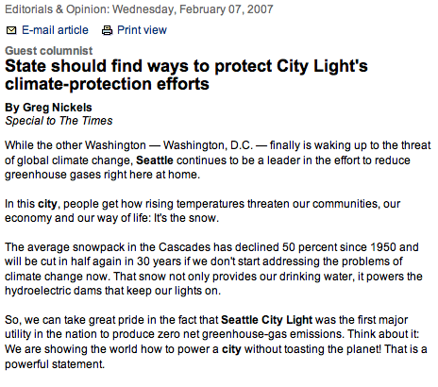
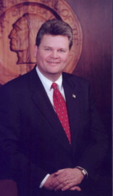
Seattle’s mayor suggested our snowpack had declined by 50%

Slide 37
And the poor predictions get noticed

Slide 38
The Media is Failing
Stories are either superficial or poorly disguised advocacy pieces in the liberal “mainstream” media.
Little analysis of the information provided by governments or NGOs.
Media science reporting is profoundly hollowed out, with reporters doing quick, shallow stories.
Most reporters lack the technical knowledge to analyze complex science issues.
Conservative media (e.g., National Review, WSJ) promote the opposite, non-science based viewpoints.

Slide 39
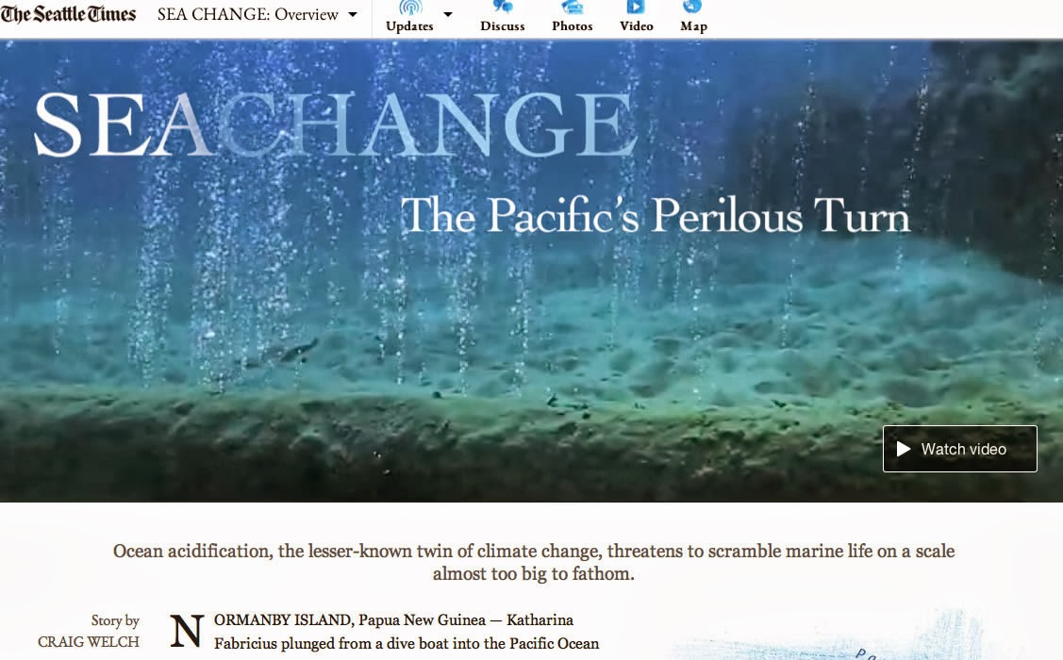

Slide 40
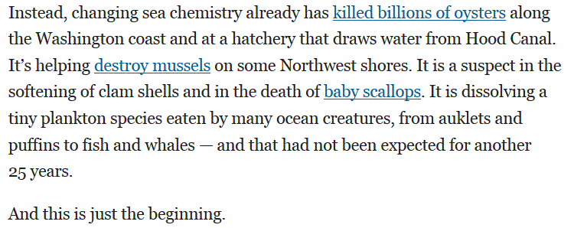
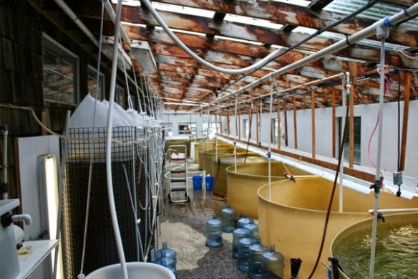
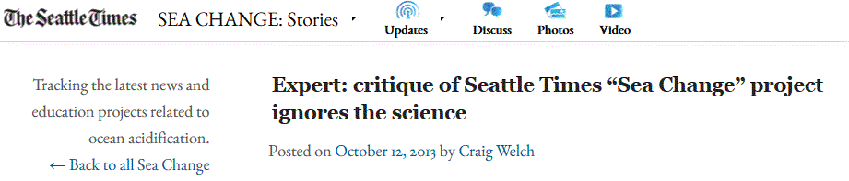


Slide 41
When one starts telling the straight story…the media, activists, and their friends go after you

Slide 42
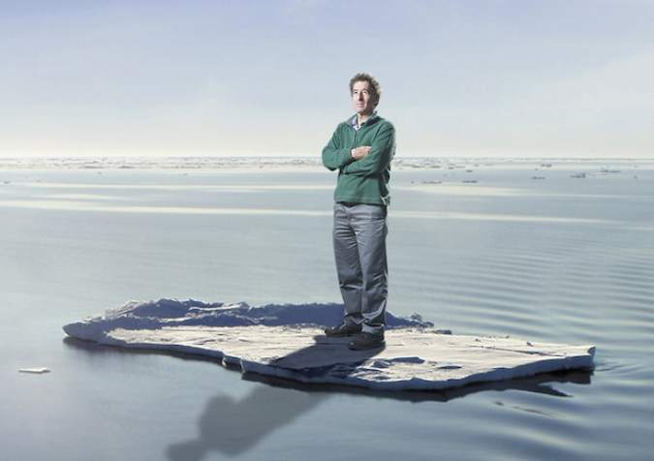

Slide 43
Global Warming and Weather Extremes: What is the best guidance we can provide?
Hurricanes:
Little impacts to date from GW.
By the end of the century there will be fewer hurricanes, but the strongest ones will get stronger
“It is premature to conclude that human activities–and particularly greenhouse gas emissions that cause global warming–have already had a detectable impact on Atlantic hurricane or global tropical cyclone activity.”

Slide 44
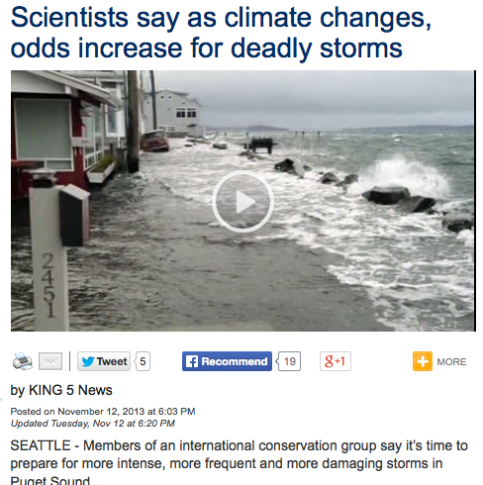
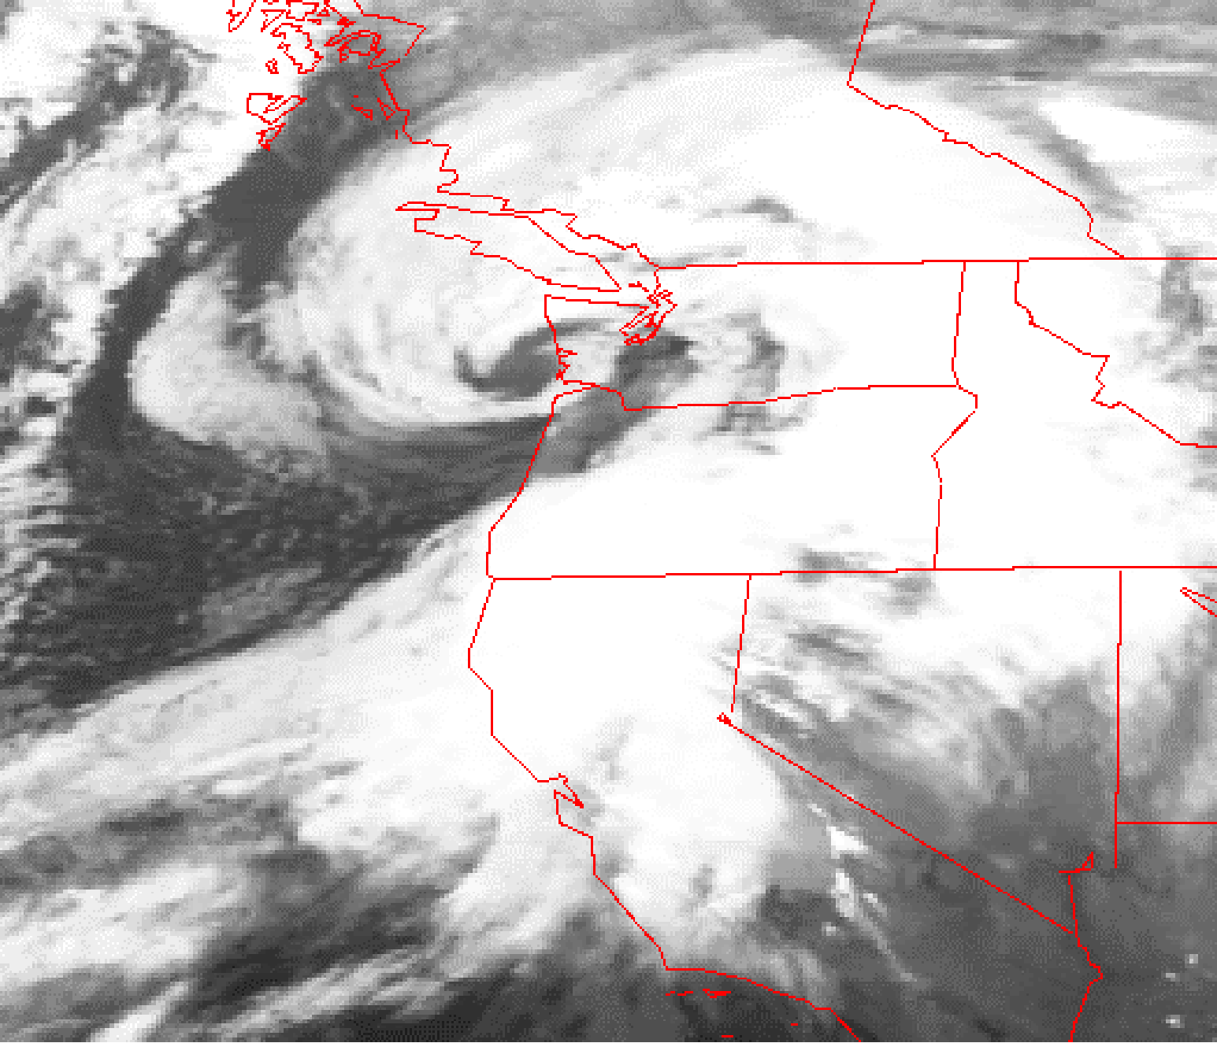
Northwest Windstorms
Will there be more of them?
Will they become more intense?
The Inauguration Day Storm
1993

Slide 45
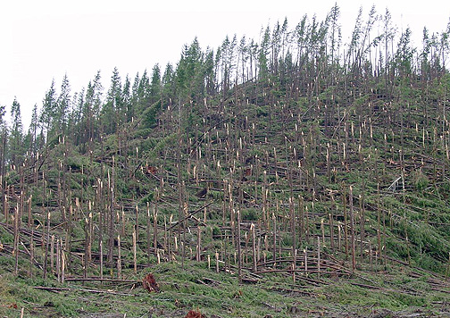
Northwest Windstorms
The answer appears to be no. No increasing trend.
UW investigated this issue for Seattle City Light

Slide 46
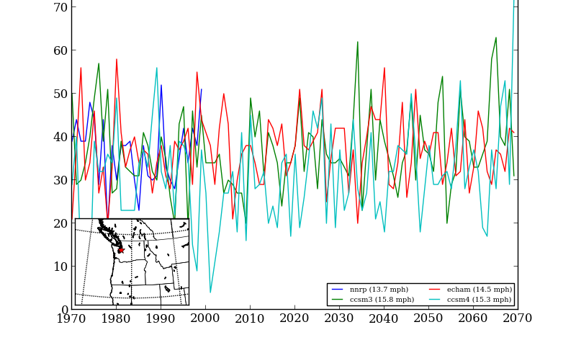
Number of times per year winds exceed a high-wind threshold (DJF) at Seattle for several simulations

Slide 47
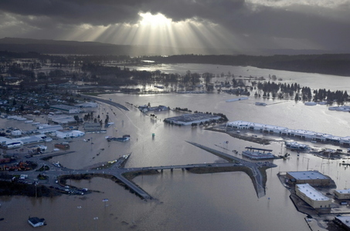
Northwest extreme precipitation and flooding: Will Increase Under Global Warming Later in the Century

Slide 48
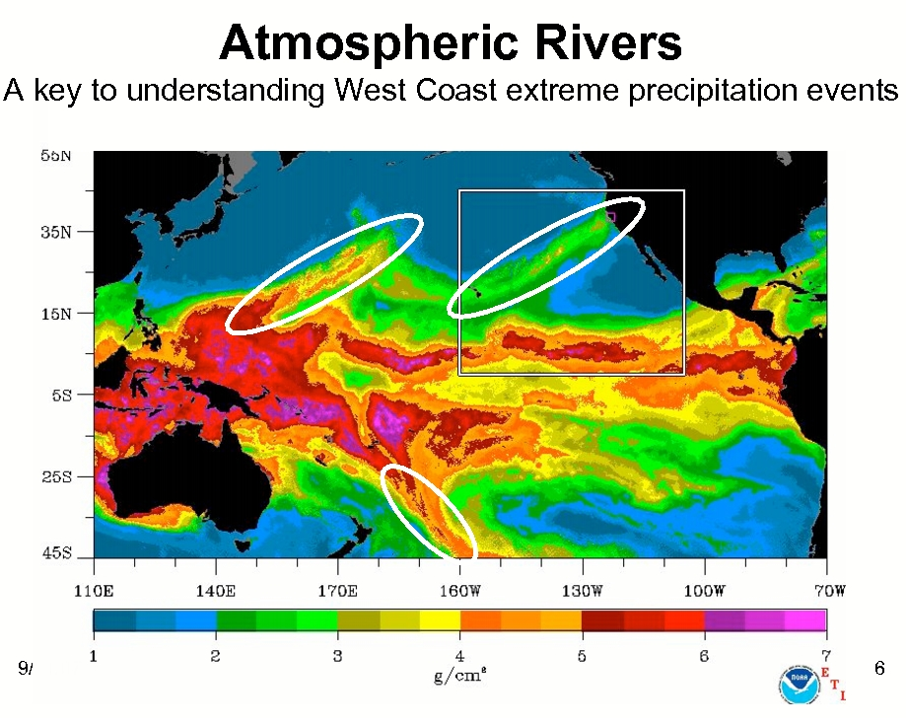
Super Atmospheric Rivers

Slide 49
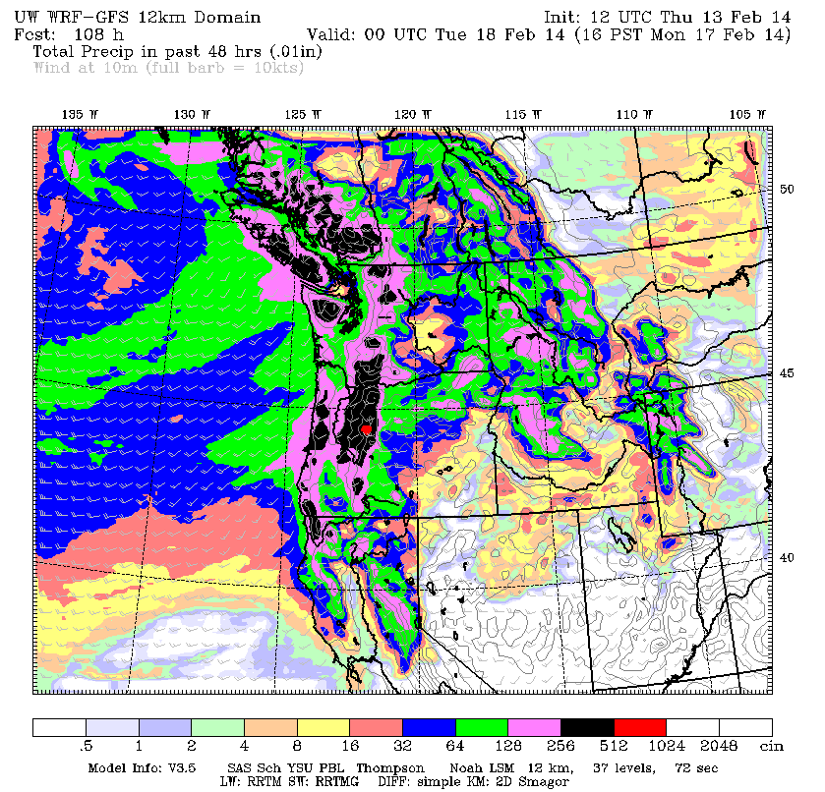
Global warming will intensify atmospheric rivers
Warmer air holds more water vapor.
Examined a large collection of climate model simulations for changes from 1970-2000 to 2070-2100 based on “business as usual” greenhouse gas emissions.
Winter-mean precipitation over the NW increases by 11-18% while precipitation on extreme atmospheric river days increases by 15-39% .

Slide 50
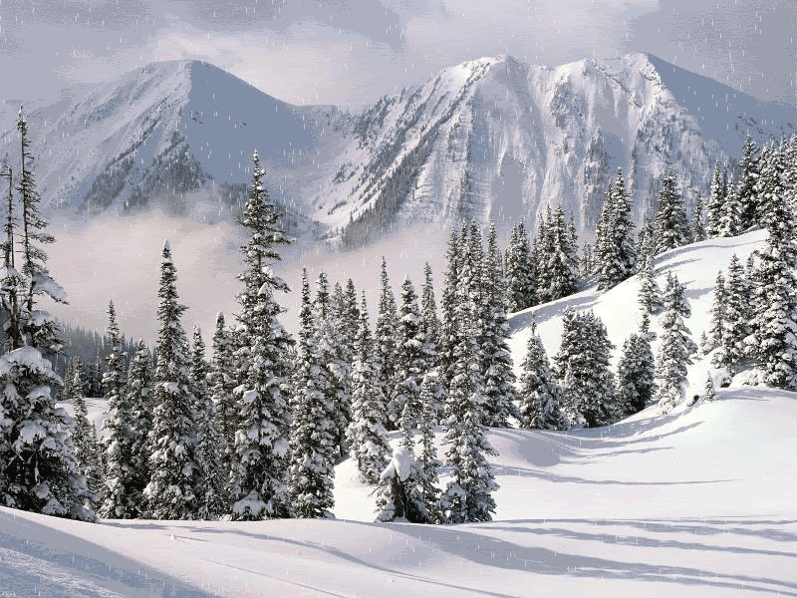
Flooding Potential Increases
Snow absorbs and helps to buffer heavy rain events.
With less snow, there will be less “protection.”
Thus, heavier rainfall could lead to greater flooding on major rivers.

Slide 51
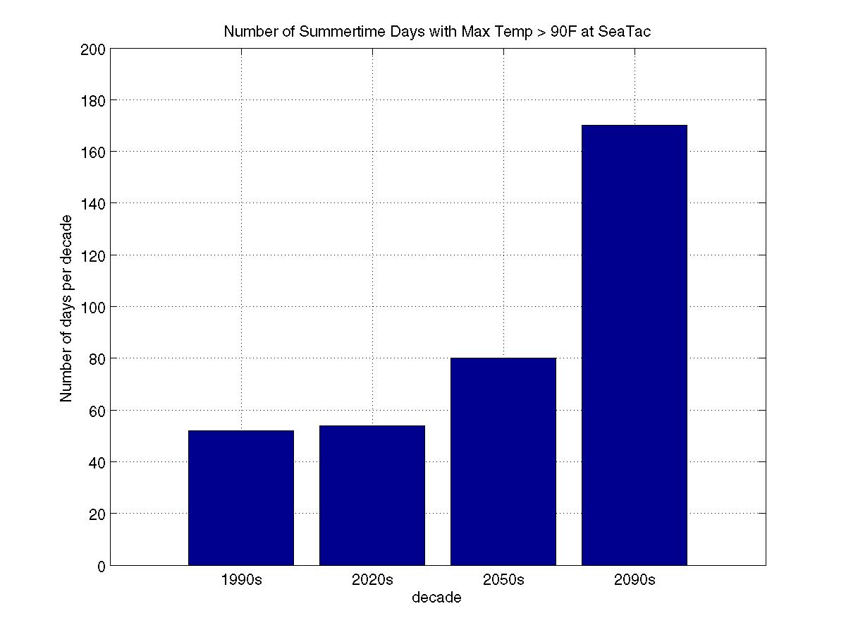
A Key Issue for Communicating Climate Change Impacts: Most of the Significant Impacts in the Future

Slide 52
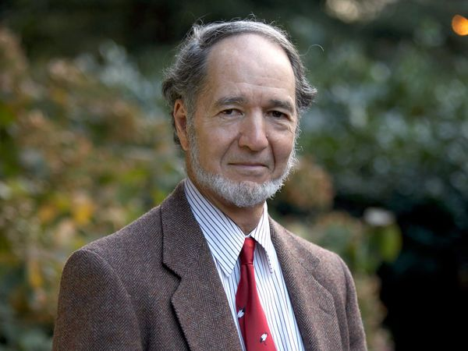
Professor Jared Diamond, Author of Collapse, Guns, Germs and Steel. No precedent of advanced action for a future threat

Slide 53
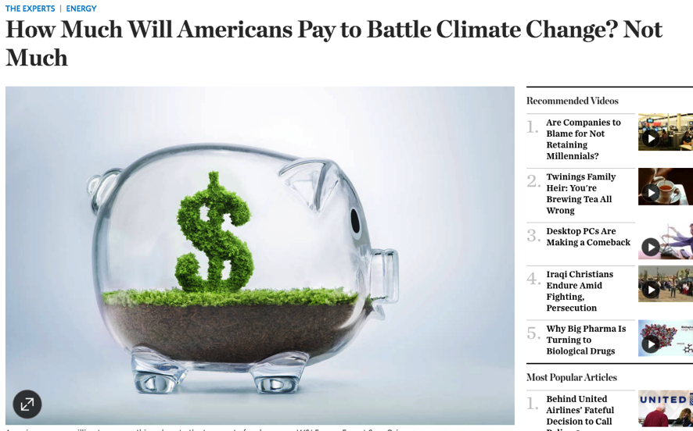
A Large Majority of Americans Would Not Pay $10. a Month to Deal with Global Warming

Slide 54
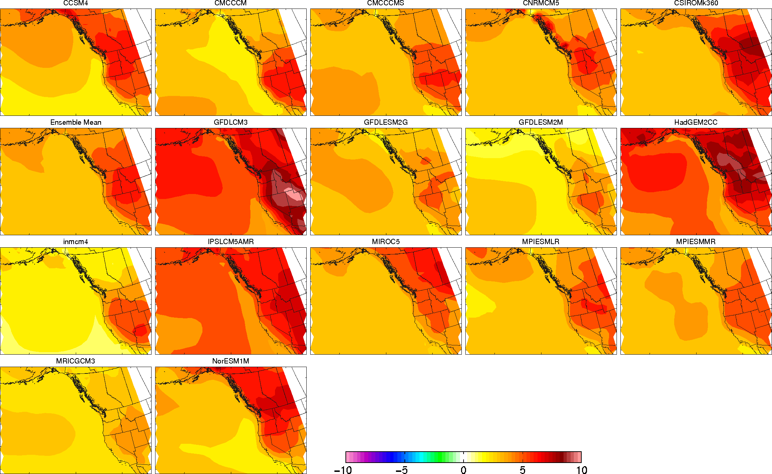
Uncertainty in Model Projections: How Do We Communicate This?
Surface Temperature Change from 1970-2000 compared to 2070-2100

Slide 55
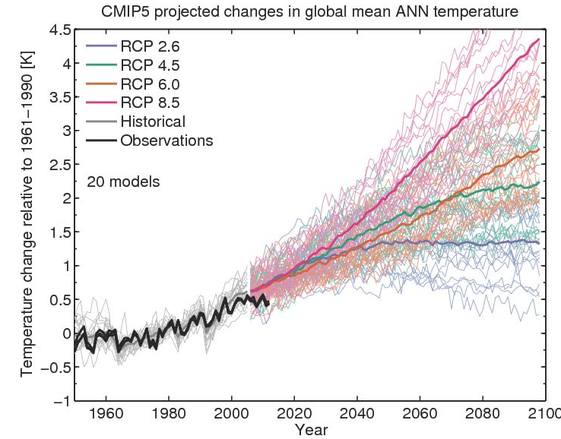

Substantial Variation Among Models

Slide 56

The Importance in Realistically Communicating the Impacts of Greenhouse Gas Increases on Extreme Weather
Society needs to make adaptations to climate change to improve resilience
Includes improving infrastructure, moving people/buildings, changing management of the environment (e.g., coasts and forests)
Such adaptations must be based on the best possible information to be effective and not prohibitive in cost.
Hyping climate impacts may undermine dealing with the real problems.

Slide 57
Real Problems we Need to Deal With
Poor forest management and increased population in the urban/forest interface
Too many living near rivers
Too many living near slopes
Cities built on flood plains, swamps, or without sufficient drainage.
And many more…

Slide 58
Some principles for climate communication
Provide society with the most accurate information and projections as possible.
Do not exaggerate or hype to get people “to do the right thing”
Provide information about the uncertainty of climate projections
Don’t obfuscated by being incomplete or leaving off critical information. Tell the full story.
Don’t politicize the communication.

Slide 59

The Paris agreement assumes that the world will find ways to suck CO₂ out of the air. In any realistic scenario, emissions cannot be cut fast enough to keep the total stock of greenhouse gases sufficiently small to limit the rise in temperature successfully. But there is barely any public discussion of how to bring about the extra “negative emissions” needed to reduce the stock of CO₂. Unless that changes, the promise of limiting the harm of climate change is almost certain to be broken.

Slide 60
The END

Slide 62
Accurate, Scientific-Based Communication of Past, Current, and Future Climate Change is Essential if Mankind is Going to Make the Correct Decisions

