Slide 1
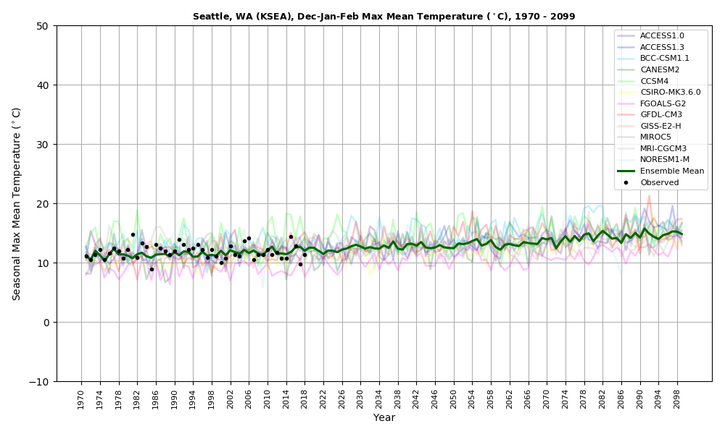
Ensemble-based High-Resolution Regional Climate Modeling
Cliff Mass, Rick Steed, and Jeff Baars
University of Washington

Slide 2
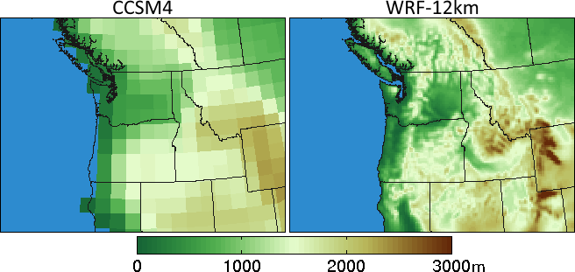
Global climate models are too coarse to simulate key Northwest terrain features
Climate Model Terrain

Slide 3

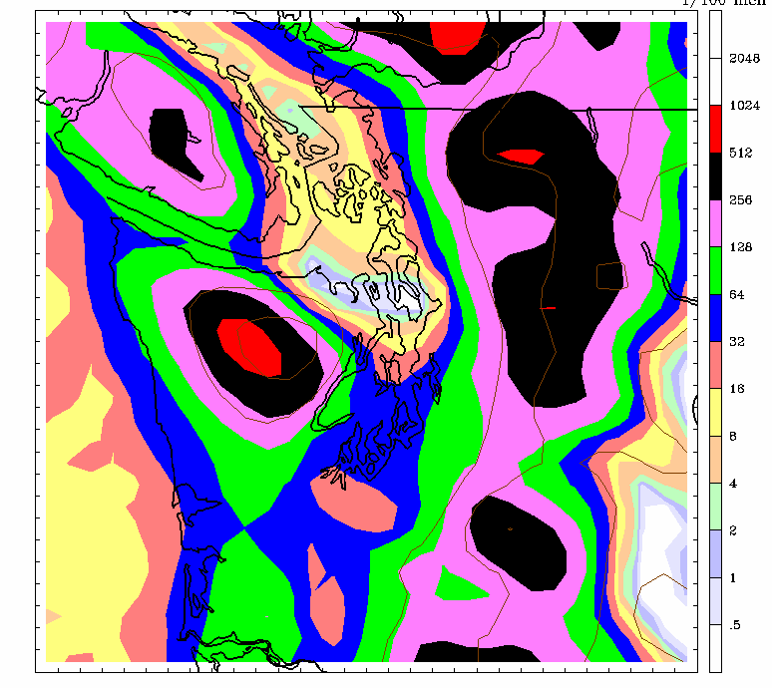
Need at Least 12-km Grid Spacing to Realistically Simulate the Essential Mesoscale Meteorology of the Region
36-km
12-km

Slide 4
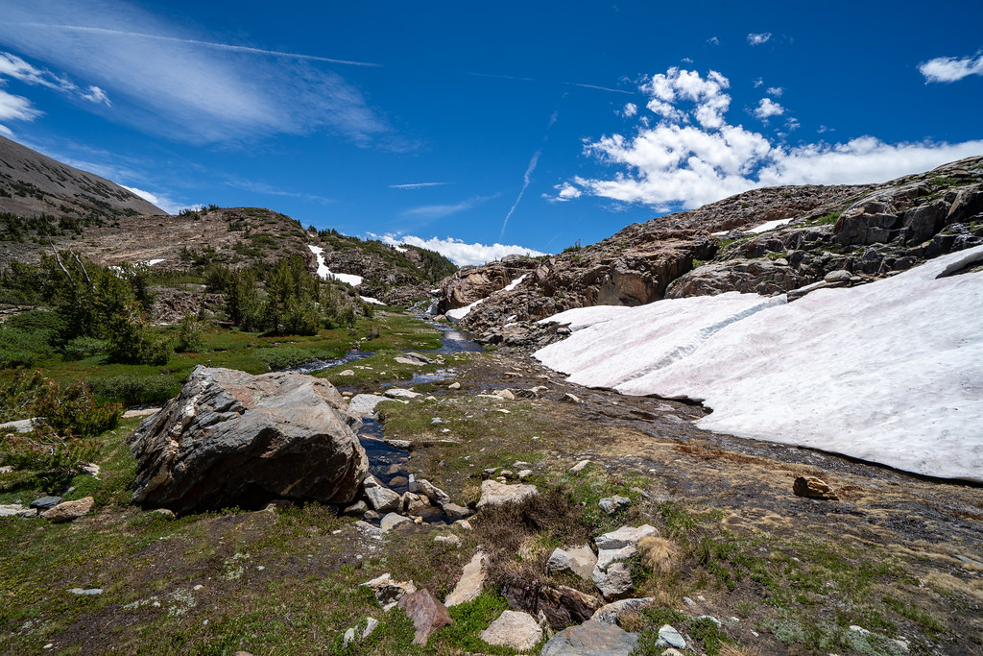
Are There Regional Climate Surprises That Can Only Be Determined by Dynamical Downscaling?
Snow-albedo feedbacks
Orographic precipitation effects
Convective features
Downslope winds and heat waves
Cloud effects
Regional sea breeze effects

Slide 5
Early Downscaling Work at UW Showed Interesting Feedbacks
MM5 mesoscale model using 12-km grid spacing
ECHAM-5 GCM
1970-2100

Slide 6
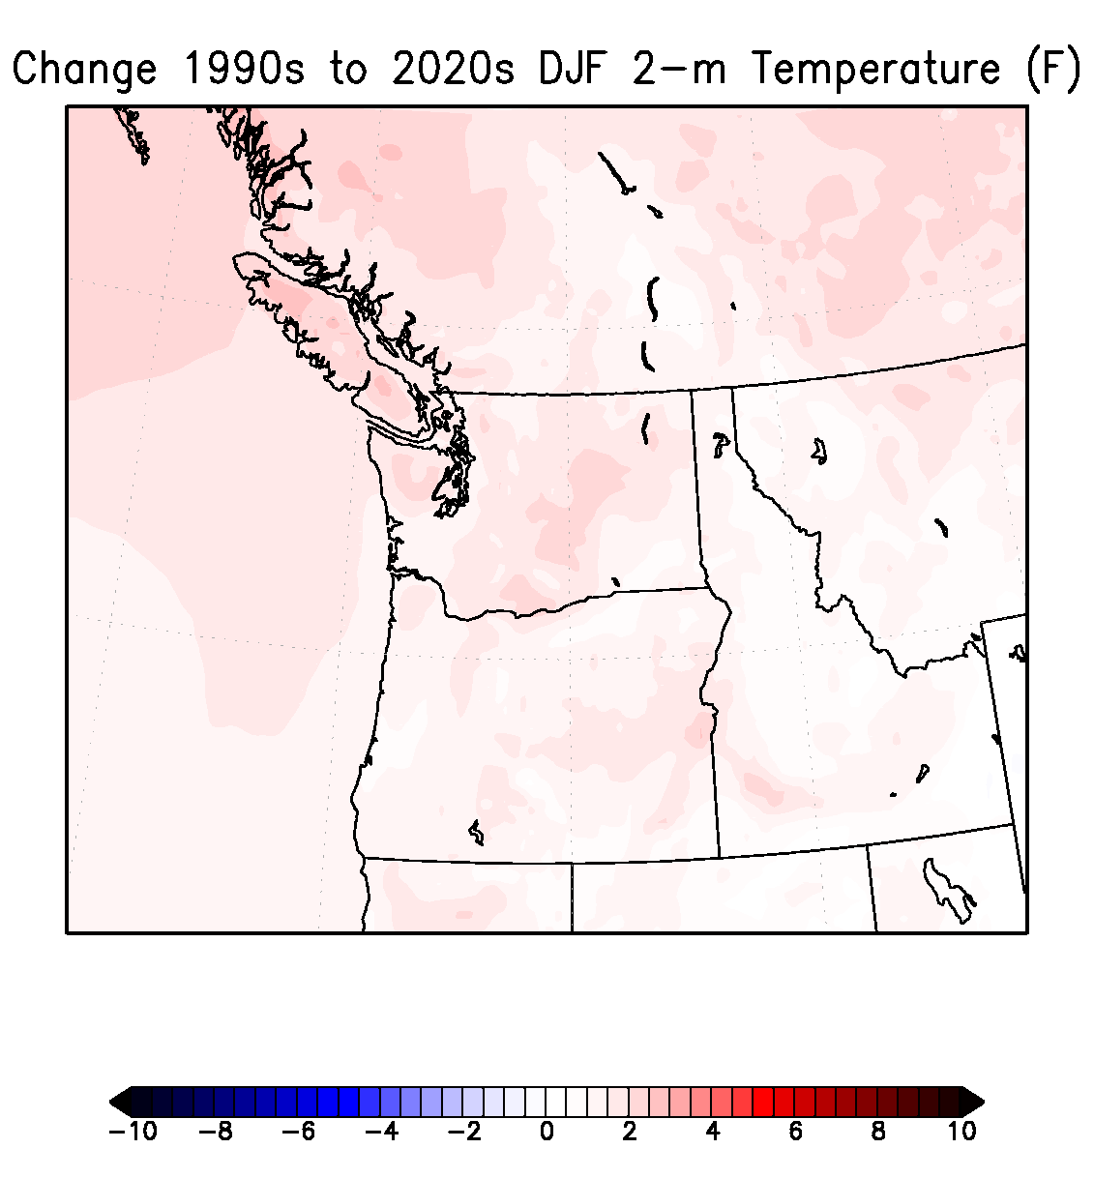
Change in Winter Surface Air Temperatures (F)
Notes:
6

Slide 7
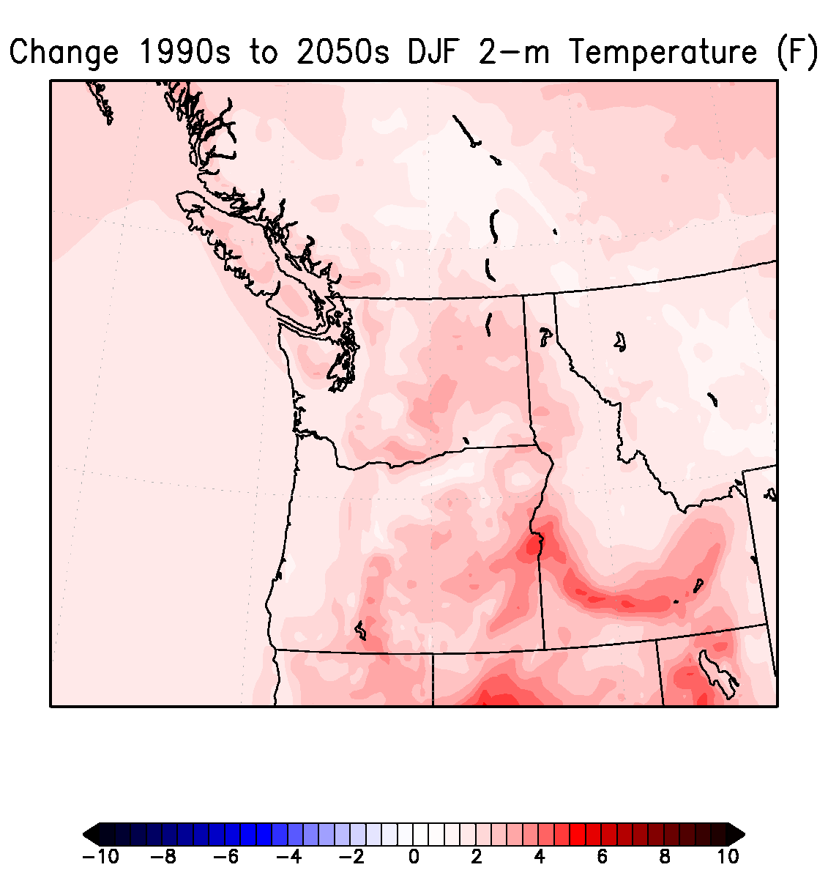
Notes:
7

Slide 8
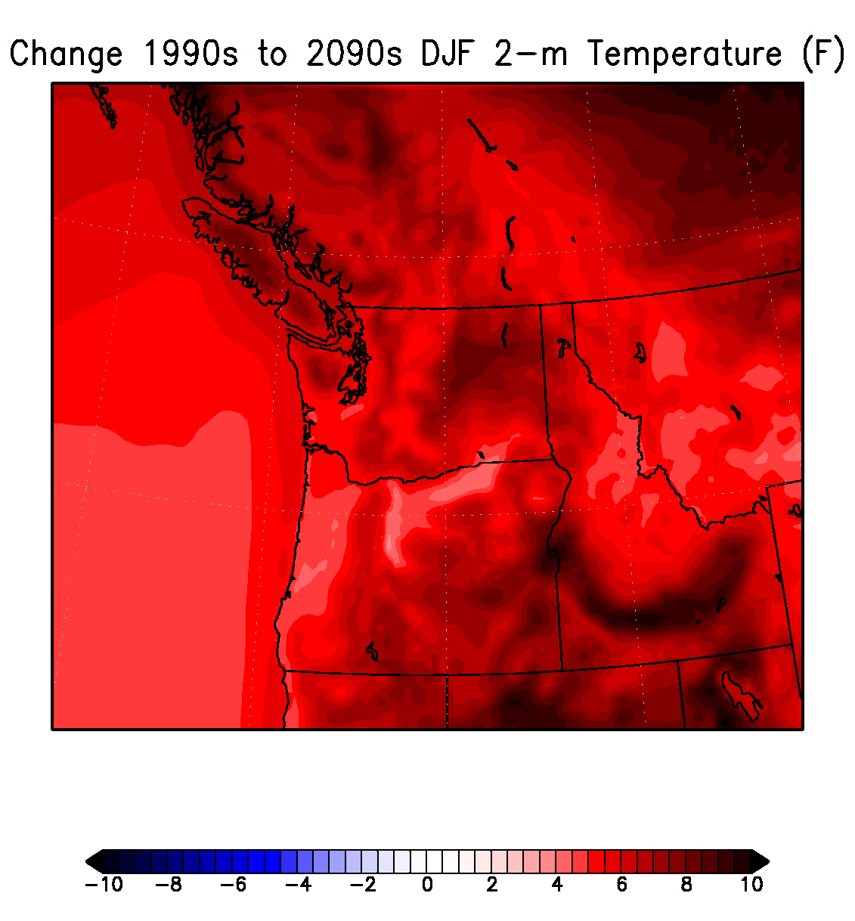
Enhanced Warming Where Snow Level Was Raised By Warming
Banded Structures
Notes:
8

Slide 9
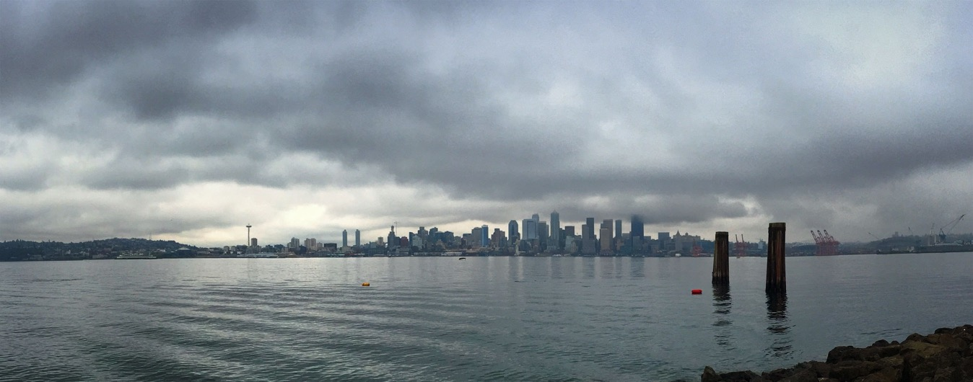
More low clouds during spring/early summer over coastal zone west of Cascades under GW

Slide 10
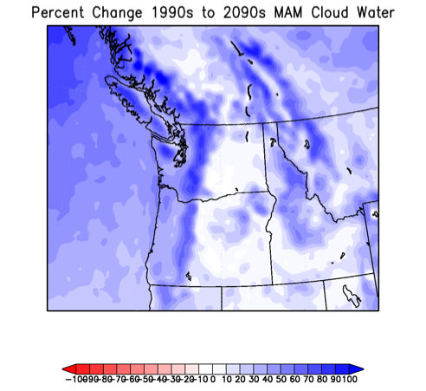
March-April-May Changes (1990s-2090s)

Slide 11
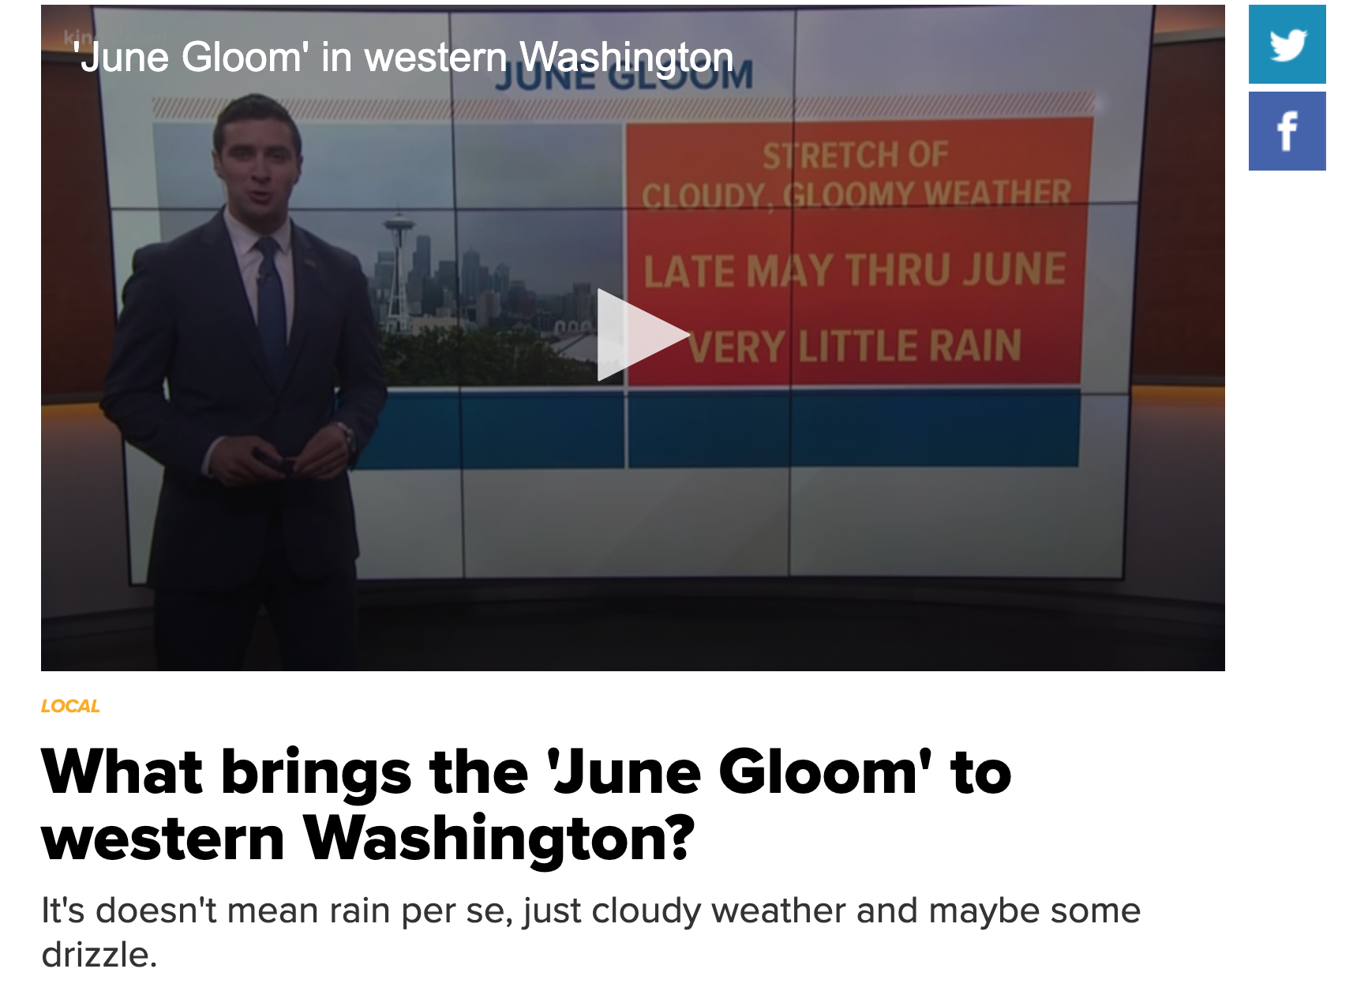
June Gloom May Get Worse Under GW

Slide 12

Improving Regional Dynamical Downscaling High-resolution (12-km) WRF Ensemble Driven by 12 CMIP-5 Global Models.
Paid by

Slide 13
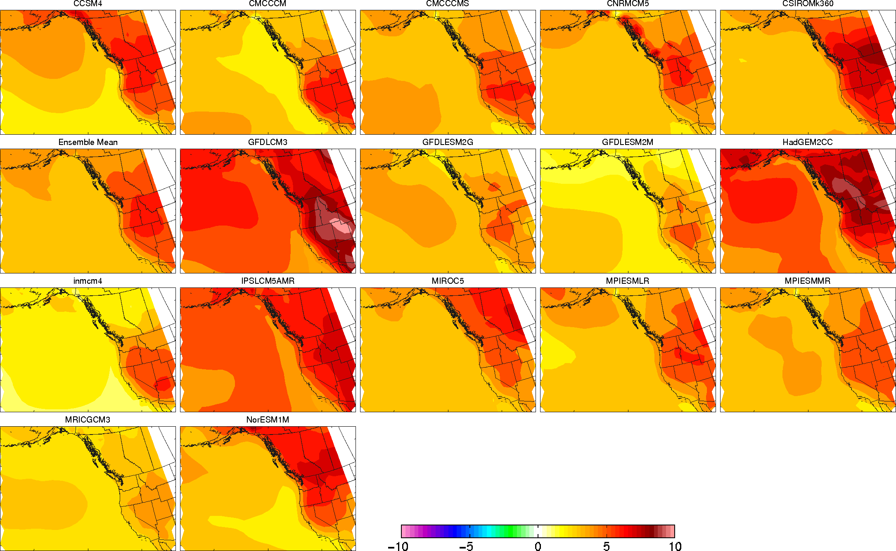
Substantial Differences in GCM: What do all or most downscaled simulations have in common?
Surface Temperature Change from 1970-2000 compared to 2070-2100

Slide 14

Some Details
WRF 3.7.1
RCP 8.5: Perhaps too aggressive, but shows the worst case.
Ran under 12 CMIP-5 GCMs with 6-hr output
36 and 12 km domains, with 36-km nudged to the parent GCM
Ran for 1970-2100. No breaks
Used both Amazon AWS cloud and local clusters.

Slide 15
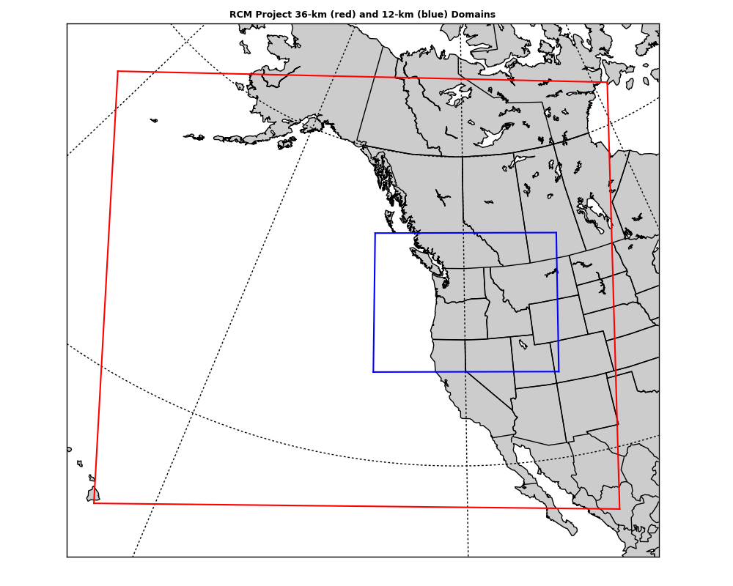
Domains
36 km
12-km

Slide 16
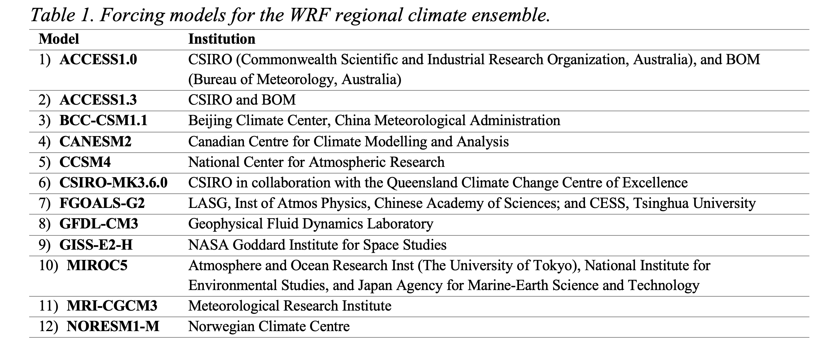
GCMs Used

Slide 17
Initial Results

Slide 18
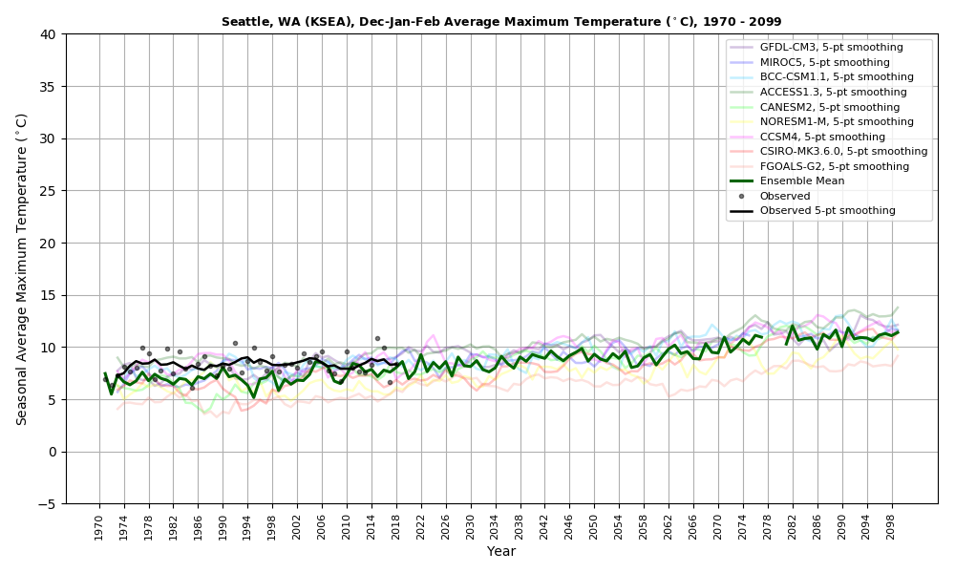
Average Temperatures At Seattle
Warmer

Slide 19
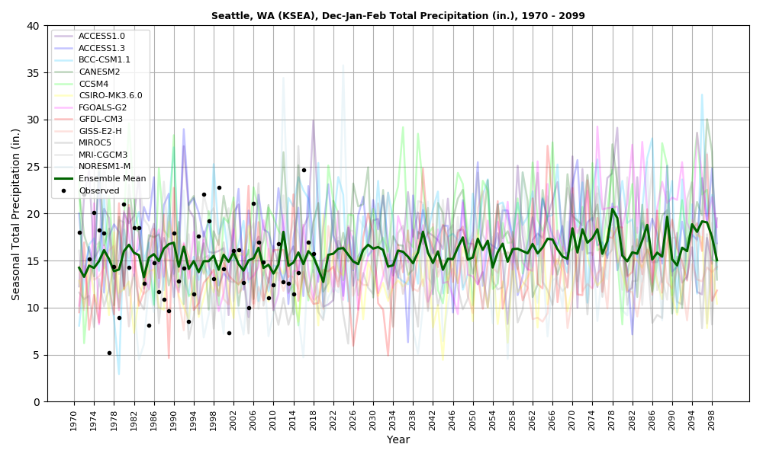
Seattle Winter Precipitation: Small Increase

Slide 20
But Now the ”Surprising” Material

Slide 21
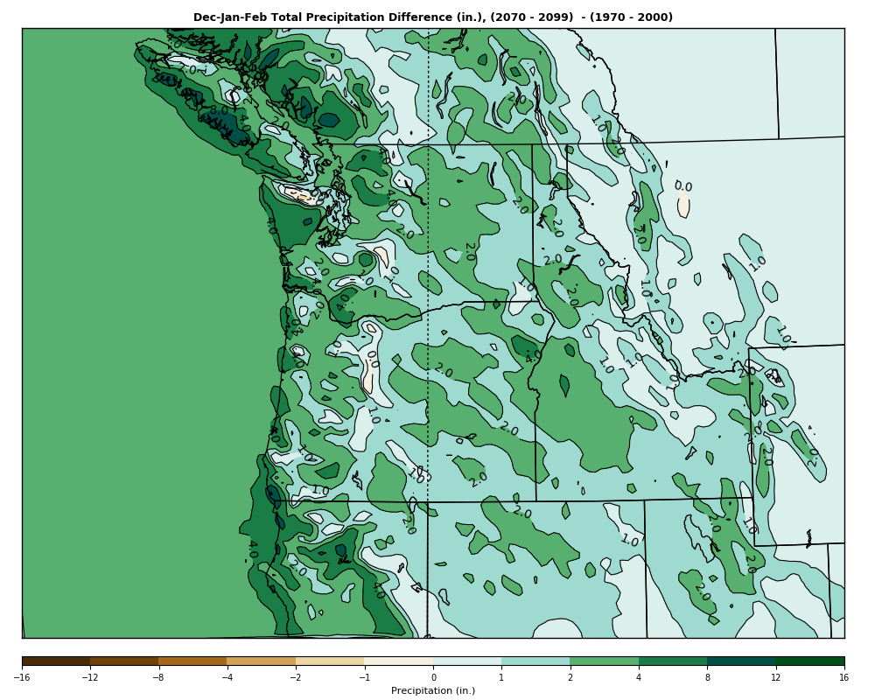
Change in Winter Precipitation 1970-2000 to 2070-2100 (ensemble mean)
Overall increase but DECLINES in the lee of major barriers. Why?

Slide 22
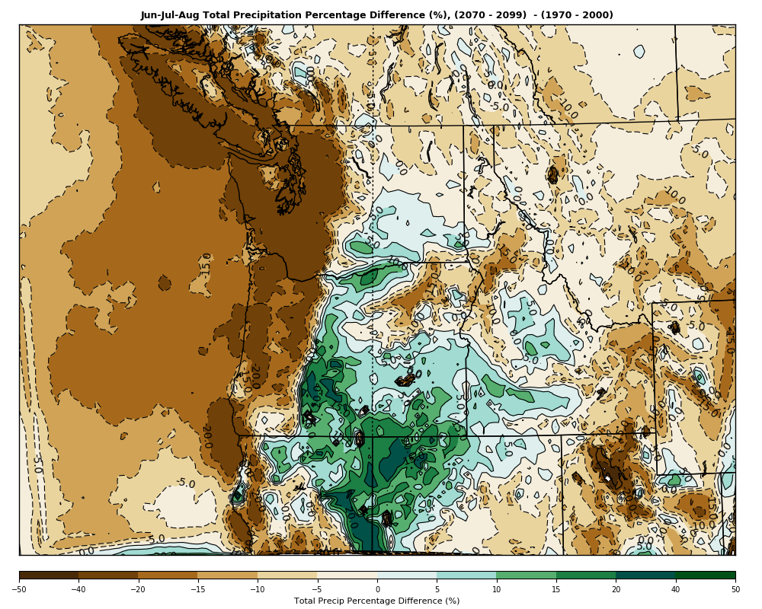
Summer Precipitation Changes
Drier west of the Cascade crest but wetter over eastern Oregon, NE California, NW Nevada. Why? Stronger SW Monsoon?
Figure 3. Ensemble-mean percent change in Jun-Jul-Aug precipitation, 1970-2000 to 2070-2100.

Slide 23
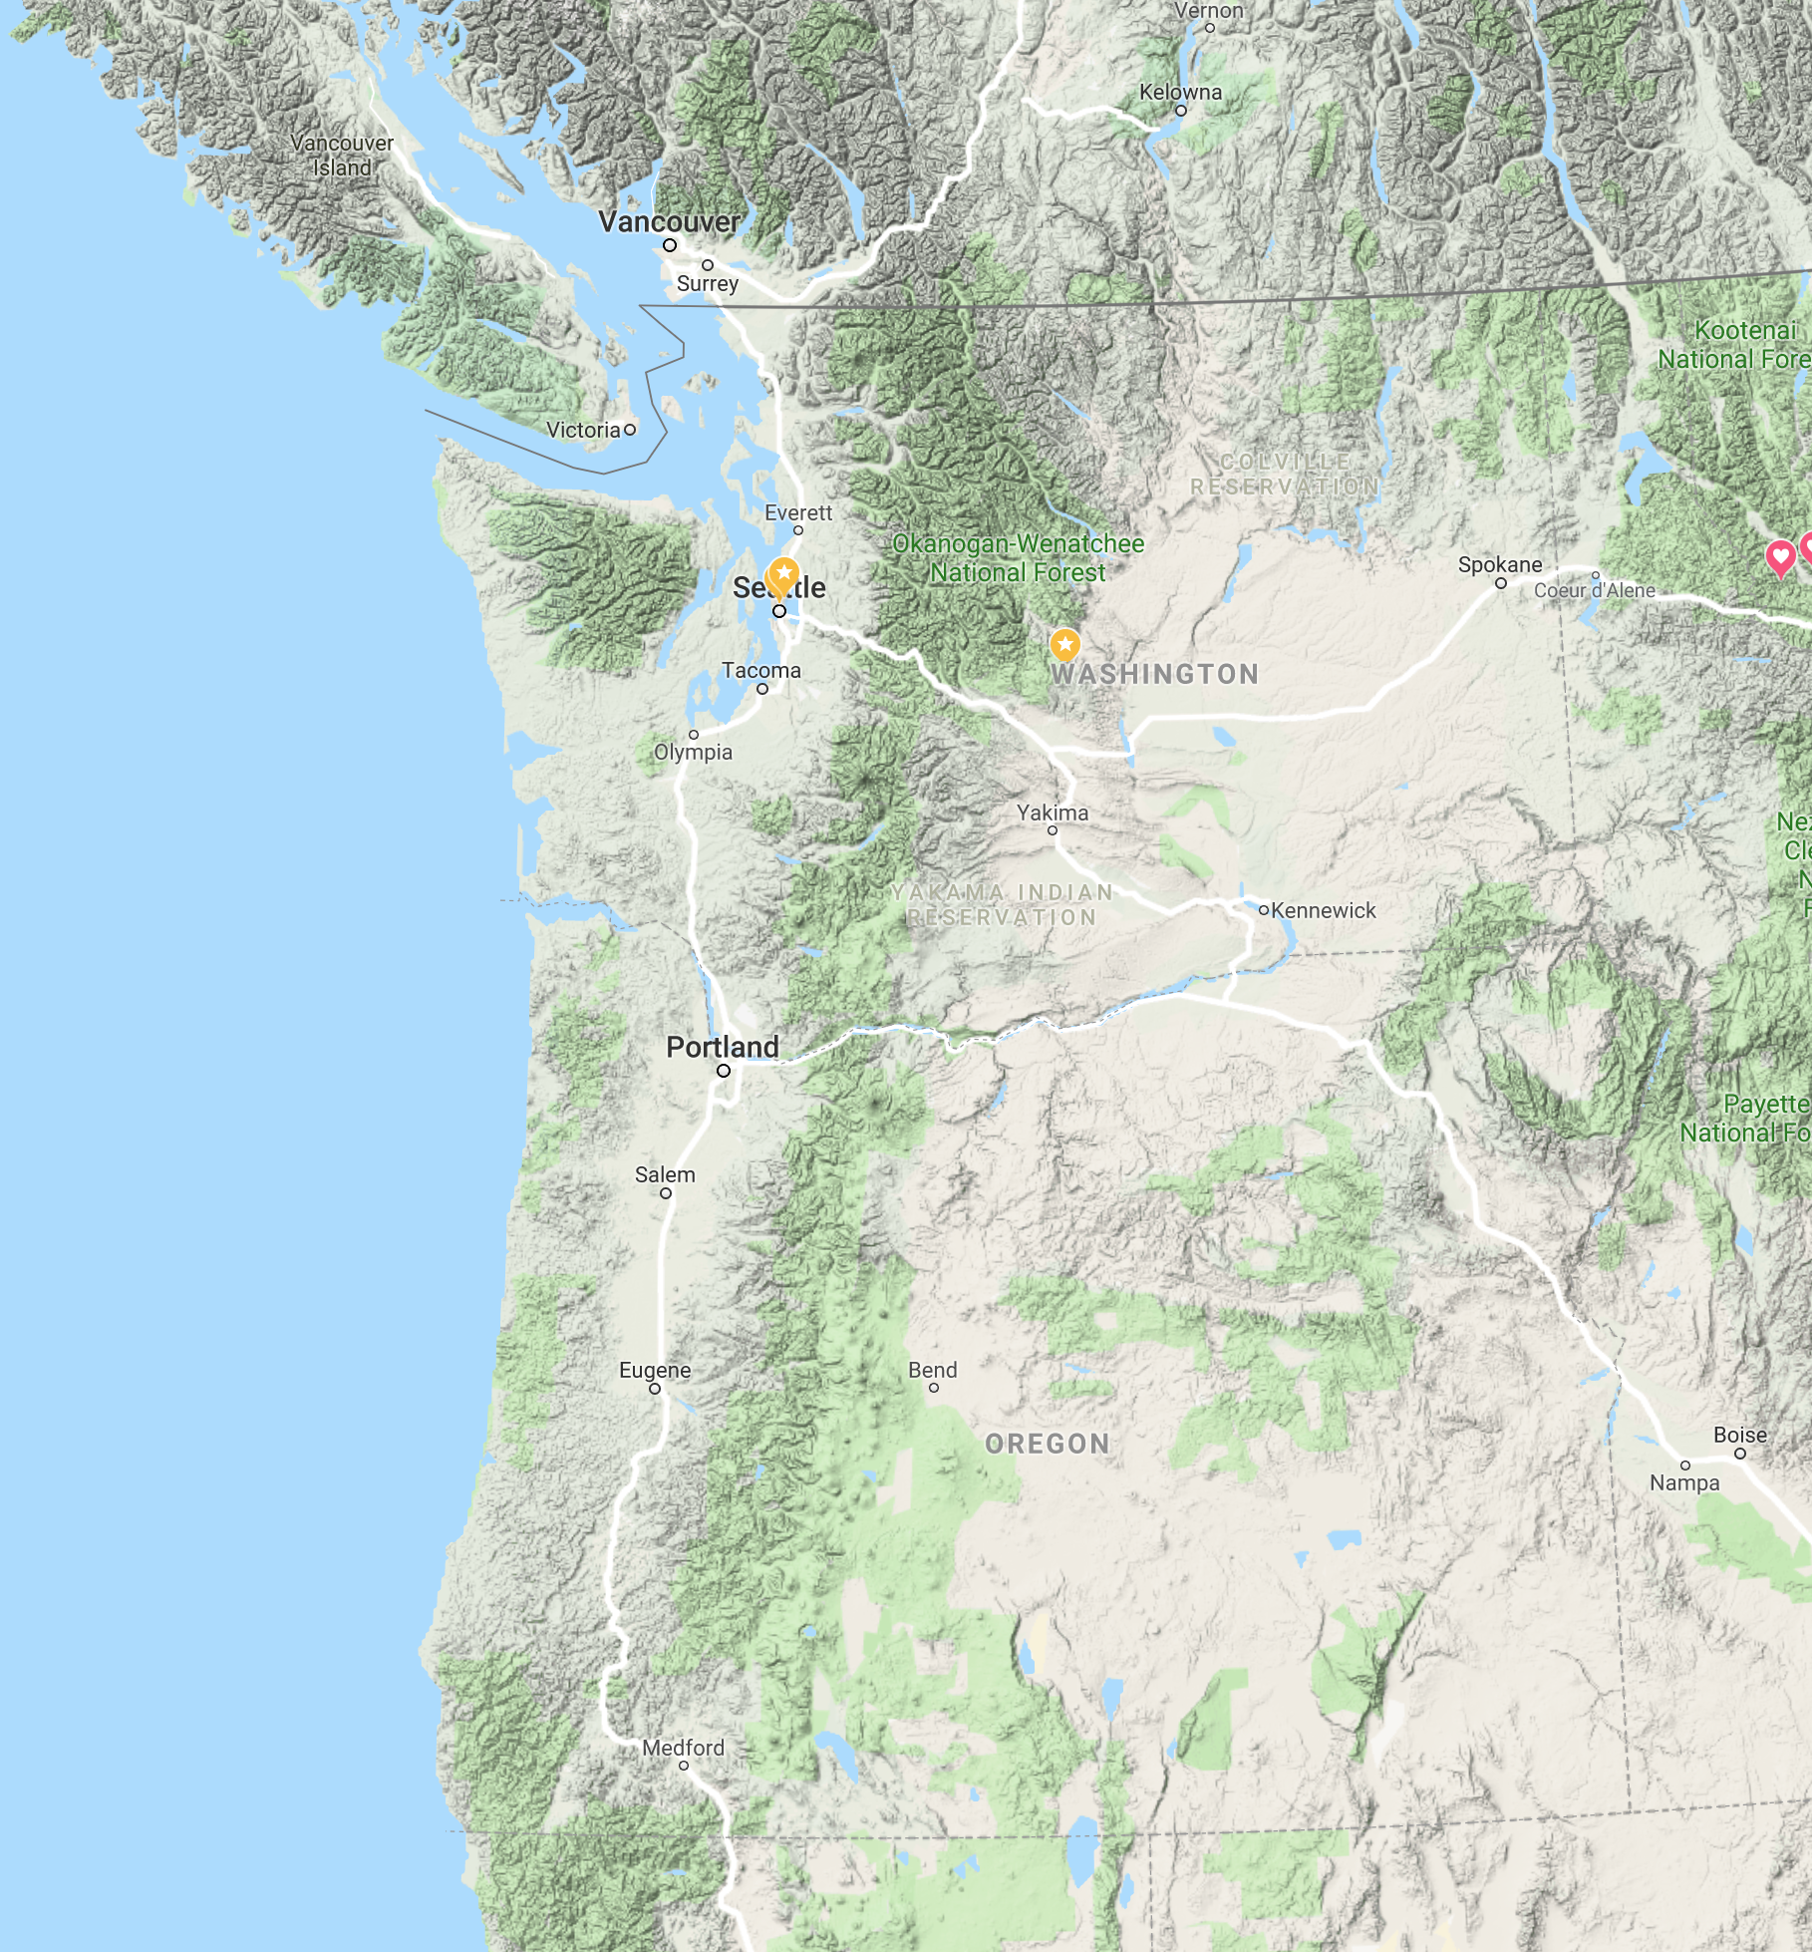
What about heat waves and major wildfires west of the Cascade Crest? Both are driven by strong easterly flow.
How will easterly flow change under GW?

Slide 24
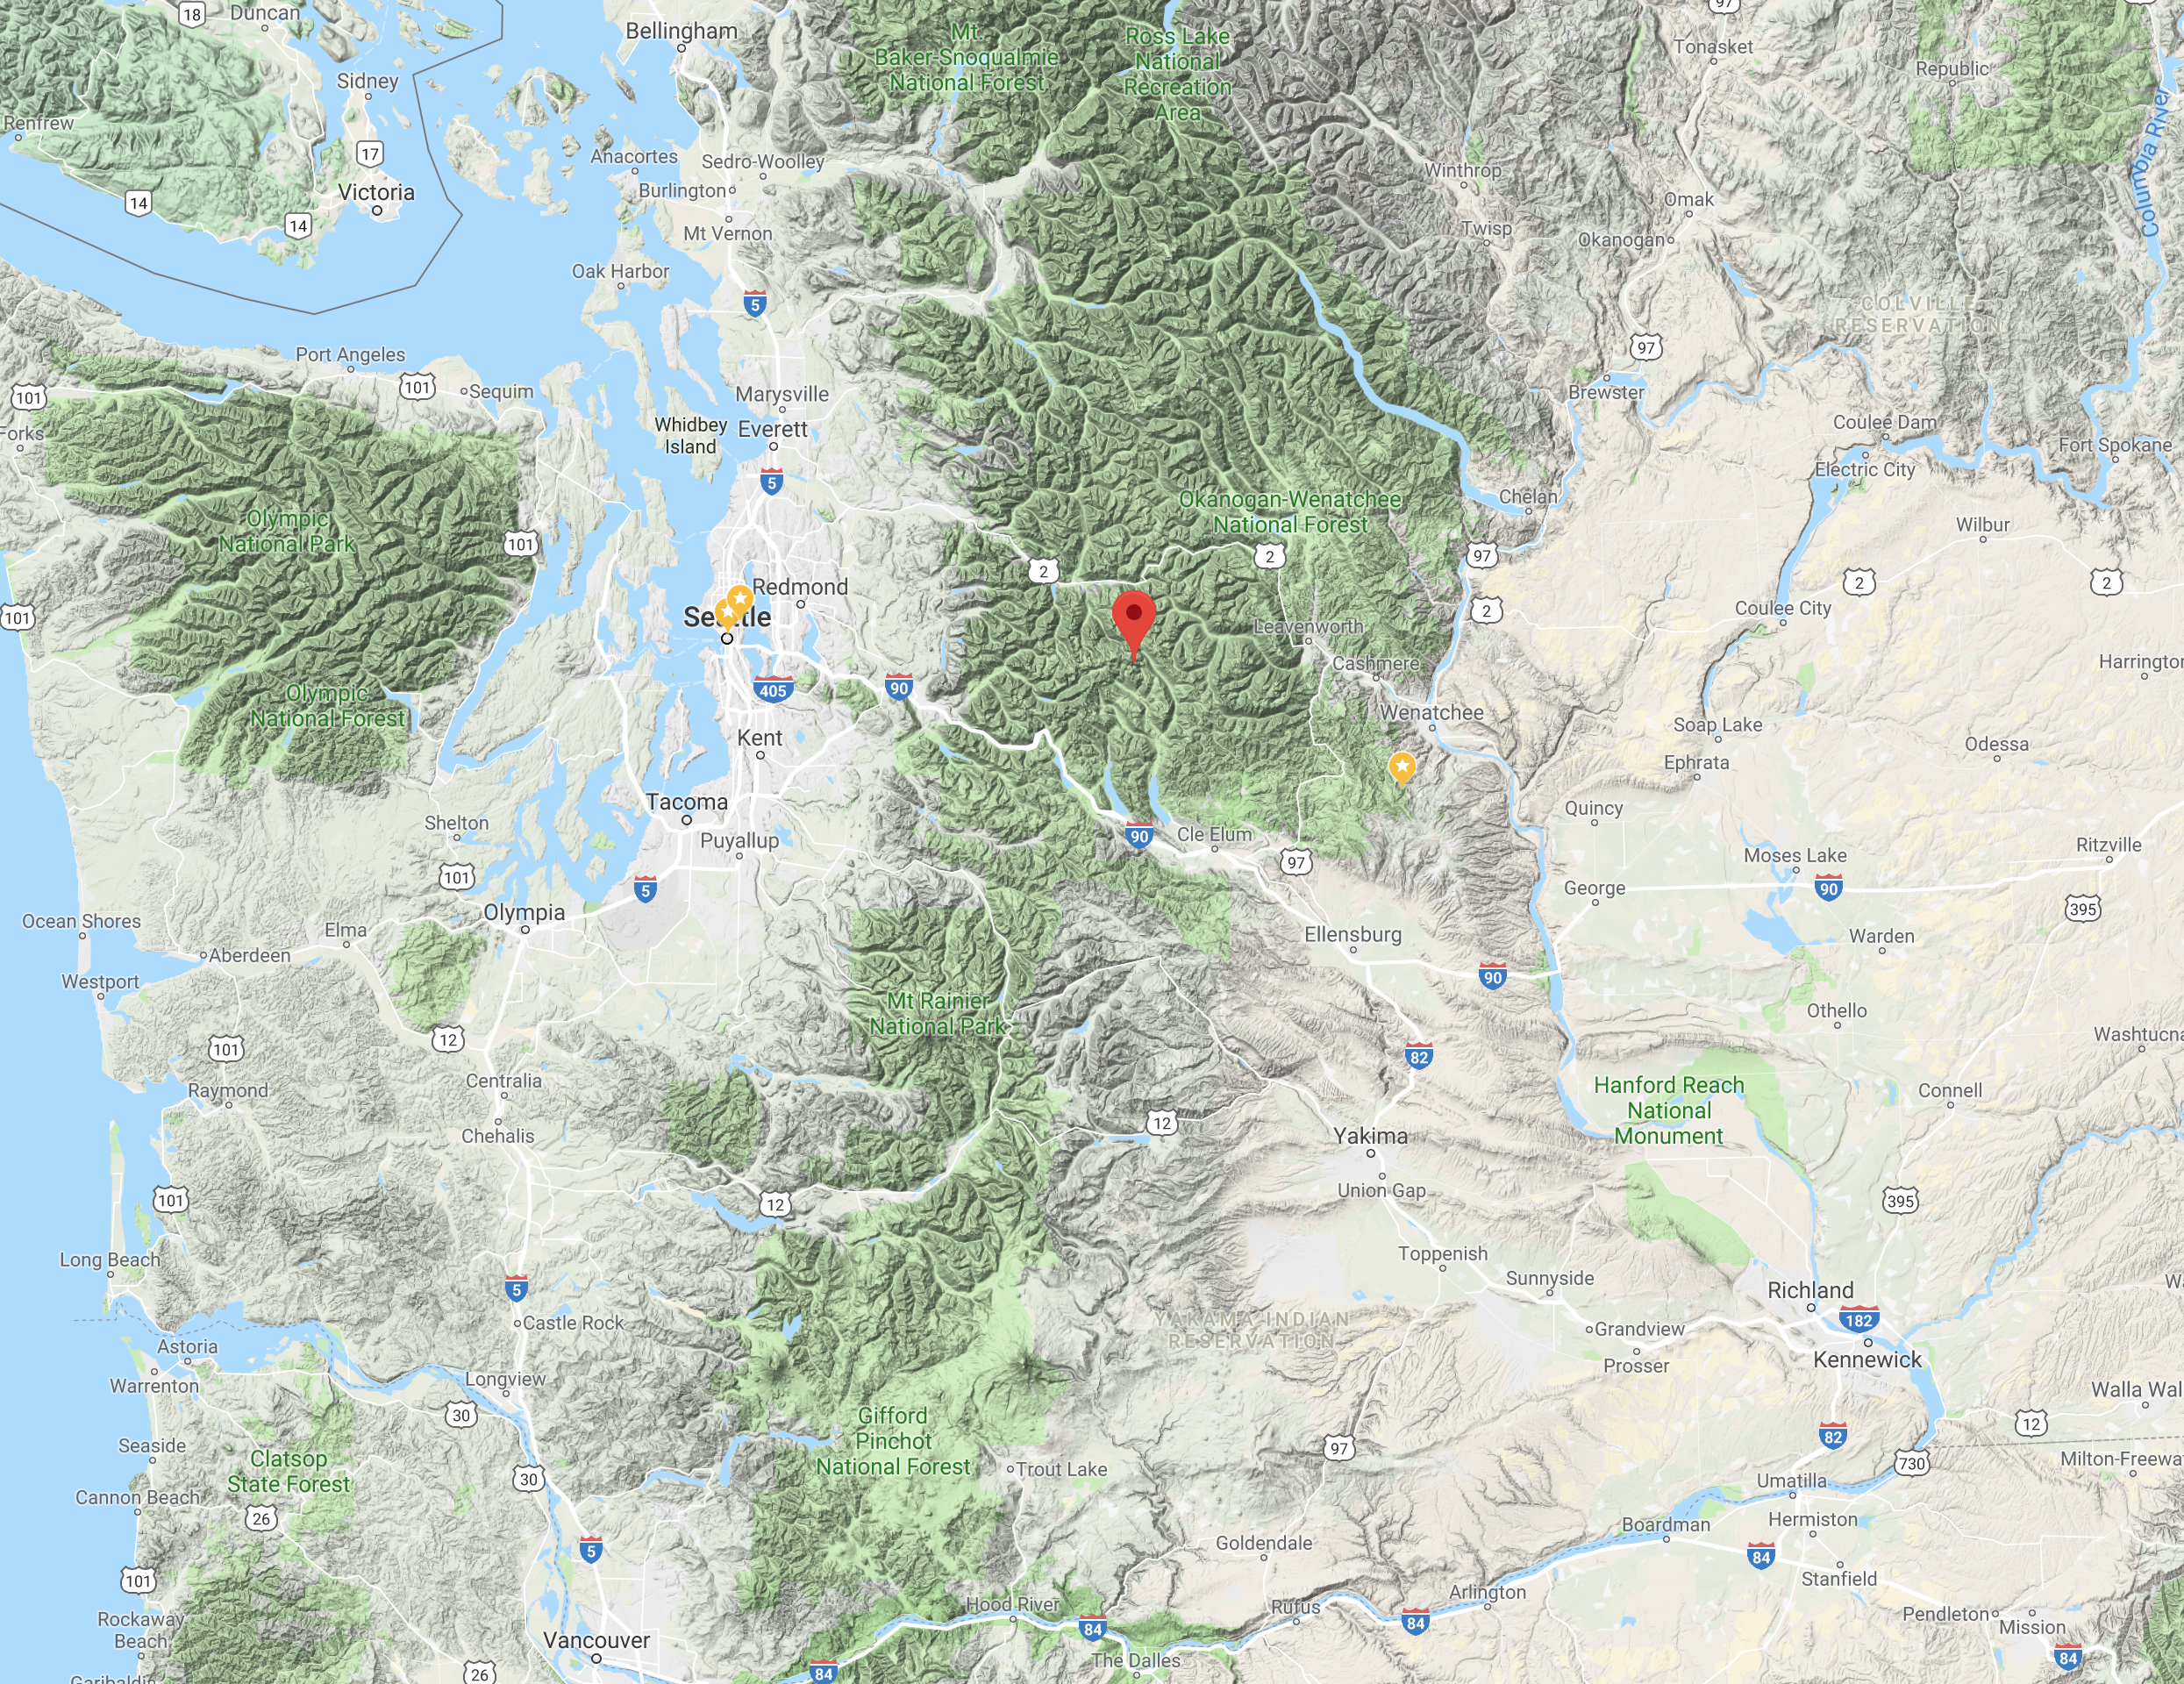
Consider a point near the crest of the Cascade Mountains

Slide 25
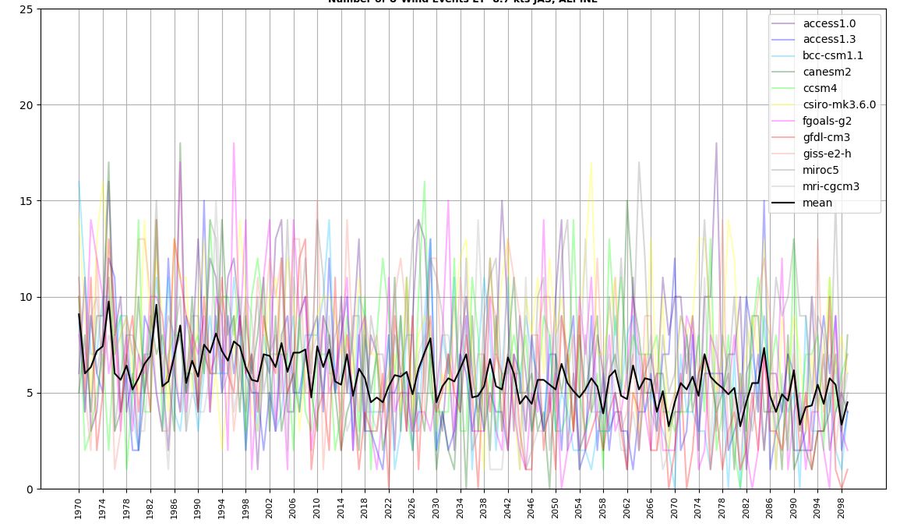
Maximum Daily Easterly Winds Each Year (Cascade crest)
Maximum Easterly Winds are Projected to Decline!

Slide 26
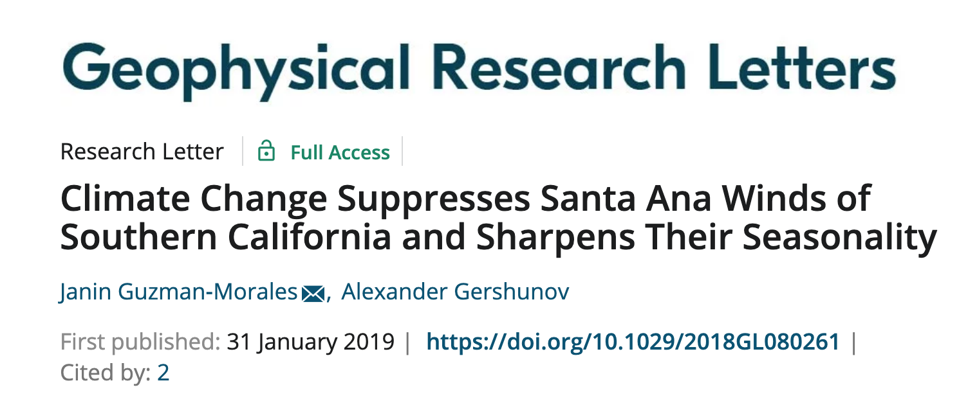
Reduced Easterly Flow Under Global Warming
Consistent with other studies in southern California (reduced easterly flow driving Santa Anas).
Global warming preferentially heats the interior of the continent versus the ocean, producing enhanced pressure falls over the interior.
Results in stronger onshore flow (or weaker offshore/easterly flow).

Slide 27
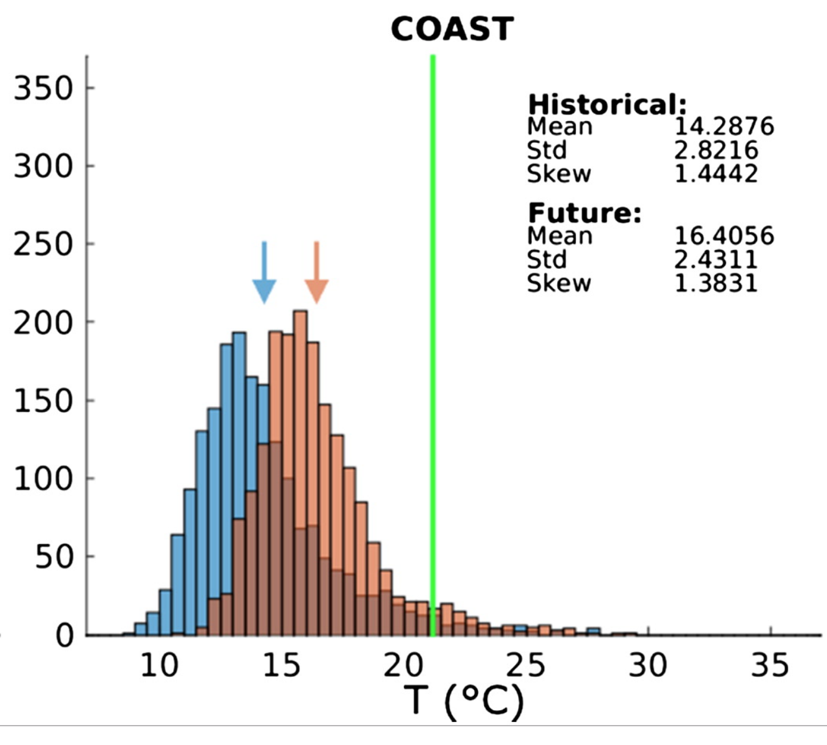
Major Implications
Could partially compensate for rising regional/global temperatures.
Reduce increases of extreme heat waves
Reduce increases in major wildfires over western Washington and Oregon
WRF-CCSM3
Number of Days
Washington Coastal Location

Slide 28
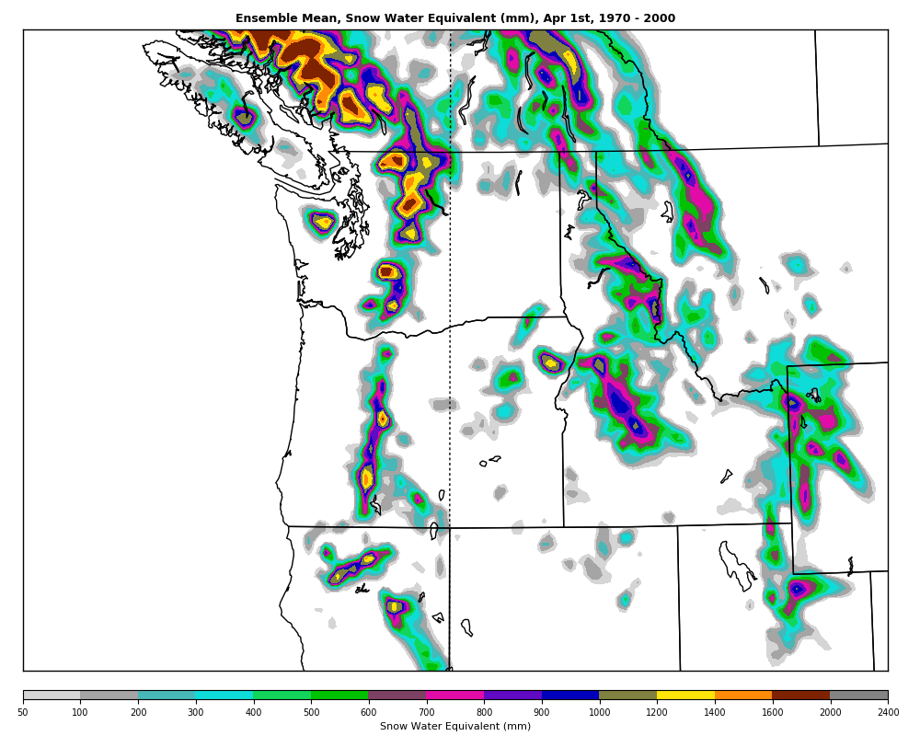
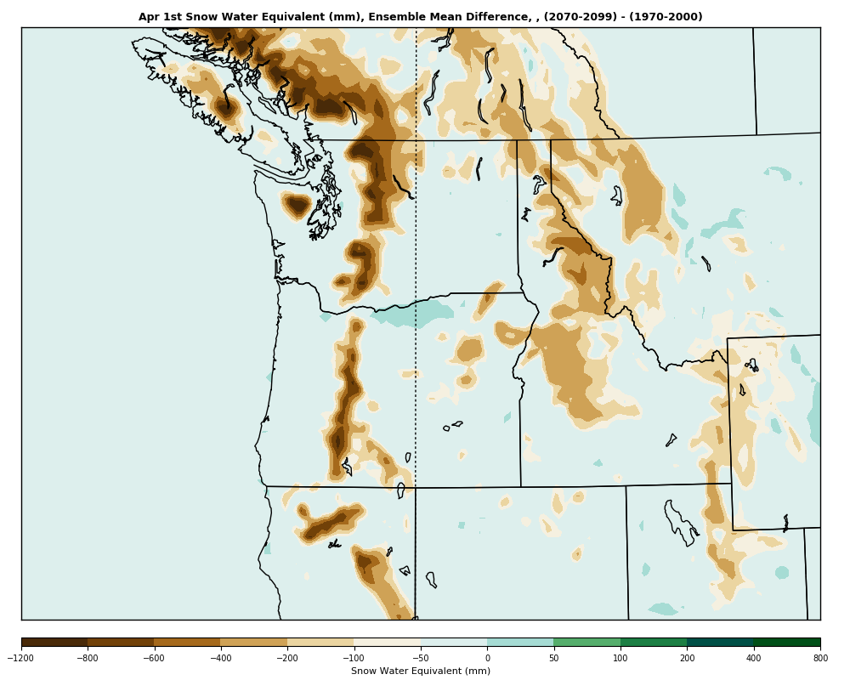
April 1 Snowpack (SWE): Big Losses
Current
Loss

Slide 29
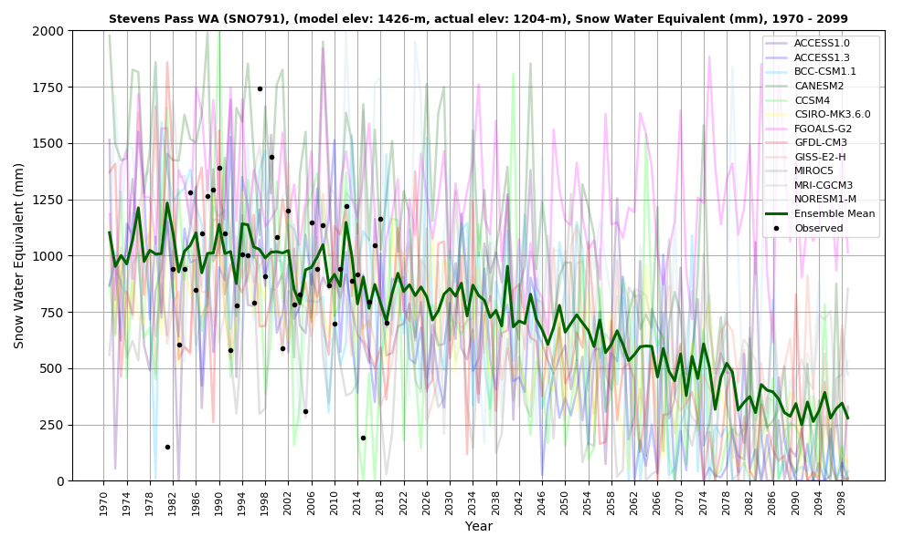
Steven’s Pass, Cascade Crest

Slide 30
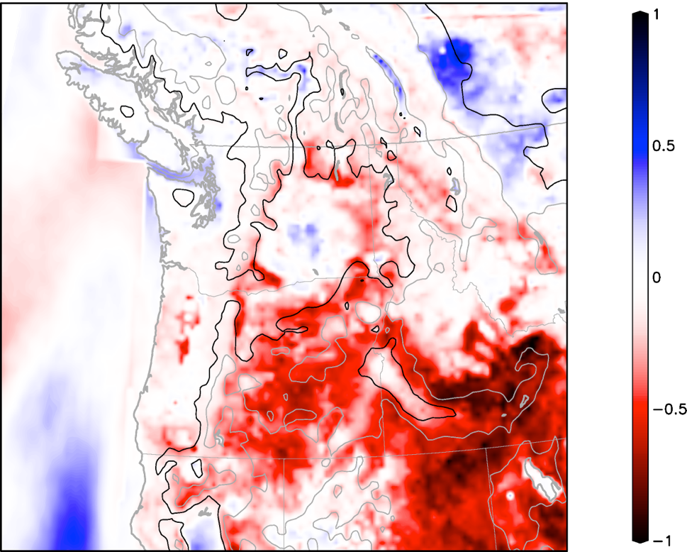
Soil Moisture Feedbacks
In red areas, surface moisture fluxes (which cool) decline as the region warms
Positive feedback for warming
Change from 1970-1999 to 2030-2059 in the correlation between moisture flux and temperature for summer.

Slide 31
Future Work
Analyze and understand what we have
Rerun using RCP 4.5 (more realistic perhaps) and add physics diversity.
Add Bayesian Model Averaging (BMA) and other post-processing, training on contemporary period.

Slide 32
The END

