Slide 1
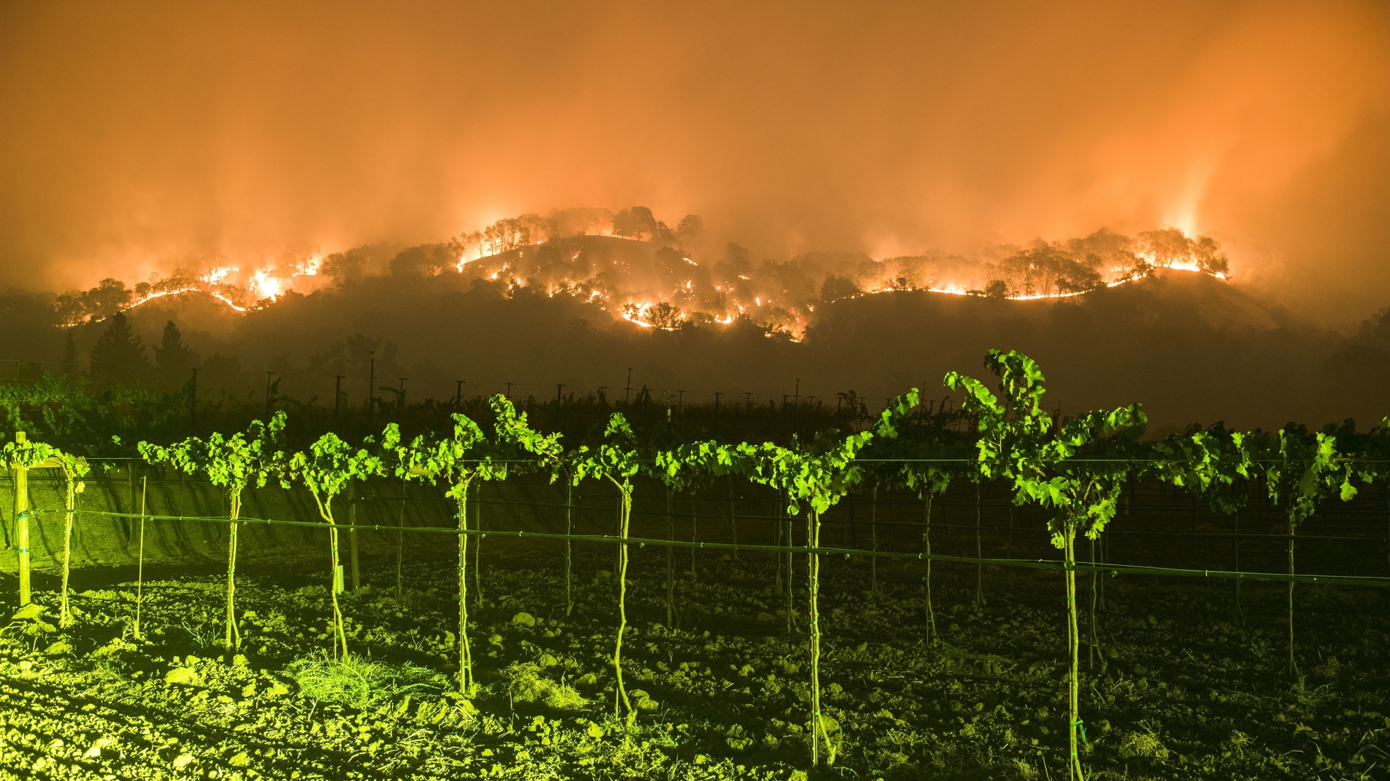
The Northern California Fires of October 2017: A Terrain-Induced Downslope Windstorm Well Predicted by Mesoscale Models
Cliff Mass
Atmospheric Sciences
University of Washington
AMS WAF/NWP Denver, June 2018

Slide 2
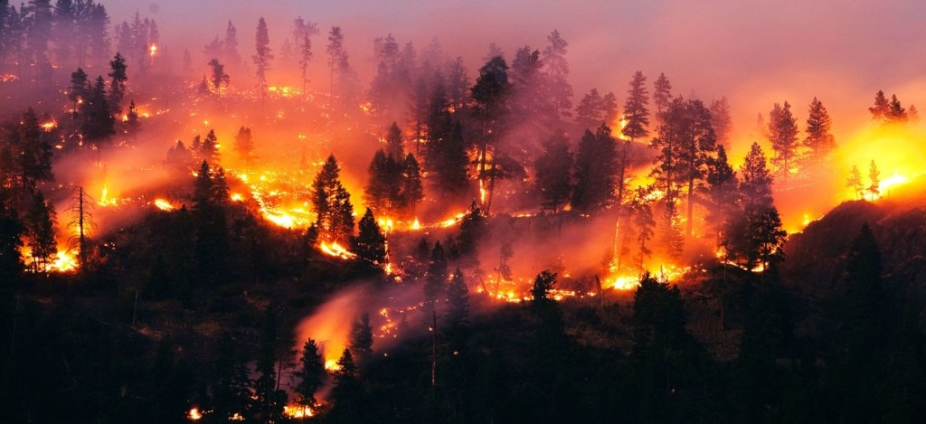
During the evening of Sunday, October 8, 2017, wildfires began in the hills above Santa Rosa, Napa, and other towns of the ”wine country” north of San Francisco

Slide 3
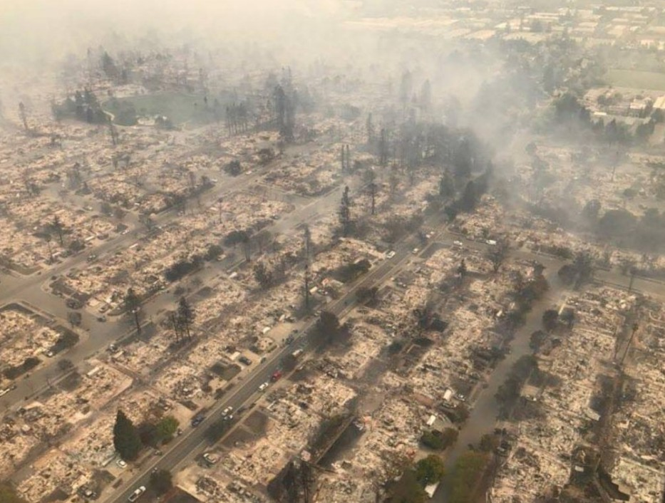
And pushed by strong winds, rapidly descended into populated areas

Slide 4
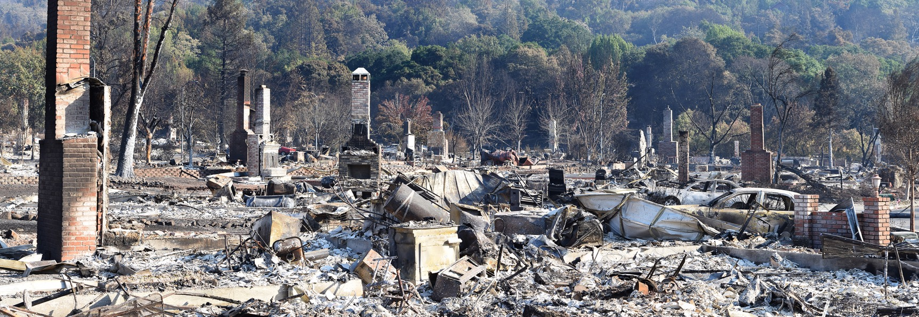
The Fountaingrove Neighborhood

Slide 5
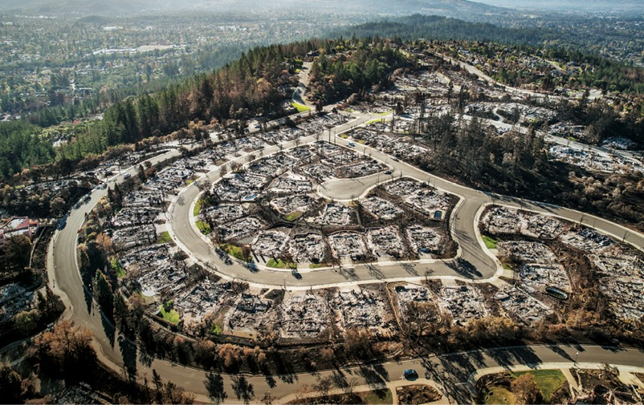
Before it was over, the “Wine Country” wildfires became the most devastating in CA history
44 died and hundreds were hospitalized
More than 9,000 structures were destroyed. 21,000 damaged.
Burned 245,000 acres of land
More than 10 billion in insured property loss
Total damage/loss much more.
Serious air quality degradation over the region for over a week.

Slide 6
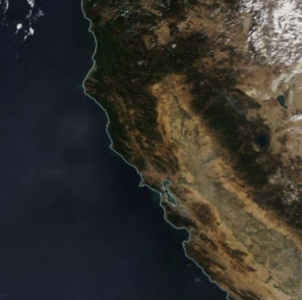
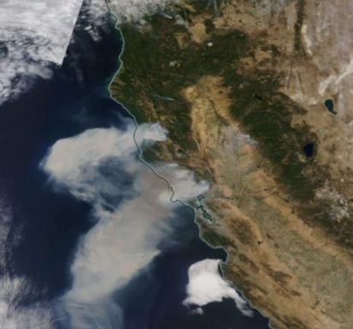
Modis Imagery: October 8 versus October 9, 2017

Slide 7
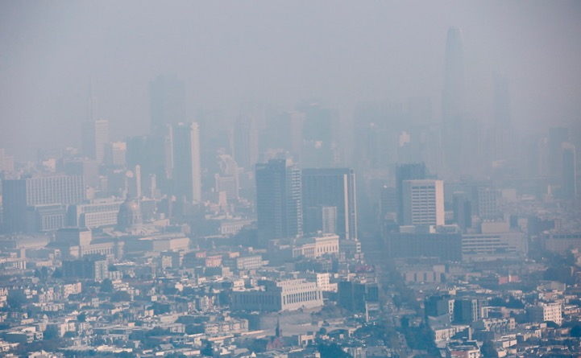
Serious Air Quality Impacts
Many Bay Area AQ sites had their worst air quality on record
Extremely unhealthy levels for millions of people for days
Hundreds of people ended up in Bay Area hospitals

Slide 8

Some key questions
What meteorological conditions accompanied the fires?
Were these conditions predictable?
How good were our models?
What started the fires?
Could this disaster have been prevented by better using meteorological guidance?

Slide 9
The Geography of the Region

Slide 10
Major Wine Country Fires

Slide 11
Climatological Lead Up

Slide 12
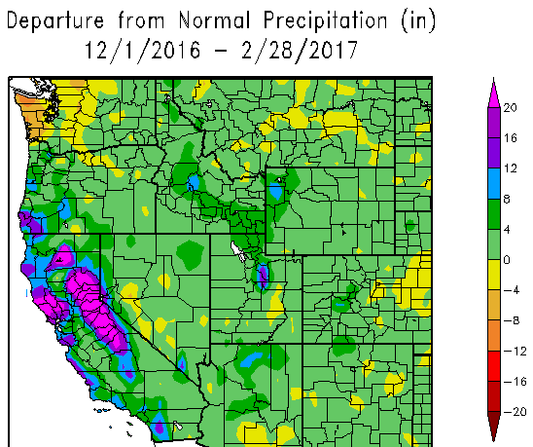
A Very Wet Winter Before the Fires

Slide 13
The Wet Winter Led to Luxuriant Grass Growth

Slide 14
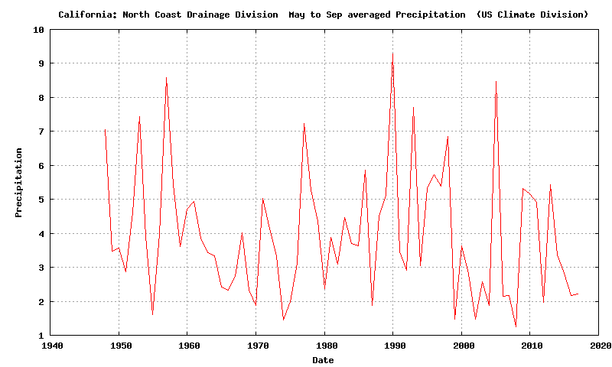
The Preceding Summer Was Typically Dry Division Data: North Coast Drainage

Slide 15
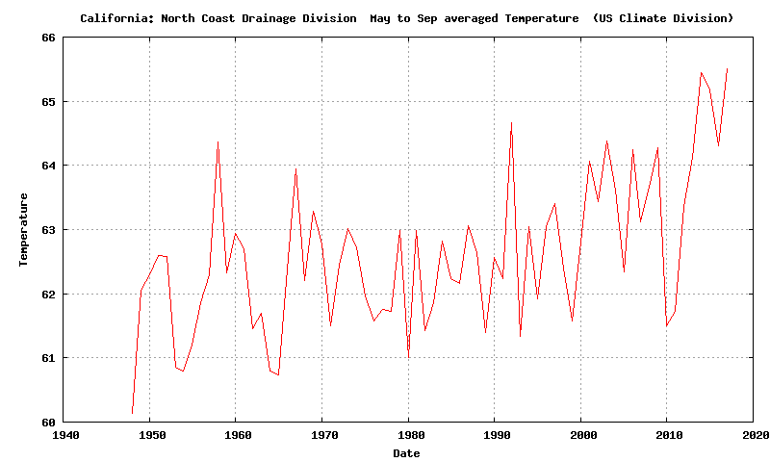
But it was warmer than normal by ~3F.

Slide 16
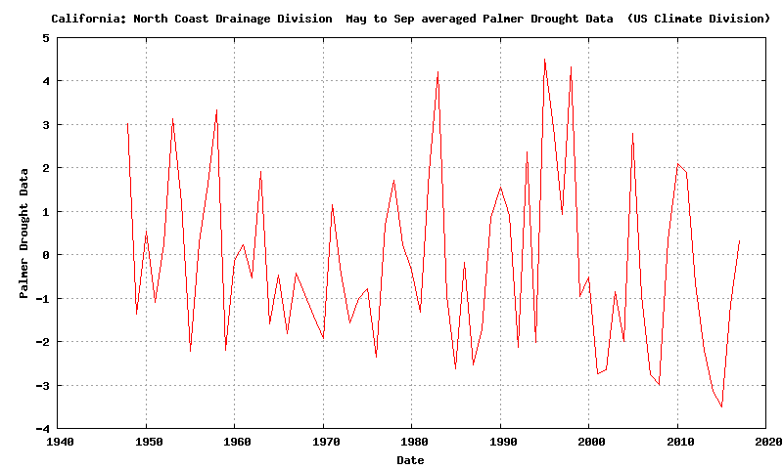
With a wet winter/spring, and a normally dry, but warmer than normal summer, the Palmer Drought Severity Index was near normal

Slide 17
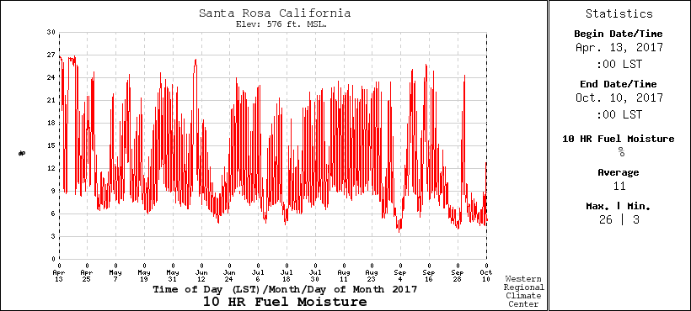
Low 10-hour Fuel Moisture (.25 to 1 inch diameter) Drops with offshore flow. Below 10% is dangerous

Slide 18
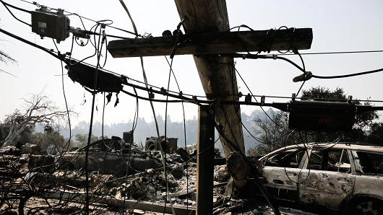
Fire Initiation
172 fire starts leading to 18 major fires
911 calls about power outages and small fires started around 9 PM October 8, just when winds accelerated
Initial investigation traced most fires to failing electrical infrastructure (downed lines, exploded transformers) resulting from strong winds

Slide 19
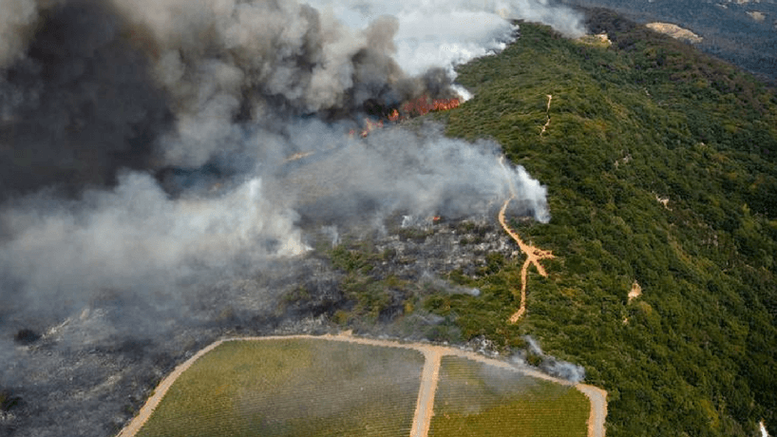
The Winds

Slide 20
Max Gusts During the Event (knots) Big spatial variation with strongest winds (60-95 knots) on upper lee (SW) slopes of terrain

Slide 21
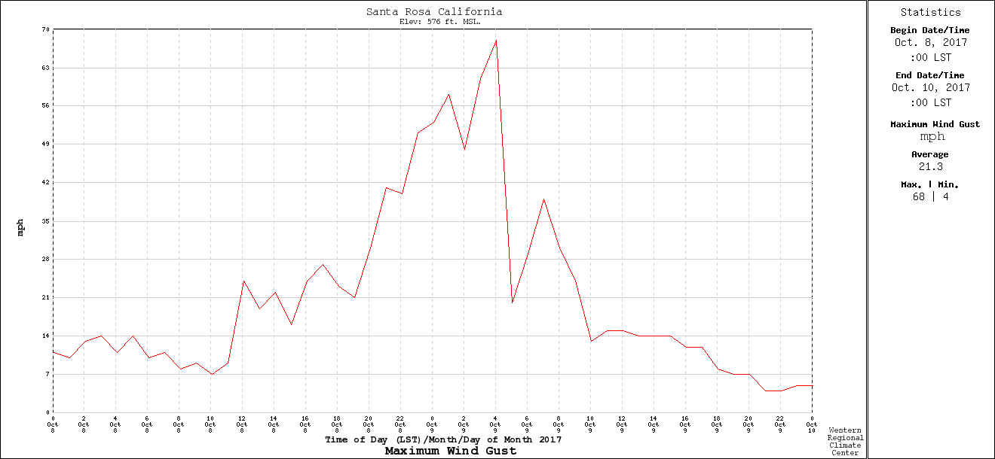
Temporal Variation: Rapid Increase and Decline
Santa Rosa RAWS
9 PM
PDT
midnight
6AM

Slide 22
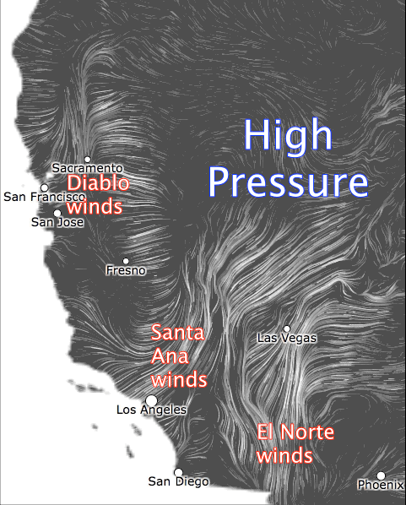
Such warm, dry offshore winds are associated with high pressure over the intermountain west and an offshore pressure gradient Known as Diablo Winds
High Pressure

Slide 23


Slide 24
The Synoptic and Mesoscale Origins of the Strong Winds

Slide 25
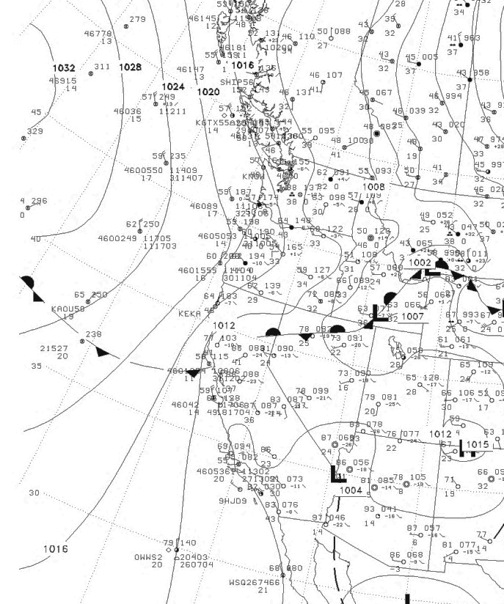
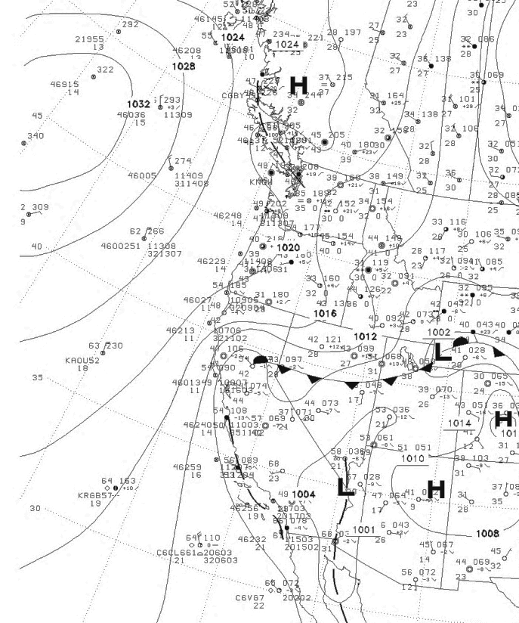
High Pressure
Built into the
Northwest and then into the Intermountain West
0000 UTC 8 October
1200 UTC 8 October

Slide 26
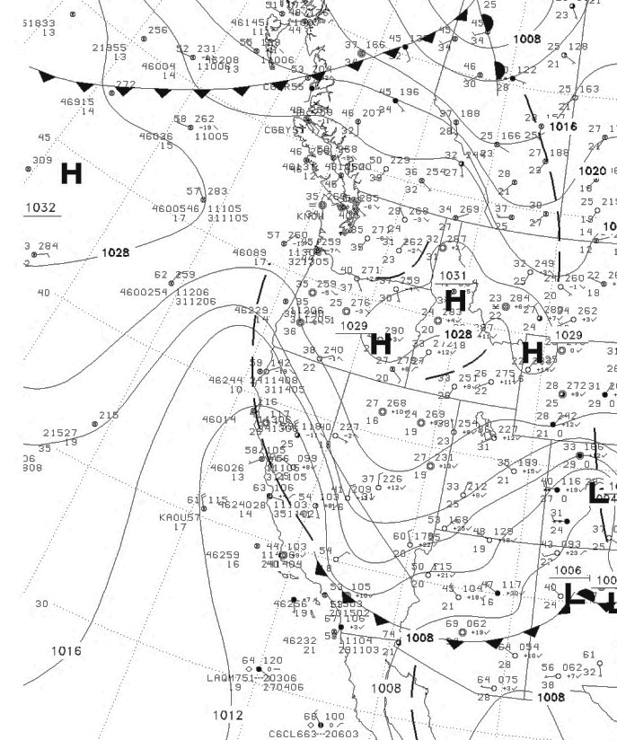
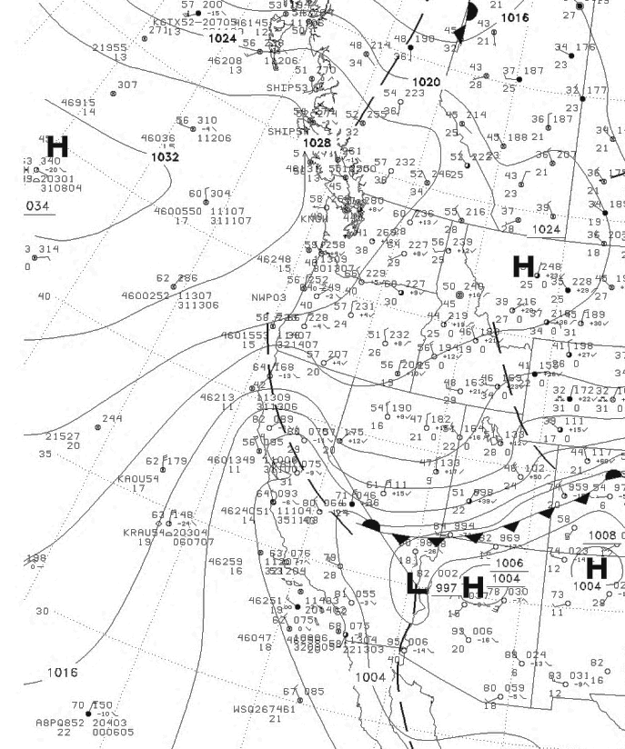
0000 UTC 9 October
1200 UTC 9 October

Slide 27
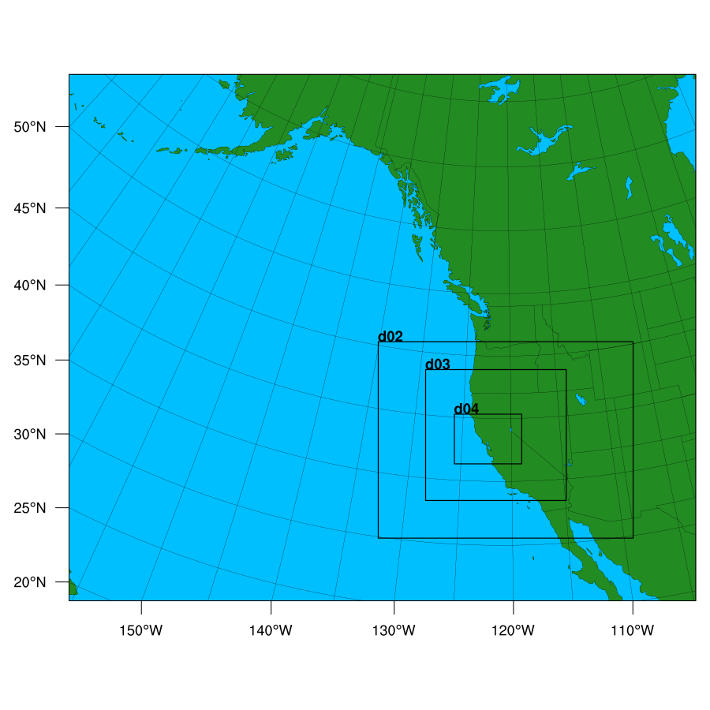
High-Resolution WRF Simulation of the Event
36-12-4-1.3 km domains
Initialized at 1200 UTC Oct. 8

Slide 28
12-km domain
9
1200 UTC 8 October

Slide 30
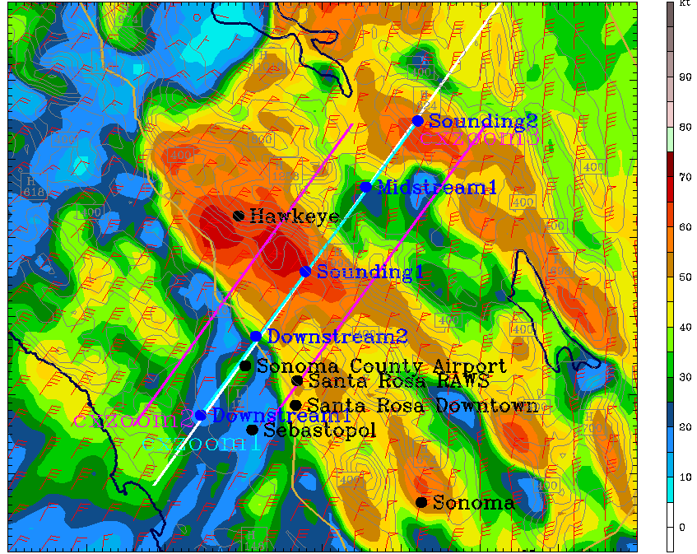
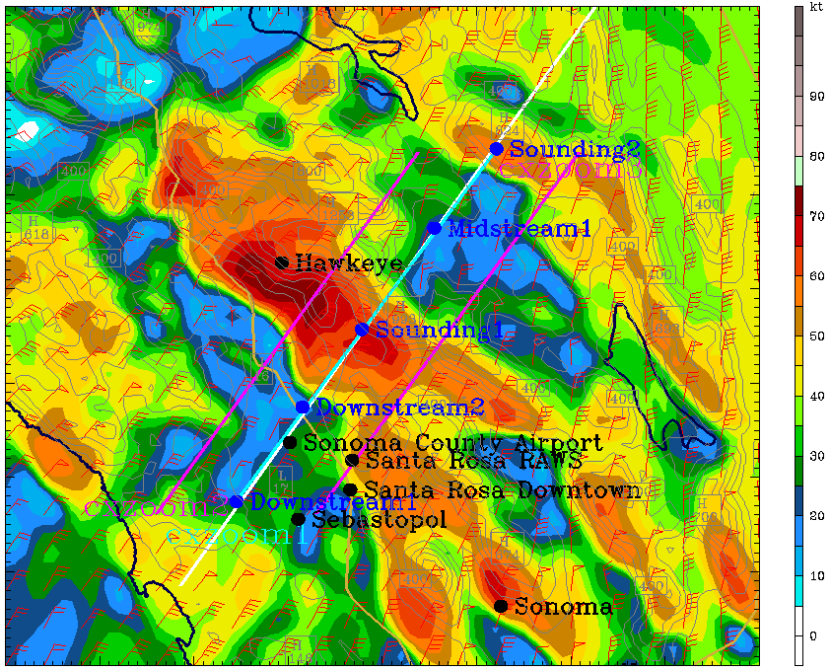
Strongest winds in lowest 250 m
8 PM October 8
10 PM October 9

Slide 31
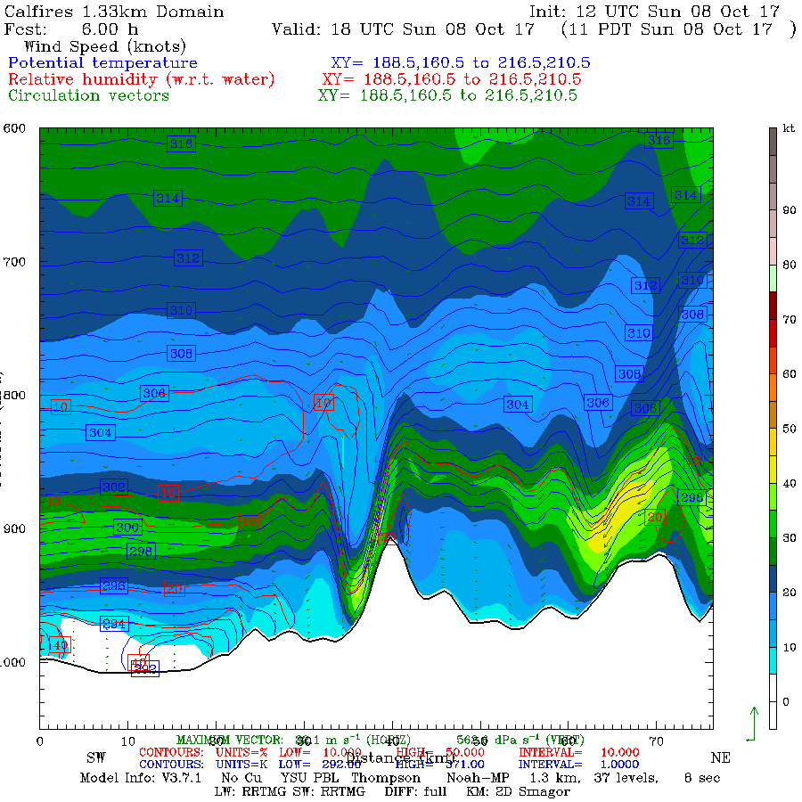
1800 UTC
Oct 8

Slide 32
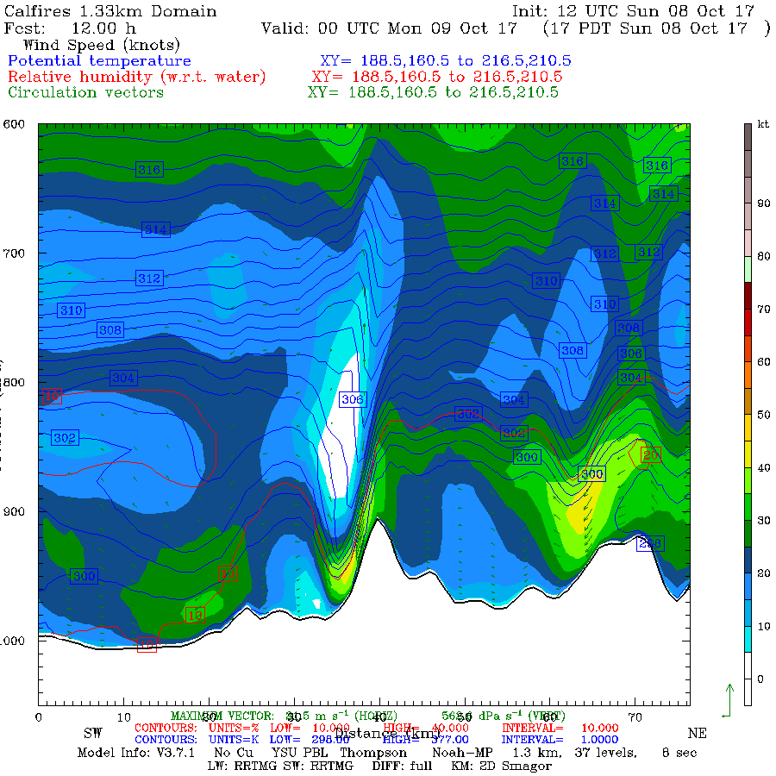
0000 UTC
Oct 9

Slide 33
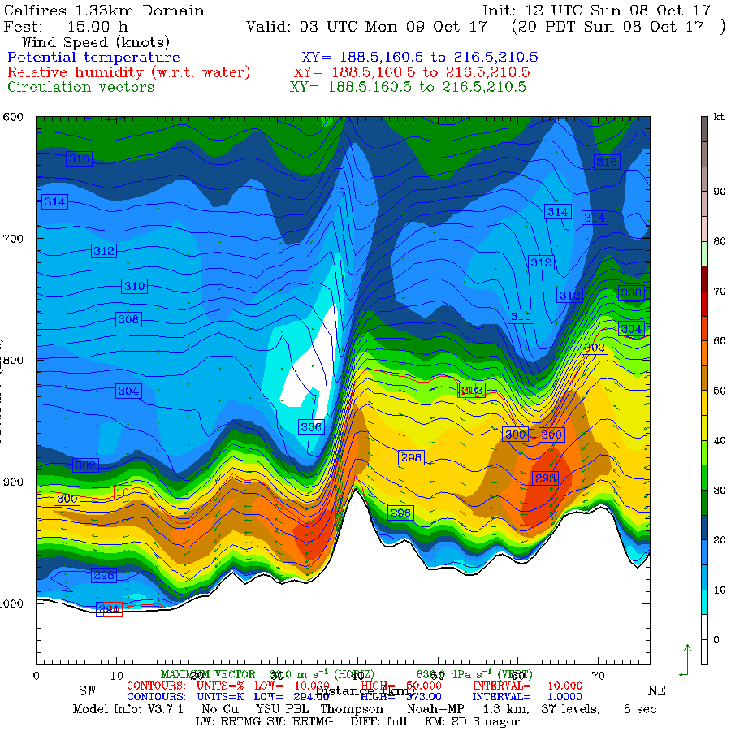
0300 UTC
Oct 9

Slide 34
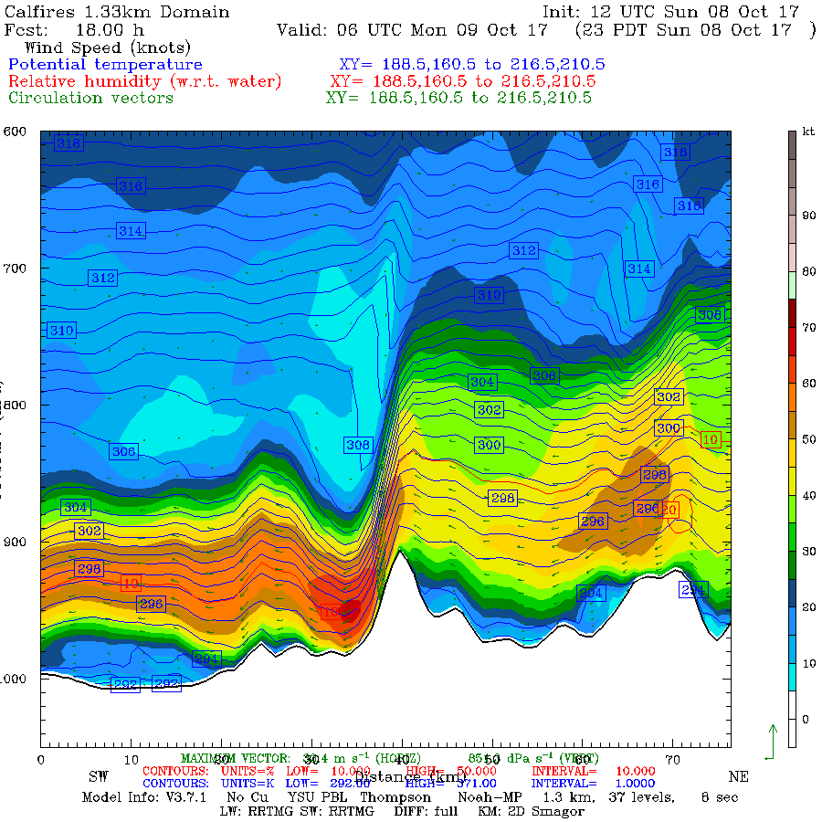
0600 UTC
Oct 9
Terrain-Related
Downslope
Windstorm

Slide 35
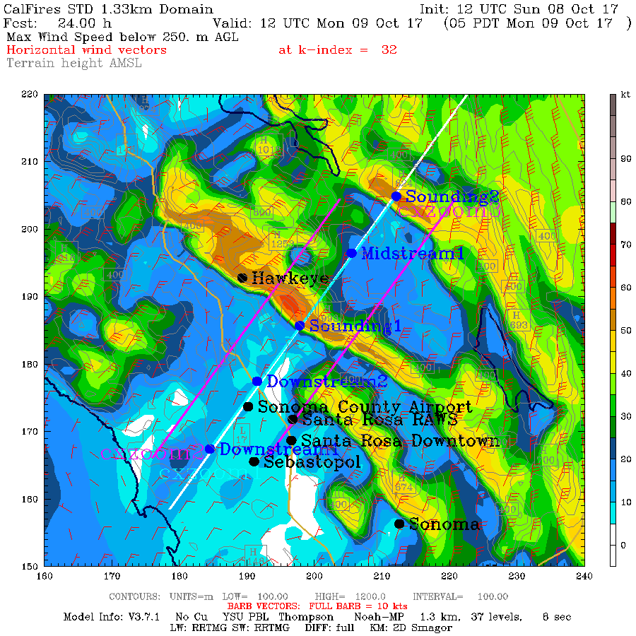
Conclusions Based On the Model Simulation
The WRF model did an excellent job in duplicating the structure and temporal evolution of the winds. Good forecast.
Strong winds were associated with a downslope wind event.

Slide 36
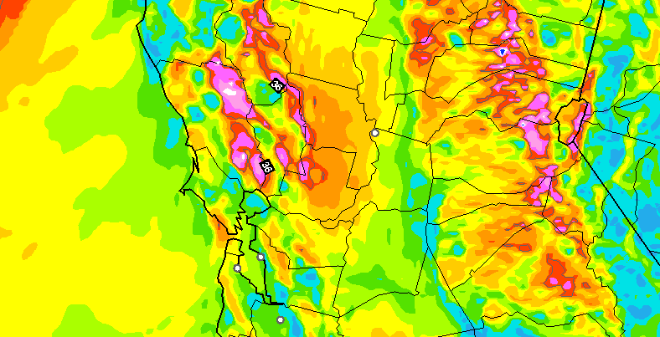
Operational Forecast Guidance Was Excellent, Even Days Out
10-h surface (10-m) wind gust forecast (kt) valid at 0700 UTC 9 October 2017. The model was initialized at 1200 UTC 8 October 2017. Wind gusts are derived by determining the highest wind speed in the lowest km.
NOAA/NWS Operational
HRRR Model
NOAA/NWS Operational
HRRR Model

Slide 37
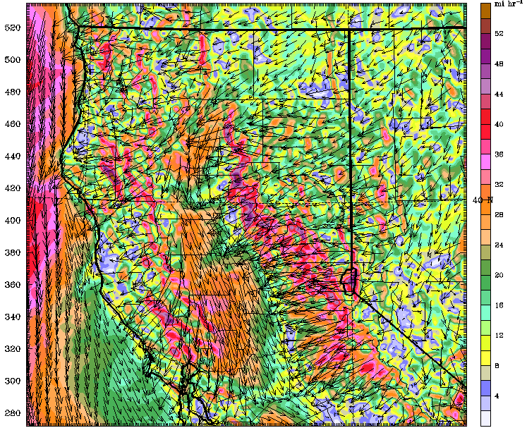
Operational CANSAC WRF Model
30-h surface wind forecast (mph) for 0600 UTC 9 October 2017 for a run initialized at 0000 UTC 8 October 2017 from the nested 2-km domain

Slide 38
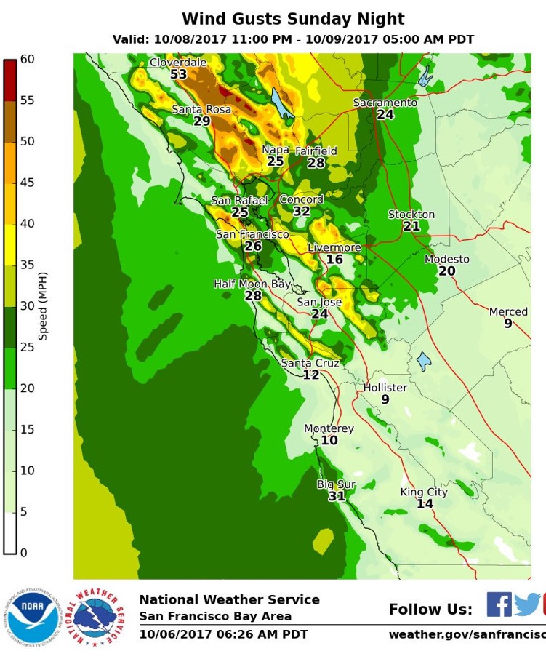
The San Francisco NWS Office Ran WRF for this Event Excellent forecast.

Slide 39
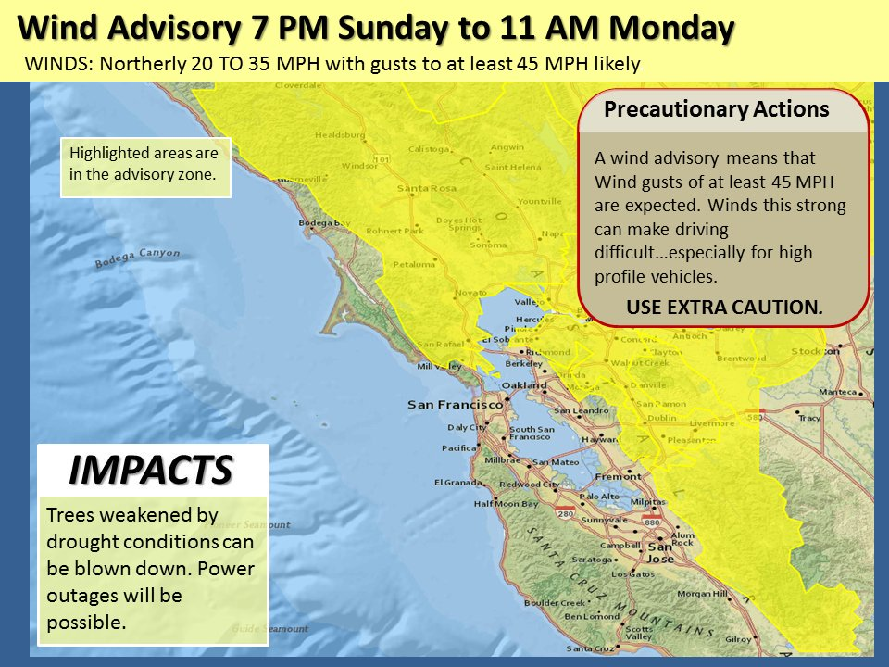
Based on these and other modeling systems, the NWS released high wind and red flag warnings—days before.
Two Days Before

Slide 40
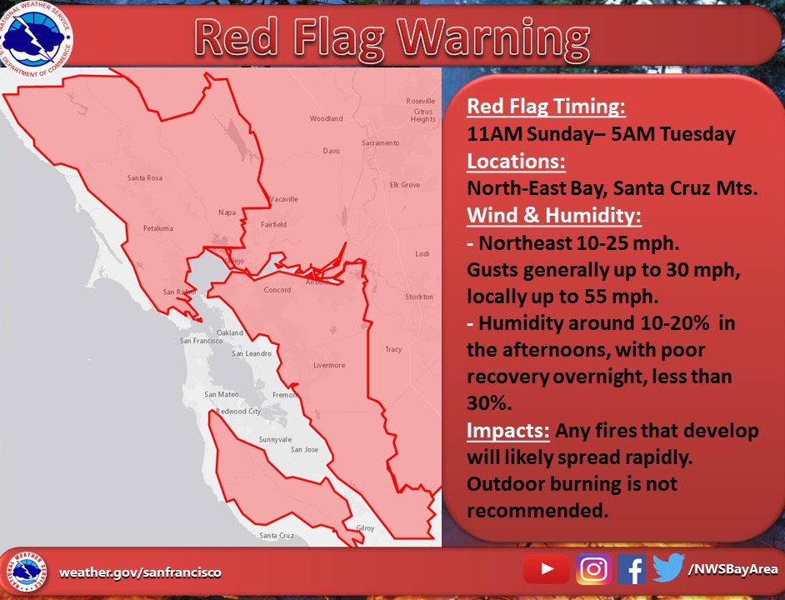

Slide 41
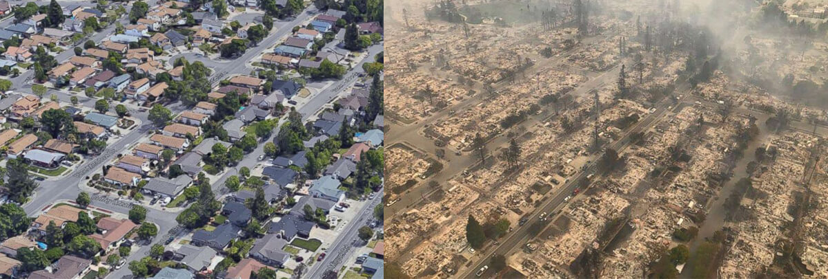
Could we have prevented the fires with better use of weather forecasts?

Slide 42
Quite possibly, yes, with pre-emptive power outages and other measures

Slide 43
Better use of forecasts
The winds caused the fires and allowed them to explode.
The winds were skillfully forecast the previous days.
With such strong predicted winds, power failures/fires were inevitable.
Why not de-energize the powerlines in the hills and vulnerable areas a few hours before the winds were going to hit?

Slide 45
A Major Opportunity for Our Discipline
Rapidly improving high-resolution prediction and better observations (satellite, surface obs., etc.) provide a huge opportunity to profoundly intervene in weather-related disasters.
Such predictive capabilities represent our first line of defense for extreme weather, including extremes enhanced by global warming
To be successful requires an integration of our warning capabilities with local agencies, utilities, and regional decision making organizations.

Slide 46
The End

