Slide 1
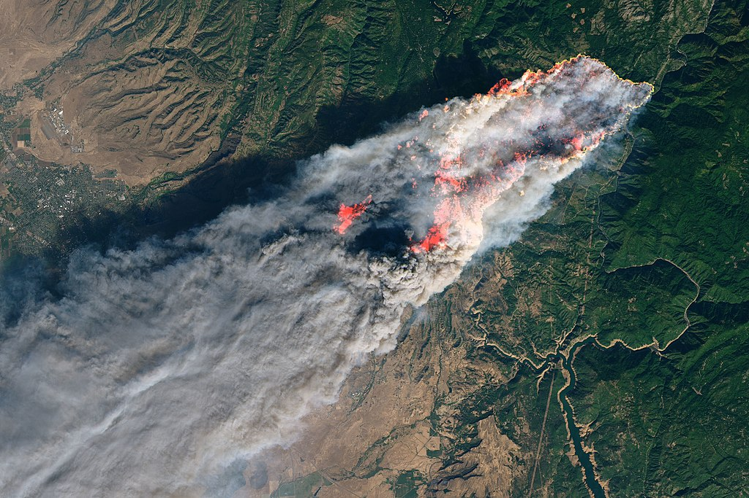
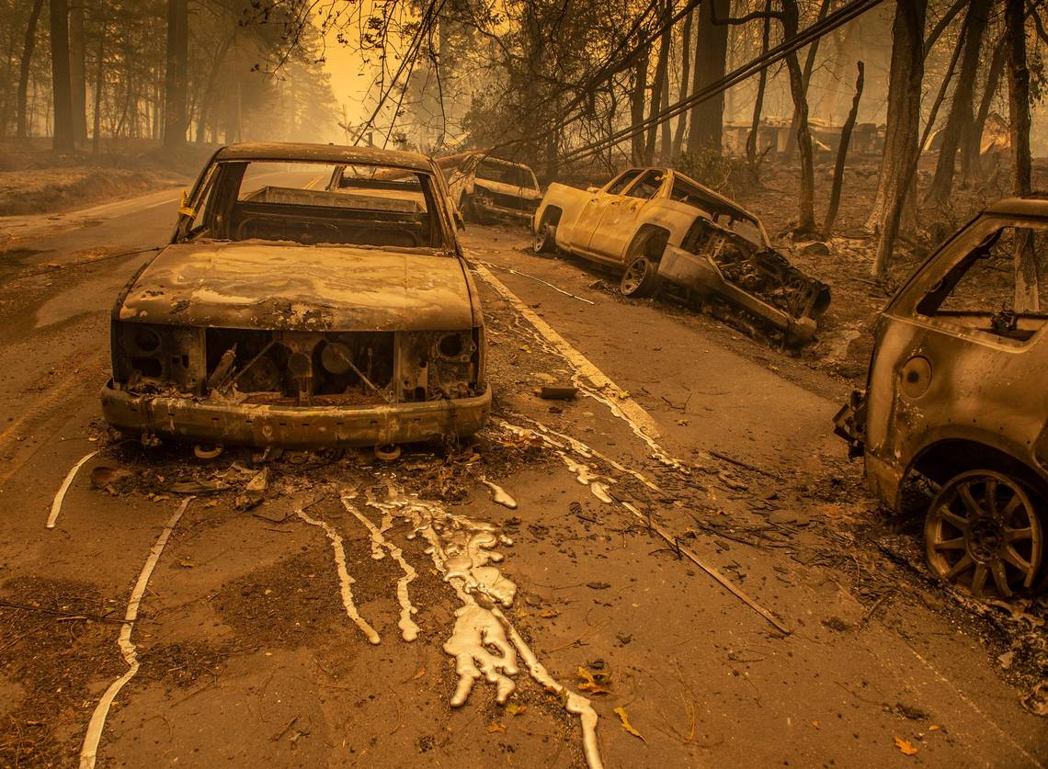
The Meteorology of the Camp Fire
Cliff Mass and David Ovens
Department of Atmospheric Sciences
University of Washington

Slide 2
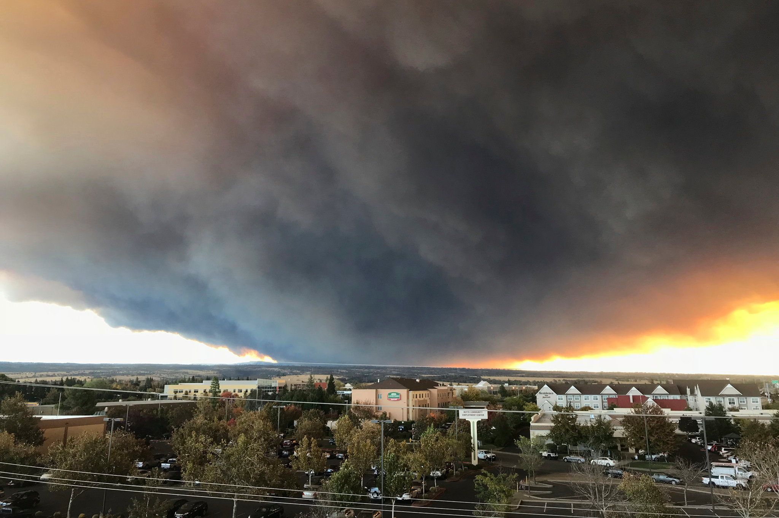
Camp Fire: November 8-25, 2018
Deadliest and most destructive fire in California history
86 deaths
Essentially destroyed the city of Paradise, CA
~19, 000 buildings destroyed
Burned across ~153,000 acres
~ 17 billion dollars of damage

Slide 3
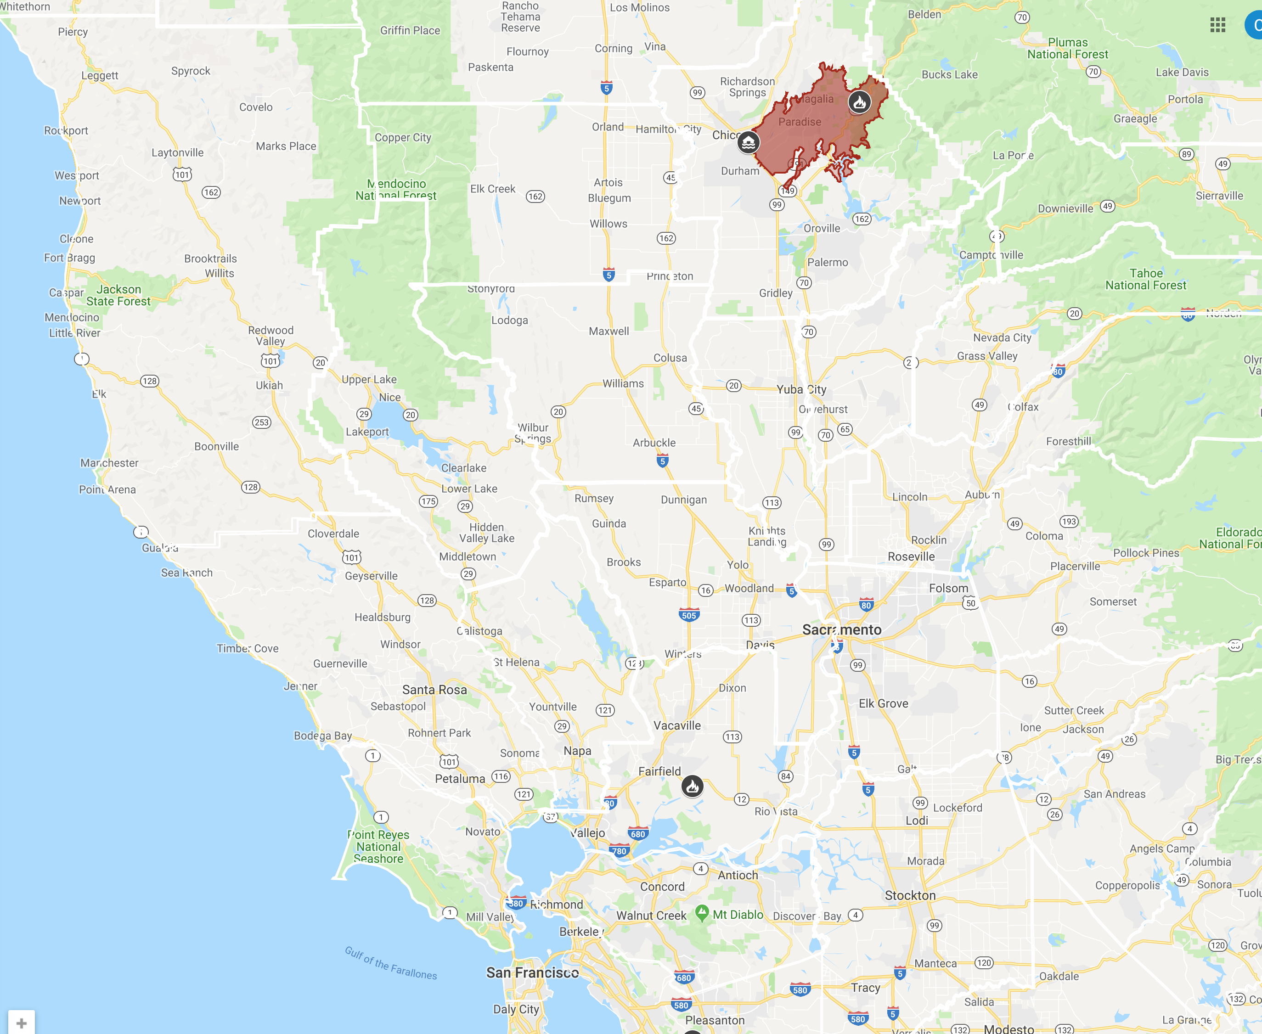
Camp Fire

Slide 4
Fire started around 6:30 AM Under PG&E Powerlines near Camp Creek Road in the Feather River Valley

Slide 5
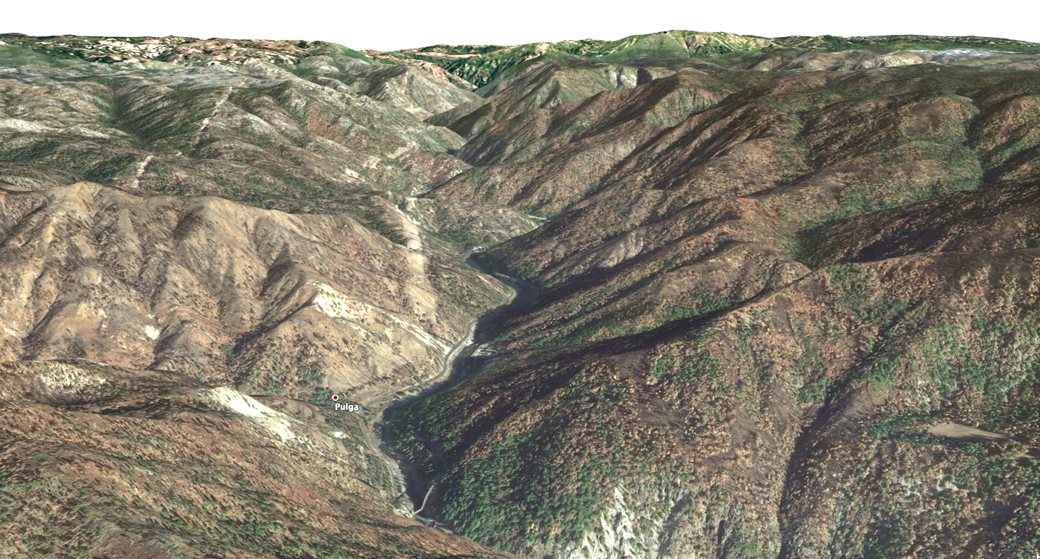

Slide 6
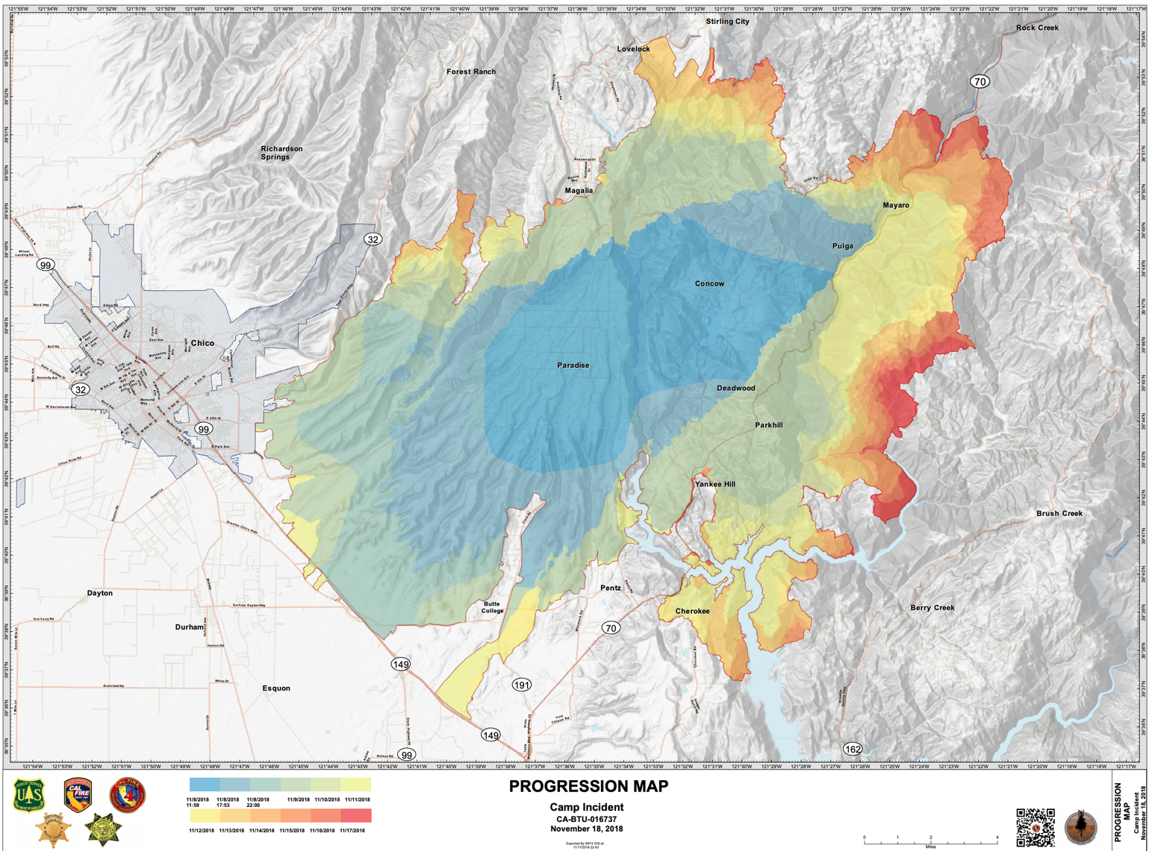

Slide 7
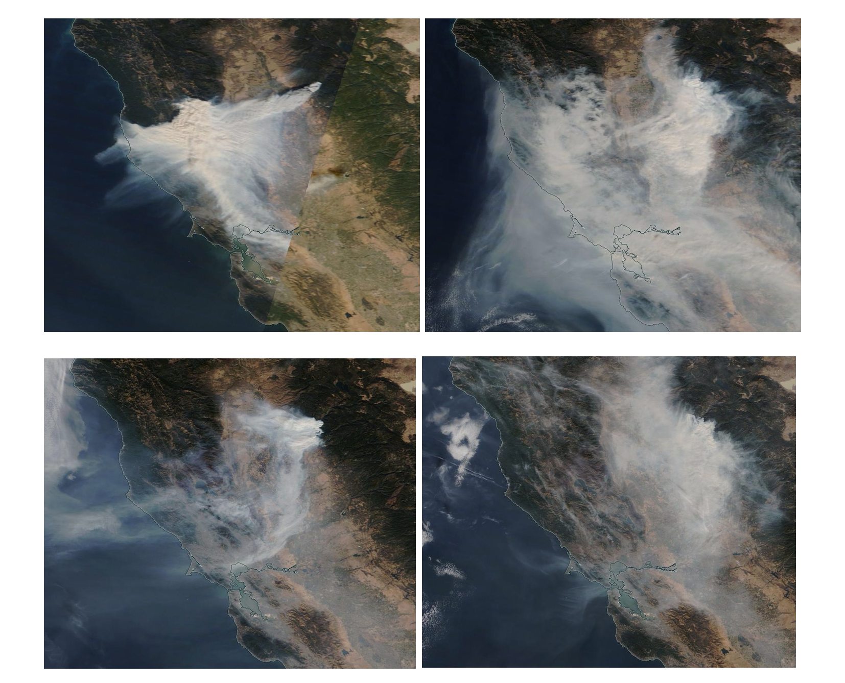
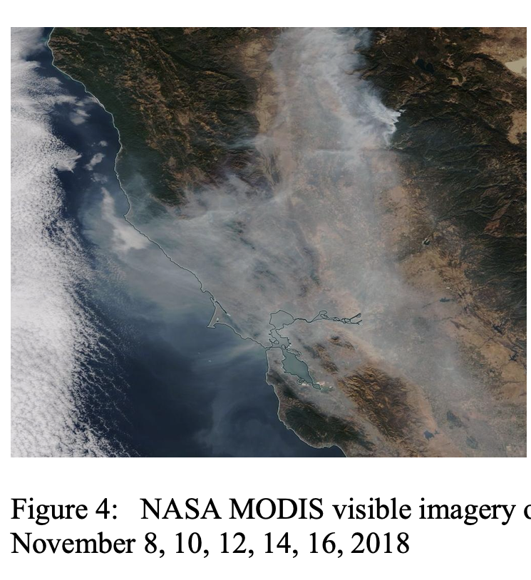
Lots of smoke

Slide 8
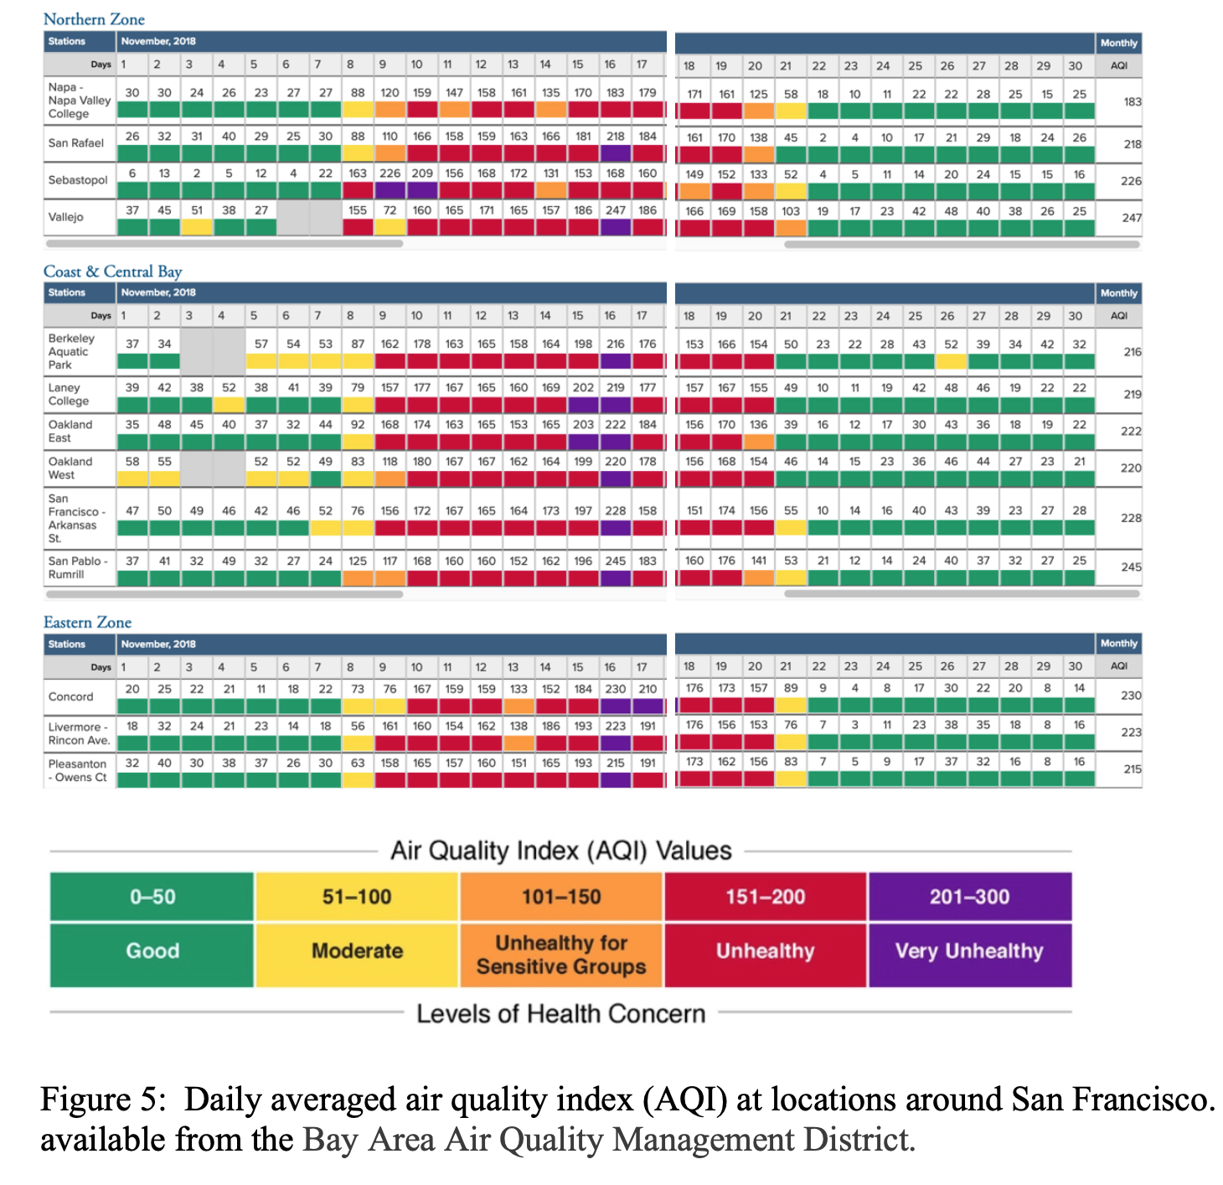
Bay Area Air Quality

Slide 9
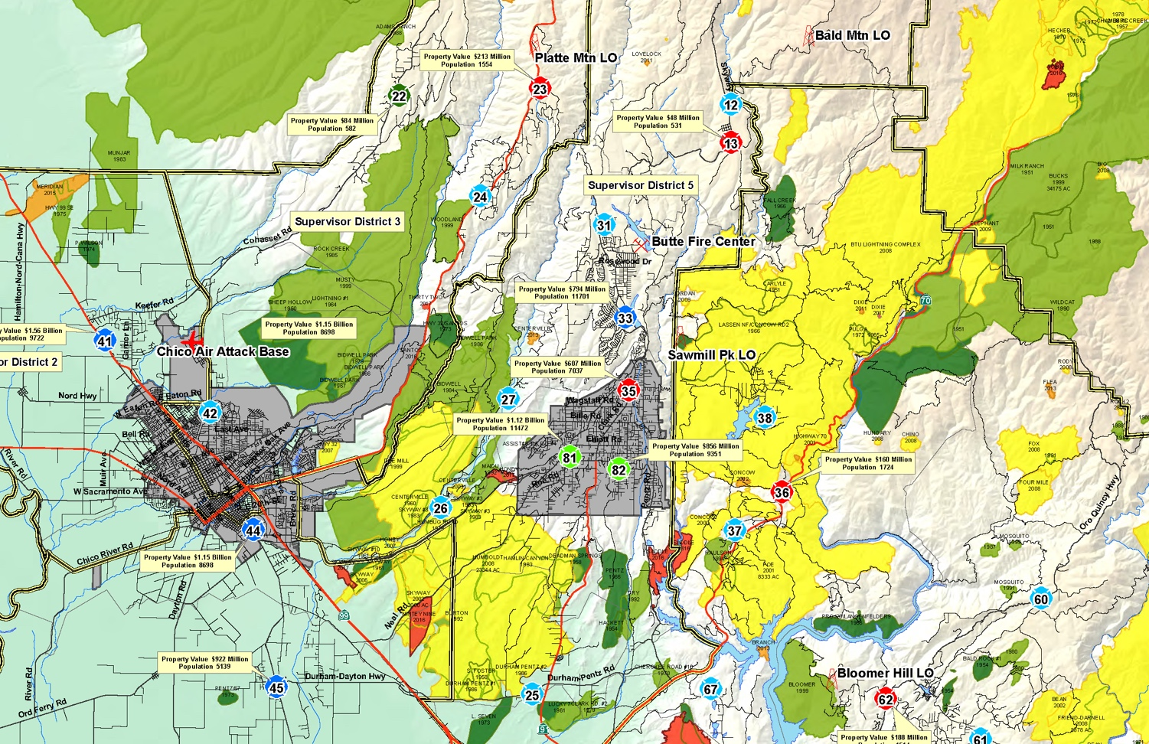
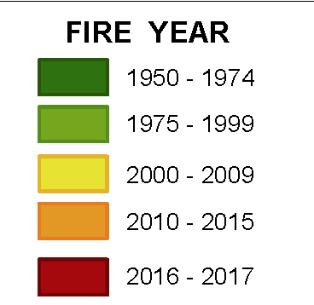
A History of Fire in the Region

Slide 10
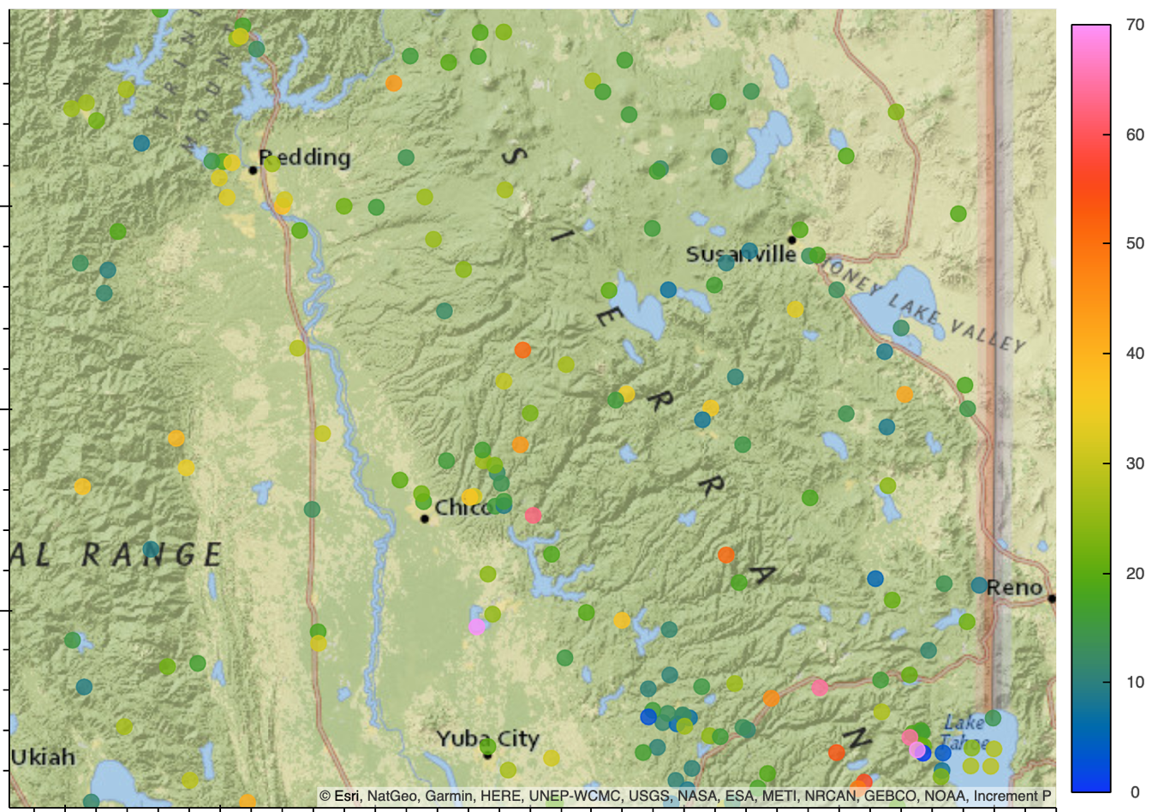
Max Wind Speeds (kt) credit: Conor McNicholas

Slide 11
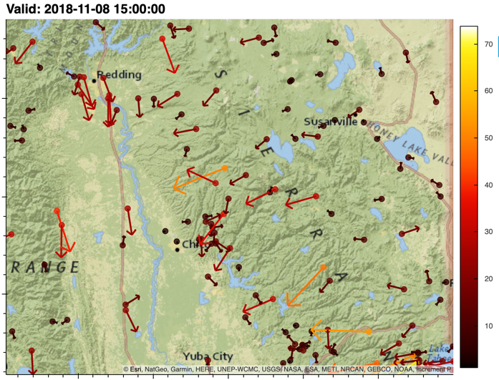
15 UTC 8 Nov

Slide 12
Known as Diablo Winds

Slide 13
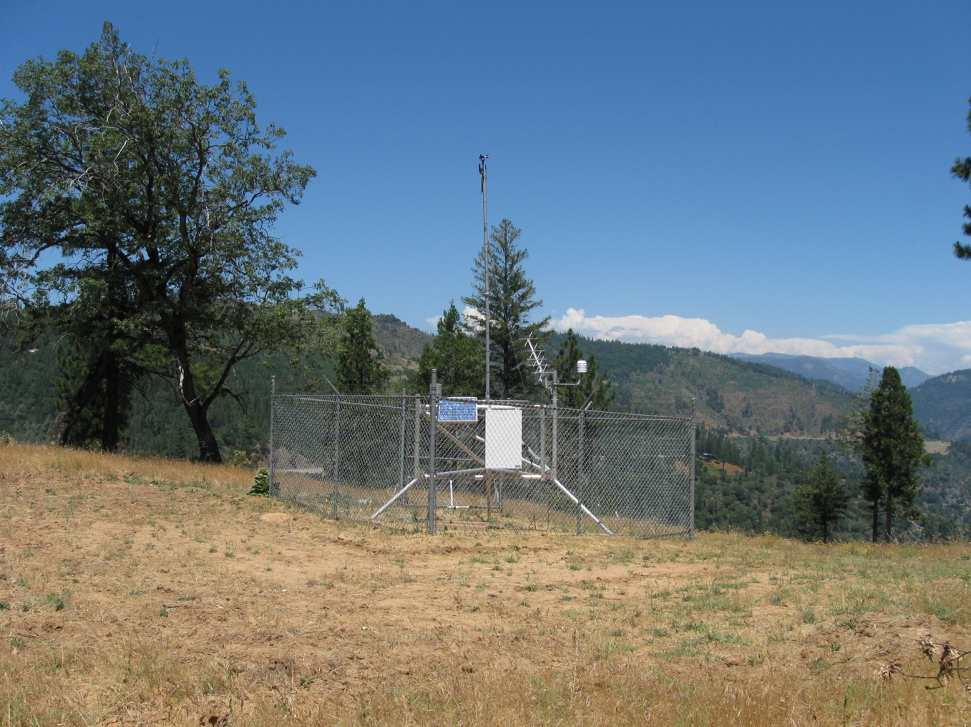
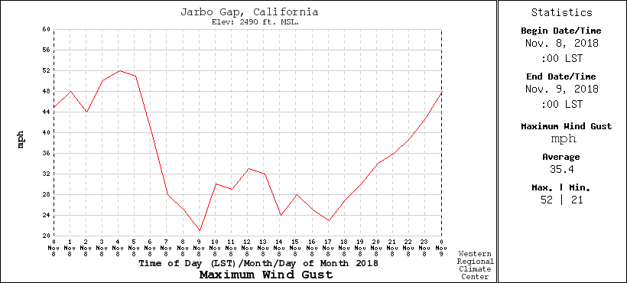
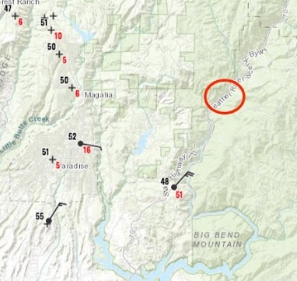
Jarbo Gap RAWS

Slide 14
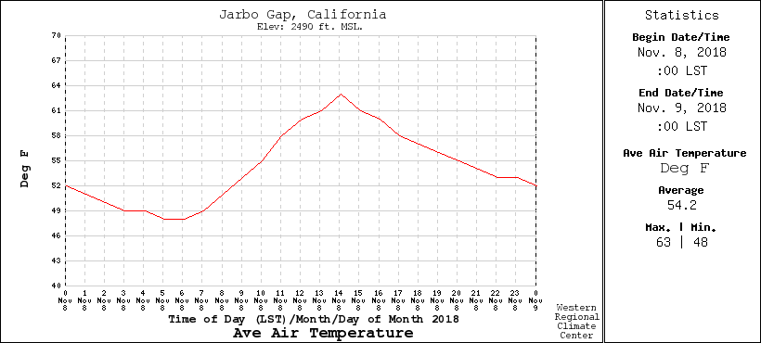
No Heat Wave

Slide 15
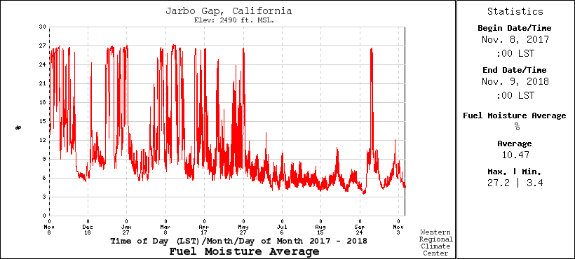
Dry Fuel Moisture was Low

Slide 16
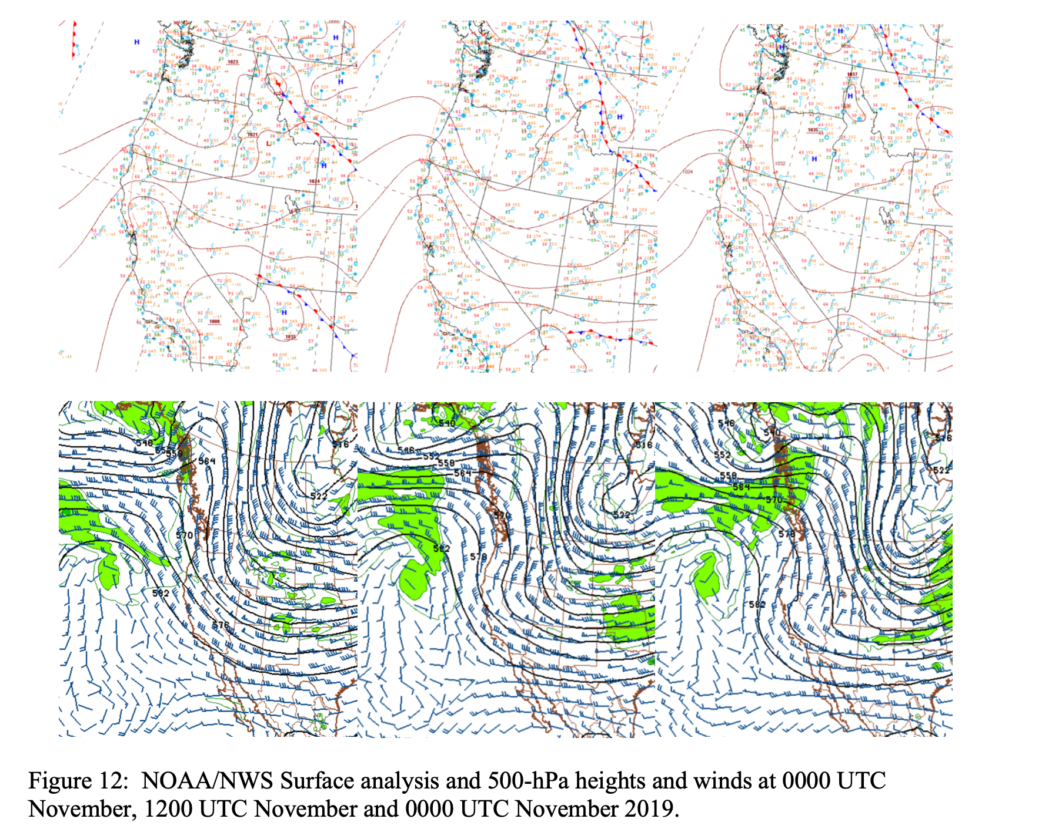

Slide 17
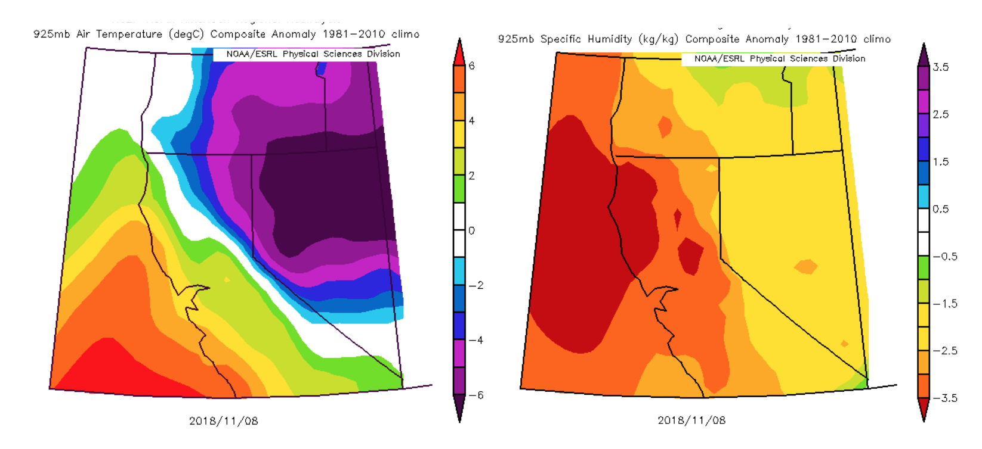
Anomalies from Climatology

Slide 18
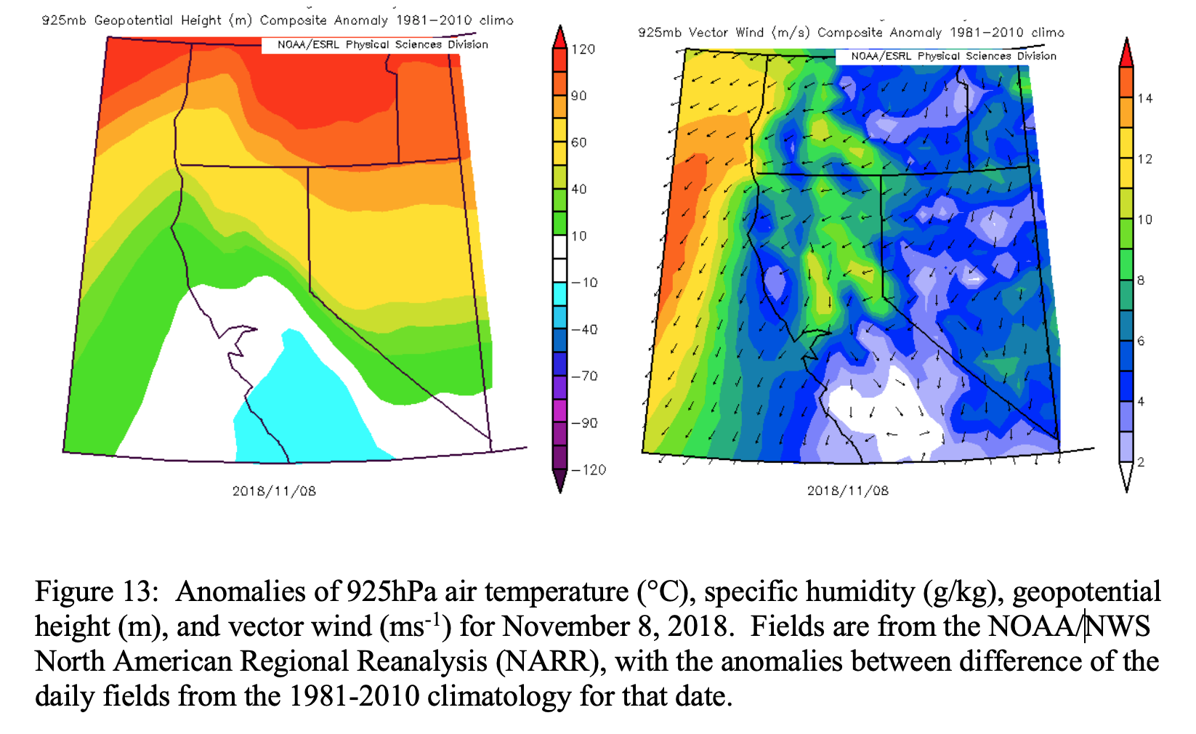

Slide 19
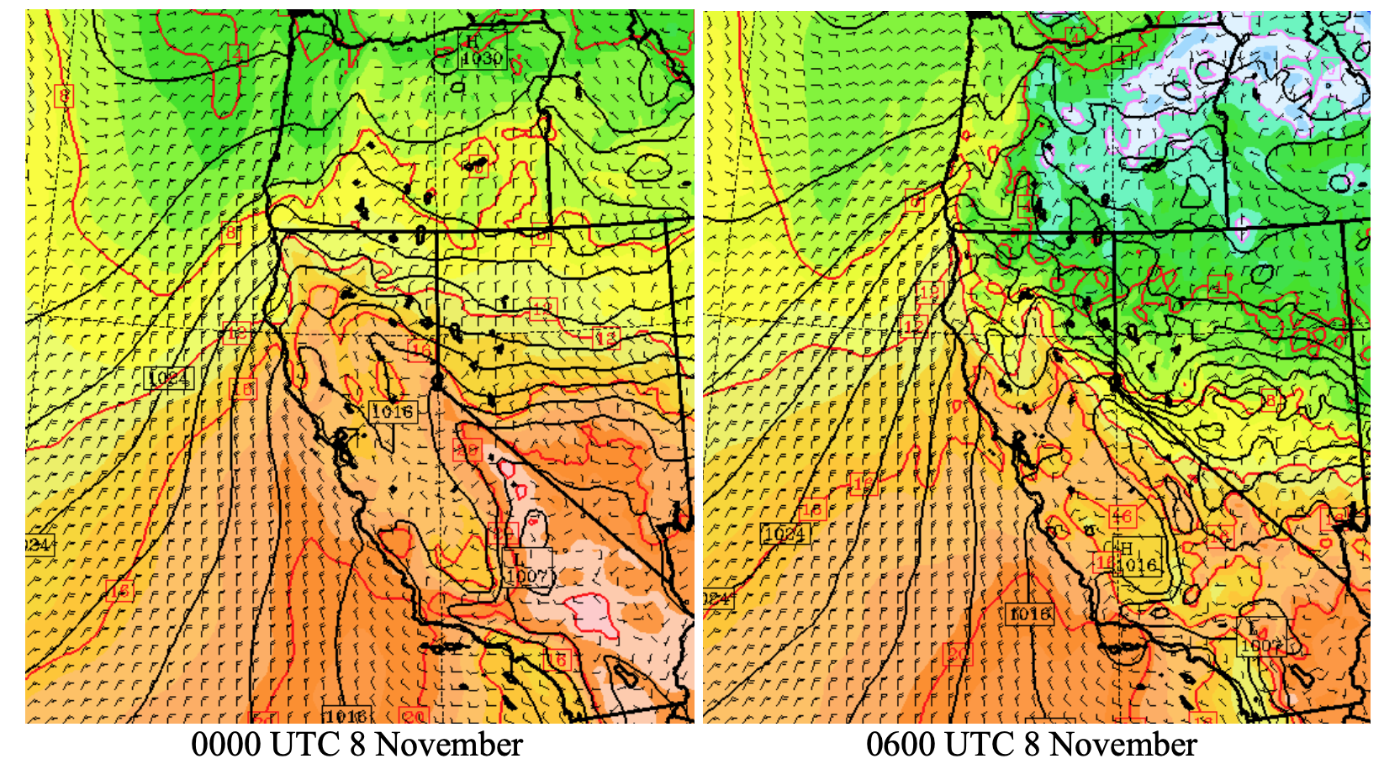
WRF Model Simulation (12-km nest)

Slide 20
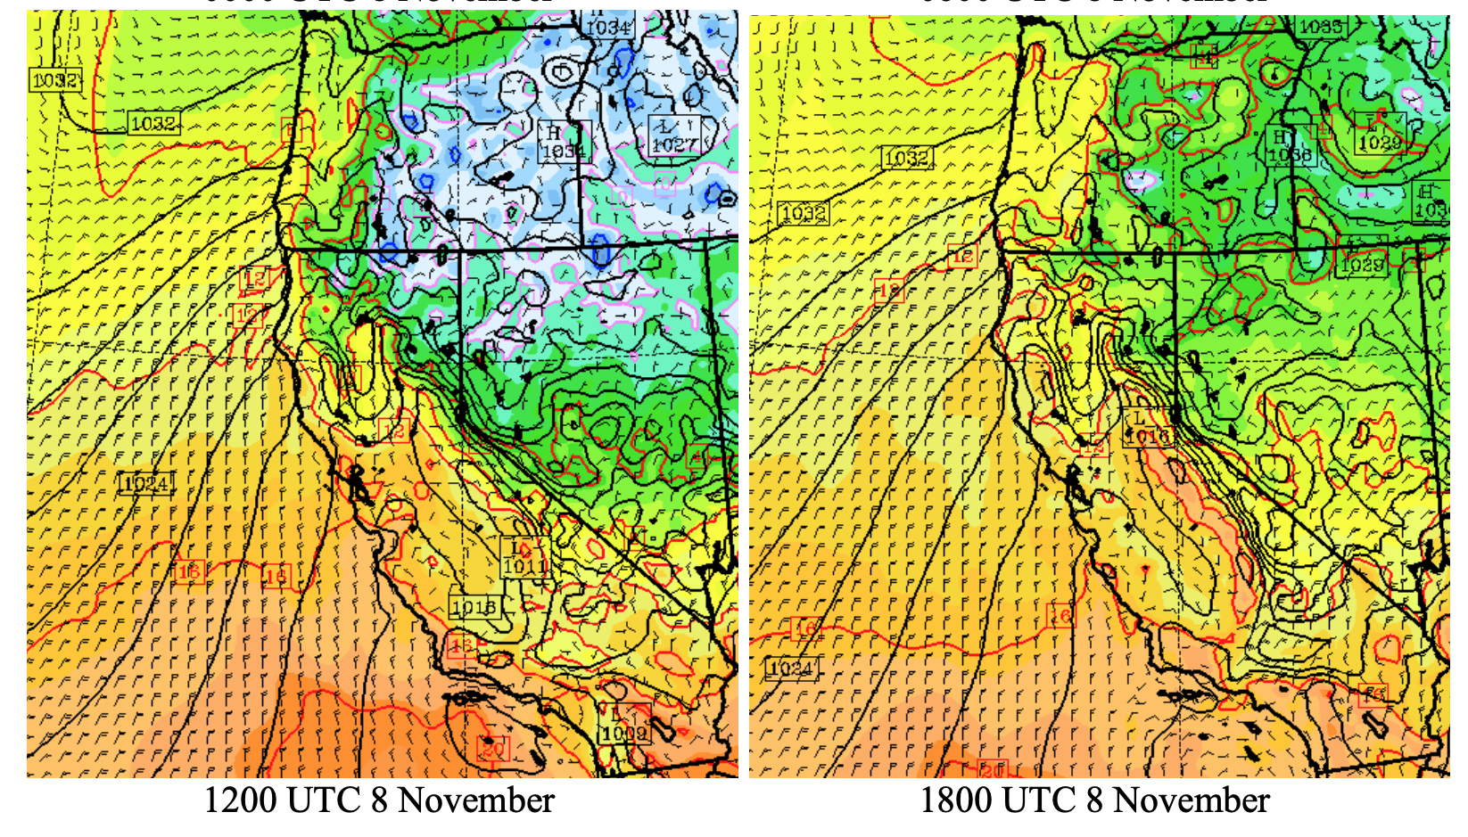

Slide 21
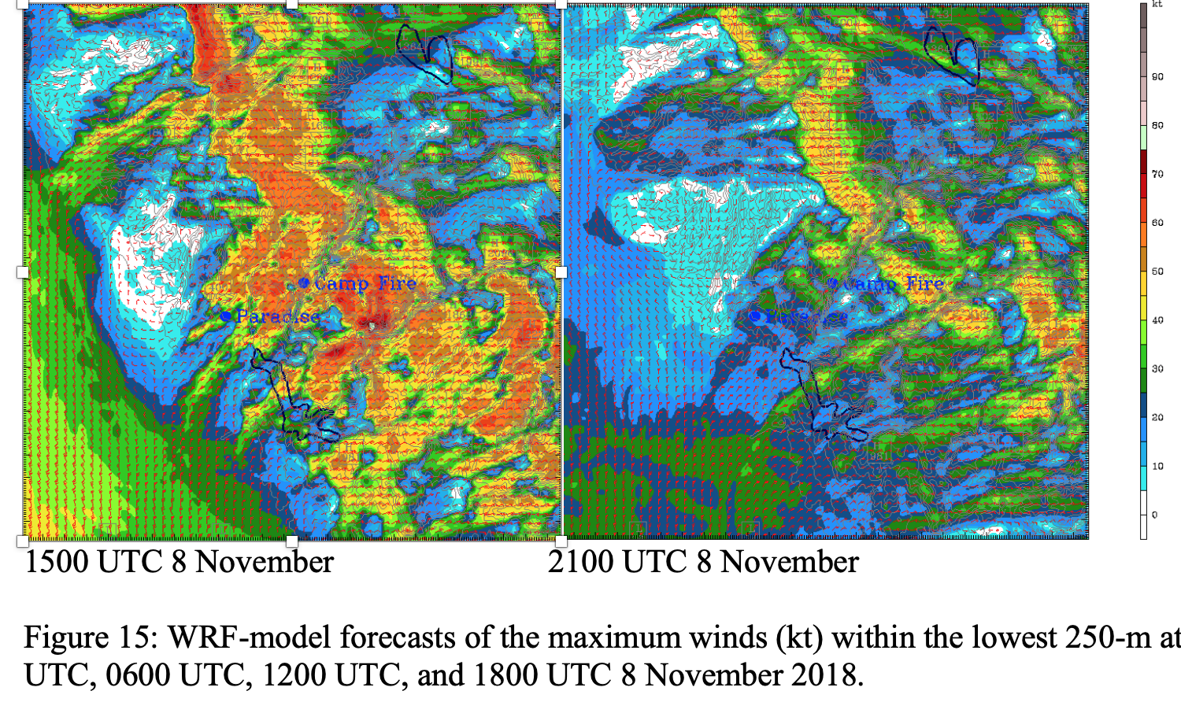

Slide 22
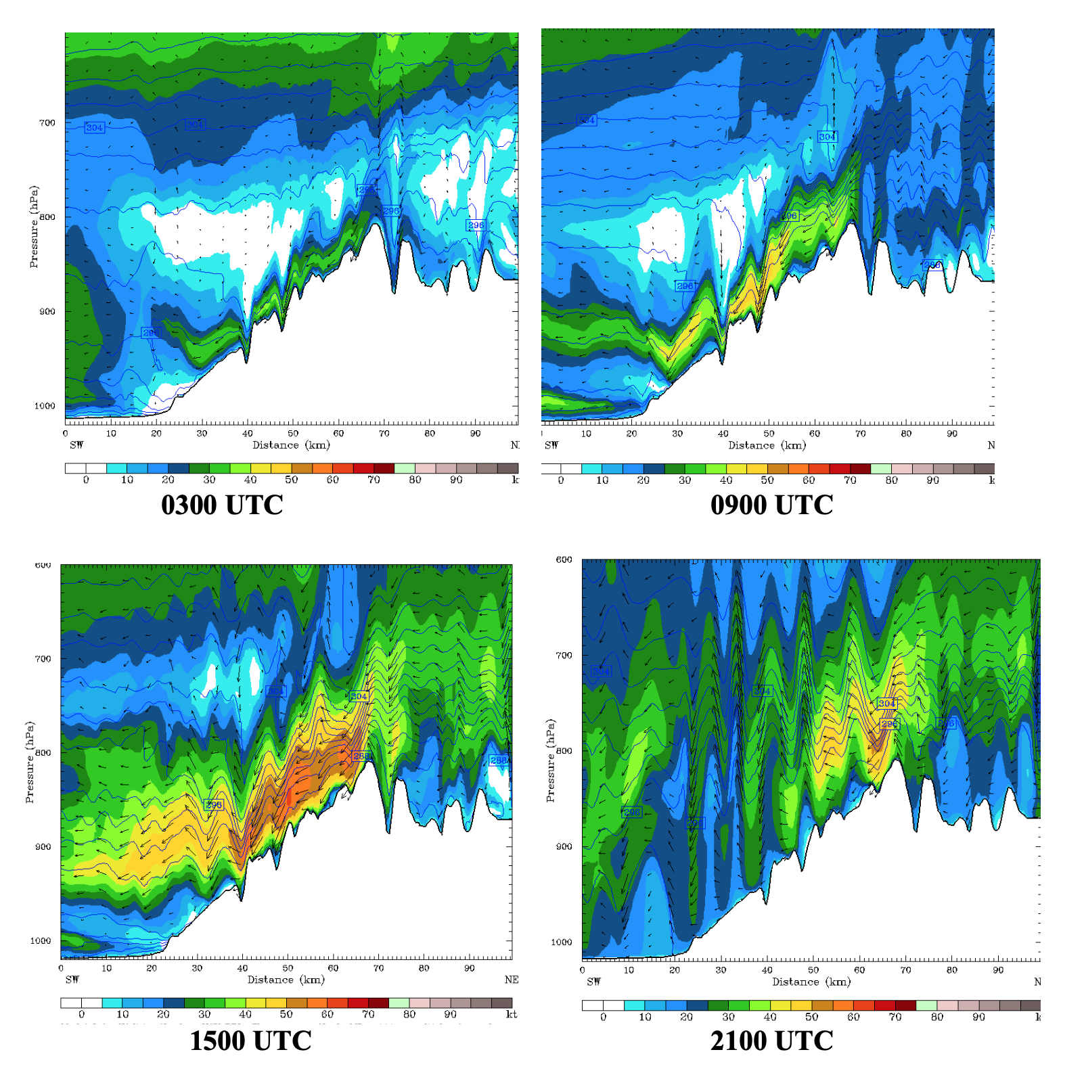

Slide 23
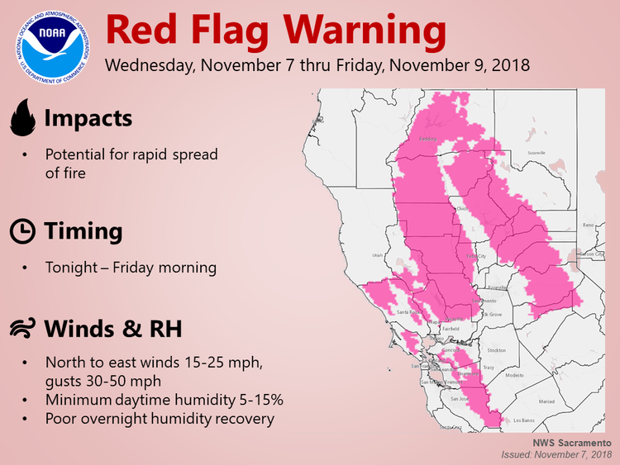
Wind forecasts were good

Slide 24
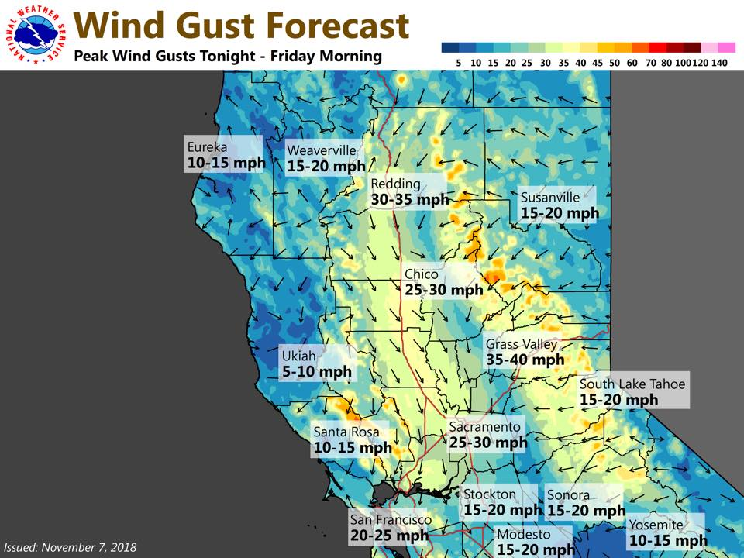

Slide 25
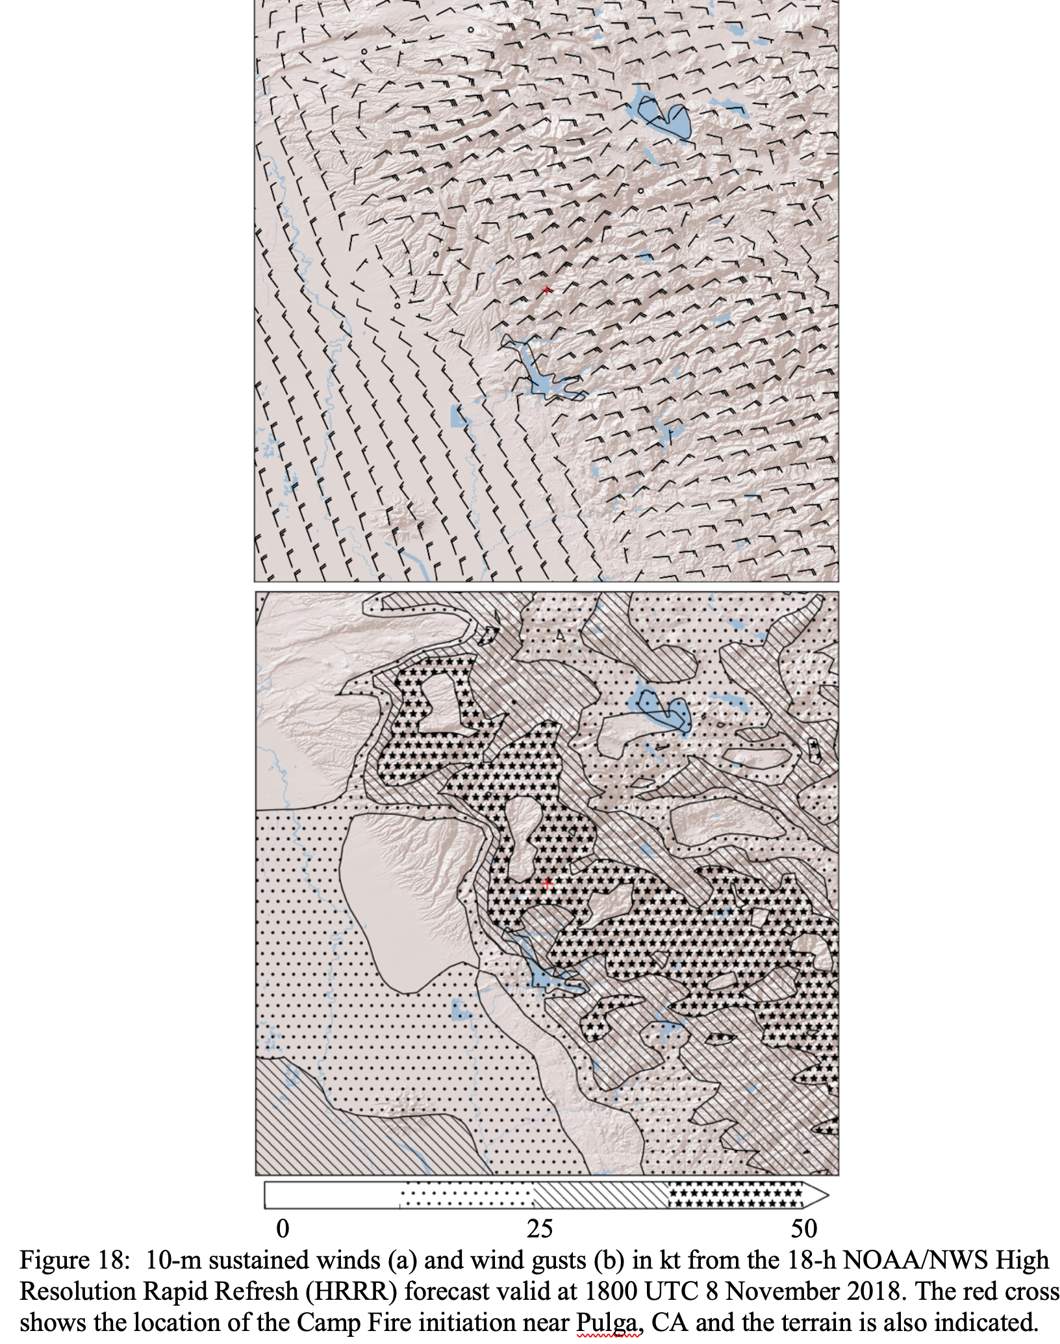
HRRR- 18h Forecasts

Slide 26
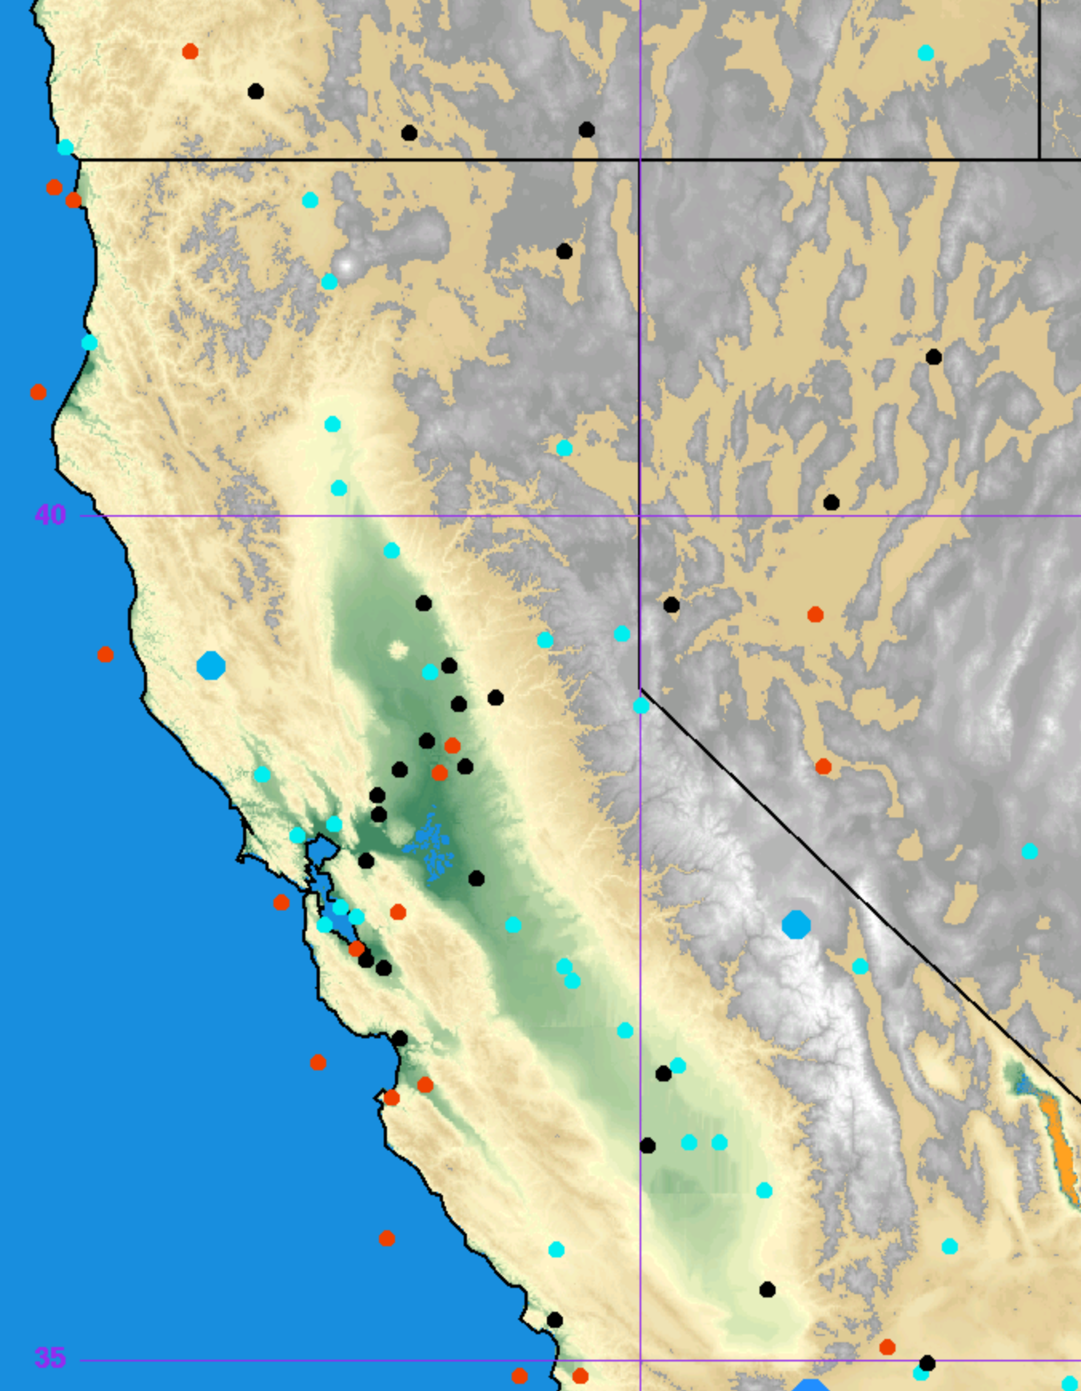
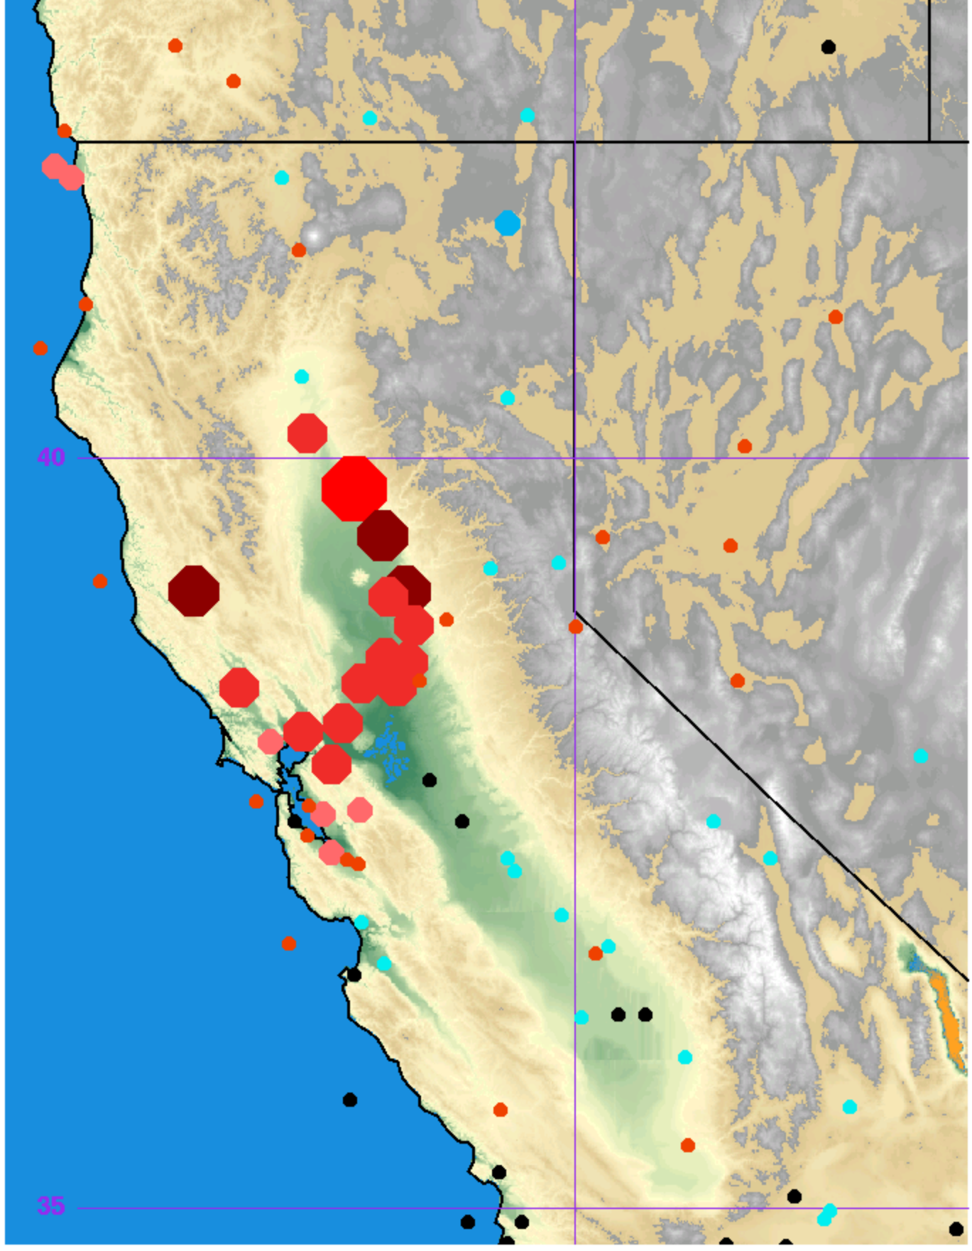
Models Without Smoke Physics Had Large Temperature Errors (UW WRF shown)
24 h forecast
Valid 00 UTC 10 Nov
24 h forecast
Valid 00 UTC 7 Nov

Slide 27
Summary
The Camp Fire event was associated with strong, but not extreme, winds on the lower to mid-slopes of the Sierra Nevada.
Associated with downslope winds on the barrier (Diablo winds)
Initiated by the movement of cool, high pressure into intermountain west
Fire spread over grass and small bushes and trees
Temperatures were relatively cool but vegetation was quite dry
Winds were well forecast.
Appears to have been initiated by failing power infrastructure

Slide 28
The END

