Slide 1

Atmospheric Sciences 101
2026
Humidity
Humidity is a measure of the water vapor content of the air

Slide 2
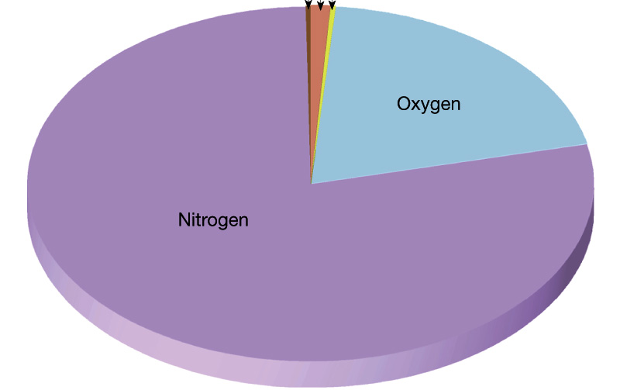
Air is mostly composed of Nitrogen (N₂, 78%) and Oxygen (O₂, 21%) gases, with the next largest component being water vapor (H₂0, ~0-4%)

Slide 3
Water vapor plays a central role in the atmosphere
  Associated with clouds and precipitation
  Very important way of moving energy in the atmosphere
    E.g., solar energy evaporates water vapor in the tropics, which condenses and releases energy in the midlatitudes
  Has a big influence on our comfort and how we keep cool
  Big effects on atmospheric temperature (greenhouse gas)

Slide 4


Tropics Midlatitudes
Water Vapor

Slide 5

Some basic water vapor concepts
H₂O vapor is a DRY gas, just like O₂ and N₂. It is not ”wet”
Warmer air can “hold” or contain more water vapor than cooler air.
The amount of water vapor air can “hold” increases rapidly with temperature

Slide 6
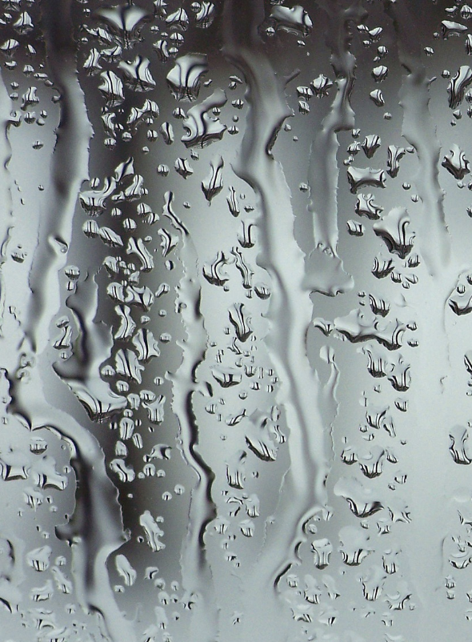
An Experiment
Start with a sample of air with some water vapor.
Start cooling it down. It will progressively be able to hold less water vapor
Eventually it will only be able to hold the water vapor it started with.
This is called saturation.
If one cools the air down further, some of the moisture condenses out.

Slide 7


You See This Process Happening All the Time

Slide 8

Measures of Atmospheric Water Vapor

Slide 9
Dew Point Temperature (T_{d})
The temperature to which must be cooled (at constant pressure) to become saturated.
Measured in °C or °F
A measure of water vapor in the air. Why?

Slide 10
Dew Point Temperature (T_{d})
The more water vapor there is in the air, the less you have to cool it down to saturate it!
Thus, more water vapor means higher dew points.

Slide 11

Dew Point
Typical dew point temperature in Seattle during summer is ~50°F
In humid Washington DC during summer: 65-75F
Reported at most airport stations around the world.

Slide 12
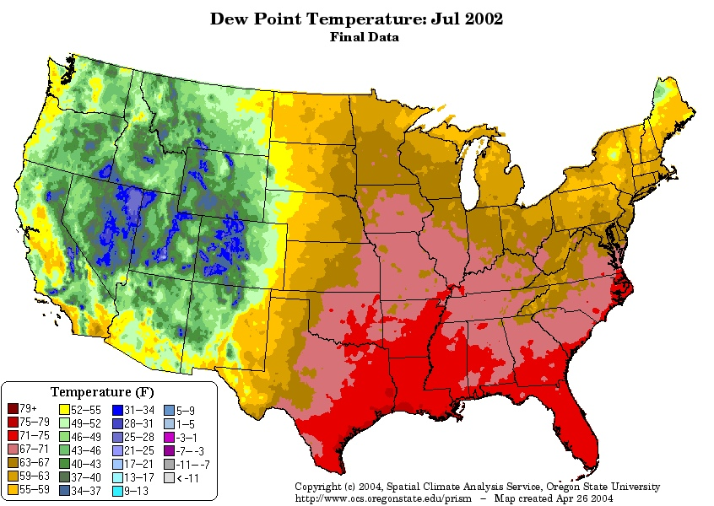
Dry West, more humid east

Slide 13
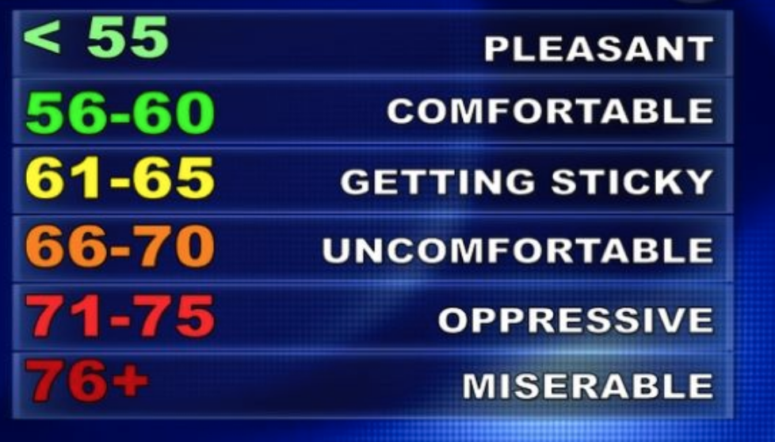
Dew Point and Comfort

Slide 14
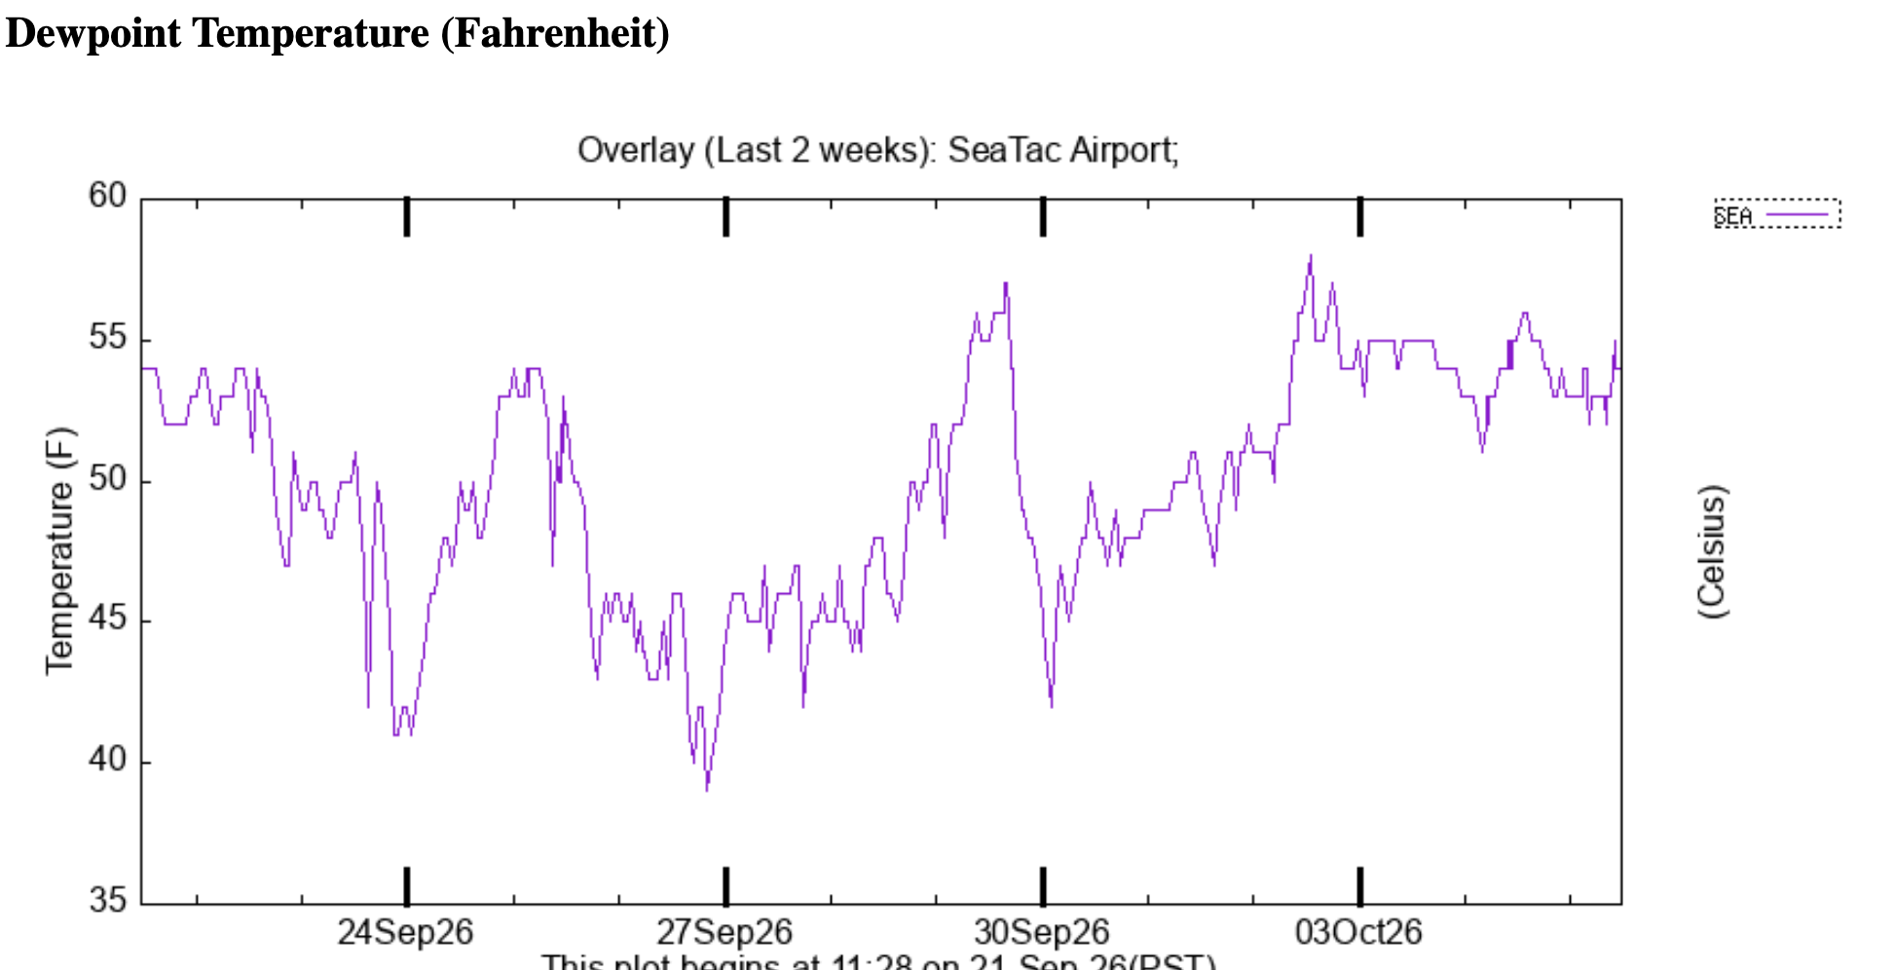
Dew Point Temperature at SeaTac Airport

Slide 15
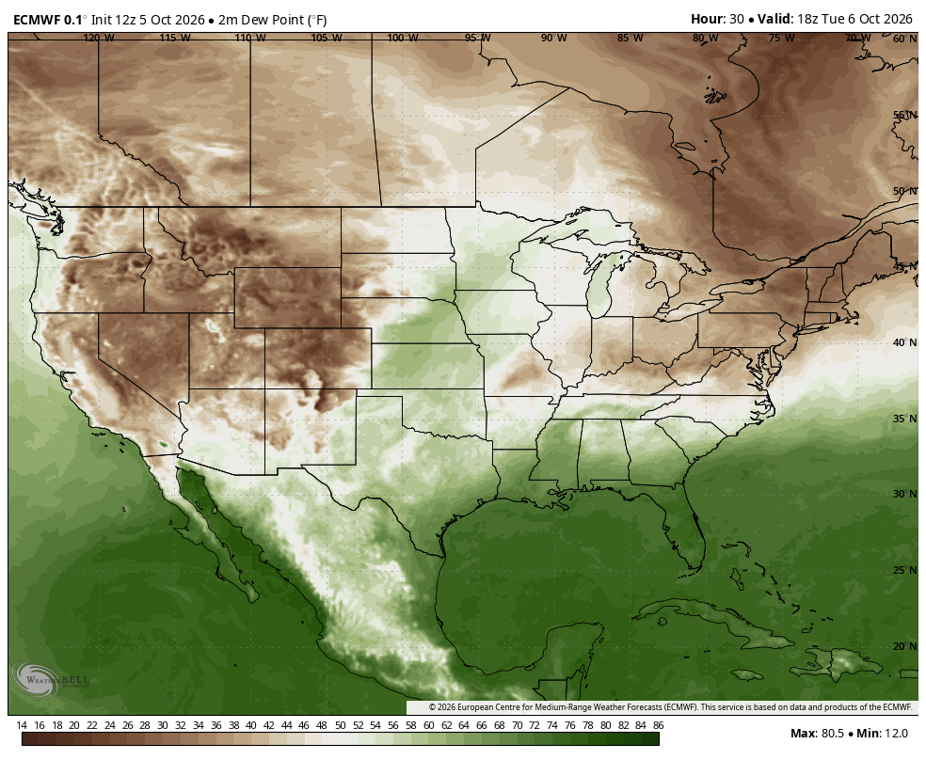

Slide 16
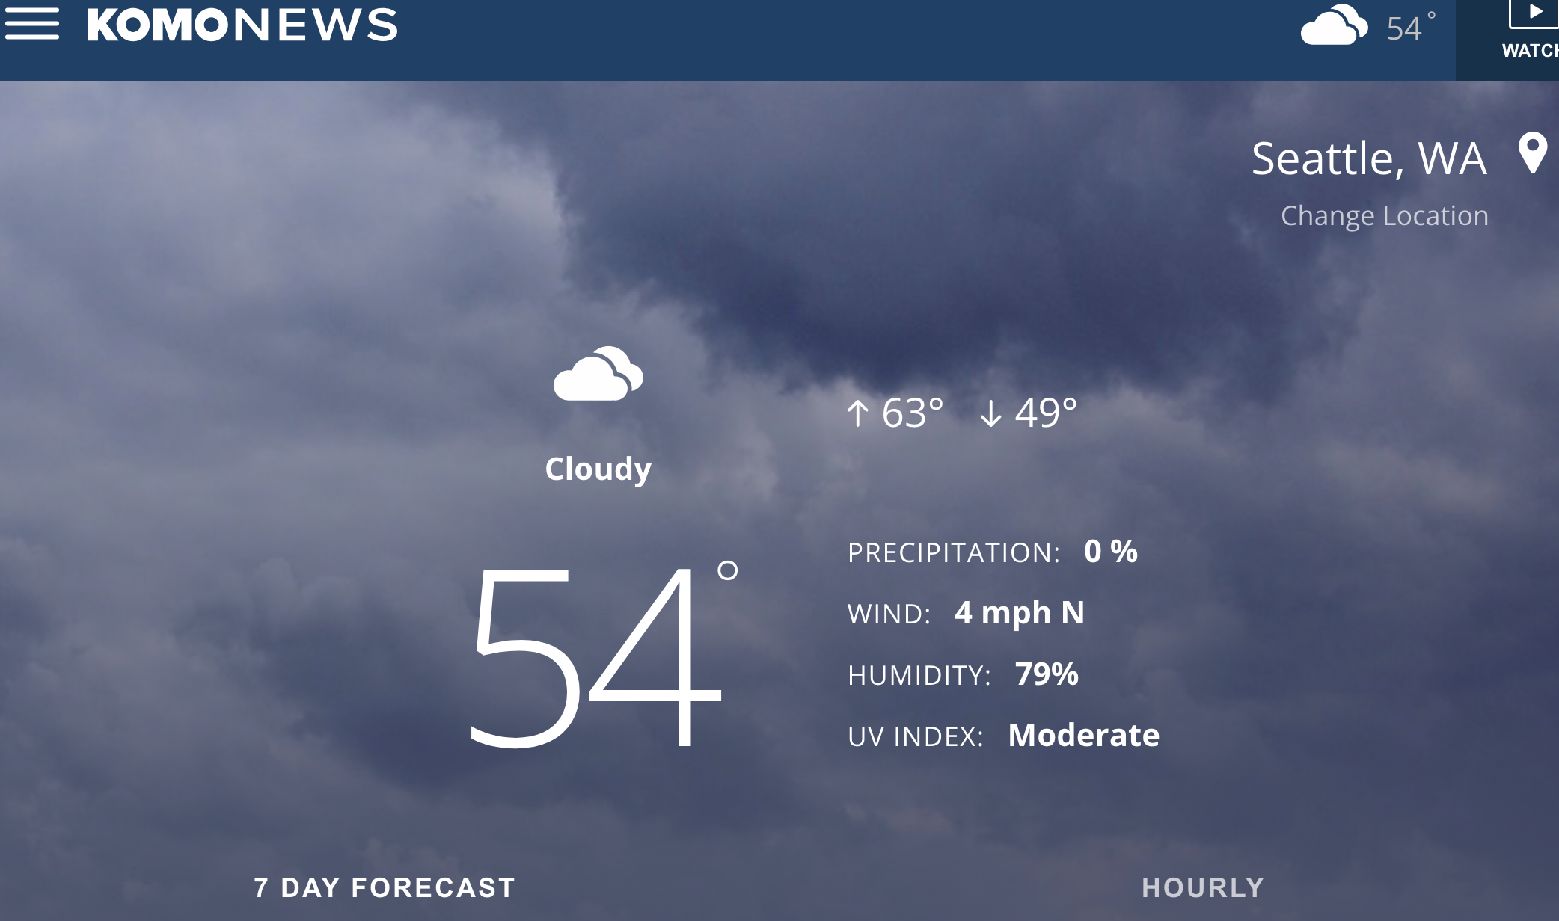
On your smartphone app and on TV often see Relative Humidity (RH)

Slide 17
Relative Humidity (RH)=
100 X amount of water vapor in some volume maximum amount of water vapor vapor that volume can hold at that temperature
RH = 100 x actual water vapor amount max possible water vapor amount
If a volume of air is holding half the maximum possible amount at that temperature, the RH is 50%

Slide 18
Relative Humidity Varies During the Day/Night
Lower during the day when temperatures are warm
Higher at night when temperatures are cool

Slide 19
Why does RH vary during the day?
The amount of water vapor does not change much during the day.
But the amount of water vapor that air can hold varies greatly, because temperature is changing.

Slide 20
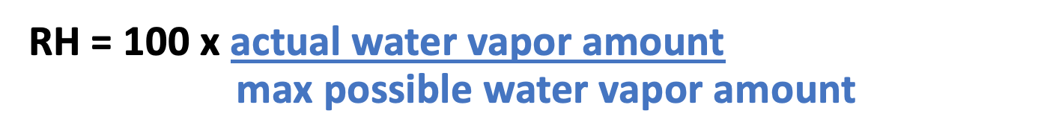
Why does RH vary during the day?
During the warmest part of the day, the air can hold more water vapor
Thus, the relative humidity declines.

Slide 21
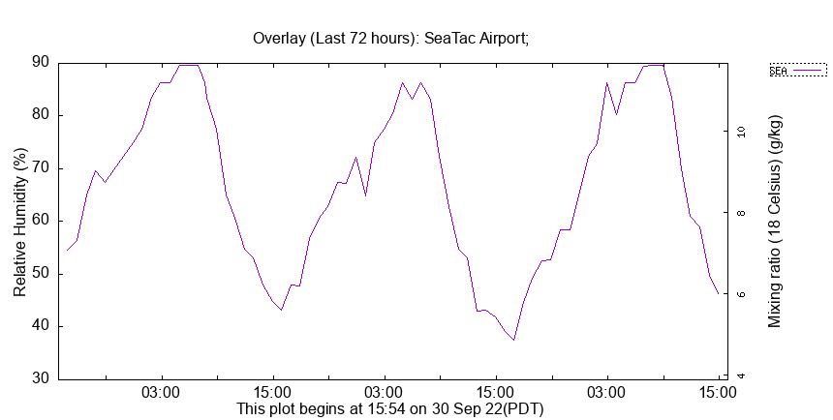

Slide 22
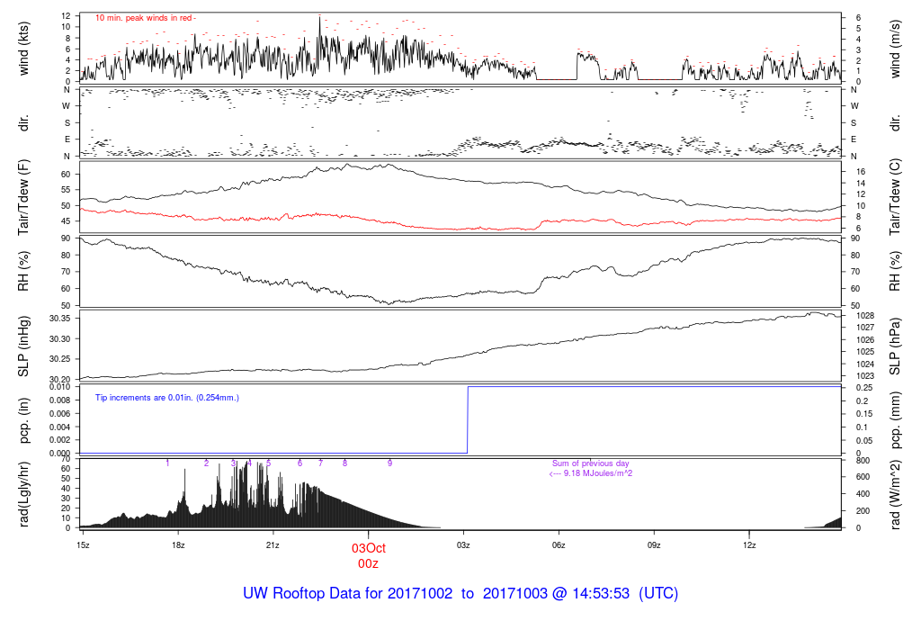
Atmospheric Sciences Rooftop Example
Temperature warms
Relative humidity falls
DAY
NIGHT

Slide 23
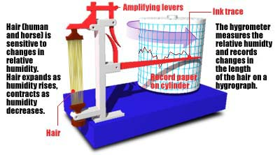
How do we measure humidity?
Use devices called hygrometers.
In the old days, hair hygrometers

Slide 24

Humidity affects hair and can cause a bad-hair day

Slide 25
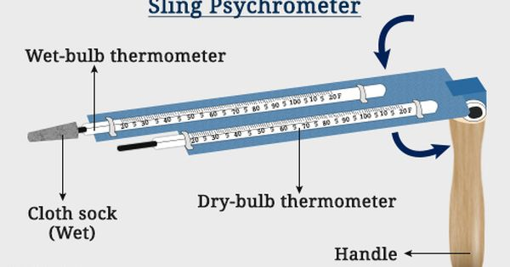
Later moved to psychrometers, with two thermometers, one with a “wet bulb” the other being a ”dry bulb”

Slide 26
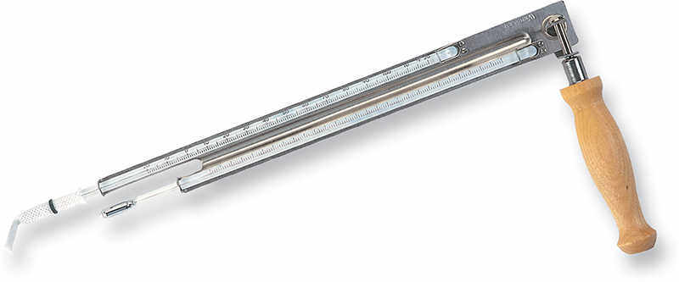
Psychrometer
Measures both a ”dry bulb” and “wet bulb” temperature
The wet bulb is cooled by evaporation
The difference between the two can be used to calculate humidity, either relative humidity or dew point

Slide 27
Psychrometer
The drier the air the bigger the difference in the two temperatures.
If the air is saturated, they are the same.

Slide 28
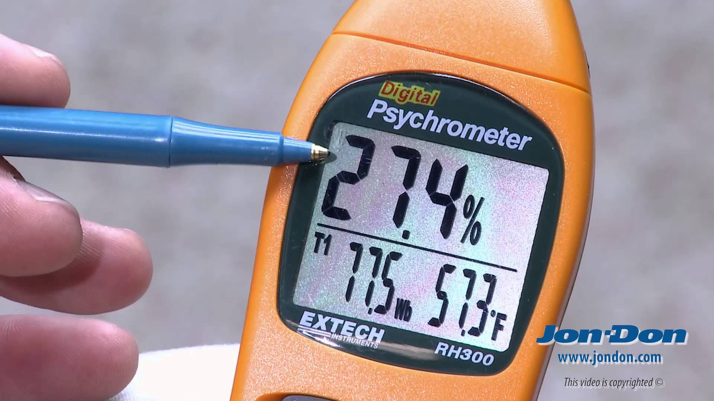
More Recently: Electronic Psychrometers/Hygrometers Available
Some use solid state devices
Others chilled mirrors

Slide 29
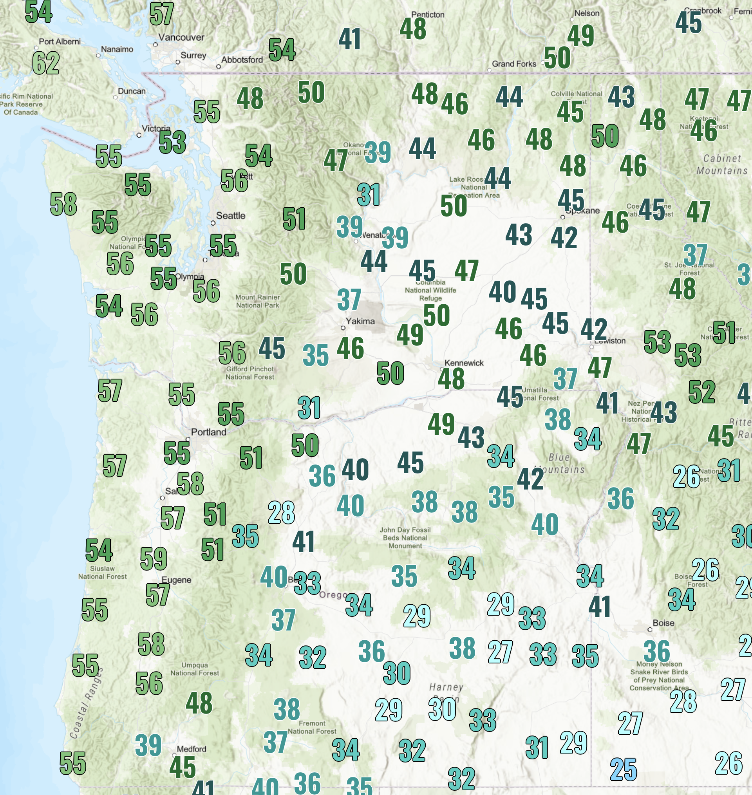
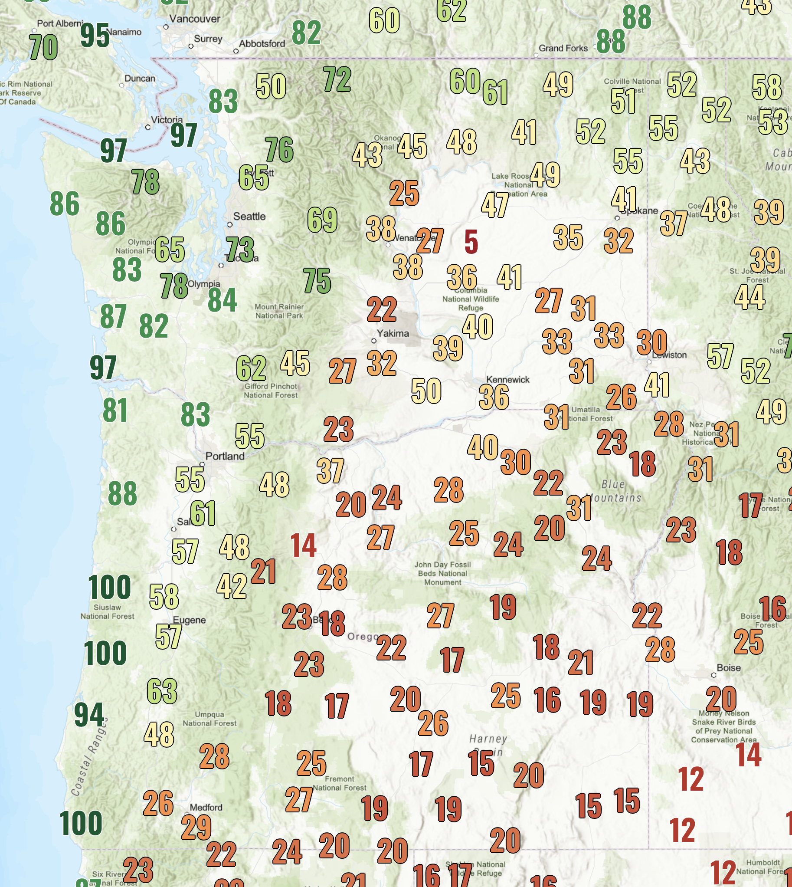
Noon, Oct 5
Dew point
Relative Humidity

