Slide 1
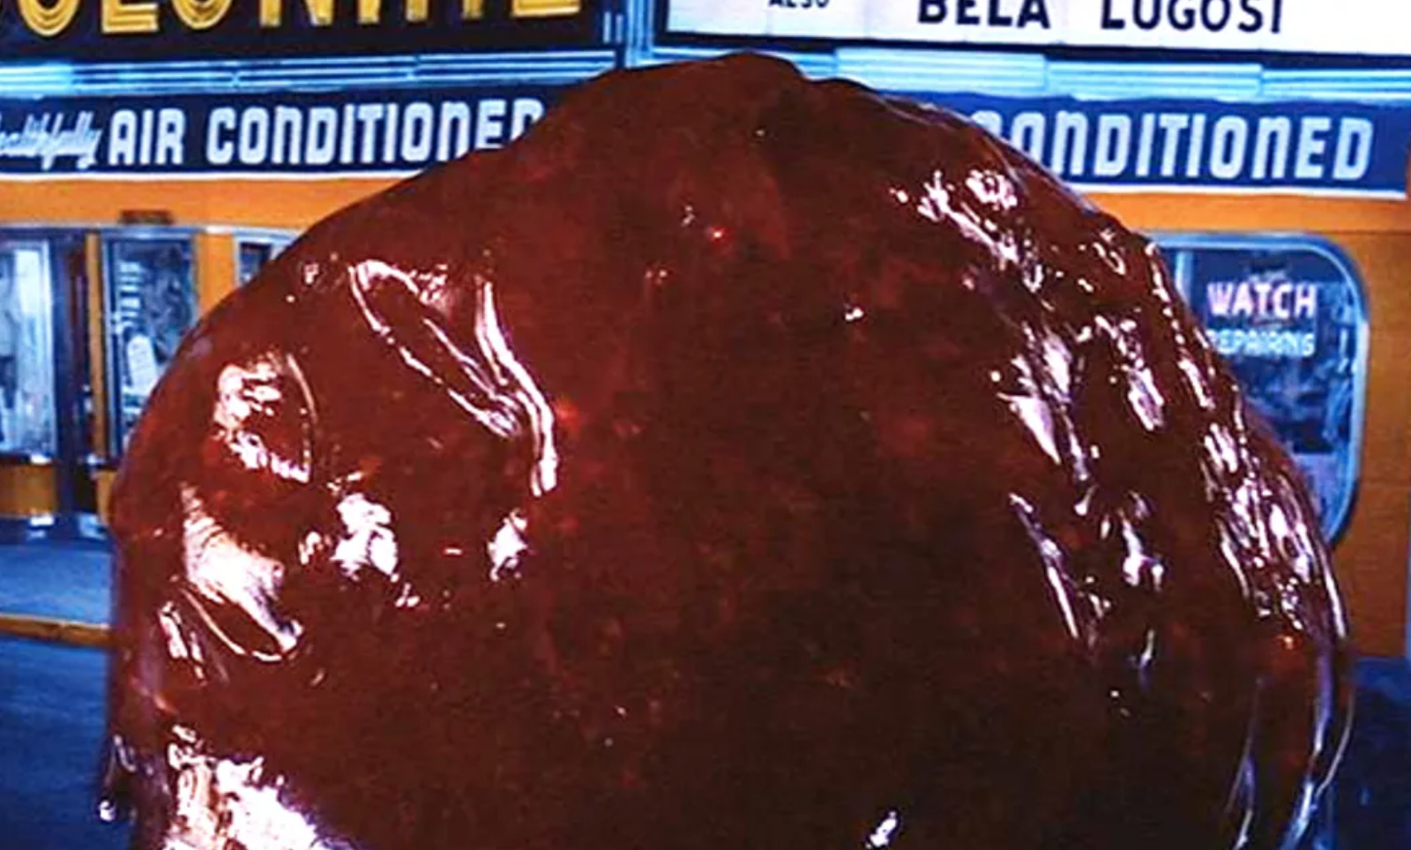
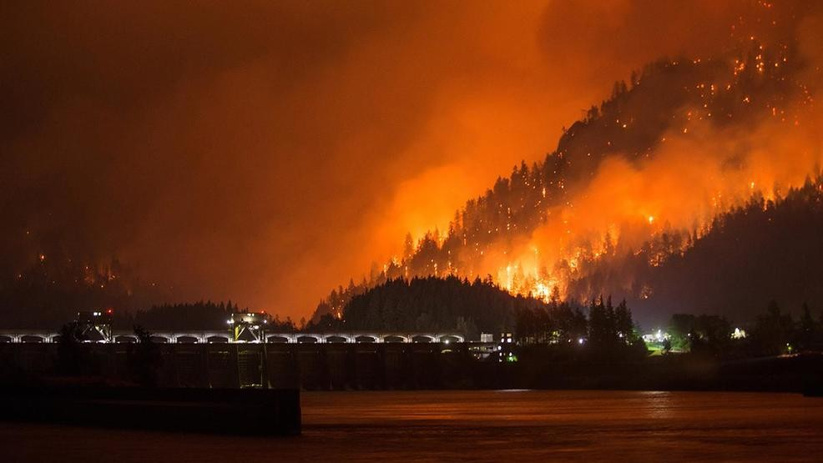
The BLOB and West-Side Wildfires: Some New Insights from High Resolution Weather and Climate Modeling
Cliff Mass
University of Washington

Slide 2
Have You Noticed Something Unusual About Our Weather This Summer and Early Fall?

Slide 3
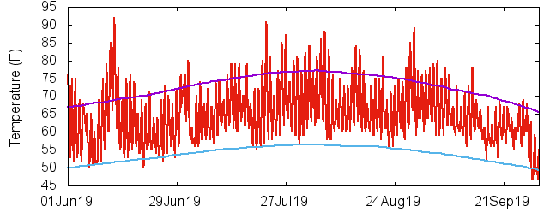
Minimum Temperatures Were Warmer Than Normal This Summer over western Oregon and Washington
Seattle Tacoma Airport

Slide 4
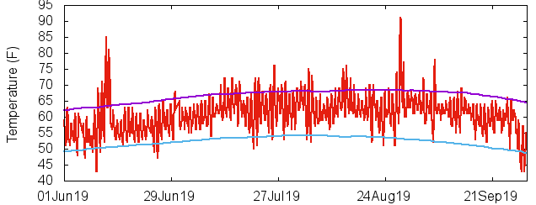
Hoquiam

Slide 5
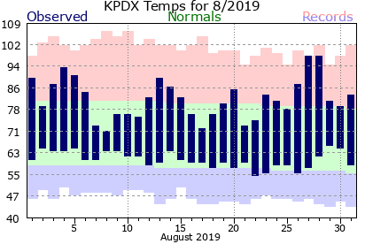
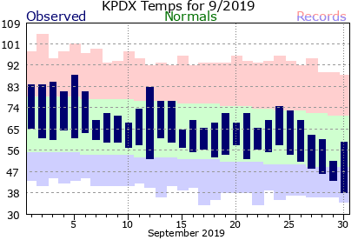
Portland
August
September

Slide 6
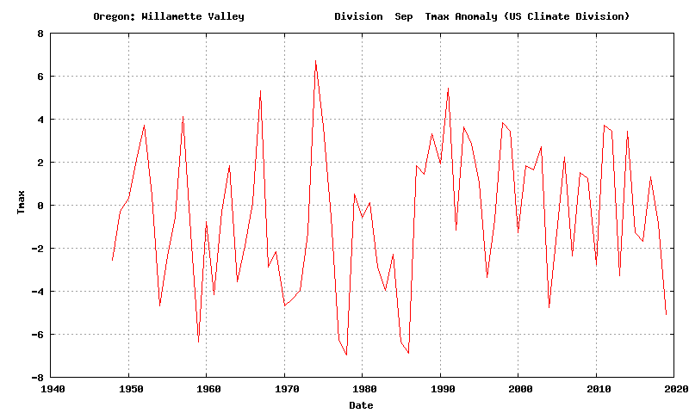
September Willamette Valley Temperatures. Sept 2019 Maxima were cool
Max
-5F

Slide 7
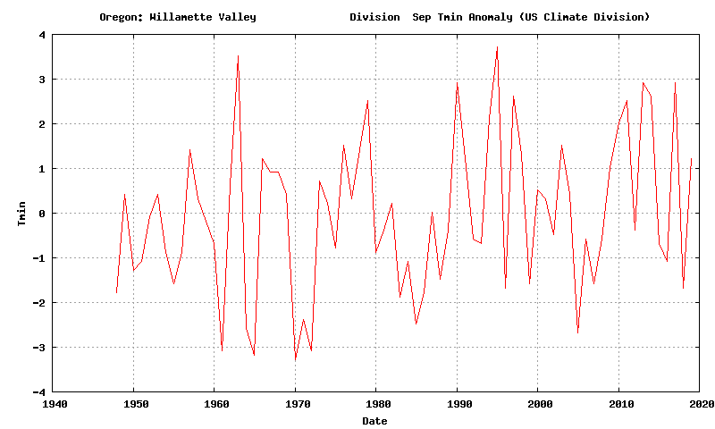
Sept 2019 Minima were warm
+1.2F
Min

Slide 8
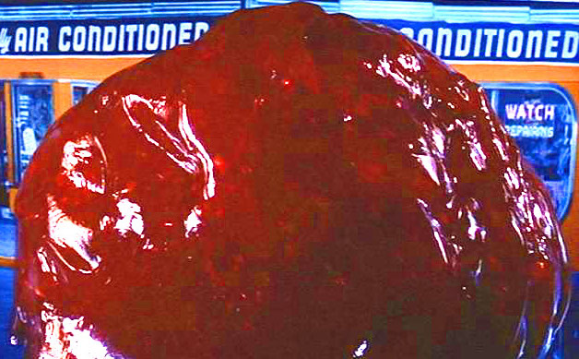
Why so warm in the morning?
Could it be the BLOB?

Slide 9

BLOB 101

Slide 10
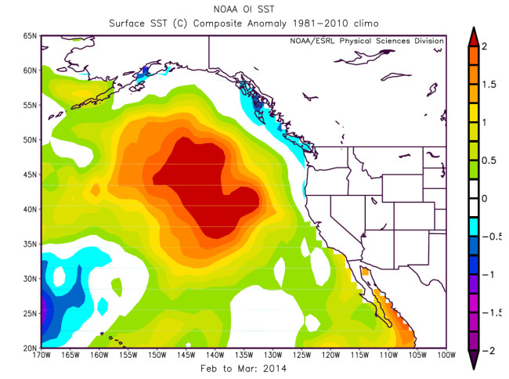
The Blob is associated with warmer than normal water over the NE Pacific
Feb-March 2014 Sea Surface Temperature Anomaly

Slide 11
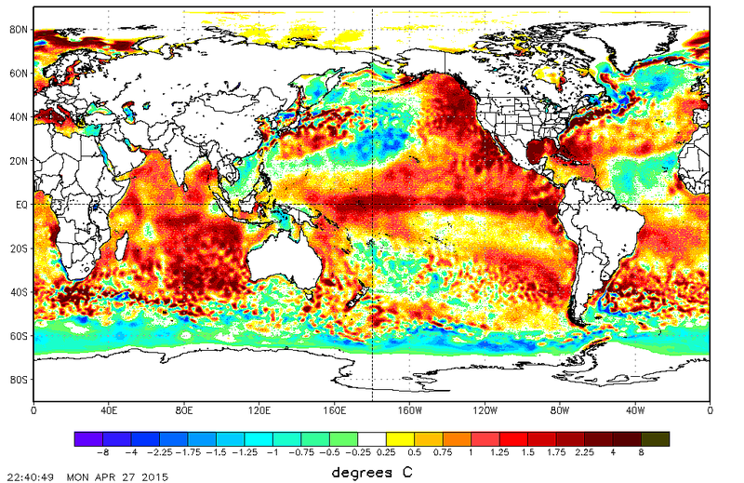
April 2015
SST
Anomaly from Normal

Slide 12
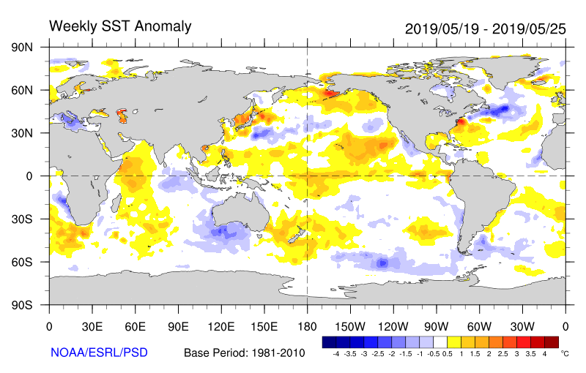
The BLOB Redeveloped This Summer

Slide 13
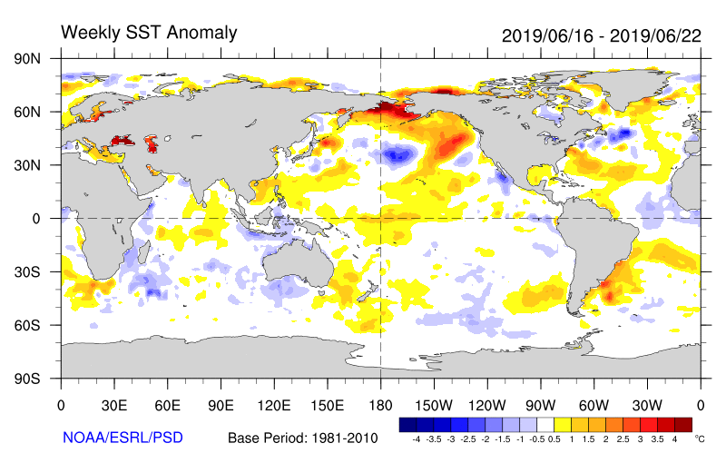

Slide 14
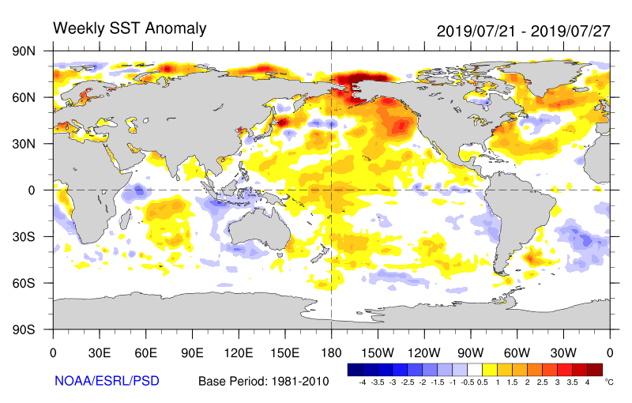

Slide 15
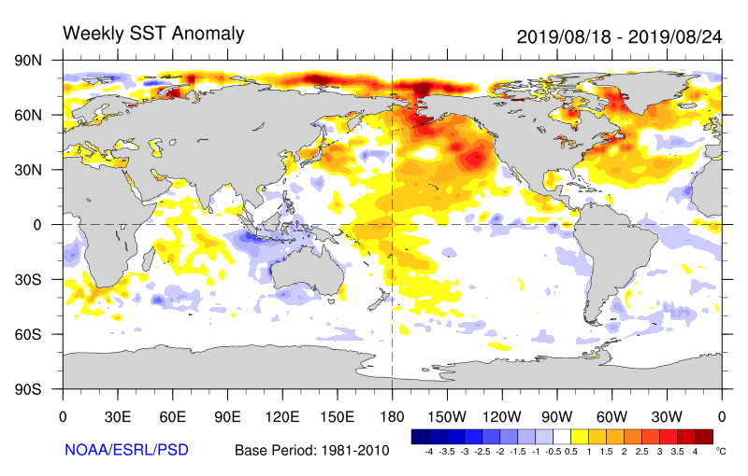

Slide 16
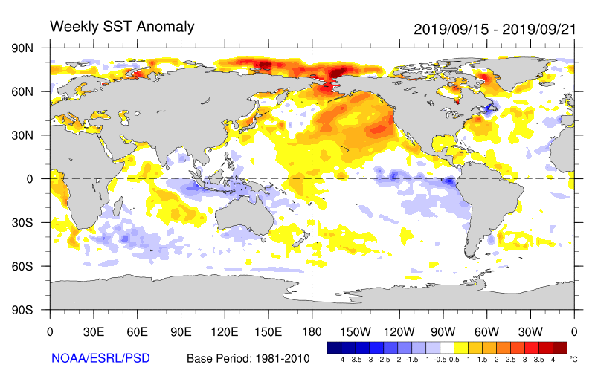

Slide 17
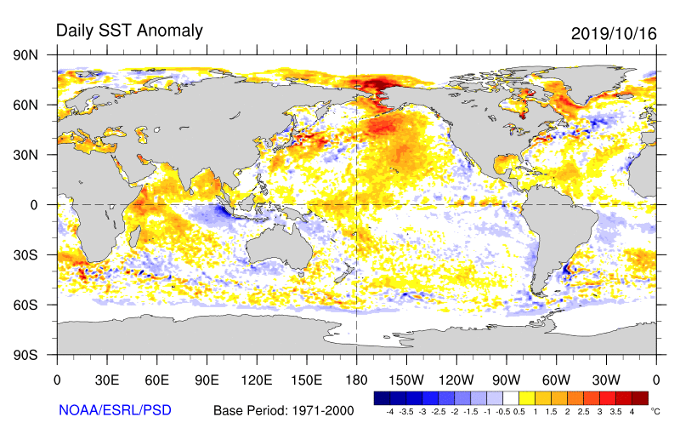
But recently it has started to weaken

Slide 18
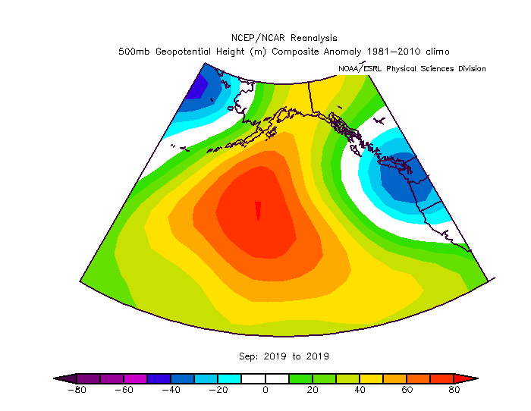
Why is there a Blob?
Answer: Persistent High Pressure over the NE Pacific
500 hPa Height Anomaly (Difference from Normal)
September 2019

Slide 19
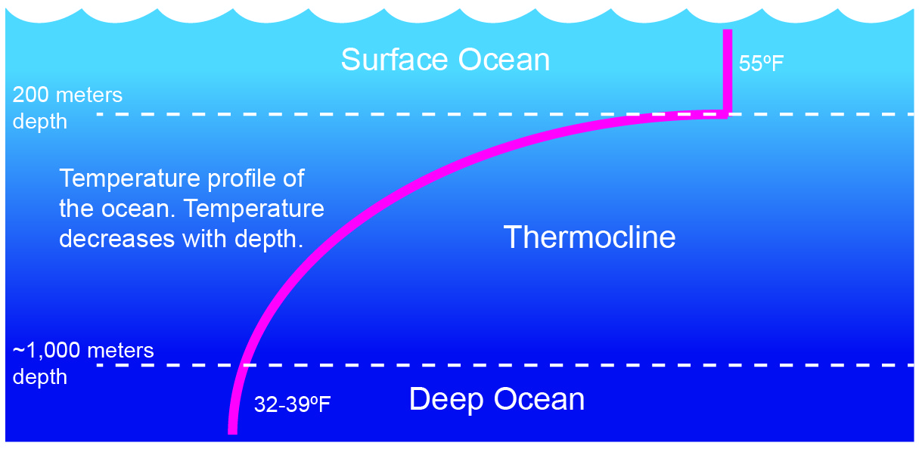
High Pressure is Associated with Lighter Winds and Thus Less Mixing of Cooler Water From Below

Slide 20
Also winds moving around highs push warm water northward
H
Water
Air

Slide 21
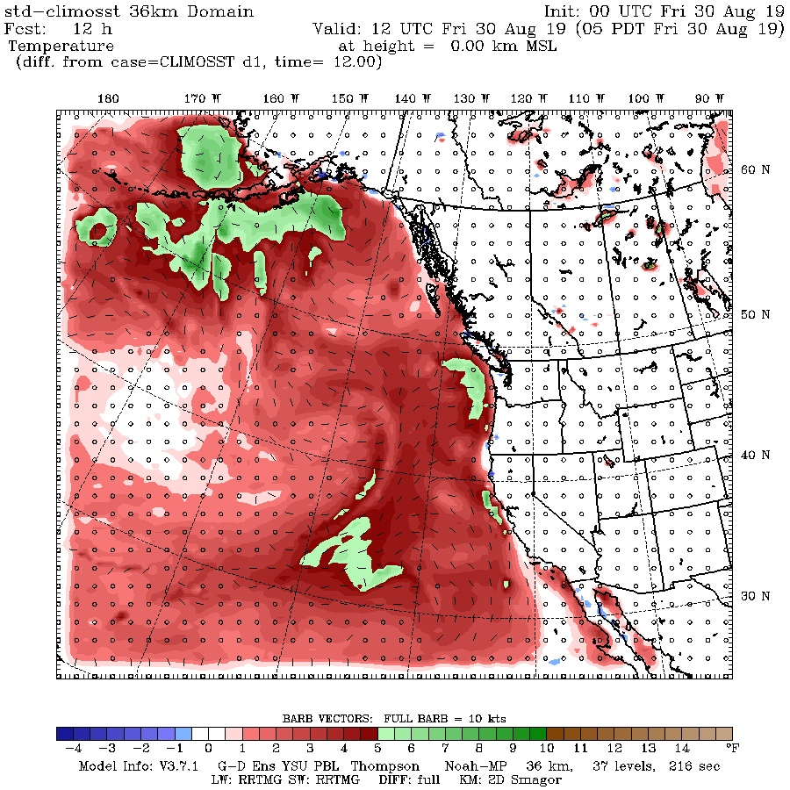
Can We Show a Connection of the BLOB With Our Minima Temperatures Using High-Resolution Modeling?
Replace the warm BLOB sea surface temperatures with climatological normal ocean conditions and rerun the WRF model!

Slide 22
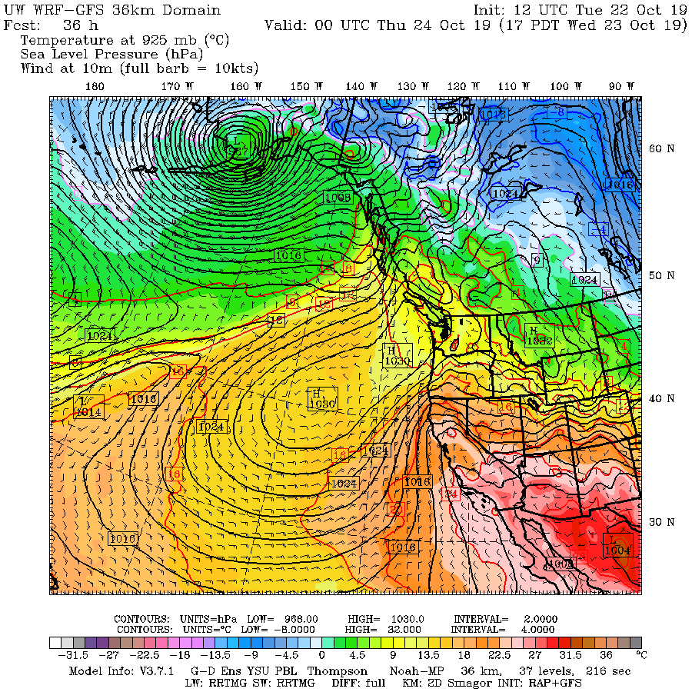
The UW WRF Model

Slide 23
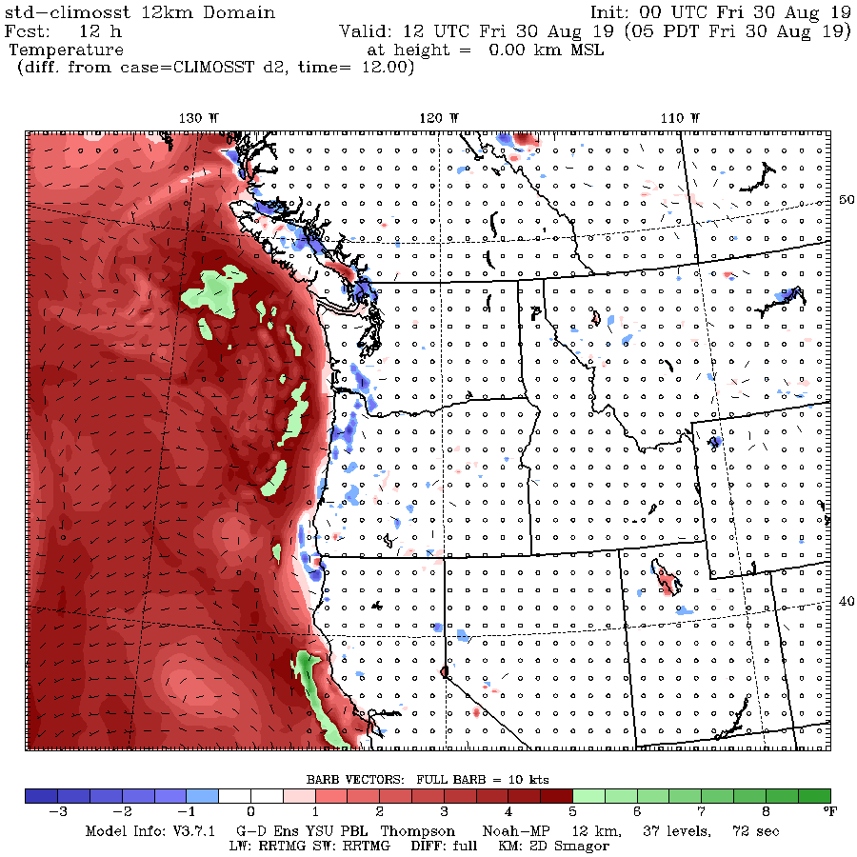
Surface Air Temperature Difference
(BLOB-Normal)
12-hours into
the forecast

Slide 24
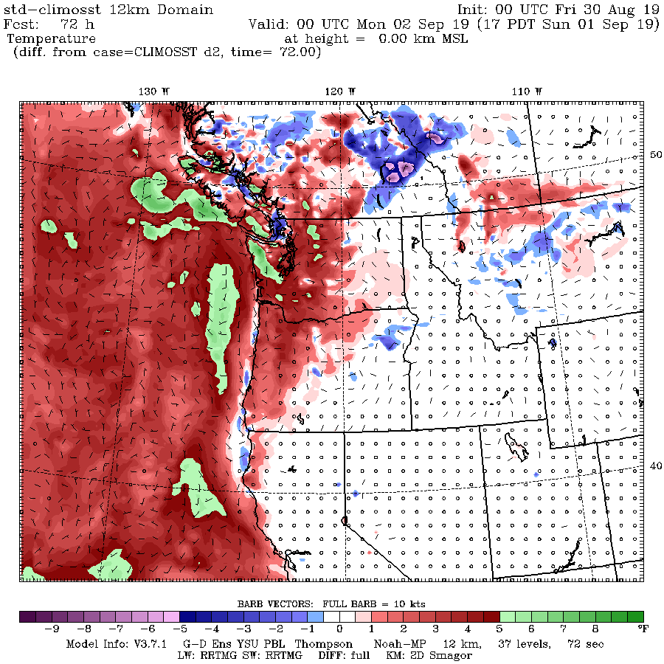
72- hours

Slide 25
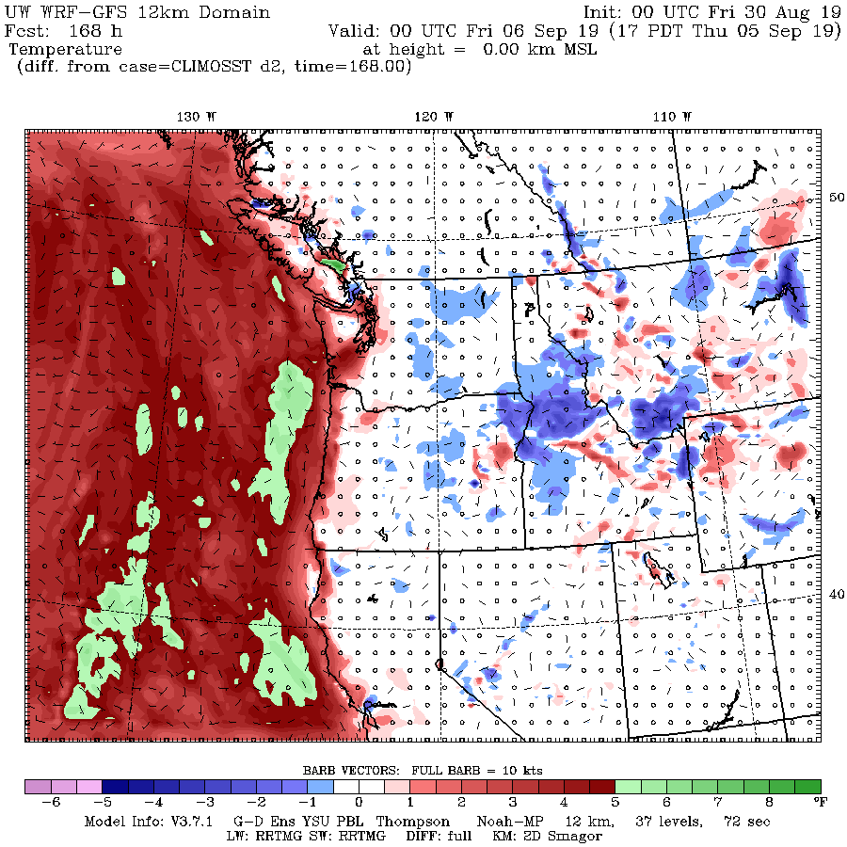
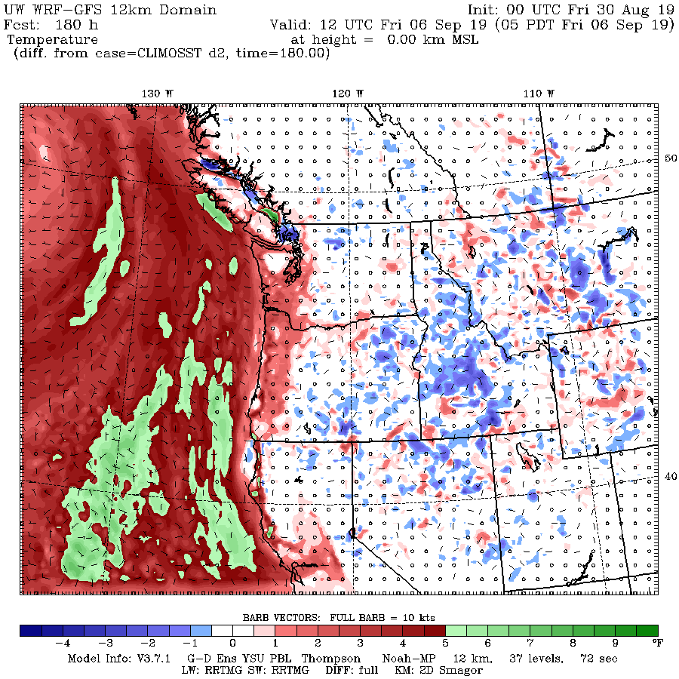
Warming Tends to Move Inland More During Night
168 hours
180 hours
5 PM
5 AM

Slide 26
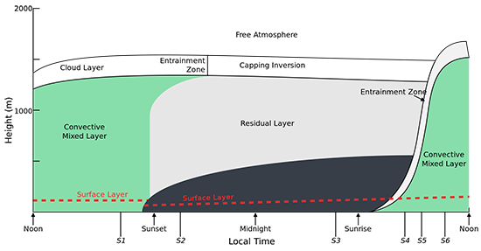
Physical Insights: Why Minima Is More Affected?
During day, there is vertical mixing in the boundary layer, so high temperature is controlled by temperatures aloft (say at 850 hPa—about 5000 ft).
In contrast, at night, low level flow off the ocean is more important in determining temperatures.

Slide 27
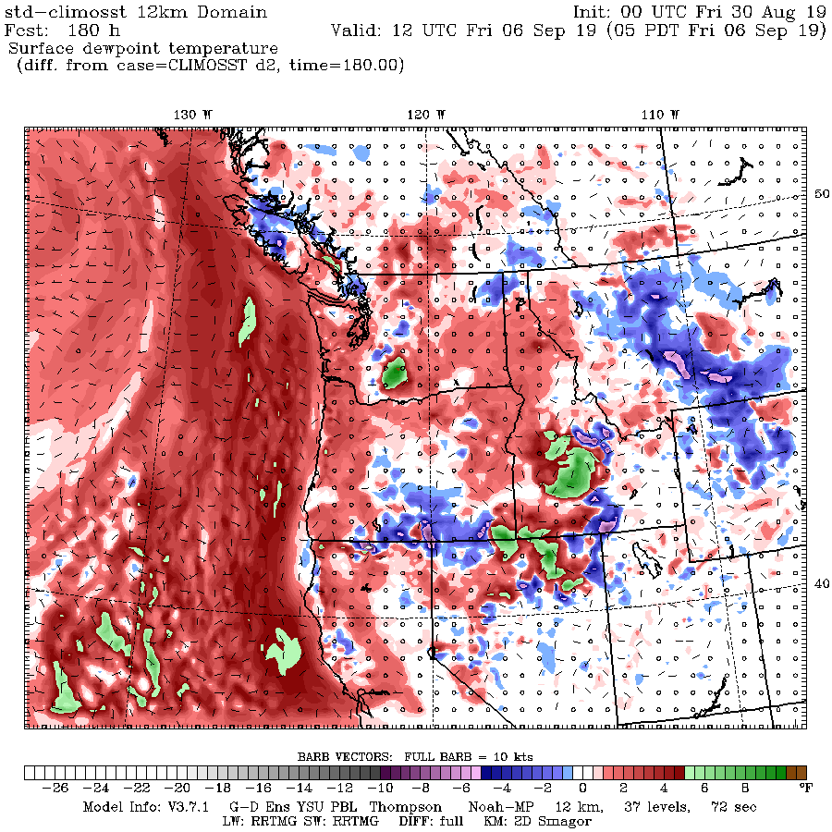
Humidity?
Surface Dew Point is Increased Inland Due to Warmer Waters

Slide 28
Basic Points
Warm water offshore (the Blob) preferentially warms our minimum temperature.
Less effect on maximum.
Low temperatures are warmed in two ways:
  Warmer air moves in off the Pacific
  More humid air helps keep minima up as well

Slide 29
Western Oregon and Washington Wildfires: An Interesting Twist

Slide 30
Major, Large Wildfires Can Occur on the West Sides of the Cascades (Oregon Events)
1933 Tillamook Burn 240,000 acres
1939 Second Tillamook Burn 217000 acres
1945 Third Tillamook Burn 173000 acres.
1936 Bandon Fire 287,000 acres
1987 Silver Complex Fire 96540 acres
2002 Biscuit Fire 500,000 acres.
2017 Chetco Bar Fire. 191,000 acres
2017 Eagle Creek Fire 50,000 acres

Slide 31
Will Such Wildfires Increase Under Global Warming?

Slide 32
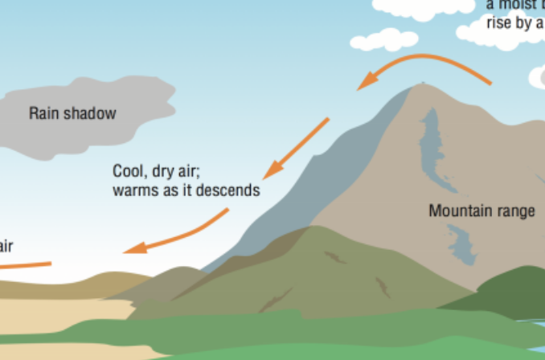
There is something they all have in common:
Strong Easterly Flow
Have looked at a dozen of such west-side wildfires, looking at newspaper accounts and meteorological data for recent events.
ALL were accompanied by strong easterly flow!
Such flow is generally very dry

Slide 33
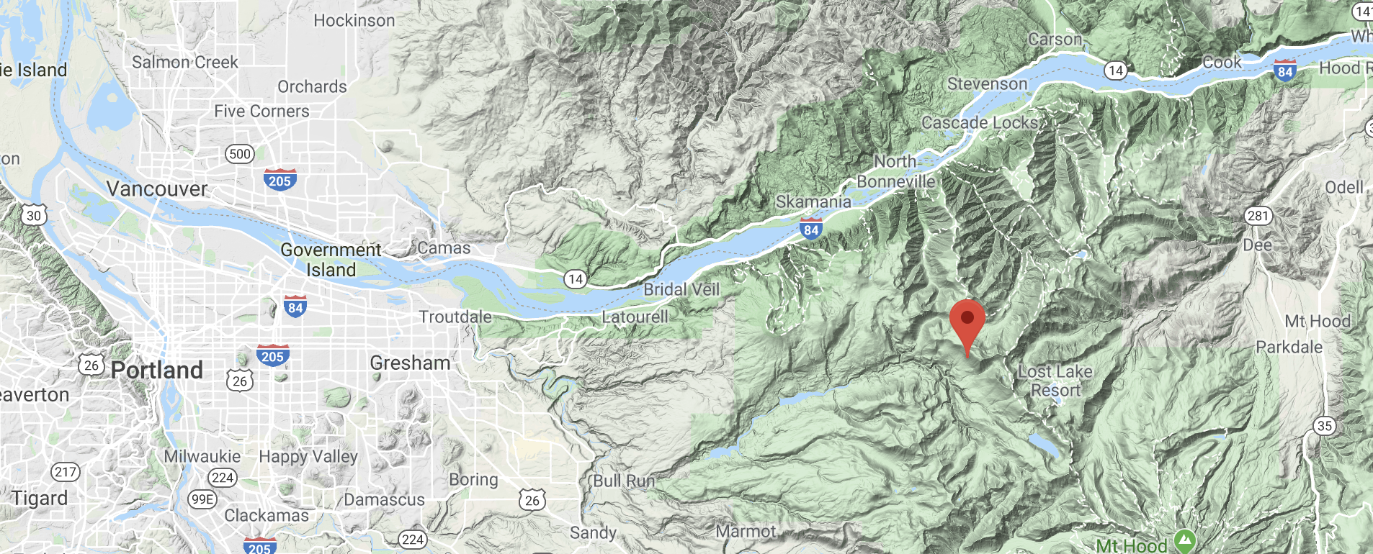
Consider the 2017 Eagle Creek Fire and a Nearby USDA RAWS Observing Site (Log Creek)

Slide 34
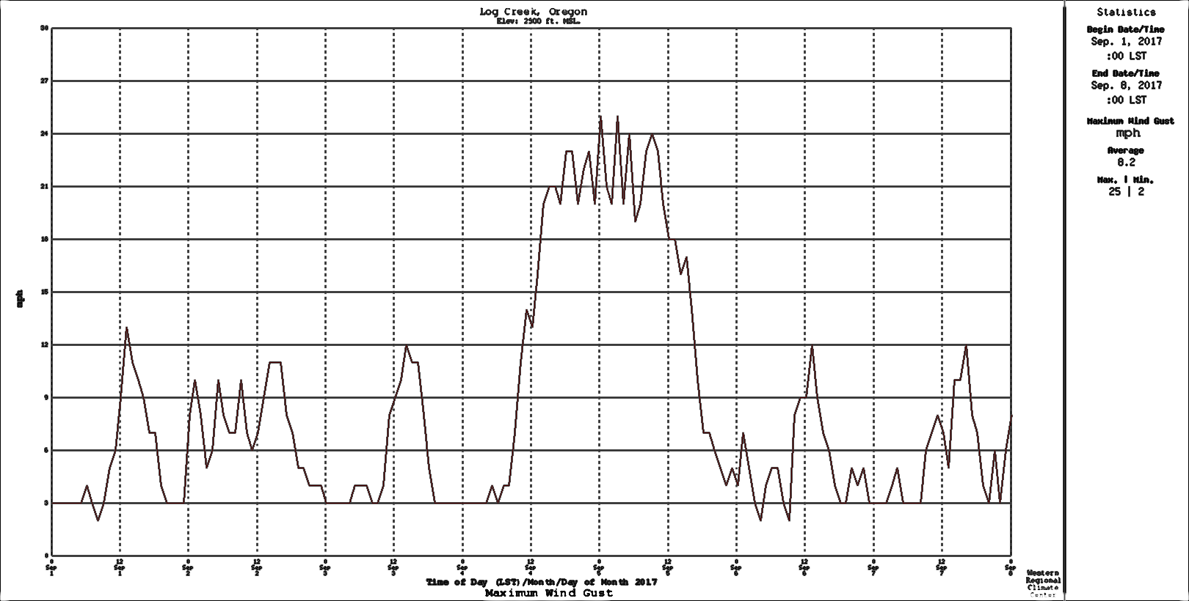
Log Creek RAWS: Strong Winds From the East
Wind Speed
September

Slide 35
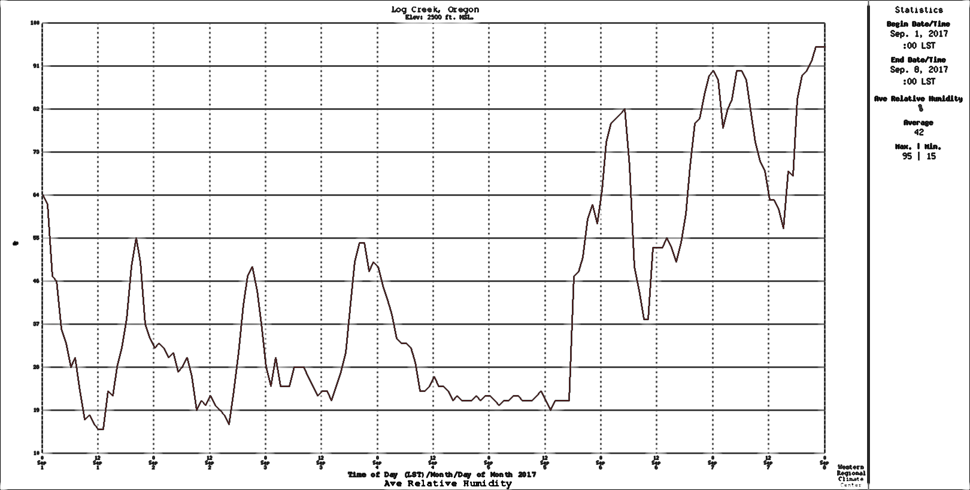
Low Relative Humidity

Slide 36
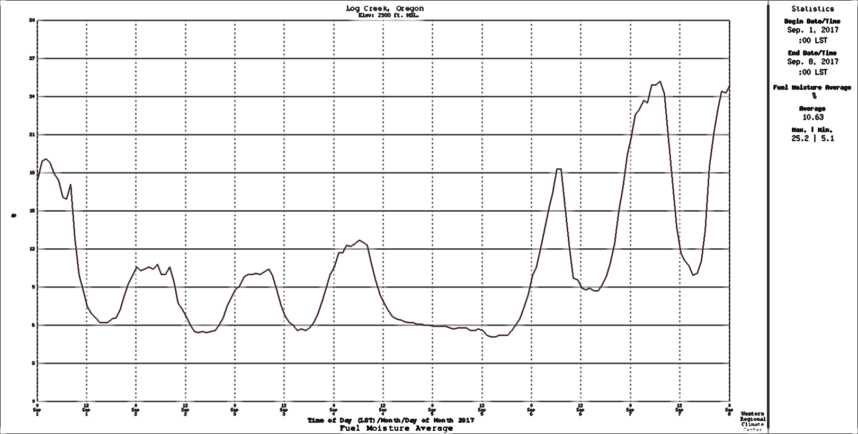
Dry Fuels

Slide 37

No consistent signal for temperatures and precipitation for summers proceeding fires
Some major questions regarding easterly flow:
Will global warming make easterly flow more frequent?
Will global warming make easterly flow stronger when it does occur?

Slide 38

Regional Dynamical Downscaling
High-resolution (12-km) WRF Ensemble Driven by 12 CMIP-5 Global Climate Models.
Paid by

Slide 39
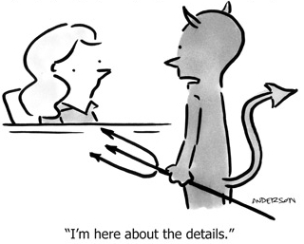
Some Details
WRF Model 3.7.1
RCP 8.5: Perhaps too aggressive, but shows the worst case.
Ran under 12 CMIP-5 GCMs with 6-hr output
36 and 12 km domains
Ran for 1970-2100. No breaks

Slide 40
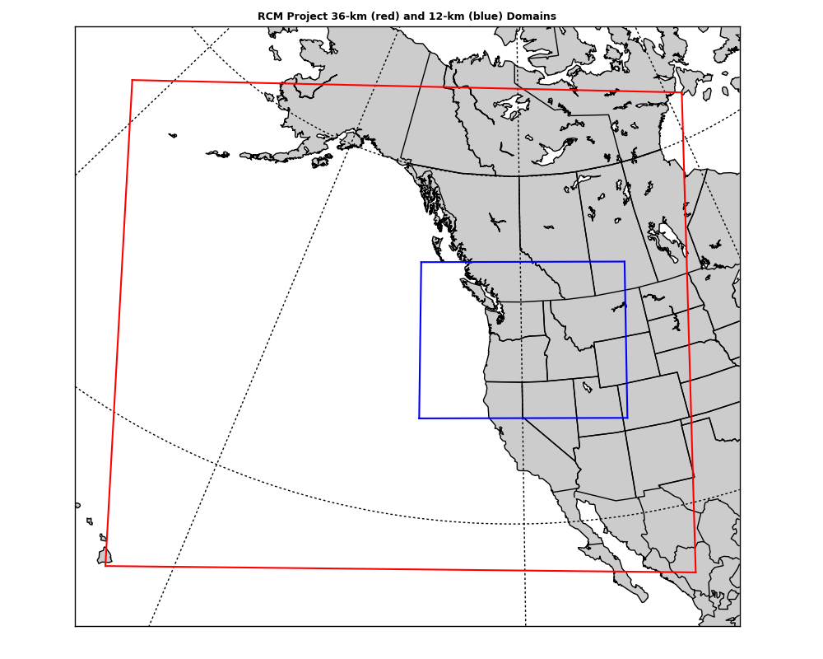
Domains
36 km
12-km

Slide 41
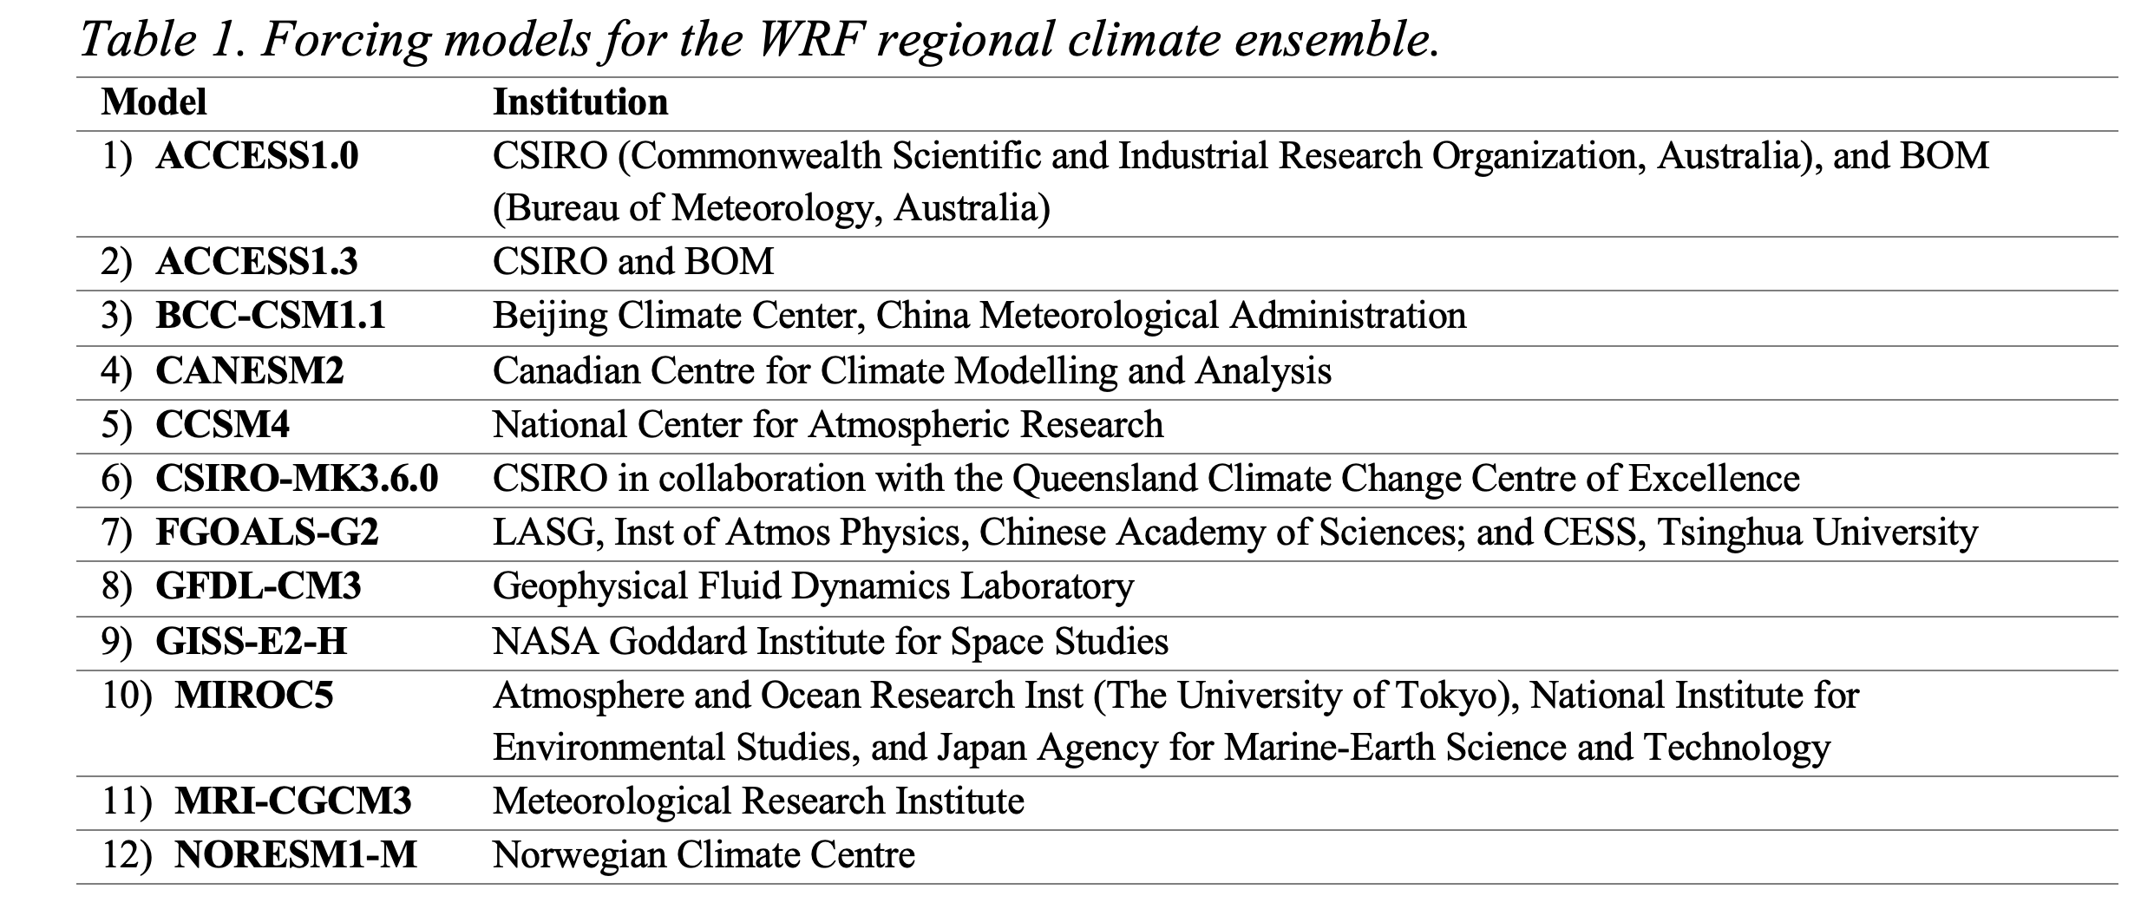
GCMs Used

Slide 42
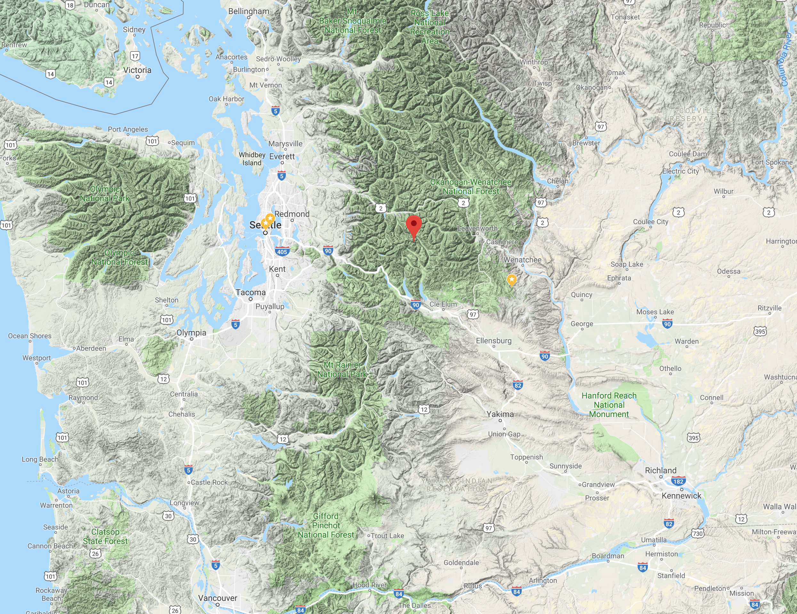
Consider a point near the crest of the Cascade Mountains

Slide 43
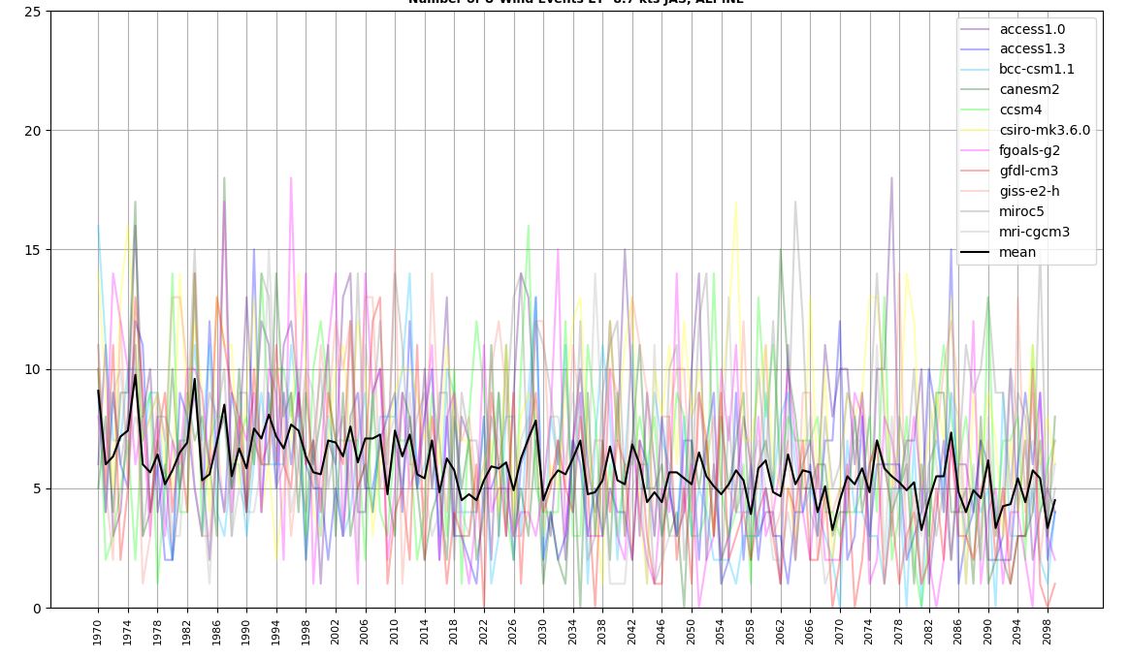
Maximum Daily Easterly Winds Each Year (Cascade crest)
Maximum Easterly Winds are Projected to Decline!

Slide 44
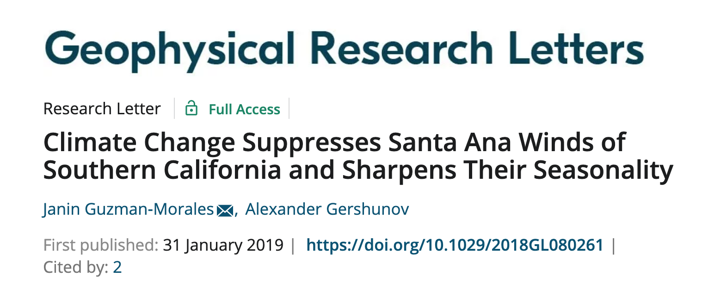
Reduced Easterly Flow Under Global Warming
Consistent with other studies in southern California (reduced easterly flow driving Santa Anas).
Global warming preferentially heats the interior of the continent versus the ocean, producing enhanced pressure falls over the interior.
Results in stronger onshore flow (or weaker offshore/easterly flow).

Slide 45
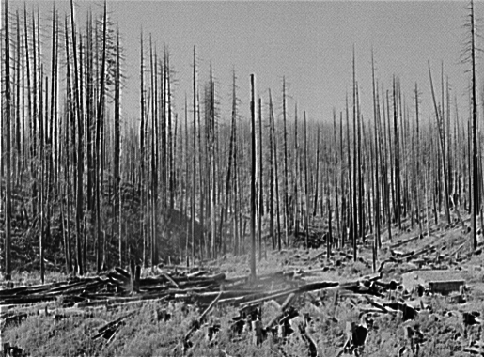
On the other hand…
Summers will get warmer
Summers (already dry), will get a bit drier
Thus, it is not clear what will happen to the frequency and intensity of western Oregon/Washington wildfires.

Slide 46
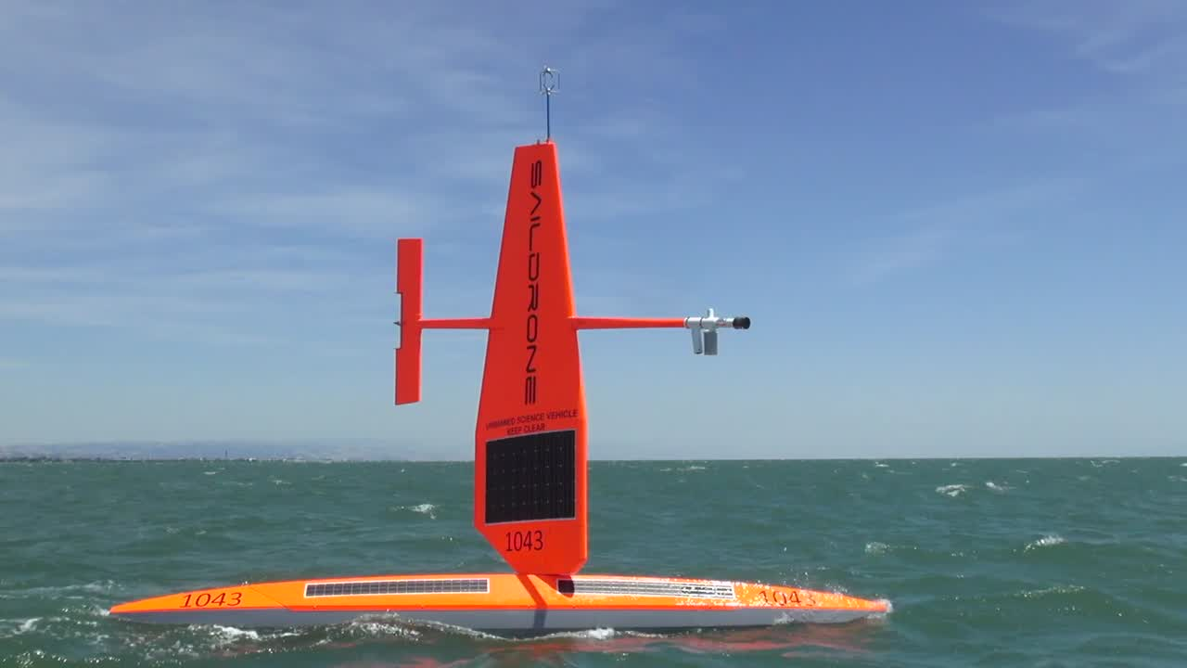
Exciting New Observation System Off the Coast: Saildrones

Slide 47
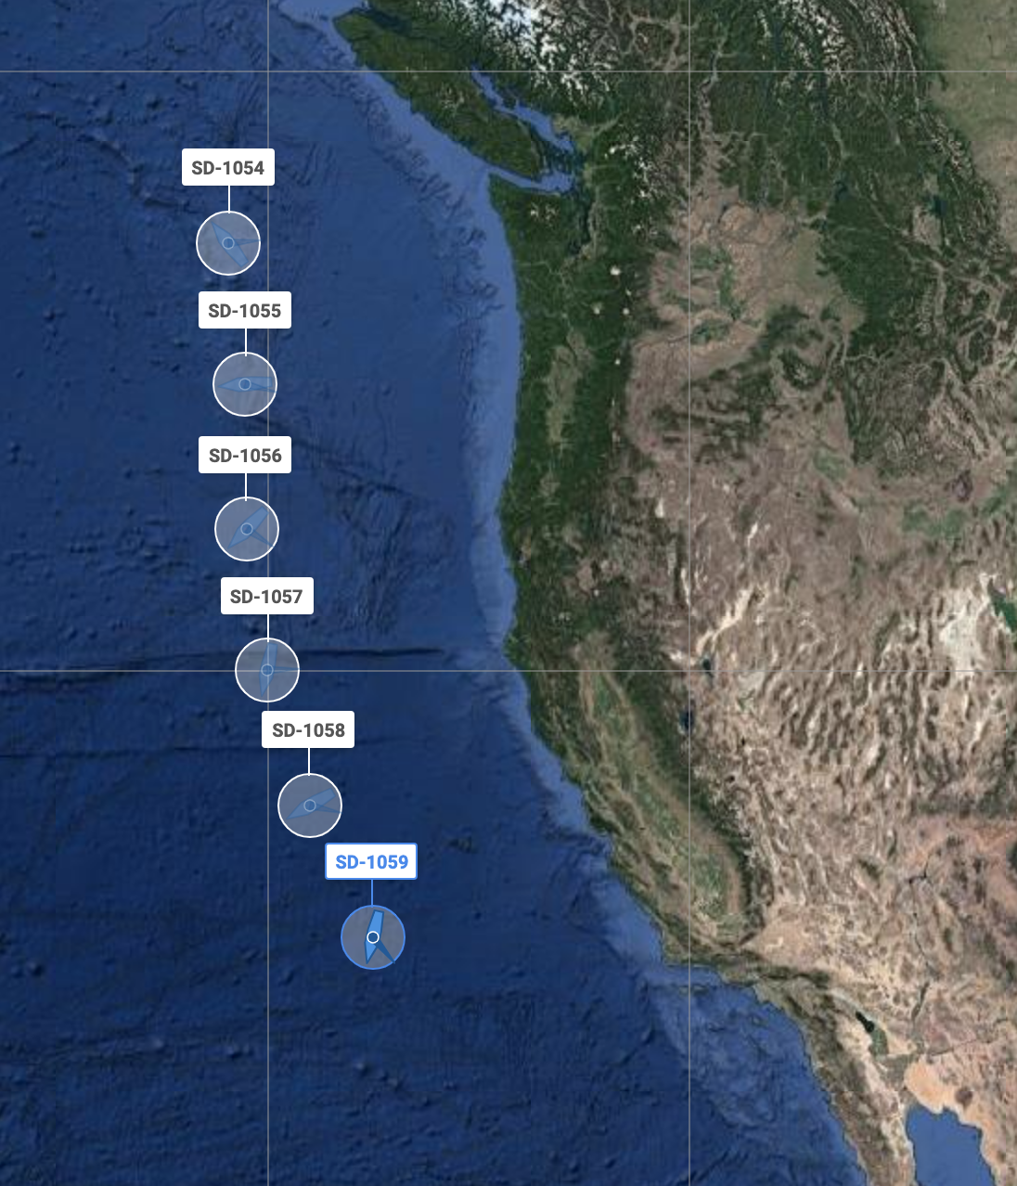
“Picket Fence” off the Coast
Can we improve forecasts along the West Coast with a line of Saildrones offshore?

Slide 48
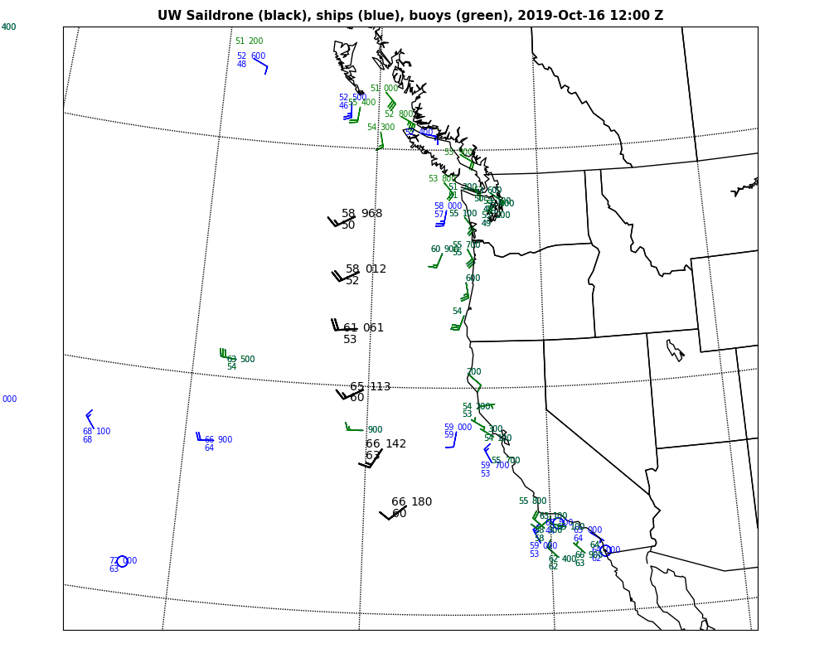
http://sailnet. uw.edu

Slide 49
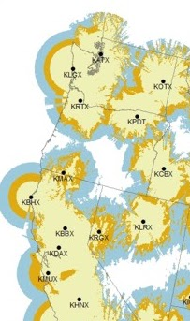
We Still Need an Oregon Coastal Radar

Slide 50
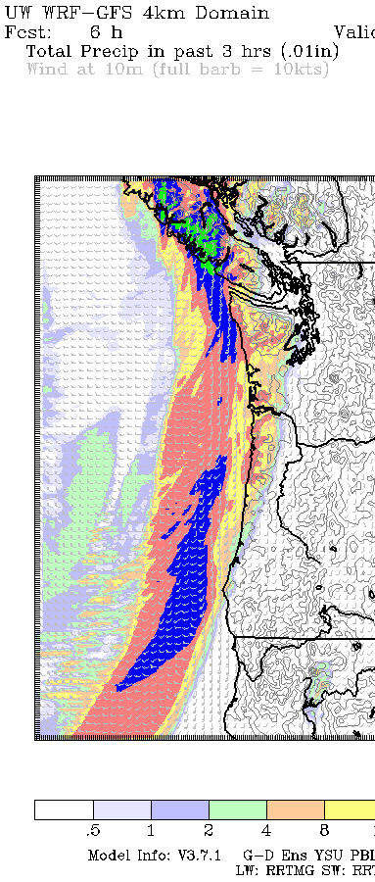
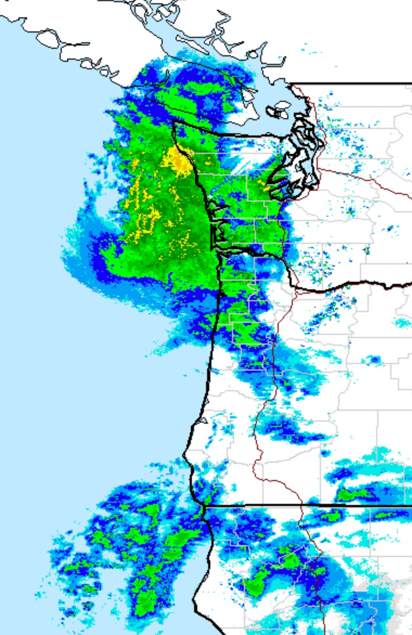
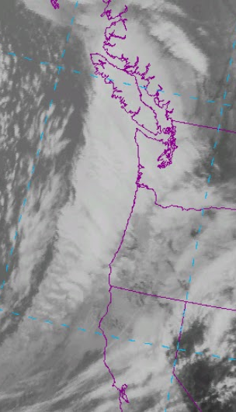
11 April 2018

Slide 51
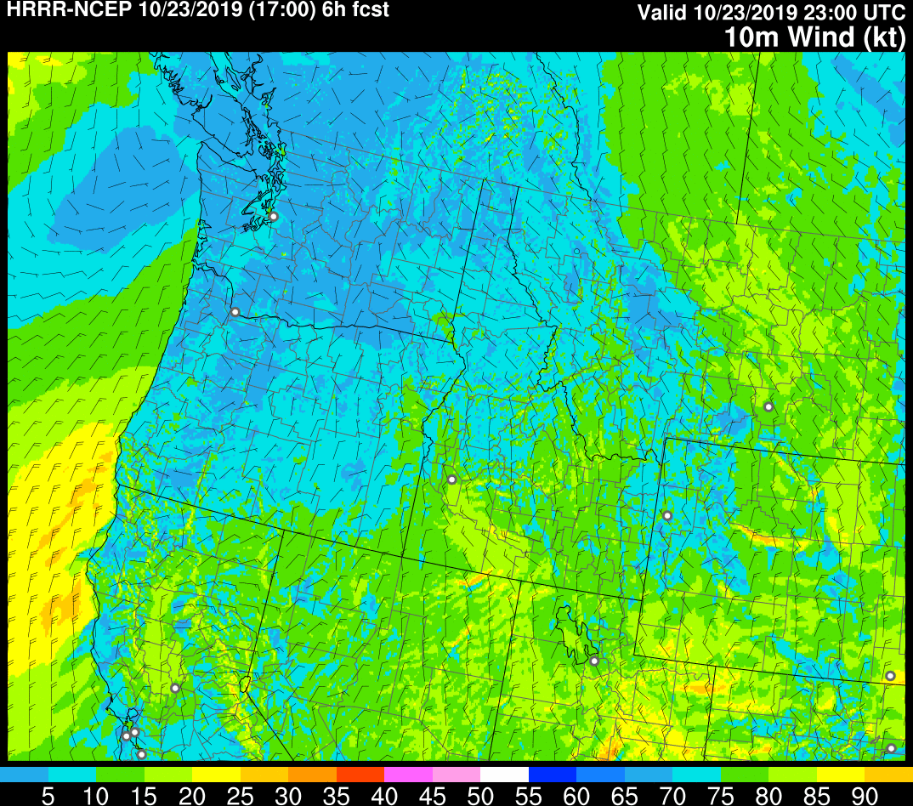
Even more important today because NOAA HRRR (High Resolution Rapid Refresh) Uses Radar Data

Slide 52

In Ancient Rome, Cato the Censor Would End All His Speeches With:
Carthago Delenda Est
(Carthage Must Be Destroyed)

Slide 53
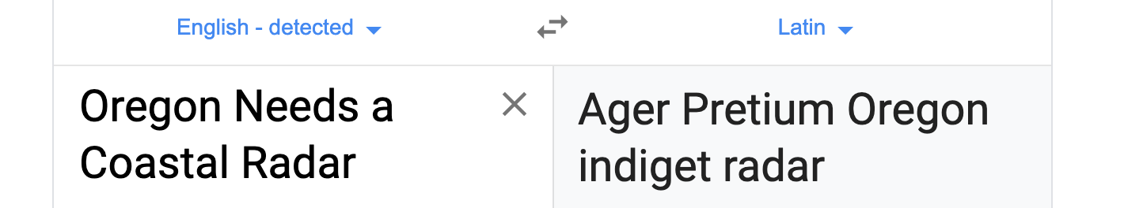
We need a modern day Cato for an Oregon coastal radar
" Ager Pretium Oregon Indiget Radar "

Slide 54
Ager Pretium Oregon Indiget Radar
The End

