Slide 1
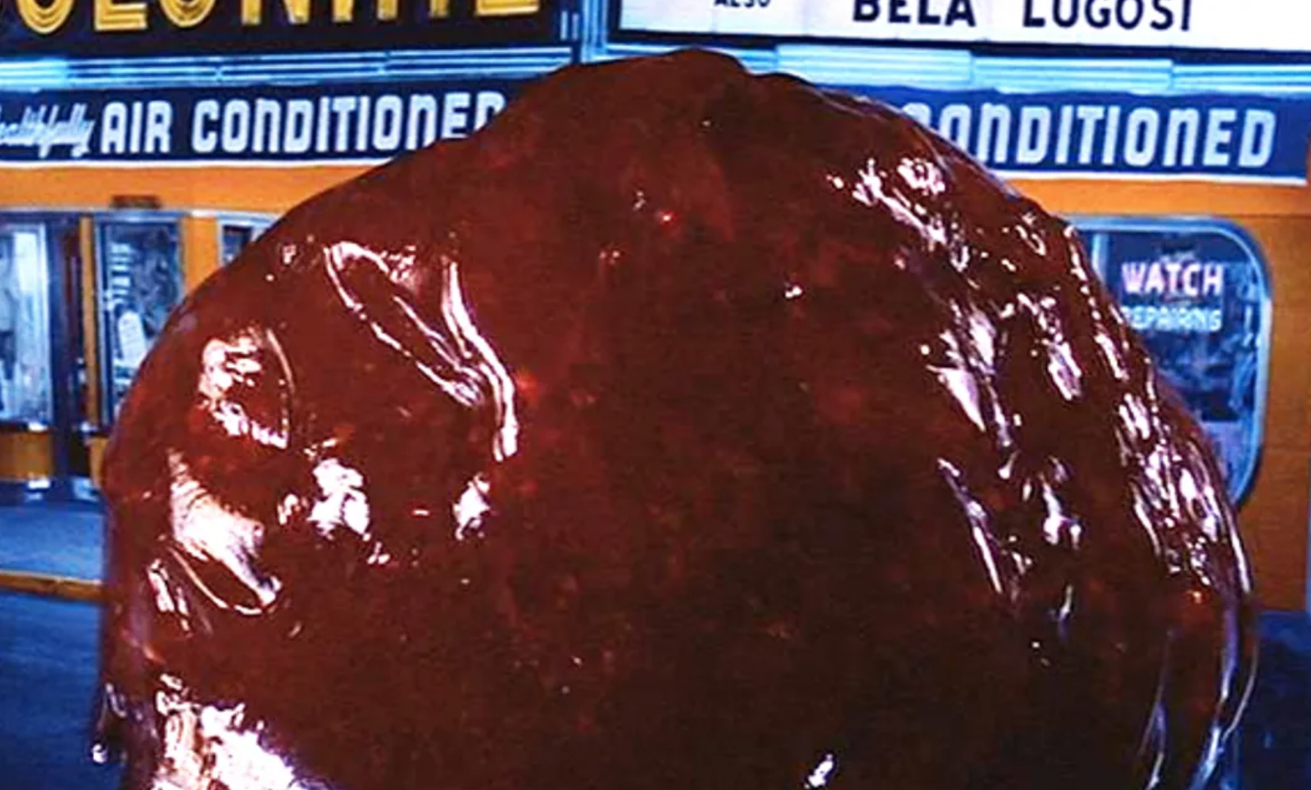
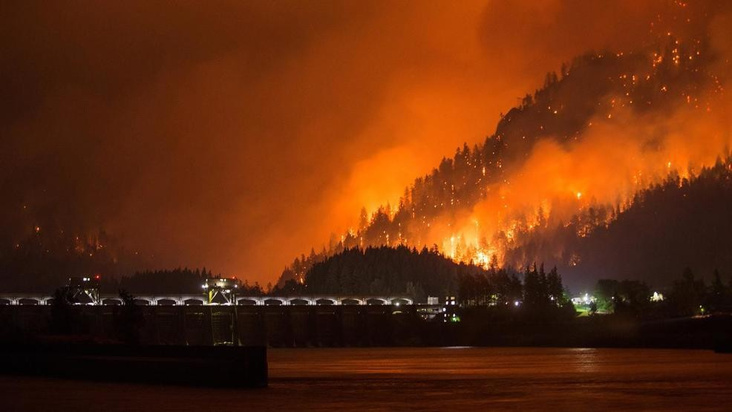
The BLOB and West-Side Wildfires: Some New Insights from High Resolution Weather Modeling
Cliff Mass
University of Washington

Slide 2
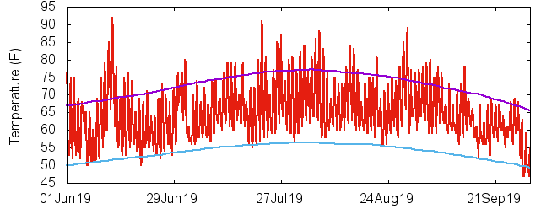
Minimum Temperatures Were Warmer Than Normal This Summer over western Oregon and Washington
Seattle Tacoma Airport

Slide 3
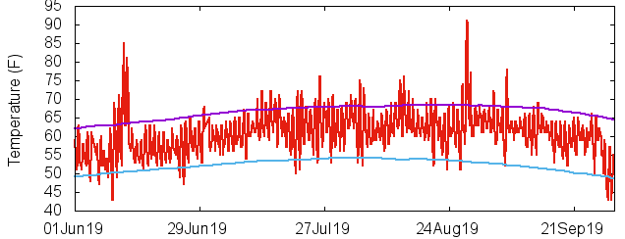
Hoquiam

Slide 4
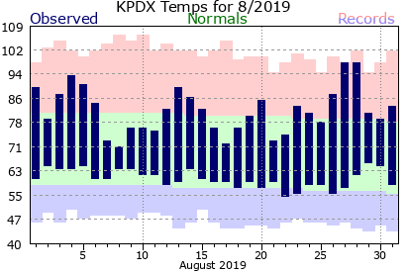
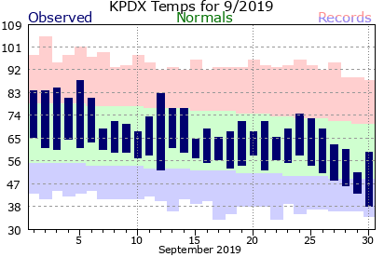
Portland
August
September

Slide 5
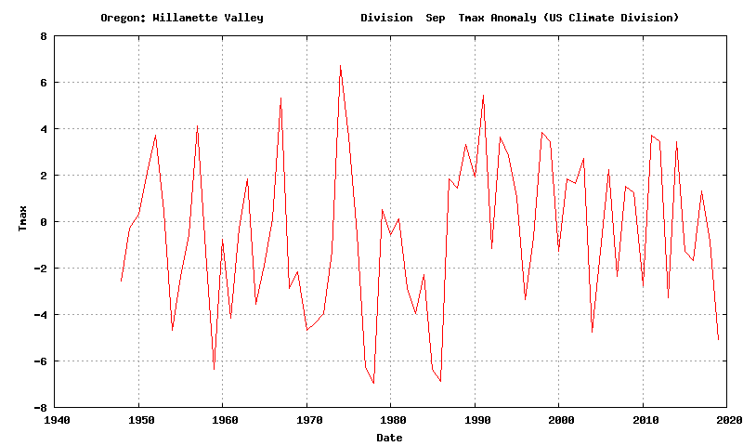
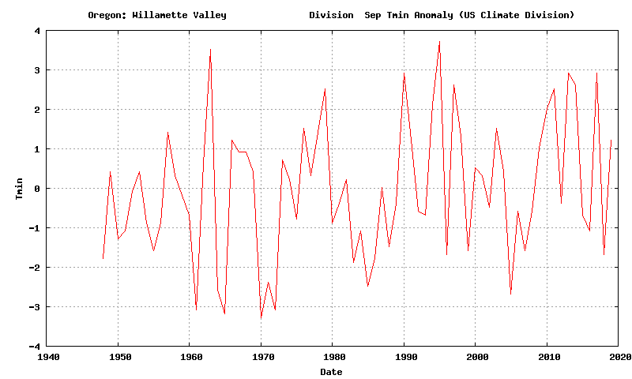
September
Willamette Valley Temperatures
(1948-2019)
Sept 2019:
Maxima were cool
Minima were warm
Max
-5F
+1.2F
Min

Slide 6
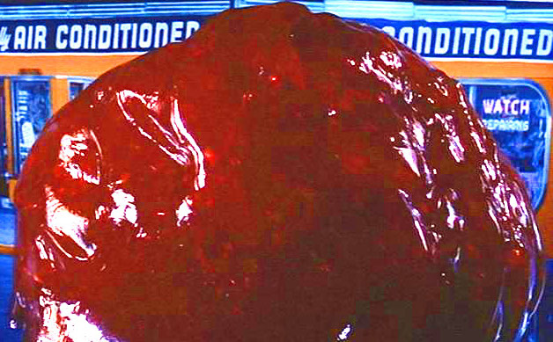
Why so warm in the morning?
Could it be the BLOB?

Slide 7
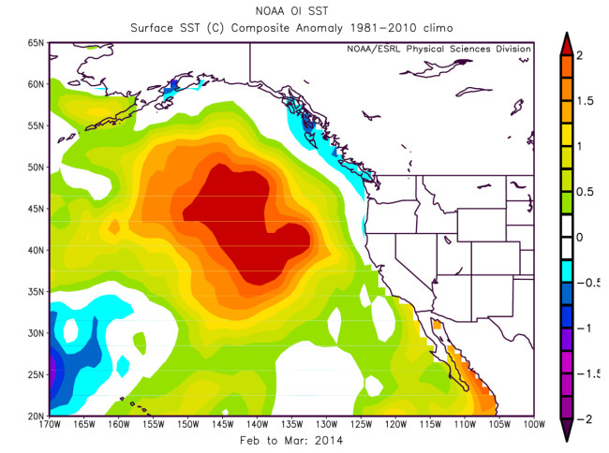
The Blob is associated with warmer than normal water over the NE Pacific
Feb-March 2014 Sea Surface Temperature Anomaly

Slide 8
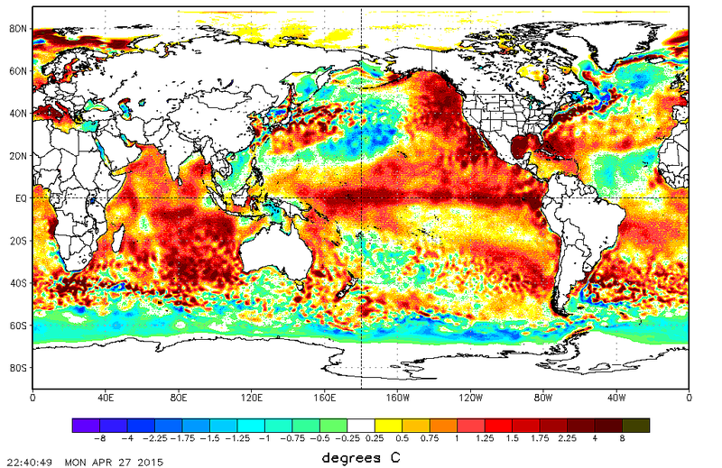
April 2015
SST
Anomaly from Normal

Slide 9
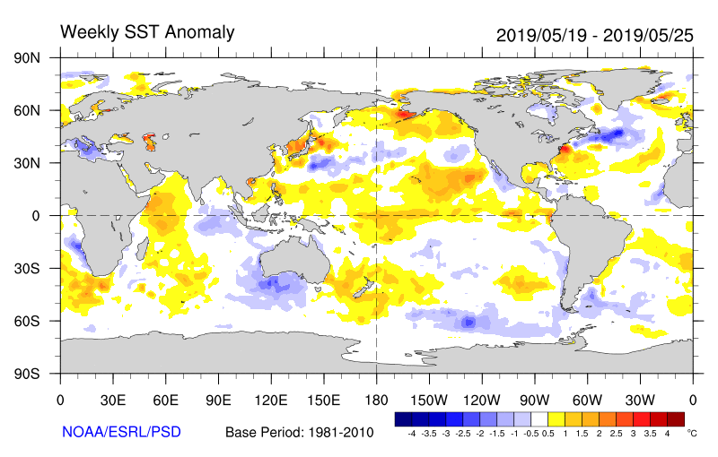
The BLOB Redeveloped This Summer

Slide 10
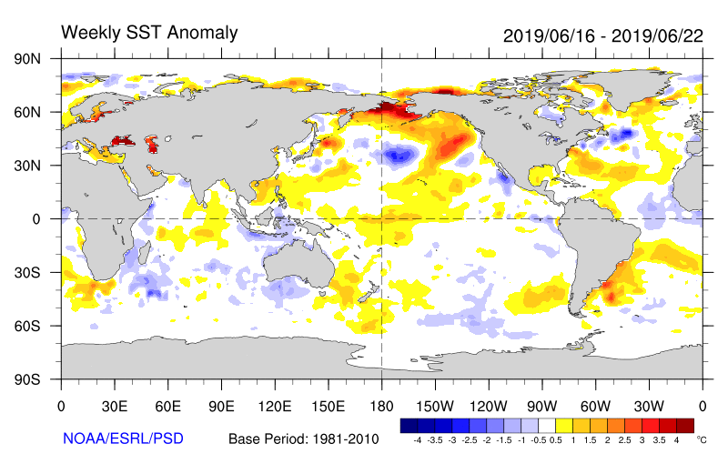

Slide 11
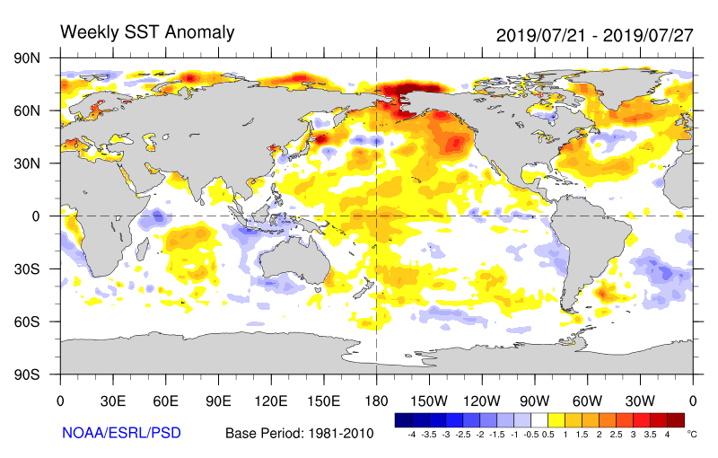

Slide 12
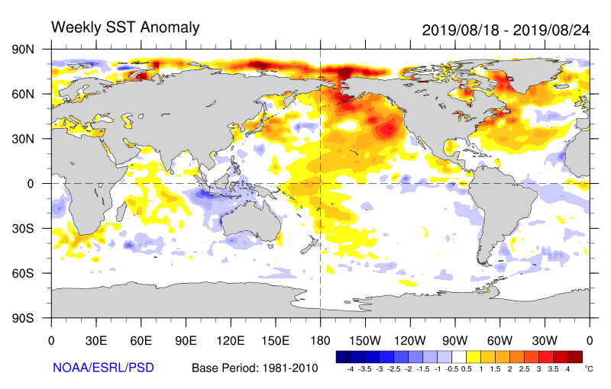

Slide 13
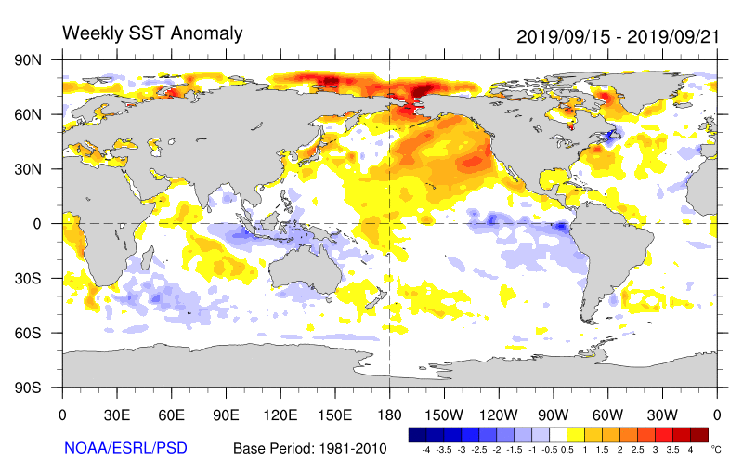

Slide 14
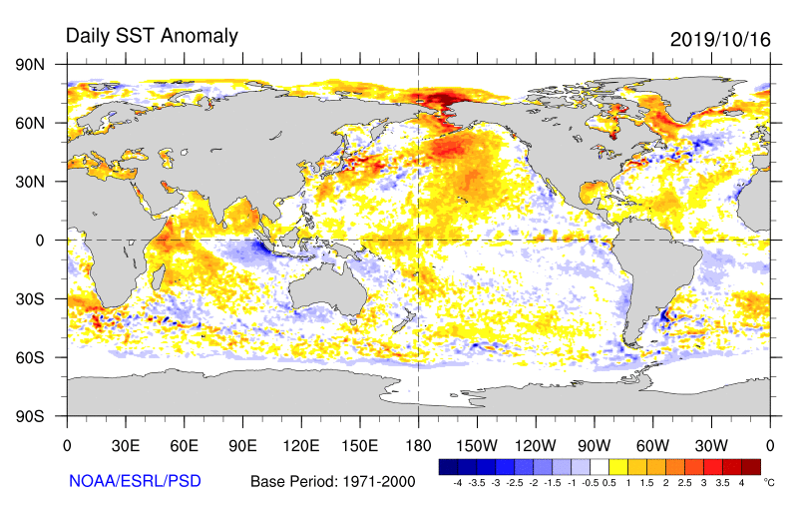
And recently it has started to weaken

Slide 15
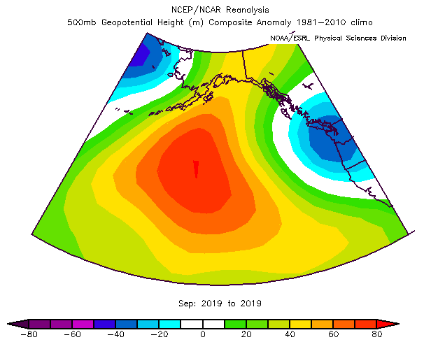
Why the Blob? Persistent High Pressure over the NE Pacific

Slide 16
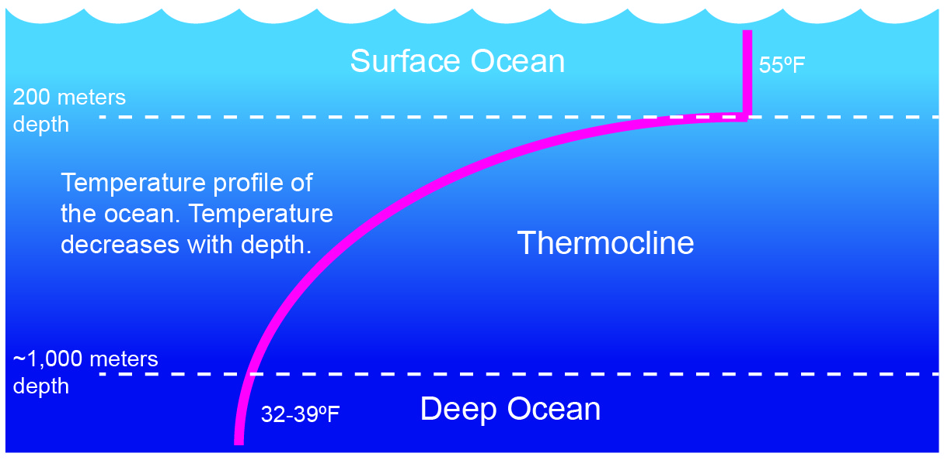
High Pressure is Associated with Lighter Winds and Thus Less Mixing of Cooler Water From Below

Slide 17
Also winds moving around highs push warm water northward

Slide 18
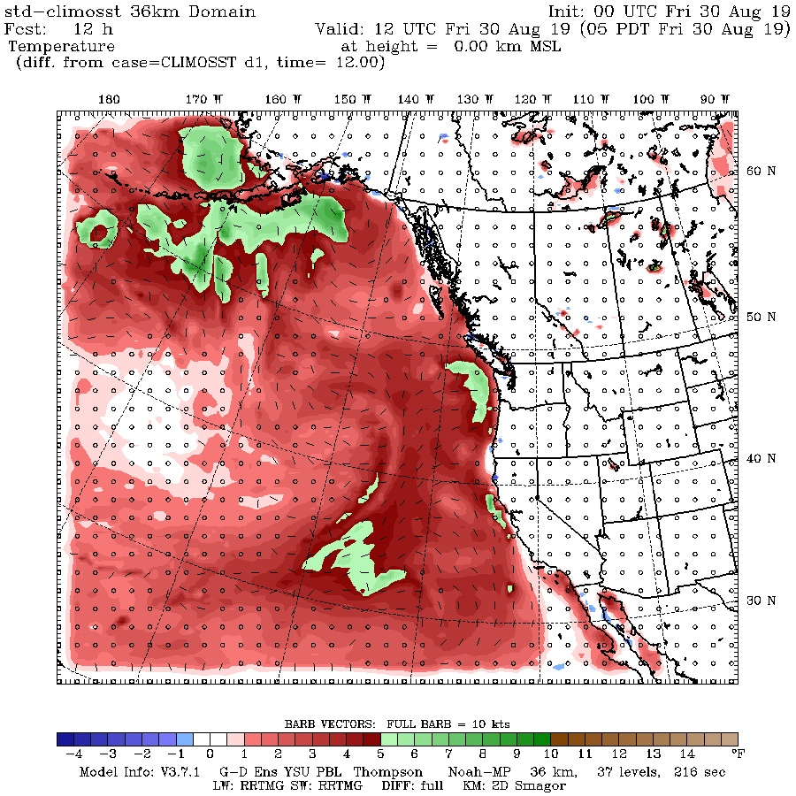
Proving a Connection of the BLOB With Our Minima Temperatures Using High-Resolution Modeling
Replace the warm BLOB sea surface temperatures with climatological normal conditions and rerun the WRF model

Slide 19
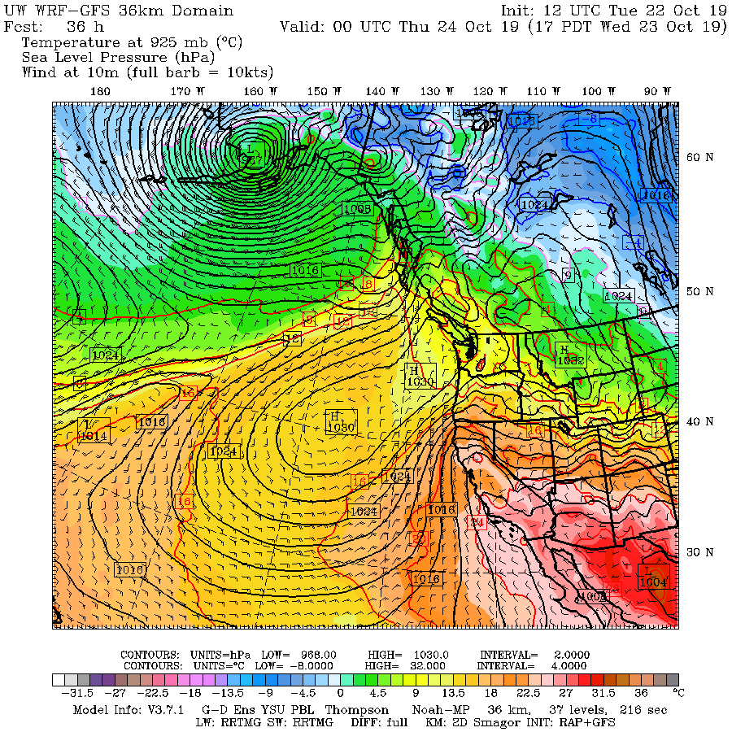

Slide 20
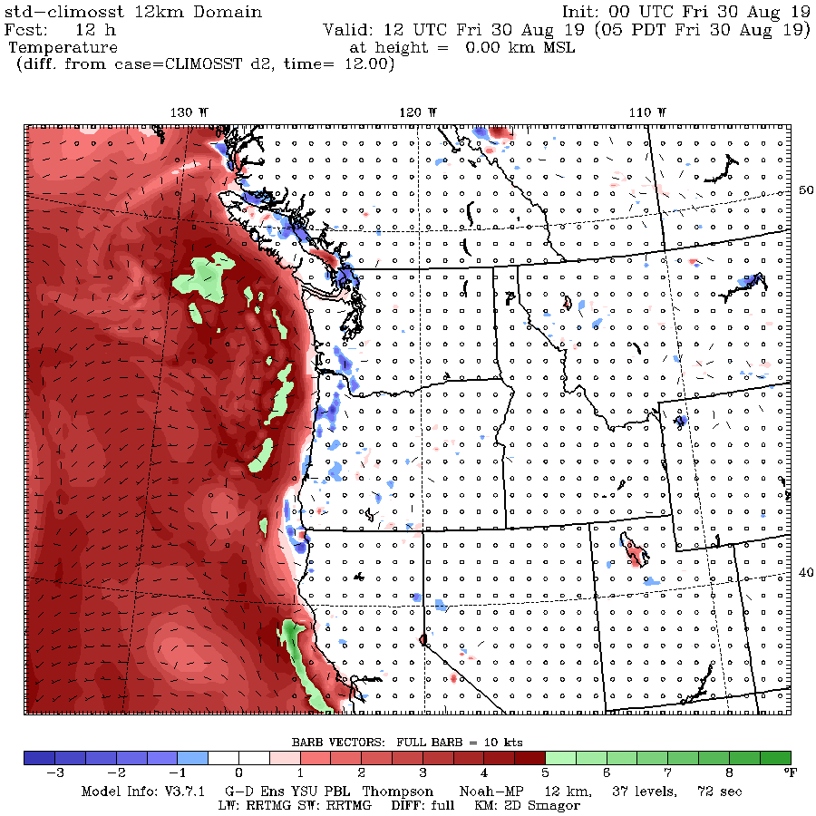
Surface Air Temperature Difference
(BLOB-Normal)
12-hour

Slide 21
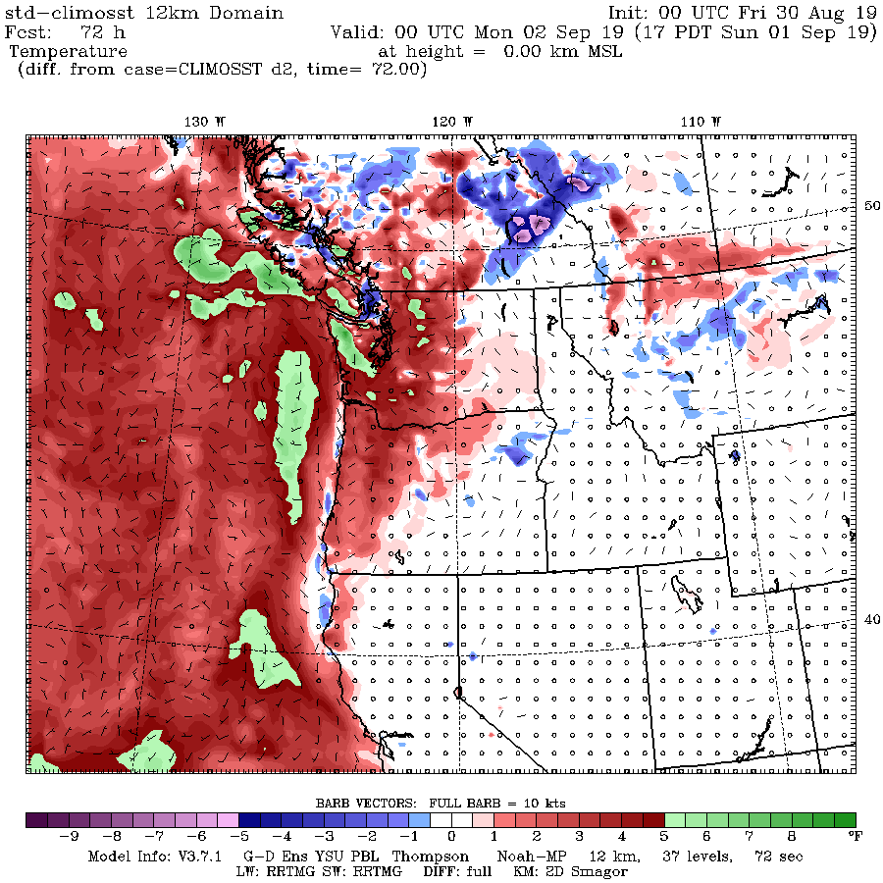
72- hours

Slide 22
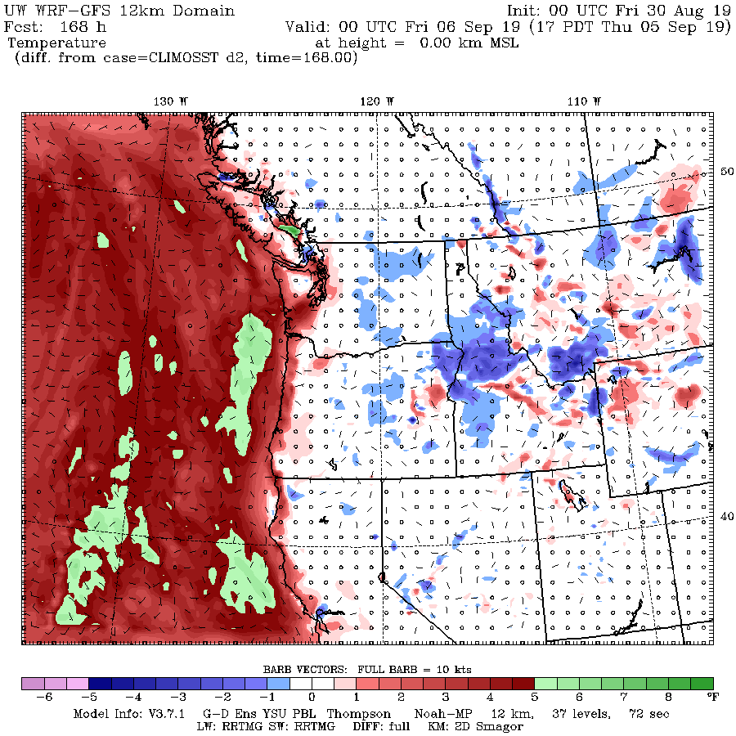
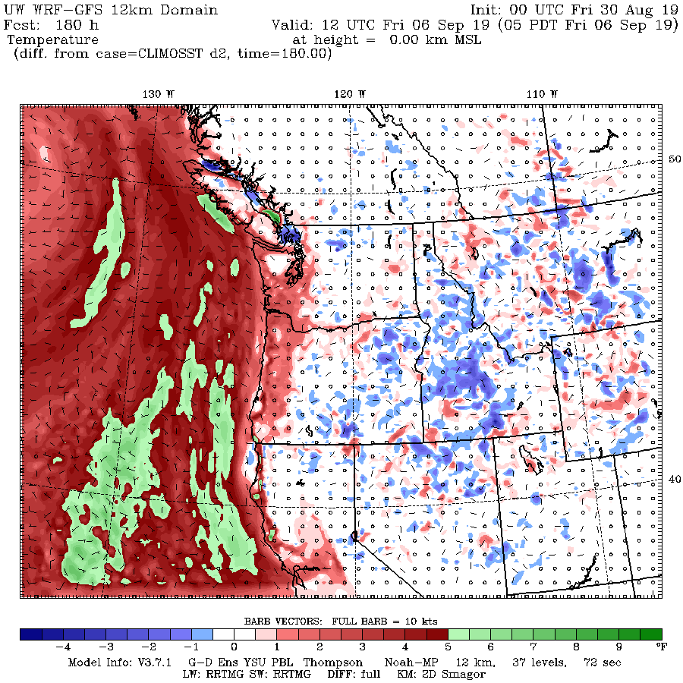
Warming Tends to Move Inland More During Night
5 PM
5 AM

Slide 23
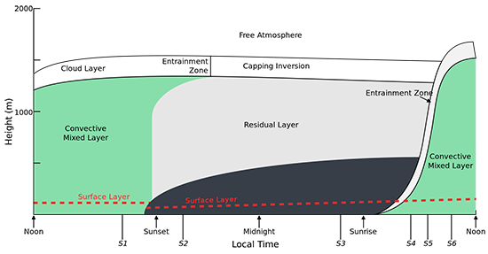
Physical Insights
During day, there is vertical mixing in the boundary layer, so the high temperature is controlled by temperatures aloft (say at 850 hPa—about 5000 ft).
In contrast, at night, low level flow off the ocean is more important in determining temperatures.

Slide 24
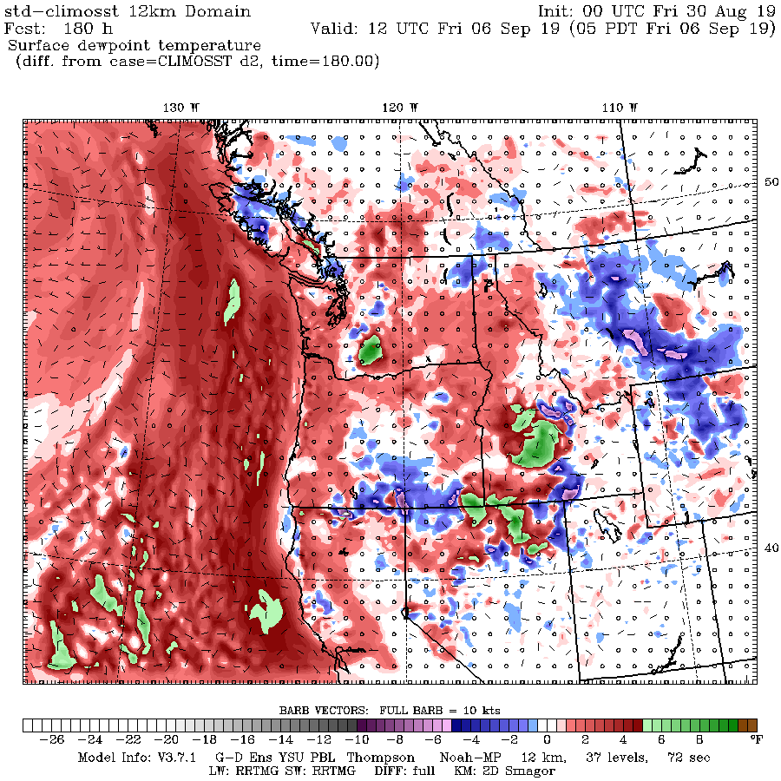
Surface Dew Point is Increased Inland Due to Warmer Waters

Slide 25
Basic Points
Warm water offshore (the Blob) preferentially warms our minimum temperature.
Less effect on maximum.
Low temperatures are warmed in two ways:
  Warmer air moves in off the Pacific
  More humid air helps keep minima up as well

Slide 26
Western Oregon and Washington Wildfires: An Interesting Twist

Slide 27
Major, Large Wildfires Can Occur on the West Sides of the Cascades
1933 Tillamook Burn 240,000 acres
1939 Second Tillamook Burn 217000 acres
1945 Third Tillamook Burn 173000 acres.
1936 Bandon Fire 287,000 acres
1987 Silver Complex Fire 96540 acres
2002 Biscuit Fire 500,000 acres.
2017 Chetco Bar Fire. 191,000 acres
2017 Eagle Creek Fire 50,000 acres

Slide 28
Will Such Wildfires Increase Under Global Warming?

Slide 29
There is something they all have in common:
Strong Easterly Flow
Have looked at a dozen of such west-side wildfires, looking at newspaper accounts and meteorological data for recent events.
ALL were accompanied by strong easterly flow!

Slide 30
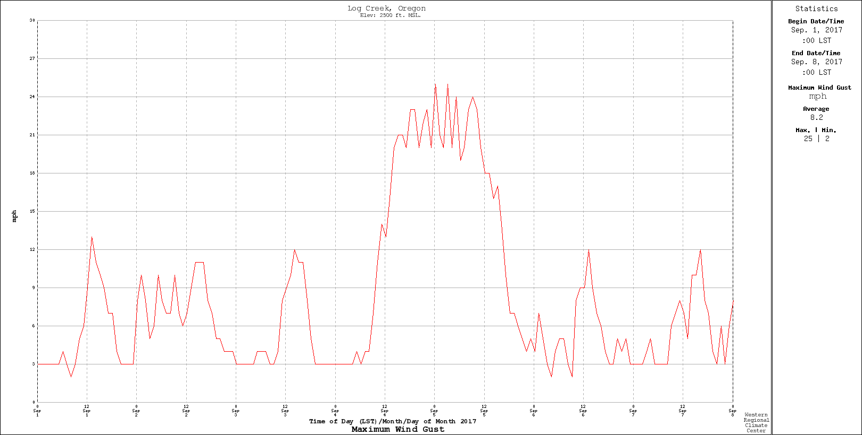
Log Creek RAWS

Slide 31
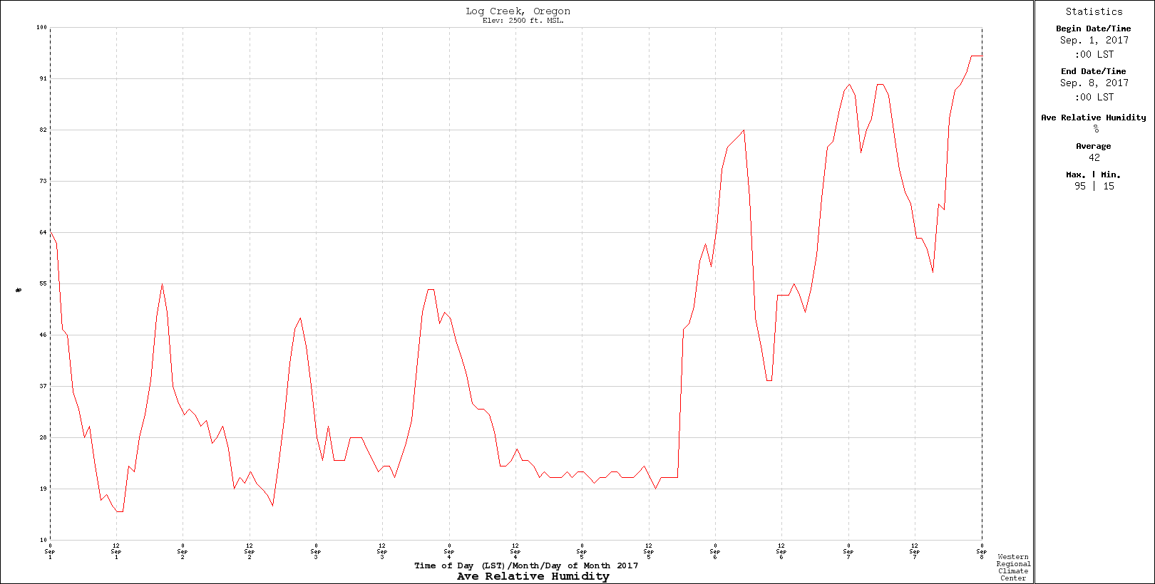

Slide 32
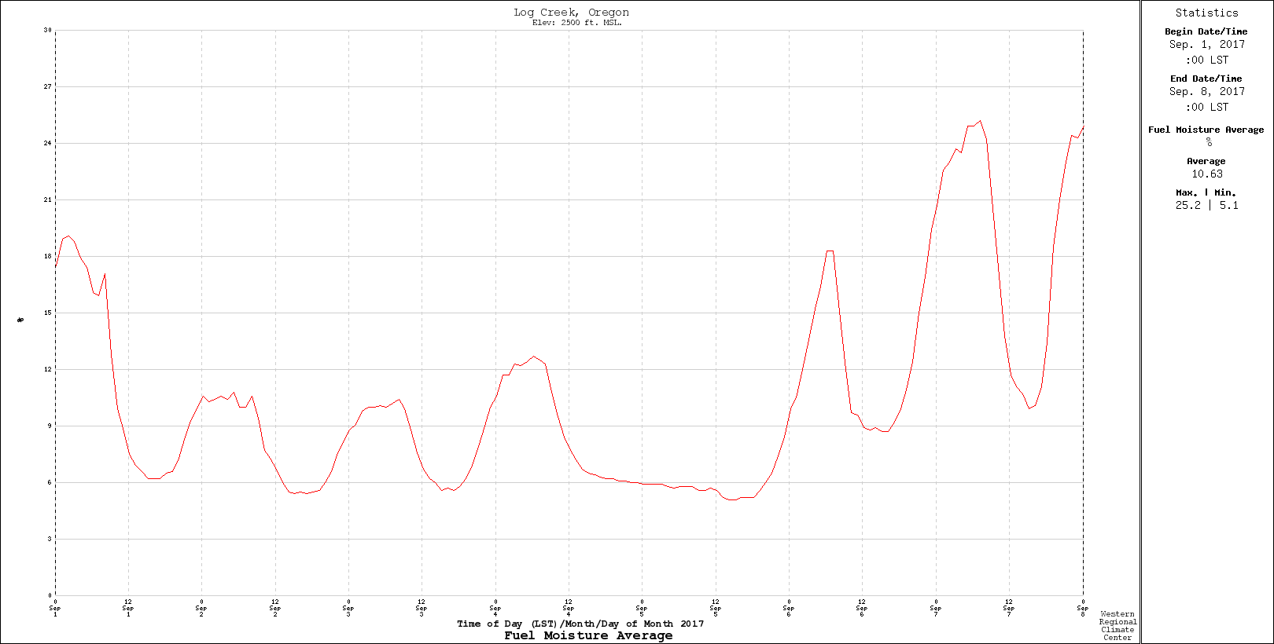

Slide 33

No consistent signal for temperatures and precipitation for proceeding summer
So major questions regarding easterly flow:
Will global warming make easterly flow more frequent?
Will easterly flow make easterly flow stronger when it does occur?

Slide 34

Regional Dynamical Downscaling
High-resolution (12-km) WRF Ensemble Driven by 12 CMIP-5 Global Climate Models.
Paid by

Slide 35
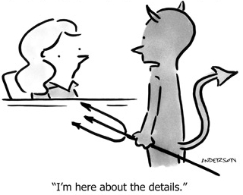
Some Details
WRF Model 3.7.1
RCP 8.5: Perhaps too aggressive, but shows the worst case.
Ran under 12 CMIP-5 GCMs with 6-hr output
36 and 12 km domains, with 36-km nudged to the parent GCM
Ran for 1970-2100. No breaks
Used both Amazon AWS cloud and local clusters.

Slide 36
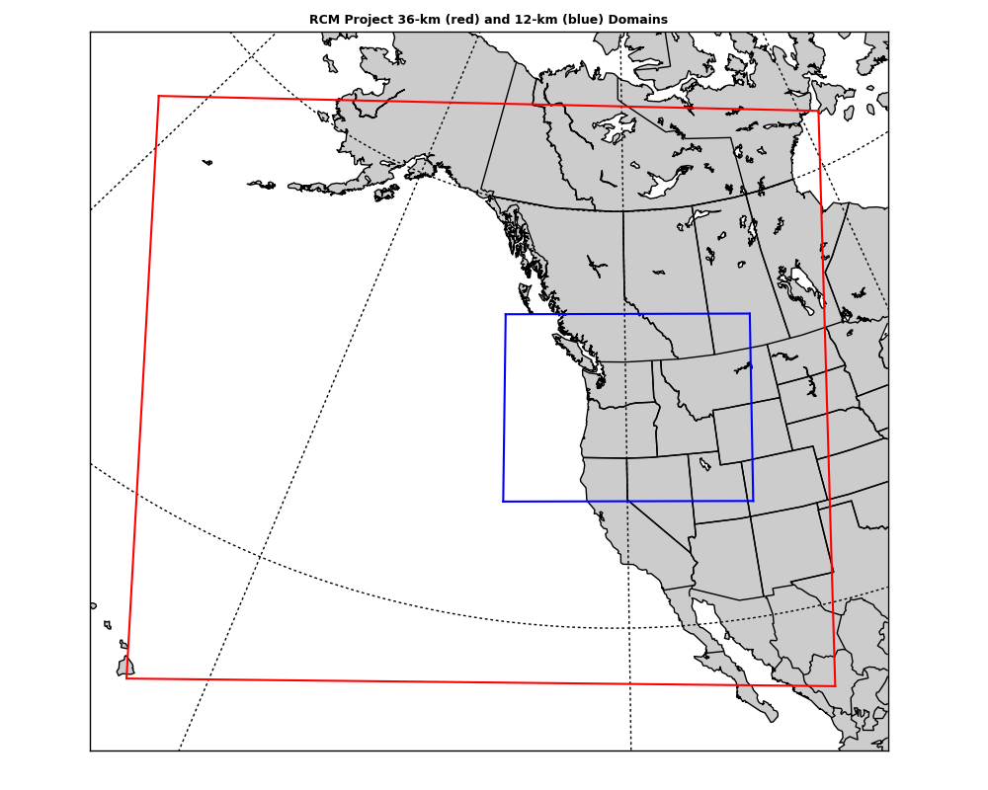
Domains
36 km
12-km

Slide 37
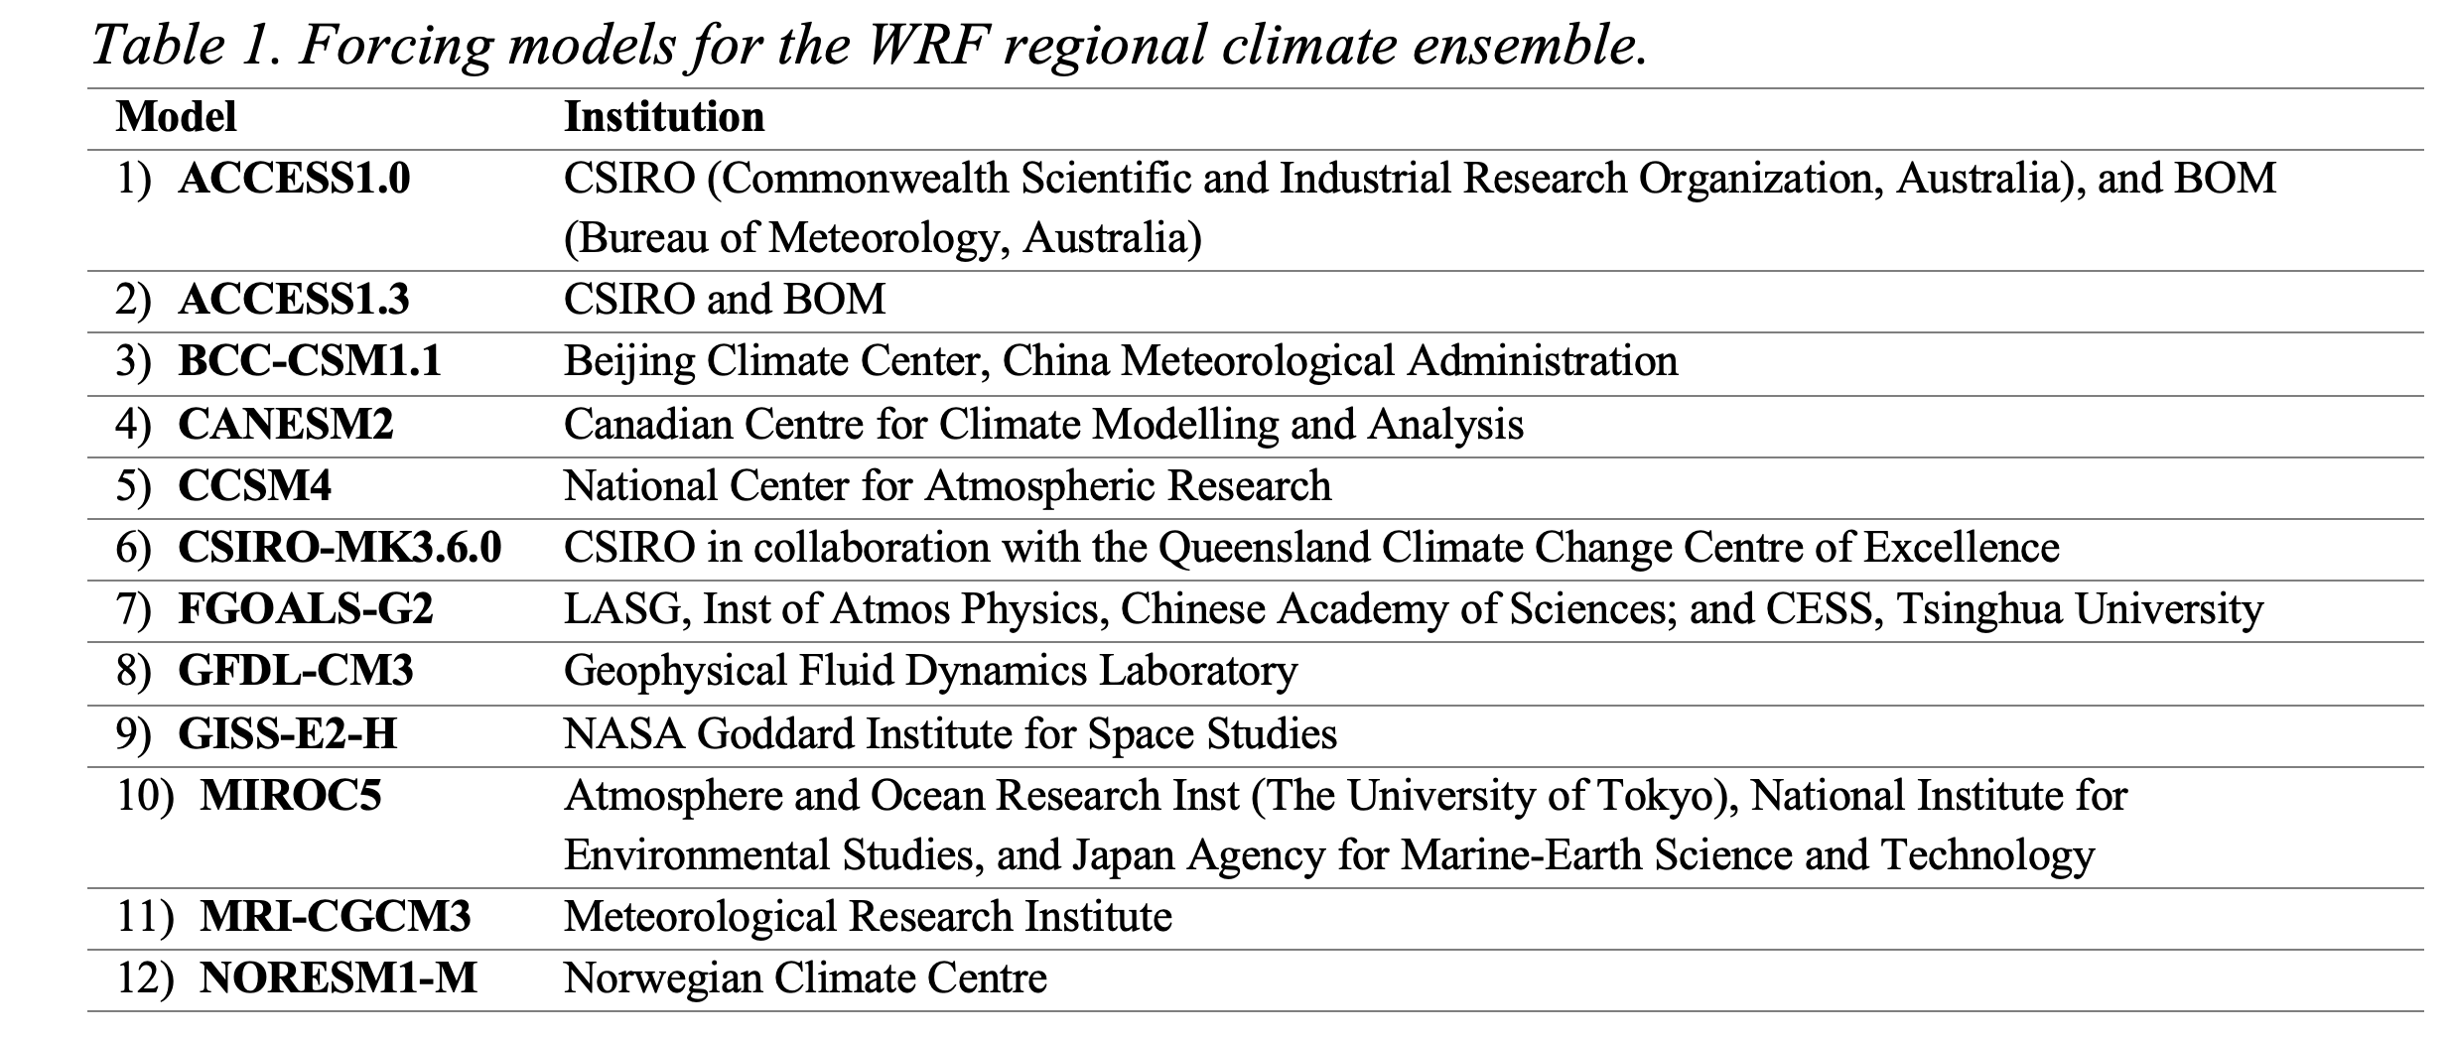
GCMs Used

Slide 38
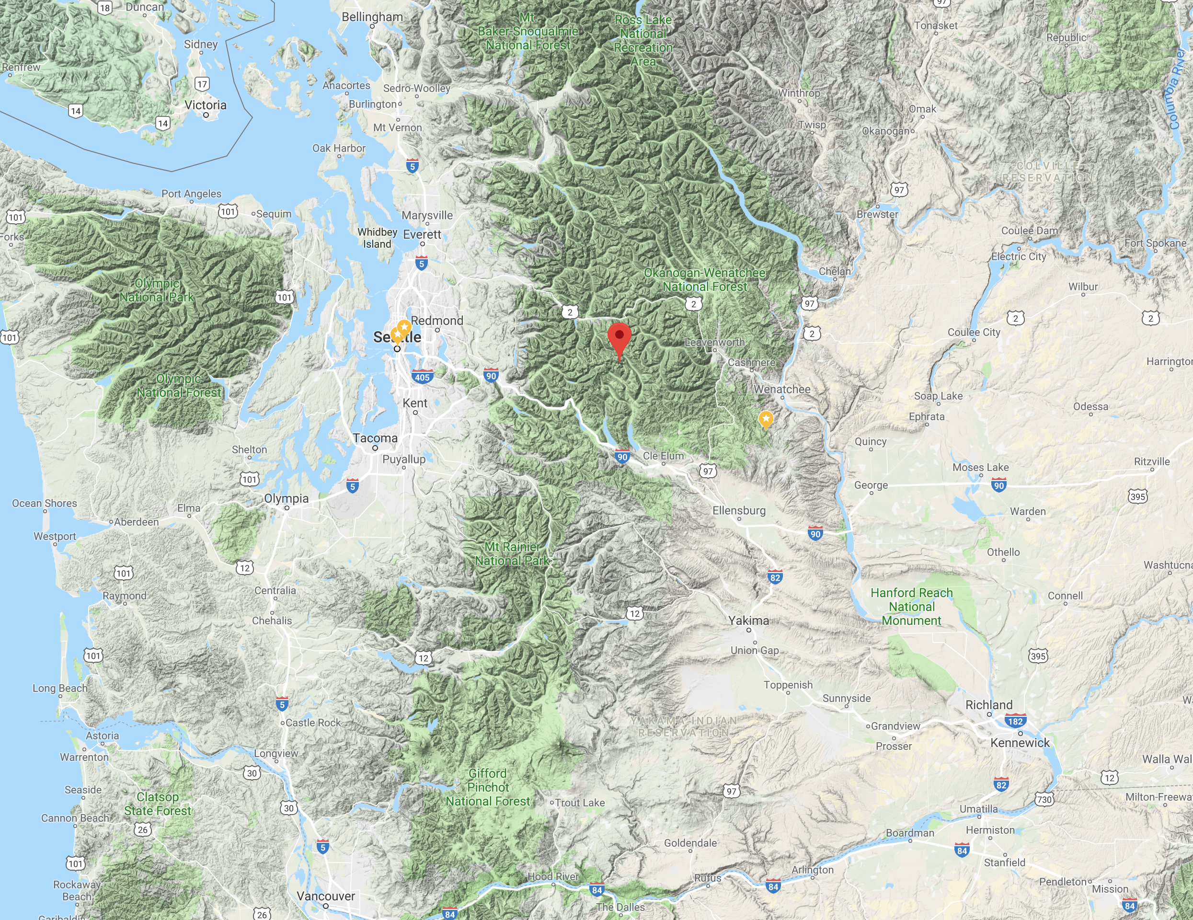
Consider a point near the crest of the Cascade Mountains

Slide 39
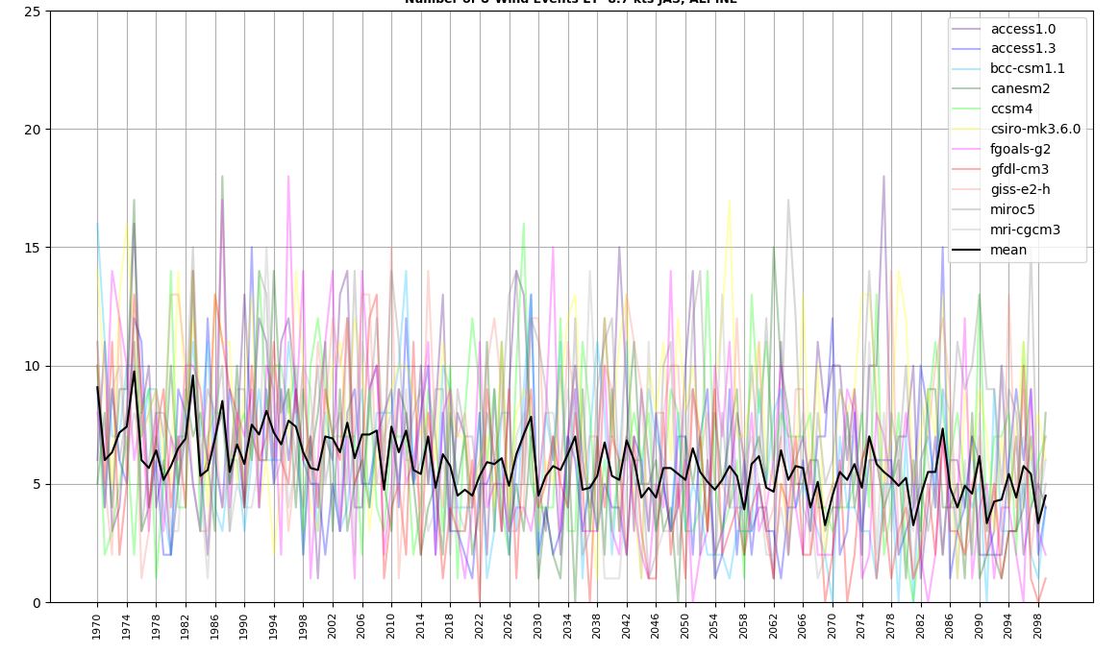
Maximum Daily Easterly Winds Each Year (Cascade crest)
Maximum Easterly Winds are Projected to Decline!

Slide 40
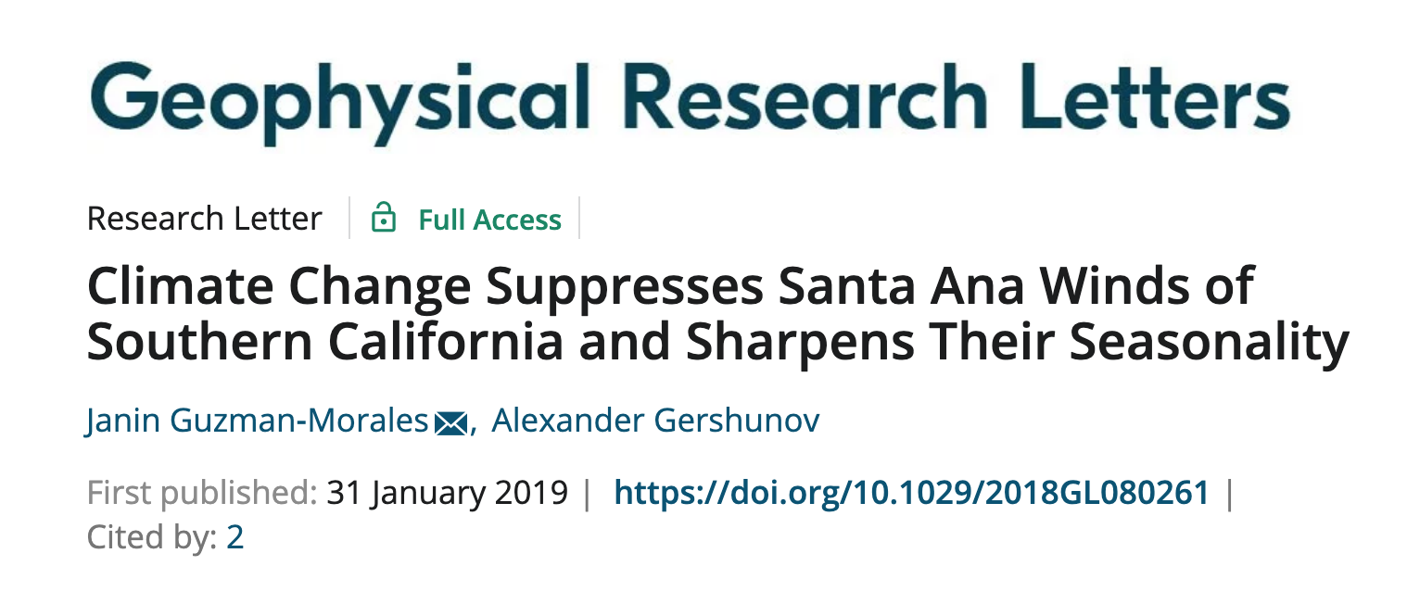
Reduced Easterly Flow Under Global Warming
Consistent with other studies in southern California (reduced easterly flow driving Santa Anas).
Global warming preferentially heats the interior of the continent versus the ocean, producing enhanced pressure falls over the interior.
Results in stronger onshore flow (or weaker offshore/easterly flow).

Slide 41
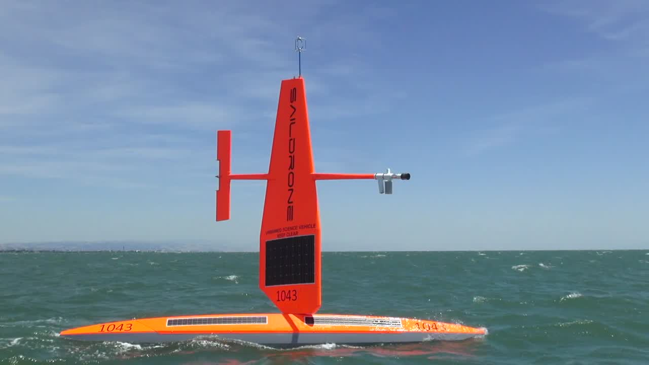
Exciting New Observation System Off the Coast: Saildrones

Slide 42
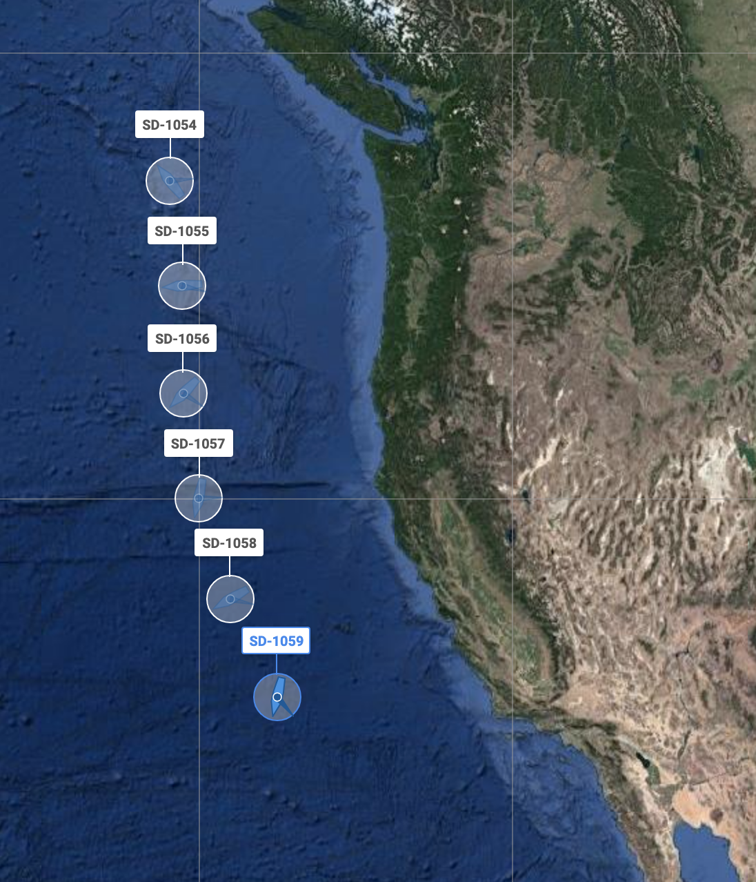
“Picket Fence” off the Coast
Can we improve forecasts along the West Coast with a line of Saildrones offshore?

Slide 43
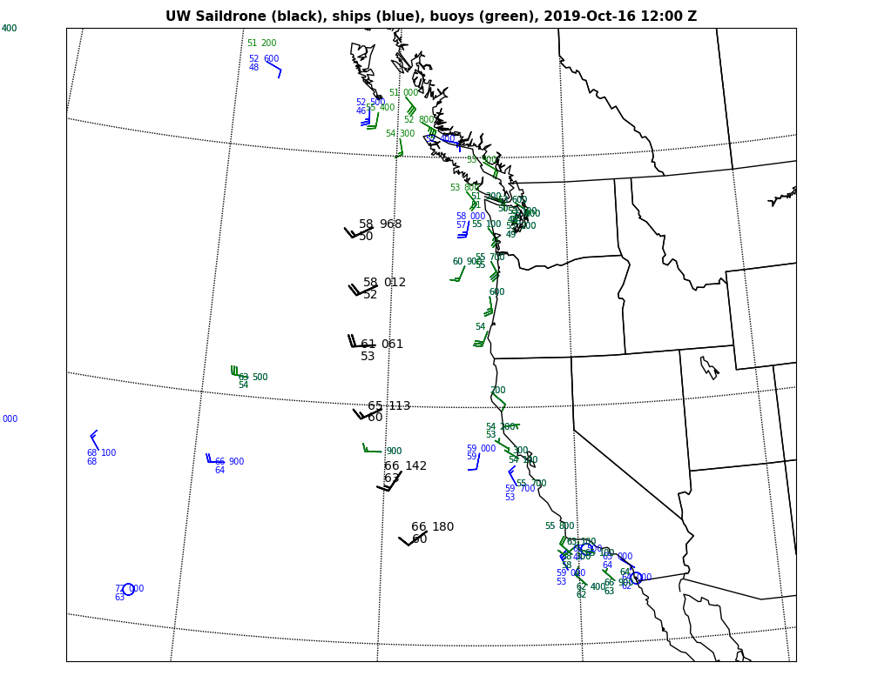
https://a.atmos.washington.edu/~jbaars/images/saildrone/2019101612.png

Slide 44
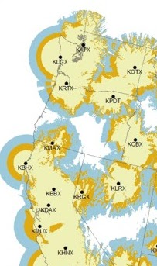
We Still Need an Oregon Coastal Radar

Slide 45
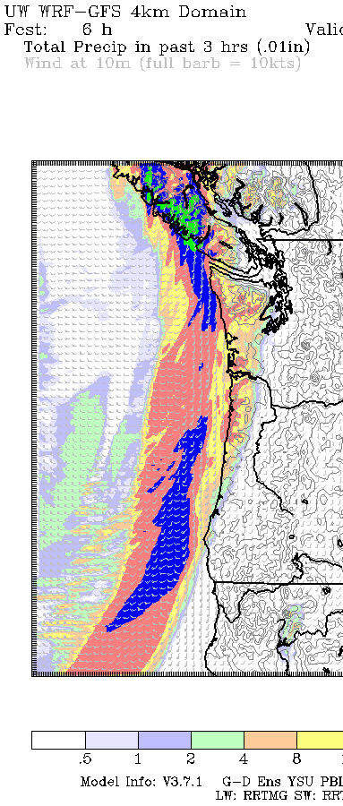
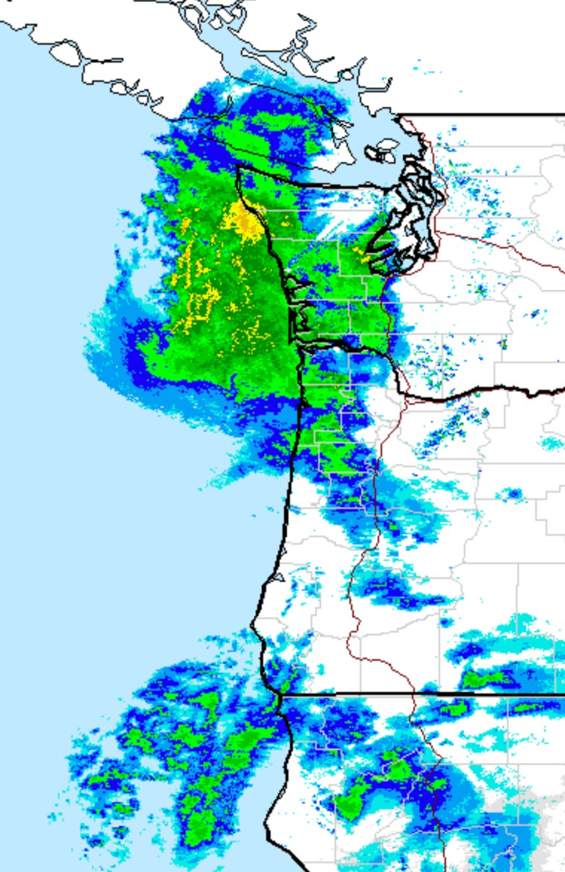
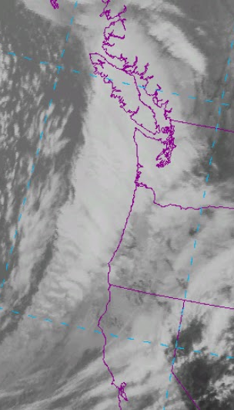
11 April 2018

Slide 46
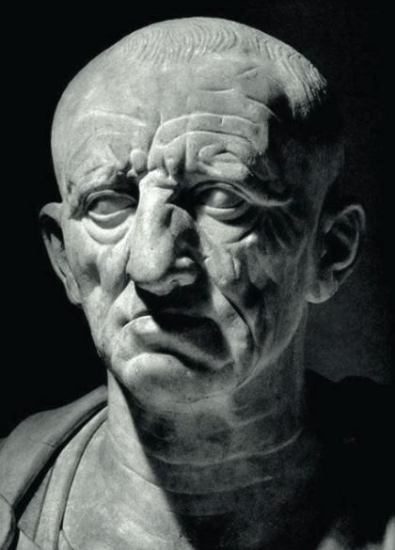
In Ancient Roman, Cato the Censor, Would End All His Speeches With:
Cathago Delenda Est
(Carthage Must Be Destroyed)

Slide 47
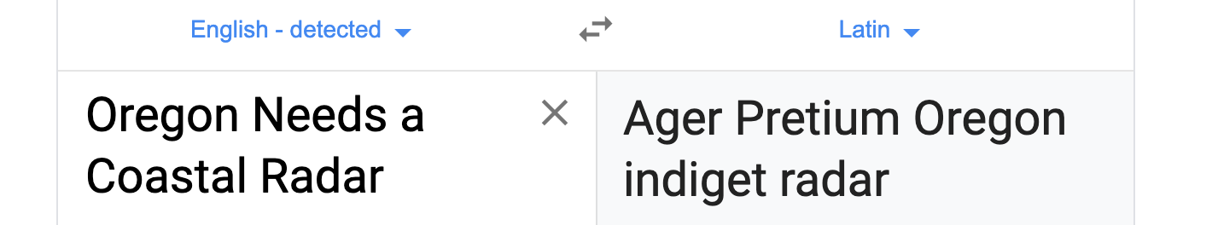
We need a modern day Cato for an Oregon coastal radar
" Ager Pretium Oregon Indiget Radar "

Slide 48
Ager Pretium Oregon Indiget Radar
The End

