Slide 1
Mixing and Isallobaric Wind Issues

Slide 2
Stability and Vertical Momentum Mixing

Slide 3
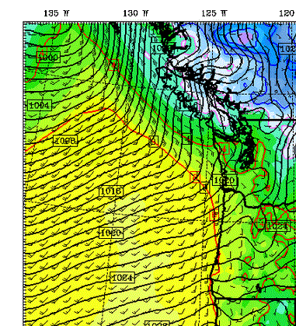
Wind Speed Up After WF Passage

Slide 4
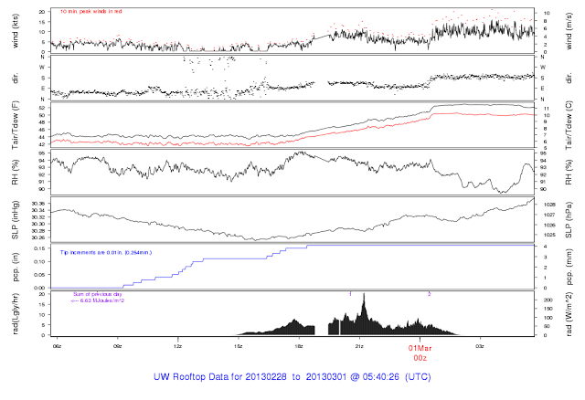

Slide 5
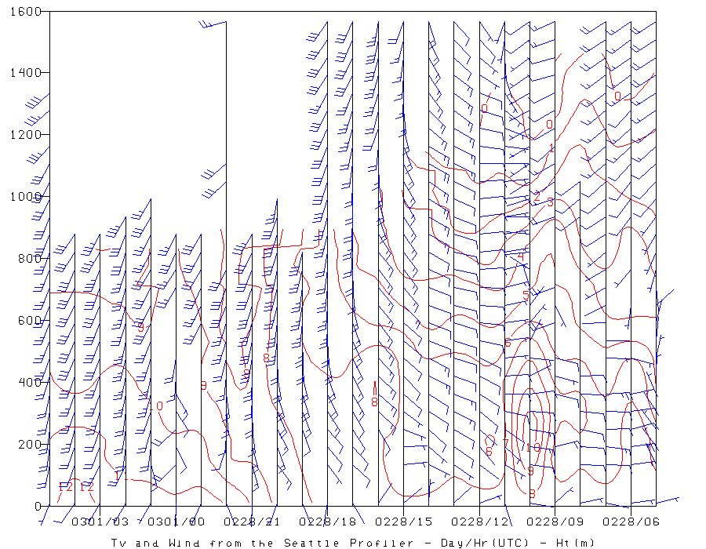

Slide 6
The Chanukah Eve Windstorm Stability Changes and Winds

Slide 7
Momentum mixing: 12/17/06

Slide 9
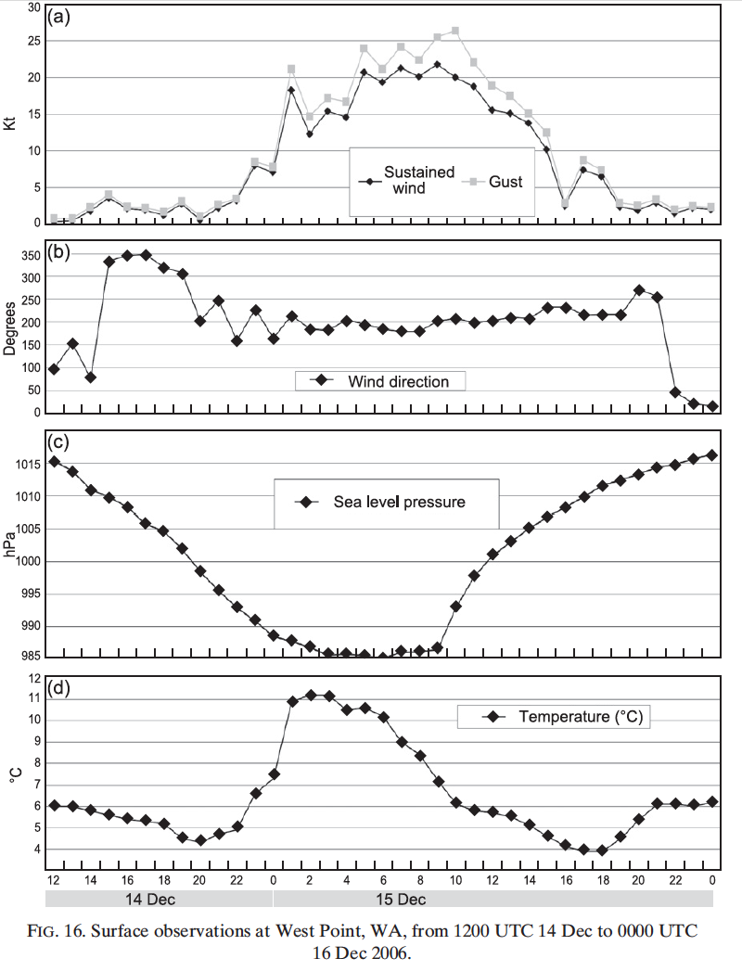

Slide 10
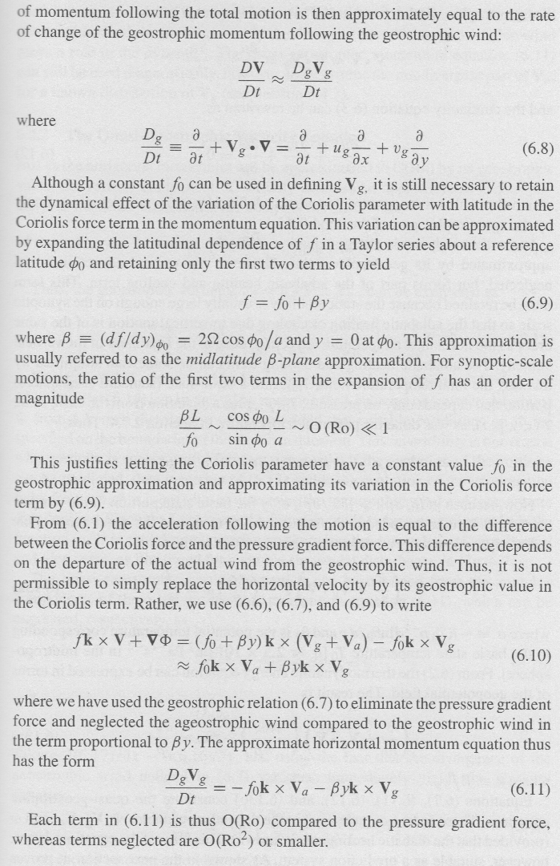
Isallobaric Wind

Slide 11
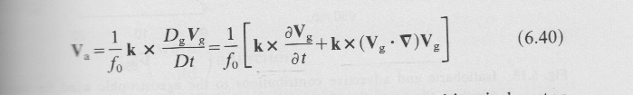
Isallobaric wind blows toward max pressure falls

Slide 12
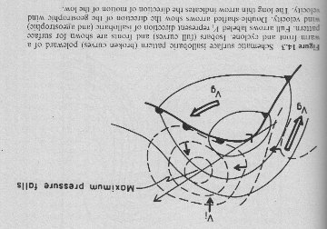
Schematic

Slide 13
