Slide 1
Temperature Atmospheric Sciences 101 Winter 2019

Slide 2
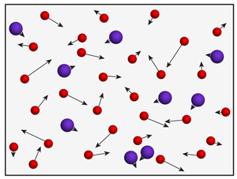
Temperature is a measure of the average speed of atoms and molecules

Slide 3
Temperature
When a substance warms, atoms and molecules move faster.
In a solid, molecules remain bound together in a rigid crystalline structure
In a liquid, molecules are bound together but can move around.
In a gas, molecules move as independent entities

Slide 4
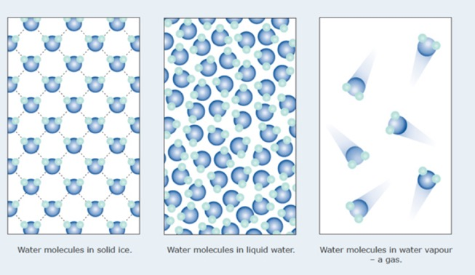

Slide 5
Definition
Temperature is a measure of the average speed of atoms and molecules of a substance
More exactly, temperature is proportional to the average kinetic energy of a substances atoms and molecules
Kinetic Energy (KE) = (1/2)mv², where m=mass, and v is speed
http://www.falstad.com/gas/fullscreen.html

Slide 6
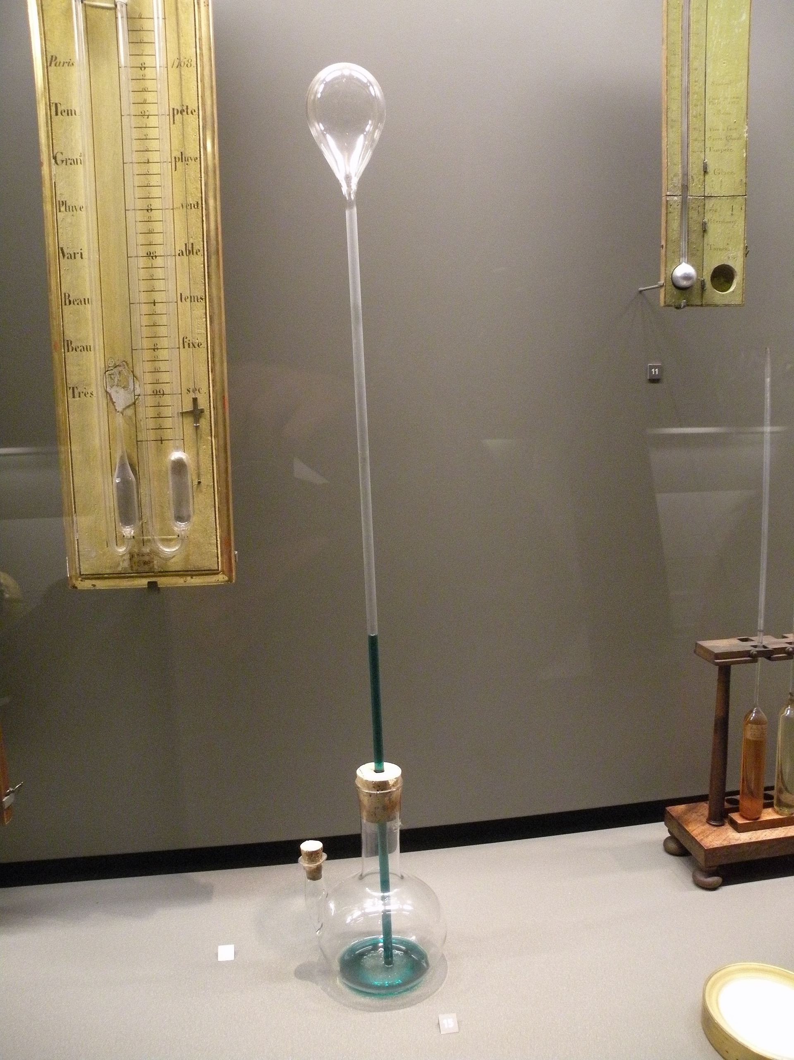
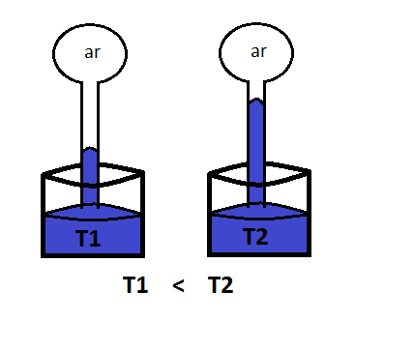
Temperature is measured with thermometers—and there are many types
Galileo developed the first thermometer in the late 1500s.

Slide 7
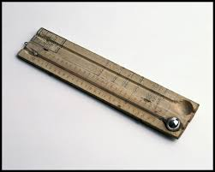
Thermometer
In 1600s, alcohol thermometers came into use
In 1714, Gabriel Fahrenheit, a German physicist, constructed the first mercury thermometer.
A problem developed, different thermometers had different scales!
Promoted lots of confusion!

Slide 8
Three Major Scales Used Today
Fahrenheit (°F)
Centigrade or Celsius (°C)
Kelvin or Absolute (°K, °A)
How to Convert Freezing Boiling
C=(5/9)(F-32) 0 100
F=(9/5)C + 32 32 212
K=C + 273 273 373
The rest of world uses C, only the US uses F

Slide 9
Temperatures in Celsius (F)
100 (212F) boiling point of water at standard pressure
57 (134F) record high temperature (Libya)
50 (122F) typical summer high in Death Valley, CA
30 (86F) typical summer high over U.S. East Coast
20 (68F) normal room temperature
0 (32F) freezing
-10 (14F) super cold wave in Seattle
-40 (-40F) record cold in northern U.S.
-88 (-126F) record low temperature at South Pole
-273 (-460) absolute zero

Slide 10
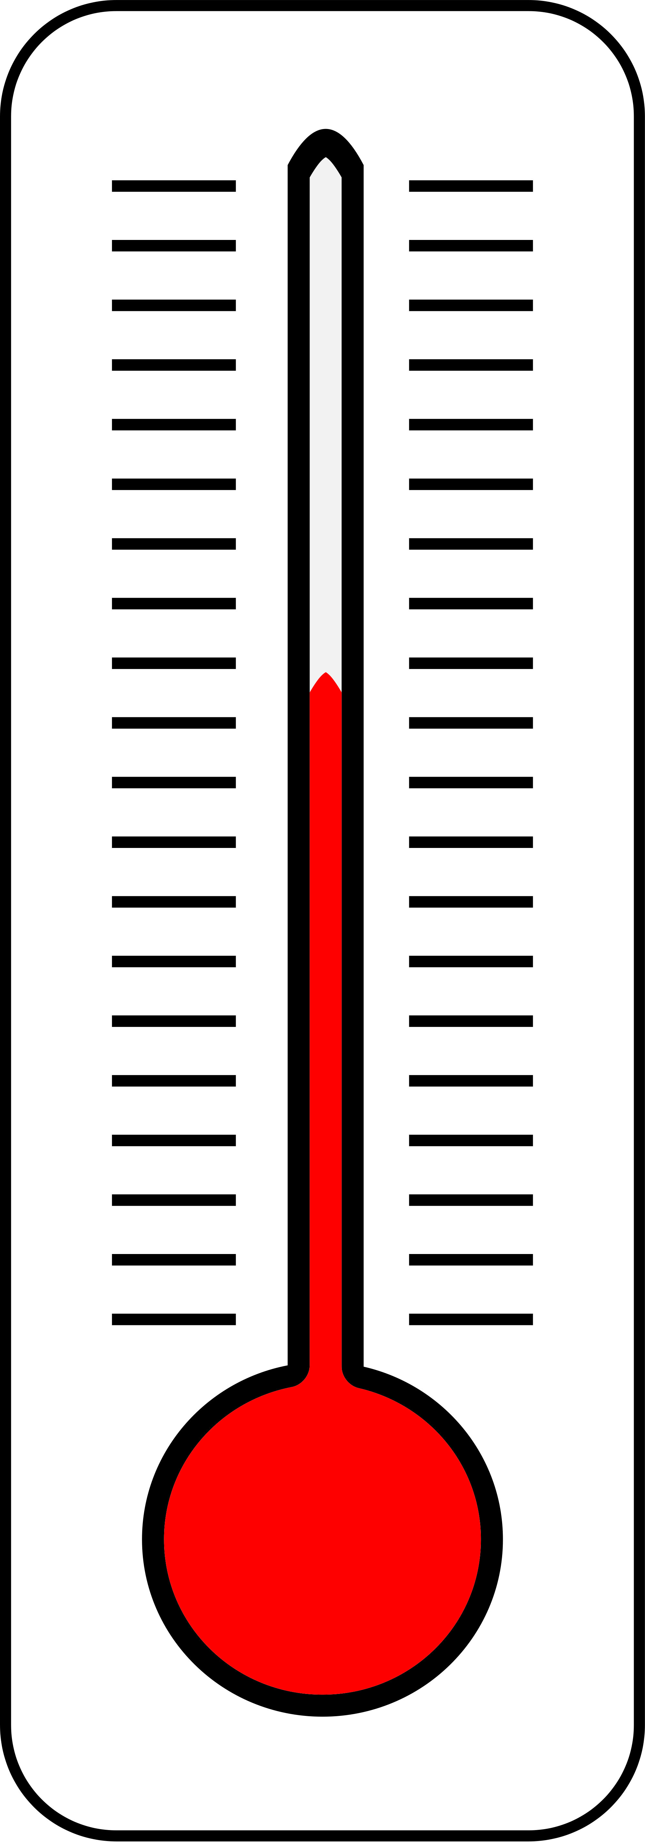
Types of Thermometers
The classic: hollow glass tube connected to a bulb filled with alcohol or mercury
Fluid expands or contracts as temperature changes
Fairly accurate. Typically good to about 1F.

Slide 11
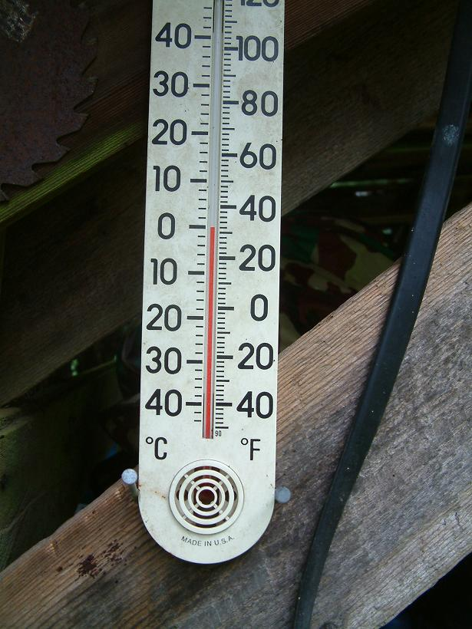
Alcohol and Mercury
Thermometers

Slide 12
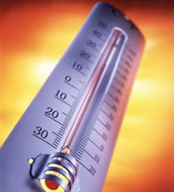
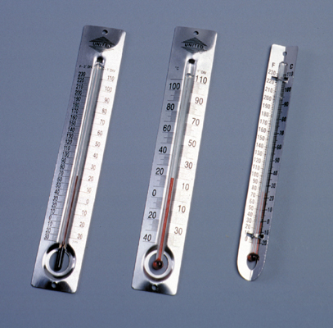
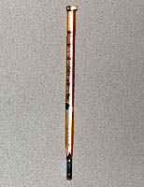

Slide 13
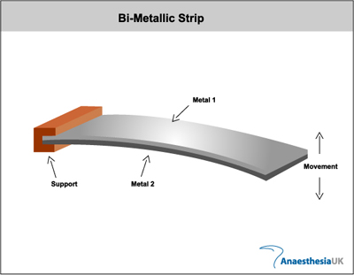
Bimetallic Strip Thermometers
2 different types of metals fused together
Different metals expand differently as temperature changes
Used in thermostats and cheap thermometers. Metal strips often in spirals.

Slide 14
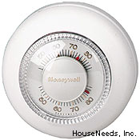
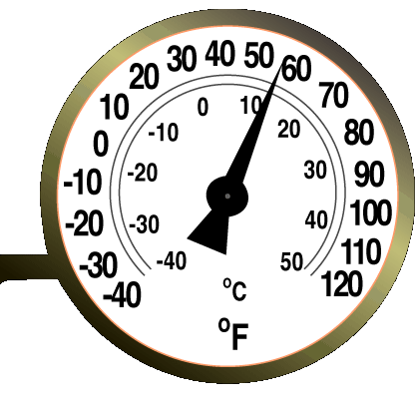
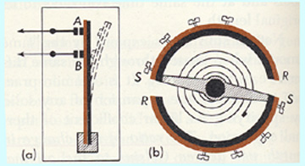

Slide 15
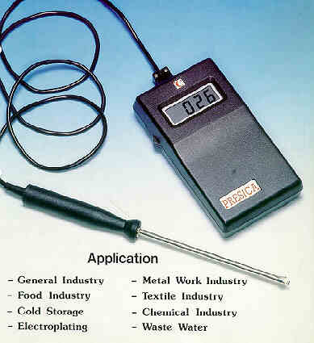
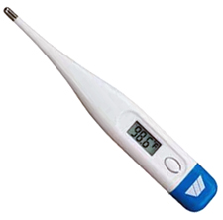
Electronic Thermometers
Often use thermisters, a device whose electrical resistance varies with temperature
Car thermometers, medical thermometers, etc.

Slide 16
Radiometers
A device that measures the amount of radiation emitted by a substance
Amount and wavelength of radiation emitted is a function of temperature (warmer objects emit more and at shorter wavelengths)
Radiometers used by satellites to measure temperatures of clouds, atmosphere, and surface

Slide 17
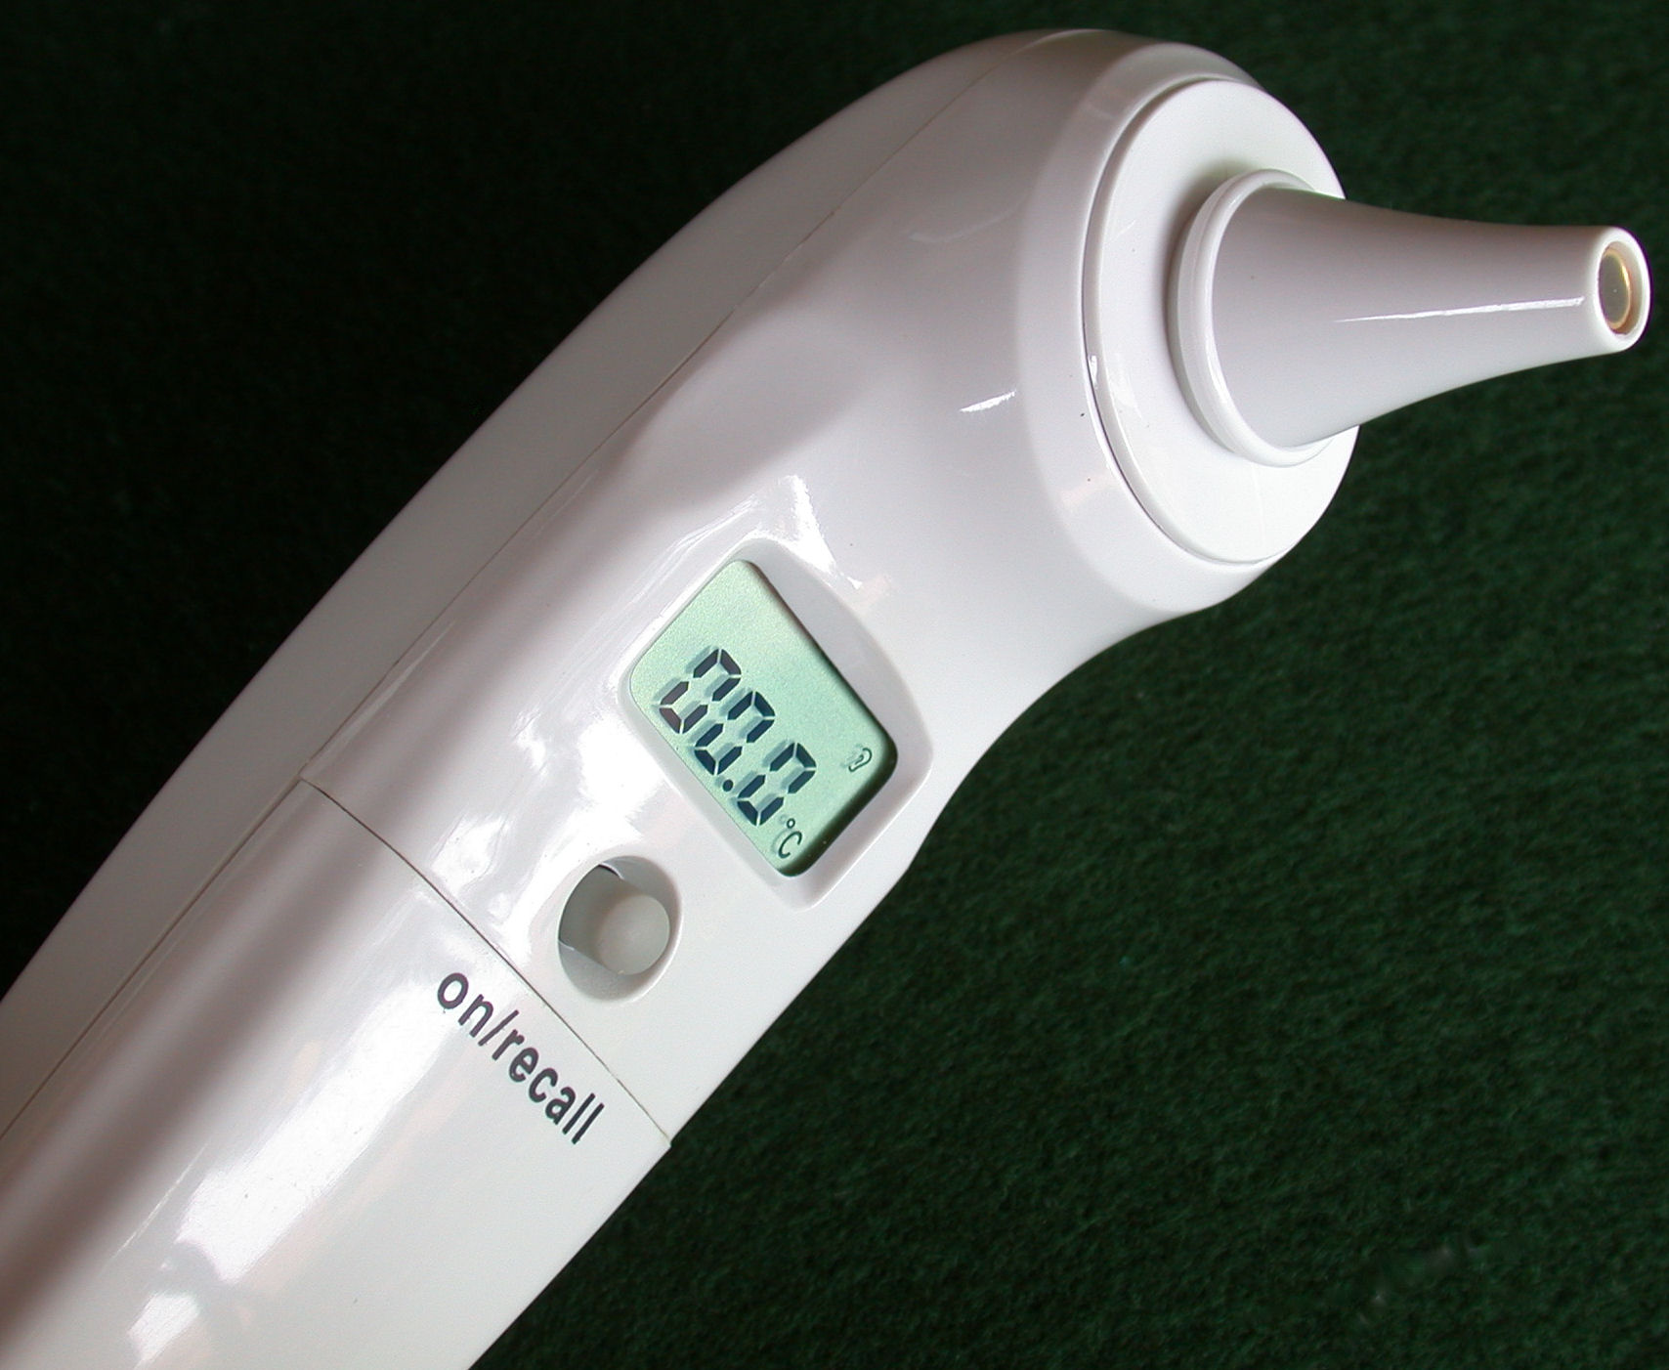
A radiometer you are familiar with

Slide 18
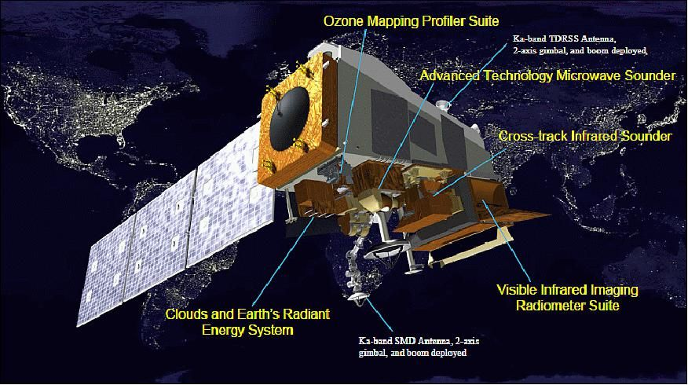
One you may not be…

Slide 19
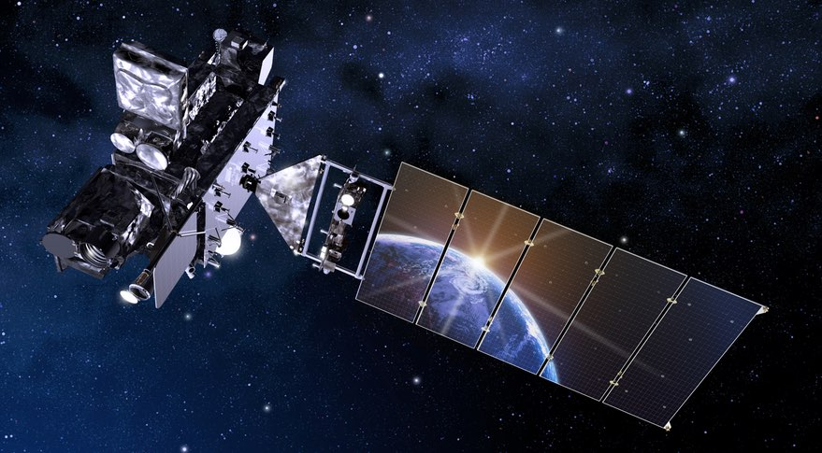
GOES Weather Satellite

Slide 20
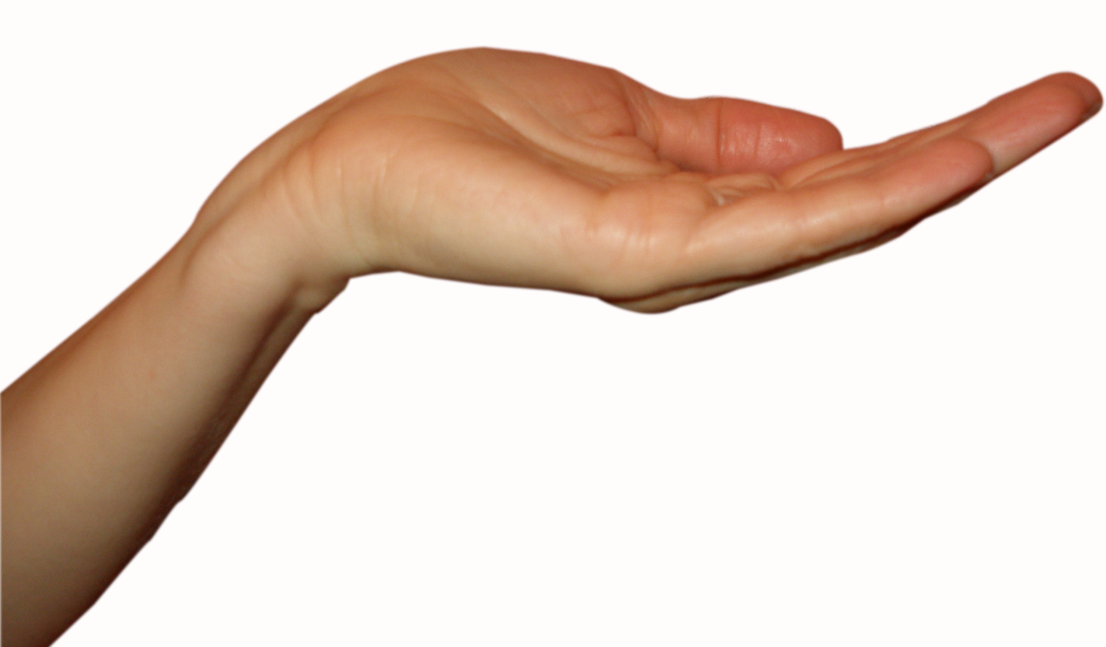
Human Skin
With practice…good to roughly 2F.

Slide 21
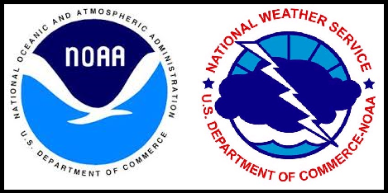
Official Surface Air Temperature Measurement
Always measured in the SHADE
Should be measured at 2-meters (about 6.6 ft) above surface.
Should be above grass or native vegetation

Slide 22
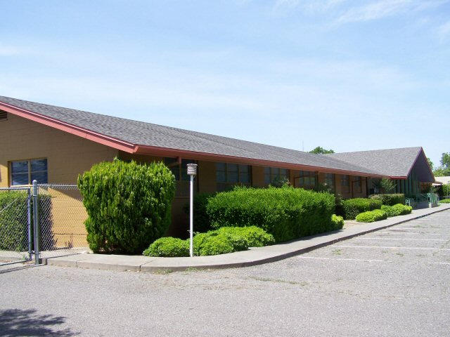
Bad Exposure Can Produce Poor Observations

Slide 23
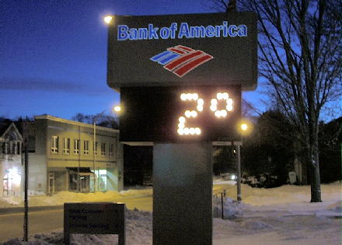
How NOT to Get Dependable Temperatures

Slide 24
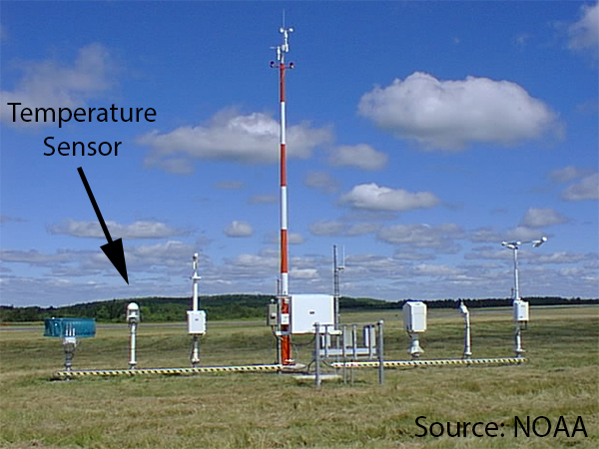
Much Better

Slide 25
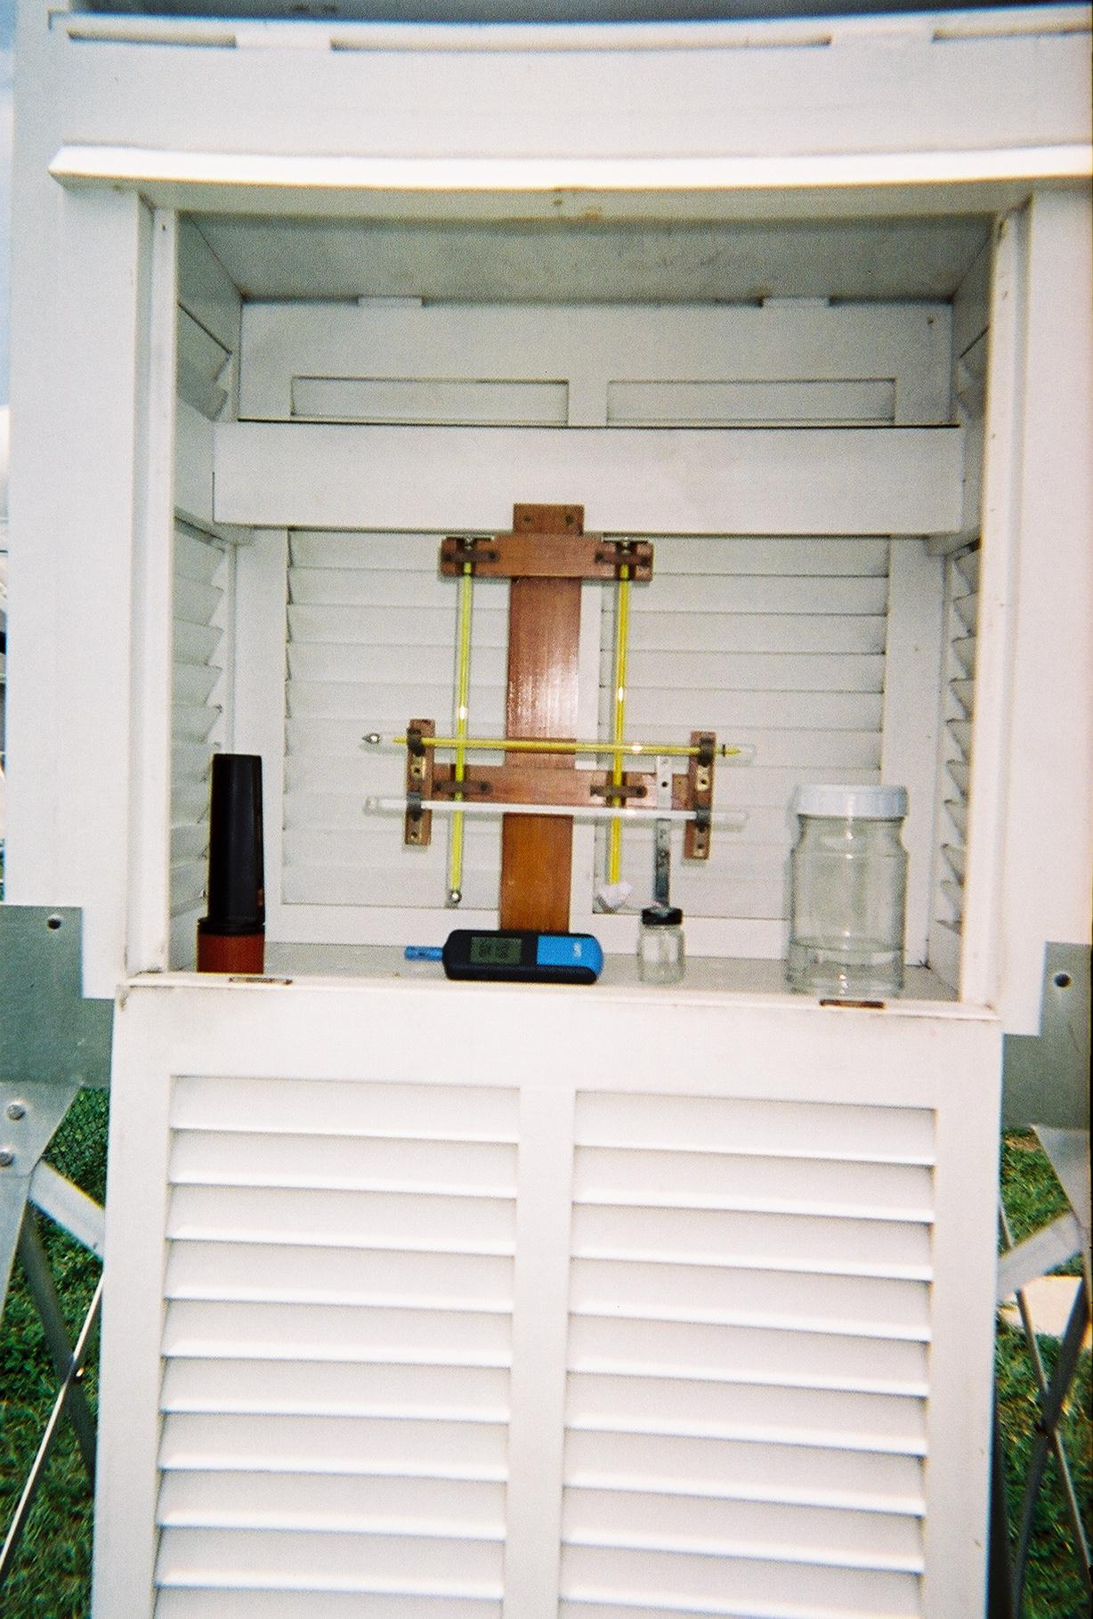
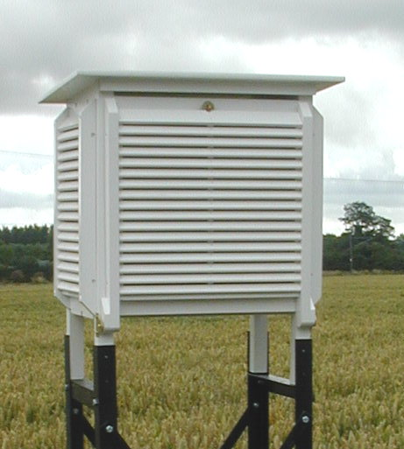
Traditional Stevenson Screen

Slide 26
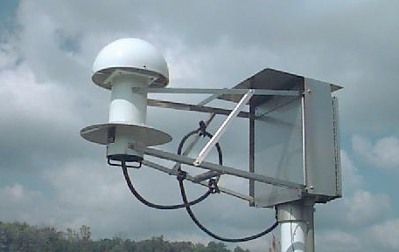
Today: NOAA/NWS/FAA ASOS Temperature/Humidity
Senor

Slide 27
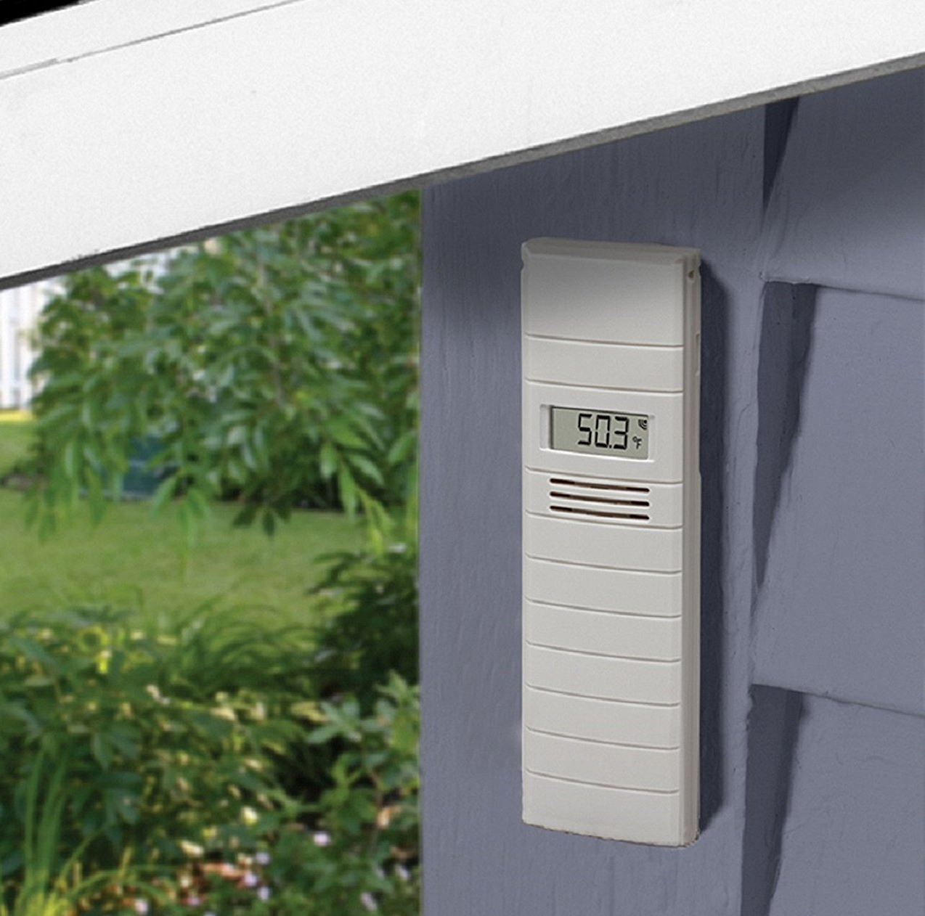
Home Thermometer Tips
Put sensor on north side of the house/apartment IN PLACE THAT IS ALWAYS IN SHADE
Out of rain
Not above a BBQ!

Slide 28
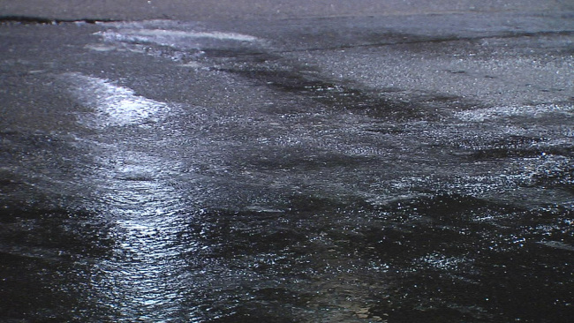
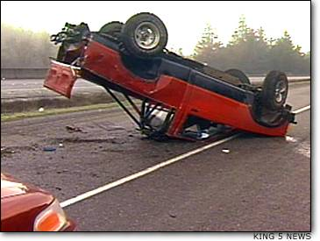
Why can knowing that temperatures are taken at 2-m save your life?

Slide 29
Saving Your Life
On cold winter nights, temperature of the road surface can be 2-5F cooler than at 2 meters (or the 2 ft above the ground of your care thermometer)
Thus, when air temperatures get to around 35-37F here is the possibility that the road temperatures have dropped to freezing, with ice.
Slow down!

Slide 30
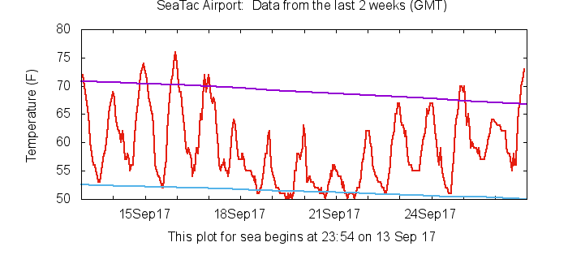
Diurnal (Daily) Temperature Variations
When are temperatures generally warmest and coolest?

Slide 31
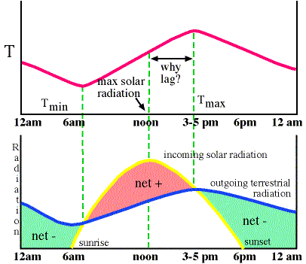
Diurnal Temperature Variations
Minimum temperature generally just after sunrise
Max temps 3-4 hours after solar noon.
In Seattle, max temps are typically 2-3 PM in winter, 5-6 PM midsummer.

Slide 32
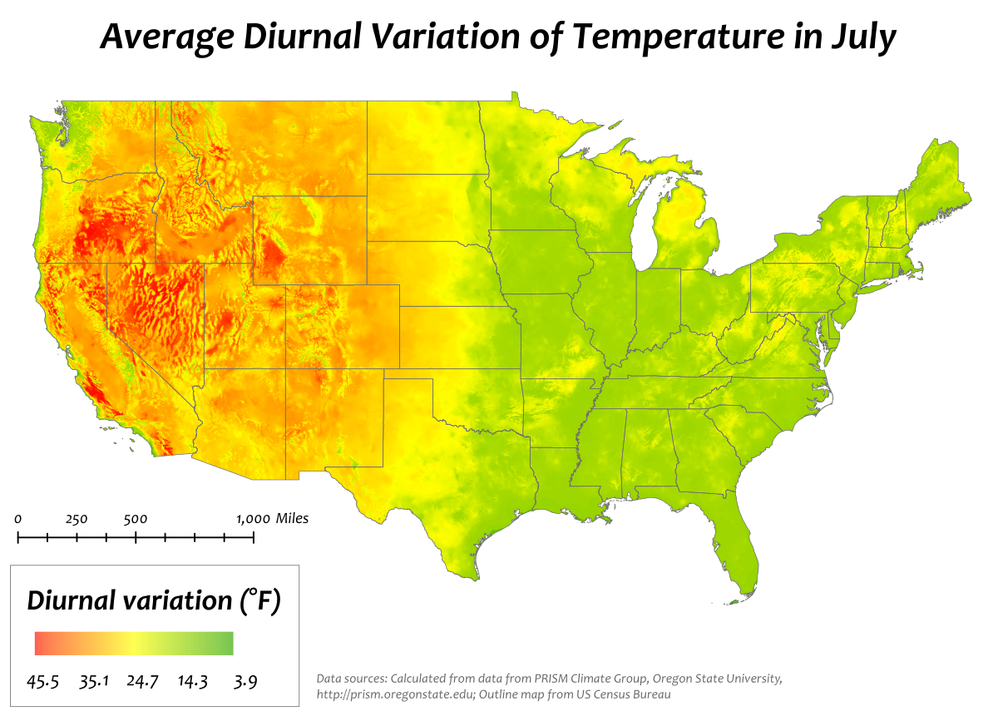
Diurnal Amplitude Varies
Big Diurnal
Variations
In West Where
Air is Dry
Less
Diurnal
Variation
Where is
Is Moister

Slide 33
All Temperatures Are Local
Temperatures can vary in small distances due to a number of factors:
Proximity to water (cooler in summer, warmer in winter)
Elevation (usually cooler aloft, but cool air can pool near the surface at night/winter)
Surface characteristics/urban heat island (warmer in urban core)

Slide 34
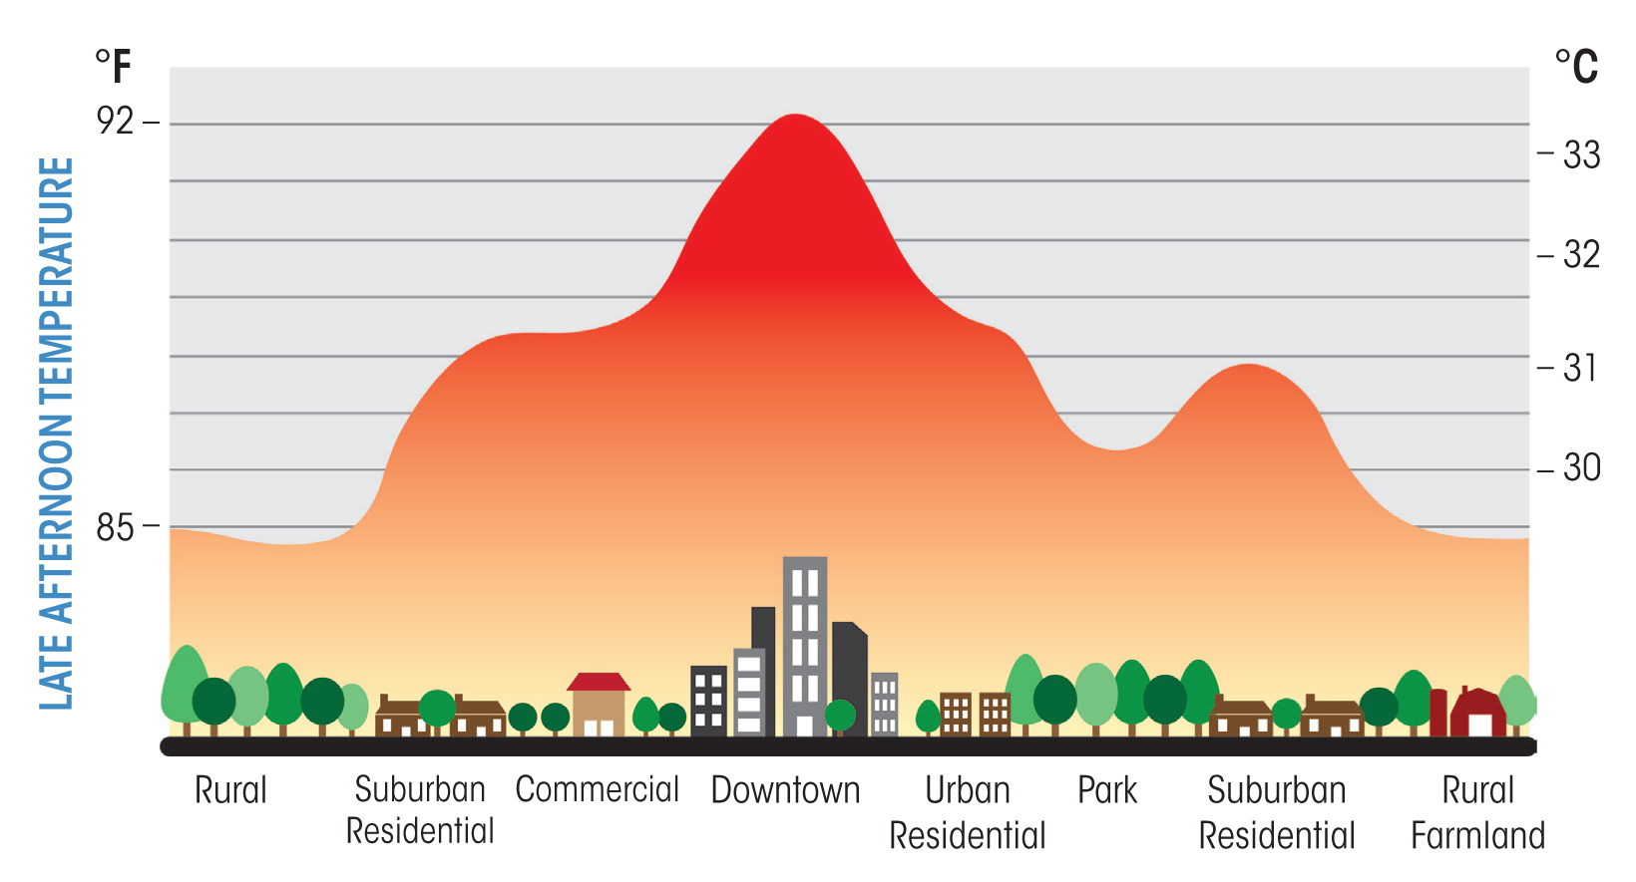
Urban Heat Island Can easily be 5-10F warmer in urban core

Slide 35
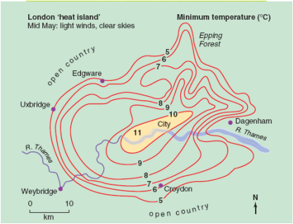
London

Slide 36
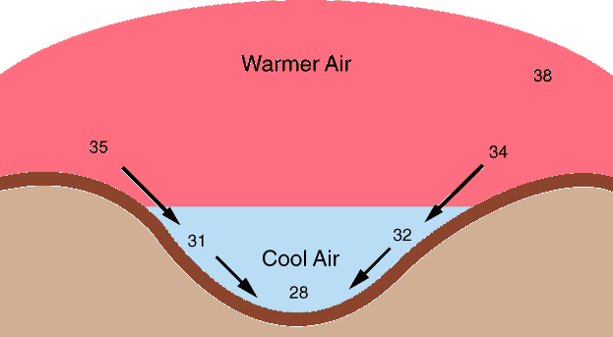
Elevation
During the night, cooler, denser air often drains into lower elevations

Slide 37
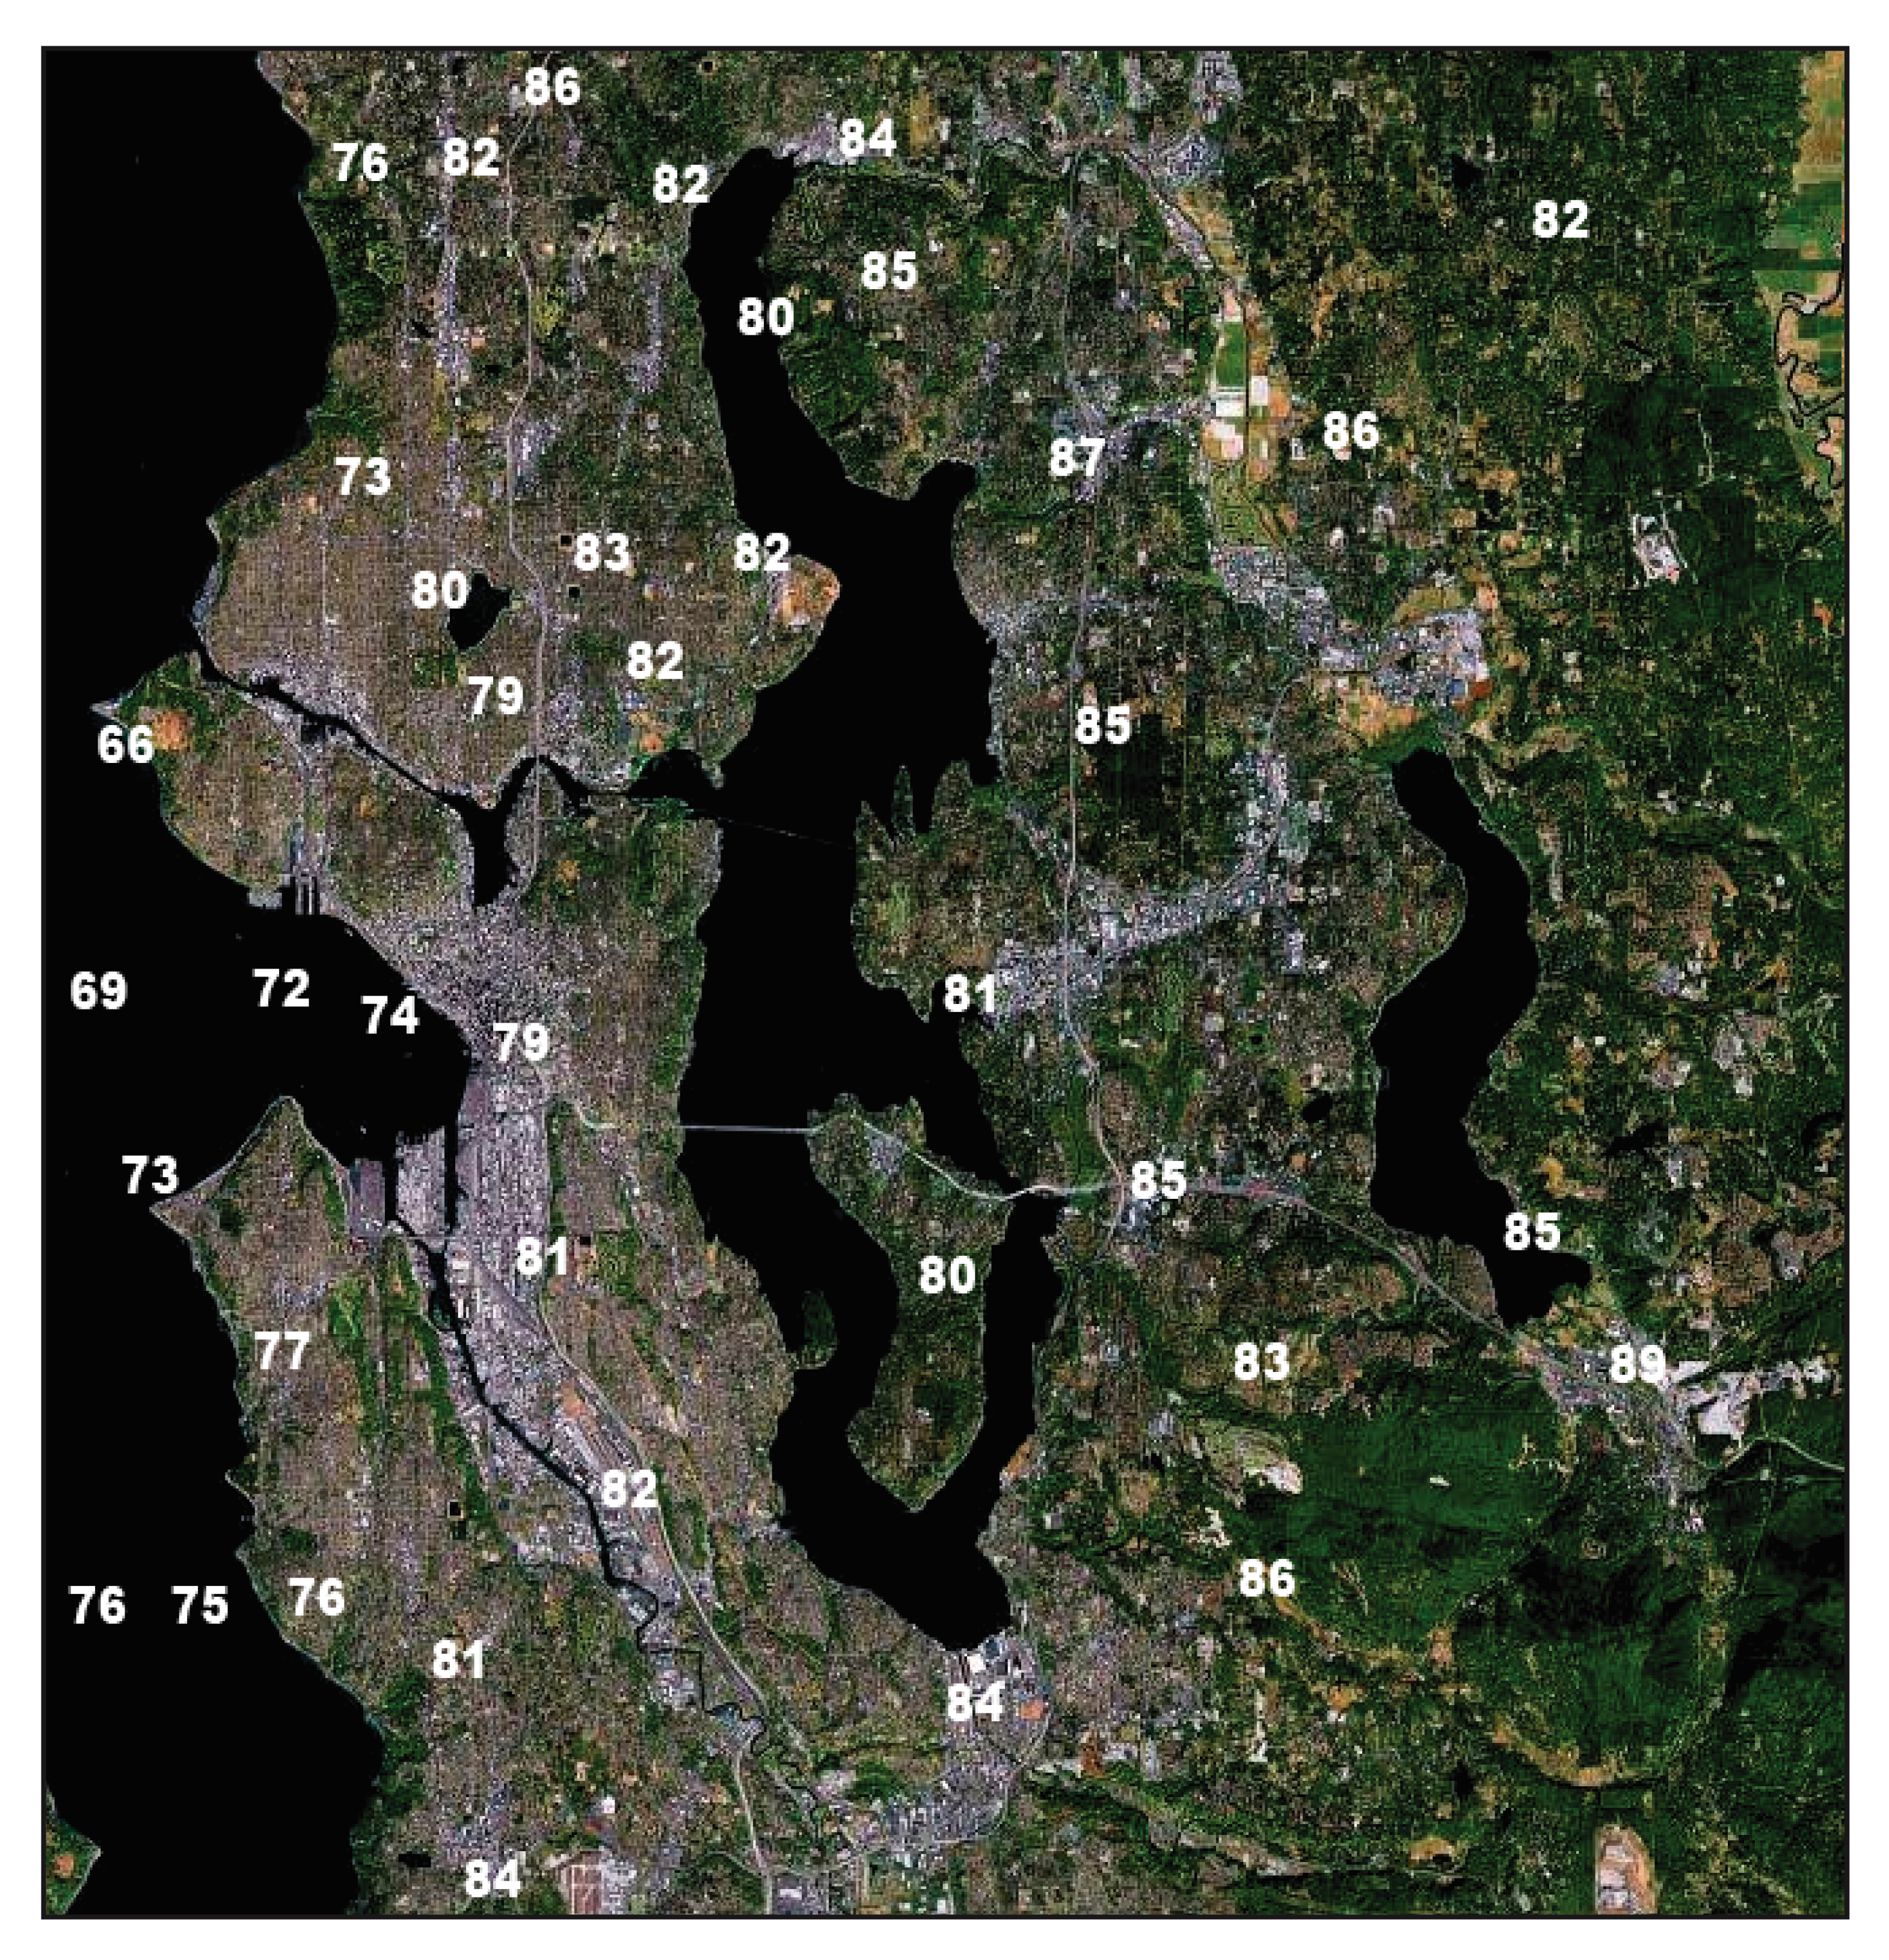
Typical
Summer
Day
Near 5 PM

Slide 38
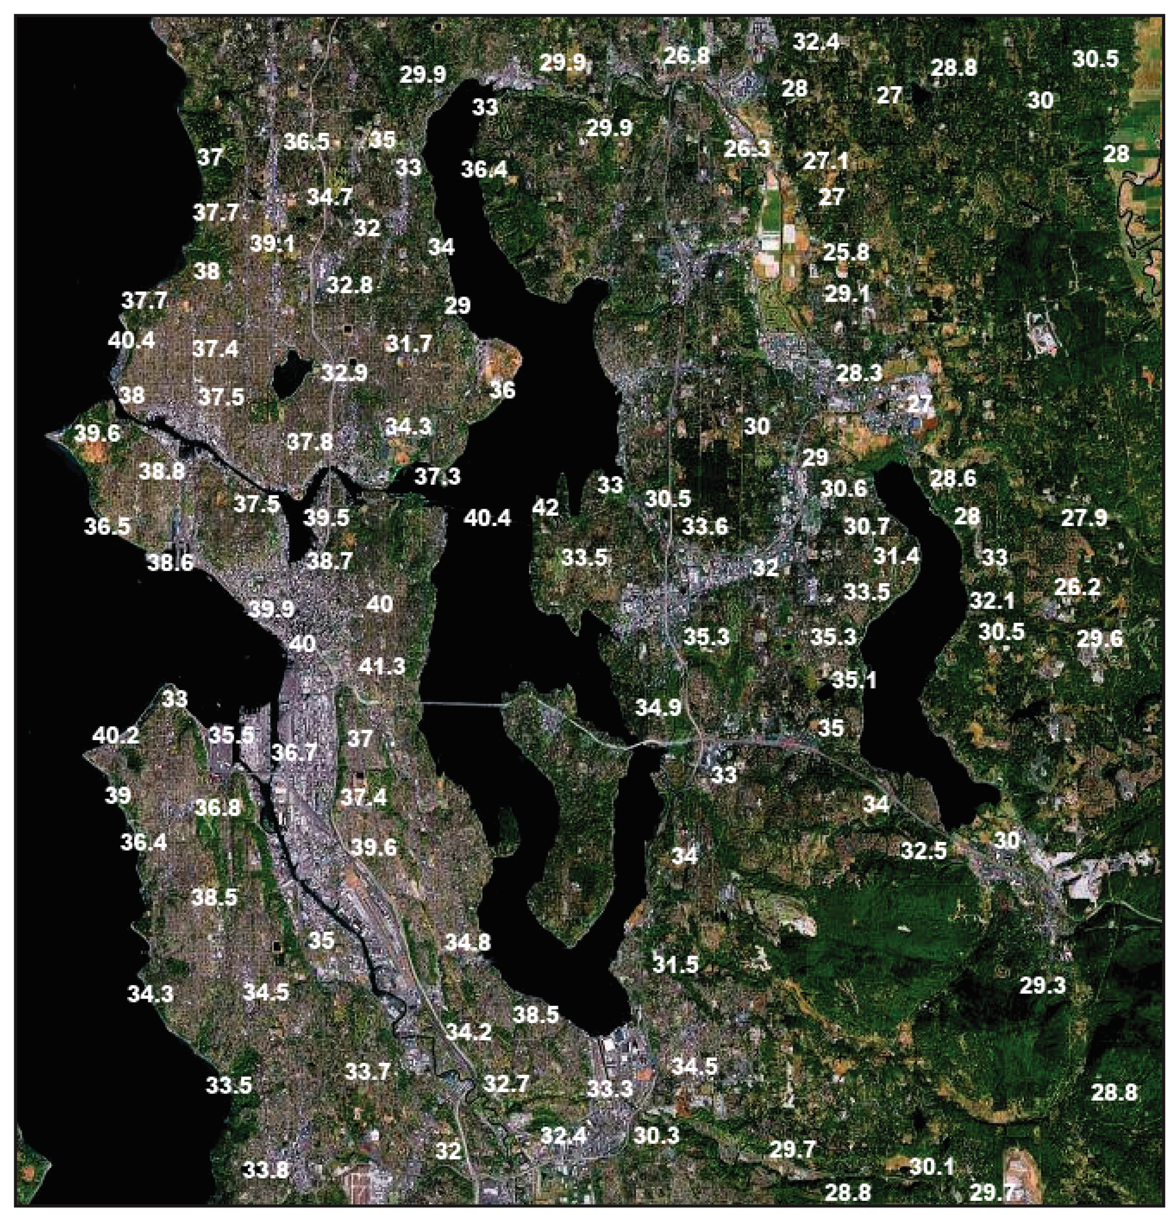
Winter
Temps
Near 6 AM

Slide 39
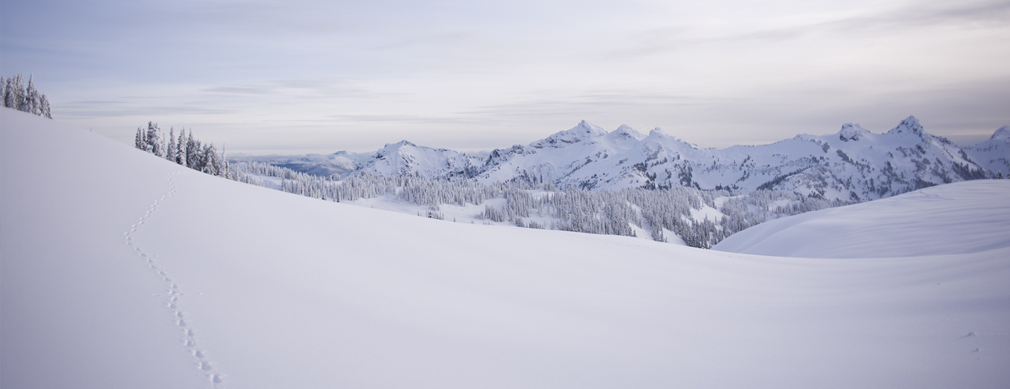
Snow Promotes Cooling Good in reflecting solar radiation, good emitter in infrared, good insulator Often record cold temperatures are associated with snow

Slide 40
The Most Extreme Cold Locations Puts All of These Together
Valley
Snow
Away from water

Slide 41
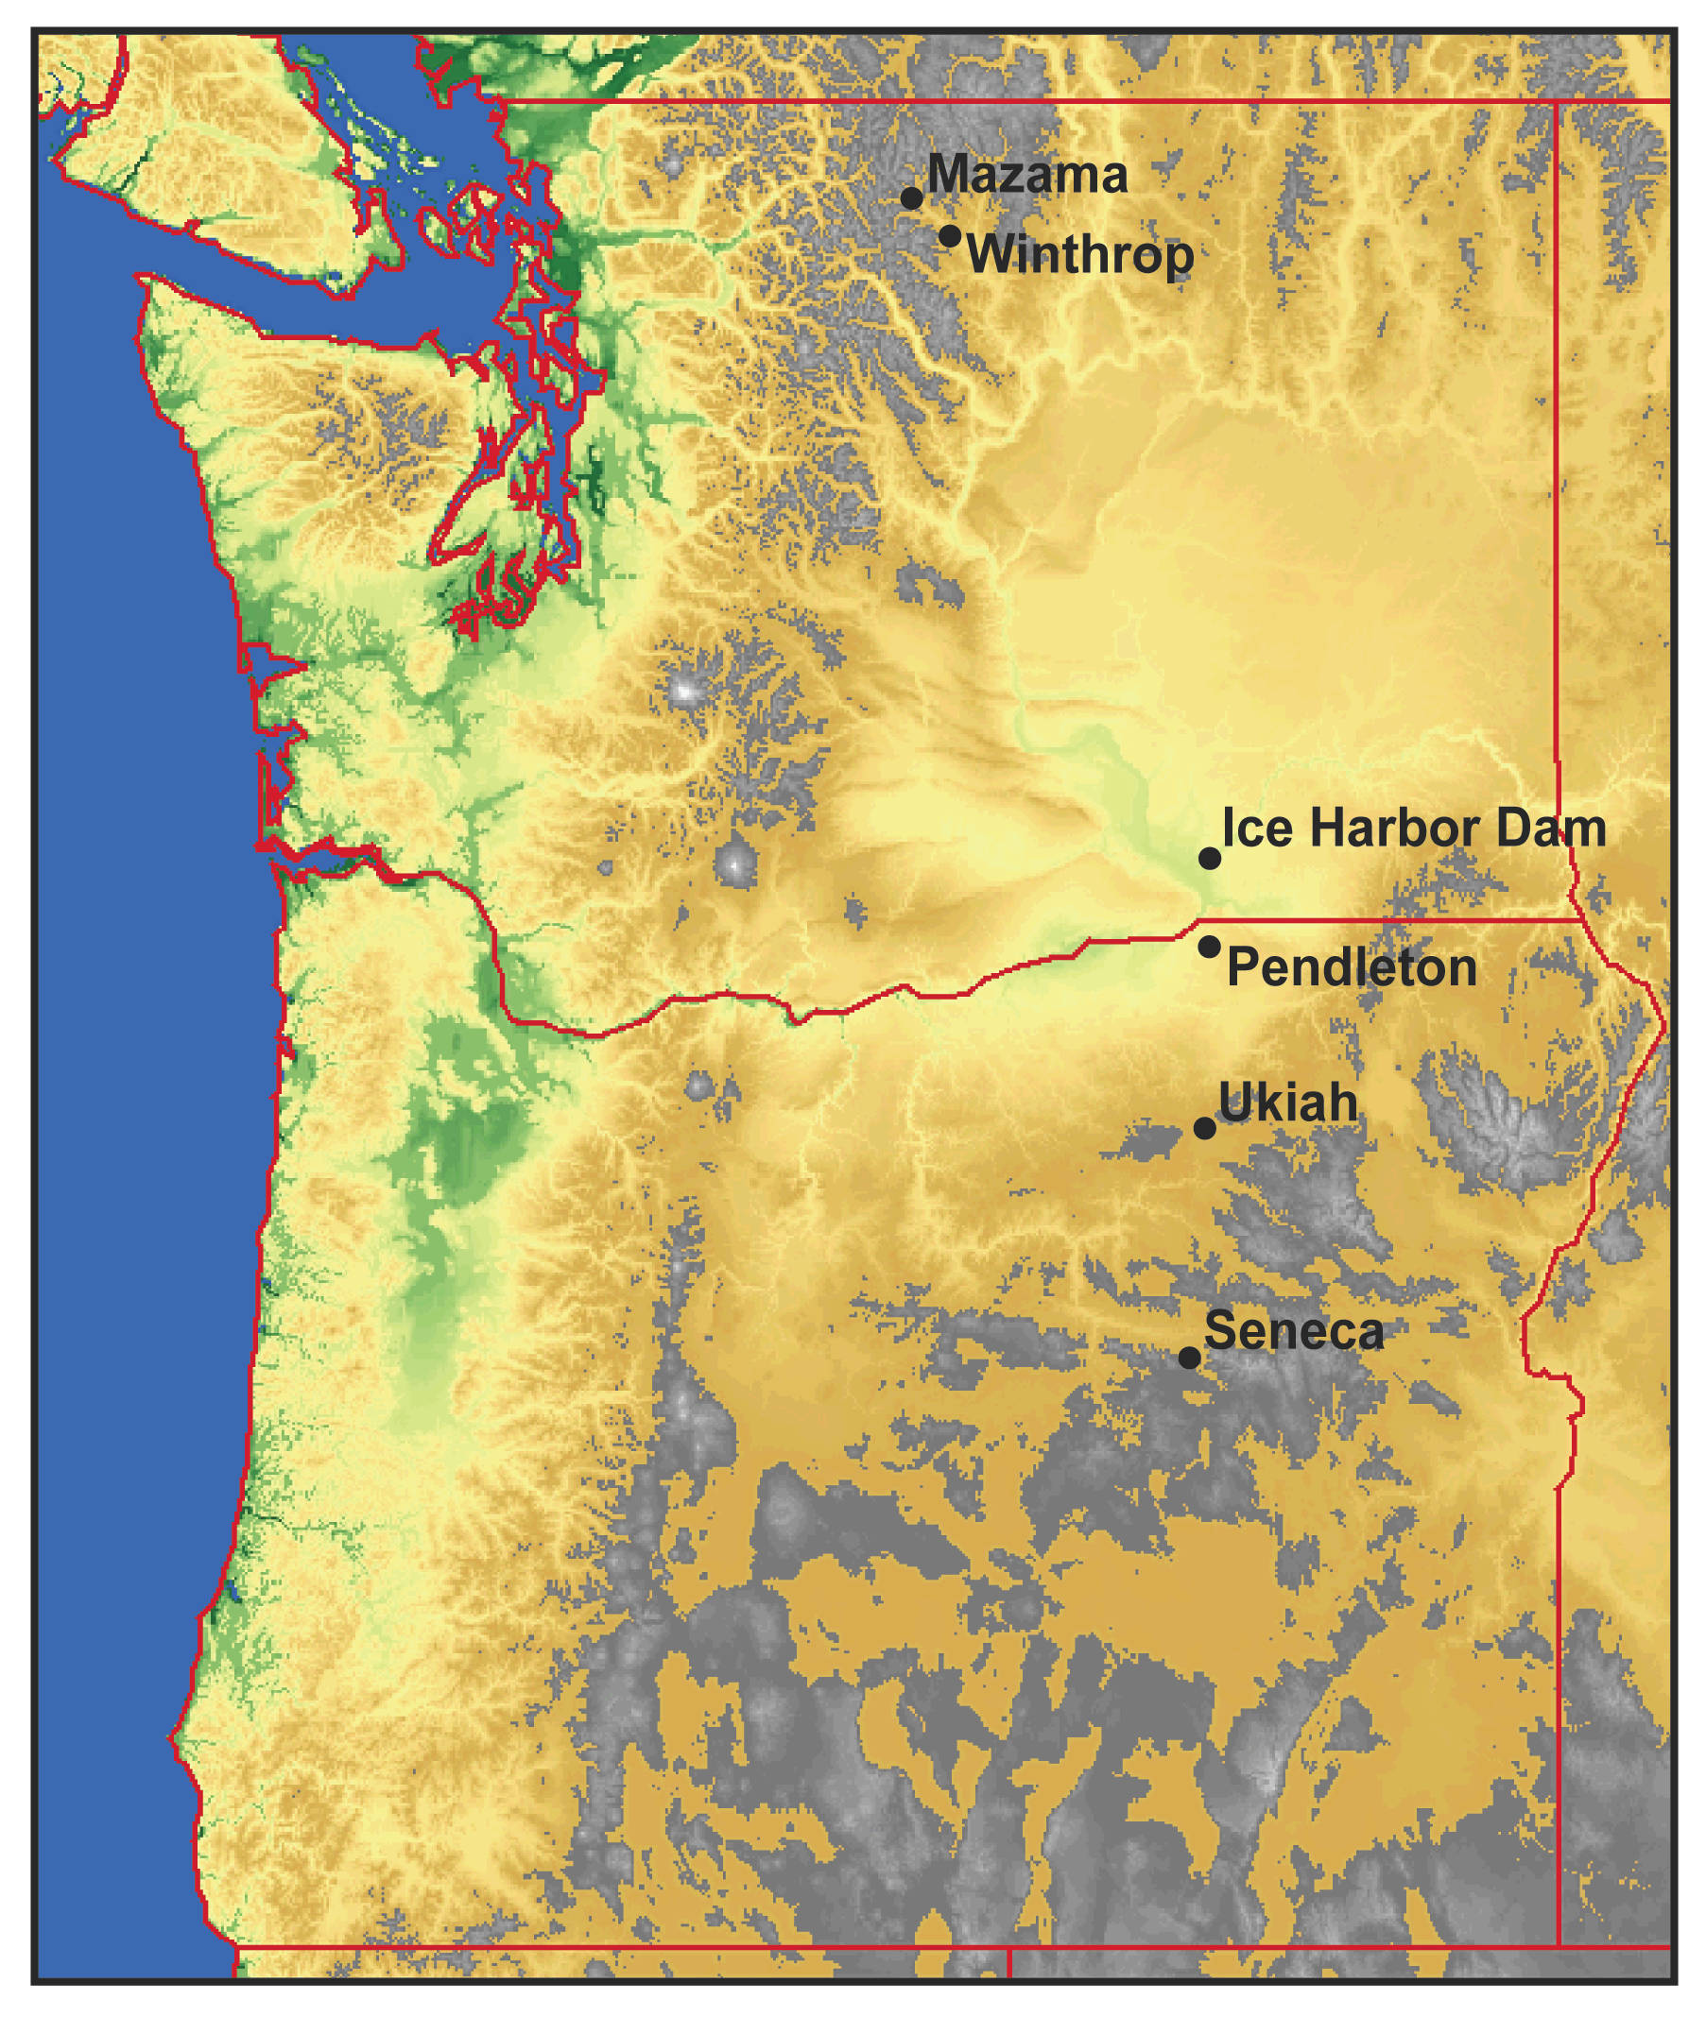
WA cold records are all east of the Cascades
On December 30, 1968 both Mazama and Winthrop, WA dropped to -48F—the state record.
Why there?

Slide 42
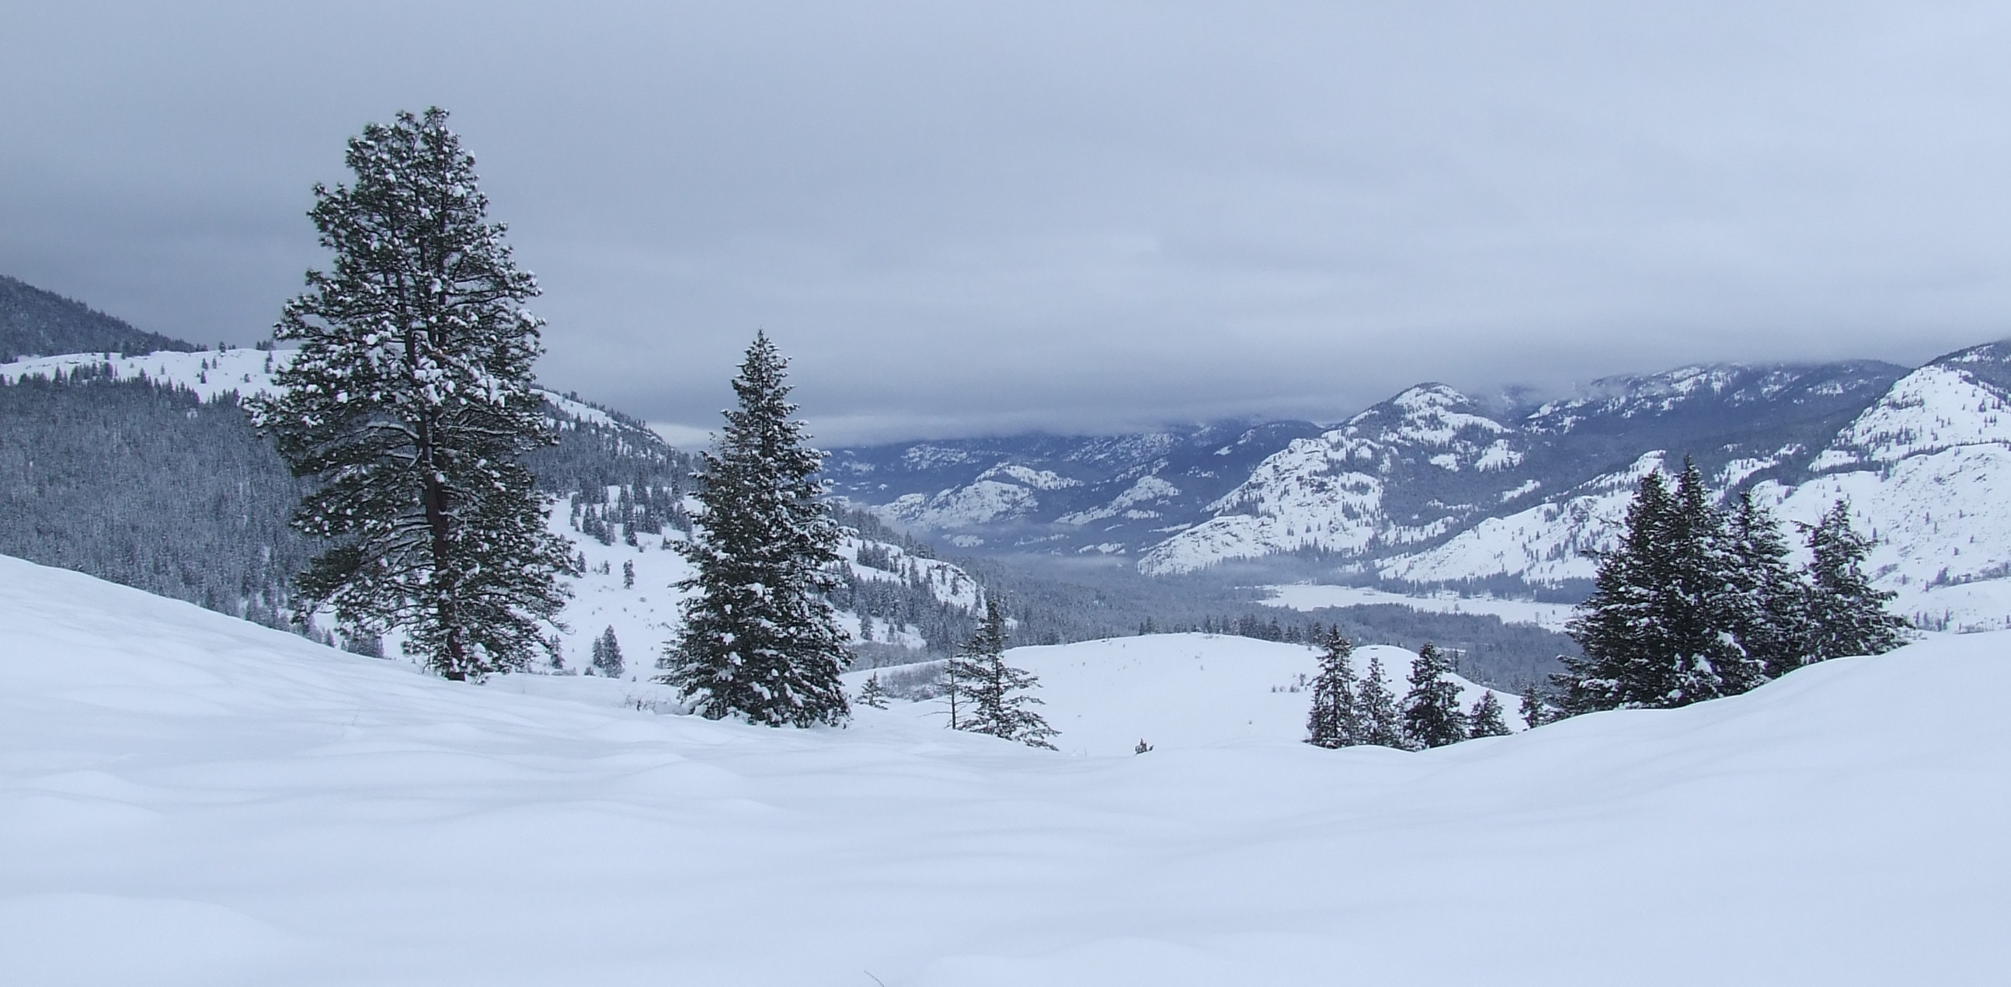
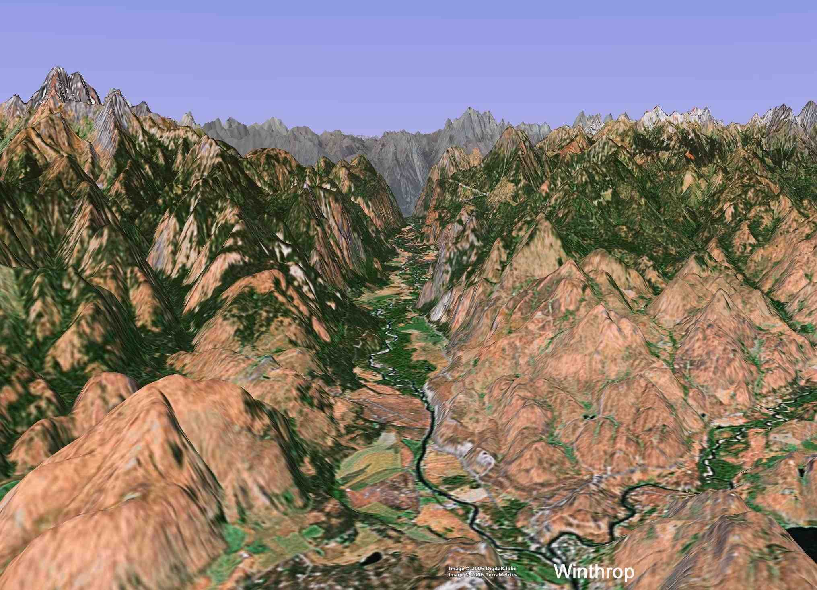
Winthrop and Mazama are in a deep valley of the northeast Cascades
When snow on ground

