Slide 1
Thunderstorms

Slide 2
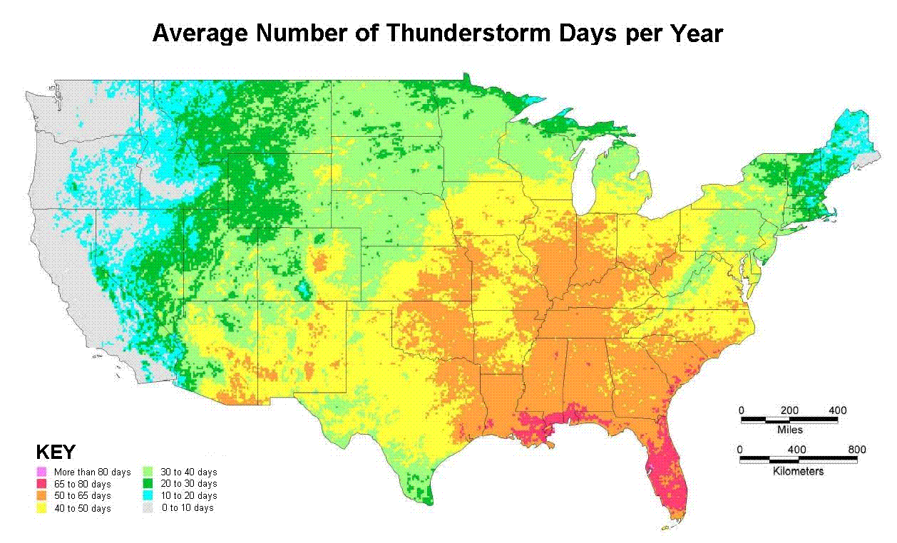
Thunderstorm Frequency
See Figure 10.23 in text

Slide 3
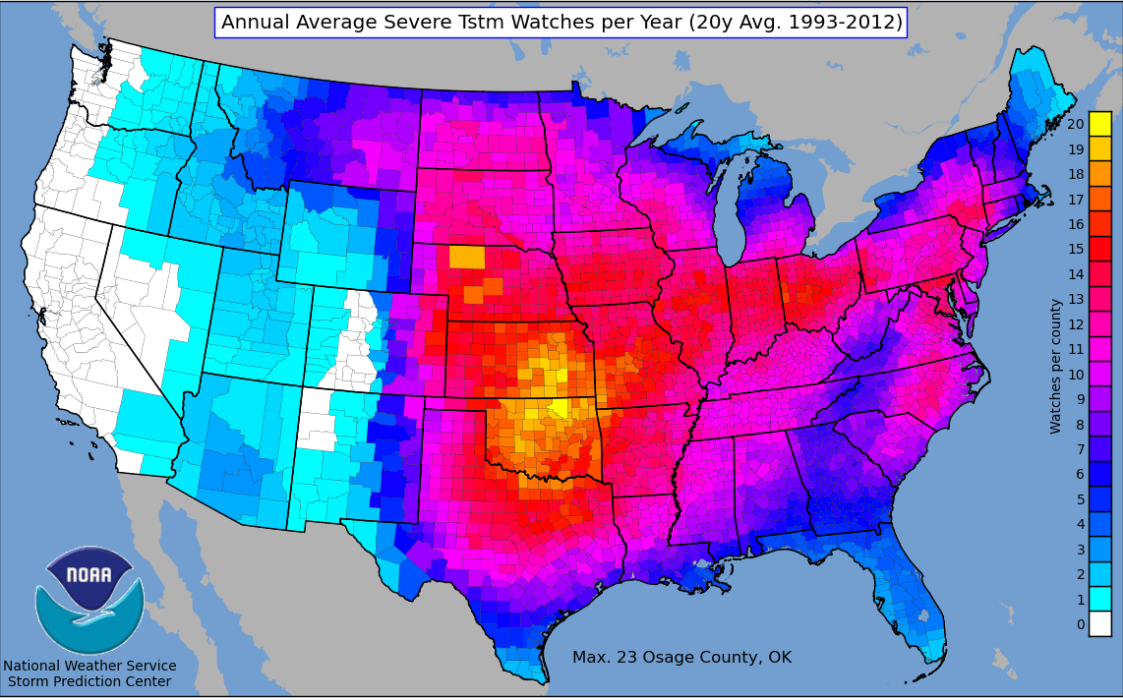
Thunderstorm Frequency
See Figure 10.23 in text

Slide 4
Thunderstorm Requirements
Moisture source
  Latent heat provides much of the energy associated with thunderstorms
Instability
  An unstable atmosphere will promote the development of deep convection
Lifting mechanism
  A method of nudging the air parcels above the level of free convection

Slide 5
Lightning & Thunder
by definition, thunderstorms are defined by the presence of lightning & thunder
there are an estimated 40,000 thunderstorm occurrences each day (1.46 million per year)
although the exact mechanisms are not completely understood, lightning arises due to charge separation within the cloud
lightning can discharge from cloud to cloud or cloud to ground
see figure 10.28 in text

Slide 6
Lightning & Thunder
following a lightning discharge, the air is heated to a temperature of approximately 30,000⁰C, 5 times the temperature of the sun
as a result the air undergoes explosive expansion, making a “snap” or “crack” sound, and generating a shock wave (sonic boom) that can travel great distances
the rumbling sound of thunder is the sound of those waves having travelled a distance from the initial lightning strike

Slide 7
Types of Thunderstorms
Single Cell/Ordinary/Pulse Storms/Air Mass
Multi-Cell Cluster
Multi-Cell Line/Squall Line
Supercell

Slide 8
Single Cell Thunderstorm
very little vertical wind sheer
severe weather is limited to brief isolated downbursts, small hail, lightning, heavy rain, and weak tornadoes
3 stages: cumulus, mature, dissipating
NOTE: A "severe" storm is a somewhat arbitrary NWS definition of a storm with one or more of the following elements: 3/4 inch or larger diameter hail, 50 knot downbursts, or tornadoes

Slide 9
3 Stages of Life Cycle
Cumulus stage
grows vertically in gradual but rapid steps
release of latent heat from condensation provides more energy for air to rise
precipitation particles grow but do not yet fall, no lightning/thunder
entrainment of drier air from outside cloud occurs, causes some evaporation which cools air and leads to formation of denser and colder air up in cloud

Slide 10
3 Stages of Life Cycle
Mature stage
begins with downdraft; colder, denser air starts to fall through the cloud
precipitation begins falling (which also helps pull the downdraft toward the ground)
may take on anvil shape as ice crystals at top of cloud spread horizontally (reaches stable layer)
lightning and thunder most intense
downdraft reaches surface and it spreads horizontally across the surface; leading edge referred to as gust front

Slide 11
3 Stages of Life Cycle
Dissipating stage
about half an hour after mature stage the storm begins to die off
downdraft begins to dominate and eliminates the updraft (cool pool of air spreads)
precipitation becomes very light and the cloud often precipitates and evaporates away until only the ice crystal anvil remains

Slide 12
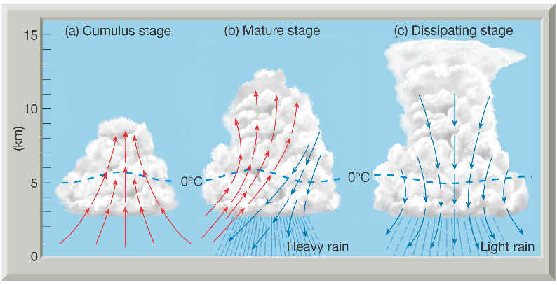
3 Stages of Life Cycle
see figure 10.2 in text

Slide 13
Multicell Thunderstorms
thunderstorms that contain a number of convection cells, each in a different stage of development
cold pool and gust front from one storm provide the lifting trigger to generate new storms
moderate to strong wind shear
shear has effect of keeping the downdraft from cutting off the updraft, often by tilting the storm so that it remain over the edge of the cold pool thus allowing it to continue to receive the rising warm, moist air that feeds it
Updraft can be very intense, even overshooting slightly into the stable air topping the troposphere
Hail grows large as ice particles have water droplets freeze onto them with the more intense updraft able to hold the hail particles in the cloud longer
stronger downdraft in multi-cell thunderstorms
very strong winds at surface when downdraft comes to ground

Slide 14
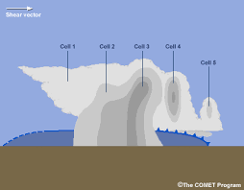
Multicell Cluster Thunderstorm
See figures 10.4, 10.5, & 10.6 in text

Slide 15
Squall Line Thunderstorms
squall-line thunderstorms are lines of multi-cell thunderstorms
occur pre-frontal, predominantly ahead of the cold front
can extend hundreds of miles and can exist for many hours producing potentially severe weather and very strong winds

Slide 16
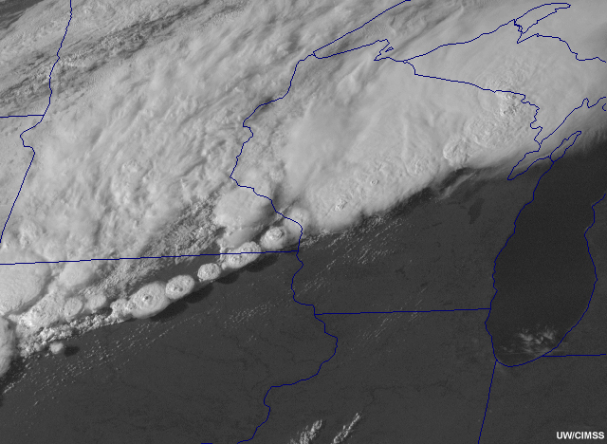
Squall Line Thunderstorms
See Figure 10.14 in text

Slide 17
Supercell Thunderstorms
large, isolated, long-lasting thunderstorms with a deep rotating updraft which can reach speeds of 100mph
responsible for nearly all the significant tornadoes produced in the U.S. (though only about 30% spawn tornadoes) and most of the hailstones greater than 2” in diameter
supercells can also produce damaging outflow winds exceeding 100 mph and heavy precipitation which can result in flash floods
vertical wind shear (both speed and directional) important
outflow never undercuts updraft

Slide 18
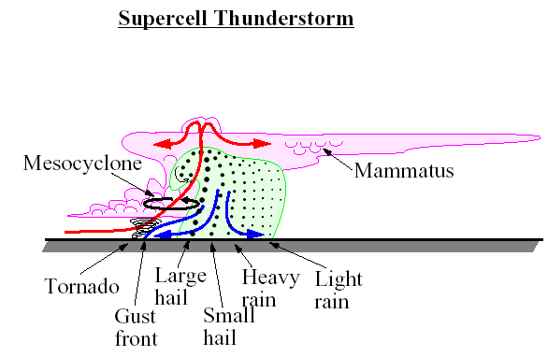

Slide 19
Supercell Features
The “classic” supercell will generally have:
large, flat updraft bases, often with rotating wall cloud

Slide 20
Supercell Features
The “classic” supercell will generally have:
large, flat updraft bases, often with rotating wall cloud
an overshooting top and large cirrus anvil

Slide 21
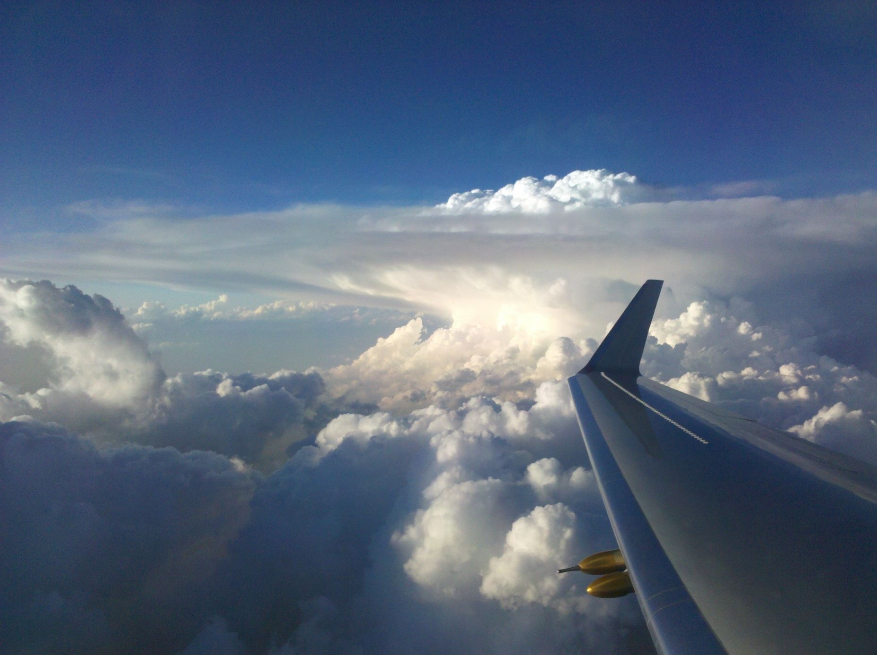
Overshooting Top & Cirrus Anvil

Slide 22
Supercell Features
The “classic” supercell will generally have:
large, flat updraft bases, often with rotating wall cloud
an overshooting top and large cirrus anvil
flanking line of developing cumulus clouds which may merge with the storm

Slide 23
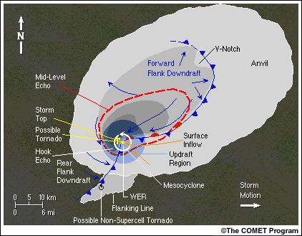

Slide 24
Supercell Features
The “classic” supercell will generally have:
large, flat updraft bases, often with rotating wall cloud
an overshooting top and large cirrus anvil
flanking line of developing cumulus clouds which may merge with the storm
A “hook echo” in the radar reflectivity at low levels

Slide 25
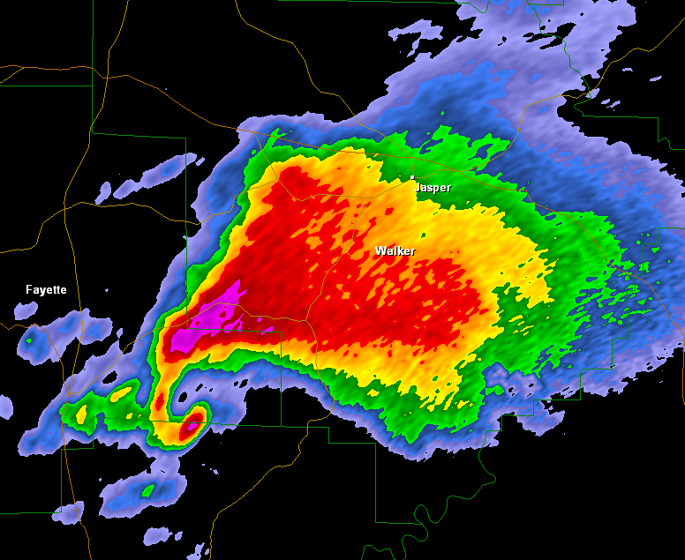
Hook Echo

Slide 26
Tornadoes

Slide 27
Tornadoes
rapidly rotating column of air that blows (most commonly counter-clockwise in northern hemisphere) around a small area of intense low pressure with a circulation that reaches the ground
generally short-lived, but strong tornadoes can last more than an hour and can travel considerable distances
The U.S. experiences more tornadoes than any other country in the world (~1,300 per year)
the peak of the tornado season in the U.S. extends from April through June (warm, moist surface air with cold, dry air aloft)

Slide 28
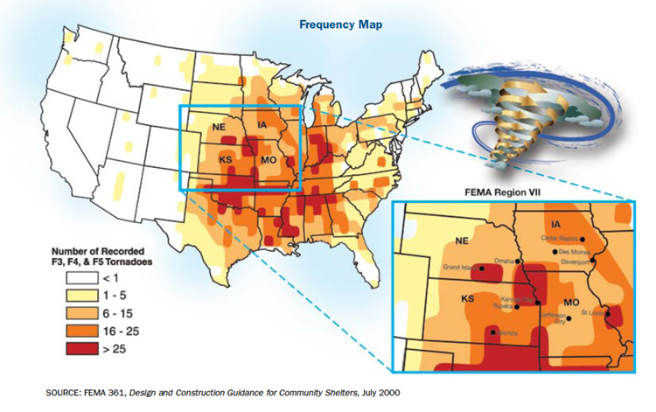
Tornado Frequency
see Figure 10.21 in text
Notes:
Figure 10.21: Surface conditions that can produce a dryline with intense thunderstorms.

Slide 29
Tornado Formation
basic requirements are an intense thunderstorm, conditional instability, and wind shear
supercell tornadoes
  wind shear causes spinning vortex tube that is pulled into thunderstorm by the updraft
  vortex tube is vertically stretched, increasing the speed of rotation
  tube of air initially descending from the base of thunderstorm is called a “funnel cloud”

Slide 30
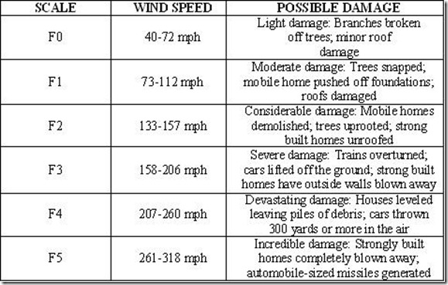
The Fujita Scale
See Tables 10.2 & 10.3 in text

