Slide 1
Hurricane Definition
a non-frontal synoptic scale (same scale as MLC) low-pressure system over tropical waters with organized convection (thunderstorm activity) & definite cyclonic surface wind circulation

Slide 2
Anatomy of a Hurricane
the “eye” is the region of limited cloud development and calm weather near the hurricane centre; air from high in the hurricane descends into the eye (warms by compression) suppressing cloud formation

Slide 3
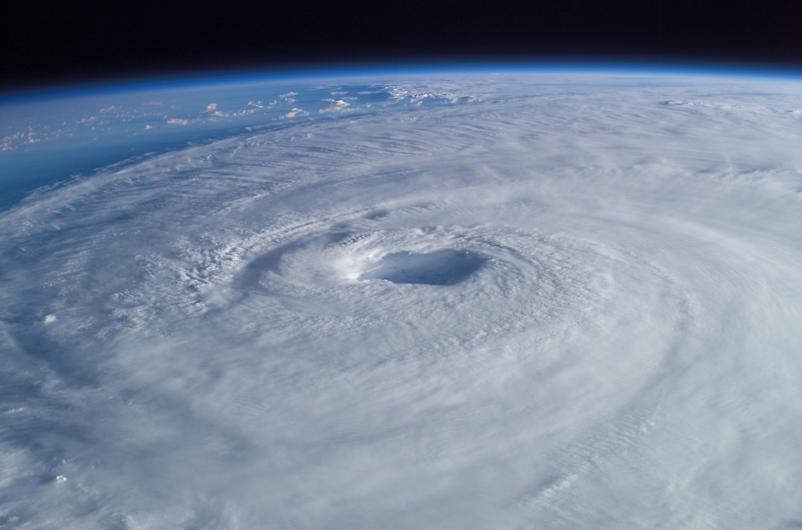
Hurricane “Eye”

Slide 4
Anatomy of a Hurricane
the “eye” is the region of limited cloud development and calm weather near the hurricane centre; air from high in the hurricane descends into the eye (warms by compression) suppressing cloud formation
the “eye wall” is a ring of intense thunderstorms that surround the eye – the eye wall region has the strongest winds

Slide 5

Hurricane “Eye Wall”

Slide 6

Hurricane “Eye Wall”

Slide 7

Hurricane “Eye Wall”

Slide 8
Anatomy of a Hurricane
the “eye” is the region of limited cloud development and calm weather near the hurricane centre; air from high in the hurricane descends into the eye (warms by compression) suppressing cloud formation
the “eye wall” is a ring of intense thunderstorms that surround the eye – the eye wall region has the strongest winds
“spiral rain bands” swirl around the eye as wind speeds increase near centre of storm; spiralling clouds (lines of thunderstorms) are often obscured by overlying cirrostratus clouds

Slide 9
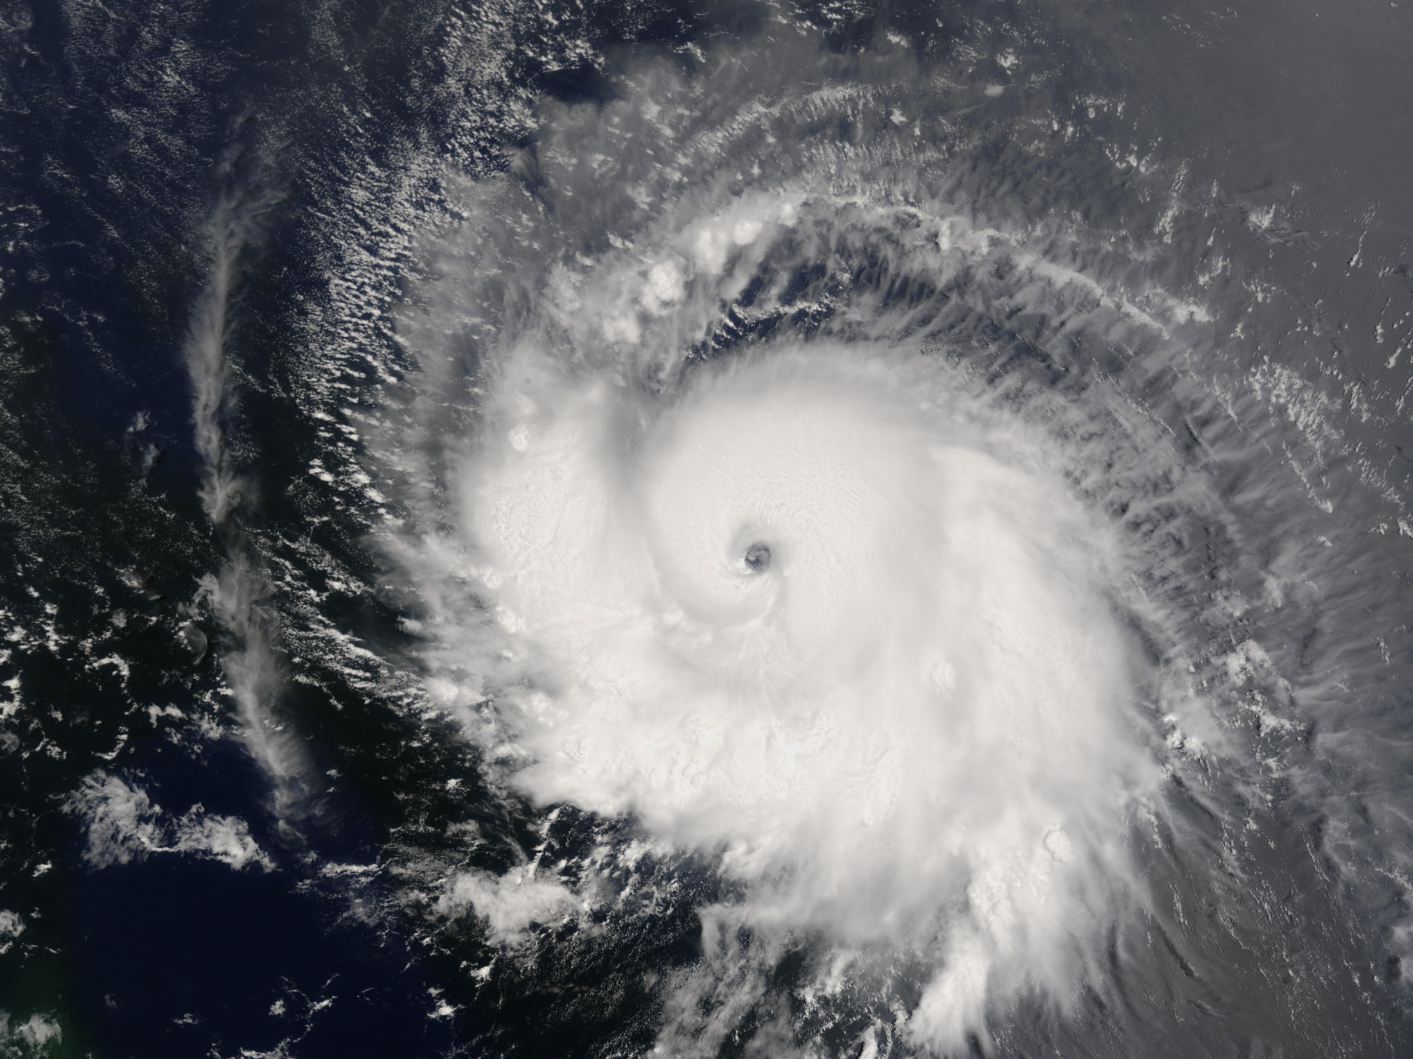
Spiral Rain Bands

Slide 10
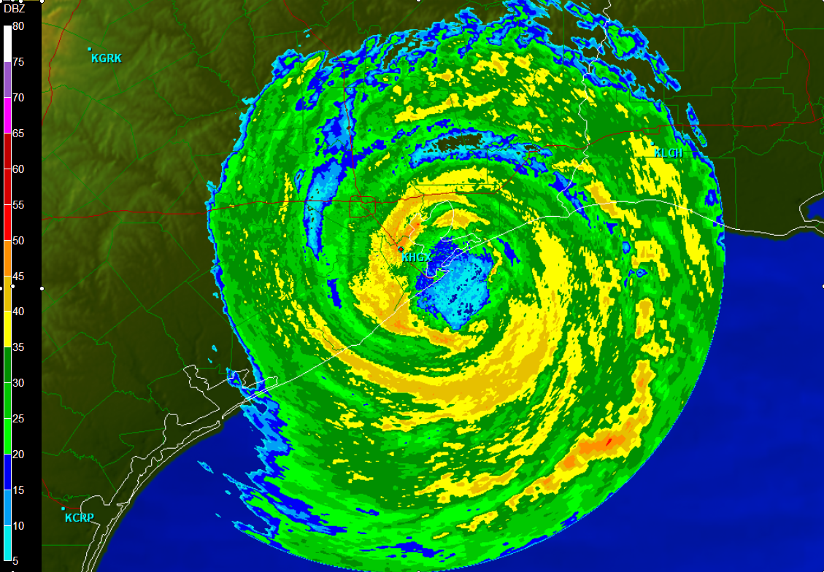
Radar Reflectivity of Spiral Rain Bands

Slide 11
Anatomy of a Hurricane
the “eye” is the region of limited cloud development and calm weather near the hurricane centre; air from high in the hurricane descends into the eye (warms by compression) suppressing cloud formation
the “eye wall” is a ring of intense thunderstorms that surround the eye – the eye wall region has the strongest winds
“spiral rain bands” swirl around the eye as wind speeds increase near centre of storm; spiralling clouds (lines of thunderstorms) are often obscured by overlying cirrostratus clouds
rising air in the eye wall and the release of latent heat at upper levels creates a region of high pressure (relative to the surrounding air) aloft at the top of the storm which results in subsiding air above the eye and anti-cyclonic “outflow” aloft, which removes air from above the eye maintaining the surface low pressure (see Figures 11.2 - 11.5, & 11.7 in text)

Slide 12
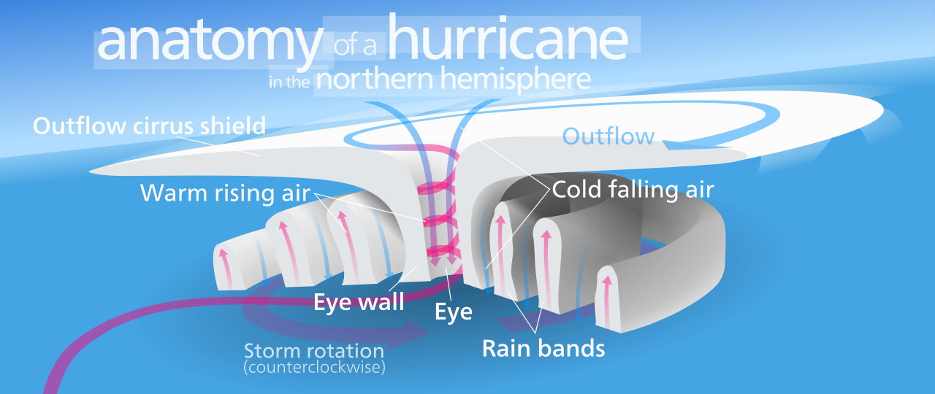

Slide 13
3-D Structure of Hurricanes
The COMET Program

Slide 14
Components & Characteristics of Hurricanes, Typhoons, & Cyclones
Visible Satellite Loop of Hurricane Charley
cyclonically swirling storm rotation (around central low pressure centre) – Coriolis Force plays a role
highly organized complex of thunderstorms arranged in “spiral bands”
300 – 700 km in diameter (about ½ the size of MLC)
hurricanes have no fronts
hurricane’s winds are strongest at surface and weaken with height
hurricanes and tropical systems form under weak high-altitude winds (vertical wind shear inhibits formation and can weaken or destroy developed storms)

Slide 15
Components & Characteristics of Hurricanes, Typhoons, & Cyclones
the centres of hurricanes are warmer than their surroundings
air sinks at the centre of a hurricane forming the “eye”
hurricanes' main energy source is the latent heat of condensation (energy released per day is equivalent to 200 times the amount of electricity generated per day globally)
form over tropical oceans with SST greater than 26.5˚C; this provides the warm moist air required to fuel the hurricane

Slide 16
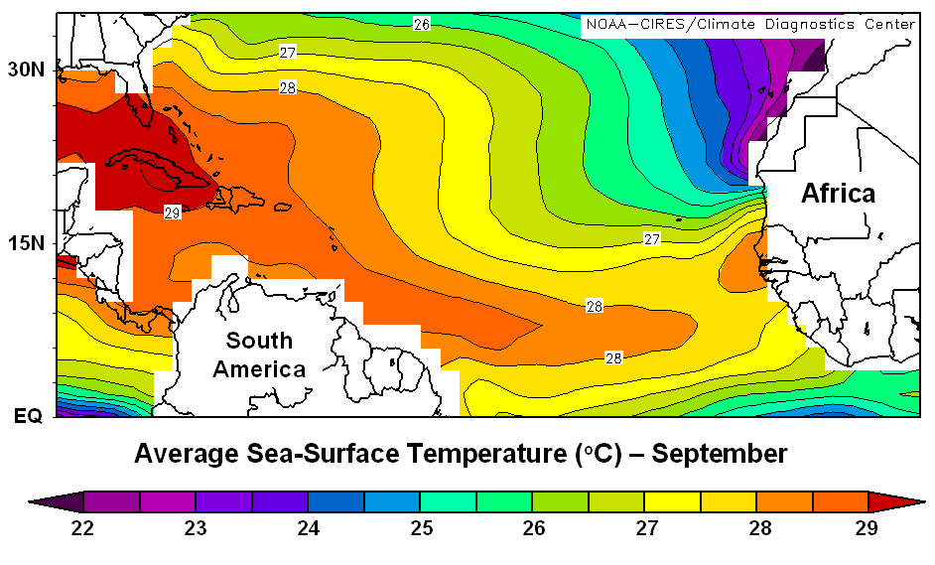

Slide 17
Components & Characteristics of Hurricanes, Typhoons, & Cyclones
hurricanes are essentially limited to a band between 5˚ & 20˚ N & S

Slide 18
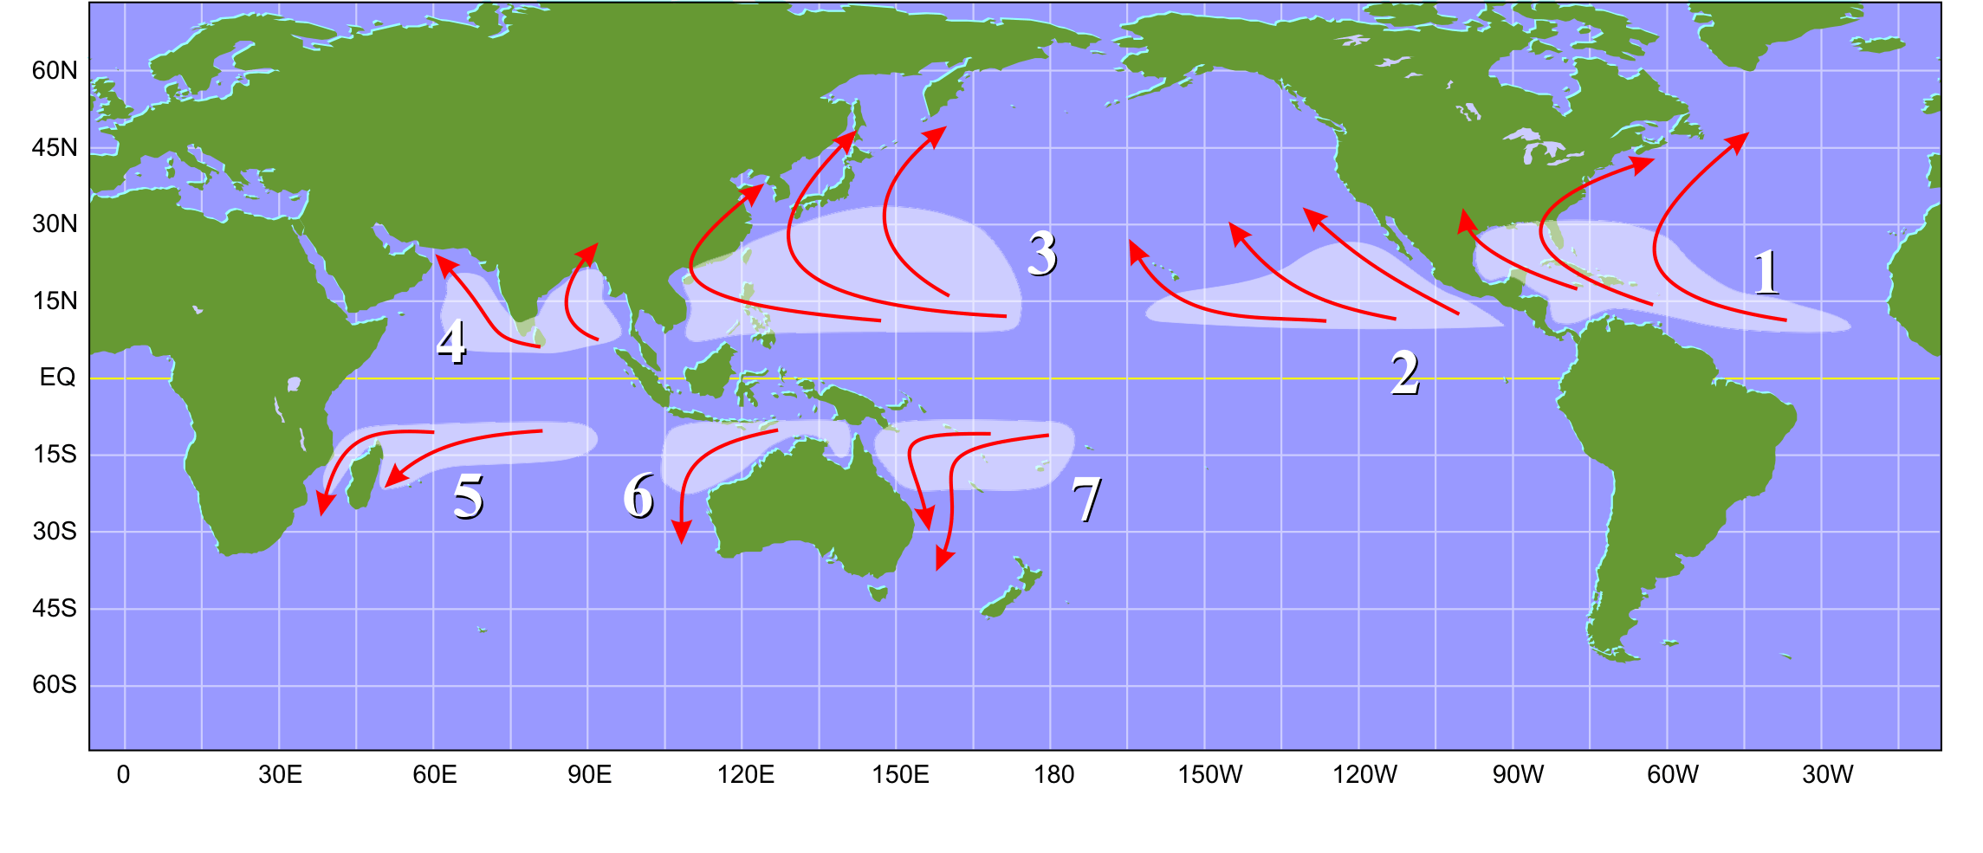
Hurricane Breeding Grounds

Slide 19
Components & Characteristics of Hurricanes, Typhoons, & Cyclones
hurricanes are essentially limited to a band between 5˚ & 20˚ N & S
the Atlantic hurricane season runs from June 1st through November 30th

Slide 20
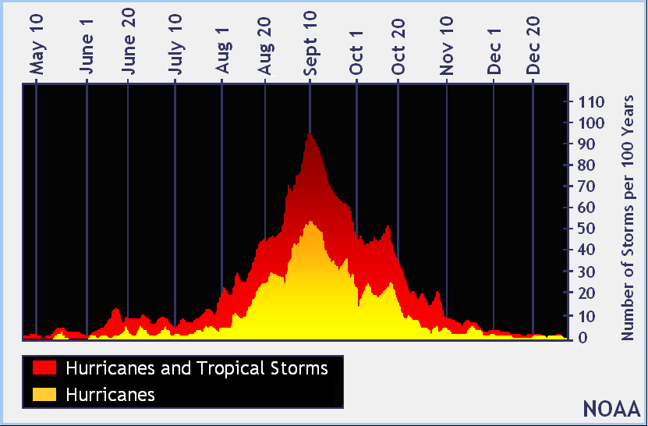
Hurricane Frequency

Slide 21
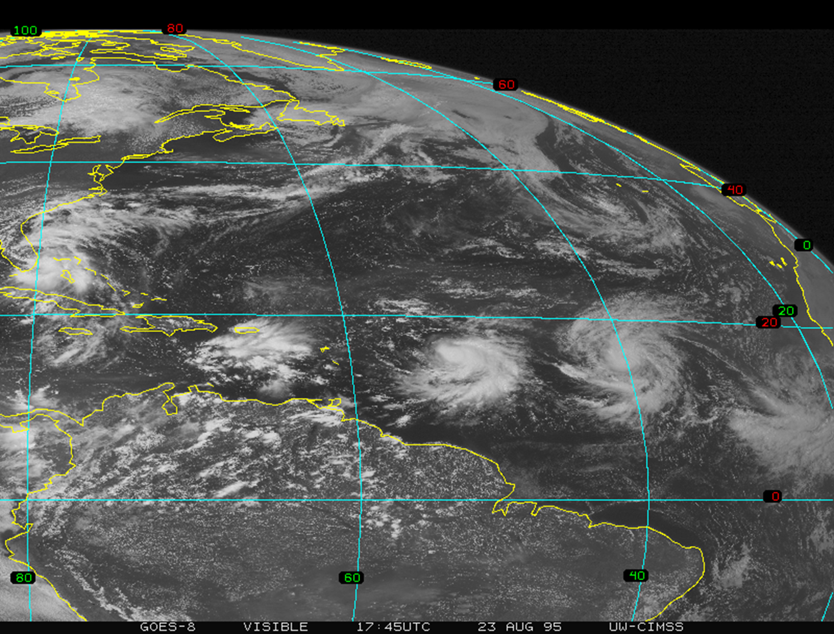
Hurricane Developmental Stages
based on wind speed and degree of organization

Slide 22
Hurricane Developmental Stages
Tropical Disturbance (Tropical Wave):
easterly waves are oscillations (waves) in the trade winds moving from east to west across the Atlantic
these waves are characterized by clusters of thunderstorms separated by a distance of about 2000km (3-4 days) across the Atlantic
if thunderstorm cluster exists for over 24 hours it is classified as a “tropical disturbance”

Slide 23
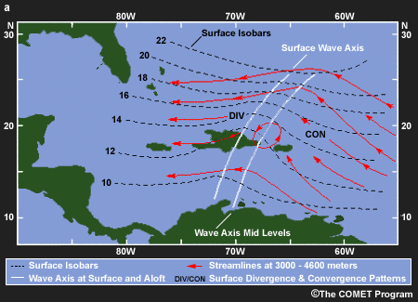
Easterly (Tropical) Waves

Slide 24
Hurricane Developmental Stages
Tropical Depression:
if circulation develops due to convergent air rotating cyclonically and the sustained winds are between 23 & 39 mph, the storm is classified as a “tropical depression”
tropical depressions are assigned numbers

Slide 25
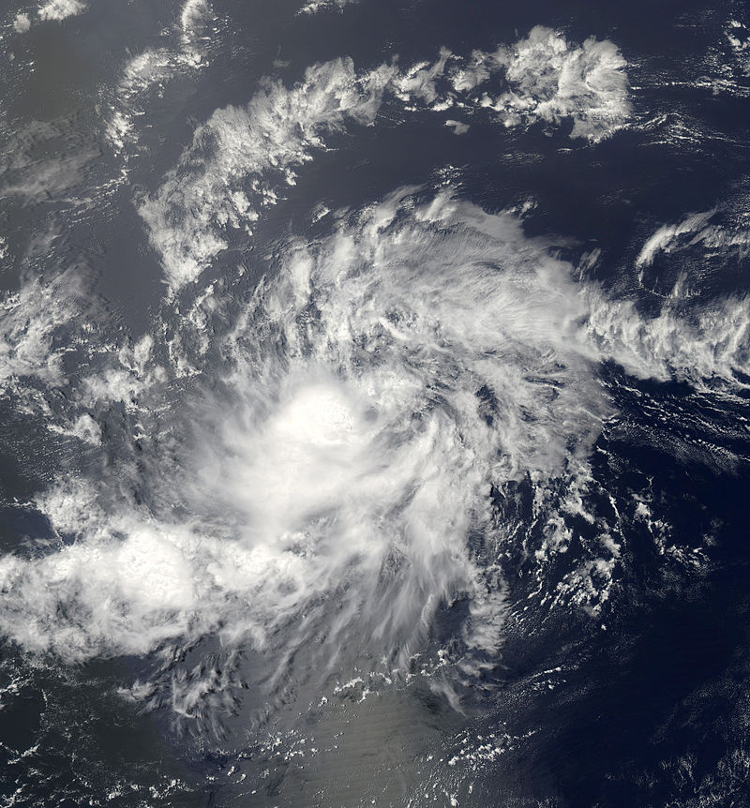
Tropical Depression Two 2014
Atlantic Hurricane Season

Slide 26
Hurricane Developmental Stages
Tropical Storm:
if the depression strengthens (central pressure decreases) & its strongest sustained winds are between 40 & 73 mph, it becomes a “tropical storm” and the National Hurricane Center assigns a name (see Table 11.1)
the convection in tropical storms is usually concentrated near the centre with outer rainfall organizing into distinct bands

Slide 27
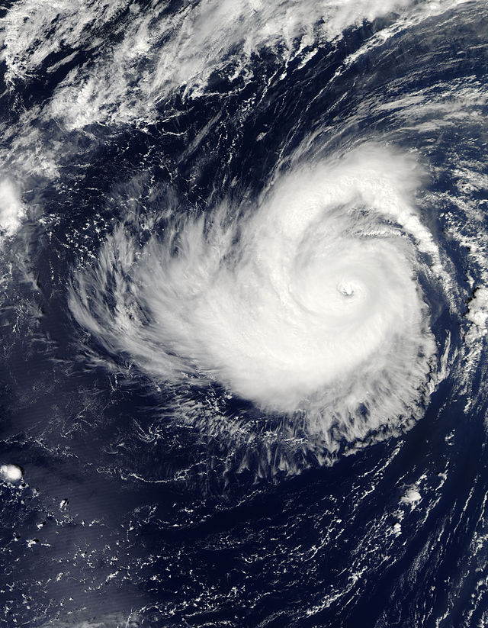
Tropical Storm Dolly 2014 Atlantic Hurricane Season

Slide 28
Hurricane Developmental Stages
Hurricane:
hurricanes are defined by sustained winds greater than 74 mph
“major hurricanes” have sustained winds greater than 111 mph
“super typhoons” in the NW Pacific have sustained winds greater than 150 mph

Slide 29
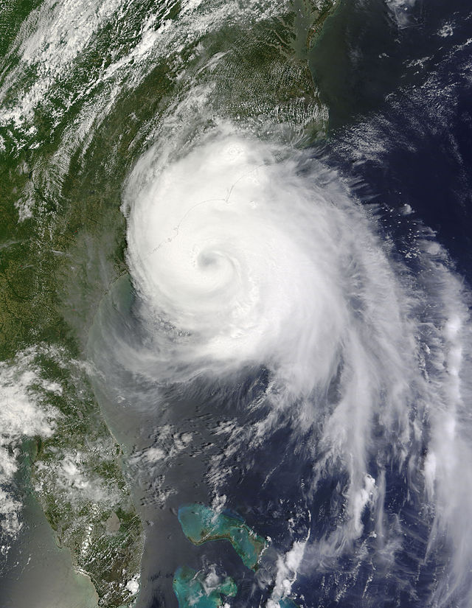
Hurricane Arthur 2014 Atlantic Hurricane Season

Slide 30
Hurricane Damage
the cost of land falling hurricanes is enormous in terms of property and lives
the estimated costs of hurricane Katrina range from $80-100 billion
Hurricane Mitch in 1998 was responsible for the loss of 11,000 lives in Central America
the 1970 Bhola cyclone that made land fall in Bangledesh was responsible for 500,000 deaths
the damage is due to winds, storm surge and flooding due to heavy precipitation

Slide 31
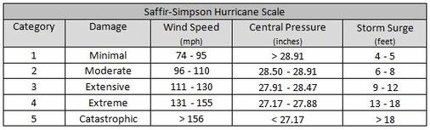
Hurricane Classification

Slide 32
Hurricane Damage
Wind
the most obvious source of damage is due the very high winds (between 74 & 190+ mph)
aligned with the direction of motion the right side of the hurricane has strongest winds – this is due to the storm motion
upon landfall, hurricanes can spawn tornadoes
Hurricane Andrew resulted in $20 billion in wind damage

Slide 33
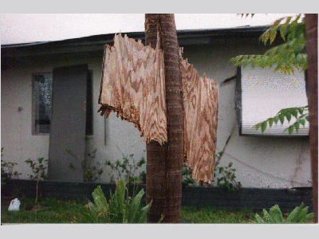
Wind Damage

Slide 34
Damage by Category & Wind Speed

Slide 35
Wind Damage Animation
The COMET Program

Slide 36
Hurricane Damage
Storm Surge
the most damage and loss of life is attributed to storm surge
coastal locations can be impacted by a 2-8 metre increase in high tide level; highest recorded was 13 metres
storm surge is generated by two compounding factors:
(a) the approaching low pressure results in a modest increase in sea level (pressure surge); &
(b) intense winds “piling up” water against the shore (wind driven surge)
the effect is usually most severe on the right side of the storm where the winds are strongest

Slide 37
Storm Surge Animation
The COMET Program

Slide 38
Hurricane Damage
Flooding
Hurricanes can also bring significant precipitation (~25cm per day) to inland regions unaffected by storm surge flooding
This effect can be particularly severe in mountainous regions where the potential for landslides or mudslides exists (e.g., Central America)

Slide 39
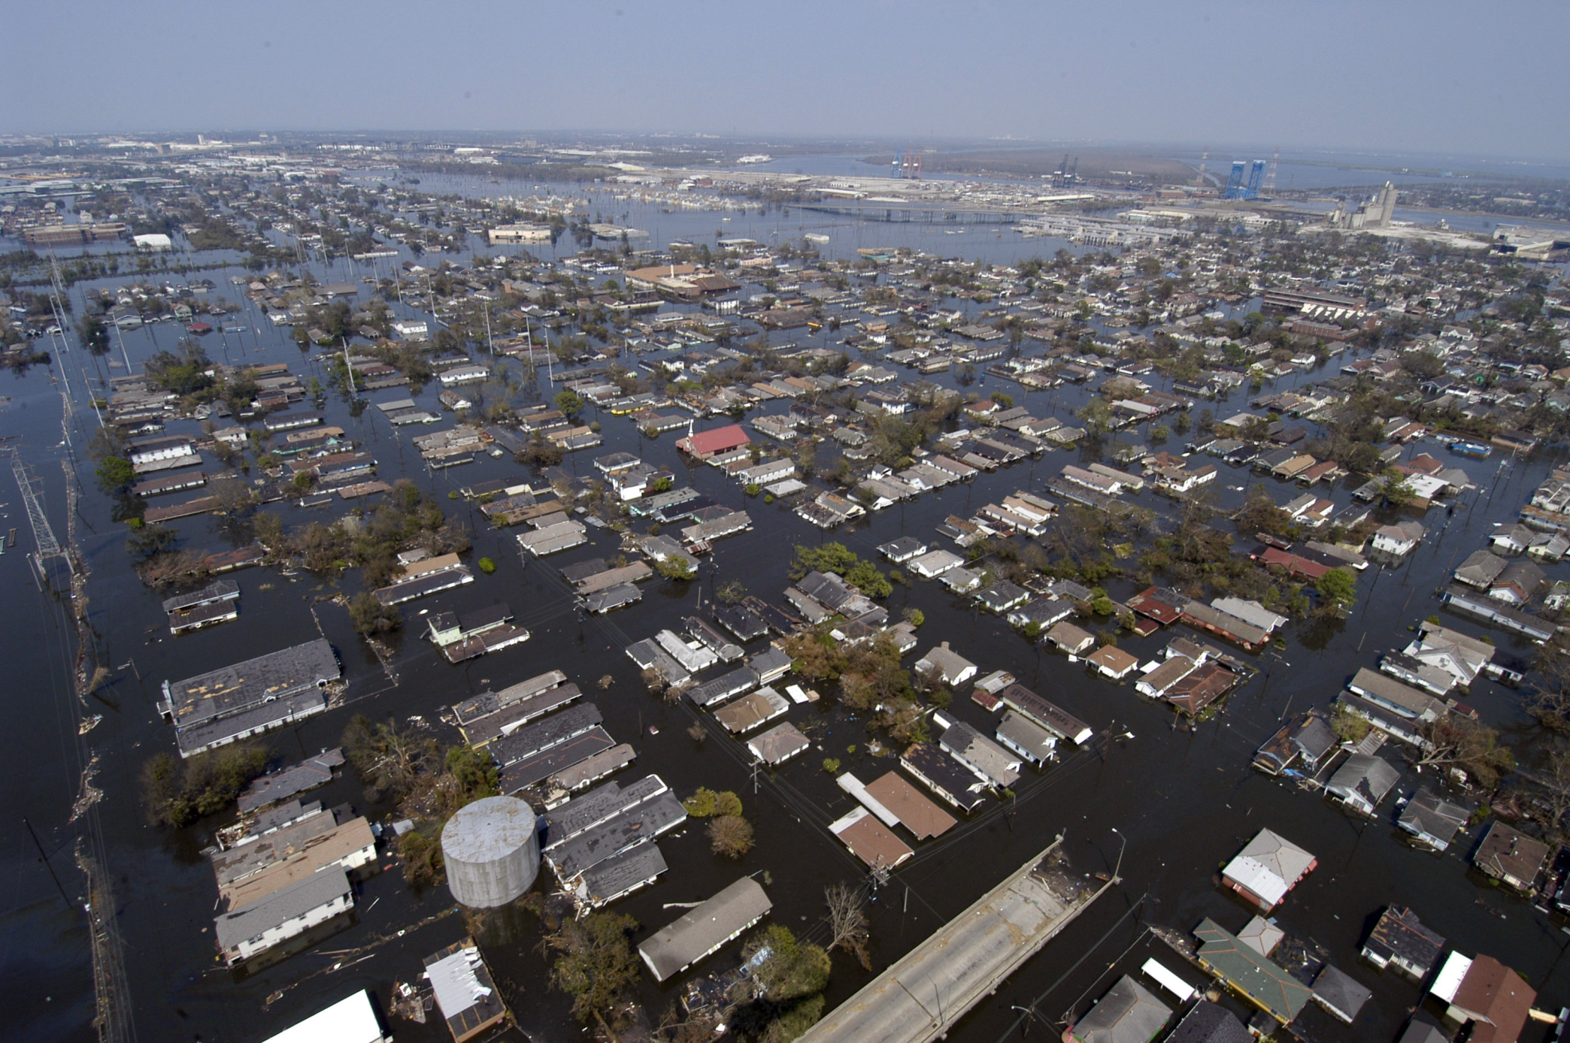
Flooding from Hurricane Katrina

Slide 40
Hurricane Decay
when hurricanes move over land they are cut off from their key source of energy, the warm surface waters (friction also plays a minor role)
strong upper level winds (wind shear) can weaken or destroy hurricanes
steering of hurricanes by upper level jet can move hurricanes over cooler water surfaces which again removes the key energy source

Slide 41
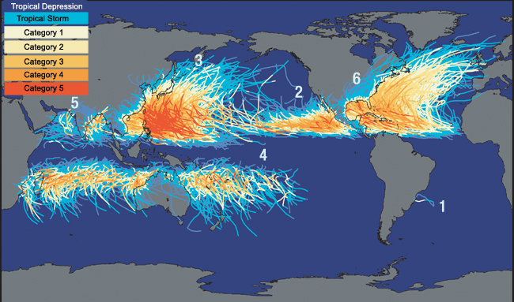
Tropical Cyclone Tracks

